Slide 1








7 C's Animated—Gen. 1:31 omitted
CREATION
CORRUPTION
CATASTROPHE
THE SEVEN C's OF HISTORY
CONFUSION
CHRIST
CONSUMMATION
CROSS
Designed by Dr. Terry Mortenson
Uploaded by Dr. Rick Griffith • Jordan Evangelical Theological Seminary
All files in many languages for free download at BibleStudyDownloads.org
Notes:
Each element is a TIFF image with alpha channels. This whole page totals 1.1 MB rather than 11+ MB that flat JPEGs would produce.

Slide 2
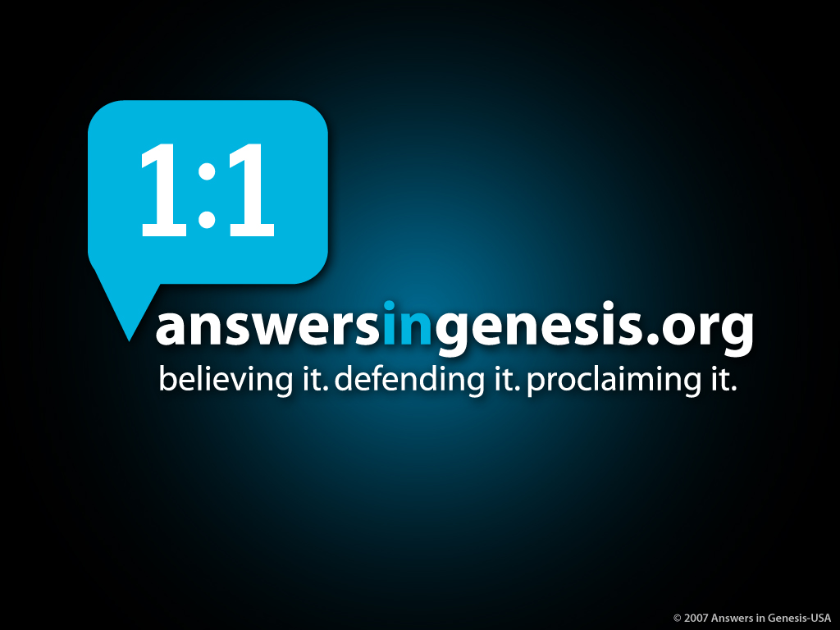
AiG web site #1

Slide 3

Psalm 11:3 NAS
Psalm 11:3
If the foundations are destroyed, what can the righteous do?

Slide 4

Typical House
Notes:
4

Slide 5
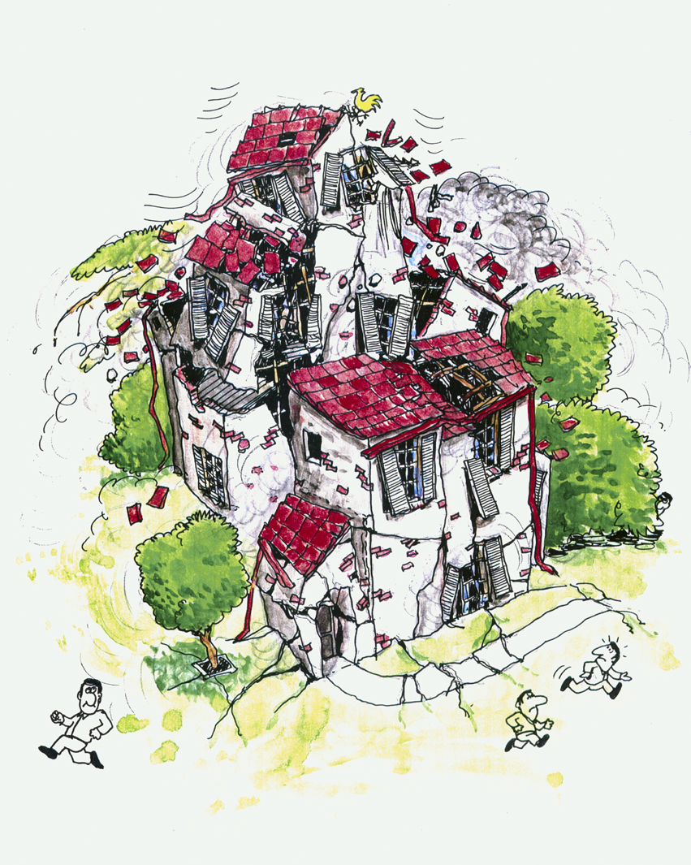
Typical House collapsed
Notes:
5

Slide 6
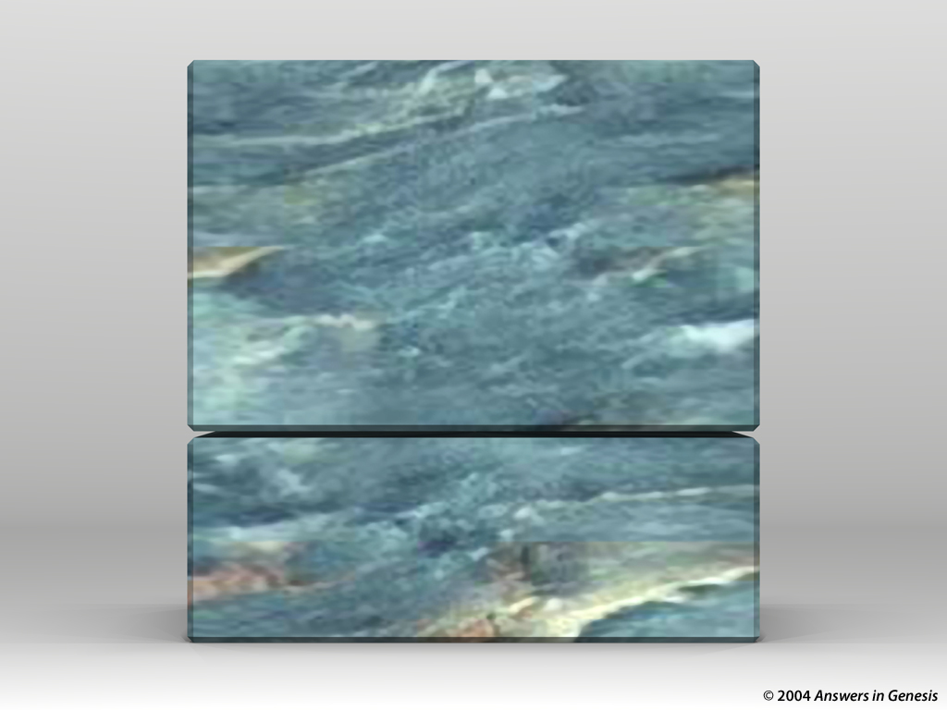
Blocks-Genesis + Doctrine 00874
X
DOCTRINE
X
GENESIS

Slide 7
CORRUPTION
CATASTROPHE
CREATION
CONFUSION
THE SEVEN C’s OF HISTORY
CONSUMMATION
CHRIST
CROSS
Notes:
This is fully animated. The Scripture text frame is editable so you can insert a different version if you so desire.
In case you want to know. Each element is a TIFF image with alpha channels. This whole page totals 1.1 MB rather than 11+ MB that flat JPEGs would produce.

Slide 8
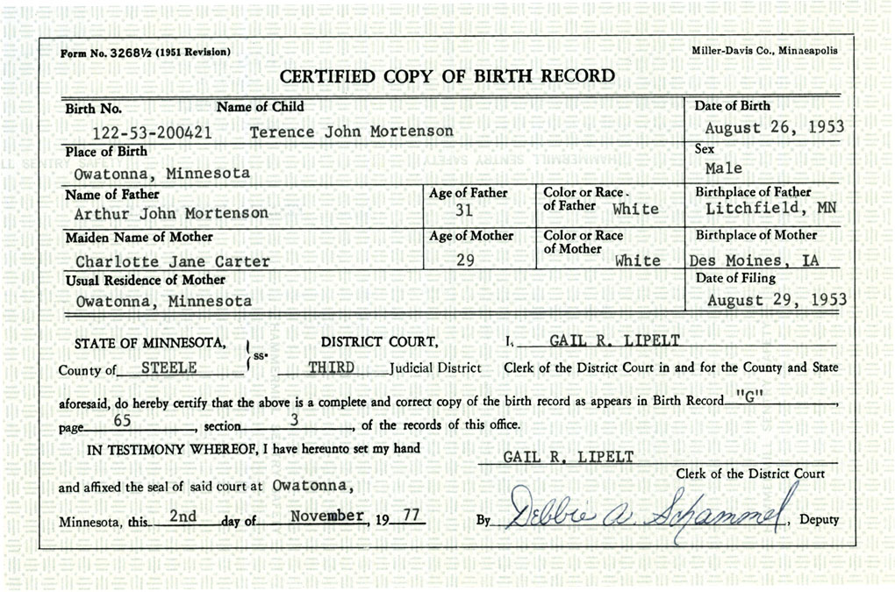
Terry's Birth Certificate

Slide 9
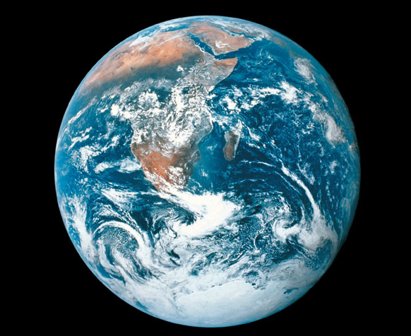
How old is the earth?
God (Bible):
6,000 years
Evolutionists:
Earth: 4,500,000,000 years
Universe 13,700,000,000 years

Slide 10




Scientist & Bible—layered new
The earth is billions of years old. Take my word for it!
I created in 6 days. Take my Word for it!
HOLY BIBLE

Slide 11
Job 38:4 NAS
Job 38:4
Where were you when I laid the foundation of the earth? Tell Me, if you have understanding.

Slide 12

D – Where you there?
25 million years ago
Were you there?

Slide 13

Template Suite 1-Content 01360
Why should we trust God more than scientists?
Notes:
13
As a content template, this is best suited for standard content such as outlines, quotations, Scriptures, and maybe illustrations or photos. Presentation Team recommends 48–60 pt. font for headings and 28–40 pt. for body text. Because of eye flow and visual psychology, the top line may be a little closer than all other sides. This also contains a floating AiG logo that can be repositioned or removed as appropriate for the overhead's content.

Slide 14
Template Suite 1-Content 01360
God
--was there at the beginning
--knows everything
--always tells the truth
--never makes mistakes
--loves us
Notes:
14
As a content template, this is best suited for standard content such as outlines, quotations, Scriptures, and maybe illustrations or photos. Presentation Team recommends 48–60 pt. font for headings and 28–40 pt. for body text. Because of eye flow and visual psychology, the top line may be a little closer than all other sides. This also contains a floating AiG logo that can be repositioned or removed as appropriate for the overhead's content.

Slide 15
Template Suite 1-Content 01360
Scientists
--were not there at the beginning
--do not know everything
--do not always tell the truth
--often make mistakes
--do not love us like God does
Notes:
15
As a content template, this is best suited for standard content such as outlines, quotations, Scriptures, and maybe illustrations or photos. Presentation Team recommends 48–60 pt. font for headings and 28–40 pt. for body text. Because of eye flow and visual psychology, the top line may be a little closer than all other sides. This also contains a floating AiG logo that can be repositioned or removed as appropriate for the overhead's content.

Slide 16

History Book of the Universe 02022
The History Book of the Universe
Holy Bible
Notes:
16

Slide 17
CORRUPTION
CATASTROPHE
CREATION
CONFUSION
THE SEVEN C’s OF HISTORY
CONSUMMATION
CHRIST
CROSS
Notes:
This is fully animated. The Scripture text frame is editable so you can insert a different version if you so desire.
In case you want to know. Each element is a TIFF image with alpha channels. This whole page totals 1.1 MB rather than 11+ MB that flat JPEGs would produce.

Slide 18






Days of Creation in Genesis One 00825—layered—NAS
DAYS OF CREATION IN GENESIS 1
DAY
DAY
DAY
EARTH, SPACE, TIME & LIGHT
EXPANSE
DRY LAND & PLANTS
DAY
DAY
SUN, MOON & STARS
FLYING & SEA CREATURES

Slide 19

Chicken or Egg?
WHICH CAME FIRST,
THE CHICKEN OR THE EGG?
Notes:
Kirby picture

Slide 20

Days of Creation in Genesis One 00825—layered—NAS
DAYS OF CREATION IN GENESIS 1
DAY
DAY
DAY
EARTH, SPACE, TIME & LIGHT
EXPANSE
DRY LAND & PLANTS
DAY
DAY
DAY
SUN, MOON & STARS
FLYING & SEA CREATURES
LAND ANIMALS & MAN

Slide 21
Gen. 1:21, 25 “kinds” NAS
Genesis 1:21, 25
21. God created the great sea monsters and every living creature that moves, with which the waters swarmed after their kind, and every winged bird after its kind; and God saw that it was good.
25. God made the beasts of the earth after their kind, and the cattle after their kind, and everything that creeps on the ground after its kind; and God saw that it was good.

Slide 22
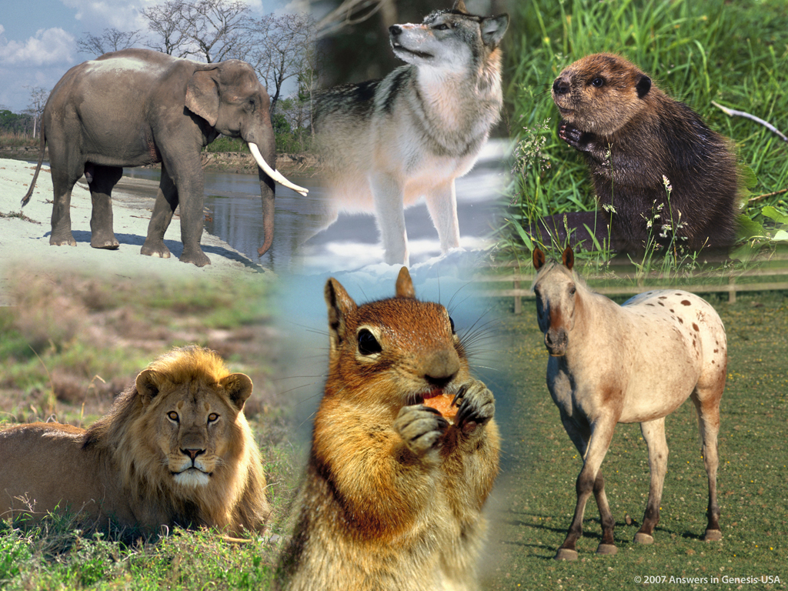
Different Kinds 03119

Slide 23
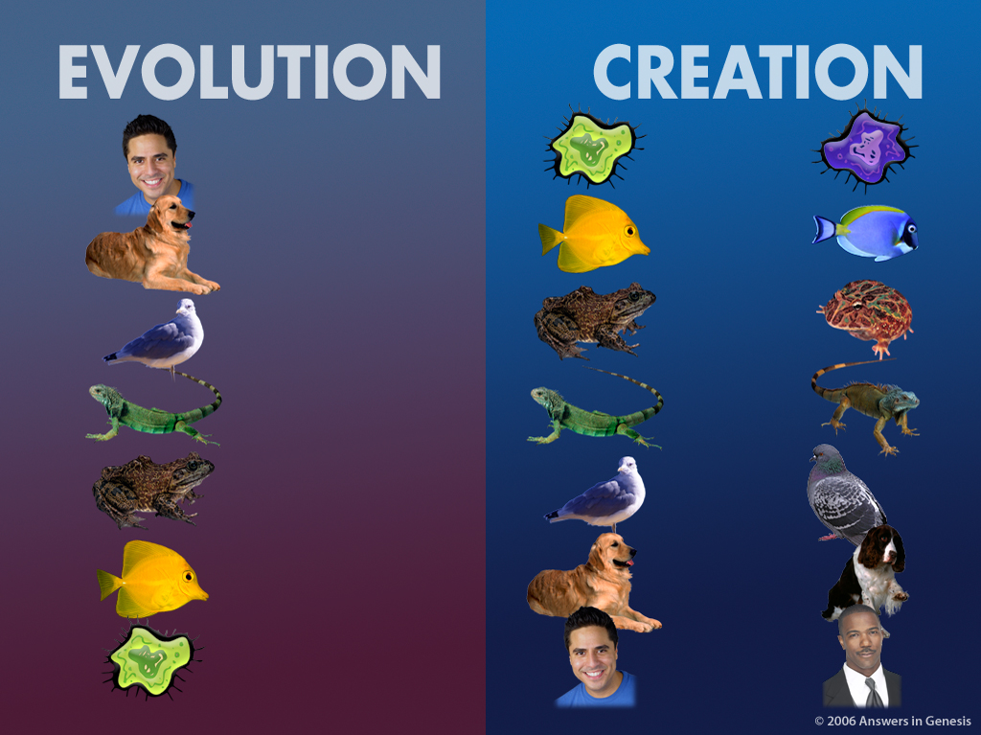
Evol V vs Crea H 01427
Pull black box back to translate
EVOLUTION
CREATION
Evol V vs Crea H 01427
X
Notes:
NOTE: The word for creation is under the black panel so just move this panel aside to translate the word.

Slide 24
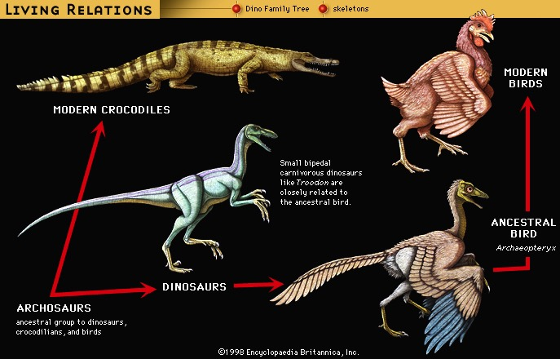
Living “Relatives” of Dinosaurs
X
LIVING RELATIONS
Dino Family Tree
Skeletons
MODERN BIRDS
MODERN CROCODILES
Small bipedal carnivorous dinosaurs like Troodon are closely related to the ancestral bird
ANCESTRAL BIRD
Arcaeopteryx
DINOSAURS
ARCHOSAURS
Ancestral group to dinosaurs, crocodilians, and birds
(Encyclopaedia Britannica, CD, 1999)
Notes:
Cf. Presentations 4.16; 10.25
Archosaurs: The only picture of Archosaurs I could find on the web were artist's drawings of the skull. The UC Berkeley web site below under the icon “Fossil record” has a picture only of an artist's rendition of an “close relative” of Archosaurs. No picture of a fossil is shown.…That page says “Students of archosaur evolution are blessed with a wonderful fossil record for many groups of archosaurs, including some very bizarre extinct taxa.” We have to take it by faith that they have the majority of or whole skeleton of any of these creatures. Wikipedia.com tells us that living archosaurs are crocodiles and birds!
“Archosauria (the "ruling reptiles") is a major group of diapsids [see below], differentiated from the other diapsids by the presence of single openings in each side of the skull, in front of the eyes (antorbital fenestrae), among other characteristics.
This continues the tetrapod trend of the reduction of skull bones by the fusion of multiple bones and the opening of fenestrae in the skull. This helps to lighten the skull, provides more room for muscles and other tissues, and allows more skull flexibility (kinesis) when eating. Other typical archosaurian characteristics include another opening in the lower jaw (the mandibular fenestra), a high narrow skull with a pointed snout, teeth set in sockets (called thecodont tooth implantation), and a modified ankle joint.
The ancestral archosaurs probably originated some 250 million years or so ago, in the late Permian period. Their descendants (such as the dinosaurs) dominated the realm of the terrestrial vertebrates for a majority of the Mesozoic Era. Today, only the birds and crocodilians exist to provide a glimpse into the past glory of archosaurs.” http://www.ucmp.berkeley.edu/diapsids/archosauria.html, accessed 17 April 2007
“All members of the group called the Reptilia [including all dinosaurs], except for the anapsids (turtles and their ilk), and a few extinct groups, are diapsids. The main diagnostic physical character for a diapsid is the presence of two openings on each side of the skull; the upper and lower temporal openings. Even the birds are considered diapsids (and hence reptiles), because they are descended from certain dinosaurs (which are also diapsids), …” http://www.ucmp.berkeley.edu/diapsids/index.html, accessed 17 April 2007.

Slide 25
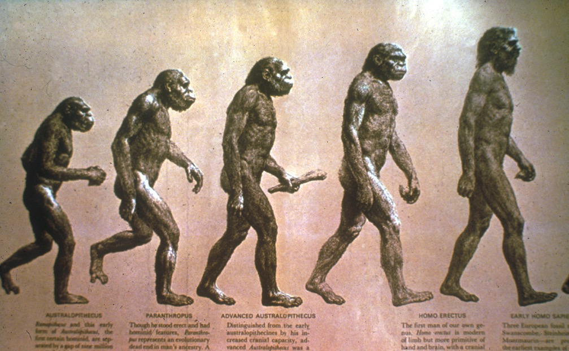
Evolution of man progression?
Evolution of Man?
X

Slide 26
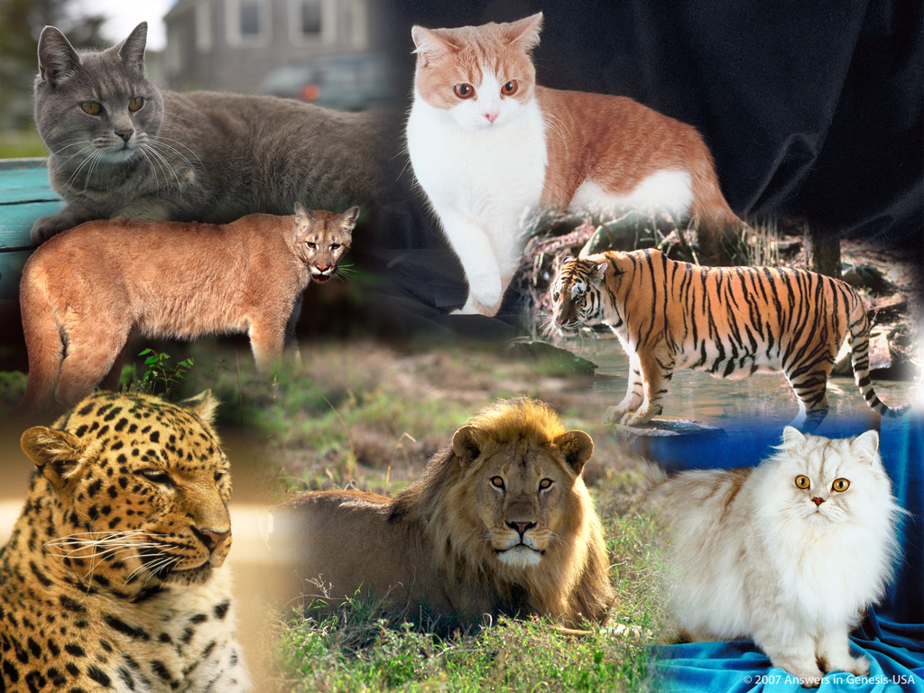
Cat Kind 03118
Notes:
26

Slide 27
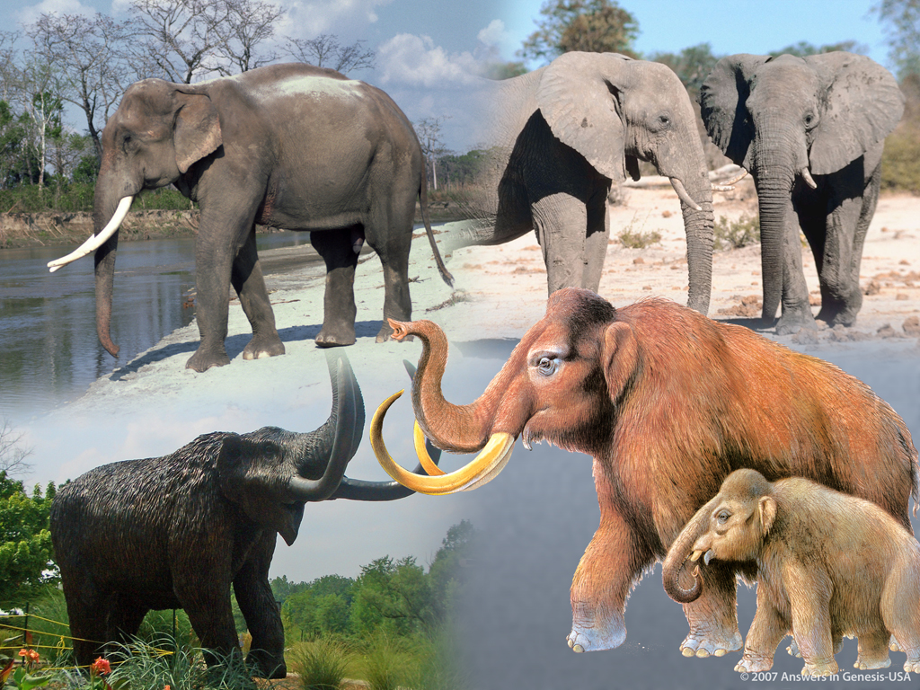
Elephant Kind 03120
Notes:
27

Slide 28
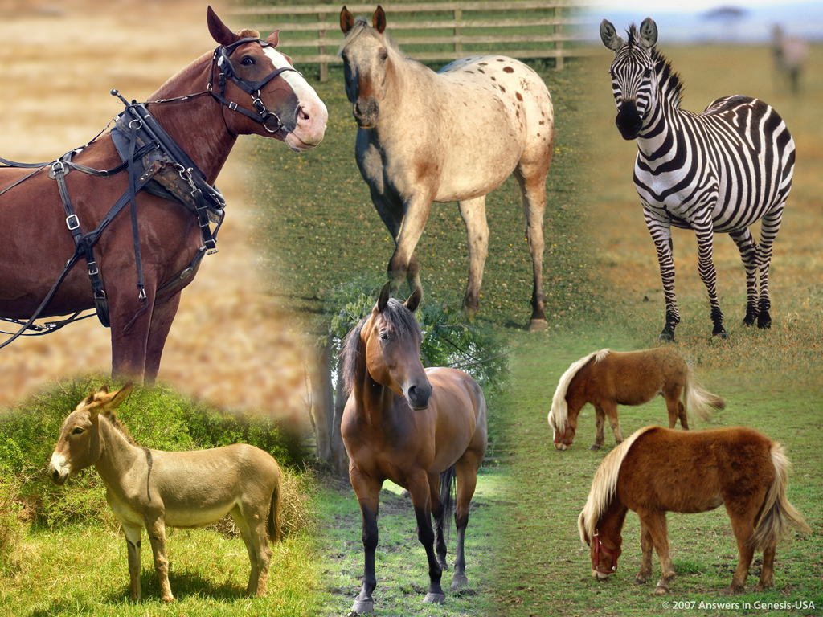
Horse Kind 03121
Notes:
28

Slide 29

Skin Tones Line-up 03051
Notes:
29

Slide 30
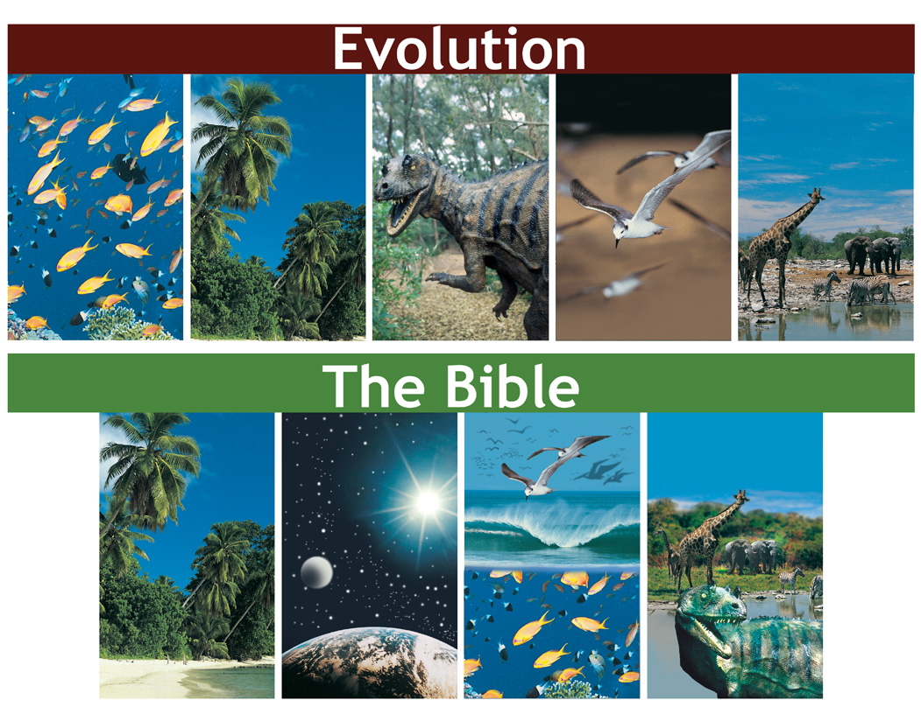
Evolution vs Bible timeline
Evolution
X
The Bible

Slide 31
Genesis 1:1 NAS
Genesis 1:5
God called the light day, and the darkness He called night. And there was evening and there was morning, one day.
Numbers the days: first, second, …
Modifies with “evening” & “morning”

Slide 32
Gen. 1:14 NAS
Genesis 1:14
Then God said, “Let there be lights in the expanse of the heavens to separate the day from the night, and let them be for signs and for seasons and for days and years.

Slide 33
Ex. 20:11 NAS
Exodus 20:11
For in six days the Lord made the heavens and earth, the sea, and all that is in them, and rested on the seventh day; therefore the Lord blessed the Sabbath day and made it holy.

Slide 34

Time since Genesis 1:1
Time Since First Day of Creation
5 days before Adam = 5 days
Adam to Abraham = ~ 2,000 yrs
Abraham to Christ = ~ 2,000 yrs
Christ to present = ~ 2,000 yrs
Total = ~ 6,000 yrs
(Genesis 1)
(Genesis 5 & 11)
Notes:
This uses only the background from Template Suite 1. Nearly any content will work with this template. Presentation Team recommends keeping the main content at least half an inch from the edges. This also contains a floating AiG logo that can be repositioned or removed as appropriate for the overhead's content.

Slide 35
Gen. 1:31 NAS
Genesis 1:31
God saw all that He had made, and behold, it was very good. And there was evening and there was morning, the sixth day.

Slide 36
CORRUPTION
CATASTROPHE
CREATION
CONFUSION
THE SEVEN C’s OF HISTORY
CONSUMMATION
CHRIST
CROSS
Notes:
This is fully animated. The Scripture text frame is editable so you can insert a different version if you so desire.
In case you want to know. Each element is a TIFF image with alpha channels. This whole page totals 1.1 MB rather than 11+ MB that flat JPEGs would produce.

Slide 37

Perfection: Lion and lamb
Life in a
PERFECT WORLD!
And God saw every thing that he had made, and, behold, it was very good (Gen. 1:31).
Notes:
37
37

Slide 38
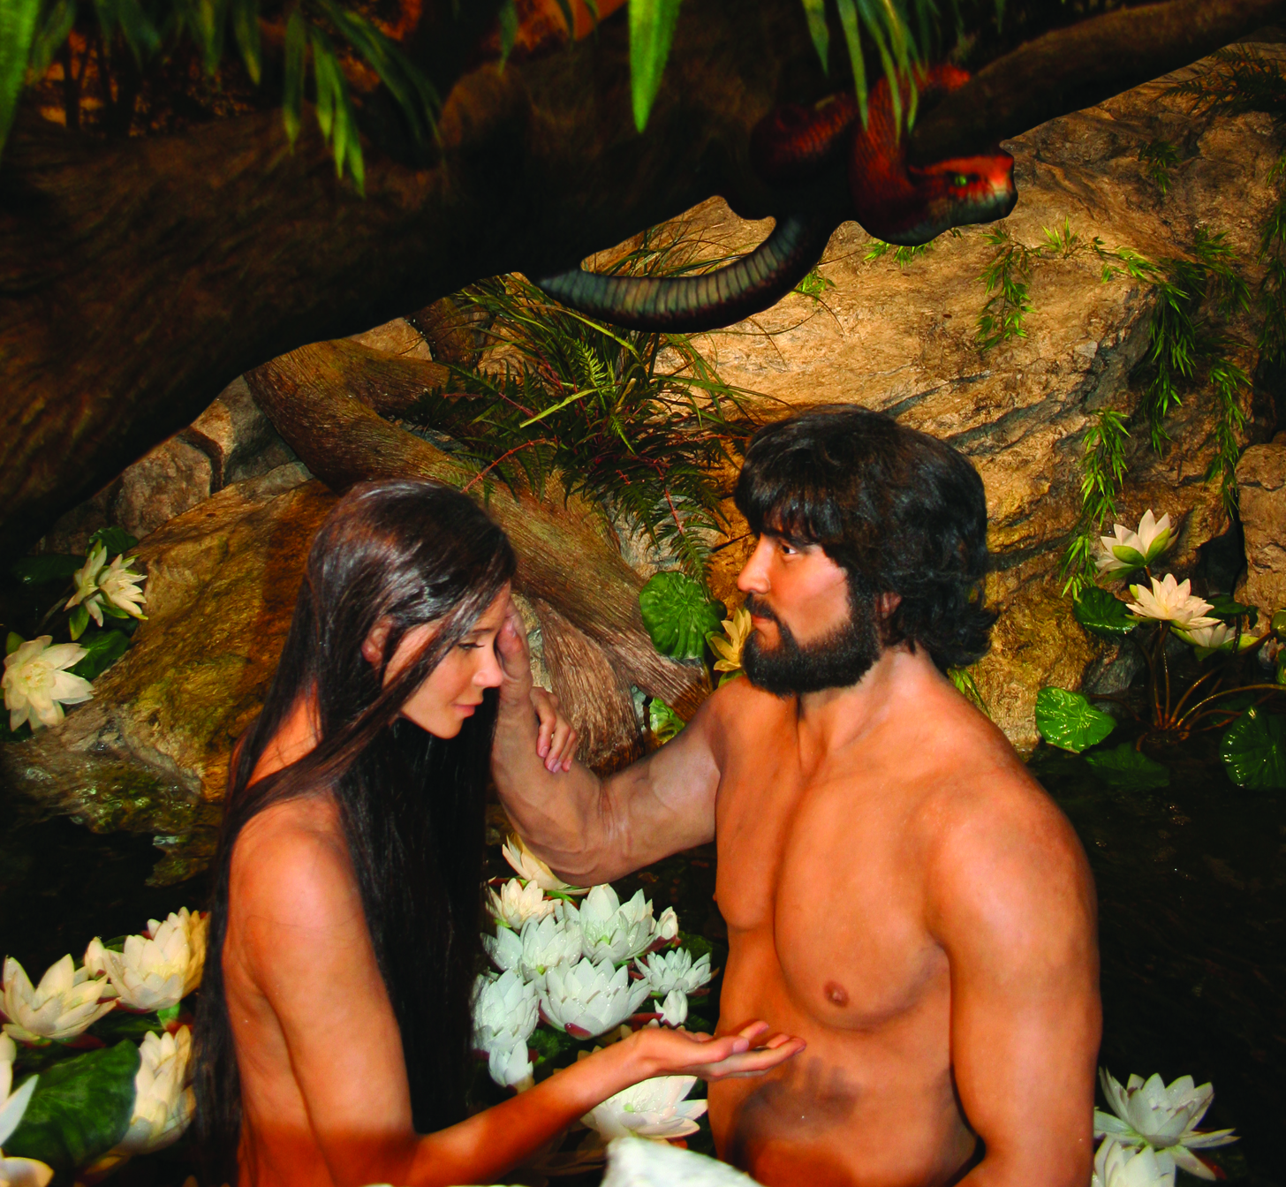
Adam & Eve with Serpent
Notes:
38

Slide 39
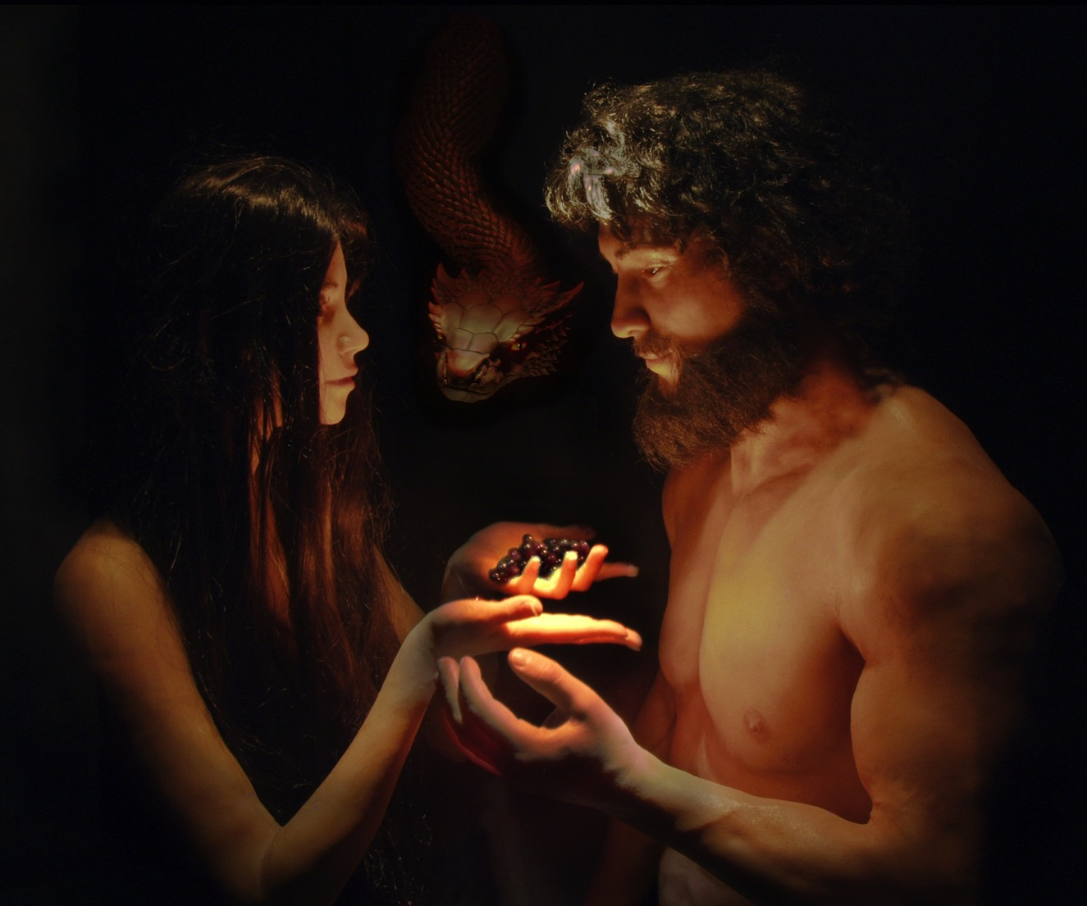

Slide 40
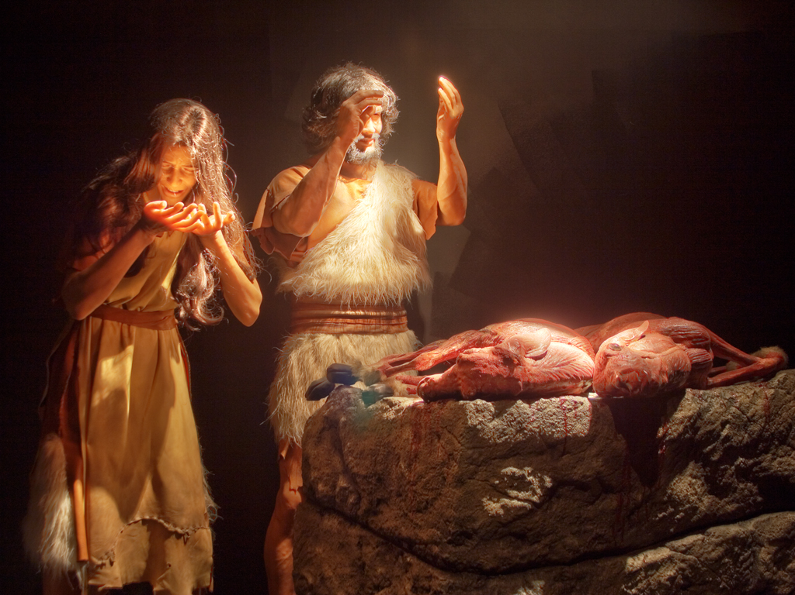
Adam & Eve—coats of skin
Genesis 3:21
Notes:
40

Slide 41
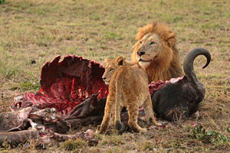
Notes:
41
http://en.wikipedia.org/wiki/Carnivore

Slide 42
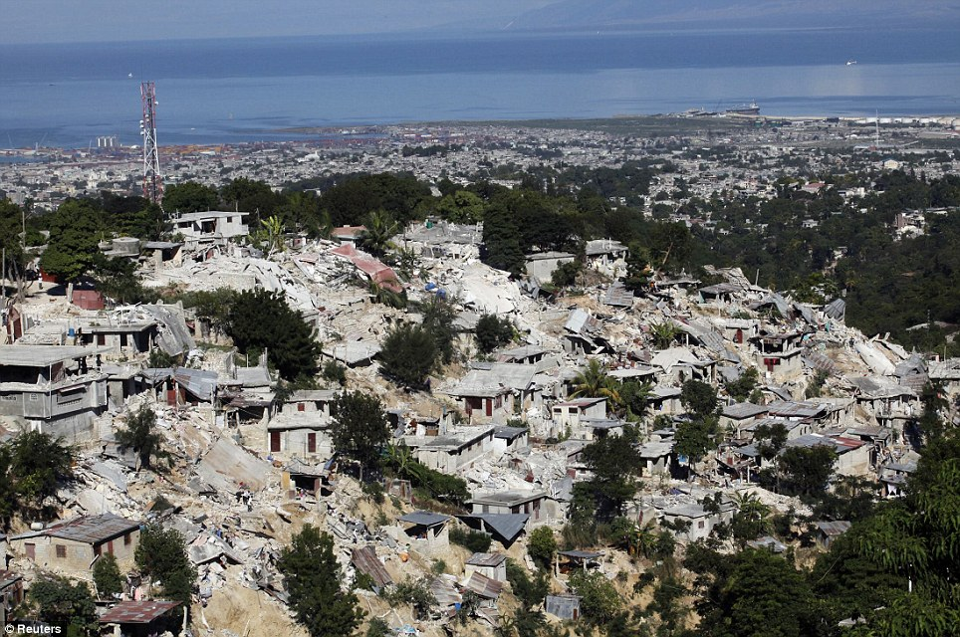
Haiti Earthquake, Jan 2010

Slide 43
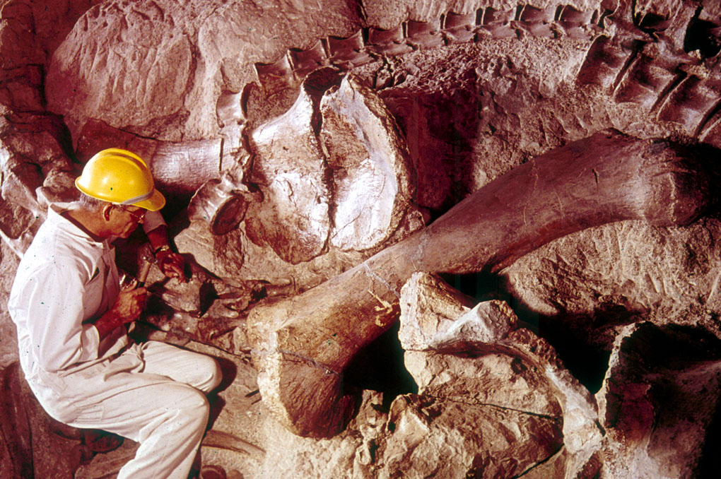
Fossil dinosaur with scientist
Notes:
43
Picture from Dinosaur National Monument (national park) in Utah & Colorado
Show my fossil shells

Slide 44


FOSSIL
RECORD
PAIN
DEATH
X
KILLING
MILLIONS OF YEARS
=
DISEASE
STRUGGLE
SUFFERING
EXTINCTION

Slide 45
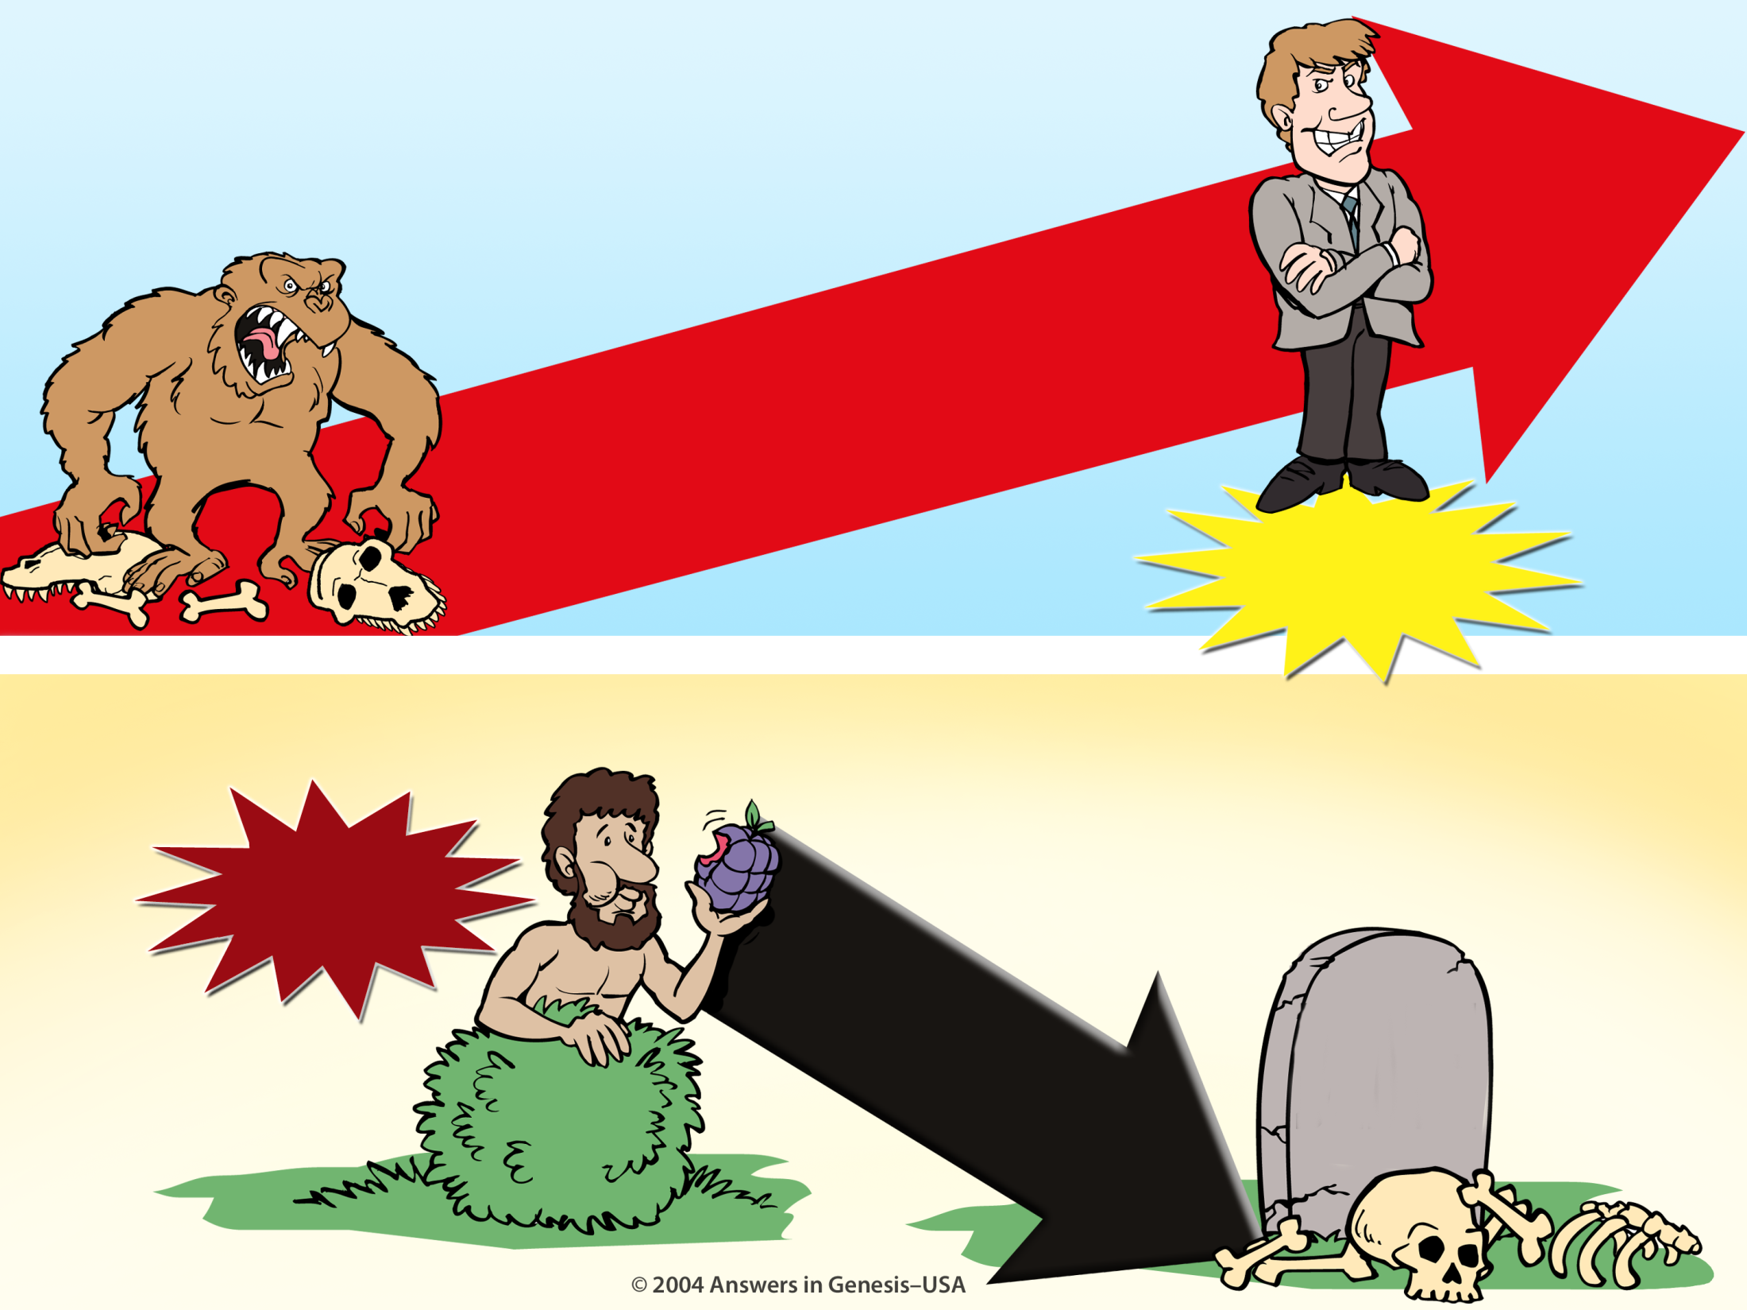
Evolution Millions of Years + Creation 01133
EVOLUTION
MILLIONS OF YEARS
DEATH
Suffering Disease Bloodshed
MAN'S
EXISTENCE
CREATION
MAN'S
ACTIONS
SIN
DEATH
Notes:
45
Do these two views agree?
No, of course not. They are diametrically opposed to each other.

Slide 46
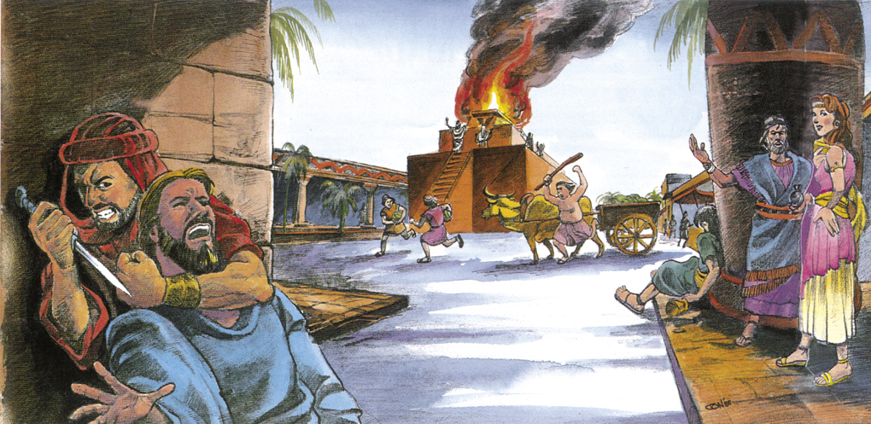
Pre-Flood violence
Notes:
46
Source: Gary Parker, Creation: Facts of Life (Master Books), p. 152.

Slide 47
CORRUPTION
CATASTROPHE
CREATION
CONFUSION
THE SEVEN C’s OF HISTORY
CONSUMMATION
CHRIST
CROSS

Slide 48

Template Suite 1-Content 01360
What was the purpose of the Flood?
Notes:
48
What was the Flood going to destroy?

Slide 49
Gen. 6:7, 13 NAS
Genesis 6:7, 13
7. The LORD said, “I will blot out man whom I have created from the face of the land, from man to animals to creeping things and to birds of the sky; for I am sorry that I have made them.”
13. Then God said to Noah, “The end of all flesh has come before Me; for the earth is filled with violence because of them; and behold, I am about to destroy them with the earth.”
Notes:
The underlined word is eretz, the same word translated earth in Gen. 1:1 and 2:1 and 2:4. Eretz is used 45 times in the Flood account in Gen. 6:5-9:17. The circled word is adamah, which in modern translations is rendered more accurately as “ground” or “land.” It is used only 9 times in the Flood account. In his rejection of the global Flood, OT scholar Dr. Walter Kaiser said in the Feb. 2006 John Ankerberg debates on creation that eretz is never used in the flood account, but that only adamah is used. He was seriously in error.

Slide 50

Template Suite 1-Content 01360
Where did the water come from?
Notes:
As a content template, this is best suited for standard content such as outlines, quotations, Scriptures, and maybe illustrations or photos. Presentation Team recommends 48–60 pt. font for headings and 28–40 pt. for body text. Because of eye flow and visual psychology, the top line may be a little closer than all other sides. This also contains a floating AiG logo that can be repositioned or removed as appropriate for the overhead's content.

Slide 51
Gen. 7:11 NAS
Genesis 7:11
In the six hundredth year of Noah's life, in the second month, on the seventeenth day of the month, on the same day all the fountains of the great deep burst open, and the floodgates of the sky were opened.
Notes:
Tsunamis caused by seaquakes can travel at speeds up to 500 mph for thousands of miles.

Slide 52
Template Suite 1-Content 01360
How big was the Flood?
Notes:
As a content template, this is best suited for standard content such as outlines, quotations, Scriptures, and maybe illustrations or photos. Presentation Team recommends 48–60 pt. font for headings and 28–40 pt. for body text. Because of eye flow and visual psychology, the top line may be a little closer than all other sides. This also contains a floating AiG logo that can be repositioned or removed as appropriate for the overhead's content.

Slide 53
Gen. 7:19-20 NAS
Genesis 7:19-20
19. The water prevailed more and more upon the earth, so that all the high mountains everywhere under the heavens were covered.
20. The water prevailed fifteen cubits higher, and the mountains were covered.
Notes:
Where did all water go? Into late-flood ocean basins and underground reservoirs, as we have today. Present mountains were raised in the latter part of the flood (Ps. 104:6-9 is describing the flood, not the creation of dry land on Day 3, if you study the text carefully). There are marine fossils on the tops of all the high mountains which is part of the evidence that shows that they were once horizontal sediments under the sea that were hardened into stone and later broke and tilted in the process of mountain-building.

Slide 54
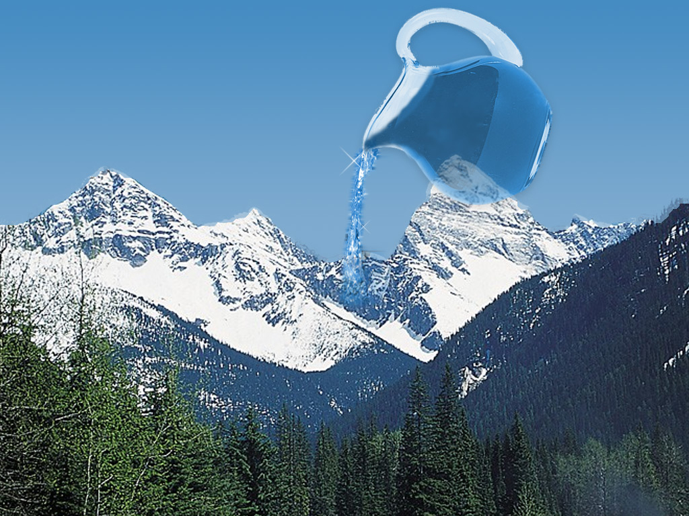
Water covering mountains
Notes:
54
Canadian Rockies, picture adapted from http://www.rocky-mountains-vacation.com/images/photogallery/03_yoho_nat_park_bc.jpg
If possible, have a child pour colored liquid from a pitcher over two different size large rocks in a clear glass pan to illustrate to kids how water seeks a level plane and only a global flood could cover all the mountains.
But explain that the present mountain ranges were produced as the waters of the Flood receded to produce new dry land and that creationists believe there are good reasons to think that the pre-flood mountains were not as high as our mountains today. Reasons would be evidence in Gen. 1 that there was only one land mass, possibly no rain before the flood and long ages of patriarchs, fossil evidence of global tropical/subtropical climate worldwide all suggest less extremes in climate which would imply less variations in topography.

Slide 55
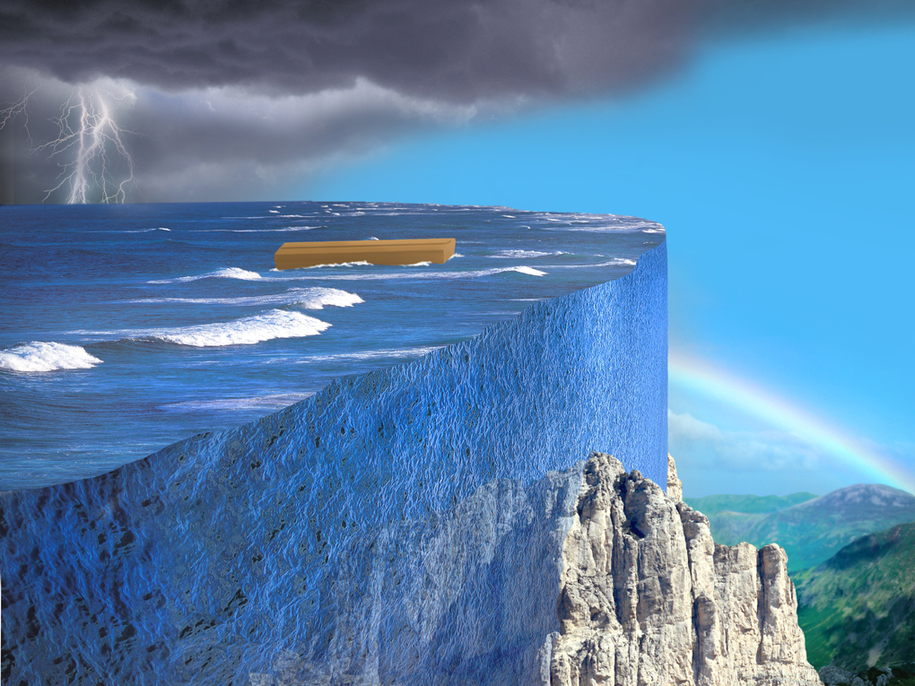
Local flood miracle wall
X
Notes:
55

Slide 56
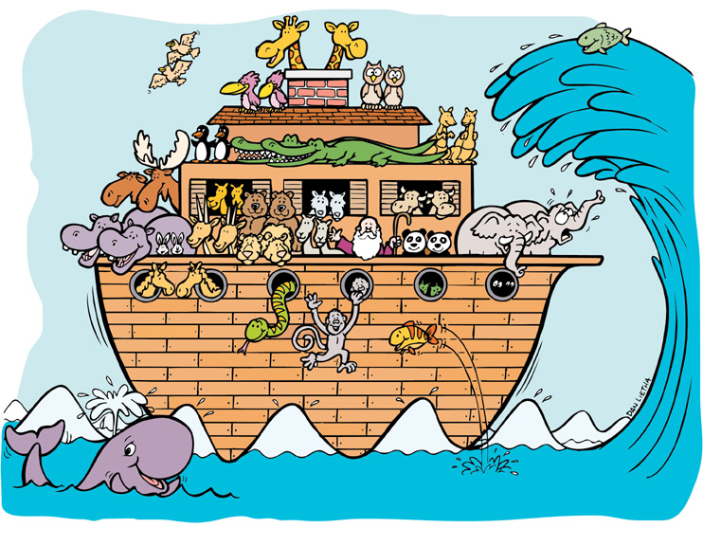
Noah's Ark (kids) & wave
X
Notes:
56

Slide 57
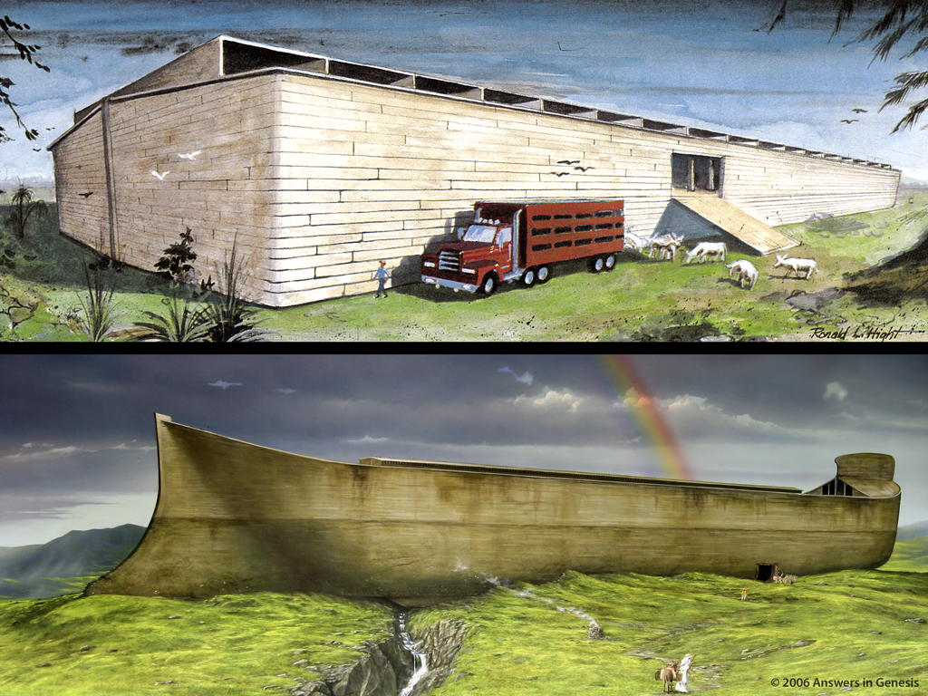

Two Arks Comparison 1 01810
560
Notes:
57

Slide 58
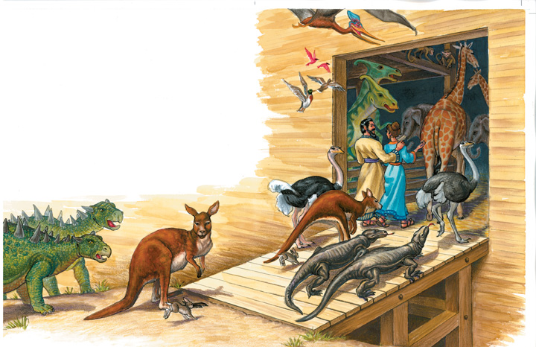
D of E – animals entering Ark
Two of every kind of land animal and bird
Notes:
58

Slide 59
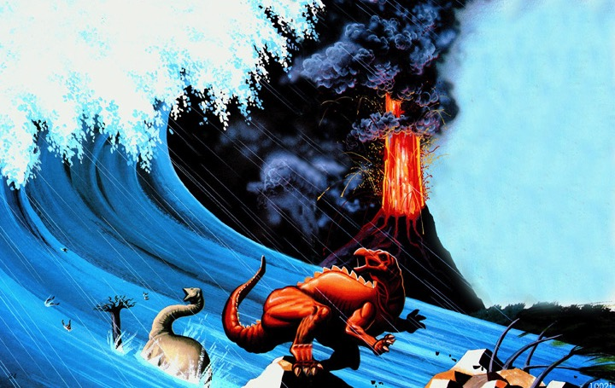
Dinosaurs in Flood
Notes:
59

Slide 60
Billions of Dead Things 00058
Billions of dead things
buried in rock layers
laid down by water
all over the earth

Slide 61
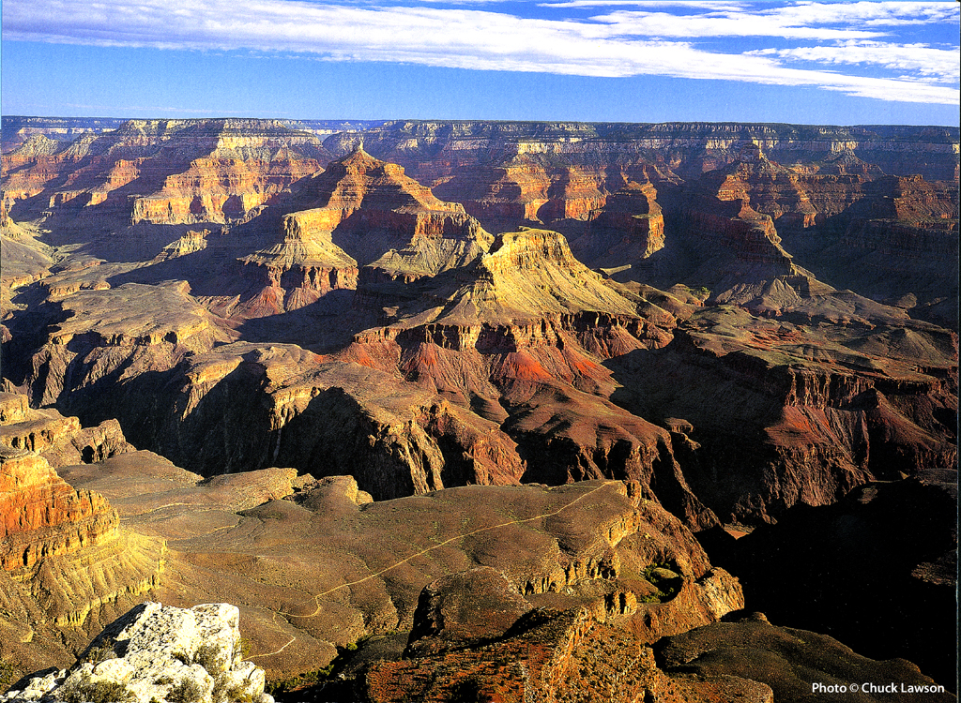
Grand canyon
Grand Canyon, USA
Notes:
61
Photo from “Grand Canyon 2004 Engagement Calendar” (August) produced by Smith-Southwestern, Inc., P.O. box 20100, Mesa, AZ 85277-100.

Slide 62
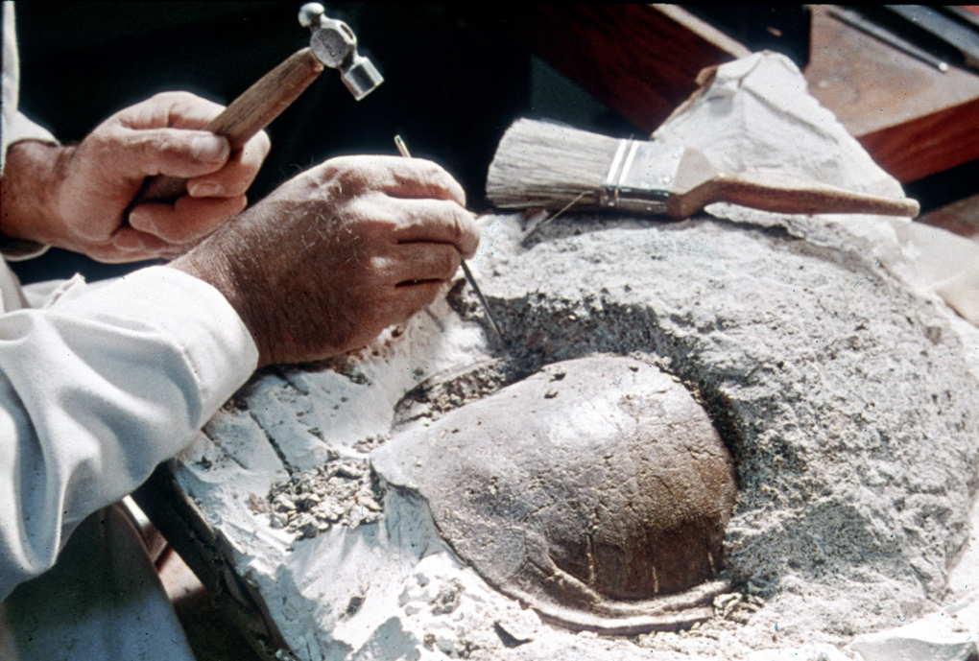
Fossil turtle
Notes:
62

Slide 63
Fossil dinosaur with scientist
Notes:
63
Picture from Dinosaur National Monument (national park) in Utah & Colorado
Show my fossil shells

Slide 64
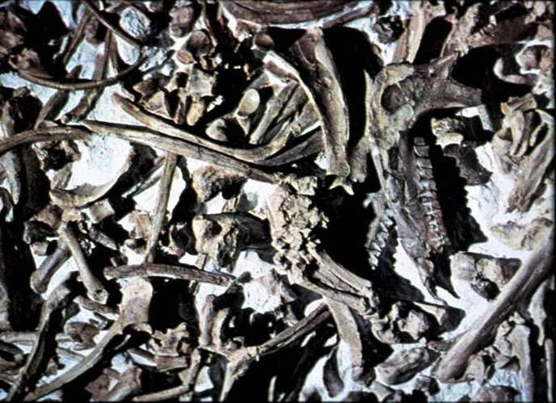
Fossil Graveyards
Agate Springs, Nebraska
Notes:
64
Source: The Genesis Flood, pp. 157-61. At Agate Springs are 1000s of fossils of rhinos, camels, giant boars and many other exotic animals all mixed together in the limestone stratum.

Slide 65

Earl the Cat Day 1
Day 1
SCIENTIFIC EXPERIMENT
IN PROGRESS
DO NOT TOUCH!
DEAD CAT
ON GRASS

Slide 66

Earl Day 3
Day 3
SCIENTIFIC EXPERIMENT
IN PROGRESS
DO NOT TOUCH!
SMELLY DEAD CAT
ON GRASS

Slide 67


Earl Day 9
Day 9
SCIENTIFIC EXPERIMENT
IN PROGRESS
DO NOT TOUCH!
VERY SMELLY
DEAD CAT
ON GRASS

Slide 68


Earl Day 20
Day 20
SCIENTIFIC EXPERIMENT
IN PROGRESS
DO NOT TOUCH!
PART OF EARL MISSING

Slide 69


Earl Day 38
Day 38
SCIENTIFIC EXPERIMENT
IN PROGRESS
DO NOT TOUCH!
MORE OF EARL MISSING

Slide 70


Earl Day 65
Day 65
SCIENTIFIC EXPERIMENT
IN PROGRESS
DO NOT TOUCH!
EARL MISSING!!
WHERE IS EARL?

Slide 71

Fish fossilizing 1
Notes:
71

Slide 72
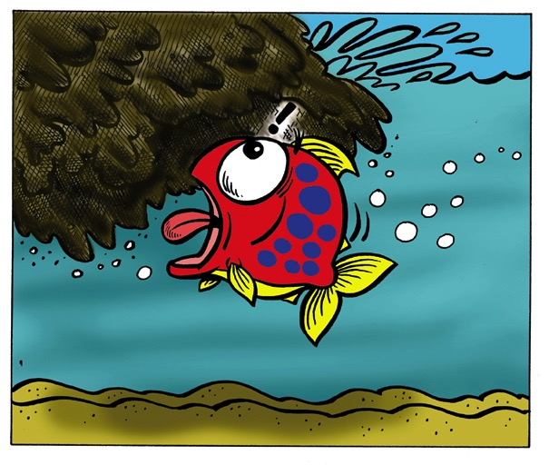
Fish fossilizing 2
Notes:
72

Slide 73
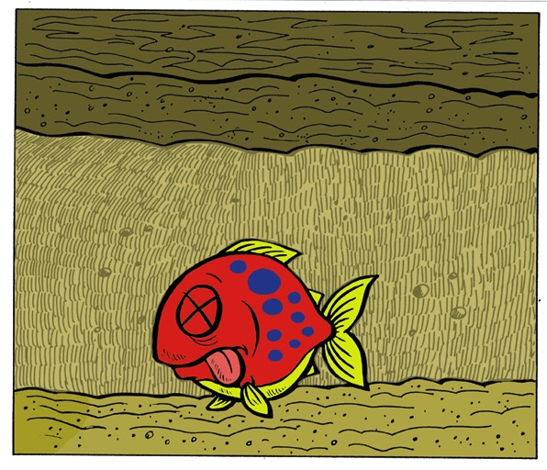
Fish fossilizing 3
Notes:
73

Slide 74
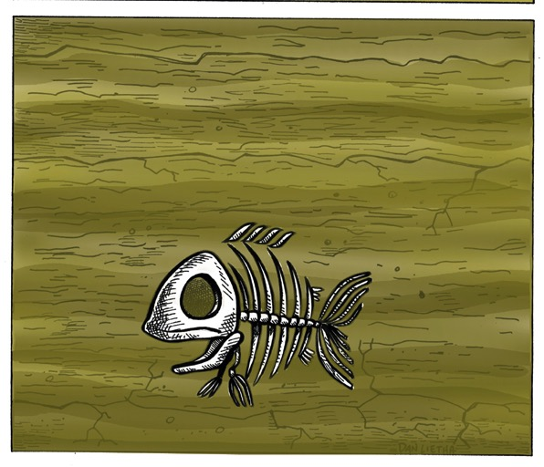
Fish fossilizing 4
Notes:
74

Slide 75
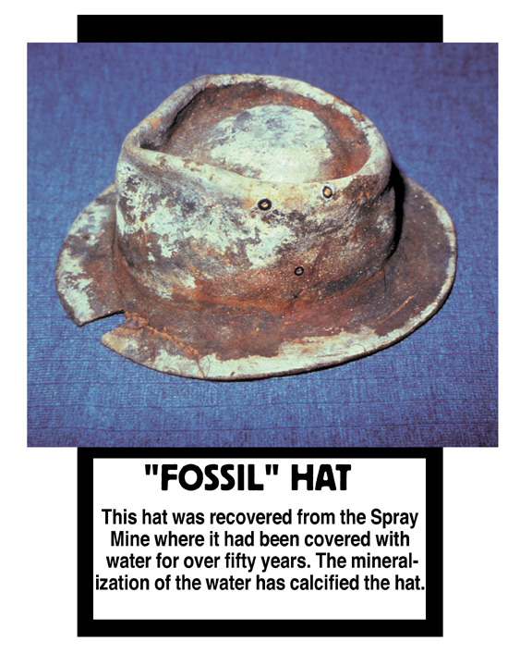
"FOSSIL" HAT
This hat was recovered from the Spray Mine where it had been covered with water for over 50 years. The mineralization of the water calcified the hat.
Notes:
75

Slide 76
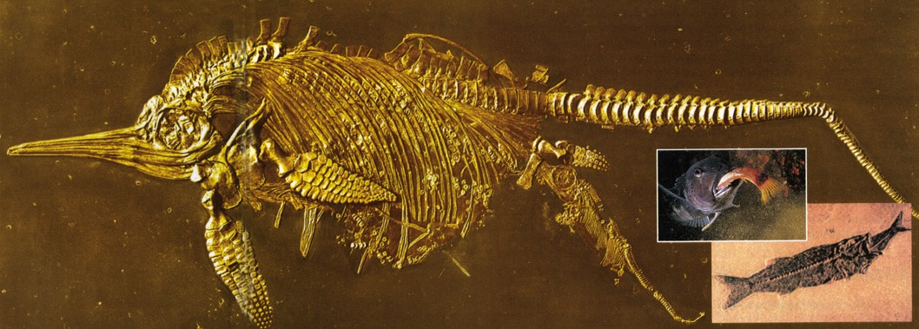
Ichthyosaur giving birth
Fish eating lunch
Notes:
76
Creation, Vol. 23, No. 1 (Dec. 2000-Feb 2001), pp. 10-11.

Slide 77
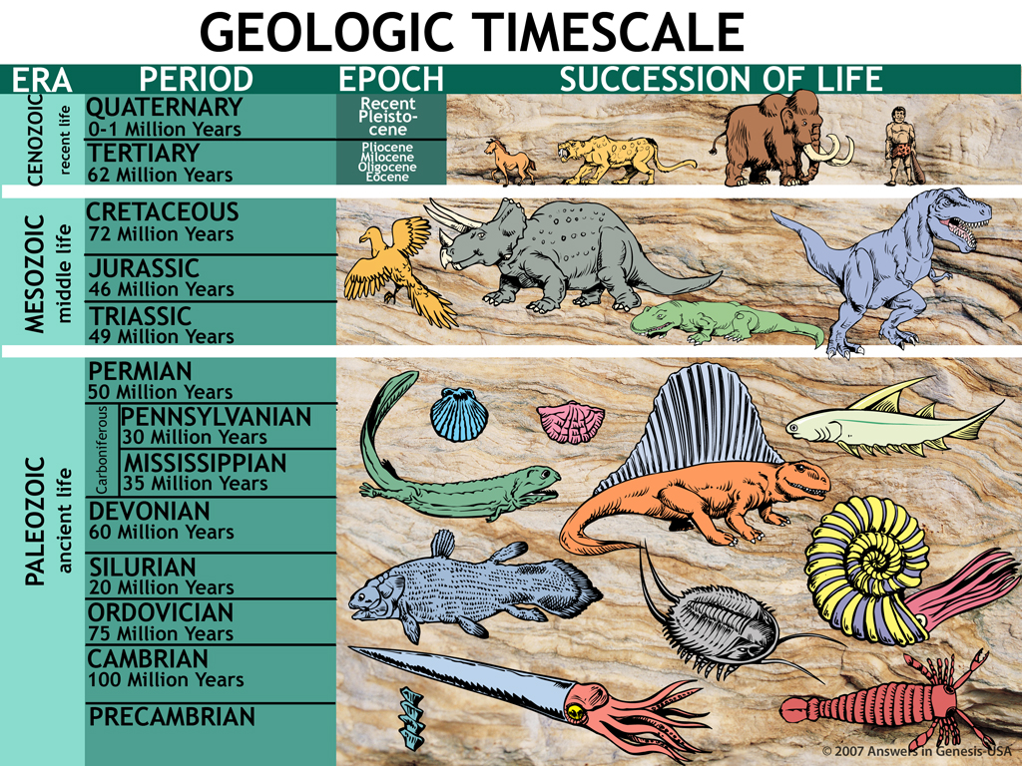
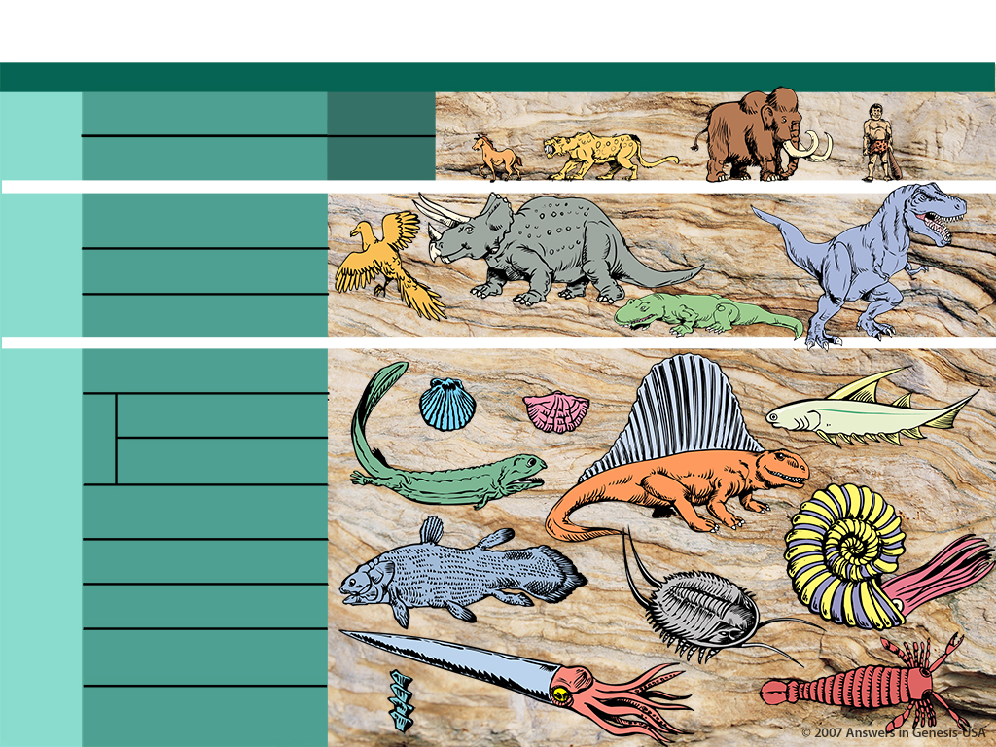
GEOLOGIC TIMESCALE
ERA
PERIOD
EPOCH
SUCCESSION OF LIFE
1.9—3.8 Billion Years: single cell to man
X
CENOZOIC
(recent life)
QUATERNARY
0-1 Million Years
Recent Pleistocene
TERTIARY
62 Million Years
Pliocene
Milosene
Oligocene
Eocene
MESOZOIC
(middle life)
CRETACEOUS
72 Million Years
JURASSIC
46 Million Years
TRIASSIC
49 Million Years
PALEOZOIC
(ancient life)
PERMIAN
50 Million Years
PENNSYLVANIAN
30 Million Years
Carboniferous
MISSISSIPPIAN
35 Million Years
DEVONIAN
60 Million Years
SILURIAN
20 Million Years
According to Evolution
ORDOVICIAN
75 Million Years
CAMBRIAN
100 Million Years
PRECAMBRIAN
Notes:
The age of the earth is a huge debate today—how did we get this low in such a short time? By accident?!
_____________
Same slide at:
02-Noah's Flood-slide 4
06-Millions of Years-slide 4
10-Seven Cs-slide 79

Slide 78
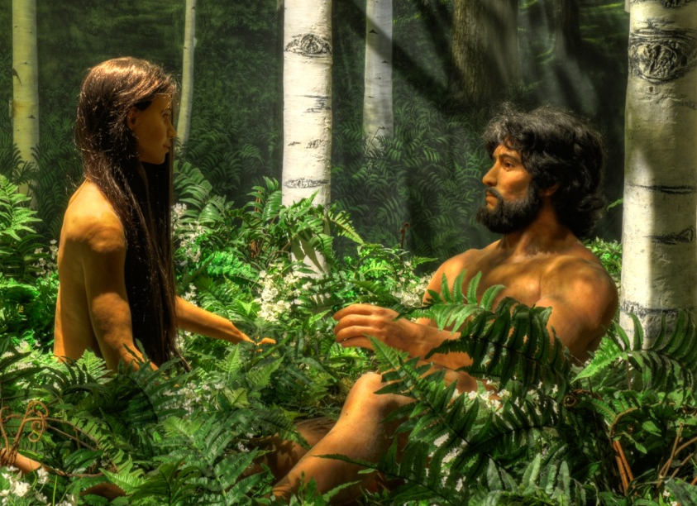

A&E on bones
PAIN
DEATH
KILLING
DISEASE
STRUGGLE
SUFFERING
EXTINCTION
X
Noah's
Flood
MILLIONS
OF YEARS
PAIN
DEATH
KILLING
DISEASE
STRUGGLE
SUFFERING
EXTINCTION
Notes:
78
Some think the ravages of sin came BEFORE Adam and Eve. NO.
• The Bible says that their life was the foundation, then sin came after that, leading to Noah's Flood. I'd say YES to that.
• We have no support for the first view!

Slide 79
CORRUPTION
CATASTROPHE
CREATION
CONFUSION
THE SEVEN C’s OF HISTORY
CONSUMMATION
CHRIST
CROSS
Notes:
This is fully animated. The Scripture text frame is editable so you can insert a different version if you so desire.
In case you want to know. Each element is a TIFF image with alpha channels. This whole page totals 1.1 MB rather than 11+ MB that flat JPEGs would produce.

Slide 80

4-11 Hello World 02280
Notes:
80

Slide 81

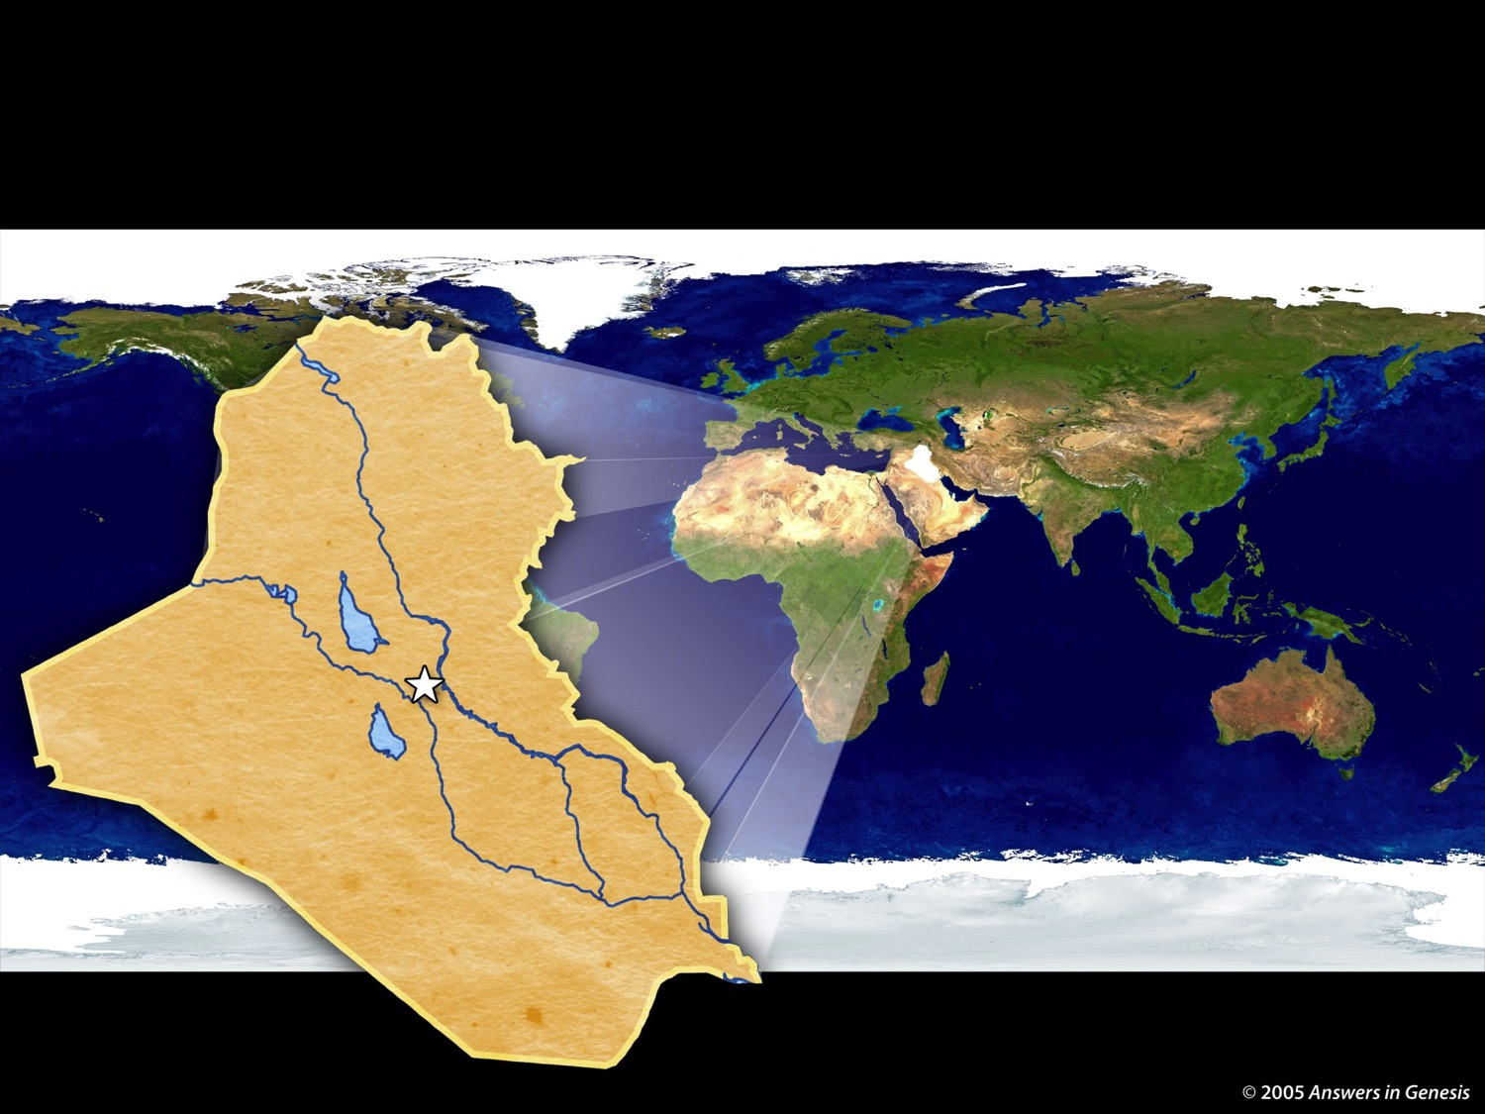
4-07 Tower of Babel Map 02277
TOWER OF BABEL
IRAQ
Tower
of Babel
possible location
Notes:
81
81

Slide 82
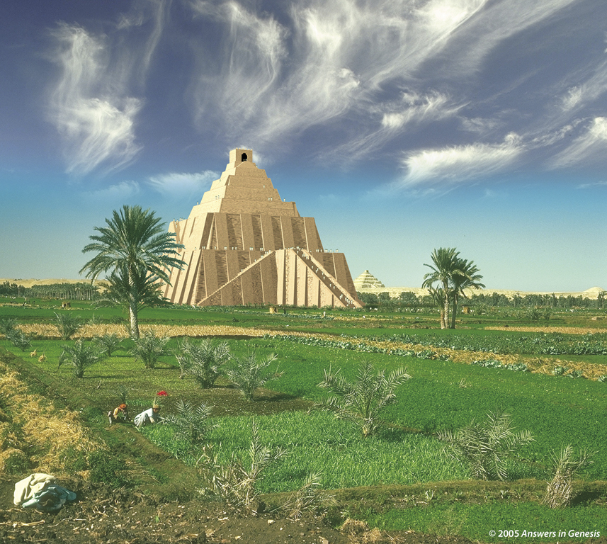
Tower of Babel 02275
Notes:
Created: September 2005.

Slide 83
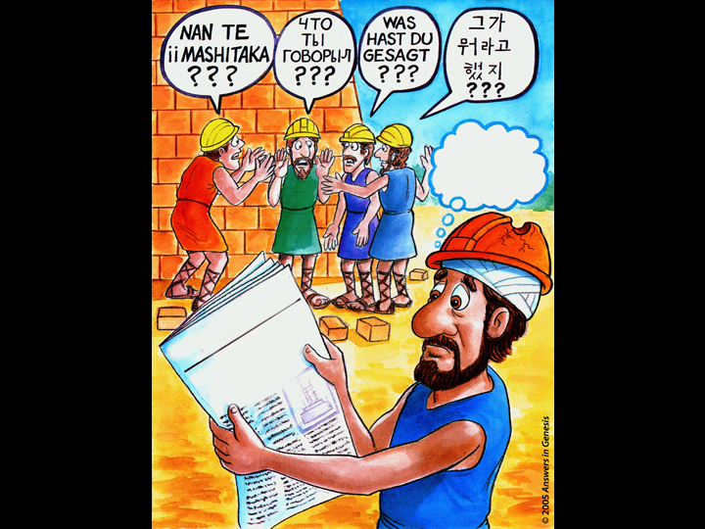
4-06 A-Tower of Babel Doomed 02276
THIS
PROJECT
IS DOOMED!
BABEL DAILY
TOWER IN TROUBLE!
THE
LANGUAGE
NEEDED!
TRANSLATORS
Notes:
83
83
They lost their understanding of God, so God caused them to lose their understanding of each other.

Slide 84
Gen. 11:9 NAS
Genesis 11:9
Therefore its name was called Babel, because there the LORD confused the language of the whole earth; and from there the LORD scattered them abroad over the face of the whole earth.
Notes:
The Bible only speaks of the first heaven and earth and the new ones. The gap theory would mean that there was a first, second and new—so three heavens and earths instead of only two.

Slide 85
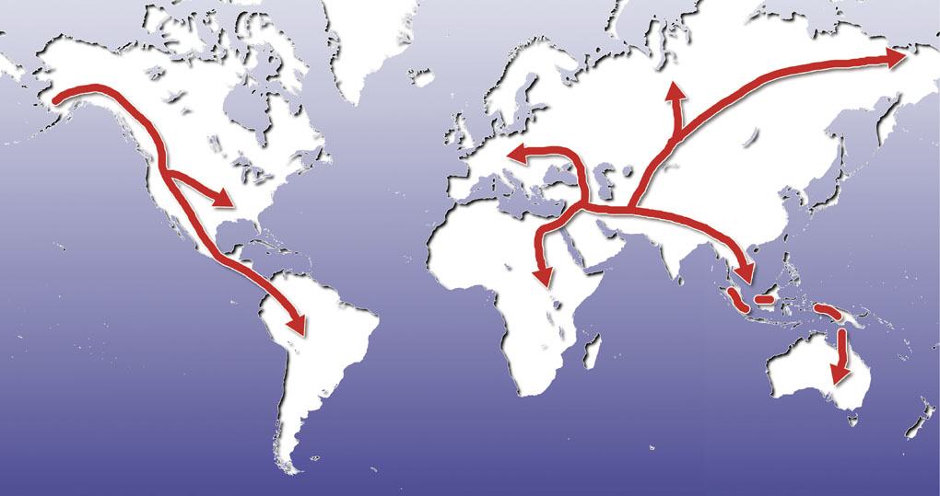
Map—post-flood dispersion
Babel Dispersion

Slide 86
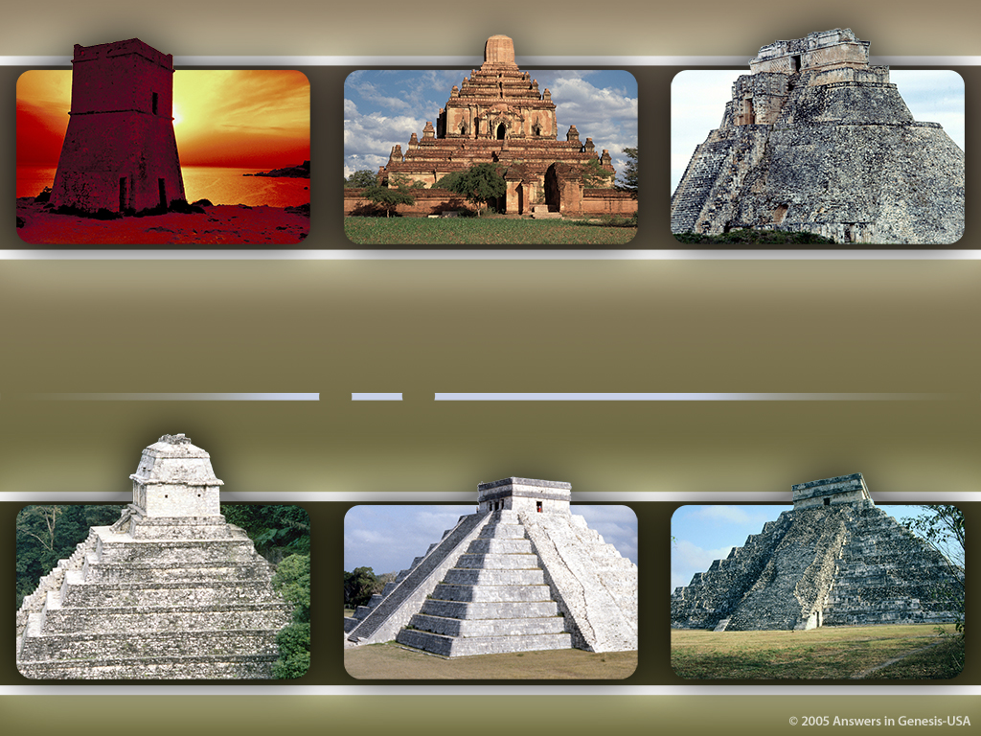
Ziggurats Around the World 02278
Ziggurats
AROUND THE WORLD
Notes:
Created: September 2005.

Slide 87

Races?
RACES?

Slide 88
Evolution of man progression?
Evolution of Man?
X

Slide 89

One Race 02279
One “Race”
Adam & Eve
1 Corinthians 15:45
Genesis 3:20
Sons & Daughters
Genesis 5:4
Noah & Sons
Genesis 9:17-19
People at Tower of Babel
Genesis 11:8-9
Acts 17:26
Different People
Groups/Cultures
Notes:
89
Revised: September 2005.

Slide 90
Skin Tones Line-up 03051

Slide 91
CORRUPTION
CATASTROPHE
CREATION
CONFUSION
THE SEVEN C’s OF HISTORY
CONSUMMATION
CHRIST
CROSS
Notes:
This is fully animated. The Scripture text frame is editable so you can insert a different version if you so desire.
In case you want to know. Each element is a TIFF image with alpha channels. This whole page totals 1.1 MB rather than 11+ MB that flat JPEGs would produce.

Slide 92
Perfection: Lion and lamb
And God saw every thing that he had made, and, behold, it was very good (Gen. 1:31).
Notes:
92

Slide 93
Notes:
93

Slide 94
Adam & Eve—coats of skin
Genesis 3:21
Notes:
94

Slide 95
Gen. 3:15 NAS
Genesis 3:15
And I will put enmity between you and the woman, and between your seed and her seed; he shall bruise you on the head, and you shall bruise him on the heel.

Slide 96
Isaiah 7:14 NAS
Isaiah 7:14
Therefore the Lord Himself will give you a sign: behold, a virgin will be with child and bear a son, and she will call His name Immanuel.
Notes:
The Hebrew word here is used in OT in Gen. 24:43, Ex. 2:8, Ps. 68:25, Prov. 30:19, Song 1:3 and 6:8 and refers there to a chaste unmarried maiden. There is no instance where the Hebrew word (almah) can be proved to designate a young woman who is not a virgin.

Slide 97
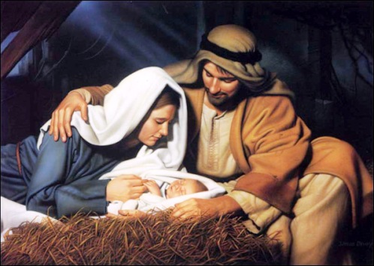
Birth of Jesus
Notes:
97
We celebrate his birth at Christmas
Picture: http://oneyearbible.blogs.com/photos/uncategorized/jesus_manger.jpg, accessed 1 Sept. 2006

Slide 98
Matt. 1:21 NAS
Matthew 1:21
She will bear a Son; and you shall call His name Jesus, for He will save His people from their sins.
Notes:
And Adam gave names to all cattle, and to the fowl of the air, and to every beast of the field; but for Adam there was not found an help meet for him.

Slide 99

Cross 02285
Christ
OUR
DIED FOR SINS
ACCORDING
TO THE
Scriptures
Notes:
Created: September 2005.

Slide 100
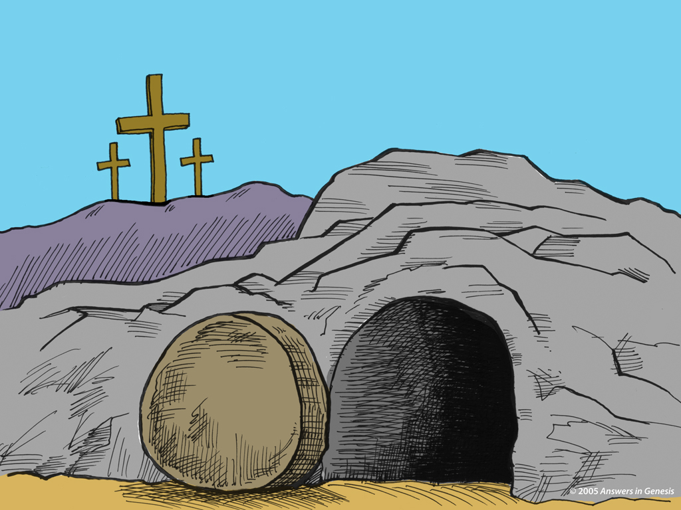
Grave + Crosses 02286
Notes:
100
We celebrate the death and resurrection of Christ at Easter time.

Slide 101

Bozarth 1979 Q053TM--1
“Christianity has fought, still fights, and will fight science to the desperate end over evolution, because evolution destroys utterly and finally the very reason Jesus' earthly life was supposedly made necessary.”
G. Richard Bozarth, “The Meaning of Evolution,” American Atheist (Feb. 1978), p. 30.

Slide 102
Bozarth 1979 Q053TM--2
“Destroy Adam and Eve and the original sin, and in the rubble you will find the sorry remains of the son of god [sic]. Take away the meaning of his death. If Jesus was not the redeemer who died for our sins, and this is what evolution means, then Christianity is nothing!”
G. Richard Bozarth, “The Meaning of Evolution,” American Atheist (Feb. 1978), p. 30.

Slide 103
CORRUPTION
CATASTROPHE
CREATION
CONFUSION
THE SEVEN C’s OF HISTORY
CONSUMMATION
CHRIST
CROSS

Slide 104

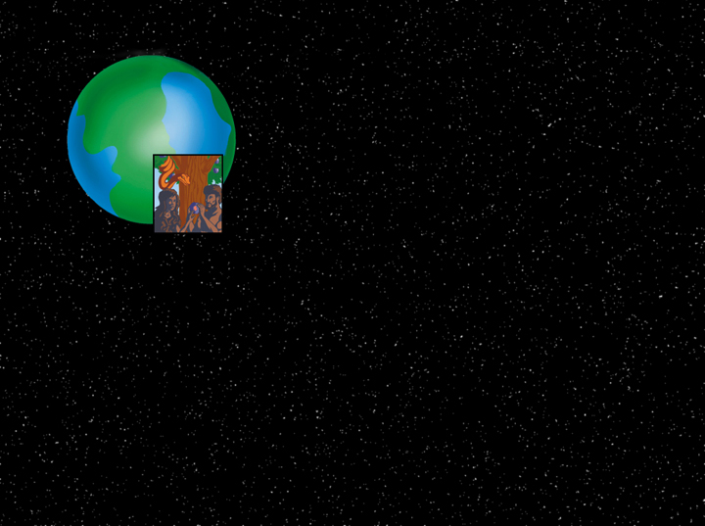
Sin Intrusion1
PERFECT WORLD
Notes:
104
Revised: September 2005.

Slide 105

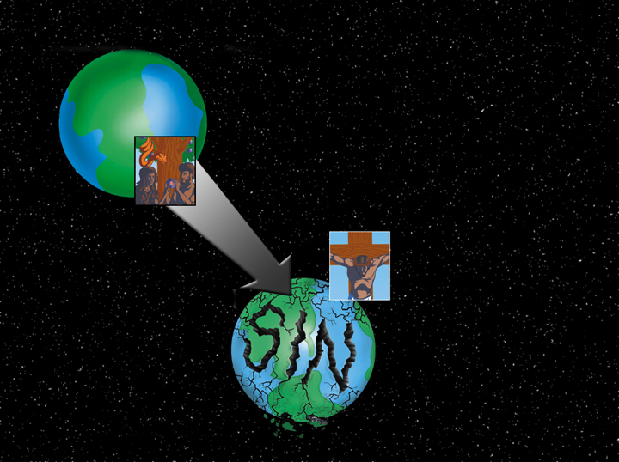
Sin Intrusion2
PERFECT WORLD
INTRUSION
DEATH
DISEASE
PAIN
SUFFERING
EMOTIONAL
ANGUISH
Notes:
105
Revised: September 2005.

Slide 106
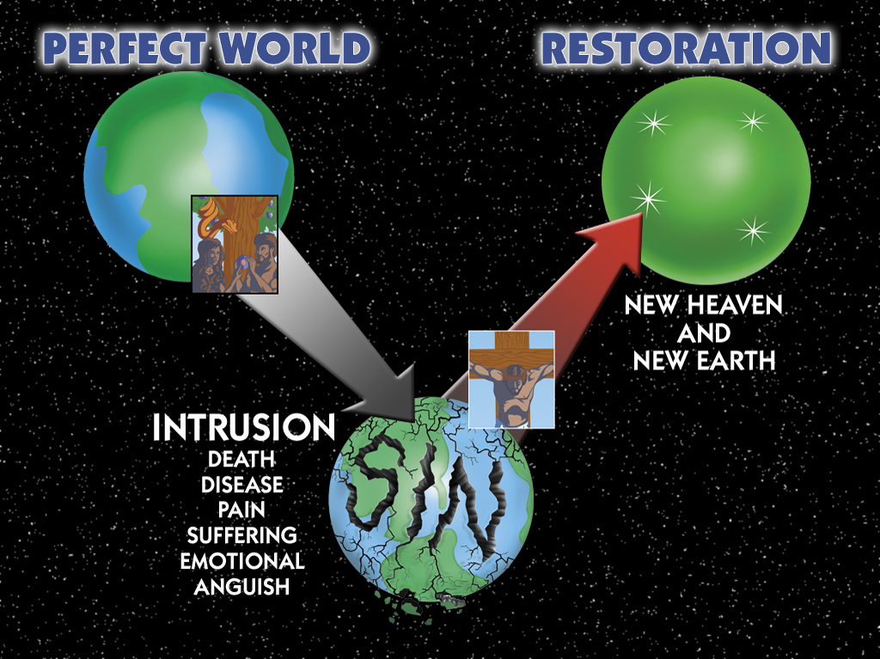
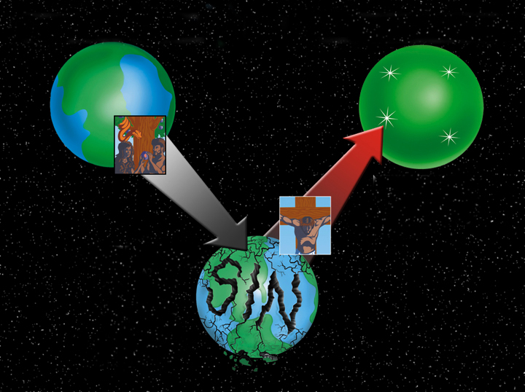
Sin Intrusion
PERFECT WORLD
RESTORATION
NEW HEAVEN
AND
NEW EARTH
INTRUSION
DEATH
DISEASE
PAIN
SUFFERING
EMOTIONAL
ANGUISH
Notes:
106
Revised: September 2005.

Slide 107
Rev. 21:4 & 22:3a NAS
Revelation 21:4
And He will wipe away every tear from their eyes; and there will no longer be any death; there will no longer be any mourning, or crying, or pain; the first things have passed away.
Revelation 22:3a
There will no longer be any curse …

Slide 108
Rom. 8:21 NAS
Romans 8:21
that the creation itself also will be set free from its slavery to corruption into the freedom of the glory of the children of God.
Notes:
Rom. 8:23 uses the same Greek word to say that believers “wait eagerly” for the redemption of our bodies.

Slide 109
Matt. 24:37-39 NAS
Matthew 24:37-39
37. For the coming of the Son of Man will be just like the days of Noah.
38. For as in those days before the flood they were eating and drinking, marrying and giving in marriage, until the day that Noah entered the ark,
39. and they did not understand until the flood came and took them all away; so will the coming of the Son of Man be.

Slide 110
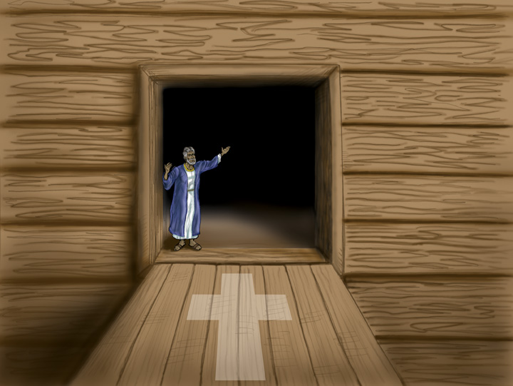
Noah's Ark - Invitation
Notes:
110

Slide 111

Ark Door Closed with cross NAS 00339
“I am the door; if anyone enters through Me, he will be saved, and will go in and out and find pasture.” (John 10:9)
Notes:
111

Slide 112

Family Praying at Cross
Notes:
112

Slide 113

Big Bang Time line
Big Bang Future of the Universe
X
BIG BANG
Billions of Years
Heat Death
Big Bang Time line
Biblical Future of the Universe
Heat Destruction
6-Day
New
Heavens
Thousands of Years
Eternity
Creation
& Earth
Sin and Death
Genesis
2 Peter 3
Revelation

Slide 114
CORRUPTION
CATASTROPHE
CREATION
CONFUSION
THE SEVEN C’s OF HISTORY
CONSUMMATION
CHRIST
CROSS
Notes:
Translators: This is slide 103 to paste here and then add the two black boxes above over them.

Slide 115
2 Corinthians 10:4-5 NAS
2 Corinthians 10:4-5
4. for the weapons of our warfare are not of the flesh, but divinely powerful for the destruction of fortresses.
5. We are destroying speculations and every lofty thing raised up against the knowledge of God, and we are taking every thought captive to the obedience of Christ,

Slide 116
Scientist & Bible—layered new
The earth is billions of years old. Take my word for it!
I created in 6 days. Take my Word for it!
HOLY BIBLE

Slide 117







Turning church kids into skeptics
Turning Church Kids into Skeptics
Secular
Media &
Education
Notes:
117
After book sales and before final statements:
“Parents and grandparents, Your kids and grandkids are being indoctrinate with evolution and millions of years a whole lot more than you were when you were in school. Can they stand strong in their faith in the face of this relentless challenge? Do you care? If you walk out of here and say “That was a nice message, I believe Genesis” but don't get any resources for your kids and grandkids and make sure that they believe Genesis and know how to defend their faith, then you don't care enough. And when they crumble under the intellectual pressure, you will be partly responsible for not equipping them with answers.

Slide 118
I Peter 3:15 NAS
1 Peter 3:15
But sanctify Christ as Lord in your hearts, always being ready to make a defense to everyone who asks you to give an account for the hope that is in you, yet with gentleness and reverence.

Slide 119
AiG web site #1
Notes:
119

Slide 120
CORRUPTION
CATASTROPHE
CREATION
CONFUSION
THE SEVEN C’s OF HISTORY
CONSUMMATION
CHRIST
CROSS

Slide 121
CORRUPTION
CATASTROPHE
CREATION
CONFUSION
HISTORY
THE SEVEN C’s OF HISTORY
CONSUMMATION
CHRIST
CROSS
Notes:
This is fully animated. The Scripture text frame is editable so you can insert a different version if you so desire.
In case you want to know. Each element is a TIFF image with alpha channels. This whole page totals 1.1 MB rather than 11+ MB that flat JPEGs would produce.

Slide 122
History Book of the Universe 02022
The History Book of the Universe
Holy Bible
Notes:
122

Slide 123
D – Where you there?
25 million years ago
Were you there?

Slide 124
Scientist & Bible—layered new
The earth is billions of years old. Take my word for it!
I created in 6 days. Take my Word for it!
HOLY BIBLE

Slide 125
Black
Notes:
125

Slide 126

Rainbow Promise

Slide 127


Kids & the Book of Life
I FOUND MY NAME!
MY NAME IS IN THERE TOO!
MINE TOO!
MINE TOO!
IS YOUR NAME IN THE LAMB'S BOOK OF LIFE?

Slide 128



Ages of People When They Died
God Shortened the Length of Human Life
to an Average of 70 Years
Adam
930 Years
Methusaleh
969 Years
Lived & Died Before the Flood
Noah
950 Years
Shem
600 Years
Lived & Died Before the Flood
Abraham
175 Years
Moses
120 Years
David
70 Years
Lived & Died After the Flood
"Before the Flood, when the world was much different than today, people sometimes lived almost one thousand years! But after the Flood, people's lives were much shorter. Today, few people live to be even 100 years old" (John Morris, Noah's Ark & the Ararat Adventure, page 10).
Notes:
From John Morris, Noah's Ark and the Ararat Adventure, p. 10.

Slide 129

Creatures buried with feet Up
DON'T WORRY ABOUT ME, BOYS AND GIRLS! I AM ON THE ARK!

Slide 130
Days of Creation in Genesis One 00825—layered—NAS
DAYS OF CREATION IN GENESIS 1
DAY
DAY
DAY
EARTH, SPACE, TIME & LIGHT
EXPANSE
DRY LAND & PLANTS
DAY
DAY
DAY
SUN, MOON & STARS
FLYING & SEA CREATURES
LAND ANIMALS & MAN

Slide 131
Black
Notes:
131

Slide 132


Creation link at BibleStudyDownloads.org
Get this presentation for free!
Notes:
OT Survey (os)

