Slide 1
Spiritual Gifts
An Introduction
Dr. Rick Griffith • Jordan Evangelical Theological Seminary • BibleStudyDownloads.org

Slide 2
Today we will address a lot of issues…
Basic Issues in 1 Corinthians 12
Talents v. Gifts
Why Study & Know Our Gifts
Scriptural Gift Commands
Lists of Gifts in the NT

Slide 3
Spiritual Gifts
Where should we begin studying gifts?

Slide 4
I. Understanding gifts begins with seeing Christ as God (12:1-3).
Father
is
is not
is not
GOD
is
is
Son
Spirit
is not

Slide 5
1 Corinthians 12:1-3 (NIV)
¹Now about spiritual gifts, brothers, I do not want you to be ignorant.
²You know that when you were pagans, somehow or other you were led astray to mute idols.
³Therefore I tell you that no one who is speaking by the Spirit of God says, "Jesus is Lord," except by the Holy Spirit.

Slide 6
Basic Issues in 1 Cor 12
2
What
Who
Where
When
Why

Slide 7
What is a spiritual gift?
"a God-given ability for service" (Ryrie)
"a spiritual capacity for development" (Radmacher)

Slide 8
What is a spiritual gift?
NOT
Place of service
Age group ministry
Natural talent

Slide 9
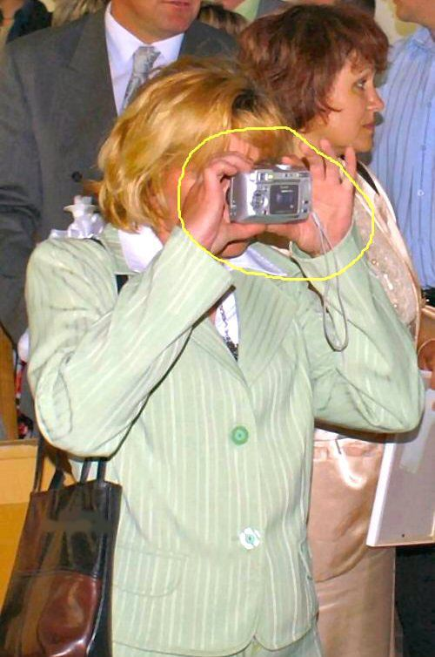
Me? Gifted?

Slide 10
Basic Issues in 1 Cor 12
2
What
Who
Where
When
Why

Slide 11
1 Corinthians 12:1-3 (NIV)
¹Now about spiritual gifts, brothers, I do not want you to be ignorant.
²You know that when you were pagans, somehow or other you were led astray to mute idols.
³Therefore I tell you that no one who is speaking by the Spirit of God says, "Jesus is Lord," except by the Holy Spirit.

Slide 12
II. Our different gifts are united in the triune God (12:4-6).
Father
is
is not
is not
GOD
is
is
Son
Spirit
is not
H. Wayne House, Charts of Christian Theology and Doctrine, 45

Slide 13
1 Corinthians 12:4-6 (NIV)
There are different kinds of gifts,
but the same Spirit.
There are different kinds of service,
but the same Lord.
There are different kinds of working,
but the same God
works all of them in all men.

Slide 14
GIVES
"There are different kinds of gifts,
but the same Spirit" (12:4).
Father
is
is not
is not
GOD
is
is
Son
Spirit
is not
H. Wayne House, Charts of Christian Theology and Doctrine, 45

Slide 15
Talents versus Gifts
2
Issue
Talents
Gifts
Who has?
All
Christians only
How got?
Work
Grace
When got?
Varies
New birth
Who benefits?
All
Church

Slide 16
The Real Issue
2
Does it really matter if we call an ability a talent or a gift?
Yes
We shouldn’t add to God’s Word by calling an ability a “spiritual gift” if the Bible doesn’t call it a gift, but…
&
No
Both talents & gifts are: Given by God, and To be used for God!!

Slide 17
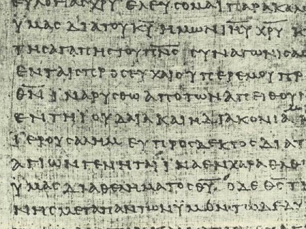
The Basis & Nature of Gifts
3
1) Charisma (ca,risma)
Roots: charis means grace (basis) chara means joy (result)

Slide 18
GIVES
Father
is
is not
is not
GOD
"spiritual"
is
is
Son
Spirit
is not
H. Wayne House, Charts of Christian Theology and Doctrine, 45

Slide 19
APPOINTS
"There are different kinds of service,
but the same Lord" (12:5).
Father
is
is not
is not
GOD
is
is
Son
Spirit
is not
H. Wayne House, Charts of Christian Theology and Doctrine, 45

Slide 20
The Basis & Nature of Gifts
3
2) Diakonia (dia,konia)
• Place of service (1 Cor. 12:5) • Category of gifts (1 Pet. 4:11) • "service" (NIV), "ministries" (NASB)

Slide 21
EMPOWERS
Father
is
is not
is not
"There are different kinds of working,
but the same GOD
works all of them in all men" (v. 6).
is
is
Son
Spirit
is not
H. Wayne House, Charts of Christian Theology and Doctrine, 45

Slide 22
The Basis & Nature of Gifts
3
2) Diakonia (dia,konia)
• Place of service (1 Cor. 12:5) • Category of gifts (1 Pet. 4:11) • "service" (NIV), "ministries" (NASB)
3) Energema (e;nerghma)
• Energy operating gifts (1 Cor. 12:6) • "working" (NIV), "effects" (NASB)

Slide 23
The Key Idea
Q: Where should we begin studying gifts?
A: Gifts praise the triune God—not us!

Slide 24
The Triune Involvement
EMPOWERS
Father
is
is not
is not
GOD
is
is
Son
Spirit
APPOINTS
GIVES
is not
H. Wayne House, Charts of Christian Theology and Doctrine, 45

Slide 25
How do you see the Spirit working in your life?
Notes:
Intro to MPI: But do you identify with this? How do you see the Spirit working in your life?

Slide 26
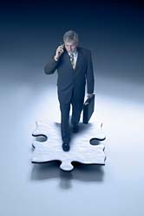
One evidence of the Spirit's work in your life is your spiritual gift (12:7-11)
"A spiritual gift is given to each of us so we can help each other" (1 Cor. 12:7 NLT)

Slide 27
The Spirit gives every gift (12:8)
⁸To one person the Spirit gives the ability to give wise advice [a word of wisdom]; to another the same Spirit gives a message of special knowledge [a word of knowledge].*

Slide 28
The Spirit gives every gift (12:9-10a)
⁹The same Spirit gives great faith to another, and to someone else the one Spirit gives the gift of healing. ¹⁰He gives one person the power to perform miracles.

Slide 29
The Spirit gives every gift (12:10b-11a)
and another the ability to prophesy. He gives someone else the ability to discern whether a message is from the Spirit of God or from another spirit. Still another person is given the ability to speak in unknown languages,* while another is given the ability to interpret what is being said. ¹¹It is the one and only Spirit who distributes all these gifts.

Slide 30
The Spirit alone chose your gift (12:11b)
He alone decides which gift each person should have.

Slide 31
Why Study & Know Our Gifts?
3
1) MINISTRY TO THE CHURCH BODY - Ministering in the area of our gifts results in:
a) edification of the body— unity and interdependency (1 Cor. 14:12)
b) mobilizing the church for mission to a lost world.
c) encouraging other believers to discern and develop their gifts.

Slide 32
Why Study & Know Our Gifts?
3
2) PERSONAL FULFILLMENT - Exercising our gifts results in:
a) ministering in areas of strength, reducing frustration and wasted time.
b) assisting us in establishing priorities for study, growth, and ministry (Eph. 4:13).
c) a sense of usefulness and belonging in the body of Christ (1 Cor. 12:14-17).

Slide 33
Why Study & Know Our Gifts?
3
3) OBEDIENCE TO GOD'S WORD - Scripture gives several commands relating to gifts:
a) "Do not neglect the spiritual gift within you..." (1 Tim 4:14a).
b) "Now about spiritual gifts, brethren, I do not want you to be unaware " (1 Cor. 12:1).
c) "And since we have gifts that differ according to the grace given us, let us exercise them accordingly..." (Rom. 12:6a).
d) "As each one has received a special gift, employ it in serving one another (1 Pet. 4:10).

Slide 34
Scriptural Gift Commands
4
Teaching
Col. 3:16-- “Let the word of Christ richly dwell within you… teaching… one another…”
Evangelism
Matt. 28:19-- “Go therefore and make disciples of all nations…”
Pastor- Teacher
Gal. 6:1-- “Brothers, if a man is caught in any trespass, you who are spiritual, restore him…”
Exhortation
Heb. 3:13a-- “But encourage one another daily…”

Slide 35
Scriptural Gift Commands
4
Adminis- tration
1 Cor. 14:40-- “But let all things be done properly and in an orderly manner”
Faith
Heb. 11:6a-- “And without faith it is impossible to please Him…”
Giving
1 Cor. 16:2-- “On the first day of the week let each of you put aside and save [for] collections…”
Service
Gal 5:13-- “…Serve one another in love”
Showing Mercy
Col. 3:12-- “And so, as those who have been chosen of God, holy and beloved, put on a heart of compassion, kindness, humility, gentleness and patience”

Slide 36
We need to define each gift
THE LEMON IS A YELLOW FRUIT THAT GROWS ON TREES.
THE SAME WORDS MAY MEAN DIFFERENT THINGS TO DIFFERENT PEOPLE!
Notes:
CH-07-Intro-36
CH-08-Dangers-39
HS-06-Intro-36
HS-07-Dangers-39

Slide 37
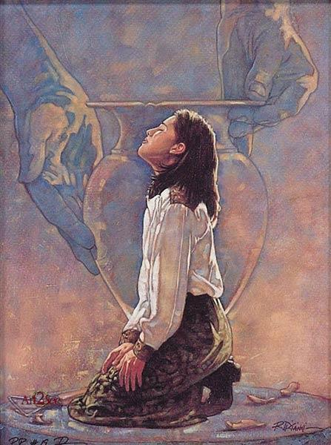
New Testament Gift Lists
6
Gifts (All) | Rom 12:6-8 | Eph 4:11 | 1 Cor 12:28 | 1 Cor 12:29-30 | 1 Cor 12:8-10
Teaching | Teaching |  | Teaching | Teaching
Evangelism |  | Evangelists
Pastor-Teacher |  | Pastor-Teachers
Exhortation | Exhortation
Administration |  |  | Administration
Faith |  |  |  |  | Faith
Giving | Giving
Service | Service |  | Helping
Showing Mercy | Mercy
Apostleship |  | Apostles | Apostles | Apostles
Wisdom |  |  |  |  | Wisdom
Knowledge |  |  |  |  | Knowledge
Prophecy | Prophecy | Prophets | Prophecy | Prophecy | Prophecy
Discerning Spirits |  |  |  |  | Discerning Spirits
Tongues |  |  | Tongues | Tongues | Tongues
Interpretation |  |  |  | Interpretation | Interpretation
Miracles |  |  | Miracles | Miracles | Miracles
Healings |  |  | Healings | Healings | Healings
Speaking 1 Pet. 4:11a
Permanent
Serving 1 Pet. 4:11b
Foundational Eph. 2:20
Temporary
Sign Heb. 2:4

Slide 38
Black

Slide 39
Church (Ecclesiology) link at BibleStudyDownloads.org
Get this presentation for free!
Notes:
Church (ch)

