Slide 1

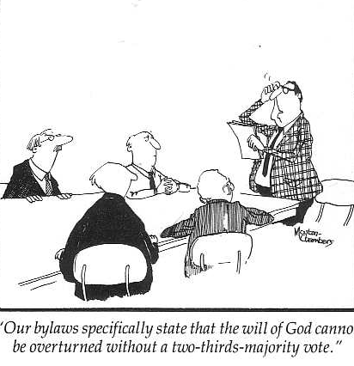
Leadership Structure in the Bible
Ecclesiology Notes, pages 35-85
OT
•
Inter-testament
•
NT
Dr. Rick Griffith
Jordan Evangelical Theological Seminary
BibleStudyDownloads.org
"Our bylaws specifically state that the will of God cannot be overturned without a 2/3 majority vote."

Slide 2
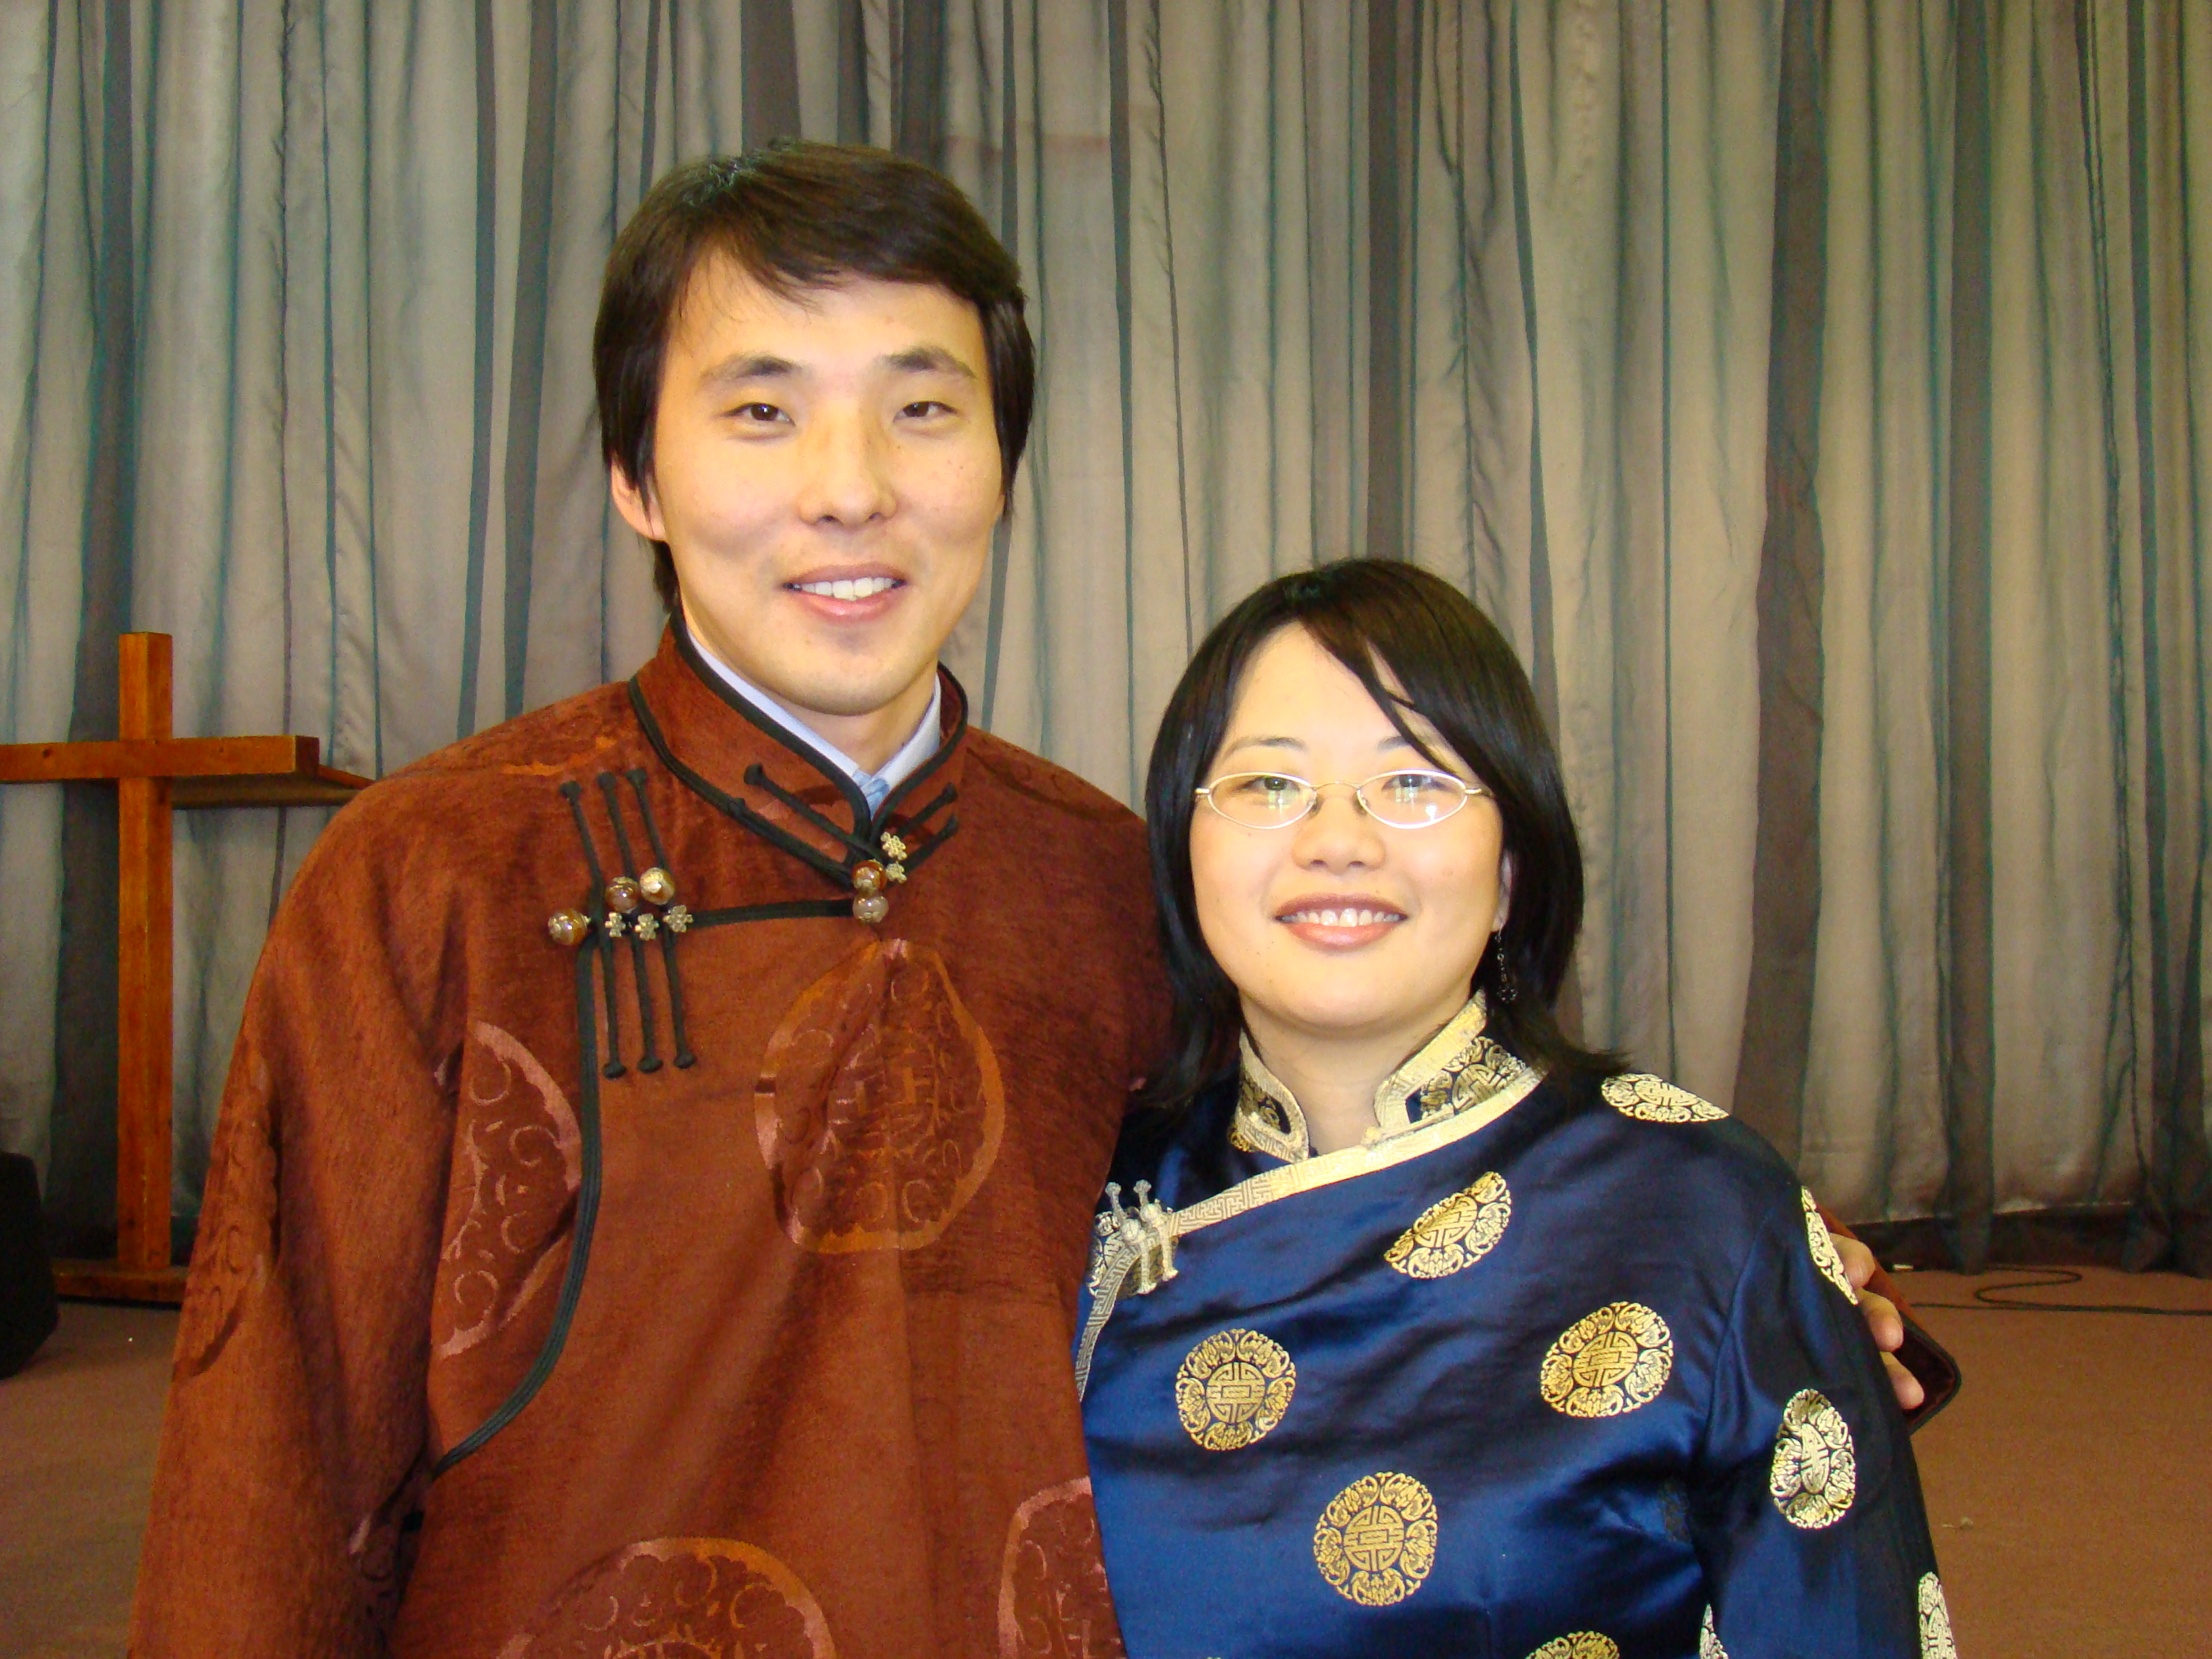
Church Leadership
35
What does it take?

Slide 3

Secular versus Pastoral Leadership: What's the Difference?
35
Secular
Pastoral
Appointed
Divine call
Physical needs
Spiritual needs
Highly educated
Calling qualif.
Voice of people
Listen to God
Directing
Leading
The Key Principle
Notes:
3

Slide 4
Secular versus Pastoral Leadership: What's the Difference?
35
Secular
Pastoral
Rancher
Shepherd
Profit motive
Glorify God
Own interests
Will of God
Power & image
Others concern
Authoritarian
Servant leader
The Key Principle
Notes:
4

Slide 5
Secular versus Pastoral Leadership: What's the Difference?
35
Secular
Pastoral
Wealthy leaders
Poor pastors
Selfish
Selfless
Position
Spiritual Qualif.
Boss (CEO)
Servant of all
Pride, ego
Meek humility
The Key Principle
Notes:
5

Slide 6
Secular versus Pastoral Leadership: What's the Difference?
35
Secular
Pastoral
Depend on self
Depend on God
Served
Serve
Impatient
Patient
Dishonesty
Integrity
Own benefit
Sacrificial
The Key Principle
Notes:
6

Slide 7
Secular versus Pastoral Leadership: What's the Difference?
35
Secular
Pastoral
Human sources
Bible
Temporal results
Eternal reward
Immoral OK
Morality
Time bound
Timeless
Duty
Call
The Key Principle
Notes:
7

Slide 8
Secular versus Pastoral Leadership: What's the Difference?
35
Secular
Pastoral
One birth OK
Born again
Paid followers
Volunteers
Complaining OK
Contentment
The Key Principle
Notes:
8

Slide 9
My Key Leadership Principles:
35
Be faithful (1 Cor. 4:1-2)
Help the poor (Isa. 58:7-8)
Love even immoral people
Teach children (Matt. 18:1-10)
Be an example (1 Pet. 5:3)
Notes:
9

Slide 10
My Key Leadership Principles:
35
Preach sincerely (1 Thess. 2:10)
Maintain unity (Eph. 4:1)
Notes:
10

Slide 11

What Should Leaders Aim For?
36
Numerical church growth is not a NT emphasis
(1 Cor. 4:2)

Slide 12

Scriptural Marks of a Healthy Church
36
Healthy churches...
are measured in spiritual rather than numerical terms
follow biblical rather than cultural patterns of ministry
are based on theological rather than sociological foundations
Kenneth O. Gangel, "Marks of a Healthy Church,"
Bibliotheca Sacra 158 (October-December 2001): 467-77
Notes:
Dr Gangel is a leading educator who gives signs of a Christian congregation that functions well. He counters the following heresies:
a) "Large churches must be healthy churches: We must be doing many things well!"
b) "Large churches are relevant churches: Our church attracts people because it relates well to the world."
c) "A successful church meets the social needs of its area: We must have God's blessing even if we are not helping lost people become saved."
d) "The best church sells itself well to the world: We are not persecuted because we have good relations with the lost."
e) "Our church leaders have the respect of the unbelieving community: We therefore must be biblical."
Gangel brings up many points that church leaders should discuss. We should consider that Jesus promised persecution and marginalization by the world when we act truly Christian and care for the gospel by reaching people's eternal needs.
_____________
CH-03-Leadership-12
HS-12-Discerning Gifts-3

Slide 13
Scriptural Marks of a Healthy Church
36
Healthy churches...
focus on a ministry model rather than a marketing model
adopt scriptural rather than secular models of leadership
Kenneth O. Gangel, "Marks of a Healthy Church,"
Bibliotheca Sacra 158 (October-December 2001): 467-77

Slide 14

Biblical Leadership Principles
37
Personal Leadership
• God's Priorities
• Adapt Your Style
• Serve People
2. Selecting Leaders
• Delegate
• Spiritual Qualities
• Build a Team
3. Other Principles

Slide 15

LEADERSHIP STRUCTURE IN THE OLD TESTAMENT
38
Is there a pattern?

Slide 16
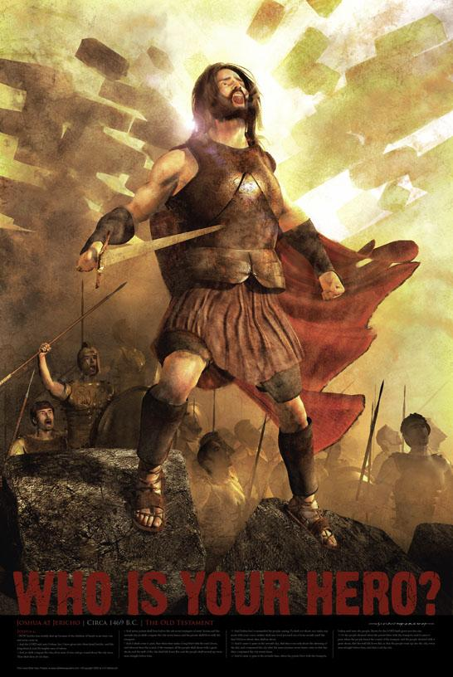
THE SINGLE LEADER MODEL
JOSHUA
38
MISSION
IMPOSSIBLE

Slide 17
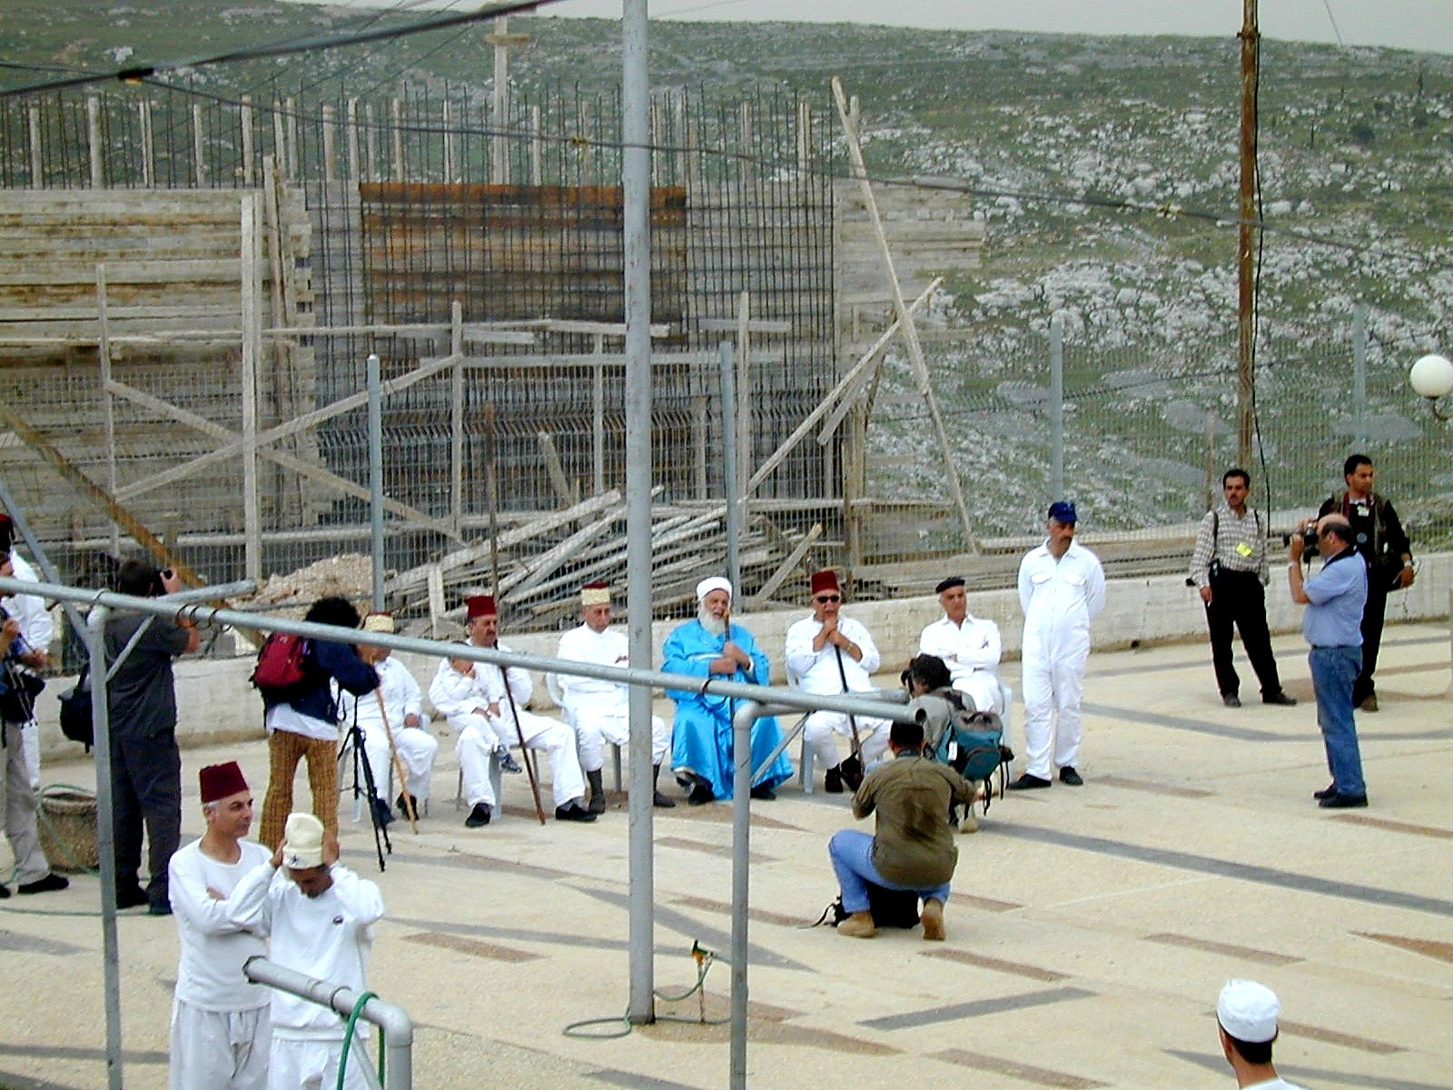
38
The Elders of Israel
What do you learn about the elders of Israel from your assigned verses?
Samaritan Elders Today

Slide 18
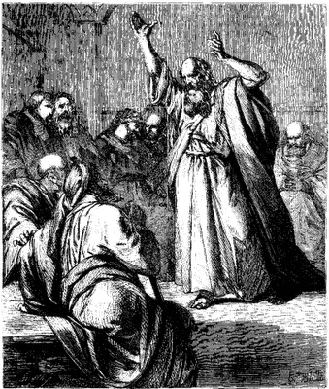
The Elders of Israel
48
Elders are found throughout
the nation's history
Elders were prominent even when God spoke revelation through a single man such as Moses (Exod. 3:16, 18; 4:29, etc.) or a prophet like Elijah (2 Kings 6:32)
There was always a plurality of elders in the OT—only once does the word appear in the singular ("elder" in Isa. 3:2)

Slide 19
The Elders of Israel
48
Elders led at various levels:
national, regional, city, house
Elders ruled other nations, such
as Midian (Num. 22:4), Moab (Num. 22:7), and Gibeon (Josh. 9:11).
Once Israel's elders prophesied (Num. 11:25-26).
Elders were commanded to teach the people God's laws every seven years (Deut. 27:1-8; 31:9-10), which they did under Josiah (2 Kings 23:1-2).

Slide 20
The Elders of Israel
50
Elders were respected for their
wisdom (Ps. 107:32; Prov.
31:23; Lam. 4:16; 5:12)
Elders counseled kings in their ruling (1 Kings 12:6-8, 13; 20:7-8; Jer. 26:17) and anointed kings to power (1 Chron. 11:3)
Elders submitted to prophets' instructions (Elijah in 2 Kings 6:32; Ezekiel in Ezek. 14:1)

Slide 21
The Elders of Israel
50
Elders ruled alongside other administrators: a palace
administrator, the city
governor, and officials (2 Kings 10:1, 5). Their decision was especially binding in postexilic times (Ezra 10:8, 14).
OT elders often failed to lead the people biblically
Elders will rule over Israel in the future millennial reign of Christ (Isa. 24:23)

Slide 22
The Elders of Israel
51
Unfortunately, the OT gives no
explicit instructions on who
they were or how to select
them. Yet the term itself implies that each group of elders was composed of older, mature men.

Slide 23
Key Questions to Answer
What is the biblical form of church government?
Who has the ultimate authority in local church matters?
How is congregational say balanced with biblical commands to respect leaders?

Slide 24
OUTLINE
Introduction
  Four facts
  Basic approach
Church Government in the NT
  Key functions of an Elder
  Key function of a Deacon
  Appointment of church officers

Slide 25
OUTLINE
Body:
  Decision making in the local church
  Proposed form of church government
  Leaders-Congregation dynamics
Conclusion
Sources

Slide 26
Four facts:
The Bible does not explicitly indicate a form of church government.
The Bible does not command the church to adopt any particular form of government.
INTRODUCTION

Slide 27
Four facts:
Two church offices are mentioned in the NT:
  Elder (Pastor/Overseer/Bishop – Acts 14:23; Phil. 1:1; Titus 1:5)
  Deacon (servant) – Acts 6:3
INTRODUCTION

Slide 28
Four facts:
The qualifications of these two church officers are clearly stated in the Bible:
  Elder (1 Tim. 3:1-7; Titus 1:5-7)
  Deacon (Acts 6:3; 1 Tim. 3:8-13)
INTRODUCTION

Slide 29
Our Basic Approach
INTRODUCTION
We will determine the correct form of church government by understanding the key qualifications of elders and deacons in the NT since they are the only church offices noted.

Slide 30
Two Questions:
Who has the ultimate say in the church?
What is the biblical pattern for church leadership?

Slide 31
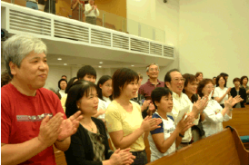
I. Ultimate authority in the local church rests with the congregation

Slide 32
Congregational Authority
NA
In Church Discipline (Matt. 18:17)
  "Take it to the church…"
In Leader Selection (Acts 6:3)
  "Choose… from among you…"
In Maintaining True Doctrine:
"For I received from the Lord what I also passed on to you…" (1 Cor. 11:23)
"Friends… test the spirits" (1 John 4:1)
"Contend for the faith" (Jude 3)

Slide 33
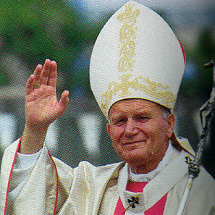
Episcopal Church
Structure
(Simplified)
92
Bishop
Anglican
Lutheran
Methodist
Orthodox
Catholic
Vicar
Vicar
Vicar
Deacons
Deacons
Deacons
People
People
People

Slide 34

Lower Presbyterian Structure
92
Presbytery
Senior
Pastor
Senior
Pastor
Senior
Pastor
Elders
(Session)
Elders
(Session)
Elders
(Session)
People
People
People

Slide 35
Middle Presbyterian Structure
92
Synod
Presbytery
Presbytery
Senior
Pastor
Senior
Pastor
Senior
Pastor
Senior
Pastor
Senior
Pastor
Senior
Pastor
Elders
(Session)
Elders
(Session)
Elders
(Session)
Elders
(Session)
Elders
(Session)
Elders
(Session)
People
People
People
People
People
People

Slide 36
Highest Presbyterian Structure
92
General Assembly
Synod
Synod
Presbytery
Presbytery
Presbytery
Presbytery
Elders
(Session)
Elders
(Session)
Elders
(Session)
Elders
(Session)
Elders
(Session)
Elders
(Session)
Elders
(Session)
Elders
(Session)
Elders
(Session)
Elders
(Session)
Elders
(Session)
Elders
(Session)
People
People
People
People
People
People
People
People
People
People
People
People

Slide 37
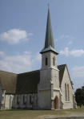
What About Baptists?
92
The Autonomy of the Local Church

Slide 38

Two Questions:
92
Who has the ultimate say in the church?
What is the biblical pattern for church leadership?

Slide 39
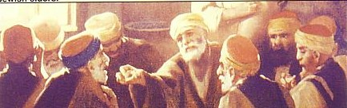
II. The biblical pattern is church leadership by elders.
92

Slide 40
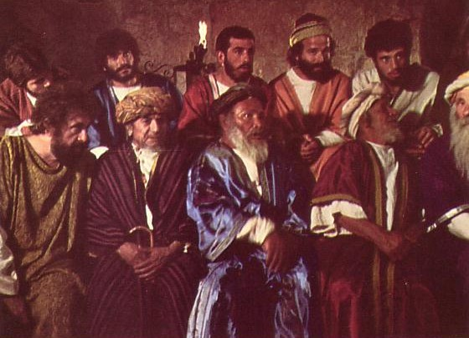
Elders led from the time of Moses
48
Elders
led with
Moses
1400 BC
"Go, assemble the elders of Israel and say to them…"
(Exod. 3:16)

Slide 41

Who Led the Synagogue?
51
Elders
led with
Moses
1400 BC
Elders
led
Synagogues
600 BC

Slide 42
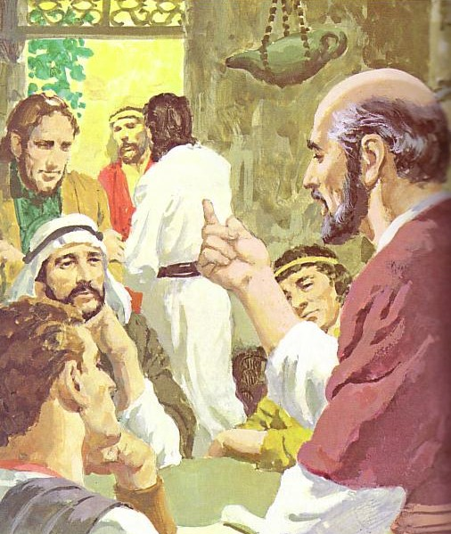
God has advocated group leadership through the ages
55
Elders
led with
Moses
1400 BC
Elders
led
Synagogues
600 BC
NT
Elders

Slide 43
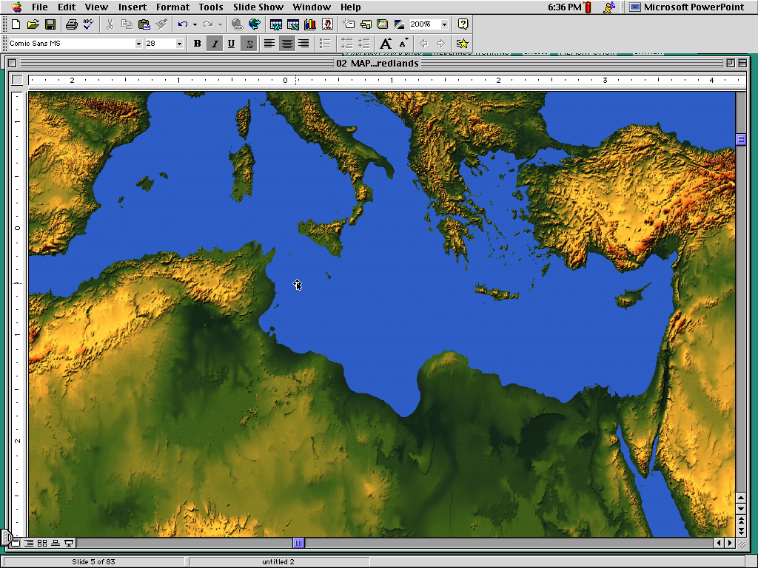
Places Mentioning Elders
elders = overseers = bishops = pastors
55
Jerusalem (AD 47):
NIV Acts 11:30 This they did, sending their gift to the elders by Barnabas and Saul.
Ephesus (AD 57):
NIV Acts 20:17 From Miletus, Paul sent to Ephesus for the elders of the church.
Galatia (AD 48):
NIV Acts 14:23 Paul and Barnabas appointed elders {or Barnabas ordained elders; or Barnabas had elders elected} for them in each church
Crete (AD 66):
NIV Titus 1:5 The reason I left you in Crete was that you might straighten out what was left unfinished and appoint {or ordain} elders in every town, as I directed you.
Philippi (AD 62):
NIV Philippians 1:1 Paul and Timothy, servants of Christ Jesus, To all the saints in Christ Jesus at Philippi, together with the overseers and deacons:
Pontus, Galatia, Cappadocia, Asia & Bithynia (AD 64)
NIV 1 Peter 5:1 To the elders among you, I appeal as a fellow elder… (cf. 1:1)

Slide 44
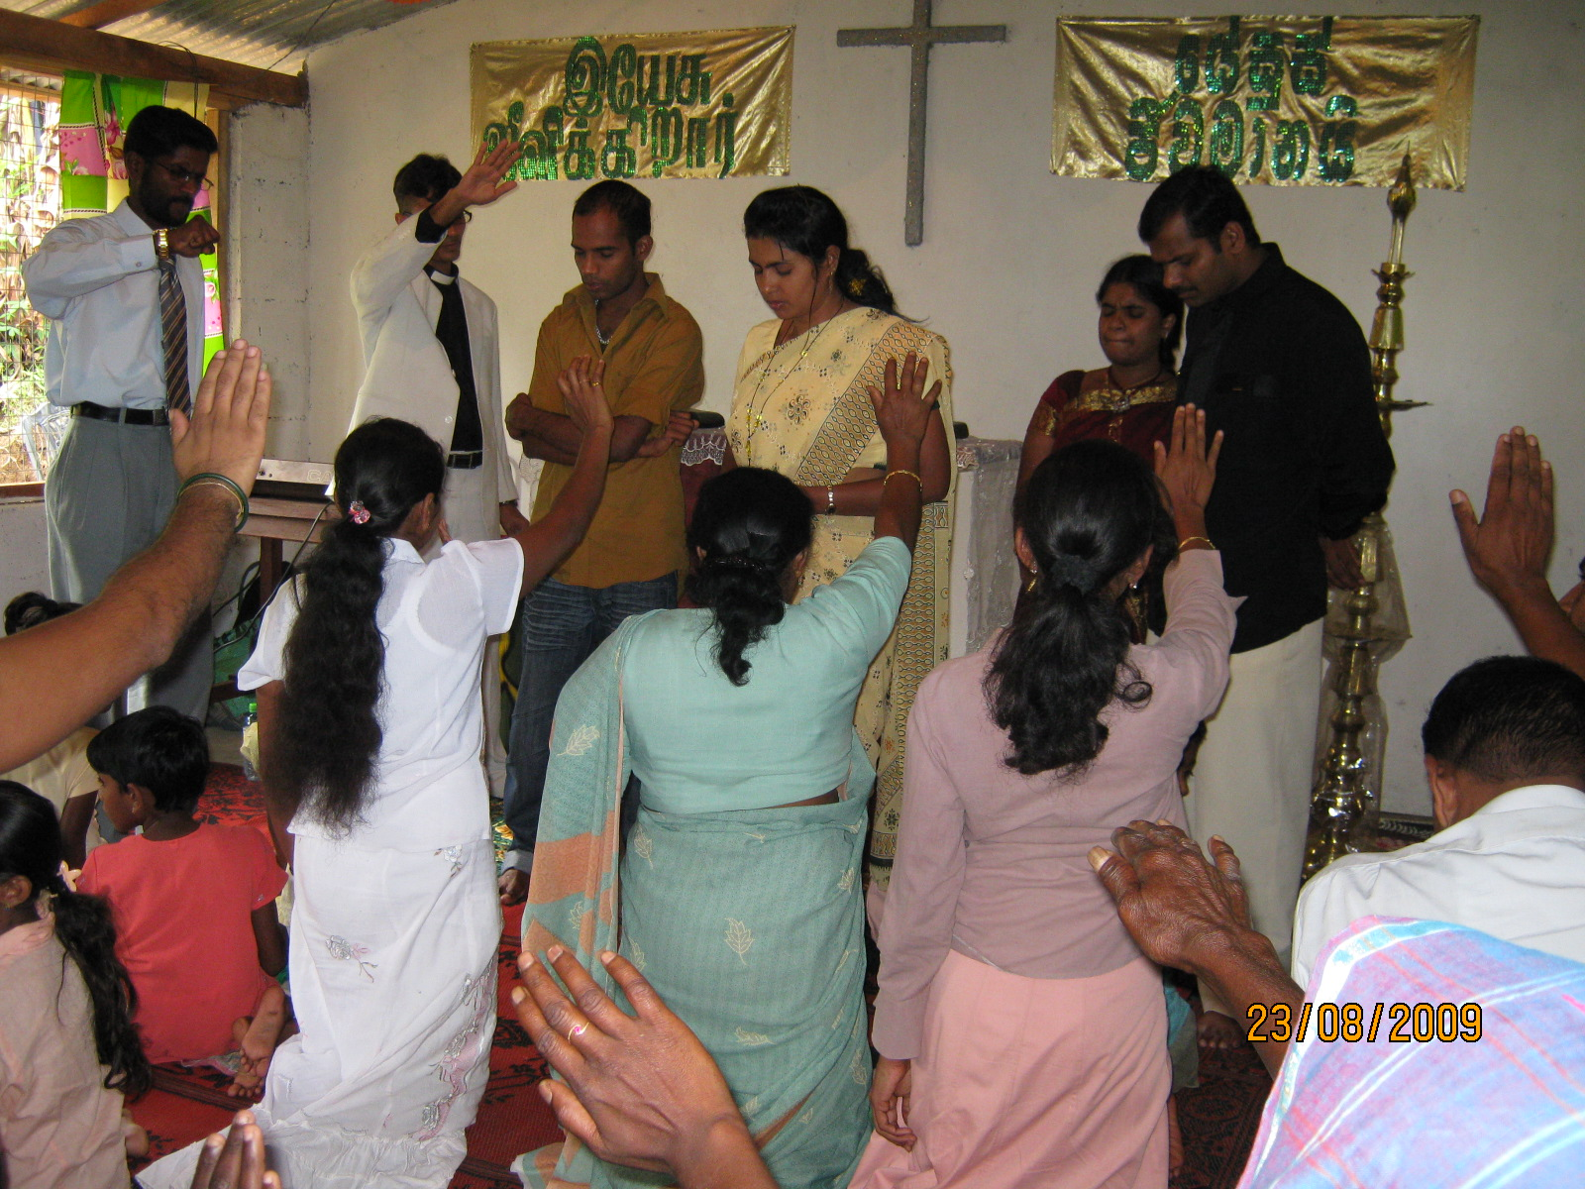
What should elders do?
58

Slide 45
Pastoral Leadership of an Elder:
59
(a) Elders teach:
INTRODUCTION
"Shepherd the flock" (Acts 20:28)
"Able to teach" (1 Tim. 3:2)
Scriptural foundation (Tit. 1:9a)
Instruct (1 Thess. 5:12)
Teach God's plan (Acts 20:20, 27)
Get paid for teaching (1 Tim. 5:17)
Highest office teach (Acts 6:1-7)
Jerusalem had apostles & elders
BODY

Slide 46
Three Shepherd Tasks of Elders
59
Teaching
1 Tim. 3:2; 5:17

Slide 47
How Elders Relate to Deacons
60
Model 1: Senior Pastor over Deacons
Senior Pastor
Deacons
Unbiblical

Slide 48
How Elders Relate to Deacons
60
Model 2: Senior Pastor alongside Deacons
Senior Pastor
Deacons
Unbiblical

Slide 49
How Elders Relate to Deacons
60
Model 3: Deacons lead elders/pastors
Deacons
Unbiblical
Pastors

Slide 50
How Elders Relate to Deacons
60
Model 4: Elder Board leads Deacon Board
Elders
Deacons

Slide 51
How Elders Relate to Deacons
60
Apostles over "The Seven"
Apostles
DDDDDDD
DDDD
DDDDD
"The Seven"
Acts 21:8

Slide 52
How Elders Relate to Deacons
60
Model 5: Elders with Deacon Committees
Elders
DDDDDDD
DDDD
DDDDD

Slide 53
Three Shepherd Tasks of Elders
60
Teaching
1 Tim. 3:2; 5:17
Pastor-Teacher
Eph. 4:11
Pastoring
(Protect & Lead)
1 Pet. 5:1-4
Acts 20:29, 35
1 Thess. 5:12

Slide 54
Three Types of Elders
61
"The elders who direct the affairs of the church well are worthy of double honor, especially those whose work is preaching and teaching"
(1 Tim. 5:17 NIV).
ALL ELDERS
Teach, protect, lead, serve, testify
Unpaid or $
if Needed
PAID MANAGERS
$
PREACHERS
&
TEACHERS
$$

Slide 55
Three Shepherd Tasks of Elders
61
Administration
(Serve, care for & testify)
Teaching
1 Tim. 3:2; 5:17
1 Tim. 3:1, 4-5; 5:17
Pastor-Teacher
Episkopos =
Epi "over" +
skopos "look" =
"watch over"
Eph. 4:11
Pastoring
(Protect & Lead)
1 Pet. 5:1-4
Acts 20:29, 35
1 Thess. 5:12

Slide 56
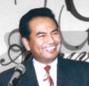







Shared Leadership
62
Scriptural support for a plurality of elders:
plurality
plurality
  Not One Elder…
  But Many…

Slide 57
Summary on Elders
INTRODUCTION
Therefore, the New Testament presents an elder whose functions are to teach, pastor and administer.
BODY

Slide 58
Key functions of a Deacon:
77
To serve:
  Acts 6:1-6
  1 Timothy 3:8-13
INTRODUCTION
BODY

Slide 59
Attention:
77
Deacons are not rulers. They are a subordinate class of officers who serve under the direction of the elders. Deacons assist the elders, especially by relieving them of distractions in the temporal affairs of the church.¹
¹http://www.swrb.com/newslett/actualNLs/bcg_ch02.htm.
INTRODUCTION
BODY

Slide 60
Attention:
77
It is significant that nowhere in the New Testament do deacons have ruling authority over the church as the elders do, nor are deacons ever required to be able to teach Scripture or sound doctrine.¹
¹Wayne Grudem, Systematic Theology: An Introduction to Biblical Doctrine, 920.
INTRODUCTION
BODY

Slide 61
Church Government Summary
244a
 | Episcopal | Presbyterian | Congregational | Elder/ Congregational
Definition | Bishop rule over several churches | Local church elders submit to higher bodies | Individual local church members have ultimate say | Individual church members balanced with elected elders
Structure | Bishop Archdeacon Vicar Priest Warden Parish Church Council Leaders Congregation | General Assembly Synod Presbytery Session Local church | Congregation Deacons Pastors | Elders/Pastors Deacons Congregation
Notes:
These four slides aim for an objective contrast between the four major forms of church government. However, within each form, many differences occur due to personalities, history, tradition, and many other factors.
————————————————
CH-03-Leadership Structure-61
NS-17-Titus-262

Slide 62
Church Government Summary
244a
 | Episcopal | Presbyterian | Congregational | Elder/ Congregational
Unique Elements | Various levels of clergy Most hierarchical structure | One level of clergy Teaching and ruling elders distinguished (1 Tim. 5:17) | One level of clergy Democratic Local church autonomy Often only one pastor per church | One level of clergy Democratic Local church autonomy
Groups | Anglican/ Episcopal Lutheran Methodist Orthodox Catholic | Presbyterian Reformed | Congregational Baptist Bible Presbyterian Evangelical Free Pentecostal | Bible churches Independent

Slide 63
Church Government Summary
244a
 | Episcopal | Presbyterian | Congregational | Elder/ Congregational
Biblical Support Cited | OT precedent of single leader Matt. 16:18; 18:18; 28:18-20 (apostolic succession) Acts 6:3, 6 (bishop ordaining) Acts 15:13 (James) Tit. 1:5 (Titus's authority) | OT precedent of rule by elders Acts 11:30 (elders handled finances) Acts 14:23 (group of elders per church) Acts 15 (assembly higher than local church) Acts 20:17f. (elders as ultimate church authority) | Matt. 18:17; Acts 1; 6:3-5; 11:22; 15:25; 1 Cor. 5:12; 2 Cor. 2:6-7; 2 Thess. 3:14; 1 John 2:20; 4:1 (group decisions) Elder, bishop, pastor & overseer synonymous (e.g., 1 Tim. 3:1 vs. Tit. 1:5) 1 Pet. 2:9 (priesthood of believers) NT focus on local church (many verses) | Presbyterian column (except Acts 15 is not seen as denoting an assembly higher than the local church) + Congregational verses

Slide 64
Church Government Summary
244a
 | Episcopal | Presbyterian | Congregational | Elder/ Congr.
Biblical Refutation | No clear evidence of structure above the local church (James presided rather than ruled) Power to ordain not clearly given to a single bishop Apostolic succession unproved Bishop/ presbyter distinction unwarranted | No clear evidence of structure above the local church (Jerusalem church in Acts 15 has no authority over Antioch as decision made by whole church in v. 22) Priesthood of believers not sustained with elders who lord it over the flock | Single pastor (=elder) concept unbiblical as elders always functioned as a group | None

Slide 65
Church Government Summary
244a
 | Episcopal | Presbyterian | Congregational | Elder/ Congregational
Practical Benefits | Efficiency Unity (fewer church splits?) | Group decision making | Group decision making Congregation has significant input | Balance of power between elders & congregation
Practical Minuses | Too much authority in one person (bishop) Little place for congregational input | Too much authority in one group (elders) Little place for congregational input | Inefficiency Major decisions often made by the uninformed Disunity (church splits) Pastor too often seen as employee rather than a leader | Danger of an overpowering elder board Difficulty determining which issues are elder issues and which are congregational

Slide 66

Proposed Form of Church Government
Elders (govern /make decisions)
Deacons (service)
Congregation (appoint)
60
INTRODUCTION
BODY

Slide 67
Elder-Congregation dynamics:
INTRODUCTION
E l d e r s
C o n g r e g a t i o n
L
O
V
E
Regard
themselves as
servants
BODY
Regard
them as
leaders
Notes:
Having seen the structure, it is vital that the dynamics be understood.

Slide 68

What about Elder Qualifications?
63

Slide 69

How Do We Pick Leaders for the Local Church?
63
P
Popularity
Past
Politics
Pocketbook
Profession
Chuck Swindoll, Excellence in Ministry (Fullerton, CA; Insight for Living, 1985), 39

Slide 70
How Should Churches Select Leaders?
63
INTRODUCTION
Scriptural Examples:
Congregation decides/nominates
  APOSTLES
  Acts 1:12-26 – congregational selection, apostolic appointment
  DEACONS
  Acts 6:3 – congregational selection, apostolic appointment
BODY

Slide 71
Appointment of church officers:
63
INTRODUCTION
An apostle (e.g., Paul) or his assistants ordained the elders
  Acts 14:23
  Titus 1:5
BODY

Slide 72
Conclusion
63
With the demise of the apostolic age, it is therefore logical and scriptural to have the congregation choose both the elders and deacons of the church.
INTRODUCTION
BODY

Slide 73
How to Choose Leaders
The process of choosing or nominating and the election process should be clearly documented in the local church constitution in order to avoid confusion and misunderstanding.
(The constitution should also give the process of hiring and firing both elders and deacons even though the Bible is silent on this matter.)
INTRODUCTION
BODY

Slide 74

Elder & DEACON Qualifications
For Life and Order in the Church

Slide 75
Required
Leader Qualities
64
Apply only to men
All qualifications are essential and of equal importance
Qualifications refer to present life of the leader
Who are they? Overseers (Elders, Bishops, Pastors) and Deacons
If the leader fails, he must step down
Character is more important than abilities (only 2 traits involve ability)
Managing of home given priority over work
Must be qualified so that
  they can give godly direction
  the church can avoid problems that come from bad or inept leaders

Slide 76
Required Qualities of an
Overseer (O) or Deacon (D)
65
General reputation
    (Perceived character)
  Above reproach (O)
  Good reputation with outsiders (O)
  Respectable (O & D)

Slide 77
Required Qualities of an
Overseer (O) or Deacon (D)
65
II. Family life (if married)
  Having 1 wife (O & D)
  Wife must be worthy of respect, not malicious talkers but temperate and trustworthy in everything (D)
  See that his children obey
    (O & D)

Slide 78
Required Qualities of an
Overseer (O) or Deacon (D)
65
III. Negative characteristics
  Not quick tempered (O)
  Not violent (O)
  Not quarrelsome (O)
  Not a new convert (O)
  Not pursuing dishonest gain (O & D)
  Not addicted to wine; temperate (O & D)

Slide 79
Required Qualities of an
Overseer (O) or Deacon (D)
65
IV. Positive characteristics
  Hospitable (O)
  Sensible (O)
  Tested (D)
  Sincere (D)
Able to Teach (O)

Slide 80
1 Timothy 3:8-13 (NIV)
77
⁸Deacons, likewise, are to be men worthy of respect, sincere, not indulging in much wine, and not pursuing dishonest gain. ⁹They must keep hold of the deep truths of the faith with a clear conscience. ¹⁰They must first be tested; and then if there is nothing against them, let them serve as deacons. ¹¹In the same way, their wives {¹¹Or way, deaconesses} are to be women worthy of respect, not malicious talkers but temperate and trustworthy in everything. ¹²A deacon must be the husband of but one wife and must manage his children and his household well. ¹³Those who have served well gain an excellent standing and great assurance in their faith in Christ Jesus.

Slide 81
Views on Women in 1 Timothy 3:11
79
Gynaikos (gunaiko.j) can be legitimately translated as either "women" or "wives."
At least six views on this phrase exist:
women in general
wives of both elders and deacons
a group similar to deacons in function but subordinate to them in rank
deacon wives
deaconesses (woman deacons), or
deacon wives who are called deaconesses

Slide 82
Support for "Like Deacons But Ranking Below Them"
80
"They are a group by themselves, not just the wives of the deacons nor all the women who belong to the church.…On the other hand, the fact that no special and separate paragraph is used in describing their necessary qualifications, but that these are simply wedged in between the stipulated requirements for deacons, with equal clarity indicates that these women are not to be regarded as constituting a third order in the church, the office of deaconess, on par with and endowed with authority equal to that of deacons"
(William Hendricksen, Pastoral Epistles, NTC, 346;
Donald Guthrie, The Pastoral Epistles, 85; See my p. 232, note 2).

Slide 83
Supporters of "Deacon Wives"
80
Translations: NIV, KJV, NKJV, GNB, Beck, LB, Phillips
Scholars:
  Warren Wiersbe, 51-52
  Earle, Expositors Bible Commentary, 11:368
  Litfin, Bible Knowledge Commentary, 2:238 says the view has a slim advantage.

Slide 84
Supporters of "Deaconesses"
80
Translations: NIV footnote, Williams trans.
Scholars:
  James B. Hurley, Man and Woman in Biblical Perspective, 229-33
  Kelly, 83
  Newport J. D. White, in Expositors Greek Testament, 4:115-16
  J. H. Bernard, The Pastoral Epistles, 58-59
  Walter Lock, A Critical and Exegetical Commentary on the Pastoral Epistles, ICC, 40-41

Slide 85

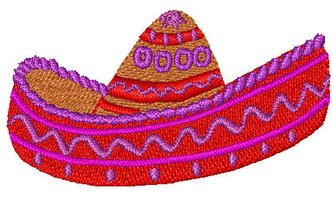
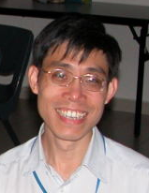

To change to a biblical structure, can't a church just call the present deacons "elders"?
84a & 90j
Deacon
Deacon
Elder
Elder

Slide 86
Elder-Deacon Contrasts
84a
No. There are many differences between them…
Deacon
Elder
Qualifications
Character
Character + Teaching
Role (Gifting)
Administration
Pastoral
Time Involved
Much
Even more extensive
Age
Younger
Older

Slide 87

Leadership by elders and congregational authority are not contradictory
90 i

Slide 88
Summary
The elders rule the church and minister the Word of God to build up the body of Christ whilst the deacons (a subordinate class of officers) are to serve the body of Christ as directed by the elders.
INTRODUCTION
BODY
CONCLUSION

Slide 89
Summary
Two vital points to bear in mind:
  It must not be forgotten that no institution or structure is perfect as man is fallible;
  The goal of the leaders and the congregation is not to manage the church successfully but to glorify God which sometimes happens through failures.
INTRODUCTION
BODY
CONCLUSION

Slide 90
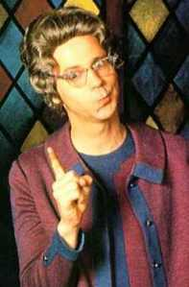
Biblical Decision Making
86
How were decisions made in the Bible?

Slide 91
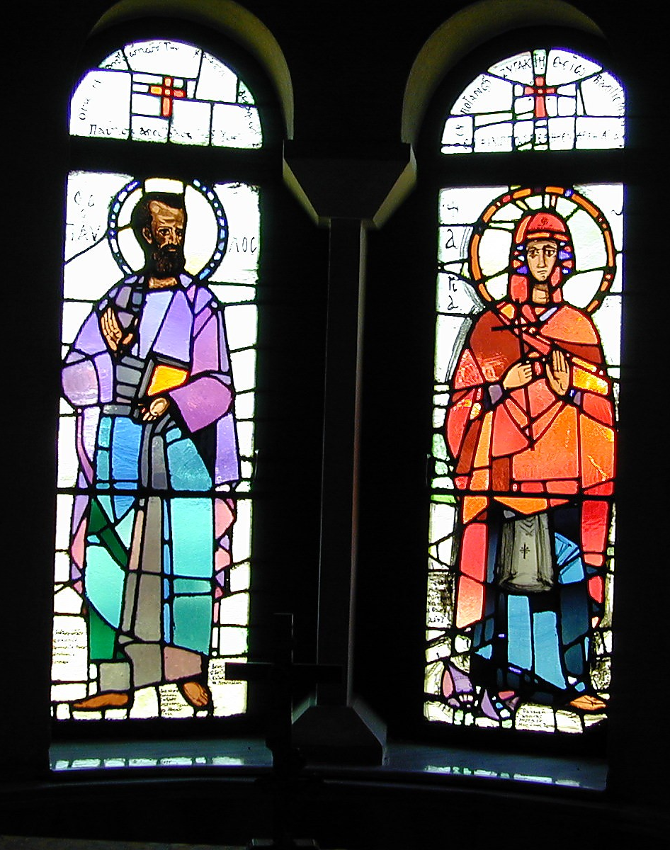
Methods Used
86
Leader's Choice
Lots
Urim & Thummin
Fleece
Others?
Paul & Lydia in Philippian Church

Slide 92
Making Key Decisions
Ecclesiology Notes, pages 35-85
What percentage was the biblical pattern?
"Our bylaws specifically state that the will of God cannot be overturned without a 2/3 majority vote."

Slide 93

Key Decisions in Acts 15
86-87
Circumcision at the Jerusalem Council (vv. 1-35)
Conflict over John Mark's Restoration (vv. 36-40)

Slide 94
Decision making in the local church
88
INTRODUCTION
From a biblical viewpoint:
  Apostles (over all churches)
  Elders (over local issues)
  Congregation (for serious cases)
    Matt. 18:17
    Acts 15:22
    1 Cor. 5:4-5
BODY

Slide 95

Attention:
88
Therefore it is only wise to state explicitly in the local church constitution the confines of the decision-making prerogative by both the elders and the congregation.
INTRODUCTION
BODY

Slide 96
Discussion Questions
89-91
Questions on Elders & Deacons
Questions on Normative Structure

Slide 97

SOURCES
Grudem, Wayne. Systematic Theology: An Introduction to Biblical Doctrine (Leicester, England: IVP and Grand Rapids, Michigan: Zondervan), 904-949.
Reed, Kevin. Biblical Church Government http://www.swrb.com/newslett/actualNLs/bcg_ch02.htm.

Slide 98

This presentation is edited from…
Presenter : Loke Chee Kiong
Topic : Church Government

Slide 99
Black
Notes:
99

Slide 100


Church link at BibleStudyDownloads.org
Get this presentation for free!
Notes:
Church (ch)

