Slide 1

The Nature of the Church
What is the church?
What is its purpose?
Dr. Rick Griffith • Jordan Evangelical Theological Seminary • BibleStudyDownloads.org

Slide 2
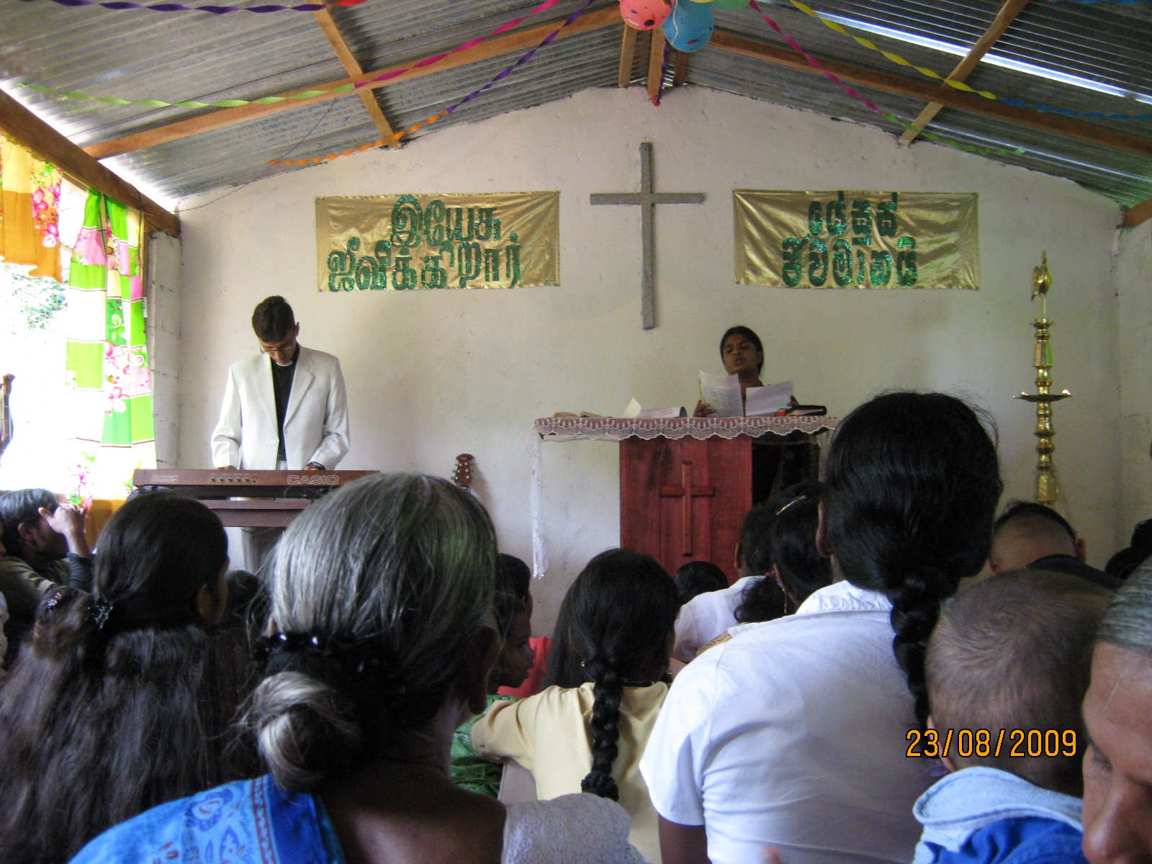
Different Views on the Nature of the Church
7

Slide 3
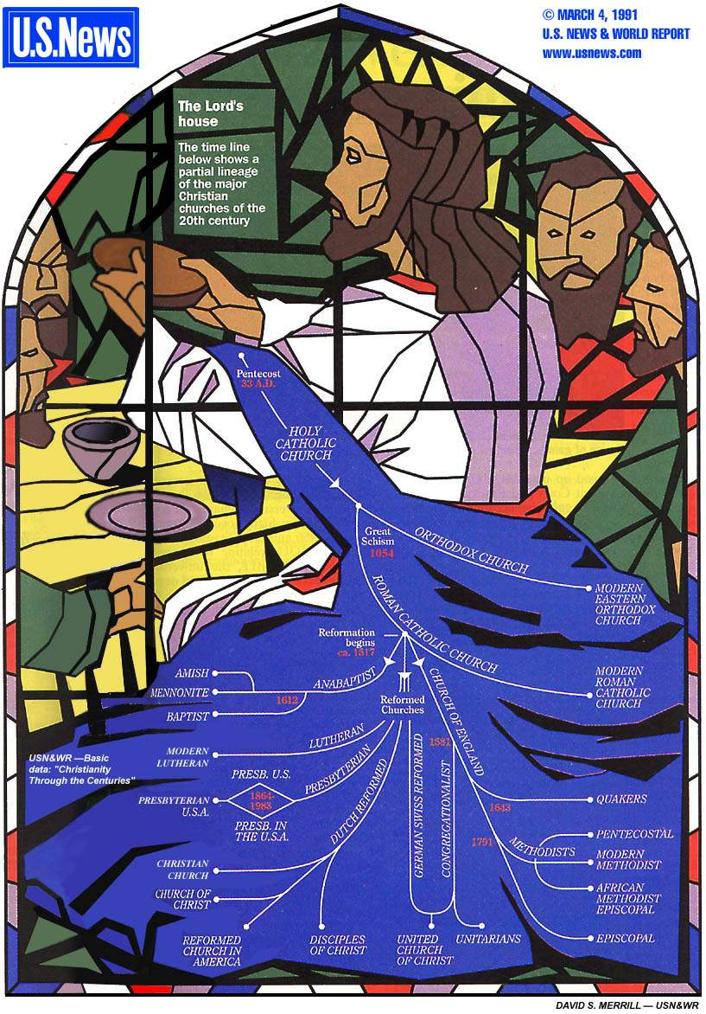
Denominations
This tree of church history depicts the relationships between the various branches of the Christian Church

Slide 4
Denominations
This tree of church history depicts the relationships between the various branches of the Christian Church

Slide 5
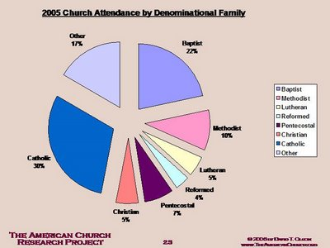
2005 USA Church Attendance
Other
17%
Baptist
22%
Methodist
10%
Catholic
30%
Lutheran
5%
Reformed
4%
Christian
5%
Pentecostal
7%
THE AMERICAN CHURCH RESEARCH PROJECT
© 2005 David T. Olson
http://www.theamericanchurch.org

Slide 6

What is Your Own Definition of the Local Church?
8

Slide 7

A Biblical Definition
9
"The church is the living community of people in Christ Jesus, organized to fulfill corporately a threefold purpose:
worship, edification, and multiplication"
Church Dynamics (BEE World Course), 40.

Slide 8
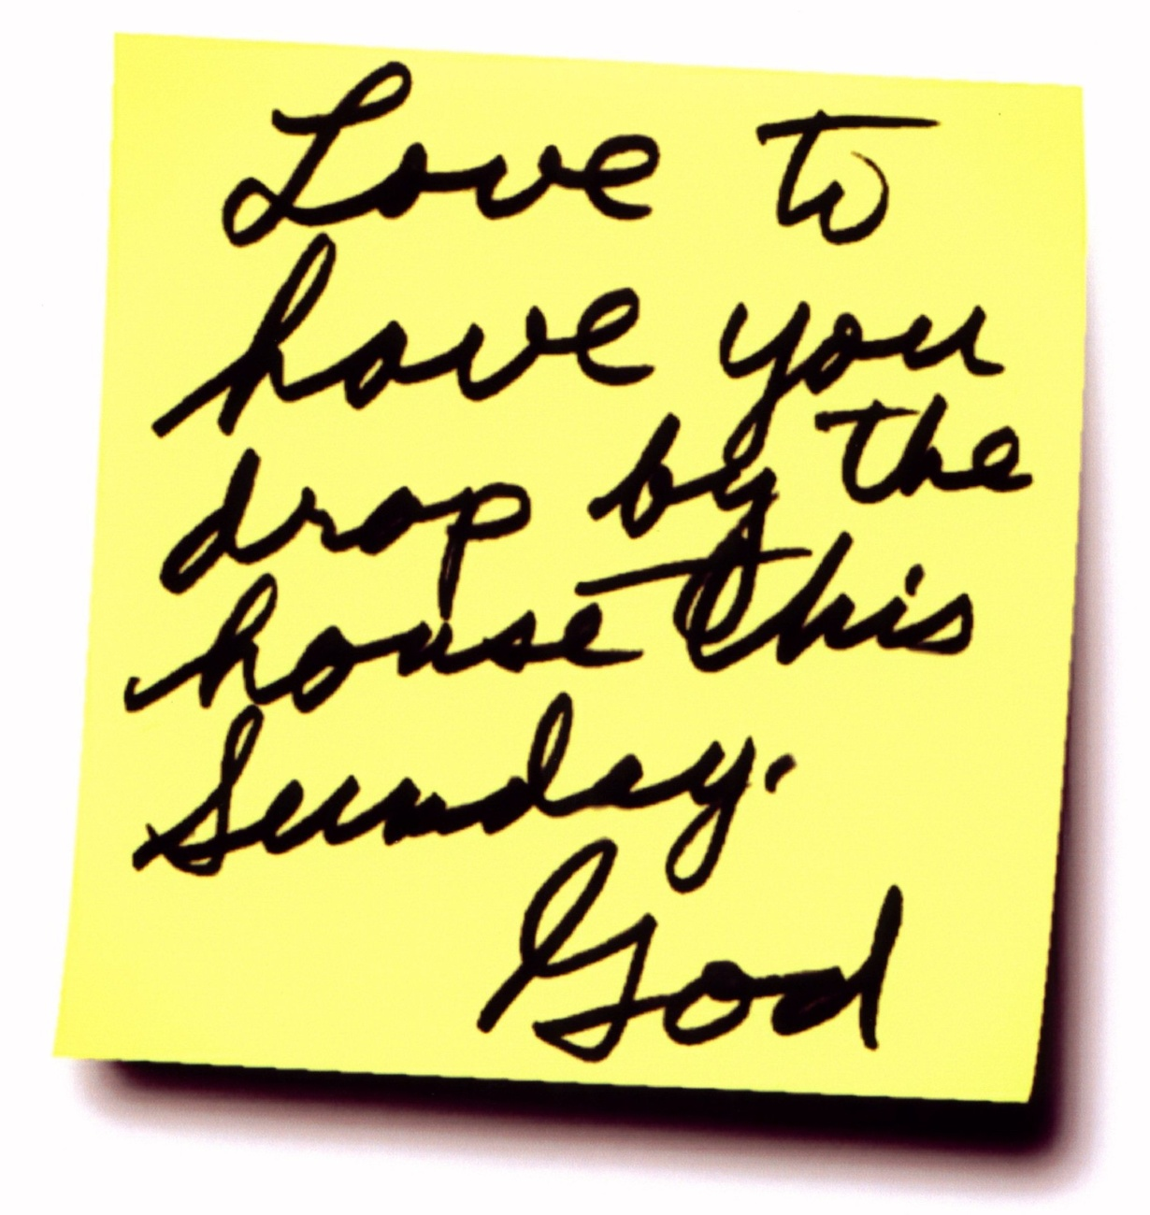
Is the building the "house of God"?
Love to have you drop by the house this Sunday.
—God

Slide 9
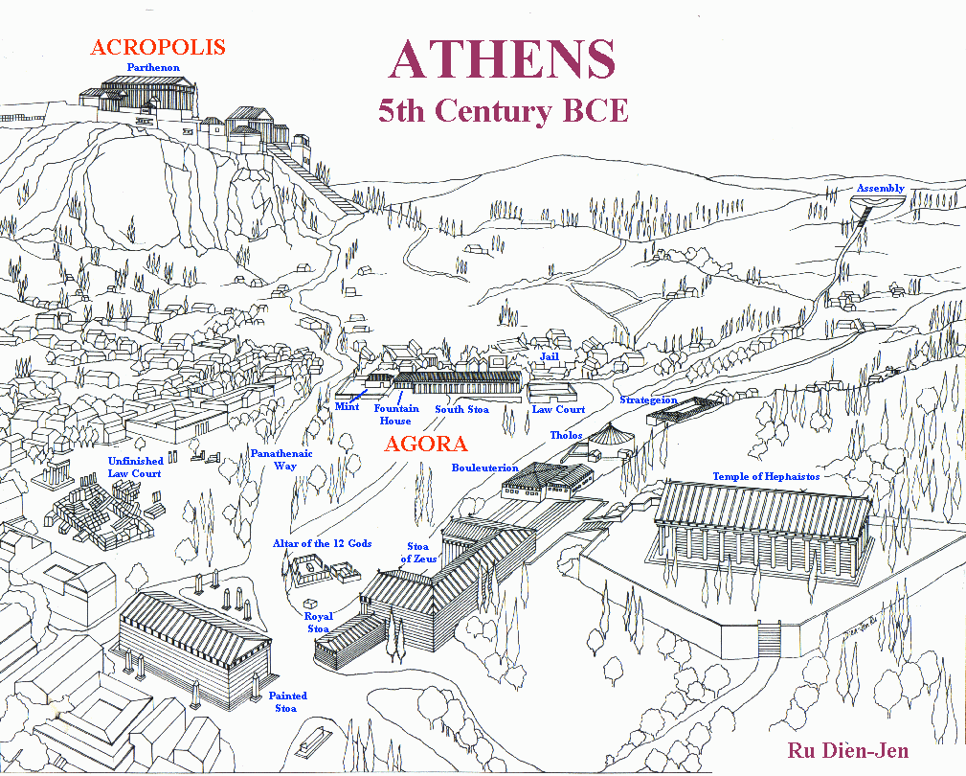
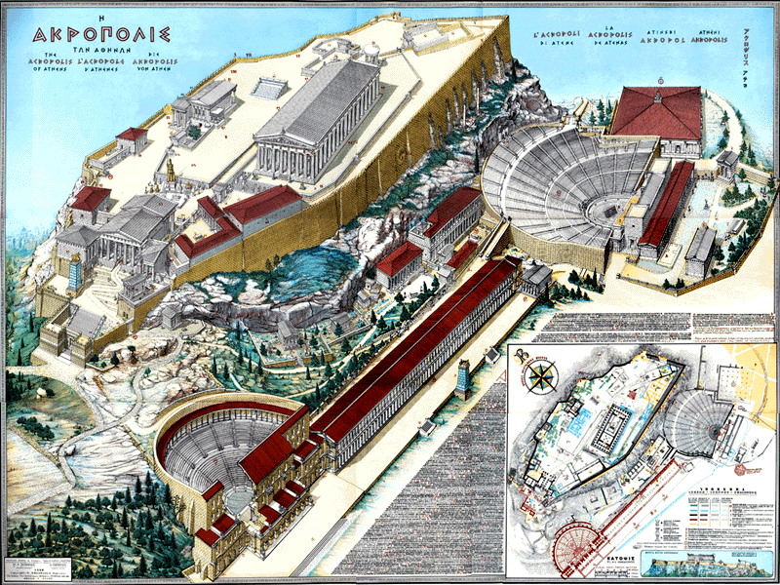
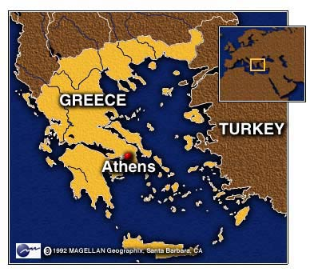
ATHENS
9
Ecclesia
"called out ones"
(Acts 19:32, 39, 41)
Idiotes
"one who does his own thing"
Kurioikos (4th cent. Latin)
kurios (Lord) + oikos (house)
"house of the Lord"
"church" via Latin
Notes:
9
The church is a body—not a building.
In ancient Athens, the citizens were very appreciative of their privilege to be a vital part of the city-state—and they recognized their responsibility as well. When a herald would call a meeting of the citizens, each would close his shop, drop what he was doing, and walk out of the city, past the Acropolis and to the next hill for a meeting. This group became known as the ecclesia, or "called out ones" as in the Ephesian meeting in Acts 19:32, 39, 41.
Some citizens, of course, loved the privileges of being part of the city-state but felt no responsibility for it. They left their shops open and refused to join the ecclesia, so the latter called them idiotes, or ones who did their own thing for selfish purposes. We derive our English word "idiot" from this group of lazy people characterized by self concern and social irresponsibility (CHURCH definition of—"called out ones" by Stuart Briscoe, Singapore missionary retreat, 92).
For the first three centuries of Christianity, the body of believers was always called the ecclesia. Only in the time of Constantine in the 4th century did the term kurioikos, "house of the Lord," come about, from which through the Latin we arrive at our English word "church." The early Christians never associated themselves with a building called the "church" (CHURCH body, not a building by W.A. Criswell at DTS chapel). They saw themselves only as the ecclesia, or "called out ones"—called out from the world to be God's own people!

Slide 10

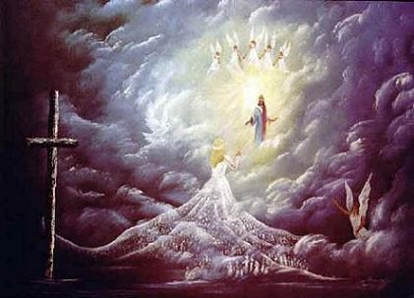
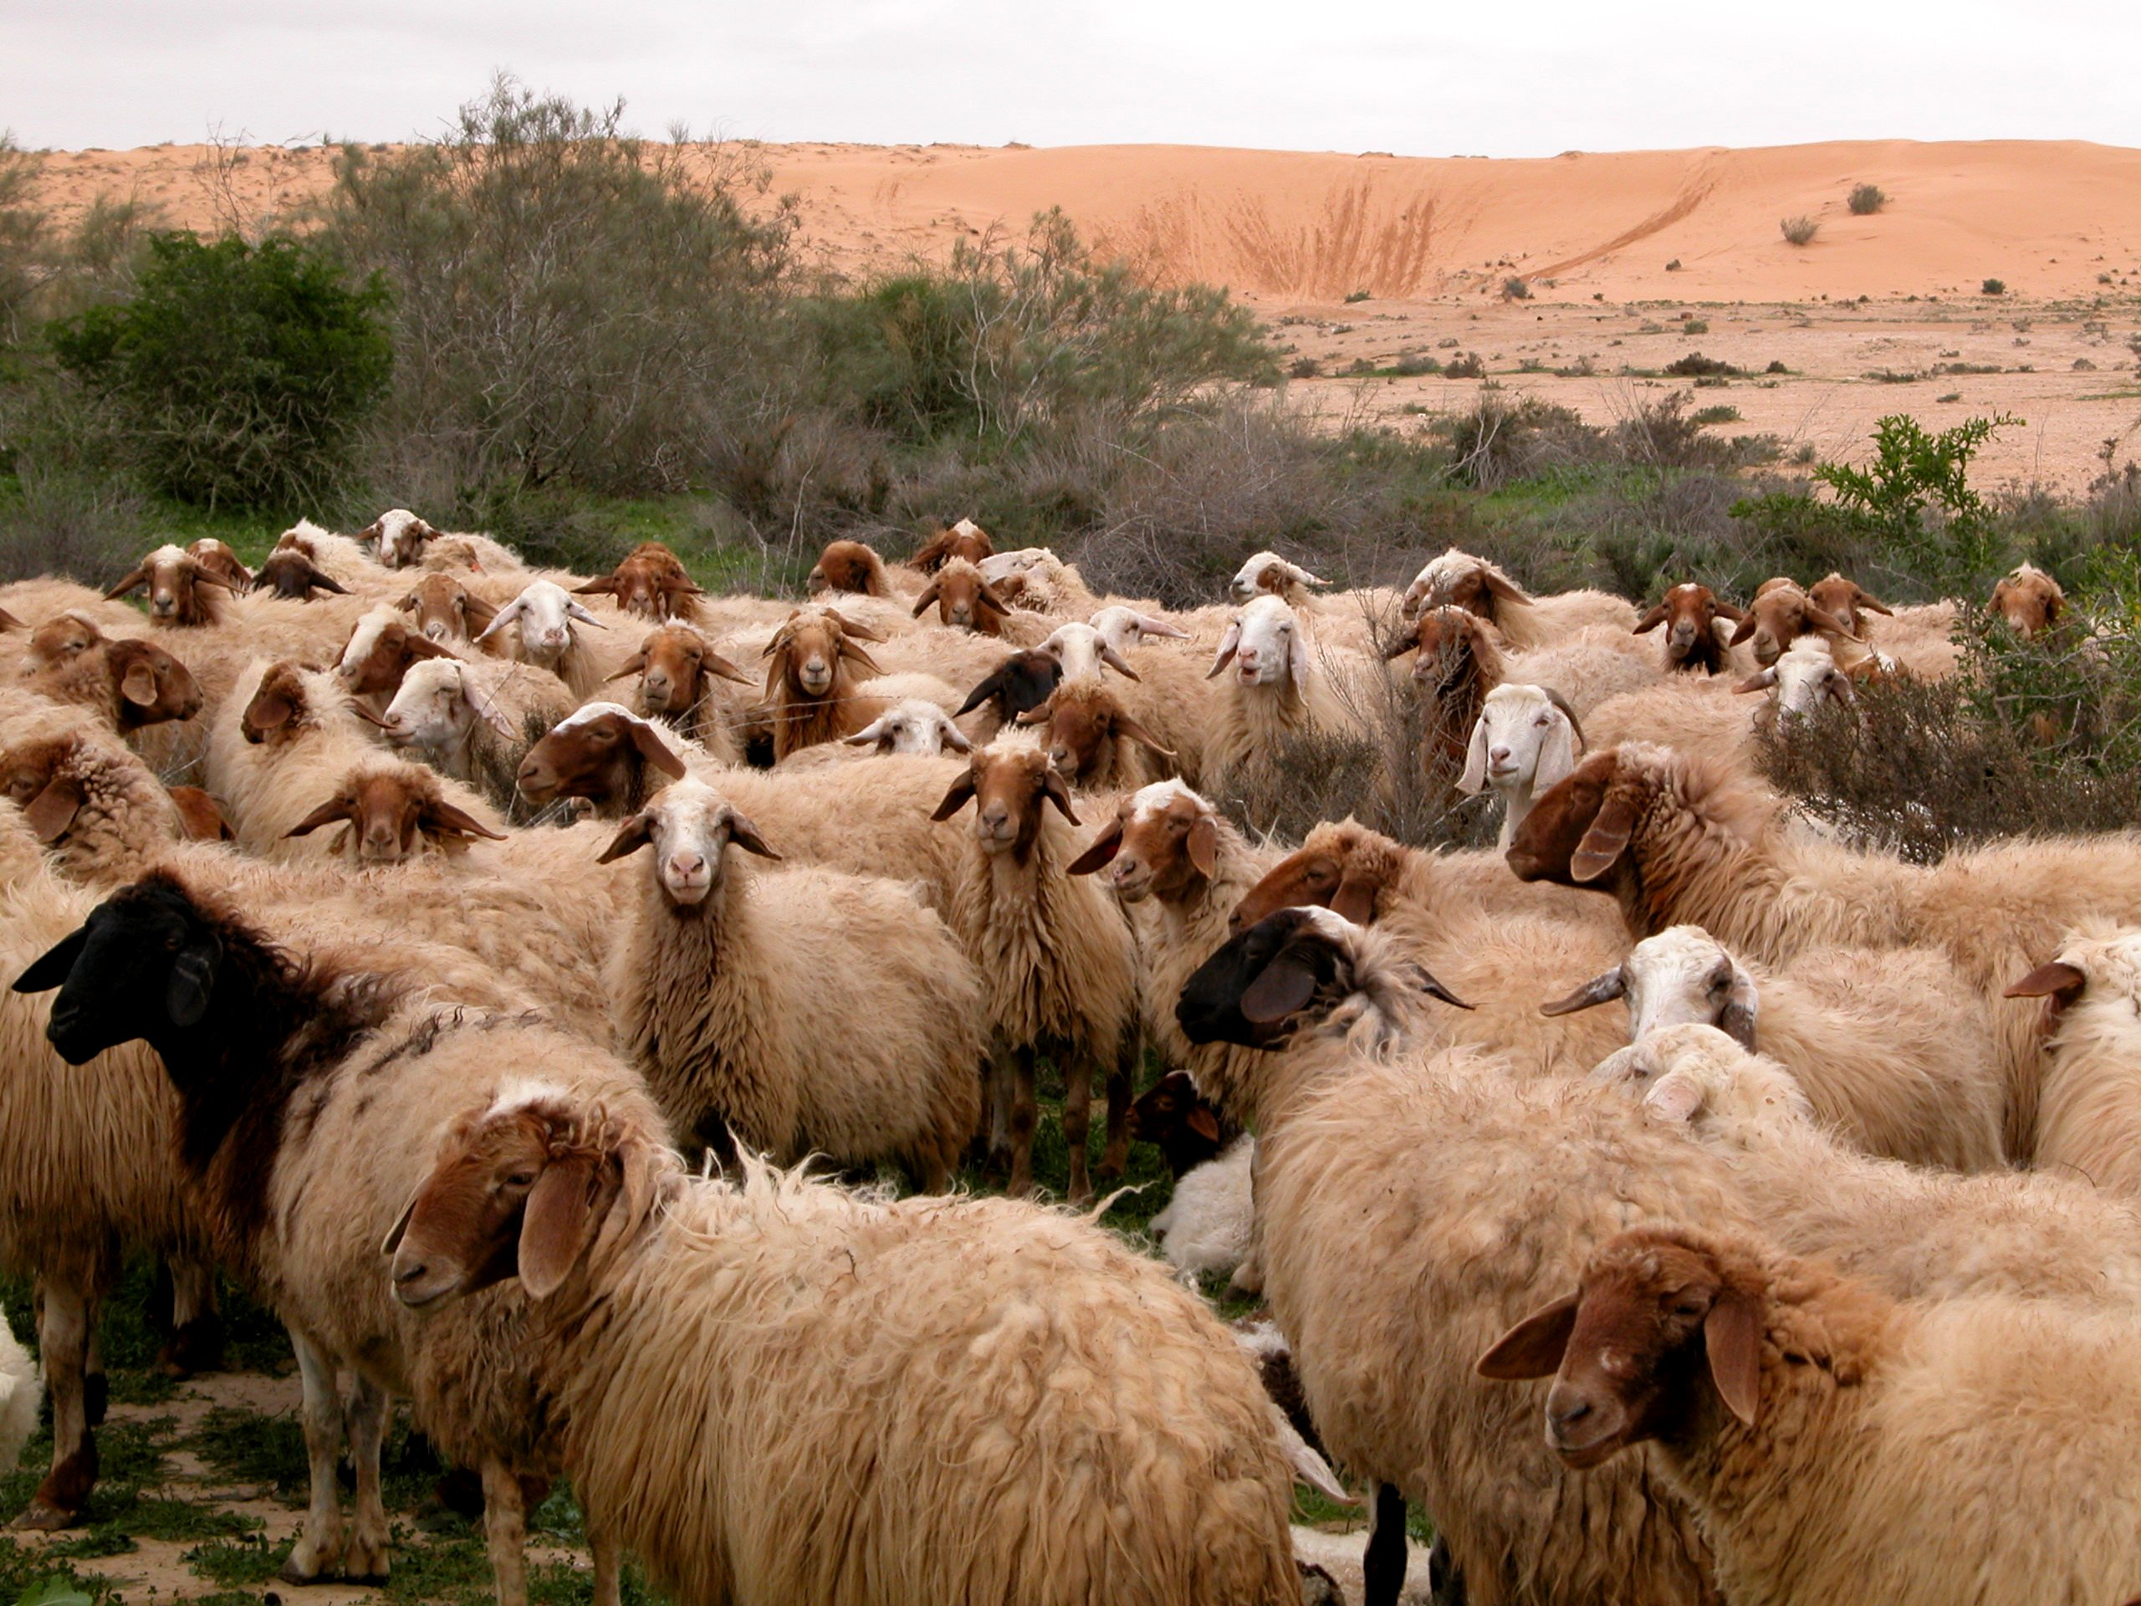
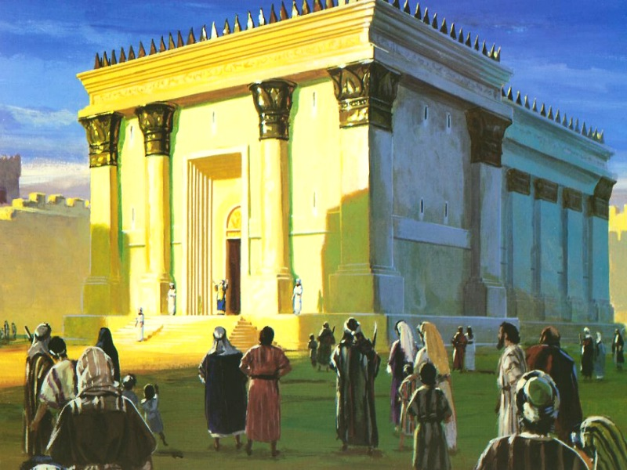
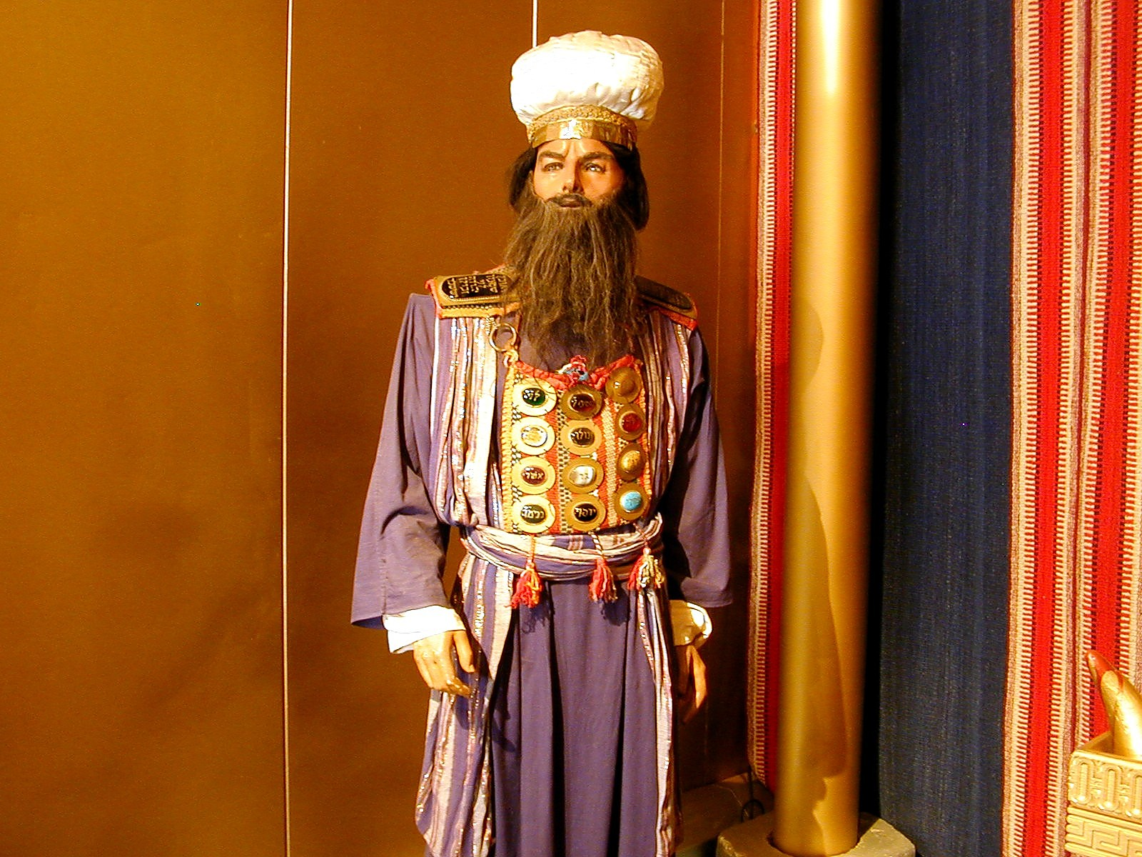
Five Church Metaphors
10
10
Ministry of Christ
(What does the metaphor teach about Jesus?)
Ministry of Church
(What does the metaphor teach about us?)
Applications
(How does grasping this metaphor help our ministry?)
Purposes
Does the metaphor emphasize worship, edification, multiplication or a combination of these purposes?
Notes:
10
Break into 5 groups, each studying one of the metaphors. Fill in your own row to answer the meaning of the metaphor in the three blank columns, including the purpose for the church that this metaphor describes: worship, edification and/or multiplication.

Slide 11
Body
10
10
Ministry of Christ
(What does the metaphor teach about Jesus?)
Ministry of Church
(What does the metaphor teach about us?)
Applications
(How does grasping this metaphor help our ministry?)
Notes:
11

Slide 12
The church has many people with different gifts (1 Cor. 12:14)
10
Notes:
12

Slide 13
"Now the body is not made up of one part, but many" (1 Cor. 12:14)
10
Speaking | Serving
Teaching | Administering
Evangelism | Faith
Pastor-Teacher | Giving
Encouraging | Service
 | Mercy
Notes:
13

Slide 14
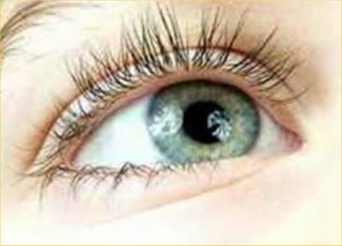

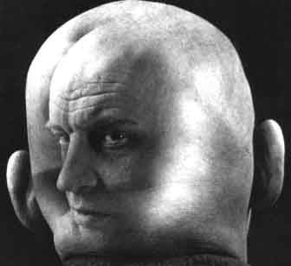
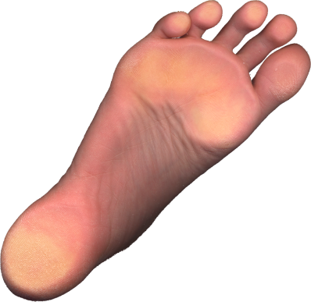
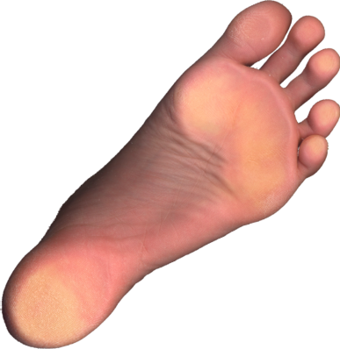
"Up-front" believers, don't arrogantly say,
"I don't need you with less honored roles"
(1 Cor. 12:21)
10
"The eye cannot say to the hand,
"I don't need you!"
And the head cannot say to the feet,
"I don't need you!"

Slide 15
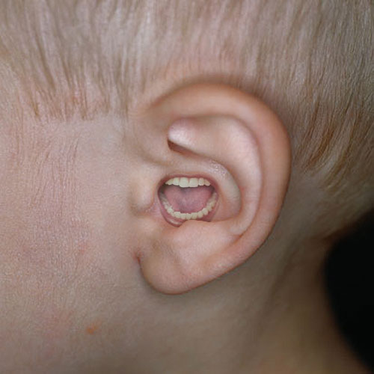
Believers with less honored gifts shouldn't feel unneeded (1 Cor. 12:15-16).
10
¹⁵ If the foot should say,
"Because I am not a hand, I do not belong to the body,"
it would not for that reason cease to be part of the body.
¹⁶ And if the ear should say,
"Because I am not an eye, I do not belong to the body,"
it would not for that reason cease to be part of the body.

Slide 16
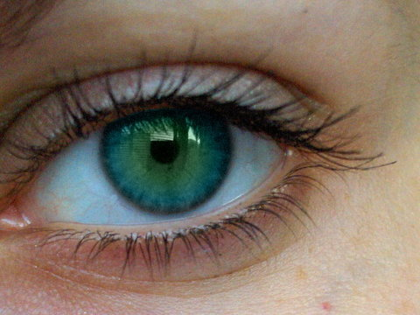
Diversity in the church makes it more effective (1 Cor. 12:17-20).
10
¹⁷If the whole body were an eye, where would the sense of hearing be? If the whole body were an ear, where would the sense of smell be? ¹⁸But in fact God has arranged the parts in the body, every one of them, just as he wanted them to be. ¹⁹If they were all one part, where would the body be? ²⁰As it is, there are many parts, but one body.

Slide 17
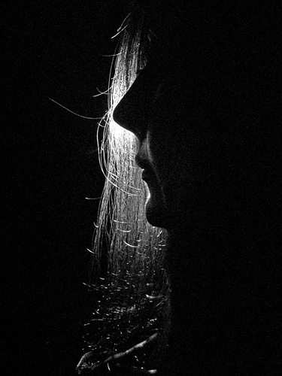
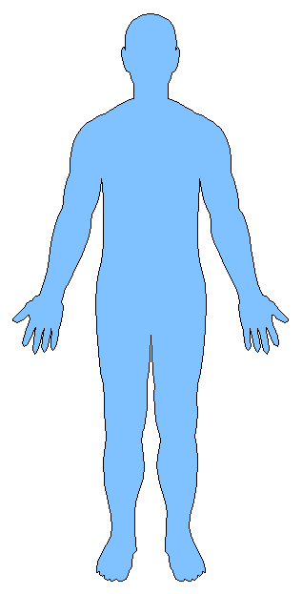
It takes humble use of all the gifts for the church to care
(1 Cor. 12:21-26).
10
Notes:
17

Slide 18
Weaker gifts are indispensable (1 Cor. 12:22)
²²On the contrary, those parts of the body that seem to be weaker are indispensable
Notes:
18

Slide 19
Less honorable gifts are honored
(1 Cor. 12:23a)
²²On the contrary, those parts of the body that seem to be weaker are indispensable, ²³and the parts that we think are less honorable we treat with special honor.
Notes:
19

Slide 20
But gifts never to be seen are also guarded with modesty (1 Cor. 12:23b)
…And the parts that are unpresentable are treated with special modesty
Notes:
20

Slide 21
Yet the "up-front" believers need less acknowledgment (1 Cor. 12:24a)
²⁴while our presentable parts need no special treatment.
Notes:
21

Slide 22
God gives greater honor to "behind-the-scenes" believers (1 Cor. 12:24b).
But God has combined the members of the body and has given greater honor to the parts that lacked it
Notes:
22

Slide 23
God honors serving gifts so we'll care for them too (1 Cor. 12:25-26).
²⁵so that there should be no division in the body, but that its parts should have equal concern for each other. ²⁶If one part suffers, every part suffers with it; if one part is honored, every part rejoices with it.
Notes:
23

Slide 24
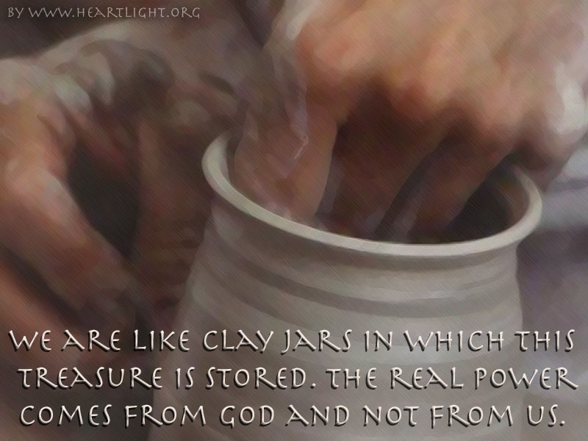
It takes all of our gifts for the church to be diversified (1 Cor. 12:27-31).
Notes:
24

Slide 25
B. The hierarchy of members shows that all don't have the same gifts
(1 Cor. 12:28-30).
And in the church God has appointed
first of all apostles,
second prophets,
third teachers,
then workers of miracles,
also those having gifts of healing,
those able to help others,
those with gifts of administration,
and those speaking in different kinds of tongues.
Are all apostles? Are all prophets? Are all teachers?
Do all work miracles? Do all have gifts of healing?
Do all speak in tongues? Do all interpret?
Notes:
25

Slide 26
Emphasize the gifts that edify the most members (1 Cor. 12:31).
1 Corinthians 12:31
"But eagerly desire the greater gifts."
"desire" = "all of you desire" (second person plural)
"greater gifts" = verse 28
Notes:
26

Slide 27
Bride
10
10
Ministry of Christ
(What does the metaphor teach about Jesus?)
Ministry of Church
(What does the metaphor teach about us?)
Applications
(How does grasping this metaphor help our ministry?)
Notes:
27

Slide 28

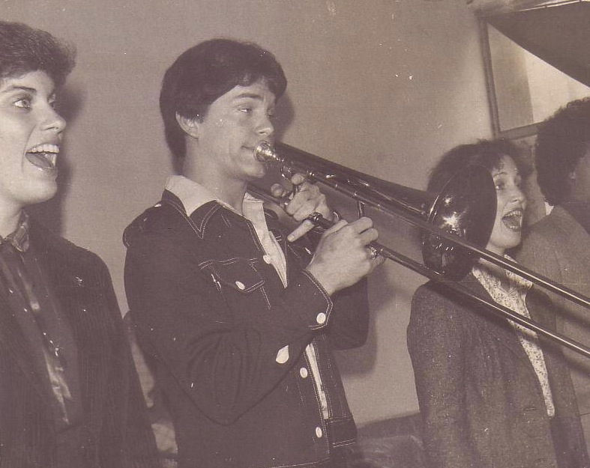

Susan & Rick, 1982
Notes:
God also began to open my eyes to the woman singing next to me! She initially despised me but after a year or so she saw the light. That's our engagement picture. In 1983 we returned to the USA..

Slide 29
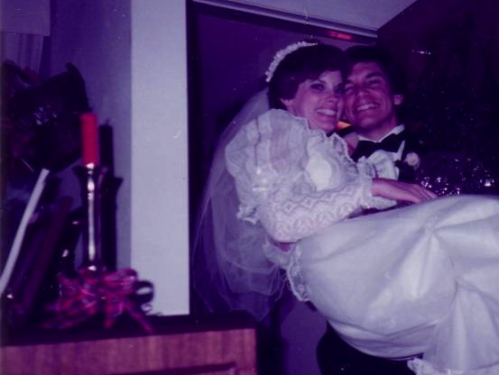
Marriage:
30 December 1983
Notes:
I married her and took her to Dallas Seminary a few days later. Three years later our first son was born on his grandpa's 70th birthday, so we named him Kurt in honor of Susan's father. I also pastored a church, had a ministry to international students, and served as a chaplain.

Slide 30
Temple
10
10
Ministry of Christ
(What does the metaphor teach about Jesus?)
Ministry of Church
(What does the metaphor teach about us?)
Applications
(How does grasping this metaphor help our ministry?)
Notes:
30

Slide 31

God's Household (Eph. 2:19-22)
10
Non-Equipping Gifts
(Eph. 4:12b)
Pastor-Teachers
Evangelists
Teachers
Equipping Gifts
(Eph. 4:11-12a)
Foundation: Apostles & Prophets (Eph 2:20)
Foundation: The Lord Jesus Christ (1 Cor. 3:11)
Adapted from Charles R. Swindoll. "Spiritual Gifts Study Guide" (IFL, 1983), 7

Slide 32
Priesthood
10
10
Ministry of Christ
(What does the metaphor teach about Jesus?)
Ministry of Church
(What does the metaphor teach about us?)
Applications
(How does grasping this metaphor help our ministry?)
Notes:
32

Slide 33
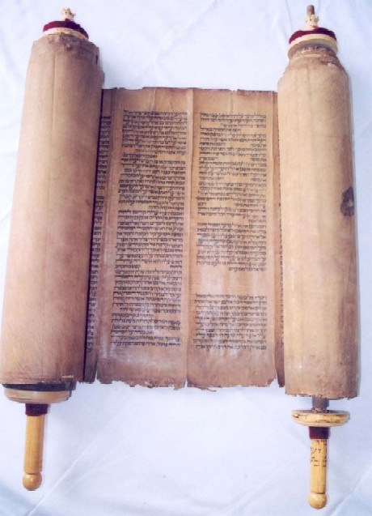
Priesthood
in Old Testament Times

Slide 34
Levi's Family Tree
LEVI
Gershon
Kohath
Merari
Levites
Amram
Priests
High Priest
Mariam
Aaron
Moses
Offered
Unauthorised Fire;
Killed by God
Nadab
Abihu
Eleazar
Ithamar

Slide 35
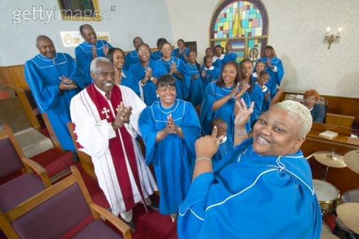
The Priesthood of Believers

Slide 36
Flock
10
10
Ministry of Christ
(What does the metaphor teach about Jesus?)
Ministry of Church
(What does the metaphor teach about us?)
Applications
(How does grasping this metaphor help our ministry?)
Notes:
36

Slide 37
Metaphors for the Church
10
Metaphor & Text | Ministry of Christ | Ministry of Church | Applications
Body • 1 Cor. 12 • Col. 1:18 | Sustains church for unity LIFE of Christ | Depends upon Christ Worship, edification | Let diversity within unity focus on Christ as the common source
Bride • Eph. 5:25-27 • Eph. 3:18-19 • 2 Cor. 11:2 | Depth of love Bridegroom (Christ) has for Bride (Church) LOVE of Christ | Purifies herself to show her love Worship, edification | Prepare to meet Christ as a bride prepares for her wedding
Building/Temple • Eph. 2:21-22 • 1 Pet. 2:4-6 • 1 Cor. 3:10-11 | Foundation Stone for growth who indwells each believer PRESENCE of Christ | Grows together as all believers build on the foundation Worship, edification, multiplication | Maintain unity so as not to dishonor Christ's presence

Slide 38
Metaphors for the Church
10
Metaphor & Text | Ministry of Christ | Ministry of Church | Applications
Priesthood • 1 Pet. 2:5-9 • Rev. 1:4-6 • Rev. 5:9-10 • Rev. 20:6 | Accepts worship from every Christian DEITY of Christ | Each believer should offer a sacrifice of praise to God as a witness to the world Worship, multiplication | No real clergy-laity distinction exists
Flock • Acts 20:28 • 1 Pet. 5:4 • John 10:11, 14 | Cares for sheep as the Good Shepherd CARE of Christ | Focus on needs of sheep rather than ministry: rest, food, guidance, encouragement, healing, etc. Edification | Remain within the flock for protection and care from the Shepherd

Slide 39

Three Purposes for the Church
14
WORSHIP
To Christ
Body
EDIFICATION
To Believers
Bride
Building
Flock
Priesthood
MULTIPLICATION
To Unbelievers

Slide 40
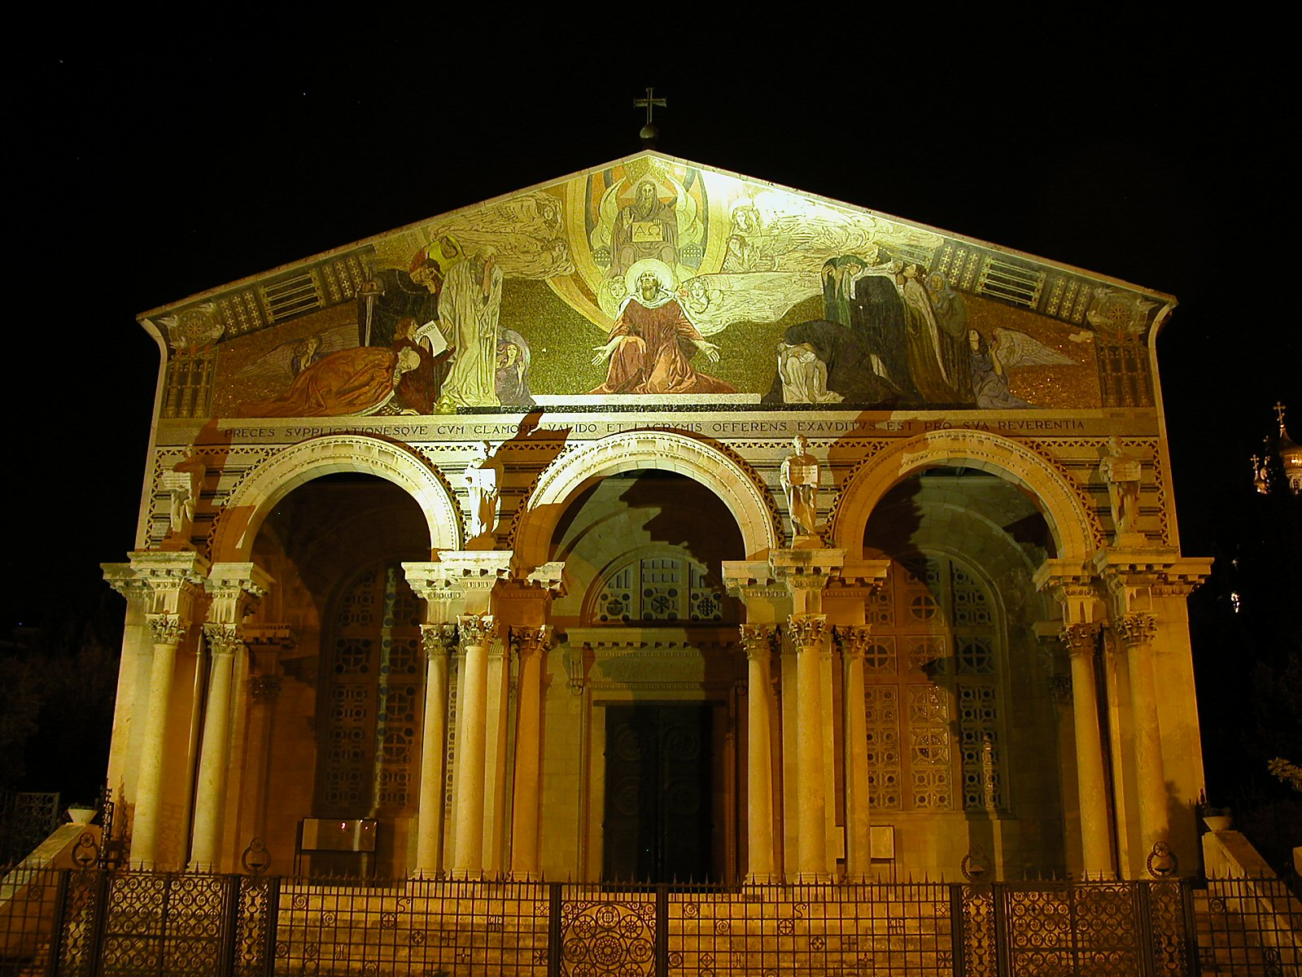
Other Metaphors for the Church...
15
The Church of All Nations
(nighttime in Jerusalem)

Slide 41

The Branch Metaphor in John 15…
15

Slide 42
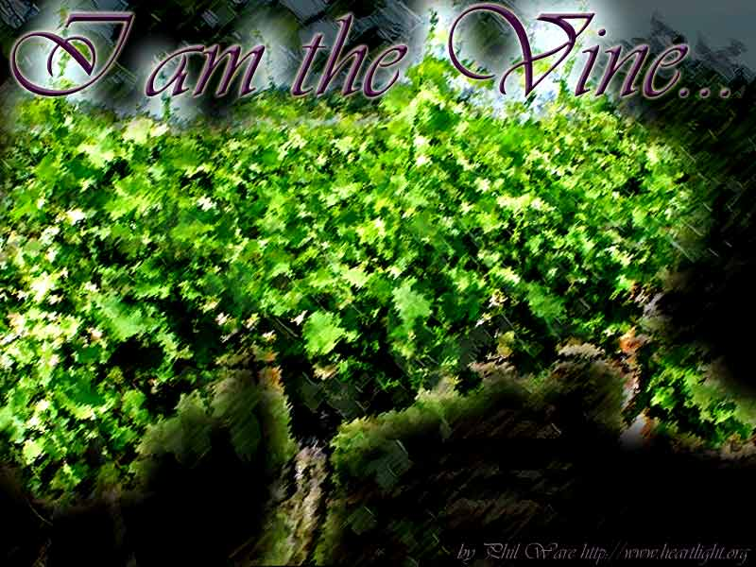
I am the Vine… (15:1)
15

Slide 43
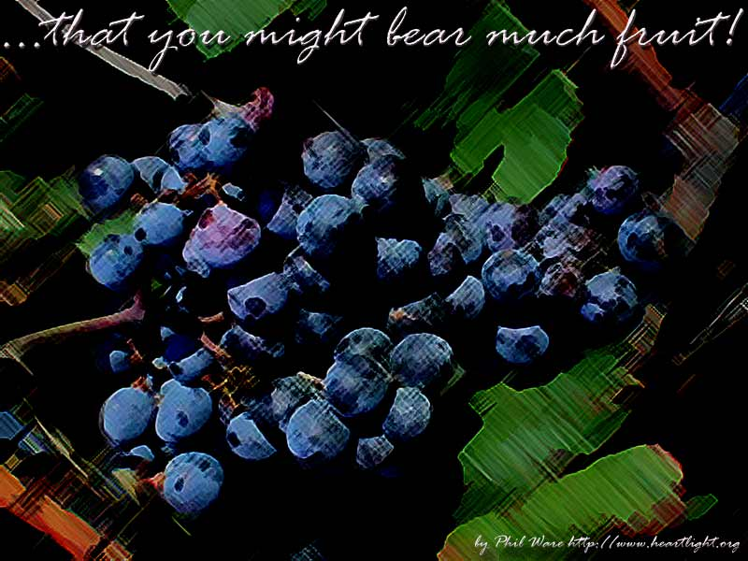
What is the "fruit"?
15

Slide 44
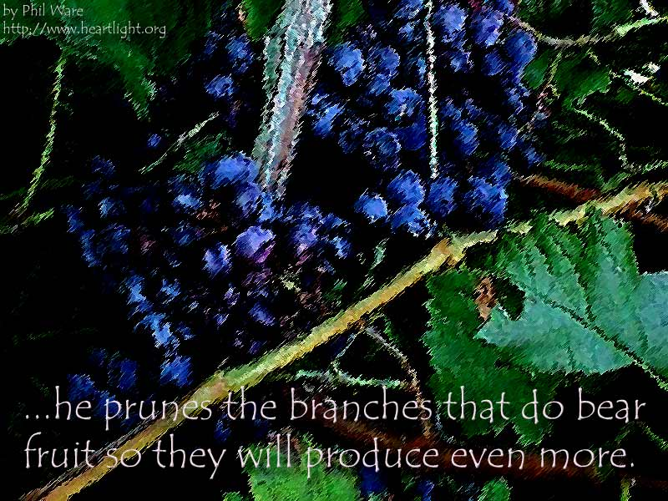
The pruning metaphor is not easy to understand...
15

Slide 45

John 15:2
15
"He cuts off (lifts up) every branch in me that bears no fruit
while every branch that does bear fruit he prunes so that it will be even more fruitful."

Slide 46
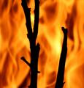
But what is the branch thrown away and burned in verse 6?
15

Slide 47
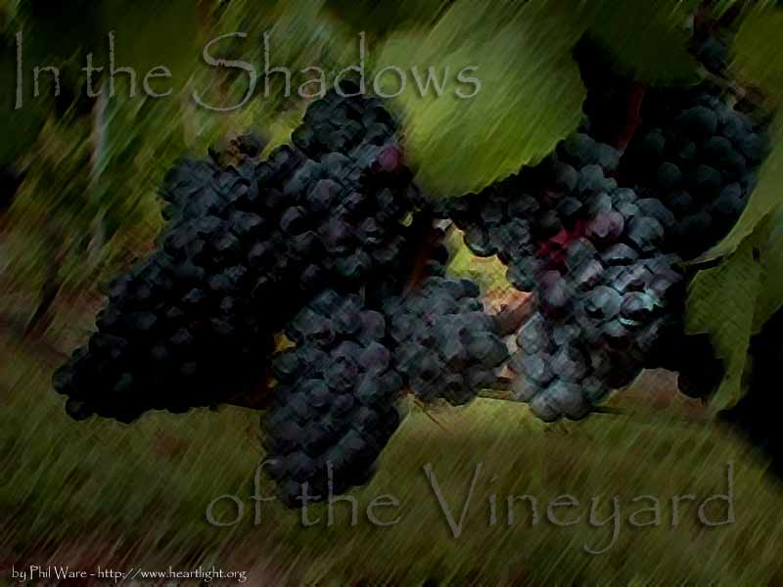
A Closer Look at John 15:1-6
Issues | Arminian | Calvinist | Partakers | Derickson
"The Father ai;rw" (2a) | "cuts off" = loses salvation | "cuts off" = disciplines | "lifts up" = cares for | "lifts up" = cares for
"branch… that does not bear fruit" (2b) | Christian who stops believing | Unbeliever who never believed | Christian who stops believing | Christian who stops believing
"in me" (2c) | Adjective that modifies the noun: "branch in me" | Adverb that modifies the verb: "does not bear fruit in me" | Adjective that modifies the noun: "branch in me" | Adjective that modifies the noun: "branch in me"

Slide 48
A Closer Look at John 15:1-6
Issues | Arminian | Calvinist | Partakers | Derickson
"The Father prunes" (2d) | Discipline of believers in contrast to judgment of former believers in v. 2a | Discipline of believers in contrast to judgment of professing believers in v. 2a | Discipline of believers in same sense as loving care of believers in v. 2a | Discipline of believers in same sense as loving care of believers in v. 2a
"You are already clean" (3) | Saved | Refers only to disciples' salvation? | Saved | Saved
"thrown away & burned" (6) | Judgment by loss of salvation | Judgment by never having salvation | Discipline by death and loss of rewards | Loving care to gain fruitful-ness

Slide 49

A Suggested John 15 Sermon
15
Subject: How can you be most effective for Christ?
Depend on Christ (15:1-11)
Love other believers (15:12-17)
Accept hate from the world (15:18–16:4)

Slide 50
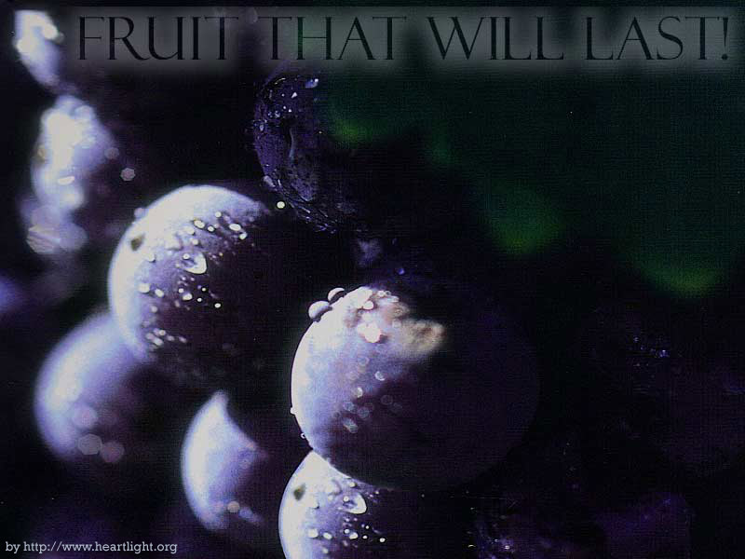
What is your
"fruit that will last"?
15

Slide 51

The Church as a Kingdom
For he has rescued us from the kingdom of darkness
and transferred us into the Kingdom of his dear Son
¹⁴ who purchased our freedom and forgave our sins (Col 1:13-14)

Slide 52
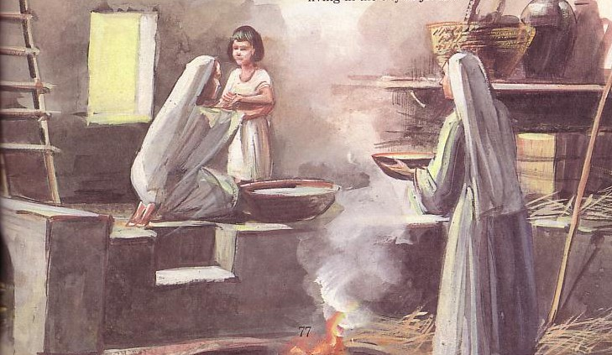
The Church as a Household/Family (Eph. 2:19)
15

Slide 53

Summary
"Every biblical metaphor of the church, without exception, emphasizes its unity. The church is one bride with one husband; one flock with one shepherd; one set of branches on one vine; one kingdom with one king; one family with one father; one building with one foundation; one body with one head, Jesus Christ."
John MacArthur, The Church: The Body of Christ (Grand Rapids: Zondervan, 1973), 19.
Notes:
53

Slide 54
How is Your Church in the Three Purposes?
15
WORSHIP
To Christ
EDIFICATION
To Believers
Is your church body giving God his worth or just attending services?
How well are the believers ministering to one another?
MULTIPLICATION
To Unbelievers
How well is your church growing numerically?

Slide 55
Function versus Form
16
Function | Form
What to do | How to do it
Absolutes | Non-absolutes
Directives | Methods
Unchanging | Changing
Principles | Pattern
Notes:
55

Slide 56
Function versus Form
16
Function | Form
Organism | Organization
Truth | Tradition
Learning | Doing
Instruction | Implementation
Vision | Process
Notes:
56

Slide 57
Function versus Form
16
Function | Form
Message | Method
Studied first | Enacted Later
Supra-cultural | Cultural
Command Given | Command Obeyed
Meet together (Heb. 10:24-25) | Home groups, cells, services, etc.
Notes:
57

Slide 58
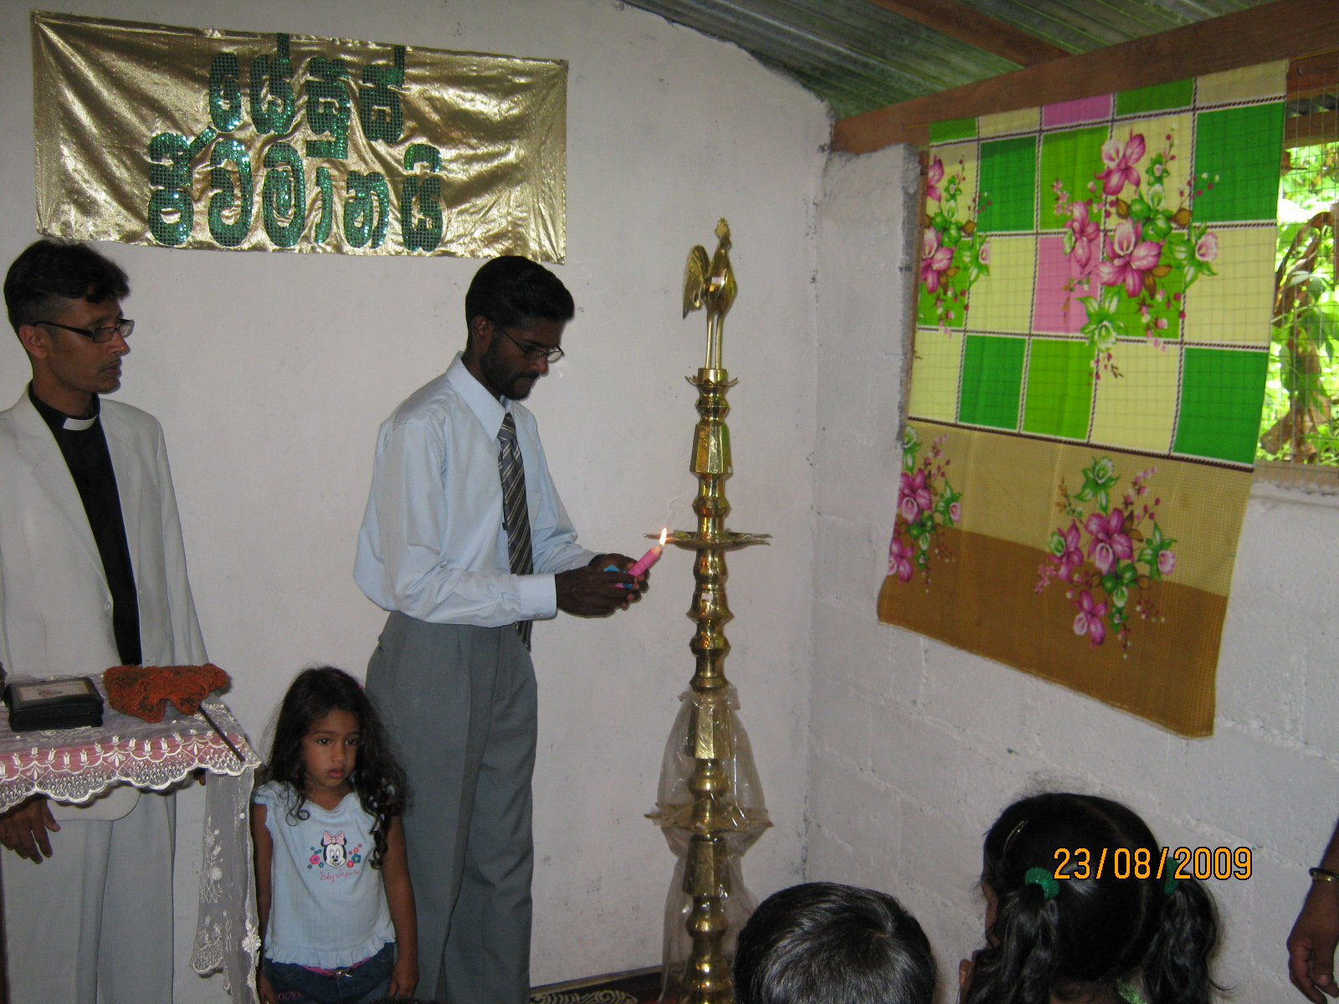
Now let's evaluate some church practices...
17
The following is adapted from the Church Dynamics Course Guide (BEE World: Colorado Springs), 55

Slide 59
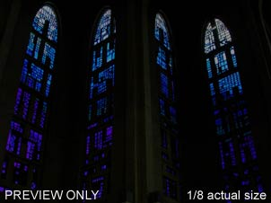
Supra Cultural or Cultural?
17
S
C
C
Celebrating the Lord's Supper with white bread and red wine
Celebrating the Lord's Supper on Sunday
Celebrating the Lord's Supper in a church building
Celebrating the Lord's Supper
Having a Sunday school
The pastor wearing a tie at church
C
C
S
C
C

Slide 60
Supra Cultural or Cultural?
17
C
The pastor receiving a full salary from the congregation
Having a choir during worship services
Guitar accompaniment in worship services
Handing out gospel tracts to unbelievers
Caring for the sick and discouraged among the church membership
C
C
C
S

Slide 61
Supra Cultural or Cultural?
17
C
Calling the main preacher "Rev." or pastor
Meeting regularly in small groups for prayer and Bible study
Instructing believers to regularly memorize verses of Scripture
Main church worship services on Sunday
Church leadership by a group of elders
Head coverings for women during worship
S
C
C
S
C

Slide 62

Steps to Relevance
(Applying the Right Form for the Function)
18
How can we truly have an indigenous church—relevant both to the Bible as well as to the culture? What are some helpful principles to apply to a certain practice?
The following is adapted from the Church Dynamics Course Guide (BEE World: Colorado Springs), 63-65

Slide 63
Steps to Relevance
(Applying the Right Form for the Function)
18
a) Clarify in your own mind whether the Bible commands or prohibits a certain practice (see the examples immediately above). If so, then you must obey Scripture over culture.

Slide 64
Steps to Relevance
(Applying the Right Form for the Function)
18
b) Even if Scripture allows a practice, it may not be best suited to your own particular culture, so evaluate the culture in which your church ministers.

Slide 65
Steps to Relevance
(Applying the Right Form for the Function)
19
c) Ask not "what do I do" but "why do I practice this method, custom, or tradition?" Knowing the reason will help you to see if you are following a biblical command or simply carrying on a tradition for its own sake.

Slide 66
Steps to Relevance
(Applying the Right Form for the Function)
19
Be willing to change—even eager to change! Are you flexible to change anything that is not biblically mandated?
Discuss with your leaders the need for change until they agree that it is God's timing.

Slide 67
Steps to Relevance
(Applying the Right Form for the Function)
19
f) Teach the people within the church the biblical and cultural rationale for the necessary change, noting that the entire church leadership agrees.

Slide 68
Steps to Relevance
(Applying the Right Form for the Function)
19
g) Prayerfully implement the needed change while simultaneously getting feedback from the people.

Slide 69

Evaluating Function & Form
19
What are the various activities of my regular church ministry?
Which of these activities should never be changed because they are biblical?
Which timeless biblical principles are not being implemented in my ministry?
Notes:
69

Slide 70
Evaluating Function & Form
20
What can I learn from history that would benefit my ministry today?
What practice am I treating as if it is supra cultural even though it is cultural? What long-term effect can this have on my ministry?
Notes:
70

Slide 71
Evaluating Function & Form
20
What is the single most important task that I must carry out to accomplish my God-given ministry? What is second?
Notes:
71

Slide 72

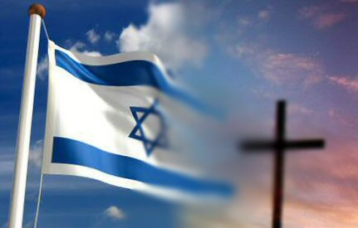
Israel & the Church:
Discontinuity or Continuity?
20
Answer: Both!
But is the Church the "New Israel"?

Slide 73

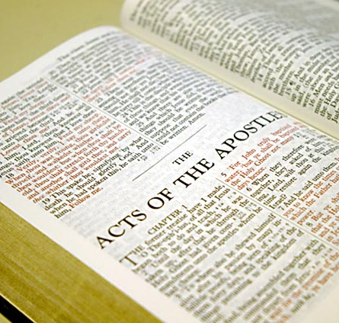
But why is Distinguishing
Israel & the Church Significant?
22
Does the Mosaic Law apply today?
Should we spiritualize Scripture?
Notes:
73

Slide 74


Contrasting Two Key Covenants
22a
 | Abrahamic | Mosaic
Recipient (Date & Place) | Abraham as mediator for all nations in 2060 BC at Ur of the Chaldees | Moses as mediator for Israel in 1445 BC at Mount Sinai
Scripture | Genesis 12:1-3 (but formalized into a covenant in Genesis 15) | Exodus 20–31 is the heart of the covenant
Between God & | A person (for a future nation) | A nation
Scope | Universal ("all peoples will be blessed through you") | Only Israel received the Law (Deut. 4:8; Ps. 147:20)

Slide 75
Contrasting Two Key Covenants
22a
 | Abrahamic | Mosaic
Promises | Land, seed, and blessing (without indication of time of fulfillment) | Blessing for obedience and cursing for disobedience (Lev. 26; Deut. 28)
Conditions | Unconditional: "I will…" | Conditional: "If you will…then I will…"
Partici-pation | Abraham asleep (Gen. 15:17) | Israel agreed to obey (Exod. 19:8)
Analogy | Father to son (royal grant) | Suzerain (superior king) to vassal (servant nation)

Slide 76
Contrasting Two Key Covenants
22a
 | Abrahamic | Mosaic
Form | Oral (no written stipulations) | Written on tablets of stone & Pentateuch
Emphasis | Blessing over discipline/judgment (five "blessings" in Gen. 12:1-3) | Judgment/discipline over blessing (contrast Deut. 28:1-14 & 28:15-68)
Christology | Ultimate seed (Gen. 12:3) | Typified in tabernacle (Heb. 8–10)
Sign | Circumcision (Gen. 17:11) | Sabbath (Exod. 31:13, 17)

Slide 77
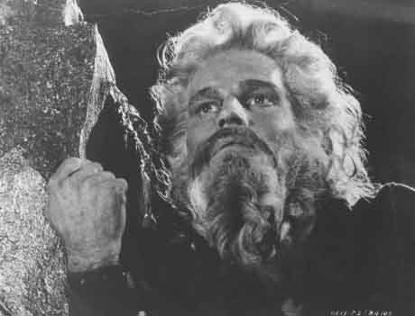
The heart of the
Mosaic Covenant is the
Ten Commandments

Slide 78
TRADITIONAL VIEW ON LAW
Ex. 25-31
22b
A Godly Education In Three Parts:
MORAL: The Ten Commandments; a basis for our current legal system.
CIVIL: How the people are to live with each other in the new social structure.
CEREMONIAL: How to worship God in the new social structure.
BUT ARE THE BIG 10 MORAL LAW?
MOSES
Exodus
Sinai
M - C - C
40
Handbook pg. 26-29
13

Slide 79
The Ten Commandments
22b
#
Old Testament Commands
New Testament Repetitions
1
And God spoke all these words: "I am the LORD your God, who brought you out of Egypt, out of the land of slavery. You shall have no other gods before me" (Exod. 20:1-3).
"Men, why are you doing this? We too are only men, human like you. We are bringing you good news, telling you to turn from these worthless things to the living God…" (Acts 14:15; noted 50+ times).
2
"You shall not make for yourself an idol… for I… am a jealous God, punishing the children for the sin of the fathers … but showing love to a thousand generations of those who love me…" (Exod. 20:4-6).
"Dear children, keep yourselves from idols" (1 John 5:21; cf. 1 Thess. 1:9; Rev. 2:14, 20; 9:20; mentioned in the NT 12 times = 12x).
* This chart is adapted and expanded from one by Lewis Sperry Chafer, Systematic Theology, 4:209-10
3
"You shall not misuse the name of the LORD your God, for the LORD will not hold anyone guiltless who misuses his name" (Exod. 20:7).
"Above all…do not swear—not by heaven or by earth or by anything else. Let your 'Yes' be yes, and your 'No,' no, or you will be condemned" (James 5:12; 4x).

Slide 80
The Ten Commandments
22b
#
Old Testament Commands
New Testament Repetitions
4
"Keep the Sabbath day holy. Six days you shall labor... but the seventh day is a Sabbath to the LORD your God. On it you shall not do any work… nor your son or daughter, nor your manservant or maidservant, nor your animals, nor the alien within your gates. For in six days the LORD made the heavens and the earth… but he rested on the seventh day…" (Exod. 20:8-11).
No NT text requires this of Christians.
However, one passage clearly prohibits the practice as required for believers: "Therefore do not let anyone judge you by what you eat or drink, or with regard to a religious festival, a New Moon celebration or a Sabbath day. These are a shadow of the things that were to come; the reality, however, is found in Christ" (Col. 2:16-17; 0x).
5
"Honor your father and your mother, so that you may live long in the land the LORD your God is giving you" (Exod. 20:12).
"Children, obey your parents in the Lord, for this is right. 'Honor your father and mother'—which is the first commandment with a promise—that it may go well with you and that you may enjoy long life on the earth" (Eph. 6:1-3; Matt. 15:4-6; 19:19; Mark 7:10; 10:19; 6x).
6
"You shall not murder" (Exod. 20:13).
"Anyone who hates his brother is a murderer, and you know that no murderer has eternal life in him" (1 John 3:15; cf. Matt. 19:18; Mark 10:19; Luke 18:20; Rom. 13:9; James 2:11; 6x).

Slide 81
The Ten Commandments
22b
#
Old Testament Commands
New Testament Repetitions
The Law (Ten Commandments) fulfilled its
purpose by prohibiting coveting to reveal sin (Rom. 7:7).
Believers died to this law when they were joined to Christ
(7:4, 6). Since the Ten Commandments are a unit,
Christians also died to the other nine as well.
7
"You shall not commit adultery" (Exod. 20:14).
"Marriage should be honored by all, and the marriage bed kept pure, for God will judge the adulterer and all the sexually immoral" (Heb. 13:4; cf. Mark 10:19; 12x).
8
"You shall not steal" (Exod. 20:15).
"He who has been stealing must steal no longer, but must work, doing something useful with his own hands…" (Eph. 4:28; cf. Matt. 27:64; Mark 10:19; Luke 18:20; Rom. 13:9; Titus 2:10; 6x).
9
"You shall not give false testimony against your neighbor" (Exod. 20:16).
"Do not lie to each other, since you have taken off your old self with its practices" (Col. 3:9; cf. Eph. 4:25; 4x).
10
"You shall not covet your neighbor's house… wife, or his manservant or maidservant, his ox or donkey, or anything that belongs to your neighbor" (Exod. 20:17).
"'Watch out! Be on your guard against all kinds of greed; a man's life does not consist in the abundance of his possessions'" (Luke 12:15; Rom. 7:7; 13:9; Eph. 5:3; James 4:2; 2 Pet. 2:3, 14; 9x).

Slide 82
In your small group...
22b
In what ways do believers today still try to live by the Mosaic law?
Sabbath observance
Food laws
Tithing
Not charging Christians interest
Circumcision

Slide 83
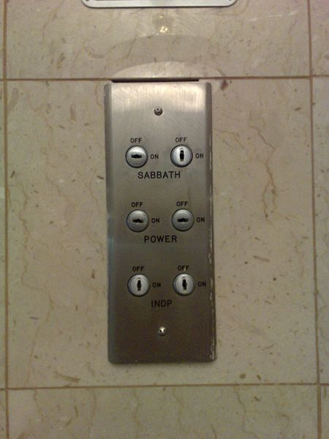
Our Sabbath Lift in Galilee
We arrived at our hotel on the Sabbath, so it would not stop at our floor. Instead, we carried our luggage up two floors by hand in celebration of the day of rest!
Notes:
On my 2007 trip that I led to Israel, the lift was turned on to the Sabbath setting, meaning that it stopped only every fourth floor.

Slide 84
Righteousness in Romans
23
Theme | Needed | Provided | Imparted | Proved | Applied | Dissem-inated
Intro 1:1-17 | Condem-nation 1:18– 3:20 | Justifi-cation 3:21– 5:21 | Sanctifi-cation 6–8 | Election 9–11 | Trans-form-ation 12:1– 15:13 | Propa-gation 15:14– 16:27
Start | Sin | Salva-tion | Set Apart | Sove-reignty | Service | Send

Slide 85

"Israel" always means ethnic seed of Jacob (9:1-5)
23
"For not all who are descended from Israel are Israel" (9:6)
≠ "Israel" refers to believing Gentiles?!?!
= Not all Jews believe

Slide 86

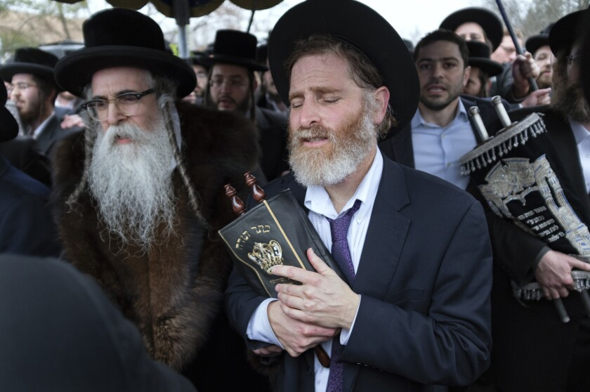
Is There a Future for National Israel?
155u
Notes:
About 27% of the Bible related to the future when it was written, and half of these prophecies have already been fulfilled. But should we expect more fulfillments to come for the descendants of Jacob?
_________
Common-347
BE-45-Rom-slide 70
OS-02-Exodus-444
OS-31-Obadiah-145
NS-06-Rom9-16-slide 26

Slide 87
Summary of Romans 9–11
24
9:1-29 | 9:30–10:21 | 11:1-36
Israel's past | Israel's present | Israel's future
God elected Israel | Israel rejects God | God will reject Israel only partially and temporarily
Israel's failure is not due to God's unfaithfulness | Israel's failure is due to rejecting her Messiah | Israel's failure will be neither total in scope nor final
A Jewish remnant has been preserved by God | Only a small Jewish remnant accepts Him now | Yet this remnant will grow into an entire believing nation
Gentiles have also become elect of God in Christ | Gentiles are now becoming saved by faith in Christ | Gentiles should not be proud over blessings that Jews reject
Divine side | Human side | Divine results
God's election | Man's responsibility | God's mercy
Human unbelief cannot eradicate God's promises because they are based on the principle of sovereign election | However, God's election in sovereign grace to fulfill His Word does not eradicate human responsibility for unbelief | Ultimately, God's election will be justified in the salvation of the Jewish nation alive when Christ returns

Slide 88
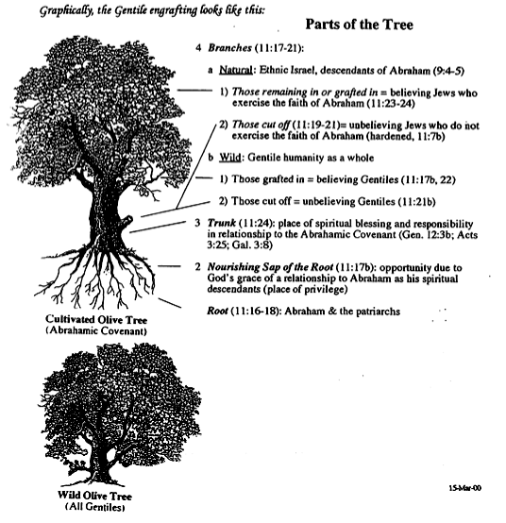

Gentile Engrafting
25
Branches (11:17-21)
a. Natural: Ethnic Israel (9:4-5)
1) Remaining/Grafted = Believing (11:23-24)
2) Cut off = Unbelieving (11:19-21)
b. Wild: Gentile humanity
1) Grafted = Believing (11:17b, 22)
2) Cut off = Unbelieving (11:21b)
Trunk (11:24)
Sap (11:17b)
Root (11:16-18)

Slide 89
Discontinuity
26
Issue
Israel
Church
Seed
Physical
Spiritual
Pal. Cov.
Partial Fulfill.
No land promise
Law
Required
Freedom from
Duration
Abraham to Eternity
Pentecost to Rapture

Slide 90
Discontinuity
26
Issue
Israel
Church
Wrath
Experienced
Freedom from
Faith
By sacrifices
Trusting Christ
Priesthood
Has one
Is one
Activity
Set aside until 70th week
Between 69th & 70th Weeks a mystery

Slide 91
Discontinuity
26
Issue
Israel
Church
Qualifi-cation
Ethic:
descendants of Abraham or Gentile proselytes who became Jews through circumcision
Non-ethnic: "Neither Jew nor Gentile"
(Gal. 3:28) means Jews and Gentiles without need to become Jewish proselytes

Slide 92
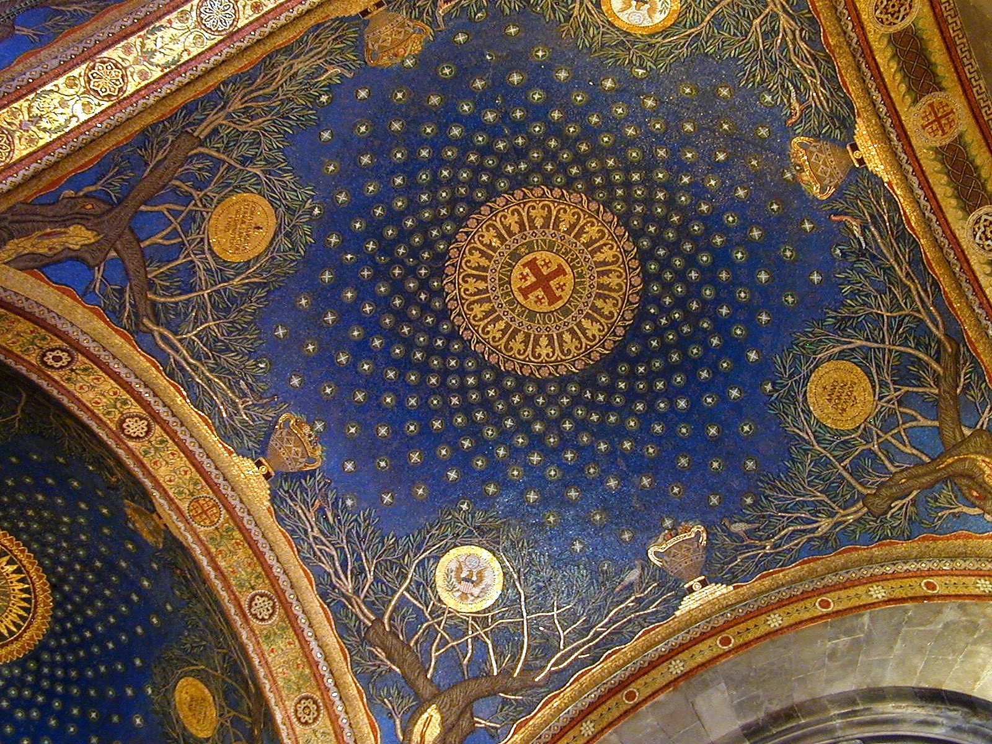
Continuity
27
Issue
Israel
Church
Abraham
Origin
Grafted in
David Cov.
Literal Temple
Spiritual Temple
New Cov.
Promised
Part Fulfilled
Law
Law of Moses
Law of Christ

Slide 93
Continuity
27
Issue
Israel
Church
Salvation by
Grace via faith
Grace via faith
Salv. Basis
sacrificial lamb
Sacrificial Lamb
Spirit
Filled leaders
Indwells all
Prophets
Revealed God's Word
Also founded the Church

Slide 94
Continuity
27
Issue
Israel
Church
Election
Israel by grace
All by grace
Disobeying
➔ discipline
➔ discipline
Leaders
Elders
Elders
Witness
"Light"
"Kingdom"
"Holy nation"
"Light"
"Kingdom"
"Holy nation"

Slide 95
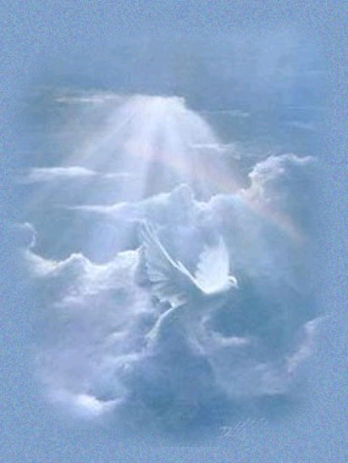
The New Covenant
30
IN BRIEF

Slide 96

The New Covenant
30
Jeremiah 31:31-34
My Definition: God's unconditional amplification of the blessing promise in the Abrahamic Covenant in which Israel and Judah will experience national and spiritual redemption but in which the church also experiences partial present blessings.
Alternate (Amillennial) Definition: The blessing of the Spirit in the present age given to each believer as the "seed of Abraham" (Gal. 3:7, 16, 29; 4:31) since God has rejected national Israel and replaced it with the church.

Slide 97
Four Unconditional Biblical Covenants
N/A
ABRAHAMIC
Genesis 12:1-3
BLESSING
LAND
SEED
LAND
Deut 30:1-10
DAVIDIC
2 Sam 7:12-16
NEW
Jer. 31:31-34
God's unconditional amplification of the blessing promise in the Abrahamic Covenant where Judah and Israel will experience national and spiritual redemption.
Notes:
A recap of the covenants that are amplified from the Abrahamic covenant of which the new covenant was one of them.
(cf. Deut. 30:1-10) promises:
Land from Wadi of Egypt to Euphrates River (Isa. 27:12)
Eternal possession of land (Gen. 17:8) after exile/restoration
Whole world blessed via the land (Isa. 14:1-2)
2 Samuel 7:12-16 promises perpetual:
Sons ("house" never wiped out)
Kingdom (political dynasty)
Throne (right to rule by descendants)
Temple (son to build it)
Jeremiah 31:31-34 promises:
Forgiveness
Indwelling Spirit
New heart, nature, mind
Reunification of Israel and Judah
No need for evangelism

Slide 98
The New Covenant
30
Jeremiah 31:31-34
³¹"The time is coming," declares the LORD, "when I will make a new covenant with the house of Israel and with the house of Judah.
³²It will not be like the covenant I made with their forefathers when I took them by the hand to lead them out of Egypt, because they broke my covenant, though I was a husband to them," declares the LORD.
³³"This is the covenant I will make with the house of Israel after that time," declares the LORD.

Slide 99
The New Covenant
30
Jeremiah 31:31-34
^{33b} "I will put my law within them, and I will write it on their hearts. And I will be their God, and they shall be my people. And no longer shall each one teach his neighbor and each his brother, saying, 'Know the LORD,' for they shall all know me, from the least of them to the greatest, declares the LORD. For I will forgive their iniquity, and I will remember their sin no more."

Slide 100
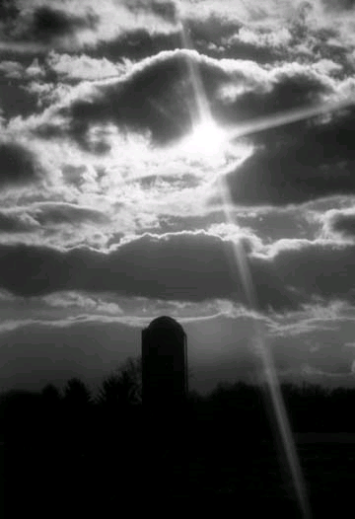
Provisions
30
FULFILLED
Indwelling of the Holy Spirit
(Jer. 31:33 with Ezek. 36:27)
New nature, heart & mind
(Jer. 31:33; Isa. 59:21)
Forgiveness of sins
(Jer. 31:34b)
NOT YET FULFILLED
Everyone will know the Lord
(Jer. 31:34a)
Israel and Judah will be reunited (Jer. 31:31)
Notes:
There are debates that exist about the how far or when or to whom the covenant refers to. This is because Jeremiah 31 declares the covenant is for Israel and Judah but in the new testament. (Luke 22:20; 1 Cor 11:25; 2 Cor.3:6; Heb 8:8;9:15 ) it is declared for the church.
.
So questions arise if is there a new covenant? Is it especially for the church? Or is it only for Israel? Or was there two covenants? Or are these promises built upon each other?

Slide 101
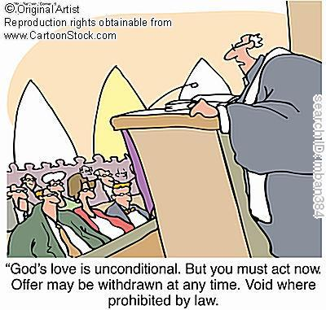
Unconditional Nature
30
Eternal (Jer. 31:36, 40; 32:40; 50:5; Isa 61:2. 8-9; 24:5; Ezek. 37:26)
Amplification of the Abrahamic Covenant, which is unconditional
Unqualified "I will" statements of God
Notes:
How did we know that it was unconditional?

Slide 102

Views on the Time of Fulfillment
30
Amillennialists often say all of the provisions of the New Covenant are being realized now in the church which they consider the "new Israel." But are they?
1. Partial Fulfillment in the present church age
Only one New Covenant for Israel (Darby)
Two New Covenants: one for Israel and one for the church (Chafer)
One New Covenant with a two fold- application: primarily to Israel, secondarily to the Church
2. Complete fulfillment after the return of Christ
Notes:
Ignores NT, Christ's words, Paul's teachings
Ignore present work of the Holy Spirit cue cards
1)Cannot reconcile same terminology for OT and NT covenants.
2) The distinctions are too sharp.
View most modern pre-mils take. Deals with both OT/NT data, forgiveness and the holy spirit are blessings that we experience now.
Ignoring OT data between the distinctions between church and Israel

Slide 103
Kingdom & Covenants Timeline
103
CH-34a
OS1-22
OS2-337
NS-9g
SA-19
34a
Dr. Rick Griffith • BibleStudyDownloads.org
22
Kingdom Teaching...
Adam rules with God (Gen. 1:26, 28; 2:19)
Satan begins rule as god of this world (Gen. 3:15;
2 Cor. 4:4)
God covenants with Abraham to reestablish man's rule via Israel as a "kingdom of priests" (Gen. 12:1-3; Exod. 19:6)
Israel's failure to witness to nations as a kingdom of priests is judged via exile under foreign rule
Israel rejects Messiah's offer of kingdom (Matt. 12:41-42; 23:37-39)
Jesus extends His kingdom in mystery form to the Church (Matt. 13)
Christ subdues Israel's enemies and nation believes (Rom. 11:26-27)
Christ rules over everything with saints (Eph. 1:9-10; Rev. 20:1-6; 22:5b)
337
9g
Fall of Man (Gen. 3)
Noahic Covenant
19
Genesis 6:18; 9:8-17
Land Covenant
ISRAEL
CHURCH
MESSIANIC KINGDOM
(National Focus)
The "New Man" (Eph. 2:15)
Millennial Eternal
land
Genesis 15:18 (cf. Deut. 30:1-10) promises:
Land from Wadi of Egypt to Euphrates River (Isa. 27:12)
Eternal possession of land (Gen. 17:8) after exile/restoration
Whole world blessed via the land (Isa. 14:1-2)
Israel judged for rejecting Messiah by dispersion away from land for 19 centuries
(AD 70–AD 1948) but now partially restored (Ezek. 37:1-7)
Full restoration (Ezek. 37:8-28) Jerusalem world capital
(Isa. 2:1-5)
New Jerusalem
(Rev. 21–22)
Davidic Covenant
Christ is Head over His Church, which is a spiritual temple (Eph. 2:19-22; 2 Cor. 6:16)
Christ reigns over the world
(Isa. 11)
with saints (Rev. 5:10; 20:4-6)
Christ hands kingdom over to Father (1
Cor. 15:24)
Genesis 12:1-3
2 Samuel 7:12-16 promises:
Sons ("house" never wiped out)
Kingdom (political dynasty)
Throne (right to rule by descendants)
Temple (son to build it)
seed
Abrahamic Covenant
New Covenant
All
things made new!
(Rev. 21:5)
All 5 elements fulfilled in national restoration (Zech. 8)
Jeremiah 31:31-34 promises:
Forgiveness
Indwelling Spirit
New heart, nature, mind
Reunification of Israel and Judah
No need for evangelism
Mosaic Law replaced with first three elements of the New Covenant (Luke 22:20; 2 Cor. 3:6)
blessing
Mosaic Covenant
Law abolished, fulfilled, and replaced at the cross (Rom. 7:1-6;
1 Cor. 9:19-21; Heb. 8:13)
10th Edition
10 Nov 2020
Temporary (Gal. 3:19) and conditional (Deut. 28) to reveal sin (Rom. 7:7) and regulate Israel (Gal. 3:23-25)
Scripture has a dual kingdom-covenant theme. Israel's role from Abraham to Christ expands to include the Church (continuity) yet the Church never replaces the nation as the "new Israel" (discontinuity). Israel will enjoy world prominence after trusting Christ at His second coming.
Notes:
All agree that a partial fulfillment of the covenant to Abraham exists now to the Church in the indwelling Holy Spirit and forgiveness of sins (Jer 31:31-34)—and the ultimate fulfillment will be in the eternal state.
The main area of disagreement relates to the time period from now to eternity. Will there be a literal land, throne, and worldwide blessing to national (ethnic) Israel before the eternal kingdom? This chart shows verses giving a resounding YES to that question in a present partial fulfillment and a future full fulfillment in the normal sense of language in the verses cited. But the messianic kingdom will be in two stages—first in a millennial fulfillment to last 1000 years, but then, after that, the eternal stage in the new Jerusalem after the destruction of our present heavens and earth (Rev 21–22). What an amazing future remains for those who trust Jesus!
____________
Common English-7
CH-02-Nature-103-p34a
OS-02-Exodus-267-p22
OS-05-Deut-248-p22
OS-10-2Sam-96-p22
OS-24-Jeremiah-174-p337
OS-23-Isaiah-97-p337
NS-09-Gal-125-p9g
NS-19-Hebrews-319-p9g
SA-08-Mosaic Law-19-p38a

Slide 104

…This cup is the
NEW COVENANT in my blood, which is
POURED OUT for you.
The cup (not baptism) is the new covenant sign
LUKE 22:20
Notes:
The Passover had its "cup of redemption" that referred to the salvation of Israel from slavery in Egypt. But Jesus changed the familiar wording on the night of the Last Supper to apply this "cup of redemption" not simply to political redemption. He declared himself as the fulfillment of this cup as it ultimately celebrates redemption in HIS blood as the TRUE Passover Lamb!
Many today say that baptism is the sign of the new covenant for believers. But Luke 22:20 says that the cup of the Lord's supper is that sign.
__________
Common-389
BE-24-Jeremiah-62?
ES-05-Biblical Covenants-33
OS-24-Jeremiah-170
NS-03-Luke13-24-slide 161
NS-08-2 Corinthians-83?
NS-19-Hebrews-375

Slide 105
How could Jesus apply the new covenant promises to his disciples when the other provisions were not fulfilled then?
(What about Israel and Judah reunified? What about all people knowing God?)
Notes:
We must reconcile these seemingly contradictory applications.
__________
Common-390
BE-24-Jeremiah-62?
ES-05-Biblical Covenants-33
OS-24-Jeremiah-170
NS-03-Luke13-24-slide 161
NS-08-2 Corinthians-83?
NS-19-Hebrews-375

Slide 106

"Old" Replaced by "New"
31
Wayne Grudem, Systematic Theology, 521
"What then is the 'old covenant' in contrast with the 'new covenant' in Christ? It is not the whole of the Old Testament, because the covenants with Abraham and David are never called 'old' in the New Testament. Rather, only the covenant under Moses, the covenant made at Mount Sinai (Ex. 19-24) is called the 'old covenant' (2 Cor. 3:14; cf. Heb. 8:6, 13), to be replaced by the "new covenant" in Christ (Luke 22:20; 1 Cor. 11:25; 2 Cor. 3:6; Heb. 8:8, 13; 9:15; 12:24)."

Slide 107
Signs of the Covenants
32
Covenant | Definition | Promise | Fulfillment | Sign
Noahic | Unconditional promise not to flood earth again | Gen. 9:12-17 | No more sea (Rev. 21:1) | Rainbow (Gen. 9:12-17)
Abrahamic | Promise to provide Israel a land, rule, and spiritual blessing | Gen. 12:1-3; 15:13-18 | Continues at present (Gal. 3:17) but Israel still has a future (Rom. 11:25-27) | Circumcision (Gen. 17:11)
Mosaic | Conditional stipulations for blessing on Israel | Exod. 19-31; Deut. 28 | Death of Christ (Rom. 7:4-6) | Sabbath (Exod. 31:13)
Land | Promise of physical land from the Wadi of Egypt to the River Euphrates | Deut. 30:1-10 | Land blessed (Amos 9:13-15) | No sign (that I know of)
Davidic | Promise of eternal, political rule of a descendant of David | 2 Sam. 7:12-17 | Rule renewed (Amos 9:11-12) | Christ seated at the Father's right hand (Acts 2:34-36)
New | Promise of spiritual indwelling of the Spirit ("law written on hearts"), forgiveness, and total evangelization of Israel | Jer. 31:31-34 | Paul & the Apostles (2 Cor. 3–4) All Israel saved (Rom. 11:26-27) | Cup of the Lord's Supper (Luke 22:20; 1 Cor. 11:25)

Slide 108
Contrasting the Covenants (2 Cor. 3–4)
33
Old Covenant | New Covenant
initiated by Moses (3:8) | initiated by Christ (3:4)
of the letter (3:6a) | of the Spirit (3:6a, 18b)
kills (3:6b, 7a) | gives life (3:6b)
engraved on stone (3:3b, 7a) | engraved on hearts (3:3b; Jer. 31:33
glorious (3:7a) | more glorious (3:8, 10)
glory faded (3:7b, 11a, 13b) | glory ever-increases (3:11b, 18)
condemns men (3:9a) | brings righteousness (3:9b)
deception (3:13) | boldness (3:12)
veiled face of Moses (3:13b) | unveiled faces (3:13a, 18a)
veiled minds (3:14a) | unveiled minds (3:14b; 4:3-6)
veiled hearts (3:15) | unveiled hearts (3:16)
dullness (3:14a) | freedom (3:17)
Moses reflected God's glory | all believers reflect Christ's glory (3:17)
non-transforming (3:7) | transforming (3:18)
lack of zeal (3:13) | confidence, steadfastness (3:4-5; 4:1)
deception (3:13) | sincerity (4:2)

Slide 109
How to Reconcile?
34
Jeremiah 31:31-34 (for Israel)
'everlasting covenant'
'a new heart'
'a new spirit'
'a covenant of peace'
'a covenant'
Luke 22:20 (for church)

Slide 110
Views on New Covenant Fulfillment
View | Explanation | School & Scholars | Problems
Restated Mosaic | No New Covenant | Critical: –Couturier –Duhm –Schmidt –Potter | 1. OC/NC distinctions in text ignored 2. OC=conditional, NC=unconditional 3. OC=temporal, NC=eternal 4. OC=external, NC=internal 5. OC=no enablement, NC=enablement 6. NC=peace, prosperity, sanctuary, Spirit (parallel passages)
Church Alone | No Israel Participation | Amillennial/ Postmillennial: –Allis –Cox –Smick –Boettner | 1. Ignores OT data by equating Israel & the Church 2. NC introduced ≠ fulfilled to Israel 3. Present need to know YHWH (we still need to obey the Great Commission) 4. AD 70 Jerusalem vs. Jer. 31:40
34

Slide 111
Views on New Covenant Fulfillment
View | Explanation | School & Scholars | Problems
Israel Alone | No Church Participation | Misc/Classical Dispensational: –Darby – Thompson –von Rad | 1. Ignores NT data –Christ's Last Supper words –Paul's statements –Hebrews application to Church 2. Ignores present work of Spirit
Two New Covenants | NC for Israel + NC for Church | Early 1900s Dispensational: –Chafer –Walvoord (old) –Ryrie (old) | 1. Same terminology for OT & NT NCs 2. Israel/Church distinction too sharp 3. Basis of forgiveness the same 4. If 2 NCs then no OC for Church 5. Church doesn't possess Israel's promises
34

Slide 112
My View on New Covenant Fulfillment
View | Explanation | School & Scholars | Problems
Church Participation | Primarily for Israel Secondarily for the Church | Misc/Present Dispensational: –Keil –Lemke –Bright –Scofield –Walvoord (DTS) –Ryrie (DTS) –Archer (TEDS) –Kaiser (TEDS) | Support: 1. Primary fulfillment is future–Rom 11 2. Deals with both OT & NT data 3. Forgiveness & the Spirit are blessings experienced now 4. NC has new law 5. Rebuttals to above views
34

Slide 113

"This cup is the new covenant in my blood" (Luke 22:20)
32
Refers back to Jeremiah 31:31-34
The new covenant replaces the old
The church participates in the covenant promised to Israel
Never does Scripture say that the church replaces Israel since God has not rejected the nation (Rom. 11:1; cf. Jer. 31:35-37)

Slide 114
Black
Notes:
114

Slide 115


Church link at BibleStudyDownloads.org
Get this presentation for free!
Notes:
Church (ch)

