Slide 1
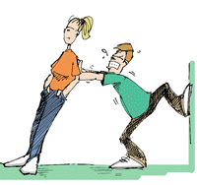
MOTIVATION
Designed by Dr. Scott Wooddell Uploaded by Dr. Rick Griffith • Jordan Evangelical Theological Seminary All files in many languages for free download at BibleStudyDownloads.org

Slide 2
MOTIVATION
Grace – Grace is the greatest motivator because grace frees us from the bondage of sin.
2. Love – When a leader loves his followers, he motivates his followers.
3. Positive Climate – Leaders create an atmosphere where everyone feels free to be their most productive.

Slide 3
MOTIVATION
4. Communication – The transmission of ideas between persons in a language common to both.
Leaders communicate with balance
Leaders communicate accurately
Leaders communicate clearly
Leaders communicate with courtesy
Leaders communicate continuously
Leaders communicate challenge

Slide 4
MOTIVATION
5. Listening – Good listening skills motivate people because they feel you care.
6. Changing – The ultimate motivator is for a leader to listen and make changes.
7. Serving – A servant spirit is the heart of the Christian faith.

Slide 5
MOTIVATION
8. Delegating – Delegating is a recognition of the ability of others and one’s trust in them.
9. Evaluating – Evaluating others affirms them in their strengths and helps them in their weaknesses.
10. Confronting – Confronting those who fail to follow through encourages them and others.

Slide 6
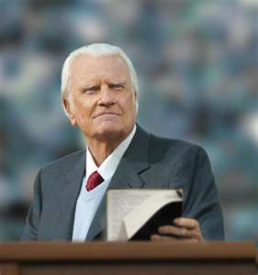
OUR PASTORAL MINISTRY MOTIVATES OTHERS
Our preaching motivates others
Our shepherding motivates others
Our vision motivates others
Our impact on the lives of people motivates others
Our church ministry motivates others
Our endurance motivates others

Slide 7
Black

Slide 8
Church Dynamics link at BibleStudyDownloads.org
Get this presentation for free!
Notes:
Church Dynamics (cd)

