Slide 1
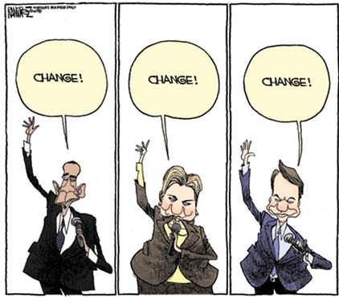
LEADING CHANGE
CHANGE!
CHANGE!
CHANGE!
Designed by Dr. Scott Wooddell
Uploaded by Dr. Rick Griffith • Jordan Evangelical Theological Seminary
All files in many languages for free download at BibleStudyDownloads.org

Slide 2




LEADING CHANGE
It must be remembered that there is nothing more difficult to plan, more doubtful of success, nor more dangerous to manage, than the creation of a new way to do things.
THE KEY REQUIREMENT FOR LEADING CHANGE
Strive always to make the change for the right reasons in the right way at the right time.

Slide 3



FIVE WARNINGS FOR LEADING CHANGE
Never Make Change Personal.
Never Take Resistance to Change Personally.
Never Close Your Mind to the Suggestions of Others.
Realize the Change Process is Far More Important than the End Result.
Have the Courage to Lead the Change Process – Never Let Fear Prevent You from Leading Change.

Slide 4
THE GOVERNING PRINCIPLE FOR LEADING CHANGE
If the change is not going to bring more people to salvation or move more people forward in Christlikeness or encourage more people to face their fears, struggles, and sufferings, why make the change?
All changes must be measured in light of this principle.
All changes must be promoted in light of this principle.

Slide 5

THE GOVERNING PRINCIPLE FOR LEADING CHANGE
If we cannot honestly demonstrate the need for a change in light of this governing principle, don’t make the change.
If we can demonstrate the need for a change in light of this governing principle, we must make the change.

Slide 6

THE GOVERNING PRINCIPLE FOR LEADING CHANGE
The cross is God’s primary instrument of change. God is the God of change.
While God Himself doesn’t change, sin has brought about the greatest change possible in the human race. Since sin entered the world, God has been about change.

Slide 7
THE GOVERNING PRINCIPLE FOR LEADING CHANGE
AND SO WE ARE ABOUT CHANGE:
Not necessarily change in structures, unless we face structures that hinder the changes God is making.
Not necessarily changes in programs, unless we are running programs that hinder the changes God is making.
Not necessarily changes in worship, unless we are leading worship that hinders the changes God is making.
Not necessarily changes in theology, unless we are holding theology that is contrary to the changes God is making.

Slide 8


FOUNDATIONAL STEPS IN THE CHANGE PROCESS
1. Know where you want to go: (Needs and Solutions)
2. Plan how you will get there.
3. Test the plan with selected participants.
4. Evaluate & adjust your plan in light of what you learned.

Slide 9
FOUNDATIONAL STEPS IN THE CHANGE PROCESS
5. Go public with your model in a pilot project that all know about.
6. Communicate your vision to the church at large through all means.
7. Incorporate your model into the mission of the church.
8. Highlight your vision through reports, testimonials, and other positive results.
9. Build a larger network of support and accomplish your vision.

Slide 10
THE EIGHT MOST COMMON REASONS LEADERS ENCOUNTER RESISTANCE TO CHANGE
Loss of control
Excess uncertainty
Surprise, surprise
Loss of face
Concerns about future competence
Ripple effects
More work
Past resentments

Slide 11
Black

Slide 12


Church Dynamics link at BibleStudyDownloads.org
Get this presentation for free!
Notes:
Church Dynamics (cd)

