Slide 1
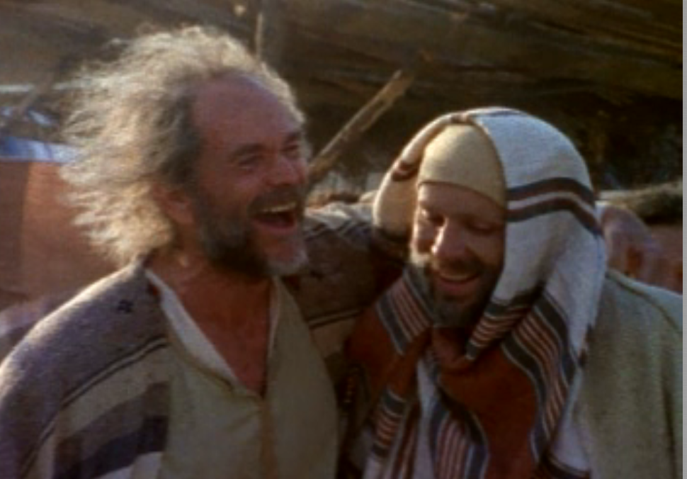
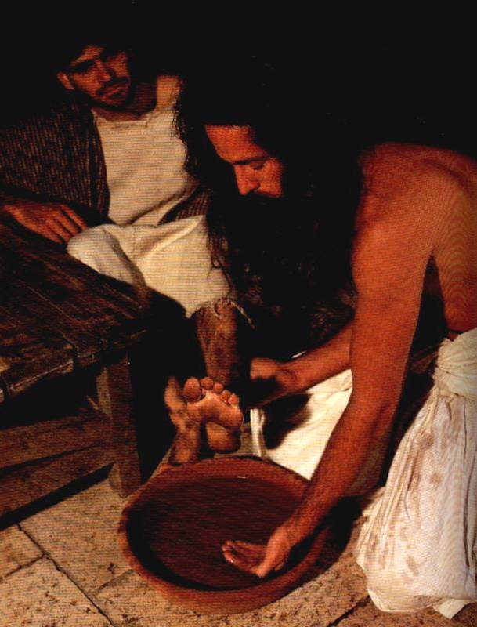
THE LEADERSHIP
TRAINING PROCESS
Designed by Dr. Scott Wooddell
Uploaded by Dr. Rick Griffith • Jordan Evangelical Theological Seminary
All files in many languages for free download at BibleStudyDownloads.org

Slide 2
THE LEADERSHIP
TRAINING PROCESS
FROM NEW CONVERT TO EXPERIENCED LEADER

Slide 3
FROM NEW CONVERT TO EXPERIENCED LEADER
STAGE ONE – NEW CONVERT
STAGE TWO – DISCIPLE
STAGE THREE – EQUIPPER
STAGE FOUR – MINISTRY LEADER

Slide 4
THE 1-2-3-4-5 PROCESS
STEP ONE – YOU DO IT
STEP TWO – YOU DO IT WHILE FUTURE LEADER WATCHES
STEP THREE – FUTURE LEADER DOES IT WHILE YOU WATCH
STEP FOUR – FUTURE LEADER DOES IT ALONE
STEP FIVE – FUTURE LEADER DOES IT WITH ANOTHER FUTURE LEADER

Slide 5
Black

Slide 6


Church Dynamics link at BibleStudyDownloads.org
Get this presentation for free!
Notes:
Church Dynamics (cd)

