Slide 1
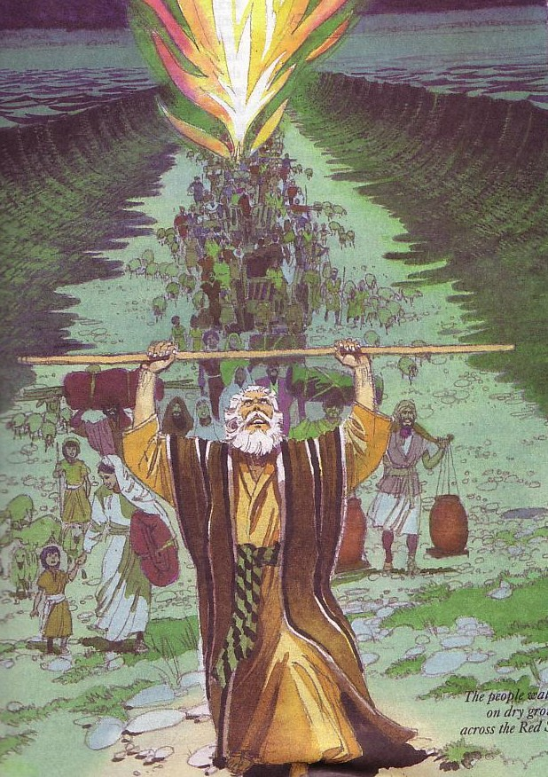
HOW LEADERS LEAD
Designed by Dr. Scott Wooddell Uploaded by Dr. Rick Griffith • Jordan Evangelical Theological Seminary All files in many languages for free download at BibleStudyDownloads.org

Slide 2
HOW LEADERS LEAD

Slide 3
LEADERS LEAD BY PROVIDING VISION FOR THE CHURCH
The leaders primary task is to be the keeper of the vision.
The leaders primary responsibility is to articulate the vision and assist all team members to stay on target in the accomplishment of the vision.

Slide 4
2. LEADERS LEAD BY PROMOTING AN OPTIMISTIC ATTITUDE
Leaders must act to develop teamwork, intervening as necessary to maintain unity.
Leaders must keep everyone fully informed concerning team events as this is one of the keys to a positive attitude.

Slide 5
3. LEADERS LEAD BY SHOWING RESPECT FOR CHURCH MEMBERS
Leaders appreciate the gifts others bring to the church.
Leaders praise the accomplishments of others.
Leaders build on their strengths, not focusing on their weaknesses.

Slide 6
4. LEADERS LEAD BY BEING SENSITIVE TO CHURCH MEMBERS
Leaders must be able to tolerate personality differences and act to help people of differing outlooks work well together.
Leaders must seek to raise the participation of all to their highest level of ability.
Leaders must be flexible, willing to listen to new ideas and open to differing perspectives.

Slide 7
5. LEADERS LEAD BY MODELING CHRISTLINENESS
“Be imitators of me, as I am of Christ.”
1 Corinthians 11:1

Slide 8
Black

Slide 9
Church Dynamics link at BibleStudyDownloads.org
Get this presentation for free!
Notes:
Church Dynamics (cd)

