Slide 1
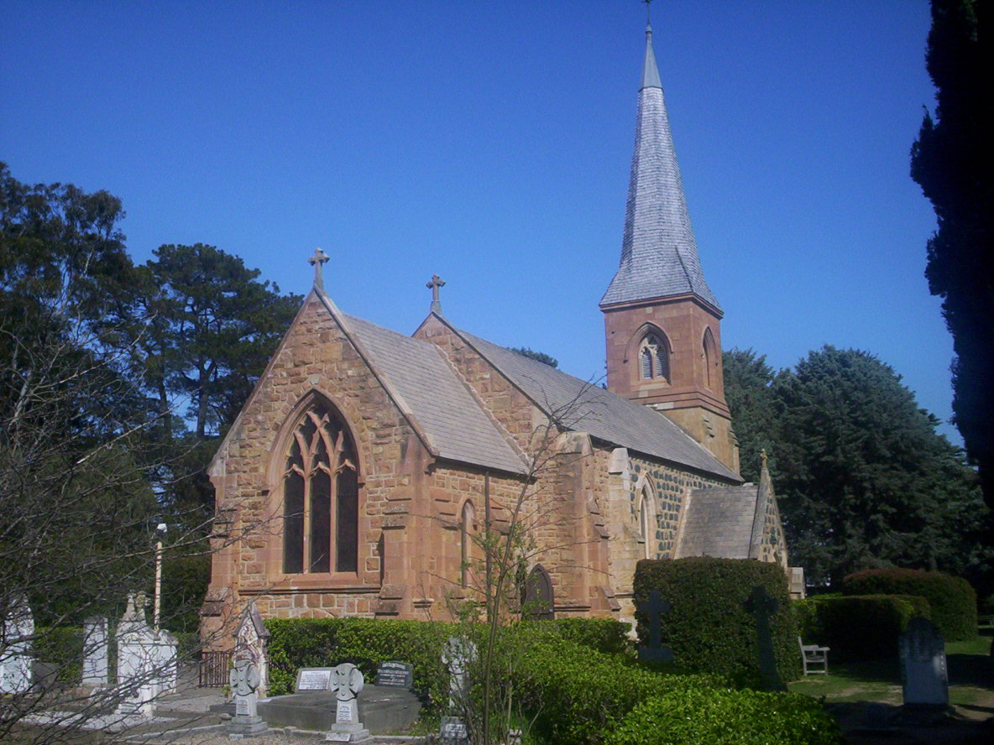
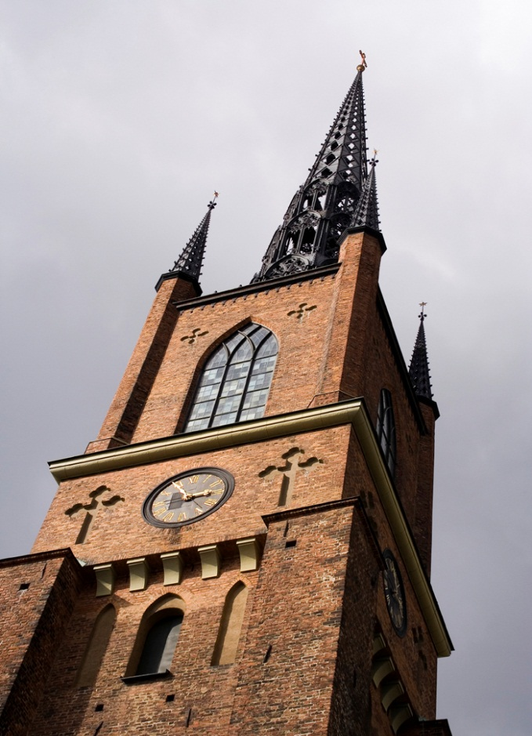
CHURCH DYNAMICS
Designed by Dr. Scott Wooddell
Uploaded by Dr. Rick Griffith • Jordan Evangelical Theological Seminary
All files in many languages for free download at BibleStudyDownloads.org

Slide 2
CHURCH DYNAMICS
Jesus said, “I will build my church and the gates of hades will not overpower it.” (Matthew 16:18)

Slide 3
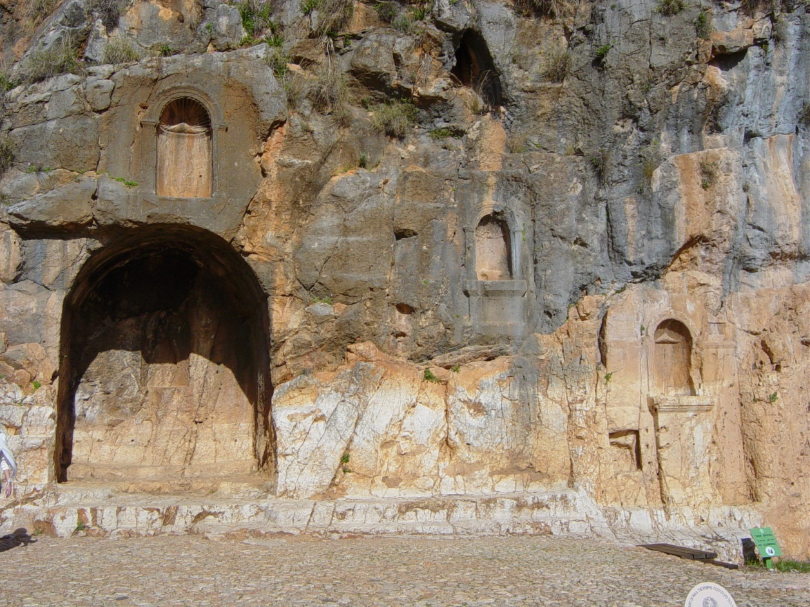
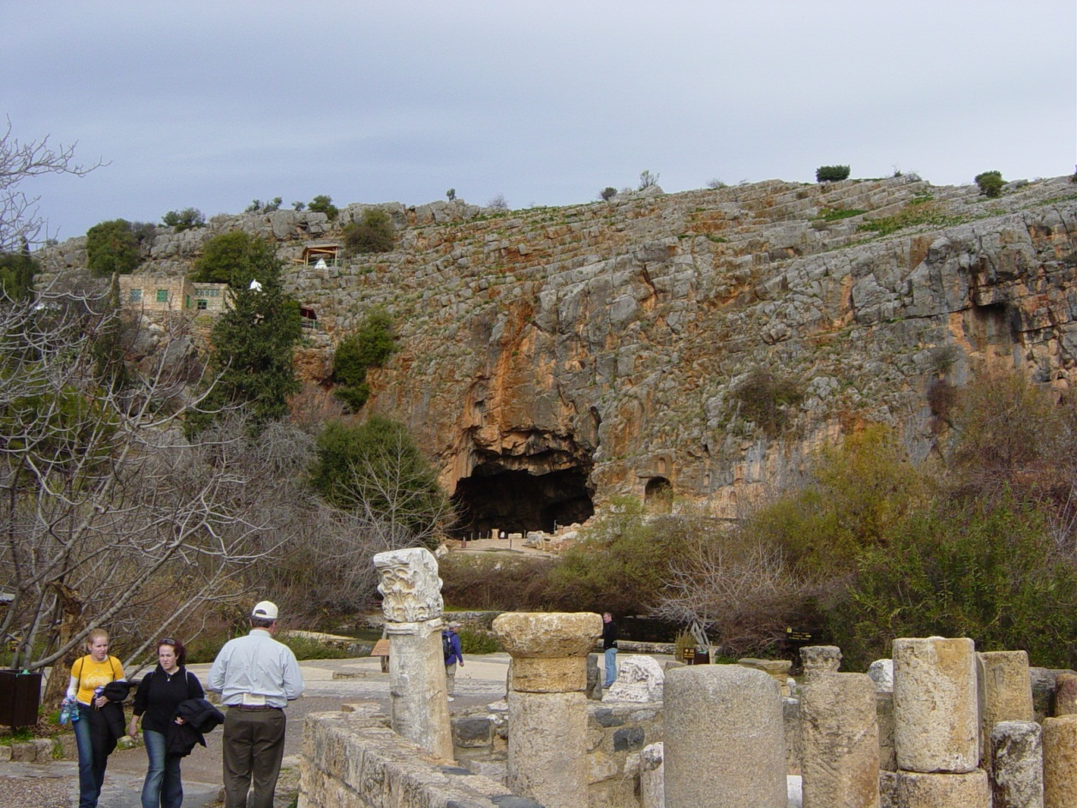
CHURCH DYNAMICS
Jesus said, “I will build my church and the gates of hades will not overpower it.” (Matthew 16:18)

Slide 4
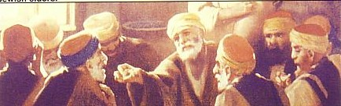
CHURCH DYNAMICS
What is the purpose of the church?
How should it be organized?
Who should lead it?
What kind of activities and ministries should it have?

Slide 5
UNDERSTANDING THE NATURE AND PURPOSE OF THE CHURCH
The word translated “church” in the New Testament is the Greek word ekklesia.
Non-Christian usage (Acts 19:32, 41)
Christian usage (Acts 13:1)

Slide 6
UNDERSTANDING THE NATURE AND PURPOSE OF THE CHURCH
EKKLESIA
NON
CHRISTIAN
Acts 19:32
LOCAL
CHURCH
Acts 13:1
UNIVERSAL
CHURCH
Ephesians 5:25

Slide 7

THE PURPOSE OF THE CHURCH
“Therefore, go and make disciples of all nations, baptizing them in the name of the Father and of the Son and of the Holy Spirit and teaching them to obey everything I have commanded you” (Matthew 28:19-20)
EVANGELIZE THE LOST
DISCIPLE THE SAINTS

Slide 8
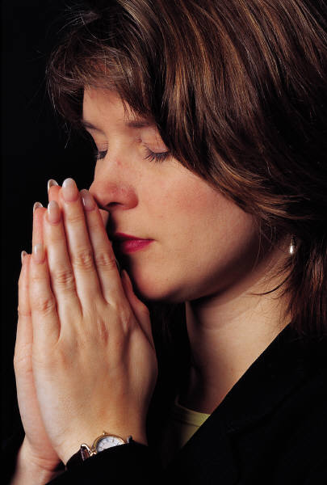


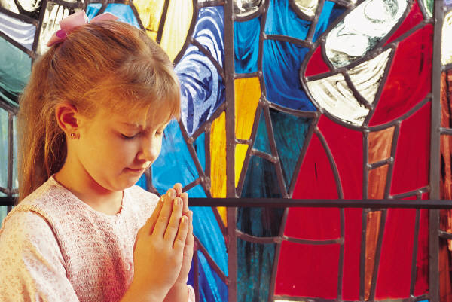
THE METAPHORS OF THE CHURCH
THE BODY OF CHRIST
THE BRIDE OF CHRIST
THE TEMPLE OF GOD
THE PRIESTHOOD OF GOD
THE FLOCK OF GOD

Slide 9
A DEFINITION OF THE CHURCH
The church is the living community of people who trust in Christ Jesus, organized and serving in unity to fulfill corporately a four-fold purpose: worship, edification, evangelism and fellowship.

Slide 10
Black

Slide 11


Church Dynamics link at BibleStudyDownloads.org
Get this presentation for free!
Notes:
Church Dynamics (cd)

