Slide 1
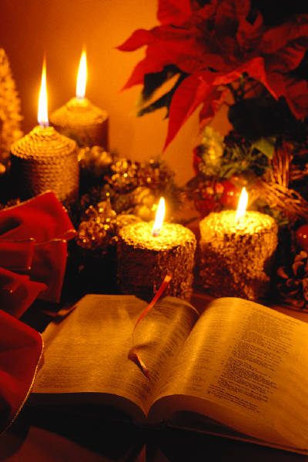
OT Biblical Theology
Dr. Rick Griffith • Jordan Evangelical Theological Seminary • BibleStudyDownloads.org
Notes:
Most of us are good at looking at details. We can evaluate a verse of Scripture or preach a passage. But what about the big picture? So I want to give you a challenge.

Slide 2
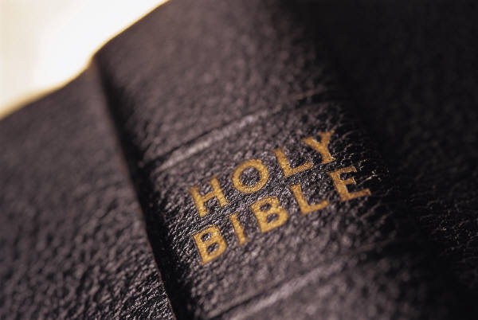
What's the Theme of the OT?
54
Write this out in a single sentence
Notes:
Suppose you were talking to an unbeliever and he asked, "So you are a Bible student? What is the OT about?"
On the notes section of your phone or on a piece of paper, please write a single sentence to describe the main theme of just the OT.
Now share this with the person next to you—what is your theme? Redemption? Jesus? God? Blessing? Covenants?

Slide 3
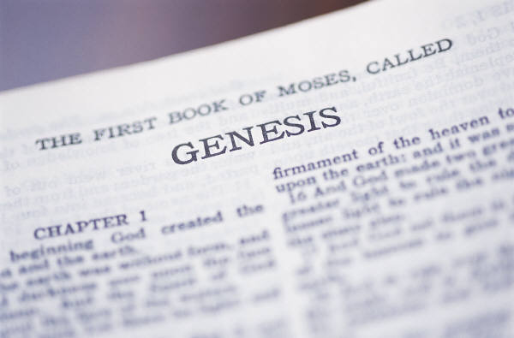
Criteria to Discern the Key OT Theme
54
Yes
No
Text-based
Covers whole OT
Narrow enough to be helpful
Focuses on God as He is the Subject
Not from systematics
Not piecemeal
“Life” is too general a theme to help us
Man is not the subject of the Bible
Notes:
What principles will assure that our theme for the OT and NT is accurate?
• The theme should come out of the text rather than be imposed on the text from systematic theology.
• It should be comprehensive enough to cover all of the OT from Genesis 1 to Malachi 4.
• It should be narrow and specific enough to be helpful (e.g., it is not helpful to say that the Bible talks about “life”).
• Since God is the main subject of the Word, it should focus more on God than man.

Slide 4

Opinions on the Key OT Theme
54-57
Redemption of Man
Notes:
Probably the most common theme presented is the redemption or salvation of man.

Slide 5

Redemption means
“to release from ransom”
Notes:
The idea is freedom from the "prison of sin."

Slide 6

Redemption in the Media
People have an inherent sense that they need redemption
Notes:
Think about most movies. They follow a familiar plot:
1. There is a problem that comes to a crisis point.
2. A Savior figure rises to conquer the problem.
3. Resolution results.

Slide 7


The Focus of History is the Redemption Provided by Christ
Notes:
Scholars often rightfully speak of the process of God redeeming us.

Slide 8

The Centrality of the Cross
WHAT?
1st
A
d
a
m
2nd
A d a m
NAT
ION
TRI
BE
FAMI LY
5 0 0 0
1 2 0
11
Notes:
Human history narrowed down to Jesus Christ and expanded from there. From the "First Adam" came all peoples initially but this narrowed to the nation of Israel, the tribe of Judah, and the line or family of David that brought us, Jesus. Then history expands from the 11 apostles to the 120 at Pentecost to over 5000 that saw the resurrected Jesus, and eventually this "Second Adam" will rule the entire world!

Slide 9
The Centrality of the Cross
55
E
T
E
R
N
I
T
Y
E
T
E
R
N
I
T
Y
But redemption as the KEY OT Theme has these problems:
It is an external structure imposed on the OT from systematic theology.
It focuses too much on man rather than God.
Christ is the central person of the Bible, but the OT focuses on Him as King more than as Savior (the OT rarely notes the salvation of individuals.)
This view also does not include God's program for angels, those not redeemed, and creation as a whole, so it is too restrictive.
The view is not traced in the wisdom books (not supported in Eccles., Prov., etc.).
It neglects the physical (land) aspects prominent in the OT.
Notes:
The person of Christ bridges the OT and the NT.
His redemption is taught some in the OT: Gen 3:15; Leviticus typology; Isa 53; 61:1-4
However, his rule bridges the OT and NT more than his atonement.
• It also has at least six other problems (read).

Slide 10
Opinions on the Key OT Theme
54-57
Redemption of Man
Glory of God
Notes:
Others claim that the key theme of the OT (and the Bible) is the glory of God.

Slide 11

The Glory of God
The Glory of God
Notes:
God certainly wants us to praise him above all else.

Slide 12
The Glory of God
1600 years
40 authors
ONE THEME:
the glory of God
4
3
5
GOSPELS
6
2
PROPHECIES
WRITINGS
ACTS
7
HISTORIES
EPISTLES
1
LAW
8
REVELATION
©2003 TBBMI
7.5.06.
2
15
Notes:
• Every section of the Bible teaches us to glorify God.

Slide 13

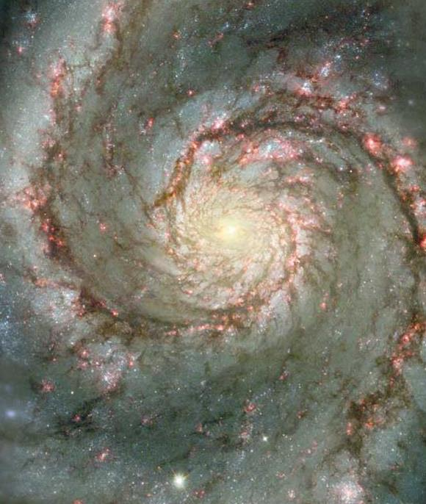

Glory and the Cross
The Glory of God
06-31
40
1
©2003 TBBMI
7.5.06.
Notes:
So the Westminster Catechism tells us that the chief aim of man is to glorify God.
• Jesus prayed in John 17 for God to glorify the Son through the cross so that the Father would be glorified.
And we should glorify God—but exactly how will he do this—and the cross wasn't even needed in Genesis 1–2 so redemption to glorify God wasn't needed then.

Slide 14
Opinions on the Key OT Theme
54-57
Redemption of Man
Glory of God
Sovereignty of God
God
Creation Faith
Deuteronomistic Theology of History
Worship
Promise (Covenant)
Notes:
C. Others say God's sovereignty is the main theme. He is the Big Boss, so just accept it!
D. Still, others say the key idea is simply "God"—but isn't that too broad?
Various other themes are presented that we don't have time to cover (E, F, and G).
H. The Promise Theme emphasizes God's covenants.

Slide 15

Types of Unconditional Covenants
43
Abrahamic
Land
Davidic
New
Land | Seed | Blessing
Physical | Political | Spiritual
Deut. 30:1-10 | 2 Sam. 7:12-16 | Jer. 31:31-34
Notes:
We have already seen how the Abrahamic Covenant is fleshed out further in three other OT covenants.
Covenant is also prominent in the very names of the Old Testament (Old Covenant) and New Testament (New Covenant).
We don’t have these major divisions of the Bible called the Old Kingdom and New Kingdom—or Old Worship and New Worship—or some other designation that highlights a different theme.

Slide 16
Opinions on the Key OT Theme
54-57
Redemption of Man
Glory of God
Sovereignty of God
God
Creation Faith
Deuteronomistic Theology of History
Worship
Promise (Covenant)
No Overall Theme
Rule of God
Kingdom & Covenants
Notes:
I. OT scholar Gerhard Hasel essentially gives up here, throws up his hands, and says that there is no main theme—only many lesser themes.
J. But I think the main theme is the Rule of God shared with man.
K. Or, more completely, God's kingdom expands through his covenants as a secondary theme.

Slide 17

The Lord Reigns 1
The Lord reigns, the Lord reigns,
the Lord reigns let the earth rejoice
let the earth rejoice let the earth rejoice
Let the people be glad;
that our God reigns.
(repeat)
Notes:
Our song, "The Lord Reigns," captures the Kingdom theme well.

Slide 18
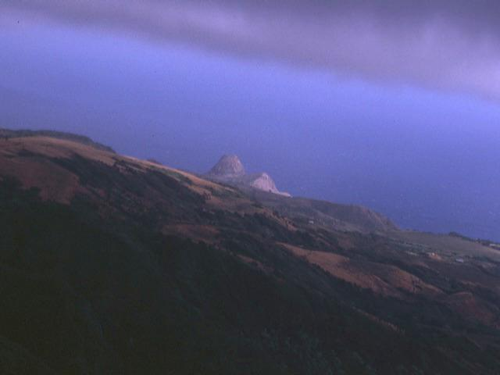
The Lord Reigns 2
The heavens declare His righteousness.
The people see His glory
For You, O Lord, are exalted
over all the earth
over all the earth.
Notes:
All people actually can see God's glory and reign!

Slide 19
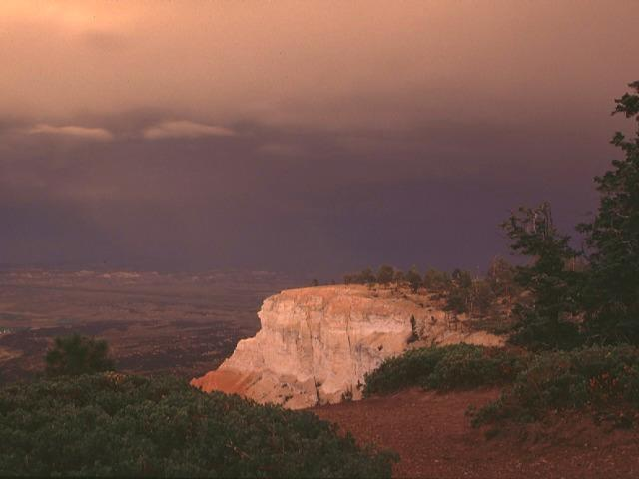
The Lord Reigns 3
The Lord reigns, the Lord reigns,
the Lord reigns let the earth rejoice
let the earth rejoice let the earth rejoice
Let the people be glad;
that our God reigns,
our God reigns,
our God reigns,
our God reigns.
Notes:
Our response should be rejoicing.

Slide 20

Animals
God's Creation…Day 6
"Then God said, 'Let the earth bring forth living creatures after their kind: cattle and creeping things and beasts of the earth after their kind'; and it was so. God made the beasts of the earth after their kind, and the cattle after their kind, and everything that creeps on the ground after its kind; and God saw that it was good" (24-25).
Notes:
But we should do more than just rejoice.
Remember that on Day 6 God made all the land animals.

Slide 21

Man
God's Creation…Day 6
58
"Then God said, 'Let Us make man in Our image, according to Our likeness; and let them rule over the fish of the sea and over the birds of the sky and over the cattle and over all the earth, and over every creeping thing that creeps on the earth'" (Gen. 1:26).
Notes:
And he told us to rule over all these land animals along with the fish and birds. People have asked me, "What is God's plan for my life?" I respond, "Have you read the first chapter of the Bible? You are to rule over creation."

Slide 22

Woman
God's Creation…Day 6
"So God created man in his own image
in the image of God he created him
male and female he created them" (Gen. 1:27).

Slide 23
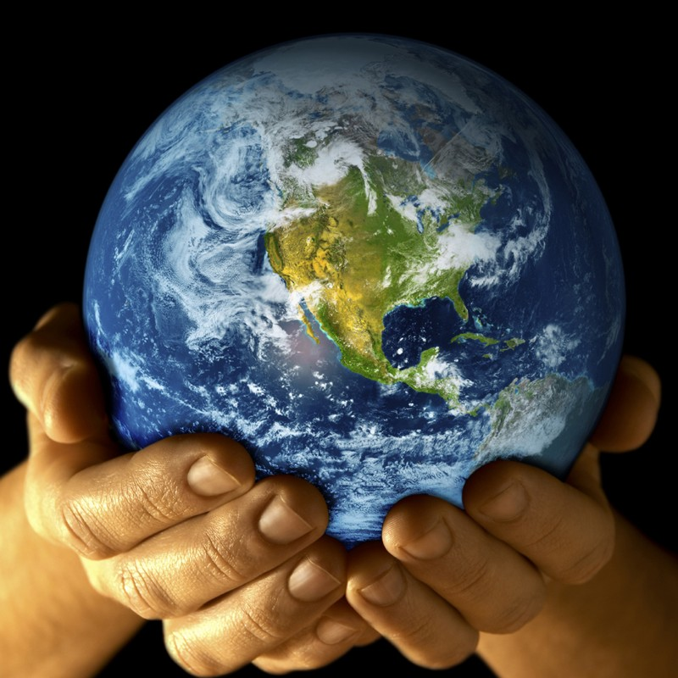
Mandate
448
and over the birds of the air
"And God blessed them, and God said to them, 'Be fruitful and multiply, and fill the earth and subdue it;
and have dominion over the fish of the sea
and over every living thing that
moves upon the earth'" (Gen. 1:28 NLT).
Notes:
Notice the repetition:
"Subdue" the earth!
"Have dominion" over the fish, the birds, and animals that move on the earth.

Slide 24
An All-Encompassing Theme
33
Genesis 1:26-28
"Then God said, 'Let us make man in our image, in our likeness, and let them rule over the fish … birds … livestock … all the earth, and over all the creatures that move along the ground…' God blessed them and said to them, 'Be fruitful and increase in number; fill the earth and subdue it. Rule over the fish of the sea and the birds of the air and over every living creature that moves on the ground.'"
Revelation 22:5
"There will be no more night. They will not need the light of a lamp or the light of the sun, for the Lord God will give them light. And they will reign for ever and ever."
The Bible's Theme: God extends His rule to man
Command
Covenants
Fulfillment
Notes:
The Kingdom theme goes from the first to the last chapters of the Bible.
• God created us to rule creation
• and we will do that even in the new Jerusalem!
• This means that the overall theme of the Bible is that God shares his rule with us!
• Then God's command
• will finally be fulfilled.
• And the covenants will be his vehicle to accomplish this rule.
God chose believers like us to rule the world!
Throughout Scripture, we see the Kingdom of God as the primary theme from the first to the last chapter. But we also see God establishing covenants, or promises, alongside his kingdom rule to enable us to see our eventual rule with him accomplished.
__________
Common Slides Arabic-51
Common English-85
BT-01-OT Biblical Theology-24
OS-00-Intro-89
OS-01-Gen1-3-slide 100
OS-23-Isaiah_49-66/Slide 105 on Supplements
NS-05-Acts1-2-slide 45
NS-22-Rev20-22-slide

Slide 25
Kingdom & Covenants Timeline
22
CH-34a
OS1-22
OS2-337
NS-9g
SA-19
34a
Dr. Rick Griffith • BibleStudyDownloads.org
22
Kingdom Teaching...
Adam rules with God (Gen. 1:26, 28; 2:19)
Satan begins rule as god of this world (Gen. 3:15;
2 Cor. 4:4)
God covenants with Abraham to reestablish man's rule via Israel as a "kingdom of priests" (Gen. 12:1-3; Exod. 19:6)
Israel's failure to witness to nations as a kingdom of priests is judged via exile under foreign rule
Israel rejects Messiah's offer of kingdom (Matt. 12:41-42; 23:37-39)
Jesus extends His kingdom in mystery form to the Church (Matt. 13)
Christ subdues Israel's enemies and nation believes (Rom. 11:26-27)
Christ rules over everything with saints (Eph. 1:9-10; Rev. 20:1-6; 22:5b)
337
9g
Fall of Man (Gen. 3)
Noahic Covenant
19
Genesis 6:18; 9:8-17
Land Covenant
ISRAEL
CHURCH
MESSIANIC KINGDOM
(National Focus)
The "New Man" (Eph. 2:15)
Millennial Eternal
land
Genesis 15:18 (cf. Deut. 30:1-10) promises:
Land from Wadi of Egypt to Euphrates River (Isa. 27:12)
Eternal possession of land (Gen. 17:8) after exile/restoration
Whole world blessed via the land (Isa. 14:1-2)
Israel judged for rejecting Messiah by dispersion away from land for 19 centuries
(AD 70–AD 1948) but now partially restored (Ezek. 37:1-7)
Full restoration (Ezek. 37:8-28) Jerusalem world capital
(Isa. 2:1-5)
New Jerusalem
(Rev. 21–22)
Davidic Covenant
Christ is Head over His Church, which is a spiritual temple (Eph. 2:19-22; 2 Cor. 6:16)
Christ reigns over the world
(Isa. 11)
with saints (Rev. 5:10; 20:4-6)
Christ hands kingdom over to Father (1
Cor. 15:24)
Genesis 12:1-3
2 Samuel 7:12-16 promises:
Sons ("house" never wiped out)
Kingdom (political dynasty)
Throne (right to rule by descendants)
Temple (son to build it)
seed
Abrahamic Covenant
New Covenant
All
things made new!
(Rev. 21:5)
All 5 elements fulfilled in national restoration (Zech. 8)
Jeremiah 31:31-34 promises:
Forgiveness
Indwelling Spirit
New heart, nature, mind
Reunification of Israel and Judah
No need for evangelism
Mosaic Law replaced with first three elements of the New Covenant (Luke 22:20; 2 Cor. 3:6)
blessing
Mosaic Covenant
Law abolished, fulfilled, and replaced at the cross (Rom. 7:1-6;
1 Cor. 9:19-21; Heb. 8:13)
11th Edition
29 Jan 2023
Temporary (Gal. 3:19) and conditional (Deut. 28) to reveal sin (Rom. 7:7) and regulate Israel (Gal. 3:23-25)
Scripture has a dual kingdom-covenant theme. Israel's role from Abraham to Christ expands to include the Church (continuity) yet the Church never replaces the nation as the "new Israel" (discontinuity). Israel will enjoy world prominence after trusting Christ at His second coming.
Notes:
This complicated chart combines the two themes of Kingdom and Covenants. God's kingdom rule extends to humanity across the ages at the top. But the major part shows the unfolding of the Abrahamic Covenant in its land, Davidic, and New Covenant promises—partially fulfilled in the present, but fully completed in the Messianic Kingdom. This will happen in the Millennial Age and especially in the Eternal State.
• This chart also shows that the Old (Mosaic) Covenant was replaced by the New Covenant.
All agree that a partial fulfillment of the covenant to Abraham exists now to the Church in the indwelling Holy Spirit and forgiveness of sins (Jer 31:31-34)—and the ultimate fulfillment will be in the eternal state.
The main area of disagreement relates to the time period from now to eternity. Will there be a literal land, throne, and worldwide blessing to national (ethnic) Israel before the eternal kingdom? This chart shows verses giving a resounding YES to that question in a present partial fulfillment and a future full fulfillment in the normal sense of language in the verses cited. But the messianic kingdom will be in two stages—first in a millennial fulfillment to last 1000 years, but then, after that, the eternal stage in the new Jerusalem after the destruction of our present heavens and earth (Rev 21–22). What an amazing future remains for those who trust Jesus!
____________
Common English-84
BT-01-OT Biblical Theology-25
CH-02-Nature-103-p34a
OC-10-Chronology-42
OS-00-Intro & Biblical Theology-25 & 90
OS-02-Exodus-267-p22
OS-05-Deut-279, 300
OS-10-2Sam-96-p22
OS-12-Kings & Prophets Charts-25
OS-13-1 Chron-46
OS-23-Isaiah-97-p337
OS-24-Jeremiah-174-p337
OS-23-Isaiah-97-p337
OS-28-Hosea-49
OS-31-Obadiah-164
05-Acts1-2-slide 45
NS-09-Gal-143-p9g
NS-19-Hebrews-342-p9g
SA-08-Mosaic Law-19-p38a

Slide 26

My View of the OT's Theme
33
The Old Testament narrates
God's restoring man to participate in His kingdom rule for His own glory
mandated in Eden but lost in the Fall
and accomplished by redeeming man
through Israel as a kingdom of priests
and ultimately through the Messiah,
who will reign as Saviour and King
to fulfill the Abrahamic Covenant
Notes:
•The OT is a story more than a poetic description.
• This part in yellow italics is the main part of the main theme!
• Most descriptions of the overall theme lack kingdom ideas. But this one includes the problem
• the solution (redemption)
• the covenant nation of Israel
• the Messiah as King
• (not just Savior),
• and the Abrahamic Covenant.
__________
Common English-86
BT-01-OT Biblical Theology-26
OS-00-Intro-91
OS-23-Isaiah_49-66/Slide 106 on Supplements

Slide 27
My View of the NT's Theme
58
The New Testament narrates
God's restoring man to participate in His kingdom rule for His own glory
proclaimed by the Church
that salvation is by grace alone
though faith alone
in Christ alone
who will reign as Saviour and King
to fulfill the Abrahamic Covenant
to the glory of God alone
Notes:
The key NT theme should match or complete the OT one, right?
• Like the OT, the NT narrates—it is a story also.
• The kingdom of God is noted hundreds of times
• The means of proclamation is the Church
• The message is the same as in the OT, that is, grace
• This grace is received by faith and not works
• Christ is the only object of our salvation faith
• His salvation will result in his rule
• This will complete the Davidic aspect of the Abrahamic Covenant
• And God will receive the glory for it all
__________
Common English-87
BT-01-OT Biblical Theology-27

Slide 28
My View of the Bible's Theme
58
The Bible narrates
God's restoring man to participate in His kingdom rule for His own glory
though Israel bringing forth the Messiah
so that the Church may proclaim
that salvation is in Christ alone
who will reign as Saviour and King
to fulfill the Abrahamic Covenant
to the glory of God alone
Notes:
So, now we can give the theme of the entire Bible!
• The whole book is a story—God's story—History, or "His story"
• God sharing his rule is the key theme
• Israel had the key role to bring us Jesus
• Jesus brings the Church to preach Him
• The Bible's message is to trust Jesus
• Why? There is no other Redeemer or Ultimate Ruler
• No one else fulfills all the promises to Abraham
• No one else will glorify God like Jesus
__________
Common English-88
BT-01-OT Biblical Theology-28

Slide 29
Black

Slide 30


OT Backgrounds link at BibleStudyDownloads.org
Get this presentation for free!
Notes:
NT Survey (ns)

