Slide 1
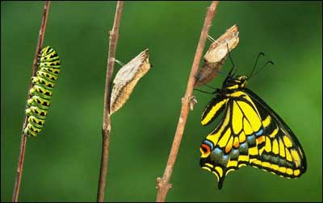
Applying for Life Change
How your Bible study can transform lives
Dr. Rick Griffith • Jordan Evangelical Theological Seminary • BibleStudyDownloads.org

Slide 2
God's Word is given to us to show us how to be different

Slide 3
Place the Main Idea Properly
63
Inductive
Deductive
Subject: How can you speak to non-Christians properly?
MI: Speak graciously & wisely to unbelievers.
I. Speak graciously (6a).
I. Speak graciously (6a).
II. Speak wise words (6b).
II. Speak wise words (6b).
MI: Speak graciously & wisely to unbelievers.
MI: Speak graciously & wisely to unbelievers.
Notes:
HOM 13.27
HSB 30.03

Slide 4
How would you apply this truth to your learners?
MI: Speak graciously & wisely to unbelievers.

Slide 5
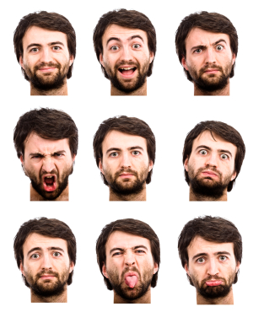
"…so that you may know how to respond to each person" (Col. 4:6)

Slide 6
How can I improve this course?
Class sessions
Assignments
Reading
Other

Slide 7
For your small group…
How are you going to apply this course? What ONE thing does God want you to do?

Slide 8
Bible Study link at BibleStudyDownloads.org
Get this presentation for free!
Notes:
Bible Study (bs)

Slide 9
Black

