Slide 1
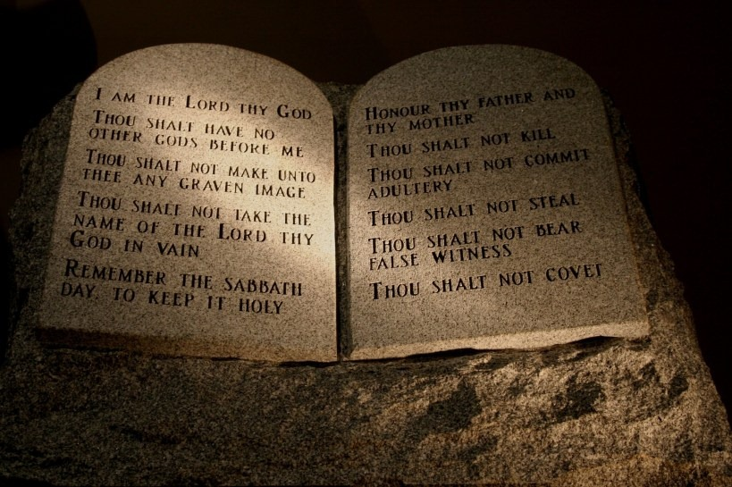
The Law of Moses & Us
Dr. Rick Griffith • Jordan Evangelical Theological Seminary • BibleStudyDownloads.org

Slide 2
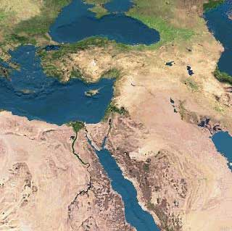
Interpreting the Pentateuch
110
MS
SG
ER
“THE LAND”
DS
Five Books That Changed the World
PG
RS
Handbook pg. 15-16
25
1

Slide 3
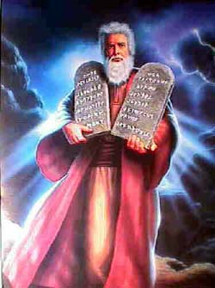
Legal Literature Quiz
110

Slide 4
A Quick Quiz About the Law…
110
T or F Christians should keep parts of the OT law which are not repeated in the NT.
T or F There are actually two laws: the moral (Ten Commandments) and ceremonial/civil.
T or F The Sabbath should still be obeyed by Christians.
T or F Believers today are obligated to keep all of the Ten Commandments.
T or F Tithing should be practiced by all followers of Christ.
T or F Christians today are prohibited from eating blood (e.g., yong tau foo, blood pudding, pig or duck blood at Chinese New Year).
T or F Believers must not charge other Christians interest based upon the Law (Deut. 23:19; Exod. 22:25; Lev. 25:36-37; Ezek. 18:8, 13, 17; 22:12; Prov. 15:5; 28:8)

Slide 5
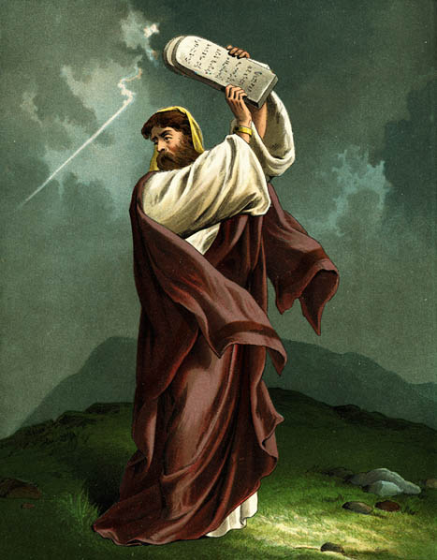
B. Defining "Law"
110
Pentateuch as single book
Pentateuch as 5 books
Whole OT
Legal literature (Exod. 20–Deut. 33)

Slide 6
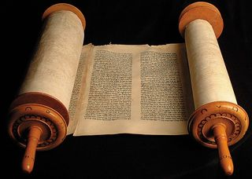
C. The Christian's Relationship to the Law
110

Slide 7
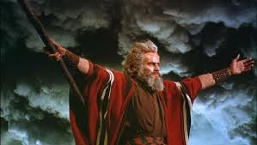
TRADITIONAL VIEW ON LAW
Ex. 25-31
112a
7
A Godly Education In Three Parts:
MORAL: The Ten Commandments; a basis for our current legal system.
CIVIL: How the people are to live with each other in the new social structure.
CEREMONIAL: How to worship God in the new social structure.
BUT ARE THE BIG 10 MORAL LAW?
MOSES
Exodus
Sinai
M - C - C
40
Handbook pg. 26-29
13

Slide 8
Moral law means God's rules that apply to…
Every time period
Every culture
Every place
Every people
Notes:
BS-28-Law of Moses-07
OS-02-Exodus-252
OS-05-Deut-111
NS-06-Rom5-8-slide79
SA-08-Mosaic Law-31

Slide 9
The Ten Commandments
112c
#
Old Testament Commands
New Testament Repetitions
1
And God spoke all these words: “I am the LORD your God, who brought you out of Egypt, out of the land of slavery. You shall have no other gods before me” (Exod. 20:1-3).
“Men, why are you doing this? We too are only men, human like you. We are bringing you good news, telling you to turn from these worthless things to the living God…” (Acts 14:15; noted at least 50 times).
2
“Do not make for yourself an idol… of anything in heaven above or on the earth beneath or in the waters below… for I… am a jealous God, punishing the children for the sin of the fathers … but showing love to a thousand generations of those who love me…” (Exod. 20:4-6).
“Dear children, keep yourselves from idols” (1 John 5:21; cf. 1 Thess. 1:9; Rev. 2:14, 20; 9:20; mentioned in the NT 12 times = 12x).
* This chart is adapted and expanded from one by Lewis Sperry Chafer, Systematic Theology, 4:209-10
3
“Do not misuse the name of the LORD your God, for the LORD will not hold anyone guiltless who misuses his name” (Exod. 20:7).
“Above all…do not swear–not by heaven or by earth or by anything else. Let your 'Yes' be yes, and your 'No,' no, or you will be condemned” (James 5:12; 4x).

Slide 10
The Ten Commandments
112c
#
Old Testament Commands
New Testament Repetitions
4
“Remember the Sabbath day by keeping it holy. Six days you shall labor and do all your work, but the seventh day is a Sabbath to the LORD your God. On it you shall not do any work… nor your son or daughter, nor your manservant or maidservant, nor your animals, nor the alien within your gates. For in six days the LORD made the heavens and the earth… but he rested on the seventh day…” (Exod. 20:8-11).
No NT text requires this of Christians.
However, one passage clearly prohibits the practice as required for believers: “Therefore do not let anyone judge you by what you eat or drink, or with regard to a religious festival, a New Moon celebration or a Sabbath day. These are a shadow of the things that were to come; the reality, however, is found in Christ” (Col. 2:16-17; 0x).
5
“Honor your father and your mother, so that you may live long in the land the LORD your God is giving you” (Exod. 20:12).
“Children, obey your parents in the Lord, for this is right. 'Honor your father and mother'–which is the first commandment with a promise–that it may go well with you and that you may enjoy long life on the earth” (Eph. 6:1-3; Matt. 15:4-6; 19:19; Mark 7:10; 10:19; 6x).
6
“You shall not murder” (Exod. 20:13).
“Anyone who hates his brother is a murderer, and you know that no murderer has eternal life in him” (1 John 3:15; cf. Matt. 19:18; Mark 10:19; Luke 18:20; Rom. 13:9; James 2:11; 6x).

Slide 11
The Ten Commandments
112c
#
Old Testament Commands
New Testament Repetitions
7
“You shall not commit adultery” (Exod. 20:14).
“Marriage should be honored by all, and the marriage bed kept pure, for God will judge the adulterer and all the sexually immoral” (Heb. 13:4; cf. Mark 10:19; 12x).
8
“You shall not steal” (Exod. 20:15).
“He who has been stealing must steal no longer, but must work, doing something useful with his own hands…” (Eph. 4:28; cf. Matt. 27:64; Mark 10:19; Luke 18:20; Rom. 13:9; Titus 2:10; 6x).
9
“You shall not give false testimony against your neighbor” (Exod. 20:16).
“Do not lie to each other, since you have taken off your old self with its practices” (Col. 3:9; cf. Eph. 4:25; 4x).
10
“You shall not covet your neighbor's house… wife, or his manservant or maidservant, his ox or donkey, or anything that belongs to your neighbor” (Exod. 20:17).
“'Watch out! Be on your guard against all kinds of greed; a man's life does not consist in the abundance of his possessions'” (Luke 12:15; Rom. 7:7; 13:9; Eph. 5:3; James 4:2; 2 Pet. 2:3, 14; 9x).

Slide 12
Does the Law of Moses Apply to Me? (Five Views)
112b
Spectrum on Degree of Applicability:
Theonomic Greg Bahnsen | Reformed Willem VanGemeren | Weightier Issues Walter Kaiser | Modified Lutheran Douglas Moo | Dispensational Wayne G. Strickland
Law as fully applicable in every sense
Law as fully abolished in every sense
This chart summarizes Stanley N. Gundry, ed. Five Views on Law and Gospel (Grand Rapids: Zondervan, 1996), where each author presents his view and responds to the other four views. Generally speaking, views 1-2 are similar as both are Reformed (stressing continuity between the NT and OT) and these stand against views 3-5 which alike stress discontinuity. In my opinion, the dispensational view has the most to commend it as law in the NT is never broken into component parts and this view clearly distinguishes Israel from the church. Further, it is inconsistent to change the Sabbath (Saturday) to Sunday but not apply the OT penalties for Sabbath-breaking today (i.e., death by stoning; cf. Exod. 31:14-15; 35:2). The following chart is adapted from Lee Hwee Chin, "The Applicability of the Law Today," unpublished research paper for the course "Old Testament Survey," Singapore: Singapore Bible College, 2001), 1.

Slide 13
Does the Law of Moses Apply to Me?
112a
Stanley N. Gundry, ed. Five Views on Law & Gospel summarized by Lee Hwee Chin, SBC, 2001
 | THEONOMIC Bahnsen | REFORMED Van Gemeren | WEIGHTIER ISSUES Kaiser | MODIFIED LUTHERAN Moo | DISPENSATIONAL Strickland
What is the Law? | Same definition as the views 3-5 | God's oral or written instructions since creation | The whole Mosaic law given in the Pentateuch (Genesis to Deuteronomy) but also amplified in the rest of the Old Testament
Who is the Law for? | The Elect (Israel = Church) | All mankind (Israel = Church) | Believers (Israel and Church) | Believers (Israel and Church) | Israel only (Israel ≠ Church)
Notes:
13
#92 in original file

Slide 14
Does the Law of Moses Apply to Me?
112a
Stanley N. Gundry, ed. Five Views on Law & Gospel summarized by Lee Hwee Chin, SBC, 2001
 | THEONOMIC Bahnsen | REFORMED Van Gemeren | WEIGHTIER ISSUES Kaiser | MODIFIED LUTHERAN Moo | DISPENSATIONAL Strickland
Which parts of the Law apply today? • "Moral law"? (i.e., Decalogue or 10 Command-ments) | All moral laws apply to people of God only in every age, so all elect persons since creation should observe either the Jewish Sabbath (Sat. before Christ) or "Christian Sabbath," (Sunday, after Christ) | All moral laws apply to believers and unbelievers of every age (e.g., all persons–including unbelieving Gentiles since creation–should observe the Sabbath or "Christian Sabbath," being Sunday) | All moral laws that stem from God's character: • 10 Command-ments • Leviticus 18–19 (sex) (i.e., Sabbath is required since Israel's nationhood & prohibited sexual practices still apply) | The Mosaic Law is fully abolished, but its moral content are good Christian guidelines. Yet Christ holds the final say via the Spirit's ministry in believers today; Sabbath obedience is not consistently applied (?) | God's "moral law" before Moses is now called the "law of Christ" (Gal. 6:2) and governs believers through the Spirit's new covenant indwelling; The Law does not easily divide into "parts" and is done away with in its entirety (Rom. 7:1-6; 1 Cor. 9:19-21; Heb. 8:13), including the Sabbath (Col. 2:16-17)
Notes:
14
#92 in original file

Slide 15
Does the Law of Moses Apply to Me?
112a
Stanley N. Gundry, ed. Five Views on Law & Gospel summarized by Lee Hwee Chin, SBC, 2001
 | THEONOMIC Bahnsen | REFORMED Van Gemeren | WEIGHTIER ISSUES Kaiser | MODIFIED LUTHERAN Moo | DISPENSATIONAL Strickland
• Civil laws? (i.e., judicial law) | All apply (e.g., laws today should require death for adultery) | Some apply (e.g., still tithe and don't charge believers interest) | Judicial principles (not laws) apply since moral laws underlie all judicial and ceremon-ial laws | Only principles apply now as the Mosaic law was given only to Israel | None apply as these regulated Israel alone (but principles such as love and compassion still apply)
• Cere-monial laws? | All five views agree that ceremonial aspects such as the sacrificial system and Jewish priesthood are now fulfilled in Jesus Christ
Notes:
15
#92 in original file

Slide 16
Does the Law of Moses Apply to Me?
112a
Stanley N. Gundry, ed. Five Views on Law & Gospel summarized by Lee Hwee Chin, SBC, 2001
 | THEONOMIC Bahnsen | REFORMED Van Gemeren | WEIGHTIER ISSUES Kaiser | MODIFIED LUTHERAN Moo | DISPENSATIONAL Strickland
What is the relation-ship of the Abrahamic Covenant to Mosaic Covenant? | Both are God's "covenant of grace." They consist of the same substance of God's saving relation-ship which makes the MC still apply today | MC was added to the AC; both still apply though they are similar in substance but different in form and purpose | MC was given specifically to Israel but its moral principles are still relevant to all believers under the AC | Like dispensa-tionalists, MC was conditional but AC was not; MC was a temporary framework that prescribed terms of obedience for Israel in Law period | MC regulated Israel's life so she could experience the blessings of the AC, but MC is no longer operative as it is fulfilled in Christ
Notes:
16
#92 in original file

Slide 17
Does the Law of Moses Apply to Me?
112b
Stanley N. Gundry, ed. Five Views on Law & Gospel summarized by Lee Hwee Chin, SBC, 2001
 | THEONOMIC Bahnsen | REFORMED Van Gemeren | WEIGHTIER ISSUES Kaiser | MODIFIED LUTHERAN Moo | DISPENSATIONAL Strickland
Strengths | • Continuity between the OT and NT upheld • Desires ethics to relate to all of life • Sees positive aspects of the law | • Continuity between the OT and NT upheld • Notes Mosaic law's foreshadow-ing of Christ • Sees a convicting role of the law today for unbelievers | • Biblical support for some law aspects (i.e., moral) being weightier than others (Matt. 23:23) • Holiness Code of Leviticus 18–19 stem from nature of God | • Accounts for new covenant emphases under the Law of Christ (Gal. 6:2) • Says OT laws repeated in the NT are applicable • Applies law principles today | • Biblical in that Mosaic law began at Sinai and ended with Christ's death as a temporary tutor (Gal. 3:19, 24-25) • Keeps Israel and church separate • Advocates continued guidance in law of Christ
Notes:
17
#92 in original file

Slide 18
Does the Law of Moses Apply to Me?
112b
Stanley N. Gundry, ed. Five Views on Law & Gospel summarized by Lee Hwee Chin, SBC, 2001
 | THEONOMIC Bahnsen | REFORMED Van Gemeren | WEIGHTIER ISSUES Kaiser | MODIFIED LUTHERAN Moo | DISPENSATIONAL Strickland
Weak-nesses | • Dividing law as moral, civil & ceremonial not biblical • Misguided to apply godly commands to unregenerate • All "law" need not be Mosaic (natural law and law of Christ also exist) • The NT never applies the OT to civil matters • Law condemned man (2 Cor. 3:9) | • Dividing law as moral, civil & ceremonial not biblical • Using "law" in differing ways is inconsistent & confusing • Requiring Sabbath for today contradicts Col. 2:16-17 • Unclear if moral law became law of Christ • Merges Israel & church | • Dividing law as moral, civil & ceremonial not biblical • Arbitrary to pick and choose which parts of the law are required • Choice of Decalogue and Lev. 18–19 too narrow for moral law | • Seeks to teach the indivisibility of the law while upholding its moral content • Too extreme to claim that the law has absolutely no purpose today • Fails to see the gospel in the OT by demarcating Law and Gospel into distinct, discontinuous eras | • Distinguishing law's revelatory aspects (eternal, revealing God's nature) from regulatory (temporary, ruled Israel) makes distinctions within an inseparable code–if the OT law is essentially a unity, then why divide it into two parts? • The law is not nullified but actually upheld by faith (Rom. 3:31)
Notes:
18
#92 in original file

Slide 19
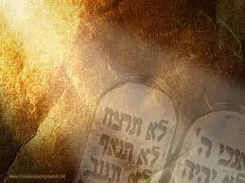
D. The Purposes of the Law
110
It revealed or exposed the sinfulness of man (Gal. 3:19).
It revealed the holiness of God (1 Pet. 1:15).
It revealed the standard of holiness for people in fellowship with God (Ps. 24:3-5).
It supervised the physical, mental, and spiritual development of the redeemed Israelite until he could come to maturity in Christ (Gal. 3:24).
J. Dwight Pentecost, “The Purpose of the Law,” Bib Sac 128 (July 1971): 227-33

Slide 20
D. The Purposes of the Law
113
It unified the people to establish the nation in voluntary submission to God's decrees (Exod. 19:5-8; Deut. 5:27-28).
It separated Israel among the nations as a kingdom of priests to mediate God's truth to these nations (Exod. 31:13).
It provided forgiveness of sins for individual Israelites to restore their fellowship with God, even though they already functioned as a redeemed people (Lev. 1–7).
J. Dwight Pentecost, “The Purpose of the Law,” Bib Sac 128 (July 1971): 227-33

Slide 21
D. The Purposes of the Law
113
It made provision for Israel to worship God as a redeemed people (Lev. 23).
It tested if one was in the kingdom or the theocracy over which God ruled (Deut. 28). Faith led to obedience and blessing; lack of faith led to disobedience and judgment.
It revealed Jesus Christ (typology in the sacrificial system; Luke 24:27).
J. Dwight Pentecost, “The Purpose of the Law,” Bib Sac 128 (July 1971): 227-33

Slide 22
Interpreting and Preaching Legal Literature
36
1. Interpretation: Study the intent behind the legal command, asking, "Why was this command given in Israel?"
2. Principlizing: State the law's intent in a general principle showing God's character.
3. Application: Show how this principle relates to a modern parallel situation.
Notes:
We do not follow the Law literally as new covenant believers. But we still apply its basic teaching in relevant ways.
________
Common-214
BS-28-Law of Moses-21-p110
OS-02-Exodus-243-p113
OS-03-Leviticus-378
OS-05-Deut-205-p113
NS-06-Rom5-8-slide96-p155p
SA-08-Mosaic Law-23-p36

Slide 23
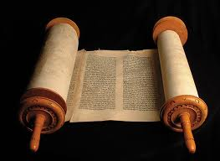
A Suggested Strategy for Expounding the OT Law
36
Principlizing: Universal truth
Interpretation: Intent behind the command
Application: Parallel Modern Situation
Notes:
We do not follow the Law literally as new covenant believers. But we still apply its basic teaching in relevant ways.
________
Common-215
BS-28-Law of Moses-22-p110
OS-02-Exodus-244-p113
OS-03-Leviticus-379
OS-05-Deut-206-p113
NS-06-Rom5-8-slide97-p155p
SA-08-Mosaic Law-24-p36

Slide 24
A Suggested Strategy for Expounding the OT Law
36
Divinely Ordained Laziness?
"When you harvest the crops of your land, do not harvest the grain along the edges of your fields, and do not pick up what the harvesters drop. Leave it for the poor and the foreigners living among you. I am the LORD your God" (Lev. 23:22 NLT).
Notes:
We do not follow the Law literally as new covenant believers. But we still apply its basic teaching in relevant ways.
________
Common-216
BS-28-Law of Moses-23-p110
OS-02-Exodus-245-p113
OS-05-Deut-207-p113
NS-06-Rom5-8-slide98-p155p
SA-08-Mosaic Law-25-p36

Slide 25
A Suggested Strategy for Expounding the OT Law
36
Principlizing: God wants His people to give the underprivileged the chance to earn a living
Interpretation: Do not harvest the corners of the fields because God had compassion on the poor who should glean for their food
Application: As an employer you should provide opportunities for the poor to support themselves
Notes:
We do not follow the Law literally as new covenant believers. But we still apply its basic teaching in relevant ways.
________
Common-217
BS-28-Law of Moses-24-p110
OS-02-Exodus-246-p113
OS-05-Deut-208-p113
NS-06-Rom5-8-slide99-p155p
SA-08-Mosaic Law-26-p36

Slide 26
A Suggested Strategy for Expounding the OT Law
36
Divinely Ordained Stealing?
"When you enter your neighbor's vineyard, you may eat your fill of grapes, but you must not carry any away in a basket. ²⁵And when you enter your neighbor's field of grain, you may pluck the heads of grain with your hand, but you must not harvest it with a sickle" (Deut. 23:24-25 NLT).
Notes:
We do not follow the Law literally as new covenant believers. But we still apply its basic teaching in relevant ways.
________
Common-218
BS-28-Law of Moses-25-p110
OS-02-Exodus-247-p113
OS-05-Deut-209-p113
NS-06-Rom5-8-slide100-p155p
SA-08-Mosaic Law-27-p36

Slide 27
A Suggested Strategy for Expounding the OT Law
36
Principlizing: God allows taking small items for He cares more for human need than human property
Interpretation: Do not steal your neighbor's crops, but also don't be so fearful of stealing that you become ridiculous
Application: As a guest, don't be afraid to take the food given to you––but don't secretly pack a lunch or steal the towels!
Notes:
We do not follow the Law literally as new covenant believers. But we still apply its basic teaching in relevant ways.
________
Common-219
BS-28-Law of Moses-26-p110
OS-02-Exodus-248-p113
OS-05-Deut-210-p113
NS-06-Rom5-8-slide101-p155p
SA-08-Mosaic Law-28-p36

Slide 28
Contrasting the Covenants
112d
Abrahamic Covenant
Mosaic Covenant
Recipient
(Date & Place)
Abraham as mediator for all nations
2060 BC, Ur of the Chaldees
Moses as mediator for Israel
1445 BC, Mount Sinai
Scripture
Genesis 12:1-3 (but formalized into a covenant in Genesis 15)
Exodus 20–31 is the heart of the covenant
Between God &
A person (for a future nation)
A nation
Scope
Universal (“all peoples will be blessed through you”)
Only Israel received the Law (Deut. 4:8; Ps. 147:20)
Character & Significance
Grace (promises)
–primary (what God will do)
Works (laws)
–secondary (how God will do it)
Notes:
28

Slide 29
Contrasting the Covenants
112d
Abrahamic Covenant
Mosaic Covenant
Promises
Land, seed, and blessing (without indication of time of fulfillment)
Blessing for obedience and cursing for disobedience (Lev. 26; Deut. 28)
Conditions
Unconditional: “I will…”
Conditional: “If you will… then I will…”
Participation
Abraham asleep (Gen. 15:17)
Israel agreed to obey (Exod. 19:8)
Analogy
Father to son (royal grant)
Suzerain (superior king) to vassal (servant nation)
Purpose
Clarified Israel's blessings generally to motivate righteousness by faith in God's provision of a great future (Gen. 12:1; 15:1, 6)
Clarified how Israel could be blessed in the Abrahamic Covenant as soon and full as possible; didn't restate or expand the Abrahamic Covenant but revealed sin (Rom. 5:20; Gal. 3:19, 24)
Notes:
29

Slide 30
Contrasting the Covenants
112d
Abrahamic Covenant
Mosaic Covenant
Form
Oral (no written stipulations)
Written on tablets of stone & Pentateuch
Emphasis
Blessing over discipline/judgment (five “blessings” in Gen. 12:1-3)
Judgment/discipline over blessing (contrast Deut. 28:1-14 with 28:15-68)
Christology
Ultimate seed (Gen. 12:3)
Typified in tabernacle (Heb. 8–10)
Sign
Circumcision (Gen. 17:11)
Sabbath (Exod. 31:13, 17)
Never ended (Gal. 3:15-18) as an eternal covenant (Gen. 17:8)
Ended at Christ's death (Rom. 7:6; 10:4; 2 Cor. 3:7-11; Gal. 5:1; Heb. 7:11-12)
End
Notes:
30

Slide 31
A Quick Quiz About the Law…
112
True (T)? Or False (F)? What's your view?
1. T or F Christians should keep parts of the OT law which are not repeated in the NT.
2. T or F The Sabbath should still be obeyed by Christians.
3. T or F Believers today are obligated to keep all of the Ten Commandments.
4. T or F Tithing should be practiced by all followers of Christ.
5. T or F Christians today are prohibited from eating blood (e.g., yong tau foo, blood pudding, pig or duck blood at Chinese New Year).
6. T or F Believers must not charge other Christians interest based upon the Law (Deut. 23:19; Exod. 22:25; Lev. 25:36-37; Ezek. 18:8, 13, 17; 22:12; Prov. 15:5; 28:8)
7. T or F There are actually two laws: the moral (Ten Commandments) and ceremonial/civil.
I marked all FALSE
Notes:
___________
BS-28-Law of Moses & Us-31
OS-02-Exodus-290

Slide 32
Bible Study link at BibleStudyDownloads.org
Get this presentation for free!
Notes:
Bible Study (bs)

