Slide 1
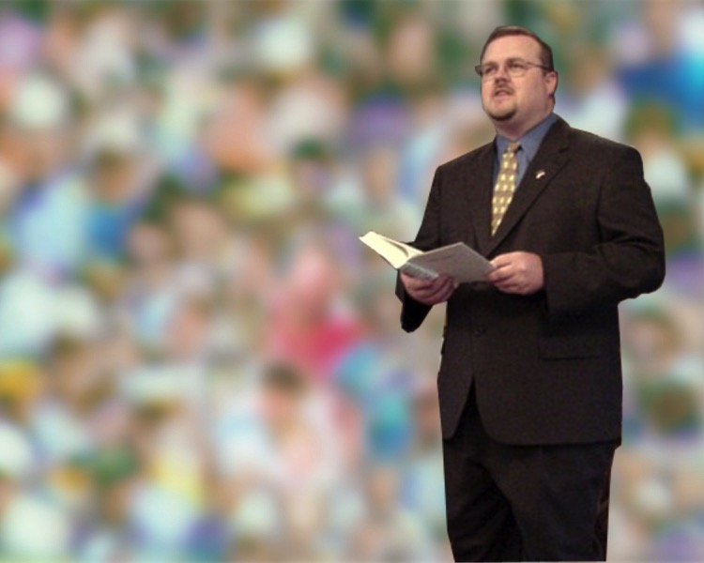
Illustrating to Apply
Where God's Word Shows Up in Real Life
Dr. Rick Griffith • Jordan Evangelical Theological Seminary • BibleStudyDownloads.org

Slide 2
The Preparing Expository Sermons Process
27-28, 251
Based on Ramesh Richard's text, Preparing Expository Sermons
TEXT
SERMON
5 Desired Listener Response
Brain
4 The Three
Developmental
Questions
Purpose Bridge
Application
3.2 Exegetical Idea
CPT
Heart
CPS
6 Homiletical Idea
Interpretation
7 Homiletical
Outline
8 Clarity
9 Intro/Concl
3.1 Exegetical
Outline
Structure
Skeleton
Structure
Study
Observation
2 Analyze Text
Flesh
Preach
10 MSS &
Preach
1 Choose Text
White text shows 10 steps adapted from Haddon Robinson, Biblical Preaching (notes, 105)

Slide 3
Restore People in Sin
Restore People in Sin
72
“Brothers, if someone is caught in a sin, you who are spiritual should restore him gently, but look to yourselves, or you too will be tempted.”
Galatians 6:1

Slide 4
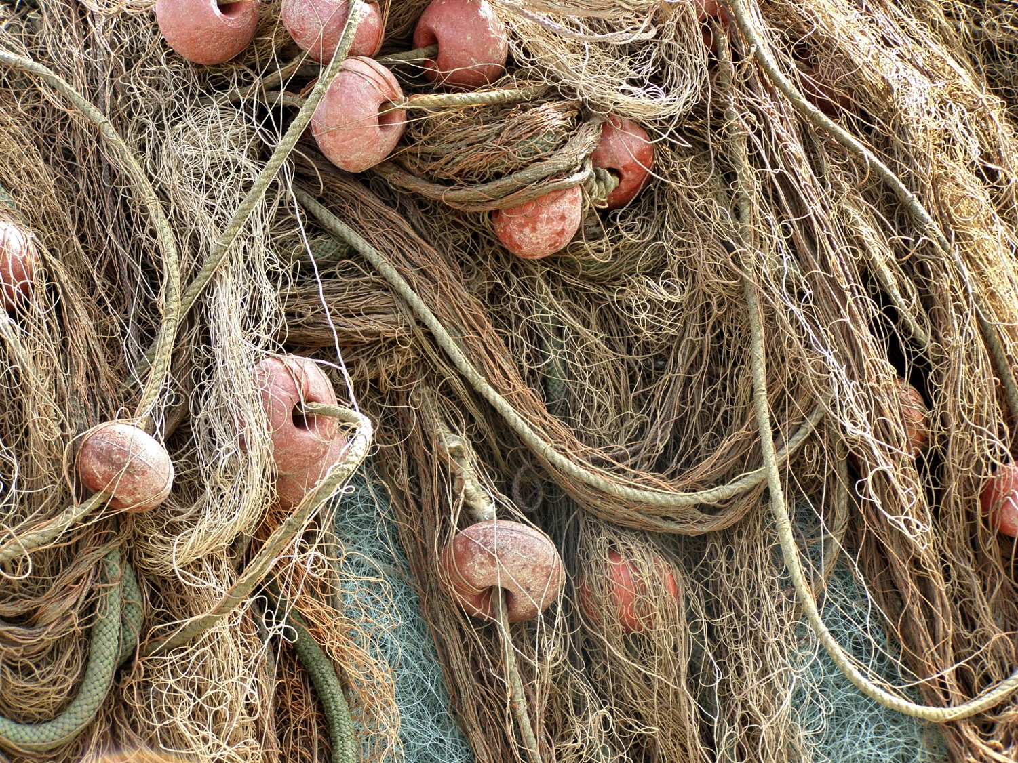
A. Some illustrations only explain a concept as they come from an unrelated area of life.
72
Restore nets

Slide 5
A. Some illustrations only explain a concept as they come from an unrelated area of life.
72
“The love of money is the root of all kinds of evil...” (1 Tim. 6:10)
The monkey & tinsel
“Don't be greedy”
Notes:
Monkeys put their hands in hollowed out logs to grab the tinsel ball inside. However, their clenched hands over the tinsel becomes too large to withdraw from the log. Since they are unwilling to let go of the tinsel, hunters easily club them to death. This illustration has been used to show the perils of wealth--but all it teaches us is how stupid monkeys are! It helps very little to illustrate the point of greed so the sermon time taken is better invested in sharing how a human has gotten trapped due to greed.

Slide 6
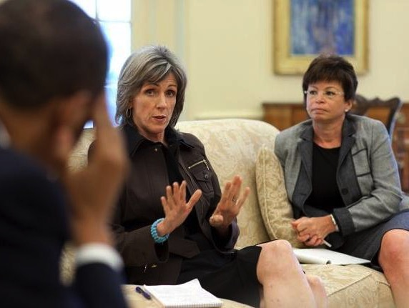
B. Better illustrations apply a concept because they relate to the same area of life.
72
Restore nets
Restore people
Notes:
Instead of restoring nets, share about a genuine reconciliation between people.

Slide 7
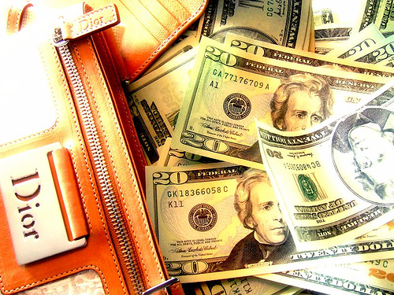
B. Better illustrations apply a concept because they relate to the same area of life.
72
“The love of money is the root of all kinds of evil...” (1 Tim. 6:10)
The monkey & tinsel
The pastor who fell
“Don't be greedy”
Notes:
Instead of the monkey and tinsel story, to illustrate greed, share about a person who gave up ministry simply for better pay.

Slide 8
Law of Application: Model
51
Resource
Method
Result
“All Scripture is inspired by God and profitable for teaching, for reproof, for correction, for training in righteousness; so that the man of God may be adequate, equipped for every good work (2 Tim. 3:16-17 NAU)
Doctrine (Teaching)
Belief
Correction
Training
Behavior
Reproof
Adapted from Bruce Wilkinson, 7 Laws of the Learner (Walk Thru The Bible)

Slide 9
Application Maxims
51
Maxim 1: Application is the central reason for God's revelation.
Maxim 2: Application is the responsibility of the teacher.
Maxim 3: Application and information should be balanced.
Maxim 4: Application focuses Scripture on students' needs.
Maxim 5: Application has the maximum influence when the student sees its biblical basis
Maxim 6: Application that has impacted the teacher tends to impact the student
Maxim 7: Application must ultimately lead the student from studying the Bible to obeying the Lord.
Bruce Wilkinson, 7 Laws of the Learner (Walk Thru The Bible)

Slide 10
Application Method
54
Explain
Distill
Personalize
Persuade
Evaluate
Source: Bruce Wilkinson, 7 Laws of the Learner (Walk Thru The Bible)

Slide 11
Application Maximizers
54
Maximizer 1: Ask God to develop in you an applier's heart.
Maximizer 2: Prepare applications in relation to your students' needs.
Maximizer 3: Plan all parts of the lesson to contribute to the application.
Maximizer 4: Lead your student beyond general applications to specific steps of obedience.
Maximizer 5: Illustrate the application with Scripture, history, personal experience and imagination.
Maximizer 6: Employ an appropriate style when calling for commitment.
Maximizer 7: Strengthen application with student accountability.
Source: Bruce Wilkinson, 7 Laws of the Learner (Walk Thru The Bible)

Slide 12
Bible Study link at BibleStudyDownloads.org
Get this presentation for free!
Notes:
Bible Study (bs)

Slide 13
Black

