Slide 1
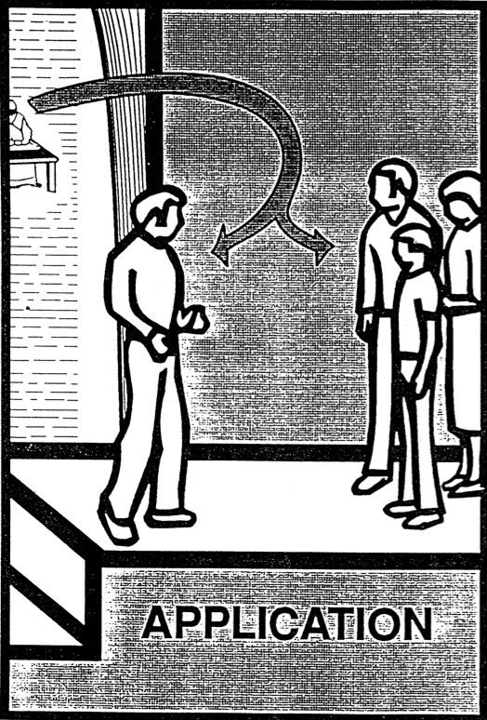
Application
50
Now we are ready to ask what the text means to me!
Dr. Rick Griffith • Jordan Evangelical Theological Seminary • BibleStudyDownloads.org

Slide 2
Why do so many people fail to apply the text to their lives?

Slide 3
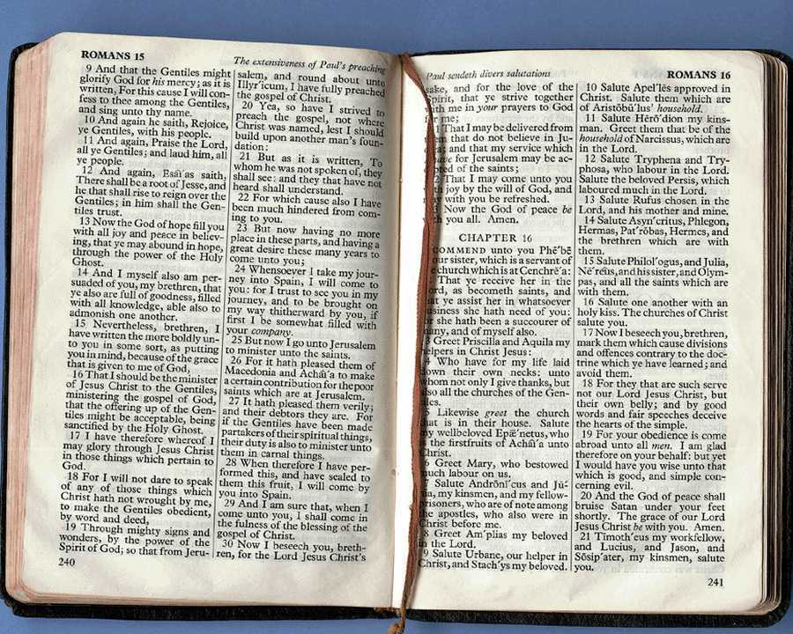
Applying Scripture
62
Pray for a humble spirit, the Spirit to teach you, & no hindrances to apply
Observe and interpret FIRST!

Slide 4
Apply First to Your-self!
“This is a great sermon, folks. I feel so convicted I don't think I can finish it.”

Slide 5
Applying Scripture
Pray for a humble spirit, the Spirit to teach you, & no hindrances to apply
Observe and interpret FIRST!
Write the application principle
Apply this principle to your relationships in life (p. 61)
62

Slide 6
Areas of Life to Apply the Bible
61
Your Relation to God
Your Relation to Yourself
Your Relation to Others
Your Relation to the Enemy

Slide 7
Applying Scripture
Pray for a humble spirit, the Spirit to teach you, & no hindrances to apply
Observe and interpret FIRST!
Write the application principle
Apply this principle to your relationships in life (p. 61)
Apply it specifically to one of your relationships
62

Slide 8
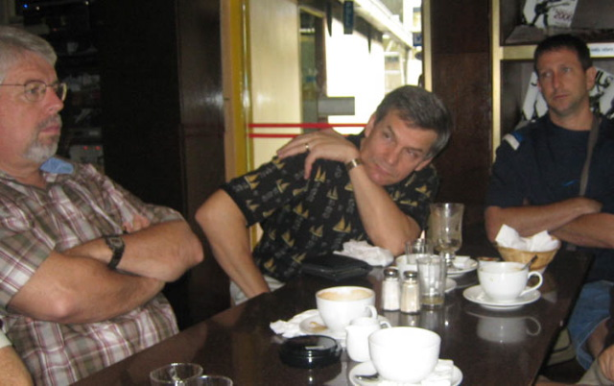
Be Relevant to Different Groups
Men
61
Women
Children
Students

Slide 9
How to Restore Relationships
Matthew 18:15-20
10 December 2006
6 March 2011

Slide 10
Matthew 18:15-20
If your brother sins against you, go and show him his fault, just between the two of you. If he listens to you, you have won your brother over. ¹⁶But if he will not listen, take one or two others along, so that 'every matter may be established by the testimony of two or three witnesses.' ¹⁷If he refuses to listen to them, tell it to the church; and if he refuses to listen even to the church, treat him as you would a pagan or a tax collector
How to Restore 15-17
Apply what this means…
Notes:
Jesus ended his teaching on restoring Christians in sin by commanding that unrepentant believers be treated like a pagan or tax collector—but how this? What does it mean?

Slide 11
What's God Saying to You?
a. The Church Body
M
M
M
M
M
M
M
M
M
M
M
M
b. Your Own Life
M
M
M
M
S
M
M
M
M
M
M
M
M
c. Helping Others
M
M
M
Notes:
Apply restoring relationships in at least three areas…

Slide 12
How NOT to Discipline
EXCOMMUNICATE !
Notes:
Sometimes we can show what to do by also telling first what NOT to do…

Slide 13
How to Discipline Someone Like a "Pagan or Tax Collector"
93
Don't refer to him/her as a Christian.
Evangelize this person.
Don't let him/her take the Lord's Supper.
Remove the person from membership.
Remove this person from church roles.
Unbeliever
“Deliver over to Satan” one in sex sin (1 Cor. 5:5).
Don't eat with him/her (1 Cor. 5:11).
Prohibit him/her from attending church?
Worse

Slide 14
Zuck's Ninety Verbs
60
If you can't think of an application based on one of these 90 verbs then you are hopeless!

Slide 15
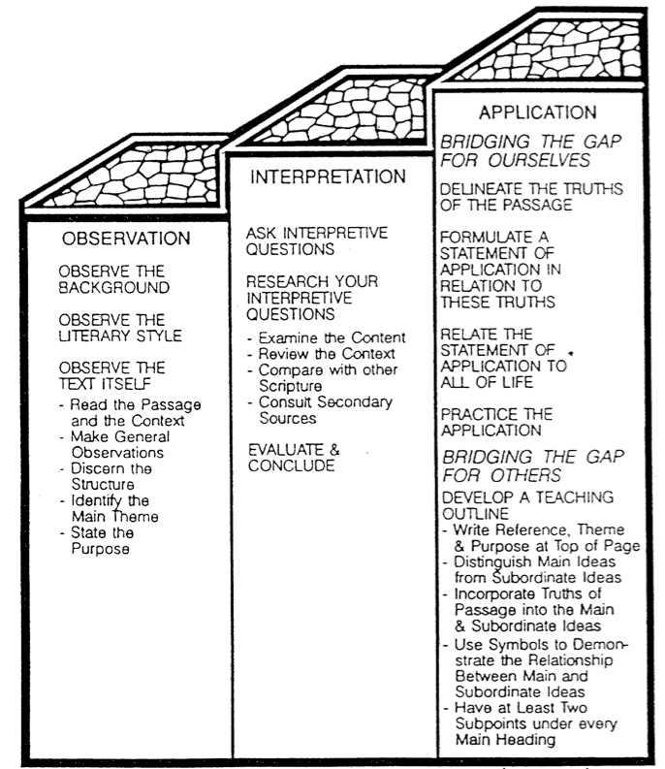
Conclusion
63
How to Study the Bible (Monument, CO: Biblical Education by Extension), 1:121

Slide 16
Bible Study link at BibleStudyDownloads.org
Get this presentation for free!
Notes:
Bible Study (bs)

Slide 17
Black

