Slide 1
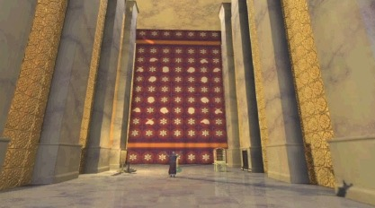
Figures of Speech
Another key to interpreting properly…
Evocative language for effect
Dr. Rick Griffith • Jordan Evangelical Theological Seminary • BibleStudyDownloads.org

Slide 2
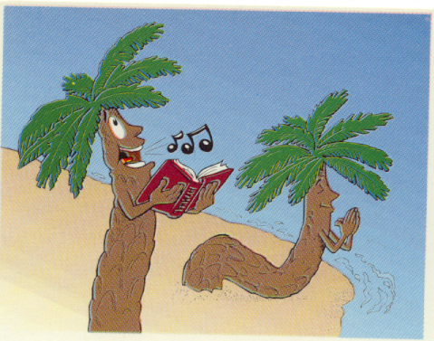
Title Slide
P alms
s
Palms
Notes:
From OT Survey on Psalms

Slide 3
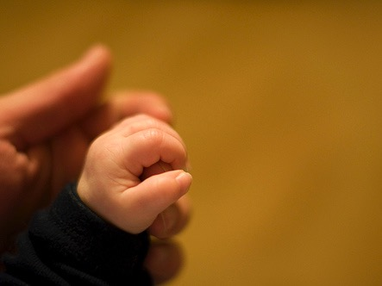
What is Poetry?
In the next 30 seconds define poetry to the person next to you

Slide 4

Characteristics of Hebrew Poetry
390
P 13
Stress Patterns (not rhymes)
Evocative language
Acrostic Arrangement
Thought Rhyme

Slide 5

The Key:
Hebrew Parallelism
390
P 13

Slide 6
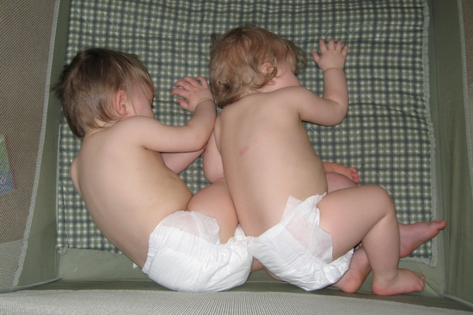
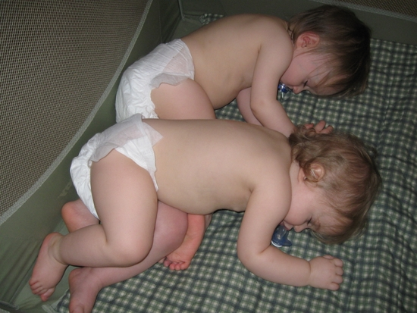
What is Parallelism?
390
P 13
"the repetition of meaning in parallel expressions"
(Ross, BKC, 1:780)

Slide 7
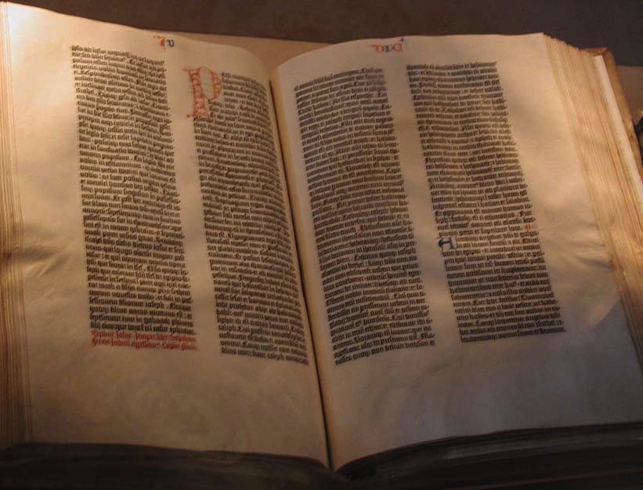
390
P 13
Synonymous: 2nd line restates the 1st in the same or similar form

Slide 8
390
P 13
Synonymous: 2nd line restates the 1st in the same or similar form
Psalm 2:3 "Let us break their chains," they say, "and throw off their fetters."

Slide 9
390
P 13
Synonymous: 2nd line restates the 1st in the same or similar form
Psalm 2:3 "Let us break their chains," they say, "and throw off their fetters."

Slide 10
390
P 13
Synonymous: 2nd line restates the 1st in the same or similar form
Psalm 2:3 "Let us break their chains," they say, "and throw off their fetters."

Slide 11
390
P 13
Synonymous: 2nd line restates the 1st in the same or similar form
Psalm 2:3 "Let us break their chains," they say, "and throw off their fetters."
Psalm 10:1 “Why, O LORD, do you stand far off? Why do you hide yourself in times of trouble?”

Slide 12
390
P 13
Synonymous: 2nd line restates the 1st in the same or similar form
Psalm 2:3 "Let us break their chains," they say, "and throw off their fetters."
Psalm 10:1 “Why, O LORD, do you stand far off? Why do you hide yourself in times of trouble?”

Slide 13
390
P 13
Synonymous: 2nd line restates the 1st in the same or similar form
Psalm 2:3 "Let us break their chains," they say, "and throw off their fetters."
Psalm 10:1 “Why, O LORD, do you stand far off? Why do you hide yourself in times of trouble?”

Slide 14

390
P 13
Psalm 19:2 ”Day after day they pour forth speech; night after night they display knowledge.”

Slide 15

390
P 13
Psalm 19:2 “Day after day they pour forth speech; night after night they display knowledge.”

Slide 16
390
P 13
Psalm 27:1 “The LORD is my light and my salvation—whom shall I fear? The LORD is the stronghold of my life— of whom shall I be afraid?”

Slide 17
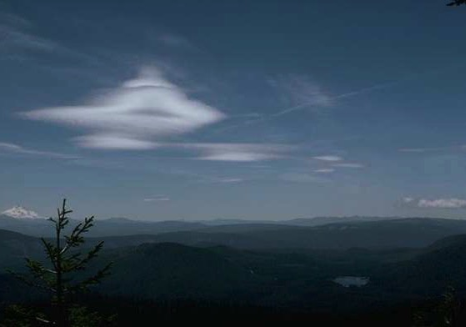
390
P 13
Psalm 27:1 “The LORD is my light and my salvation—whom shall I fear? The LORD is the stronghold of my life
—of whom shall I be afraid?”

Slide 18
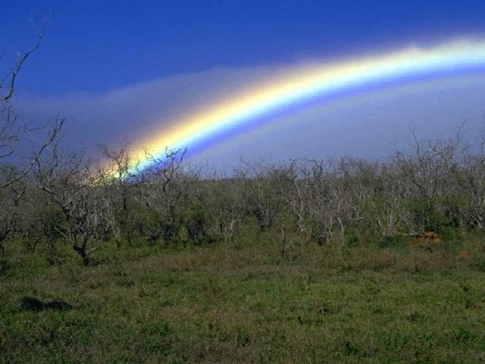
390
P 13
Psalm 27:1 “The LORD is my light and my salvation—whom shall I fear? The LORD is the stronghold of my life
—of whom shall I be afraid?”

Slide 19

390
P 13
Psalm 27:1 “The LORD is my light and my salvation—whom shall I fear? The LORD is the stronghold of my life
—of whom shall I be afraid?”

Slide 20
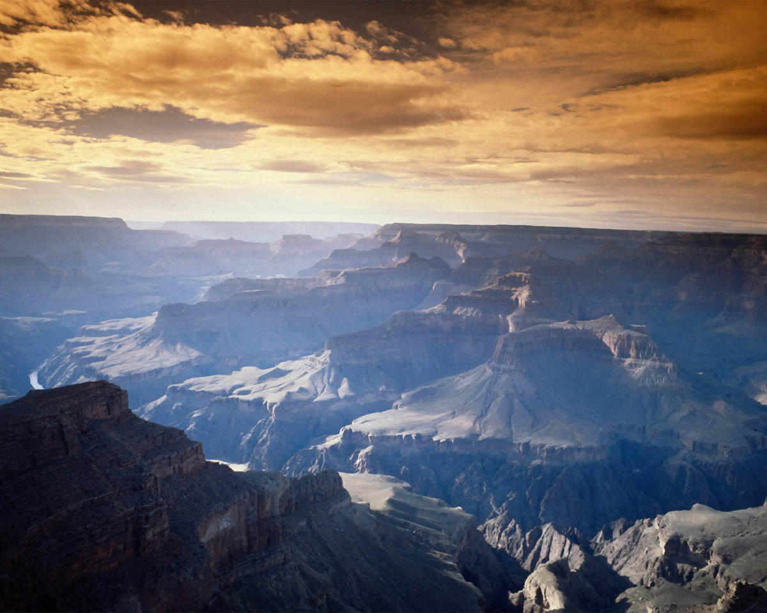
390
P 13
Psalm 34:1 “Glorify the LORD with me; let us exalt his name together.”

Slide 21
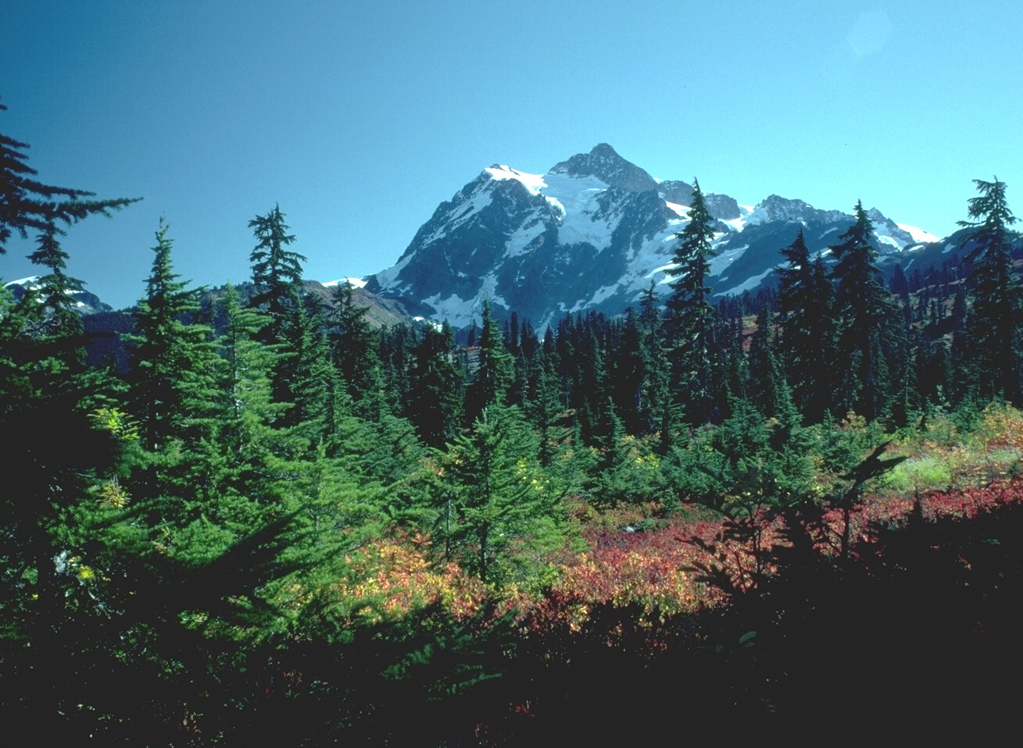
390
P 13
Psalm 34:1 “Glorify the LORD with me; let us exalt his name together.”

Slide 22
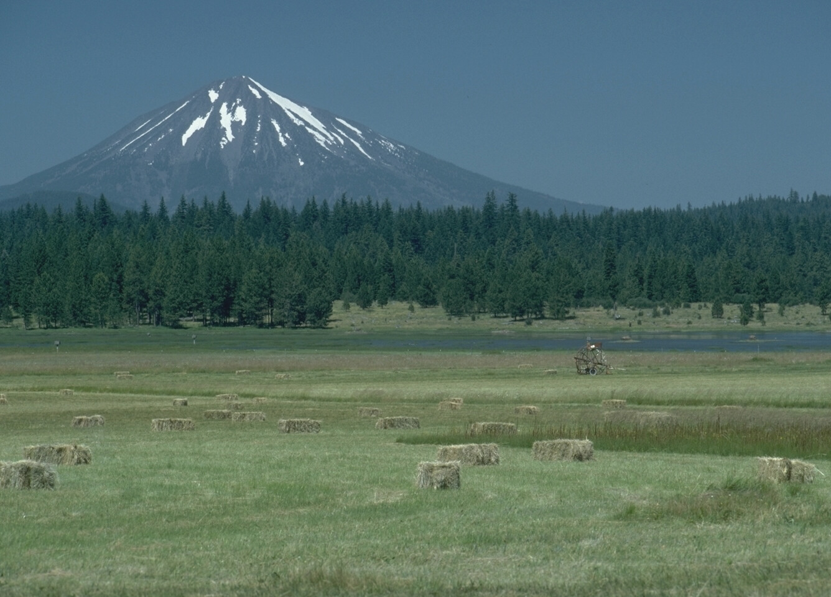
390
P 13
Psalm 34:1 “Glorify the LORD with me; let us exalt his name together.”

Slide 23

390
P 13
Psalm 34:1 “Glorify the LORD with me; let us exalt his name together.”

Slide 24
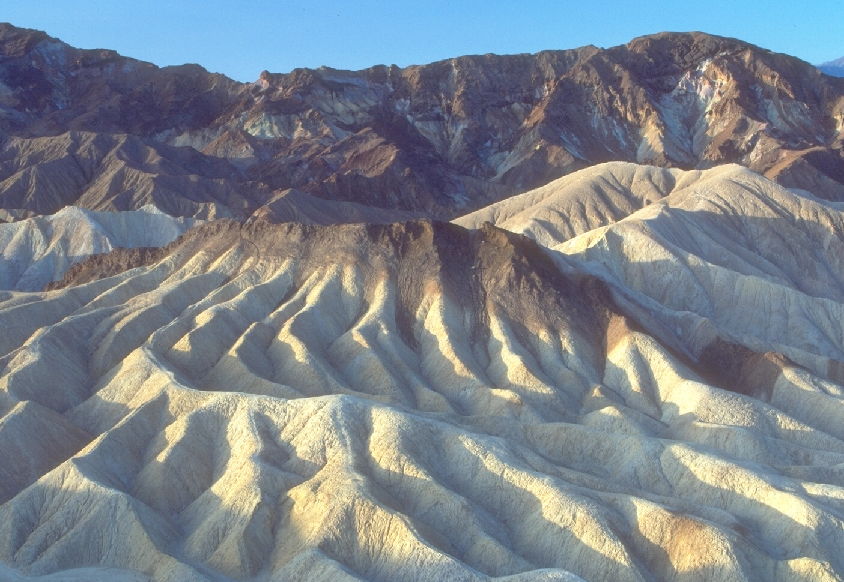
391
P 14
Antithetic: 2nd line offers a contrast of thought to the 1st
Psalm 1:6 “For the LORD watches over the way
of the righteous,
but the way of the wicked will perish.”

Slide 25

391
P 14
Antithetic: 2nd line offers a contrast of thought to the 1st
Psalm 1:6
“For the LORD watches over the way of the righteous,
but the way of the wicked will perish.”

Slide 26

391
P 14
Antithetic: 2nd line offers a contrast of thought to the 1st
Psalm 1:6
“For the LORD watches over the way of the righteous,
but the way of the wicked will perish.”

Slide 27
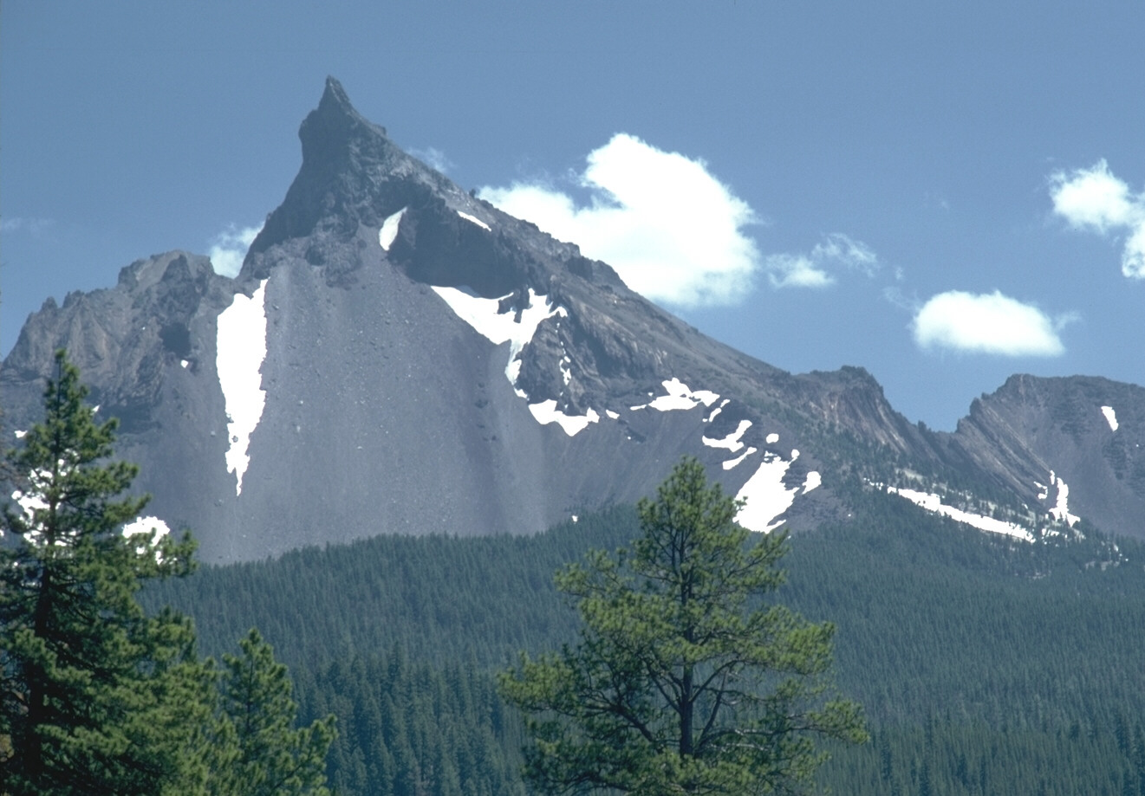
391
P 14
Antithetic: 2nd line offers a contrast of thought to the 1st
Psalm 1:6
“For the LORD watches over the way of the righteous,
but the way of the wicked will perish.”

Slide 28
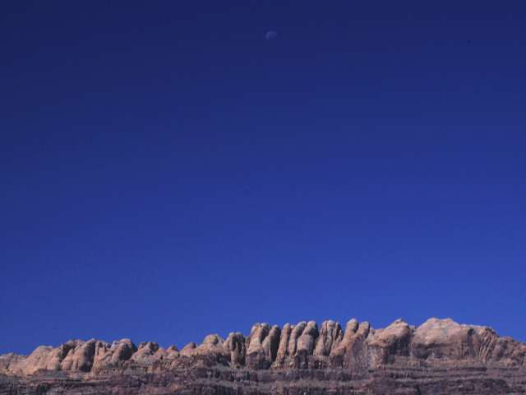
391
P 14
Antithetic: 2nd line offers a contrast of thought to the 1st
Psalm 37:9 “For evil men will be cut off, but those who hope in the LORD will inherit the land.”

Slide 29
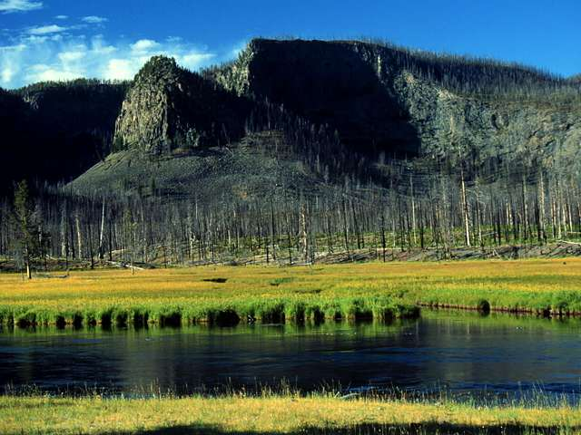
391
P 14
Antithetic: 2nd line offers a contrast of thought to the 1st
Psalm 37:9 “For evil men will be cut off, but those who hope in the LORD will inherit the land.”

Slide 30
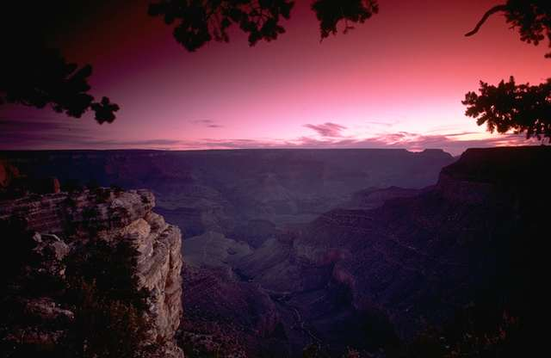
391
P 14
Antithetic: 2nd line offers a contrast of thought to the 1st
Psalm 37:9 “For evil men will be cut off, but those who hope in the LORD will inherit the land.”

Slide 31
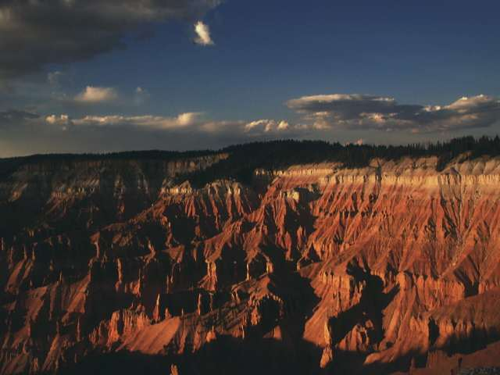
391
P 14
Antithetic: 2nd line offers a contrast of thought to the 1st
Psalm 37:9 “For evil men will be cut off, but those who hope in the LORD will inherit the land.”

Slide 32
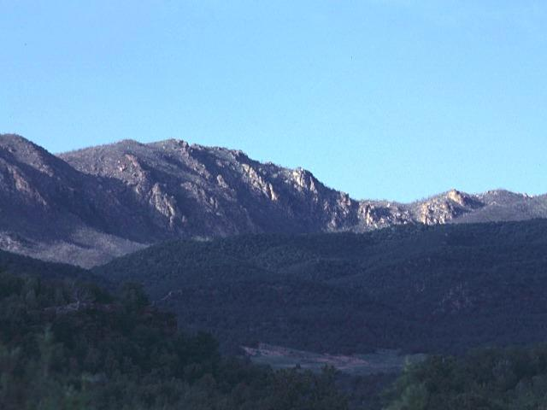
391
P 14
Emblematic: 2nd line reproduces the 1st line by metaphorical comparison
Psalm 1:4 “Not so the wicked! They are like chaff that the wind blows away.”

Slide 33
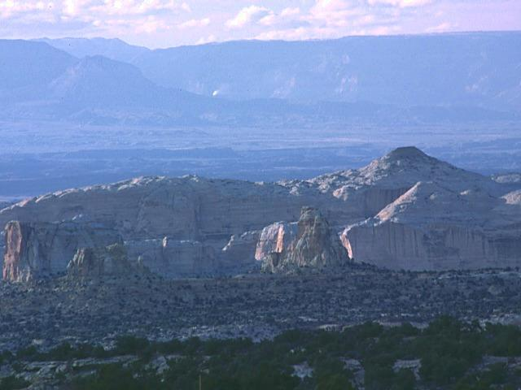
391
Synthetic (Incomplete with Compensation): 2nd line develops the thought of the 1st line
P 14
Psalm 95:3 “For the LORD is the great God, the great King above all gods.”

Slide 34
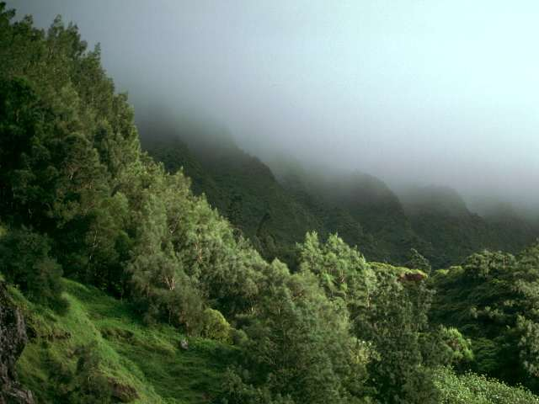
391
Synthetic Climatic: 2nd line repeats the first, but omits the last term
P 14
Psalm 29:1-2
“Ascribe to the LORD, O mighty ones, ascribe to the LORD glory and strength.
Ascribe to the LORD the glory due his name; worship the LORD in the splendor of his holiness.”

Slide 35
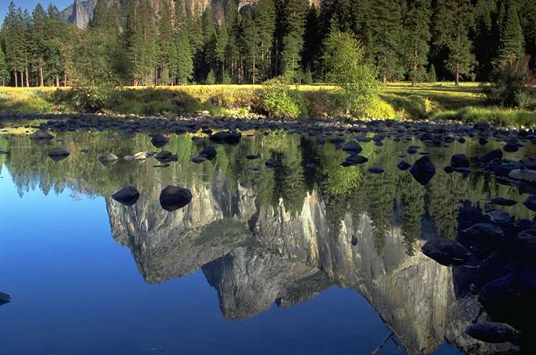
391
P 14
Synthetic (Incomplete without Compensation): lines of different length with only some terms parallel
Psalm 6:1
"O LORD, do not rebuke me in Your anger
or discipline me in Your wrath."

Slide 36
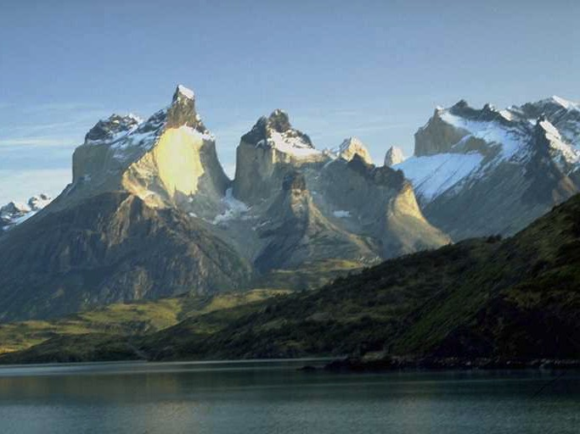
391
P 14
Synthetic Formal: 2nd line develops the thought of the 1st line
Psalm 2:6 "I have installed my King on Zion,
my holy hill."

Slide 37
PARALLELISM
388c
Similarities & Differences
Two categories of Parallelism :
Grammatical Parallelism (syntax)
Semantic Parallelism (meaning of words)

Slide 38
PARALLELISM
388c
“Then He rebukes them in his anger
And in his wrath he terrifies them.”
(Psalm 2:5)
Semantic parallelism:
rebukes and terrifies
anger and wrath are parallel in meaning
Grammatical parallelism:
Verb -- direct object -- prepositional phrase
Prepositional phrase -- verb -- direct object

Slide 39

Unlocking Figures of Speech…
392
P 15

Slide 40
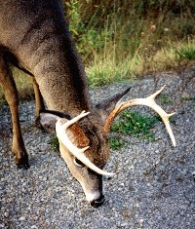

Simile
392
P 15
Formal comparison between two different objects where one is likened to another.
Psalm 42:1 “As the deer pants for streams of water, so my soul pants for you, O God.”

Slide 41
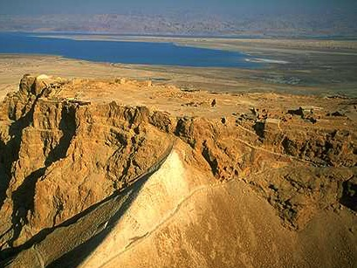
Metaphor
392
P 15
A figure of speech containing an implied comparison between two different objects.
Psalm 27:1 “The LORD is my light and my salvation—The LORD is the stronghold of my life.”

Slide 42
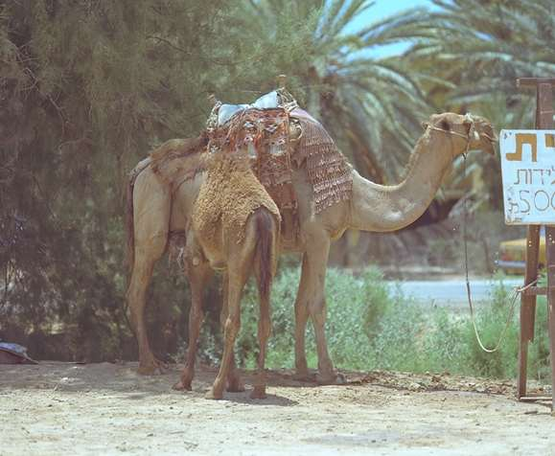
Hyperbole
392
P 15
When more is said than is literally meant; exaggeration.
Psalm 6:6 “I am worn out from groaning; all night long I flood my bed with weeping and drench my couch with tears.”

Slide 43

Personification
392
P 15
Inanimate objects are given properties or characteristics of living things
Psalm 73:9 “Their mouths lay claim to heaven, and their tongues take possession of the earth.”

Slide 44


Personification
392
P 15
Inanimate objects given properties or characteristics of living things
Psalm 137:5 “If I forget you,
O Jerusalem, may my right hand forget its skill.”

Slide 45
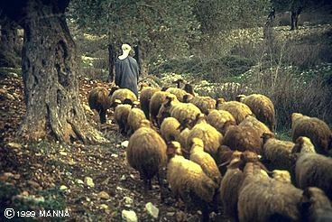
IMAGERY
388c
“The Lord is my shepherd;
I shall not be in want.”
(Ps. 23:1)
Imagery accomplishes the word pictures by means of a comparison

Slide 46
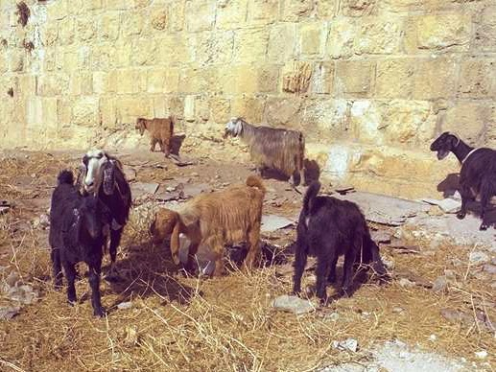
What kind of animal are you?

Slide 47

Psalm 23
¹The LORD is my shepherd, I shall not be in want. ²He makes me lie down in green pastures, he leads me beside quiet waters, ³he restores my soul. He guides me in paths of righteousness for his name's sake. ⁴Even though I walk through the valley of the shadow of death, I will fear no evil, for you are with me; your rod and your staff, they comfort me. ⁵You prepare a table before me in the presence of my enemies. You anoint my head with oil; my cup overflows. ⁶Surely goodness and love will follow me all the days of my life, and I will dwell in the house of the LORD forever.

Slide 48
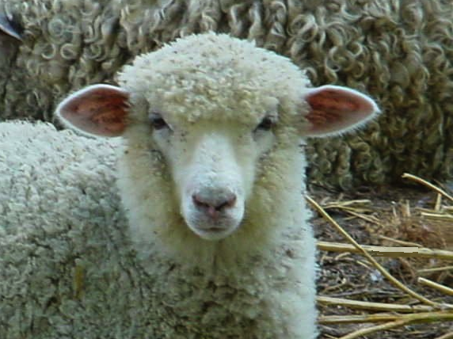
You're a sheep

Slide 49
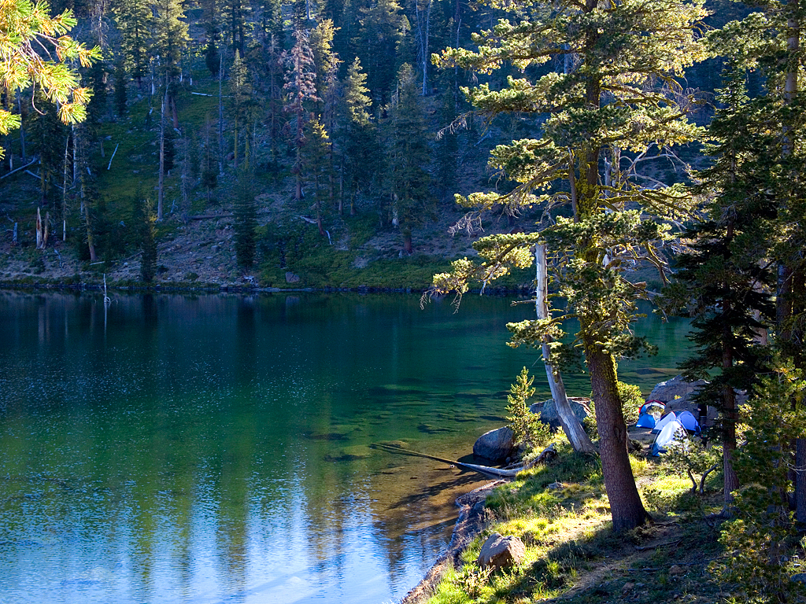
He leads me beside still waters

Slide 50
Psalm 23
¹The LORD is my shepherd, I shall not be in want. ²He makes me lie down in green pastures, he leads me beside quiet waters, ³he restores my soul. He guides me in paths of righteousness for his name's sake. ⁴Even though I walk through the valley of the shadow of death, I will fear no evil, for you are with me; your rod and your staff, they comfort me. ⁵You prepare a table before me in the presence of my enemies. You anoint my head with oil; my cup overflows. ⁶Surely goodness and love will follow me all the days of my life, and I will dwell in the house of the LORD forever.

Slide 51

Psalm 23 Exegetical Outline
46
I. The response of David to God's provision & protection [like a shepherd for his sheep] was comfort instead of fear (1-4).
      A. The way the LORD satisfied David was by
      providing all of his needs (1-3).
      1. The LORD provided quality physical food, rest and water that satisfied David (1-2) .
      2. The LORD provided spiritual refreshment that restored David's soul (3a) .
      3. The LORD provided guidance in holiness to protect His own name (3b) .
      B. The response of David to the LORD protecting him in dangerous situations was a lack of fear (4).

Slide 52
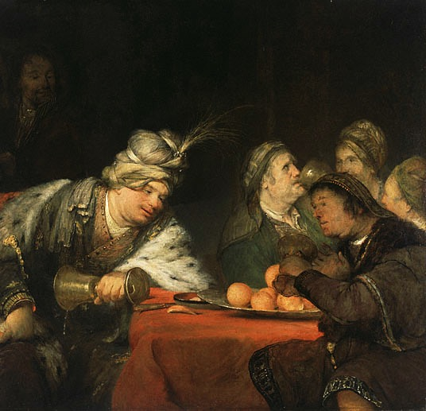
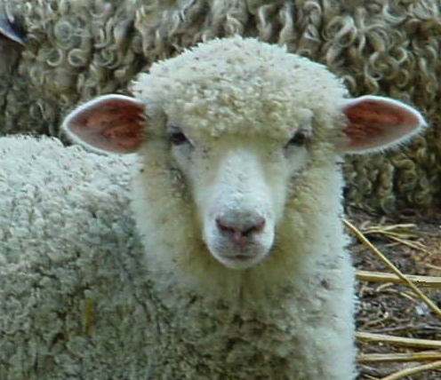
"You prepare a table before me in the presence of my enemies" (v. 5)
or
?
Sheep
Banqueting Victor

Slide 53

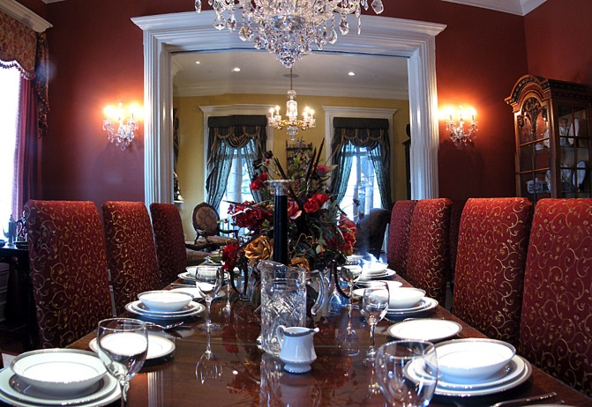
"You prepare a table before me in the presence of my enemies" (v. 5)
or
?
"Banquet" of grass
Literal banquet

Slide 54
Psalm 23 Exegetical Outline
46
    II. The manner in which God showed His goodness to David was by exalting him like honoring a banqueting victor before his enemies (5).
"You prepare a table before me in the presence of my enemies"
      A. The LORD protected & exalted David like a banqueting victor before humbled enemies (5a).
"You anoint my head with oil"
      B. The LORD honored David (5b).
"My cup overflows"
      C. The LORD provided more blessings than David could possibly enjoy (5c).

Slide 55
Psalm 23
¹The LORD is my shepherd, I shall not be in want. ²He makes me lie down in green pastures, he leads me beside quiet waters, ³he restores my soul. He guides me in paths of righteousness for his name's sake. ⁴Even though I walk through the valley of the shadow of death, I will fear no evil, for you are with me; your rod and your staff, they comfort me. ⁵You prepare a table before me in the presence of my enemies. You anoint my head with oil; my cup overflows. ⁶Surely goodness and love will follow me all the days of my life, and I will dwell in the house of the LORD forever.

Slide 56
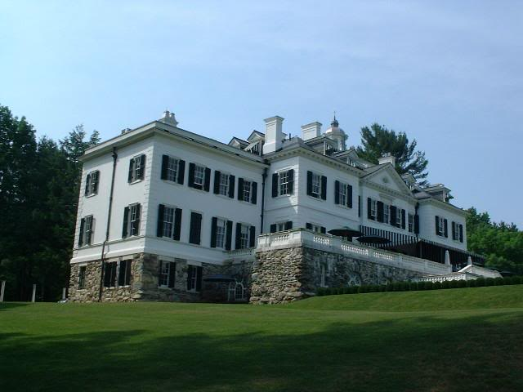
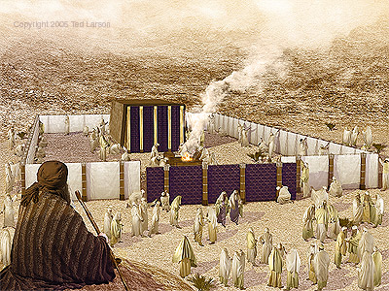
What is dwelling
"in the house of the Lord forever"?
or
?
Living in heavenly house
Tabernacle worship

Slide 57
Colossians 4:6 EO & HO
Let your speech always
be with grace,
as though seasoned with salt,
so that you will know
how you should respond
to each person

Slide 58
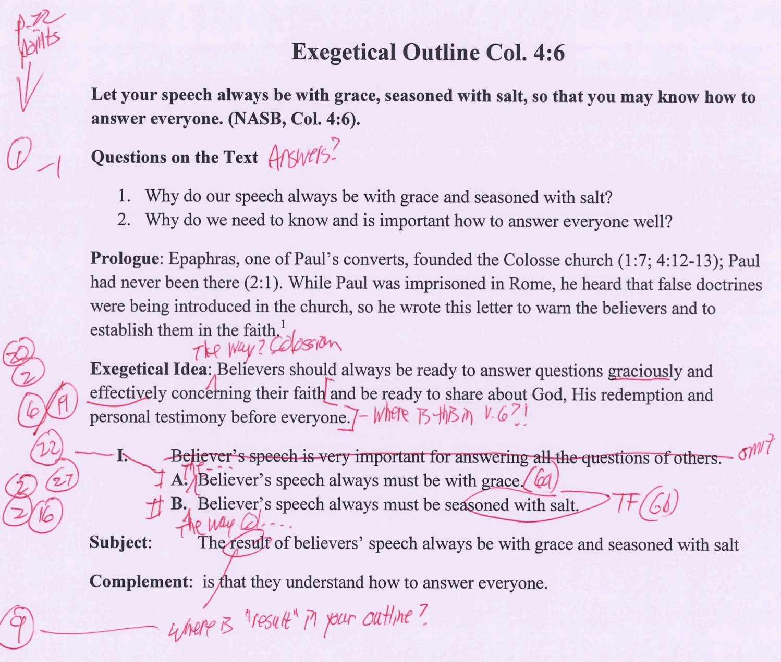
How I grade Col. 4:6 EO (Assign. #8)
22
Make sure you follow each item on the p. 22 checklist
1. Have you written your questions & answers of the text and the text itself at the top (if preaching 1-2 verses)?
2. Are the Exegetical Idea (EI) and Main Points (MPs) all written in proper Z1+X+Z2+Y form?
20. Is the focus the recipients in the past (not present) tense (Write “The way the Colossians should…” not “We should…”) and in active (not passive) voice?
Is the EI and outline exegesis true to the author’s intent? (AI = evaluate Authorial Intent)?
19. Do SPs (or MPs) avoid ideas not in the text (e.g., from cross-references)? (“NP” = not in passage)?
22. Does each point have a coordinating point (“I” has “II”, “A” has “B”; p. 61 [II.A.1.] & p. 55)?
2. Are the Exegetical Idea (EI) and Main Points (MPs) all written in proper Z1+X+Z2+Y form?
27. Does each sentence in the outline include its correct verse, verses, or verse portion (1a, 1b, 1c, etc.)?
Does at least one Z1 in the MPs match that of the EI?
16. Do statements translate figures of speech rather than use the text’s words? (“TF”)
Notes:
Homiletics 12.02 slide

Slide 60


Bible Study link at BibleStudyDownloads.org
Get this presentation for free!
Notes:
Bible Study (bs)

