Slide 1
What's the BIG
Idea?
Dr. Rick Griffith • Jordan Evangelical Theological Seminary • BibleStudyDownloads.org
Notes:
Identical to Homiletics PPT 07

Slide 2
Importance of the "Big Idea"
29
"A major affirmation of our definition of expository preaching, therefore, maintains that 'expository preaching is the communication of a biblical concept.' That affirms the obvious. A sermon should be a bullet and not buckshot. Ideally each sermon is the explanation, interpretation, or application of a single dominant idea supported by other ideas, all drawn from one passage or several passages of Scripture"
(Haddon Robinson, Biblical Preaching, 33)

Slide 3
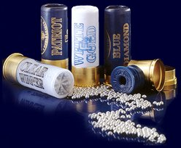
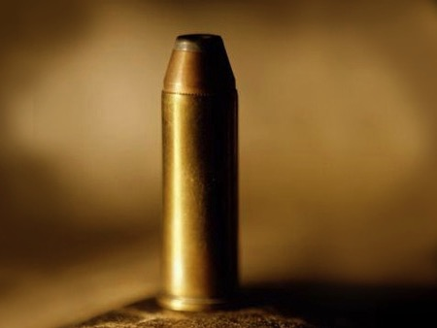
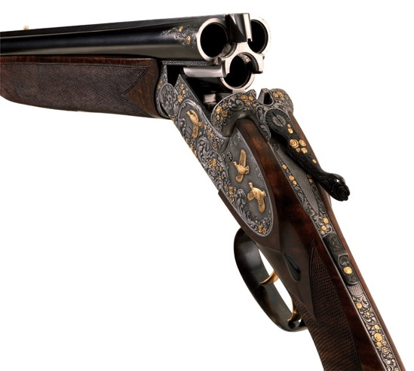
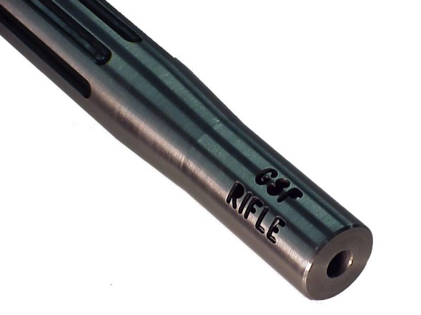

Slide 4
The Preparing Expository Sermons Process
27-28, 251
Based on Ramesh Richard's text, Preparing Expository Sermons
TEXT
SERMON
5 Desired Listener Response
Brain
4 The Three
Developmental
Questions
Purpose Bridge
3.2 Exegetical Idea
CPT
Heart
CPS
6 Homiletical Idea
7 Homiletical
Outline
8 Clarity
9 Intro/Concl
3.1 Exegetical
Outline
Structure
Skeleton
Structure
2 Analyze Text
Study
Flesh
Preach
10 MSS &
Preach
1 Choose Text
White text shows 10 steps adapted from Haddon Robinson, Biblical Preaching (notes, 105)

Slide 5
Other names for Big Idea
Homiletical Idea
Proposition
29
Central Idea
Synthetic Statement
Biblical Concept
Central Proposition of the Sermon (CPS)
Main Idea
Dominant Idea
Main Thought
Central Thought
Sermon Idea
Thesis Statement
Subject-Complement Statement

Slide 6
Forming the Big Idea (CPS)
29
Subject
(Theme)
Complement
(Thrust)
The Question
The Answer
Why should we praise God?
What is the test of a person's character?

Slide 7
What's the Difference?
29
Topic
Subject (Theme)
Single word
More than 1 word
Not a question
Can be worded as as question
"Love"
"The way to love"
"How should we love?"
"Reasons to love"
"Why should we love?"

Slide 8
Some Practice…
29a
Topic
Subject
M.I.
1. God has put us together as a family so that we can help one another
2. What is a peacemaker?
Who is a peacemaker?

Slide 9
Some Practice…
29a
Topic
Subject
M.I.
3. No substitute for leadership.
4. What is God's prescription for anxiety?

Slide 10
Some Practice…
29a
Topic
Subject
M.I.
5. One of the essential qualities of a servant of God is dependence on God.
6. Consecrated Christians, courageous commitment, and continuing convictions are the three foundational pillars of a mission-minded church.

Slide 11
Some Practice…
29a
Topic
Subject
M.I.
7. How and why your work matters to God.
8. To be a faithful servant of God till the end is the third quality of a faithful servant of God.

Slide 12
Some Practice…
29a
Topic
Subject
M.I.
9. As a Christian, we must set our mind on Jesus.
10. Why will many who are first be last and many who are last will be first?

Slide 13
The Preparing Expository Sermons Process
27-28, 251
Based on Ramesh Richard's text, Preparing Expository Sermons
TEXT
SERMON
5 Desired Listener Response
Brain
4 The Three
Developmental
Questions
Purpose Bridge
3.2 Exegetical Idea
CPT
Heart
CPS
6 Homiletical Idea
7 Homiletical
Outline
8 Clarity
9 Intro/Concl
3.1 Exegetical
Outline
Structure
Skeleton
Structure
2 Analyze Text
Study
Flesh
Preach
10 MSS &
Preach
1 Choose Text
White text shows 10 steps adapted from Haddon Robinson, Biblical Preaching (notes, 105)

Slide 14

Exegetical Idea: The reason the church should restore a sinning Christian correctly is because this restoration is carried out as an extension of God's authority.
  (15-17) The manner in which the church should correctly restore a sinning Christian is by keeping the matter as private as possible.
  (18-20) The reason the church can restore or excommunicate errant believers is because it acts as an extension of the authority of God Himself.

Slide 15
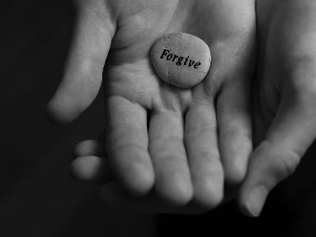
Main Idea:
Exegetical Idea: The reason the church should restore a sinning Christian correctly is because this restoration is carried out as an extension of God's authority.
We must restore sinning members properly since we act on God's behalf

Slide 16



How do we restore sinning Christians properly?
Our First Question Today (for vv. 15-17)
Notes:
Fill in your bulletin outline

Slide 17

Our 2nd question is answered in verses 18-20:
Why do we restore sinning Christians properly?

Slide 18
Black

Slide 19


Bible Study link at BibleStudyDownloads.org
Get this presentation for free!
Notes:
Bible Study (bs)

