Slide 1
Consulting Study Tools
29
Sources to Understand
Scripture for Today
Dr. Rick Griffith • Jordan Evangelical Theological Seminary • BibleStudyDownloads.org

Slide 2
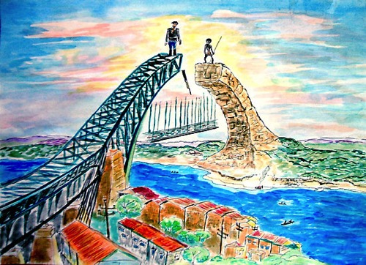
Recommended Bible Study Helps
29-40
Bible: Ryrie Study Bible
29
Concordance: NASB Exhaustive Concordance
29, 32
Commentary: Bible Knowledge Commentary
30, 33
Bible Survey: Talk Thru the Bible
30, 34
Word Study: Vine's Expository Dictionary
30, 35
Bible Encyclopedia: Zondervan Pictorial
30, 36
Bible Atlas: Moody Atlas of Bible Lands (2009)
31, 37
Theology: Major Bible Themes/Basic Theology
31, 38, 40
Topical Bible: Nave's Topical Bible
31, 39
Bible Dictionary: The New Bible Dictionary
31

Slide 3
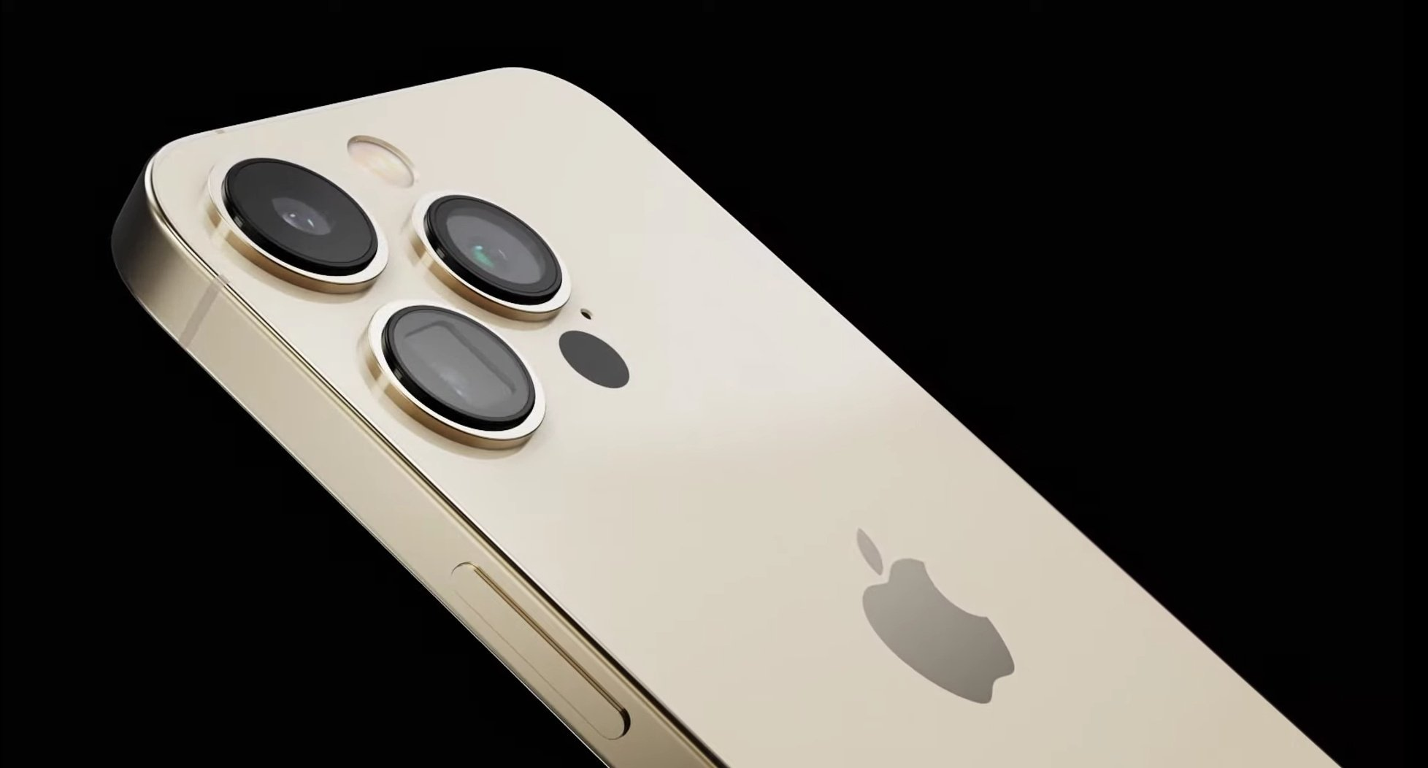
Digital Sources

Slide 4
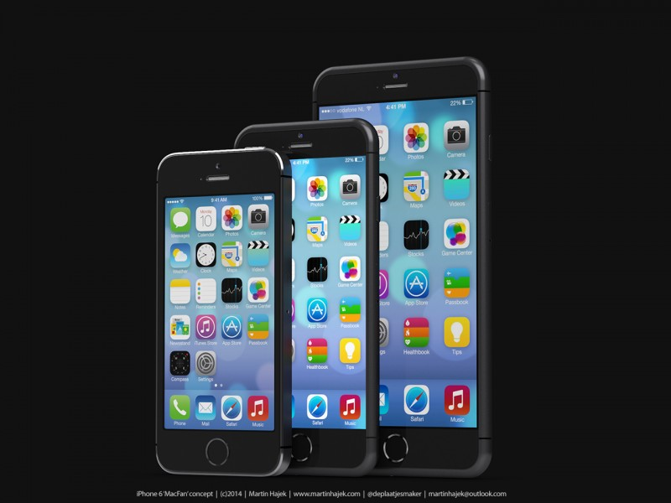
Free Bible Software
Smart Phone
YouVersion
AndBible
ESVBible
OliveTree
E-Sword
FaithLifeStudyBible (Logos)

Slide 5
Free Bible Software
Computer
Bible.org
Blue Letter Bible (KJV)
BibleGateway
E-Sword
FaithComesByHearing
OliveTree
NetBible

Slide 6
Broken & Spilled Out
Matthew 26:6-13
Mark 14:1-11
John 12:1-11
Free Bible images
Performed By Steve Green
JESUS IS ANOINTED
Notes:
FreeBibleImages.org does what it says it does, offering photos and cartoons on narrative portions of Scripture. These are copyright-free as well and continually updated.
This 1980s song accurately narrates how Mary of Bethany anointed Jesus for his burial as no time would be available to perform these Jewish rites the next day when the body of Jesus was hastily buried.
______________
Common-431
BS-20-Study Tools-6
NS-01-Matt15-28-slide
NS-02-Mark9-16-slide
NS-04-John12-21-slide 5

Slide 7
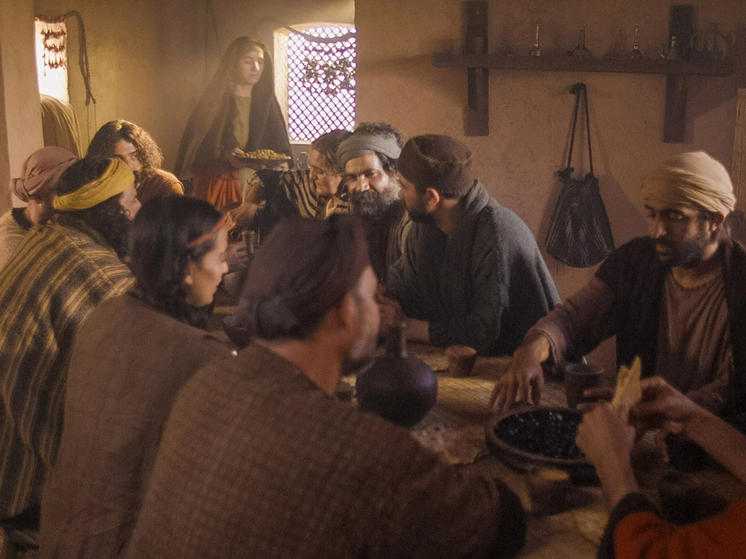
Notes:
Music background 1 of 2

Slide 8
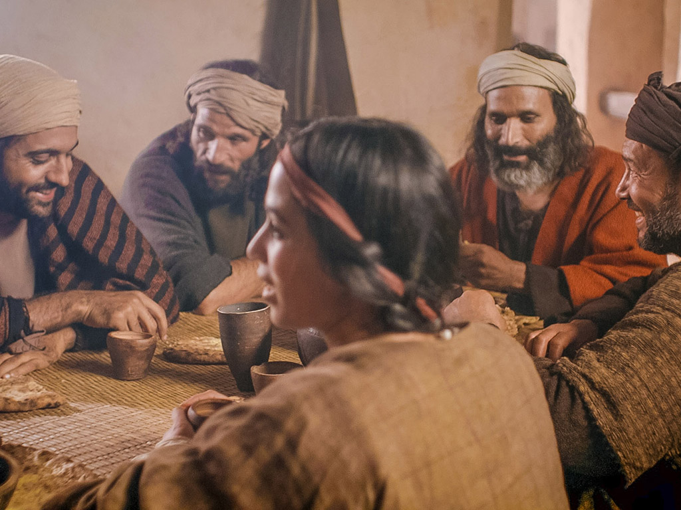
Notes:
Music background 1 of 2

Slide 9
One day a plain village woman, driven by love for her Lord

Slide 10
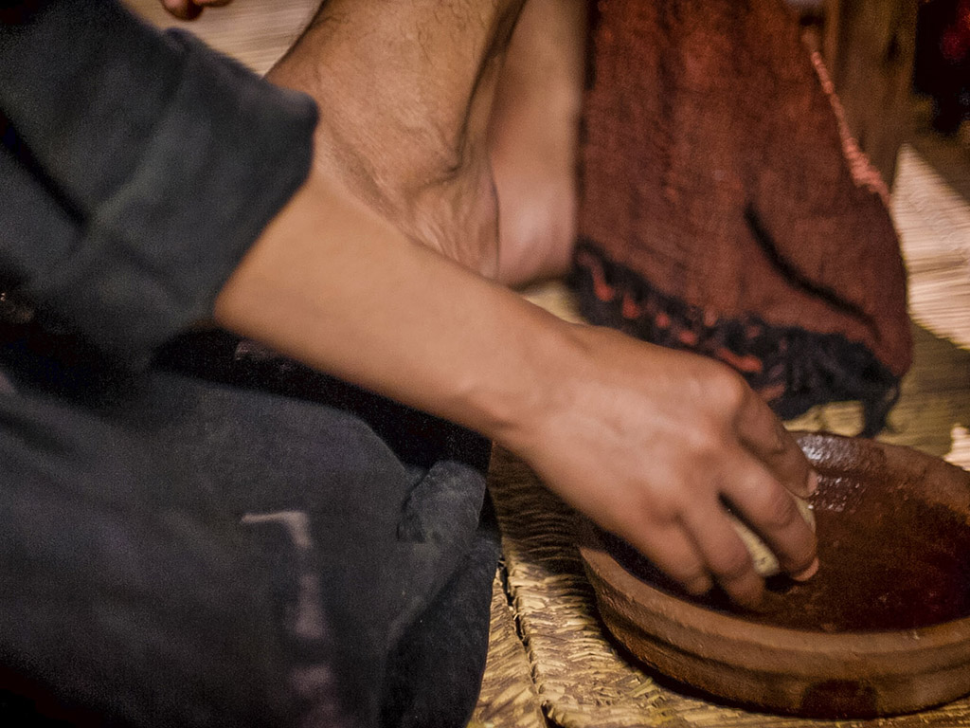
Recklessly poured out a valuable essence, disregarding the scorn

Slide 11
And once it was broken and spilled out A fragrance filled all the room.

Slide 12
Like a prisoner released from his shackles Like a spirit set free from the tomb

Slide 13
Broken and spilled out, just for love of you, Jesus

Slide 14
Life's most precious treasure, lavished on Thee

Slide 15
Broken and spilled out, and poured at Your feet

Slide 16
In sweet abandon let me be spilled out and used up for Thee

Slide 17
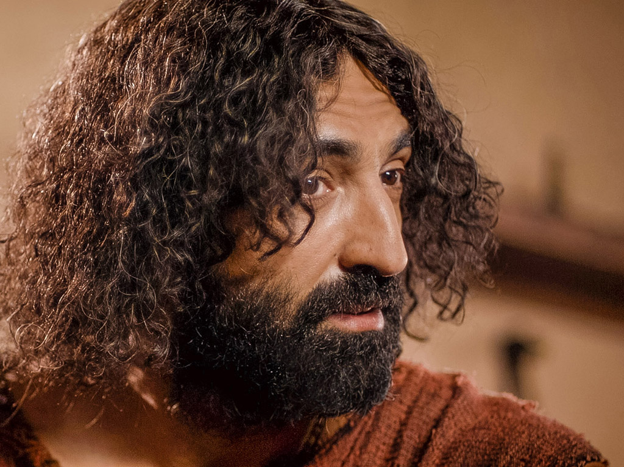
Lord, You were God's precious treasure, His loved and His own perfect Son

Slide 18
Sent here to show me the love of the Father, just for love it was done

Slide 19
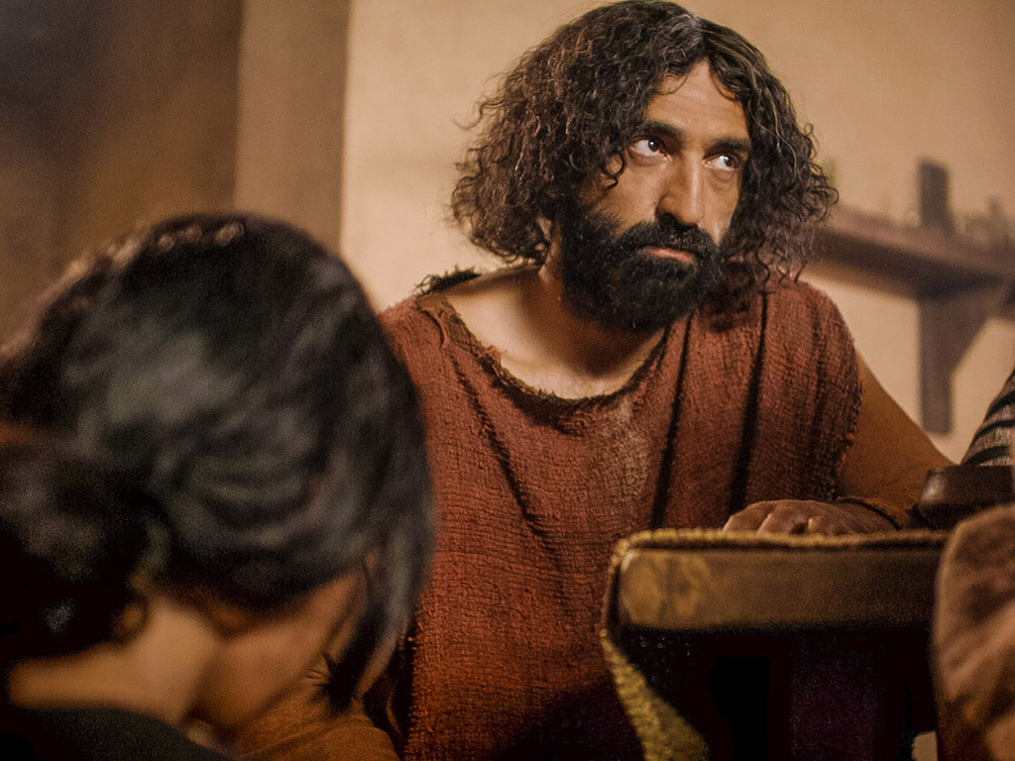
And though You were perfect and holy You gave up Yourself willingly

Slide 20
You spared no expense for my pardon You were used up and wasted for me

Slide 21
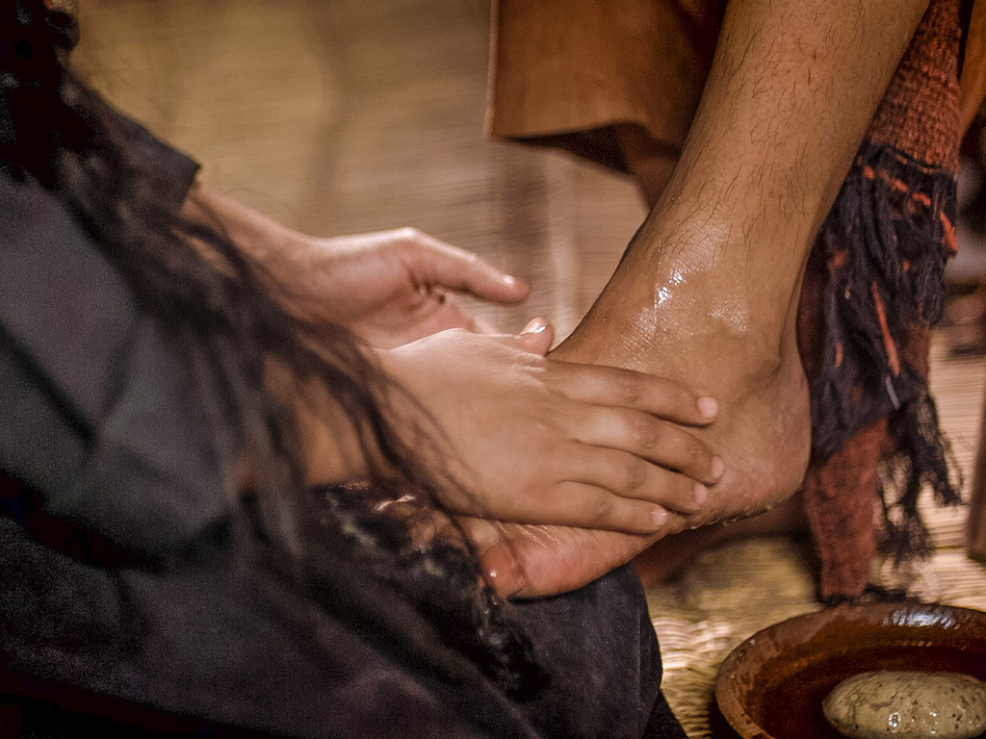
Broken and spilled out Just for love of me, Jesus––

Slide 22
God's most precious treasure lavished on me

Slide 23
Broken and spilled out and poured at my feet.

Slide 24
In sweet abandon, Lord, You were spilled out and used up for me

Slide 25
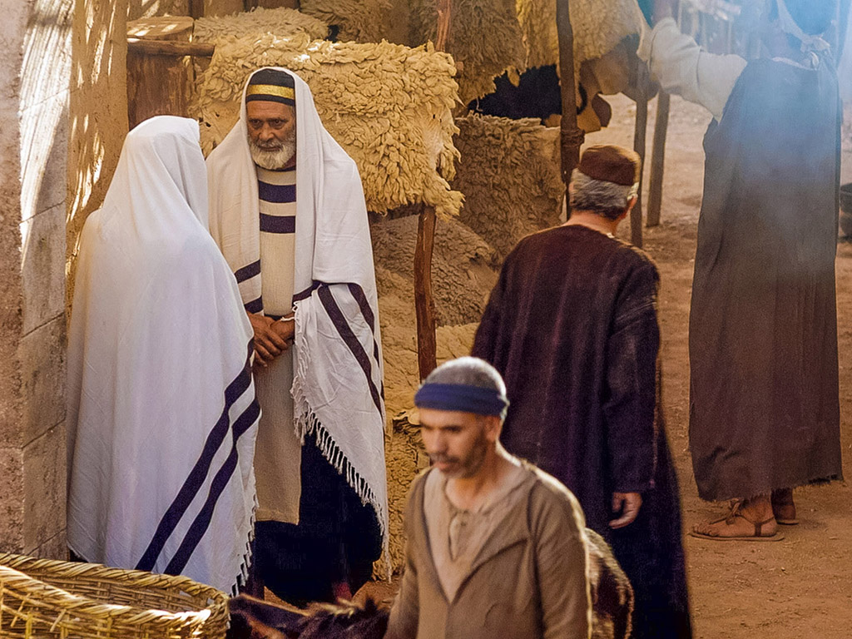
In sweet abandon, let me be spilled out and used up for Thee

Slide 28
Other Free Image Sites
Studybible.info/vines
Bibleplaces.com
Biblestudytools.com
Bible.org

Slide 29
Bible Study link at BibleStudyDownloads.org
Get this presentation for free!
Notes:
Bible Study (bs)

