Slide 1
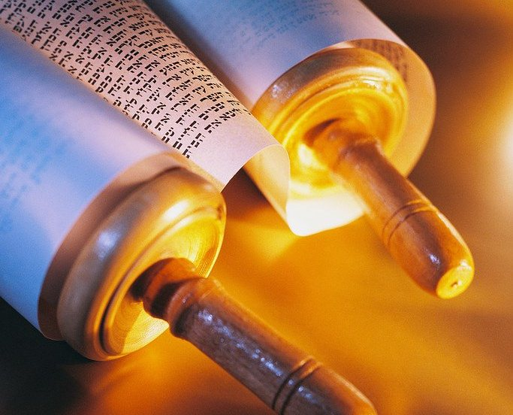
Interpreting
OT Literature
109
Dr. Rick Griffith • Jordan Evangelical Theological Seminary • BibleStudyDownloads.org

Slide 2

Interpreting the Pentateuch
110
MS
SG
ER
“THE LAND”
DS
We Will Cover This in Session 28
PG
RS
Handbook pg. 15-16
25
1

Slide 3
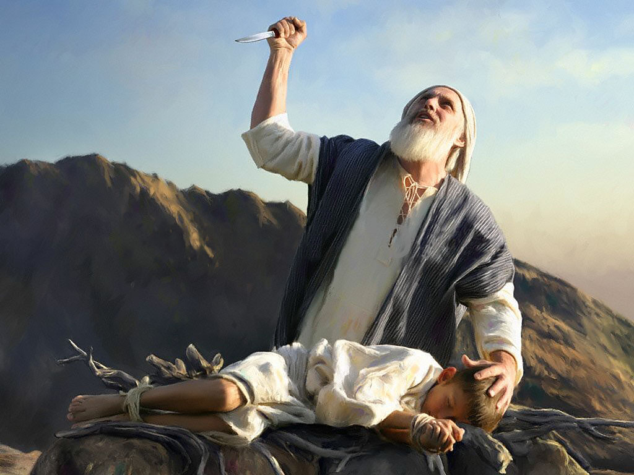
Interpreting the Historical Books
Genesis 22

Slide 4
Interpretive traps
Sidney Greidanus, The Modern Preacher and the Ancient Text, 159-166
!
Moralizing
Allegorizing
Spiritualizing
Imitating Bible Characters
Notes:
Moralising
Reducing everything to a list of do’s and don’t’s
Allegorising
Everything written is about me and my situation
Spiritualising
Significant elements of the text are about me.
Imitating Bible Characters.
The lesson is to be like or not be like every character I read of.

Slide 5
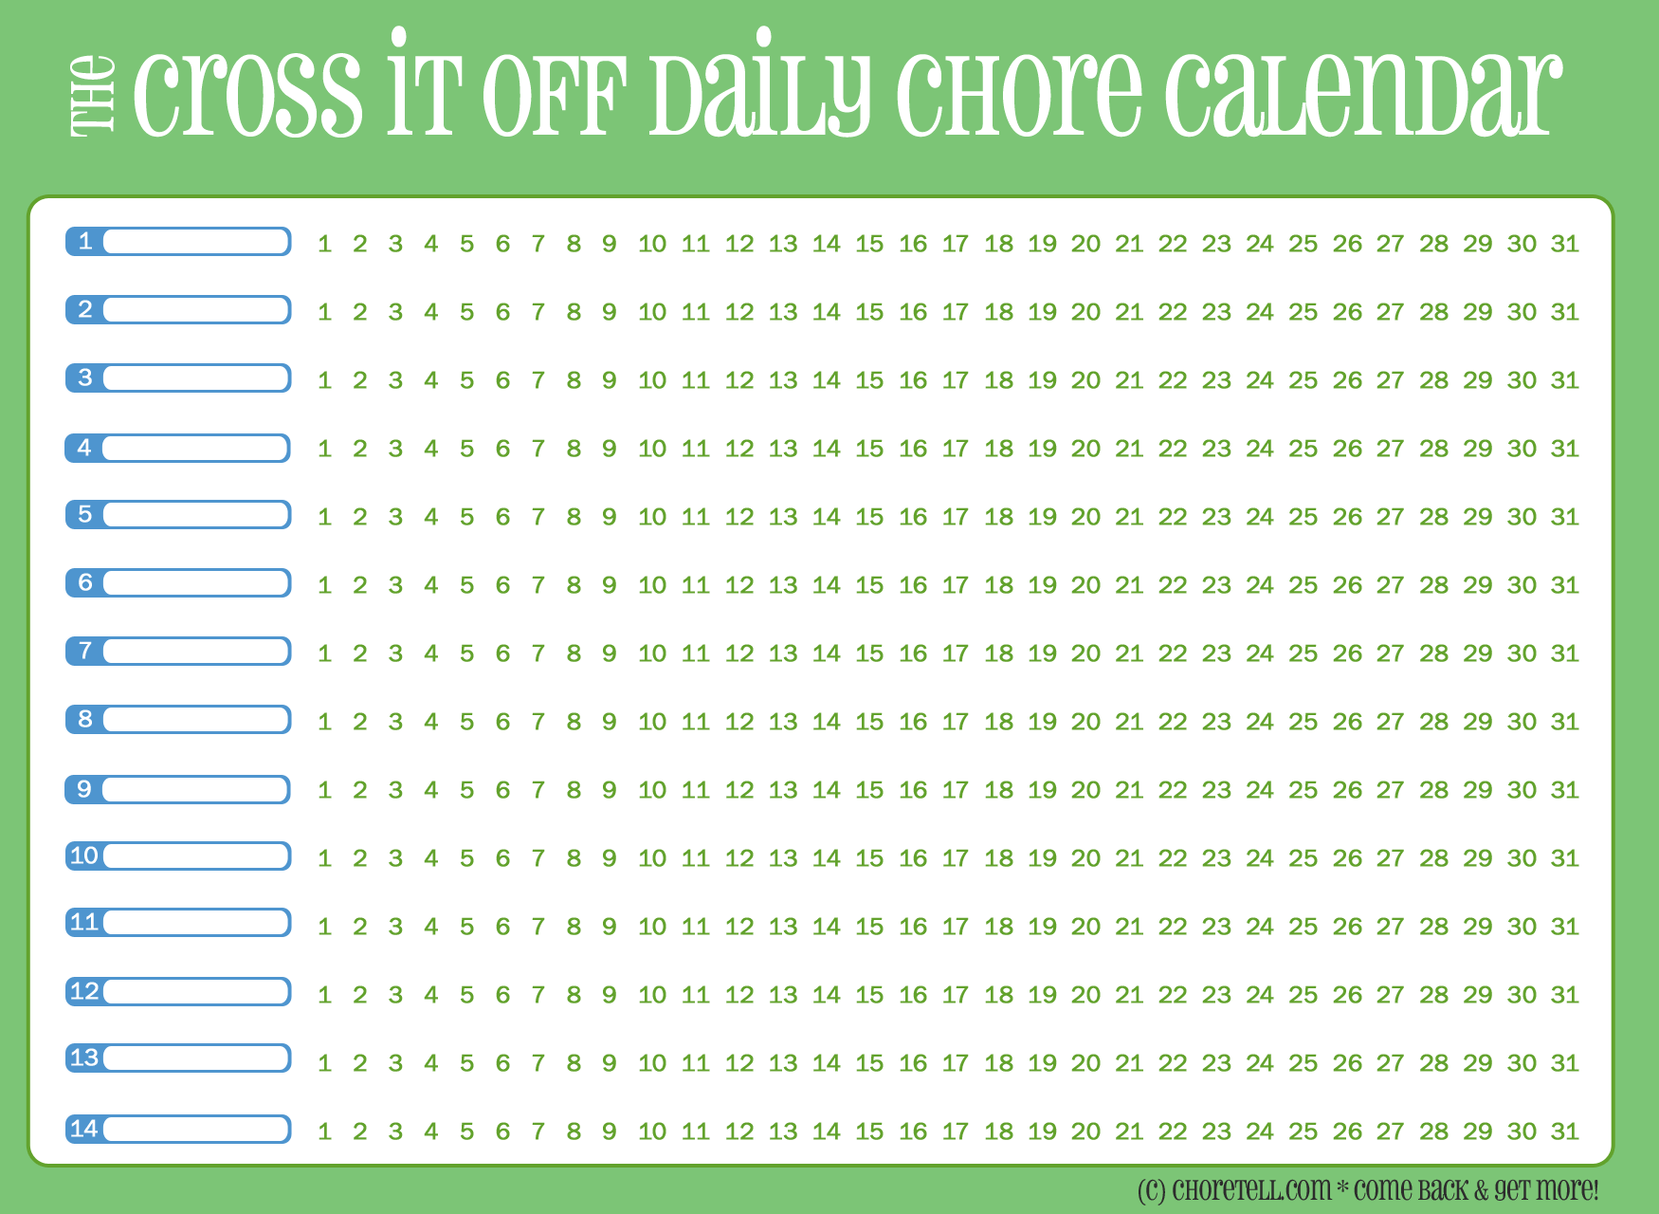

Interpretive traps
The Cross it Off Daily Chore Calendar
Moralising
  Reducing everything to a list of do’s and don’t’s

Slide 6
Not less but more
The Bible is more than just commands.
It reveals who God is and how He acts.
We need to understand what God wanted the first readers to be and do so that we can accurately know what we should be and do.
Most parts of the Bible are not written as a set of commands or propositions.
back

Slide 7
Allegorising & Spiritualising
Allegorising
  There is no real historical story here; instead…
  Everything written is about me and my situation.
Spiritualising
  There is a genuine story but…
  Significant elements of the text are about me.
Interpretive traps

Slide 8


Imitating Bible characters:
  Always asking: Is this a hero to copy or a villain not to copy?
Interpretive traps

Slide 9
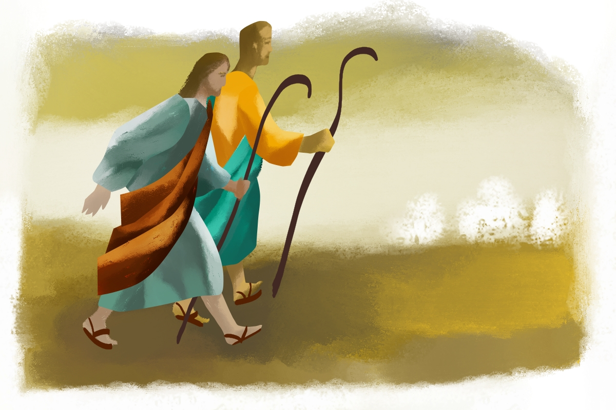
Imitate Jesus!
"Have this attitude in yourselves which was also in Christ Jesus"
(Phil. 2:5 NASB)
“You shall be holy,
for I am holy”
(1 Pet. 1:16 ESV)
"We should not be like Cain, who was of the evil one and murdered his brother"
(1 Jn. 3:12 ESV)
Notes:
ESV 2 Chronicles 30:7 Do not be like your fathers and your brothers, who were faithless to the LORD God of their fathers, so that he made them a desolation, as you see. ⁴ Do not be like your fathers, to whom the former prophets cried out, 'Thus says the LORD of hosts, Return from your evil ways and from your evil deeds.' But they did not hear or pay attention to me, declares the LORD.
ESV Matthew 6:8 Do not be like them, for your Father knows what you need before you ask him.
"We should not be like Cain, who was of the evil one and murdered his brother. And why did he murder him? Because his own deeds were evil and his brother's righteous." (1 Jn. 3:12 ESV)
"Woe to them! For they walked in the way of Cain and abandoned themselves for the sake of gain to Balaam's error and perished in Korah's rebellion." (Jude 1:11 ESV)
1 Peter 1:14-16 "So you must live as God’s obedient children. Don’t slip back into your old ways of living to satisfy your own desires. You didn’t know any better then. But now you must be holy in everything you do, just as God who chose you is holy. For the Scriptures say, “You must be holy because I am holy.”
1 John 3:7 "Dear children, don’t let anyone deceive you about this: When people do what is right, it shows that they are righteous, even as Christ is righteous."
John 15:10-14 Jesus says, "When you obey my commandments, you remain in my love, just as I obey my Father’s commandments and remain in his love. I have told you these things so that you will be filled with my joy. Yes, your joy will overflow! This is my commandment: Love each other in the same way I have loved you. There is no greater love than to lay down one’s life for one’s friends. You are my friends if you do what I command."
1 Cor 1:30 "God has united you with Christ Jesus. For our benefit God made him to be wisdom itself. Christ made us right with God; he made us pure and holy, and he freed us from sin."
Eph 1:4 "Even before he made the world, God loved us and chose us in Christ to be holy and without fault in his eyes."
Eph 5:27 "He did this to present her to himself as a glorious church without a spot or wrinkle or any other blemish. Instead, she will be holy and without fault."

Slide 10
Have a go
Read 1 Samuel 17
Look at the interpretation on the sheet
Match the error to the interpretation

Slide 11
How do I interpret correctly?
  Follow the good ways of doing Bible study
  Look at the various contexts of a passage
  Find the author’s emphasis and message in the passage.

Slide 12
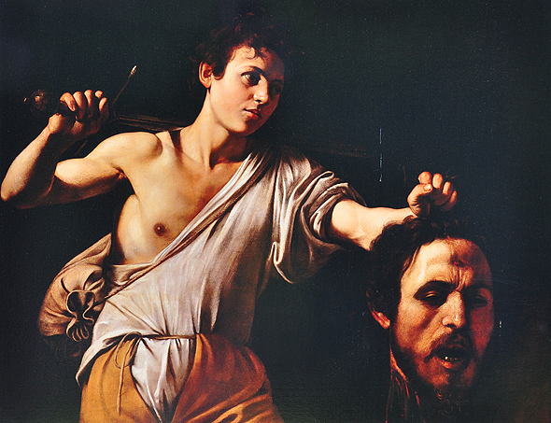
For your small group…
What's the Big Idea of 1 Sam. 17?

Slide 13
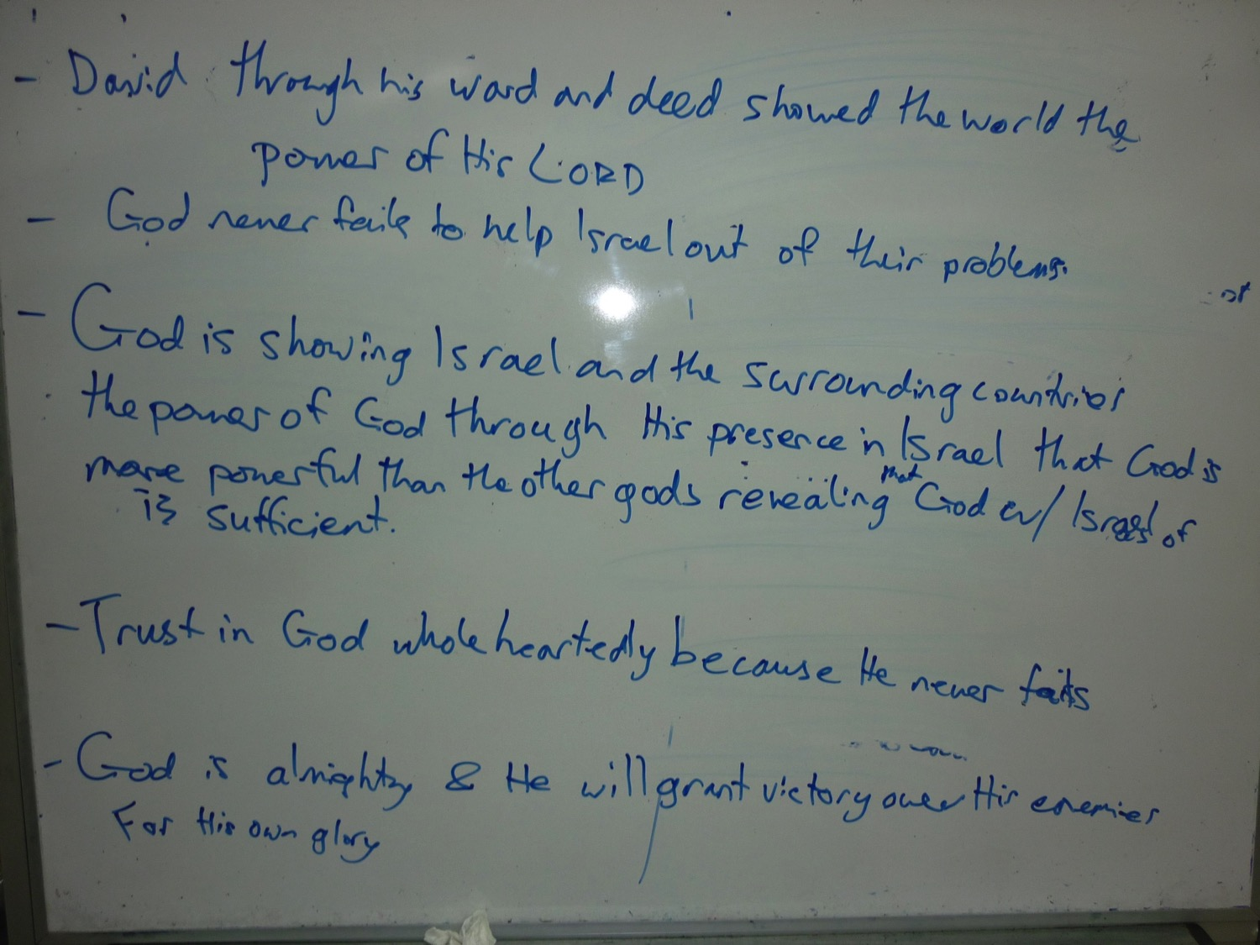
Some Big Ideas for 1 Sam. 17
Notes:
Suggestions from participants last week.

Slide 14
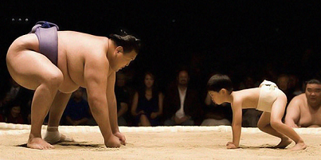
More Big ideas for 1 Sam 17
God is asserting His kingship and establishing David so that all peoples will know He is God.
God is rescuing Israel to assert His Kingship, secure / advance the messianic line and show the world that He alone is God.
Notes:
My attempts.

Slide 15
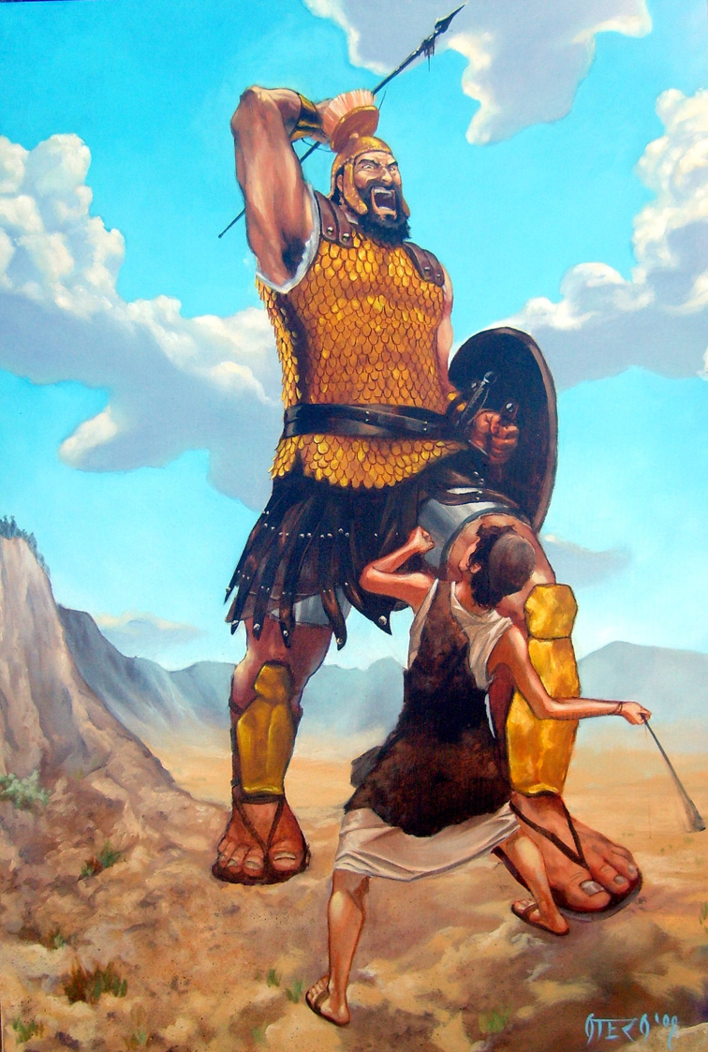
From OT to NT: Principles
Find a citation of this text in the NT
Connect it to the larger passage & Bible's story.
Take these NT truths into view:
  Jesus’ death and resurrection
  The new covenant
  Israel and Church

Slide 16
OT quotes / allusions in the NT
Does the author quote the OT exactly?
Is the NT author using it to say the same thing as the OT did?
If it is different, what difference did that make to the message of the quote?
How do the OT and NT contexts fit in the overall picture of the Bible?

Slide 17
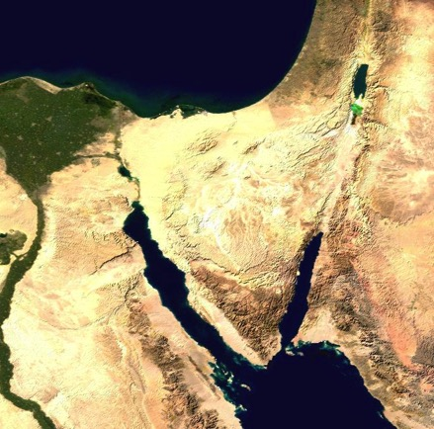
Case Study:
Hosea 11:1 in Matthew 2:15
Who does “son” refer to in each passage?
What difference does this make?
What is Matthew's message for us?
Is it faithful to the OT context and message?
Israel
(Hos. 11:1)
Jesus
(Matt. 2:15)

Slide 18
Case Study:
Hosea 11:1 in Matthew 2:15
Hosea called Israel God’s “son,” but Israel was a disobedient son.
Matthew calls Jesus God’s Son, but He is an obedient Son. Unlike Israel, Jesus was perfect in every instance where Israel failed.
Israel
(Hos. 11:1)
Jesus
(Matt. 2:15)

Slide 19
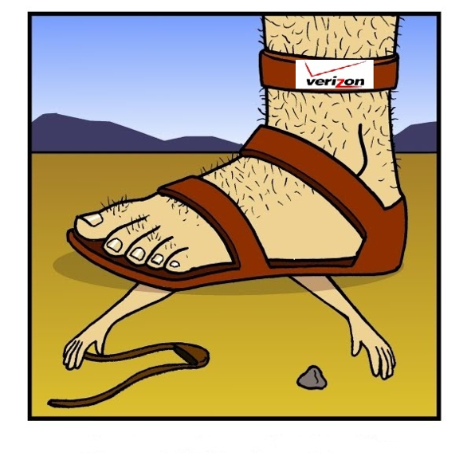
What about 1 Samuel 17?
Since there is no direct citation from 1 Sam 17 in the NT, we need to ask some questions:
  Who is David paralleled
  with in the NT?
  In 1 Samuel 17, how was
  David a type of Jesus?
Notes:
In 1 Sam 17, David was a type of Christ because his victory was for Israel and they rejoiced over it (1 Sam 18:6). Their chasing the army was only the mop-up job of a victory already won for them. Today God’s enemies are not always people. Jesus defeated Satan and sin for us, and we can rejoice in that.

Slide 20
How was David like Jesus in 1Samuel 17?
David won the victory FOR Israel, and their chasing the Philistine army was only the mop-up job.
Jesus is completely victorious over sin and death FOR us.
David saw things as God did and trusted in God. Jesus did all that perfectly.

Slide 21
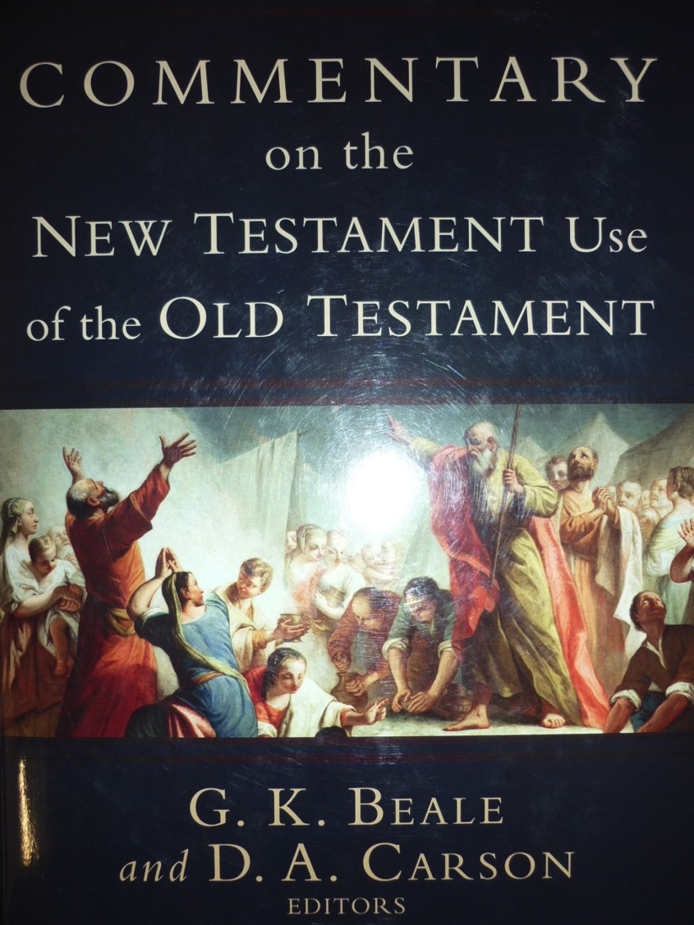
Recommended
Resource

Slide 22
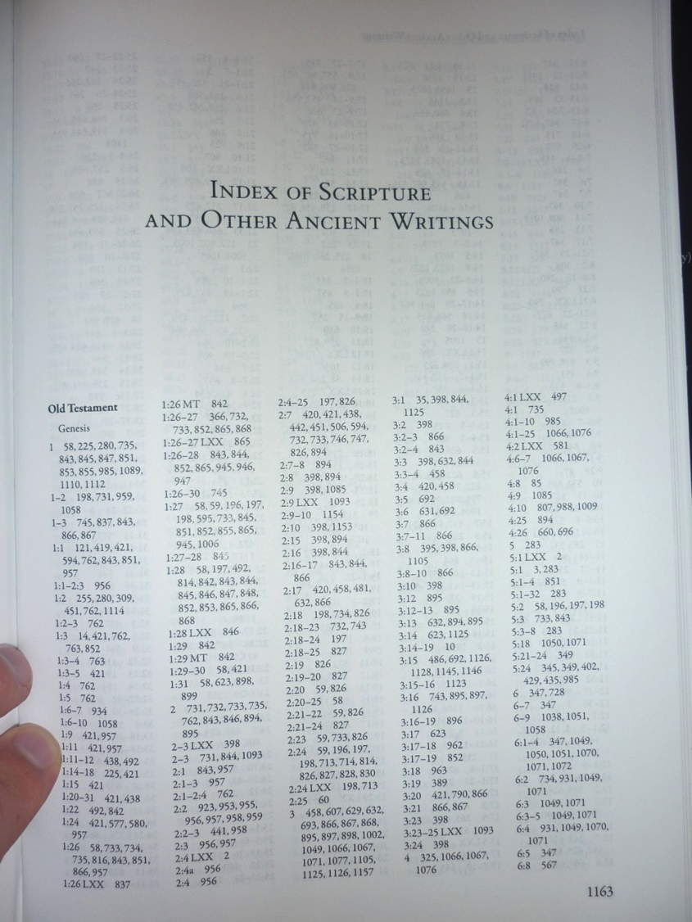
Look up the Scripture index

Slide 23
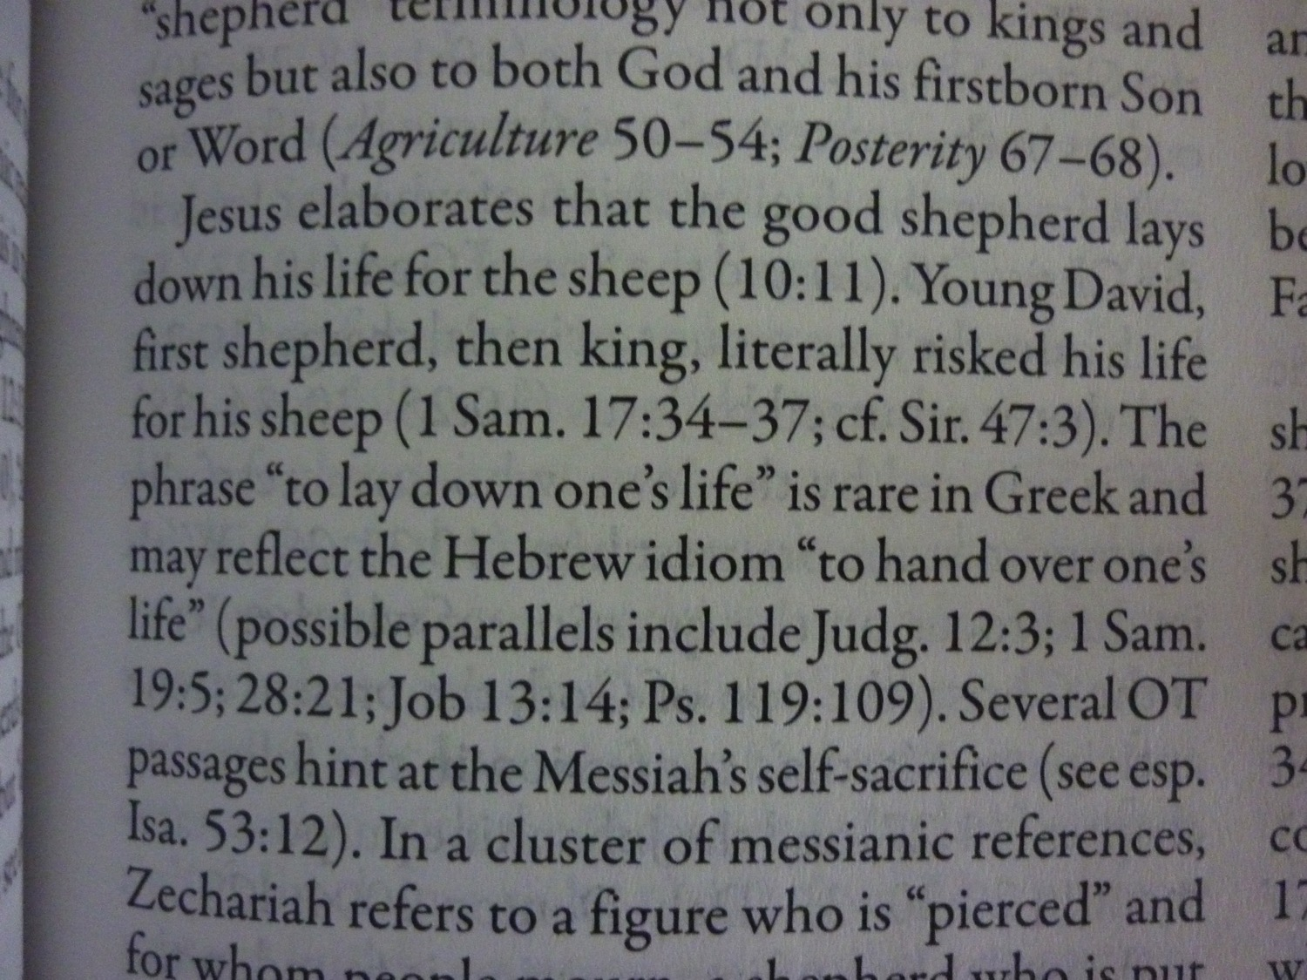
p. 463

Slide 24
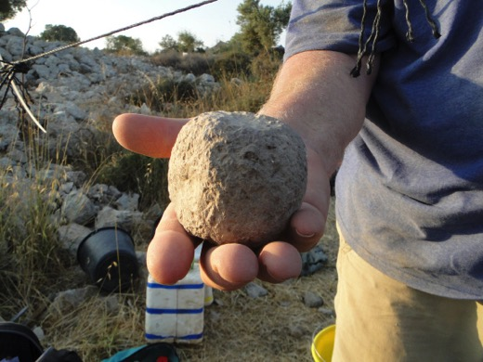
Observations for Application
The battle was God’s and He won it.
However, David still had to:
  See things God’s way.
  Be obedient.
  Defeat Goliath while imperfect.
David is compared to Jesus:
  Jesus saw things God’s way perfectly.
  Jesus was perfectly obedient.
  Jesus perfectly defeated sin and death for us.

Slide 25
Applications
We should be like Jesus
  John 13:13-17; 1 Cor. 11:1; Eph. 5:1-2; 1 John 2:6
We should live in Jesus’ victory over sin and death
  Rom. 6:5-14; Eph. 4:1ff; Phil. 1:27; 3:17ff; Col. 3:1ff
David, Jesus, and we have the Holy Spirit. We need to be filled with the Spirit and see things God’s way, knowing that He has the victory.
  Col. 3:1ff; Heb. 12:1ff

Slide 26
Applications
We can have confidence that God is able to deal with anything and anyone who stands in His way. We have a mighty God!
God fought though David so the whole world would know that He alone is God.
Jesus alone is God and one day the whole world will know it.
  We must live and do things so that the world will know that Jesus is the LORD our God (= for the glory of God).

Slide 27
Applications
David risked his life to give victory for Israel.
Jesus gave his live and achieved victory over sin and death for all people.
Are you willing to risk your life to show that God is supreme over the world?

Slide 28
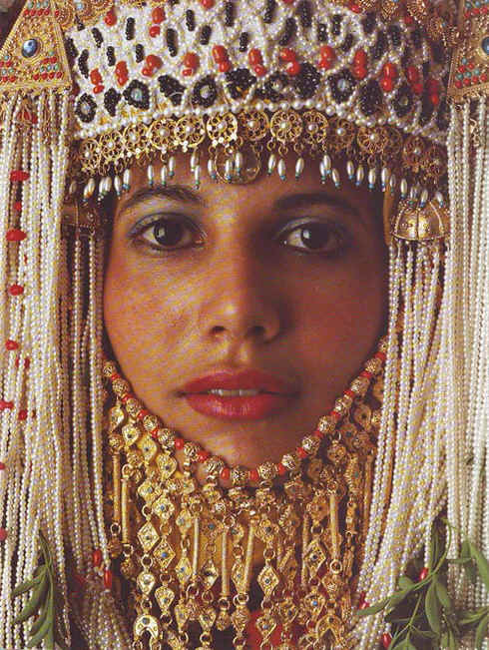
Interpreting the Historical Books
Esther

Slide 29
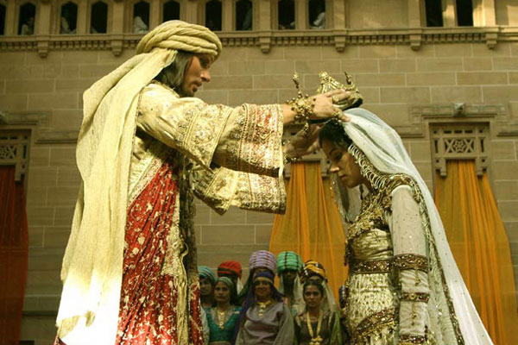
Did Esther act honorably?

Slide 30
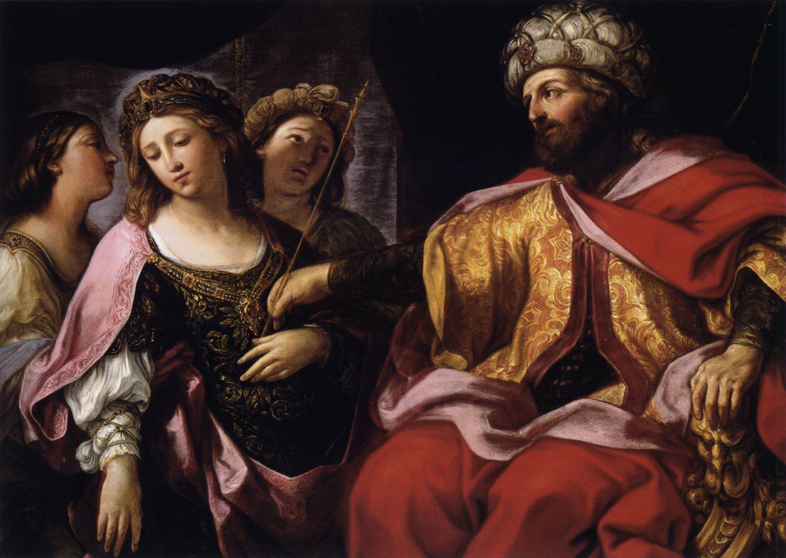
Plot–Characterization–Climax–Resolution
113
(Mordecai to Esther)
"For if you remain silent at this time, relief & deliverance for the Jews will arise from another place, but you & your father's family will perish. And who knows but that you have come to royal position for such a time as this?"
(Esther 4:14).

Slide 31
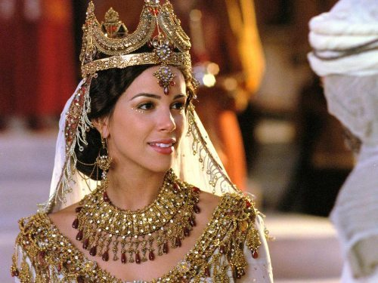
"...for such a time as this"

Slide 32
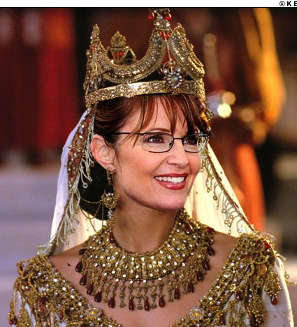
"...for such a time as this"

Slide 33
Interpretive Approaches to Esther: Seeking a "Deeper Meaning"
113
Response: Nothing is mentioned of the "times of the Gentiles" & the account is presented in a straightforward manner as history.
1. Prophetical—Esther predicts that the Jews will be preserved while outside of the land during the times of the Gentiles.
Historical—Esther records God's providential care of His chosen people as evidence of His commitment to the Abrahamic Covenant. The following "Argument" section will demonstrate this to be the best option.
Response: This is ambiguous & the account is presented in a straightforward manner as historical narrative.
2. Allegorical—Esther is the story of mankind.
3. Typical—Esther is a divinely intended illustration of the Christian experience in the Church Age or a type of the Millennium.
Response: While this is an ingenious view, it fails in that it reads the NT back into the OT.

Slide 34
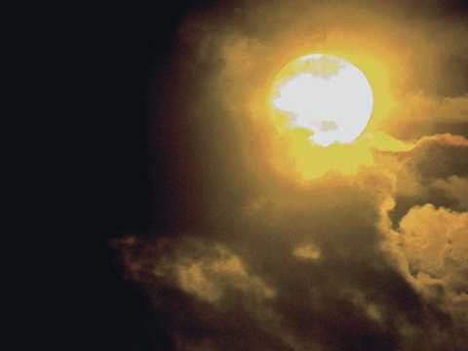
Synthesis
311
Extermination plot foiled
1–4 Plot planned—threat
5–10 Plot foiled—triumph

Slide 35

Interpreting the Wisdom & Poetic Books
115

Slide 36

115
Historical
Prophetical
Genesis
Exodus
Leviticus
Numbers
Deuteronomy
Isaiah
Jeremiah
Lamentations
Ezekiel
Daniel
POETIC BOOKS
Job
Psalms
Proverbs
Ecclesiastes
Song of Solomon
Joshua
Judges
Ruth
1 Samuel
2 Samuel
1 Kings
2 Kings
1 Chronicles
2 Chronicles
Ezra
Nehemiah
Esther
Hosea
Joel
Amos
Obadiah
Jonah
Micah
Nahum
Habakkuk
Zephaniah
Haggai
Zechariah
Malachi
Notes:
The 4 poetic books show where the people of the historical books obey or disobey the exhortations of the prophetical books.
In English, the 5 books progressively have longer names.

Slide 37

Wisdom vs Poetic
115
Wisdom vs Poetic
Contents of Writing
Style of Writing
Principles to live by
Repetition of Thought
Logic
Total Being
Job, Proverbs, Ecclesiastes
Job, Proverbs, Ecclesiastes, Psalms, Song, Lamentations
Smaller Category (Subset)
Larger Category

Slide 38
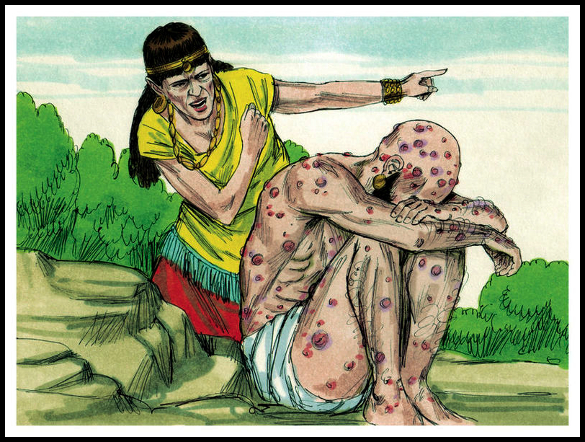
Job's Wife: "Curse God and die!"

Slide 39
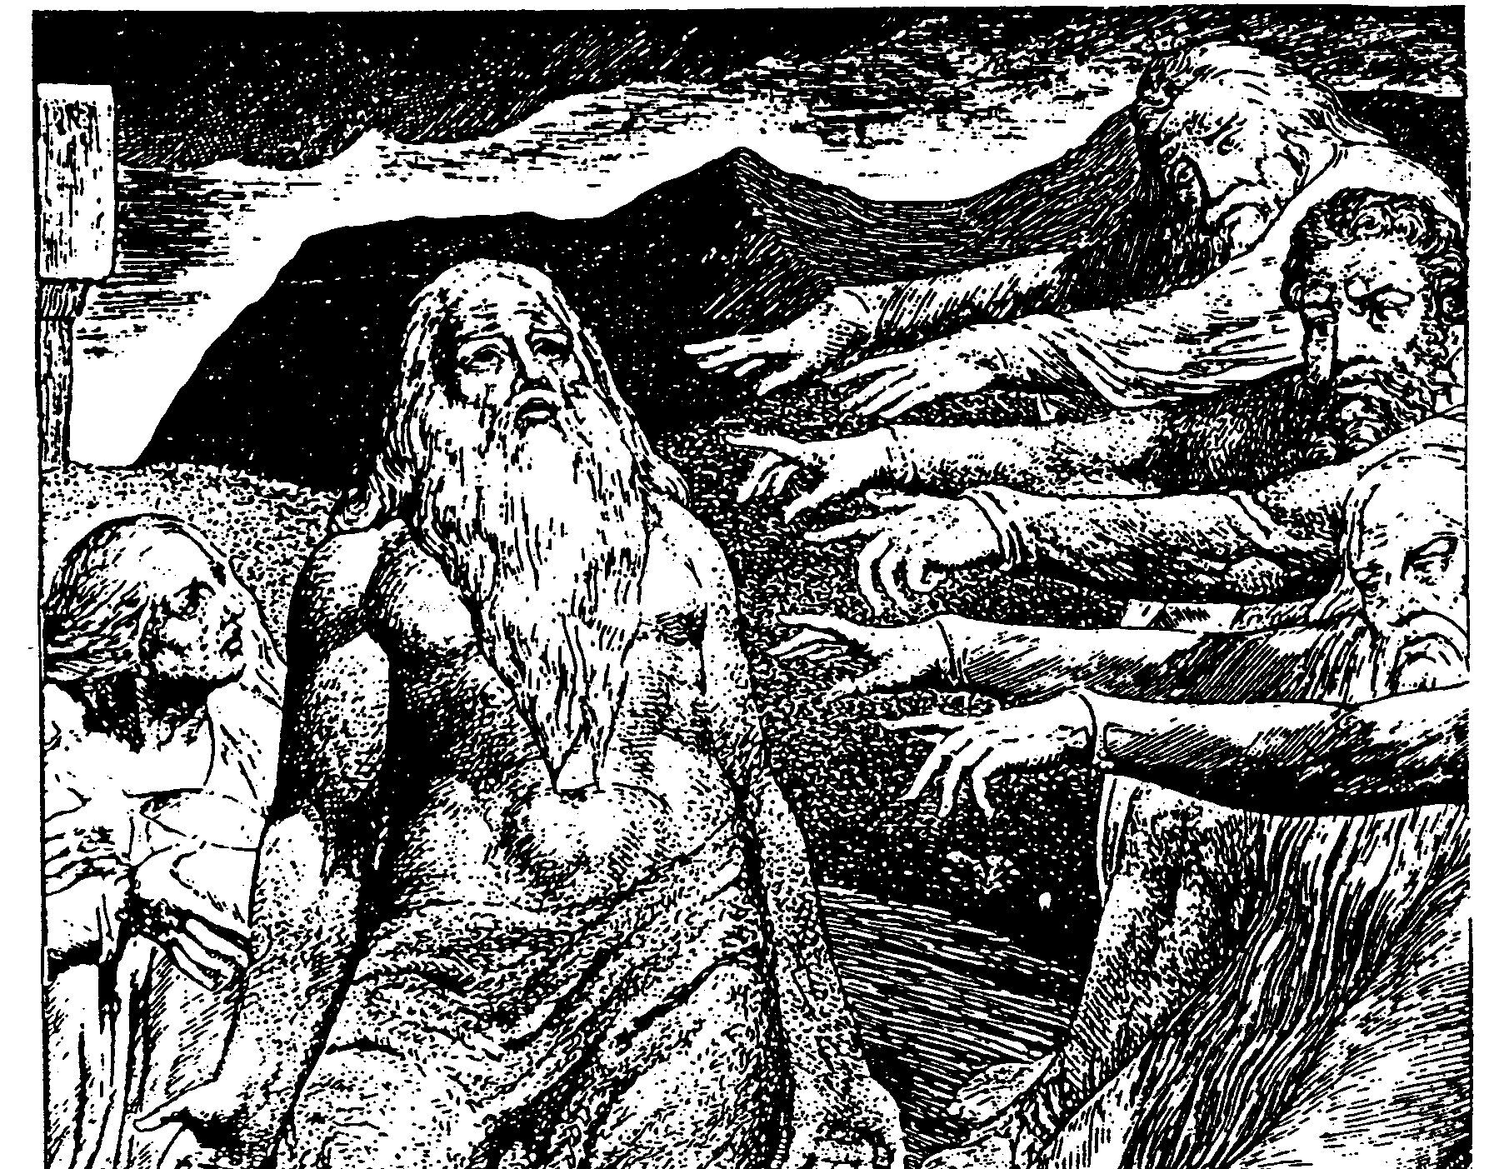
The Cycles of Debate in Job
115

Slide 40
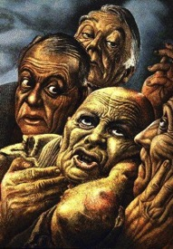
Perspectives of Job's Friends
115
Bruce Wilkinson & Kenneth Boa, Talk Thru the Bible
Eliphaz
Bildad
Zophar
Elihu
Characteristic
Theologian
Historian, legalist
Moralist, dogmatist
Young theologian, intellectual
Relies on
Observation, Experience
Tradition
Assumption
Education
Personality
Considerate
Argumentative
Rude, blunt
Perceptive, some
conceit
Voice
Philosophy
History
Orthodoxy
Logic
Argument
"If you sin, you suffer"
"You must be sinning"
"You are sinning"
"God purifies and
teaches"
Advice to Job
Only the wicked
suffer
The wicked always
suffer
The wicked are
short-lived
Humble yourself
and submit to God
Key Verse
4:8; 5:17
8:8
20:5
37:23
Concept of God
Righteous;
punishes wicked, blesses good
Judge; immovable
lawgiver
Unbending,
merciless
Disciplinarian,
teacher

Slide 41
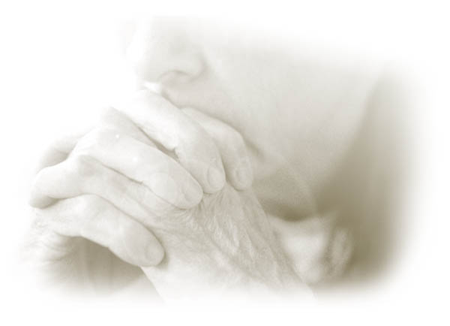
Proverbs

Slide 42
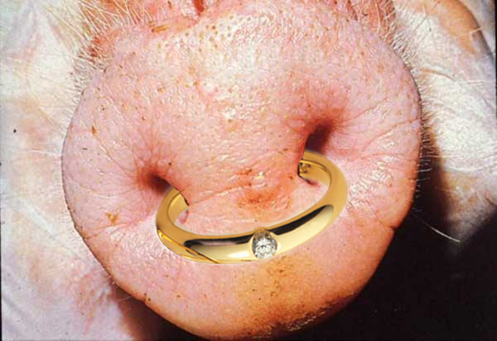
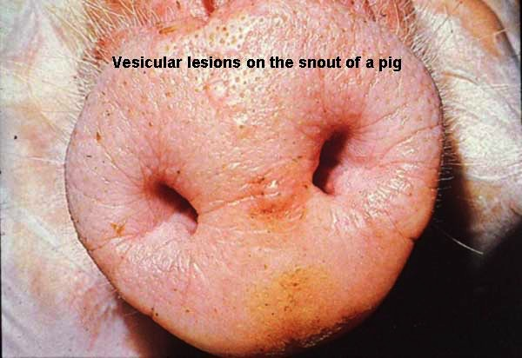
VERY Descriptive!
"As a ring of gold in a swine's snout, so is a beautiful woman who lacks discretion"
(Proverbs 11:22)

Slide 43
Interpretation
116
This genre of Proverbs requires greater discernment in interpretation
Are proverbs absolute, unconditional promises? In other words, are they principles with no exceptions?

Slide 44
Hermeneutical Guidelines
116
Do not consider the proverbs as promises from God, but rather as general observations and principles that are usually valid but not always
  e.g. Proverbs 22:6, "Train a child in the way he should go, and when he is old he will not turn from it."

Slide 45
Hermeneutical Guidelines
116
OT teaching must be understood in line with revelation given directly to the church (Acts and Epistles) in this dispensation.
  Reiterated Statements
    "Thou shalt not bear false witness against your neighbor" (Exodus 20:16)
    "Stop lying to one another" (Ephesians 4:25)

Slide 46
Hermeneutical Guidelines
OT teaching must be understood in line with revelation given directly to the church (Acts and Epistles) in this dispensation.
  Reiterated Statements
  Quoted Statements
    Proverbs 25:21, "If your enemy hungers, feed him," reappears in Romans 12:20

Slide 47
Hermeneutical Guidelines
116
OT teaching must be understood in line with revelation given directly to the church (Acts and Epistles) in this dispensation.
  Reiterated Statements
  Quoted Statements
  Parallel Statements
    Proverbs 6:24 and 1 Thessalonians 4:3

Slide 48
Hermeneutical Guidelines
116
OT teaching must be understood in line with revelation given directly to the church (Acts and Epistles) in this dispensation.
  Reiterated Statements
  Quoted Statements
  Parallel Statements
  If not a-c, should not be treated as commands but principles

Slide 49
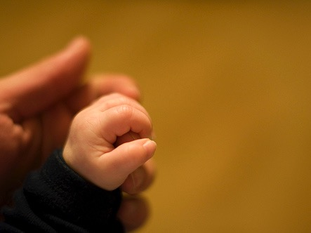
What is Poetry?
In the next 30 seconds define poetry to the person next to you

Slide 50
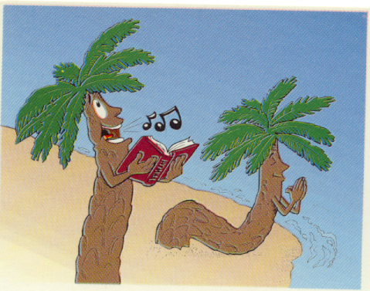
Title Slide
P alms
s
Palms

Slide 51

Categories of Psalms
Praise
Messianic
Lament
Testimonial
Pilgrim (Ascent)
Wisdom
Imprecatory
Penitential
Historical
Nature

Slide 52

Tips for Interpreting the Psalms
117
Pay attention to structure
Summarize the psalm in a sentence (p. 387)
Consider titles and background information in their superscriptions
Classify the psalm using Lindsey's p. 386
Interpret the psalm's incomplete theology in light of NT revelation (e.g., Ps. 51:11)
Reword figures of speech and parallelisms
Use NT allusions and/or quotations but don't read back into the text what the OT author would not have understood (e.g., Ps. 16:10 expanded in Acts 2:25-31)

Slide 53
Tips for Interpreting the Psalms
117
Read psalms slowly (in our speed-reading day).
Graph the emotional outline of the psalm.
e.g., Psalm 77
Does it start high or low?
77:1-3
77:4-9
77:10
77:11-20

Slide 54

Structure of the Old Testament
Walk Thru the OT
117c
( )
( )
( )
History
17
Poetry
5
Prophecy
17
5
Genesis
Exodus
Leviticus
Numbers
Deuteronomy
Joshua
Judges
Ruth
1 Samuel
2 Samuel
1 Kings
2 Kings
1 Chronicles
2 Chronicles
Ezra
Nehemiah
Esther
Job
Psalms
Proverbs
Ecclesiastes
Song of Solomon
Isaiah
Jeremiah
Lamentations
Ezekiel
Daniel
Hosea
Joel
Amos
Obadiah
Jonah
Micah
Nahum
Habakkuk
Zephaniah
Haggai
Zechariah
Malachi
Major
( )
Exodus
Exile
( )
Law
5
Pre-Exilic
History
Pre-Exilic
Prophets
12
Number of books in the OT:
3 + 9
39
27
Minor
Number of books in the NT:
( )
3 x 9
( )
66
Narrative
Number of books in the Bible:
Exile
Exile
Post-Exilic
History
Post-Exilic
Prophets
12
Events
Experience
Expectation
Actions
Axioms
Alarms
What people did
What people felt
What people should do
Notes:
The Christian arrangement of the OT shows many parallels in structure. The 17 historical books parallel the 17 prophetical books, and both sections are divided after the first 5 books, which is itself parallel to the 5 poetic books. Even the titles of these 5 books in English become longer from Job to Song of Solomon. In the history and prophecy sections, the exile took place prior to the last three books. Finally, subdivisions associated with the second books in the history and prophecy sections (Exodus and Jeremiah) show how Jews were kicked out of Egypt and Israel, respectively. As for remembering the number of OT books, think 3+9, and the NT, 3x9.

Slide 55
Kingdom & Covenants Timeline
22 &
337
9g
Dr. Rick Griffith • Singapore Bible College • BibleStudyDownloads.org
Kingdom Teaching...
Adam rules with God (Gen. 1:26, 28; 2:19)
Satan begins rule as god of this world (Gen. 3:15;
2 Cor. 4:4)
God covenants with Abraham to reestablish man's rule via Israel as a "kingdom of priests" (Gen. 12:1-3; Exod. 19:6)
Israel's failure to witness to nations as a kingdom of priests is judged via exile under foreign rule
Israel rejects Messiah's offer of kingdom (Matt. 12:41-42; 23:37-39)
Jesus extends His kingdom in mystery form to the Church (Matt. 13)
Christ subdues Israel's enemies and nation believes (Rom. 11:26-27)
Christ rules over everything with saints (Eph. 1:9-10; Rev. 20:1-6; 22:5b)
Fall of Man (Gen. 3)
Noahic Covenant
Genesis 6:18; 9:8-17
Land Covenant
ISRAEL
CHURCH
MESSIANIC KINGDOM
(National Focus)
The "New Man" (Eph. 2:15)
Millennial Eternal
land
Genesis 15:18 (cf. Deut. 30:1-10) promises:
Land from Wadi of Egypt to Euphrates River (Isa. 27:12)
Eternal possession of land (Gen. 17:8) after exile/restoration
Whole world blessed via the land (Isa. 14:1-2)
Israel judged for rejecting Messiah by dispersion away from land for 19 centuries
(AD 70–AD 1948) but now partially restored (Ezek. 37:1-7)
Full restoration (Ezek. 37:8-28) Jerusalem world capital
(Isa. 2:1-5)
New Jerusalem
(Rev. 21–22)
Davidic Covenant
Christ is Head over His Church, which is a spiritual temple (Eph. 2:19-22; 2 Cor. 6:16)
Christ reigns over the world
(Isa. 11)
with saints (Rev. 5:10; 20:4-6)
Christ hands kingdom over to Father (1
Cor. 15:24)
Genesis 12:1-3
2 Samuel 7:12-16 promises:
Sons ("house" never wiped out)
Kingdom (political dynasty)
Throne (right to rule by descendants)
Temple (son to build it)
seed
Abrahamic Covenant
New Covenant
All
things made new!
(Rev. 21:5)
All 5 elements fulfilled in national restoration (Zech. 8)
Jeremiah 31:31-34 promises:
Forgiveness
Indwelling Spirit
New heart, nature, mind
Reunification of Israel and Judah
No need for evangelism
Mosaic Law replaced with first three elements of the New Covenant (Luke 22:20; 2 Cor. 3:6)
blessing
Mosaic Covenant
Law abolished, fulfilled, and replaced at the cross (Rom. 7:1-6;1 Cor. 9:19-21; Heb. 8:13)
Eighth Edition
29 Aug 2016
Temporary (Gal. 3:19) and conditional (Deut. 28) to reveal sin (Rom. 7:7) and regulate Israel (Gal. 3:23-25)
Scripture has a dual kingdom-covenant theme. Israel's role from Abraham to Christ expands to include the Church (continuity) yet the Church never replaces the nation as the "new Israel" (discontinuity). Israel will again enjoy world prominence after trusting Christ at His second coming.
Notes:
Slides 13 and 127 repeated

Slide 56
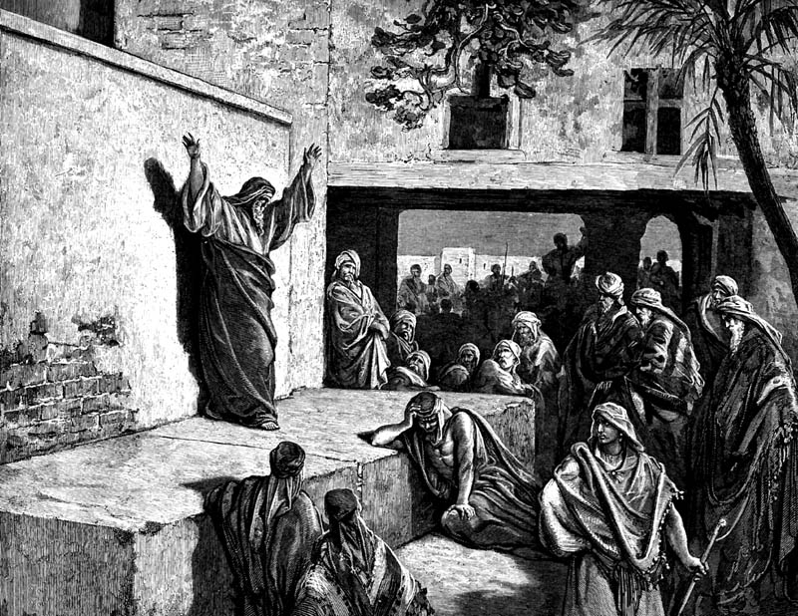
Interpreting the Prophets
118

Slide 57
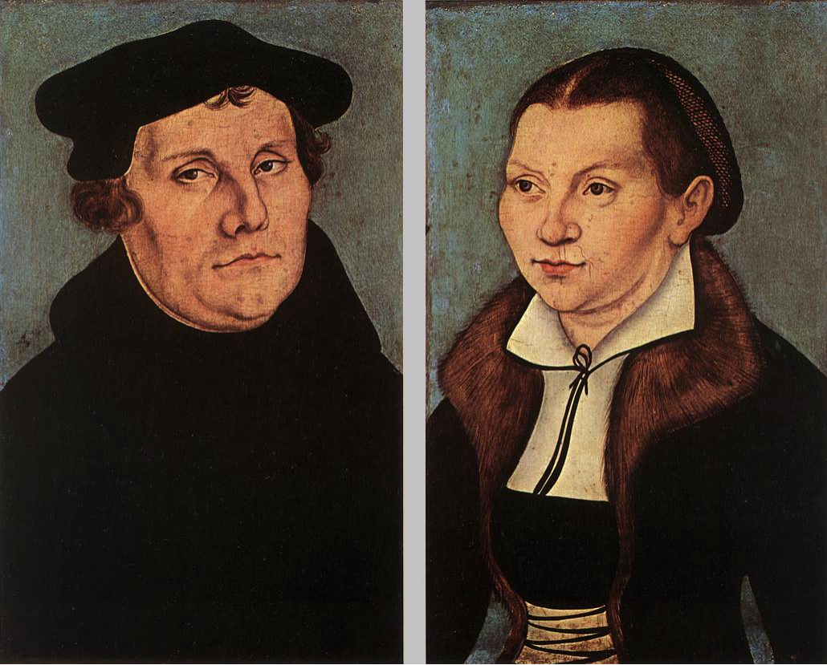
Luther on the Prophets
“The prophets have a queer way of talking, like people who, instead of proceeding in an orderly manner, ramble off from one thing to the next, so that you cannot make head or tail with them or see what they are getting at.”
Notes:
Quoted by Gerhard von Rad, Old Testament Theology (New York: ET, 1962), 2:33.

Slide 58

Problems & Tips in Interpreting Prophecy
438
Inaccurate Presuppositions
Prophets were mainly covenant enforcers based on the Mosaic law
Ethical
Forthtelling
Mosaic Covenant
Predictive
Foretelling
Abrahamic Covenant
Notes:
________________
BS-14-OT Literature-58
OS-23-Prophets Intro-20

Slide 59
Placing the Prophetical Books
119
S "O" S
Pre-Exile
(800-606 BC)
Exile
(606-536 BC)
Post-Exile
(536-400 BC)
S
O
L
O
M
O
N
D
A
V
I
D
Israel
Hosea
Amos
Assyria
Jonah
Nahum
S
A
U
L
"HA"
"NAH"
Jews in Jerusalem
Haggai
Zechariah
Malachi
Judah
Habakkuk
Isaiah
Jeremiah
Joel
Micah
Zephaniah
Lamentations
Jews in Exile
Ezekiel
Daniel
Edom
Obadiah
"HIJJMZL"
"IE"
(In Exile)
"HaZeMa"
(final
OT books)
"BAD"
The Daily Walk
Adapted from Walk Thru the Old Testament
Walk Thru the Bible Press, 1978
Notes:
The UK (United Kingdom) had the kings Saul, David, and Solomon.
Yet the UK had warning signs as SDS almost looks like SOS
Sure enough, the UK split with Israel in its own "Brexit" in the north
This began the Pre-Exile prophets
Israel was the first to say "HA" to God in rejection, so God sent Hosea and Amos
Meanwhile, Assyria was even worse. After first repenting under Jonah, they later said "NAH" so God sent both JoNAH and NAHum to warn them.
Of course, Edom as a blood relative to Israel and should have known better, so they were really BAD. Thus, God sent them OBADiah.
Jews in Exile included only Ezekiel and Daniel, who were the only two prophets with IE in their name = In Exile.
But God brought the people of Judah back as Jews in Jerusalem and raised up 3 prophets with the memory divice HaZeMa.
But we can't forget th largest group of prophets back in the Pre-Exile times, but how can we remember all 7 of them?
Fortunately, singing Twinkle, Twinkle with their first letters gives HIJJMZL, which, sung over and over, is unforgettable.

Slide 60
Difficulties Interpreting Prophets
120
Incomplete Background Data
Historical Distance
Lack of Appreciation for Poetry
Unfamiliarity with Prophetic Books
Ignorance of Eschatology
Dual Eschatological Viewpoint
Notes:
________________
BS-14-OT Literature-60
OS-23-Prophets Intro-21

Slide 61
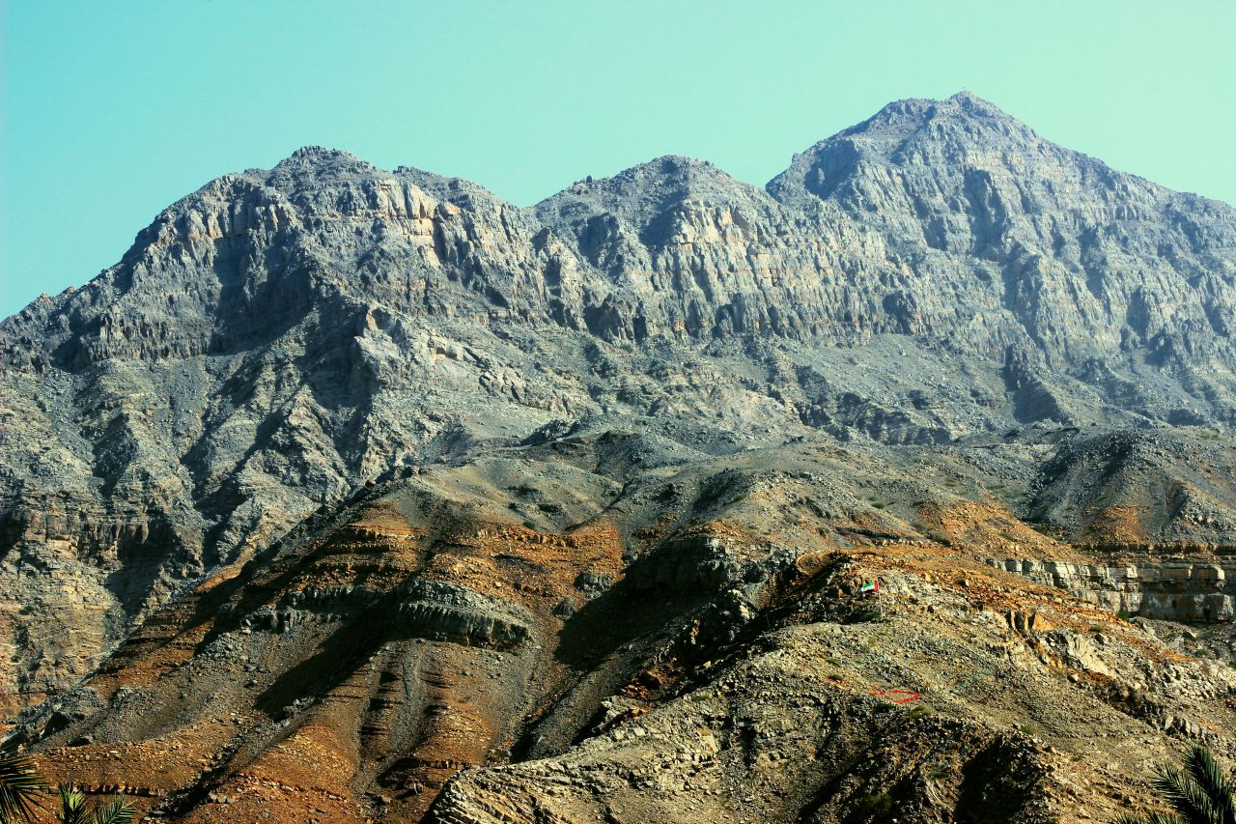
Approaching a Summit

Slide 62

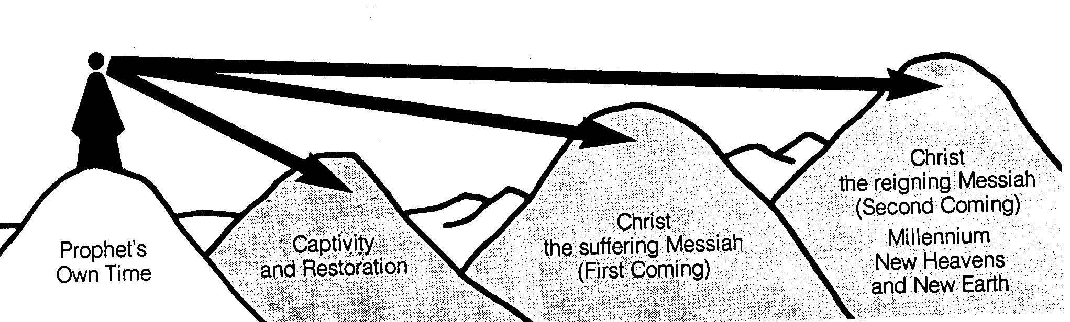
Time Periods of the Prophets
Isaiah:
442
7–8
39–40
52–53
2, 11
25:8
New Heavens & New Earth
Christ's Second Coming to Reign in Millennium
Christ's First Coming to Suffer
Exile & Return
Prophet's Own Time
Adapted significantly from Salem Kirban, Charts on Revelation (1979), 49
Notes:
The prophets often looked to the future but did not know how far their prophecies referred. It is like a person standing on a mountain looking into the distance and seeing what appears to be the same mountain. However, the person standing at these same mountains from the side can clearly see significant gaps between the peaks. Such is the viewpoint that we have thousands of years later. There generally existed five time periods, including the prophet’s own era. Isaiah especially prophesied of each of these time periods in the chapters above.
____________
Common-334
BE-31-Obadiah-64
OS-OT_Book_Overviews-782_pp42a_and_347a-613
OS-23-Prophets_Introduction-19
OS-23-Isaiah1-12—slide 357
OS-31-Obadiah-13

Slide 63

We See the Valleys

Slide 64
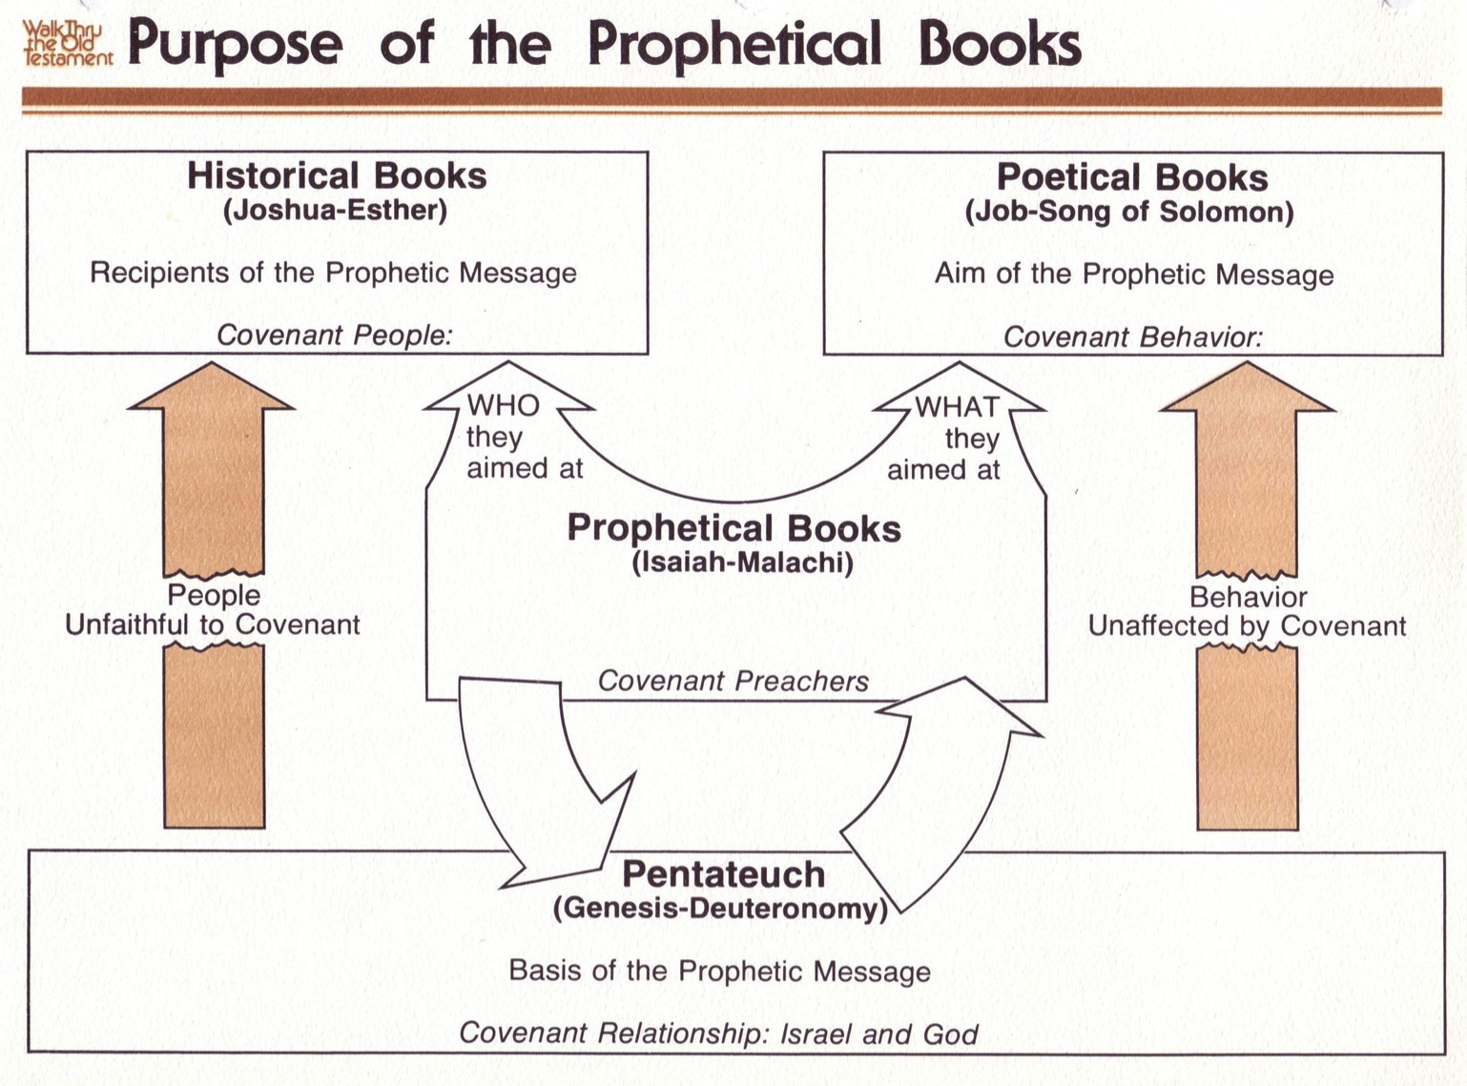
Purpose of the Prophetic Books
122
Mosaic Covenant
Abrahamic Covenant
Deut. 28; Lev. 26
Gen. 12:1-3; 15:18
Conditional
Unconditional
Judgment
Blessing

Slide 65
Black

Slide 66


Bible Study link at BibleStudyDownloads.org
Get this presentation for free!
Notes:
Bible Study (bs)

