Slide 1
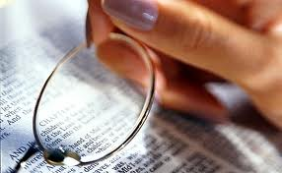
Charts &
Mechanical Layouts
26
Dr. Rick Griffith • Jordan Evangelical Theological Seminary • BibleStudyDownloads.org

Slide 2
How to Study a Section of a Biblical Book
26
Read the whole text
Paragraph titles
Relate the paragraphs
Section to the whole
State the theme
Observations
Persons & places
Ask questions
What learned?

Slide 3

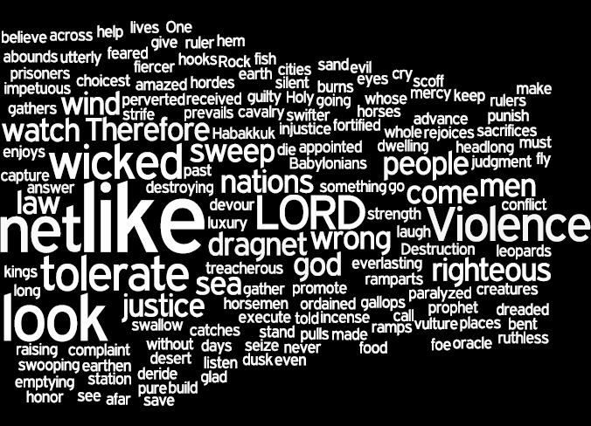
Literary Structure of Habakkuk

Slide 4
Book Chart
Habakkuk: Babylon's Destruction
Chapters 1–2 |  |  |  | Chapter 3
Punishment of Babylon |  |  |  | Praise Song
Habakkuk's Perplexity |  |  |  | Habakkuk's Praise
God's Actions Challenged |  |  |  | God's Actions Commended
Faith Troubled |  |  |  | Faith Triumphant
Problem |  |  |  | Resolution
Habakkuk | God | Habakkuk | God | Habakkuk
Why aren't you judging Judah's sin, God? | I will. I'll judge Judah with the Babylonians! | But can you use a nation more wicked than Judah? | Sure, but I'll judge them too. | In wrath remember mercy. | Our God is an awesome God! | I'll wait patiently for Babylon's judgment and rejoice in God.
1:1-4 | 1:5-11 | 1:12–2:1 | 2:2-20 | 3:1-2 | 3:3-15 | 3:16-19
Judah
c. 607-605 BC
627

Slide 5
Book Chart
Philemon
245
Forgive Others and Seek Forgiveness
Forgive Others and Seek Forgiveness
Greeting
1-3
Prayer & Commendation
4-7
Appeal for Onesimus
8-21
Conclusion
22-25
Greeting
1-3
Prayer & Commendation
4-7
Appeal for Onesimus
8-21
Conclusion
22-25
Preface
Praise
Petition
Postscript
Preface
Praise
Petition
Postscript
People
Concerned
People
Concerned
Philemon's
Character
Philemon's
Character
Onesimus'
Conversion
Onesimus'
Conversion
Paul's
Co-Workers
Paul's
Co-Workers
Authors
1a-b
Authors
1a-b
Recipients
1c-3
Recipients
1c-3
Thanks
4-5
Thanks
4-5
Relationships
6-7
Relationships
6-7
General Appeal
8-11
General Appeal
8-11
Reasons for Return
12-16
Reasons for Return
12-16
Specific Appeal
17-21
Specific Appeal
17-21
Preparations
Greetings
Blessing
22-25
Preparations
Greetings
Blessing
22-25
Rome to Colosse
Rome to Colosse
Fall AD 61
Fall AD 61

Slide 6
Book Chart
Amos
583
Judgment for Social Injustice
Eight Judgments |  | Three Sermons | Five Visions | Promise of Restoration
Chapters 1–2 |  | Chapters 3–6 | 7:1–9:7 | 9:8-15
“This is what the LORD says…” (1:3, 6, 9, 11, 13; 2:1, 4) |  | “Hear this word…” (3:1; 4:1; 5:1) | “This is what the Sovereign LORD showed me…” (7:1, 4, 7; 8:1) | “In that day…” “The days are coming…” (9:11, 13)
God's Impartiality |  | God's Justice | God's Judgments | God's Grace
Pronouncements of Judgment |  | Provocations of Judgment | Future of Judgment | Promises after Judgment
Judgment |  |  |  | Renewal
Horror |  |  |  | Hope
Neighbor Nations | Northern Nation
767-753 BC (before the fall of Samaria)

Slide 7

How does God respond to injustice?
Two ways...

Slide 8
Placing the Prophets
342
Placing the Prophets
Key Dates
931
Obadiah
1:1–9:7
722
Jonah
Amos
PAST
9:8-15
586
FUTURE
Notes:
Preview: Today we will see two ways God deals with this inequity. From our view, the first way is past and the second way is yet future.
Text: The book of Amos reveals the way God dealt with injustice in the 700s BC in Amos 1:1–9:7 and the way he will address injustice in the future, addressed in Amos 9:8-15.

Slide 9
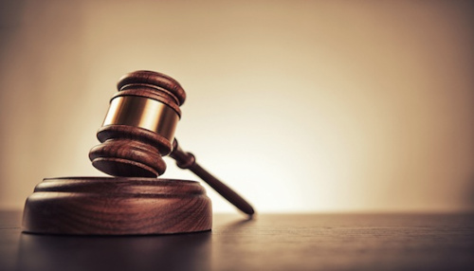
I. God judged injustice in Israel (Amos 1:1–9:7).
Notes:
The LORD warned the northern nation of exile that happened 40 years later.

Slide 10
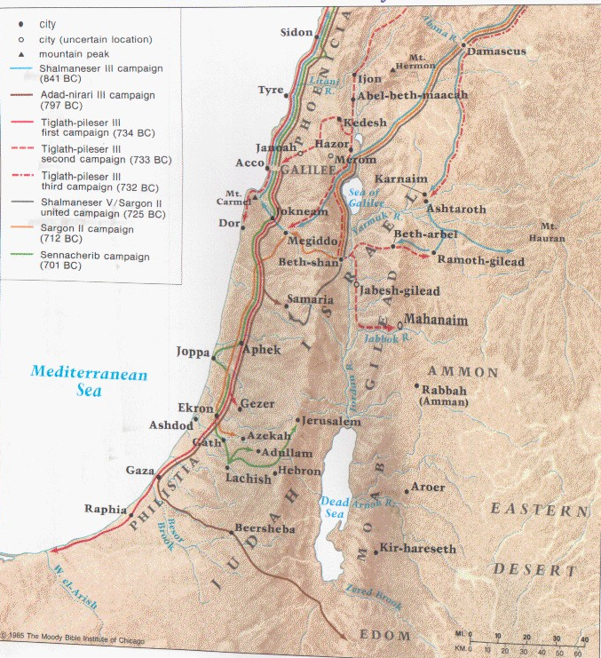
Judgment Against the Nations
(Amos 1-2)
591

Slide 11

Judgment Against the Nations
(Amos 1–2)
591
Asher
Naphtali
Amos declared the sins and penalties of Israel and 7 surrounding countries for their sins against God's people, Israel
Zebulun
Manasseh
Issachar
Manasseh
Gad
Ephraim
Dan
Benjamin
Reuben
Judah
Simeon

Slide 12

God will Judge Damascus
591
Damascus
Phoenicia
Amos 1:3-4 NLT
Syria
"This is what the LORD says:
'The people of Damascus have sinned again and again,
and I will not let them go unpunished!
They beat down my people in Gilead
as grain is threshed with iron sledges.
⁴So I will send down fire on King Hazael's palace,
and the fortresses of King Ben-hadad will be destroyed.'"
Gilead
Israel
Ammon
Philistia
Judah
Moab
Edom

Slide 13
God will Judge Philistia
591
Phoenicia
Amos 1:6-7 NIV
Syria
"This is what the LORD says:
'For three sins of Gaza,
even for four, I will not turn back [my wrath].
Because she took captive whole communities
and sold them to Edom,
⁷I will send fire upon the walls of Gaza that will consume her fortresses.'"
Israel
Ammon
Philistia
Judah
Gaza
Moab
Edom

Slide 14
God will Judge Phoenicia
591
Tyre
Phoenicia
Amos 1:9-10 NIV
Syria
"This is what the LORD says:
'For three sins of Tyre,
even for four, I will not turn back [my wrath].
Because she sold whole communities of captives to Edom, disregarding a treaty of brotherhood, ¹⁰I will send fire upon the walls of Tyre that will consume her fortresses."
Israel
Ammon
Philistia
Judah
Moab
Edom

Slide 15
God will Judge Edom
591
Phoenicia
Amos 1:11-12 NIV
Syria
"This is what the LORD says:
'The people of Edom have sinned again and again, and I will not let them go unpunished! They chased down their relatives, the Israelites, with swords, showing them no mercy. In their rage, they slashed them continually and were unrelenting in their anger.
¹²So I will send down fire on Teman, and the fortresses of Bozrah will be destroyed.'"
Israel
Ammon
Philistia
Judah
Moab
Edom

Slide 16
God will Judge Ammon
591
Phoenicia
Amos 1:13-15 NIV
Syria
"This is what the LORD says:
'The people of Ammon have sinned again and again, and I will not let them go unpunished! When they attacked Gilead to extend their borders, they ripped open pregnant women with their swords.
¹⁴So I will send down fire on the walls of Rabbah, and all its fortresses will be destroyed. The battle will come upon them with shouts, like a whirlwind in a mighty storm. ¹⁵And their king and his princes will go into exile together,'
says the LORD."
Gilead
Israel
Ammon
Philistia
Judah
Moab
Edom

Slide 17
Slides on
Amos 2

Slide 18
God will Judge Moab
591
Phoenicia
Amos 2:1-2 NIV
Syria
"This is what the LORD says: 'The people of Moab have sinned again and again, and I will not let them go unpunished! They desecrated the bones of Edom's king, burning them to ashes. ²So I will send down fire on the land of Moab, and all the fortresses in Kerioth will be destroyed. The people will fall in the noise of battle, as the warriors shout and the ram's horn sounds.
³ And I will destroy their king and slaughter all their princes,' says the LORD."
Israel
Ammon
Philistia
Judah
Moab
Edom

Slide 19
God will Judge Judah
591
Phoenicia
Amos 2:4-5 NIV
Syria
"This is what the LORD says: 'The people of Judah have sinned again and again, and I will not let them go unpunished! They have rejected the instruction of the LORD, refusing to obey his decrees. They have been led astray by the same lies that deceived their ancestors.
⁵So I will send down fire on Judah, and all the fortresses of Jerusalem will be destroyed.'"
Israel
Ammon
Philistia
Judah
Moab
Edom

Slide 20
God will Judge Israel
591
Phoenicia
Amos 2:6-7 NIV
Syria
"This is what the LORD says:
'For three sins of Israel, even for four, I will not turn back [my wrath]. They sell the righteous for silver, and the needy for a pair of sandals. ⁷They trample on the heads of the poor as upon the dust of the ground
and deny justice to the oppressed. Father and son use the same girl and so profane my holy name.'"
Israel
Ammon
Philistia
Judah
Moab
Edom

Slide 21
God will Judge Israel
591
Phoenicia
Amos 2:8-9 NIV
Syria
"They lie down beside every altar on garments taken in pledge. In the house of their god they drink wine taken as fines. ⁹I destroyed the Amorite before them, though he was tall as the cedars and strong as the oaks. I destroyed his fruit above and his roots below.'"
Israel
Ammon
Philistia
Judah
Moab
Edom

Slide 22
Crimes & Punishments of Eight Nations in Amos 1–2
591
NATION | CRIME | PUNISHMENT
SYRIA (1:1-5) | Harassed Israel many times, such as invading Gilead | Damascus burned Strongholds burned Citizens to be slaves (732 BC by Tiglath-Pileser III; cf. 2 Kings 16:7-9)
PHILISTINES (1:6-8) | Sold people of Judah to Edom as slaves | Four main cities burned: Gaza, Ashdod, Ashkelon, Ekron (by Assyrians later in the 8th century BC, and more completely in the Maccabean period (168-134 BC)
PHOENICIA (1:9-10) | Sold people of Israel to Edom as slaves | Tyre's forts and palaces burned (in 332 BC by Alexander)
EDOM (1:11-12) | Murdered many Jews | Cities destroyed (by 8th century Assyria and by Nabateans in 400-300 BC)
Notes:
"Edom was subjugated by the Assyrians in the eighth century B.C., turned into a desolate wasteland by the fifth century B.C. (Mal. 1:3), and overtaken by the Nabateans, an Arabian tribe, around 400-300 B.C. " (Donald R. Sunukjian, "Amos," in The Bible Knowledge Commentary, 1:1430).

Slide 23
Crimes & Punishments of Eight Nations in Amos 1–2
591
NATION | CRIME | PUNISHMENT
AMMON (1:13-15) | Murdered pregnant Jewish women of Gilead | Cities burned (734 BC by Tiglath-Pileser III; cf. 2 Kings 16:7-9) Exile of king and people
MOAB (2:1-3) | Desecrated Edom's royal tombs | Kerioth and other cities defeated in battle and burned (734 BC by Tiglath-Pileser III)
JUDAH (2:4-5) | Rejected God's Word | Temple was destroyed (in 586 BC by Babylonian king Nebuchadnezzar)
ISRAEL (2:6-16) | Accepted bribes (2:6b) Abused the poor (2:7a) Sexual sin (2:7b) Abused collateral (2:8a) False worship (2:8b) | Cities destroyed (by 8th century Assyria and by Nabateans in 400-300 BC)
Notes:
"Israel had violated the Mosaic Covenant in several ways, including social injustice (2:6b), legal perversion (v. 7a), sexual sin (v. 7b), abuse of collateral (v. 8a), and idolatry (v. 8b)" (Donald R. Sunukjian, "Amos," in The Bible Knowledge Commentary, 1:1430).

Slide 24

II. God will restore Israel to fulfill his promises (Amos 9:8-15).

Slide 25
Matthew 18:15-20
27
If your brother sins against you, go and show him his fault, just between the two of you. If he listens to you, you have won your brother over. ¹⁶But if he will not listen, take one or two others along, so that 'every matter may be established by the testimony of two or three witnesses.' ¹⁷If he refuses to listen to them, tell it to the church; and if he refuses to listen even to the church, treat him as you would a pagan or a tax collector.
¹⁸I tell you the truth, whatever you bind on earth will be bound in heaven, and whatever you loose on earth will be loosed in heaven. ¹⁹Again, I tell you that if two of you on earth agree about anything you ask for, it will be done for you by my Father in heaven. ²⁰For where two or three come together in my name, there am I with them.
Notes:
two main teachings on restoring Christians in sin

Slide 26

The Mechanical Layout
28
Rewrite the text for more accurateunder-standing
Main statements at left
One statement per line
Subordinate clauses below
Modifiers generally below
Coordinate clauses at left
Lists tabulated vertically
Reveal the Grammar

Slide 27
Ephesians 4:11-15 ASV (1901)
11 And he gave
some (to be) apostles
and some, prophets;
and some, evangelists
and some,
pastors
and teachers;
12 for the perfecting of the saints,
unto the work of ministering,
unto the building up of the body of Christ:
13 till we all attain
unto the unity
of the faith,
and of the knowledge of the Son of God,
unto a fullgrown man,
unto the measure of the stature of the fulness of Christ:
14 that we may be no longer children,
tossed to and fro
and carried about with every wind of doctrine,
by the sleight of men,
in craftiness,
after the wiles of error;
15 but ——–––— may grow up
speaking truth in love, in all things
into him,
who is the head,
(even) Christ;
Notes:
The mechanical layout of these five verses shows:
—who God gave to the Church (11)
—the strategy of their work (12)
—the goal of this strategy (13)
—the alternative if God's strategy is not followed (14)
—and what those trained are supposed to do as well (15)
___________
BS-Charts & Mechanical Layouts-27

Slide 28
Matthew 18:15-20 Mechanical Layout
If your brother sins against you,
go and show him his fault, just between the two of you.
If he listens to you, you have won your brother over.
¹⁶But if he will not listen,
take one or two others along,
so that 'every matter may be established
by the testimony of two or three witnesses.'
¹⁷If he refuses to listen to them,
tell it to the church;
and if he refuses to listen even to the church,
treat him as you would a pagan or a tax collector.
¹⁸I tell you the truth,
whatever you bind on earth will be bound in heaven,
and whatever you loose on earth…loosed in heaven. ¹⁹Again, I tell you
that if two of you…agree about anything you ask for,
it will be done for you by my Father in heaven.
²⁰For where two or three come together in my name,
there am I with them.
27
Notes:
two main teachings on restoring Christians in sin

Slide 29
Matthew 18:15-20
If your brother sins against you, go and show him his fault, just between the two of you. If he listens to you, you have won your brother over. ¹⁶But if he will not listen, take one or two others along, so that 'every matter may be established by the testimony of two or three witnesses.' ¹⁷If he refuses to listen to them, tell it to the church; and if he refuses to listen even to the church, treat him as you would a pagan or a tax collector.
¹⁸I tell you the truth, whatever you bind on earth will be bound in heaven, and whatever you loose on earth will be loosed in heaven. ¹⁹Again, I tell you that if two of you on earth agree about anything you ask for, it will be done for you by my Father in heaven. ²⁰For where two or three come together in my name, there am I with them.
How to Restore
15-17
Why to Restore
18-20
Notes:
two main teachings on restoring Christians in sin

Slide 30


Bible Study link at BibleStudyDownloads.org
Get this presentation for free!
Notes:
Bible Study (bs)

Slide 31
Black

