Slide 1
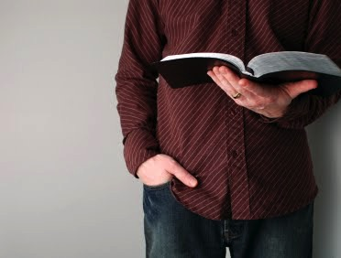
Reading Paragraphs & Context
What to look for
Dr. Rick Griffith • Jordan Evangelical Theological Seminary • BibleStudyDownloads.org

Slide 2


Specific Things to Observe
22
Key Words
"by faith" in Hebrews 11
WORDS
Oletta Wald, The Joy of Discovery

Slide 3
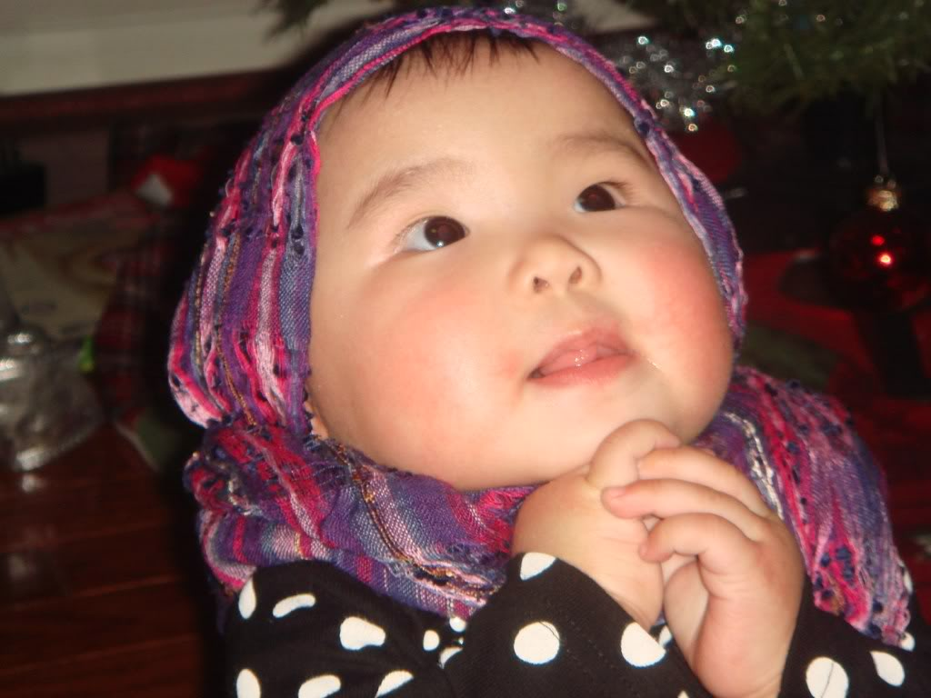
"By Faith…" (Hebrews 11)
"Faith is the confidence that what we hope for will actually happen; it gives us assurance about things we cannot see. ²Through their faith, the people in days of old earned a good reputation" (Heb. 11:1 NLT)

Slide 4
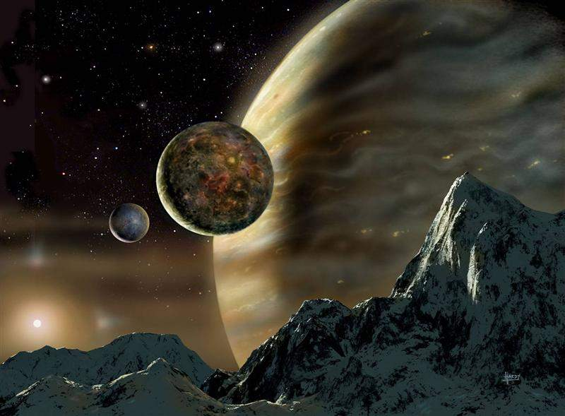
"By Faith…" (Hebrews 11)
"By faith we understand that the entire universe was formed at God’s command, that what we now see did not come from anything that can be seen" (Heb. 11:3 NLT)

Slide 5
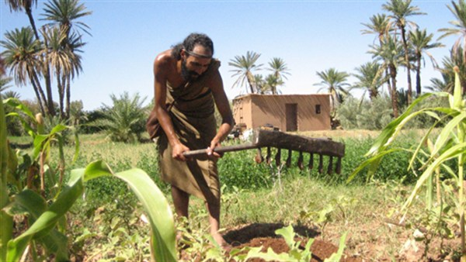
"By Faith…" (Hebrews 11)

Slide 6
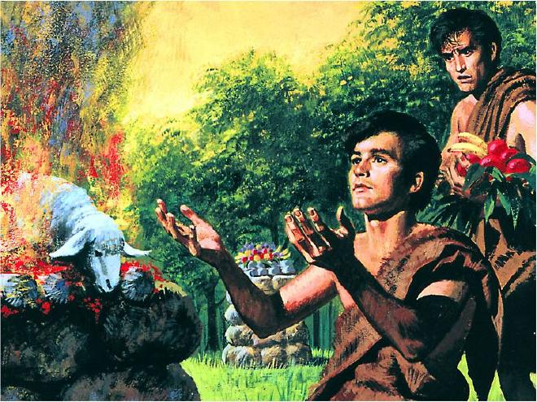
"By Faith…" (Hebrews 11)
"It was by faith that Abel brought a more acceptable offering to God than Cain did. Abel’s offering gave evidence that he was a righteous man, and God showed his approval of his gifts. Although Abel is long dead, he still speaks to us by his example of faith" (Heb. 11:4 NLT)

Slide 7
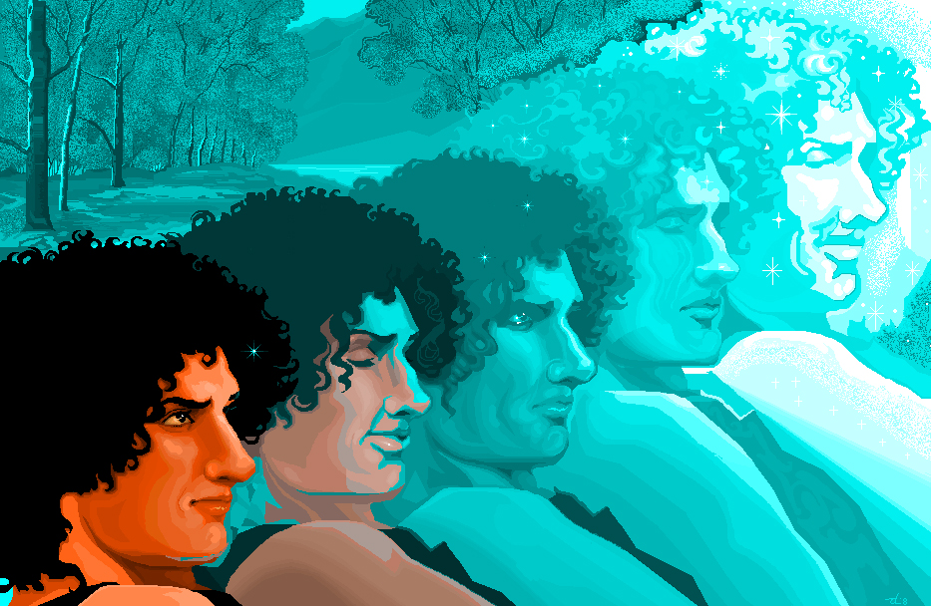
"By Faith…" (Hebrews 11)
"It was by faith that Enoch was taken up to heaven without dying—'he disappeared, because God took him.' For before he was taken up, he was known as a person who pleased God" (Heb. 11:5 NLT)

Slide 8
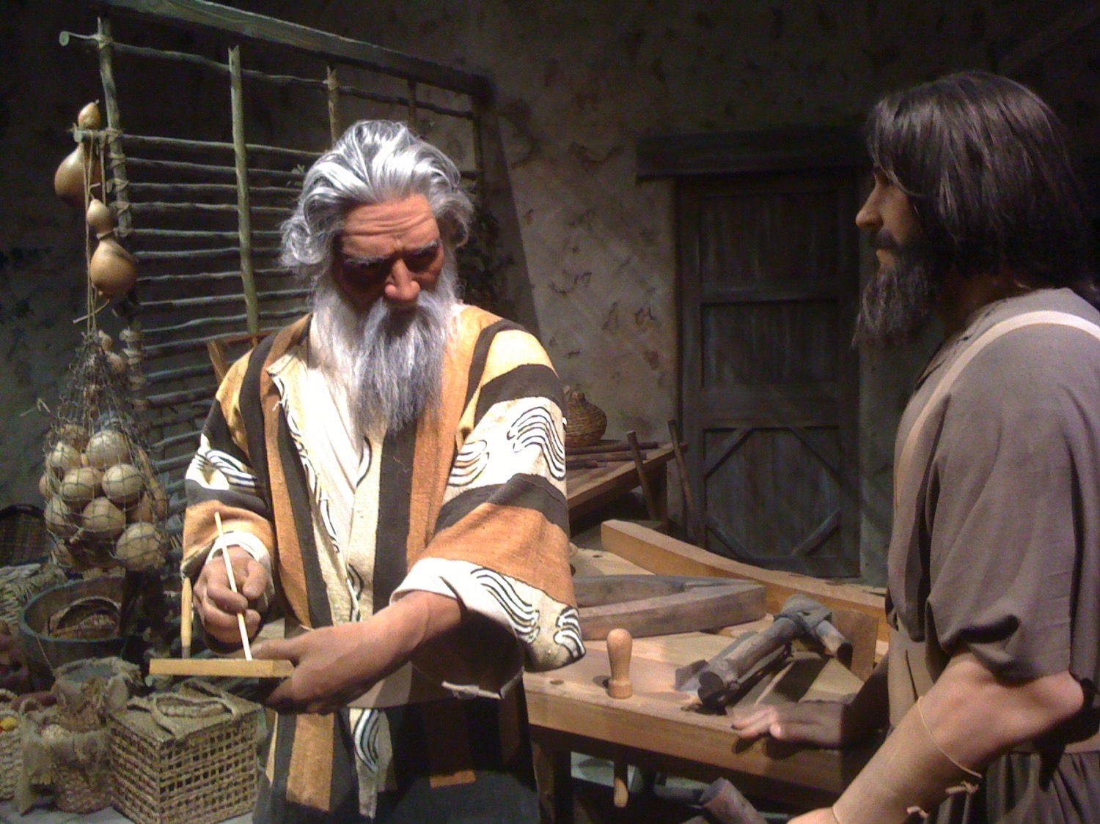
"By Faith…" (Hebrews 11)
"It was by faith that Noah built a large boat to save his family from the flood. He obeyed God, who warned him about things that had never happened before. By his faith Noah condemned the rest of the world, and he received the righteousness that comes by faith" (Heb. 11:7 NLT)

Slide 9

FAITH
"And it is impossible to please God without faith. Anyone who wants to come to him must believe that God exists and that he rewards those who sincerely seek him" (Heb. 11:6 NLT)

Slide 10
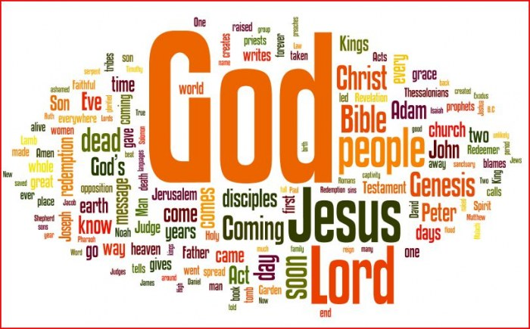
The Key Words of the Bible
The larger the word, the more times it appears
Notes:
This is called a "tag cloud"

Slide 11
Specific Things to Observe
22
Advice
Admonitions
Warnings
Promises
"Listen, my son…"
(Proverbs)
Oletta Wald, The Joy of Discovery

Slide 12
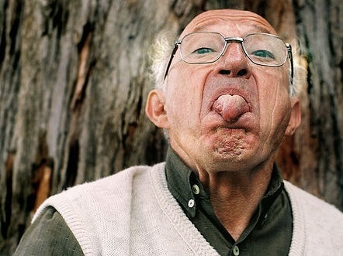
"Rejoice in the Lord always!"
(Phil. 4:4)
Really?

Slide 13
Summary of Hebrews
258
An unknown author shows Hebrew believers the superiority of Christ as High Priest and the superiority of Christianity over Judaism to exhort them to endure persecution rather than return to their former life under Judaism.

Slide 14
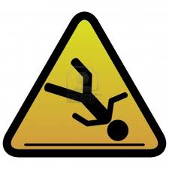
5 Warnings in Hebrews
258
Warning of discipline (2:1-4)
Warning of disinheritance (3:7-19)
Warning of death (6:4-8)
Warning of death (10:26-31)
Warning of disinterest (12:14-29)
Notes:
We have already seen three other warnings in this book…

Slide 15
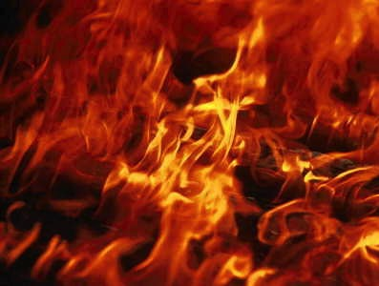
An Impossibility (Heb. 6:4-6 NLT)
"For it is impossible to bring back to repentance those who were once enlightened—those who have experienced the good things of heaven and shared in the Holy Spirit, ⁵who have tasted the goodness of the word of God and the power of the age to come— ⁶and who then turn away from God. It is impossible to bring such people back to repentance; by rejecting the Son of God, they themselves are nailing him to the cross once again and holding him up to public shame."

Slide 16
Views on the Warning Passages
266c
What group of Jews is being addressed ?
False Believer | Former Believer | Carnal Believer
People who are not really believers | Christians who sin by not seeing Christ's superiority | Christians who sin by not seeing Christ's superiority

Slide 17
Views on the Warning Passages
266c
What is the nature of their punishment ?
False Believer | Former Believer | Carnal Believer
Never had Salvation | Loss of Salvation | Loss of Reward

Slide 18
Views on the Warning Passages
266c
What is the result ?
False Believer | Former Believer | Carnal Believer
Hell | Hell | Divine Discipline

Slide 19
Views on the Warning Passages
266c
Which theological perspective
holds to this view ?
False Believer | Former Believer | Carnal Believer
Reformed | Arminian | Partakers

Slide 20
Views on the Warning Passages
266c
Strengths
False Believer | Former Believer | Carnal Believer
Signifying Hell (sees the judgment as serious) | Signifying Hell (sees the judgment as serious) | Loss of rewards as a judgment (a concept often taught in the NT)

Slide 21
Views on the Warning Passages
266c
Weaknesses
False Believer | Former Believer | Carnal Believer
Consistently speaks of the readers as genuine Christians | Temporal security goes against NT doctrine of justification by grace | 10:27 refers to judging persons, not deeds

Slide 22
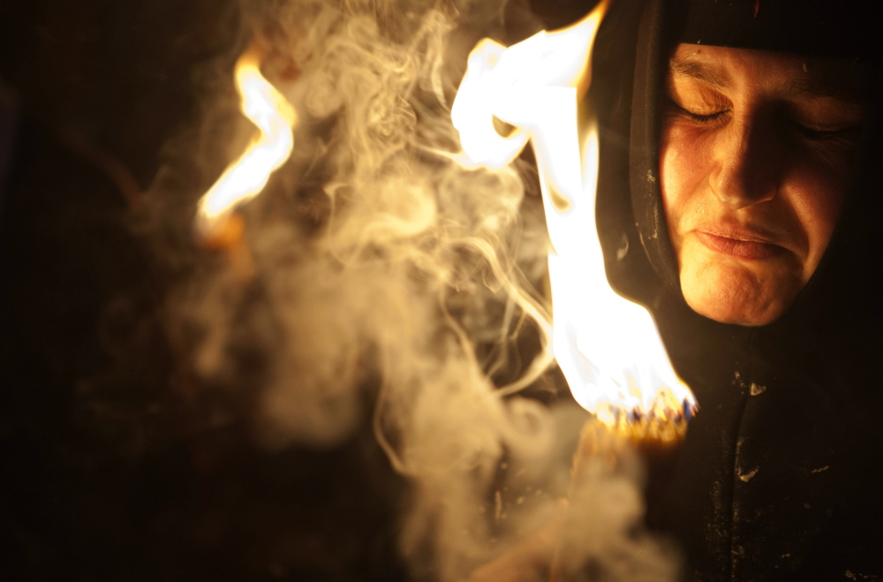
"…if we deliberately continue sinning after we have received knowledge of the truth, there is no longer any sacrifice that will cover these sins. ²⁷There is only the terrible expectation of God's judgment and the raging fire that will consume his enemies"
(10:26-27 NLT).
ARE THESE PEOPLE CHRISTIANS?
YES!

Slide 23
Why believers?
The letter repeatedly refers to the readers as believers.
They had already professed this hope in Christ (10:23).
They should build one another up in the faith (10:24-25).
They had "received the knowledge of the truth" (10:26).
The author was also could sin like this (10:26).
They had been "sanctified" (10:29).
They had faithfully suffered for Christ (10:32-34).
They had confidence in the Lord (10:35).
They needed only to persevere in that faith (10:36).
They were deemed among "the righteous" (10:38).

Slide 24
Will each genuine Christian persevere in faithfulness at death?
274i
Yes
No
Reformed
Partakers
Arminian
Apostasy
Cannot Happen
Apostasy Leads to Loss of Rewards
Apostasy Leads to Loss of Salvation
Eternal Security but No Assurance
Eternal Security
and Assurance
No Eternal Security and No Assurance
Notes:
How do scholars see perseverance and God’s discipline for the believer who turns away (10:26-31)?
• Reformed: All persevere so apostasy cannot happen—security but no assurance.
• Arminians claim they experience hell, but these readers are believers and thus already saved from hell in light of the scriptural evidence for eternal security (cf. John 3:16; 10:28-29; Eph. 1:14; 1 John 5:11-13).
• Partakers say they lose their rewards (Dillow, 542), but the fire here consumes "the enemies of God" (10:27b). It will burn up people, not burn up rewards.

Slide 25

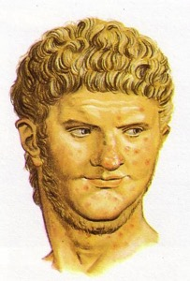
The Jewish War (AD 66-73)
257
Caesarea desecration
Jerusalem revolt
Temple sacrifice for Nero stopped
Rome sent Vespasian
Nero died
Siege of Jerusalem by Titus (April-Sept. 70)

Slide 26


Jerusalem Siege Wall (AD 70)
Josephus notes that a siege wall surrounded the entire city, including the tomb of Annas, located among the tombs of Akeldama. This lends support to these being a wealthy burial place (not Potter's Field).
Leen & Kathleen Ritmeyer, “Akeldama: Potter's Field or High Priest's Tomb?” BAR 20 (Nov/Dec 94): 34

Slide 27
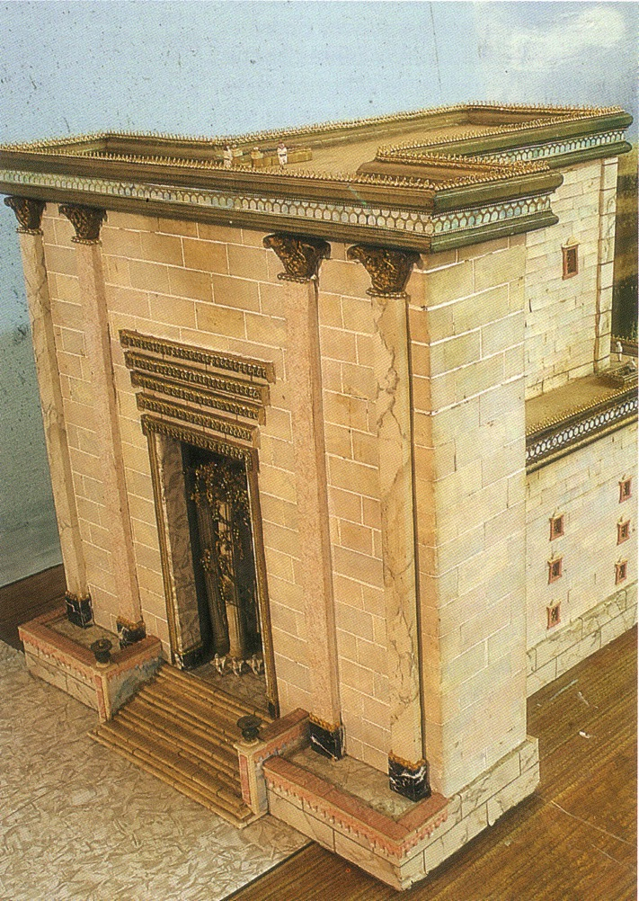
The Temple Sanctuary

Slide 28
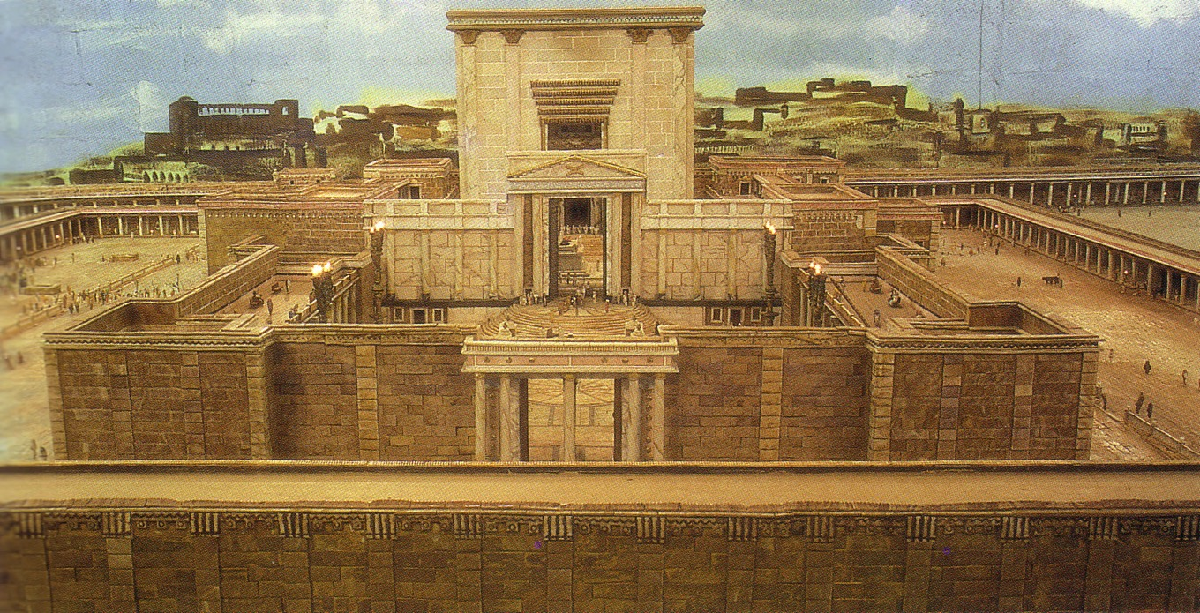
The Temple from the east

Slide 29
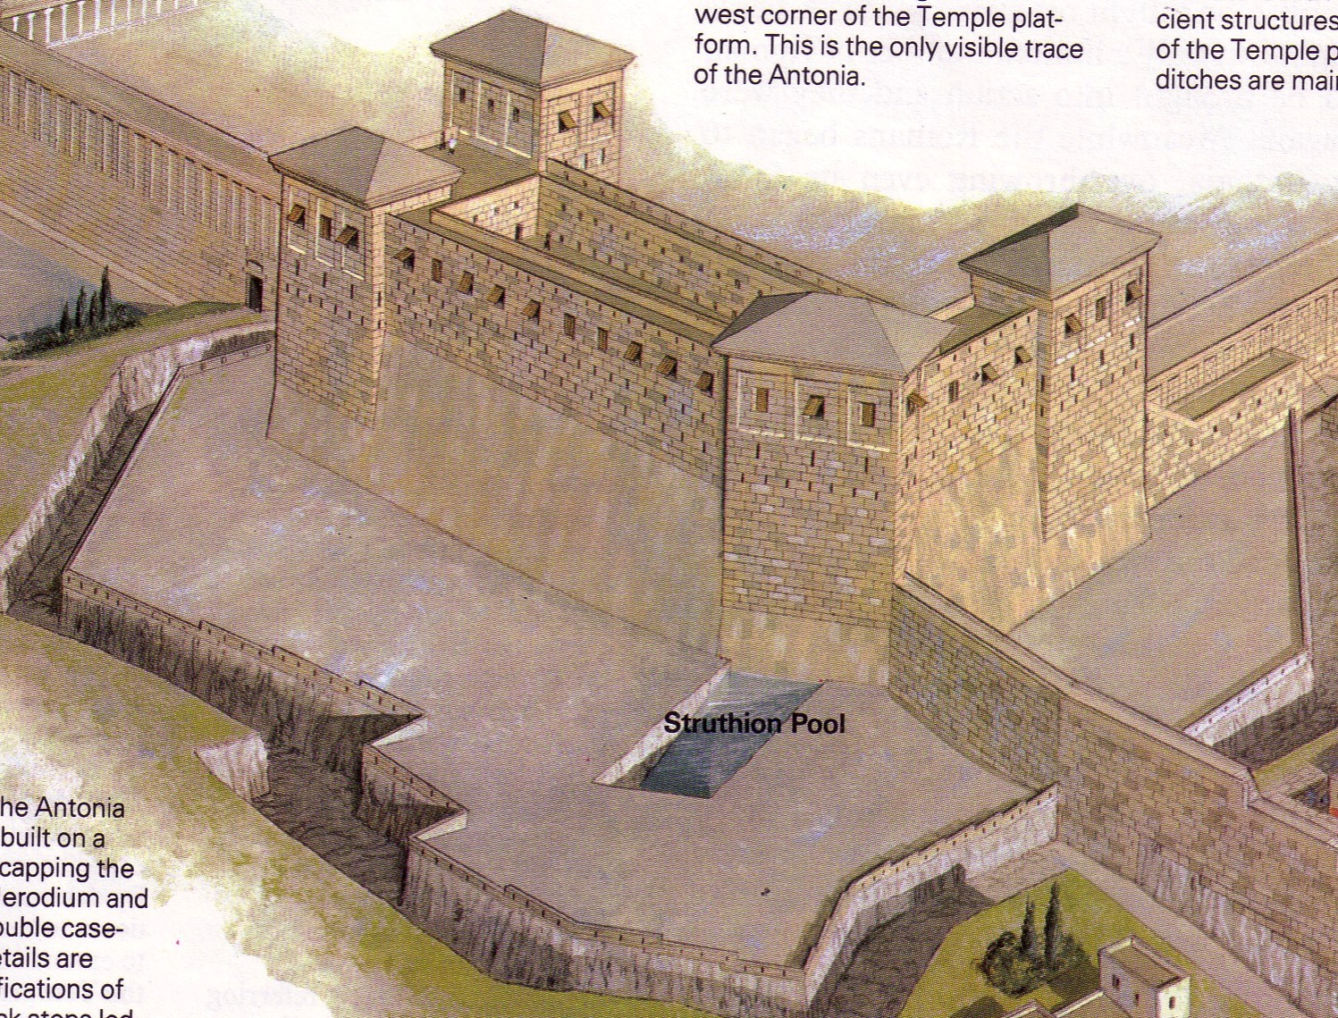
Antonia Fortress

Slide 30
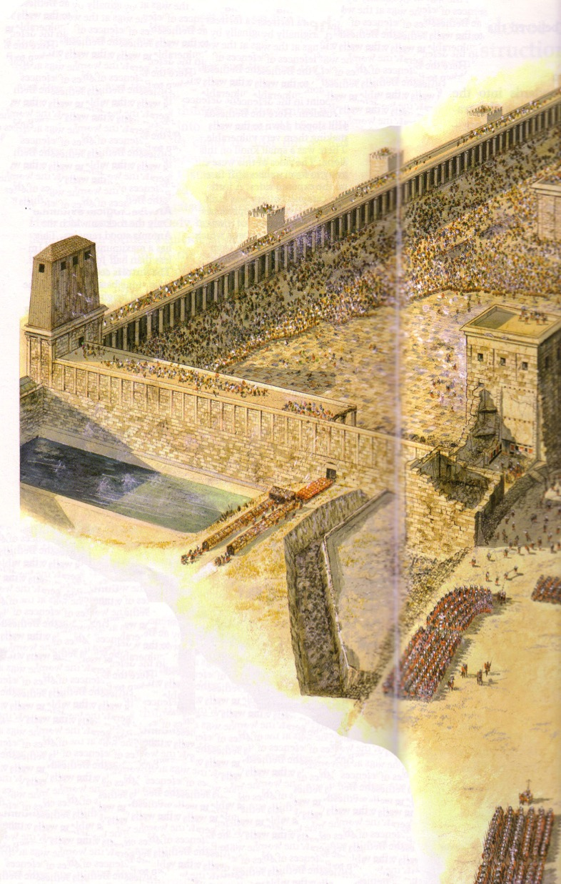
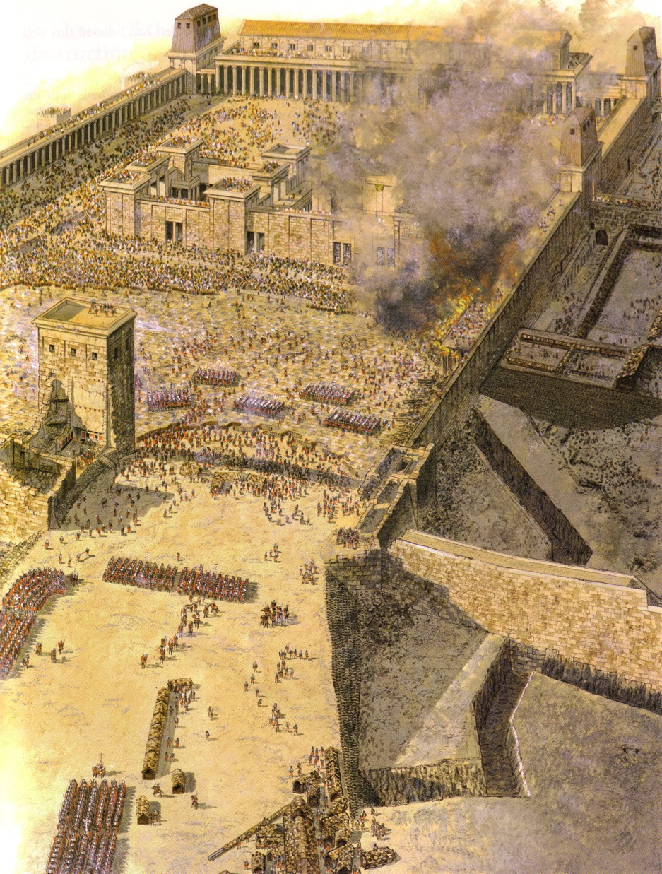
Antonia Fortress Leveled

Slide 31
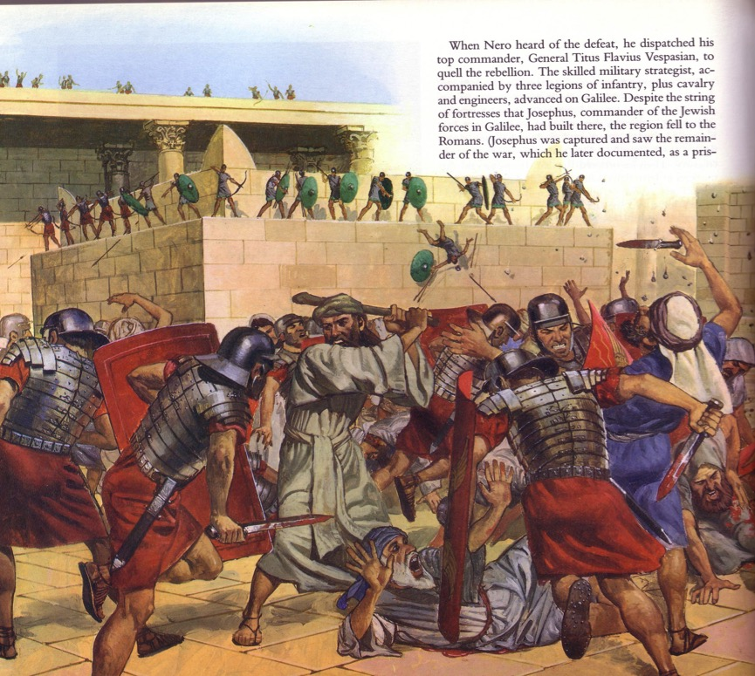
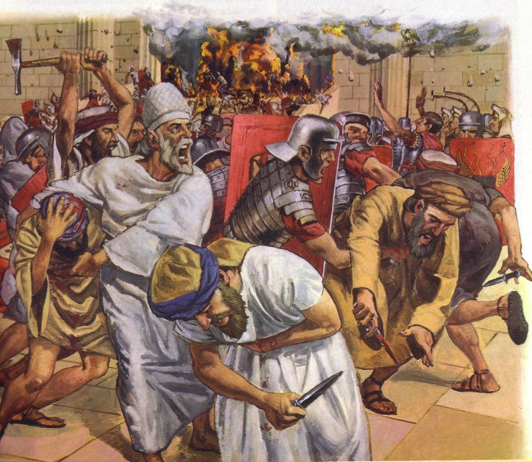
The Temple Assault

Slide 32
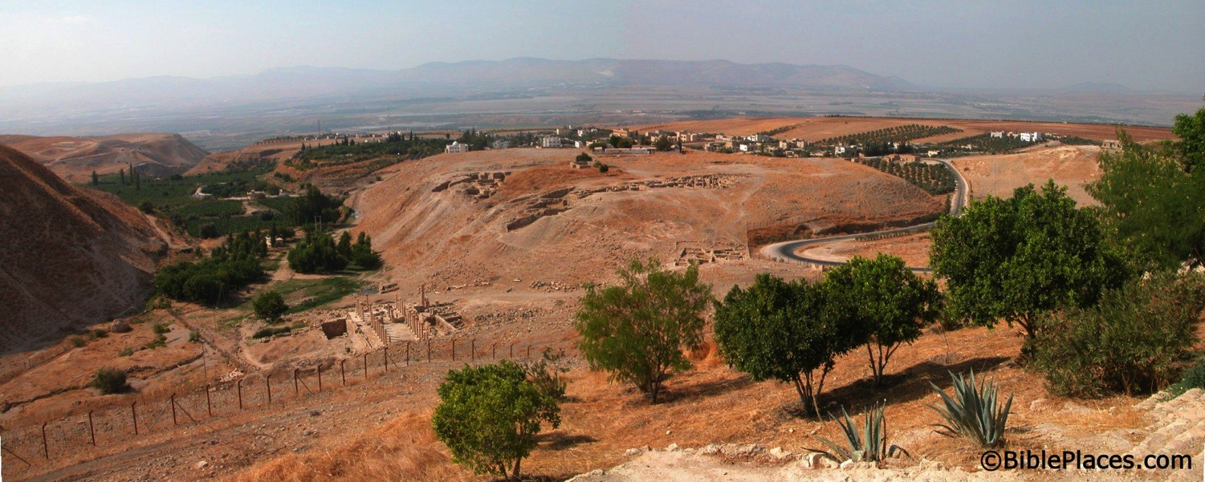
What happened to the Christians in Jerusalem?
A revelation told them to find protection in Pella.
Pella
Jerusalem
Notes:
Todd Bolen: “Pella/Pehel is not mentioned explicitly in the Bible but it was prominent in biblical times. In the days of the judges, it led a rebellion against Egypt which was crushed by Pharaoh Seti I. In NT days, Pella was the site where Christians sought refuge during the Jewish Revolt against the Romans in 66-70 A.D. Eusebius records that the Jewish believers fled here in obedience to a revelation, which some correlate with Jesus' words in Matthew 24:16. This photo views the tell from the east. Several Byzantine churches have been excavated as well as a building believed to be a Late Bronze temple. The Jordan Rift and the mountains of Israel are visible in the background.”

Slide 33

The Fire
"Dear friends, if we deliberately continue sinning after we have received knowledge of the truth, there is no longer any sacrifice that will cover these sins. ²⁷ There is only the terrible expectation of God's judgment and the raging fire that will consume his enemies" (Hebrews 10:26-27 NLT).
Hell fire?
No, Jerusalem fire!
Notes:
What would be God’s judgment on these readers if they turned away?
• Verses 26-27 define God's judgment as “the raging fire that will consume his enemies." The readers would not be forgiven and would be judged with unbelievers. But when and how?
• Most commentaries claim that this means the readers would go to hell.
But is this hell fire? If so, that would mean these Christians would then go to hell! This is against all that the NT teaches about believers having eternal life.
• No, it refers to Jerusalem fire! Their salvation was secure—but their apostasy would lead to being killed along with the unbelieving Jews who stayed in Jerusalem to protect them temple! The letter consistently calls them believers, but they would bear a punishment of unbelievers by identifying with them. Yet the fire of 10:27 is not hell fire but Jerusalem fire. It was not eternal fire but temporal fire that would take their lives along with the godless who gave their lives in AD 70 while trying to preserve a temple system that was already a generation obsolete.
__________
Common-465
BE-58-Hebrews Be Uncompromising-80
BS-09-Read Paragraphs-33
ES-10-Other Events at the Rapture-52
HS-03-Spirit Ministries to Believer-19
NP-19-Hebrews Be Uncompromising-80
NS-19-Hebrews-421, 458
OS-36-Zephaniah-38
SA-09-Perseverance-42, 66
SA-14-Eternal Security-66
SA-15-Inheritance-169

Slide 34
Hebrews 8:13
¹³ By calling this covenant “new,” he has made the first one obsolete; and what is obsolete and aging will soon disappear.
Obsolete
AD 33
Hebrews Written
AD 67-68
Disappeared
AD 70

Slide 35


Bible Study link at BibleStudyDownloads.org
Get this presentation for free!
Notes:
Bible Study (bs)

