Slide 1

Observing Things Through Drama
Dr. Rick Griffith • Jordan Evangelical Theological Seminary • BibleStudyDownloads.org

Slide 2
Postcard to Philemon
ROME
Παῦλος δέσµιος Χριστοῦ Ἰησοῦ καὶ Τιµόθεος ὁ ἀδελφὸς Φιλήµονι τῷ ἀγαπητῷ καὶ συνεργῷ ἡµῶν καὶ Ἀπφίᾳ τῇ ἀδελφῇ καὶ Ἀρχίππῳ τῷ
συστρατιωτῃ ἡµῶν καὶ τῇ κατ· οἶκόν σου
ἐκκλησίᾳ
χάρις ὑµῖν καὶ εἰρήνη ἀπὸ θεοῦ πατρὸς
ἡµῶν καὶ κυρίου Ἰησοῦ Χριστοῦ.
Dramatizing the Postcard to Philemon

Slide 3
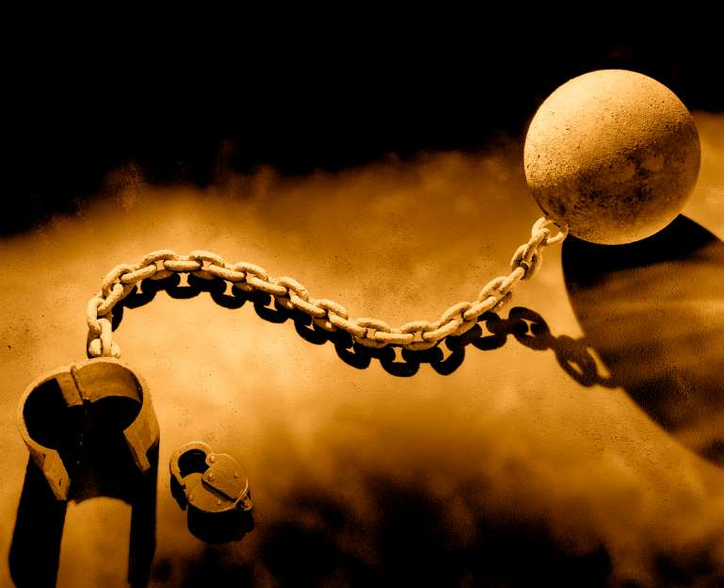
. Occasion .
246
Paul led a fugitive slave of Philemon named Onesimus to Christ

Slide 4
Book Chart
Philemon
245
Forgive Others and Seek Forgiveness
Forgive Others and Seek Forgiveness
Greeting
1-3
Prayer & Commendation
4-7
Appeal for Onesimus
8-21
Conclusion
22-25
Greeting
1-3
Prayer & Commendation
4-7
Appeal for Onesimus
8-21
Conclusion
22-25
Preface
Praise
Petition
Postscript
Preface
Praise
Petition
Postscript
People
Concerned
People
Concerned
Philemon's
Character
Philemon's
Character
Onesimus'
Conversion
Onesimus'
Conversion
Paul's
Co-Workers
Paul's
Co-Workers
Authors
1a-b
Authors
1a-b
Recipients
1c-3
Recipients
1c-3
Thanks
4-5
Thanks
4-5
Relationships
6-7
Relationships
6-7
General Appeal
8-11
General Appeal
8-11
Reasons for Return
12-16
Reasons for Return
12-16
Specific Appeal
17-21
Specific Appeal
17-21
Preparations
Greetings
Blessing
22-25
Preparations
Greetings
Blessing
22-25
Rome to Colosse
Rome to Colosse
Fall AD 61
Fall AD 61

Slide 5

. Summary Statement .
245
Paul requests the Christian slave owner, Philemon, to forgive his runaway but repentant slave, Onesimus, whom Paul led to Christ and sent back to Philemon to be received as a Christian brother and to teach forgiveness.

Slide 6
• Application •
245
With whom do you best relate to now?
Philemon
Onesimus
Paul
The Church
Notes:
Carolyn
With whom do you best relate to now?
Philemon: Whom do you need to forgive a wrong done to you?
Onesimus: Whose forgiveness do you need to request?
Paul: How can you help two others reconcile?
The Church: How can you affirm the reconciliation of others?

Slide 7
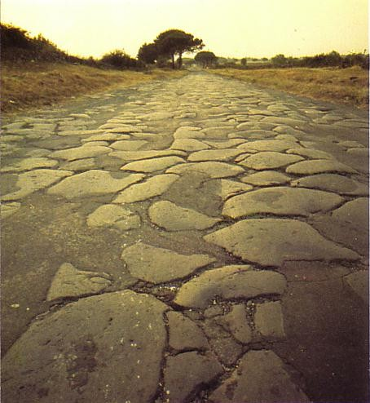
Basic Steps to Gain a Forgiving Spirit
252
1. Realize that God is working through the actions of your offender
2. Thank God for the benefit He plans through each offense
3. Discern what character qualities God wants to develop in me through the offense
4. Expect to suffer for doing right as a normal part of Christian living
The Via Appia, "Queen of Roman roads," which was the road from Rome that Onesimus took back to Colosse for Philemon's forgiveness
Bill Gothard, IBLP

Slide 8


How do I ask forgiveness?
253
Never say, "I'm sorry"
(period/full stop).
Say, "Will you forgive me for ___________"
(specify your offense).
Philemon 10,18
Notes:
Carolyn

Slide 9

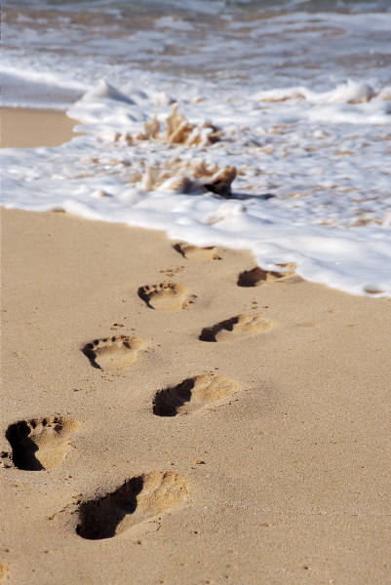
How do I ask forgiveness?
253
Not by phone or letter or fax or text message or facebook or Twitter or email or through mediators…
Onesimus traveled 1400 km to speak to Philemon in person
Notes:
Carolyn

Slide 10
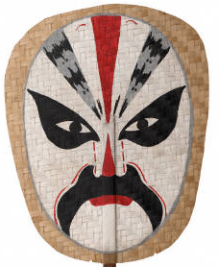
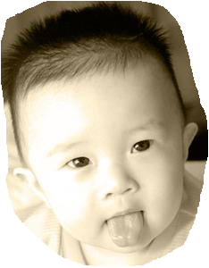
How do I ask forgiveness?
253
Demonstrate humility without concern for saving face.
Philemon 1,8-9, 14 (cf. Gal. 6:1b,3-4)
Notes:
Carolyn

Slide 11
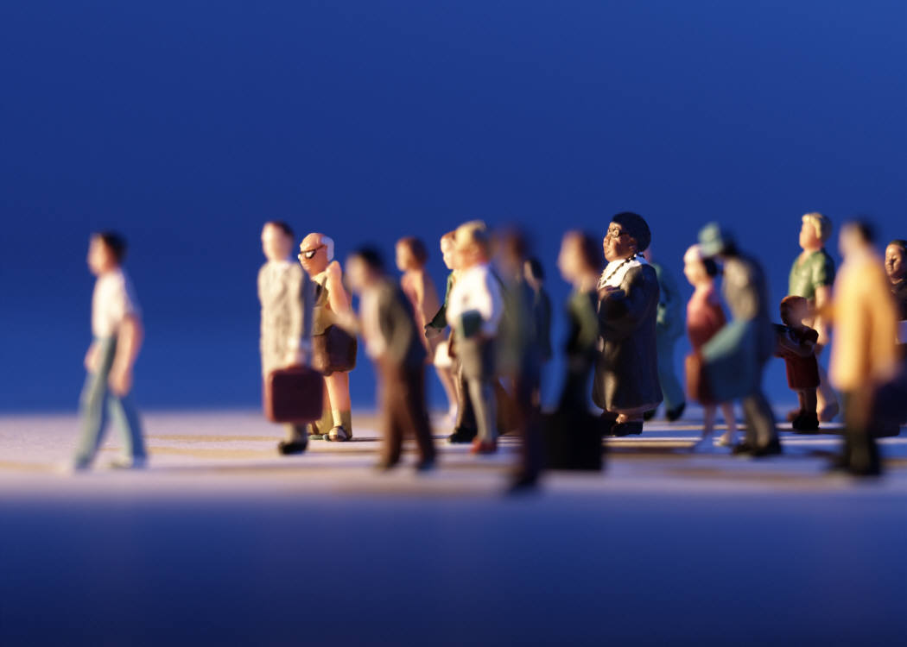
How do I ask forgiveness?
253
Remember that your response is not a private issue, but public, involving many people.
Philemon 1-2, 25 (plural)
Notes:
Carolyn

Slide 12
How do I ask forgiveness?
253
Make the request for
forgiveness as public
as the offense.
Public sins require public apology
(1 Tim. 5:20)
Private sins require private apology (Matt. 18:15)
Notes:
Carolyn

Slide 13
Restoring Relationships
253
General Principle
Romans 12:18
"If it is possible, as far as it depends on you,
live at peace with everyone."
For the Offender: GO!
Matthew 5:23-24
James 5:16
For the Offended: GO!
Matthew 18:15
Galatians 6:1
Notes:
What does the Bible have to say….

Slide 14


Bible Study link at BibleStudyDownloads.org
Get this presentation for free!
Notes:
Bible Study (bs)

