Slide 1
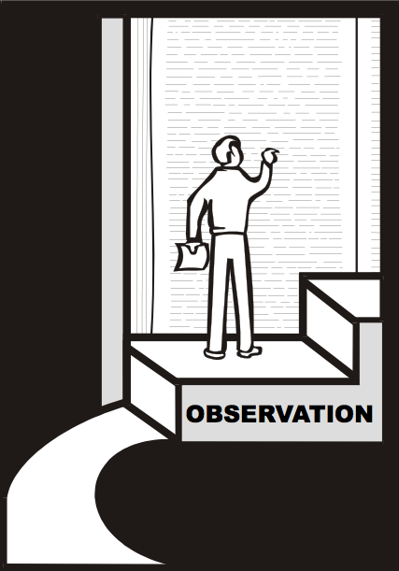
Observation
We must observe before we can interpret!
18
Dr. Rick Griffith • Jordan Evangelical Theological Seminary • BibleStudyDownloads.org

Slide 2
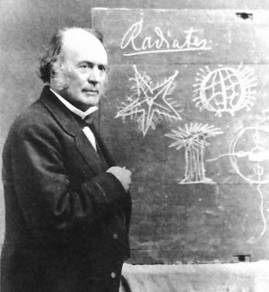
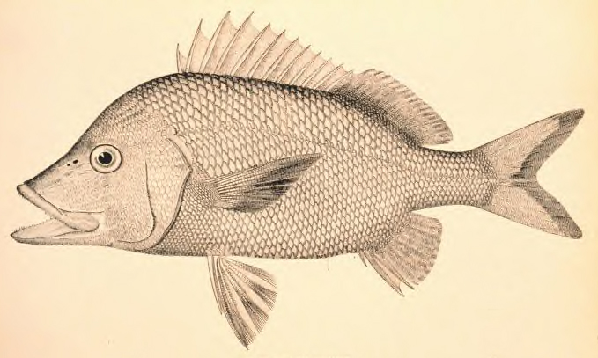
The Student, the Fish, & Agassiz
23-25
Please tell the person next to you the point of this story
"We all miss many blessings in life because we don't work at simply observing!"

Slide 3
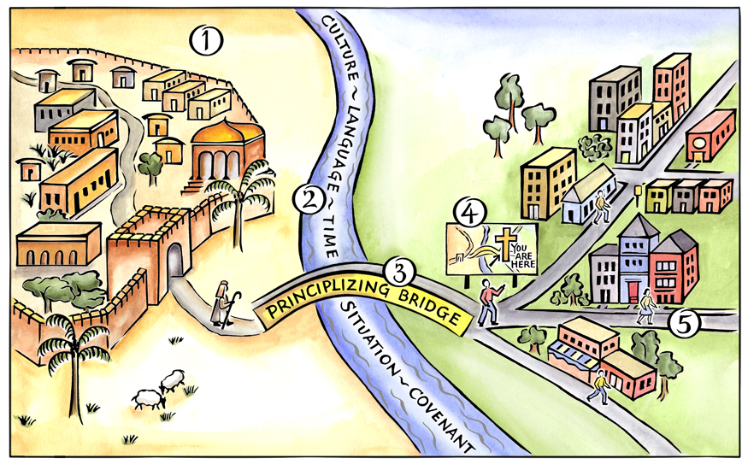
Basics of the Journey
Their Town
Our Town
Biblical Map
River Measurement
Principlizing Bridge
Duvall & Hays, Grasping God's Word
Notes:
Above is a pictorial representation of our consistent approach to biblical interpretation. We call it the Interpretative Journey. There are 5 steps on this journey:
Grasping the Text in Their Town
Measuring the Width of the River to Cross
Crossing the Principlizing Bridge
Consult the Biblical Map
Grasping the Text in Our Town
By embarking on this journey we commit to the goal of grasping the meaning of text. We do not create meaning out of a text; rather, we seek to find the meaning that is already there.

Slide 4
The Inductive Approach
20
 | Book (Synthetic)
Observe (What do I see?) | Passage or Detail (Analytical) | Interpret the Observations (What does it mean?)
 | Topic (Topical)

Slide 5
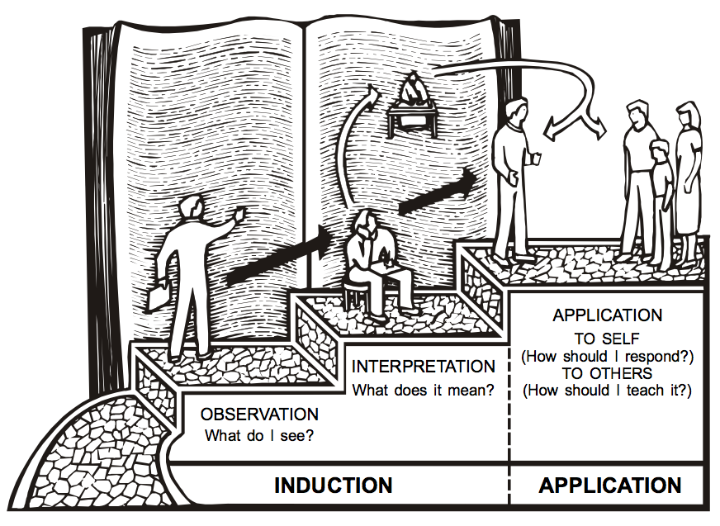
The 3-Step Process
20

Slide 6
Basics of the Journey
Observation
Application
Their Town
Our Town
Interpretation
Biblical Map
River Measurement
Principlizing Bridge
Duvall & Hays, Grasping God's Word
Notes:
Above is a pictorial representation of our consistent approach to biblical interpretation. We call it the Interpretative Journey. There are 5 steps on this journey:
Grasping the Text in Their Town
Measuring the Width of the River to Cross
Crossing the Principlizing Bridge
Consult the Biblical Map
Grasping the Text in Our Town
By embarking on this journey we commit to the goal of grasping the meaning of text. We do not create meaning out of a text; rather, we seek to find the meaning that is already there.

Slide 7
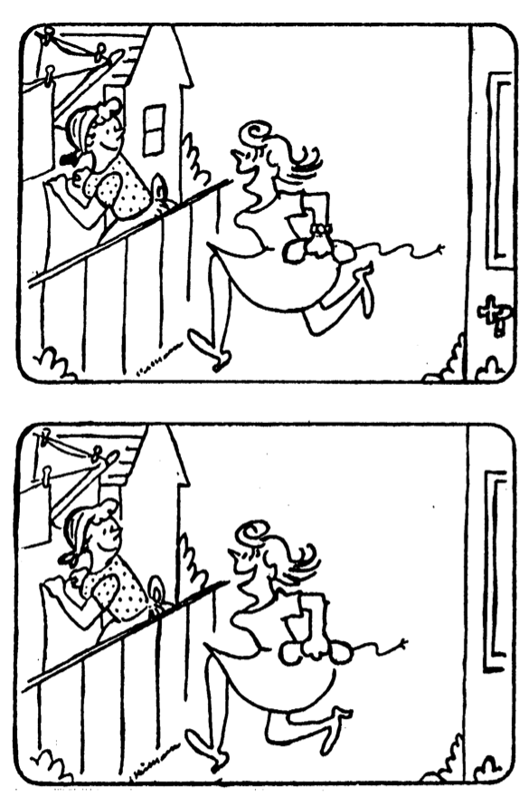
Observe Six Differences Between the Drawings
19
Notes:
True of Lower Picture (L to R): Shorter sheet, no window, legs closer together, shorter cord, no faucet, no bracelet
Also: blonde ponytail, wider apron bow, dot on eaves, grass dot on fence, elbow hair, fly flew away from window

Slide 8
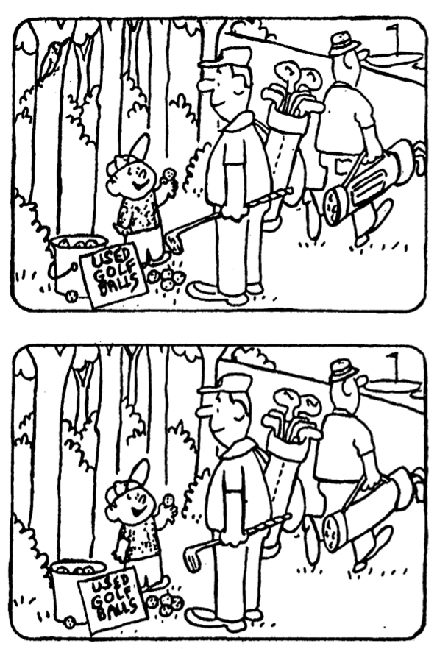
Observe Six Differences Between the Drawings
19
Notes:
True of Lower Picture (L to R): No bird in tree, no pail handle, boy short sleeve, shorter club, no bag pocket, no walking man pocket
Also: No fly on left pail golf ball, boy left thumb not bent, bottom of four golf balls has 3 dots, club twisted, "Golf" has dot, boy's dots missing on chest, flag black

Slide 9
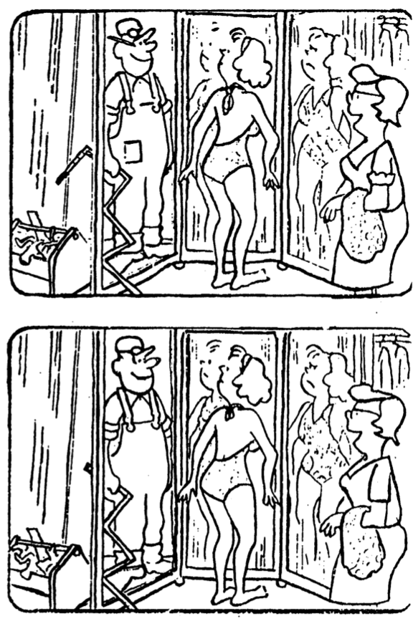
Observe Six Differences Between the Drawings
19
Notes:
True of Lower Picture (L to R): Shorter measuring tape, no pencil on ear, no pocket, shorter swimsuit back tie, no blouse sleeve cuff, higher neckline
Also: Left glass pane reflection lines, worker chest line crosses completely, dot on breast, swimsuit pattern differs, swimsuit lady right hand has only 3 fingers & spine dot

Slide 11
Bible Study link at BibleStudyDownloads.org
Get this presentation for free!
Notes:
Bible Study (bs)

