Slide 1

Biblical Interpretation & Study Methods
Syllabus
Dr. Rick Griffith • Jordan Evangelical Theological Seminary • BibleStudyDownloads.org

Slide 2
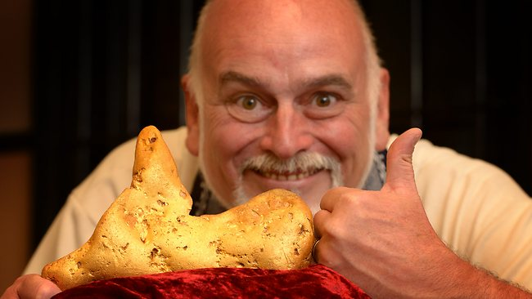
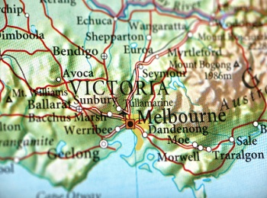
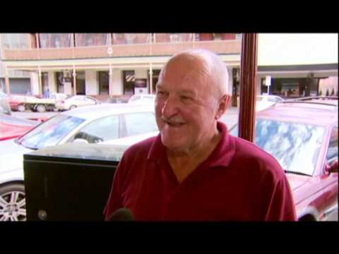
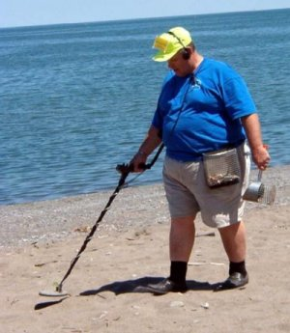
Australian Gold
Notes:
"TIME TO BUY A METAL DETECTOR
11 pound gold nugget found in Australia by guy with metal detector
January 17, 2013, 11:58 AM
Pack your bags, gold bugs! An Australian prospector using a state-of-the-art metal detector has discovered a gold “nugget” that weighs as much as some small dogs, the BBC reports.The 5.5 kg (11 pound) nugget was found about 2 feet below the surface of the ground near the town of Ballarat, in Victoria, according to the report. (See map below.)The gold in the nugget is worth more than $300,000 at current prices. But the size of the sample likely makes it worth even more. Gold was first discovered in the area more than 160 years ago."
http://www.theburningplatform.com/?tag=gold-nugget accessed 24 Jan 2013

Slide 3

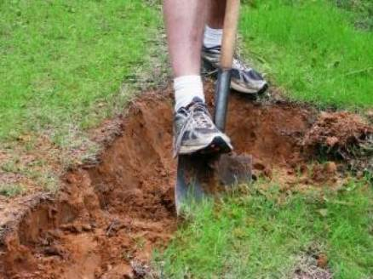
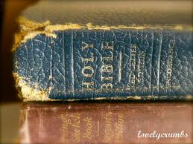
Scripture Gold
"Your instructions are more valuable to me than millions in gold and silver”
(Psalm 119:72 NLT).
Notes:
"Application:
You may not have access to an ultra powerful metal detector, but God has made His Spirit available to all. And the Holy Spirit is all you need to probe deeper into the depths of God's Word and grasp truths that the casual reader will pass by without knowing the true value of what he is missing.
Beyond the realm of what can be seen, heard, or touched are treasures of eternal worth, just waiting to be discovered. And when you discover them, you give others hope that the riches of God's Word can be theirs, as well.
"Let the word of Christ dwell in you richly as you teach and admonish one another with all wisdom, and as you sing psalms, hymns and spiritual songs with gratitude in your hearts to God" (Colossians 3:16).
"Your laws are my treasure; they are my heart's delight" (Psalm 119:111, NLT)."
Illustration Exchange 24 Jan 2013

Slide 4
Scripture Gold
"Truly, I love your commands more than gold, even the finest gold"
(Psalm 119:127 NLT).
Notes:
"Application:
You may not have access to an ultra powerful metal detector, but God has made His Spirit available to all. And the Holy Spirit is all you need to probe deeper into the depths of God's Word and grasp truths that the casual reader will pass by without knowing the true value of what he is missing.
Beyond the realm of what can be seen, heard, or touched are treasures of eternal worth, just waiting to be discovered. And when you discover them, you give others hope that the riches of God's Word can be theirs, as well.
"Let the word of Christ dwell in you richly as you teach and admonish one another with all wisdom, and as you sing psalms, hymns and spiritual songs with gratitude in your hearts to God" (Colossians 3:16).
"Your laws are my treasure; they are my heart's delight" (Psalm 119:111, NLT)."
Illustration Exchange 24 Jan 2013

Slide 5


Our People
Susan teaches church women
Notes:
I also lead the woman's Precept Bible study at our church

Slide 6

LADIES BIBLE STUDY ON
1-2 THESS
USA • Singapore • New Zealand • Holland

Slide 7

Thailand • Mongolia • Myanmar • Indonesia
Notes:
INTERVIEWER: And Susan, what ministries has the Lord granted you?
SUSAN: I have been teaching the wives of leaders at SBC. These 5 women come from 5 different nations!
SUSAN: I also lead the woman's Bible study at our church

Slide 8
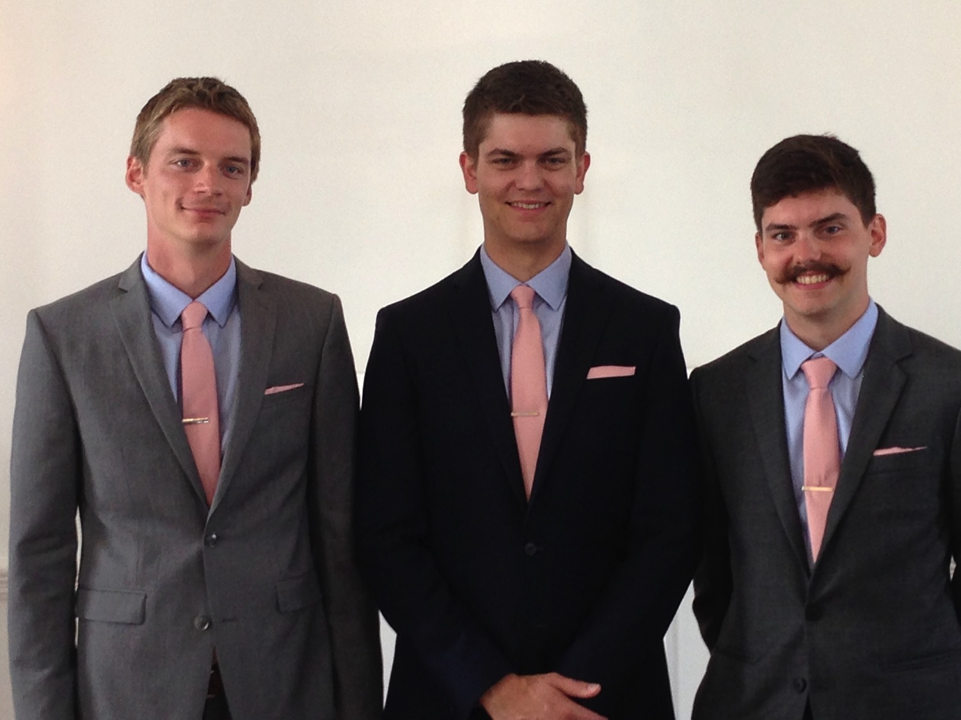
Our Three Sons

Slide 9
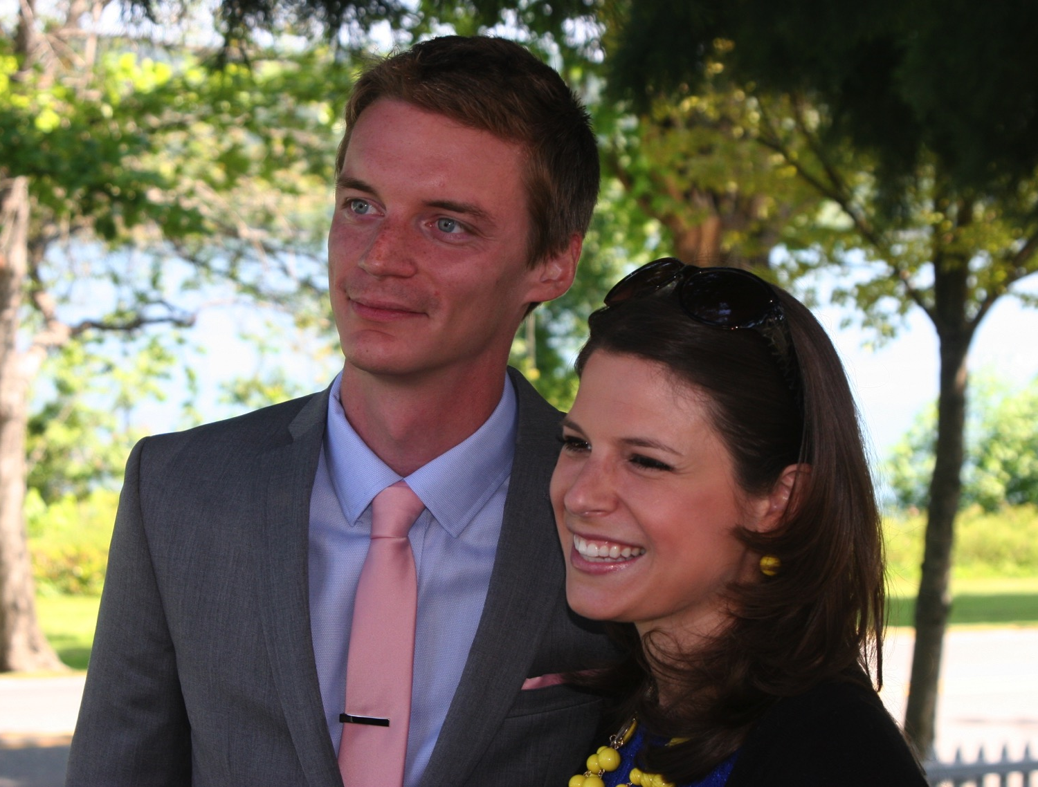
Kurt works in IT
9g

Slide 10
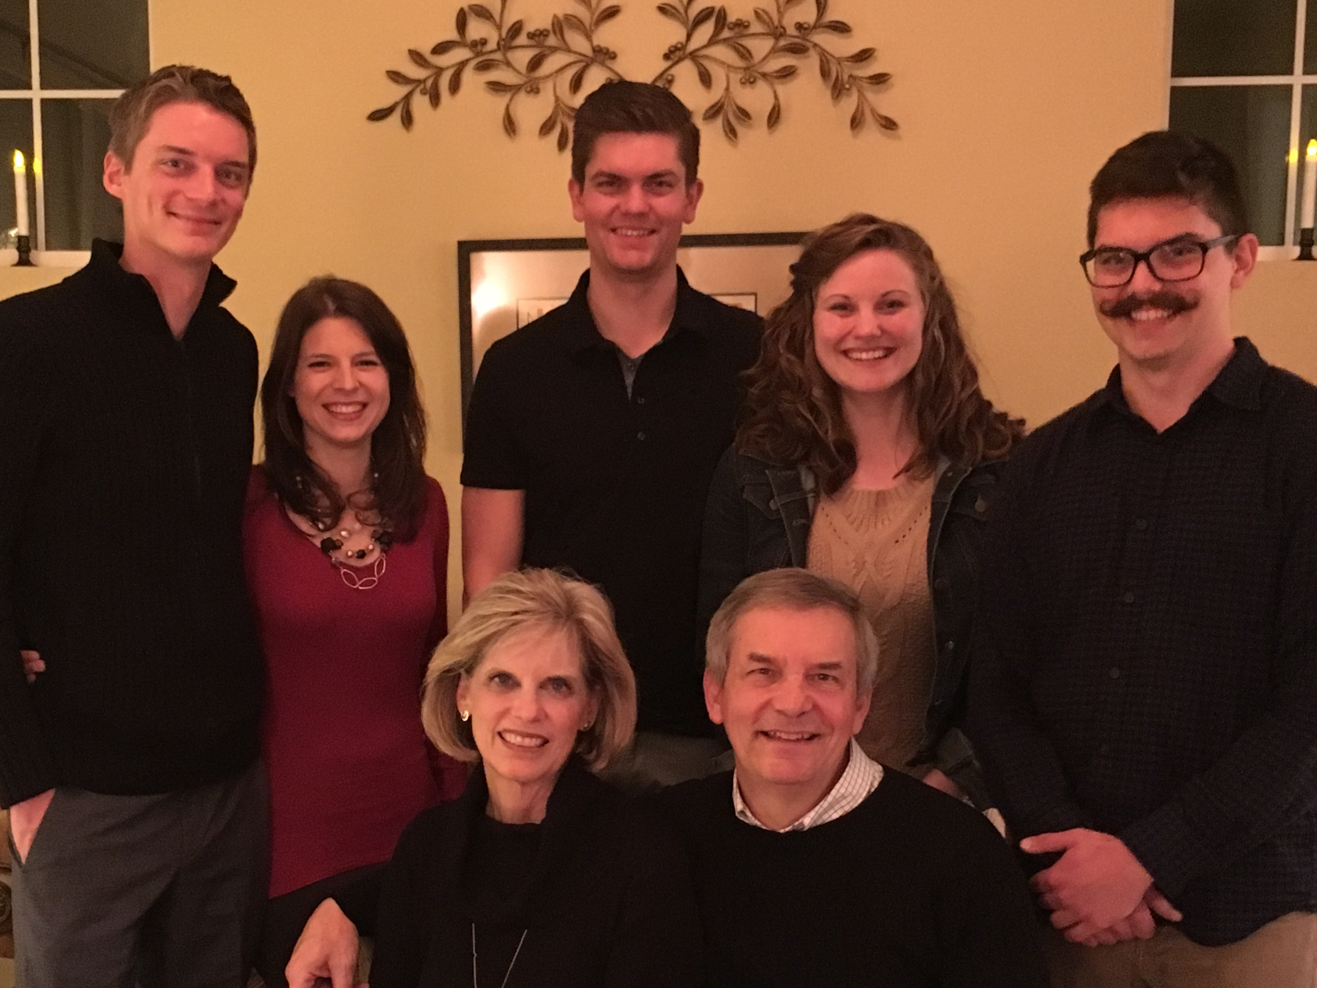
The Griffiths
9 Jan 2016
2017
Stephen & Katie (27)
John
(24)
Kurt & Cara (30)
Susan & Rick

Slide 11
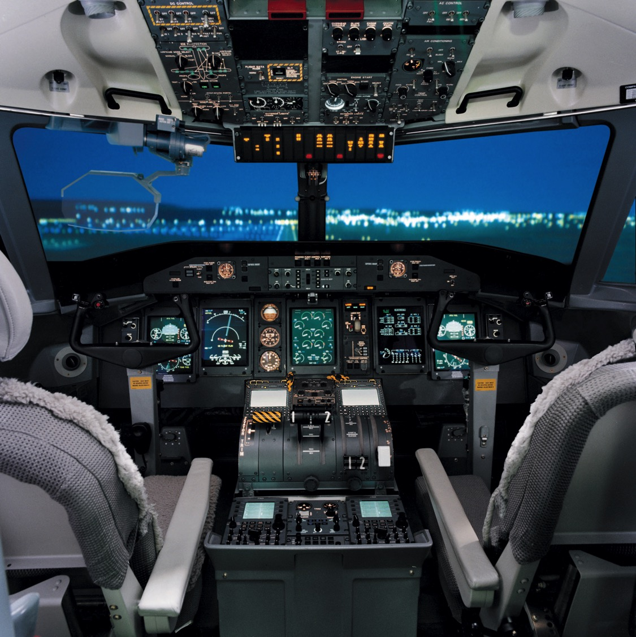
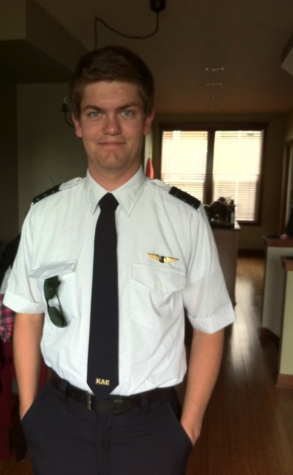
Stephen is a pilot with Spirit Airlines, Boise, Idaho
6

Slide 12
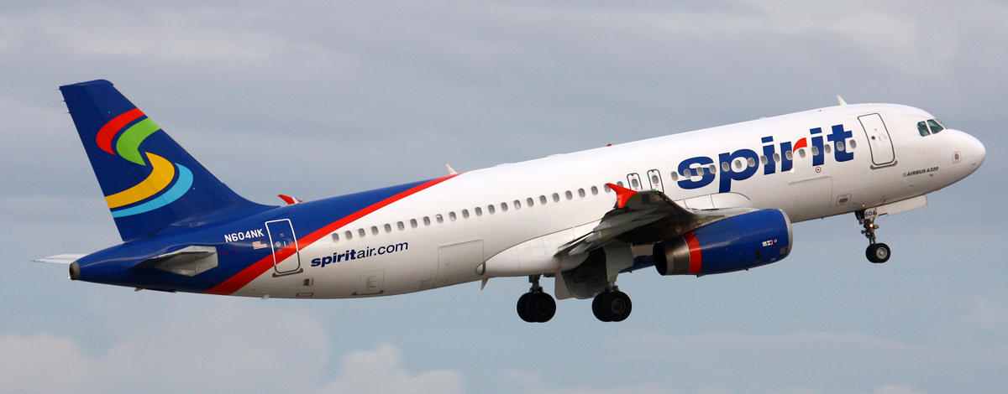
Spirit Airbus A320
8
Stephen's Plane

Slide 13
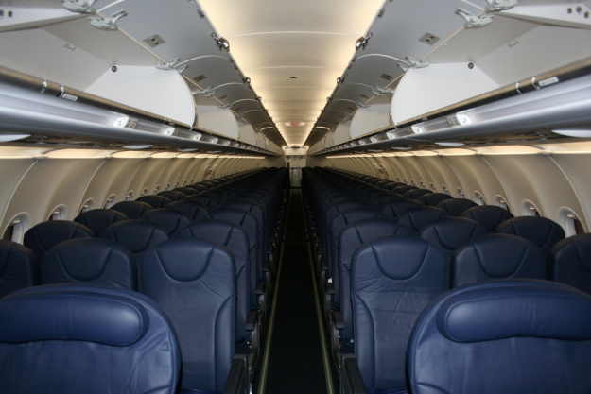
Stephen flies 174 passengers
8

Slide 14
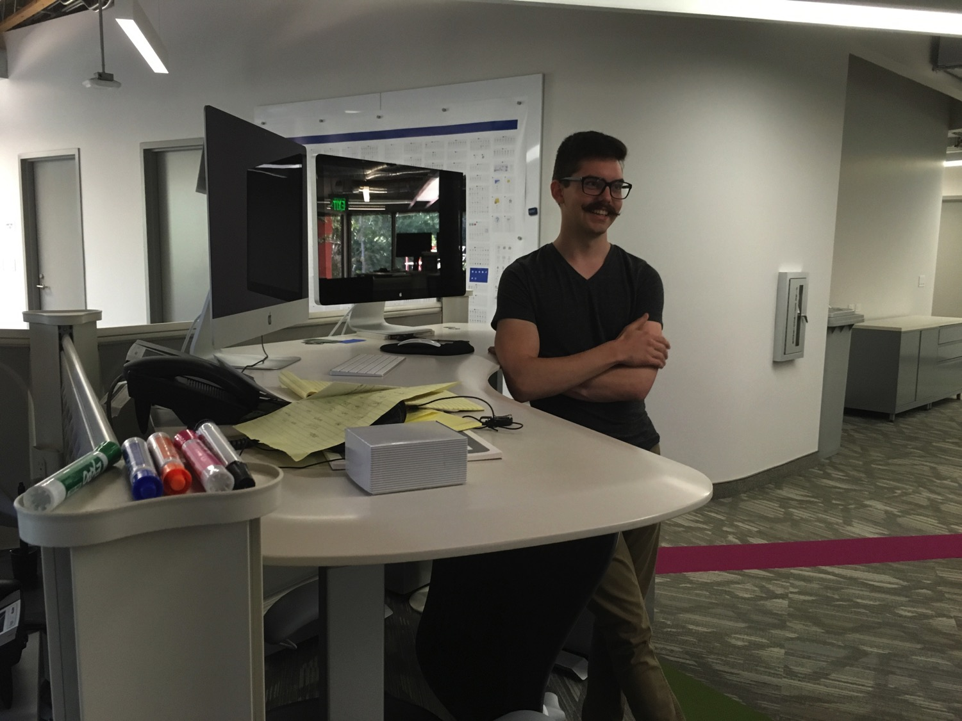

John (24) is a graphic artist in Redlands, California
8

Slide 15

Our Mission Organization…

Slide 16
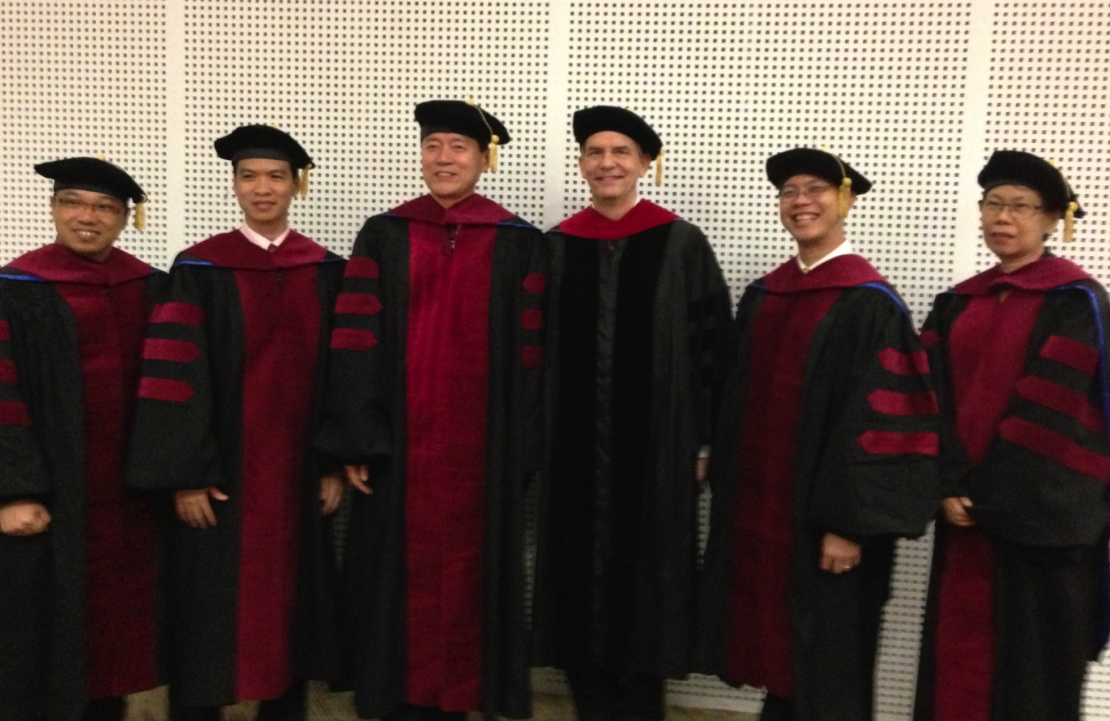
I direct the SBC Doctor of Ministry studies (DMin)
9
Notes:
I'm also the director of the doctoral program at SBC that trains about 80 seminary professors and pastors throughout Asia in English and Chinese. Generallly each year about 5 of them received their Doctor of Ministry degree.

Slide 17
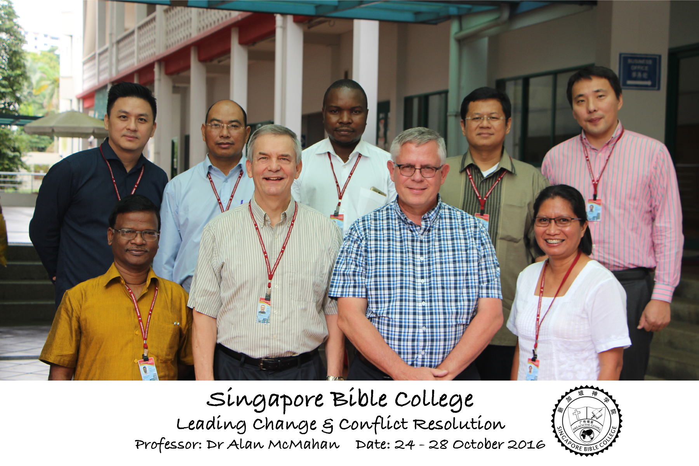
Leading Change & Conflict Resolution
(Dr. Alan McMahan Oct 2016)

Slide 18

SINGAPORE BIBLE COLLEGE
9
Notes:
I've served as a seminary professor with 30 other faculty at Singapore's largest training school: Singapore Bible College

Slide 19
SBC Courses I Teach
(English • Bahasa • Chinese)
Survey • The Bible…Basically
OT NT Bible Study
Backgrounds • Research & Writing
OT NT Geography
Theology • Creation • Jesus
Church • Spirit • Salvation • Future
Preaching
Homiletics 1 Homiletics 2
Notes:
I get to teach these leaders every book of the Bible in survey courses, plus backgrounds to both the OT and NT, three areas of theology, and how to preach.

Slide 20
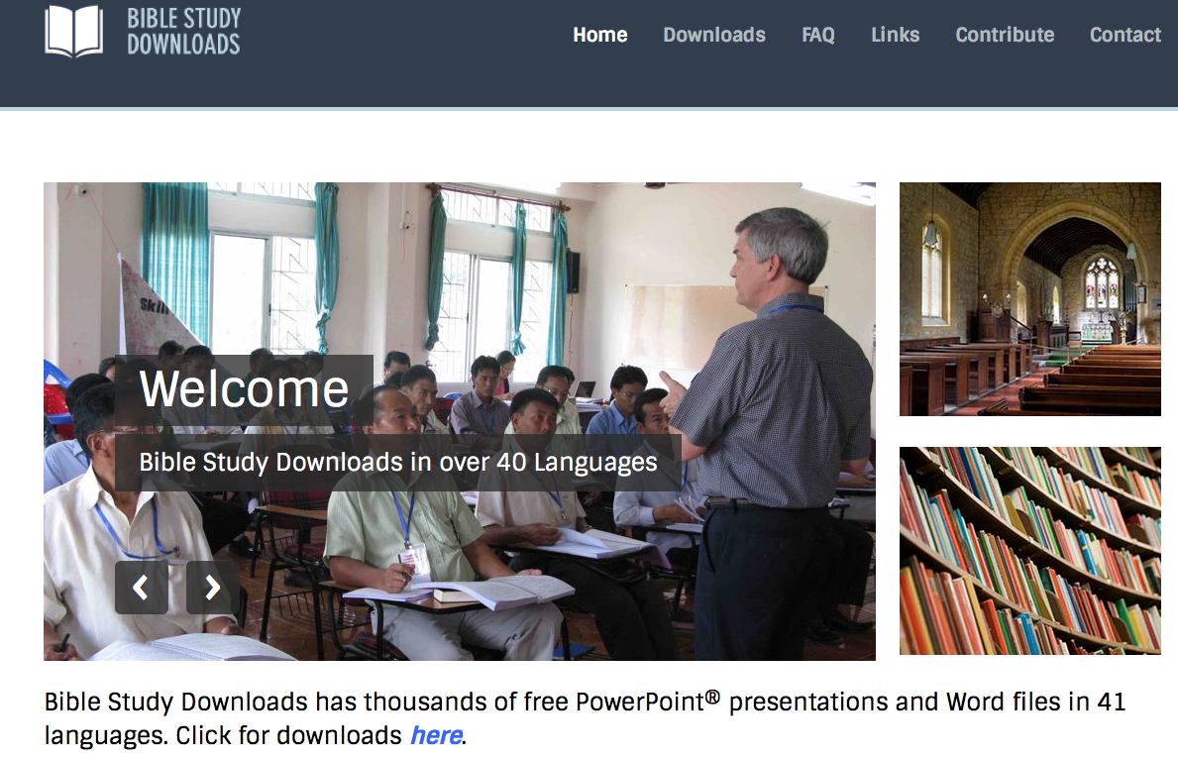
BibleStudyDownloads.org
7
Notes:
This has resulted in Bible teaching and study materials—mostly PowerPoint—in 42 languages! All a teacher needs to do is to click on a file and it downloads for free to teach any book of the Bible and many other subjects.

Slide 21
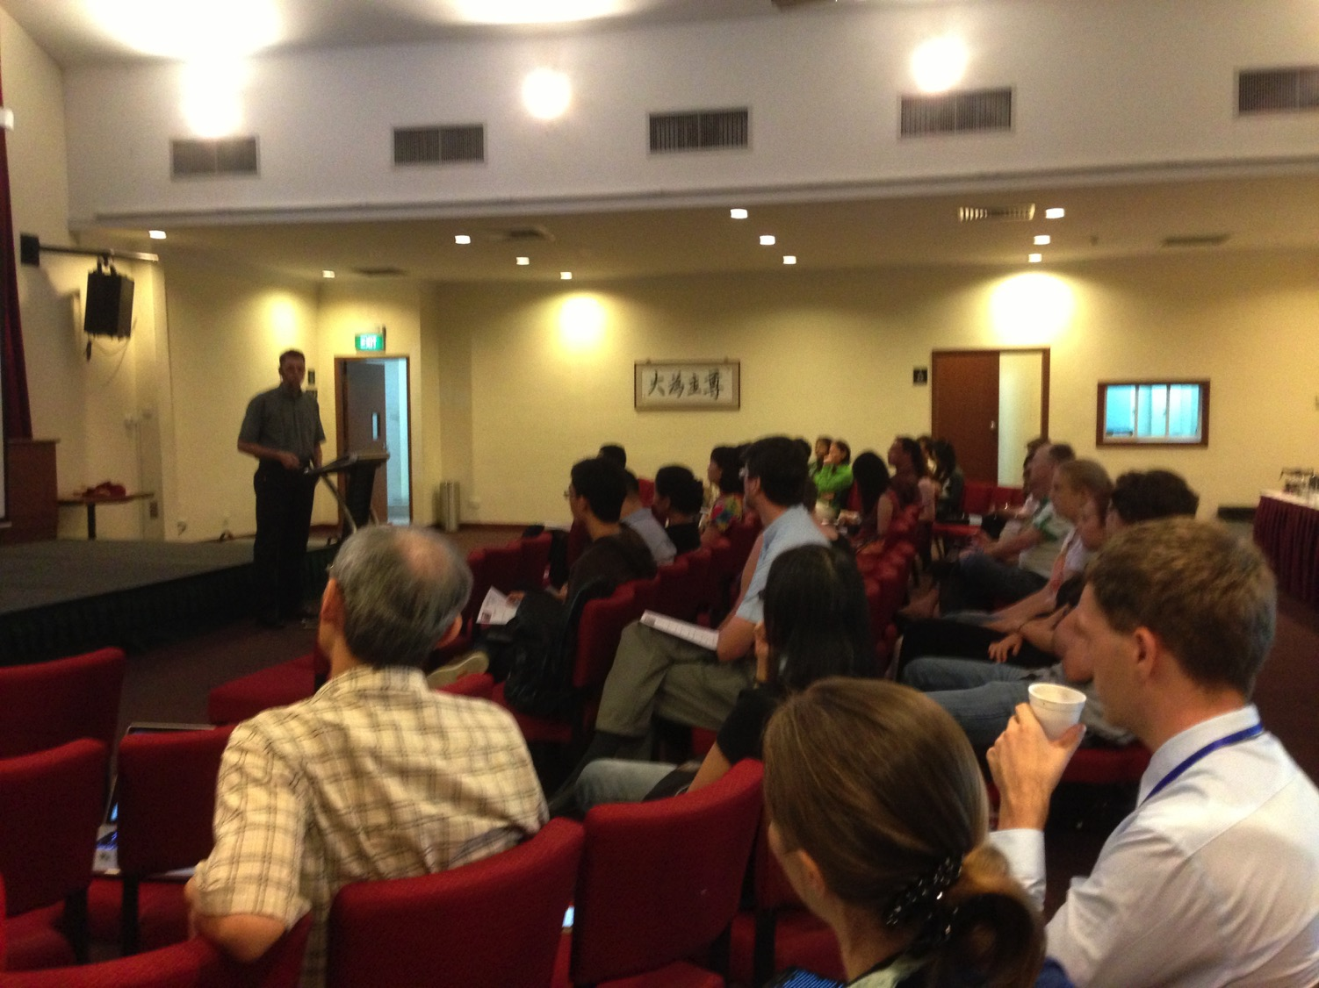
Our People
9
37 people from 12 nations
January 2017

Slide 22

Our People
9
SBC students serve at church
Notes:
One special joy is mentoring my students who serve with us at church and led ministries to youth, children, home groups, and the worship team.

Slide 23
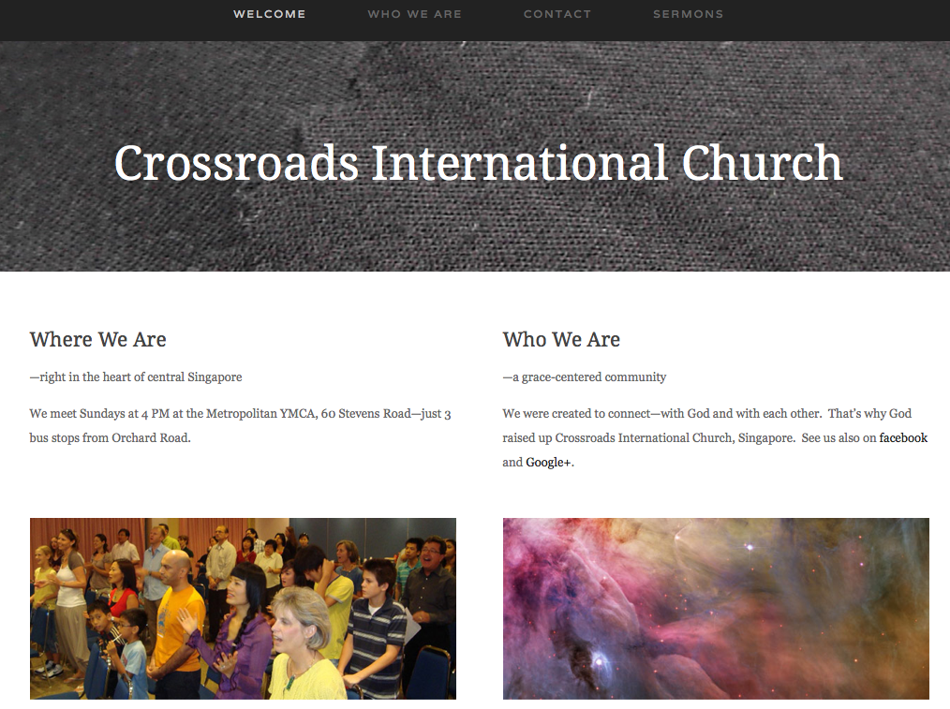
www.cicfamily.com

Slide 24
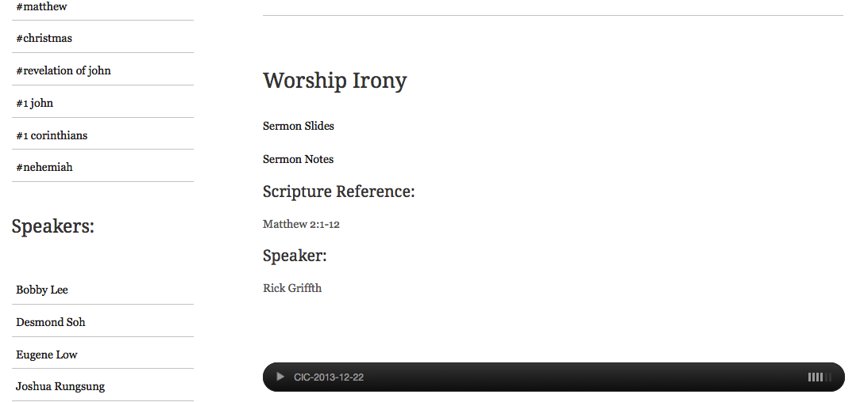
www.cicfamily.com

Slide 25

Teaching Ministry 1997-2017
MONGOLIA
JORDAN
KOREA
CHINA
NEPAL
MYANMAR
INDIA
THAILAND
VIETNAM
MALAYSIA
SRI LANKA
SINGAPORE
SBC
INDONESIA
Notes:
From 1997-March 2017 God has seen fit to grant me the privilege to train pastors in 12 other countries on 60 trips. Often pastors in the US team-teach with me on these trips.

Slide 26
Ministries God Gave Us
WorldVenture Singapore field leader
Singapore Bible College Bible & preaching professor
Singapore Bible College Doctor of Ministry director
Adjunct Professor teaching in 12 nations
The Bible…Basically translation director
BibleStudyDownloads.org web author
Crossroads International Church pastor-teacher

Slide 27
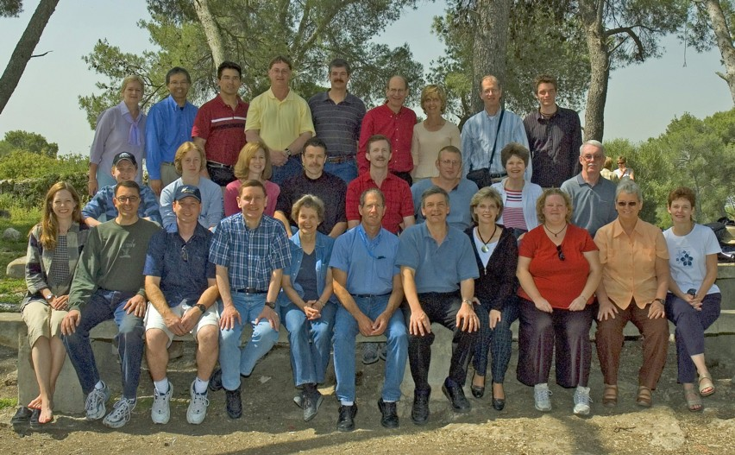
WorldVenture Seminary Professors in Israel

Slide 28
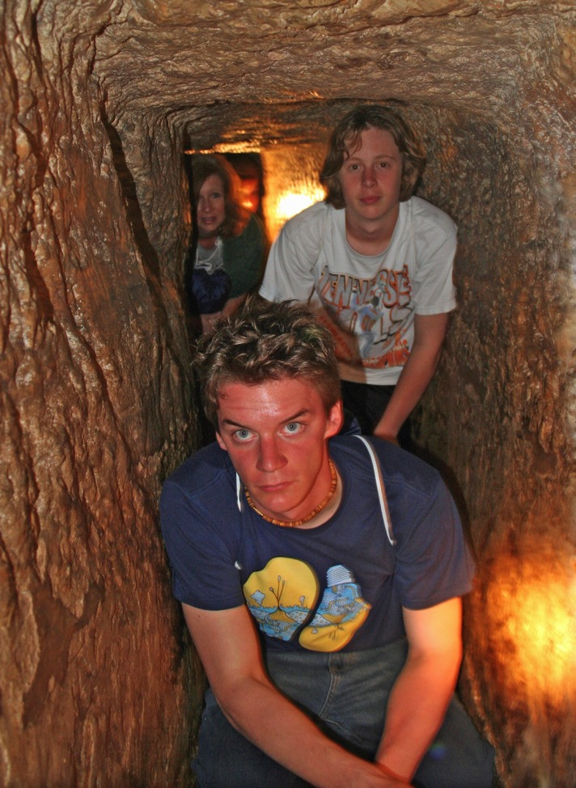
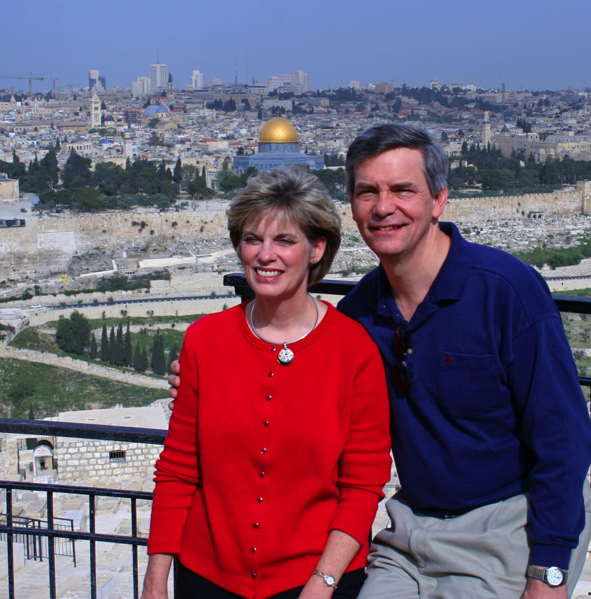
Susan & Rick at Mount of Olives
Kurt in
Hezekiah’s Tunnel

Slide 29
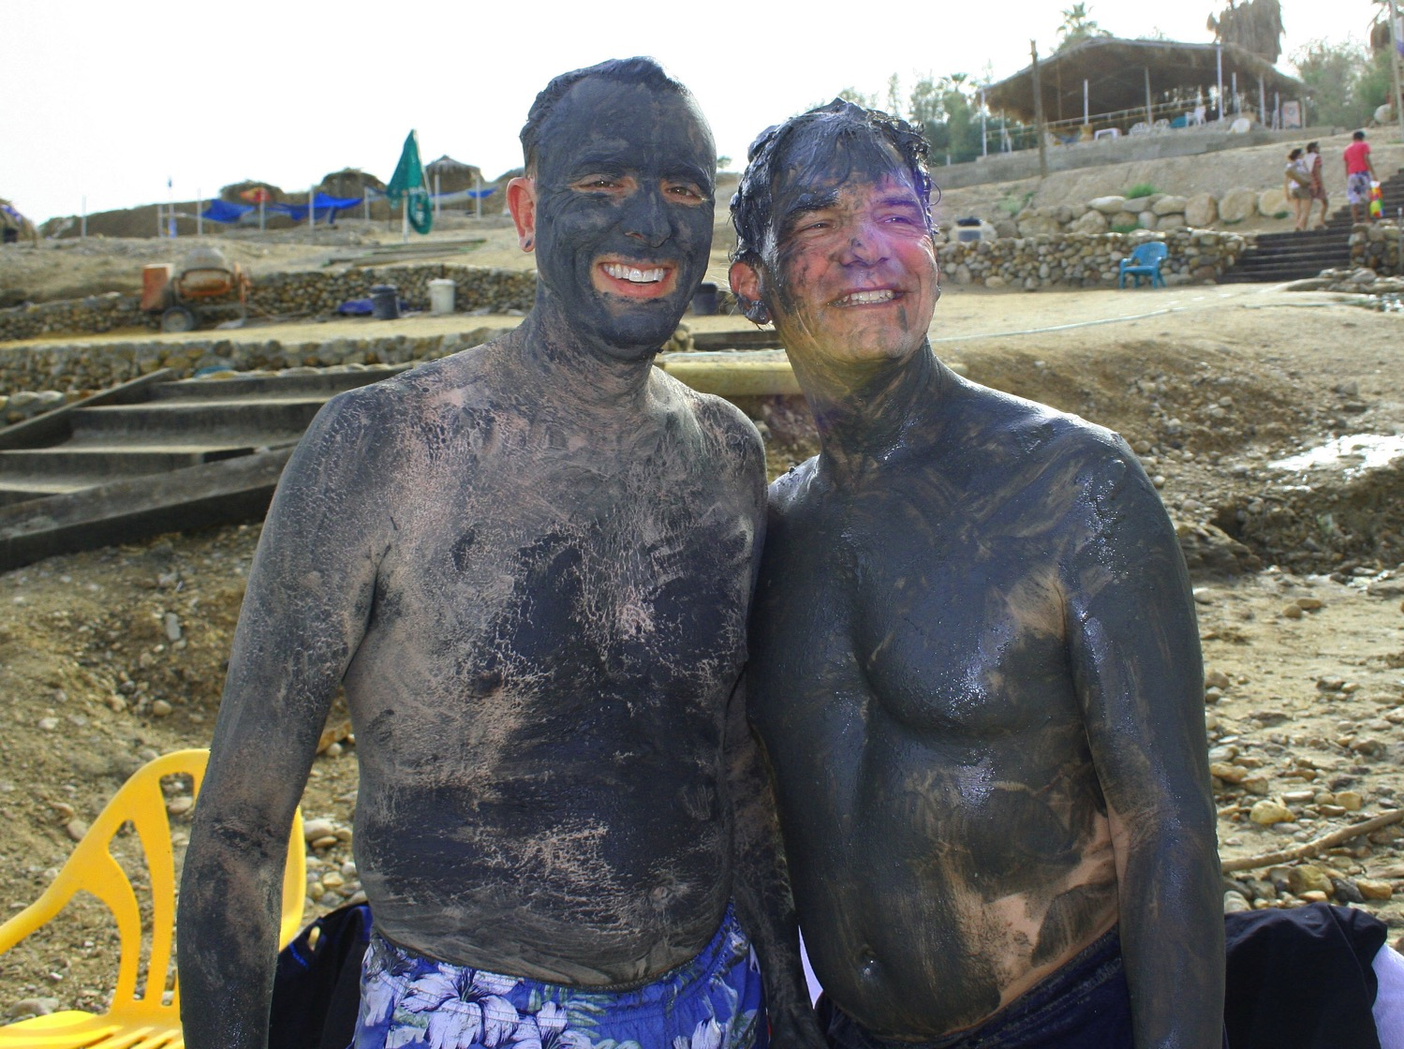
Dead Sea Mud

Slide 30
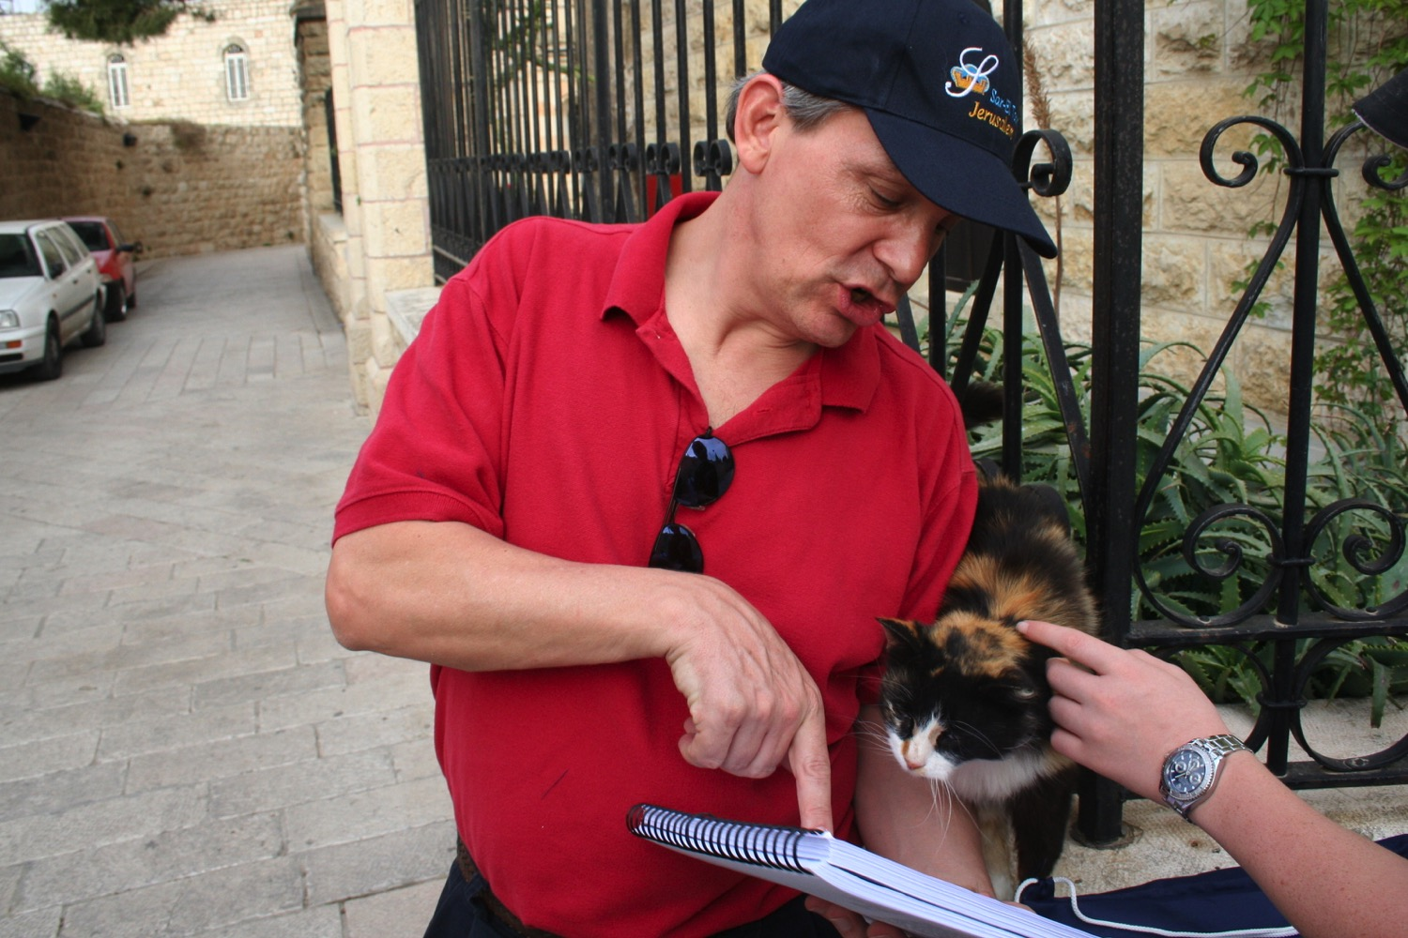
"Preach to every creature" (Mark 16:15)

Slide 31
Course Description
1
This course provides a hands-on rather than philosophical approach to properly apply the Bible through the study of many Scripture texts.
It follows the Inductive Bible Study method to observe a text, interpret it by consistent use of hermeneutical principles, and then apply the passage to the student’s own life and to others in a teaching or preaching ministry

Slide 32
Course Objectives
1-2
By the end of this course the student will be able to…
Grasp foundations for life-changing biblical study.
Observe Scripture so that no key elements are missed.
Interpret Scripture to determine what God actually said.
Apply Scripture for life-change in your life and others.

Slide 33

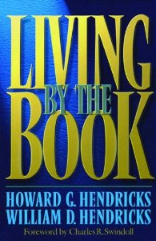
Course Requirements
2
Readings (10%)
Assignments (90%)

Slide 34
Other Matters
18
Copying Class Notes
Contacting Me
At SBC box L19 or office phone (6559-1513)
Home address is Block 2-302
Mobile number: +65 9113-7090
My office hours
E-mail: griffith@sbc.edu.sg
Let’s have lunch too!

Slide 35
Black
1
4
2
5
3
6

Slide 36


Bible Study link at BibleStudyDownloads.org
Get this presentation for free!
Notes:
Bible Study (bs)

