Slide 1
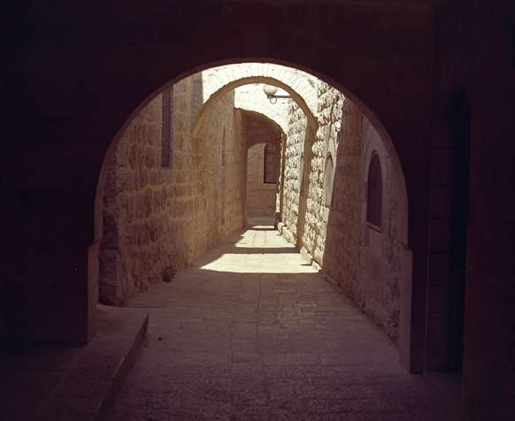
Present & Future Geography
Jerusalem
Israel
The World
Dr. Rick Griffith • Jordan Evangelical Theological Seminary • BibleStudyDownloads.org

Slide 2






The Spirit Leaves & Returns
Mt. of Olives
656
Ezek. 8:4; 9:3; 10:4; 10:18-19; 11:23
Luke 19:37; 24:50; Acts 1:10
Acts 1:11; Zech. 14:4; Ezek. 43:1-5
Notes:
The Mount of Olives plays a significant role in history. It is the last place the Spirit is present in Ezekiel 11:23, the last place Christ was honored as king in Luke 19:37, the last place Christ was seen by his disciples in Acts 1:10, and the NEXT place Christ will appear on earth to fulfill Acts 1:11!
The Kidron Valley below the mount is likely the Valley of Jehoshaphat where Jesus will judge the nations (Joel 3).
_____________
Common Slides English-197
BG-13-Present & Millennium-2
OS-26-Ezek1-39-slide 178
OS-38-Zechariah-179
NS-03-Luke13-24-slide 111
NS-Acts1-2-slide 215

Slide 3
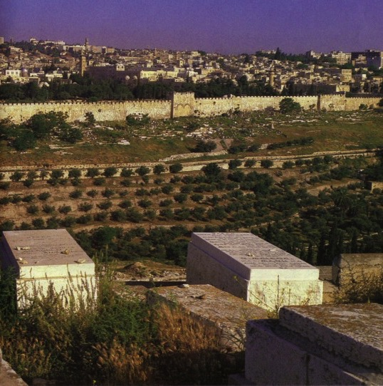
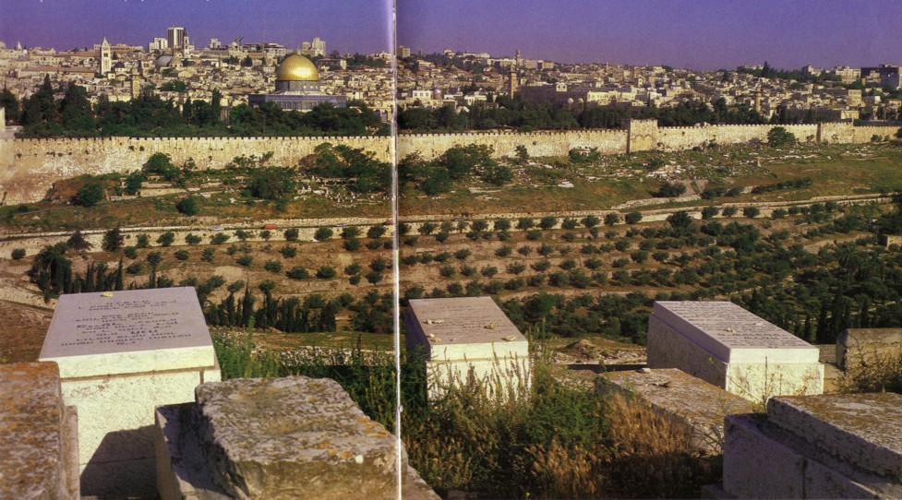
Jewish Hope of Resurrection
115
Jews buried on the Mt. of Olives hope to be the first to enter the Eastern Gate with Messiah when He comes

Slide 4
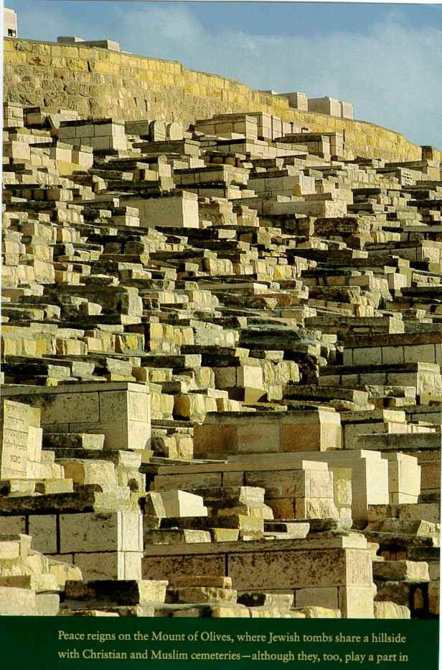
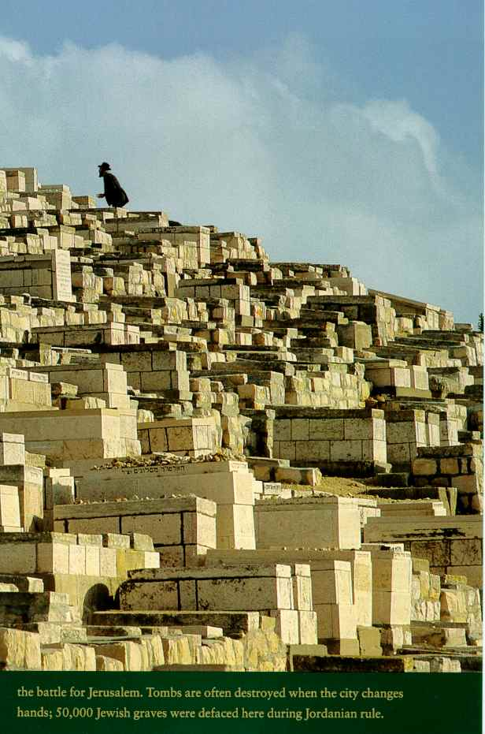
First to Rise?

Slide 5
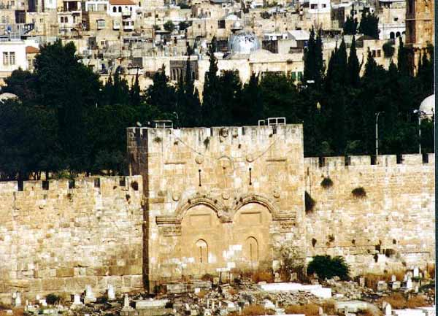
Muslims Sealed the Eastern Gate

Slide 6

Borders of the Land Promised to Abraham
Syria
Lebanon
Israel
Jordan
Genesis 15:18
"On that day the LORD made a covenant with Abram, saying, 'To your offspring I give this land, from the river of Egypt to the great river, the river Euphrates'" (ESV)
India
Egypt
Notes:
God’s promised land stretched northward from the small wadi of Egypt south in the Sinai to the large Euphrates River in the far north—a HUGE piece of real estate! When today’s boundaries are placed over this land we can see the struggle modern Israel has to claim land from Egypt, Lebanon, Syria, and possibly even Jordan on the other side of the Jordan River.
_____________
BG-13-Present & Future-6
OC-19-Daniel Authorship-?
OS-17-Esther-16

Slide 7
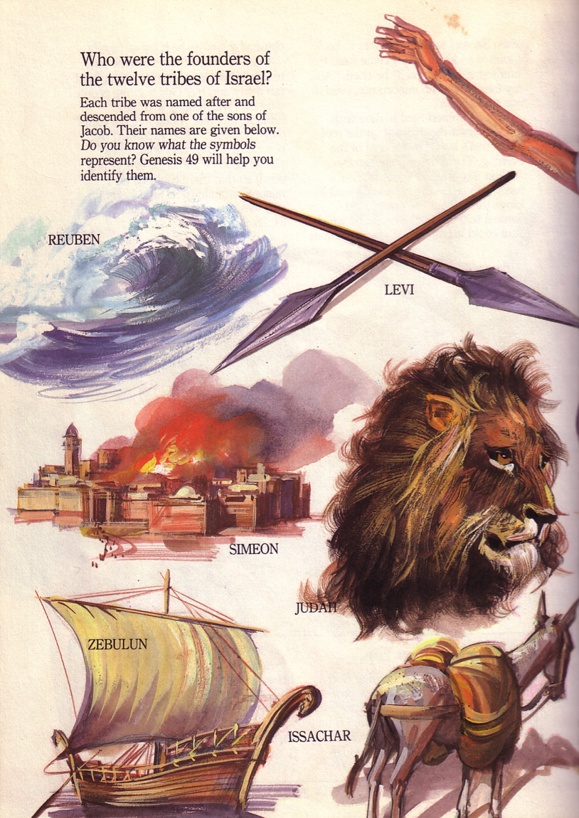
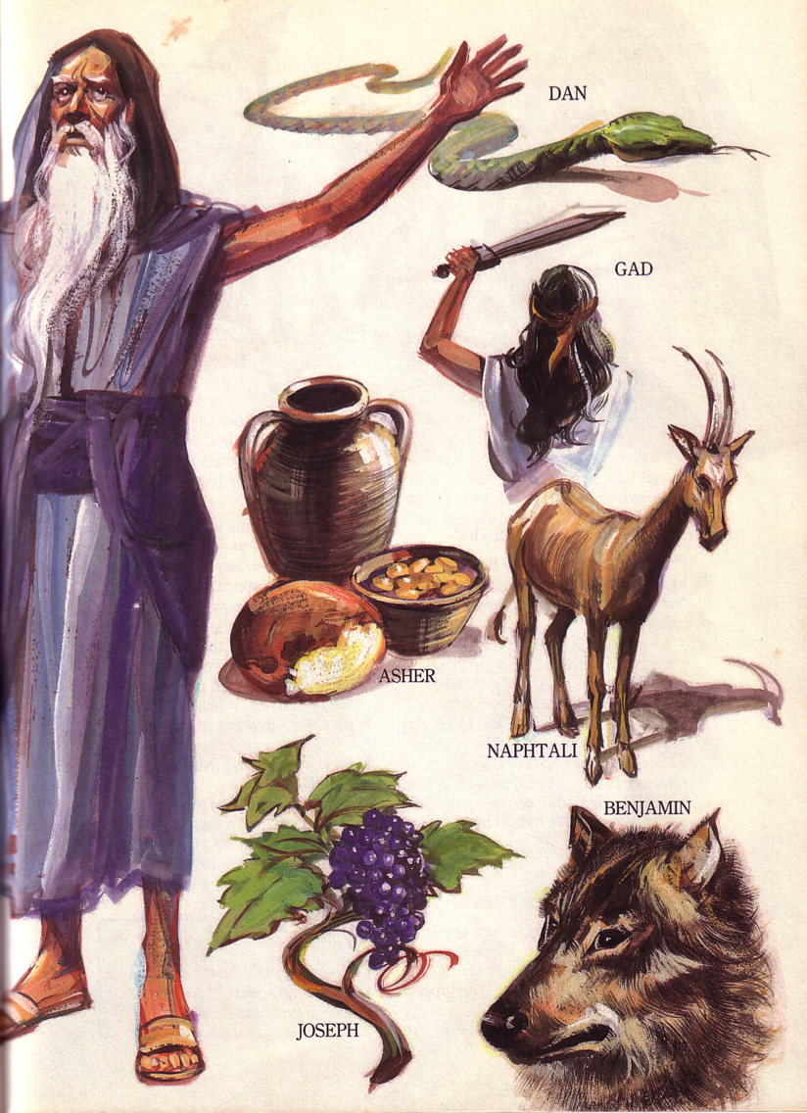
Jacob's Blessing His 12 Sons Was Prophetic (Gen. 49-50)

Slide 8

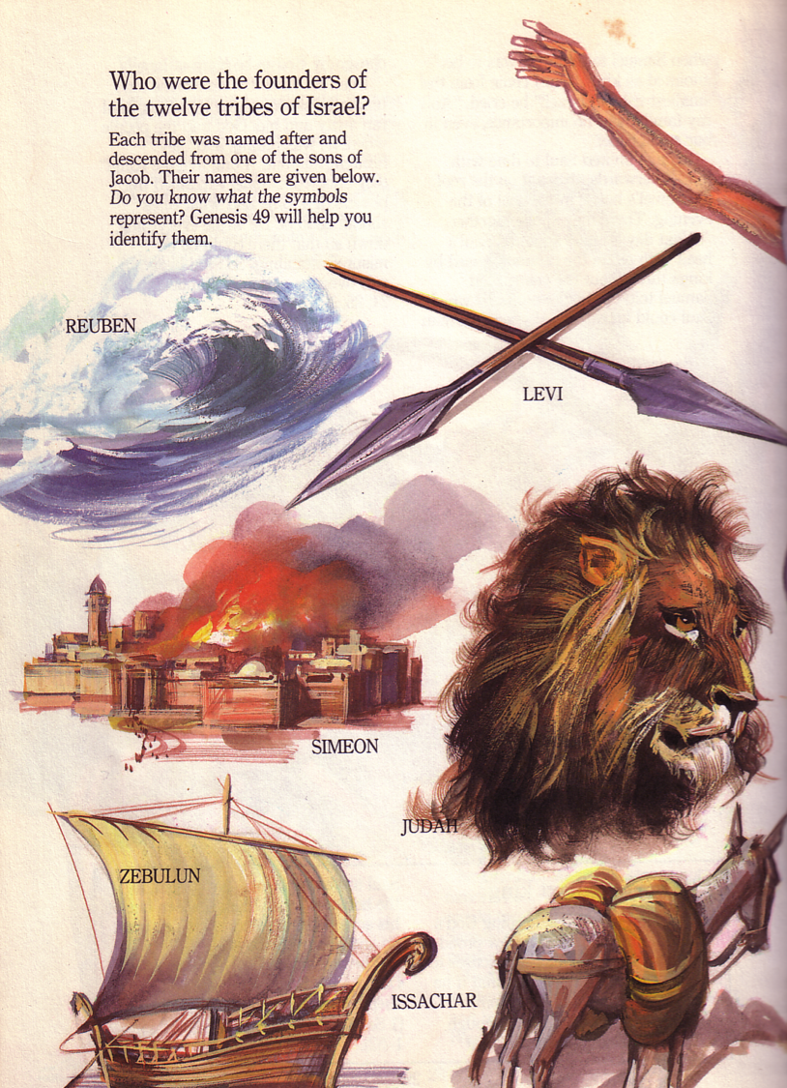
First Six Tribes
37
Jacob's Blessing His 12 Sons Was Prophetic (Gen. 49-50)
Zebulun
Issachar
Levi
Judah
Reuben
Simeon

Slide 9

Christ Descended from Judah
"Judah, my son, is a young lion that has finished eating its prey. Like a lion he crouches and lies down; like a lioness—who dares to rouse him?
¹⁰The scepter will not depart from Judah, nor the ruler's staff from his descendants, until the coming of the one to whom it belongs, the one whom all nations will honor" (NLT).
Since Jacob's blessing in Genesis 49:9-10, the lion has depicted a king…

Slide 10

Last Six Tribes
37
Naphtali
Asher
Manasseh
Zebulun
Issachar
Manasseh
Ephraim
Gad
Dan
Benjamin
Levi
Judah
Reuben
Simeon

Slide 11


Tribal Redistribution
Dan
210
211
Asher
After Conquest
(Josh. 13)
Millennial Israel
(Ezek. 47-48)
Naphtali
Manasseh
Ephraim
Reuben
Judah
Leaders & Temple
Benjamin
Simeon
Issachar
Zebulun
Gad

Slide 12
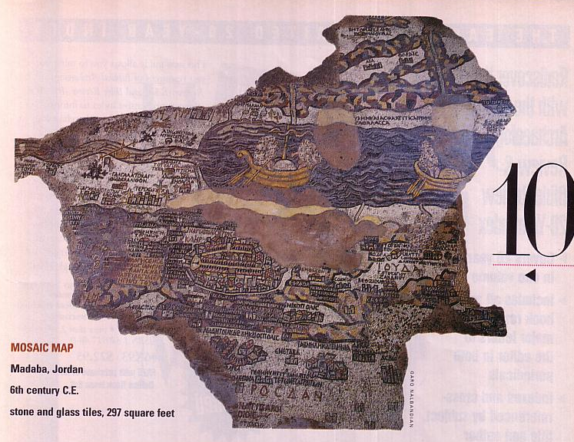
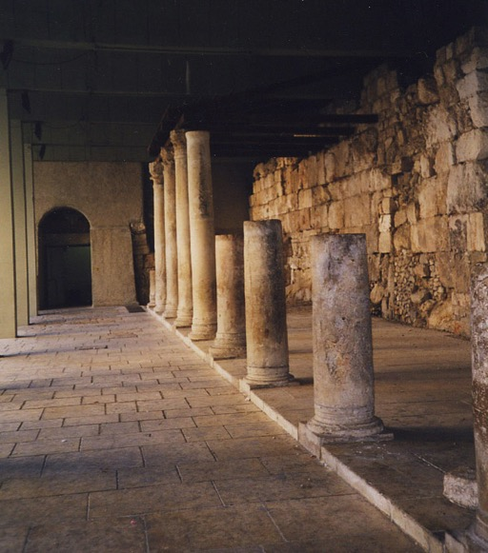
Jerusalem Mosaic Map
Madaba, Jordan
AD 550
Largest & oldest map of Jerusalem, with Cardo
The Cardo

Slide 13
Israel Today
224
Foundation for Middle East Peace
(March 2002)

Slide 14
The West Bank (2002)
224
Foundation for Middle East Peace
(March 2002)

Slide 15
The Gaza Strip (2002)
224
Foundation for Middle East Peace
(March 2002)

Slide 16
The Golan Heights (2002)
225
Foundation for Middle East Peace
(March 2002)

Slide 17
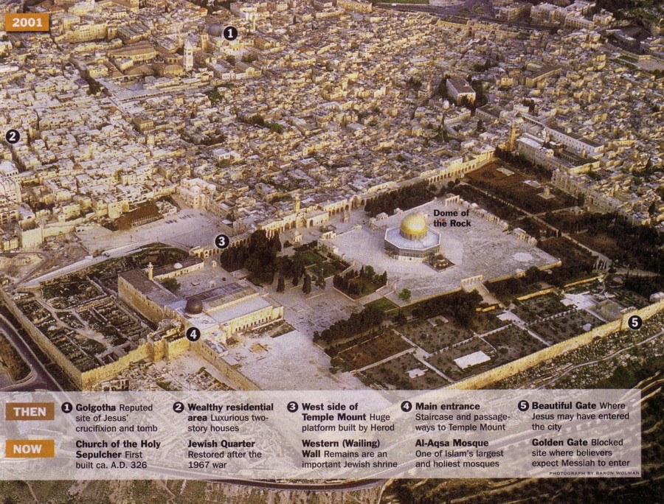

Jerusalem
Then & Now
131

Slide 18

Present Jerusalem Population
West = Jews
East = Arabs

Slide 19
Jerusalem (2002)
Foundation for Middle East Peace
(March 2002)

Slide 20
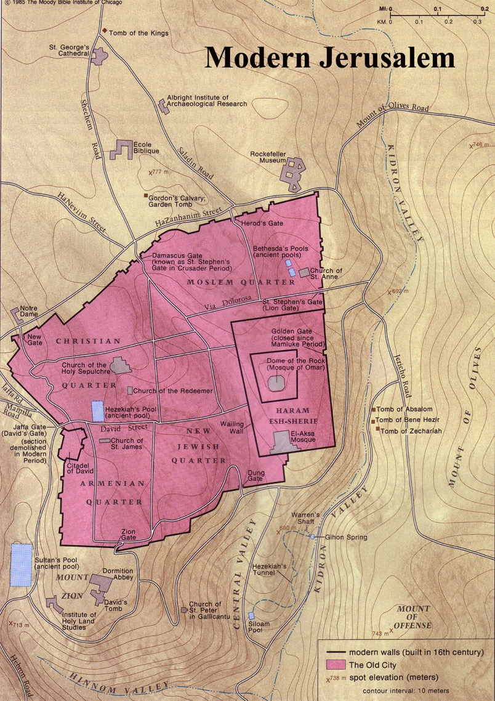
The Old City Today
117

Slide 21

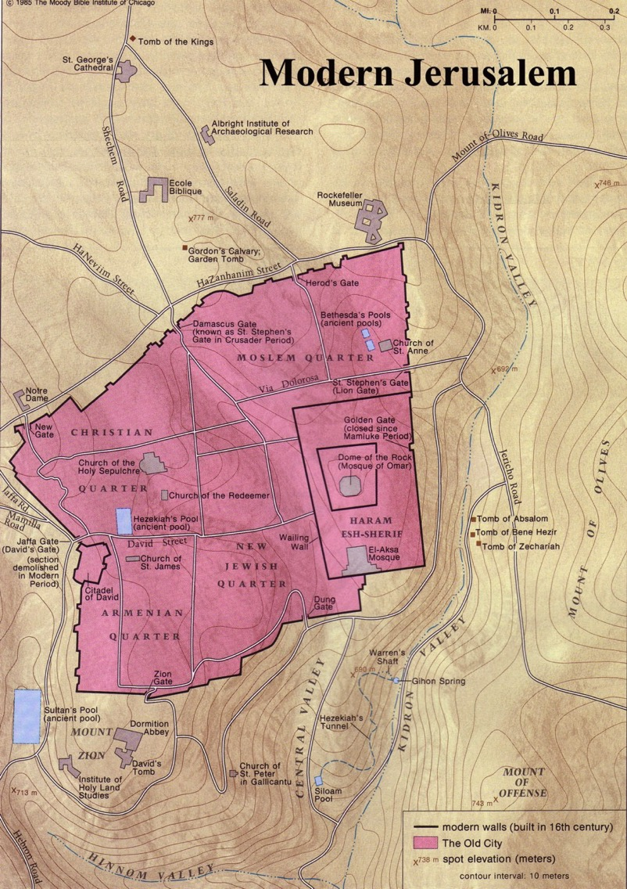

Modern Jerusalem Surroundings

Slide 22
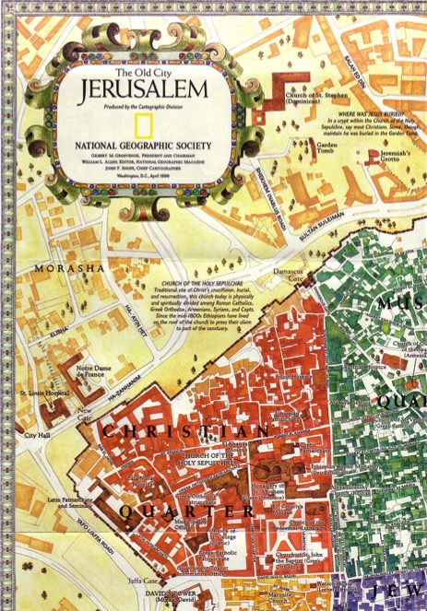
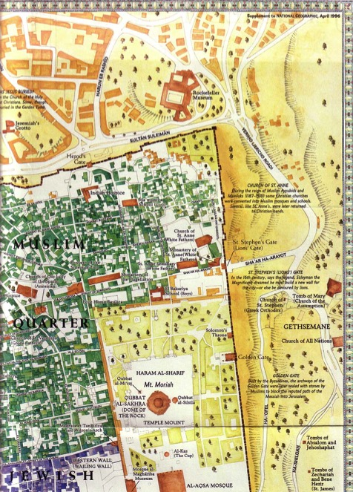
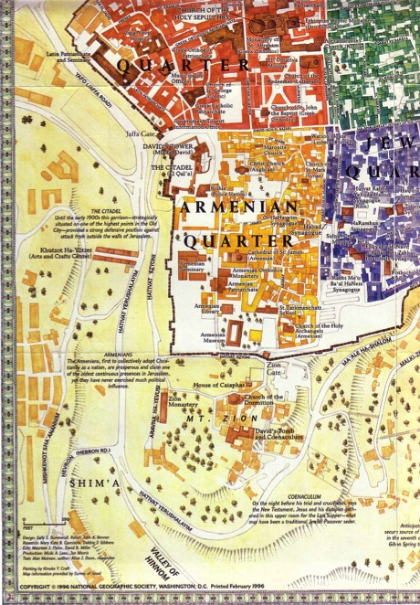
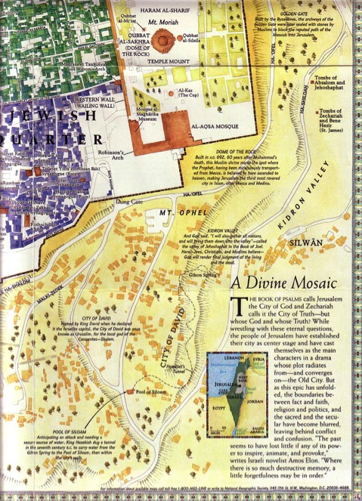
Quarters of Old Jerusalem
147g
• Christian
• Muslim
• Jewish
• Armenian

Slide 23
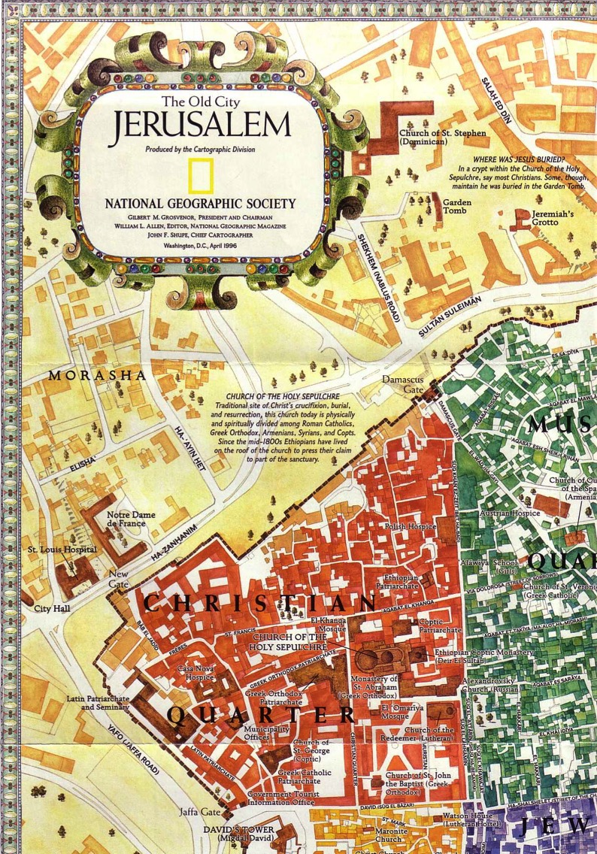
Christian Quarter
147g

Slide 24
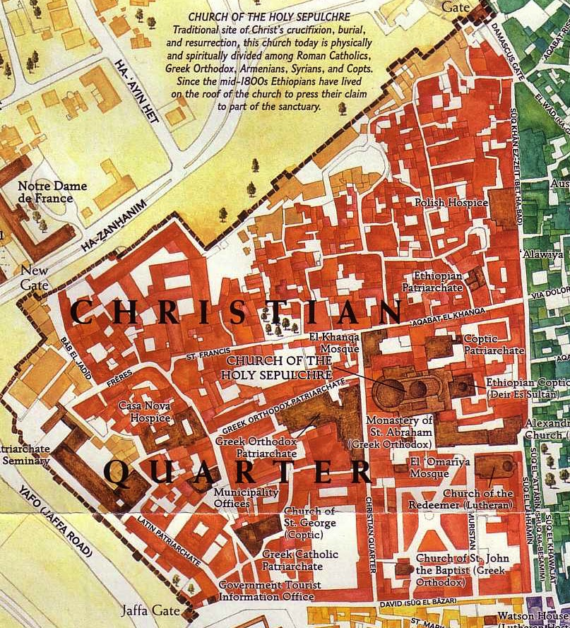
Christian Quarter
147g

Slide 25
A New Model of Temple Mount

Slide 26

Muslim Quarter
147g

Slide 27
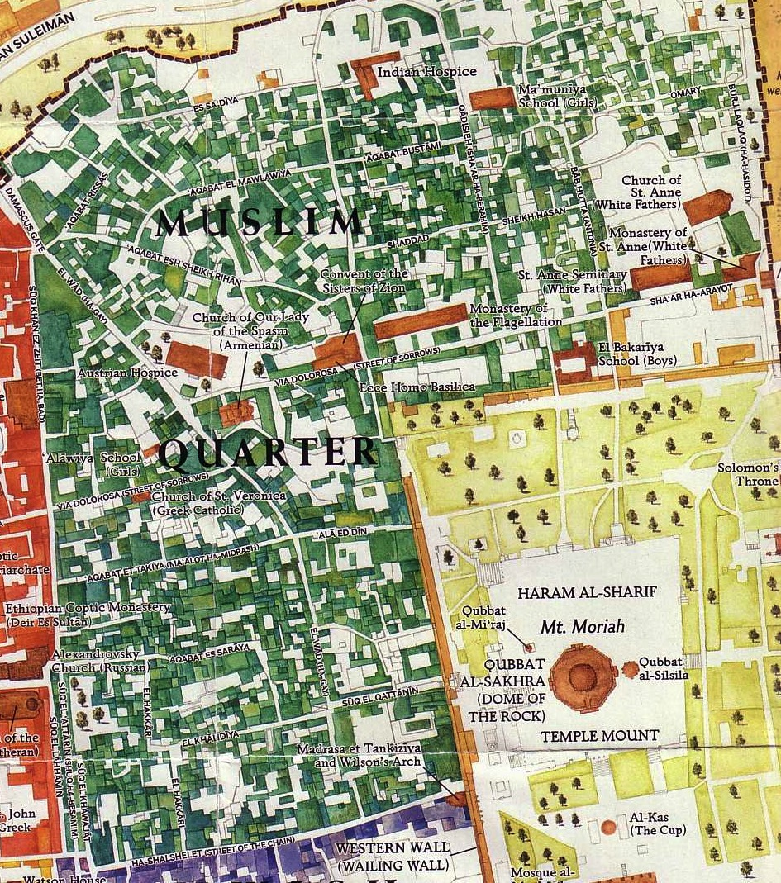
Muslim Quarter
147g

Slide 28

Jewish Quarter
147g

Slide 29
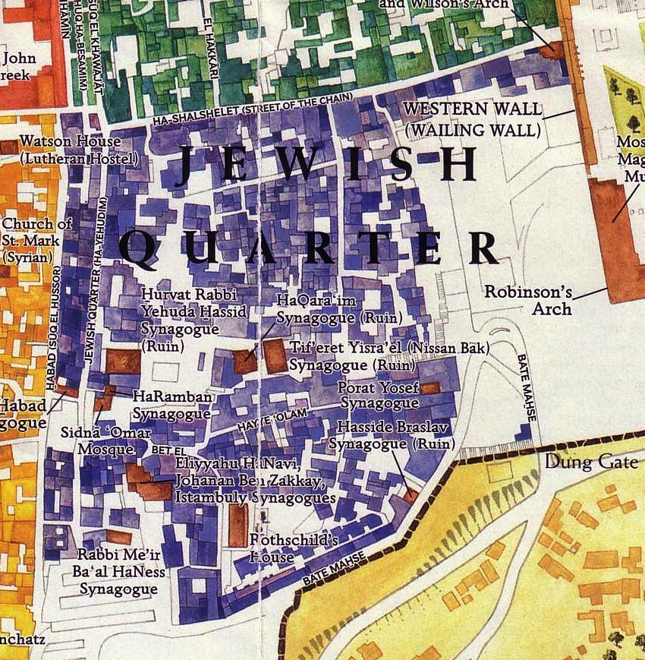
Jewish Quarter
147g

Slide 30
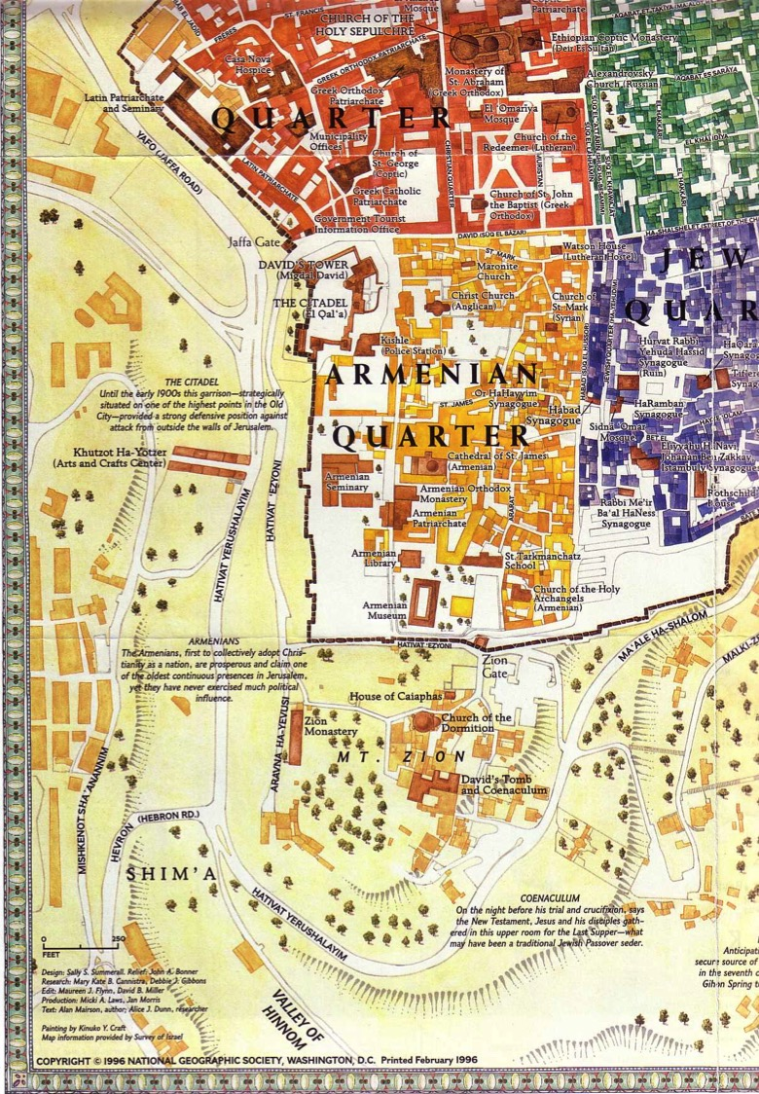
Armenian Quarter
147g

Slide 31
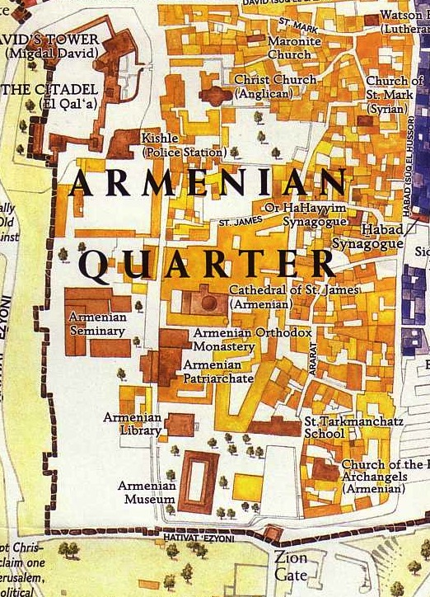
Armenian Quarter
147g

Slide 32

What's the Future for the Dome and World Geography in the Kingdom after Messiah Comes?

Slide 33

Jewish life then revolved around Solomon's temple for 400 years (959-586 BC)

Slide 34
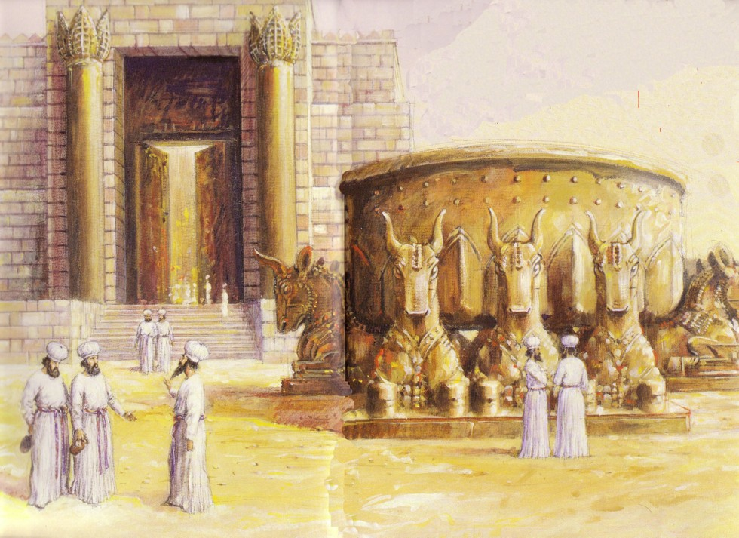
Jews Maintained Holiness at the Basin
586 BC: Temple Destroyed!

Slide 35


After temple rebuilding, in NT Passovers 100,000 Jews visited the Temple!
AD 70: Temple Destroyed Again!

Slide 36

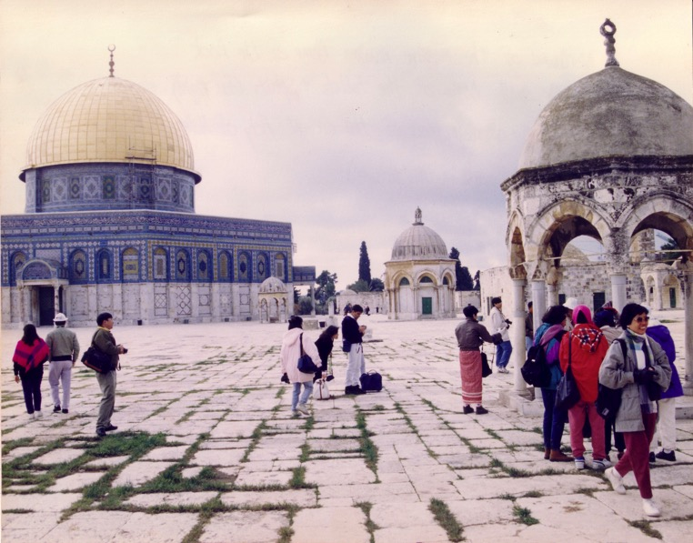

Muslim Control
135
Mosque of Omar
(Dome of the Rock)
Al-Aksa Mosque

Slide 37
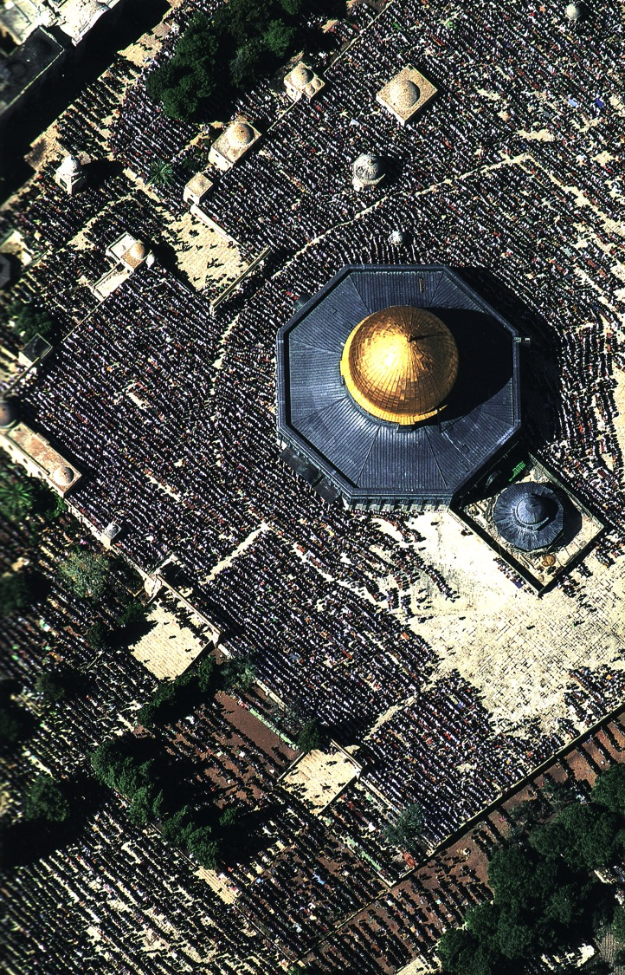
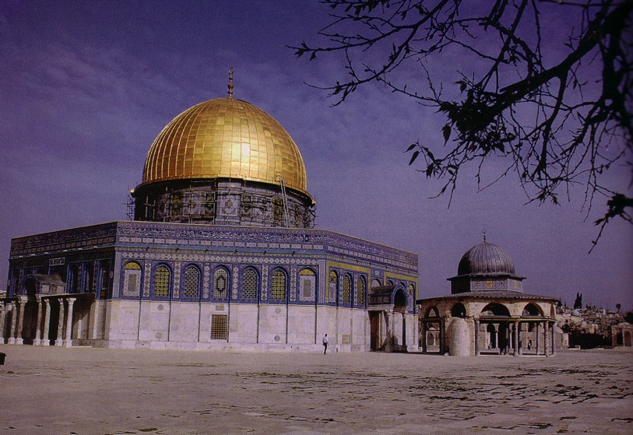
Muslim Prayers at the Dome
135

Slide 38
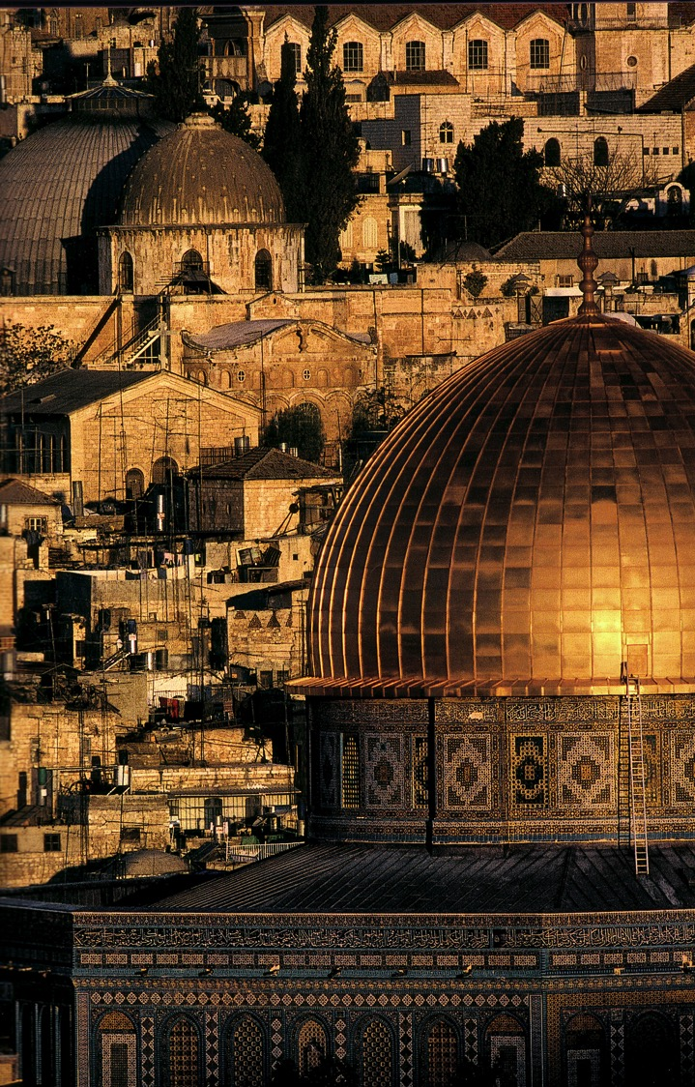
A Dome to Outshine the Dome

Slide 39
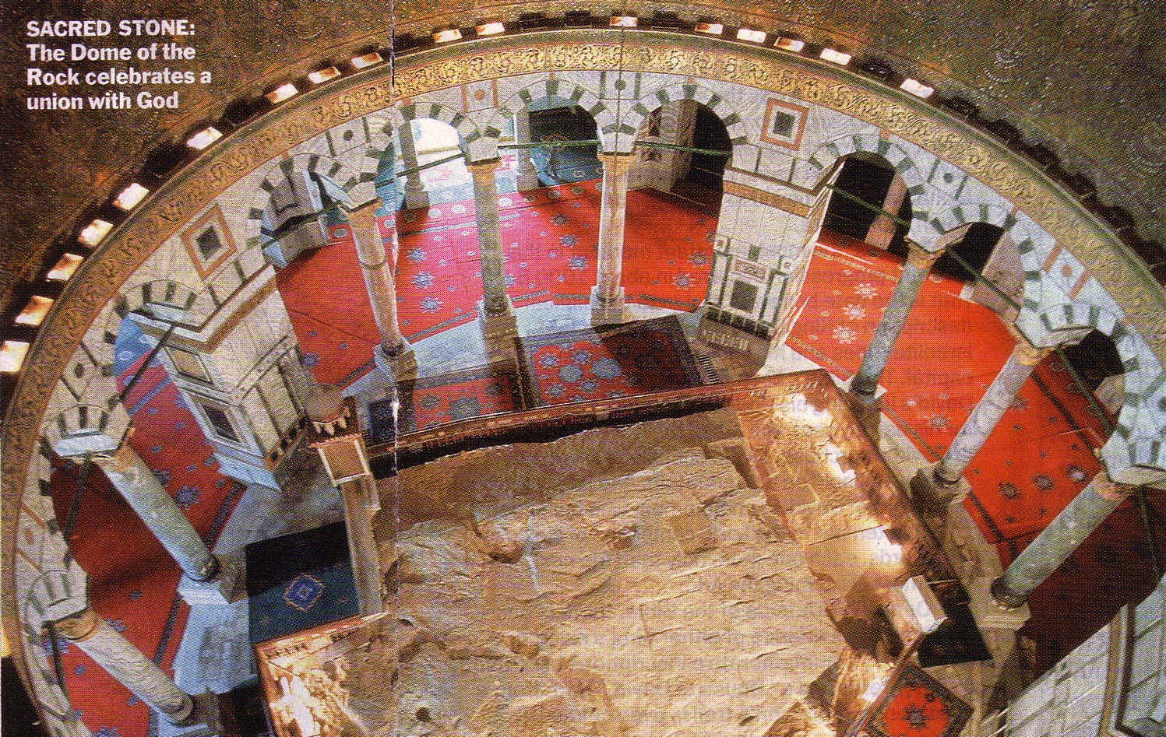
The Rock Inside
137

Slide 40
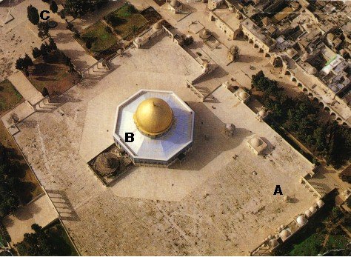
An Imposing Structure

Slide 41

Modern Temple Mount
131

Slide 42


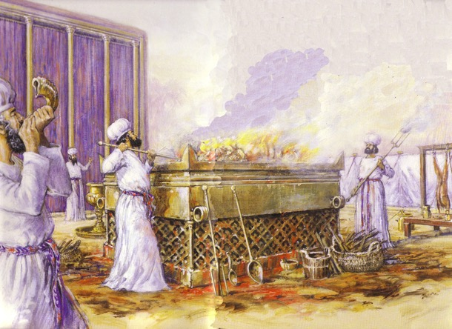
Jewish Western Wall
128

Slide 43
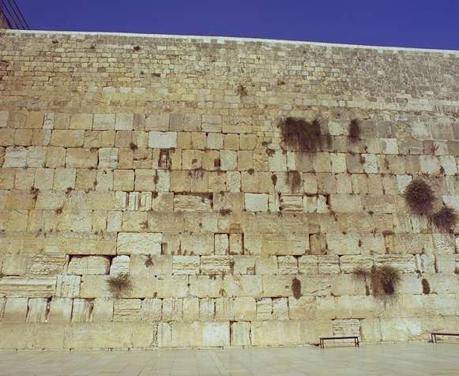
The Western Wall
128

Slide 44

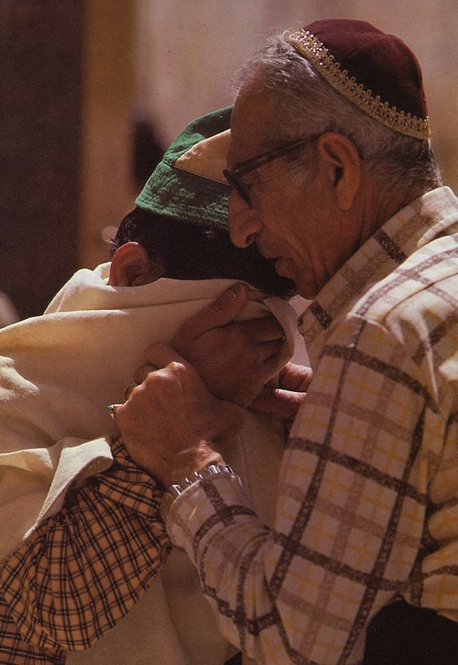
Prayers for the Third Temple

Slide 45
What about Ezekiel's Nine Chapters on the Temple and Land?
Ezekiel 40-48

Slide 46
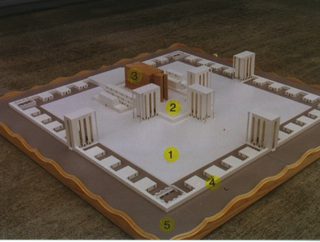
The Five Sections
517
1. Outer Court - 40:17-19
2. Inner Court - 40:44-47
3. The Temple or Sanctuary - 41:1-26
4. Wall around the outside of the temple - 40:5 (42:15-20; 45:2)
5. Fifty cubits of open space - 45:2
www.pauljab.net/temple/ TemplePictures.html
Notes:
Ezekiel's temple will be like the first two temples in that it will be surrounded by both inner and outer courts, although the height of the gates is not given and thus is left to the imagination.

Slide 47


Solomon's & Ezekiel's Temples Contrasted
518
Notes:
47
One suggestion is that this is Solomon's temple (Adam Clarke, "Ezekiel," in Clarke's Commentary, 4:535), but this view has several flaws.
First, the dimensions of these two temples are different. While Solomon's temple was fairly small (90 feet long, 30 feet wide, and 45 feet high), Ezekiel's temple measures much larger (175 feet long and 87.5 feet wide). This is the minimum measurement based upon Ezekiel 41:13 using Ezekiel's long (21-inch) cubit explained in 40:5 (cf. 43:13) where a rod is equal to 6 long cubits, each of which is an 18-inch cubit plus a 3-inch handbreadth; therefore, a rod must be 10.5 feet long since 6 cubits at 21 inches equals 126 inches, or 10.5 feet. Nowhere does the account provide the height of the temple although the entire temple area is enclosed by a wall one rod ("stalk, reed" BDB 889d) in height (40:5), or 10.5 feet. (If the measurement is with the normal, or shorter [18-inch] cubit, the temple dimensions must be adjusted slightly to 150 feet by 75 feet.) This issue becomes even more confusing as the temple area measurements in 42:16-19 are plagued with textual difficulties. In each verse the MT measures in "rods" (NASB, NIV margin, KJV, NKJV, Ampl), but the LXX follows the Qere which reads the transposed "cubits" (NIV, RSV, GNB). Therefore, a single temple court side in the MT is "500 rods" or 5250 feet, but in the LXX it is "500 cubits" or 875 feet (using the long cubit). Furthermore, the situation is complicated by the fact that Ezekiel uses the cubit (40:5b, 9, 11–42:20; etc.), the rod (40:3, 5a-7; 42:16-19), and an ellipsis (45:1-6; 48:8-21, 30-35) for measurement. Most commentators agree that the cubit is the proper unit since use of the rod would make four sides of the temple area nearly one mile in length, an unlikely size. For further study on the measurements of the temple in cubits see Theo G. Soares, "Ezekiel's Temple," BW 14 (1899): 93-103. Adhering to the rod view is Cameron M. MacKay, "The City and the Sanctuary: Ezekiel 48," PTR 20 (1922): 399-417 (cf. MacKay, "Prolegomena to Ezekiel 40–48," ET 55 (1943/44): 292-95), who advocates an enormous temple situated in the Valley of Shechem (cf. MacKay, "Ezekiel's Sanctuary and Wellhausen's Theory," PTR 20 [1922]: 661-65, which argues against the documentary hypothesis). MacKay's first article (pp. 399-417) is critiqued by W. F. Lofthouse, "The City and the Sanctuary," ET 34 (1922/23): 198-202 and rebutted by MacKay in "The City and the Sanctuary," ET 34 (1922/23): 475-76. In either case, whether rods or cubits are used, the temple is one that has never been constructed in Israel.
Solomon's temple measurements in 1 Kings 6:2 are noted at 60, 20, and 30 cubits; the above measurements in feet were obtained by multiplying these three lengths by the standard 18 inches per cubit. "The square of the temple in 42:20 is six times as large as the circuit of the wall enclosing the old temple, and, in fact, is larger than the former city itself” (Hobart E. Freeman, An Introduction to the Old Testament Prophets, 313).
Second, if this description depicted the former temple, it must be asked what hope Ezekiel could offer his oppressed brethren by reminding them of the glory of Solomon's temple which at that time lay in ruins. Third, the Books of Kings and Chronicles already provide detailed descriptions of Solomon's temple, so another record would be unnecessary. For these reasons, Ezekiel's temple is not the same as Solomon's.

Slide 48
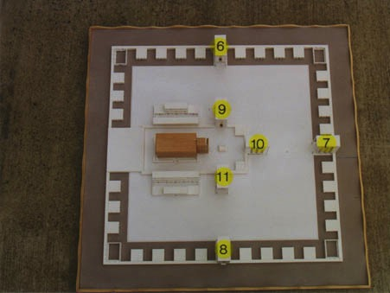
View from Above
517
6. Outer Court Northern Gateway - 40:20-23
7. Outer Court Eastern Gateway - 40:6-16
8. Outer Court Southern Gateway - 40:24-27
9. Inner Court Northern Gateway - 40:35-37
10. Inner Court Eastern Gateway - 40:32-34
11. Inner Court Southern Gateway - 40:28-31
www.pauljab.net/temple/ TemplePictures.html
Notes:
48
Note that at least 4 of Solomon’s temples fit into Ezekiel’s—maybe even 5-6 of them. Ezekiel is obviously not describing the first temple built by Solomon.

Slide 49
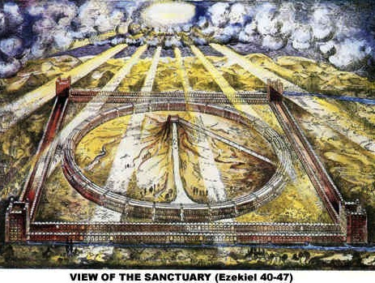
View of the Sanctuary (Ezekiel 40-48)
521
www.antipas.org/.../ezekiels_temple/ ezekiels_temple.html
Notes:
Ezekiel's depiction matches Isaiah 2…
Is. 2:2 In the last days, the mountain of the LORD’s house
will be the highest of all—
the most important place on earth.
It will be raised above the other hills,
and people from all over the world will stream there to worship.
³ People from many nations will come and say,
“Come, let us go up to the mountain of the LORD,
to the house of Jacob’s God.
There he will teach us his ways,
and we will walk in his paths.”
For the LORD’s teaching will go out from Zion;
his word will go out from Jerusalem.
⁴ The LORD will mediate between nations
and will settle international disputes.
They will hammer their swords into plowshares
and their spears into pruning hooks.
Nation will no longer fight against nation,
nor train for war anymore.

Slide 50
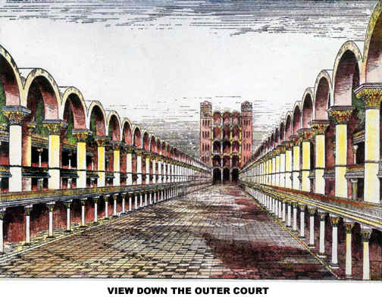
View Down the Outer Court
Notes:
If you think Solomon's temple was glorious, how much more so Ezekiel's!

Slide 51
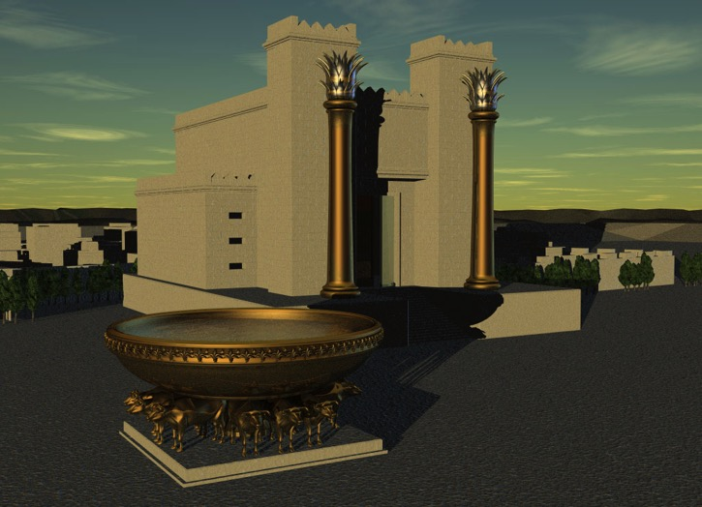
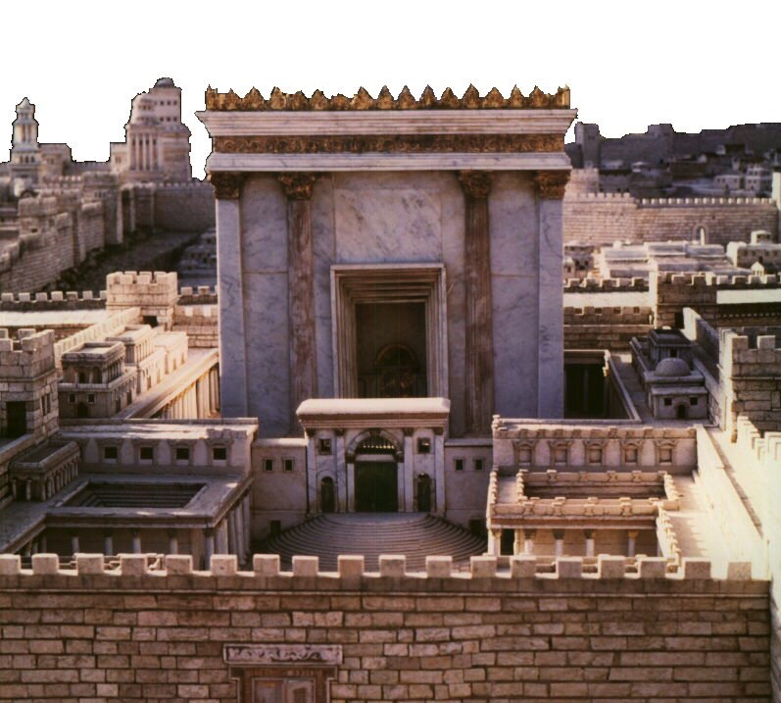
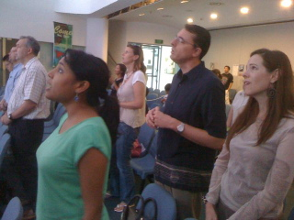
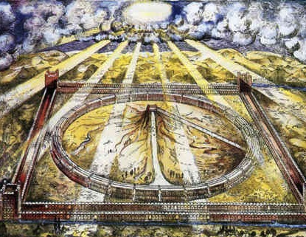
Which temple for Ezekiel?
520
Solomon
Zerubbabel/Herod
Three
Literal
Views
Conditional
Millennial
Church
Notes:
Ezekiel 40–46 has at least five different interpretations but the only one that takes the text at face value is that this temple with these dimensions has not yet been built—so it must happen in the future millennium.
The conditional view says that the people did not truly believe in the Lord sufficiently, so God never built it and will not do so in the future. But hundreds of verses in the Prophets speak of a believing Israel in the future. See the Isaiah 60–66 slides on the restoration of Israel.

Slide 52
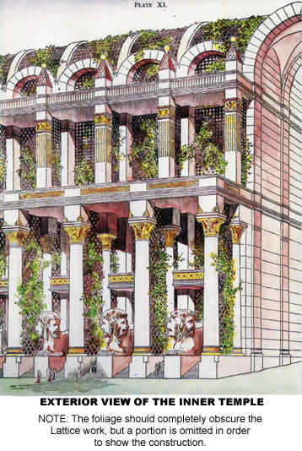
Exterior View of the Inner Temple
207

Slide 53
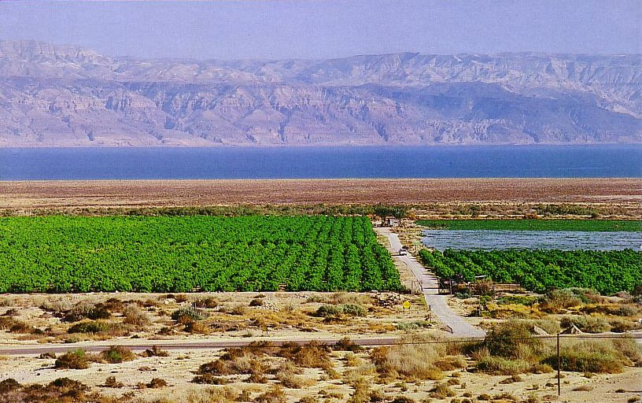
Crops from a Fresh Water Oasis
Ezekiel 47:10

Slide 54
Water will flow through the Mt. of Olives!
115
Ezek. 47:1-12

Slide 55

Millennial Jerusalem
"The law will go out from Zion,
the word of the LORD from Jerusalem"
--Isaiah 2:3

Slide 56
Is there a future for ethnic believing Israel?
Dispensational
Premillennialism
Amillennialism &
Postmillennialism
Church & Israel distinct
Israel has a future
Church is new Israel
Israel has no future
Covenant
Premillennialism

Slide 57
Pretribulational Premillennialism
160
Rapture
2nd Advent
Great
White
Throne
Church Age
Tribulation
Millennium
Battle of
Armageddon
Battle of
Gog and Magog
"How awful that day will be! None will be like it. It will be a time of Jacob's trouble but he will be saved out of it" (Jer. 30:7)

Slide 58
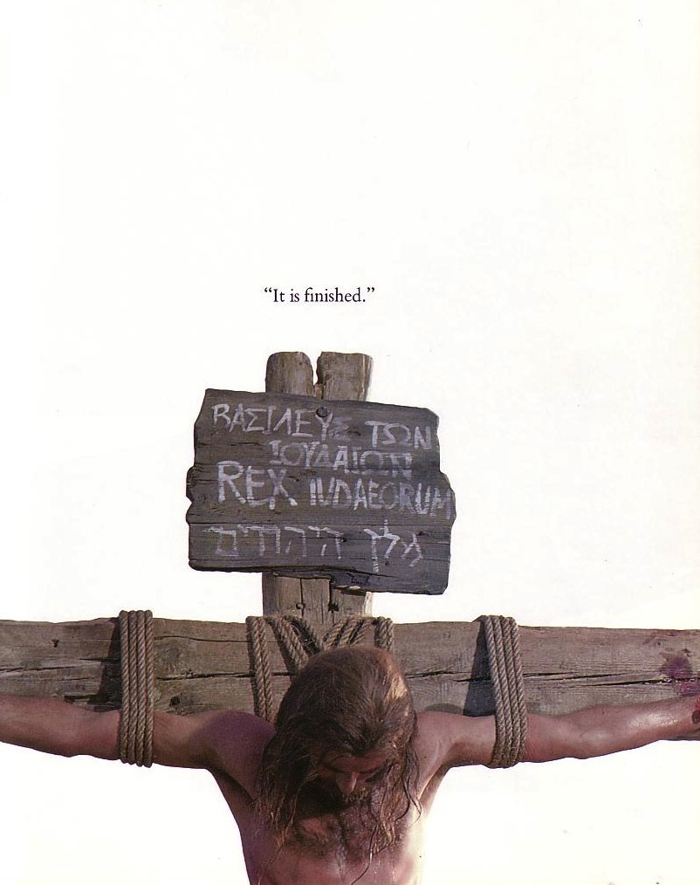
Tribulation Results
"They will look on the one they have pierced…"
(Zech. 12:1-10; esp. v. 10)
"The Redeemer will come to Zion, to those in Jacob who repent of their sins" (Isa. 59:20)
"The deliverer will come from Zion; he will turn godlessness away from David"
(Rom. 11:26b)
"And so all Israel will be saved" (Rom. 11:26a)

Slide 59
Why Am I Premillennial?
124
The best hermeneutic is a normal, literal, historical, and grammatical reading of a text
Rev. 19 (Christ's return) is before Rev. 20 (Christ's rule)

Slide 60

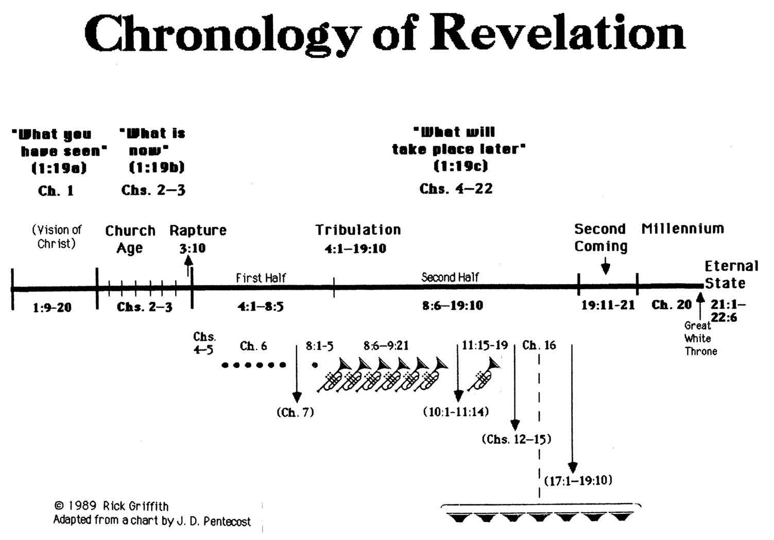
Chronology of Revelation
333
"What you have seen"
(1:19a)
Rev. 1
"What is
now"
(1:19b)
Rev. 2–3
"What will
take place later"
(1:19c)
Rev. 4–22
Vision of Christ
Church
Age
Rapture
3:10
Tribulation
4:1 – 19:10
Second Coming
Millennium
First Half
Second Half
Eternal State
Great White Throne Judgment
Copyright 1989 Rick Griffith
Adapted from a chart by J. D. Pentecost
Notes:
The 3 main divisions of Revelation are summarized in 1:19
The 3 main cycles of judgment are squared in blue
The 4 parenthetical sections appear in parentheses within the scrolls. They do not advance the chronology but add important information that is not associated with a particular judgment.

Slide 61
Why Am I Premillennial?
124
The best hermeneutic is a normal, literal, historical, and grammatical reading of a text
Rev. 19 (Christ's return) is before Rev. 20 (Christ's rule)
Natural way to see the 1000 years (20:1-6)
OT prophets saw a future period which is neither the present age nor heaven
  Animal kingdom tamed (Isa. 11:6-9)

Slide 62
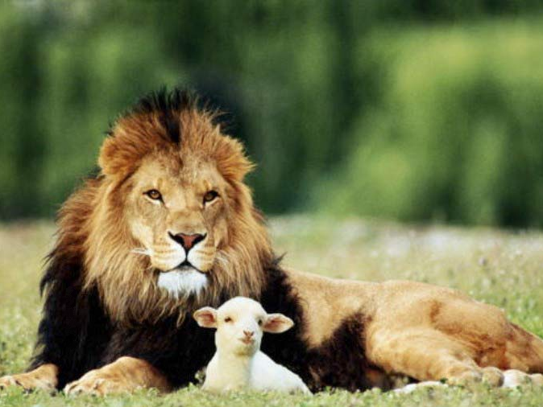
Isaiah 11:6-9
⁶ And the wolf will dwell with the lamb, and the leopard will lie down with the young goat, and the calf and the young lion and the fatling together; and a little boy will lead them. ⁷ Also the cow and the bear will graze, their young will lie down together, and the lion will eat straw like the ox. ⁸ The nursing child will play by the hole of the cobra, and the weaned child will put his hand on the viper's den. ⁹ They will not hurt or destroy in all My holy mountain, for the earth will be full of the knowledge of the LORD as the waters cover the sea.

Slide 63
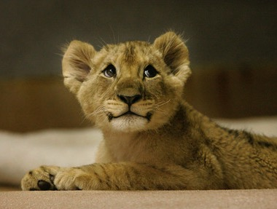
Even lions tamed!

Slide 64

Romans 8:19-21
"The creation waits in eager expectation for the sons of God to be revealed. . . The creation itself will be liberated from its bondage to decay and brought into the glorious freedom of the children of God."

Slide 65
Why Am I Premillennial?
124
The best hermeneutic is a normal, literal, historical, and grammatical reading of a text
Rev. 19 (Christ's return) is before Rev. 20 (Christ's rule)
Natural way to see the 1000 years (20:1-6)
OT prophets saw a future period which is neither the present age nor heaven
  Animal kingdom tamed (Isa. 11:6-9)
  Long life but still death (Isa. 65:20)

Slide 66
Incredibly Long Life!
NIV Isaiah 65:20 "Never again will there be in [Jerusalem] an infant who lives but a few days, or an old man who does not live out his years; he who dies at a hundred will be thought a mere youth; he who fails to reach a hundred will be considered accursed."

Slide 67
Incredibly Long Life!
NLT Isaiah 65:20 "No longer will babies die when only a few days old. No longer will adults die before they have lived a full life. No longer will people be considered old at one hundred! Only sinners will die that young!"

Slide 68
Why Am I Premillennial?
124
The best hermeneutic is a normal, literal, historical, and grammatical reading of a text
Rev. 19 (Christ's return) is before Rev. 20 (Christ's rule)
Natural way to see the 1000 years (20:1-6)
OT prophets saw a future period which is neither the present age nor heaven
  Animal kingdom tamed (Isa. 11:6-9)
  Long life but still death (Isa. 65:20)
  Yearly observances after Messiah's return (Zech. 14:15-17)

Slide 69
Millennial Jerusalem
106
"The law will go out from Zion,
the word of the LORD from Jerusalem"
--Isaiah 2:3

Slide 70
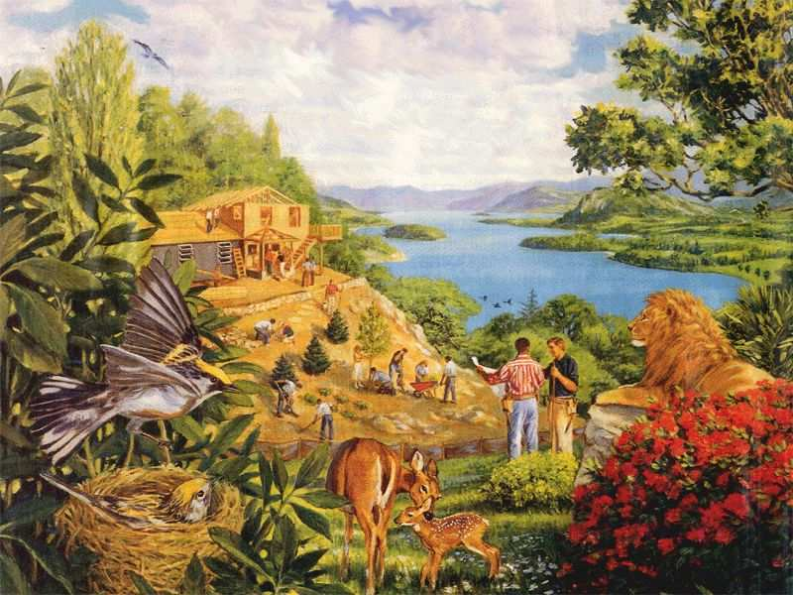
Rebuilding brings…

Slide 71
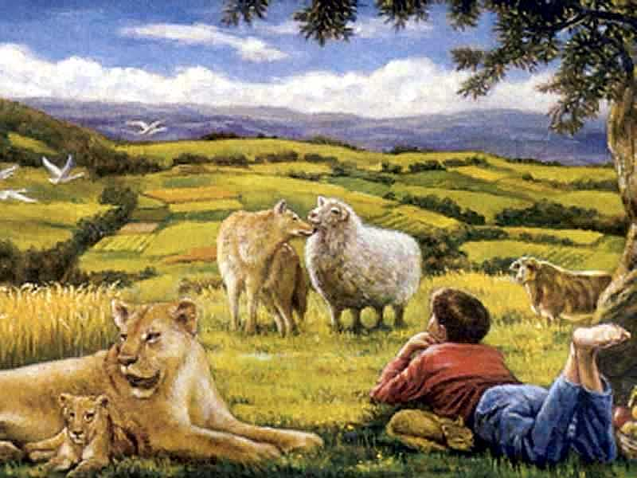
…a totally renewed earth!

Slide 72
Why Am I Dispensational?
127
The Church Age was unseen in the OT
Saints will reign on the earth (Rev. 5:10), not in heaven as amillennialists claim
Ezekiel's temple will be a real temple (cf. "Outline of End-Time Events," 105-106).

Slide 73
Why Am I Dispensational?
127
The Church Age was unseen in the OT.
Saints will reign on the earth (Rev. 5:10), not in heaven as amillennialists claim.
Ezekiel's temple will be a real temple (cf. "Outline of End-Time Events," 105-106).
Dispensationalism best explains how the Abrahamic, Land, Davidic, and New Covenants will be fulfilled.

Slide 74
Kingdom & Covenants Timeline
22
CH-34a
OS1-22
OS2-337
NS-9g
SA-19
34a
Dr. Rick Griffith • BibleStudyDownloads.org
22
Kingdom Teaching...
Adam rules with God (Gen. 1:26, 28; 2:19)
Satan begins rule as god of this world (Gen. 3:15;
2 Cor. 4:4)
God covenants with Abraham to reestablish man's rule via Israel as a "kingdom of priests" (Gen. 12:1-3; Exod. 19:6)
Israel's failure to witness to nations as a kingdom of priests is judged via exile under foreign rule
Israel rejects Messiah's offer of kingdom (Matt. 12:41-42; 23:37-39)
Jesus extends His kingdom in mystery form to the Church (Matt. 13)
Christ subdues Israel's enemies and nation believes (Rom. 11:26-27)
Christ rules over everything with saints (Eph. 1:9-10; Rev. 20:1-6; 22:5b)
337
9g
Fall of Man (Gen. 3)
Noahic Covenant
19
Genesis 6:18; 9:8-17
Land Covenant
ISRAEL
CHURCH
MESSIANIC KINGDOM
(National Focus)
The "New Man" (Eph. 2:15)
Millennial Eternal
land
Genesis 15:18 (cf. Deut. 30:1-10) promises:
Land from Wadi of Egypt to Euphrates River (Isa. 27:12)
Eternal possession of land (Gen. 17:8) after exile/restoration
Whole world blessed via the land (Isa. 14:1-2)
Israel judged for rejecting Messiah by dispersion away from land for 19 centuries
(AD 70–AD 1948) but now partially restored (Ezek. 37:1-7)
Full restoration (Ezek. 37:8-28) Jerusalem world capital
(Isa. 2:1-5)
New Jerusalem
(Rev. 21–22)
Davidic Covenant
Christ is Head over His Church, which is a spiritual temple (Eph. 2:19-22; 2 Cor. 6:16)
Christ reigns over the world
(Isa. 11)
with saints (Rev. 5:10; 20:4-6)
Christ hands kingdom over to Father (1
Cor. 15:24)
Genesis 12:1-3
2 Samuel 7:12-16 promises:
Sons ("house" never wiped out)
Kingdom (political dynasty)
Throne (right to rule by descendants)
Temple (son to build it)
seed
Abrahamic Covenant
New Covenant
All
things made new!
(Rev. 21:5)
All 5 elements fulfilled in national restoration (Zech. 8)
Jeremiah 31:31-34 promises:
Forgiveness
Indwelling Spirit
New heart, nature, mind
Reunification of Israel and Judah
No need for evangelism
Mosaic Law replaced with first three elements of the New Covenant (Luke 22:20; 2 Cor. 3:6)
blessing
Mosaic Covenant
Law abolished, fulfilled, and replaced at the cross (Rom. 7:1-6;
1 Cor. 9:19-21; Heb. 8:13)
10th Edition
10 Nov 2020
Temporary (Gal. 3:19) and conditional (Deut. 28) to reveal sin (Rom. 7:7) and regulate Israel (Gal. 3:23-25)
Scripture has a dual kingdom-covenant theme. Israel's role from Abraham to Christ expands to include the Church (continuity) yet the Church never replaces the nation as the "new Israel" (discontinuity). Israel will enjoy world prominence after trusting Christ at His second coming.
Notes:
All agree that a partial fulfillment of the covenant to Abraham exists now to the Church in the indwelling Holy Spirit and forgiveness of sins (Jer 31:31-34)—and the ultimate fulfillment will be in the eternal state.
The main area of disagreement relates to the time period from now to eternity. Will there be a literal land, throne, and worldwide blessing to national (ethnic) Israel before the eternal kingdom? This chart shows verses giving a resounding YES to that question in a present partial fulfillment and a future full fulfillment in the normal sense of language in the verses cited. But the messianic kingdom will be in two stages—first in a millennial fulfillment to last 1000 years, but then, after that, the eternal stage in the new Jerusalem after the destruction of our present heavens and earth (Rev 21–22). What an amazing future remains for those who trust Jesus!
____________
Common English-51
CH-02-Nature-103-p34a
OC-10-Chronology-42
OS-00-Intro & Biblical Theology-25 & 90
OS-02-Exodus-267-p22
OS-05-Deut-248-p22
OS-10-2Sam-96-p22
OS-12-Kings & Prophets Charts-25
OS-13-1 Chron-46
OS-23-Isaiah-97-p337
OS-24-Jeremiah-174-p337
OS-23-Isaiah-97-p337
OS-28-Hosea-49
OS-31-Obadiah-164
05-Acts1-2-slide 45
NS-09-Gal-143-p9g
NS-19-Hebrews-342-p9g
SA-08-Mosaic Law-19-p38a

Slide 75

The Last Beginning
331
The Last Beginning
Revelation 21:
A new heaven and earth this time unspoiled by sin, death, pain or sorrow
(Translate from left)
Notes:
75
The last beginning=最后一个开始 , Revelation 21:9-22: 5=启示录21:9 -22:5

Slide 76

The New Jerusalem
331

Slide 77



The New Jerusalem
331
Size of New Jerusalem
2,250,000 sq. miles

Slide 78

The New Jerusalem & SE Asia
2200 km
331
2200 km
2200 km
2200 km

Slide 79

The New Jerusalem over present Jerusalem
331

Slide 80
Are there "holy things" today?
God called Jerusalem the Holy City since it was where He put His presence.
God's presence is no longer in a city but in the hearts of believers (1 Cor. 6:19).
How do people see you as holy?

Slide 81
Black

Slide 82


Bible Geography link at BibleStudyDownloads.org
Get this presentation for free!
Notes:
Bible Geography (bg)

