Slide 1
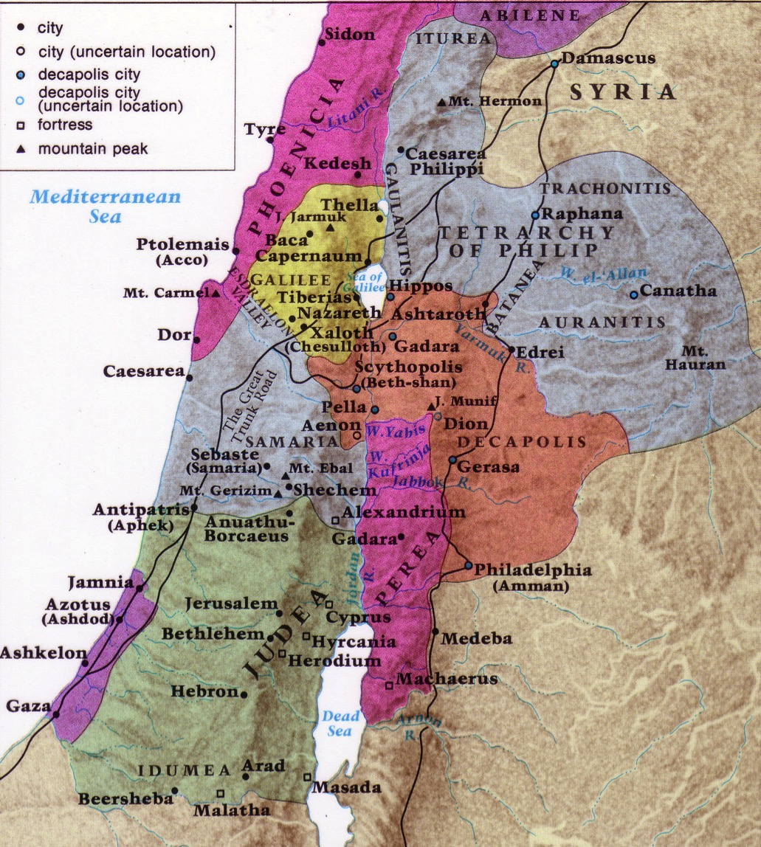
Northern Israel:
• Caesarea
• Galilee
• Decapolis
85
Dr. Rick Griffith • Jordan Evangelical Theological Seminary • BibleStudyDownloads.org

Slide 2
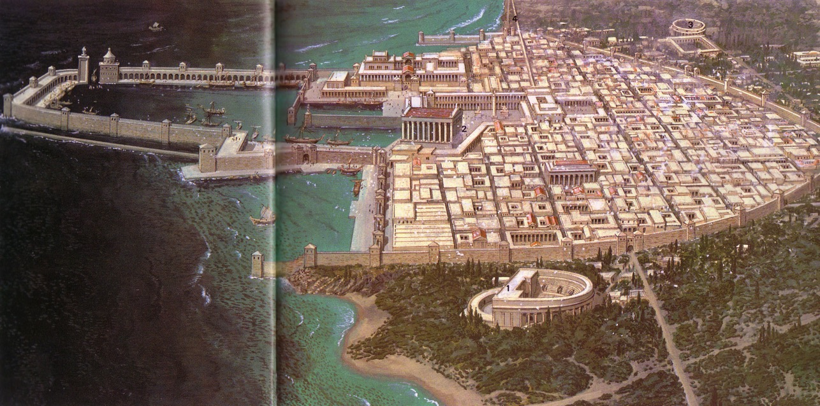
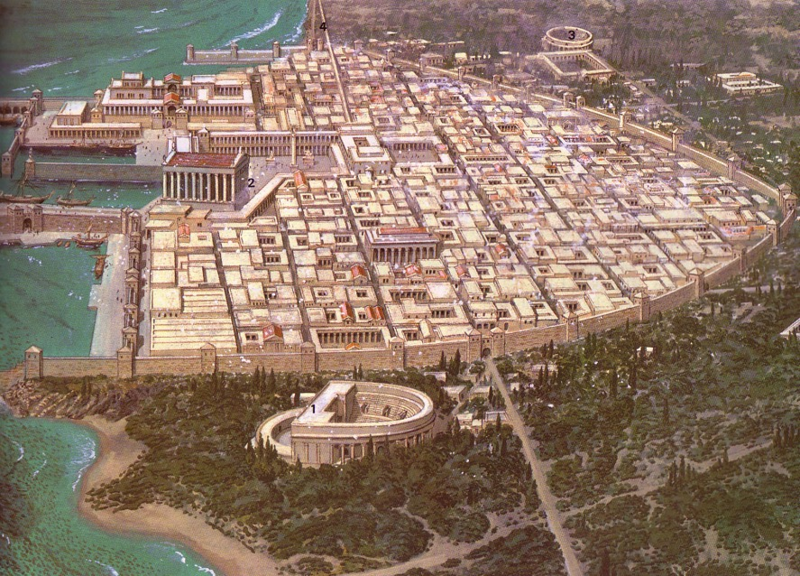
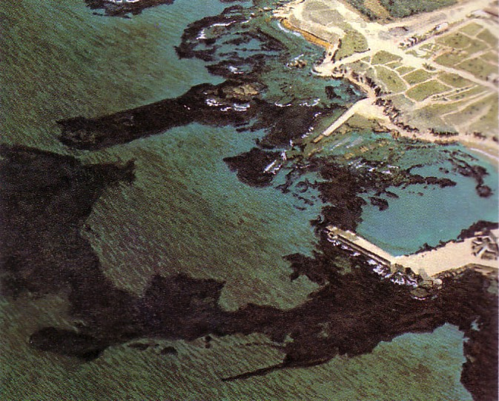
Herod Built to Honor Caesar
103
Caesarea

Slide 3
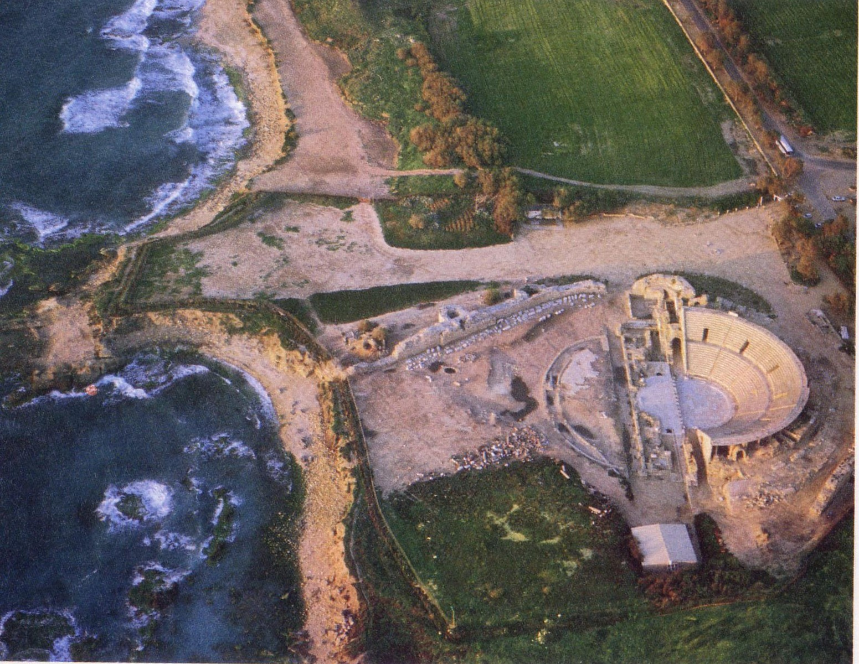
Caesarea Ruins

Slide 4
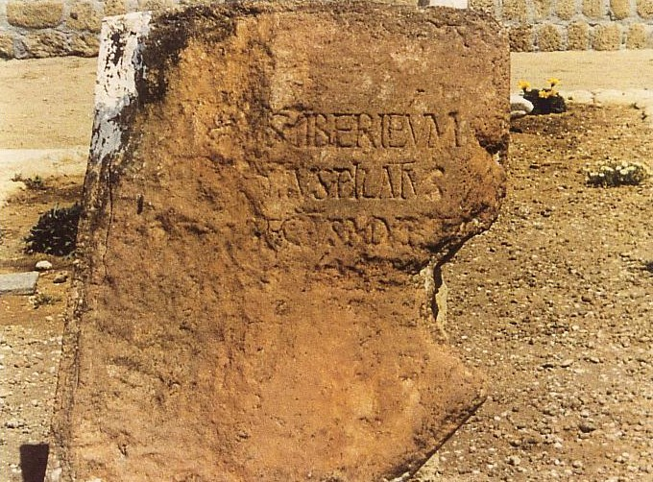
The Pilate Inscription
105
“To the people of Caesarea Tiberium,
Pontius Pilate, Prefect of Judea.”
Pilate was noted in some historical references, but some scholars doubted his existence due to no archaeological evidence mentioning him
But in 1961 this inscription was unearthed
It was found on a piece of stone re-used as part of a landing for a theatre in Caesarea
It is the first archaeological reference to Pilate

Slide 5
Northern Israel:
• Caesarea
• Galilee
• Decapolis
85

Slide 6
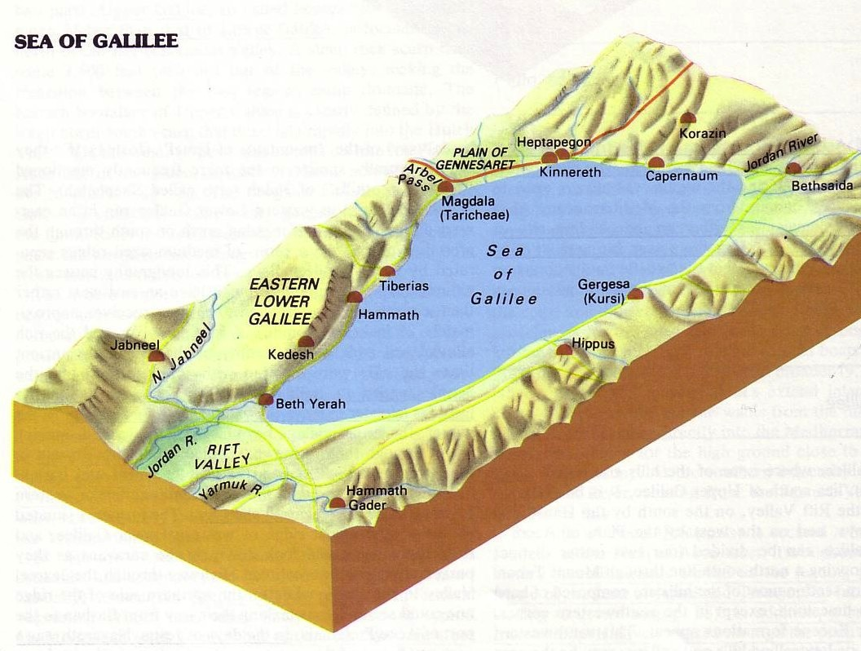
Capernaum on the Sea of Galilee
88

Slide 7
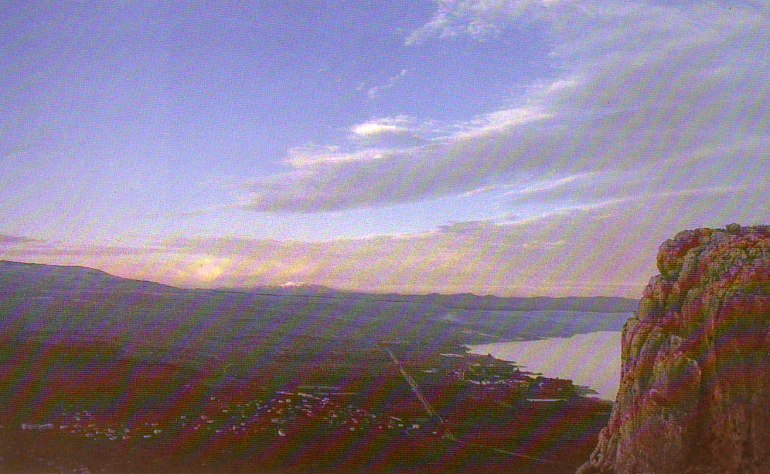
The Sea of Galilee
(North shore looking east))

Slide 8
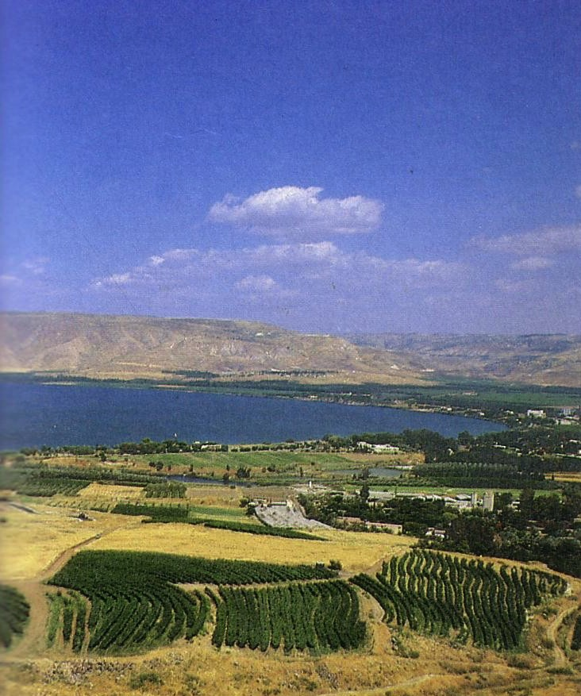
The Sea of Galilee
(South shore looking east))

Slide 9
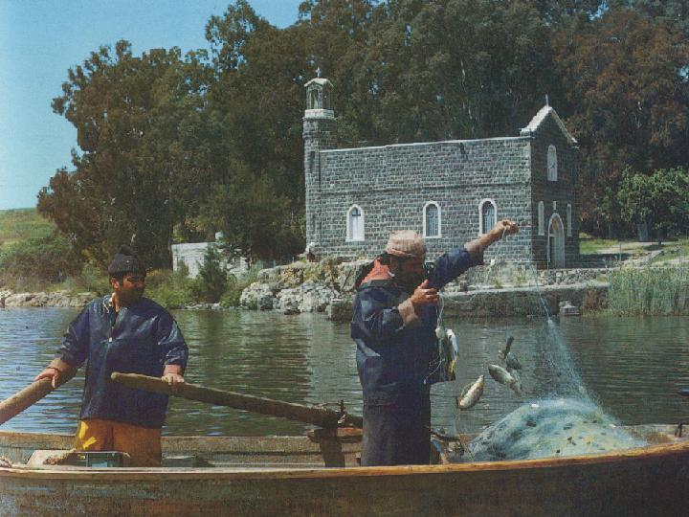
Modern Net Fishing

Slide 10
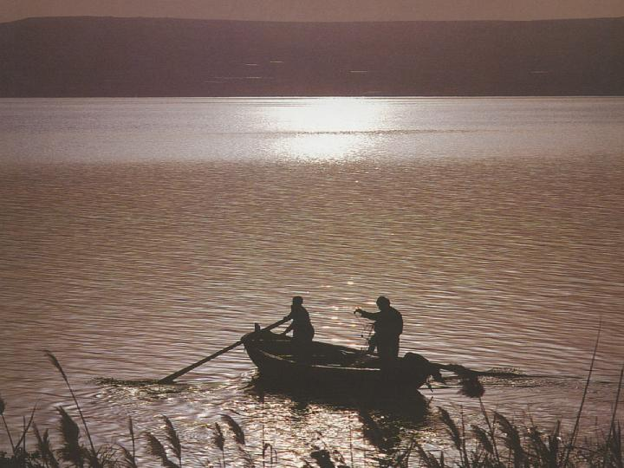
Night shift is normal for fishermen

Slide 11
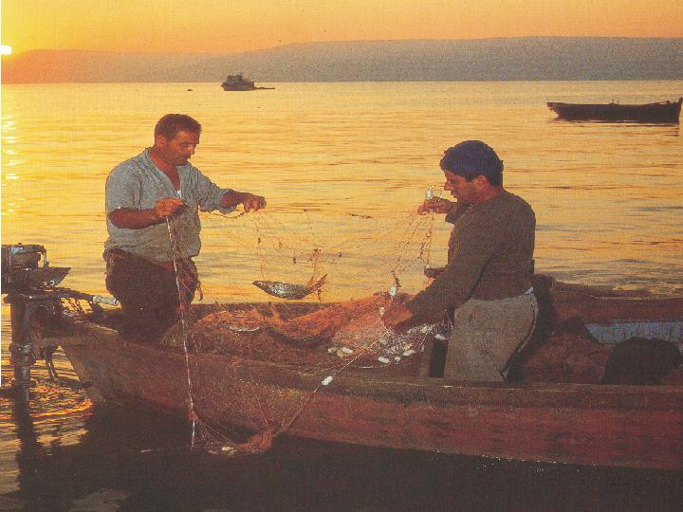
St. Peter's Fish
(fresh water bass)

Slide 12
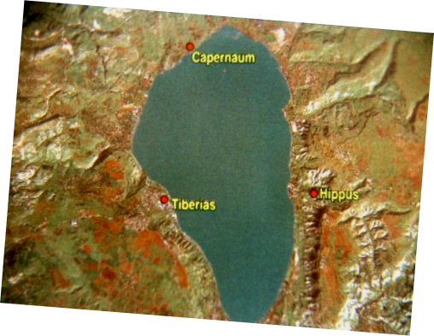
NASA View of the Lake
87
Capernaum
Hippus
Tiberias

Slide 13
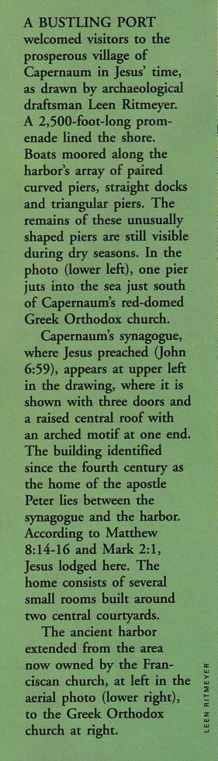
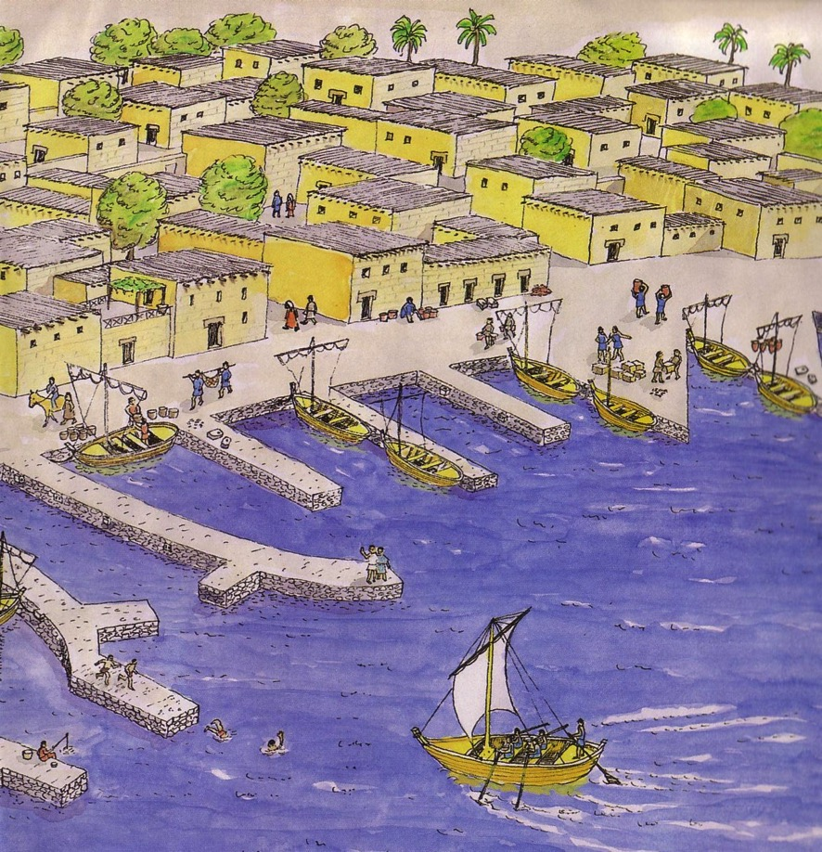
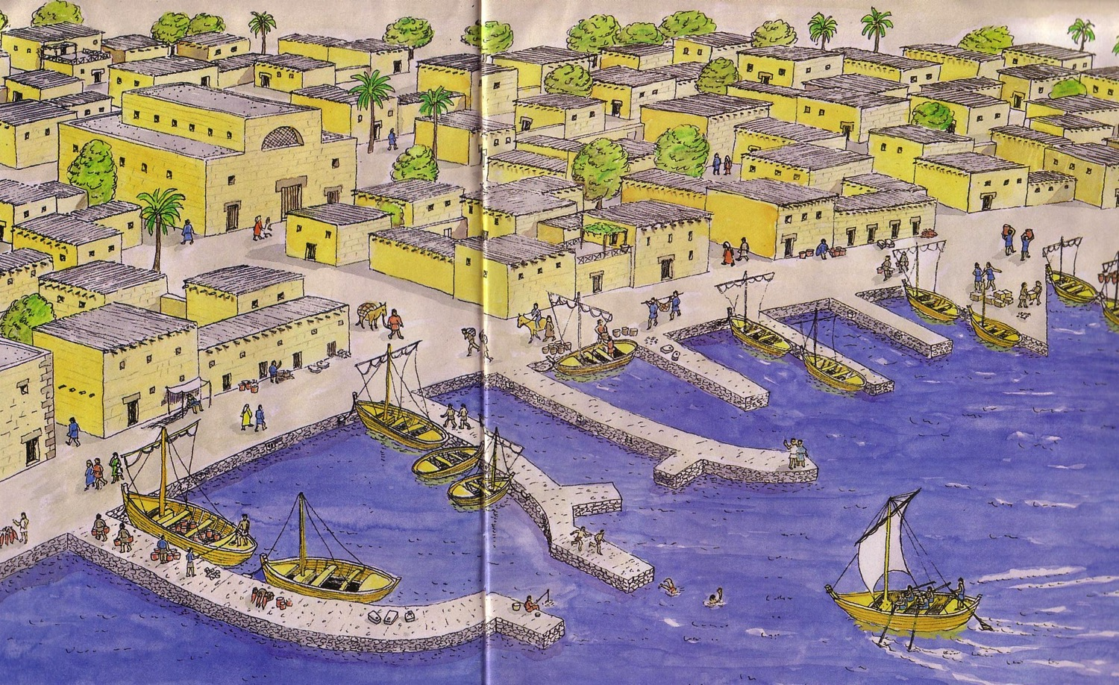
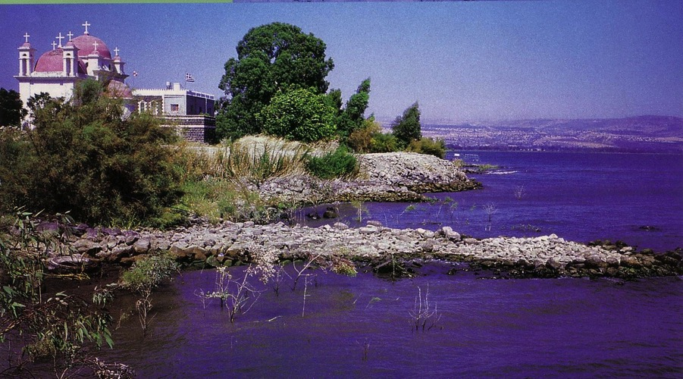
Peter was a Jewish businessman from Capernaum
93
Peter’s Synagogue
Peter’s House
Peter’s Business
Notes:
Biblical Archaeology Review (July/Aug 1999): 24-25

Slide 14
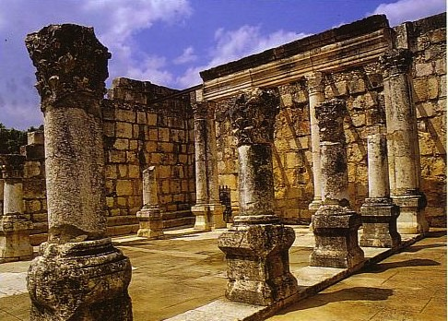
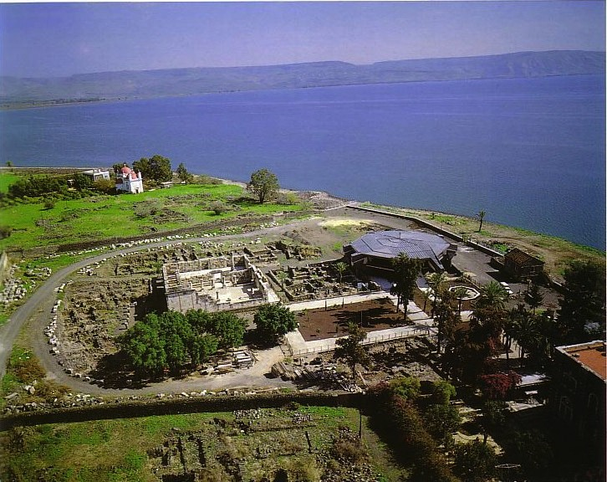
Capernaum Today
91-93
Peter’s House
Synagogue

Slide 15
Tiberias on the Sea of Galilee
88

Slide 16
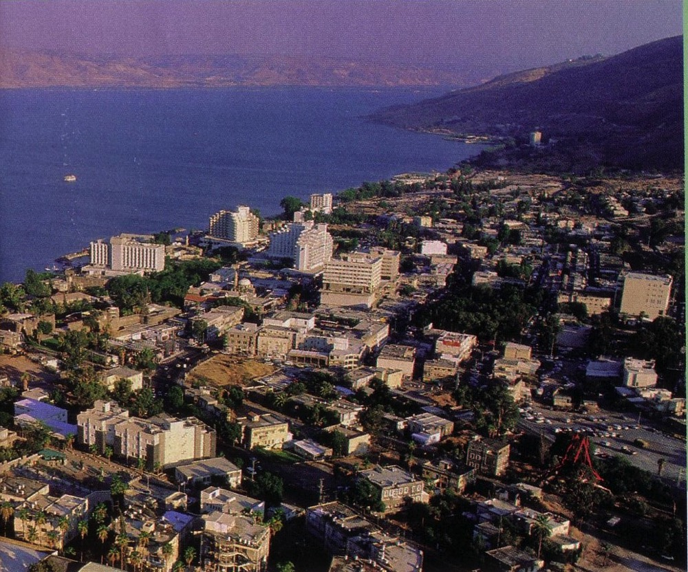
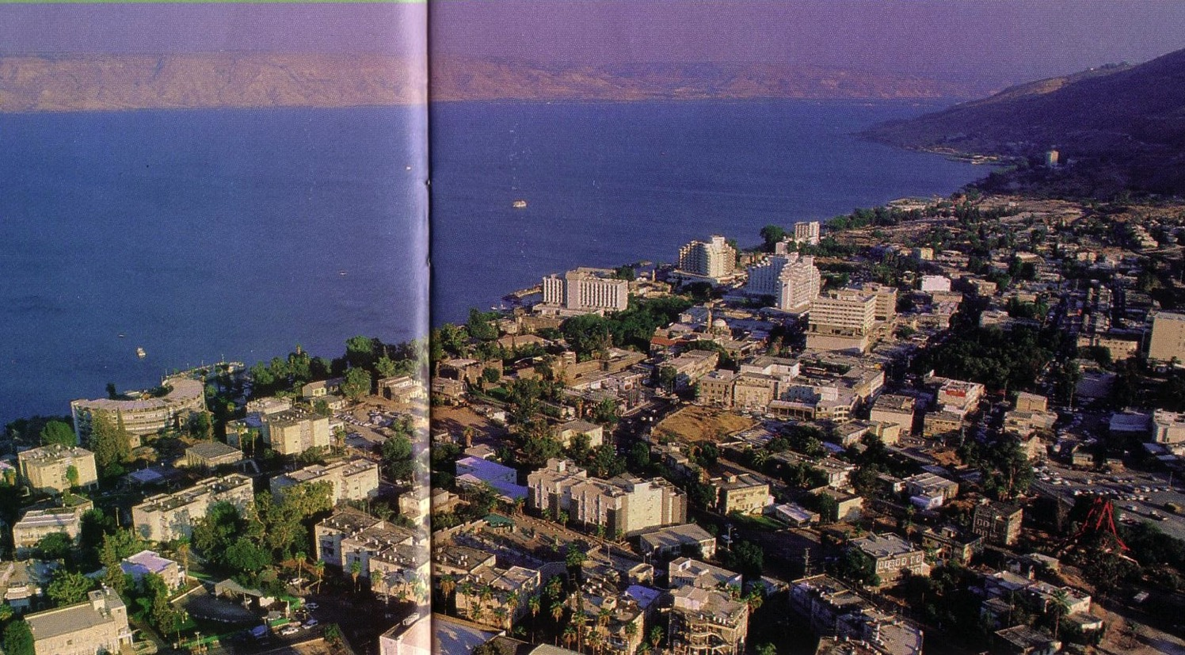
Down the Coast . . . Tiberias!
The Gentile city par excellance

Slide 17
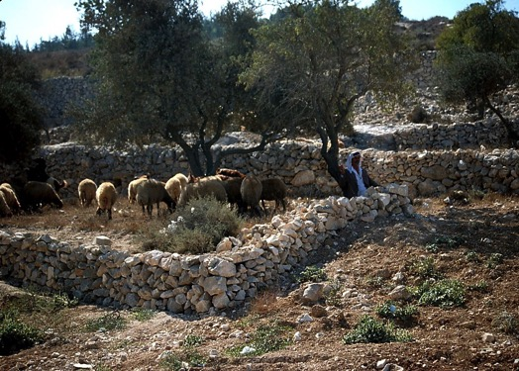
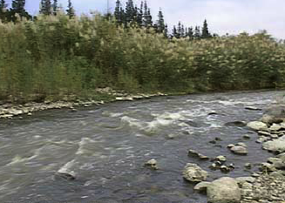
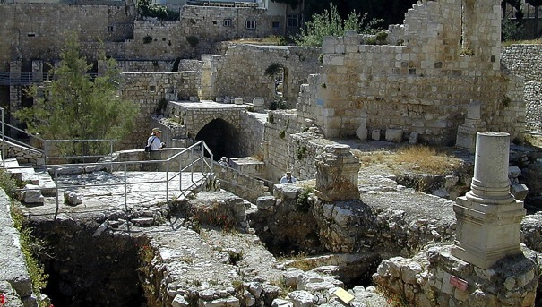

TBB
Matt. 4:11-16
Shepherds Near Bethlehem
Hillside Near Capernaum
JESUS
Life
Upper Jordan River
Pools of Bethesda
The backdrop of Our Lord’s daily life...
Scenes the Savior saw with his own eyes.
Handbook pg. 39-41
04

Slide 18
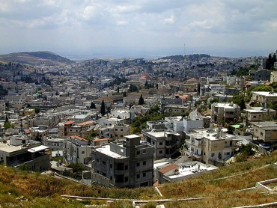
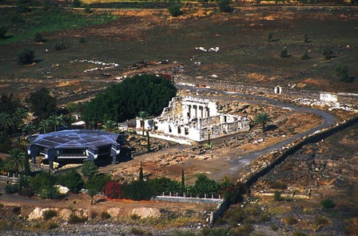

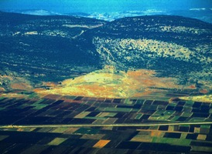
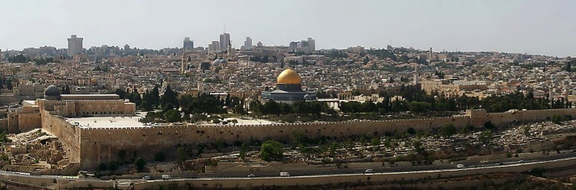
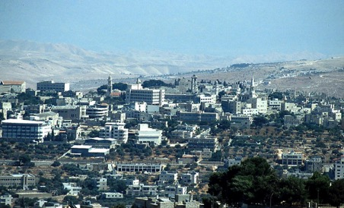
7
CAPERNAUM
SIX FOCAL POINTS OF JESUS’ LIFE AND TRAVELS
NAZARETH
GALILEE
CANA
JESUS
Life
JERUSALEM
BETHLEHEM
Handbook pg. 39-41
05
6

Slide 19
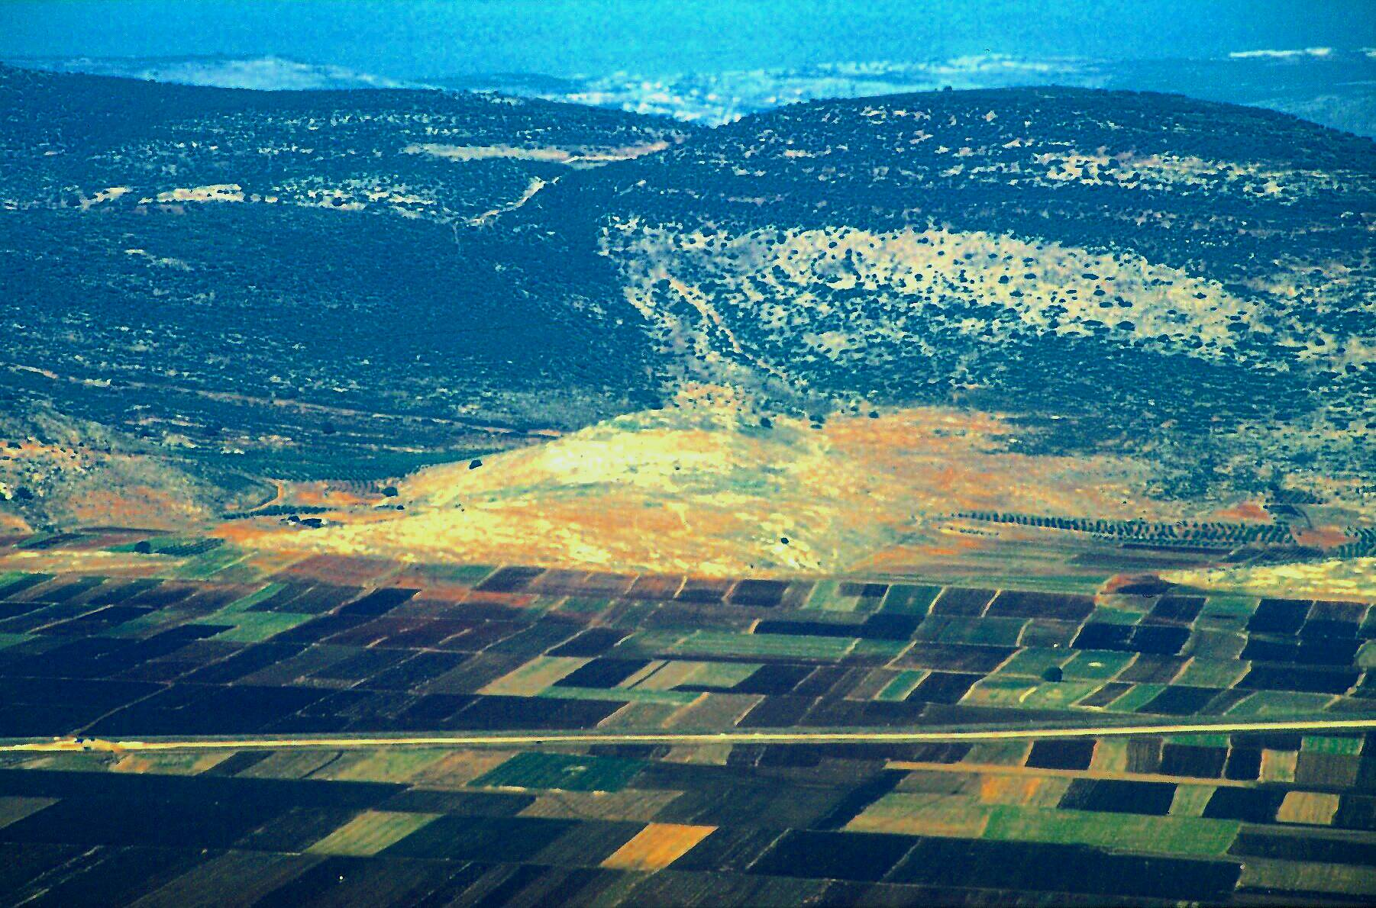
John 2:1-11
JESUS
JESUS
Life
Jesus Traveled His Land:
Cana: Site of Jesus’ First Recorded Miracle!
06

Slide 20




7
JESUS
Life
Think of the shape of a thistle...
Handbook pg. 39-41
07
1

Slide 21
7
Acts 17:16-34
JESUS
Life
The Thistle Route of Jesus’ Travels...
Handbook pg. 39-41
08
1

Slide 22
John 2:13-2:25
7
STUDY HELP #07
JESUS
Life
1. THE LORD’S
FIRST
JERUSALEM
MINISTRY
The Thistle Route of Jesus’ Travels...
Handbook pg. 39-41
09
1

Slide 23
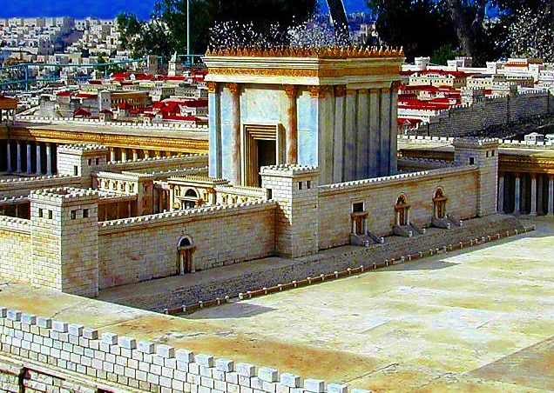
John 2:13-2:25
7
JESUS
Life
Herod the Great’s Jerusalem Temple
Handbook pg. 39-41
10

Slide 24

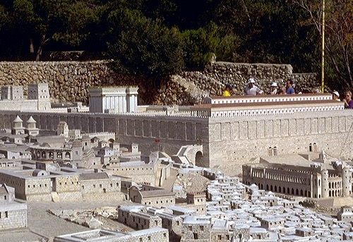
John 2:13-2:25
JERUSALEM IN THE TIME OF JESUS
JESUS
Life
The Surrounding City
The Temple Mount, The Temple, Antonia Fortress
Location Credit: Holyland Hotel, Jerusalem
Handbook pg. 39-41
11

Slide 25
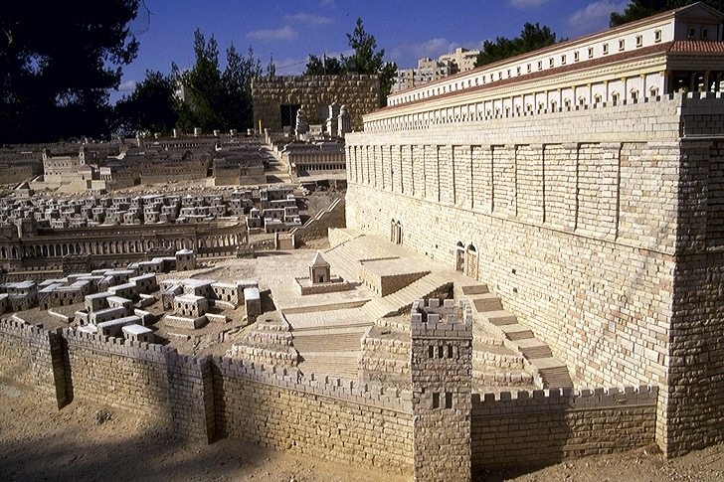

Mark 11:27
JERUSALEM IN THE TIME OF JESUS
JESUS
Life
The Temple Mount’s Southern Steps
The Eastern Gate
Location Credit: Holyland Hotel, Jerusalem
Handbook pg. 39-41
12

Slide 26
John 4:1-6
7
2. THE
SAMARITAN
TRANSIT
JESUS
Life
1. THE LORD’S
FIRST
JERUSALEM
MINISTRY
SHILOH: The Tabernacle
The Thistle Route of Jesus’ Travels...
Handbook pg. 39-41
13
3

Slide 27
Matt. 4:13-16; 9:1
3. THE GALILEAN
MINISTRY AT
CAPERNAUM
2. THE
SAMARITAN
TRANSIT
JESUS
JESUS
Life
1. THE LORD’S
FIRST
JERUSALEM
MINISTRY
The Thistle Route of Jesus’ Travels...
Handbook pg. 39-41
14

Slide 28
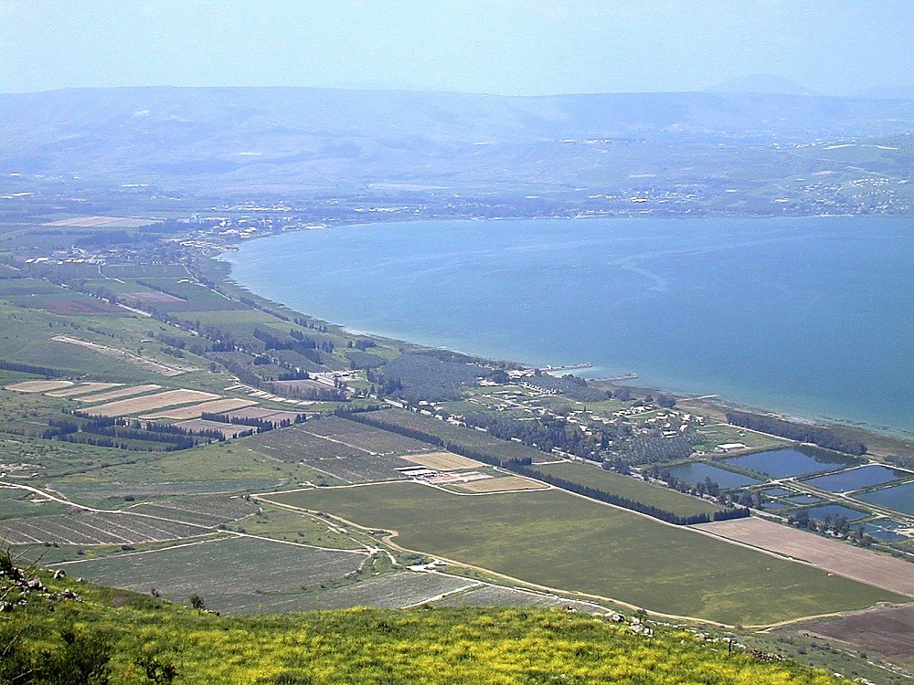
Capernaum: Ministry Headquarters
JESUS
JESUS
Life
Jesus Traveled His Land:
Northwestern Shore, Sea of Galilee
15

Slide 29
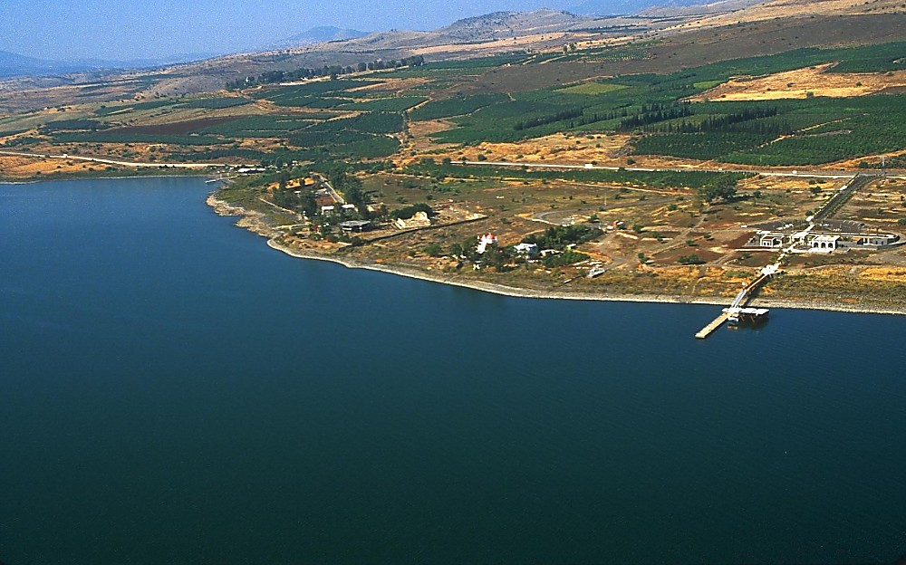
JESUS
JESUS
Life
Jesus Traveled His Land:
Approaching Capernaum By Air
16

Slide 30
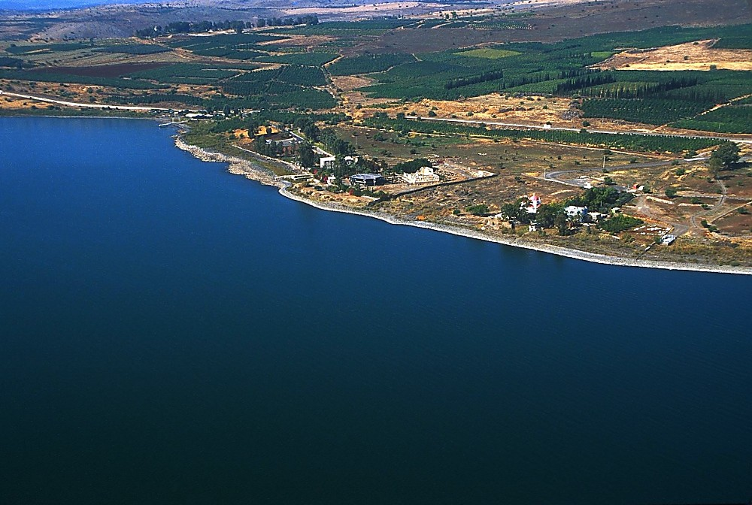
JESUS
JESUS
Life
Jesus Traveled His Land:
Approaching Capernaum By Air
17

Slide 31
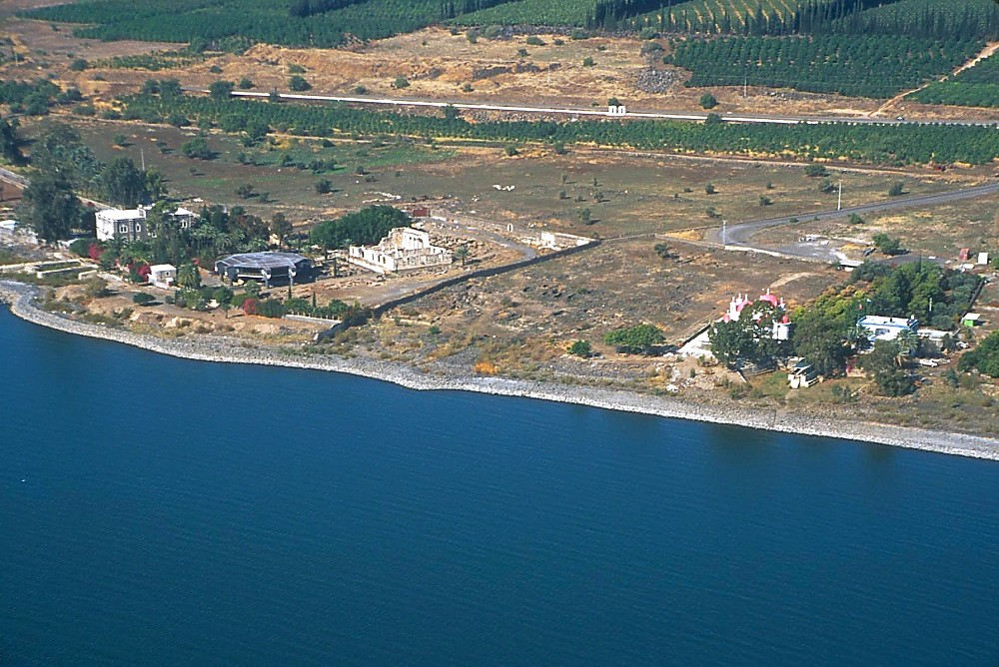
JESUS
JESUS
Life
Jesus Traveled His Land:
Approaching Capernaum By Air
18

Slide 32
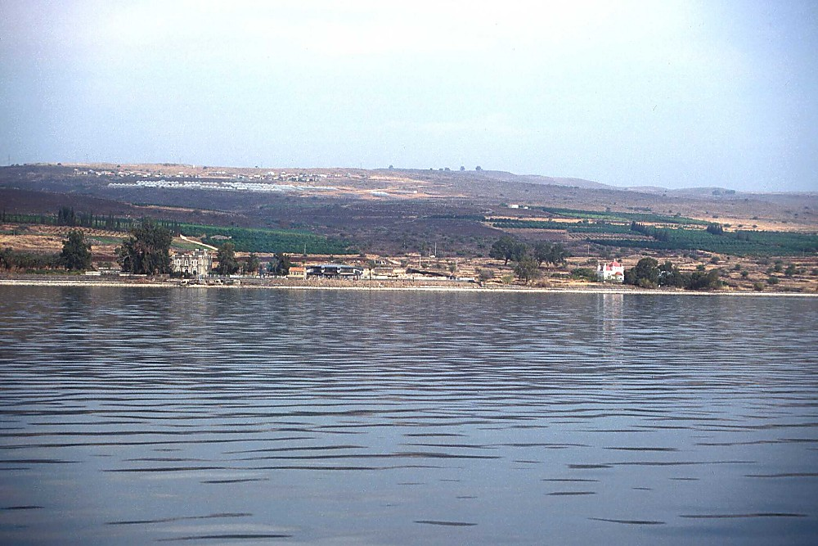
JESUS
JESUS
Life
Jesus Traveled His Land:
Approaching Capernaum By Boat
19

Slide 33
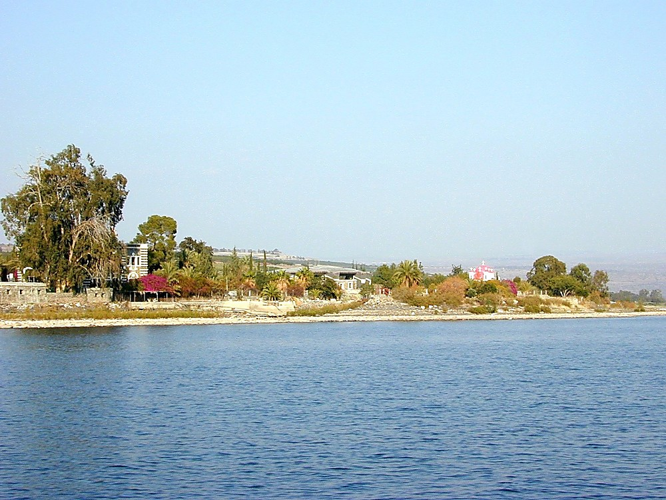
JESUS
JESUS
Life
Jesus Traveled His Land:
Approaching Capernaum By Boat
20

Slide 34
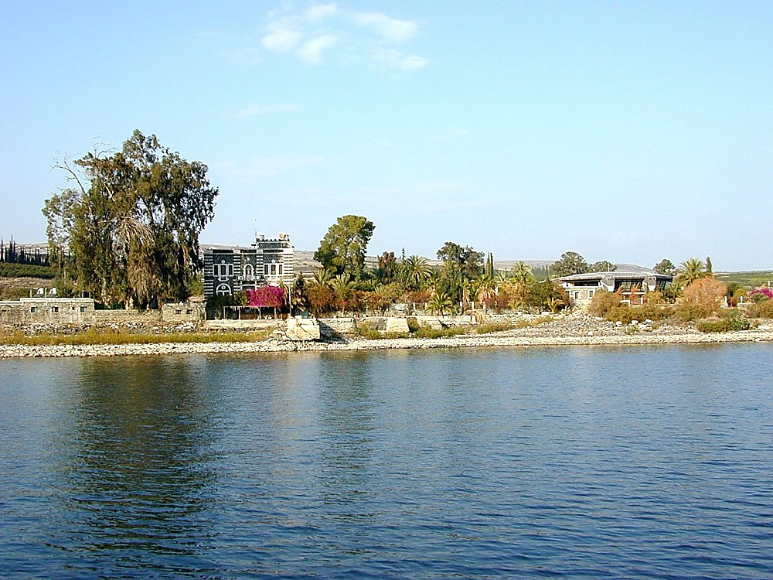
JESUS
JESUS
Life
Jesus Traveled His Land:
Approaching Capernaum By Boat
21

Slide 35
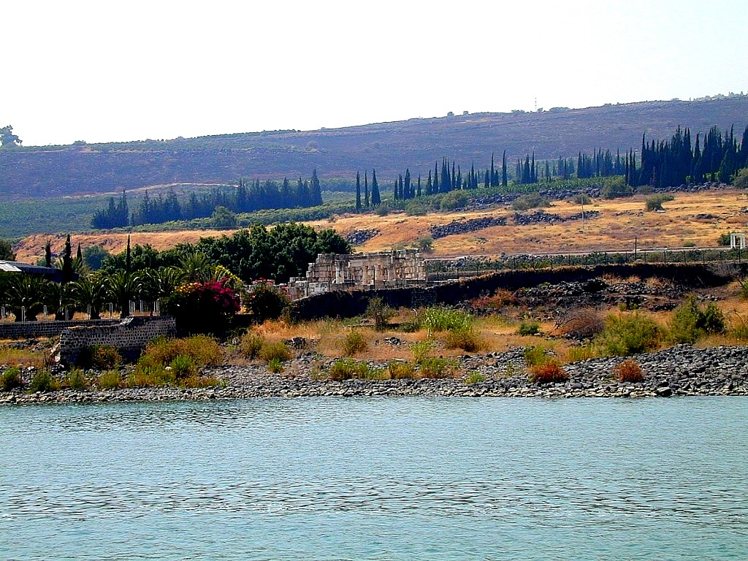
JESUS
JESUS
Life
Jesus Traveled His Land:
Approaching Capernaum: The Synagogue
22

Slide 36
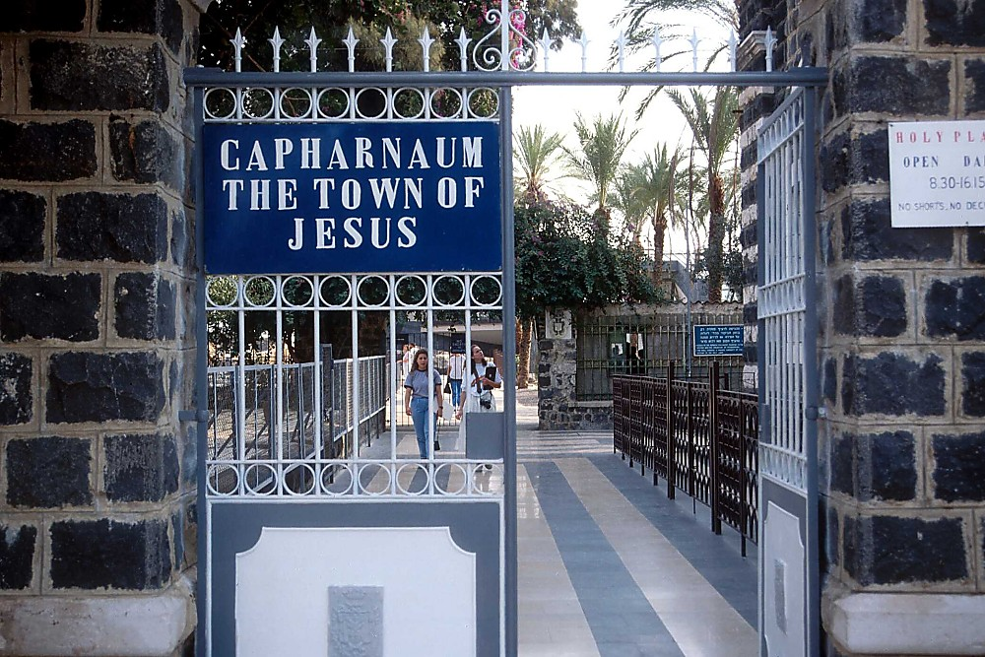
JESUS
JESUS
Life
Jesus Traveled His Land:
Entering “The Town of Jesus”
23

Slide 37
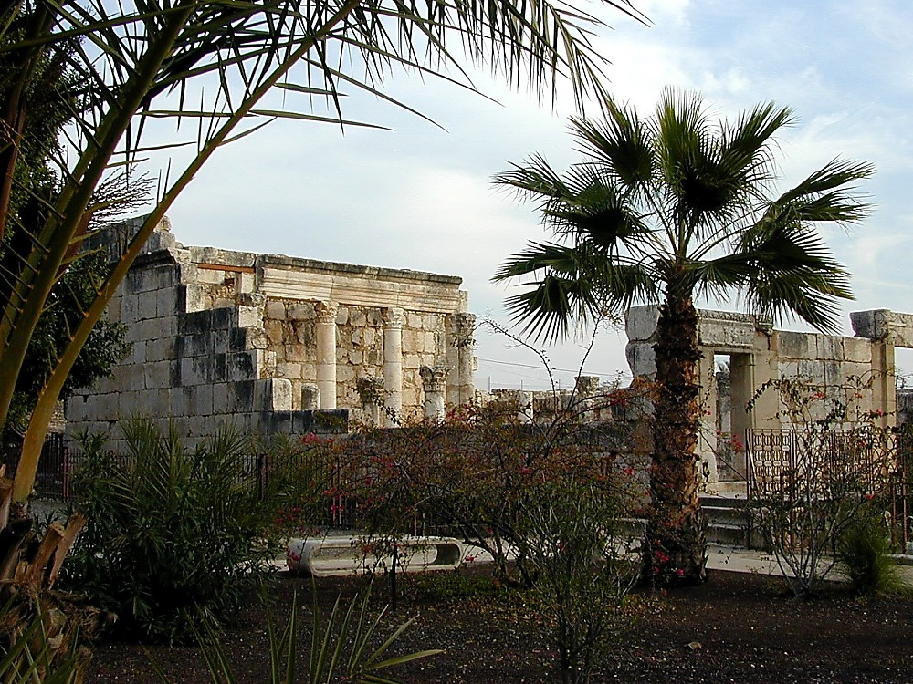
JESUS
JESUS
Life
Jesus Traveled His Land:
The Later Capernaum Synagogue
24

Slide 38
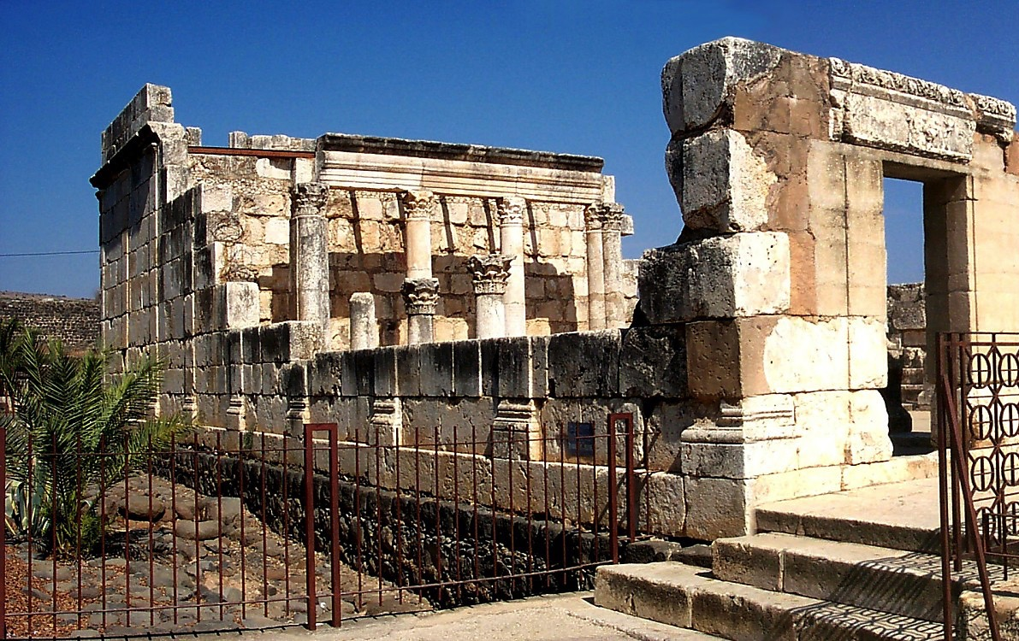
JESUS
JESUS
Life
Jesus Traveled His Land:
The Later Capernaum Synagogue
25

Slide 39
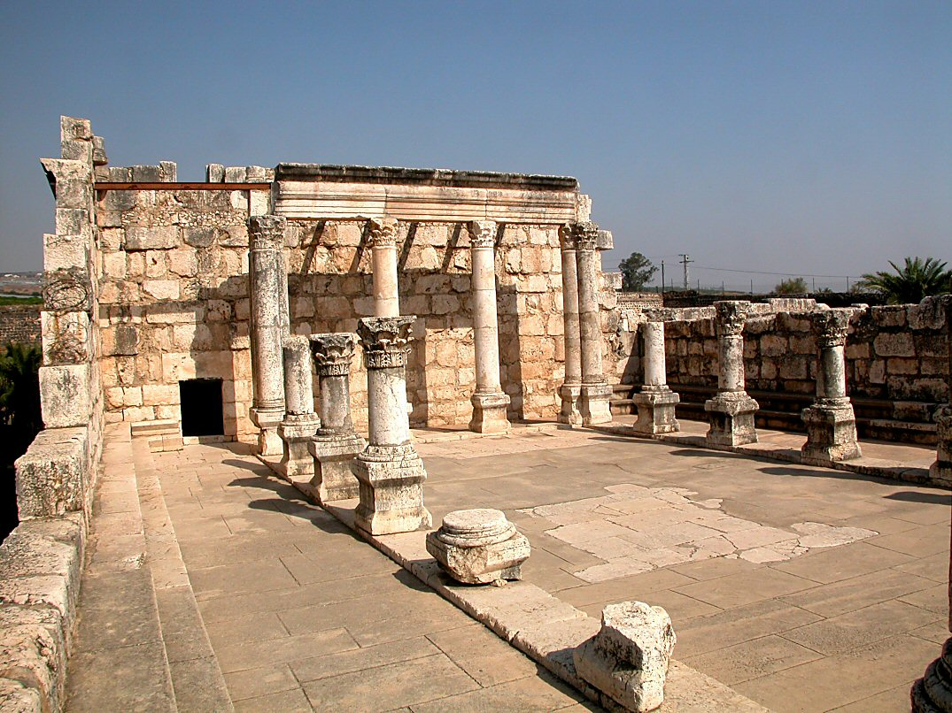
Mark 1:21; John 6:59
JESUS
Life
Jesus Traveled His Land:
The Later Capernaum Synagogue
26

Slide 40
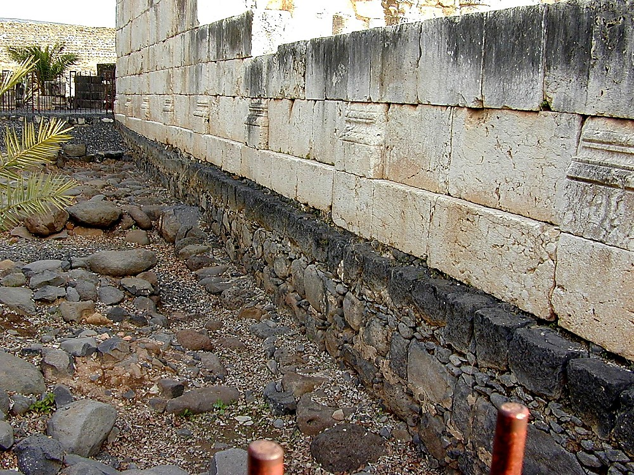
JESUS
JESUS
Life
Jesus Traveled His Land:
The Basalt Streets of Capernaum
27

Slide 41
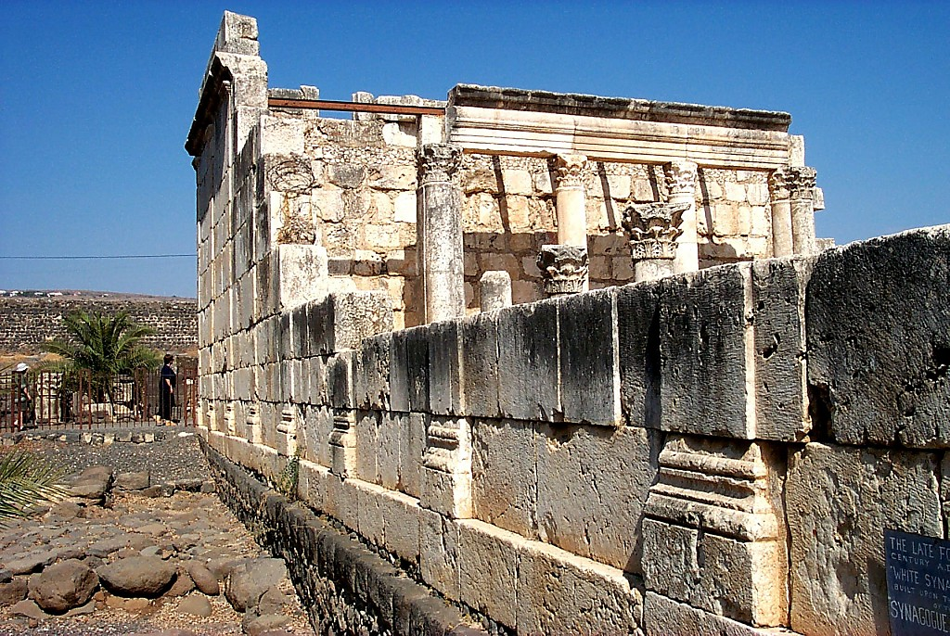
JESUS
JESUS
Life
Jesus Traveled His Land:
The Basalt Streets of Capernaum
28

Slide 42
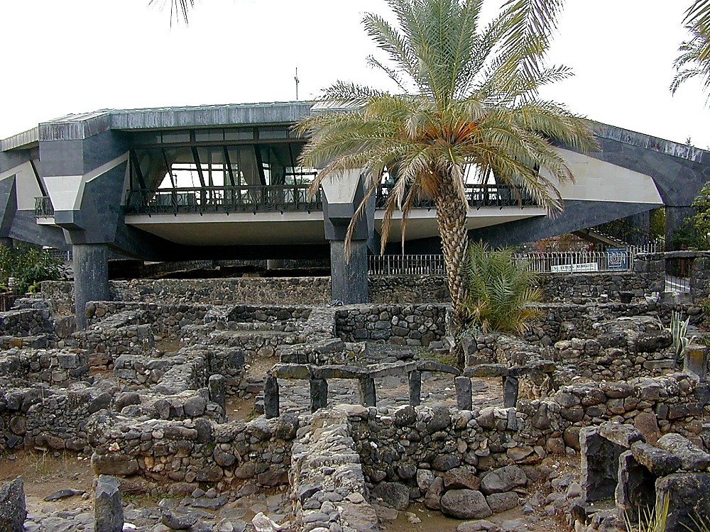
JESUS
JESUS
Life
Jesus Traveled His Land:
Protecting Peter’s House in Capernaum
29

Slide 43
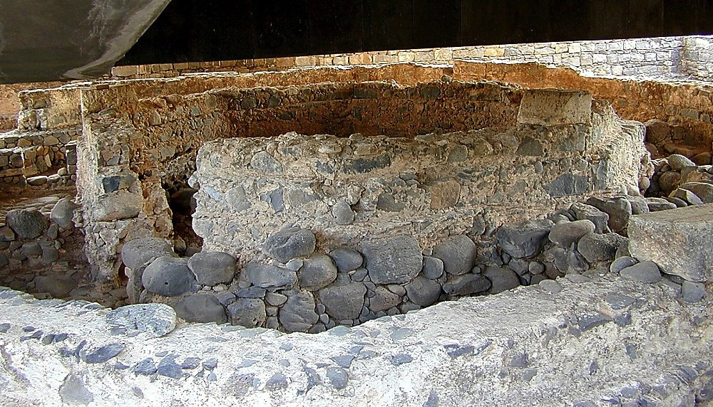
JESUS
JESUS
Life
Jesus Traveled His Land:
The Remains of Peter’s House in Capernaum
30

Slide 44

JESUS
JESUS
Life
Jesus Traveled His Land:
Sunset On the Sea of Galilee
31

Slide 45
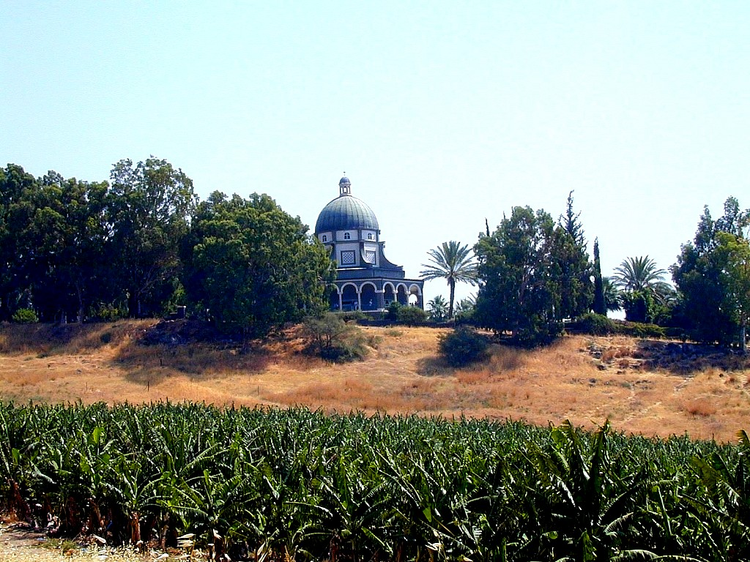
JESUS
JESUS
Life
Jesus Traveled His Land:
Mount of the Beatitudes
32

Slide 46

JESUS
JESUS
Life
Jesus Traveled His Land:
On the Heights of the Galilee
33

Slide 47

JESUS
JESUS
Life
Jesus Traveled His Land:
The Galilee’s High Country
34

Slide 48

Matt 16:13-28
JESUS
JESUS
Life
Jesus Traveled His Land:
Caesarea Philippi -- To Peter: “…on this rock!”
35

Slide 49

JESUS
JESUS
Life
Jesus Traveled His Land:
Waters of the Upper Jordan
36

Slide 50

JESUS
JESUS
Life
Jesus Traveled His Land:
The River Jordan Moves South
37

Slide 51

JESUS
JESUS
Life
Jesus Traveled His Land:
The Galilee’s Bountiful Waters
38

Slide 52
Northern Israel:
• Caesarea
• Galilee
• Decapolis
85

Slide 53

Greek Cities in Israel

Slide 54

Jerash of the Decapolis

Slide 55

Jerash in Its Glory Days

Slide 56

Black
THANK YOU
By Samuel and Michael

Slide 57
Note on Greek & Hebrew Fonts
BWHEBB, BWHEBL [Hebrew]; BWGRKL, BWGRKN, and BWGRKI [Greek] Postscript® Type 1 and TrueType™ fonts Copyright © 1994-2002 BibleWorks, LLC. All rights reserved. These Biblical Greek and Hebrew fonts are used with permission and are from BibleWorks, software for Biblical exegesis and research.

Slide 58
Black

Slide 59


Bible Geography link at BibleStudyDownloads.org
Get this presentation for free!
Notes:
Bible Study (bs)

