Slide 1
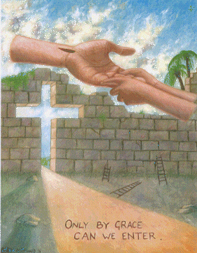
My Testimony
Words & lyrics by Gerrit Gustafson
Dr. Rick Griffith • Jordan Evangelical Theological Seminary • BibleStudyDownloads.org

Slide 2

Only by grace can we enter
Only by grace can we stand
Not by our human endeavor
But by the blood of the Lamb

Slide 3
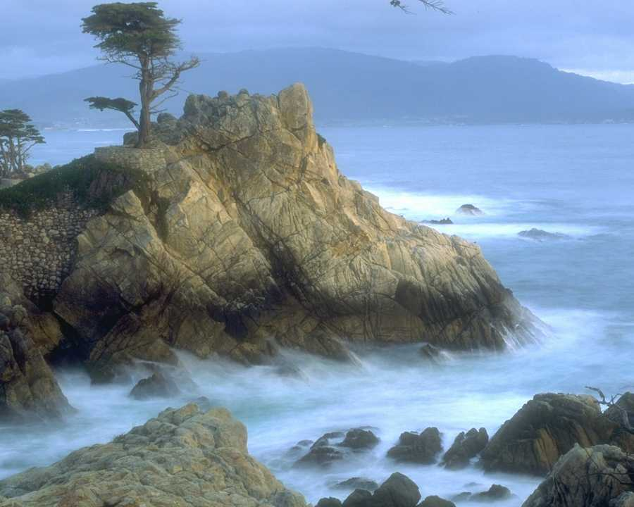
Into Your presence You call us
Call us to come
Into Your presence You draw us
And now by Your grace we come
Now by Your grace we come

Slide 4
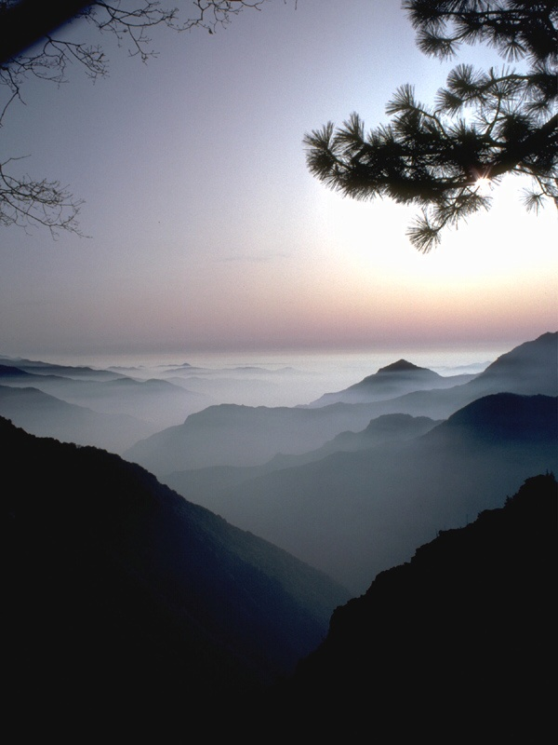
Lord, if You marked our transgressions
who would stand?
But thanks to Your grace
we are cleansed by the blood of the Lamb

Slide 5
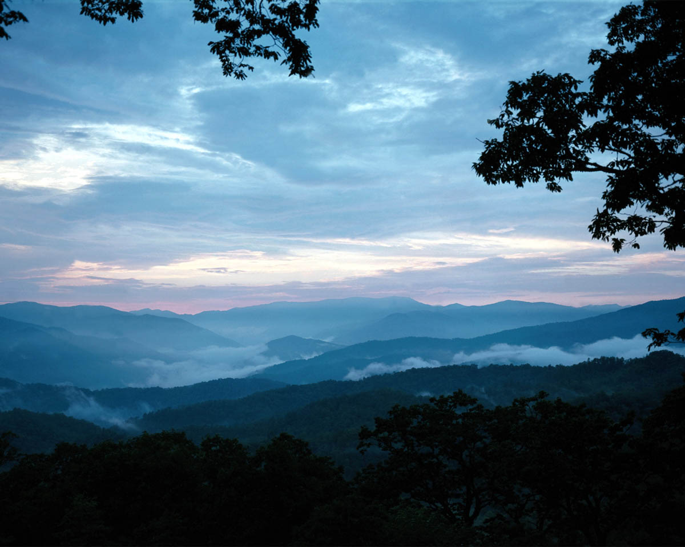
Only by grace can we enter
And now by Your grace we come
Now by Your grace we come
Now by Your grace we come

Slide 7

This is My Life
A Family Album
Notes:
Today instead of the usual chapel message I thought I'd share something I know something about—what God has done in my own life

Slide 8
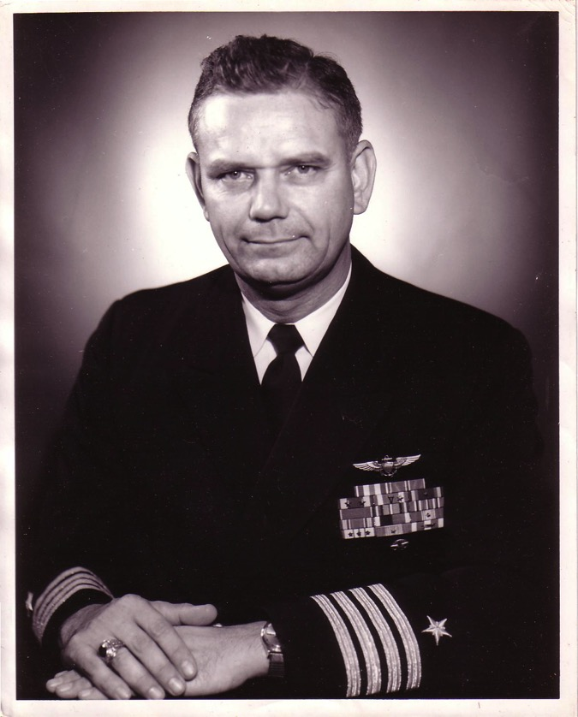
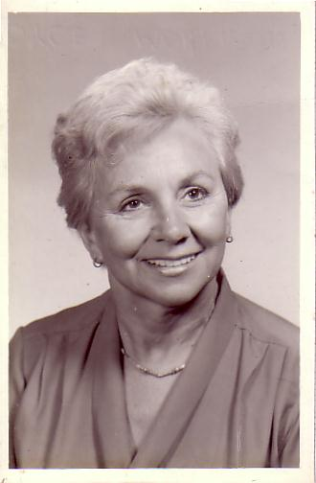
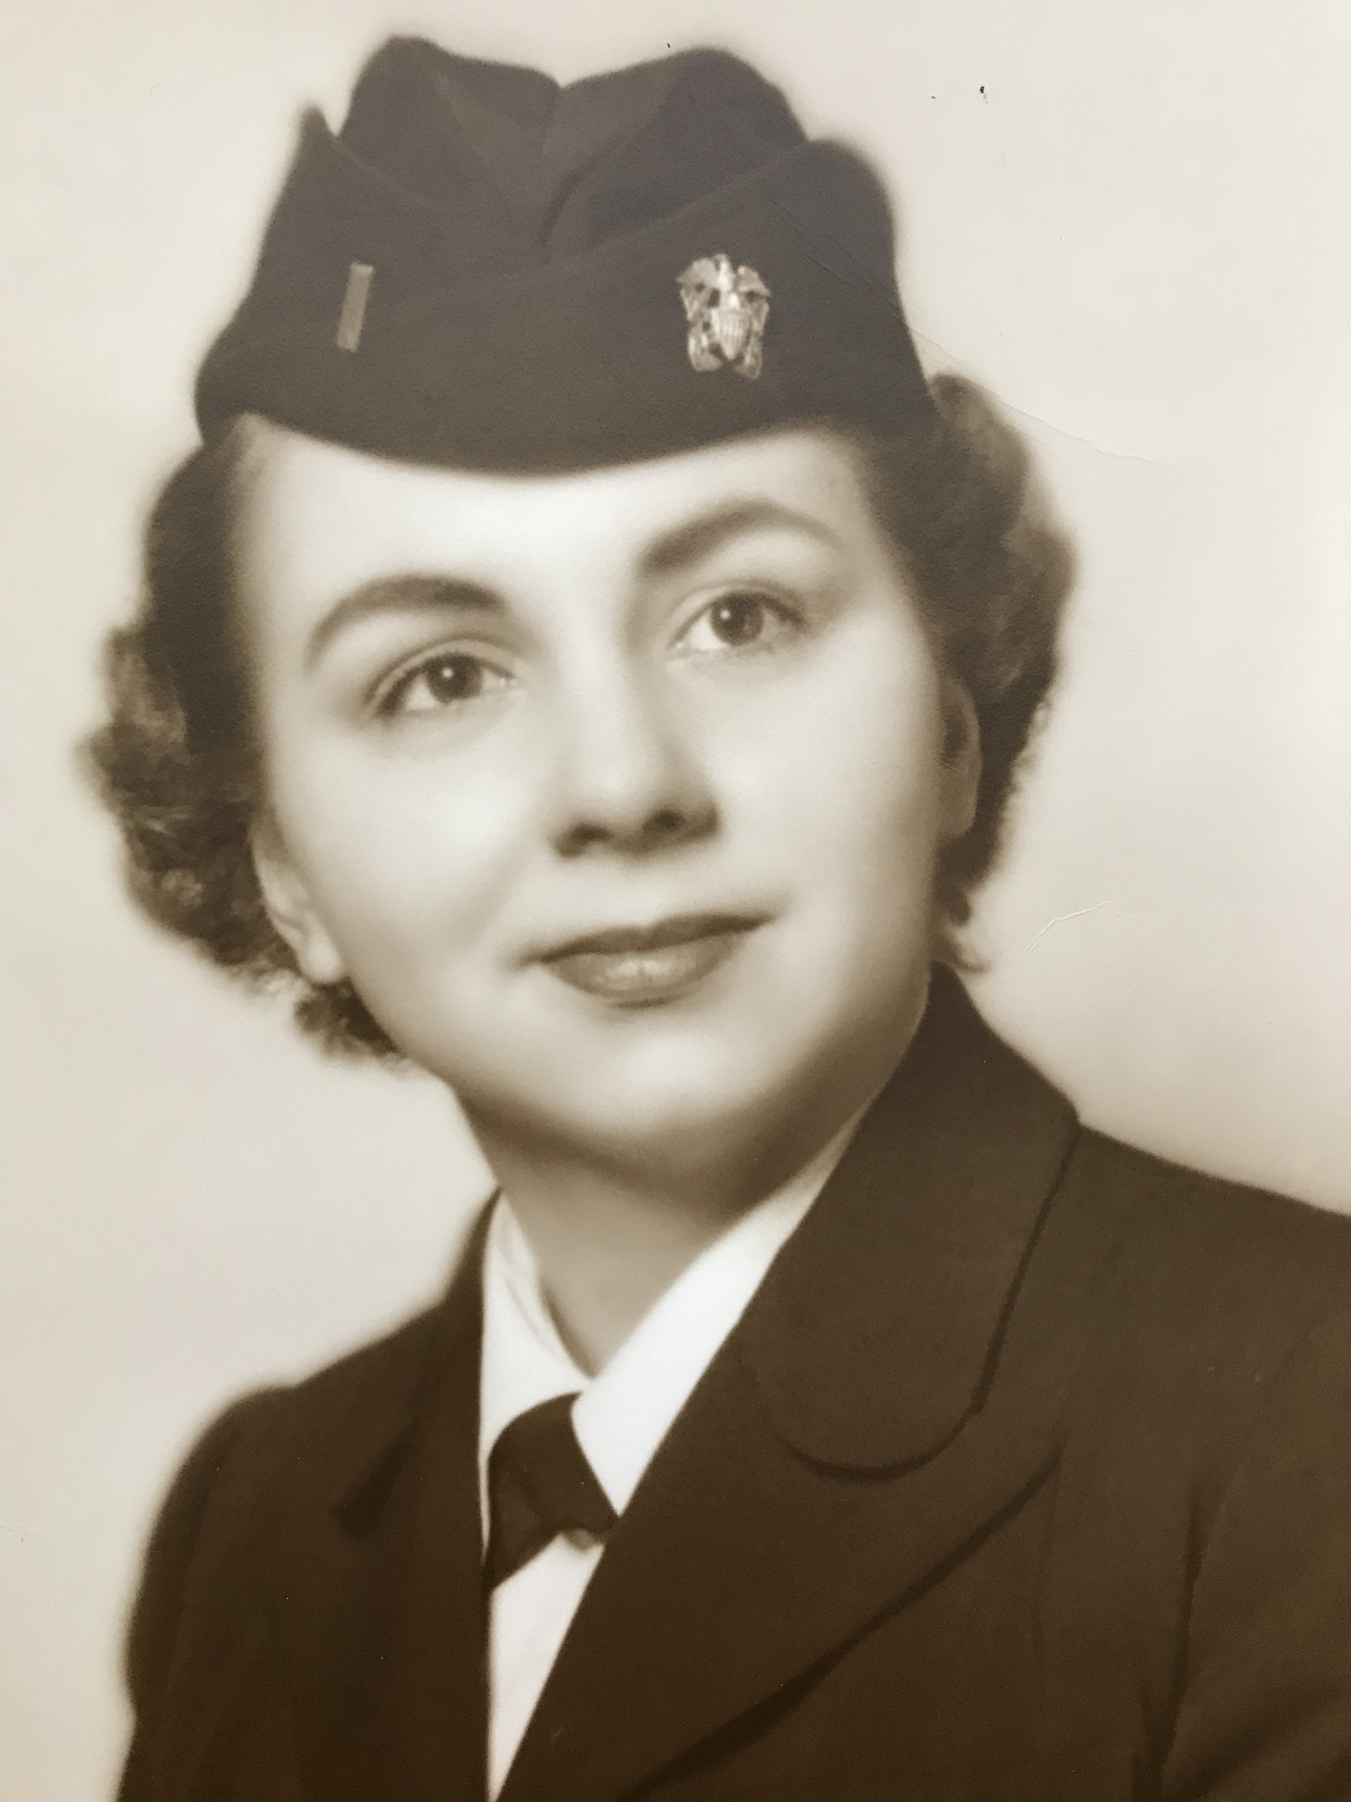
The Marriage
Navy Lieutenant
Harold F. Griffith (alias Dad)
Navy Ensign
Joyce I. Griffith (alias Mom)
Notes:
The story, of course, must begin with my parents who met in the Navy.
They had a baby boy (my older brother Bob) and then were transferred to Japan.

Slide 9
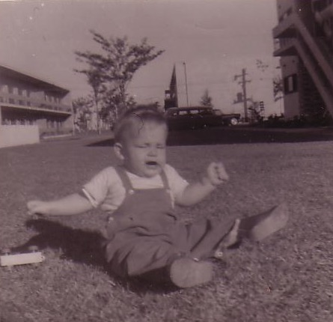
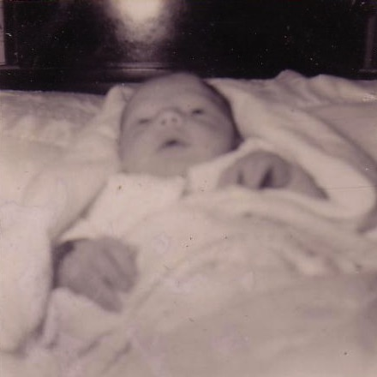
Baby Ricky
“Unto us a child is born… unto us a son is given…”
Tokyo, 1958
Notes:
That's where I made my appearance. I was born in Japan at a very young age… as an MK (Military Kid)

Slide 10
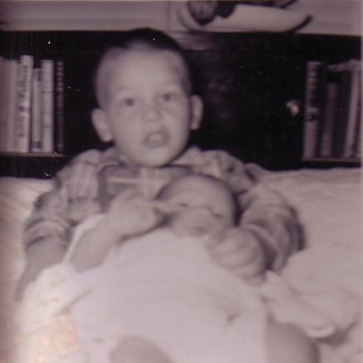
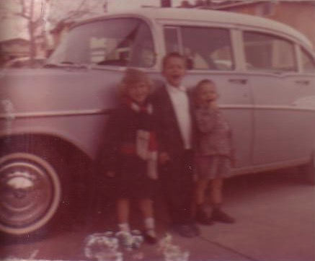
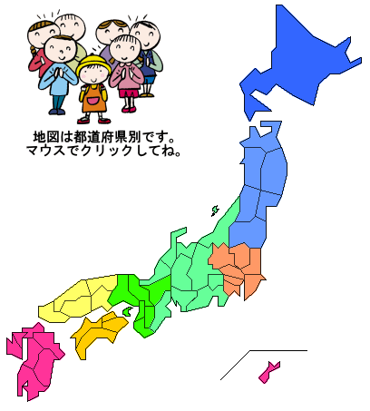
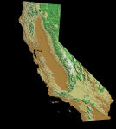
The Family Grew & Moved…
Notes:
After my sister's birth there 19 months later we moved to a strange land—California!

Slide 11
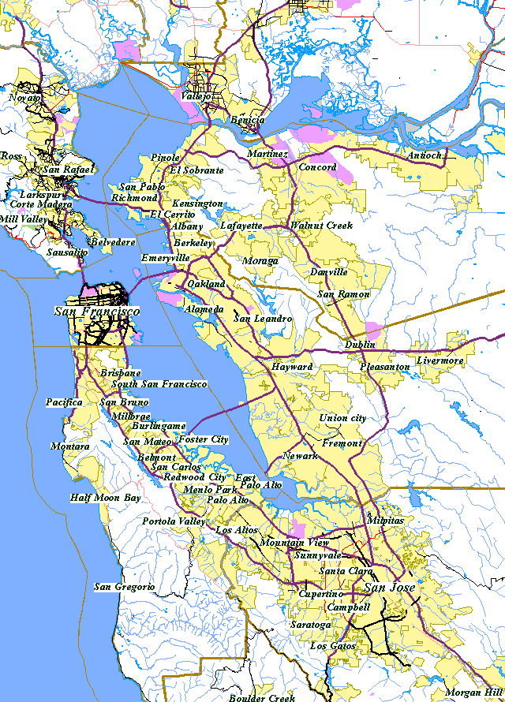
San Francisco Bay Area
Alameda
SF
Castro Valley
Hayward
Notes:
We first lived in Alameda across the bay from San Francisco, then later in two other cities.

Slide 12
The Divorce
1962
Navy Commander
Harold F. Griffith (alias Dad)
Social Worker
Joyce I. Griffith (alias Mom)
Notes:
After my younger brother's birth my Mom concluded that my Dad was actually married to the Navy, so she divorced him. Ironically, she became a social worker to help other families put their lives together.

Slide 13
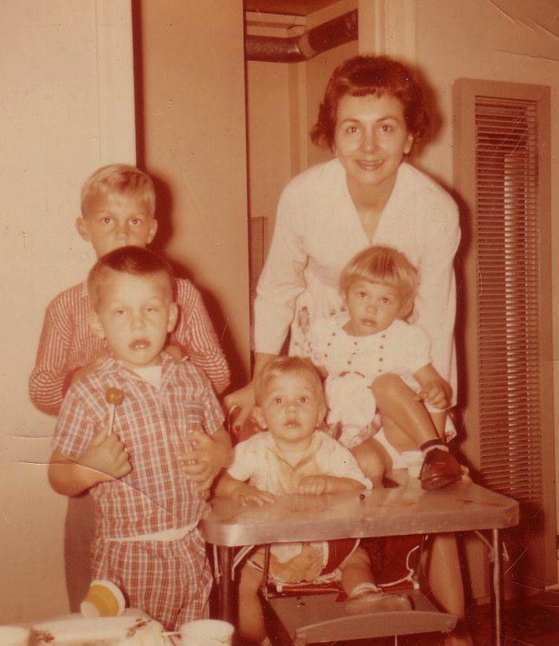
Divorce for Mom was tough…
Bobby, 6
Ricky, 4
Kathy, 3
Tommy, 1
Notes:
Those were tough years for Mom as a single mother with four kids age 6 and under. Yes, I'm the good looking one with the sucker!

Slide 14
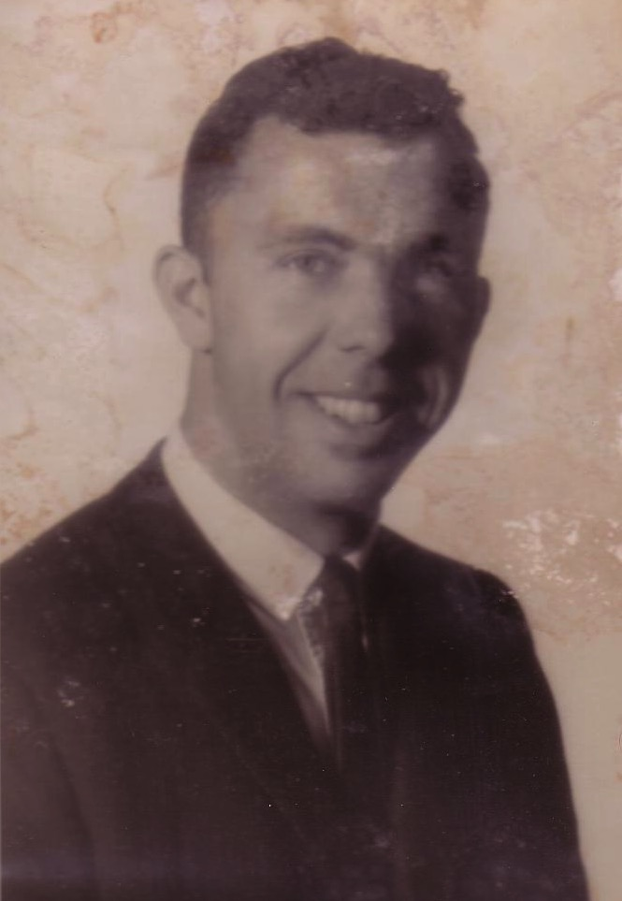
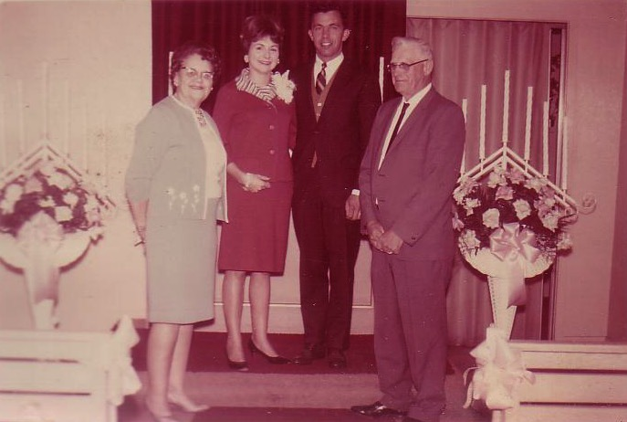
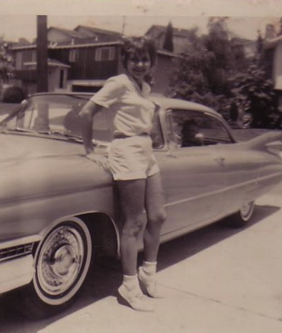
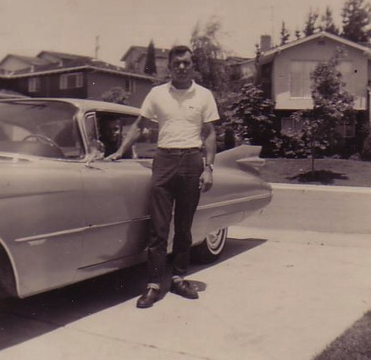
Renewal Under Bill
Notes:
Three or four years later my Mom met Bill—another divorcee with three children. They married once when I was on vacation to see my real Dad.

Slide 15
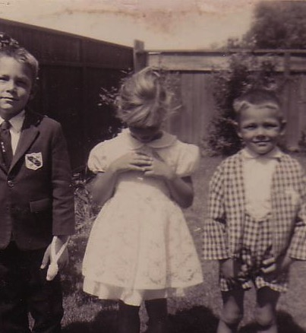
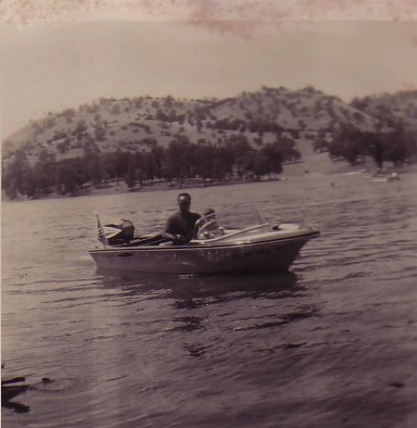
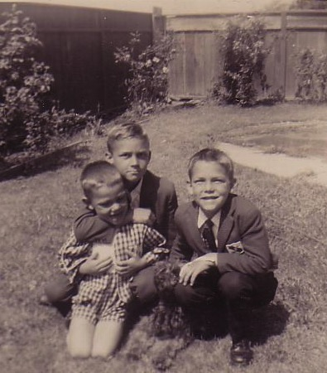
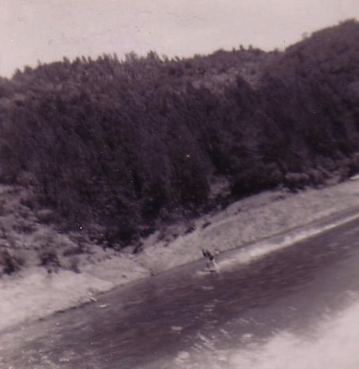
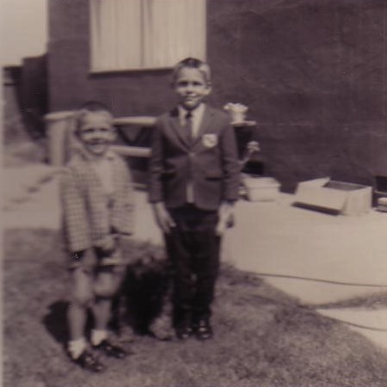
One Year of Water Skiing…
& One Year of Church…
1966-1968
Notes:
Life began to turn around. Bill played sports with us and even took us to church for a year.

Slide 16
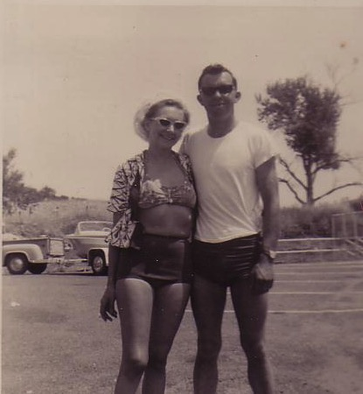
Another Divorce…
Notes:
But the arguments with my Mom became unbearable so my Mom divorced him too.

Slide 17
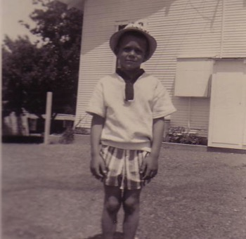
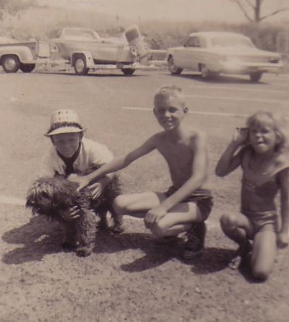
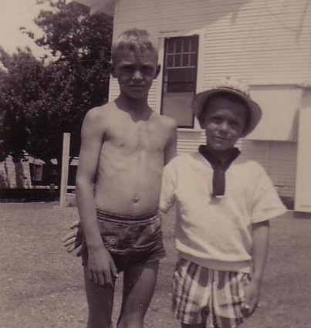
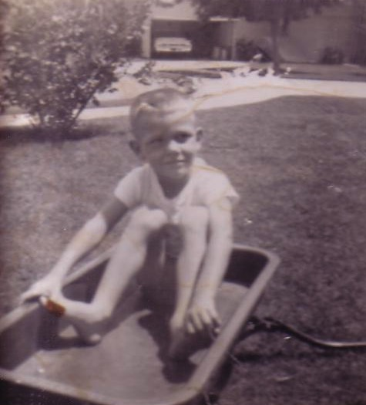
But We Had Each Other…
Notes:
You may think I was lonely—but I had my big brother Bob and my sister Kathie. My little brother Tom was a pest.

Slide 18
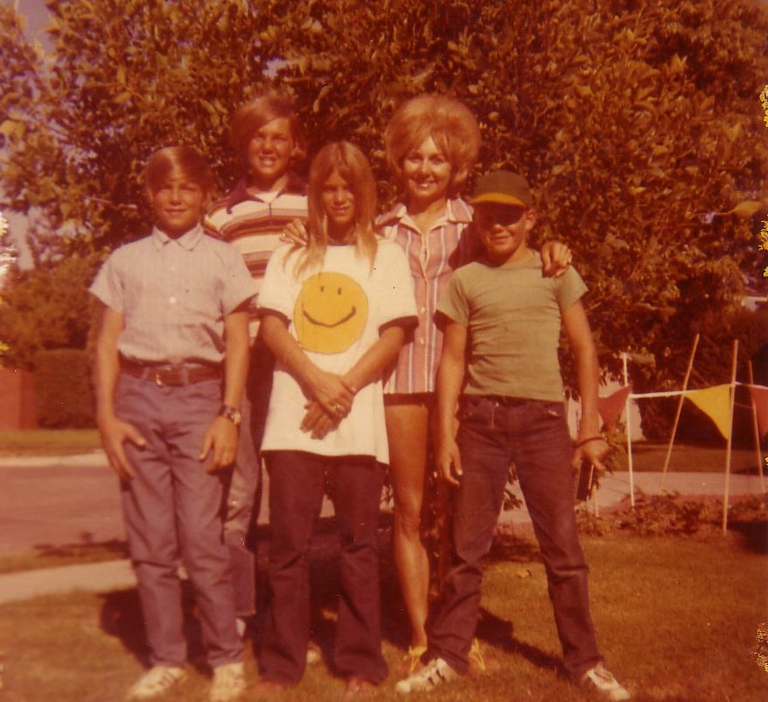
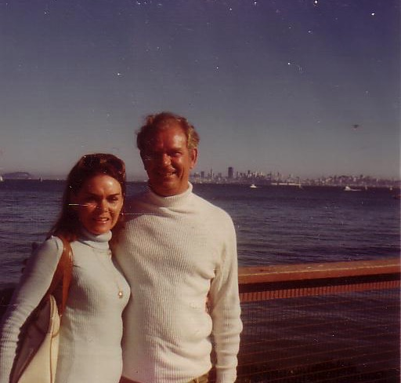
Our Family of 5 (1972)
Notes:
But we learned to live without a Dad again while my real Dad married a third time—actually five times total!

Slide 19
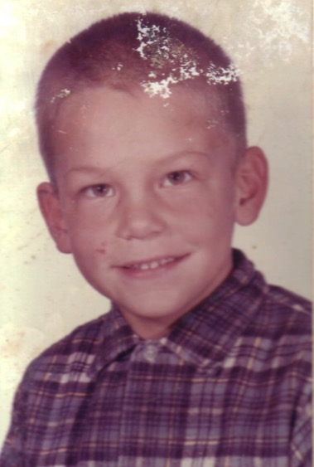
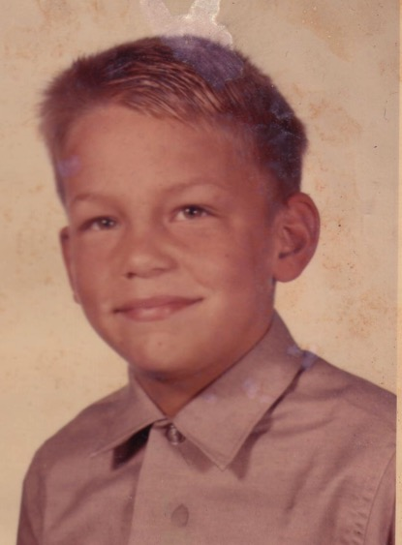
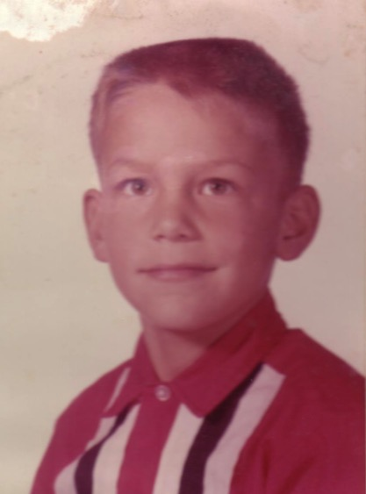
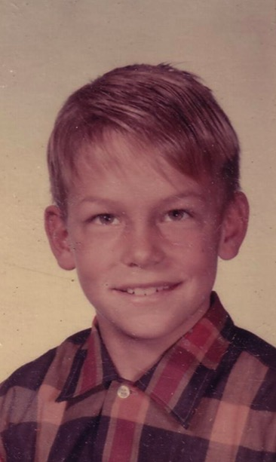
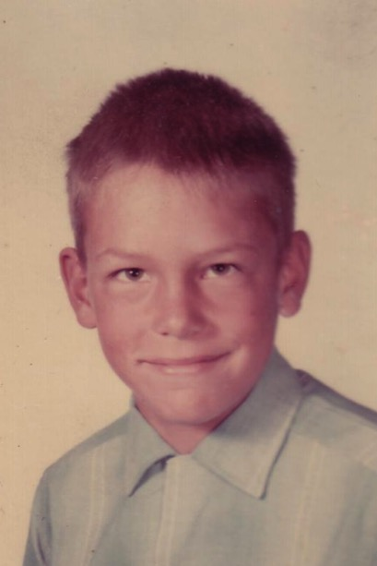
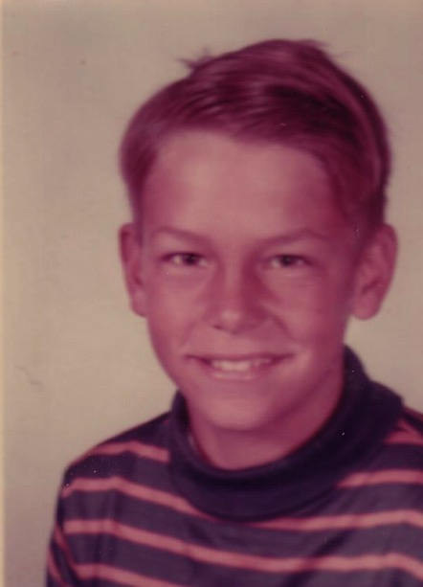
School Pictures
Kindergarten
Grade 1
Grade 2
Grade 3
Grade 4
Grade 5
Notes:
Life went on and, despite my rotten family background, I sensed that there was a God—so I figured that I better be a good boy. I obeyed my parents and did well in school and sports over the years.

Slide 20
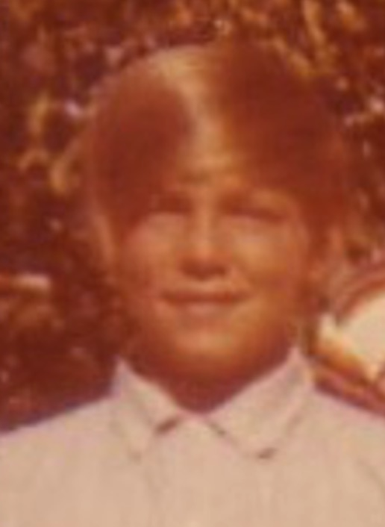
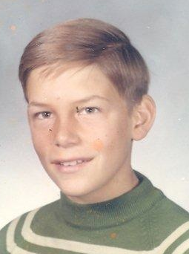
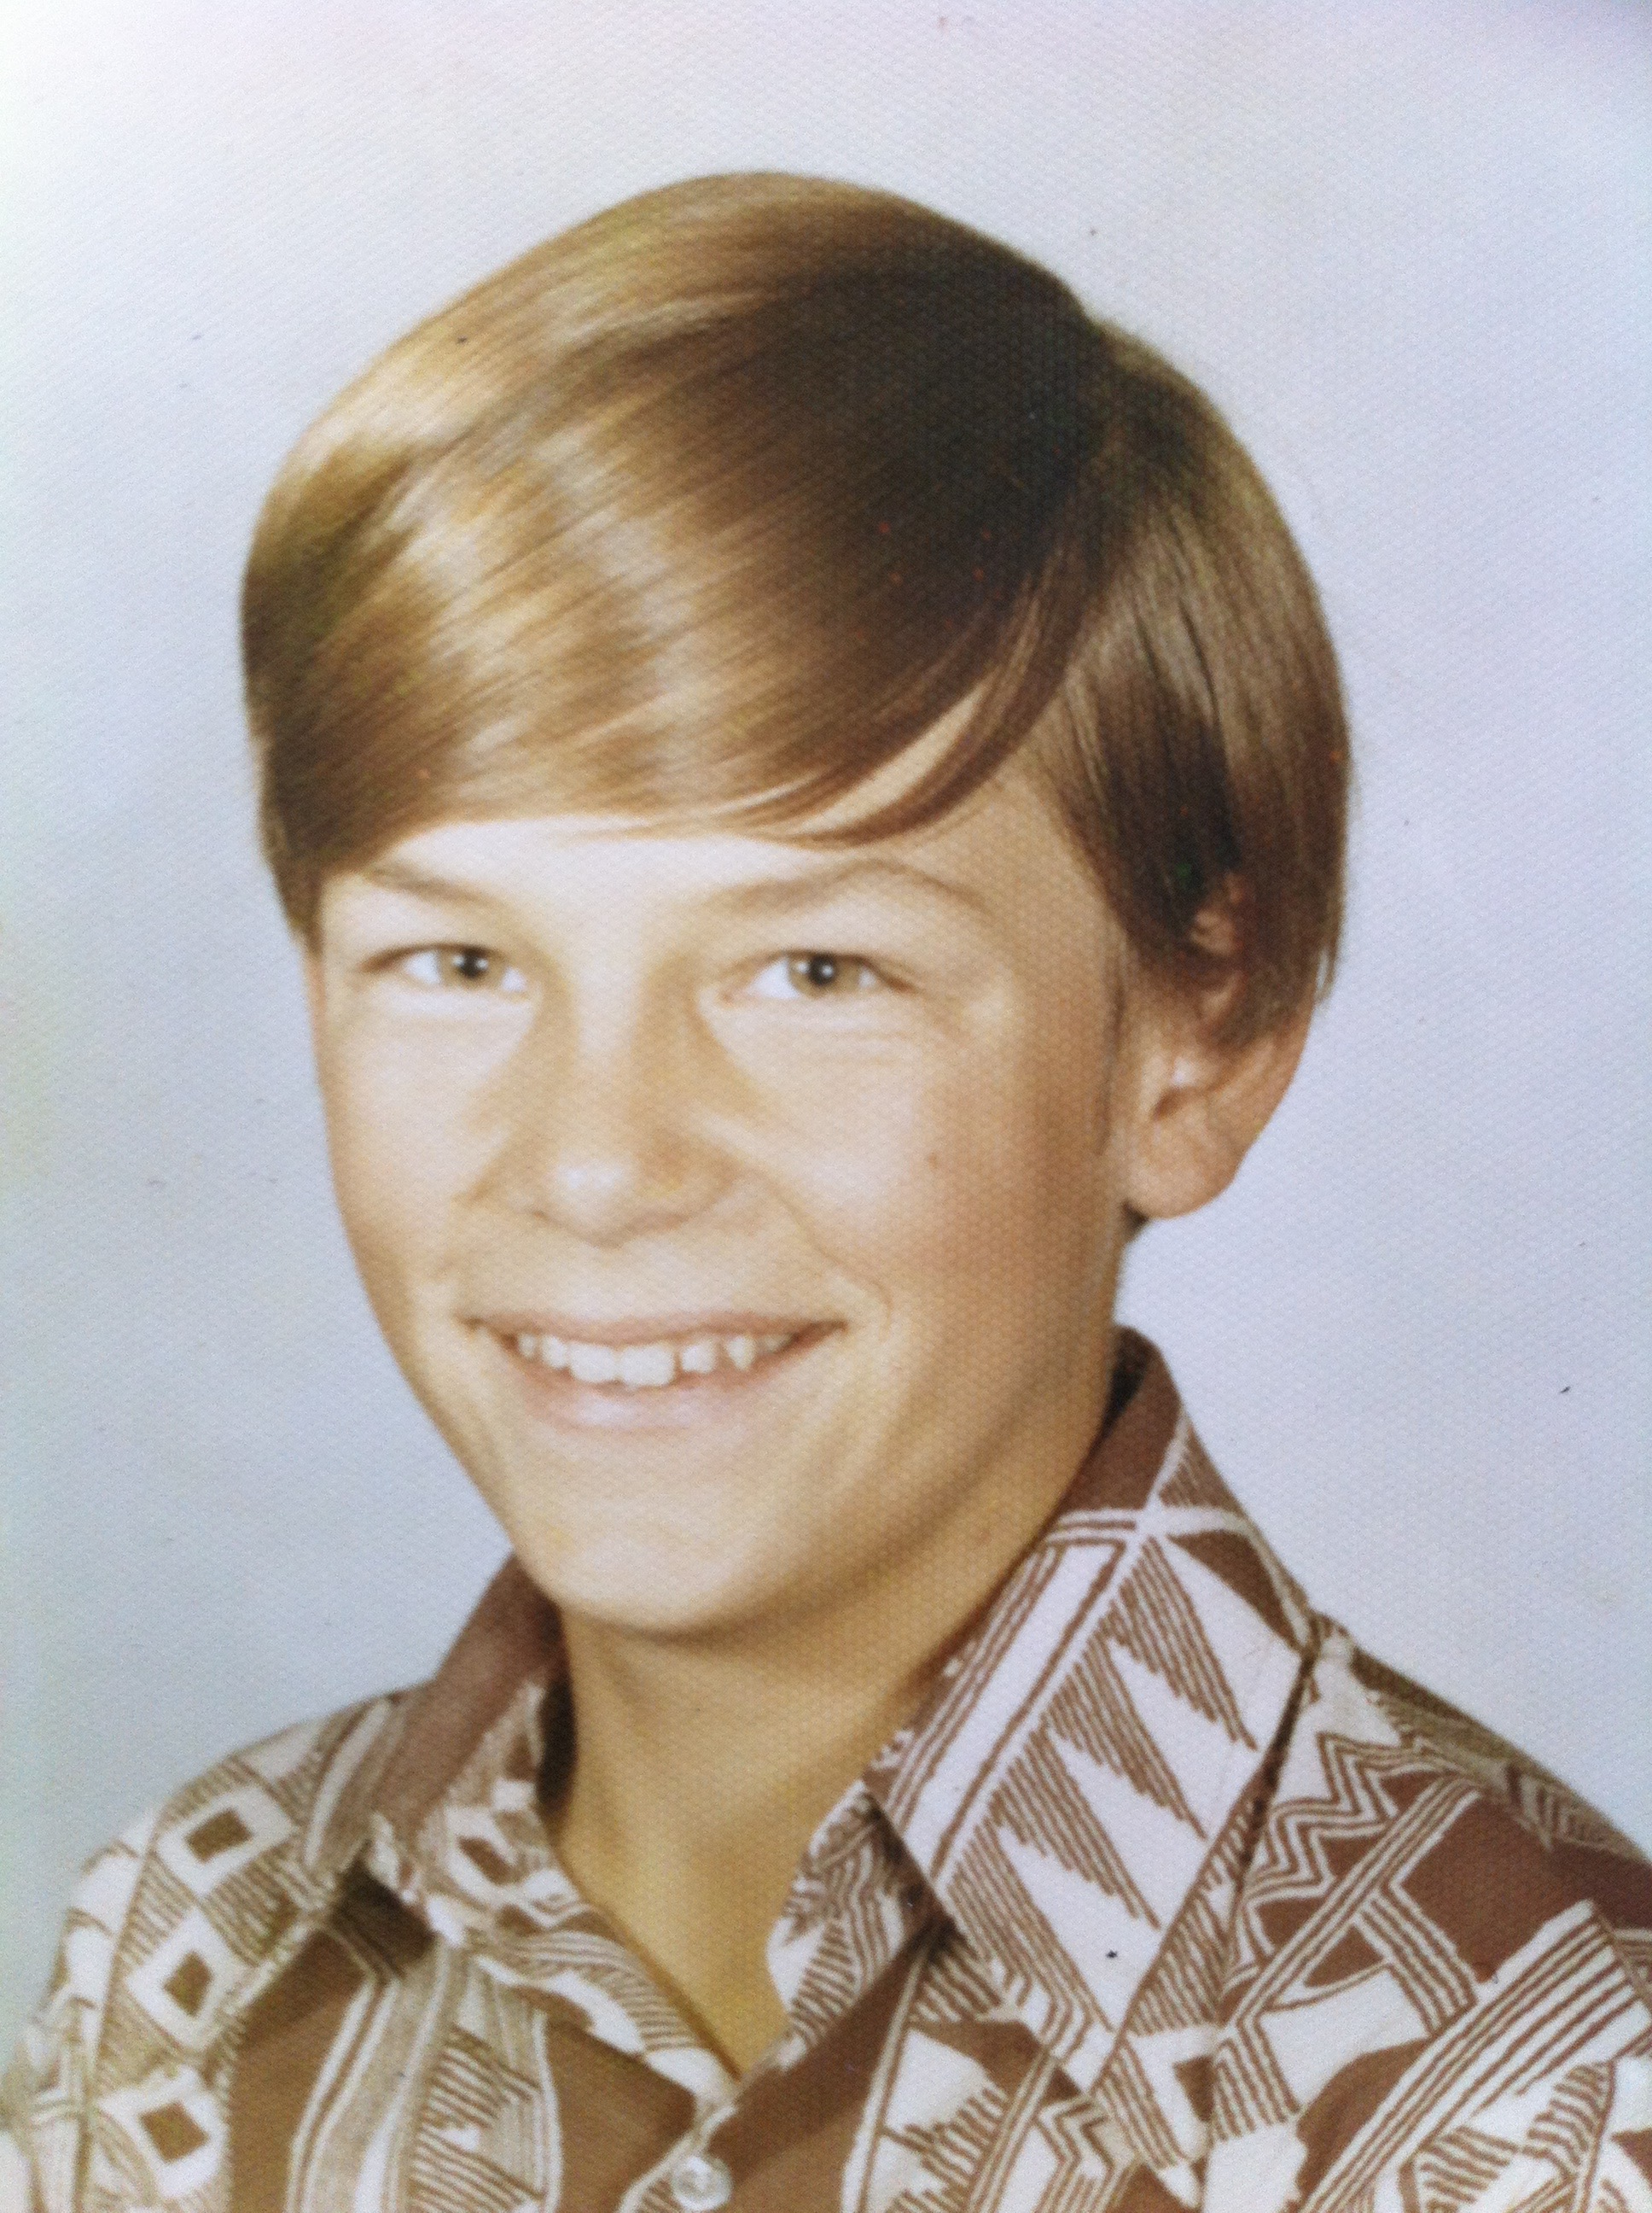
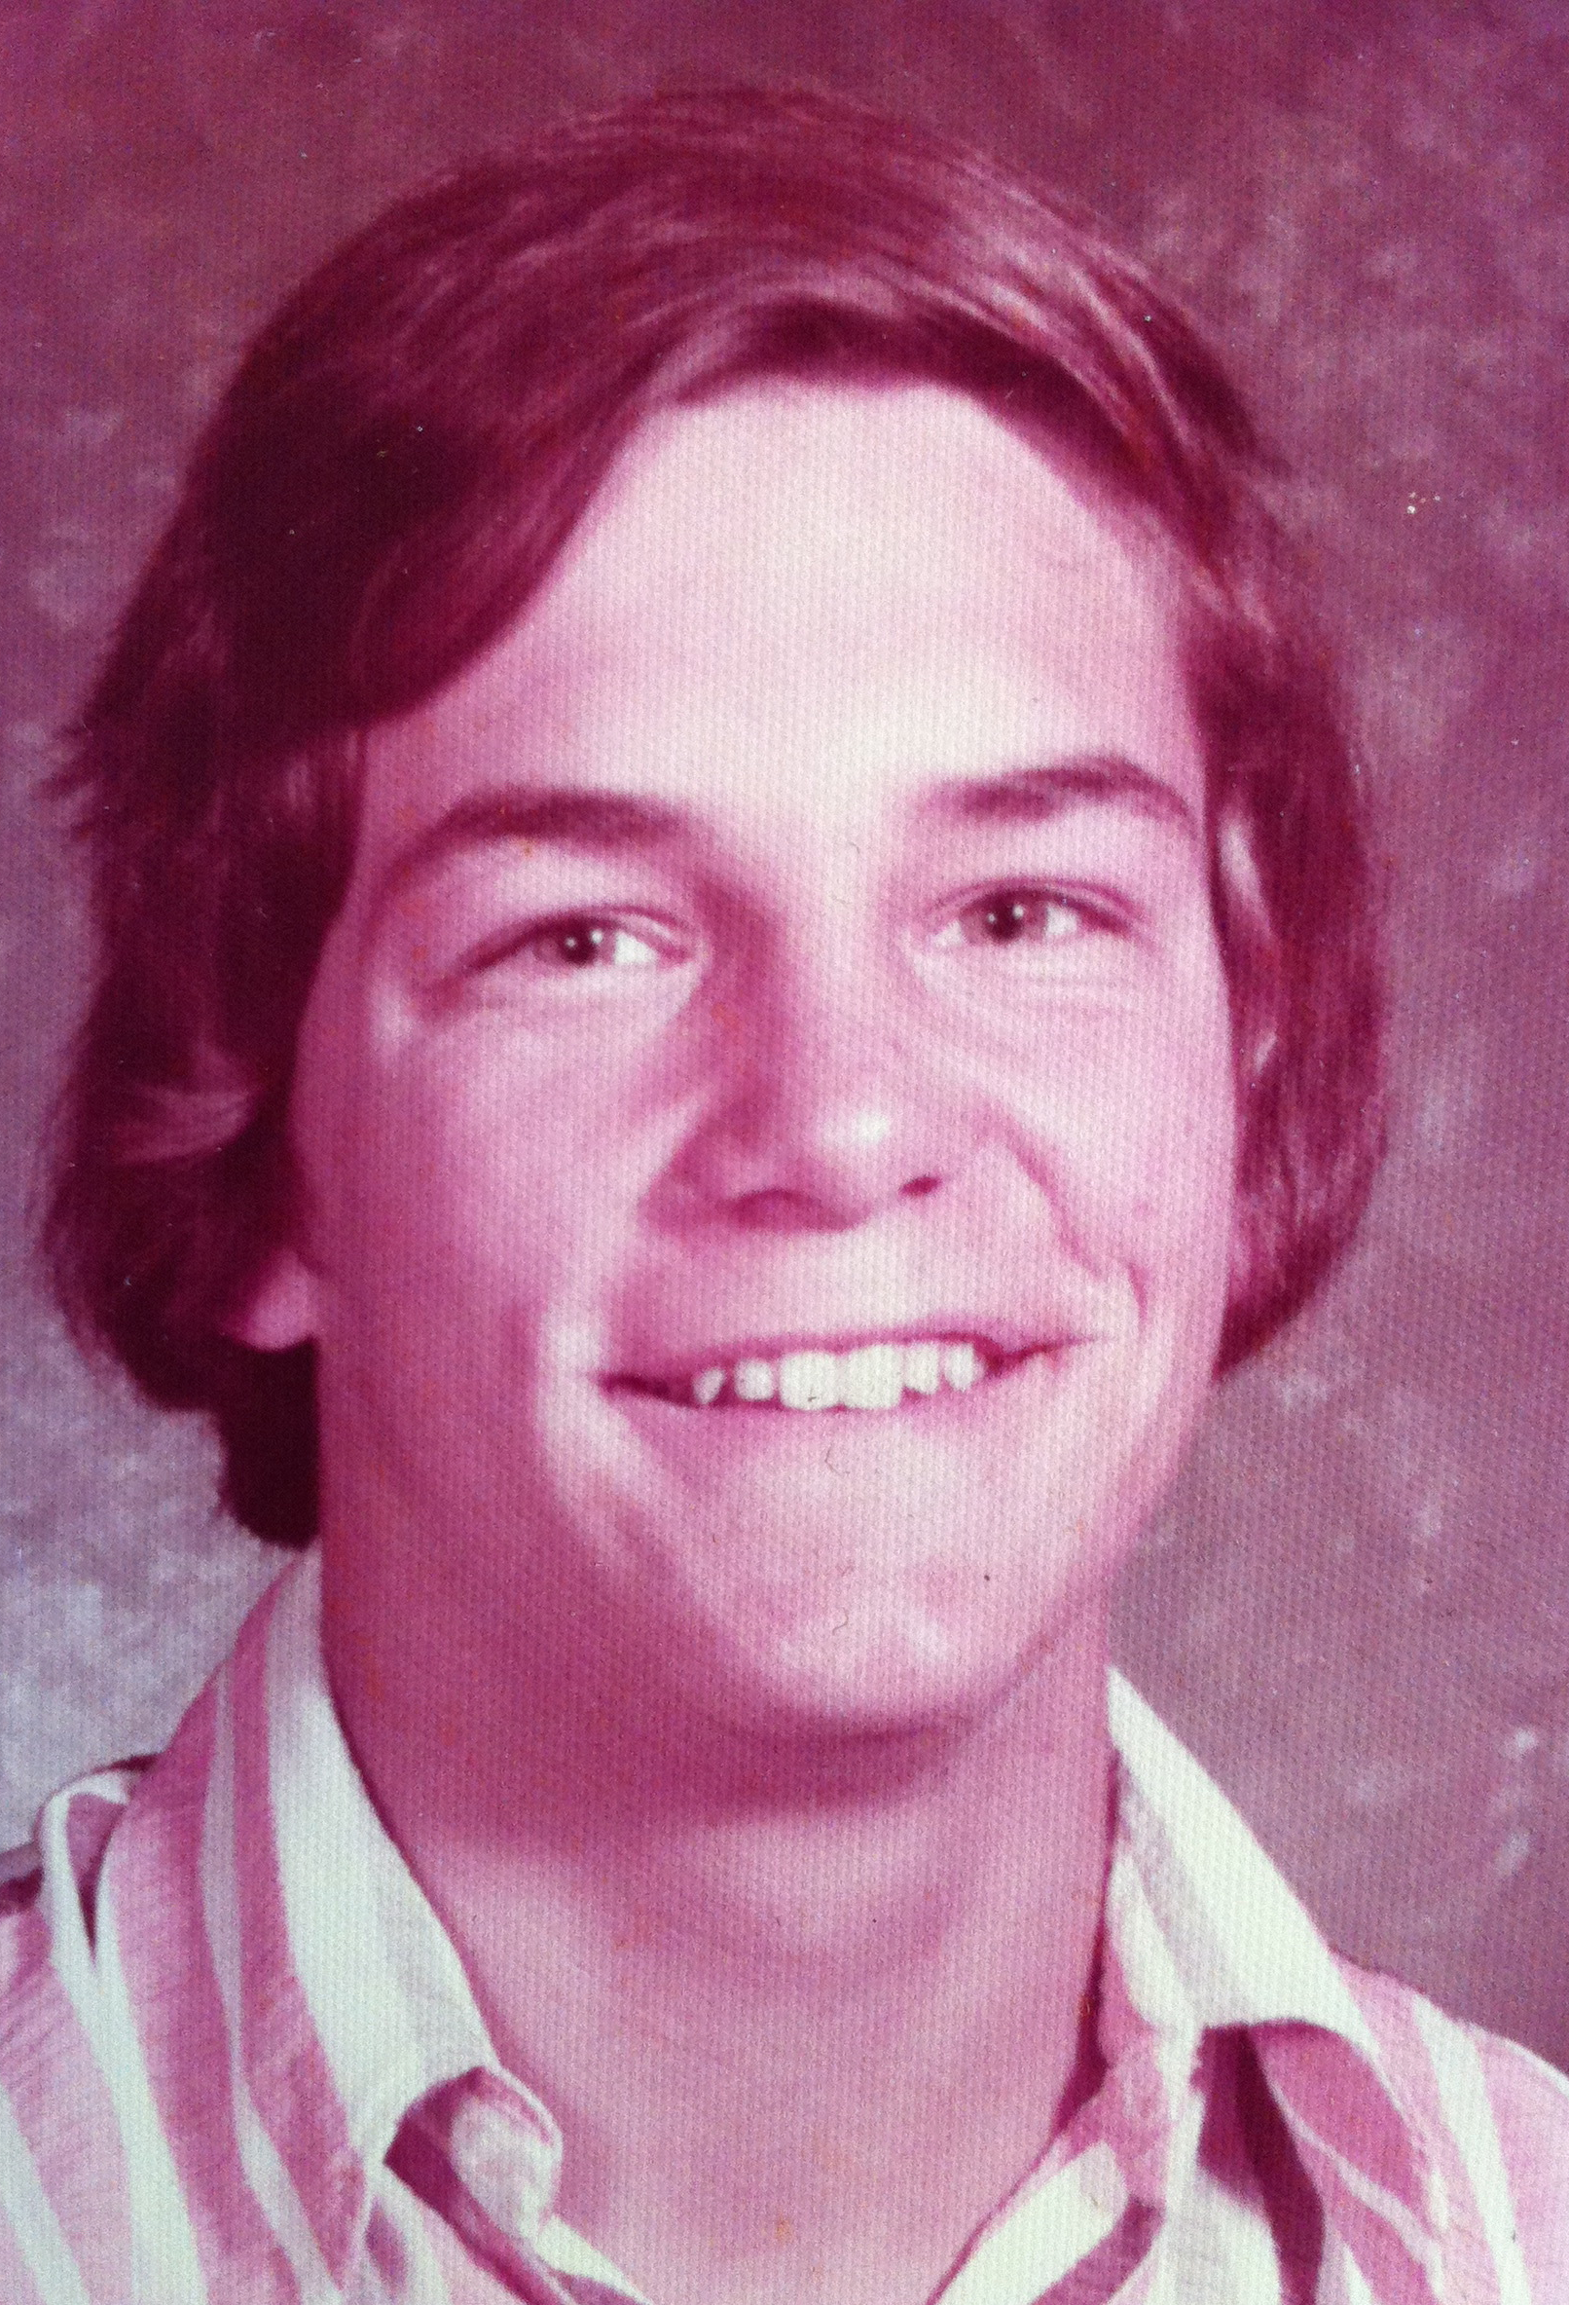
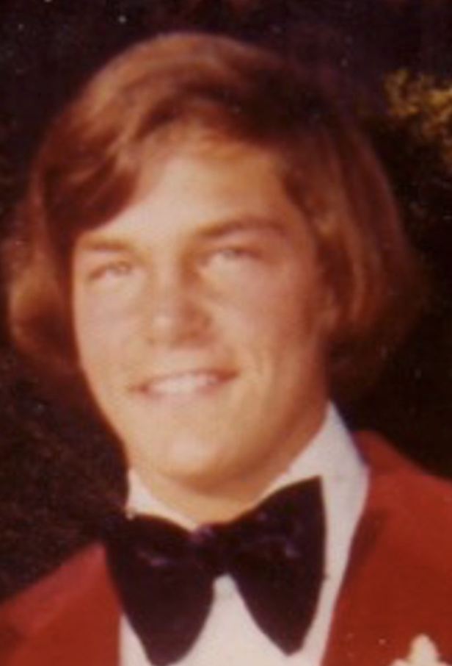
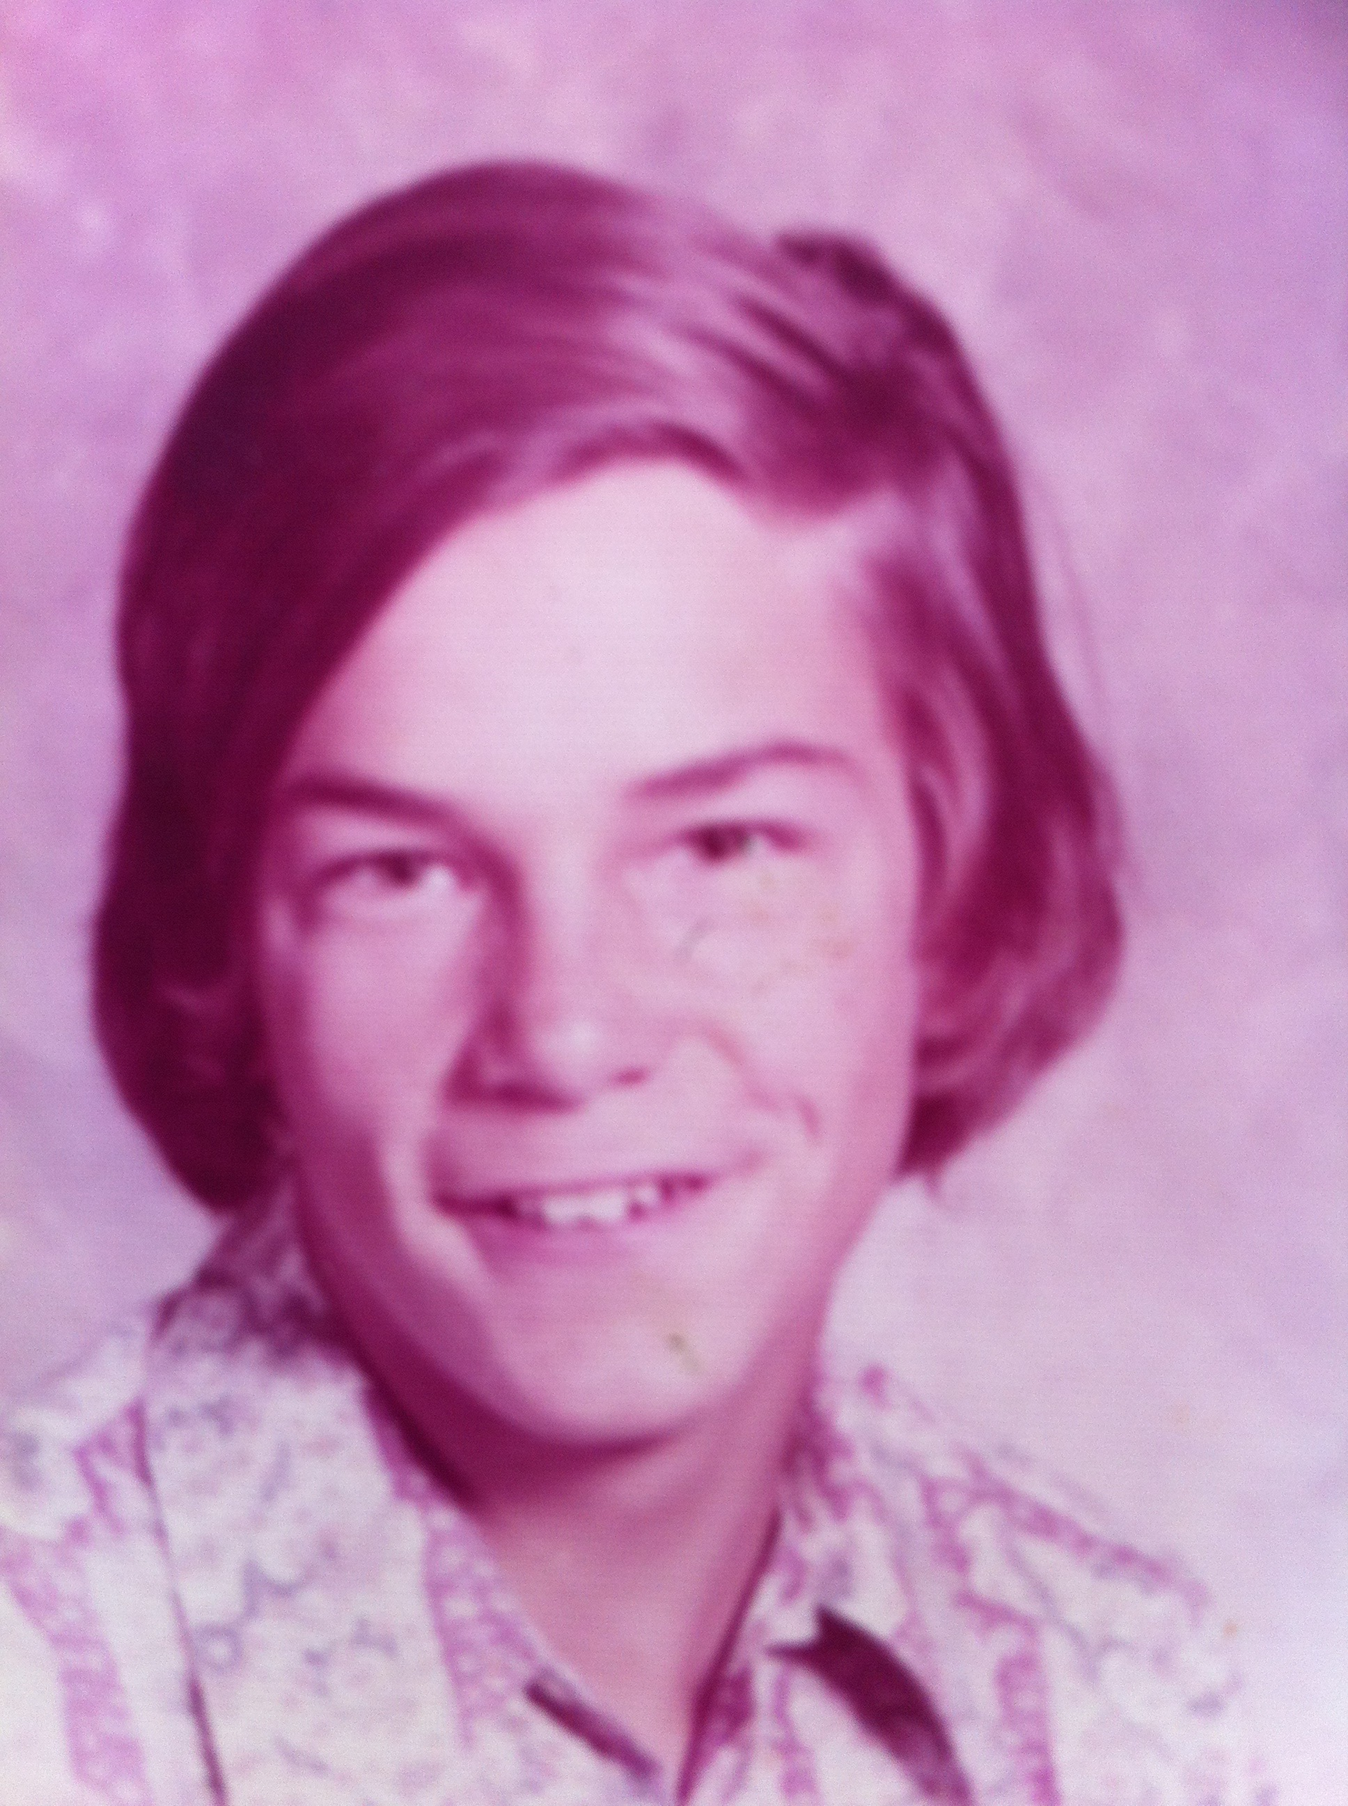
School Pictures
Grade 6
Grade 7
Grade 8
Grade 9
Grade 10
Grade 11
Notes:
Life went on and, despite my rotten family background, I sensed that there was a God—so I figured that I better be a good boy. I obeyed my parents and did well in school and sports over the years.

Slide 21
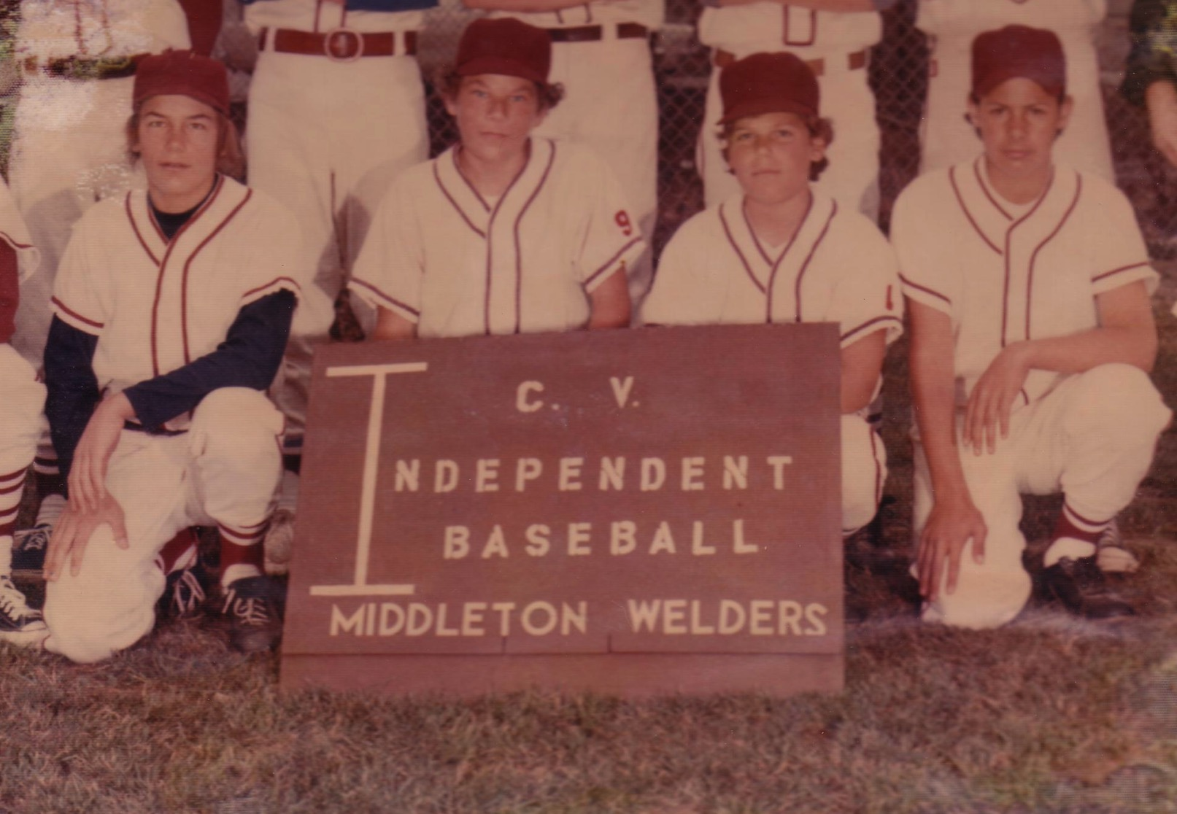
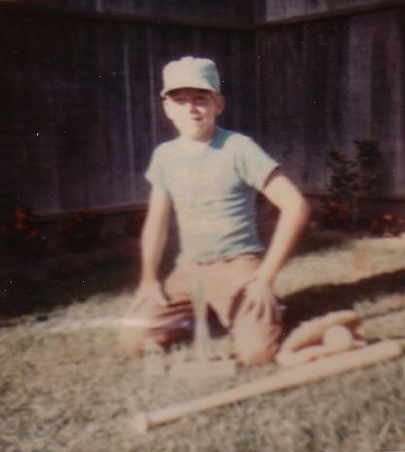
Baseball
Notes:
Of course, when Sunday morning came I still played baseball.

Slide 22
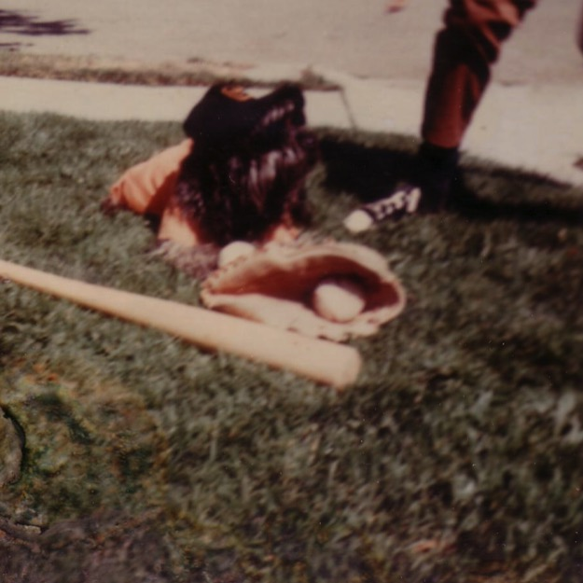
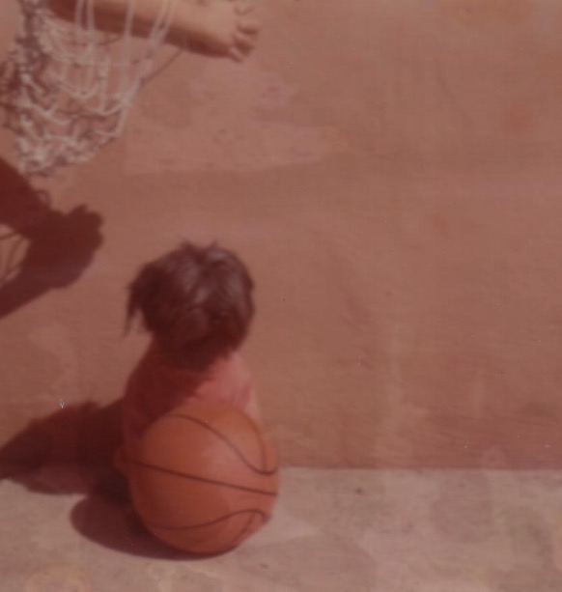
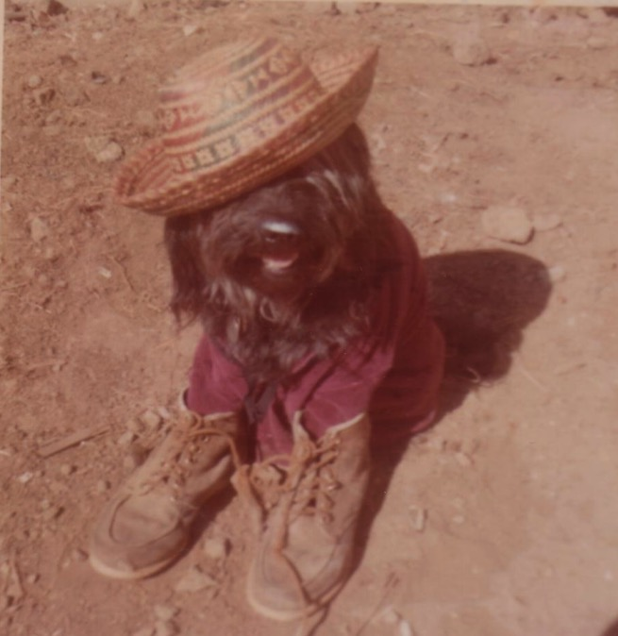
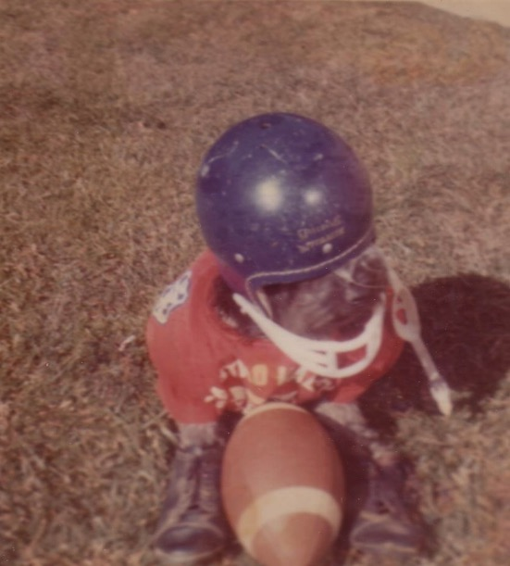
Peppy Sports
Notes:
My siblings and I even dressed our dog Peppy up to play baseball—as well as hiking, football, and basketball. Yes, don't remind me that my hands are in the basketball picture. My brother didn't frame it right!

Slide 23
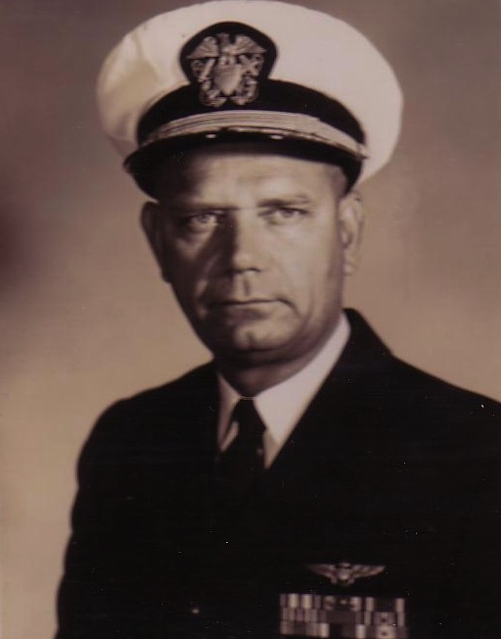

My Spiritual Journey
Notes:
It's been said that our view of the Heavenly Father follows our view of our earthly father. My father was an important man who achieved the rank of Captain. He loved me but was always far away fighting in Vietnam, so I saw God the same—One who loved me but was far away doing important things.

Slide 24


Searching in the 70s…
Love
Notes:
I was too young to be a hippie, but I did identify with the search for love and peace. I painted in bright fluorescent colors the love and peace signs on my bedroom wall, turned on my black light, laid on my bed and said “groovy,” “far out,” and other things hoping that real peace would fill my heart. It didn't!

Slide 25


The influence of friends
John
Terry
Notes:
So I tried and tried to be good—but I always knew I was failing to live up to my own expectations let alone God's! Then two friends at school told me I could never be good enough—and that I needed to trust Christ by faith. When I saw the reality of the Christian life in their own families (especially their fathers), I finally trusted Christ at age 13.

Slide 26
Finally I understood
Grace
to me
Grace set me free from trying to be “good enough” for God!
Notes:
For the first time in my life I had peace with God—His grace set me free from the nagging knowledge that I couldn't make it alone.

Slide 27


The Big Move
Castro Valley
Hayward
Notes:
But what about my friends who thought I was already a good guy? What would I tell them? God solved this by moving my family to the next town. I went to a school where I hardly knew anyone and it helped me start to make new friends and be known as a Christian.

Slide 28

A New Start
Grace
to others
Dean
Notes:
My first week at school I met Dean. He was spiritually hungry and soon trusted Christ. Within three years most of my secondary school friends had heard the gospel from me, Dean, and the other new believers. Dean is now the editor for the Navigators at their headquarters!

Slide 29


Mormon Investigation
Notes:
When I liked a cute Mormon girl at school, I even considered becoming a Mormon until I studied the ridiculous things they believe—like polygamy for eternity. I was amazed that anyone would rather have a religion of works rather than grace!

Slide 30



1976 Graduation
Grade 12
Notes:
My high school graduation was one of the most fulfilling days of my life. God's grace had transformed my whole value system so that the guys I and my Bible study had shared with almost reached all the guys in my graduating class of 100 young men.

Slide 31




“Hay U”
California State University, Hayward
Notes:
University life at “Hay U” helped me see what happened when I put a plastic bag over my face—as well as how to rebuild the steering system in my car all through the night before I graduated the next morning and left for missionary service. But my involvement with Campus Crusade was probably most significant under Bob & Kathy—our campus leaders.

Slide 32

The Crossroads (1981-83)
Notes:
After college it seemed the natural thing to do to join Campus Crusade staff in the Philippines on a seven-member music team.

Slide 33

Crossroads Ministry
Korea
China
Japan
Hong Kong
Taiwan
Macau
Thailand
Philippines
Malaysia
Singapore
Indonesia
Notes:
The Crossroads team shared the gospel in 11 Asian nations and saw over 10,000 people indicate decisions to trust Christ! Again I was amazed at God's grace!

Slide 34




China, 1981
Notes:
Our first tour to China we were celebrities as the first Christian musical team to visit the New China. We sang in music conservatories, parks, and even from the bus! God began to open my eyes to the needs of East Asia…

Slide 35



Romance, 1982
Notes:
God also began to open my eyes to the woman singing next to me! She initially despised me but after a year or so she saw the light. That's our engagement picture. In 1983 we returned to the USA..

Slide 36



Seminary
My 7-year Tribulation was from 1983-1990
Notes:
I married her and took her to Dallas Seminary a few days later. Three years later our first son was born on his grandpa's 70th birthday, so we named him Kurt in honor of Susan's father. I also pastored a church, had a ministry to international students, and served as a chaplain.

Slide 37


The City-State of Singapore
Notes:
But Asia (where I had courted Susan) was still on our hearts, so we were appointed with another mission called CBInternational to come to Singapore.

Slide 38


Multi-cultural • Multi-ethnic • Multi-religious
99% of Hindus are Indian
99% of Buddhists are Chinese
99% of Muslims are Malay
Only Christians effectively cross racial lines though Malays are still unreached
Notes:
I was drawn to teach and minister in such a diverse place as Singapore. I still am!

Slide 39

No Gum
Notes:
My boy's biggest complaint seems to be the limitations of the small island.

Slide 40

20 Feb 1991: Move to Singapore
Rick, 33
Susan, 30 something
Kurt, 4
Stephen, 1
Notes:
So 10 years after our first move to Asia as singles, we arrived as a family of four.

Slide 41

1992
Notes:
In our second year here, our third son John was born.

Slide 42

1993
Notes:
The boys continued to grow…

Slide 43

1994
Notes:
It seems natural to spend holidays here…

Slide 44

1995
Notes:
When we want dry climate we visit the cactus at the Botanic Gardens!

Slide 45

1996
Notes:
We have lived briefly in the USA since moving to see you in 1991.

Slide 46

1997
Notes:
These trips remind us of our cultural heritage.

Slide 47

1999
Notes:
After all, my ancestors were Puritans who immigrated to the USA from England in the 1650s.

Slide 48

2000
Notes:
So while Singapore is our home, we don't have any family here.

Slide 49

2001
Notes:
As the boys have gotten taller, their family is right in their own home.

Slide 50

2002
Notes:
We thank God that the rough teen years are long behind us!

Slide 51

2003
Notes:
My wife Susan has been the queen in our family.

Slide 52

2004
Notes:
Ministry in 2004 included having one of their friends live with us for 18 months so we had four sons for a while.

Slide 53

2005
Kurt
Stephen
Rick
Susan
John
Notes:
We shifted from Grace Baptist to International Baptist Church for five years.

Slide 54

2006
Notes:
Then in 2006 the family embarked on a new adventure of starting a church 9 months before my older sons moved to the USA.

Slide 55

2007
Notes:
Our last family picture just before Kurt and Stephen moved to live together in Seattle, Washington.

Slide 56

2008
Notes:
We joined them there in this winter picture the next year!

Slide 57

2009
Notes:
But they have returned to Singapore over the years a few times…

Slide 58

2009
Stephen
Kurt
Rick
Susan
John
Notes:
Meanwhile we moved on campus while John went through his four high school years.

Slide 59

2010
Stephen
Kurt
Rick
Susan
John
Notes:
The guys came back to Asia in 2010 for us to take a trip to Hong Kong.

Slide 60

2010
Notes:
Or we joined them in Hawaii, where we climbed Diamond Head.

Slide 61

2011
Notes:
We love hiking together in the mountains of Washington!

Slide 62

The Griffith Family
Oct 2011
2011
Stephen
22
John
19
Kurt
24
Susan
Rick
Notes:
God continues working in our family as we see Him work in our three sons. Our two older ones work in Seattle and our youngest (John) attends Biola University in Southern CA. We lived close by in 2011 during his first semester, pretending that he needed us until we return to Singapore in January.

Slide 63

The Griffith Family
Dec 2012
2012
Stephen
23
John
20
Kurt
25
Rick
Susan
Notes:
Now Mom and Dad are the shortest in the family.

Slide 64

The Griffith Family
Dec 2013
2013
Susan
John
21
Stephen
24
Rick
Kurt
26
Notes:
John also got hairy on his nose so he doesn’t look so young.

Slide 65

The Griffith Family
Sept 2014
2014
Rick
Stephen
25
Susan
John
22
Kurt & Cara
28

Slide 66

The Griffiths
May 2015
2015
Kurt & Cara (28)
John
(22)
Rick
Susan
Stephen & Katie (25)

Slide 67

The Griffiths
9 Jan 2016
2016
John
(23)
Rick & Susan
Kurt & Cara (29)
Stephen & Katie (26)

Slide 68

The Griffiths
9 Jan 2016
2017
Stephen & Katie (27)
John
(24)
Kurt & Cara (30)
Susan & Rick

Slide 69

The Griffiths
Nov 2017
2018
Stephen (28)
John
(25)
Kurt (31)
Susan & Rick

Slide 70

The Griffiths
31 May 2019
2019
Rick & Susan
John
(26)
Kurt & Cara (31)
Stephen, Katie & Jesse (29)

Slide 71

The Griffiths
28 Nov 2019
2019
John
(27)
Rick & Susan
Kurt & Cara (32)
Stephen, Katie & Jesse (30)

Slide 72

The Griffiths
5 July 2020
2020
Kurt & Cara (33)
John &
Chloe
(27)
Stephen, Katie & Jesse (30)
Rick & Susan

Slide 73

The Griffiths
Actually 2020
2021
John &
Chloe
(29)
Kurt & Cara (34)
Stephen & Katie (32)

Slide 74

The Griffiths
2022
2022
John &
Chloe
(30)
Rick & Susan
Kurt & Cara (35)
Stephen & Katie (33)

Slide 75


The Griffiths
2023
2023
Stephen & Katie & Jesse & Norah (33)
Kurt & Cara & Kadon (35)
John &
Chloe
(30)
Rick & Susan

Slide 76


The Griffiths
2024
Kurt & Cara & Kadon (38)
2024
Rick & Susan
Stephen & Katie & Jesse & Norah (35)
John & Chloe (31)
Notes:
2024-07-06 Family on Harstine Porch

Slide 77

The Griffiths
28 Nov 2019
2025
John
& Chloe
(33)
Kurt
& Cara (39)
Stephen & Katie (36)
Rick & Susan

Slide 78

Grandson Jesse

Slide 79



Kurt works in marketing & IT
9g

Slide 80

Stephen the Pilot

Slide 81

John at Biola University

Slide 82

Cara & Kurt • Katie & Stephen

Slide 83

John always has been our eager learner
Notes:
John wants to learn the Bible so much that he prefers my Sunday School class over his Primary 5 class since his doesn't study the Bible as much.

Slide 84

SBC
Friends (both faculty and students) have come and gone
Notes:
SBC faculty and students have come and gone, but we haven't found a wider door for ministry yet!

Slide 85

What I've learned over the years…
All
that I am
that I have
that I can do
is due to God's grace!
Notes:
So what have I learned? Everything I am, have, and do—it's all because of God's grace. Who would have ever thought that this shy boy—from a broken home whose parents and those they have married have endured 12 divorces—who would ever thought that this guy would be privileged to serve Him at SBC and beyond?

Slide 86

Were It Not For Grace
Words & music by David Hamilton & Phil McHugh
Time measured out my days
Life carried me along
In my soul I yearned to follow God
But knew I'd never be so strong
I looked hard at this world
To learn how heaven could be gained
Just to end when I began
Where human effort is all in vain.

Slide 87

Were it not for grace
I can tell you where I'd be
Wand'ring down some pointless road to nowhere
With my salvation up to me
I know where that would go
The battles I would face
Forever running but losing the race
Were it not for grace

Slide 88

So here is all my praise
Expressed with all my heart
Offered to a Friend who took my place
And ran a course I could not start
And when He saw in full
Just how much His love would cost
He still went the final mile between me and heaven
So I would not be lost

Slide 89

Were it not for grace
I can tell you where I'd be
Wand'ring down some pointless road to nowhere
With my salvation up to me
I know where that would go
The battles I would face
Forever running but losing the race
Were it not for grace

Slide 90

Notes:
And now we're even privileged to have Dr. Roy Low's family join us with our mission.

Slide 91

Dad & Carolynn
Notes:
My Dad and his wife visited once.

Slide 92

Mom & Bob
Notes:
And we're hoping my Mom and her husband can come next year.

Slide 93

Susan's Parents
Kurt & Doris
Notes:
Meanwhile God's grace ahs given all three sets of grandparents good health.

Slide 94

The Ahlstroms
Notes:
Susan's sister has visited us too…

Slide 95

Susan's Sister Karen
And husband Tom
Notes:
We're still praying for her to truly trust Christ.

Slide 96

My Three Sons
Kurt, 18
Stephen, 15
John, 12
Notes:
My sons effectively cross cultures between Singapore and the USA (though they still don't eat hawker food!)

Slide 97

John's Baseball Team
2001 Season
Notes:
But we still have had opportunities like my coaching John's baseball team in Woodlands.

Slide 98

The Only Grandkids
Notes:
But they are Susan's parents' only grandkids which makes leaving the US difficult each time we come back.

Slide 99

Susan's Family
Notes:
I think all this is made easier by having good family relationships.

Slide 100







Our Ministry Tree
Internet Biblical Seminary
Crossroads
International Church
Biblical Education by Extension
International Community School
Singapore Bible College
WorldVenture
Notes:
100

Slide 101
BEE Ministry
CHINA
NEPAL
MYANMAR
VIETNAM
Notes:
The BEE ministry has seen several faculty and students help train leaders in other Asian countries.

Slide 102
Internet Biblical Seminary Advantages
Cost efficient
Better retention
Reaches where we cannot go
Easily multiplied
Notes:
But now I'm learning how to train over the internet because it has so many advantages over traditional seminary classroom instruction.

Slide 103

Please Pray for Me
IBS vision
Notes:
So please pray for us!

Slide 104



Please Pray for Susan
Teaching
Mentoring
Singing
Choir leader
Librarianing (is that a word?)
Notes:
My wife Susan appreciates your prayers too.

Slide 105

Please Pray for Kurt
Heart for God
College
Notes:
We are especially concerned that Kurt adopt biblical values as he soon heads to college.

Slide 106

Kurt (18) runs AV at church
Notes:
He's a very “hands-on” guy who enjoys behind-the-scenes service.

Slide 107

Please Pray for Stephen
Heart for God
Notes:
Stephen is also at a very important stage in his life where he's making crucial decisions.

Slide 108

Notes:
He has many friends here—as do the other two boys.

Slide 109

Please Pray for John
Continued heart for God
Notes:
Probably the least of my concerns is John, who shows God's grace to us on a daily basis.

Slide 110

John serves as resident clown.
Notes:
He also adds spice to our lives!

Slide 111
Black

Slide 112


Bible Geography link at BibleStudyDownloads.org
Get this presentation for free!
Notes:
Bible Geograhpy (bg)

