Slide 1
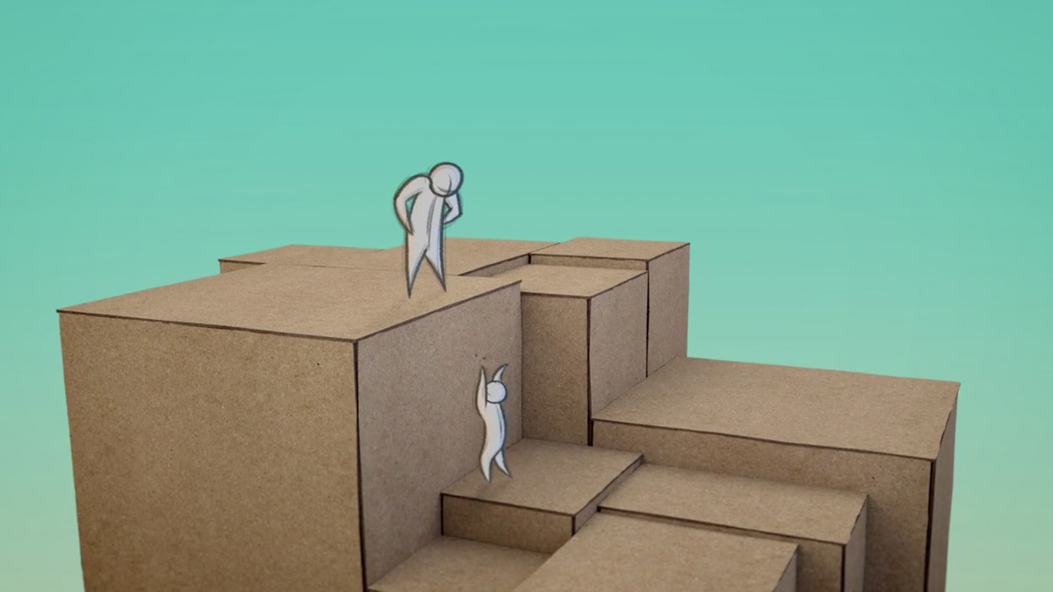
Be Attracting
1 Peter
Dr. Rick Griffith • Crossroads International Church Singapore
BibleStudyDownloads.org

Slide 2
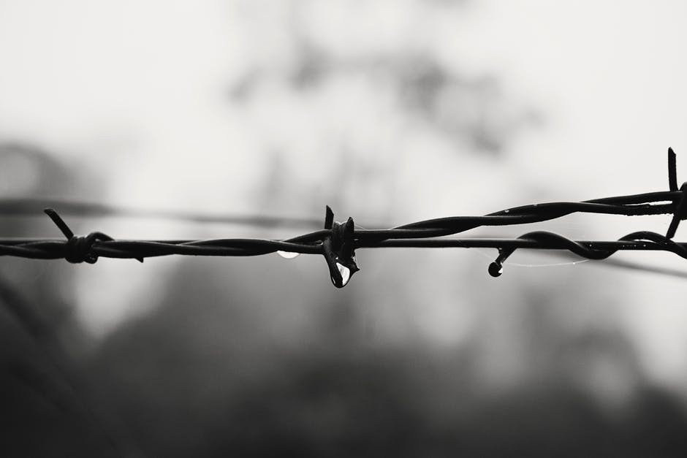
Suffering for Jesus

Slide 3
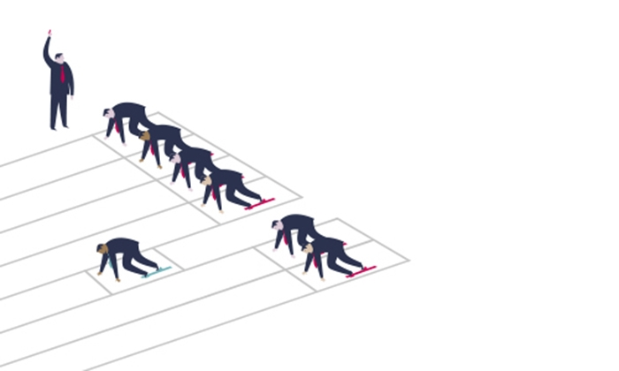
Are you suffering unfairly right now?
School?
Home?
Work?
Church?
Friends?
Government?

Slide 4


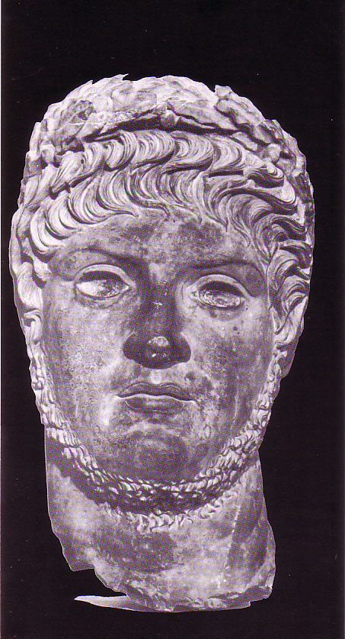
Why Peter wrote…
277
Why did Peter's readers need encouragement?
1 Pet. 4:12-13
"Dear friends, don't be surprised at the fiery trials you are going through, as if something strange were happening to you. Instead, be very glad-- because these trials will make you partners with Christ in his suffering, and afterward you will have the wonderful joy of sharing his glory when it is displayed to all the world."
Nero

Slide 5

Argument & Themes of 1 Peter
278
Argument
"… I have written to you briefly, encouraging you and testifying that this is the true grace of God. Stand fast in it" (5:12)
The Dual Themes:
"This is the true grace of God" 1 Pet. 1:1-12 Election Sovereignty of God Positional sanctification Initiated by Godhead (1:2) | "Stand firm in it" 1 Pet. 1:13–5:14 Endurance Responsibility of man Practical sanctification Effected in Godly Living (1:13ff)

Slide 6
What is Grace?
"The power to do God's will"
- Bill Gothard
(Institute in Basic Life Principles)

Slide 7
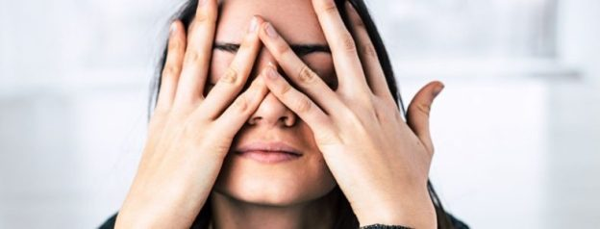
Too often we repel unbelievers when we suffer

Slide 8
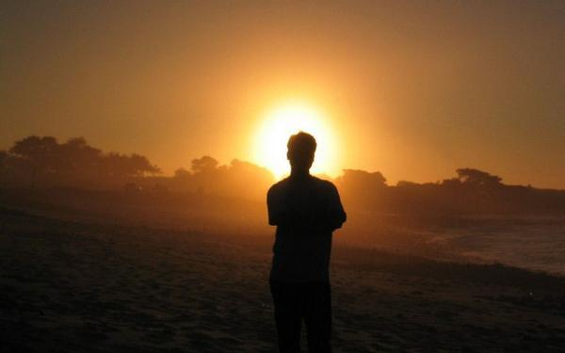
How can we tap into God’s grace in our difficulties to attract others to Jesus?

Slide 9
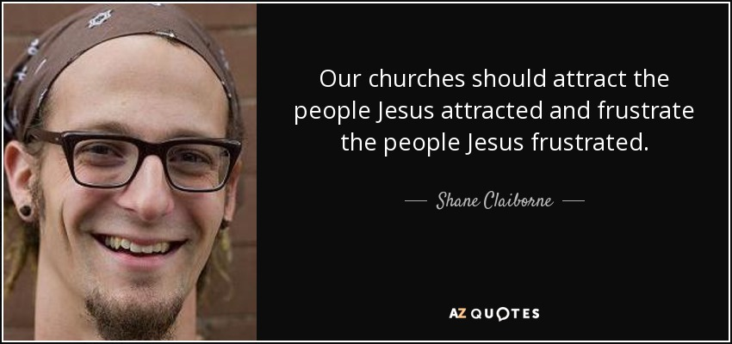
Attract Others to Jesus
Our churches should attract the people Jesus attracted and frustrate the people Jesus frustrated.
—Shane Claiborne—

Slide 10
NT Overview (General + Key Words)
38
124
39-41
"To the remotest part of the earth" (Acts 1:8)
Acts 9 13 14 15 16 18 21 27 28
Apr 48-
Sep 49
1
Galatia
Apr 50-
Sep 52
2
Aegean
Spr 53-
May 57
3
Asia
Feb 60-
Mar 62
1
Rome
Spr 62-
Fall 67
4
Spain
Aut 67-
Spr 68
2
Rome
Summer 35-
37
Damascus
Antioch
May 57-
Aug 59
Trials
Fall 49
The
Council
Spring 68
Expansion of Church
35 48 49 50 52 53 57 60 62 67 68 95
Matt
Kingdom
Luke
Sov 1
Acts
Sov 2
Mark
Disciple
John
Believe
Gal
Justify
1 Thess
Rapture
1 Cor
Eph
Unity
1 Tim
Order
2 Tim
Sanctify
Doctrine
James
Works
2 Thess
Tribulation
2 Cor
Col
Deity
Titus
Apostle
Conduct
Romans
Philem
1 Pet
Righteous
Forgive
Suffering
Gospels & Acts
Phil
Attitude
Pauline Epistles
1234
Journeys
General Epistles
Rome
Imprisonments
General Epistles + Key Words

Slide 11

Common Responses
Peter counters the natural responses to suffering:
278
Common Responses to Persecution | Peter's Exhortation
"I'll get even" | "Do not repay evil with evil or insult with insult, but with blessing, because to this you were called to inherit a blessing" (3:9; cf. 2:1)
"I'm discouraged" | "Rejoice that you participate in the sufferings of Christ…do not be ashamed…" (4:13, 16)
"I'm afraid" | "Do not fear what they [persecutors] fear; do not be frightened" (3:14b)
"Forget Christianity. It's not worth it" | "…by His wounds you have been healed" (2:24)
"Why do they only persecute me?" | "…your brothers throughout the world are undergoing the same kind of sufferings" (5:9)
"Hey! I have my rights!" | "Humble yourselves…under God's mighty hand, that He may lift you up in due time" (5:6)

Slide 12
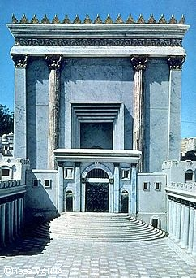

Persecution in the First Century
39-41, 320
All Emperors Were Not Equal
Christ Crucified
AD 33
Jerusalem Destroyed
AD 70
Revelation Written
AD 95
Tiberius
14-37
Caligula
37-41
Claudius
41-54
Nero
54-68
Vespasian
69-79
Titus
79-81
Domitian
81-96
Emperors in black caused Jews and/or Christians to suffer
Notes:
Emperors in black persecuted Christians
This course teaches that Revelation was written during the reign of Domitian at the end of the first century.

Slide 13

Rome AD 64
ROM
e
ROM
A.D. 64

Slide 14
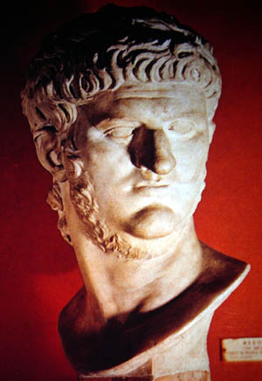
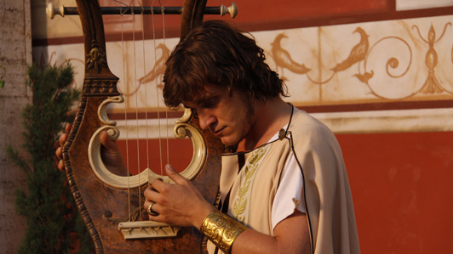
Nero (AD 54-68)
"Favorite sayings: He played the lyre very badly but people told him he was brilliant.
The Greeks were particularly creepy about telling him he was good. 'Only the Greeks are worth my genius,' he would say.
When he knew he had to die all he could say was, 'What a loss I shall be to the art of music!'"
Terry Deary, The Rotten Romans, Horrible Histories (Scholastic, 1994), 66

Slide 15
Theme
23
How to Attract Others During Righteous Suffering
1 Peter

Slide 16
1 Peter Outline
275
How to Attract Others During Righteous Suffering
Sanctification |  |  | Submission |  |  |  | Selflessness
1:1–2:12 |  |  | 2:13–3:12 |  |  |  | 3:13–5:14
Holiness |  |  | Humility |  |  |  | Honoring Others
Salu-tation 1:1-2 | Praise for hope 1:3- 12 | Holy Life Exhort-ed 1:13– 2:12 | Gov't 2:13- 17 | Work Place 2:18- 25 | Marri-age 3:1-7 | Church & all of Life 3:8-12 | Christ's triumph 3:13–4:6 | Edify others 4:7-19 | Elders 5:1-4 | Young Men 5:5a | Humility & watch-fulness 5:5b-11 | Purpose 5:12-14
Rome to Northern Asia
Early AD 64

Slide 17

I. Show holiness with hope (1:1–2:12).
How to attract others to Jesus…
HOPE
IN THE DARKNESS
Notes:
[Our holy anticipation of God's reward attracts unbelievers.]
[Sanctification in light of our hope of future glory helps watching unbelievers praise God.]

Slide 18

Show holiness with hope.

Slide 19
Slides on
1 Peter 1

Slide 20
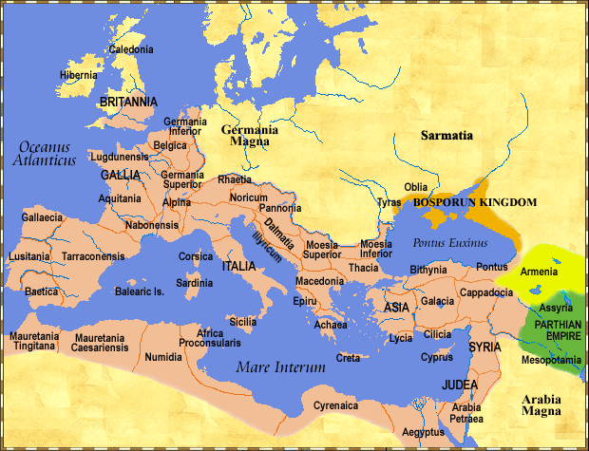
Recipients: Pilgrims in Dispersion
277
280a
"This letter is from Peter, an apostle of Jesus Christ. I am writing to God’s chosen people who are living as foreigners in the provinces of Pontus, Galatia, Cappadocia, Asia, and Bithynia”
—1 Pet 1:1 NLT—

Slide 21
Do you feel like an alien?
"Peter, an apostle of Jesus Christ,
To those who reside as aliens…"
—1 Pet 1:1 NAS—

Slide 22
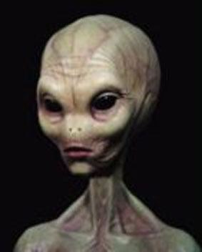
What does an alien look like?
"Peter, an apostle of Jesus Christ,
To those who reside as aliens…"
—1 Pet 1:1 NAS—

Slide 23
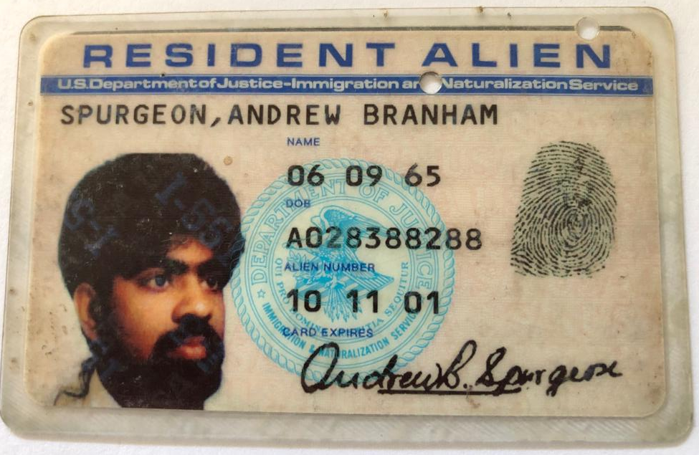
What does an alien look like?

Slide 24
What is an Alien?
1. Reside in a foreign land
2. Citizenship is in another place (cf. Phil. 3:20)
3. Abode is temporary (not a P.R.)
4. Different values than the majority—sense of humor, dress, view of money, job, giving, etc.
5. Often persecuted for being different—laughed at, ridiculed, etc.
Notes:
Seriously speaking, the Greek word for “alien” refers to one who stays for a while in a strange or foreign place; pilgrim, refugee

Slide 25
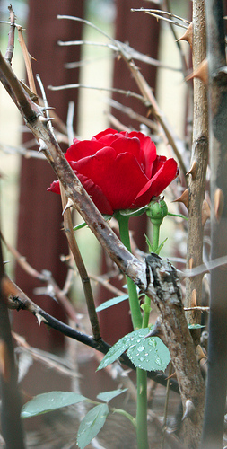
"Praise be to the God and Father of our Lord Jesus Christ! In his great mercy he has given us new birth into a living hope through the resurrection of Jesus Christ from the dead, ⁴and into an inheritance that can never perish, spoil or fade—kept in heaven for you, ⁵who through faith are shielded by God's power until the coming of the salvation that is ready to be revealed in the last time.”
—1 Pet 1:3-5 NIV—

Slide 26
"In this you greatly rejoice, though now for a little while you may have had to suffer grief in all kinds of trials. ⁷These have come so that your faith—of greater worth than gold, which perishes even though refined by fire—may be proved genuine and may result in praise, glory and honor when Jesus Christ is revealed."
—1 Pet 1:6-7 NIV—

Slide 27
"Though you have not seen him, you love him; and even though you do not see him now, you believe in him and are filled with an inexpressible and glorious joy, ⁹for you are receiving the goal of your faith, the salvation of your souls."
—1 Pet 1:8-9 NIV—

Slide 28
"Concerning this salvation, the prophets, who spoke of the grace that was to come to you, searched intently and with the greatest care, ¹¹trying to find out the time and circumstances to which the Spirit of Christ in them was pointing when he predicted the sufferings of Christ and the glories that would follow."
—1 Pet 1:10-11 NIV—

Slide 29
"It was revealed to them that they were not serving themselves but you, when they spoke of the things that have now been told you by those who have preached the gospel to you by the Holy Spirit sent from heaven. Even angels long to look into these things."
—1 Pet 1:12 NIV—

Slide 30

Holiness:
What is it?
280a
Belonging to God
: set apart to or by God, consecrated; holy, morally pure, upright
Set apart for special use

Slide 31
How Holy are You?
280a
How true are these statements of you?
My work (or school or neighborhood) friends know me as a believer in Jesus Christ.
People are more like God because they know me well.

Slide 32
1 Peter Outline
275
How to Attract Others During Righteous Suffering
Sanctification |  |  | Submission |  |  |  | Selflessness
1:1–2:12 |  |  | 2:13–3:12 |  |  |  | 3:13–5:14
Holiness |  |  | Humility |  |  |  | Honoring Others
Salu-tation 1:1-2 | Praise for hope 1:3- 12 | Holy Life Exhort-ed 1:13– 2:12 | Gov't 2:13- 17 | Work Place 2:18- 25 | Marri-age 3:1-7 | Church & all of Life 3:8-12 | Christ's triumph 3:13–4:6 | Edify others 4:7-19 | Elders 5:1-4 | Young Men 5:5a | Humility & watch-fulness 5:5b-11 | Purpose 5:12-14
Rome to Northern Asia
Early AD 64

Slide 33

Why replace the evil desires of our former life with moral purity now?
280a
God is Our Example (13-16)

Slide 34
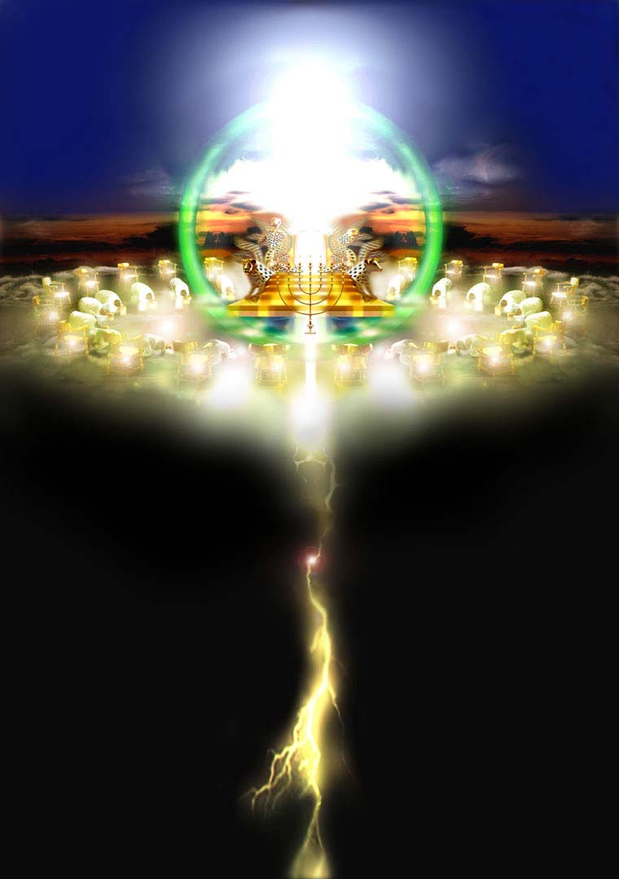
God our Example is holy (1:13-16)
Who can even begin to comprehend God's holiness at his throne (Rev. 4-5)?
280a

Slide 35

1 Peter 1:13 (NLT)
So prepare your minds for action and exercise self-control. Put all your hope in the gracious salvation that will come to you when Jesus Christ is revealed to the world.

Slide 36
So you must live as
God's obedient children. Don't slip back into your old ways of living to satisfy your own desires. You didn't know any better then.

Slide 37
But now you must
be holy in everything
you do, just as God who chose you is holy. For the Scriptures say, "You must be holy because I am holy."

Slide 38
And remember that the heavenly Father to
whom you pray has no favorites. He will judge or reward you according to what you do. So you must live in reverent fear of him during your time as "foreigners in the land."

Slide 39
For you know that
God paid a ransom
to save you from the empty life you inherited from your ancestors. And the ransom he paid was not mere gold or silver.

Slide 40
It was the precious
blood of Christ, the
sinless, spotless Lamb of God. God chose him as your ransom long before the world began, but he has now revealed him to you in these last days.

Slide 41
Why replace the evil desires of our former life with moral purity now?
280a
God is Our Example (13-16)
God is Our Judge (17)

Slide 42
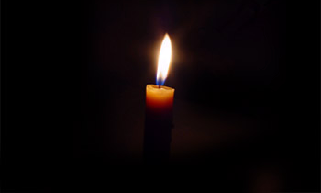
Be holy because God is Judge
280a
"Since you call on a Father who judges each man's work impartially, live your lives as strangers here in reverent fear"
(1 Peter 1:17)
In what way do you feel like a "stranger" here on earth?

Slide 43
Why replace the evil desires of our former life with moral purity now?
280a
God is Our Example (13-16)
God is Our Judge (17)
God is Our Redeemer (18-21)

Slide 44

Be holy because God is Redeemer
280a
"…it was not with perishable things such as silver or gold that you were redeemed from your empty way of life handed down to you from your forefathers, but with the precious blood of Christ, a lamb without blemish or defect" (1 Peter 1:18-19)
How was your former way of life as a non-Christian "empty"?

Slide 45


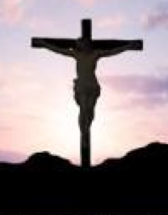
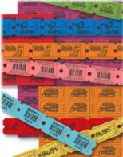
Redemption (Rom 3:24):
"to pay a ransom" (Greek)
280a
Christ's blood paid our ransom
(1 Pet. 1:18)
X
Slave Market
of Sin
Notes:
We redeem something when we pay for it with something of equal or greater value to release it from someone else's control. Christ's death was far more valuable than the hold that sin had on us.
______________
BE-60-1 Peter-45
NS-06-Rom3-4—slide 69
NS-21-1Peter-111

Slide 46

Jesus' death paid for our sin (John 19:16b-42)
280a
Notes:
The penalty must be paid for justice to be satisfied. But a substitute is allowed. Jesus was our substitute for the penalty of sin that we owe.
______________
BE-60-1 Peter-46
NS-06-Rom3-4—slide 61
NS-21-1Peter-112

Slide 47


"It is finished"
280a
Legal
Paid
in Full

Slide 48
Why replace the evil desires of our former life with moral purity now?
280a
God is Our Example (13-16)
God is Our Judge (17)
God is Our Redeemer (18-21)
God is Our Communicator (1:22–2:3)

Slide 49
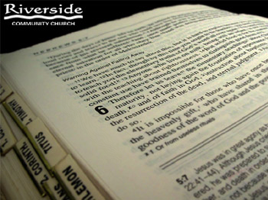
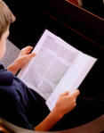
God as Communicator purifies us through his Word (1:22–2:3)
"Now that you have purified yourselves by obeying the truth…
…living and enduring word of God…
…the word of the Lord stands forever…
And this is the word that was preached to you
…crave pure spiritual milk…"
280a
Which 2:1 sins are reduced in you by "the pure spiritual milk"?

Slide 50
Slides on
1 Peter 2

Slide 51
Theme
23
How to Attract Others During Righteous Suffering
1 Peter

Slide 52
I. Show holiness with hope (1:1–2:12).
How to attract others to Jesus…
HOPE
IN THE DARKNESS
Notes:
[Our holy anticipation of God's reward attracts unbelievers.]
[Sanctification in light of our hope of future glory helps watching unbelievers praise God.]

Slide 53
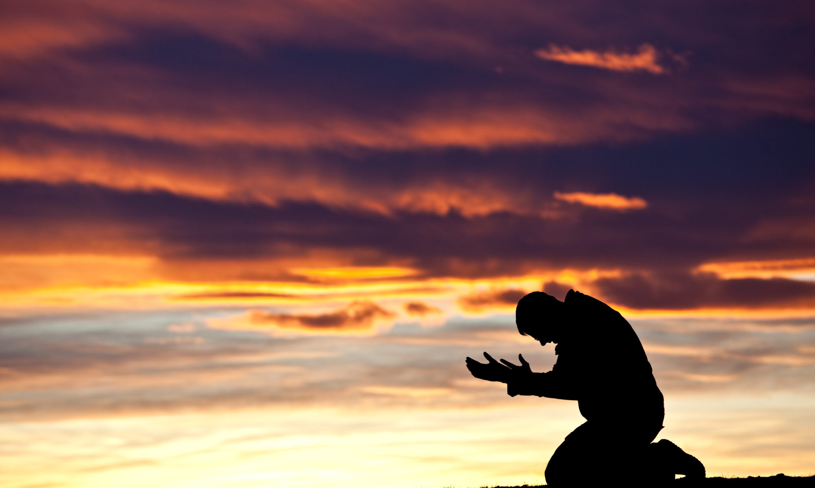
II. Show submission to both God and people (2:13–3:12).
How to attract others to Jesus…
Notes:
[Submit in all areas of life and this pleases both God and man.]

Slide 54
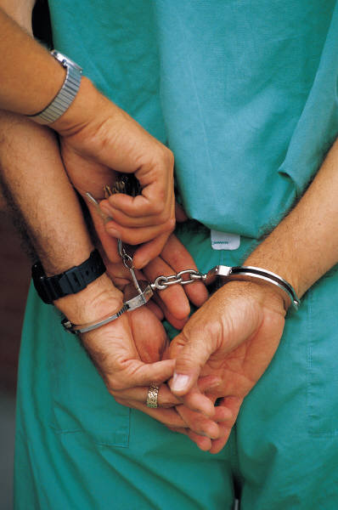
Endurance in Suffering By God's Grace (is achieved by…)
280d
II. Submission 2:13–3:12 (Humility)
To Government 2:13-17
In Work Place 2:18-25
In Marriage 3:1-7
In Church & All of Life 3:8-12

Slide 55



Submit to Which Country?
N O R T H K O R E A

Slide 56
Submit to Government no matter what type…
281
Socialism: You have two cows…
and you give one to your neighbor.
Communism: You have two cows…
the government takes both of them
and gives you some milk.
Fascism: You have two cows…
the government takes both of them
and sells you some milk.

Slide 57
Submit to Government no matter what type…
281
Nazism: You have two cows…
the government takes both of them
and shoots you.
Bureaucracy: You have two cows…
the government takes both of them,
shoots one, milks the other, and pours the milk down the drain.
Capitalism: You have two cows…
you sell one and buy a bull.

Slide 58
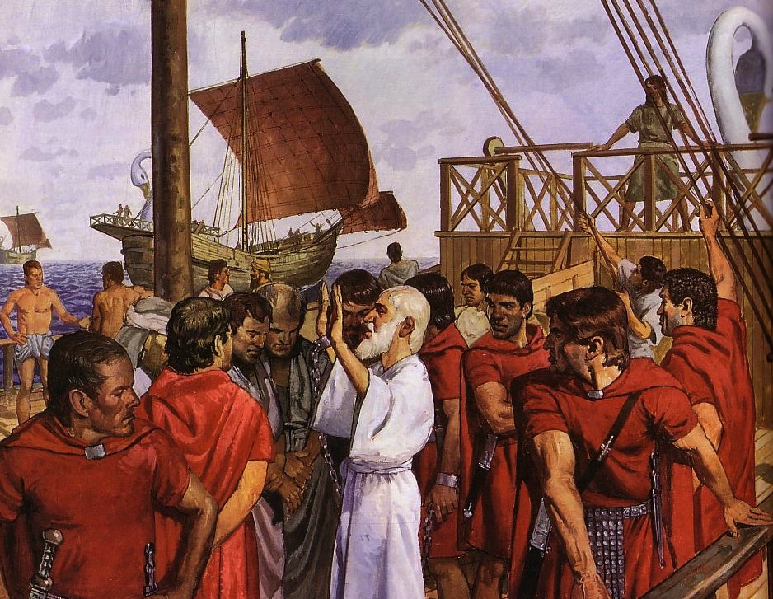
The Emperor Cult Threatened Christians
Ignatius, Bishop of Antioch, refused emperor worship and was brought to Rome to be fed to wild beasts. En route he wrote seven letters.

Slide 59
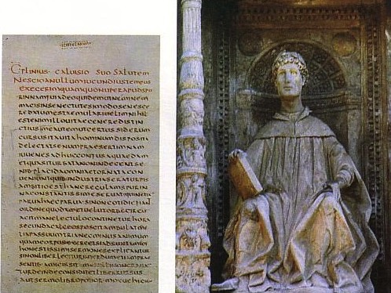
Pliny the Younger (AD 111-113)
281b
He was the governor of Bithynia who wrote letters to the Emperor Trajan for counsel on various matters

Slide 60

Helpful Correspondence (AD 111)
MAP OF THE ROMAN EMPIRE
Emperor Trajan in Rome
Governor Pliny in Bithynia

Slide 61
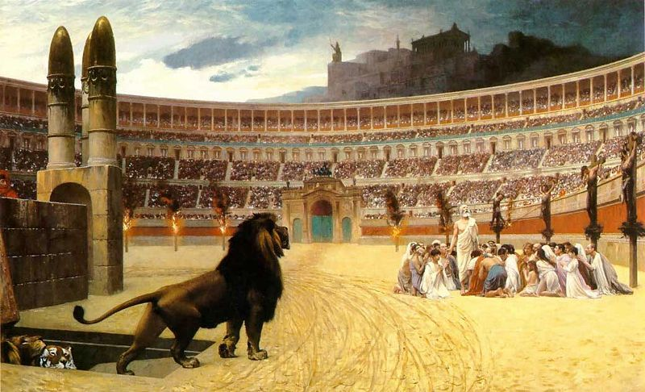
Early Church Suffering
281b
Governor Pliny to Emperor Trajan (AD 111):
I have observed the following procedure: I interrogated these as to whether they were Christians; those who confessed I interrogated a second and a third time, threatening them with punishment; those who persisted I ordered executed…
Pliny, Letters 10.96
(c)Paul Halsall Mar 1996. halsall@murray.fordham.edu http://www.fordham.edu/halsall/source/pliny1.html
Notes:
(c)Paul Halsall Mar 1996. halsall@murray.fordham.edu http://www.fordham.edu/halsall/source/pliny1.html

Slide 62
Early Church Suffering
281b
Governor Pliny to Emperor Trajan (AD 111):
"I have observed the following procedure:
I interrogated these as to whether they were Christians; those who confessed I interrogated a second and a third time, threatening them with punishment; those who persisted I ordered executed…"
Pliny, Letters 10.96
(c)Paul Halsall Mar 1996. halsall@murray.fordham.edu http://www.fordham.edu/halsall/source/pliny1.html
Notes:
(c)Paul Halsall Mar 1996. halsall@murray.fordham.edu http://www.fordham.edu/halsall/source/pliny1.html

Slide 63
Early Church Suffering
281b
Governor Pliny to Emperor Trajan (AD 111):
"Those who denied that they were or had been Christians, when they invoked the gods in words dictated by me, offered prayer with incense and wine to your image, which I had ordered to be brought for this purpose together with statues of the gods, and moreover cursed Christ—none of which those who are really Christians, it is said, can be forced to do—these I thought should be discharged."
Pliny, Letters 10.96
(c)Paul Halsall Mar 1996. halsall@murray.fordham.edu http://www.fordham.edu/halsall/source/pliny1.html
Notes:
(c)Paul Halsall Mar 1996. halsall@murray.fordham.edu http://www.fordham.edu/halsall/source/pliny1.html

Slide 64
Slides on
1 Peter 3

Slide 65
1 Peter Outline
275
How to Attract Others During Righteous Suffering
Sanctification |  |  | Submission |  |  |  | Selflessness
1:1–2:12 |  |  | 2:13–3:12 |  |  |  | 3:13–5:14
Holiness |  |  | Humility |  |  |  | Honoring Others
Salu-tation 1:1-2 | Praise for hope 1:3- 12 | Holy Life Exhort-ed 1:13– 2:12 | Gov't 2:13- 17 | Work Place 2:18- 25 | Marri-age 3:1-7 | Church & all of Life 3:8-12 | Christ's triumph 3:13–4:6 | Edify others 4:7-19 | Elders 5:1-4 | Young Men 5:5a | Humility & watch-fulness 5:5b-11 | Purpose 5:12-14
Rome to Northern Asia
Early AD 64

Slide 66
Submission as a Way of Life
(2:13–3:12)
280g
"Submit… to the king" (2:13)
"Slaves, submit…" (2:18)
"Wives, in the same way, be submissive to your husbands…" (3:1)
"Husbands, in the same way be considerate…" (3:7)

Slide 67
Submission in Marriage
280i
Wives (3:1-6)
Husbands (3:7)
How?
How?
Quiet spirit
Understand & Respect
Why?
Why?
Witness to husband
Please God
Unhindered prayer

Slide 68
1 Peter Outline
275
How to Attract Others During Righteous Suffering
Sanctification |  |  | Submission |  |  |  | Selflessness
1:1–2:12 |  |  | 2:13–3:12 |  |  |  | 3:13–5:14
Holiness |  |  | Humility |  |  |  | Honoring Others
Salu-tation 1:1-2 | Praise for hope 1:3- 12 | Holy Life Exhort-ed 1:13– 2:12 | Gov't 2:13- 17 | Work Place 2:18- 25 | Marri-age 3:1-7 | Church & all of Life 3:8-12 | Christ's triumph 3:13–4:6 | Edify others 4:7-19 | Elders 5:1-4 | Young Men 5:5a | Humility & watch-fulness 5:5b-11 | Purpose 5:12-14
Rome to Northern Asia
Early AD 64

Slide 69
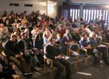

Our Final Section on Submission
(3:8-12)
280j
Submission
in the church
(8)
Submission
to attackers
(9)
Submission
in all of life
(10-12)

Slide 70
Blessing, Not Retaliation (3:9)
280j
Do not repay
evil with evil
or insult with insult
but with blessing,
Why?
because to this you were called
so that you may inherit a blessing

Slide 71
Theme
23
How to Attract Others During Righteous Suffering
1 Peter

Slide 72
I. Show holiness with hope (1:1–2:12).
How to attract others to Jesus…
HOPE
IN THE DARKNESS
Notes:
[Our holy anticipation of God's reward attracts unbelievers.]
[Sanctification in light of our hope of future glory helps watching unbelievers praise God.]

Slide 73
II. Show submission to both God and people (2:13–3:12).
How to attract others to Jesus…
Notes:
[Submit in all areas of life and this pleases both God and man.]

Slide 74

III. Show selfless living like Jesus (3:13–5:14).
How to attract others to Jesus…
Notes:
[A self-sacrificing lifestyle follows Christ's example of suffering then triumph.]

Slide 75

You attract people by the qualities you display. You keep them by the qualities you possess.

Slide 76
Endurance in Suffering By God's Grace (is achieved by…)
280
III. Selflessness 3:13–5:14 (Honoring Others)
Christ's triumph 3:13–4:6
Edify others 4:7-19
Elders 5:1-4
Young Men 5:5a
Humility/watchfulness 5:5b-11
Purpose 5:12-14

Slide 77
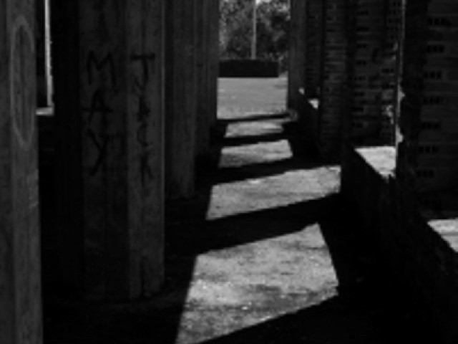
Who fears more?
Persecutors?
Persecutees?
"Do not fear what they [persecutors] fear…"
(1 Peter 3:14b)

Slide 78
1 Peter 3:18-20
283a
1 Peter 3:18-20 (NASB)
¹⁸ For Christ also died for sins once for all, the just for the unjust, so that He might bring us to God, having been put to death in the flesh, but made alive in the spirit;
¹⁹ in which also He went and made proclamation to the spirits now in prison,
²⁰ who once were disobedient, when the patience of God kept waiting in the days of Noah, during the construction of the ark, in which a few, that is, eight persons, were brought safely through the water.
"A wonderful text is this, and a more obscure passage perhaps than any other in the New Testament, so that I do not know for a certainty just what Peter means."
Martin Luther

Slide 79
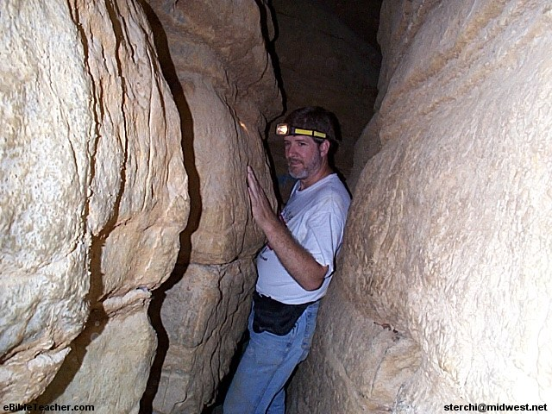
Whatever your view…
283a
1 Peter 3:18-20
… you're between a rock and a hard place!

Slide 80
Slides on
1 Peter 4

Slide 81
How to show selfless concern (4:7-11)
280m
Clear-minded prayer (4:7)
Love (4:8)
Hospitality (4:9)
Use of gifts (4:10-11)

Slide 82
Categories of Gifts
(1 Peter 4:11)
Get
words
from
God
Get
strength
from
God
280n
Speaking | Serving
Teaching | Administering
Evangelism | Faith
Pastor-Teacher | Giving
Encouraging | Service
 | Mercy

Slide 83

¹⁵ If you suffer, however, it must not be for murder, stealing, making trouble, or prying into other people’s affairs. ¹⁶ But it is no shame to suffer for being a Christian. Praise God for the privilege of being called by his name!

Slide 84
Slides on
1 Peter 5

Slide 85
ELDERS?
What does this have to do with me?
280o

Slide 86
What kind of leader are you?
280o
People seem to like having me as their leader
When I lead, people follow
I lead others because I want to do it
I serve the people under my care rather than expecting them to serve me
Others tell me that I am an example of integrity for them
Notes:
None of us are church elders.
But every one of us is a leader of some sort!
(Advance to title)
Yet what kind of leader are you?
(Pass out handouts)

Slide 87
The danger of "lording it over"
What does this mean?

Slide 88
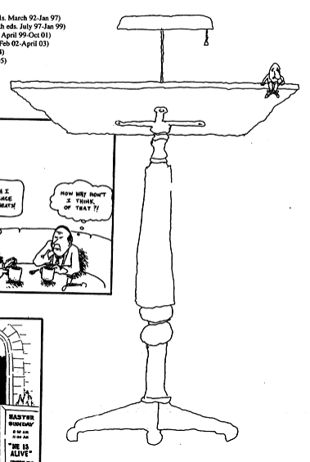
What is Humility?
Pride | Humility
"Do not think of yourself more highly than you ought" (Rom. 12:3a) | "…but rather think of yourself with sober judgment" (Rom. 12:3b)

Slide 89
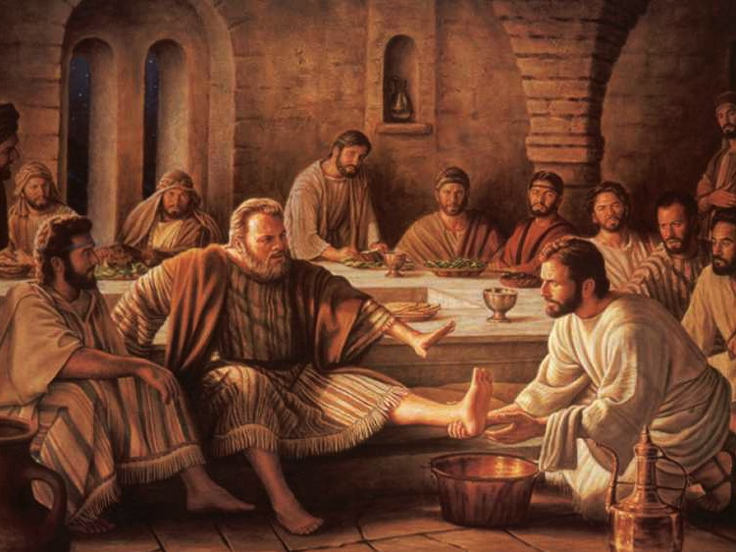
How to triumph in suffering (5:5b-9)
280q-r
Humility (5b-7)
Watchfulness (8-9)
Notes:
http://lovejesuschurch2.tripod.com/pics04/humility.jpg

Slide 90
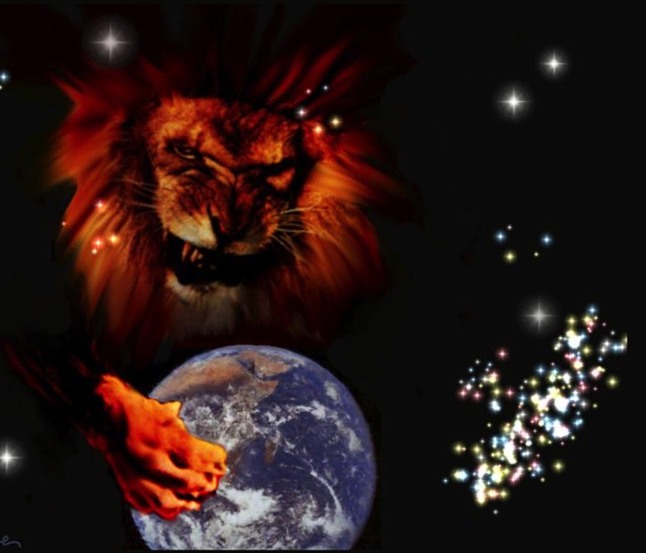
Why Be Watchful?
Satan is on the loose (1 Pet. 5:8)
⁸Stay alert! Watch out for your great enemy, the devil. He prowls around like a roaring lion, looking for someone to devour.
Others are succeeding over Satan (1 Pet. 5:9)
⁹Stand firm against him, and be strong in your faith. Remember that your Christian brothers and sisters all over the world are going through the same kind of suffering you are.

Slide 91
God's Response to Humble Watchfulness (5:10-11)
"And the God of all grace, who called you to his eternal glory in Christ, after you have suffered a little while, will himself restore you and make you strong, firm and steadfast. ¹¹ To him be the power for ever and ever. Amen."

Slide 92
Argument & Themes of 1 Peter
278
Argument
"… I have written to you briefly, encouraging you and testifying that this is the true grace of God. Stand fast in it" (5:12)
The Dual Themes:
"This is the true grace of God" 1 Pet. 1:1-12 Election Sovereignty of God Positional sanctification Initiated by Godhead (1:2) | "Stand firm in it" 1 Pet. 1:13–5:14 Endurance Responsibility of man Practical sanctification Effected in Godly Living (1:13ff)

Slide 93
Conclusion
280r
Woman?
Church?
Babylon?
Rome?
¹³ She who is in Babylon, chosen together with you, sends you her greetings, and so does my son Mark.
¹⁴ Greet one another with a kiss of love. Peace to all of you who are in Christ.

Slide 94
Summing Up 1 Peter
280r
Peter encourages north Asia Minor believers to suffer properly for Christ as holy, submissive, and selfless witnesses motivated by Christ's example and the hope of future glory to help them be people who attract others to hear their message.
Your response to suffering for Christ will either draw unbelievers to Jesus or repel them. Do you suffer with integrity?

Slide 95
A Problem of Attitude…
275
"When it is all over, you will not regret having suffered;
rather you will regret having suffered so little —
and suffered that little so badly"
— Sebastian Valfre (1629-1710)—

Slide 96
Main Idea of 1 Peter
How to attract others to Jesus…
Show a holy humility that honors others.

Slide 97

Which of these three qualities is the biggest challenge for you?
      Holiness Where are your standards too low?
      Submission Where do you want to be boss but God wants you to yield?
Selflessness What battle do you need to lose?

Slide 98
Black

Slide 99


NT Preaching • BibleStudyDownloads.org
Get this presentation and script for free!

