Slide 1

Be Established
1 Chronicles
Dr. Rick Griffith • Crossroads International Church Singapore
CICFamily.com • BibleStudyDownloads.org

Slide 2

Let's Study Through Scripture
The Bible: Book by Book
Notes:
We are in a study through the whole Bible right now, book by book. The goal is to give us a basic understanding of each book of the Bible.

Slide 3

Oh, no… I hit the geneaologies
in my read-through-the-Bible program again…

Slide 4
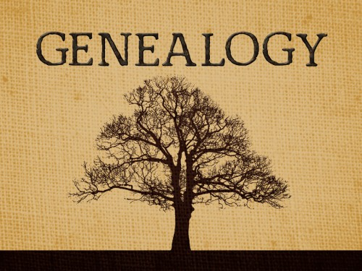
What’s the point?
GENEALOGY

Slide 5

What’s the point?
Here’s a great way to catch up on your sleep?

Slide 6
What’s the point?
GENEALOGY
The throne is empty but David’s descendants continue

Slide 7

United Kingdom
140
Phoenicia
Aram
1 Samuel 8–1 Kings 11
1 Chronicles 1—2 Chronicles 9
Israel
Ammon
Philistia
Moab
Conquered kingdoms in red
Egypt
Edom

Slide 8

Making Sense of Samuel, Kings, and Chronicles
220
264
1
Chronicles
2
Chronicles
Books
1
Samuel
2
Samuel
1
Kings
2
Kings
Kings
Saul
David
Solomon-Ahaziah
Ahaziah-Zedekiah
Dates
1043
1011
971 931 852
852 722 586 560
538
Kingdom
---------United-------
------------------- ---------Divided------------
Surviving
-Returned-

Slide 9
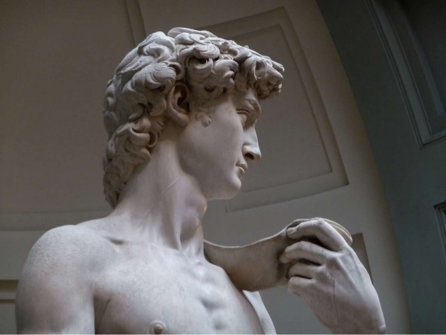
Why would God invest six books about David?
Notes:
Text

Slide 10
Two Histories of the Same Events
Earlier History Close to
the Events
Time for
Reflection
Later History Long After the Events
Kings
Chronicles

Slide 11

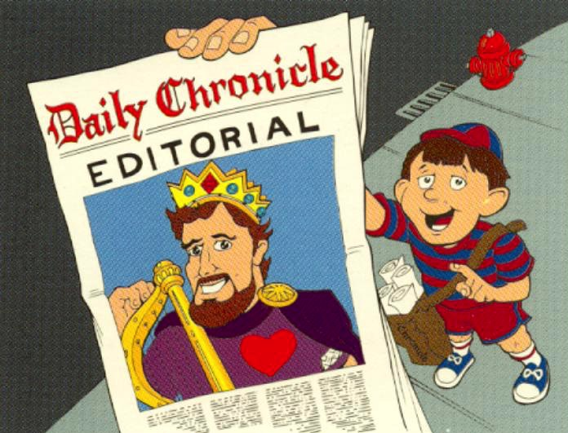
Editorial Nature of 1 Chronicles
1 Chronicles:
Editorial on David
Walk Through The Bible ©1989

Slide 12
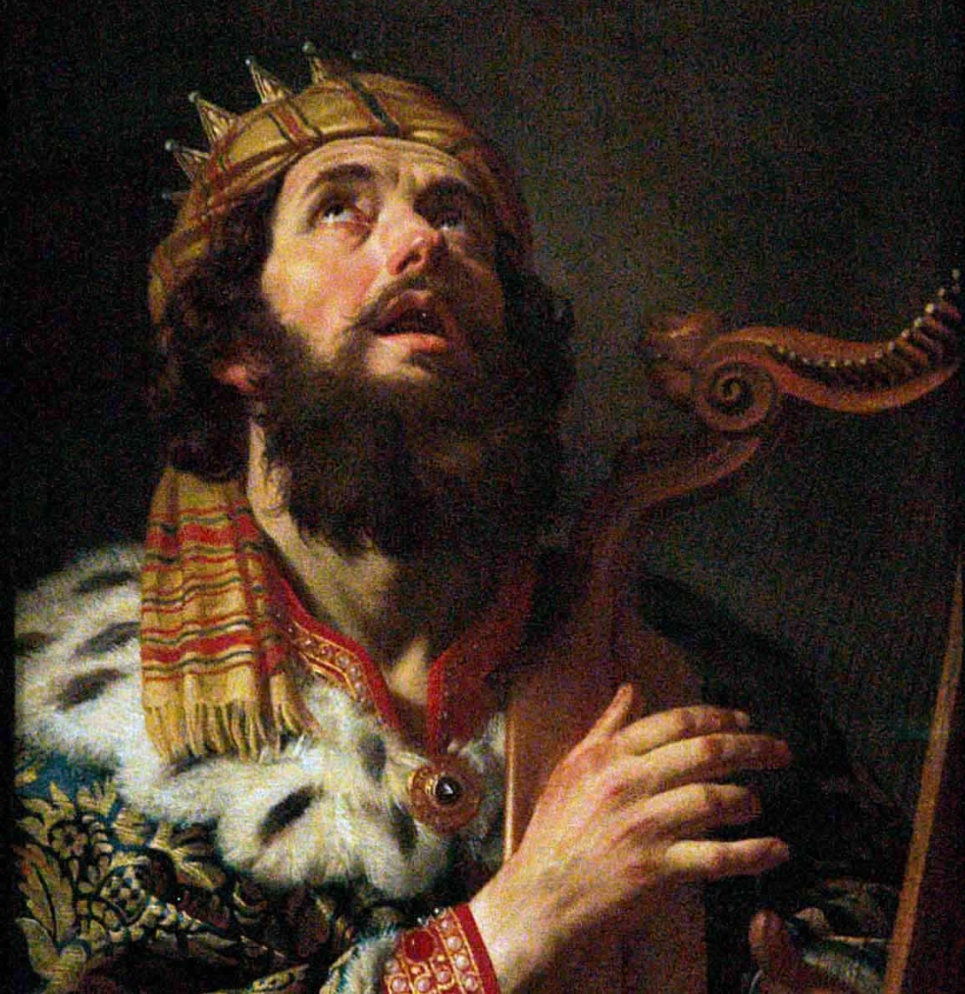
I. God established David’s kingdom to promote temple worship over idolatry.
Notes:
The LORD exalted David because David exalted God.

Slide 13
Key Word
262
39
Establishment
1 Chronicles

Slide 14
Theme
262
David's Line Established
1 Chronicles

Slide 15
Slides on
1 Chronicles 1

Slide 16
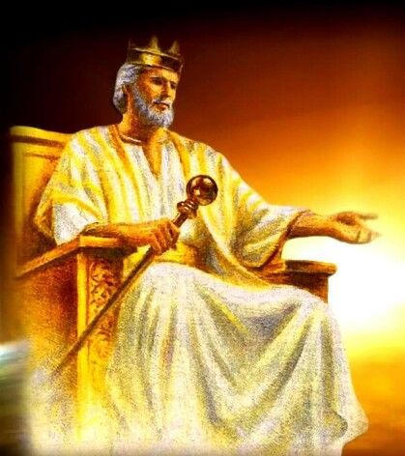
The genealogy from Adam to 450 BC showed David’s throne absent but his line still present due to God’s grace
(1 Chron 1–9) .

Slide 17

Adam to Noah Genealogy (1 Chron. 1:1-4)
85
Adam
Seth
Enosh
Kenan
Mahalalel
Jared
Enoch
Methuselah
Lamech
= Genesis 5
Noah

Slide 18

The Table of Nations
92
1 Chronicles 1:4-27
NOAH
Sino
Japheth
HAM
SHEM
Sin
Caucasians
Canaanites
Semites
Sinai
Europeans &
East Indians
Africans &
Asians
Jews &
Arabs
Genesis 10

Slide 19
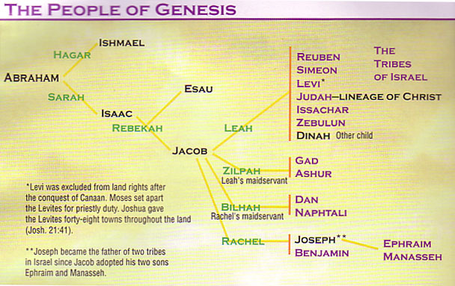
Patriarchal Family Tree
(Gen. 12–50; 1 Chron. 1:28-34)
91

Slide 20
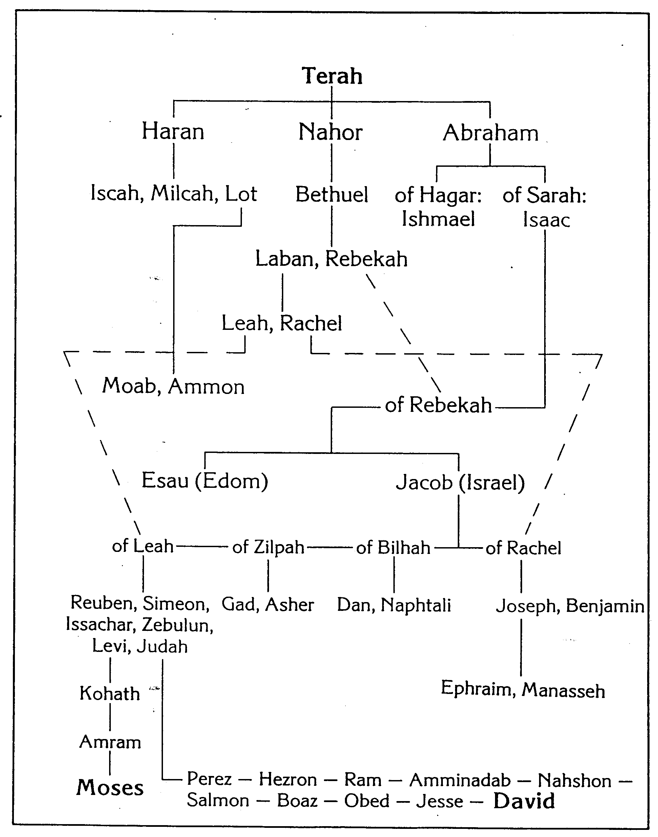
Patriarchal Family Tree
269
John H. Walton, Chronological and Background Charts of the OT

Slide 21

Eastern Tribes During Divided Kingdom
140
Phoenicia
Aram
1 Chronicles 1:35-54 (Edom)
1 Kings 12–2 Kings 17
Israel
Ammon
Philistia
Judah
Moab
Egypt
Edom

Slide 22
Slides on
1 Chronicles 2

Slide 23
Patriarchal Family Tree
Patriarchal Family Tree
91
1 Chron. 2:1-5
Terah
Haran
Nahor
Abraham
Lot
Bethuel
(of Hagar) Ishmael
(of Sarah) Isaac
Laban Rebekah
married
Esau
Jacob
Leah
Rachel
(of Leah) Reuben, Simeon, Levi,
Judah, Issachar, Zebulun
(of Zilpah) Gad,
Asher
(of Bilhah) Dan, Naphtali
(of Rachel)
Benjamin, Joseph
Manasseh
Ephraim
Green = line of blessing with rights of firstborn even though none of these were born first (1 Chron. 5:1-2)

Slide 24

Populations by Tribe
171
Numbers 26
Joshua 13:1–19:48
1 Chronicles 2:3-55 (Judah, Hezron, Caleb, Hur)
Levi
23,000
Spread Throughout Israel
Judah
76,500

Slide 25
Slides on
1 Chronicles 3

Slide 26
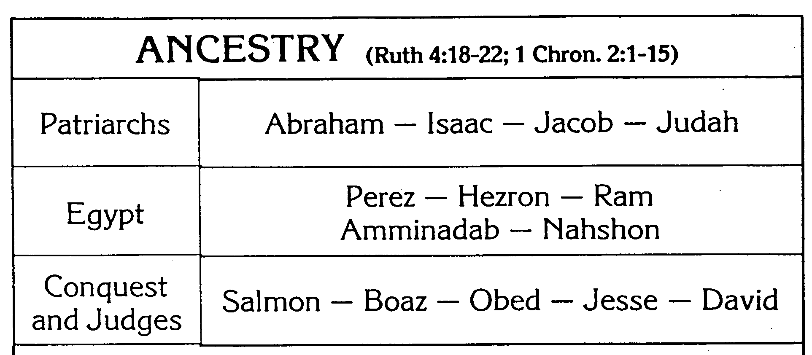
Family & Ancestry of David
270
John H. Walton, Chronological and Background Charts of the OT

Slide 27

The Lineage of
David
ABRAHAM
Isaac
Jacob
Judah
Perez
Hezron
Ram
Amminadab
Nahshon
Salmon
Boaz
Obed
Jesse
DAVID

Slide 28

Messiah from Judah
Since Jacob's blessing in Genesis 49:9-10, the lion has depicted a king…
"Judah, my son, is a young lion that has finished eating its prey. Like a lion he crouches and lies down; like a lioness—who dares to rouse him?
¹⁰The scepter will not depart from Judah, nor the ruler's staff from his descendants, until the coming of the one to whom it belongs, the one whom all nations will honor" (NLT).

Slide 29

Oh, David, why so many wives?

Slide 30
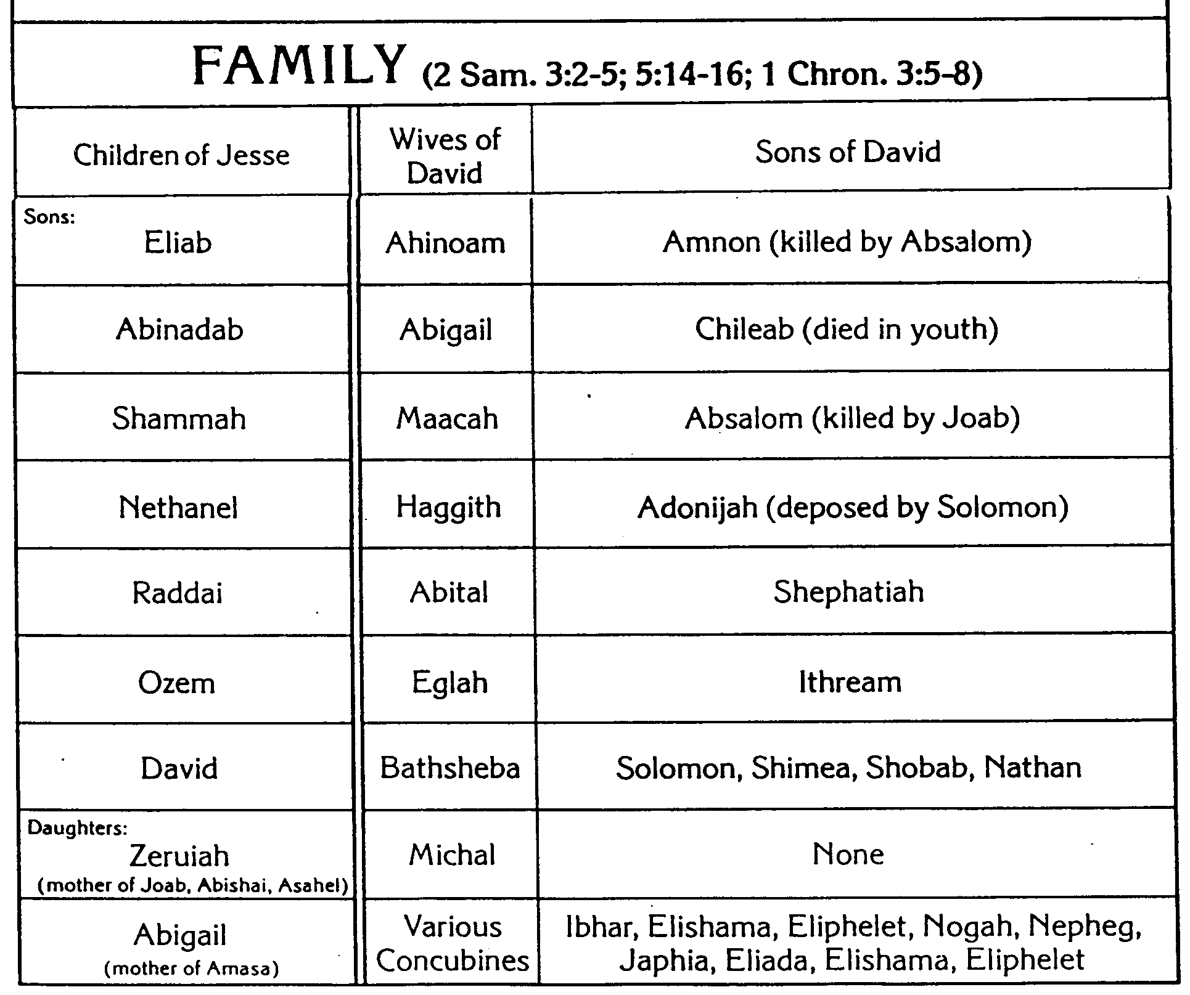
Family & Ancestry of David
270
John H. Walton, Chronological and Background Charts of the OT
1 Chron. 3:5-8

Slide 31
The Kingdom in Matthew 1
Fall of the Kingdom
Establishing the Eternal Kingdom
ABRAHAM
Solomon
Shealtiel
Isaac
Rehoboam
Zerubbabel
Jacob
Abijah
Abiud
Judah
Asa
Eliakim
Perez
Jehoshaphat
Azor
"Thus there were fourteen generations in all from Abraham to David, fourteen from David to the exile to Babylon, and fourteen from the exile to Christ."
Matthew 1:17
Hezron
Jehoram
Zadok
Ram
Uzziah
Akim
Amminadab
Jotham
Eliud
Nahshon
Ahaz
Eleazar
Salmon
Hezekiah
Matthan
Boaz
Manasseh
Jacob
Obed
Amon
Joseph +
Mary
Rise of the Kingdom
Jesse
Josiah
KING DAVID
JECONIAH (EXILE)
JESUS CHRIST

Slide 32
Slides on
1 Chronicles 4

Slide 33
Populations by Tribe
171
Numbers 26
Joshua 13:1–19:48
1 Chronicles 4 (Judah & Simeon)
Judah
76,500
Simeon
22,200

Slide 34
Slides on
1 Chronicles 5

Slide 35
Patriarchal Family Tree
Patriarchal Family Tree
91
1 Chron. 2:1-5
Terah
Haran
Nahor
Abraham
Lot
Bethuel
(of Hagar) Ishmael
(of Sarah) Isaac
Laban Rebekah
married
Esau
Jacob
Leah
Rachel
(of Leah) Reuben, Simeon, Levi,
Judah, Issachar, Zebulun
(of Zilpah) Gad,
Asher
(of Bilhah) Dan, Naphtali
(of Rachel)
Benjamin, Joseph
Manasseh
Ephraim
Green = line of blessing with rights of firstborn even though none of these were born first (1 Chron. 5:1-2)

Slide 36
Populations by Tribe
171
Numbers 26
Joshua 13:1–19:48
1 Chronicles 5 (Reuben, Gad, Manasseh)
Manasseh
Manasseh
52,700
Gad
40,500
Reuben
43,730

Slide 37
Patriarchal Family Tree
Kingly Line
91
Terah
Haran
Nahor
Abraham
Lot
Bethuel
(of Hagar) Ishmael
(of Sarah) Isaac
Laban Rebekah
married
Esau
Jacob
Leah
Rachel
(of Leah) Reuben, Simeon, Levi,
Judah, Issachar, Zebulun
(of Zilpah) Gad, Asher
(of Bilhah) Dan, Naphtali
(of Rachel)
Benjamin, Joseph
Manasseh
Ephraim
Red: Even though Judah was not the firstborn, Jacob claimed the kings of Israel would come from him.

Slide 38
Slides on
1 Chronicles 6

Slide 39
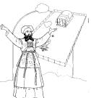
Contrasting Levites and Priests
132
Abraham
Isaac
Jacob
12 Sons: Reuben–Simeon–Levi–Judah– etc.
All other lines Aaron
Levites Priests
see p. 171a see p. 202

Slide 40
Contrasting Levites and Priests
132
Levites
Priests
Descendants of…
Levi
Aaron (also a descendant of Levi)
Population
Many (the larger group)
Few (a subset of the Levites, Josh. 21:4)
Role
Assisted priests and supervised religious activities permitted outside of the sanctuary: teaching, singing, leading worship, officials, administration, judges & gatekeepers
Mediators between God and Israel
Sacrificial Role
Didn't offer sacrifices though they did offer incense (Deut. 33:10b)
Offered sacrifices (Deut. 33:10b)
Location of Homes
Extensive–in 35 cities throughout the tribes in the central, northern, and eastern parts of Israel (Josh. 21:5-7)
Limited to 13 cities in Judah, Simeon, & Benjamin that were near the temple (Josh. 21:4, 9-13)

Slide 41
Levi's Family Tree
125
202
Levi's Family Tree
LEVI
1 Chron. 6:1-3
Gershon
Kohath
Merari
Levites
Amram
Priests
High Priest
Miriam
Aaron
Moses
Offered
Unauthorised Fire;
Killed by God
Nadab
Abihu
Eleazar
Ithamar
Adapted from Manna Bible Maps
Manna

Slide 42

48 Levitical Cities
171a
6 Cities of Refuge
Gershon (6:62)
1 Chronicles 6:54-80
Merari
(6:77)
Kohath
(6:66-70)
Merari
(6:63,
78-81)
Kohath
(6:54-61)

Slide 43
Slides on
1 Chronicles 7

Slide 44
Populations by Tribe
171
Asher
53,400
Naphtali
45,400
Numbers 26
Joshua 13:1–19:48
1 Chronicles 7
Issachar
64,300
Manasseh
52,700
Ephraim
32,500
Benjamin
45,600

Slide 45
Slides on
1 Chronicles 8

Slide 46
Populations by Tribe
171
Numbers 26
Joshua 13:1–19:48
1 Chronicles 8
Benjamin
45,600

Slide 47
Slides on
1 Chronicles 9

Slide 48
Populations by Tribe
171
Asher
53,400
Naphtali
45,400
Numbers 26
Joshua 13:1–19:48
1 Chronicles 9
Zebulun
60,500
Levi
23,000
Spread Throughout Israel
Manasseh
Issachar
64,300
Manasseh
52,700
“The first of the exiles to return to their property in their former towns were priests, Levites, Temple servants, and other Israelites. ³Some of the people from the tribes of Judah, Benjamin, Ephraim, and Manasseh came and settled in Jerusalem”
(1 Chron 9:2-3 NLT).
Gad
40,500
Ephraim
32,500
Dan
64,400
Benjamin
45,600
Reuben
43,730
Judah
76,500
Simeon
22,200

Slide 49
Why the Genealogies?
If My People
1 Chronicles
God's Sovereignty
1–9
Genealogy
Prepared
4143-1011

Slide 50
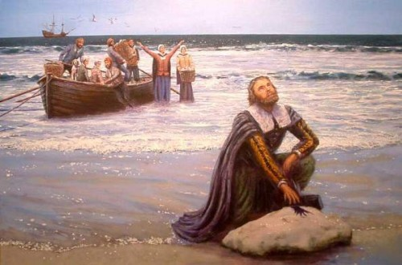
The USA began as a Christian nation
408
c

Slide 51
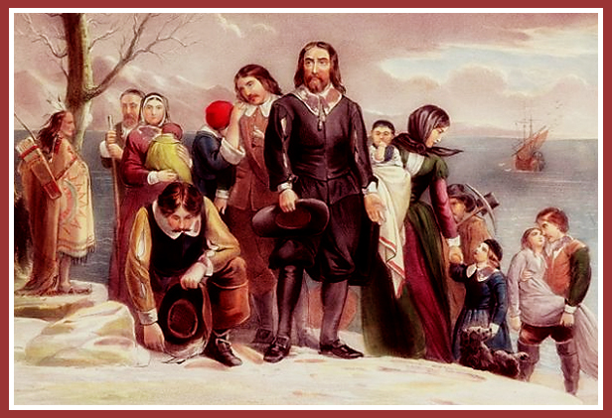
Plymouth Pilgrims
408
c

Slide 52
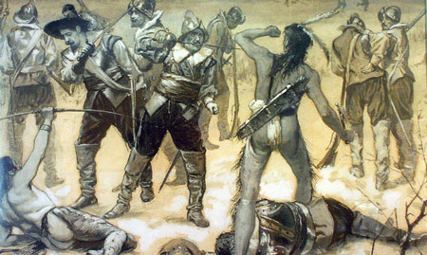
Yet they massacred the Pequot
408
c

Slide 53
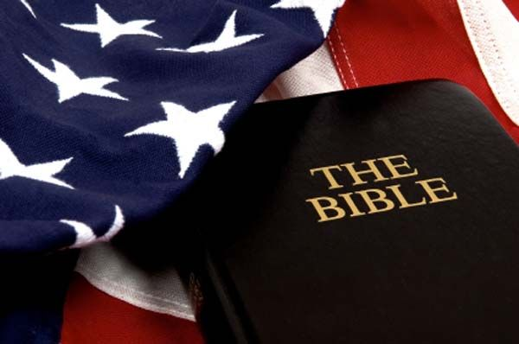
The USA began as a Christian nation
408
c
The Declaration of Independence (1776) notes God 4 times
The Founding Fathers, early presidents, and the Supreme Court called the USA a “Christian nation” until 1947 (see http://www.afn.org/~govern/Christian_Nation.html)
The US sent the most missionaries in 1900s
“In God We Trust” is the national motto
The preamble of every single state among the 50 states appeals to God for help
Notes:
http://www.afn.org/~govern/Christian_Nation.html says…
WAS THE UNITED STATES FOUNDED AS A CHRISTIAN NATION?
Recently, many authors have debated whether or not the United States of America was founded as a Christian nation. I wish to provide a few historical quotes from our Founding Era that lend credence to the supposition that we indeed were founded as a Christian nation.
Granted, God is not mentioned in the Constitution, but He is mentioned in every major document leading up to the final wording of the Constitution. For example, Connecticut is still known as the "Constitution State" because its colonial constitution was used as a model for the United States Constitution. Its first words were: "For as much as it has pleased the almighty God by the wise disposition of His Divine Providence…"
Most of the fifty-five Founding Fathers who worked on the Constitution were members of orthodox Christian churches and many were even evangelical Christians. The first official act in the First Continental Congress was to open in Christian prayer, which ended in these words: "...the merits of Jesus Christ, Thy Son, our Savior. Amen". Sounds Christian to me.
Ben Franklin, at the Constitutional Convention, said: "...God governs in the affairs of men. And if a sparrow cannot fall to the ground without His notice is it probable that an empire can rise without His aid?"
John Adams stated so eloquently during this period of time that; "The general principles on which the fathers achieved Independence were ... the general principles of Christianity ... I will avow that I then believed, and now believe, that the general principles of Christianity are as etemal and immutable as the existence and attributes of God."
Later, John Quincy Adams answered the question as to why, next to Christmas, was the Fourth of July this most joyous and venerated day in the United States. He answered: "...Is it not that the Declaration of Independence first organized the social compact on the foundation of the Redeemer's mission upon earth? That it laid the cornerstone of human government upon the first precepts of Christianity?" Sounds like the founding of a Christian nation to me. John Quincy Adams went on to say that the biggest victory won in the American Revolution was that Christian principles and civil government would be tied together In what he called an "indissoluble" bond. The Founding Fathers understood that religion was inextricably part of our nation and government. The practice of the Christian religion in our government was not only welcomed but encouraged.
The intent of the First Amendment was well understood during the founding of our country. The First Amendment was not to keep religion out of government. It was to keep Government from establishing a 'National Denomination" (like the Church of England). As early as 1799 a court declared: "By our form of government the Christian religion is the established religion; and all sects and denominations of Christians are placed on the same equal footing." Even in the letter that Thomas Jefferson wrote to the Baptists of Danbury Connecticut (from which we derive the term "separation of Church and State") he made it quite clear that the wall of separation was to insure that Government would never interfere with religious activities because religious freedom came from God, not from Government.
Even George Washington who certainly knew the intent of the Constitution and the Bill of Rights, since he presided over their formation, said in his "Farewell Address": "Of all the dispositions and habits which lead to political prosperity, religion and morality are indispensable supports. In vain would that man claim the tribute of patriotism, who should labor to subvert these great pillars." Sure doesn't sound like Washington was trying to separate religion and politics.
John Jay, the first Chief Justice of the United States Supreme Court, and one of the three men most responsible for the writing of the Constitution declared:
"Providence has given to our people the choice of their rulers, and it is their duty-as well as privilege and interest- of our Christian nation to select and prefer Christians for their rulers." Still sounds like the Founding Fathers knew this was a Christian nation.
This view, that we were a Christian nation, was hold for almost 150 years until the Everson v. Board of Education ruling in 1947. Before that momentous ruling, even the Supreme Court knew that we were a Christian nation. In 1892 the Court stated:
"No purpose of action against religion can be imputed to any legislation, state or national, because this is a religious people...This is a Christian nation." There it is again! From the Supreme Court of the United States. This court went on to cite 87 precedents (prior actions, words, and rulings) to conclude that this was a "Christian nation".
In 1854, the House Judiciary Committee said: "in this age, there is no substitute for Christianity...That was the religion of the founders of the republic, and they expected it to remain the religion of their descendants.'
It should be noted here that even as late as 1958 a dissenting judge warned in Baer v. Kolmorgen that if the court did not stop talking about the "separation of Church and State", people were going to start thinking it was part of the Constitution.
It has been demonstrated in their own words: Ben Franklin, George Washington and John Adams, to the House of Representatives and the Supreme Court, how our founding fathers felt about the mix of politics and religion.
When we read articles such as "What's God got to do with it?" (Primack, 5/4) and "The wall between state and church must not be breached" (Tager, 5/7) it just reaffirms how little, even intelligent people, understand about the founding of our great Republic. To say that this nation was not founded as a Christian nation or that the Constitution was not founded on Christian principles is totally at odds with the facts of history.
Tex Browning
Back to Citizens for Better Government
Last Modified May 1, 2003

Slide 54
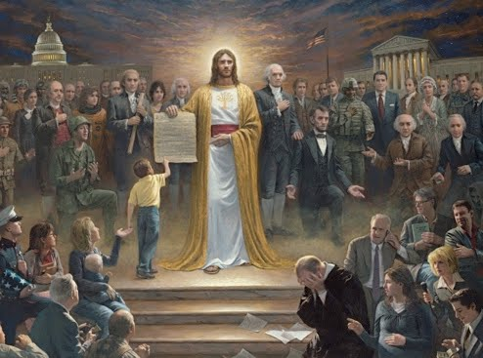
The USA began as a Christian nation
408
c

Slide 55
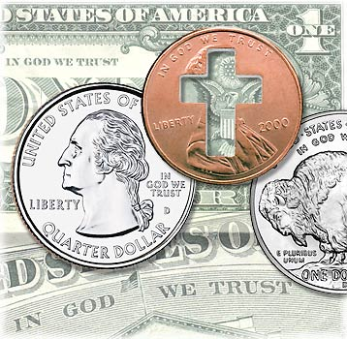
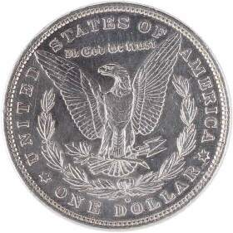
Do you trust in God?
Notes:
For over 200 years America has unashamedly declared trust in God in all forms of money--paper and coins alike. Since 1954 by law each currency and coin must say on it, "In God We Trust."

Slide 56
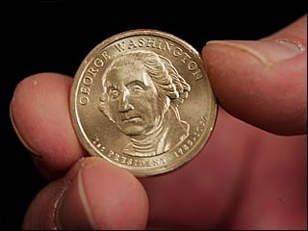
Do we trust in God?
Notes:
But do we really trust in God? (Click) I found it interesting that in 2007 the news broke that our new dollar coin produced in the previous month actually didn't have this phrase on the front or the back. Some have said that it didn't appear on the coin at all.

Slide 57
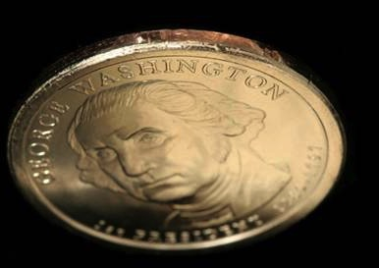
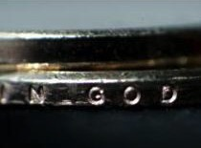
Does your trust in God embarrass you?
Notes:
But the phrase does appear--only it's on the side--at least on most of the 300 million coins minted! The news broke that an unknown amount of coins were missing the phrase totally. Interestingly, these coins are more valuable and at first sold for $600 on eBay. Now that we know there's as many as 100,000 of them, the price has dropped to $50. It seems that we are too embarrassed about Christ to put this phrase on the font or back anymore.

Slide 58

A Cause for Shame?
"Who, me? Well, I'm not saying that I am a Christian…
but I'm not saying that I'm not…"
Notes:
That reminds me of some Christians. Ask them if they are believers and they want to know why you want to know! Worse yet, they won't admit that they trust in Christ.

Slide 59
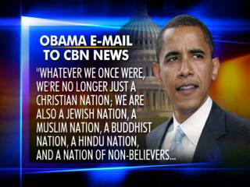
The USA began as a Christian nation but has left its godly heritage.
408
c
OBAMA EMAIL TO CBN NEWS
"WHATEVER WE ONCE WERE, WE'RE NO LONGER JUST A CHRISTIAN NATION; WE ARE ALSO A JEWISH NATION, A MUSLIM NATION, A BUDDHIST NATION, A HINDU NATION, AND A NATION OF NON-BELIEVERS…"

Slide 60
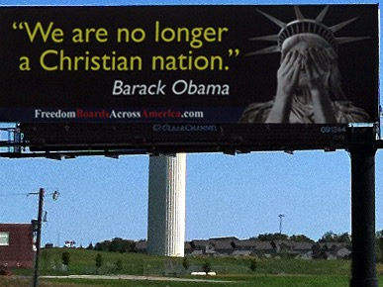
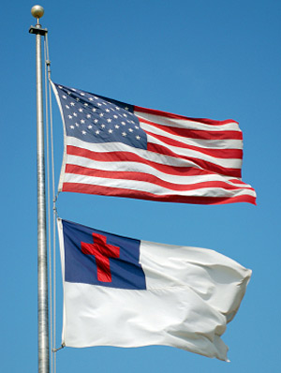
The USA began as a Christian nation but has left its godly heritage.
408
c
"We are no longer a Christian nation."
Barack Obama

Slide 61





The Christian heritage is now hotly debated!
408
c

Slide 62
Slides on
1 Chronicles 10

Slide 63
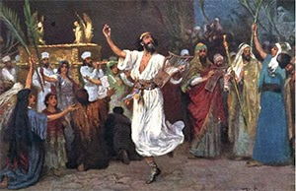

God blessed David so Israel would imitate his passion for temple worship
(1 Chron 10–29).

Slide 64
Focus on David
If My People
1 Chronicles
God's Sovereignty
1–9
David's Service
10–29
Genealogy
History
Prepared
United
4143-1011
1011–930

Slide 65
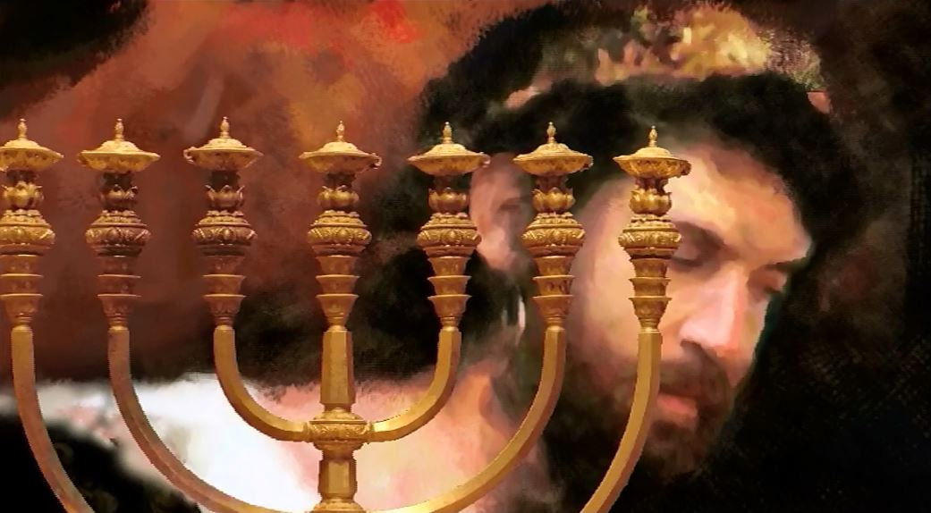
God made David king after God removed Saul as unfit for the kingship to show David as the ideal king (1 Chron 10–12).

Slide 66
Slides on
1 Chronicles 11

Slide 67
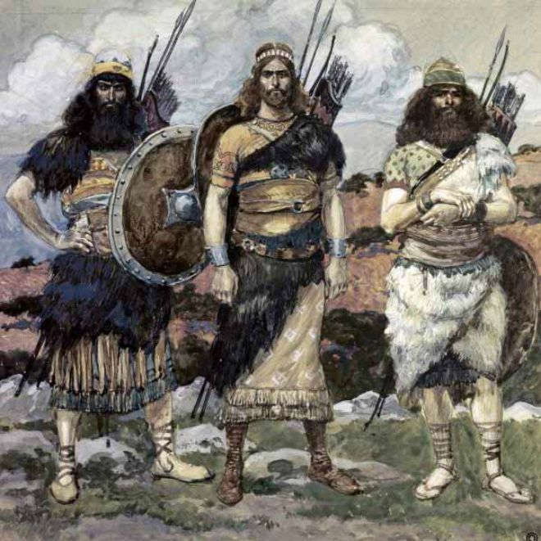
"The Three":
Jashobeam, Eleazar, & Shammah
1 Chronicles 11:10-19; 2 Sam 23:11
Notes:
James Tissot Bible c 1899 Three of David's captains
http://www.flickriver.com/photos/tags/1chronicles/interesting/
Accessed 23 Jan 2018

Slide 68
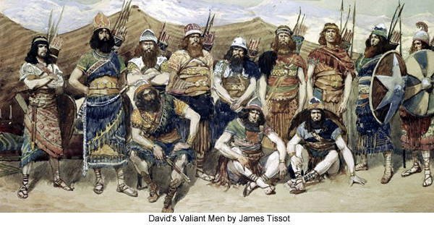
"David's Valiant Men" by James Tissot
1 Chronicles 11:26-47
Notes:
James Tissot Bible c 1899 Three of David's captains
http://www.flickriver.com/photos/tags/1chronicles/interesting/
Accessed 23 Jan 2018

Slide 69
Slides on
1 Chronicles 12

Slide 70

The Model King
What a contrast from Saul...
Notes:
Restatement

Slide 71
Slides on
1 Chronicles 13

Slide 72
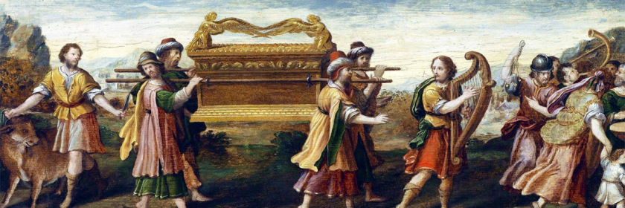
God rewarded David's respect for the ark by promising the permanent dynasty of the Davidic Covenant to show how obedience leads to blessing
(1 Chron 13–17).

Slide 73
Parallels between David's and Solomon's Transfers of the Ark
275
David
(1 Chron.)
Solomon
(2 Chron.)
Ark location before transfer
Kiriath Jearim
City of David
Ark location after transfer
House of Obed near the City of David
Temple on Moriah (former threshing floor of Araunah)
Consultation with Israel's leaders & national procession
13:1-5
5:2-3
Transports the ark correctly
15:1–16:3
5:2-10
Celebration of praise at arrival
16:7-36
5:11-14
System of regular worship set up
16:4-6, 37-42
8:12-16
Divine revelation given
17:1-15
7:12-22
Prayer by the king
17:16-27
6:12-42

Slide 74
Slides on
1 Chronicles 14

Slide 75
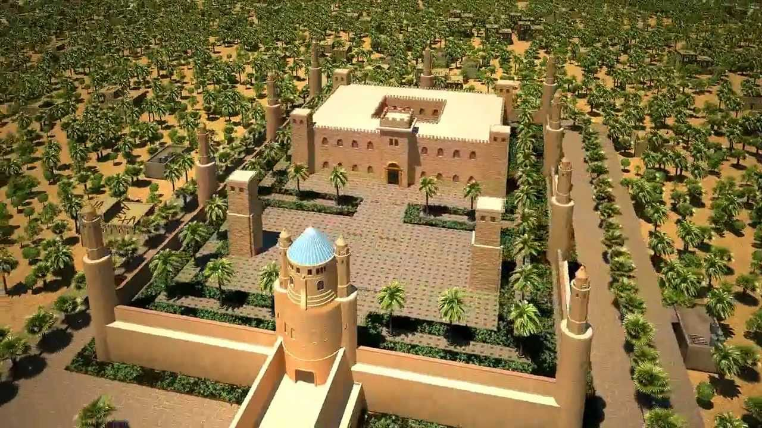
God blessed David as king though his palace, numerous wives and children, and victories over the Philistines (1 Chron 14).

Slide 76
Slides on
1 Chronicles 15

Slide 77
Parallels between David's and Solomon's Transfers of the Ark
275
David
(1 Chron.)
Solomon
(2 Chron.)
Ark location before transfer
Kiriath Jearim
City of David
Ark location after transfer
House of Obed near the City of David
Temple on Moriah (former threshing floor of Araunah)
Consultation with Israel's leaders & national procession
13:1-5
5:2-3
Transports the ark correctly
15:1–16:3
5:2-10
Celebration of praise at arrival
16:7-36
5:11-14
System of regular worship set up
16:4-6, 37-42
8:12-16
Divine revelation given
17:1-15
7:12-22
Prayer by the king
17:16-27
6:12-42

Slide 78
Slides on
1 Chronicles 16

Slide 79
Parallels between David's and Solomon's Transfers of the Ark
275
David
(1 Chron.)
Solomon
(2 Chron.)
Ark location before transfer
Kiriath Jearim
City of David
Ark location after transfer
House of Obed near the City of David
Temple on Moriah (former threshing floor of Araunah)
Consultation with Israel's leaders & national procession
13:1-5
5:2-3
Transports the ark correctly
15:1–16:3
5:2-10
Celebration of praise at arrival
16:7-36
5:11-14
System of regular worship set up
16:4-6, 37-42
8:12-16
Divine revelation given
17:1-15
7:12-22
Prayer by the king
17:16-27
6:12-42

Slide 80
Chronicles vs. Samuel/Kings
267a
What's Missing in Chronicles
but Included in Samuel/Kings?
What's Included in Chronicles
but Missing in Samuel/Kings?
These are generally negative elements or related to Israel and royalty.
These are generally positive elements or related to Judah and the temple.
Michal despises David at ark
(2 Sam. 6:20b-23)
Levites honor God at ark
(1 Chron. 16:4-42)
Discipline aspects of the Davidic covenant (2 Sam. 7:14b)
Identification of the temple site even as God disciplines David's prideful census
(1 Chron. 21:27–22:1; cp. 2 Sam. 24:25)
David's adultery with Bathsheba, murder of Uriah, & confrontation by Nathan the prophet (2 Sam. 11:2–12:25)
Divisions of Levites (1 Chron. 22–27)
David's troubles with Absalom
(2 Sam. 13–19)
David's charge to Israel & Solomon & prayer (1 Chron. 28:1–29:22a)
Sheba's rebellion put down
(2 Sam. 20)
Enterprises of Rehoboam
(2 Chron. 11:5-23)

Slide 81
Slides on
1 Chronicles 17

Slide 82
Key Verse
262
"I declare that the LORD will build a house for you: When your days are over and you go to be with your fathers, I will raise up your offspring to succeed you, one of your own sons, and I will establish his kingdom. He is the one who will build a house for me, and I will establish his throne forever. I will be his father, and he will be my son. I will never take my love away from him, as I took it away from your predecessor. I will set him over my house and my kingdom forever; his throne will be established forever" (1 Chron. 17:10b-14).
1 Chronicles

Slide 83
Parallels between David's and Solomon's Transfers of the Ark
275
David
(1 Chron.)
Solomon
(2 Chron.)
Ark location before transfer
Kiriath Jearim
City of David
Ark location after transfer
House of Obed near the City of David
Temple on Moriah (former threshing floor of Araunah)
Consultation with Israel's leaders & national procession
13:1-5
5:2-3
Transports the ark correctly
15:1–16:3
5:2-10
Celebration of praise at arrival
16:7-36
5:11-14
System of regular worship set up
16:4-6, 37-42
8:12-16
Divine revelation given
17:1-15
7:12-22
Prayer by the king
17:16-27
6:12-42

Slide 84
Slides on
1 Chronicles 18

Slide 85
David's New Vassal States
Zobah
140
Phoenicia
Aram
2 Samuel 10
God rewarded David with victory over the Philistines and other nations to show him as a righteous king to whom God had promised an eternal dynasty
(1 Chron 18–20).
Israel
Philistia
Moab
Egypt
Edom

Slide 86
Slides on
1 Chronicles 19

Slide 87
Victory over Aram & Ammon
Zobah
140
Phoenicia
Aram
1 Chronicles 19
Israel
Ammon
Philistia
Moab
Egypt
Edom

Slide 88
Slides on
1 Chronicles 20

Slide 89
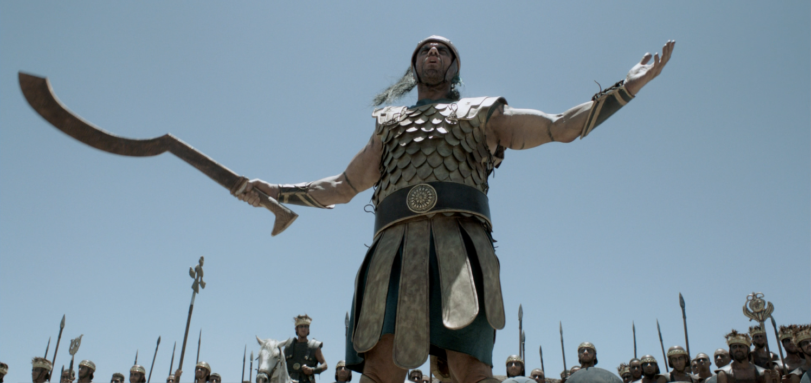
"During another battle with the Philistines, Elhanan son of Jair killed Lahmi, the brother of Goliath of Gath. The handle of Lahmi’s spear was as thick as a weaver’s beam!" (1 Chron 20:5 NLT).

Slide 90

"In another battle with the Philistines at Gath, they encountered a huge man with six fingers on each hand and six toes on each foot, twenty-four in all, who was also a descendant of the giants. ⁷But when he defied and taunted Israel, he was killed by Jonathan, the son of David’s brother Shimea"
(1 Chron 20:6-7 NLT).
Notes:
In this photo taken Wednesday Aug. 24, 2011, Yoandri Hernandez Garrido, 37
There be GIANTS!
Posted on October 6, 2015 by TheMeltingThought
https://themeltingthought2000.wordpress.com/2015/10/06/there-be-giants/
Accessed 21 Jan 2018

Slide 91
Slides on
1 Chronicles 21

Slide 92
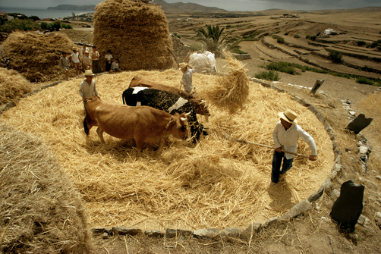
God blessed David’s worship by selecting the temple site, organizing the materials and leaders, and commissioning the work to encourage temple worship (1 Chron 21–29).

Slide 93
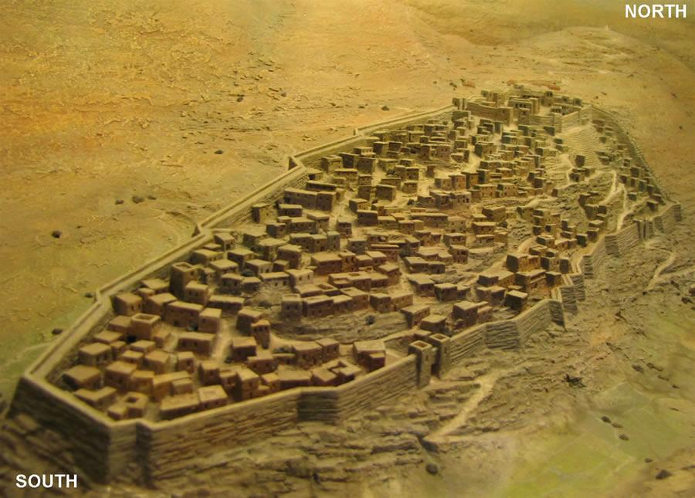
Temple Site
Website

Slide 94
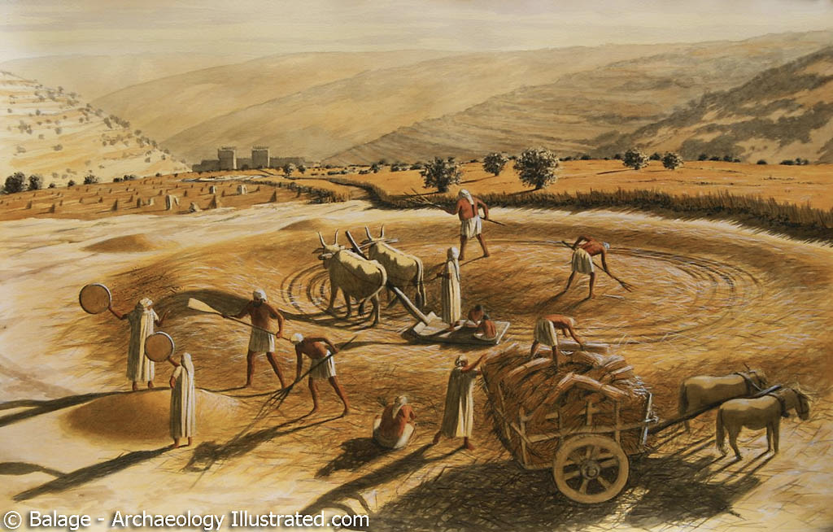
Floor of Araunah
1 Chronicles 21:15, 18
Website

Slide 95
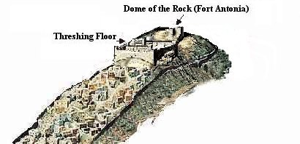
Temple Site (1 Chron 21)
Website

Slide 96
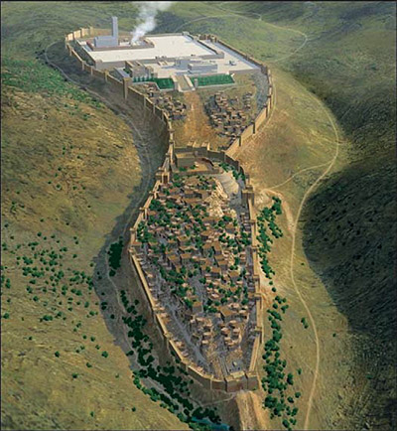
Temple Site
Website

Slide 97
Samuel/Kings vs. Chronicles
267a
What's Missing in Chronicles
but Included in Samuel/Kings?
What's Included in Chronicles
but Missing in Samuel/Kings?
These are generally negative elements or related to Israel and royalty.
These are generally positive elements or related to Judah and the temple.
Michal despises David at ark
(2 Sam. 6:20b-23)
Levites honor God at ark
(1 Chron. 16:4-42)
Discipline aspects of the Davidic covenant (2 Sam. 7:14b)
Identification of the temple site even as God disciplines David's prideful census
(1 Chron. 21:27–22:1; cp. 2 Sam. 24:25)
David's adultery with Bathsheba, murder of Uriah, & confrontation by Nathan the prophet (2 Sam. 11:2–12:25)
Divisions of Levites (1 Chron. 22–27)
David's troubles with Absalom
(2 Sam. 13–19)
David's charge to Israel & Solomon & prayer (1 Chron. 28:1–29:22a)
Sheba's rebellion put down
(2 Sam. 20)
Enterprises of Rehoboam
(2 Chron. 11:5-23)

Slide 98
Slides on
1 Chronicles 22

Slide 99
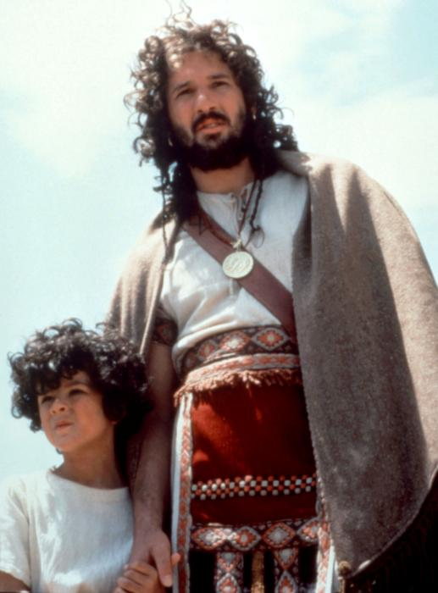
David & Solomon

Slide 100
Samuel/Kings vs. Chronicles
267a
The execution of the Saulites
(1 Sam. 21:1-14)
Abijam of Judah defeats Jeroboam of Israel by honoring temple (2 Chron. 13:3-21)
Adonijah's rebellion against his father David (1 Kings 1)
Revivals under 6 kings of Judah,
all "sons" of David
David's charge to Solomon to avenge his opposers (1 Kings 2:1–9)
David's charge to Solomon to build the temple (1 Chron. 22:2-19)
Negative information on the kings of Israel (e.g., 1 Kings 13:1–14:20 on Jeroboam;
1 Kings 15:25–21:29 on others)
Positive details about kings of Judah: Asa (1 Chron. 14:6–15:15), Jehoshaphat (2 Chron. 17:1-19), Hezekiah (2 Chron. 32:27-30), etc.
Stories of Elijah (1 Kings 15:25–21:29) and Elisha (2 Kings 2:1–8:15; 13:14-25) since
they ministered primarily in Israel
God's discipline by plague and enemy invasions upon Joram of Judah for his evil ways (1 Chron. 21:11-20)
Negative events after Judah's fall
(2 Kings 25)
Renewal of Passover (2 Chron. 30) & other reforms of worship (2 Chron. 31)
The 2 falls of Israel (2 Kings 17:1-41 & 17:5-6; 18:9-12)
The end of Judah's exile (2 Chron. 36:22-23)

Slide 101
Slides on
1 Chronicles 23

Slide 102
Samuel/Kings vs. Chronicles
267a
What's Missing in Chronicles
but Included in Samuel/Kings?
What's Included in Chronicles
but Missing in Samuel/Kings?
These are generally negative elements or related to Israel and royalty.
These are generally positive elements or related to Judah and the temple.
Michal despises David at ark
(2 Sam. 6:20b-23)
Levites honor God at ark
(1 Chron. 16:4-42)
Discipline aspects of the Davidic covenant (2 Sam. 7:14b)
Identification of the temple site even as God disciplines David's prideful census
(1 Chron. 21:27–22:1; cp. 2 Sam. 24:25)
David's adultery with Bathsheba, murder of Uriah, & confrontation by Nathan the prophet (2 Sam. 11:2–12:25)
Divisions of Levites (1 Chron. 22–27)
David's troubles with Absalom
(2 Sam. 13–19)
David's charge to Israel & Solomon & prayer (1 Chron. 28:1–29:22a)
Sheba's rebellion put down
(2 Sam. 20)
Enterprises of Rehoboam
(2 Chron. 11:5-23)

Slide 103
Slides on
1 Chronicles 24

Slide 104
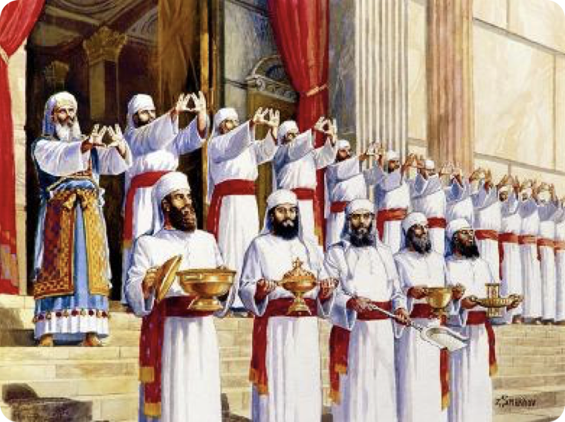
The priests became 24 divisions to offer sacrifices before the LORD in two-week rotations each year
1 Chronicles 24
Notes:
Restatement

Slide 105
Slides on
1 Chronicles 25

Slide 106
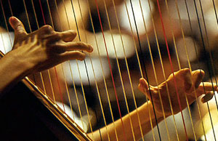
David organized the musicians
1 Chronicles 25
Notes:
Restatement

Slide 107
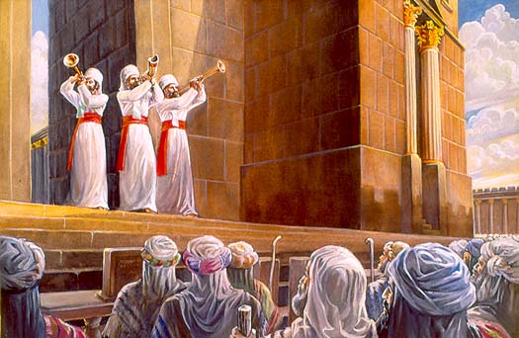
The musicians were organized into instrumentalists and singers to offer praise to the LORD in the ministry of prophesying (1 Chron 25).
Notes:
Restatement

Slide 108
Slides on
1 Chronicles 26

Slide 109
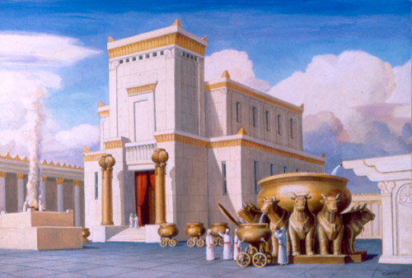
The temple officers were organized into gatekeepers, treasurers, and administrators for smooth functioning of the temple (1 Chron 26).
Notes:
Restatement

Slide 110
Slides on
1 Chronicles 27

Slide 111
Samuel/Kings vs. Chronicles
267a
What's Missing in Chronicles
but Included in Samuel/Kings?
What's Included in Chronicles
but Missing in Samuel/Kings?
These are generally negative elements or related to Israel and royalty.
These are generally positive elements or related to Judah and the temple.
Michal despises David at ark
(2 Sam. 6:20b-23)
Levites honor God at ark
(1 Chron. 16:4-42)
Discipline aspects of the Davidic covenant (2 Sam. 7:14b)
Identification of the temple site even as God disciplines David's prideful census
(1 Chron. 21:27–22:1; cp. 2 Sam. 24:25)
David's adultery with Bathsheba, murder of Uriah, & confrontation by Nathan the prophet (2 Sam. 11:2–12:25)
Divisions of Levites (1 Chron. 22–27)
David's troubles with Absalom
(2 Sam. 13–19)
David's charge to Israel & Solomon & prayer (1 Chron. 28:1–29:22a)
Sheba's rebellion put down
(2 Sam. 20)
Enterprises of Rehoboam
(2 Chron. 11:5-23)

Slide 112
Slides on
1 Chronicles 28

Slide 113
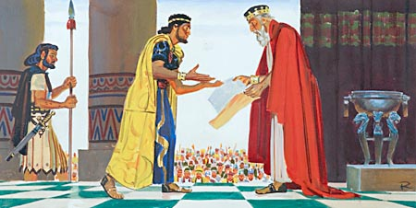
"Then David gave Solomon the plans for the Temple and its surroundings, including the entry room, the storerooms, the upstairs rooms, the inner rooms, and the inner sanctuary—which was the place of atonement. ¹²David also gave Solomon all the plans he had in mind for the courtyards of the Lord’s Temple, the outside rooms, the treasuries, and the rooms for the gifts dedicated to the LORD" (28:11-12)
Notes:
Restatement

Slide 114
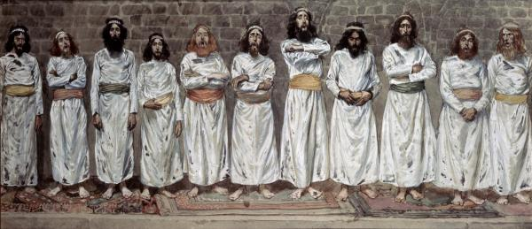
David commissioned Israel and Solomon to follow God’s design for the temple building and service by Levites and priests (1 Chron 28).
The Choristers, by James Tissot, 1896-1900
Notes:
Restatement

Slide 115
Slides on
1 Chronicles 29

Slide 116
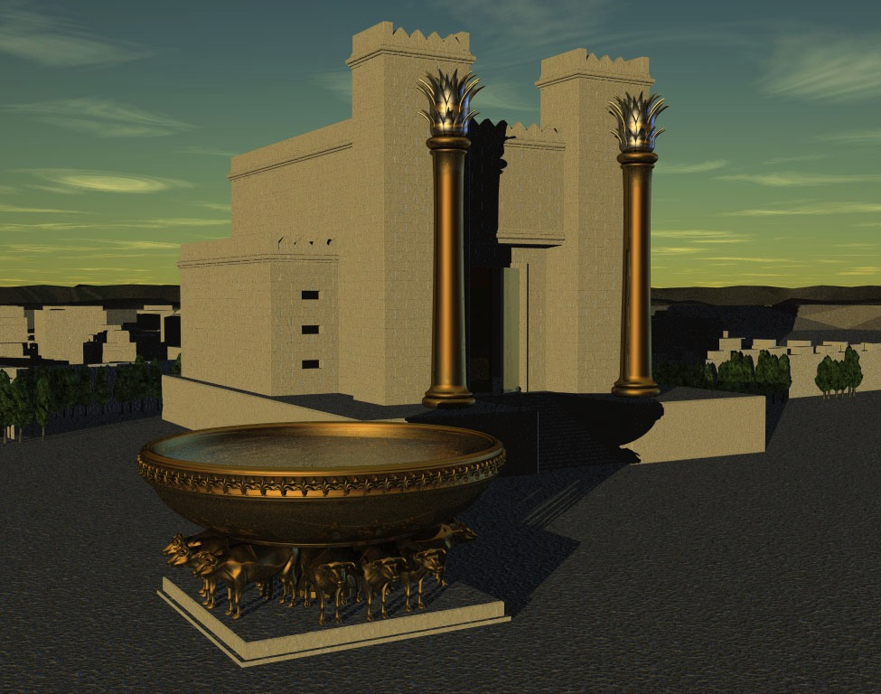
Book Chart
1 Chronicles
262
David's Line Established
David's Line
David's Concern (Ark / Temple)
Chapters 1–9
Chapters 10–29
Genealogy
History
Ancestry
Activity
Saul's Throne to David
David's Throne to Solomon
4143-1011 BC (3132 years)
1011–971 BC (40 years)
Davidic Line
1–3
Tribal
Lines
4–8
Priests /
Levites
9:1-34
Saul's Line
9:35-44
Accession to Throne
10–12
Respect for Ark
13–17
Military Victories
18–20
Temple Prep.
21–29

Slide 117
Summary Statement
262
The spiritual perspective on the establishment of David's kingdom is given to encourage the remnant with God's
establishment of the Davidic line
and to admonish them to
proper temple worship —
not the idolatry of the past.

Slide 118
I. God established David’s kingdom to promote temple worship over idolatry.
Notes:
The LORD exalted David because David exalted God.

Slide 119
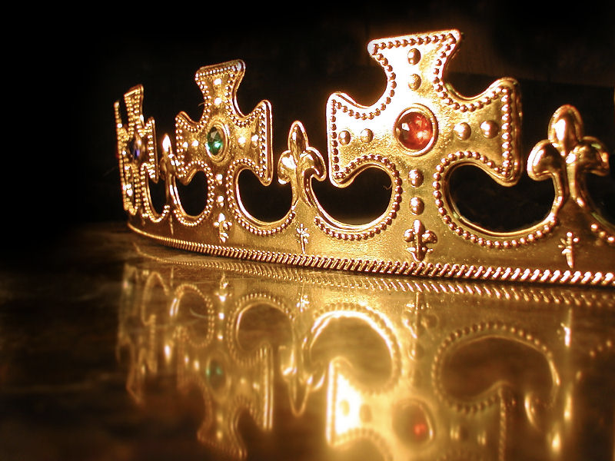
II. Be established by worshipping Jesus as David’s heir.
Notes:
Restatement

Slide 120
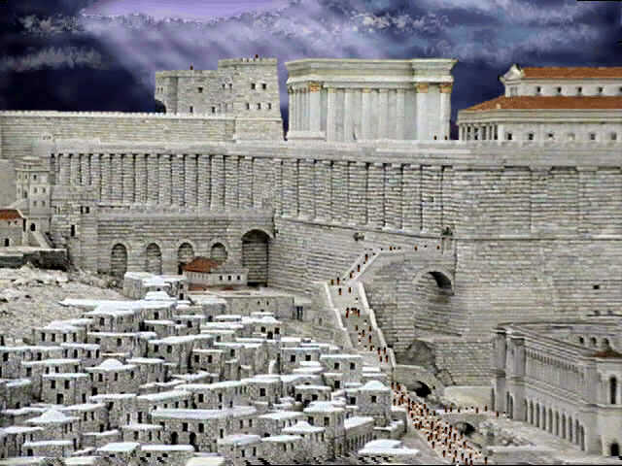
That temple was glorious
Notes:
Restatement

Slide 121
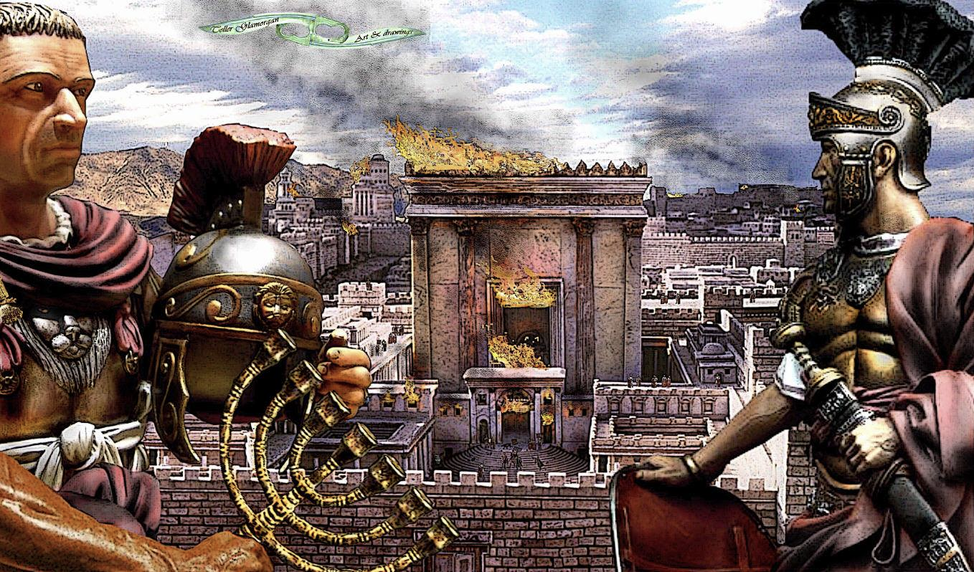
But what about that temple?
Notes:
Restatement

Slide 122
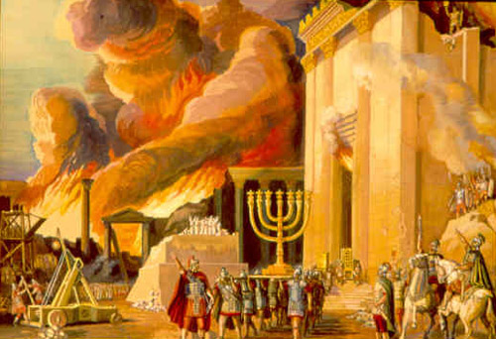
Even the temple rebuilt near the time of Chronicles was later destroyed—so what about temple worship now?
Notes:
Restatement

Slide 123


Matthew 21:12-17
Mark 11:15-19
Luke 19:45-48
John 2:13-24
THE EASTER STORY
CLEANSING THE TEMPLE
Free
Bible
images

Slide 124

It was nearly time for the Jewish Passover celebration, so Jesus went to Jerusalem.

Slide 125

In the Temple area he saw merchants selling cattle, sheep, and doves for sacrifices.

Slide 126

He also saw dealers at tables exchanging foreign money.

Slide 127


Slide 128

Jesus made a whip from some ropes and chased them all out of the Temple.

Slide 129
He drove out the sheep and cattle, scattered the money changers’ coins over the floor

Slide 130

and turned over their tables.

Slide 131

Then, going over to the people who sold doves, he told them...

Slide 132

“Get these things out of here. Stop turning my Father’s house into a marketplace!”

Slide 133

Then his disciples remembered this prophecy from the Scriptures: “Passion for God’s house will consume me.”

Slide 134


Slide 135

But the Jewish leaders demanded, “What are you doing? If God gave you authority to do this, show us a miraculous sign to prove it.”

Slide 136

“All right,” Jesus replied. “Destroy this temple, and in three days I will raise it up.”

Slide 137

“What!” they exclaimed. “It has taken forty-six years to build this Temple, and you can rebuild it in three days?”

Slide 138

But when Jesus said “this temple,” he meant his own body.

Slide 139

After he was raised from the dead, his disciples remembered he had said this, and they believed both the Scriptures and what Jesus had said.

Slide 140

THE WORD IN PICTURES
Free
Bible
images

Slide 141

Used with Permission
THE
GOSPEL
——OF—— MATTHEW
THE
GOSPEL
——OF—— MARK
THE
GOSPEL
——OF—— LUKE
THE
GOSPEL
——OF—— JOHN
Due to the Lumo Project producing its own publishing material we regret to inform you that we cannot license our photos to other clients outside of freebibleimages.org.
These images are not licensed for reuse in video, epublishing or other media. Downloaded pictures and files cannot be redistributed through any other website than freebibleimages.org or used in any context where the accompanying message is undermining of the Christian faith and gospel.
Photos can only be used on educational presentations, blogs and social media, all of which should be accompanied with reference to www.LumoProject.com.
Picture courtesy of BBM
© All Rights Reserved.
www.bigbookmedia.com

Slide 142

"Don’t you realize that your body is the temple of the Holy Spirit, who lives in you and was given to you by God? You do not belong to yourself, ²⁰ for God bought you with a high price. So you must honor God with your body"
(1 Cor 6:19-20 NLT).

Slide 143
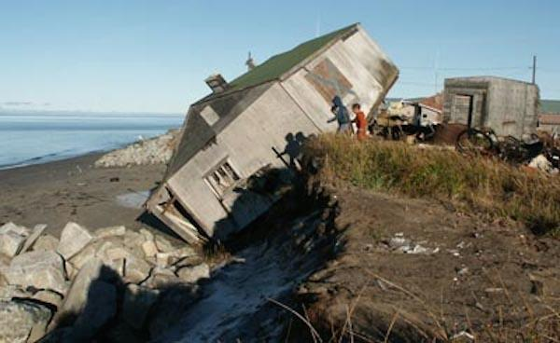
How can you be firmly established in a shaky world?
Notes:
Restatement

Slide 144
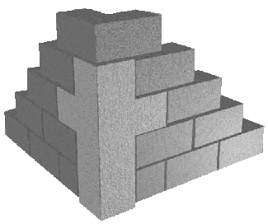
Main Idea
Be established with Christ as your foundation.
Notes:
Restatement

Slide 145
I. God established David’s kingdom to promote temple worship over idolatry.
Notes:
The LORD exalted David because David exalted God.

Slide 146
II. Be established by worshipping Jesus as David’s heir.
Notes:
Restatement

Slide 147
1 Corinthians 3:11
"For no one can lay any foundation other than the one we already have—Jesus Christ."

Slide 148

How's yours?
Notes:
Text

Slide 149
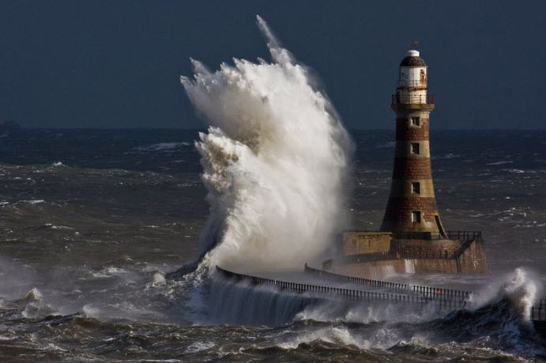
Firm Foundation

Slide 150

Firm Foundation

Slide 151

Be Established

Slide 152

Firm Foundation

Slide 153

Firm Foundation

Slide 154

Be Established

Slide 155

GOD'S WORD
A FIRM FOUNDATION

Slide 156

Build on Your Foundation
Notes:
Restatement

Slide 157
Black

Slide 158


OT Preaching link at BibleStudyDownloads.org
Get this presentation and script for free!

