Slide 1
NOTE TO STUDENTS:
THIS IS THE SET OF STUDY HELPS FOR REPRODUCTION AND USE ALONG WITH THE POWERPOINT PRESENTATION.
POWERPOINT SLIDES INDICATE THE APPROPRIATE STUDY HELP TO BE USED AT EACH POINT OF THE SEMINAR AS INDICATED IN THE UPPER RIGHT HAND CORNER OF EACH STUDY HELP PAGE.
LOCAL REPRODUCTION MUST INCLUDE THE COPYRIGHT NOTATION ON EACH PAGE WHERE APPLICABLE.
PLEASE NOTE: STUDY GUIDES NUMBERS
09/09a & 26/26a
ARE BACK-TO-BACK PAGES.
55
Notes:
Print page 61

Slide 2
FOR YOUR NOTES, THOUGHTS & IDEAS
56

Slide 3
Appendix of Study Helps
Here is your set of Study Helps that we’ll use during the seminar.
You are encouraged to fill in ALL the blanks as you follow along, even though clean copies of several are also provided. The learning result will be absolutely beneficial toward the goals of the seminar and your participation.
Thanks for being here! The Word teaches that Our Lord will bless your work. When you leave you should have a refreshed view of the credibility, rationale, coherence, logical organization and incomparable spiritual value of His matchless Word.
As a witnessing tool, you will be freshly equipped to present God’s Word to all who ask of you, “What do you believe? Tell me Why!”
THE BIBLE…BASICALLY MINISTRIES INT’L INC. Multiplying Biblical Literacy Throughout The Body of Christ
Ft. Worth, Texas www.biblebasically.org
57

Slide 4
FOR YOUR NOTES, THOUGHTS & IDEAS
58

Slide 5
_{STUDY HELPS INDEX}
PART ONE
01 The C7SJ Worksheet: “It all starts here.”
02 The C7SJ Quiz Sheet
03 Dressing the Biblical Stage: Blank
04 Indexing “The Bible File:” Blank
05 The “Silent Period:” Between Malachi and Matthew
06 The “Silent Period:” Great Crucial Accomplishments
07 The “Thistle Route” of Jesus’ Travels
08 Weaving A Fabric of the Bible’s Chronology
09 THE QUICK CHRONOLOGY Flash Card Set
10 Concerning the Word “SIN”
11 The Glorious Names of God
12 Four Interchangeable Words
13 Covenant Relationships in Ancient Times
14 The Genesis Promises to Abraham: Blank
15 The Mosaic Covenant: The Temporary Arrangement
16 The Genealogy of Jesus Christ
17 Statistical Probabilities of the Birth and Life of Jesus Christ
18 The “Opened” Bible: Blank
19 Lining Up the Old Testament Books: Blank
20 Lining Up the New Testament Books: Blank
21 A Finished Portrait of The Lord Jesus Christ
22 The Gospel of John: The Gospel Set Apart
23 The Acts of the Apostles: A Drama in Three Parts
24 Paul: His Journeys At A Glance: Blank
Two of Paul’s Key Theological Concepts
26 Main Themes of “The Letters” (with 26a)
The Revelation: Five Anchor Points
The Bible’s Consummate Objective: Jesus Christ
29 Completed Forms Introduction
30 Dressing the Stage: Completed
31 Indexing “The Bible File:” Completed
32 The Genesis Promises to Abraham: Completed
33 The “Opened” Bible: Completed
34 Lining Up the Old Testament Books: Completed
35 Lining Up the New Testament Books: Completed
36 Paul: His Journeys at a Glance: Completed
PART TWO
PART THREE
PART FOUR
PART FIVE
PART SIX
PART SEVEN
PART EIGHT
COMPLETED HELPS SECTION
59

Slide 6
FOR YOUR NOTES, THOUGHTS & IDEAS

Slide 7
01
It all starts here…
C
7
S
J
JESUS
4 People:
A
J
M
J
3 Societies:
A
R
C
YOUR MENTAL BIBLE FILE!

Slide 8
FOR YOUR NOTES, THOUGHTS & IDEAS

Slide 9
02
Now…try your hand at opening your mental Bible File, either by yourself or by drilling or quizzing someone else.
The key to opening your Bible file is:
C 7 S J
The letter “C” stands for:
CREATION
7 = 4+3 breaks out into:
4 PEOPLE & 3 SOCIETIES
The FOUR PEOPLE are:
ABRAHAM JOSEPH MOSES JOSHUA
Then…call out the group, leaving out one. Answer is ?
The THREE SOCIETIES are:
ANARCHY ROYALTY CAPTIVITY
Also…call out the group, leaving out one. Answer is ?
CREATION
The letter “S” stands for:
SILENCE
ABRAHAM
JOSEPH
The letter “J” stands for:
JESUS
MOSES
Therefore, the ten words… and your ten file folder labels… are:
JOSHUA
YOUR MENTAL BIBLE FILE!
ANARCHY
ROYALTY
CAPTIVITY
SILENCE
JESUS

Slide 10
FOR YOUR NOTES, THOUGHTS & IDEAS

Slide 11
03A
DRESSING THE BIBLICAL STAGE
(This page intentionally blank for map drawing during seminar.)

Slide 12
FOR YOUR NOTES, THOUGHTS & IDEAS

Slide 13
03B
DRESSING THE BIBLICAL STAGE
(This page intentionally blank for map drawing during seminar.)

Slide 14
FOR YOUR NOTES, THOUGHTS & IDEAS

Slide 15


04
INDEXING “THE BIBLE FILES”
CREATION
(___________)
ANARCHY
C
7
S J
C
ROYALTY
zz
(_____________)
ABRAHAM
(____________)
JOSEPH
CAPTIVITY
MOSES
(_______________)
SILENCE
S
(____________)
JESUS
J
JOSHUA
THIS PAGE, INCLUDING THE COPYRIGHT NOTICE, MAY BE REPRODUCED LOCALLY FOR STUDY AND TEACHING PURPOSES.

Slide 16
FOR YOUR NOTES, THOUGHTS & IDEAS

Slide 17
05
The “Silent” Period
BETWEEN MALACHI AND MATTHEW
Alexander died...at age ____...in the 300s B.C.
His empire was divided among his four __________.
GREECE:
ASIA MINOR:
Cassander
Lysimachus
SYRIA:
The Seleucid Emperors
_______
MEDITERRANEAN SEA
“The ______ of the Earth!
PALESTINE
EGYPT
The Ptolemaic Pharaohs
______
AND THEN… DURING THE TIME OF _________:
THE ERA OF ________________________________:
GOVERNMENT ADMINISTRATION
USE OF GEARS...WATERWHEEL
TRIGONOMETRY DEVELOPED
WATER CLOCK
ROSETTA STONE INSCRIBED
ALEXANDRIA : COLLEGE OF TECHNOLOGY
ROMAN BANKING SYSTEM
NEW CONSTRUCTION METHODS
WATER/SEWER SYSTEMS; CONCRETE
STOCK MARKETS
EMPIRE-WIDE HIGHWAY SYSTEM
365-DAY YEAR ADOPTED
PAX ROMANA
ROMAN-OCCUPIED PALESTINE
ARISTOTLE: ALEXANDER’S TEACHER
ARISTOTLE: MUSIC THEORY
GREAT WALL OF CHINA
IRON USED IN CHINA
ALEXANDRIA: CENTER OF GREEK LEARNING
EUCLID: STANDARD WORK IN GEOMETRY
FIRST ROMAN COINS
CORINTH BECOMES TRADING CENTER
JEWISH TRADING CENTERS IN EGYPT
HELLENISM: GREEK-STYLE CITIES GREEK-STYLE LIVING

Slide 18
FOR YOUR NOTES, THOUGHTS & IDEAS

Slide 19
06
The “Silent” Period
BETWEEN MALACHI AND MATTHEW
THESE GREAT CRUCIAL ACCOMPLISHMENTS:
SCRIPTURAL:
1. The ______ ______ (Old Testament) was completed.
2. The Old Testament was translated into _________. (The Septuagint -- “LXX” in the reference books)
HISTORICAL:
3. ___________ _____ ________ spread Hellenism throughout his conquered lands.
4. Palestine came under the ________: a time of high _________ and cruel _______ in the Known World (The Pax Romana)
…THUS SETTING THE STAGE FOR THE CULMINATION OF GOD’S GREAT PROMISE TO ABRAHAM…THE APPEARANCE OF THE MESSIAH, THE LORD JESUS CHRIST!

Slide 20
FOR YOUR NOTES, THOUGHTS & IDEAS

Slide 21

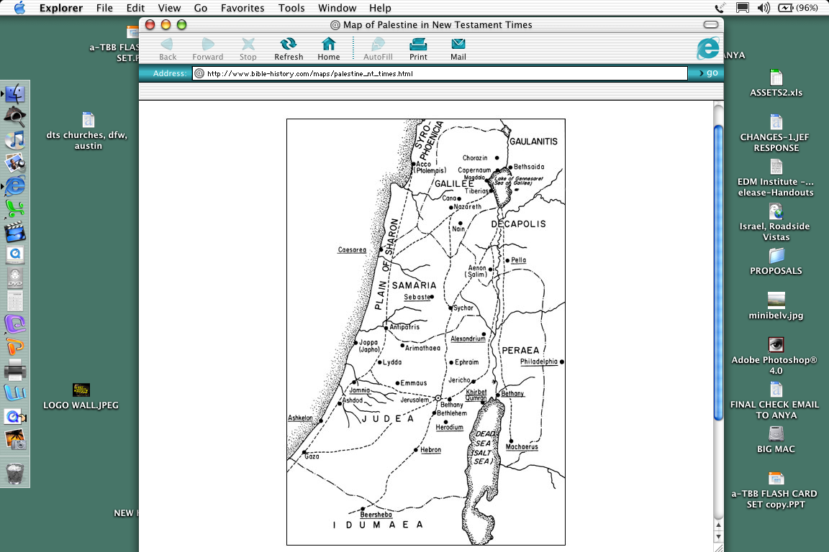
07
The “Thistle Route” of Jesus’ Travels
THE GREAT GALILEAN MINISTRY AT _____________
3
CAPERNAUM
GALILEE
4
2
SAMARIA
THE _________ MINISTRY
THE ______________ TRANSIT
5
1
THE FINAL ____________ MINISTRY
THE LORD’S MINISTRY BEGINS AT ____________
’
JERUSALEM
’
’
JUDAEA

Slide 22
FOR YOUR NOTES, THOUGHTS & IDEAS

Slide 23
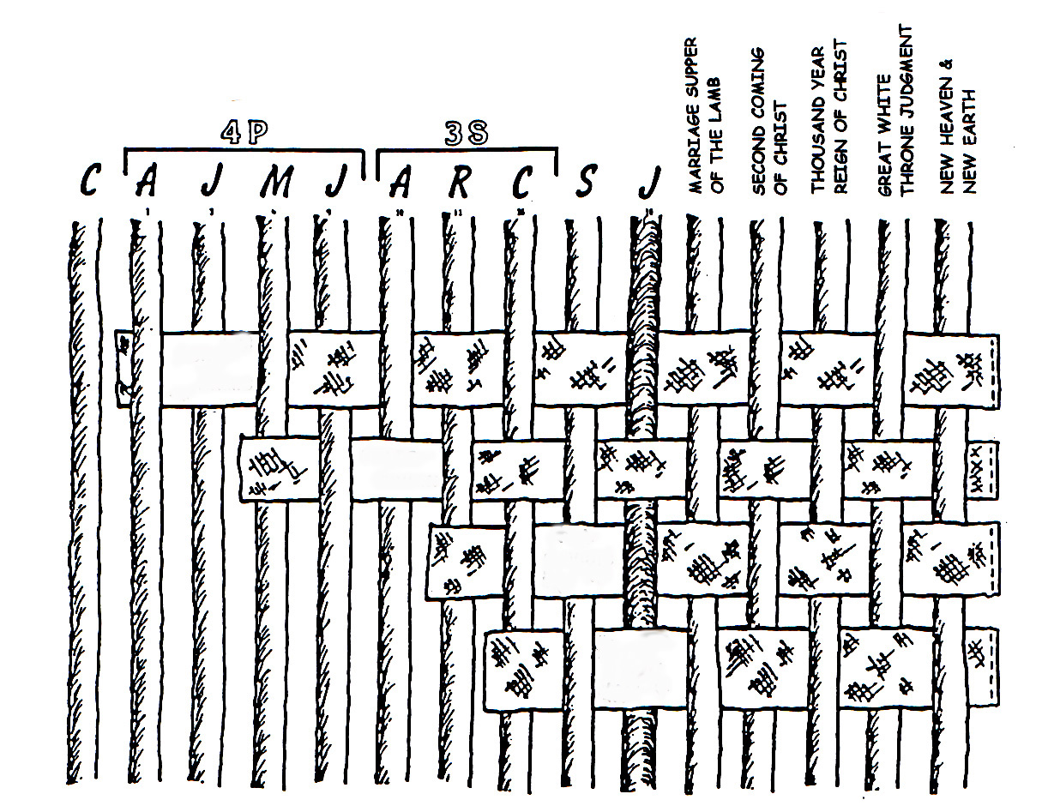
08
Weaving a Mental Fabric of the Chronology and Story Line of the Bible
C 7 S J
ABRA-HAMIC COVENANT
LAND COVENANT
DAVIDIC COVENANT
NEW COVENANT
The biblical story line progresses as the promises to Abraham realized:
•The Abrahamic Call and Covenant of Genesis 12 and 15,
•The Land (Palestinian) Covenant of Deuteronomy 30,
•The Davidic Covenant of 2 Sam. 7 and
•The New Covenant of Jeremiah 31.

Slide 24
FOR YOUR NOTES, THOUGHTS & IDEAS

Slide 25
09
TQC FLASH CARDS
This is a front-and-back printed page. Cut along the dashed lines to produce a series of small flash cards for drilling on the individual contents of each “Bible File” folder.
_________
_____ B.C.
_____ B.C.
_____ B.C.
DATE ERA
DATE ERA
DATE ERA
DATE ERA
DATE ERA
____ B.C.
MOSES
CREATION
ABRAHAM
JOSEPH
JOSHUA
The Bible…Basically
The Bible…Basically
The Bible…Basically
The Bible…Basically
The Bible…Basically
®
®
®
®
®
____ B.C.
DATE ERA
____ B.C.
____ B.C.
____ B.C.
_______
_______
DATE ERA
DATE ERA
DATE ERA
DATE ERA
ROYALTY
JESUS
ANARCHY
CAPTIVITY
SILENCE
The Bible…Basically
The Bible…Basically
The Bible…Basically
The Bible…Basically
The Bible…Basically
®
®
®
®
®
QUESTION SIDE

Slide 26
09
TQC FLASH CARDS
This is a front-and-back printed page. Cut along the dashed lines on the other side to produce a series of small flash cards for drilling on the individual contents of each “Bible File” folder.
DATE ERA
DATE ERA
2000 B.C.
2000 B.C.
1500 B.C.
1500 B.C.
DATE ERA
DATE ERA
DATE ERA
ALL TIME PRE- ABRAHAM
MOSES
Exodus
AC
CREATION
Sinai
1st Man & Woman
JOSHUA
M - C - C
JOSEPH
ABRAHAM
1st Sin
Jericho/Ai
Kadesh Barnea
Slavery
The CALL
1st Gospel
Land Divided
40
430
L - S - B
1st Family
5 Sermons
I - I
1st Murder
J - E
Flood/Rainbow
LC
12
Tower
DATE ERA
500 B.C.
500 B.C.
1000 B.C.
DATE ERA
DATE ERA
DATE ERA
1000 B.C.
FIRST CENTURY
NC
DATE ERA
DC
JESUS
ROYALTY
Life
S - D - S
Cross
SILENCE
CAPTIVITY
••• SPLIT •••
ANARCHY
Church
Alex the Greek
70 Years
North South
Judges
Gospels
Roman Systems
3 Treks
Israel Judah
350
Acts
100 Years / 50,000
10 2
Epistles
Z - E - N
THE PROPHETS
Revelation
20-J 20-R
200 350
Assyria Babylon
ANSWER SIDE

Slide 27
10
The “Backbone” of Biblical Revelation:
God’s Unconditional Covenantal Program
Concerning the Word “_____”
In both Hebrew and Greek: The English Word “SIN” means variously: misbehavior, iniquity, transgression, wickedness,trespass, and evil.
But also…
“SIN” = “ __ ____ ___ _____”
“…for all have sinned and fall short of the glory of God.” Rom 3:23

Slide 28
FOR YOUR NOTES, THOUGHTS & IDEAS

Slide 29
11
THE __________ ________ OF GOD!
ABBA…ADVOCATE…ALMIGHTY…ALPHA…AMEN…ANCIENT OF DAYS…ANOINTED ONE…APOSTLE AND HIGH PRIEST…ARM OF THE LORDAUTHOR OF LIFE…AUTHOROF OUR FAITH…BEGINNING AND THE END…BLESSED AND ONLY RULER…BRANCH…BREAD OF LIFE…BREAD OF GOD…BRIDE GROOM…BRIGHT MORNING STAR…CHIEF SHEPHERD… CHOSEN ONE…CHRIST…CHRIST OF GOD…CHRIST THE LORD…CHRIST THE SON OF THE LIVING GOD…COMFORTER…COMMANDER…CONSOLATION OF ISRAEL…CONSUMING FIRE…CORNER STONE…COUNSELOR… CREATOR…DELIVERER…. DESIRED OF ALL NATIONS… DOOR…EL SHADDAI…ETERNAL GOD… EVERLASTING FATHER…EXACT REPRESENTATION OF HIS BEING… FAITHFUL AND TRUE…FAITHFUL WITNESS…FATHER…FIRSTBORN OVER ALL CREATION…. FIRST FRUITS… FOUNDATION…FRIEND OF TAX COLLECTORS AND SINNERS… GENTLE WHISPER…GIFT OF GOD…GLORY OF THE LORD…GOD…GOD ALMIGHTY…GOD OVER ALL…GOD WHO SEES ME…GOOD SHEPHERD…GREAT HIGH PRIEST…GREAT SHEPHERD… GUIDE…HEAD OF THE BODY…HEAD OF THE CHURCH…HEIR OF ALL THINGS…HIGH PRIEST FOREVER…HOLY ONE…HOLY ONE OF ISRAEL…HOLY SPIRIT…HOPE …HORN OF SALVATION… I AM…IMAGE OF GOD…IMAGE OF HIS PERSON…IMMANUEL…JEHOVAH…
JESUS…
JESUS CHRIST OUR LORD…JUDGE…KING…KING ETERNAL…KING OF KINGS…KING OF THE AGES…LAMB OF GOD…LAST ADAM…LAW GIVER…LEADER… LIFE…LIGHT OF THE WORLD…LIKE AN EAGLE…LILY OF THE VALLEY…LION OF THE TRIBE OF JUDAH…LIVING STONE…LIVING WATER…LORD…LORD GOD ALMIGHTY…LORD JESUS CHRIST…LORD OF ALL…LORD OF GLORY…LORD OF LORDS…LORD OUR RIGHTEOUSNESS…LOVE…MAN OF SORROWS…MASTER… MEDIATOR…MERCIFUL GOD…NAZARENE…OFFSPRING OF DAVID…OMEGA…ONLY BEGOTTEN SON…OUR PASSOVER LAMB…OUR PEACE…POTTER…
POWER OF GOD…PRINCE OF PEACE… PROPHET…PURIFIER…RABBONI [TEACHER]… RADIANCE OF GOD’S GLORY…REDEEMER…REFINER’S FIRE…RESURRECTION AND THE LIFE…RIGHTEOUS ONE…ROCK…ROOT OF DAVID…ROSE OF SHARON…RULER OF GOD’S CREATION…RULER OF THE KINGS OF THE EARTH…RULER OVER ISRAEL…SAVIOR… SCEPTER OUT OF ISRAEL…SEED…SERVANT…SHEPHERD AND OVERSEER OF YOUR SOULS…SHIELD…SON OF DAVID…SON OF GOD…STAR OUT OF JACOB…STONE…SON OF RIGHTEOUSNESS… TEACHER…TRUE LIGHT…TRUTH…VINE…WISDOM OF GOD… WONDERFUL COUNSELOR…WORD…WORD OF GOD.
From: Mary Foxwell Loeks,
The Glorious Names of God,
Baker Book House, 1986
DO WE – OR DO WE NOT – MISS THE MARK?

Slide 30
FOR YOUR NOTES, THOUGHTS & IDEAS

Slide 31
12
God’s Unconditional Covenantal Program: The “Backbone” of Biblical Revelation
Consider this remarkable interchangeability of some word meanings across BOTH Testaments:
THE OLD TESTAMENT
THE NEW TESTAMENT
____
___________
___________
___________

Slide 32
FOR YOUR NOTES, THOUGHTS & IDEAS

Slide 33
13
COVENANT RELATIONSHIPS IN THE ANCIENT TIMES…AN INCREASING COMMITMENT TO PERMANENCE!
THE _______ COVENANT: Similar to the handshake of today; either shaking hands or striking palms; very temporary.
THE ___________ COVENANT: The two parties exchange sandals; symbolic of the fact that the covenant is in effect until the sandals are returned to each owner.
THE ________ COVENANT: Often, each party carried a small pouch of precious salt. Upon mutual agreement, each person placed a small pinch of salt in the other’s pouch, symbolizing that the covenant agreement could only be broken if the exact grains of salt were returned to the original owner.
THE _______ COVENANT: The party that broke the covenant would have the same thing done to them as to the slaughtered animal(s) - it carried the death penalty. The animal's death also represented the permanency of the terms of the covenant. The agreement was in effect until the death of one of the parties.
Source: J. Dwight Pentecost, Thy Kingdom Come

Slide 34
FOR YOUR NOTES, THOUGHTS & IDEAS

Slide 35
14
THE GENESIS PROMISES TO ABRAHAM: The Very “Backbone” of Biblical Revelation
The _______ to Abraham Gen. 12:1-3
ABRAHAMIC COVENANT
The __________ Gen. 15:9-18
Overarching Characteristics of the Abrahamic Covenant
Gen. 13:15
Gen. 13:14-16
Gen. 15:9-18
__________
Gen. 12:2
Gen. 12:3
Gen. 12:1
Gen. ___:___
Covenant
Covenant
Covenant
Deut. 30:1-10
2 Sam. 7:14-16
Jer. 31:31-34
The Amplified Subcovenants
A FINISHED VERSION IS PROVIDED AS STUDY HELP NUMBER 32.

Slide 36
FOR YOUR NOTES, THOUGHTS & IDEAS

Slide 37
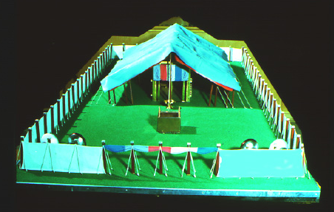
15
God’s Special Arrangement with Moses: “THE _____________ COVENANT”
M-C-C Temporary, Regulatory, Conditional
CHAPTER 20: THE __________________
_{“The Ten Commandments”}
Moral
The First Tablet -- Duties to God (Verses 1-12)
_{The Lord Your God}
_{No other gods before Him}
Idols or likenesses of Him prohibited
Worship of other gods prohibited
The Lord’s Name shall remain holy
The Sabbath Day shall remain holy
_{Six days only for work}
_{The Sabbath is a day for rest}
The Second Table -- Duties to Men (Verses 13-17)
_{Honor your parents}
_{Certain Acts Forbidden:}
_{Murder}
_{Adultery}
_{Stealing}
_{Lying}
Coveting other persons and things
CHAPTER 21-24: THE _________________ ORDINANCES
_{Personal rights}
_{Property rights}
Requirements for personal integrity
CHAPTERS 25-31: THE ________________ ORDINANCES
_{Its Ark, Table and Candlestick}
_{its general construction}
_{The Bronze Altar and the Court}
_{Its Priesthood}
Consecration of the Priesthood
The Altar of Incense and the worshippers
_{The workmen and the Sabbath}
Civil
Ceremonial

Slide 38
FOR YOUR NOTES, THOUGHTS & IDEAS

Slide 39
16
FROM ADAM TO CHRIST
THE GENEALOGY OF JESUS CHRIST
ADAM -- EVE
CAIN ABEL SETH
ENOSH
CAINAN
MAHALALEEL
JARED
ENOCH
METHUSELAH
LAMECH
NOAH
SHEM (HAM & JAPHETH)
ARPHAXAD
CAINAN
SHELAH
HEBER
PELEG
REU
SERUG
NAHOR
TERAH
ABRAHAM (SARAH)
ISAAC (REBEKAH)
JACOB
JOSEPH
Matthew 1:1-17
• THE ___________,
____________LINE
• Forward FROM Abraham
Son of David,
through Joseph
• A Revelation to the Jew
• The Legal Line
MARY
Luke 3:23-38
• THE _________ LINE
• Backward TO Adam
through Mary,
the Lineal Descent
• A Personal Genealogy,
through Mary
• A Seed of the House of David
(2 Sam. 7: 12, 13; Rom 1:3)
(ZILPAH)
(LEAH)
(RACHEL)
(BILHAH)
[ GAD, ASHER]
[REUBEN, SIMEON, LEVI, ISSACHAR, JUDAH, ZEBULON]
[JOSEPH, BENJAMIN]
[DAN, NAPHTALI]
NATHAN
MATTATHA
MENNA
MELEA
ELIAKIM
JONAM
JOSEPH
JUDAH
SIMEON
LEVI
MATTHAT
JORIM
ELIEZER
JOSHUA
ER
ELMADAM
COSAM
ADDI
MELCHI
NERI
SHEALTIEL
ZERUBBABEL
PEREZ
HEZRON
RAM
ADMIN
AMMINNADAB
NAHSHON
SALMON
BOAZ
OBED
JESSE
SOLOMON
REHOBOAM
ABIJAH
ASA
JEHOSHAPHAT
JORAM
UZZIAH
JOTHAM
AHAZ
HEZEKIAH
MANASSEH
AMON
JOSIAH
JECONIAH
HIS LINE CURSED;
SEE JER. 22: 24-30);
BLOODLINE ENDS
HERE; BUT LEGAL
LINE CONTINUES.
SHEALTIEL
ZERUBBABEL
RHESA
JOANAN
JODA
JOSECH
SEMEIN
MATTATHIAS
MAATH
NAGGAI
HESLI
NAHUM
AMOS
MATTATHIAS
JOSEPH
JANNAI
MELCHI
LEVI
MATTHAT
ELI
JOSEPH(Son-in-
MARY
DAVID
AND
BATHSHEBA
ABIUD
ELIAKIM
AZOR
ZADOK
ACHIM
ELIUD
ELEAZAR
MATTHAN
JACOB
JOSEPH
Law)
THE BLOOD LINE
THE LEGAL LINE
JESUS
THE CHRIST (CHRISTOS:”ANOINTED”) – THE SON OF GOD

Slide 40
FOR YOUR NOTES, THOUGHTS & IDEAS

Slide 41
17
JUST AN ACCIDENT OF BIRTH?
CONSIDER THE INCREDIBLE PROBABILITIES OF THE BIRTH AND LIFE OF JESUS CHRIST*
IN THE OLD TESTAMENT: MORE THAN 300 REFERENCES TO A COMING MESSIAH WERE FULFILLED UPON THE BIRTH, LIFE AND CRUCIFIXION OF JESUS CHRIST. WITH THAT SAID…
WHAT ARE THE CHANCES OF ONLY 8 PREDICTIONS BEING FULFILLED IN THE LIFE OF ANY ONE INDIVIDUAL BETWEEN THEN AND NOW?
ANSWER:ONE CHANCE IN 100 QUADRILLION (10 ¹⁷₎
_{1:100,000,000,000,000,000}
THEN…WITH JUST 48 (OF THE 300) PREDICTIONS BEING FULFILLED IN THE LIFE OF ANY ONE INDIVIDUAL BETWEEN THEN AND NOW:
_{ANSWER: one chance in 10}¹⁵⁷
1:10,000,000,000,000,000,000,000,000,000,000,000,000,000, 000,000,000,000,000,000,000,000,000,000,000,000,000,000, 000,000,000,000,000,000,000,000,000,000,000,000,000,000, 000, 000,000,000,000,000,000,000,000,000,000,000
THE BLOOD LINE (MARY)
JESUS
THE CHRIST (CHRISTOS: “ANOINTED”) THE SON OF GOD
THE LEGAL LINE (JOSEPH)
*Source: Josh MacDowell, Evidence That Demands A Verdict, 1972,
page 175; Peter Stoner, Science Speaks, Moody Press, 1963.
,

Slide 42
FOR YOUR NOTES, THOUGHTS & IDEAS

Slide 43
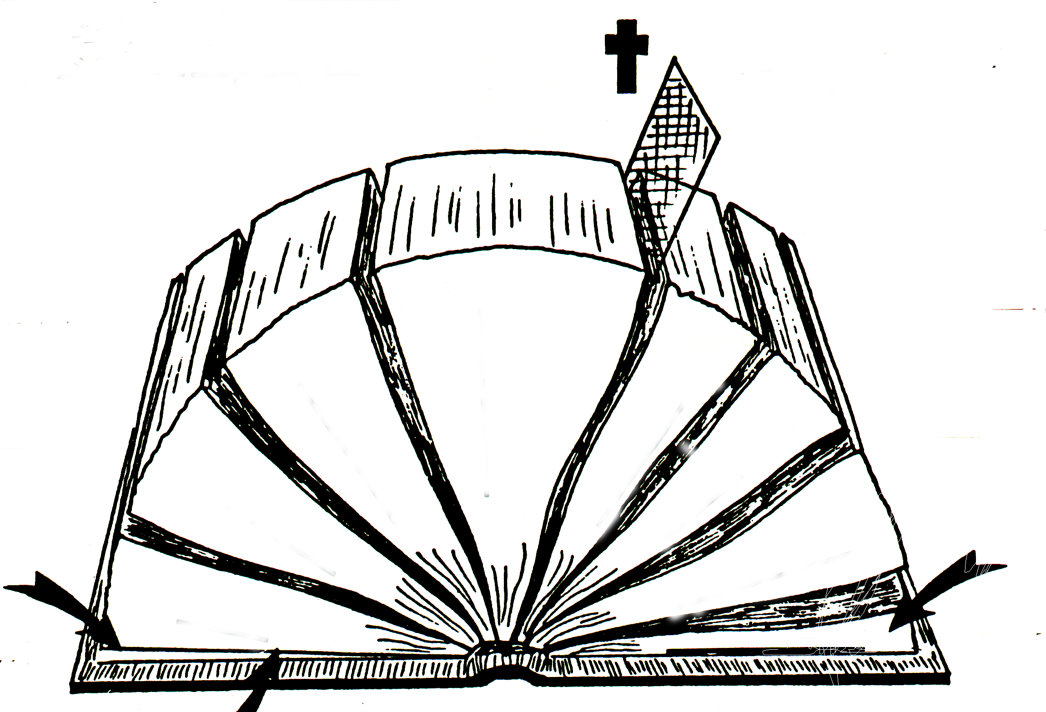
18
THE “OPENED” BIBLE
A
B
D(OT)
C
ONE THEME:
D(NT)
E(OT)
E(NT)
F(OT)
4
F(NT)
/
3
5
/
G(OT)
6
G(NT)
2
7
1
_{HISTORIES}
8
H(OT)
2
1
H(NT)
J
I(OT)
OLD & NEW TESTAMENT FUNCTIONAL PARALLELS: _________________ (1) and _________________(5) produce an historical fallout, the _________________(2) and the _________________(6); which show the development of a culture; which produces a body of writings; the _________________(3) and the _________________(7), leaving those two parts unique to our Bible, the _________________(4) and _________________(8).

Slide 44
FOR YOUR NOTES, THOUGHTS & IDEAS

Slide 45

Seminar Study Help Number
19
C 7 S J
“SETTING UP THE BOOKS:”
LINING UP THE OLD TESTAMENT
C
CREATION
1.
Approx Time Frame: All Time Prior to 2000 B.C.
Family Sin Flood Tower
ABRAHAM
circa:
2.
Approx Time Frame: 2000 B.C.
L-S-B Isaac Jacob 12 Sons
2.
ALL OTHER “WRITINGS” ARE FROM THE “ROYALTY” PERIOD
JOSEPH
THE LAW (5)
3.
Approx Time Frame: 2000 B.C.
Slavery 430
7.
4 PEOPLE
POETRY (5)
MOSES
7.
4.
Approx Time Frame: 1500 B.C.
Sinai M-C-C Kadesh 40 Years 5 Sermons
7.
7.
JOSHUA
5.
Approx Time Frame: 1500 B.C.
Jericho/Ai Land Divided
UNTANGLING THE PROPHETS:
TO ISRAEL (N. KINGDOM)
_{A}
ANARCHY
_{H}
6.
Approx Time Frame: 1000 B.C.
Judges 350 Years
_{J}
*
TO JUDAH (IN DECLINE)
_{I}
(S)
_{J}
THE HISTORIES (12)
_{M}
ROYALTY
3 SOCIETIES
7.
Approx Time Frame: 1000 B.C.
S-D-S SPLIT
(D)
}
_{O}
N:North 10 Tribes Israel 20-J 200 Assyria
S:South 2 Tribes Judah 20-R 350 Babylon
(S)
THE PROPHECIES (17)
*
(CW)
TO JUDAH (IN CRISIS)
_{J}
*
_{L}
( )
PROPHETS
WROTE IN
A FOUR-
HUNDRED
YEAR
ERA
AFTER
“THE
SPLIT”
_{H}
CAPTIVITY
_{N}
8.
Approx Time Frame: 500 B.C.
70 Years 2 Tribes 100 Years 50,000 People Z-E-N
_{Z}
*
TO JUDAH (IN CAPTIVITY)
_{E}
S
*
_{D}
SILENCE
9.
Approx Time Frame: 500 B.C.
Alex the Greek Roman Systems
©2006 John Fryman
TO JUDAH (IN RETURN)
_{H}
J
JESUS
NEW TESTAMENT GOSPELS…ACTS…EPISTLES…REVELATION
_{Z}
10.
Approx Time Frame: First Century A.D.
Life Cross Church
_{M}
A COMPLETED VERSION IS PROVIDED AS STUDY HELP NUMBER 34.

Slide 46
FOR YOUR NOTES, THOUGHTS & IDEAS

Slide 47
20
THE NEW TESTAMENT BOOKS IN ORDER
From “The Jesus File”…the New Testament covers about 100 years in the history of the Gospel and the Early Church. Long ago, the New Testament was organized into four main topics….
(4)
(1)
(21)
(1)
__________&___________
____________ ____________
____________ ____________
____________ ____________
THE GOSPELS:
Matthew*
Mark*
Luke*
John --------*Synoptic: “_______ ________”
ACTS OF THE APOSTLES
THE EPISTLES
Letters from Paul:
Romans 1 Corinthians 2 Corinthians
Galatians Ephesians Philippians Colossians
1 Thessalonians 2 Thessalonians 1 Timothy 2 Timothy Titus
Philemon
Letters from The Others:
Hebrews
James 1 Peter 2 Peter 1 John 2 John 3 John Jude
THE REVELA-TION
“Some _________ have ________.”
“_________
_________
_________
_________”
Church Treasurer’s Lament: “_________ ________ ________.”
“The end of Paul’s _________.”
In Jerusalem tonight, that ____________ television news crew… JAMES,
PETER,
JOHN
and
JUDE.
A FINISHED VERSION IS PROVIDED AS STUDY HELP NUMBER 35.

Slide 48
FOR YOUR NOTES, THOUGHTS & IDEAS

Slide 49

21
A FINISHED PORTRAIT OF THE LORD JESUS CHRIST
From the Gospel writers: their specific audiences… each writer’s unique presentation of the person of Jesus Christ…and a foundational purpose communicated in each Gospel… with the approximate dates of writing.
_{_________A.D.}
_{_________A.D.}
1
2
To:__________ As:__________ What He: ______
To:__________ As:__________ What He: _____
3
4
To:__________ As:__________ What He:_________
To:__________ As:__________ What He:_________
_{_________A.D.}
_{_________A.D.}

Slide 50
FOR YOUR NOTES, THOUGHTS & IDEAS

Slide 51
22
THE GOSPEL OF JOHN: WHAT SETS IT APART FROM THE SYNOPTICS?
4
JOHN
WE HAVE ONLY TO LOOK AT THE OPENING VERSES OF JOHN’S GOSPEL, CHAPTER ONE…
CHURCH
To:__________ As:__________ What He:_________
GOD
MEANT
THE _____ ________ _________ OF JESUS CHRIST!
• JESUS: The Pre-existent One (1:1)
• JESUS: A Person Distinct (1:1)
• JESUS: He Was and IS God (1:1)
• JESUS: Eternally Co-existent (1:2)
• JESUS: Creator of the Universe (1:3)
• JESUS: Source of all Light and Life (1:4,5,9)

Slide 52
FOR YOUR NOTES, THOUGHTS & IDEAS

Slide 53
23
AN AGELESS DRAMA IN 3 EPISODES: THE ACTS OF THE APOSTLES
1
2
3
4
5
6
7
Jesus’ Commission and Ascension
Pentecost: The Birthday of the Church
A Lame Man Healed
The First Persecution
Ananias and Sapphira
The First Deacons
Stephen and Martyrdom
IN ______________ Chs. 1-7
Part 1
IN _____________ & _____________ Chs. 8-12
8
9
10
11
12
Philip and the Eunuch
Saul’s Conversion on the Damascus Road
Peter and Cornelius
Peter Vindicates the Gentile Ministry
Herod Persecutes the Christians
Part 2
13
14
15
16
17
18
19
20
21
22
23
24
25
26
27
28
THE FIRST MISSIONARY JOURNEY
“
THE JERUSALEM COUNCIL
THE SECOND MISSIONARY JOURNEY
“
“
THE THIRD MISSIONARY JOURNEY
“
Paul: In Jerusalem
Paul: Defense Before the Multitudes
Paul: Defense Before The Sanhedrin
Paul: Defense Before Felix
Paul: Defense Before Festus
Paul: Defense Before King Agrippa
THE VOYAGE TO ROME: Shipwreck
Paul in Rome
INTO _____
_____________ Chs. 13-28
Part 3

Slide 54
FOR YOUR NOTES, THOUGHTS & IDEAS

Slide 55
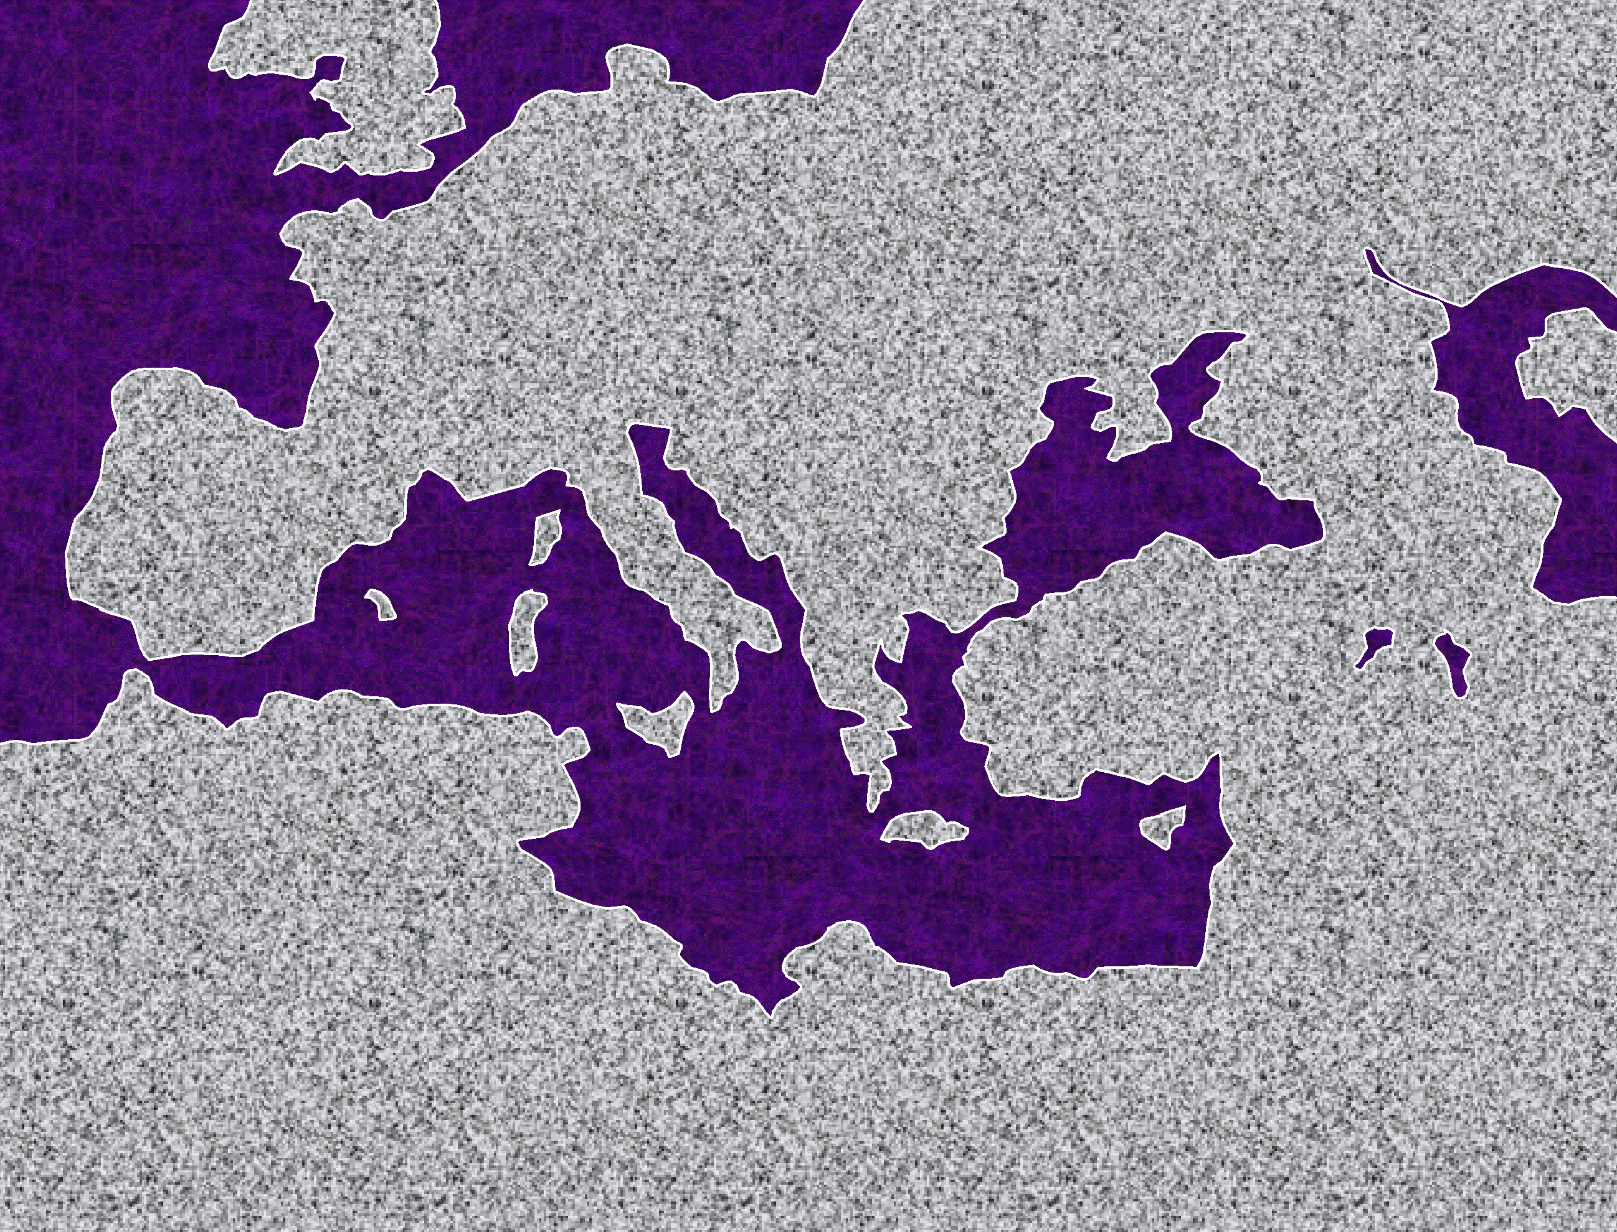

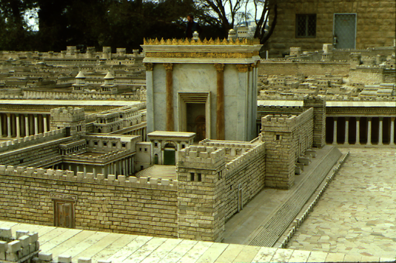
24
Paul: His Journeys At A Glance
EUROPE
1.“The _____: A ______”
Acts 13-14
Significance: Worshipped as__________; did miracles; Paul _______________; difficult work; churches were planted.
•ROME
ASIA
GREECE
•
•PISIDIAN ANTIOCH
#1
ATHENS/CORINTH•
•SYRIAN ANTIOCH
EPHESUS
•JERUSALEM
Issue settled: __________ not ________!
AFRICA
ARABIA
EUROPE
Acts 15-18
Acts 15 Jerusalem Council
•ROME
ASIA
GREECE
•PISIDIAN ANTIOCH
2. “The _________ Thrust”
ATHENS/CORINTH•
•SYRIAN ANTIOCH
#2
EPHESUS
•JERUSALEM
Significance: many church plantings; call to _____________,on to Athens; Mars Hill; lengthy ________________ stay.
AFRICA
ARABIA
EUROPE
Acts 18-21
3. “The ______ Thrust”
•ROME
ASIA
Significance: extended time at the church in _____________; young man raised from the dead; important letters written; riot with Ephesian artisans at _________________.
GREECE
•PISIDIAN ANTIOCH
#3
ATHENS/CORINTH•
•SYRIAN ANTIOCH
EPHESUS
•JERUSALEM
4
AFRICA
ARABIA
EUROPE
Acts 21-28
4. “To _____ and ____!”
•ROME
ASIA
Significance: As a prisoner, sent to _________; Christian influence in prison and into the house of ____________; important final letters; “fought the good fight, kept the faith!”
GREECE
•PISIDIAN ANTIOCH
ATHENS/CORINTH•
•SYRIAN ANTIOCH
#4
EPHESUS
AFRICA
•JERUSALEM
ARABIA
A FINISHED VERSION IS PROVIDED AS STUDY HELP NUMBER 36.

Slide 56
FOR YOUR NOTES, THOUGHTS & IDEAS

Slide 57
25
TWO OF PAUL’S KEY THEOLOGICAL TRUTHS The Very Foundation of Christian Thought and Practice
_________________ -- to release from the guilt of sin…and
MAKE ___________________________
(AN INSTANT _____________ EVENT!)
Gen. 15:6 Abram believed the Lord, and he credited it to him as righteousness. (NIV).
Rom 5:16-18 Again, the gift of God is not like the result of the one man’s sin: The judgment followed one sin and brought condemnation, but the gift followed many trespasses and brought justification. For if, by the trespass of the one man, death reigned through that one man, how much more will those who received God’s abundant provision of grace and of the gift of righteousness reign in life through the one man, Jesus Christ…Consequently, just as the result of one trespass was condemnation for all men, so also the result of one act of righteousness was justification that brings life for all men. (NIV).
__________________ -- to set apart for some sacred use.
(A _______________, MATURING PROCESS)
1 Cor 1:2 To the church of God in Corinth, to those sanctified in Christ Jesus and called to be holy, together with all those everywhere who call on the name of our Lord Jesus Christ -- their Lord and ours: (NIV).
2 Cor 5:17 Therefore, if anyone is in Christ, he is a new creation: the old has gone, the new has come! (NIV).
Rom 5: 1-4 Therefore, since we have been justified through faith, we have peace with God through our Lord Jesus Christ, through whom we have gained access by faith into this grace in which we now stand. And we rejoice in the hope of the glory of God. Not only so, but we also rejoice in the sufferings, because we know that suffering produces perseverance; perseverance, character; and character, hope. (NIV).

Slide 58
FOR YOUR NOTES, THOUGHTS & IDEAS

Slide 59
26
Main Themes of “The Letters”
FIRST:THE LETTERS FROM PAUL
ROMANS
1 COR
2 COR
GALATIANS
EPHESIANS
PHILIP-PIANS
COLOS-SIANS
JUSTIFI- CATION BY _________
CHRISTIAN CONDUCT IN THE CHURCH
PAUL’S AUTHENTIC APOSTLE-SHIP
THE POWER OF _________
POSITION AND WALK OF THE BELIEVER
JESUS CHRIST OUR JOY
JESUS CHRIST: TOTALLY ADEQUATE
1:17
1:2
12:9
3:2
1:3
4:4
2:10
1 THESS
2 THESS
1 TIMOTHY
2 TIMOTHY
TITUS
PHILEMON
HEBREWS
EVENTS OF THE LAST DAYS
THE COMING DAY OF THE LORD
PROPER ORDER IN THE CHURCH
GUARD THE GOSPEL; PREACH ON
QUALIFI-CATIONS OF _________
ACCEPT- ANCE OF OTHERS IN CHRIST
JESUS CHRIST: _________ _________
1:10
1:6
2:8
1:13
2:1-2
v.17
1:4
JAMES
1 PETER
2 PETER
1 JOHN
2 JOHN
3 JOHN
JUDE
FAITH AT WORK IN _________ _________
THE CHRISTIAN LIFE AND DUTY
FALSE TEACHERS IN THE CHURCH
SALVATION ASSURED BEWARE FALSE TEACHERS
WALKING BY CHRIST’S _COMMAND-MENTS
JOHN’S APOSTOLIC AUTHORITY
CONTEND-ING FOR THE FAITH
2:26
2:7
2:1
5:13
v. 3
vv.4, 11
vv. 20-21
SECOND:THE LETTERS FROM “THE OTHERS”

Slide 60
26a
Some Main Themes of “The Letters”
From the Letters of Paul
TITUS 2:1-2
You must teach what is in accord with sound doctrine…Teach the older men to be temperate, worthy of respect, self-controlled, and sound in faith, in love and in endurance. (NIV)
ROMANS 1:17
For in the gospel a righteousness from God is revealed, a righteousness that is by faith from first to last, just as it is written: "The righteous will live by faith.” (NIV)
PHILEMON 17-18
So if you consider me a partner, welcome him as you would welcome me…If he has done you any wrong or owes you anything, charge it to me. (NIV)
1 CORINTHIANS 1:2
To the church of God in Corinth, to those sanctified in Christ Jesus and called to be holy, together with all those everywhere who call on the name of our Lord Jesus Christ--their Lord and ours: (NIV)
From the Letters of “The Others”
2 CORINTHIANS 12:9
But He said to me, “My grace is sufficient for you, for my power is made perfect in weakness.” Therefore I will boast all the more gladly about my weaknesses, so that Christ’s power may rest on me. (NIV)
Hebrews 1:4
So he became as much superior to the angels as the name he has inherited is superior to theirs. (NIV)
James 2:26 As the body without the spirit is dead, so faith without deeds is dead. (NIV)
GALATIANS 3:2 I would like to learn just one thing from you: Did you receive the Spirit by observing the law, or by believing what you heard? (NIV)
1 Peter 2:7
Now to you who believe, this stone is precious. But to those who do not believe, "The stone the builders rejected has become the capstone,” (NIV)
EPHESIANS 1:3
Praise be to the God and Father of our Lord Jesus Christ, who has blessed us in the heavenly realms with every spiritual blessing in Christ. (NIV)
2 PETER 2:1
But there were also false prophets among the people, just as there will be false teachers among you. They will secretly introduce destructive heresies, even denying the sovereign Lord who bought them--bringing swift destruction on themselves. (NIV)
PHILIPPIANS 4:4
Rejoice in the Lord always. I will say it again: Rejoice!
COLOSSIANS 2:10
…and you have been given fullness in Christ, who is the head over every power and authority. (NIV)
1 JOHN 5:13
I write these things to you who believe in the name of the Son of God so that you may know that you have eternal life. (NIV)
1 THESSALONIANS 1:10
…and to wait for his Son from heaven, whom he raised from the dead -- Jesus, who rescues us from the coming wrath. (NIV)
2 JOHN v.3
Grace, mercy and peace from God the Father and from Jesus Christ, the Father's Son, will be with us in truth and love. (NIV)
2 THESSALONIANS 1:6
God is just: He will pay back trouble to those who trouble you and give relief to you who are troubled, and to us as well. This will happen when the Lord Jesus is revealed from heaven in blazing fire with his powerful angels. (NIV)
3 JOHN vs 4; 11
I have no greater joy than to hear that my children are walking in the truth…Dear friend, do not imitate what is evil but what is good. Anyone who does what is good is from God. Anyone who does what is evil has not seen God. (NIV)
1 TIMOTHY 2:8
I want men everywhere to lift up holy hands in prayer, without anger or disputing. (NIV)
JUDE: vs. 20-21
But you, dear friends, build yourselves up in your most holy faith and pray in the Holy Spirit…Keep yourselves in God's love as you wait for the mercy of our Lord Jesus Christ to bring you to eternal life. (NIV)
2 TIMOTHY 1:13
What you heard from me, keep as the pattern of sound teaching, with faith and love in Christ Jesus. (NIV)

Slide 61
27
FROM JOHN THE APOSTLE:
A Glimpse Into Eternity Future
THE REVELATION
THE LETTERS THE SEALS THE TRUMPETS THE BOWLS THE APOSTATE CHURCH THE RETURN OF CHRIST
THE __________ _________ OF THE LAMB REV. 19:1-10
THE __________ __________ OF JESUS CHRIST REV. 19:11-16
FIVE ANCHOR POINTS IN THE REVELATION: CHAPTERS _{19, 20, 21}
THE _______ ________ OF CHRIST REV. 20:4-6
THE GREAT __________ __________ JUDGMENT REV. 20:11-15
WRITTEN FROM THE ISLAND OF PATMOS IN THE AEGEAN SEA ABOUT 95 A.D.
THE NEW ______________ AND THE NEW ____________ REV. 21:1-8

Slide 62
FOR YOUR NOTES, THOUGHTS & IDEAS

Slide 63
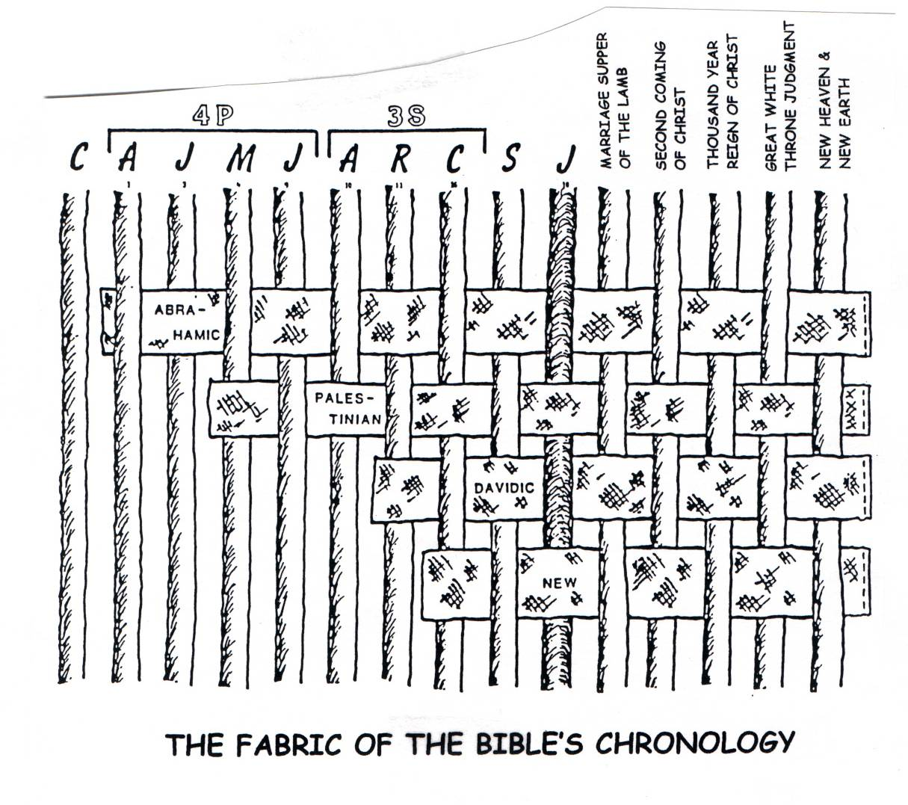
28
The Consummate Objective of the Bible’s Grand Story Line
C 7 S J
_{JESUS CHRIST}
ABRA- HAMIC
LAND
DAVIDIC
NEW
The biblical story line progresses as the promises to Abraham are realized:
•The Abrahamic Call and Covenant of Genesis 12 and 15,
•The Land (Palestinian) Covenant of Deuteronomy 30,
•The Davidic Covenant of 2 Sam. 7 and
•The New Covenant of Jeremiah 31.

Slide 64
FOR YOUR NOTES, THOUGHTS & IDEAS

Slide 65
29
The following pages are completed “clean” versions of several of the earlier study helps that require student fill-in during the seminar. However, you are encouraged to use those earlier fill-in forms during the seminar teaching; in so doing, the learning effect is highly increased.

Slide 66
FOR YOUR NOTES, THOUGHTS & IDEAS

Slide 67
30
DRESSING THE BIBLICAL STAGE
N(A)
MS
H
C
SG
J
MN
ER
B
E
DS
KB
THE STAGE
U
MS
“
OF THE
ACTION”
PG
RS
ADDING THE ROUTE OF “THE STORY”
N(A)
MS
H
C
SG
ER
J
MN
B
DS
E
“
THE STAGE
U
KB
OF THE
MS
ACTION”
PG
RS

Slide 68
FOR YOUR NOTES, THOUGHTS & IDEAS

Slide 69
31
INDEXING “THE BIBLE FILES”
CREATION
(All Time Pre-Abraham)
ANARCHY
1st Man & Woman
Judges
1st Sin
350
C
1st Gospel
C
7
S J
1st Family
ROYALTY
(1000 B.C.)
1st Murder
S - D - S
_{DC}
Flood/Rainbow
••• SPLIT •••
Tower
N
North South
ABRAHAM
(2000 B.C.)
Israel Judah
The CALL
_{AC}
10 2
_{NC}
L - S - B
THE PROPHETS
I - I
20-J 20-R
200 350
J - E
Assyria Babylon
12
JOSEPH
CAPTIVITY
70 Years
Slavery
3 Treks
430
100 Years/50,000
Z - E - N
MOSES
(1500 B.C.)
SILENCE
Exodus
S
Alex the Greek
(500 B.C.)
Sinai
Roman Systems
M - C - C
Kadesh Barnea
_{LC}
JESUS
40
Life
5 Sermons
J
Cross
JOSHUA
Church
Gospels
Jericho/Ai
Acts
Land Divided
Epistles
Revelation
THIS PAGE, INCLUDING THE COPYRIGHT NOTICE, MAY BE REPRODUCED LOCALLY FOR STUDY AND TEACHING PURPOSES.

Slide 70
FOR YOUR NOTES, THOUGHTS & IDEAS

Slide 71
32
THE GENESIS PROMISES TO ABRAHAM: The Very “Backbone” of Biblical Revelation
The CALL to Abraham Gen. 12:1-3
ABRAHAMIC COVENANT
The COVENANT Gen. 15:9-18
Overarching Characteristics of the Abrahamic Covenant
ETERNAL
LITERAL
UNCONDITIONAL
Gen. 13:15
Gen. 13:14-16
Gen. 15:9-18
LAND
SEED
__________
BLESSING
Gen. 12:1
Gen. 12:2
Gen. 12:3
Gen. ___:___
Land Covenant
Davidic Covenant
New Covenant
Deut. 30:1-10
2 Sam. 7:14-16
Jer. 31:31-34
The Amplified Subcovenants

Slide 72
FOR YOUR NOTES, THOUGHTS & IDEAS

Slide 73
33
THE “OPENED” BIBLE
A
_{1600 Years}
B
_{40 Authors}
D(OT)
_{“Old” T’ment}
D(NT)
_{“New” T’ment}
C
ONE THEME:
_{Glory of God}
E(OT)
_{“39” Books}
E(NT)
_{“27” Books}
F(OT)
_{Hebrew}
F(NT)
_{Greek}
4
_{Law}
/
3
5
_{Grace}
/
G(OT)
_{GOSPELS}
G(NT)
6
_{Fulfillment}
_{Promise}
2
_{PROPHECIES}
_{ACTS}
_{WRITINGS}
7
_{HISTORIES}
_{EPISTLES}
1
_{LAW}
8
_{HISTORIES}
_{REVELATION}
H(OT)
_{Telescope}
_{Telescopes}
H(NT)
_{Telescope}
J
2
1
_{Eternity Past}
_{Microscope}
_{Microscope}
_{Eternity Future}
I(OT)
OLD & NEW TESTAMENT FUNCTIONAL PARALLELS: LAW (1) and GOSPELS (5) produce an historical fallout, the HISTORIES (2) and the ACTS (6); which show the development of a culture; which produces a body of writings; the WRITINGS (3) and the EPISTLES (7), leaving those two parts unique to our Bible, the PROPHECIES (4) and THE REVELATION (8).

Slide 74
FOR YOUR NOTES, THOUGHTS & IDEAS

Slide 75
Seminar Study Help Number
34
C 7 S J
“SETTING UP THE BOOKS:”
LINING UP THE OLD TESTAMENT
C
CREATION
1.
Approx Time Frame: All Time Prior to 2000 B.C.
Family Sin Flood Tower
Genesis
AC
ABRAHAM
circa:
2.
Approx Time Frame: 2000 B.C.
L-S-B Isaac Jacob 12 Sons
2.
Abra- ham
Job
ALL OTHER “WRITINGS” ARE FROM THE “ROYALTY” PERIOD
JOSEPH
THE LAW (5)
1/2 David 1 Moses
3.
7.
4 PEOPLE
Approx Time Frame: 2000 B.C.
Slavery 430
Psalm
POETRY (5)
Exodus
7.
Solomon on Living
MOSES
Prov.
4.
Approx Time Frame: 1500 B.C.
Sinai M-C-C Kadesh 40 Years 5 Sermons
Leviticus
7.
Solomon on Life
Numbers
Eccl.
Deutero-nomy
LC
7.
Solomon on Marriage
S’Sol.
JOSHUA
UNTANGLING THE PROPHETS:
5.
Approx Time Frame: 1500 B.C.
Jericho/Ai Land Divided
Joshua
TO ISRAEL (N. KINGDOM)
_{A}
Amos
rabia
Judges
_{H}
Hosea
ad
ANARCHY
Jonah (Nineveh)
_{J}
6.
Approx Time Frame: 1000 B.C.
Judges 350 Years
Ruth
ewels
*
TO JUDAH (IN DECLINE)
_{I}
Isaiah
srael
1 Samuel
_{J}
(S)
THE HISTORIES (12)
Joel
ust
ROYALTY
_{M}
3 SOCIETIES
7.
Approx Time Frame: 1000 B.C.
S-D-S SPLIT
2 Samuel
DC
Micah
ust
N:North 10 Tribes Israel 20-J 200 Assyria
S:South 2 Tribes Judah 20-R 350 Babylon
(D)
}
Obadiah (Edom)
_{O}
1 Kings
bey
(S)
THE PROPHECIES (17)
*
TO JUDAH (IN CRISIS)
_{J}
2 King
NC
(CW)
*
‘lem
Jeremiah
_{L}
1 Chron.
PROPHETS
WROTE IN
A FOUR-
HUNDRED
YEAR
ERA
AFTER
“THE
SPLIT”
iterally
( )
Lamentations
_{H}
2 Chron.
Habakkuk
ad
CAPTIVITY
Nahum (Nineveh)
_{N}
8.
Ezra
oisy
Approx Time Frame: 500 B.C.
70 Years 2 Tribes 100 Years 50,000 People Z-E-N
_{Z}
Nehemiah
Zephaniah
ones
*
Esther
TO JUDAH (IN CAPTIVITY)
_{E}
Ezekiel
scape
*
_{D}
S
SILENCE
Daniel
awned
9.
Approx Time Frame: 500 B.C.
Alex the Greek Roman Systems
©2006 John Fryman
TO JUDAH (IN RETURN)
_{H}
Haggai
eaven’s
J
JESUS
NEW TESTAMENT GOSPELS…ACTS…EPISTLES…REVELATION
_{Z}
10.
Zechariah
ealous
Approx Time Frame: First Century A.D.
Life Cross Church
_{M}
Malachi
en
A BLANK VERSION IS PROVIDED AS STUDY HELP NUMBER 19.

Slide 76
FOR YOUR NOTES, THOUGHTS & IDEAS

Slide 77
35
THE NEW TESTAMENT BOOKS IN ORDER
From “The Jesus File”…the New Testament covers only some 95 years in the history of the Gospel and the Early Church. Long ago, the New Testament was organized into four topics….
(4)
(1)
(21)
(1)
FACTS & THEOLOGY
CHURCH HISTORY
CHURCH ISSUES
ETERNITY FUTURE
THE GOSPELS:
Matthew*
Mark*
Luke*
John ---------
ACTS OF THE APOSTLES
THE EPISTLES
Letters from Paul: Romans 1 Corinthians 2 Corinthians
Galatians Ephesians Philippians Colossians
1 Thessalonians 2 Thessalonians 1 Timothy 2 Timothy Titus
Philemon
Letters from The Others:
Hebrews
James 1 Peter 2 Peter 1 John 2 John 3 John Jude
THE REVELA-TION
“Some ROMANS have 2 CORS.”
“Gentiles Eat Pork Chops”
“Synoptic:”
“Seen Together”
Church Treasurer’s Lament: “THose TIMid TIThers.”
“The end of Paul’s PHILE.”
In Jerusalem tonight, that Hebrew TV news crew…
James,
Peter,
John, and
Jude

Slide 78
FOR YOUR NOTES, THOUGHTS & IDEAS

Slide 79
36
Paul: His Journeys At A Glance
EUROPE
#1.“The Hook: A Laboratory”
Acts 13-14
Significance: Worshipped as gods; did miracles; Paul stoned; difficult work; churches planted.
•ROME
ASIA
GREECE
•
•PISIDIAN ANTIOCH
#1
ATHENS/CORINTH•
•SYRIAN ANTIOCH
Issue settled: GRACE, not LAW!
EPHESUS
•JERUSALEM
AFRICA
ARABIA
EUROPE
Acts 15-18
Acts 15 Jerusalem Council
•ROME
ASIA
GREECE
•PISIDIAN ANTIOCH
2. “The European Thrust”
ATHENS/CORINTH•
•SYRIAN ANTIOCH
#2
EPHESUS
Significance: many church plantings; call to Macedonia,on to Athens; Mars Hill; lengthy Corinthian stay.
AFRICA
ARABIA
EUROPE
Acts 18-21
3. “The Asian Thrust”
•ROME
ASIA
Significance: extended time at the church in Ephesus; young man raised from the dead; important letters written; riot with Ephesian artisans at amphitheatre.
GREECE
•PISIDIAN ANTIOCH
#3
ATHENS/CORINTH•
•SYRIAN ANTIOCH
EPHESUS
4
AFRICA
ARABIA
EUROPE
Acts 21-28
4. “To Rome and GAIN!”
•ROME
ASIA
Significance: As a prisoner, sent to Rome; Christian influence in prison and into the house of Caesar; important final letters; “fought the good fight, kept the faith!”
GREECE
•PISIDIAN ANTIOCH
ATHENS/CORINTH•
•SYRIAN ANTIOCH
#4
EPHESUS
AFRICA
ARABIA

Slide 80
FOR YOUR NOTES, THOUGHTS & IDEAS

Slide 81


The Bible…Basically Ministries International Inc.
voice: 817-346-4750 cell: 817-300-6492 www.biblebasically.org johnfryman@sbcglobal.net
YOUR RESPONSE PLEASE…
IN THE FUTURE, WITH HOW MANY PEOPLE DO YOU ESTIMATE YOU WILL PROBABLY SHARE A PORTION OR ALL OF TBB CONTENT? ______________
Please use the space below to give our ministry your response to THE BIBLE…BASICALLY teaching you have just experienced. Your remarks will help us improve the content and the work of the ministry. Your name is not required. However, if you wish you may supply your name, address and email below so that we can keep you informed of ministry activities.
Use back of page for extended comments.
Concerning the length of this seminar, it was/should be ( ) Far too long ( ) Just long enough ( ) Maybe a little longer ( ) Much longer
(the information below is optional)
Name:________________________________________________
Address:______________________________________________
______________________________________________________
______________________________________________________
Email Address:_________________________________________
PLEASE PRINT THE ABOVE INFORMATION!
Multiplying Biblical Literacy Throughout The Body of Christ

Slide 82
FOR YOUR NOTES, THOUGHTS & IDEAS

Slide 83
The Bible…Basically Ministries International Inc.
voice: 817-346-4750 cell: 817-300-6492 www.biblebasically.org johnfryman@sbcglobal.net
A WORD FROM YOU WILL REALLY HELP!
YOU CAN BE OF ENORMOUS HELP TO OUR MINISTRY BY SUGGESTING INDIVIDUALS IN OTHER MINISTRIES AND CHURCHES WHO SHOULD BE MADE AWARE OF THE BIBLE…BASICALLY SEMINAR MINISTRY. PLEASE GIVE US YOUR RECOMMENDATIONS FOR THOSE MINISTRIES OR INDIVIDUALS WE SHOULD CONTACT REGARDING A SEMINAR PRESENTATION AT THEIR VENUE.
NAME OF ORGANIZATION:____________________________________
CITY OR LOCATION:_________________________________________
PERSON TO CONTACT:______________________________________
MAY WE USE YOUR NAME?____________
NAME OF ORGANIZATION:____________________________________
CITY OR LOCATION:_________________________________________
PERSON TO CONTACT:______________________________________
MAY WE USE YOUR NAME?____________
NAME OF ORGANIZATION:____________________________________
CITY OR LOCATION:_________________________________________
PERSON TO CONTACT:______________________________________
MAY WE USE YOUR NAME?____________
NAME OF ORGANIZATION:____________________________________
CITY OR LOCATION:_________________________________________
PERSON TO CONTACT:______________________________________
MAY WE USE YOUR NAME?____________
Name:________________________________________________
Address:______________________________________________
Email Address:_________________________________________ PLEASE PRINT ALL INFORMATION!
Multiplying Biblical Literacy Throughout The Body of Christ

Slide 84
FOR YOUR NOTES, THOUGHTS & IDEAS

