Slide 1
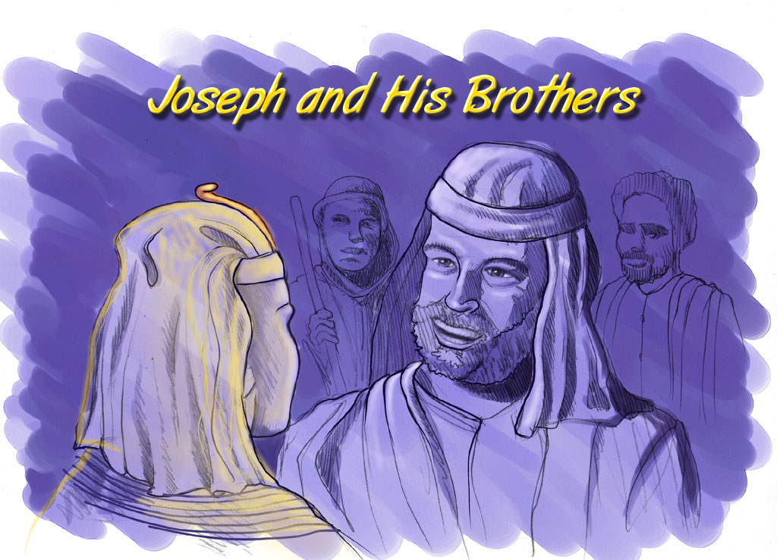
Gen. 42:7
Abraham-Joseph
Joseph and His Brothers
Designed by Dr. John Fryman, Texas, USA
Taught by Dr. Rick Griffith, Jordan Evangelical Theological Seminary
Free download of all files in many languages at BibleStudyDownloads.org
Handbook pg. 24-25
56

Slide 2


THE BIBLE... BASICALLY
©2006 TBBMI

Slide 3
Gen. 11:26 through 25:8
APPROXIMATE DATING:
ABRAHAM-JOSEPH 2000 B.C.
ALL DATES ROUNDED
TO 500-YEAR
INCREMENTS
Handbook pg. 19-24
01
1
Notes:
Now…let's begin a biblical timeline. Abraham's date on the timeline: about 2000 B.C. By the way, throughout our study…
//// …most dates will be presented in large, rounded groupings in 500 -year increments.
More precise dating is not needed in this particular study. All dates can be sharpened as your own interests direct.
2135-1960 BC Abraham's lifespan

Slide 4
7
"A
Judge
Must
Judge"
CREATION
ABRAHAM
ABRAHAM
ABRAHAM
JOSEPH
ABRAHAM
MOSES
JOSHUA
ANARCHY
ROYALTY
CAPTIVITY
The FIRST
of the
4 PEOPLE
SILENCE
JESUS
Handbook pg. 19-24
02
Notes:
The memory tool, A JUDGE MUST JUDGE, brings to mind ABRAHAM…the FIRST OF THE FOUR GREAT PEOPLE...right after the CREATION file folder. Here is ABRAHAM'S folder in the Bible File line up.

Slide 5
Gen. 12:4
DRESSING
THE
STAGE
MS
6
N(A)
H
Fertile Crescent
SG
C
ER
B
J
MN
DS
The Starting Point...
E
U
KB
MS
PG
RS
Handbook pg. 19-24
03
1
Notes:
In Chapter 12 of Genesis, this "Quick Chronology" of Abraham's life] begins – at ancient Ur of the Chaldees – the "U" on your map of the Ancient Near East. That's the place in Scripture where the Author comes to a quick narrowing of the earlier Biblical perspective.
//// And its setting is in the rich Fertile Crescent of the Middle East,
The stage of this great drama stretches from the Euphrates Valley all the way over to the Mediterranean Sea…
and in between we find some very familiar place names.

Slide 6
DRESSING
THE
STAGE
10 PLACES
MS
6
4
N(A)
H
IRAQ
IRAN
KUWAIT
SAUDI ARABIA
SYRIA
ISRAEL
TURKEY
EGYPT
SG
SEA OF GALILEE
C
ER
B
CANAAN
J
MN
DS
NILE RIVER
THE SALT SEA
E
EGYPT
U
KB
SINAI PENINSULA..
MS
PG
RS
Handbook pg. 19-24
04
14
Notes:
You've already identified some of them on your map that we called "Dressing the Stage."
There lie
//// Canaan…today's state of Israel, and the West Bank, Palestine,
//// the Sea of Galilee,
//// and the Dead or Salt Sea…as Scriptures calls it.
//// Also there is Egypt and
//// the great Nile River.
//// The Sinai Peninsula appears, a region in the headlines of recent world events.
But in our world, our own time, we also find
//// Iraq
//// Iran
//// Kuwait
//// Saudi Arabia
//// Syria
//// Modern Israel and the West Bank
//// Turkey and
//// Today's Egypt

Slide 7
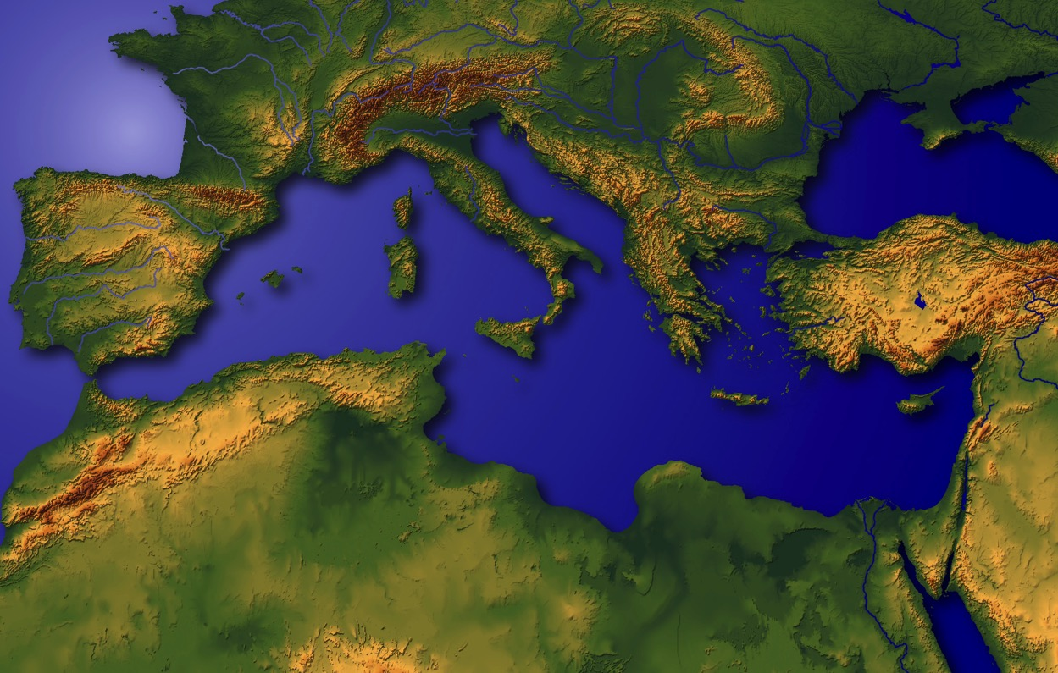
"The Navel of the Earth"
Handbook pg. 19-24
05
1
Notes:
This region has been called the very NAVEL OF THE EARTH.
Through this great hinge of history, time and again, great world powers of the past -- time and again -- have marched in conquest,
//// with Canaan/Palestine/Israel being pulled and stretched by enormous international and internal pressures.

Slide 8
Gen. 11:28
DRESSING
THE
STAGE
MS
N(A)
H
SG
C
ER
B
J
MN
DS
E
KB
U
MS
UR OF THE CHALDEES: ANCIENT CULTURAL CENTER OF THE MESOPOTAMIAN BASIN;
HOME OF ABRAHAM
PG
RS
Handbook pg. 19-24
06
1
Notes:
So the story of ABRAHAM begins at the head of the Persian Gulf, in that ancient city -- Ur of the Chaldees.
//// Abraham and his family lived in this early cultural center in the Mesopotamian Basin.
This is the "U" on map we named "Dressing the Stage."
Follow along by tracing on your own map as the story begins to unfold.

Slide 9
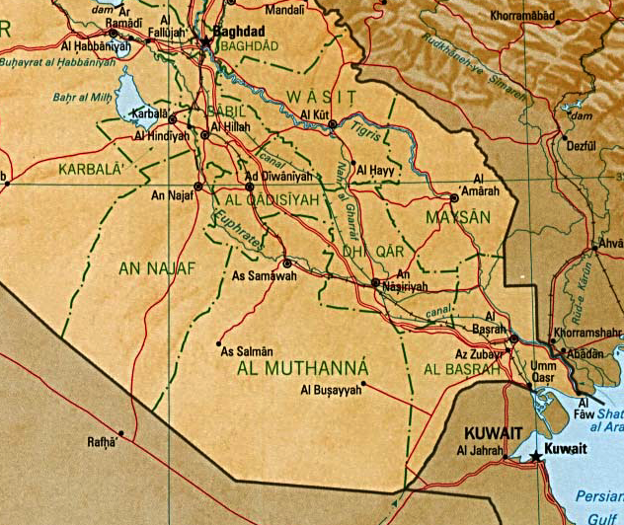
7
BABYLON
UR
REMEMBER! Persian Gulf War War in Iraq
Handbook pg. 19-24
07
6
Notes:
Here is the map of this region in today's world. Remember that this was the stage of the earlier Persian Gulf War of the 1990s…
and more recently the War in Iraq that toppled Saddam Hussein.
//// There is the familiar Tigris River…
//// …and the Euphrates…
//// …today's city of Baghdad…
//// …Kuwait stands at the head of the Persian Gulf…
//// …to the north…the location of ancient Babylon…
//// …and the beginning point of our story…the ancient city of UR.

Slide 10
7
The Mesopotamian Basin
SUMERIAN INVENTIONS…
WRITING AND THE WHEEL
BEGINNINGS…
LAW
MEDICINE
ASTRONOMY
ARCHITECTURE
EARLIEST URBAN CENTERS
Handbook pg. 19-24
07a
4
Notes:
Here in this Middle Eastern land – bordering the Persian Gulf --
were some of the earliest beginnings of mankind's discovery of an intellectual life.
//// In this triangular shaped valley,
//// called the Mesopotamian Basin,
//// the ancient Sumerians presented us the gifts of writing and the wheel. And here we see
//// the beginnings of basic concepts of civilization…of law…of medicine… of astronomy and architecture.
//// Archaeologists have also found evidence of some of the very earliest urban centers…
the communities and the cities that, through time, have led directly to the civilization and cultures we know today.

Slide 11
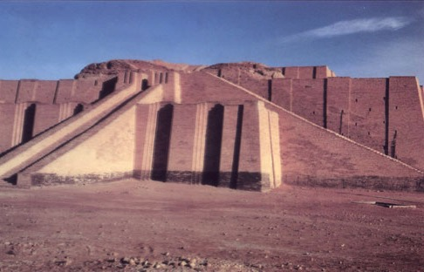
Gen 10:10; 11:28
A Typical "Ziggurat" at
Ancient Ur of the Chaldees in Today's Iraq
Handbook pg. 19-24
08
Notes:
This kind of temple tower, or ziggurat, was common in that region in Abraham's day in Ur of the Chaldees. In 2000 B.C., Ur was a great city, an international center of learning, culture, commerce and idolatrous spiritual darkness. But think about this: what kind of technology -- literally, brain power -- was required to construct a building of such size and complexity of design? Those thoughts hint at the kind of life, times and talent of those ancient civilizations!

Slide 12
Gen. 11:31
ABRAHAM'S FAMILY:
• TERAH (THE FATHER)
•ABRAHAM (ABRAM)
• SARAH (HIS WIFE, SARAI)
• LOT (ABRAHAM'S NEPHEW)
Handbook pg. 19-24
09
5
Notes:
//// The Biblical narrative tells us about a man named ABRAHAM, living with his family in ancient Ur of the Chaldees.
//// In the family was his aging father…Terah.
//// Terah's son named Abram, later to be renamed by God, ABRAHAM, as his future place in history is made clear.
//// ABRAHAM'S wife's name was Sarah (originally named Sarai)...
//// Also in the family group was ABRAHAM's nephew, Lot

Slide 13

7
ABRAHAM
ABRAHAM
ca. 2000 B.C.
The FIRST
of the
4 PEOPLE
is:
ABRAHAM
AJMJ
Genesis 12 and Forward
Handbook pg. 19-24
10
3
Notes:
So we begin with ABRAHAM's file folder.
Note also a special feature about the visuals you are watching...
//// From this point and on through the chronology there will be a small file folder image floating in most slide frames. They will help guide your thinking as the great story line unfolds. You'll always know where we are as the BILE FILE folders build out and fill up.
//// Abraham's story opens in Genesis 12 and forward...
//// Time frame: about 2000 B.C...the first of the four Great People.
It is through this one man, ABRAHAM, that God begins a new program
to provide for His creation the way back to that original intimate relationship that existed in the beginning. Through ABRAHAM unfolds all the rest of the Bible, until we see in the book of Revelation, once again, the broad view of the world and the universe.

Slide 14
7
Gen. 12: 1-3
ABRAHAM
ABRAHAM
ca. 2000 B.C.
The CALL
The FIRST
of the
4 PEOPLE
is:
ABRAHAM
The CALL
AJMJ
Genesis 12 and Forward
Handbook pg. 19-24
11
Notes:
The great story begins in the 12th Chapter of Genesis where ABRAHAM receives God's CALL, telling him to leave Ur and go toward a land that will be shown to him in due time.

Slide 15
7
Gen. 12: 1-3
ABRAHAM
ABRAHAM
ca. 2000 B.C.
The CALL
AC
AJMJ
Gen. 12:1-3
ABRAHAM
The CALL
GOD'S UNCONDITIONAL PROMISE TO ABRAHAM!
Handbook pg. 19-24
12
Notes:
This is the most crucial Biblical event in the life of the old patriarch and also the beginning point in the revelation of God's new Program with Man. On your work sheet, it's represented by the letters AC inside the image of a scroll. AC is to remind us of the great ABRAHAMIC COVENANT -- provided for us in our own Bibles at Genesis 12...verses 1-3. It is an UNCONDITIONAL covenant promise!

Slide 16
Unconditional Nature
7
ABRAHAM
ABRAHAM
ca. 2000 B.C.
The CALL
AC
L - S - B
AJMJ
Gen. 12:1-3
A LAND
A SEED
ABRAHAM
The CALL
L - S - B
A BLESSING
AN UNCONDITIONAL PROMISE LATER TO BECOME A LEGAL COVENANT!
Handbook pg. 19-24
13
Notes:
Now…on ABRAHAM'S file folder, add the letters...L...S...B...standing for the words: LAND...SEED...AND BLESSING. Here is the significance of those words. Right there in the book of Genesis, 12th Chapter, verses 1-3, God makes THAT UNCONDITIONAL COVENANT PROMISE to Abraham…later to become an actual legal contract in the culture of that day!

Slide 17
7
Genesis 12
The Lord had said to Abram,
"Leave your country, your people and your father's household, and go to the land I will show you.
1
"I will make you into a great nation
and I will bless you;
I will make your name great,
and you will be a blessing.
2
ABRAHAM
The CALL
I will bless those who bless you,
and whoever curses you I will curse;
and all peoples on earth
will be blessed through you."
L - S - B
3
Handbook pg. 19-24
14
3
Notes:
In Genesis 12, verses 1-3 present God's three-part promise to Abraham. Here it is:
//// The Lord had said to Abram,
"Leave your country, your people and your father's household, and go to THE LAND I will show you.
//// "I will make you into A GREAT NATION
and I will bless you;
I will make your name great,
and you will be a blessing.
//// I will bless those who bless you,
and whoever curses you I will curse;
and ALL PEOPLES ON EARTH
WILL BE BLESSED THROUGH YOU."

Slide 18
7
Genesis 12
The Lord had said to Abram,
"Leave your country, your people and your father's household, and go to the land I will show you.
1
A LAND
A SEED
"I will make you into a great nation
and I will bless you;
I will make your name great,
and you will be a blessing.
2
ABRAHAM
The CALL
I will bless those who bless you,
and whoever curses you I will curse;
and all peoples on earth
will be blessed through you."
L - S - B
3
A BLESSING
Handbook pg. 19-24
15
3
Notes:
The order of those covenant promises is an important key to Biblical order itself:
//// First is the promise of a LAND…then…
//// a SEED
//// followed by a BLESSING, represented by "L-S-B" on the ABRAHAM file folder.

Slide 19

The Abrahamic Covenant
("The Call")
Genesis 12:1-3
ABRAHAM
LAND
SEED
BLESSING
The CALL
L - S - B
12:1
12:2
12:3
"L-S-B"
Handbook pg. 19-24
16
3
Notes:
Now study this plan of organization…the down-to-earth meaning of those three promises…the L-S-B on ABRAHAM's folder…
//// First…PROMISE #1: GENESIS 12:1...A LAND — real estate, a geographic inheritance that most Jewish people respect politically to this present day.
//// PROMISE #2: GENESIS 12:2...A SEED — a long line of descendants...especially interesting because at the time the Promise is given, ABRAHAM and SARAH are approaching old age and yet they have never had children.
//// The final PROMISE, Number 3: GENESIS 12:3...A BLESSING promised to Abraham personally and to his descendants. Furthermore, God promises that, through His blessing to ABRAHAM, all the families of the earth will be blessed…NOT JUST ABRAHAM'S descendants! Notice that wording! It's important to an understanding of GRACE!

Slide 20
The Abrahamic Covenant
("The Call")
Genesis 12:1-3
Three Overriding Characteristics!
ABRAHAM
LAND
SEED
BLESSING
The CALL
L - S - B
• LITERAL
• ETERNAL
• UNCONDITIONAL
17
3
Notes:
Now...to the basic outline of the promise...L-S-B-...for LAND, SEED, and BLESSING...we can also add these basic concepts...three additional ideas that describe the characteristics of that Abrahamic Promise...
//// First…that great promise was -- and is -- LITERAL in that the words mean exactly what they say.
//// It is also ETERNAL, an unending arrangement, guaranteed by the maker of the contract, God Himself. And finally...
//// It is UNCONDITIONAL...indicating that no matter what Abraham or his descendants might do in the future, God would, in time…REPEAT: IN TIME…fulfill every element of His promises.
As we move farther through this story, we'll come to see how the entire Bible is built on that set of unconditional and foundational promises.... soon to become a legal contract between God and his friend, Abraham.

Slide 21
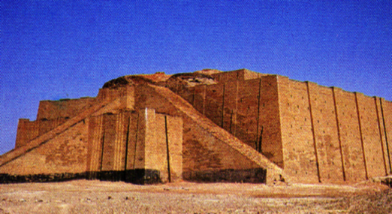
Gen. 11:31
DRESSING
THE
STAGE
THEY LEFT
IN
FAITH!
MS
N(A)
H
SG
C
R
B
J
MN
ABRAHAM
DS
The CALL
L - S - B
E
KB
U
MS
PG
RS
Handbook pg. 19-24
18
2
Notes:
After Abraham receives God's Promises…the entire family leaves Ur of the Chaldees to follow the Lord's direction.
//// They move toward the northwest with all their flocks and their possessions -- probably a large congregation of people, animals and tents. Biblical evidence shows ABRAHAM's family was probably wealthy. Again, if you have the map, add to it the map tracing that you see here in bright yellow. The main point here is this:
//// ABRAHAM and his family LEFT IN FAITH! They are moving toward a land that God will show them in due time. But as they leave Ur of the Chaldees they DO NOT know their destination. Their obedience is a profound demonstration of their faith in God's provision and His total protection as they head out into the unknown under Abraham's leadership.

Slide 22

Gen. 11:31-32
DRESSING
THE
STAGE
MS
N(A)
H
SG
C
ER
B
J
MN
ABRAHAM
DS
The CALL
L - S - B
E
KB
U
The Great City of Babylon
MS
PG
RS
Handbook pg. 19-24
19
Notes:
It is entirely possible that they passed through the region of ancient Babylon, upriver from Ur...that city to which you'll learn that Abraham's descendants – the Jews -- would be held as prisoners in the centuries to follow.

Slide 23
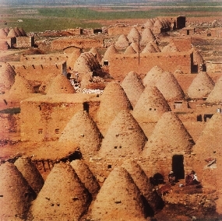
Gen. 11:31-32
DRESSING
THE
STAGE
MS
N(A)
H
THE FATHER, OLD TERAH, DIES AT HARAN.
SG
C
ER
B
J
MN
ABRAHAM
DS
The CALL
L - S - B
E
KB
U
The "Bee-Hive" City of Harran (Turkey) Today
MS
PG
RS
Handbook pg. 19-24
20
1
Notes:
They continue northwestward, finally arriving at ancient Haran…
… still in existence today in modern Turkey.
//// While settled temporarily in Haran, ABRAHAM's father, Terah, dies.

Slide 24
Gen. 12:5
DRESSING
THE
STAGE
MS
N(A)
H
SG
C
ER
B
J
MN
ABRAHAM
DS
The CALL
L - S - B
E
KB
U
MS
PG
RS
Handbook pg. 19-24
21
Notes:
Once again, God speaks to ABRAHAM, instructing him to now leave Haran and to move onward toward The Land He had promised to show him. That land is to be Canaan, or the land we call Israel today.

Slide 25

7
When Abraham enters The Land…
He is already 75 years old…
His wife, Sarah, is 65.
And yet…children are promised!
ABRAHAM
The CALL
L - S - B
Handbook pg. 19-24
22
4
Notes:
Now the great stage is set!
//// When he enters The Land,
//// ABRAHAM is already 75 years old and
//// his wife, Sarah, is 65.
//// And yet, God has promised them children? What?
Was God teasing the old couple? Children promised at that age?

Slide 26
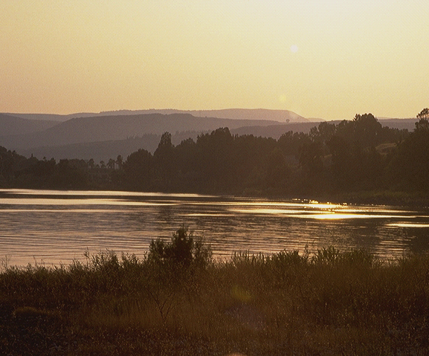
7
Gen. 15:6
ABRAHAM BELIEVES GOD'S PROMISE: A LAND, A SEED, AND A BLESSING!
_{LAND}
_{SEED,}
_{BLESSING}
Genesis 15:6!
God counts belief as righteousness
on Abraham's part!
Just simple belief!
ABRAHAM
The CALL
L - S - B
Handbook pg. 19-24
23
3
Notes:
Yes…ABRAHAM continues to believe God's promise of a LAND, a SEED, and a BLESSING!
//// His simple unquestioning belief is told to us in Genesis 15:6...
//// …where God counts that BELIEF as righteousness on ABRAHAM's part.
//// Just simple belief! This is the first step in the new program of redemption God will introduce to the earth through His old friend.

Slide 27
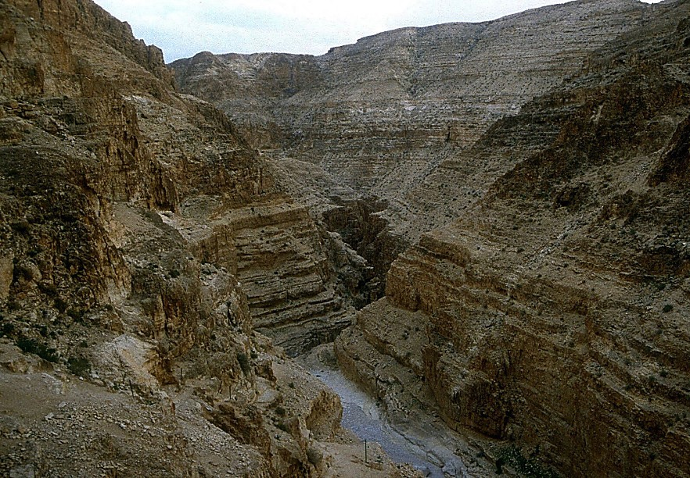
7
Gen. 16:1-4
ABRAHAM BELIEVES GOD!
Nevertheless: Abraham and Sarah become impatient.
"Abraham… go into Hagar!"
(Sarah's maidservant)
ABRAHAM
The CALL
L - S - B
Handbook pg. 19-24
24
3
Notes:
//// Abraham truly believes that God will accomplish what He has promised. And the years pass.
//// In spite of God's clear promise…ABRAHAM and Sarah become impatient as they wait for the children God had promised would be coming. In her impatience,
//// Sarah suggests that ABRAHAM go in to her Egyptian servant girl, Hagar, hoping that through that union the promised child might be born. That was not unusual in the culture of their day.

Slide 28
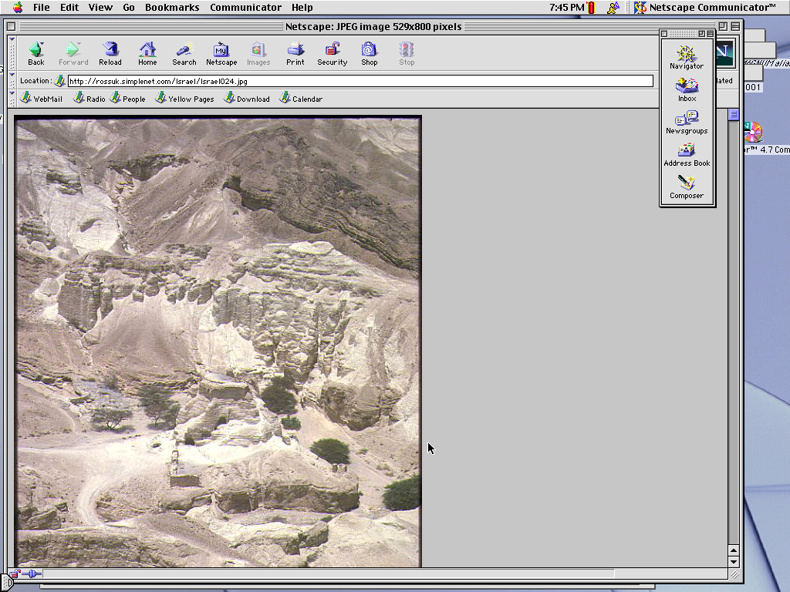
7
Gen. 16:11-12; 17:20-21
In time…Abraham fathers a son through Hagar.
His name: ISHMAEL.
(ISHMAEL IS NOT THE SON OF THE PROMISE).
ABRAHAM
The CALL
L - S - B
Handbook pg. 19-24
25
3
Notes:
//// Indeed, in time...ABRAHAM does father a son through Hagar.
//// The boy is named ISHMAEL.
//// But, God says, the infant is not the intended son of His covenant Promise to Abraham's descendants.

Slide 29
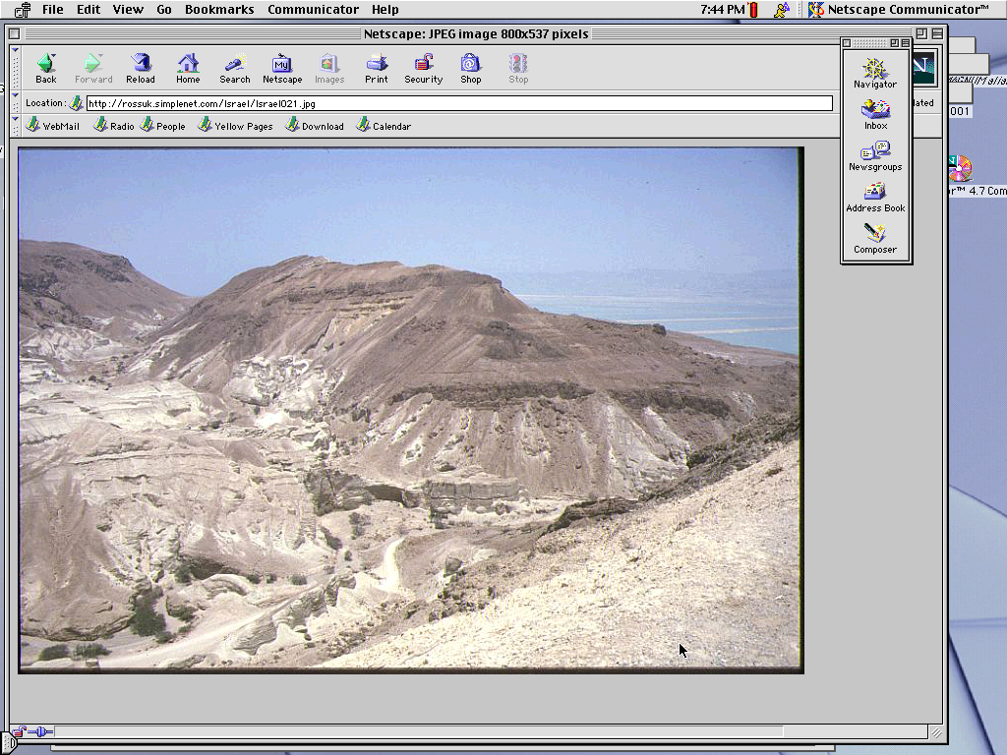
7
Gen. 17:19
By now…Abraham is 85 years old…Sarah is 75.
After another 15 years…
A son is actually born to ABRAHAM through SARAH.
NAME: "ISAAC"
ABRAHAM
The CALL
L - S - B
Handbook pg. 19-24
26
4
Notes:
//// By now, ABRAHAM is 85; Sarah, 75.
//// After another 15 years...
//// …the son of God's promise to ABRAHAM is finally born...through Sarah.
//// He is named ISAAC, a word that traces its meaning to the Hebrew root term indicating laughter. Yes, ABRAHAM thinks it hilarious that he and Sarah are to become parents at such advanced ages.

Slide 30
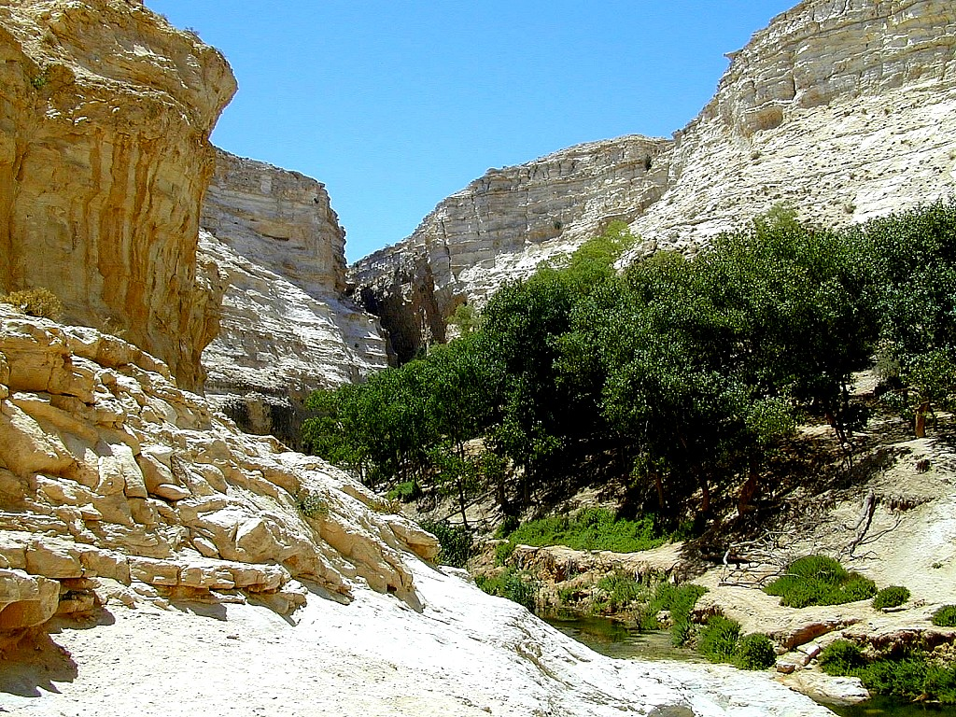
7
Gen. 17:21
Isaac is indeed the long-awaited son…
… through whom God's promise to Abraham is to be passed down…
ABRAHAM
The CALL
L - S - B
…THROUGH ISAAC'S FAMILY LINE!
Handbook pg. 19-24
27
2
Notes:
ISAAC is indeed the long-awaited son…
//// …through whom God's promise to ABRAHAM is to be passed down…
//// …through HIS family line.

Slide 31
7
Gen. 17
ABRAHAM
ABRAHAM
ca. 2000 B.C.
The CALL
AC
L - S - B
AJMJ
I - I
Gen. 12:1-3
ABRAHAM
The CALL
L - S - B
I - I
ISHMAEL & ISAAC
Handbook pg. 19-24
28
Notes:
So…the letters I and I appear on ABRAHAM's file folder. From these two sons of Abraham….ISHMAEL and ISAAC...
right here at this crucial historic point…the terrible Jewish-Arab conflict of our own time begins some 4,000 years ago...around 2000 B.C.

Slide 32
7
ABRAHAM
ABRAHAM
ca. 2000 B.C.
The CALL
AC
L - S - B
AJMJ
Gen. 12:1-3
I - I
ABRAHAM
The CALL
L - S - B
I - I
ARABIC PEOPLES
THROUGH ISHMAEL
JEWISH PEOPLE
THROUGH ISAAC
Handbook pg. 19-24
29
2
Notes:
Because...
//// …ISHMAEL is recognized today as the father of the Arab nations…through ABRAHAM…
//// while ISAAC, of course, is revered as one of the founding patriarchs of the Jews…also through ABRAHAM!

Slide 33
7
ABRAHAM
ABRAHAM
ca. 2000 B.C.
The CALL
AC
L - S - B
AJMJ
Gen. 12:1-3
I - I
ABRAHAM
The CALL
L - S - B
I - I
ARABIC PEOPLES
THROUGH ISHMAEL
JEWISH PEOPLE
THROUGH ISAAC
Handbook pg. 19-24
30
Notes:
There is enormous conflict between the two half-brothers and their mothers. And as we watch or read today's news, we see that that age-old turmoil begun in ABRAHAM's tent 4,000 years ago continues today! Both the Jews and the Arabs claim ABRAHAM as the beginning point of their respective peoples!

Slide 34
7
Gen. 22:2; 2 Chr. 3:1
WHICH SON?
"Then God said, ‘Take your son, your only son, Isaac, whom you love, and go to the region of Moriah. Sacrifice him there as a burnt offering, on one of the mountains I will tell you about.’" Genesis 22:2
ABRAHAM
The CALL
L - S - B
I - I
NIV study note: In the Hebrew text, "Isaac" follows the clause "whom you love," in order to heighten the effect: "your son, your only son, whom you love -- Isaac." Isaac was the only "son of the Promise."
2 Chr 3:1 The author identifies this site with the Temple mount [locating today's Dome of the Rock].
Handbook pg. 19-24
31
3
Notes:
The question then arises: how do we know WHICH SON was REALLY the inheritor of the Abrahamic promises? Look at Genesis 22:2…
//// "The God said, "Take your son, your only son, Isaac, whom you love, and go to the region of Moriah. Sacrifice him there as a burnt offering, on one of the mountains I will tell you about."
//// Look at this study note from the NIV translation: "In the Hebrew text, "Isaac" follows the clause "whom you love," in order to heighten the effect: "your son, your only son, whom you love – Isaac." Isaac was the only "son of the Promise."
//// Here also, you'll find in Second Chronicles 3:1 that God identifies Moriah with the Temple mount, which, today, is the site of the Moslem Dome of the Rock." Much more on that location a little later.

Slide 35
7
Gen. 17:20-21
WHICH SON?
"And as for Ishmael, I have heard you. Behold I have blessed him, and will make him fruitful, and will multiply him exceedingly. He shall beget twelve princes, and I will make him a great nation. But My covenant I will establish with Isaac, whom Sarah shall bear to you at this set time next year."
Gen. 17:20-21 (NKJV)
ABRAHAM
The CALL
L - S - B
But My covenant I will establish
I - I
with Isaac
Handbook pg. 19-24
32
2
Notes:
But Ishmael was not forgotten…not at all!
//// Genesis 17: 20-21…"And as for Ishmael, I have heard you. Behold I have blessed him, and will make him fruitful, and will multiply him exceedingly. He shall beget twelve princes, and I will make him a great nation.
//// But My covenant I will establish with Isaac, whom Sarah shall bear to you at this set time next year."

Slide 36
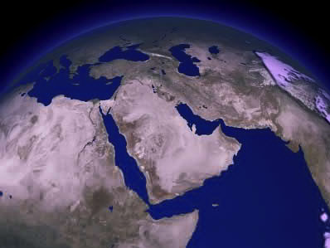
COMPARE THE GIFTS TODAY…
ISAAC
ABRAHAM
ISHMAEL
The CALL
L - S - B
I - I
WHY THE ENORMOUS DIFFERENCE?
Handbook pg. 19-24
33
3
Notes:
It's interesting to compare those gifts today…
//// Generally speaking…here are the lands populated today by the descendants of Ishmael…the lands of the Middle East.
//// But then…compare that with the descendants of Isaac in the Middle East…right there in tiny Israel.
//// Why the enormous difference?

Slide 37
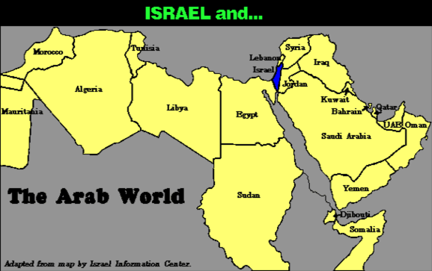
7
COMPARE THE GEOGRAPHY…
Israel and…
ABRAHAM
The CALL
L - S - B
The Arab World
I - I
Handbook pg. 19-24
34
Notes:
Practically speaking…just compare the geography…today's Israel versus the rest of the Arab world!

Slide 38
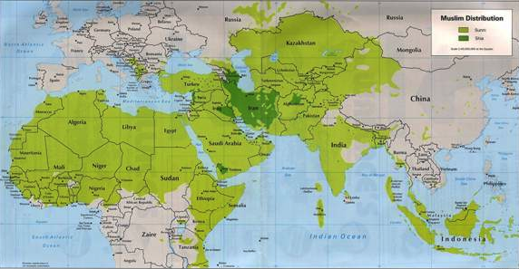
7
COMPARE THE GEOGRAPHY…
ABRAHAM
The CALL
L - S - B
I - I
MOHAMMED VERSUS ISAAC!
Handbook pg. 19-24
35
Notes:
But there is something else at work here. Compare the Middle Eastern influence of Ishmael's descendant, Mohammed, founder of Islam…with that of Isaac, the great Israelite patriarch, and the brother of Ishmael!

Slide 39
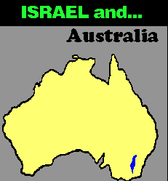
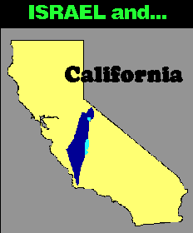
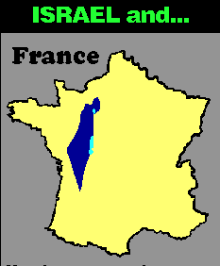
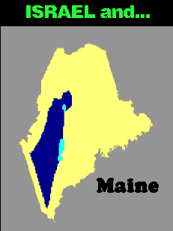


7
COMPARE THE GEOGRAPHY…
ISRAEL and…
ISRAEL and…
Australia
ISRAEL and…
France
California
ISRAEL and…
ISRAEL and…
Singapore
ABRAHAM
The CALL
L - S - B
I - I
Maine
Maps drawn to same scale with Israel in blue
Handbook, pages 19-24
4
36
9.65.03b.
Notes:
In today's geopolitical world…compare the size of tiny Israel with
Australia…
//// Israel with France…
//// Israel and the United States' state of Maine…or
//// Israel and California.
//// The width of Singapore and Israel are about the same.

Slide 40
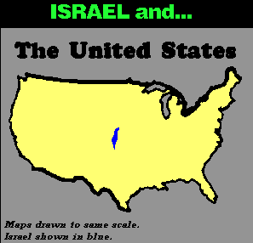
7
ISRAEL and…
THE UNITED STATES
ABRAHAM
The CALL
L - S - B
I - I
DOES THIS SEEM FAIR?
Handbook pg. 19-24
37
Notes:
And finally…even when Israel is compared to the entire United States…from the north to the south…from east to west: when it comes to size alone, there is enormous disparity between Isaac and Ishmael! Why is this so? How can we explain it?

Slide 41
7
"…the Ishmaelites were given more land and ultimately more wealth than Israelites. This was true in their past history, not to mention the vast oil wealth of modern times. And spiritual salvation has always been open to the Ishmaelites.
ABRAHAM
The CALL
L - S - B
I - I
Hal Lindsey, The Everlasting Hatred: The Roots of Jihad (2002), 65
Handbook pg. 19-24
38
Notes:
Look at this passage from Hal Lindsay's 2002 book, The Everlasting Hatred: The Roots of Jihad:
"…the Ishmaelites were given more land and ultimately more wealth than Israelites. This was true in their past history, not to mention the vast oil wealth of modern times. And spiritual salvation has always been open to the Ishmaelites."
[Continue to the next part of the passage below.]

Slide 42
7
"…the Ishmaelites were given more land and ultimately more wealth than Israelites. This was true in their past history, not to mention the vast oil wealth of modern times. And spiritual salvation has always been open to the Ishmaelites.
But God's covenant, which concerned His spiritual purposes, was only for Isaac and his descendants. The physical blessings promised to Isaac were to facilitate God's spiritual call for the nation that would come from him." [Emphasis added]
ABRAHAM
The CALL
L - S - B
I - I
Hal Lindsey, The Everlasting Hatred: The Roots of Jihad, 2002, p. 65
Handbook pg. 19-24
39
Notes:
"But God's covenant, which concerned His spiritual purposes, was only for Isaac and his descendants. The physical blessings promised to Isaac were to facilitate God's spiritual call for the nation that would come from him."

Slide 43
7
LEBANON
Mediterranean Sea
DESCENDANTS OF ISAAC
SYRIA
Sea of Galilee
IRAQ
Haifa
Nazareth
Netanya
JORDAN
Tel Aviv-Jaffa
AMMAN
JERUSALEM
Jericho
Gaza
Hebron
Dead Sea
ABRAHAM
Beersheba
The CALL
ISRAEL
L - S - B
I - I
DESCENDANTS OF ISHMAEL
EGYPT
SAUDI ARABIA
Eilat
Al' Aqaba
Gulf of Aqaba
ISHMAEL & ISAAC IN TODAY'S ISRAEL
Handbook pg. 19-24
40
2
Notes:
And inside the ancient Land right now…
//// Here, the descendants of Isaac
//// and the descendants of Ishmael continue today -- that endless conflict begun in Abraham's tent in ancient Palestine or Canaan – or Israel -- so long ago. Jewish Israel is engulfed by the descendants of Ishmael in surrounding countries on all sides! The implications of that circumstance in our own day are enormous.

Slide 44
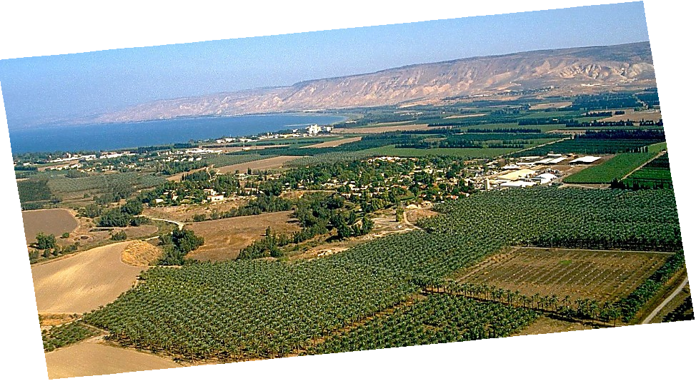
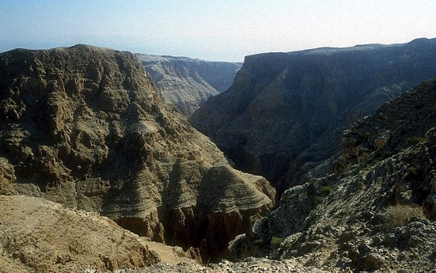
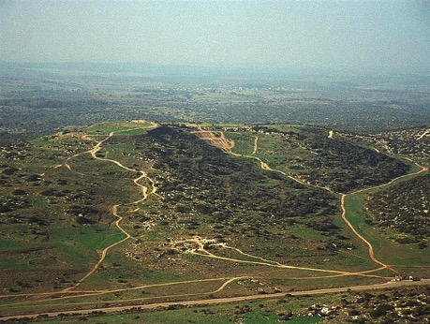
Gen. 13:10-11; Ex 3:8
A PORTION OF ABRAHAM'S PROMISE,,,
ABRAHAM
The CALL
L - S - B
I - I
THE MARVELOUS BEAUTY OF CANAAN…
THE LAND OF HIS ANCIENT INHERITANCE!
The Jordan River in Central Israel
Handbook pg. 19-24
41
1
© 2006 TBBMI
9.65.03b.
Notes:
And here is that Land today…but only a portion of God's promise to Abraham…this lush location along Israel's Jordan River.
//// the Land of his promised inheritance! From the fertile north to the desolate south…"milk and honey" are only the start of the blessings of this special piece of earth's real estate.

Slide 45
7
Ex. 2:24
ABRAHAM
ABRAHAM
ca. 2000 B.C.
The CALL
AC
L - S - B
AJMJ
I - I
Gen. 12:1-3
J - E
12
ABRAHAM
The CALL
L - S - B
I - I
J - E
Jacob is the Son of the Promise!
12
THE LINE OF THE PROMISE!
Handbook pg. 19-24
42
7
Notes:
The story now begins to move much faster. ISAAC, ABRAHAM's son through Sarah, IS the Son of God's promise.
//// ISAAC then has two sons: JACOB and ESAU (J and E on the ABRAHAM File Folder). JACOB is the son through whom the unconditional Promise now passes on.
//// Jacob, in turn has 12 sons (the number 12 on the Abraham folder).
//// So, then...the Line of the Promise...is
//// Abraham
//// Isaac
//// Jacob and
//// the 12 sons of Jacob.

Slide 46
7
Gen. 35:23-26; Gen. 34:1
ABRAHAM
ABRAHAM
ca. 2000 B.C.
The CALL
AC
L - S - B
AJMJ
I - I
Gen. 12:1-3
J - E
12
12
ABRAHAM
1
10
The CALL
L - S - B
I - I
6
J - E
8
12
4
5
13
7
11
3
9
2
Handbook pg. 19-24
43
Notes:
Here is a graphic representation of those 12 sons of JACOB, born to him and his four wives across the long years of his life. You'll see there was also a 13th child… one daughter. From those 12 sons of old Jacob emerge the 12 tribes of Israel.

Slide 47
7
Gen. 35:24
ABRAHAM
ABRAHAM
ca. 2000 B.C.
The CALL
AC
L - S - B
AJMJ
I - I
Gen. 12:1-3
J - E
12
ABRAHAM
The CALL
L - S - B
I - I
J - E
12
11
Handbook pg. 19-24
44
Notes:
But notice one particular son of Jacob – number eleven, one of his youngest -- and probably the most remembered of all his children. This son's story is familiar to almost everyone:

Slide 48
7
Gen. 35:24
ABRAHAM
ABRAHAM
ca. 2000 B.C.
The CALL
AC
L - S - B
AJMJ
I - I
Gen. 12:1-3
J - E
12
ABRAHAM
The CALL
L - S - B
I - I
J - E
12
JOSEPH!
11
Handbook pg. 19-24
45
Notes:
His name is JOSEPH. This great man of legendary character –– his name known throughout the ages -- bridges us over to the next of the four biblical personalities in this mental map of the biblical storyline:

Slide 49
7
Gen. 1 through 25
CREATION
ANARCHY
1st Man & Woman
1st Sin
C
1st Gospel
1st Family
ROYALTY
(1000 B.C.)
1st Murder
Flood/Rainbow
Tower
(2000 B.C.)
ABRAHAM
(2000 B.C.)
3 SOCIETIES
C 7 S J
The CALL
AC
L - S - B
I - I
J - E
12
CAPTIVITY
7 = 4 + 3
JOSEPH
ABRAHAM
The CALL
4 PEOPLE
L - S - B
I - I
MOSES
(1500 B.C.)
(500 B.C.)
J - E
S
S
SILENCE
12
JESUS
J
JOSHUA
46
2
Notes:
Now we've completed the second folder in the Bible File collection:
//// first is CREATION,
//// followed by ABRAHAM, the first of the four great names.

Slide 50
7
AJMJ
The SECOND
of the
4 PEOPLE
is:
?
47
Notes:
Time now to move forward to the second in the group of four great Old Testament characters…the Bible File Folder Number 3.
From "A Judge Must Judge" we know that his name begins with the letter J. Which is…

Slide 51
7
Gen 30:24
AJMJ
The SECOND
of the
4 PEOPLE
is:
"JOSEPH"
48
Notes:
Joseph. Probably no Biblical character is more famous, more legendary than this one man who -- through his character and his integrity before God -- changed all of human history.

Slide 52
7
Gen 30:24
APPROXIMATE DATING:
ABRAHAM-JOSEPH 2000 B.C.
49
Notes:
And the timeline…let's keep it generally in that early 2000 B.C. range. It's unnecessary to be more specific at this point. So don't feel burdened to remember a long lists of ancient dates. The dates presented in THE BIBLE…BASICALLY are only broad anchor points to help keep events in correct order. You can sharpen them later.

Slide 53
7
Gen. 30:24 through Gen. 50:26
CREATION
"A
Judge
Must
Judge"
ABRAHAM
ABRAHAM
ABRAHAM
JOSEPH
ABRAHAM
MOSES
JOSHUA
ANARCHY
ROYALTY
CAPTIVITY
SILENCE
JESUS
Handbook pg. 24-25
50
Notes:
And here is Joseph's folder in the Bible File lineup.
"A JUDGE MUST JUDGE"…the first "J" which brings to mind: JOSEPH.

Slide 54
7
JOSEPH
ABRAHAM
The SECOND
of the
4 PEOPLE
is:
JOSEPH
AJMJ
Handbook pg. 24-25
51
Notes:
JOSEPH's folder appears ready for two significant events to be filled in. The young man is well loved by his father, JACOB — so deeply and obviously, in fact…

Slide 55
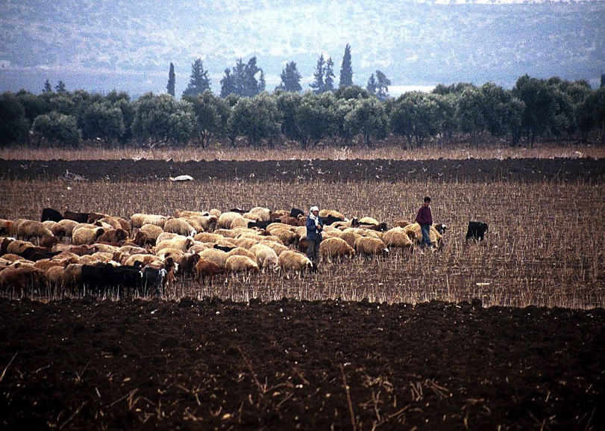
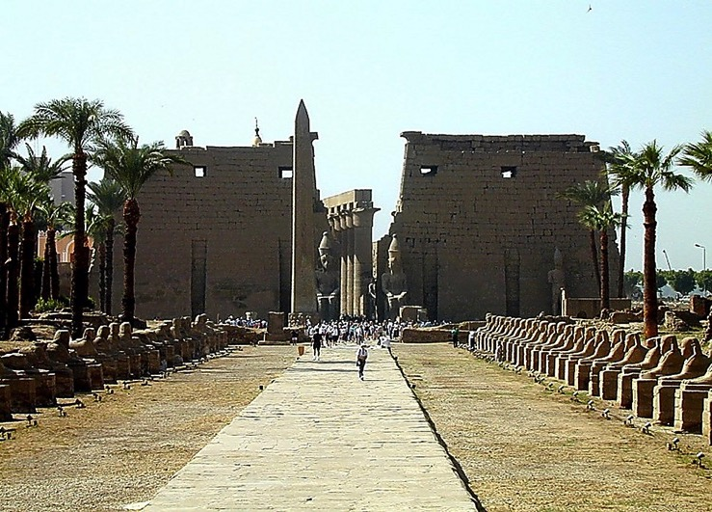
Gen. 37:16-18
Façade of Luxor Temple, Egypt
JOSEPH
Shepherds in the Fields of Dothan, Israel
Handbook pg. 24-25
52
1
Notes:
…that it arouses the envy of most of his shepherd brothers. Tending flocks at that time in the fields near today's Dothan in northern Israel…
//// the brothers plot against JOSEPH, selling him into slavery to a passing caravan on its way to Egypt.

Slide 56
Gen. 37:28
JOSEPH
Handbook pg. 24-25
53
Notes:
Once in Egypt…among the fabulous wealth and wonders of that advanced civilization…and after several difficult personal trials…JOSEPH is soon discovered to be a brilliant young man with enormous administrative ability. He learns quickly while remaining faithful and obedient to God's authority and leading in his life.

Slide 57
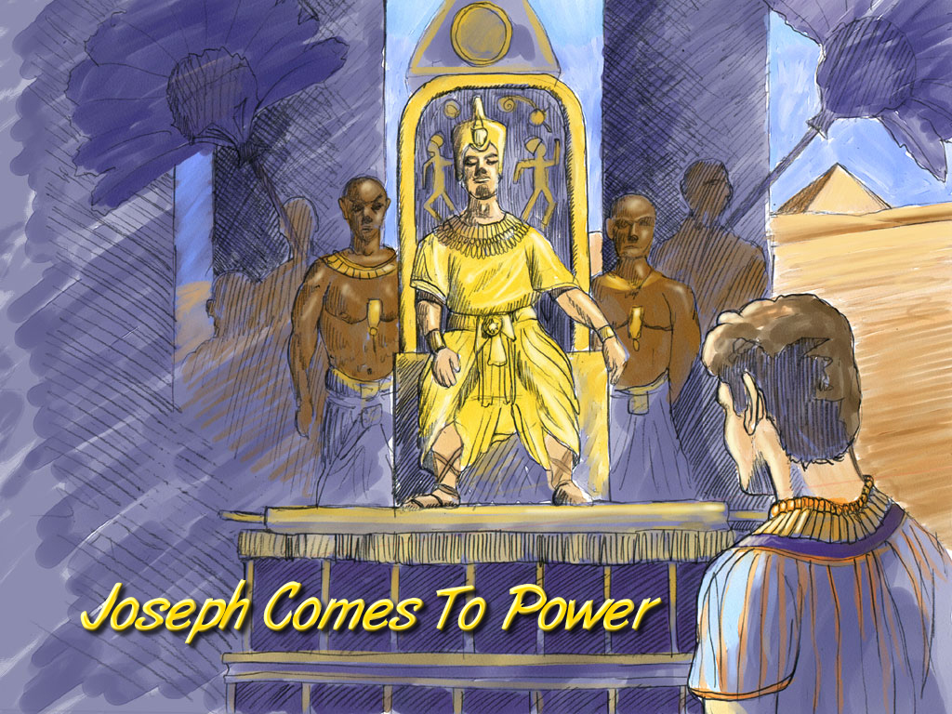
Gen. 41:41-46
JOSEPH
Joseph Comes To Power
Joseph Comes to Power
Handbook pg. 24-25
54
Notes:
In time JOSEPH rises in Egyptian civil authority. He becomes governor of all of Egypt, second only to the Pharaoh himself.

Slide 58
Gen. 42:2
DRESSING
THE
STAGE
MS
N(A)
FAMINE!
H
SG
C
ER
B
J
MN
JOSEPH
DS
E
KB
U
PLENTY!
MS
PG
RS
Handbook pg. 24-25
55
1
Notes:
At this same time, back in Canaan, famine strikes The Land.
//// In order to survive the crisis, JOSEPH's father, old JACOB (now called Israel), sends some of the brothers to Egypt to buy grain. FAMINE IN THE NORTH…PLENTY TO THE SOUTH. (On your map, add the tracing line from Canaan down to Egypt.)

Slide 59
Gen. 42:7
Joseph and His Brothers
JOSEPH
Joseph and His Brothers
Handbook pg. 24-25
56
Notes:
Through a series of dramatic events -- told about in great detail in the latter chapters of Genesis – the brothers learn that their sibling, JOSEPH, is now the governor of Egypt

Slide 60
Gen. 46:3-7
DRESSING
THE
STAGE
MS
N(A)
H
SG
C
ER
THE FAMILY FOLLOWS…
THE FAMILY WILL BECOME A NATION !
B
J
MN
JOSEPH
DS
E
KB
U
MS
PG
RS
Handbook pg. 24-25
57
Notes:
The family follows and decides to settle in Egypt permanently. And there...as a family of Hebrews…they begin to multiply into a nation, to be known through later history as the Israelites.

Slide 61
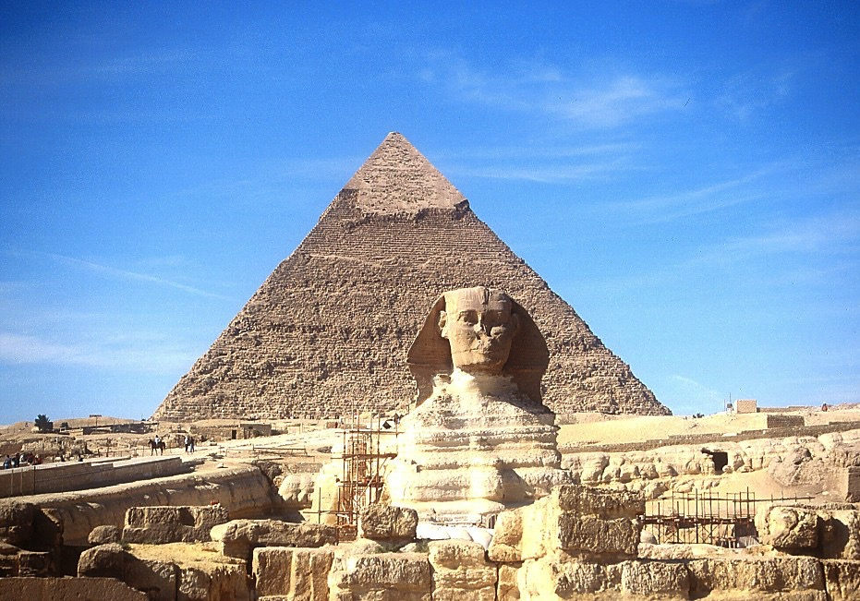
7
JOSEPH
The Sphinx and the Great Pyramid
Handbook pg. 24-25
58
Notes:
For a while, they remain in good favor with the Egyptian people and the government administration. After all, they are the family of their respected Governor! Perhaps they even saw the great structures of the Sphinx and the pyramids of Egypt even as they remain for us to marvel at today.

Slide 62
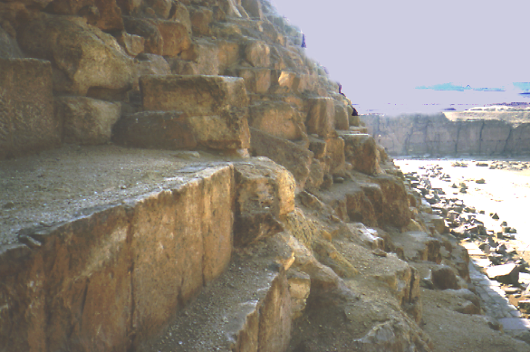
7
JOSEPH
The Quarries at the Great Pyramid
Handbook pg. 24-25
59
Notes:
We can climb the side of the Great Pyramid today and wonder: are these the quarries where Joseph's family later slaved through the centuries? Maybe so. Some evidence points in that direction.

Slide 63
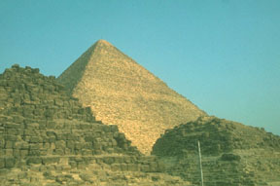
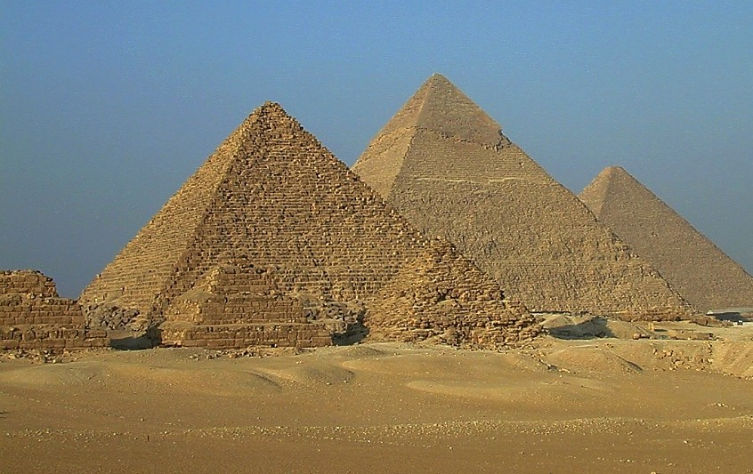
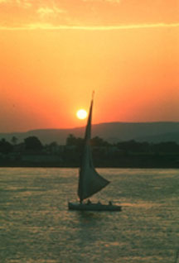
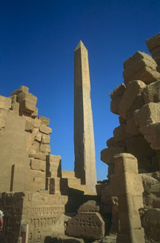
7
THE ISRAELITE'S SAW…
JOSEPH
…EGYPT'S ANCIENT WONDERS.
Handbook pg. 24-25
60
Notes:
As time passed and Joseph died, these ancient wonders would have seen the throne of Egypt undergo changes of attitude and a loss of respect for the alien Hebrews -- or the Israelites, the old family of Joseph.

Slide 64
Ex. 8:8-10
JOSEPH
ABRAHAM
SLAVERY
The SECOND
of the
4 PEOPLE
is:
AJMJ
Notes:
After his death, Joseph's long service to Egypt is soon forgotten.
//// While at the same time, as a population, the Israelites are multiplying rapidly – lots and lots of children –
[NOTE: SEVEN SETS OF "CHILDREN-DOTS" APPEAR]
– soon becoming an enormous social problem and a serious national threat to their Egyptian overlords. So…to take care of that problem…
//// the Israelites, Joseph's national descendants, become SLAVES to the Egyptians.
//// Israelites are in Egypt for some 430 years. Much of that time is lived out under the terrible bondage of Egyptian slave masters.

Slide 65
7
Gen. 1:1 through Ex. 1:6
CREATION
ANARCHY
1st Man & Woman
1st Sin
C
1st Gospel
1st Family
ROYALTY
(1000 B.C.)
1st Murder
Flood/Rainbow
Tower
(2000 B.C.)
ABRAHAM
(2000 B.C.)
3 SOCIETIES
C 7 S J
The CALL
AC
L - S - B
I - I
J - E
12
CAPTIVITY
7 = 4 + 3
JOSEPH
JOSEPH
Slavery
Slavery
430
430
4 PEOPLE
MOSES
(1500 B.C.)
(500 B.C.)
S
S
SILENCE
JESUS
J
JOSHUA
Handbook pg. 24-25
62
Notes:
Now…THE BIBLE FILE...is filled in to include
CREATION, ABRAHAM, and JOSEPH…

Slide 66
7
AJMJ
The THIRD
of the
4 PEOPLE
is:
?
63
Notes:
…which brings us now to the third person in the Group of Four great Biblical personalities.
This great person – THE LARGE CAPITAL M – will be…

Slide 67
7
Ex 2:10
AJMJ
The THIRD
of the
4 PEOPLE
is:
"MOSES"
64
Notes:
...MOSES.
In His time, God raises up the most famous of all the Old Testament characters, MOSES, known as The Great Deliverer…
to take the people out of their Egyptian bondage and on toward the land of Abraham's promised inheritance.

Slide 68


The Bible…Basically link at BibleStudyDownloads.org
Get this presentation for free!
Notes:
The Bible…Basically (bb)

Slide 69
65
©2006 TBBMI
9.65.03b.

