Slide 1
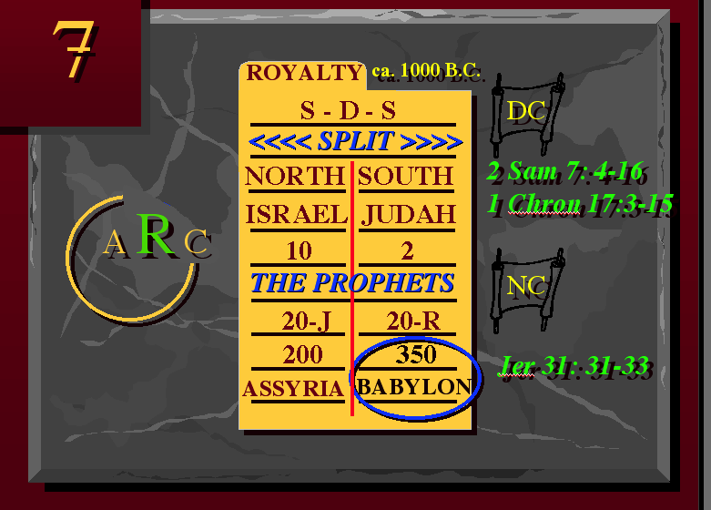
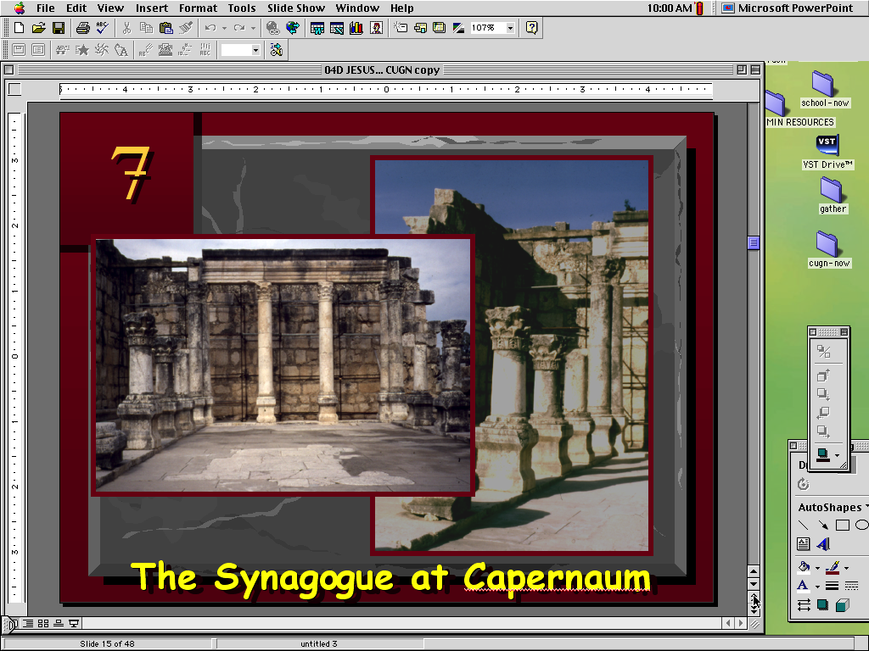
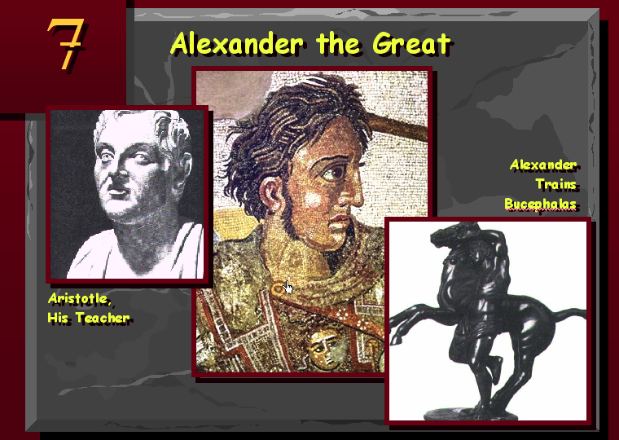
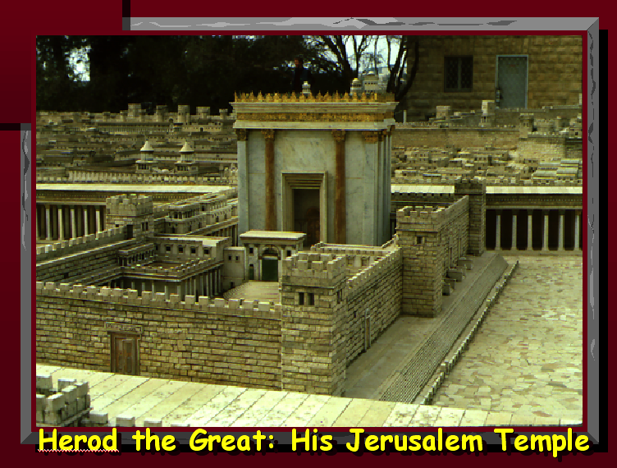
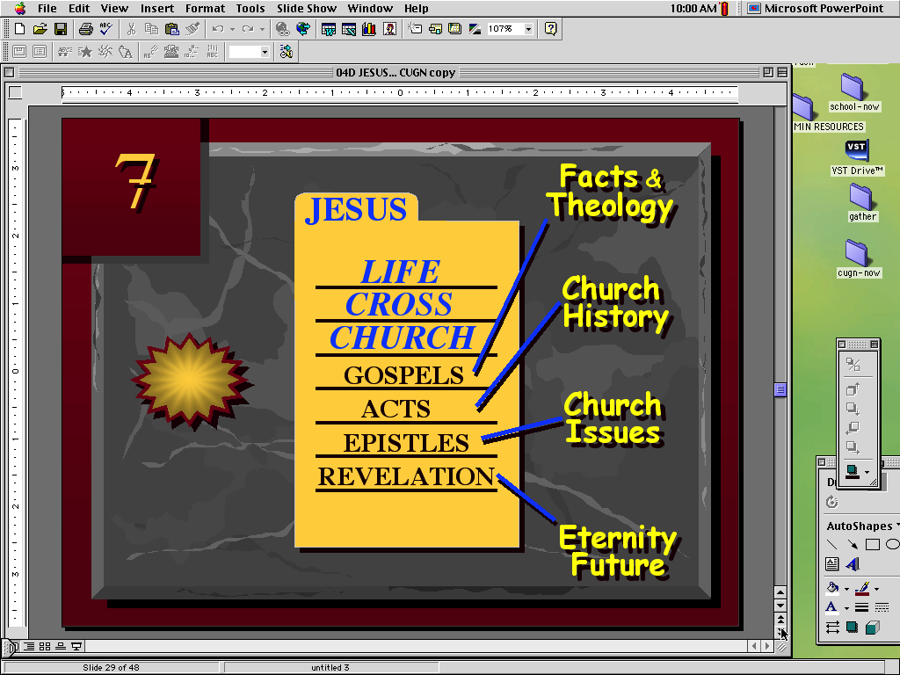
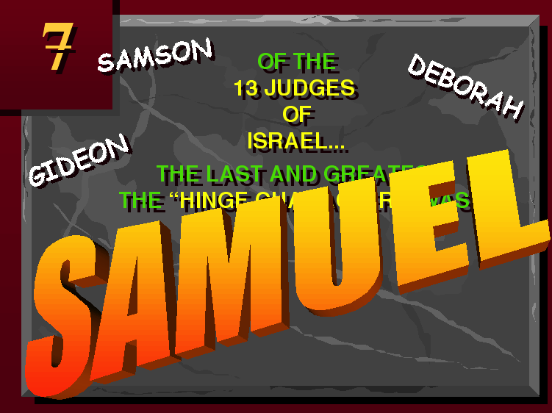
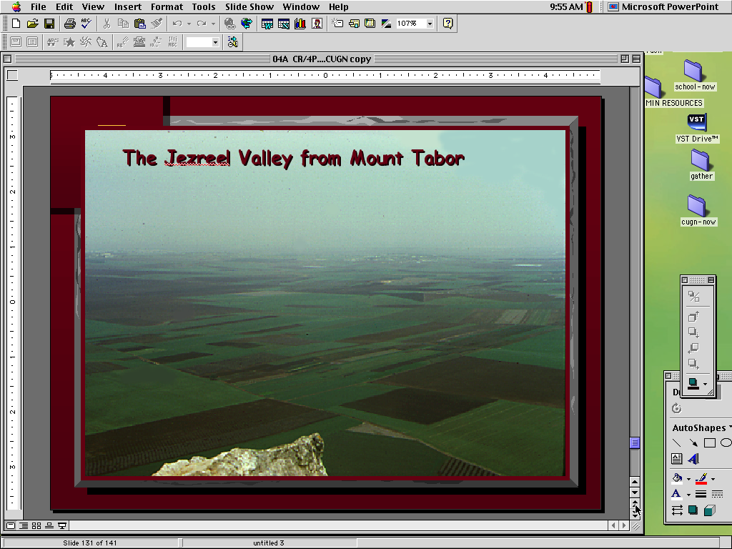
THE BIBLE PUZZLE COMES TOGETHER -- FINALLY!
Discipleship Seminars in Biblical Literacy
Discipleship Seminars in Biblical Literacy
Study Helps
Designed by John E. Fryman, PhD
Taught by Rick Griffith, PhD
Amman International Church Retreat
19-21 May 2022 • Camp Gilead, Jordan
Available in Arabic and English at
BibleStudyDownloads.org
9.65 BETA
The Bible…Basically Ministries Intl, Inc.
Notes:
Slide screen shots from these presentations and slide numbers:

