Slide 1
To translate “Dressing the Stage” go View > Master > Slide Master
Mediterranean Sea
LEBANON
SYRIA
Haifa
Sea of Galilee
IRAQ
Nazareth
Map
Netanya
Tel Aviv-Jaffa
AMMAN
JERUSALEM
Jericho
Gaza
Hebron
Dead Sea
Beersheba
ISRAEL
JORDAN
EGYPT
SAUDI ARABIA
Eilat
Gulf of Aqaba
Al' Aqaba
Designed by Dr. John Fryman, Texas, USA
Taught by Dr. Rick Griffith, Jordan Evangelical Theological Seminary
Free download of all files in many languages at BibleStudyDownloads.org
04
1
Notes:
With a closer view, you can locate the region in today's Mediterranean Basin, at its far eastern end…..
a close-up view of the Holy Land today…hotly divided politically and culturally between
//// …the Jewish and Arabic peoples.... for many reasons that we will uncover as THE BIBLE…BASICALLY moves along.

Slide 2


THE BIBLE... BASICALLY
©2006 TBBMI

Slide 3
Opening Up
"Your Bible File"
7
7
7
7
7
7
7
7
C
7
J
C
S
J
C
S
J
C
S
J
S
Handbook pg. 8-14
4
42
Notes:
We begin right here...with the single number…. 7.
That's our mental anchor point. Simply the number 7 with that all-important dash through the stem.
//// Next step...surround that number with three alphabet letters. Set them firmly in place in your mind: C 7 S J
Repeat the letter group aloud several times as you embed it in your mind... Because this is the very core of the Bible's organization and time-line flow:
//// "C 7 S J....
//// C 7 S J....
//// C 7 S J...etc."

Slide 4
10 File Folders
7
1
2
3
C
4
5
6
7
7
8
S
9
10
J
Handbook pg. 8-14
41
Notes:
As a starting point, begin thinking about 10 file folders in a filing cabinet.
You are going to organize your own Bible File into a collection of these ten mental file folders.
Very soon you'll be applying labels to each of those 10 file folders. So…now to begin…and…

Slide 5
Your New Mental "Bible File"
CREATION
CREATION
ABRAHAM
ABRAHAM
ABRAHAM
ABRAHAM
JOSEPH
ABRAHAM
MOSES
JOSEPH
JOSHUA
ANARCHY
MOSES
ROYALTY
CAPTIVITY
JOSHUA
SILENCE
JESUS
ANARCHY
ROYALTY
CAPTIVITY
SILENCE
JESUS
Handbook pg. 8-14
59
11
Notes:
Now it's time mentally to apply those ten words as labels to ten mental folders in your new Bible File –
//// right up there in your head. That mental picture might look something like this. And there they are...
//// CREATION//// ABRAHAM//// JOSEPH//// MOSES//// JOSHUA//// ANARCHY//// ROYALTY//// CAPTIVITY//// SILENCE…and…//// JESUS.
Now it's organized in a neat and orderly package in your mind --- ready for recall and use as you need it. Now just a few more
examples to drive home the point...

Slide 6

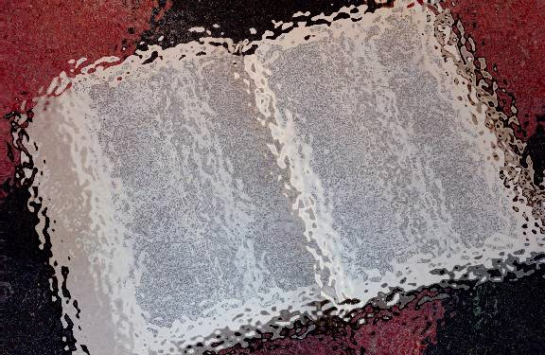

(Where is that place, anyway?)
THE BIBLE…
BASICALLY
®
PART TWO
DRESSING THE STAGE:
MAKING A MAP OF THE ANCIENT NEAR EAST
9.65.02.
©2006 TBBMI
02
Notes:
In studying God's Word…somewhere along the way a question always arises..."Where is that place, anyway?"
So for the next step in building the BIBLE FILE...we'll learn to make a map of the Ancient Near East.
As a subtitle to this section, you might call it, "Dressing the Stage" of all the Biblical action. Let's start.

Slide 7
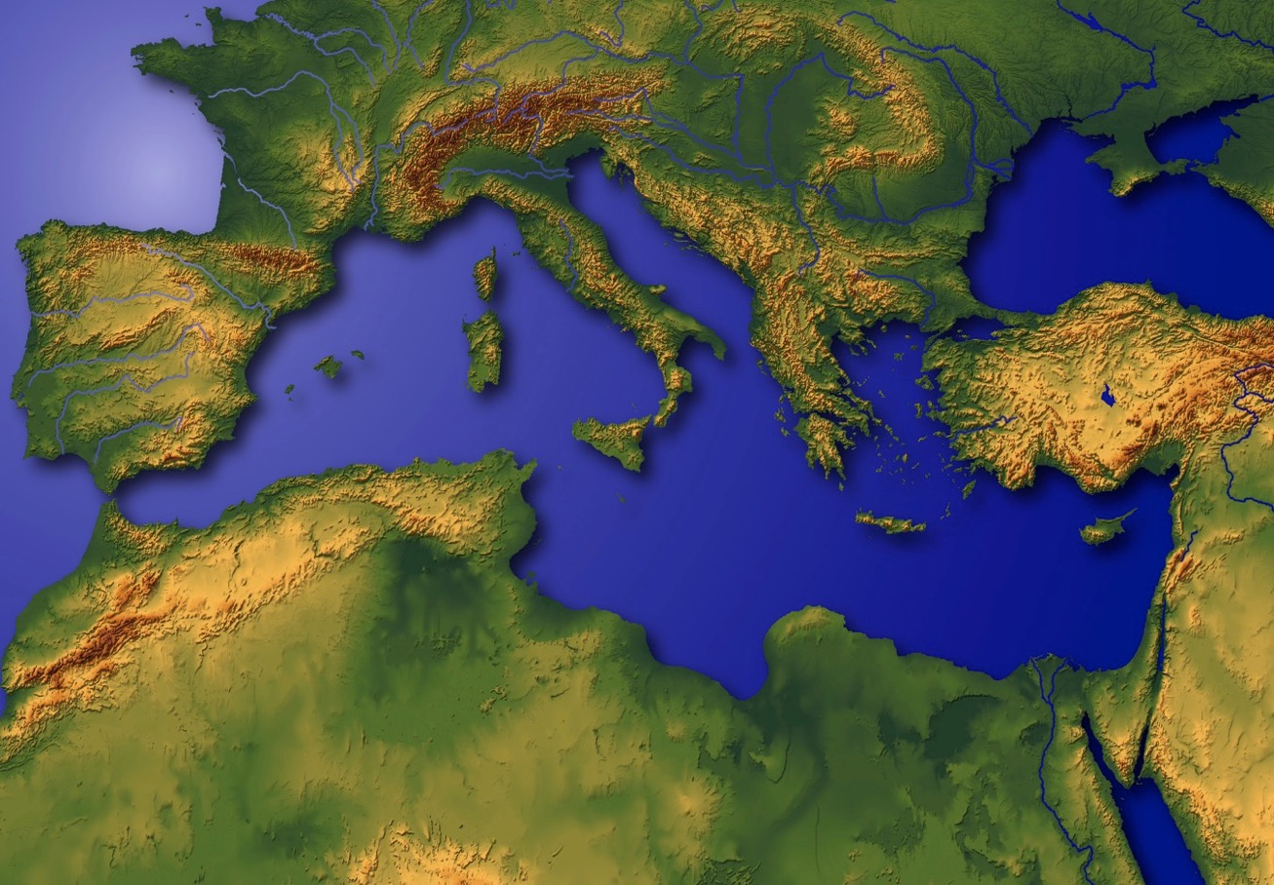
DRESSING
THE
STAGE
?
The Mediterranean Stage of the Biblical Action
4
9.65.02.
4
03
© 2006 TBBMI
03
Notes:
So…LET'S DRESS THIS STAGE!
And here we are...this lonely ball floating in God's infinite space…a beautiful but troubled planet…the scene of that great story line we'll soon explore in THE QUICK CHRONOLOGY.
//// So a basic question is.…where, on this planet, did all those great events take place?
In studying God's Word…it's really helpful to know just WHERE the WHAT really happened…and to have it in your own head!
//// Right there...in a far corner of what we call today's Middle East...
//// ….the great story was played out, beginning in that very ancient place with its mysterious and exotic past…
//// …a part of the world that many have called a hinge of history…
this is the Mediterranean Stage of the Biblical Action.

Slide 8
To translate “Dressing the Stage” go View > Master > Slide Master
Mediterranean Sea
LEBANON
SYRIA
Haifa
Sea of Galilee
IRAQ
Nazareth
Netanya
Tel Aviv-Jaffa
AMMAN
JERUSALEM
Jericho
Gaza
Hebron
Dead Sea
Beersheba
ISRAEL
JORDAN
EGYPT
SAUDI ARABIA
Eilat
Gulf of Aqaba
Al' Aqaba
04
1
Notes:
With a closer view, you can locate the region in today's Mediterranean Basin, at its far eastern end…..
a close-up view of the Holy Land today…hotly divided politically and culturally between
//// …the Jewish and Arabic peoples.... for many reasons that we will uncover as THE BIBLE…BASICALLY moves along.

Slide 9
MS
N(A)
H
SG
C
ER
B
J
MN
DS
E
KB
U
THE REASONS FOR A MAP!
MS
PG
RS
Handbook pg. 15-16
1
05
Notes:
Now…the reasons for all this. You're going to learn to make your own map of the Ancient Near East...
and you'll use your map to trace the progress of the great Biblical epic...each step of the way...
//// ...just like this…step-by-step as each major section of the story line unfolds.

Slide 10
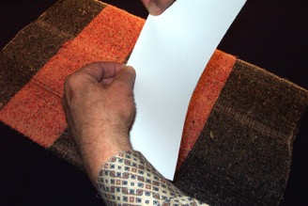
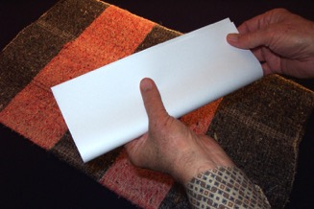
STUDY HELP #03a (extra blank page #03b)
HOLD A
PIECE
OF
PAPER
HORIZONTALLY, FOLD LENGTHWISE, ONCE
Handbook pg. 15-16
06
Notes:
Study Help Number 3A and 3B in the student handbook give you blank pieces of paper to use to make this map.
So please take one of those sheets of paper from the handbook...
then hold it horizontally...fold it lengthwise, once…

Slide 11
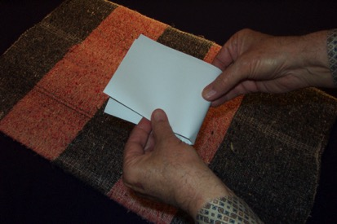
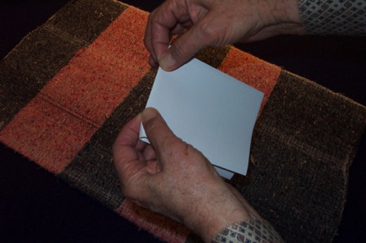
FOLD IT OVER ONCE AGAIN…
…TO MAKE TWO CREASED LINES.
Handbook pg. 15-16
07
Notes:
...then fold it over once again, so that as you unfold it you have a paper with two creases...
one vertical...one horizontal…representing North-South and East-West directions on your map.
Place it in front of you horizontally...or lengthwise.

Slide 12
Handbook pg. 15-16
3
08
Notes:
With the paper placed lengthwise, get ready to make your new map...to dress the stage...
of the Middle Eastern Biblical action.
//// As we move forward, watch for the addition of the yellow lines.
//// You'll add those yellow line segments to your own map as we move forward.
Every new line you draw will be shown in yellow as you see here…
//// while the lines you've drawn earlier will change to darker colors like this green one.

Slide 13
FIRST:
6 WATER BODIES
SECOND:
10 LAND LOCATIONS
THIRD:
RELATIVE DISTANCES
Handbook pg. 15-16
2
09
Notes:
So now you know where we are headed...First you will learn to locate SIX of the main
water bodies mentioned in Scripture...
//// and second...only 10 of the most important geographic locations.
This will not be an overwhelming geography lesson. Have no fear of that.
And third…remembering
//// that the locations and distances are ONLY RELATIVE…ONLY APPROXIMATE.
But…close enough to build a reliable mental map of the land and water relationships in Scripture.

Slide 14
Handbook pg. 15-16
1
10
Notes:
On your paper...again, arranging the paper horizontally...in the upper left hand quadrant,
draw a large crescent or arc like the yellow line here…
//// followed by another crescent or arc in the lower right hand quadrant of the paper.
The yellow lines show you exactly how to do this.
Along the way you will also see what those locations look like today.

Slide 15
Handbook pg. 15-16
11
Notes:
Next comes the shape of something like a shepherd's hook,
beginning in the middle of that lower quadrant.
Draw the hook so that it almost reaches the edge of the upper crescent.

Slide 16
USE NO PLACE NAMES...
USE ONLY
FIRST LETTERS OF NAMES...
NOT THE ENTIRE WORDS!
Handbook pg. 15-16
12
Notes:
As we move through this map-making, it's best that you use NO place names.
Instead use only the first letters of those names...not the entire words.
This will force your mind to recall the entire word as suggested by the first-letter labels on your map. Like this…

Slide 17
Numbers 34:6-7; Joshua 1:4
MS
Handbook pg. 15-16
13
Notes:
Write MS inside the upper left hand quadrant...
and here is a photo at that water body at this present time.
//// Notice in the upper left hand corner a scriptural reference to this great body of water, known in ancient times as The Great Sea. Many other references or scriptural locations will appear in that same place as we move through the other visuals of The Bible…Basically

Slide 18
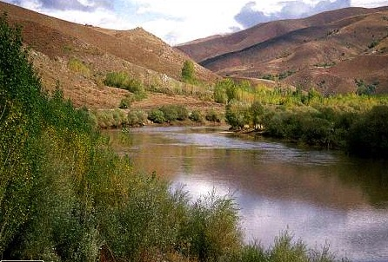
MS
ER
Handbook pg. 15-16
14
Notes:
...next…add an ER somewhere in the middle along the shepherd's hook…

Slide 19

MS
ER
PG
Handbook pg. 15-16
15
Notes:
...and finally, write in PG inside the lower right-hand quadrant.

Slide 20
MS
MEDITERRANEAN SEA
ER
EUPHRATES RIVER
PG
PERSIAN GULF
Handbook pg. 15-16
2
16
Notes:
These single letters represent the full names of the MEDITERRANEAN SEA in the upper left. Again…don't write in the full word…just the letters…
//// EUPHRATES RIVER along the shepherd's hook...and
//// PERSIAN GULF in the lower right-hand quadrant.
So...three water bodies are located...three more to go: beginning in the lower left-hand quadrant of your map.

Slide 21
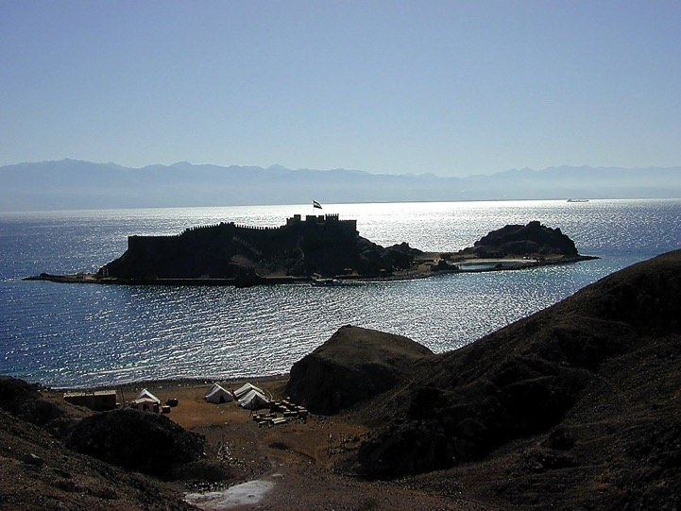
MS
ER
PG
Handbook pg. 15-16
17
Notes:
…draw a figure that looks something like well-rounded rabbit's ears

Slide 22
MS
ER
RED SEA
PG
RS
Handbook pg. 15-16
18
Notes:
Inside the ears, and on the water surface, write in RS representing THE RED SEA.
And here's a good picture of what THE RED SEA looks like today.

Slide 23
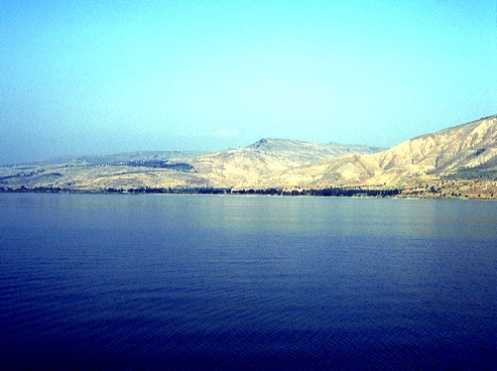
MS
ER
PG
RS
Handbook pg. 15-16
19
Notes:
Next move up to a place just below the shepherd's hook. Draw in two flattened oval shapes, a smaller one circled here…

Slide 24
MS
ER
PG
RS
Handbook pg. 15-16
20
Notes:
... above a larger one...with a single line connecting the two.

Slide 25
MS
SG
SEA OF GALILEE
ER
PG
RS
Handbook pg. 15-16
21
Notes:
Near the smaller oval...mark it with SG, for THE SEA OF GALILEE.

Slide 26
MS
SG
SEA OF GALILEE
ER
DS
DEAD SEA
PG
RS
Handbook pg. 15-16
22
Notes:
At the larger oval, add DS for THE DEAD SEA.

Slide 27
MS
SG
ER
DS
JORDAN RIVER
PG
RS
Handbook pg. 15-16
23
Notes:
Because the map will become a little crowded as we complete it, don't write in this river name...just know that the short line connecting the two ovals...the Sea of Galilee and the Dead Sea…is the famous and beautiful JORDAN RIVER. You'll remember that! Our Lord was baptized in these same waters.

Slide 28
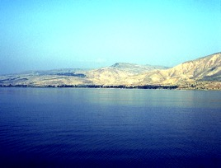

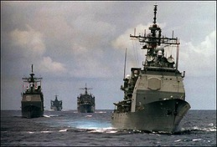
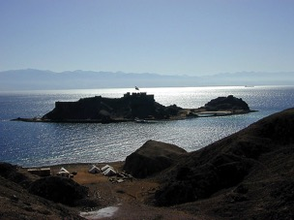
6
MS
SG
ER
DS
WATER BODIES
PG
RS
Handbook pg. 15-16
7
24
Notes:
Now...we've identified and labeled six bodies of water plus a river, each one very important
toward dressing that stage for all the Biblical action to follow. We've placed the
//// MEDITERRANEAN SEA,
//// THE EUPHRATES RIVER,
/// THE PERSIAN GULF,
//// THE RED SEA,
//// THE DEAD SEA,
//// THE SEA OF GALILEE, with the JORDAN RIVER connecting those two bodies.
//// A total of 6 water bodies that make up your map.
OK...that's the water part of your map.

Slide 29

MS
SG
ER
DS
PG
RS
Handbook pg. 15-16
25
1
Notes:
Now let's turn toward the land itself...the land that becomes the stage across which this timeless Biblical drama unfolds.
//// Scripture describes the land of the Bible as this huge land spread across an enormous stretch of Middle Eastern earth.

Slide 30
10
10 PLACES
MS
SG
ER
DS
Land Sites
PG
RS
Handbook pg. 15-16
26
1
Notes:
We're going to identify 10 --and only 10 -- geographic locations on the land...each one pivotal in the progress of the Biblical story line of THE QUICK CHRONOLOGY that follows.
//// So here we go. At the top of your map, right in the middle, on top of the north-south crease in the paper, write in the phrase, 10 PLACES.

Slide 31
10 PLACES
MS
4
SG
ER
DS
PG
RS
Handbook pg. 15-16
27
Notes:
Under "10 places," on the right side of the north-south line, add the number 4 with an arrow pointing east...that is...to the right.
THE CIRCLE YOU SEE IS ONLY A GUIDE TO CALL YOUR ATTENTION TO THE CORRECT PLACES ON THE MAP AS WE MOVE ALONG.

Slide 32
10 PLACES
MS
6
4
SG
ER
DS
The Biblical "Stage of the Action"
PG
RS
Handbook pg. 15-16
28
Notes:
Then on the left side, write in the number 6 with an arrow pointing to the left. We're now ready to identify those 10 specific land locations on this Biblical "Stage of the Action."

Slide 33
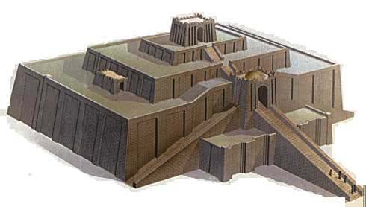
10 PLACES
MS
6
4
SG
ER
DS
U
PG
UR OF THE CHALDEES
RS
Handbook pg. 15-16
29
Notes:
Beginning on the eastern side of that north-south crease in the paper, down near the mouth of the Euphrates River, near where the river enters the Persian Gulf...write in a large letter, "U" ALONG WITH A VERY LARGE DOT FOR ITS APPROXIMATE LOCATION...standing for that great early city, UR of the Chaldees…famous for its ancient ziggurats or temple towers. Once again, we strongly recommend that you use only the first letters of the words...forcing your thinking to recall the entire word. Memory efficiency is nicely increased with such a simple tool.

Slide 34

10 PLACES
MS
6
4
SG
ER
B
DS
BABYLON
U
PG
RS
Handbook pg. 15-16
30
Notes:
So, U for UR...now we move upriver, perhaps about halfway upstream from the Persian Gulf. Write in a large B, another large dot…for the ancient city of Babylon, a city of maximum international importance in those far-away times.

Slide 35

10 PLACES
MS
6
4
H
SG
ER
B
DS
U
HARAN
(HARRAN,TURKEY)
PG
RS
Handbook pg. 15-16
31
Notes:
Next...somewhere out in that vast landscape, east of the river, write in a large H, for the ancient city of Haran, which, by the way, still exists to this day

Slide 36
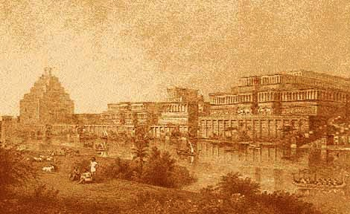
10 PLACES
MS
6
4
N(A)
H
NINEVEH (ASSYRIA) MOSUL, IRAQ
SG
ER
B
DS
U
PG
RS
Handbook pg. 15-16
32
Notes:
And finally, on the east side of the north-south coordinate, far to the east, write in a large N and in parenthesis a large A. These two letters stand for the city of Nineveh in the ancient kingdom of Assyria. Today's modern Iraqi city of Mosul is located near this ancient site.

Slide 37
10 PLACES
MS
6
4
N(A)
H
SG
ER
B
DS
U
PG
RS
Handbook pg. 15-16
33
Notes:
Four sites identified....UR OF THE CHALDEES... BABYLON... HARAN...and NINEVEH IN ASSYRIA.

Slide 38
10 PLACES
MS
6
4
N(A)
H
CANAAN TODAY
SG
ER
C
B
DS
U
PG
RS
Handbook pg. 15-16
34
1
Notes:
With the four locations east of the line identified, let's move to the six sites lying to the west of that north-south crease
//// Beginning with a large letter C placed between the Jordan River and the Mediterranean Sea. This letter stands for the entire region of CANAAN, before it came to be known as ancient Israel, or in later history, Palestine, and today, both as Israel and, once again, Palestine.

Slide 39
10 PLACES
MS
6
4
N(A)
H
SG
C
JERUSALEM
ER
J
B
DS
U
PG
RS
Handbook pg. 15-16
35
Notes:
Near the north end of the Dead Sea, still west of the Jordan River, place a large J, for, of course, the city of Jerusalem...arguably one of the world's greatest and most conflicted cities in all of our planet's history.

Slide 40
10 PLACES
MS
6
4
N(A)
H
SG
C
ER
MN
B
J
MT. NEBO
DS
U
PG
RS
Handbook pg. 15-16
36
Notes:
Now move across the Jordan, still near the north end of the Dead Sea...place the two letters MN, representing Mount Nebo. We will identify the importance of this location when we develop The Quick Chronology.

Slide 41

10 PLACES
MS
6
4
N(A)
H
KADESH BARNEA
SG
C
ER
B
J
MN
DS
KB
U
PG
RS
Handbook pg. 15-16
37
Notes:
Then...at a point below the south end of the Dead Sea, a place almost between the ears of the rabbit, write in KB...for the an ancient oasis named KADESH BARNEA, a picture as it appears today.

Slide 42
10 PLACES
MS
6
4
N(A)
H
EGYPT: The Giza Plateau
SG
C
ER
B
J
MN
DS
E
KB
U
PG
RS
Handbook pg. 15-16
38
Notes:
Two more locations to go...Near the top of the LEFT rabbit ear, write in a large E, for the kingdom of EGYPT...a land with infinite ancient mysteries and fascinating to us even today. And finally…

Slide 43
10 PLACES
MS
6
4
N(A)
H
MT. SINAI
SG
C
ER
B
J
MN
DS
E
KB
U
MS
PG
RS
Handbook pg. 15-16
39
Notes:
...deep in between the two rabbit ears write in ANOTHER MS, only this time the letters stand for MOUNT SINAI. Now you have a complete map, in your head…

Slide 44
10 PLACES
MS
6
4
N(A)
H
10 Land Sites
SG
C
ER
B
J
MN
DS
E
KB
U
MS
PG
RS
Handbook pg. 15-16
40
2
Notes:
….the 6 on the western side of the map...
//// and the 4 on the east…illustrating the land relationships between
//// these ten monumentally important Biblical land sites.

Slide 45
Judges 20:1; 2 Sam. 17:11; 1 Kings 4:25
10 PLACES
MS
6
4
N(A)
"FROM
DAN
TO
BEERSHEBA"
H
THE LAND
SG
C
ER
B
J
MN
DS
E
KB
U
MS
PG
RS
Handbook pg. 15-16
41
3
Notes:
One last addition. Throughout Scripture, we find repeated references to "The Land"...
//// such as in Judges 20:1. Notice again in the upper left hand corner of the frame that Biblical reference to this term as it's used in its Biblical sense. Many more reference citations will be placed there as we move through this study. So, as shown in the graphic, write in THE LAND in a large oval off the coast of Canaan, then, extending out from
//// …the oval sketch in two lines...one slightly below the Euphrates hook.…
and another line, running downward between the Dead Sea and the rabbit ears.
The distance between those two lines is generally known as THE LAND throughout God's Word.
//// This is the area traditionally referred to as extending "from Dan to Beersheba."

Slide 46
MS
N(A)
H
SG
C
ER
B
J
MN
"THE STAGE
OF THE
ACTION!"
DS
E
KB
U
MS
PG
RS
Handbook pg. 15-16
42
Notes:
Now the map is complete. We've sketched in the barest outlines of the "stage of the Biblical action"...the approximate places where so many of these marvelous Biblical events occurred.

Slide 47

Water in the Mid-East
28
T
Tigris
Mesopotamia
N
Nineveh
E
Euphrates
B
Babylon

Slide 48
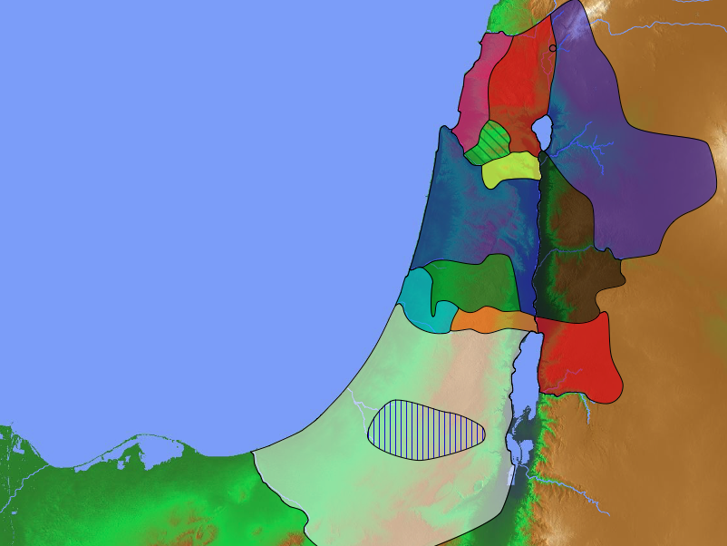
Tribal Boundaries of Israel
Naphtali
171
Asher
Zebulun
Manasseh
Issachar
Joshua 13:1–19:48
Manasseh
Levi
Gad
Spread
Ephraim
Dan
Ammon
LZGA (Leah—Zilpah)
Benjamin
Reuben
RBDN (Rachel—Bilhah)
RBJ (Rachel)
Judah
LRSLJIZ (Leah)
Simeon
Moab
Eastern tribes
Firstborn double portion & kingly tribe
Seven tribal allotments by lot
Neighboring nations related by blood
Edom
Notes:
Discussion: What do you notice about the tribes of double blessing (Joseph) and royalty?
Answer: They occupied the heartland
__________
Common-179
BB-02-Map-48
OS-00-Intro-50
OS-00-Book Overviews-119
OS-01-Gen37-50-slides 18, 277
OS-04-Numbers-217
OS-06-Joshua-18, 206, 225

Slide 49
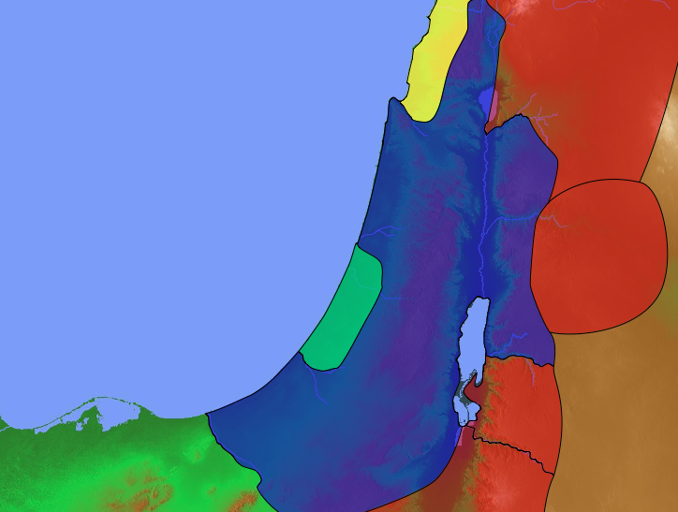
Gods of the Nations
Sidon
140
(Baal & Ashtoreth)
Aram
Judges 10:6 NLT
"…They served the images of Baal and Ashtoreth, and the gods of Aram, Sidon, Moab, Ammon, and Philistia…"
(10:6).
Israel
Ammon
Philistia
Moab
Egypt
Edom
Notes:
While Jezebel brought Baal worship into Israel during her husband Ahab's reign, it already had a history of influencing the people long before during the time of the Judges.
______________
BB-02-Map-49
OS-07-Judges-125

Slide 50
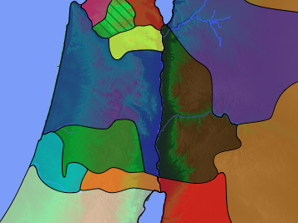
Twin Invasions
(Judges 10:8)
"Philistines and the Ammonites…began to oppress them that year. For eighteen years they oppressed all the Israelites east of the Jordan River in the land of the Amorites (that is, in Gilead)" (NLT).
171
Zebulun
Issachar
Manasseh
Manasseh
Gilead
Ammon
Ephraim
Philistines
Benjamin
Judah
Reuben
Notes:
Interestingly, Israel served the god of Philistia, so the Lord persecuted them with the Philistines!
——————————
BB-02-Map-50
OS-07-Judges-126

Slide 51
Eastern Invasions
(Judges 10:9)
171
Zebulun
"The Ammonites also crossed to the west side of the Jordan and attacked Judah, Benjamin, and Ephraim. The Israelites were in great distress" (NLT).
Issachar
Manasseh
Manasseh
Gilead
Ammon
Ephraim
Philistines
Benjamin
Judah
Reuben
Notes:
Judg. 10:6 Again the Israelites did evil in the LORD’s sight. They served the images of Baal and Ashtoreth, and the gods of Aram, Sidon, Moab, Ammon, and Philistia. They abandoned the LORD and no longer served him at all. ⁷ So the LORD burned with anger against Israel, and he turned them over to the Philistines and the Ammonites, ⁸ who began to oppress them that year. For eighteen years they oppressed all the Israelites east of the Jordan River in the land of the Amorites (that is, in Gilead).
——————————
BB-02-Map-51
OS-07-Judges-127

Slide 52
Jordan Rivers & Regions
Lebanon
140
Yarmuk
Let's play a game!
Gilead
Israel
Jabbok
G-A-M-E
Ammon
Philistia
Y-J-A-Z
Arnon
Moab
Egypt
Zered
Edom

Slide 53
NOW… FOR A QUICK REVIEW...
Handbook pg. 15-16
43
Notes:
Now here's a quick review…where exactly is that place again?

Slide 54
Handbook pg. 15-16
44
Notes:
A blank piece of paper...folded over twice, producing two creases.. NORTH/SOUTH...EAST/WEST.

Slide 55
Handbook pg. 15-16
45
Notes:
In the upper left hand quadrant, a large crescent…

Slide 56
Handbook pg. 15-16
46
Notes:
...followed by another in the lower right hand quadrant.

Slide 57
Handbook pg. 15-16
47
Notes:
Then the shape of something like a shepherd's hook, beginning in the middle of that lower quadrant. Extend the hook almost to the edge of the upper crescent. Remember, NO place names, ever. Only the first letters of the names...not the entire words. It'll help your memory process.

Slide 58
MS
Handbook pg. 15-16
48
Notes:
Write MS inside the upper left hand quadrant…

Slide 59
MS
ER
Handbook pg. 15-16
49
Notes:
...ER somewhere along the shepherd's hook..

Slide 60
MS
ER
PG
Handbook pg. 15-16
50
Notes:
...and PG inside the lower right-hand quadrant.

Slide 61
MS
(MEDITERRANEAN SEA)
ER
(EUPHRATES RIVER)
PG
(PERSIAN GULF)
Handbook pg. 15-16
51
Notes:
These single letters stand for MEDITERRANEAN SEA...EUPHRATES RIVER...and PERSIAN GULF.

Slide 62
MS
ER
PG
Handbook pg. 15-16
52
Notes:
In the lower left-hand quadrant, draw the rabbit's ears.

Slide 63
MS
ER
PG
RS
Handbook pg. 15-16
53
Notes:
Inside the ears, RS representing THE RED SEA.

Slide 64
MS
ER
PG
RS
Handbook pg. 15-16
54
Notes:
Next move up to a place just below the shepherd's hook. Draw in the two flattened oval shapes…

Slide 65
MS
ER
PG
RS
Handbook pg. 15-16
55
Notes:
…the smaller one…

Slide 66
MS
ER
PG
RS
Handbook pg. 15-16
56
Notes:
... above a larger one...and that single line connecting the two ovals…

Slide 67
MS
SG
ER
PG
RS
Handbook pg. 15-16
57
Notes:
Near the smaller oval...SG, for THE SEA OF GALILEE.

Slide 68
MS
SG
ER
DS
PG
RS
Handbook pg. 15-16
58
Notes:
At the larger oval, DS for THE DEAD SEA.

Slide 69
MS
SG
ER
JORDAN RIVER
DS
PG
RS
Handbook pg. 15-16
59
1
Notes:
The short line connecting the two ovals...the famous JORDAN RIVER.
//// …Six bodies of water and one river...THE MEDITERRANEAN SEA, THE EUPHRATES RIVER, THE PERSIAN GULF, THE RED SEA, THE SEA OF GALILEE, THE DEAD SEA, and THE JORDAN RIVER connecting the two.

Slide 70
10 PLACES
MS
SG
ER
DS
PG
RS
Handbook pg. 15-16
60
Notes:
Now turning toward the land itself…At the top of your map, at the north-south crease in the paper, the phrase, 10 PLACES.

Slide 71
10 PLACES
MS
4
SG
ER
DS
PG
RS
Handbook pg. 15-16
61
Notes:
Under that, on the right side of the north-south line, the number 4 with an arrow pointing east, to the right.

Slide 72
10 PLACES
MS
6
4
SG
ER
DS
PG
RS
Handbook pg. 15-16
62
Notes:
On the left side, the number 6 with an arrow pointing to the left.

Slide 73
10 PLACES
MS
6
4
SG
ER
DS
U
PG
RS
Handbook pg. 15-16
63
Notes:
On the eastern side of the north-south line, near the mouth of the Euphrates River, "U"...for UR of the Chaldees. Remember, again, only first letters of the words to force your memory to be active in its recall.

Slide 74
10 PLACES
MS
6
4
SG
ER
B
DS
U
PG
RS
Handbook pg. 15-16
64
Notes:
Move upriver, halfway upstream from the Persian Gulf... B, for the ancient city of Babylon.

Slide 75
10 PLACES
MS
6
4
H
SG
ER
B
DS
U
PG
RS
Handbook pg. 15-16
65
Notes:
Out in the desert, east of the river, H, for the ancient city of Haran.

Slide 76
10 PLACES
MS
6
4
N(A)
H
SG
ER
B
DS
U
PG
RS
Handbook pg. 15-16
66
Notes:
On the east side of the north-south coordinate, far to the east, a large N and in parenthesis a large A...standing for the city of Nineveh in the ancient kingdom of Assyria.

Slide 77
10 PLACES
MS
6
4
N(A)
H
SG
ER
B
DS
U
PG
RS
Handbook pg. 15-16
67
Notes:
With four locations east of the line now identified…

Slide 78
10 PLACES
MS
6
4
N(A)
H
C
SG
ER
B
DS
U
PG
RS
Handbook pg. 15-16
68
Notes:
...we move to the six locations to the west. Beginning with a large letter C placed near the Jordan River...standing for the entire region of CANAAN.

Slide 79
10 PLACES
MS
6
4
N(A)
H
SG
C
ER
J
B
DS
U
PG
RS
Handbook pg. 15-16
69
Notes:
Near the north end of the Dead Sea, west of the Jordan River, J, for the city of Jerusalem.

Slide 80
10 PLACES
MS
6
4
N(A)
H
SG
C
ER
MN
B
J
DS
U
PG
RS
Handbook pg. 15-16
70
Notes:
Across the Jordan, near the north end of the Dead Sea, MN, for Mount Nebo.

Slide 81
10 PLACES
MS
6
4
N(A)
H
SG
C
ER
B
J
MN
DS
KB
U
PG
RS
Handbook pg. 15-16
71
Notes:
Half way between the south end of the Dead Sea, almost between the ears of the rabbit, KB...for the oasis of KADESH BARNEA.

Slide 82
10 PLACES
MS
6
4
N(A)
H
SG
C
ER
B
J
MN
DS
E
KB
U
PG
RS
Handbook pg. 15-16
72
Notes:
Near the top of the LEFT rabbit ear, a large E, for the kingdom of EGYPT... and finally…

Slide 83
10 PLACES
MS
6
4
N(A)
H
SG
C
ER
B
J
MN
DS
E
KB
U
MS
PG
RS
Handbook pg. 15-16
73
Notes:
...deep between the two rabbit ears... MS, for MOUNT SINAI.
And this map for dressing the stage of the Biblical action…

Slide 84
10 PLACES
MS
6
4
N(A)
H
SG
C
ER
B
J
MN
DS
E
KB
U
MS
PG
RS
Handbook pg. 15-16
74
1
Notes:
…requires only the 10 land locations ... just 10... no more, no less…
//// … and the 6 water bodies... These few locations will do the job for now. Except for one more item…

Slide 85
10 PLACES
MS
6
4
N(A)
H
THE LAND
SG
C
ER
B
J
MN
DS
"FROM
DAN
TO
BEERSHEBA"
E
KB
U
MS
PG
Judges 20:1
RS
Handbook pg. 15-16
75
Notes:
And that is the..."The Land" as it is mentioned throughout Scripture.
The distance between those two lines is that region the Bible calls THE LAND –
… "from Dan to Beersheba"...generally the extent of God's promise to Abraham in the early chapters of Genesis. Much more about that as THE BIBLE...BASICALLY continues.

Slide 86
MS
N(A)
H
SG
C
ER
B
J
MN
"THE STAGE
OF THE
ACTION!"
DS
E
KB
U
MS
PG
RS
Handbook pg. 15-16
76
Notes:
And so: the grand "stage of the action" on which the vast Biblical drama was played out in the ancient times...an historic drama that continues working out the great Plan of the Ages up to and beyond this very moment.

Slide 87
NOW THE REASON FOR ALL THIS...
Handbook pg. 15-16
77
Notes:
Now the reason for all this... First…

Slide 88
From the fertility of the North to the desolation of the South…
Handbook pg. 15-16
78
Notes:
…to know as intimately as possible – without going there – that the Bible Land is a real place, filled with vibrant life and beauty, with enormous geographic contrasts and challenges...from the fertility of the North to the desolation of the South…the place of Abraham's ancient inheritance…with the drama extending right down to our own day.

Slide 89
MS
N(A)
H
SG
C
ER
B
J
MN
DS
…you'll "set the stage" in your mind's eye for the great biblical drama!
E
KB
U
MS
PG
RS
Handbook pg. 15-16
79
1
Notes:
[A second reason for studying geography is] so that you'll be able to set the stage in your mind's eye for the great Biblical drama! To clearly understand...and be able to create for you…
//// …the line of progress as the Biblical story unfolds. Knowing those routes of travel and interaction with the land and the environment… it's all a major key toward clarifying a unified understanding of Scripture. As you work through THE QUICK CHRONOLOGY just ahead, you will be learning about this route across the land and the progress of the Bible's timeless story...the story that brings us the Gospel message of the Lord Jesus Christ!

Slide 90
MS
CREATION
N(A)
ABRAHAM
H
JOSEPH
SG
MOSES
C
ER
JOSHUA
B
J
ANARCHY
MN
ROYALTY
DS
CAPTIVITY
E
SILENCE
KB
JESUS
U
MS
PG
RS
Handbook pg. 15-16
80
Notes:
So the basic pieces of the puzzle are in place...the ten folders of THE BIBLE FILE...CREATION THROUGH JESUS…along with this map called DRESSING THE STAGE -- which you can now draw for yourself. We're ready to start sorting out that enormous Biblical puzzle and we'll sort it all out based on the grand story line of the Bible.

Slide 91
NOW IT'S YOUR TURN…
TO MAKE A MAP OF THE ANCIENT NEAR EAST FROM INSIDE YOUR OWN HEAD!
COMPLETED MAPS AT STUDY HELP #30
Handbook pg. 15-16
81
Notes:
Now it's your turn…to make your own map of the ancient Near East from inside your own head! A completed map for reference in shown on Study Help Number 30. Blank pages for making your map are on Study Helps Number 3A and 3B.

Slide 92
The Quick Chronology
"Where is that place, anyway?"
"You'll know where that place is, after all!"
Handbook pg. 15-16
1
83
Notes:
With the map drawn and stored away mentally...we're a lot closer to being able to answer the question:
"Where is that place, anyway?"
Our strong suggestion is that, on your own, you practice making this simple map four or five times.
//// After that, you, too, will know where that place is – or was -- after all!

Slide 93

By now in The Bible…Basically,
you have in your thinking…
•An Idea Called "The Bible File"
•The Mental Key to Open "The Bible File"…C 7 S J
•A Mental Map locating The Major Biblical Events
•The Bible's "STORY" Core: "The Quick Chronology"
1
82
Notes:
By now you can make your own map of the Ancient Near East. You also have the idea called THE BIBLE FILE…the key to open it…and the map.
We know where we are going…
//// …and now we have arrived at the very core -- the heart -- of THE BIBLE...BASICALLY. We're ready now to explore THE QUICK CHRONOLOGY of Scripture's amazing storyline. And we move on along.

Slide 94
Designed by Dr. John Fryman, Texas, USA
Dr. Rick Griffith • Jordan Evangelical Theological Seminary
BibleStudyDownloads.org
©2006 TBBMI

Slide 95


The Bible…Basically link at BibleStudyDownloads.org
Get this presentation for free!
Notes:
The Bible…Basically (bb)

Slide 96
85
©2006 TBBMI
9.65.02.

