Slide 1

ENGAGING
THE
ATHEISTS
A Seminar to Strengthen Your Faith and the Faith of Others
Dr. Rick Griffith • Jordan Evangelical Theological Seminary • BibleStudyDownloads.org
Notes:
Translators—drag the image over above!
What is the best apologetic for Jesus in an anti-God world?
That is the question that I have been asked to address in this seminar called "Engaging the Atheists."
So what advice would you give me in facilitating a seminar like this? How do you address atheists?
Should we focus on proving the existence of God?

Slide 2

Don't believe in God?
Join the club.
1
Notes:
Atheists directly attack Christmas…

Slide 3

Millions of Americans are living happily without religion. CFI. LivingWithoutReligion.org
1
Notes:
One billboard is quite blatant about our rejection of God …
____________
The Center for Inquiry is an organization of humanists, skeptics, freethinkers, and atheists all working together at the public policy and grassroots levels to advance science and secularism.

Slide 4

"God free, happy, and inspired by wonder."
1

Slide 5

"Believe in humanity, not god."
1

Slide 6

Humbug.
1
Notes:
The world not only ignores the Christ of Christmas, but attacks him in direct and indirect ways

Slide 7
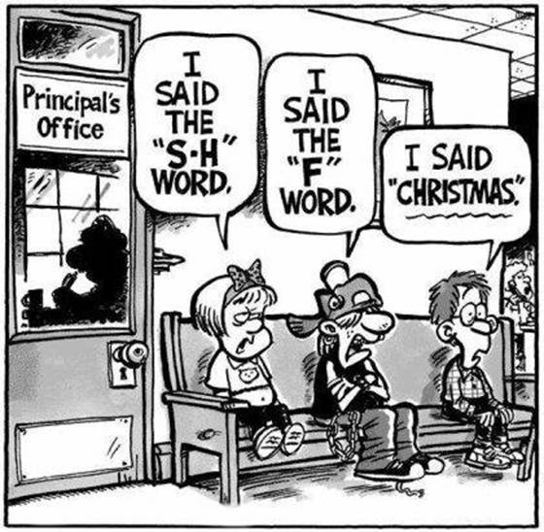
Christmas Shunned
1
I said the
"S-H" word
I said the "F" word
Principal's Office
I said "Christmas."
Notes:
In some places we get punished for even mentioning Christmas. At the principal's office, one child says, "I said the 'S-H' word," another says, "I said the 'F' word," and still another declares, 'I said 'Christmas.'"

Slide 8

Who Needs Christ During Christmas? Nobody.
1
Notes:
Satan still tries to make think we don't need God today.

Slide 9

Dear Christians, I share my toys. Why won't you share the season? Happy holidays for all!
1
Notes:
Today we also doubt God's goodness by saying God holds us back. One atheist billboard states, "Dear Christians, I share my toys. Why won't you share the season? Happy holidays for all!" Do you see the assumption here? Christians want God's goodness only for them—so we don't believe God is good to share with all!

Slide 10

Dear Santa, All I want for Christmas is skip church! I'm too old for fairy tales.
1
Notes:
Another writes, "Dear Santa, All I want for Christmas is to skip church! I'm too old for fairy tales." Some see the biblical story of the Fall as a fairy tale so that we don't want to be exposed to why God says death exists in our world. Ironic isn't? She writes to the fairy tale Santa and says she doesn't want to believe in God!

Slide 11

Atheist Christmas Card
1
DEAR CHILDREN
One day you will learn about Santa Claus. On that day remember everything the adults told you about Jesus.
Notes:
… such as in Christmas cards that equate Jesus and Santa [read card].

Slide 12

Santa
1
Notes:
But the fact is that Santa is based on Jesus and, as one blogger notes, ”The history of Santa can be a way to teach kids about giving to others. The secular version of Santa that we know today is based on St. Nicholas, who was a Christian man that lived in the third century. When his parents died, they left him a large inheritance and rather than spend it on himself, he decided to give all his money away in an effort to obey Jesus's words to take care of the poor and sick. Some of the traditions that we associate with Santa are based on the stories of St. Nicholas. For example, leaving stockings out for Santa came from tales of St. Nicholas throwing bags of gold through open windows (which apparently sometimes landed in socks and shoes that were left by the fire)." (http://www.tommynelson.com/can-santa-jesus-coexist/).

Slide 13

What to do?
1
Notes:
Do you know what you should do when you see the Christ of Christmas maligned?
• Should you rise up and kill those who dishonor him? No.
• Should you just do nothing and hope it will go away? No.
• Should you do something in between? If so, then what?

Slide 14
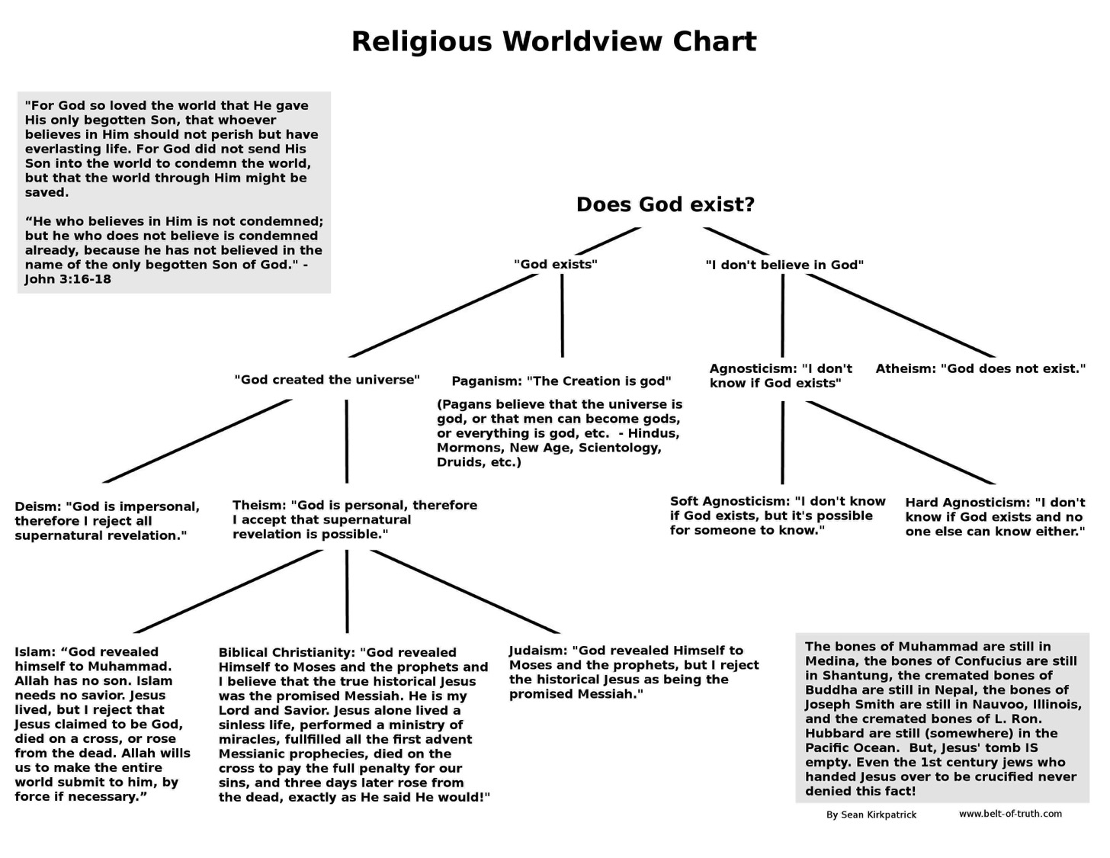
Kirkpatrick Worldview Chart
1

Slide 15
Ten Possible Worldviews
2
Indecision
(agnosticism)
Decision
No Divine
(atheism)
Divine
Many gods
(polytheism)
One God
Finite
Infinite
Impersonal
(panentheism)
Personal
(finite Godism)
Impersonal
(pantheism)
Personal
Miracles
(theism)
No Miracles
(deism)
Adapted from:
• Peter Kreeft
• Norman Geisler
• William D. Watkins
Triune
(Christian theism)
Unipersonal
(Unitarianism)
Notes:
“The chart is based in part on Peter Kreeft, “Introduction: Why Debate the Existence of God?” in Does God Exist? The Debate Between Theists and Atheists, by J. P. Moreland and Kai Nielsen (Buffalo: Prometheus Books, 1993), 15, and in part on Norman Geisler and William D. Watkins, Worlds Apart: A Handbook on World Views, 2d ed. (Grand Rapids: Baker, 1989), 16. It should be noted that in practice religions sometimes combine elements of more than one of these worldviews. For example, some forms of Hinduism affirm both pantheism and polytheism” (Kenneth D. Boa and Robert M. Bowman, Jr., “7. The Rationality of the Christian Worldview” https://bible.org/seriespage/7-rationality-christian-worldview#P33_10908 accessed 30 Sept 2015, footnote 13).

Slide 16

Worldviews:
How does God relate to the world?
2

Slide 17
Agnosticism:
We cannot be sure if a God is involved in our world (Confucius, Kant, Dewey, Bertrand Russell, Carl Sagan)
2
?
God?
?
?
?
?
?
?

Slide 18
Atheism:
No God exists or is involved in our world (Dawkins, philosophical Buddhism)
2

Slide 19
Polytheism:
Many gods relate to the worlds (Ancient Near East, Greek & Roman mythology, Mormons)
god
2
god
god
god
god

Slide 20
Panentheism:
A finite impersonal god is in the world (animism, Native American religion)
2
God

Slide 21
Finite Godism:
A finite personal god interacts with the world (Kushner)
god
2

Slide 22
Pantheism:
An infinite impersonal god is the world itself (Hinduism, Star Wars)
2
GOD

Slide 23
Deism:
God created the world but left it alone so no miracles occur (Jefferson, Franklin)
2
God

Slide 24
Christian Theism:
The Triune God loves our world and works miracles (Biblical view)
Father
2
God
Son
Spirit

Slide 25
Unipersonal Theism:
The Unitarian God relates to our world and works miracles (Islam, Jehovah Witnesses)
God
2

Slide 26
The Quick Guide for Dealing with Atheists
All Knowledge
Notes:
1. Draw a circle with a radius from the edge to the center.
2. Say, "This circle represents all the knowledge of the universe, known and unknown."
3. Hand the pen to the atheist and say, "Please draw a second line from the center to show what piece of the pie represents your own knowledge of all that can be known."
4. Humble atheists will draw a sliver to show they know about 1%. Arrogant atheists will claim to know up to half of all knowledge. I have never seen anyone draw more than half.
5. Say, "Since you know only _____% of the world's knowledge, would you not agree that God can exist in the majority of the pie that you do not know about?"
6. Whether you friend admits it or not, by claiming that he does not know everything, he has just switched from an atheist to an agnostic. God can exist outside of his knowledge.

Slide 27
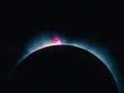
Jesus has always been God
3
"In the beginning
was the Word,
and the Word was with God,
and the Word was God"
(John 1:1)
Notes:
Scripture is very clear that Jesus is God. Christians have always believed this key doctrine called the deity of Christ.

Slide 28

God became man in Jesus
3
"So the Word became human and lived here on earth among us. He was full of unfailing love and faithfulness. And we have seen his glory, the glory of the only Son of the Father" (John 1:14 NLT)
Notes:
Any doubt as to who is meant by the "Word" is erased once we reached verse 14, which clearly shows the at "Word was God" means that Jews was God.

Slide 29

Answer the Critics
3
"But in your hearts set apart Christ as Lord. Always be prepared to give an answer to everyone who asks you to give the reason for the hope that you have. But do this with gentleness and respect."
1 Peter 3:15
Notes:
Peter tells us the foundation on which to respond (Christ's Lordship of our lives), the "what" to do (answer based on hope), and the "how" to do this (gently and respectfully). This is our desire as we respond to The Da Vinci Code.

Slide 30

Atheism is a faith system
3

Slide 31

Atheism is a faith system
3

Slide 32
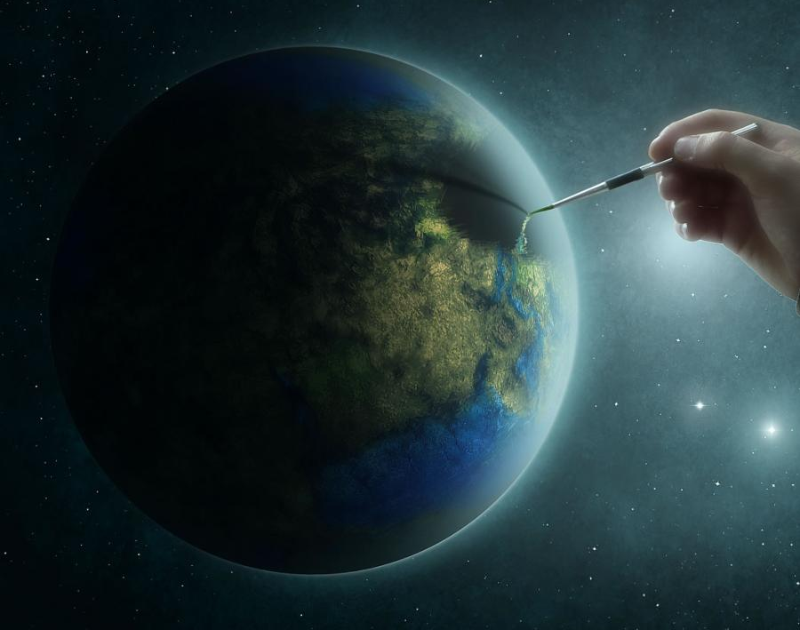
Creation: The Argument from Design
3

Slide 33

ATHEISM
3
In the beginning there was nothing…
and then it exploded.

Slide 34

ATHEISM
3
The religious belief in a spontaneous, causeless, sourceless, purposeless, meaningless existence.

Slide 35

Are our computers and smart phones designed?
3

Slide 36

Is this building designed?
3

Slide 37

Is this baby designed?
3

Slide 38

Did this turtle get here by itself?
3
If not, what is your explanation?

Slide 39


Title slide
3
Dr. Terry Mortenson
Adapted and expanded by Dr. Rick Griffith
Creation or Evolution:
Genesis Matters
Dr. Rick Griffith, Crossroads International Church
cicfamily.com & biblestudydownloads.com
Notes:
This template is intended for talk titles. Although it can be used for significant section titles, its "cover page" feel makes it best used once at the beginning of a presentation. Subtitle can be as its name suggests or the speaker's name. Presentation Team recommends title text size as 50–72 and subtitle size as 30–48 with optimal sizes already used in this example. This also contains a floating AiG logo that can be repositioned or removed as appropriate for the overhead's content.

Slide 40
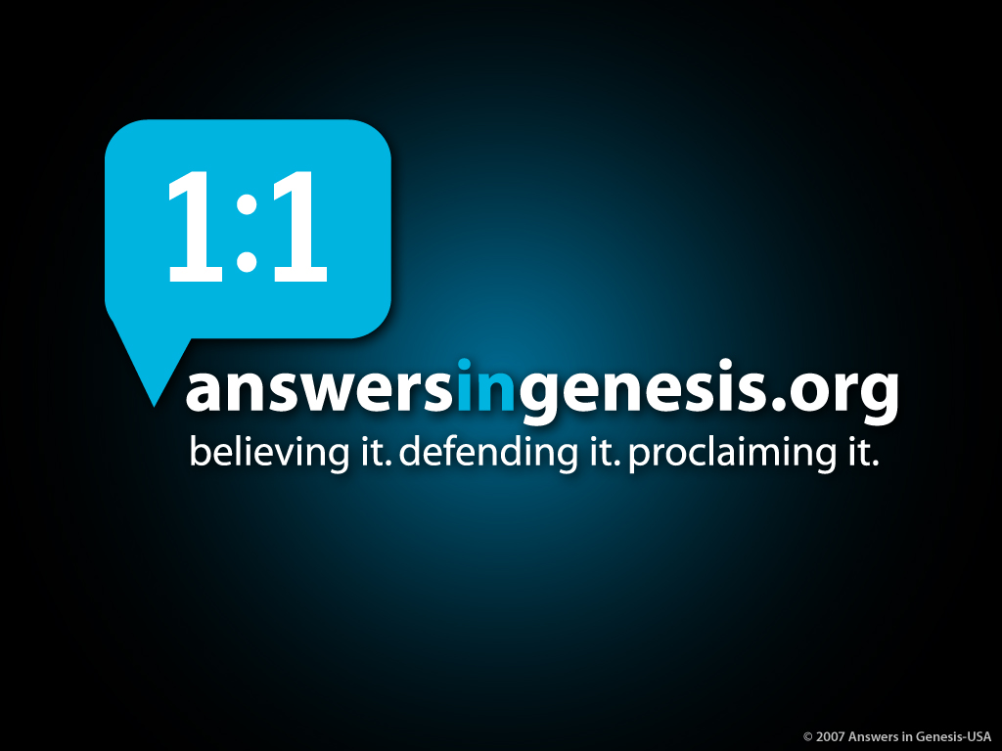
AiG web site #1
3

Slide 41

America—largest number of…
3
America has the largest number of:
• Churches/Seminaries
• Christian Colleges
• Christian Bookshops/Resources
• Christian Radio/TV

Slide 42

America—less Christian
3
America has the largest number of:
• Churches/Seminaries
• Christian Colleges
• Christian Bookshops/Resources
• Christian Radio/TV
But is becoming LESS Christian EVERY day!

Slide 43

ISSUES TODAY
3
ABORTION
SCHOOL VIOLENCE
PORN-OGRAPHY
HOMOSEXUAL BEHAVIOR
RACISM
FAMILY BREAK-UP

Slide 44

Q 899 Barna
3
"A minority of born-again adults (44%) and an even smaller proportion of born-again teenagers (9%) are certain of the existence of absolute moral truth."
Barna Research Online, 'The Year's Most Intriguing Findings, From Barna Research Studies,' December 12, 2000, www.barna.org.
Notes:
www.barna.org/cgi-bin/PagePressRelease.asp?PressReleaseID=77&Reference=E&Key=moral%20truth

Slide 45
Foster Letter 2002
3
"The 'American Family In Crises Research' by the Southern Baptist Council on Family Life uncovered some disturbing facts. Of the children raised in evangelical homes, 88% leave the church at age 18 and never return."
Pastor's Weekly Briefing, Focus on the Family, 26 July 2002, quoted in Gary Foster, The Foster Letter, 10 Aug. 2002, p. 1.
Notes:
From Carl Kerby
Following is the entire quote that was in my newsletter. My source was the 7/26/02 issue of Pastor's Weekly Briefing published by the Pastoral Ministries department of Focus on the Family.
American Family In Crises Research by the Southern Baptist Council on Family Life has uncovered some disturbing facts that are leading the group to emphasize the need to rebuild the American family.
§ 88% of the children raised in evangelical homes leave church at the age of 18, never to return.
§ The divorce ratio among members of evangelical churches is virtually the same as non-church members.
§ One million children in the U.S. see their parents divorce.
§ Personal bankruptcies are at an all-time high in America.
The majority of children in America have less than 10 minutes of significant and meaningful conversation with their parents each week. If you remove the mother, you can measure this statistic in seconds. The council recommends that families set aside one evening a week as a family night, on which no local church activities would be scheduled to interfere. It also urged an increased emphasis on biblically based premarital counseling. (PWB 7/26)
Gary D. Foster
Gary D. Foster Consulting
334 Sutherland Place
Manitou Springs, CO 80829
Phone: 719-685-1138 E-mail: GFosterCns@rmi.net Website: http://www.garydfoster.com/
"Helping Christian ministries & product companies discover new revenue streams and to better leverage existing ones."

Slide 46

Already Gone 04802
3
Already Gone
  by Ken Ham and Britt Beemer,
  with Todd Hillard
© Answers in Genesis-USA

Slide 47

High school attended
3
Catholic school
0.6%
Charter school
3.2%
Home school
3.4%
Christian school
6.9%
Public school
85.9%
Notes:
Survey done by American Research Group (similar to Barna and Gallup)—professional statistically valid study paid for by AiG supporters
Survey 20-29 year olds who grew up in church but don't go to church any more, to find out why.

Slide 48

If you don't believe, when did you first have doubts?
3
Don't know
1.61%
Elementary school
4.37%
College
10.57%
Middle school
39.77%
High school
43.68%

Slide 49

Which of these makes you question the Bible the most?
3
45.2%
Miracles not true
4.3%
Bible not make sense
10.7%
Creation account
11.2%
Too many rules
14.4%
Earth not 10K yrs
29.7%
None
25.6%
Those Who Often Attended Sunday School

Slide 50

Which of these makes you question the Bible the most?
3
32.1%
Miracles not true
0.8%
Bible not make sense
11.7%
Creation account
13.5%
Too many rules
10.7%
Earth not 10K yrs
17.8%
None
43.4%
Those Who Rarely Attended Sunday School
Notes:
We are not saying that we should get rid of Sunday school. But we are suggesting that we need to change the curriculum and the training.
Most Sunday school teachers, like most Christian adults don't know how to defend the faith against the skeptical challenges that are coming through the schools, media, science programs on TV, etc. We need apologetics training for the teachers and then they need to give it to the kids.

Slide 51

Psalm 11:3 NAS
3
Psalm 11:3
"If the foundations are destroyed, what can the righteous do?"

Slide 52

Typical House
3

Slide 53

House 2 00419
3
Notes:
Suppose many huge trucks rumbled around the house without ever touching it.

Slide 54

Typical House collapsed
3

Slide 55

Blocks-Genesis + Doctrine 00874
3
X
DOCTRINE
X
GENESIS

Slide 56

Blocks – Genesis/doctrine/sin grey
3
DOCTRINE
SIN
GENESIS
GENESIS
Genesis is foundational to all other biblical doctrines

Slide 57
Blocks – Genesis/doctrine/clothing grey
3
DOCTRINE
CLOTHING
GENESIS
GENESIS
Notes:
talk again about modesty—wedding pictures we get from committed Christians with very immodest wedding dresses, in most churches where I speak including our own, teens and older women are immodestly dressed—just reflective of the influence of nudity in our culture and our ignorance of the Genesis foundation of the Bible's teaching on clothes. Men, teach your wives and daughters. Wives and daughters, ask your husbands and dads about specific clothing.

Slide 58

Blks-Gen Doc + Doc
3
7-DAY WEEK
DOMINION
WORK
CURSE
NATIONS
1st COMING
2nd COMING
DOCTRINE
GENESIS
GENESIS

Slide 59
Blocks – Genesis/doctrine/marriage grey
3
DOCTRINE
MARRIAGE
GENESIS
GENESIS
Notes:
Mal. 2:16—God hates divorce

Slide 60


Marriage silhouettes
3
The two parts don't make one
Notes:
So as Christians, when we are confronted with this issue of homosexual marriage, which picture is consistent with the Christian foundation found in the book of Genesis? God ordained marriage as one man for one woman for life in the book of Genesis.

Slide 61
Blocks-Genesis + Gospel 00872
3
DEATH
GENESIS
Genesis is foundational to the doctrine of death

Slide 62

WHY?
3
62
Notes:
62
62
See 124

Slide 63
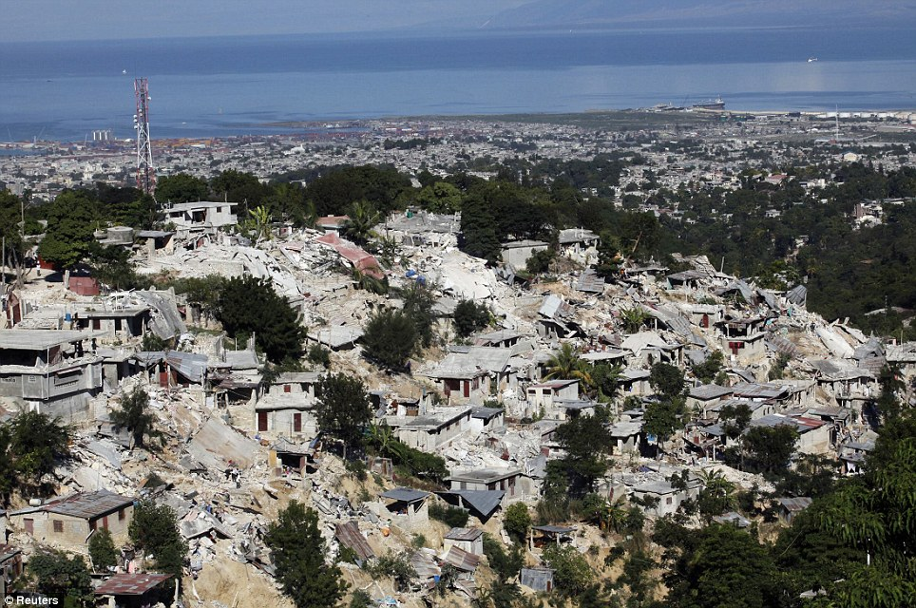
Why would a loving God allow earthquakes?
3
Notes:
63

Slide 64
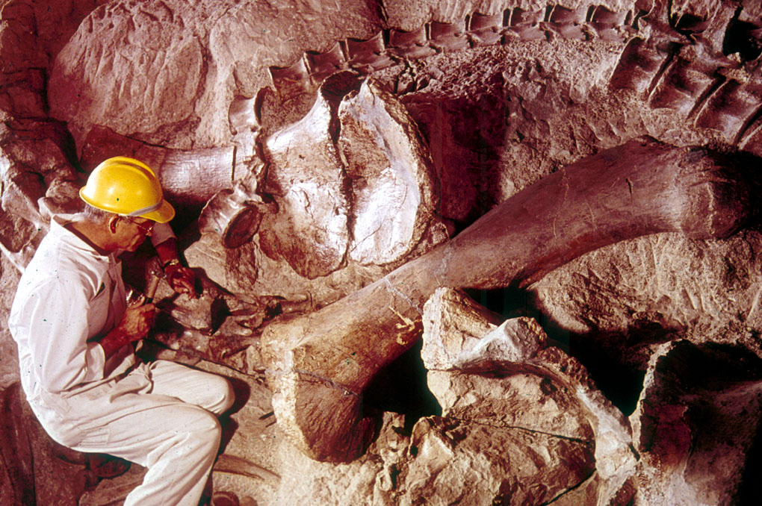
Fossil dinosaur with scientist
3
Notes:
Picture from Dinosaur National Monument (national park) in Utah & Colorado
Show my fossil shells

Slide 65


3
FOSSIL
RECORD
PAIN
DEATH
KILLING
MILLIONS OF YEARS
=
DISEASE
STRUGGLE
SUFFERING
EXTINCTION

Slide 66
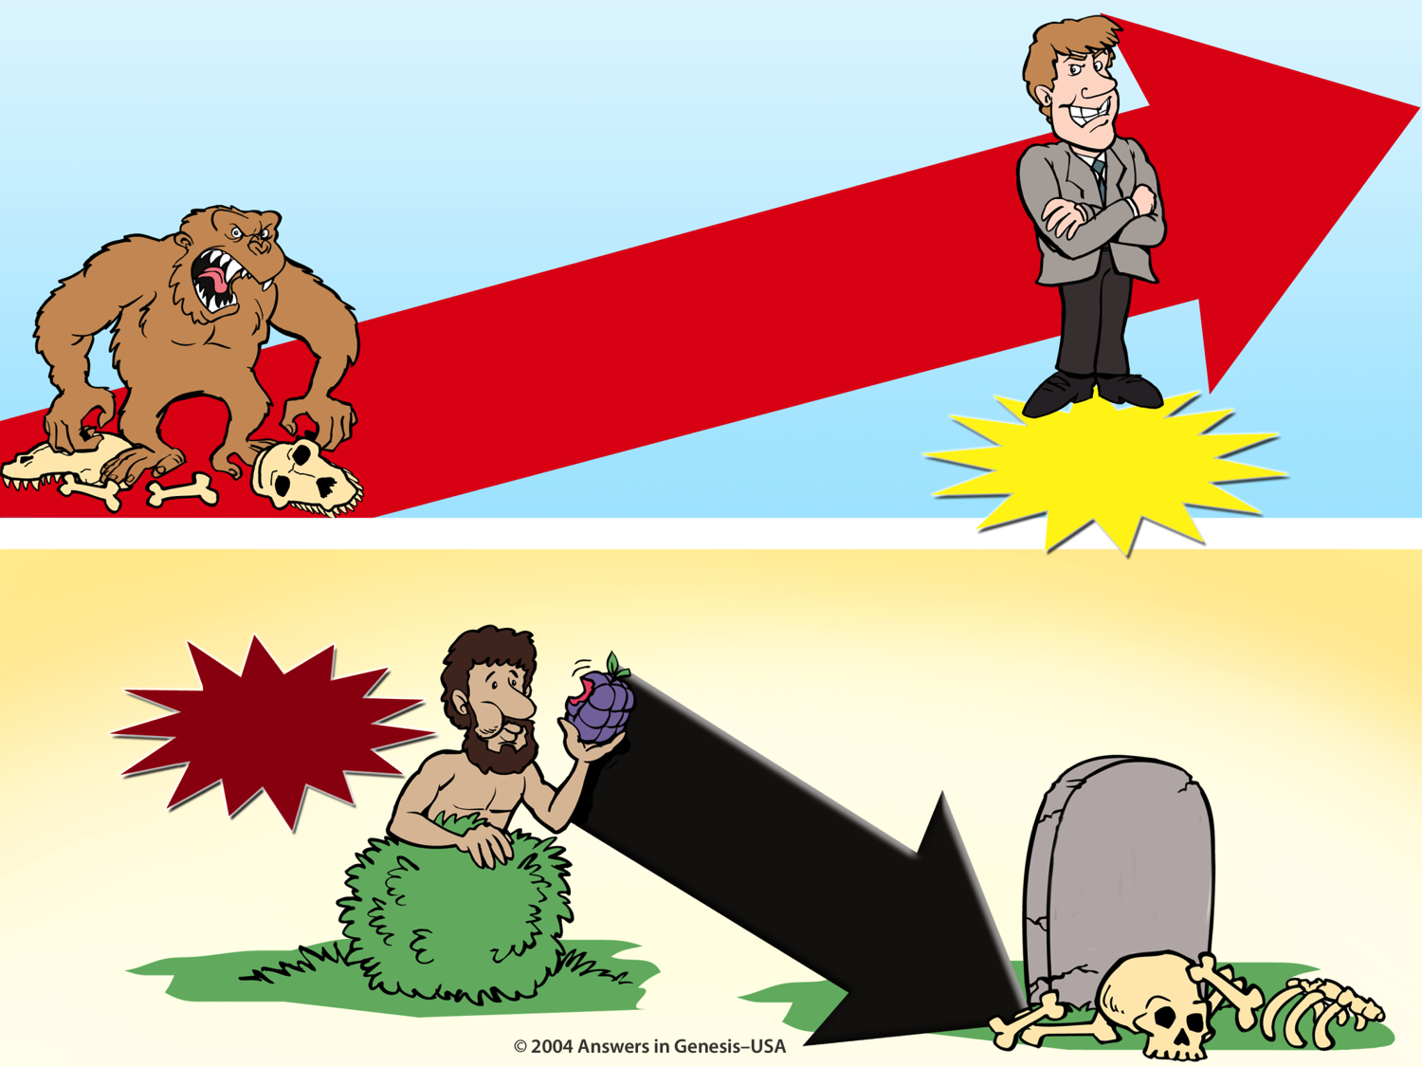
Evolution Millions of Years + Creation 01133
EVOLUTION
MILLIONS OF YEARS
3
DEATH
Suffering Disease Bloodshed
MAN'S
EXISTENCE
CREATION
MAN'S
ACTIONS
SIN
DEATH
Notes:
66
Do these two views agree?
No, of course not. They are diametrically opposed to each other.

Slide 67
Gen. 1:29-30 NAS
Genesis 1:29-30
3
"Then God said, 'Behold, I have given you every plant yielding seed that is on the surface of all the earth, and every tree which has fruit yielding seed; it shall be food for you; ³⁰and to every beast of the earth and to every bird of the sky and to every thing that moves on the earth which has life, I have given every green plant for food'; and it was so."
Pre-Fall world:
Man and animals were vegetarians.
In the Bible, plants were not living souls.

Slide 68
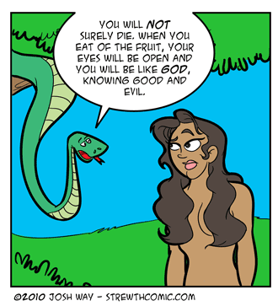
Convincing Dialogue
3
You will NOT surely die. When you eat of the fruit, your eyes will be open and you will be like GOD, knowing good and evil.

Slide 69
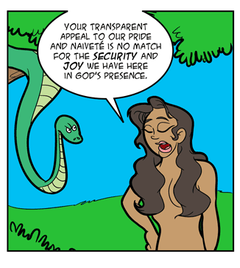
Convincing Dialogue
3
Your transparent appeal to our pride and naïveté is no match for the security and joy we have here in God's presence.

Slide 70

Convincing Dialogue
3
It's organic, rich in antioxidants, and now available in convenient GO-PACKS.
We'll take two.

Slide 71

The Sad Results
3
The Fall brought many consequences

Slide 72
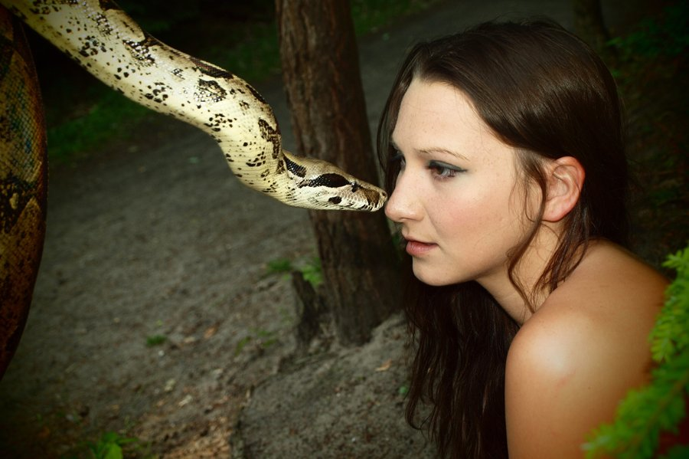
Serpent judged physically
(Gen. 3:14)
3
"Then the LORD God said to the serpent, 'Because you have done this, you are cursed… You will crawl on your belly, groveling in the dust as long as you live."

Slide 73
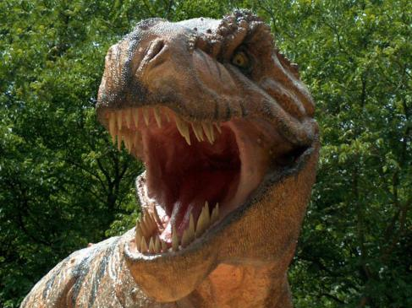
3
"…you are cursed more than all animals, domestic and wild…"
Animals cursed (Gen. 3:14 NLT)
Notes:
73

Slide 74
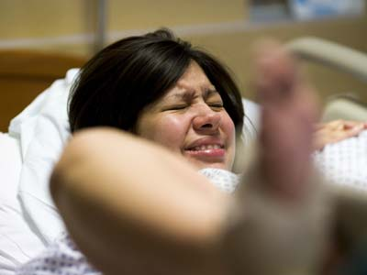
Eve judged physically: increased pain in childbirth (Gen. 3:16)
3

Slide 75
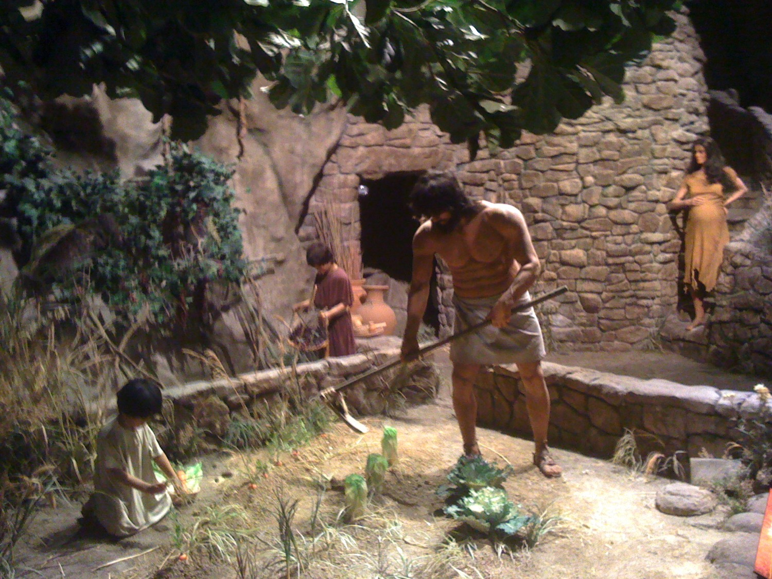
"And to the man he said, 'Since you listened to your wife and ate from the tree whose fruit I commanded you not to eat, the ground is cursed because of you. All your life you will struggle to scratch a living from it. ¹⁸It will grow thorns and thistles for you, though you will eat of its grains'" (3:17-18 NLT).
Ground was cursed (Gen. 3:17-18)
3

Slide 76
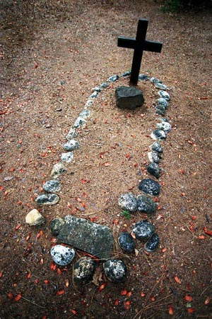
"By the sweat of your brow will you have food to eat until you return to the ground from which you were made. For you were made from dust, and to dust you will return" (3:19 NLT).
Adam & Eve began to die physically
3
Notes:
Adam's physical death did not come for another 930 years (Gen. 5:5), but his spiritual separation (death) came immediately upon sinning against God.

Slide 77
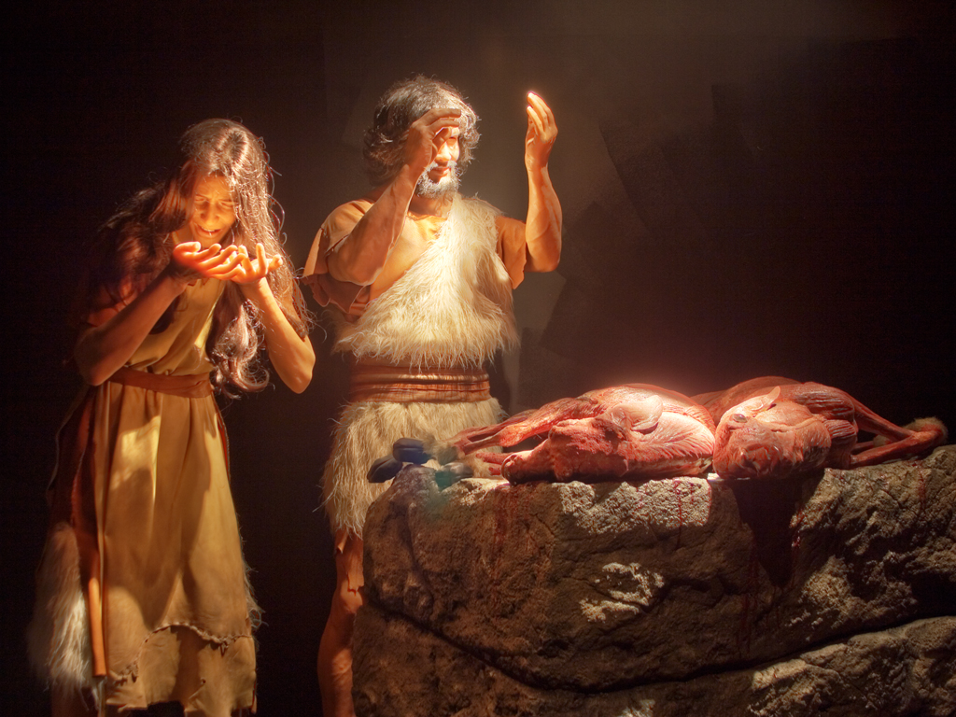
Implied Death
3
Redemption through a sacrifice gave them animal skin coverings
Genesis 3:21
Notes:
77
God killed animals to clothe Adam and Eve with reminders of redemption (3:21).
Here we see the first experience of death in the Bible—for without the shedding of blood, there is no forgiveness.

Slide 78

"For all creation is waiting eagerly for that future day when God will reveal who his children really are. ²⁰Against its will, all creation was subjected to God's curse. But with eager hope, ²¹the creation looks forward to the day when it will join God's children in glorious freedom from death and decay'"
(Rom. 8:19-21 NLT).
Creation in bondage to corruption (Rom. 8:19-23)
3

Slide 79
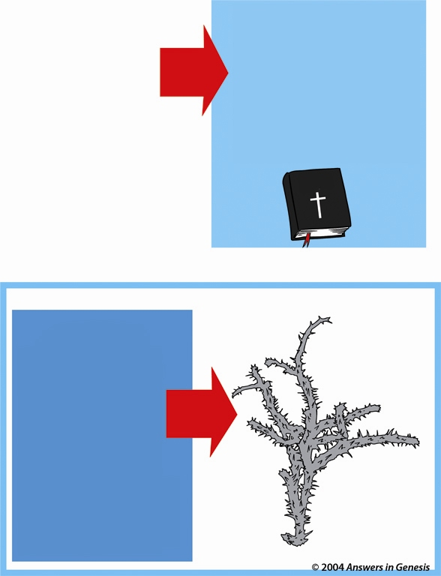
Which will you believe?
If God cursed the earth with thorns AFTER Adam sinned…
Genesis 3:18
3
"Both thorns and thistles it shall grow for you"
Psilophyton crenulatum
WHY
do we find FOSSIL THORNS from "millions of years ago"?
Lower Devonian 360-408 million years

Slide 80

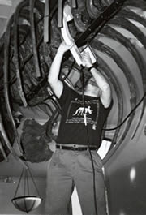
Whitehead 2003—dino cancer
3
"Many dinosaurs had cancer, researchers have discovered. Their tumours were like those of human patients, showing that cancer has been around, essentially unchanged, for a very long time. 'Diseases look the same independent of what critter is affected,' says Bruce Rothschild ..."
One of 10,000 dinosaur bones X-rayed in the USA
Disease in fossil humans are "dated" to be much older than any acceptable date for Adam
John Whitehead, "Dinosaurs got cancer," Discover, 21 Oct. 2003, <www.nature.com>.
Notes:
Picture and quote from http://www.nature.com/nsu/031020/031020-2.html

Slide 81
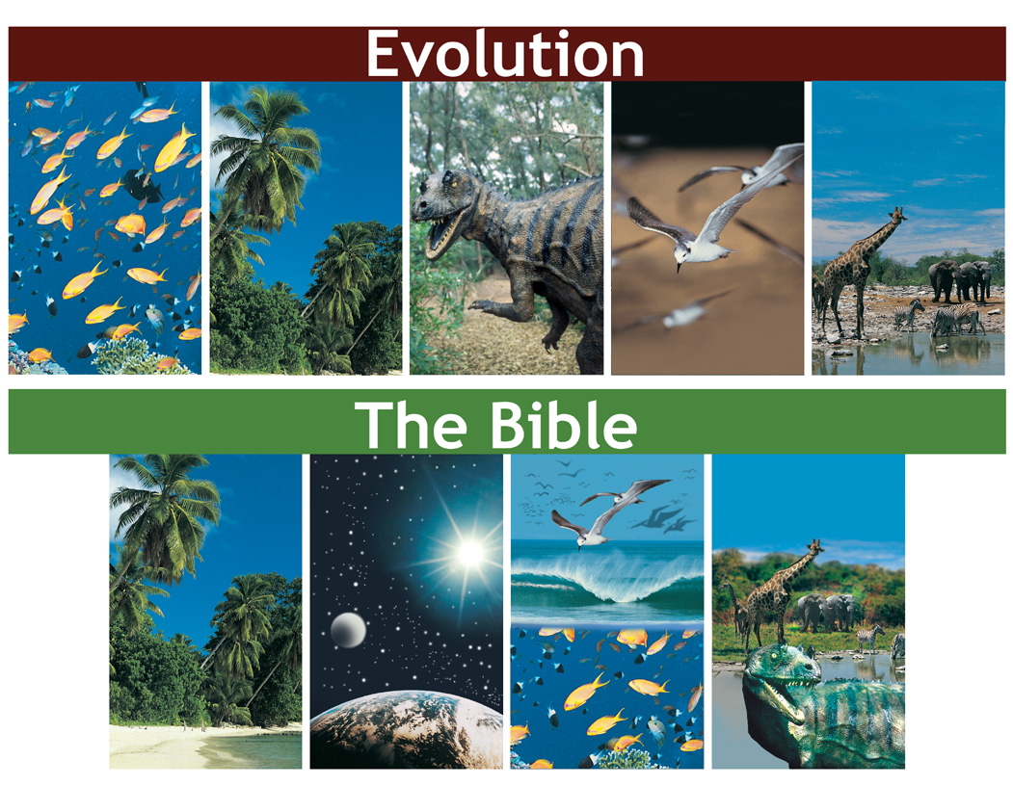
Evolution vs Bible timeline
Evolution
3
The Bible

Slide 82

Bible Modified 00814b
When people TRY to make them agree, guess which one gets "MODIFIED"?
HOLY BIBLE
EVOLUTION THEORY
God's
PERFECT
Word
Man's
FALLIBLE
Opinion
EVOLUTION THEORY
GENESIS

Slide 83


A&E on bones animated
3
OH ADAM, THIS IS SUCH A PERFECT WORLD!
X
YES EVE! IT'S "VERY GOOD" JUST LIKE GOD SAID!
GARDEN OF EDEN
PAIN
MILLIONS OF YEARS
DEATH
FOSSIL
RECORD
KILLING
DISEASE
STRUGGLE
SUFFERING
EXTINCTION

Slide 84


Fossils on Garden of Eden
3
PAIN
FOSSIL
RECORD
X
DEATH
Noah's
Flood
KILLING
DISEASE
STRUGGLE
SUFFERING
EXTINCTION

Slide 85
Fossils on Garden of Eden
Mass
Extinctions
3
GARDEN OF EDEN
PAIN
FOSSIL
RECORD
DEATH
Noah's
Flood
KILLING
DISEASE
STRUGGLE
SUFFERING
EXTINCTION
Fossil Graveyards

Slide 86
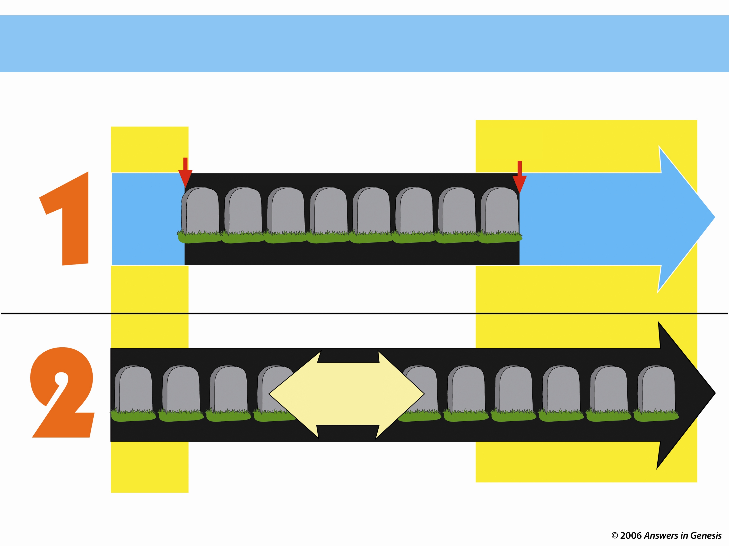
Two Histories of Death
How long has death existed (Rom. 5:12)?
Beginning
Death is an enemy
Future
Man's sin brought Death
DEATH will be done away with
ONLY THOUSANDS OF YEARS
God's Word
NO DEATH
NO DEATH
Death is temporary
Man's Opinion
MILLIONS AND MILLIONS OF YEARS
Life and death have always been together
Death is a permanent part of history
As long as there is life, there will be death
Notes:
Only two options exist, either
God’s Word that teaches no death in the creation and therefore no death in the future, or…
Man’s opinion that death has always existed and always will exist.
Each believer must answer which of these two theologies he will follow.
_____________
Common-48
AP-02-Engaging Athiests-86
CR-29-Theistic Evolution-71
OS-01-Gen1-3-slide219
06-Romans_5-8_slide 26

Slide 87


Which View of Death Matches Romans 5:12?
VERY GOOD!
PAST
Millions of Years
PRESENT
FUTURE
Adam
Death
Death
Death
Death
VERY GOOD!
PRESENT
FUTURE
PAST
Adam
No Death
Death
Death
No Death
Notes:
06-Romans_5-8_slide 27

Slide 88










Gap Where Fit Mil of Yrs 00845
WHERE DO YOU "FIT" MILLIONS OF YEARS?
5
Somewhere?
Between Genesis 1:1 and 1:2
(gap theorists)
Spread the millions of years out in the six "days"
(progressive creationists and theistic evolutionists)
DAY
DAY
DAY
DAY
DAY
DAY
EARTH, SPACE, TIME & LIGHT
ATMOSPHERE
DRY LAND & PLANTS
SUN, MOON & STARS
SEA & FLYING CREATURES
LAND ANIMALS & MAN

Slide 89
Ex. 20:11 NAS
5
Exodus 20:11
"For in six days the Lord made the heavens and earth, the sea, and all that is in them, and rested on the seventh day; therefore the Lord blessed the Sabbath day and made it holy."

Slide 90

Day 3 Ways 02007
5
Back in my grandfather's day
it took 12 days
to drive across the country in the day.
Are we there yet?
Notes:
Revised: August 2005.

Slide 91

Literal Days 1-6 animated
5
Genesis 1: Literal Days
1. Yom is defined literally in v. 5

Slide 92
Genesis 1:1 NAS
5
Genesis 1:5
"God called the light day, and the darkness He called night. And there was evening and there was morning, one day."

Slide 93
Literal Days 1-6 animated
5
Genesis 1: Literal Days
1. Yom is defined literally in v. 5
2. Yom with numerical adjectives
3. Yom with "evening" & "morning"
4. Yom is defined literally in v. 14

Slide 94
Gen. 1:14 NAS
5
Genesis 1:14
"Then God said, 'Let there be lights in the expanse of the heavens to separate the day from the night, and let them be for signs and for seasons and for days and years.'"

Slide 95
Template Suite 1-Blank 01362
5
Time Since First Day of Creation
5 days before Adam = 5 days
Adam to Abraham = ~ 2,000 yrs.
Abraham to Christ = ~ 2,000 yrs.
Christ to present = ~ 2,000 yrs.
Total = ~ 6,000 yrs.
(Genesis 1)
(Genesis 5 & 11)
Notes:
This uses only the background from Template Suite 1. Nearly any content will work with this template. Presentation Team recommends keeping the main content at least half an inch from the edges. This also contains a floating AiG logo that can be repositioned or removed as appropriate for the overhead's content.

Slide 96








Big Bang and Bible order compared
Molten
Earth
First
Oceans
5
Big Bang
Stars
Sun
15 Billion
Years Ago
10 Billion
Years Ago
5 Billion
Years Ago
4.5 Billion
Years Ago
3.8 Billion
Years Ago
Water Covered
Earth
Dry Land
and Plants
Sun, Moon,
and Stars
Day 1-2
Day 3
Day 4

Slide 97

Common Element 4
5
Theistic
Evolution
Progressive
Creation
COMMON
FACTOR
Other
Compromise
Positions
Framework
Hypothesis
Gap
Theory
Notes:
97

Slide 98

MILLIONS OF YEARS
5
X
X
Theistic
Evolution
Progressive
Creation
X
PAIN
DEATH
KILLING
THORNS
DISEASE
STRUGGLE
SUFFERING
EXTINCTION
X
X
Framework
Hypothesis
Other
Compromise
Positions
X
Gap
Theory
Notes:
98

Slide 99
Blocks-Genesis + Gospel 00872
5
X
DEATH
X
GENESIS

Slide 100
Blocks-Genesis + Gospel 00872
5
GOSPEL
GENESIS

Slide 101
Gen. 3:15 NAS
5
Genesis is foundational to the gospel
Genesis 3:15
"And I will put enmity between you and the woman, and between your seed and her seed; he shall bruise you on the head, and you shall bruise him on the heel."

Slide 102
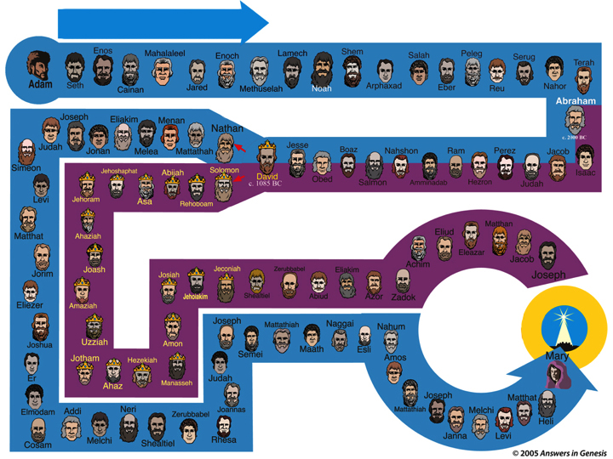
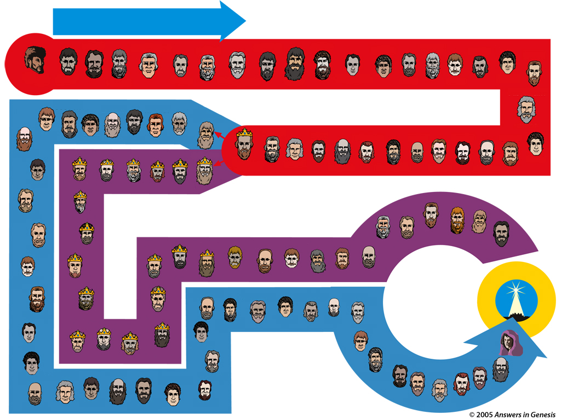
Adam to Christ
From Adam to Christ!
5
Enos
Mahalaleel
Enoch
Lamech
Shem
Salah
Peleg
Serug
Terah
Adam
Seth
Cainan
Jared
Methuselah
Noah
Arphaxed
Eber
Reu
Nahor
Abraham
Abraham
Joseph
Eliakim
Menan
David
Abraham
Nathan
David
Judah
Jonan
Melea
Mattathah
Jesse
Boaz
Nahshon
Ram
Perez
Jacob
Simeon
Jehoshaphat
Abijah
Solomon
Isaac
David
c. 1085 BC
Obed
Salmon
Amminadab
Hezron
Judah
Levi
Jehoram
Asa
Rehoboam
Eliud
Matthan
Matthat
Ahaziah
Line of Joseph
Line of Joseph
Eleazar
Jacob
Jorim
Joash
Josiah
Jeconiah
Zerubbabel
Eliakim
Achim
Joseph
Eliezer
Amaziah
Jehoiakim
Shealtiel
Abiud
Azor
Zadok
Joseph
Mattathiah
Nahum
CHRIST
Naggai
Joshua
Uzziah
Amon
Esli
Jotham
Hezekiah
Semei
Maath
Amos
Mary
Line of Mary
Er
Judah
Line of Mary
Ahaz
Manasseh
Joseph
Matthat
Elmodam
Addi
Neri
Zerubbabel
Joannas
Mattathiah
Melchi
Heli
Cosam
Melchi
Shealtiel
Rhesa
Janna
Levi
Notes:
102

Slide 103
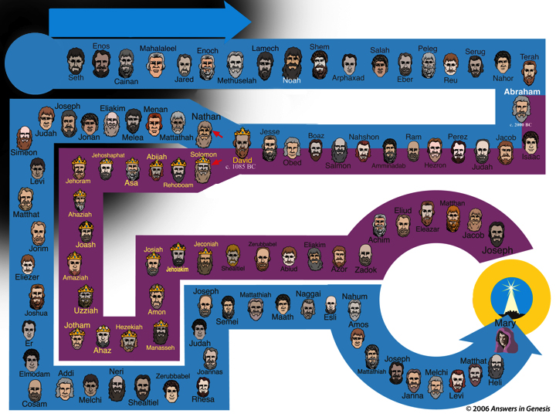


Adam to Christ
From Metaphor to Christ?
5
From Metaphor to Christ?
Enos
Mahalaleel
Enoch
Lamech
Shem
Salah
Peleg
Serug
Terah
Adam
Nahor
Metaphor
Seth
Cainan
Jared
Methuselah
Noah
Arphaxed
Eber
Reu
Abraham
Line of Mary
Abraham
Joseph
Eliakim
Menan
David
Abraham
Nathan
David
Judah
Jonan
Melea
Mattathah
Jesse
Boaz
Nahshon
Ram
Perez
Jacob
Simeon
Jehoshaphat
Abijah
Solomon
Isaac
David
c. 1085 BC
Obed
Salmon
Amminadab
Hezron
Judah
Levi
Jehoram
Asa
Rehoboam
Line of Joseph
Matthan
Ahaziah
Eliud
Matthat
Line of Joseph
Line of Joseph
Eleazar
Jacob
Jorim
Joash
Josiah
Jeconiah
Zerubbabel
Eliakim
Achim
Joseph
Eliezer
Amaziah
Jehoiakim
Shealtiel
Abiud
Azor
Zadok
CHRIST
Joseph
Mattathiah
Nahum
CHRIST
Naggai
Joshua
Uzziah
Amon
Esli
Jotham
Hezekiah
Semei
Maath
Amos
Mary
Line of Mary
Er
Judah
Line of Mary
Ahaz
Manasseh
Joseph
Matthat
Elmodam
Addi
Neri
Zerubbabel
Joannas
Mattathiah
Melchi
Heli
Cosam
Melchi
Shealtiel
Rhesa
Janna
Levi
Notes:
103

Slide 104
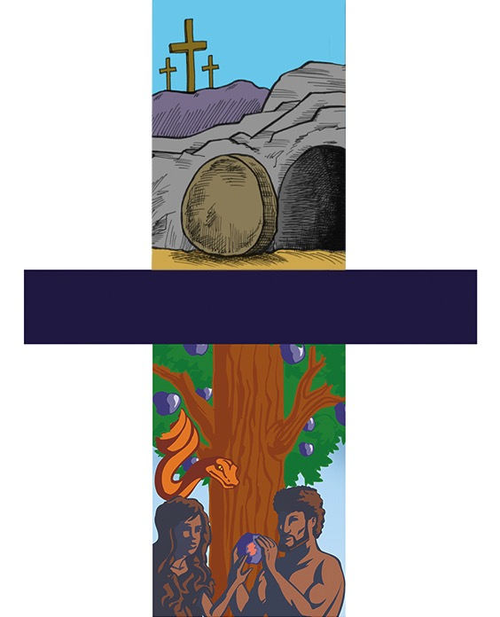
First/last Adam
He is Risen!!
Jesus Christ
"The Last Adam"
1 Cor. 15:45
5
X
For as in Adam all die,
Even so in Christ shall all be made alive.
1 Cor. 15:22
X
"The First Adam"
1 Cor. 15:45

Slide 105
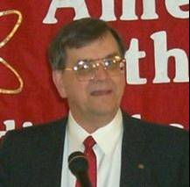
Frank Zindler
5
"The most devastating
thing though that
biology did to
Christianity was the
discovery of biological
evolution. Now that we
know that Adam and Eve
never were real people the central myth of Christianity is destroyed. If there never was an Adam and Eve, there never was an original sin…"
Notes:
Mr. Zindler is editor of American Atheist. He spent 17 years as a teacher and professor of biology, psychobiology, and geology at a branch of St. Univ of NY (SUNY). He is a member of several learned societies including the American Association for the Advancement of Science, New York Academy of Science, Society of Biblical Literature and the American Schools of Oriental Research. Mr. Zindler is also a member of the Jesus Seminar, and an expert in a number of esoteric, biblical-era languages. Neither the American Atheists web site nor the one below say where he taught and both refer to him as "Mr." and neither say that he has a PhD (so he must not, and so what is he doing in the AAAS and the NYAS and the SBL? His statements at the web site below show his gross ignorance of science, archeology and the Bible.
Picture: http://www.secularstudents.org/files/frank.jpg

Slide 106
I think that evolution is absolutely the death knell of Christianity."
5
"If there was never an
original sin, there is no
need of salvation. If there
is no need of salvation,
there is no need of a
savior. And I submit that
puts Jesus, historical or otherwise, into the ranks of the unemployed.
Frank Zindler (American atheist, in a debate with Dr. William Lane Craig), Atheism vs Christianity (video), Zondervan, 1996.
Notes:
106
Sadly, at the time (and as of 2007) Dr. Craig was compromised with the Big Bang and millions of years.

Slide 107
Blocks-Genesis + Gospel 00872
5
X
GOSPEL
X
GENESIS

Slide 108
Blocks-Genesis + Gospel 00872
5
Genesis is foundational to morality
X
MORALITY
X
GENESIS

Slide 109
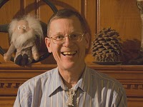
Evolution and Atheism, Provine
5
EVOLUTION & ATHEISM
"Let me summarize my
views on what modern
evolutionary biology
tells us loud and clear.
… There are no gods,
no purposes, no goal-
directed forces of any kind. There is no life after death."
William B. Provine (Prof. of Biology, Cornell
Univ.), Origins Research, 16:1/2 (1994), p. 9.
Notes:
Will Provine has been a professor at Cornell since 1969. His graduates have included Evolutionary Biology, History, Science and Technology Studies, Zoology, and Education, spanning three colleges. He earned a Ph.D. in the History of Science at the University of Chicago in 1970. He is a member of the American Academy of Arts and Sciences and the American Association for the Advancement of Science. He is the author of The Origins of Theoretical Population Genetics (1970) and Sewall Wright and Evolutionary Biology (1986), both published by The University of Chicago Press. He is currently (in Feb 2010) writing a book on the implications of evolution and another book on random genetic drift in evolution. His huge library on evolution and genetics is being moved gradually to the Cornell Library.
Photo and bio from http://debatesummit2010.blogspot.com/, accessed 2010 Feb 10.

Slide 110
Evolution and Atheism, Provine
5
EVOLUTION & ATHEISM
"When I die, I am
absolutely certain that
I am going to be dead.
That's the end for me.
There is no ultimate
foundation for ethics, no ultimate meaning to life and no free will for humans, either."
William B. Provine (Prof. of Biology, Cornell
Univ.), Origins Research, 16:1/2 (1994), p. 9.

Slide 111



6 Days or Millions of Years in Your Past 00087—layered.
5
My thinking in every area
GOD IS
AUTHORITY
IN YOUR PAST
GOD
SETS
THE
RULES
6 CREATION DAYS
OR
MILLIONS OF YEARS
IN YOUR PAST
MAN IS AUTHORITY
RELATIVE MORALITY
Man's Fallible Knowledge
My thinking
in every area

Slide 112

Balloons problem—evol vs creat
Gay
Marriage
PROBLEM
5
THE
Abortion
PSALM 11:3
Moral
Relativism
Euthanasia
CHRISTIANITY
HUMANISM
EVOLUTION
CREATION
Notes:
112
The humanistic philosophies all are undermining the very foundation of what Christians believe by focusing their attacks at creation.
Meanwhile, Christians accept their evolutionary theory and then focus our attacks at the results of humanism instead of attacking the foundation in evolution.
Some Christians shoot their own foundation and others are asleep or shooting other Christians.

Slide 113

Results of Humanism
REMOVE
THE CROSS
FROM
PUBLIC
PLACES
PRAYER OUT
OF PUBLIC
SCHOOLS
NO CHRIST IN
CHRISTMAS
5
REMOVE
GOD FROM
PLEDGE OF
ALLEGIANCE
GAY
MARRIAGE
NO PUBLIC
NATIVITY
SCENES
SCHOOL
VIOLENCE
NO
LOVING GOD
IN TRAGEDY
CREATION
OUT OF
PUBLIC
SCHOOLS
FAMILY
BREAK-UP
HOMOSEXUAL
BEHAVIOR
RACISM
PORNOGRAPHY
EUTHANASIA
ABORTION
REMOVAL OF 10 COMMAND-MENTS
HUMANISM
Notes:
113

Slide 114

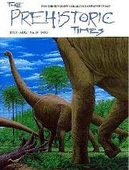
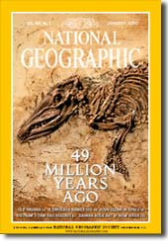




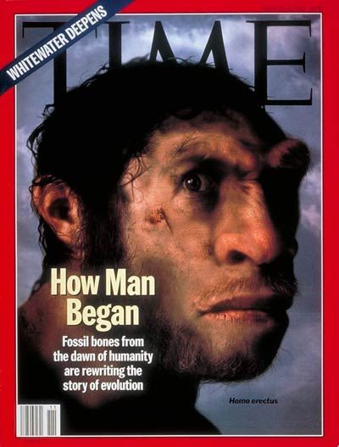
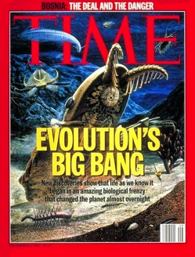

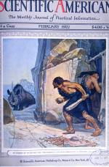
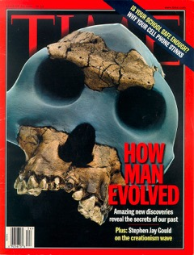

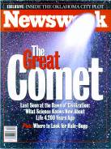
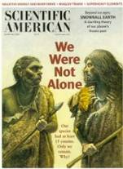
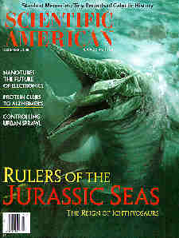

The Media assumes evolution is true
5

Slide 115

Dinosaurs & Kids - 3

Slide 116
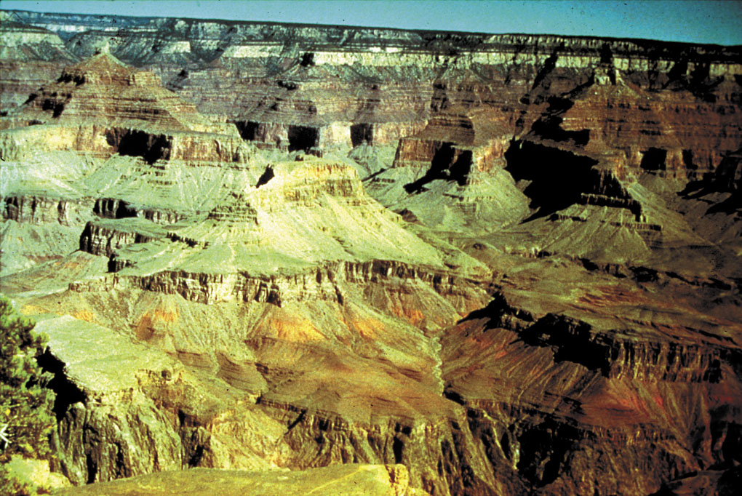
Grand Canyon--yellowish
Grand Canyon National Park
5
Notes:
Evolutionists basically dominate all the signs and brochures at the Grand Canyon, leading us to believe that it was carved gradually by the small Colorado River at the bottom.

Slide 117

UK – British Museum on Natural History
5
Natural History Museum, London
Notes:
Evolutionists also control the museums of natural history throughout the USA and London.

Slide 118





High School biology textbooks 2006
5
Glencoe
Holt
Evolution
EXPOSED
Miller-
Levine
Prentice Hall
Notes:
The basic texts all support evolution, but it is refuted by Roger Patterson, Evolution Exposed (2006)

Slide 119
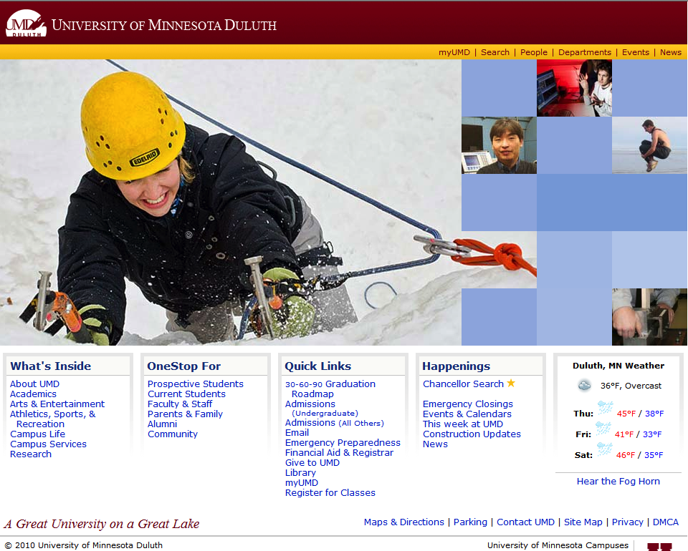
University of Minnesota Duluth
5
Notes:
Evolution also is the founding philosophy of every public university---and these universities are filled with many from Christian homes!

Slide 120







Turning "Jews" into "Greeks" 02027
5
Turning Church Kids into Skeptics
Secular
Media &
Education
Notes:
120
After book sales and before final statements:
"Parents and grandparents, Your kids and grandkids are being indoctrinated with evolution and millions of years a whole lot more than you were when you were in school. Can they stand strong in their faith in the face of this relentless challenge? Do you care? If you walk out of here and say "That was a nice message, I believe Genesis" but don't get any resources for your kids and grandkids and make sure that they believe Genesis and know how to defend their faith, then you don't care enough. And when they crumble under the intellectual pressure, you will be partly responsible for not equipping them with answers.

Slide 121

Christian College 1
5
HERE I AM!
READY TO
LEARN ABOUT
GOD'S WORD.
WELCOME
TO CHRISTIAN
COLLEGE!
Intro
to the
Bible
1-11
Genesis
Notes:
Sadly, youth are not even protected when they attend many Christian colleges! The red carpet underneath them is Genesis 1-11…

Slide 122

Christian College 2
5
LESSON #1: DON'T BELIEVE THIS PART!
1-11
Intro
to the
Bible
Notes:
And even Christian professors tell our Christian youth they need not take Genesis at face value!

Slide 123

Balloons problem—man's vs God's word
THE
SOLUTION
5
ISAIAH 58:12
Gay
Marriage
Moral
Relativism
CHRISTIANITY
HUMANISM
MAN'S WORD
GOD'S WORD
Notes:
123

Slide 124
I Peter 3:15 NAS
5
1 Peter 3:15
"But sanctify Christ as Lord in your hearts, always being ready to make a defense to everyone who asks you to give an account for the hope that is in you, yet with gentleness and reverence."
Genesis is foundational to the reliability and authority of the Bible

Slide 125
AiG web site #1
5

Slide 126
Evolution & Millions of Years: Do they really matter?
5
Destroy any basis for morality
Contradict the Bible's teaching on death
Make the gospel unbelievable
Undermine the reliability & authority of the Bible
Evolution & millions of years are destructive LIES!

Slide 127

Nailing Genesis 1-11 to church
5
GENESIS
1-11
MAN'S OPINIONS
MILLIONS OF YEARS
Notes:
127

Slide 128
Black blank------------extras
END

Slide 129

Creation link at biblestudydownloads.com
Get this presentation for free!

Slide 130
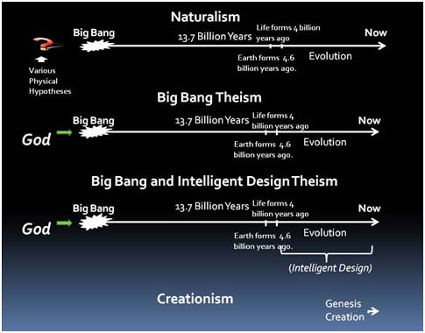
Atheism
5

Slide 131

We must deal with facts instead of speculation
6

Slide 132
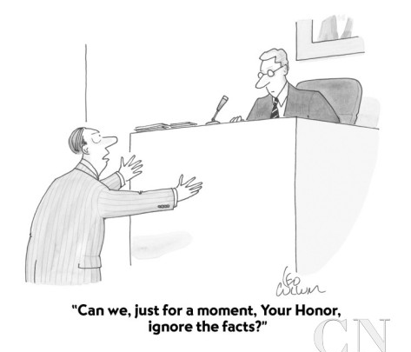
"Can we, just for a moment, Your Honor, ignore the facts?"
6
Notes:
Should we emphasize the reliability of the Bible? I don't want to be like the guy pleading before the judge, "Can we, just for a moment, Your Honor, ignore the facts?" I want to deal with facts to help atheists to see the truth of God, but how?

Slide 133
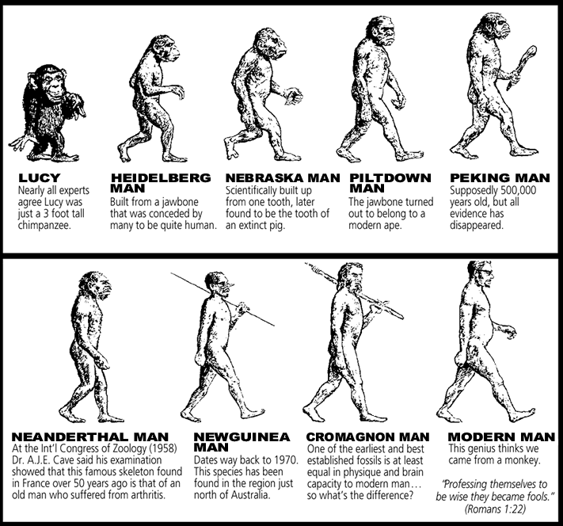
No genealogies?
6

Slide 134

The Moral Argument: Why do atheists believe in morality?
6
5

Slide 135
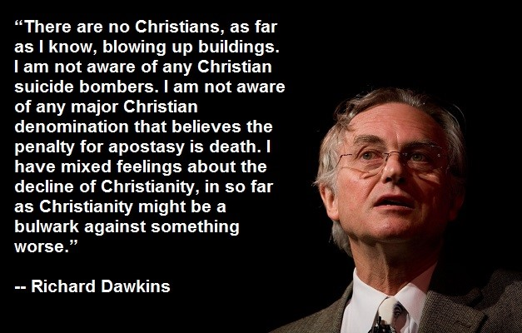
Richard Dawkins
6

Slide 136
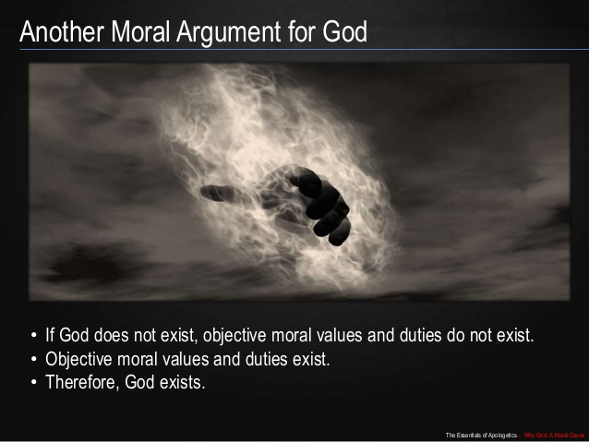
The Moral Argument: Why do atheists believe in morality?
6

Slide 137
"The fool says in his heart,
'There is no God'"
(Psalm 14:1)
Why is this true?

Slide 138
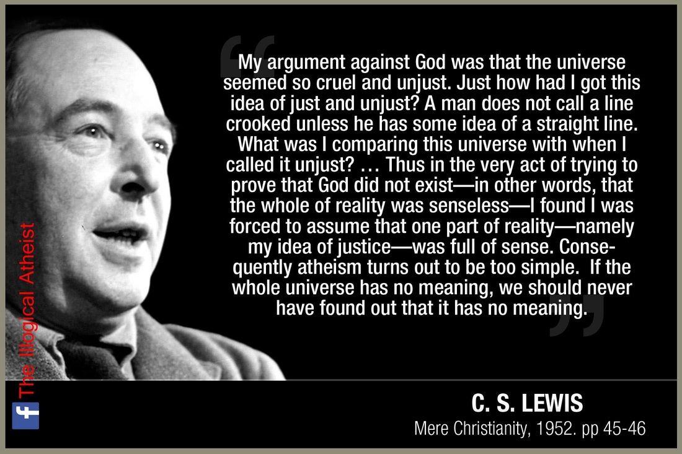
The Moral Argument: Why do atheists believe in morality?
6

Slide 139
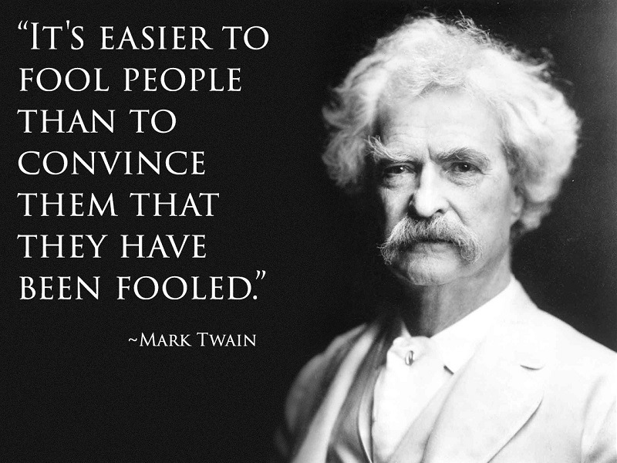
Mark Twain
6

Slide 140
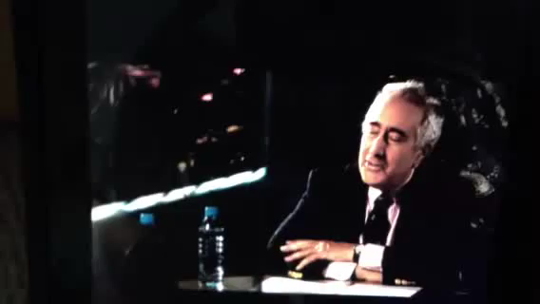
Ben Stein Interview of Richard Dawkins
6
His View on Origins

Slide 141
Black
Notes:
141

Slide 142


The Reliability of the Bible: Attacks Against Scripture
7
Since the early church false teaching has tried to undermine our faith
Presentation_ID
142
142
© 2003 Cisco Systems, Inc. All rights reserved.
142
Notes:
Yet still the deity of Christ has always been attacked but the unbelieving world.

Slide 143
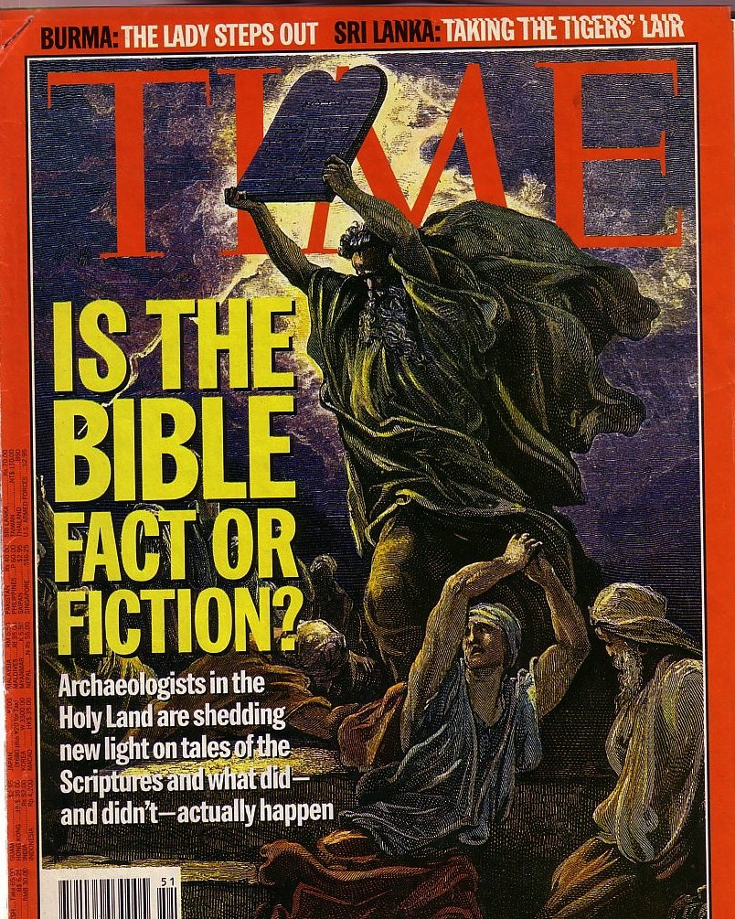
Attacks Continue
7
The Bible is continually attacked
However, discoveries continue to verify its accuracy

Slide 144

Is the Bible reliable?
7
Brown accuses via the mouth of "historian" Leigh Teabing…
"The Bible is a product of man, my dear. Not of God… [It] has evolved through countless translations, additions, and revisions. History has never had a definitive version of the book."
DVC, 195
Notes:
We are led to believe that some versions of the Bible have differing numbers of books--and that the fact that the Bible has been translated into more languages than any other book makes it suspect. No, this is a sign of worldwide recognition of it as the Word of God.

Slide 145

We trust ourselves instead of God.
7
Praying won't help.
Doing will.
Notes:
We need to be saved from our independence that leads to sin [restated].

Slide 146

We trust ourselves instead of God.
7
Lead with your heart.
Not with your Bible.
Notes:
So why do we die? Because since the beginning we have trusted ourselves instead of God.

Slide 147
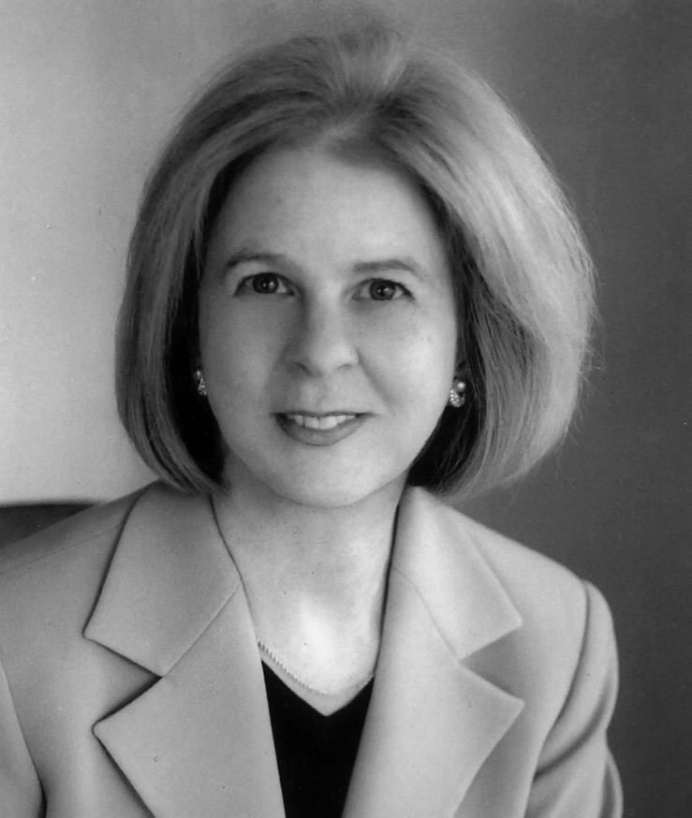
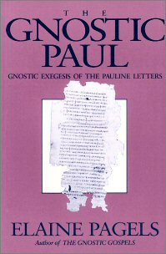
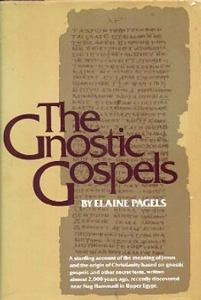
Some liberal scholars redefine Christianity
7
Elaine Pagels teaches at Princeton that first century Christianity was also Gnostic!
Notes:
Pagels is a strong proponent of Gnostic thought which believed that salvation was not by faith in Christ but by receiving a supposed "secret knowledge" from God.

Slide 148

Smearing History
7
Dan Brown
"Gospel"
Matthew
Mark
Luke
John
Selected for their "Male Bias"
Supposed 80 Gospels!
Matthew
Mark
Luke
John
Gospel
Truth
18 Heretical Gospels Written
1st Cent.
AD 325
Council of Nicaea
Notes:
In reality, of the 20 issues discussed at Nicaea, not one of them related to the correct books for the NT.

Slide 149
Clearing History
7
Acceptance of the Four Gospels Before Nicaea
Individuals
Didache (120-150)
Papias (130-140)
Pseudo-Barnabas (70-130)
Clement of Rome (95-97)
Polycarp (110-150)
Irenaeus (130-202)
X= Citation
or allusion
Hermas (115-140)
O= Named
as authentic
Matthew
Mark
Luke
John
X
X
X
X
X
O
X
X
X
O
X
X
X
O
X
X
X
O
Gospel of Thomas
AD 50-140
Gospel of Judas
AD 170?
1st Cent.
AD 325
Council of Nicaea
Geisler & Nix, Introduction to the Bible (Chicago: Moody, 1968)
Notes:
This is found in H. Wayne House, Chronological & Background Charts to the New Testament, It is also the last page of the notes for this seminar. The point here is that our four gospels were consistently cited whereas "Brown's Gnostic gospels" were likely not even written until the second century (even if Thomas appeared as early as AD 50 it was still deemed heretical).

Slide 150

Irenaeus (AD 180)
7
"They declare that Judas the traitor was thoroughly acquainted with these things, and that he alone, knowing the truth as no others did, accomplished the mystery of the betrayal; by him all things, both earthly and heavenly, were thus thrown into confusion. They produce a fictitious history of this kind, which they style the Gospel of Judas."
Against Heresies 1.31.1
Notes:
http://www.ccel.org/fathers2/ANF-01/anf01-60.htm#P7477_2003920

Slide 151
Irenaeus (AD 180)
7
"It is not possible that the Gospels can be either more or fewer in number than they are. For, since there are four zones of the world… and four principal winds… it is fitting that [the Church] should have four pillars…." (then he lists Matthew, Mark, Luke & John)
Against Heresies 3.11.8
Notes:
http://www.ccel.org/fathers2/ANF-01/anf01-60.htm#P7477_2003920

Slide 152
Irenaeus (AD 180)
7
"Matthew also issued a written Gospel among the Hebrews in their own dialect, while Peter and Paul were preaching at Rome, and laying the foundations of the Church. After their departure, Mark, the disciple and interpreter of Peter, did also hand down to us in writing what had been preached by Peter. Luke also, the companion of Paul, recorded in a book the Gospel preached by him. Afterwards, John, the disciple of the Lord, who also had leaned upon His breast, did himself publish a Gospel during his residence at Ephesus in Asia."
Against Heresies 3.1
Notes:
http://www.ccel.org/fathers2/ANF-01/anf01-60.htm#P7477_2003920

Slide 153
Clearing History
7
Acceptance of the Four Gospels Before Nicaea
Individuals
Canons
Translations
Origen (185-254)
Didache (120-150)
Papias (130-140)
Pseudo-Barnabas (70-130)
Clement of Rome (95-97)
Polycarp (110-150)
Justin Martyr (150-155)
Irenaeus (130-202)
Hermas (115-140)
Marcion (140)
Cyril of Jerusalem (315-386)
Tatian Diatesseron (170)
Old Latin (150-170)
Muratonian (170)
Barococcio (206)
Old Syriac (200)
X= Citation
or allusion
Apostolic (300)
O= Named
as authentic
Matthew
Mark
Luke
John
O
O
O
X
X
X
X
X
O
X
X
O
O
O
O
X
X
X
O
X
X
O
O
O
O
O
O
O
X
X
X
O
X
X
O
O
O
O
O
O
O
O
X
X
X
O
O
X
O
O
O
O
O
O
O
Gospel of Thomas
AD 50-140
Gospel of Judas
AD 170?
1st Cent.
AD 325
Council of Nicaea
Geisler & Nix, Introduction to the Bible (Chicago: Moody, 1968)
Notes:
This is found in H. Wayne House, Chronological & Background Charts to the New Testament, It is also the last page of the notes for this seminar. The point here is that our four gospels were consistently cited whereas "Brown's Gnostic gospels" were likely not even written until the second century (even if Thomas appeared as early as AD 40 it was still deemed heretical).

Slide 154
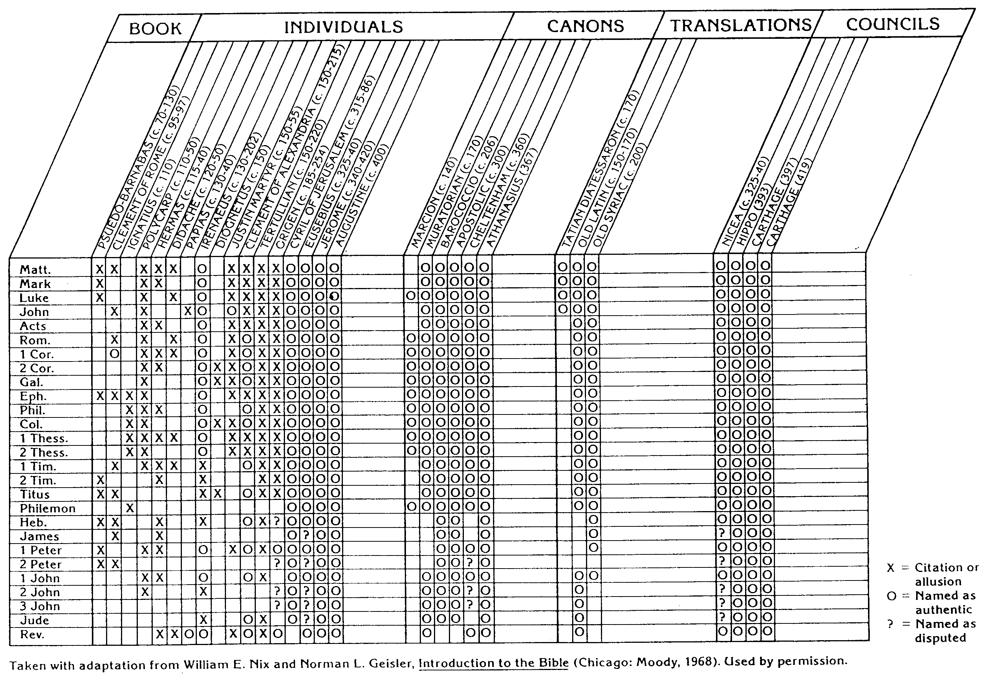
NT Canon during 1st 4C
For Further Details see...
17
The NT Canon in the First Four Centuries
H. Wayne House, Chronological & Background Charts to the NT
Notes:
This page appears at the end of your notes. Note that the first council that officially affirmed our 27 NT books was not Nicaea, but Hippo in 393.

Slide 155
NT Canonicity
Requirements
7
What did it take for early documents to be considered Scripture?
Written by Apostle (or under an Apostle)
Widely Accepted (used by churches)
Theologically Sound (no false doctrine)
None of these applied to the books Dan Brown says were the "real Scripture," such as the Gospel of Philip & Gospel of Thomas
Notes:
The "canon" or "rule" meant the officially recognized books of Scripture. None of the councils DETERMINED this list. They only AFFIRMED what the church had believed for generations.

Slide 156


Chronological Literature Chart
Dates show time of writing and works appear in italics
400 300 200 100 BC/AD 100 200 300 400 500 600 700
GREEK LXX
(Greek OT)
Polybius
Diodorus
Strabo
Plutarch
----- Hermetica ----
Philo
JEWISH ^{(Jewish/Greek)}
OT Jamnia "Council" MT
(completed) 600-1000
------OT Apocrypha-----
---------- Pseudepigrapha -------(some extended to 7th century)
- Dead Sea Scrolls -
---------------- Rabbinic Literature --------------
------------- Midrash (oral tradition) ----------
Talmud = Mishnah 200 + Gemara 500
--- Tosefta ---
Josephus 77-94
ROMAN (Jew writing for Rome)
Cicero
Livy
Pliny 113
Tacitus 115
CHRISTIAN
New Testament 40s-95
Apostolic Fathers 95-150
Most notable:
• Didache 95-120
• Epistle of Barnabas 70-132
----------------- NT Apocrypha ----------------
• Nag Hammadi Codices (Gnostic)
• Gospel of Thomas
MISCELLANEOUS
------------------------------- Select Papyri --------------------------------------------

Slide 157


The Hebrew Canon
The Hebrew Canon
Jewish and Christian books are the same but in different order and classification

Slide 158
The Hebrew Canon
The Hebrew Canon
?
Matthew 5:17 "Do not think that I have come to abolish the Law or the Prophets;
I have not come to abolish them but to fulfill them."
Jewish and Christian books are the same but in different order and classification

Slide 159
The Hebrew Canon
The Hebrew Canon
Luke 24:44 "… everything written about me in the Law of Moses and the Prophets and the Psalms must be fulfilled."
Jewish and Christian books are the same but in different order and classification

Slide 160


1. Hebrew: The Masoretic Text (MT)
Unpointed text
  (1400 BC – AD 800)
~yhla arb tyvarb
mhl rb hthsrb

Slide 161



Most Hebrew manuscripts lack vowel pointing. Both Hebrew and Greek manuscripts often lack space between words too!

Slide 162
You can read without vowels too!
W rrly rd nglsh wtht vwls
bt t s pssbl wth prctc. t's vn fn!
We rarely read English without vowels
but it is possible with practice. It's even fun!

Slide 163
1. Hebrew: The Masoretic Text (MT)
Unpointed text
  (1400 BC – AD 800)
Pointed text by Masoretes
  (AD 800 - present)
~yhla arb tyvarb
mhl rb hthsrb
mihole arab htihsereb
Bereshith bara elohim
In the beginning God created
~yhi_l{a/ ar"äB' tyviÞarEB.

Slide 164


2. Greek: The Septuagint (LXX)
The OT Hebrew text was translated into Greek in Alexandria around 250 BC
~yhla arb tyvarb
evn avrch/| evpoi,hsen o` qeo.j

Slide 165

Why study the LXX?
Earliest translation of the Hebrew Scriptures
Valued highly by Jews
Parent text
Provides intertestamental history (has Apocrypha)

Slide 166


3. OT Canonicity
7
Accepted at Council of Jamnia, AD 90
Why Adopted So Late?
Apocrypha
LXX
Antilegomena
Samaritans
Pharisaical Tradition
What Criteria was Used?
Authoritative & Enduring
Doctrinal Suitability
Prophetic Authorship
Claim to be God's Word
Dynamic Character
Canonicity is vital for those seeking God

Slide 167

NT Canonicity
7
Apostolic
Accepted

Slide 168


Really Early Fragments!
7
Magdalen Fragment of Matthew
AD 50-200
John Rylands Fragment of John 18:31-33, 37-38
AD 125
Notes:
http://www.tyndalehouse.com/staff/Head/P64TB.htm says the Magdalene fragment is actually from about AD 200.

Slide 169



Why No Original NT Documents?
7
Original Declaration of Independence
AD 1776
Engraving of the Declaration by printer William J. Stone
AD 1823
Notes:
The original Declaration of 1776 is only just over 200 years old but is barely readable.
Fortunately, a printer in 1823 engraved it, which has become the most frequently reproduced version of the document.
On it you can clearly see the signatures.
However, no such preservation techniques were possible for the original OT and NT documents, so only copies preserved in arid weather survived.
It is believed by some that, after the OT and NT autographs were copied accurately and proofread, these originals were then destroyed to prevent anyone from tampering with them.
http://www.archives.gov/exhibits/charters/declaration.html

Slide 170
NT Canonicity
7
Apostolic
Accepted

Slide 171


Paul Called Luke's Gospel "Scripture" within 5 years!
7
For the Scripture says, "Do not muzzle the ox while it is treading out the grain," and "The worker deserves his wages" (1 Timothy 5:18).
Macedonia
Paul Wrote 1 Timothy
AD 62
Caesarea
Luke Written
AD 57-59
Stay in that house, eating and drinking whatever
they give you, for
the worker deserves his wages… (Luke 10:7)

Slide 172
Peter Also Called Paul's Letters "Scripture"!
7
Paul's Letters Written
AD 49-62
Rome
Peter Wrote 2 Peter
AD 64
"…Our dear brother Paul also wrote to you with the wisdom God gave him. He writes the same way in all his letters, speaking in them of these matters. His letters contain some things that are hard to understand, which ignorant and unstable people distort, as they do the other Scriptures, to their own destruction" (2 Peter 3:15-16)

Slide 173

Would Christians who "believed that Jesus was only a man" really need to worship secretly in the catacombs? Nonsense!
8
Notes:
EVERYONE believed that Jesus was a man.

Slide 174

Would Christians who "believed that Jesus was only a man" die as martyrs? Hardly!
8
Ignatius, Bishop of Antioch, refused emperor worship and was brought to Rome to be fed to wild beasts.
Notes:
The Romans would have had no problem with Christians who only believed Jesus was a man. Their disagreement came with the Christian belief that Jesus was GOD.

Slide 175

Perpetua's Martyrdom (AD 203)
8
Notes:
Even women paid the ultimate price.

Slide 176

What About Nicaea
(AD 325)?
8
Bishops throughout the Eastern Empire gathered & excommunicated Arius of Alexandria
The Atlas of the Bible and the History of Christianity, ed. Tim Dowley (London: Three's Company, 1997), 77
Notes:
Now let's see what one of the earliest councils thought of Jesus. The focal point in Nicaea (modern Turkey) was on the contrary beliefs of two church leaders in Alexandria, Egypt.

Slide 177

Teachings of the Heretic Arius
8
John D. Hannah, Charts of Ancient & Medieval Church History (Grand Rapids: Zondervan, 2001)
Notes:
One of these leaders was named Arius. He denied that Christ was "co-eternal" with the Father. Arius taught that Christ had a beginning point in eternity past.

Slide 178

Arianism: Opponents and the Issue
John D. Hannah, Charts of Ancient & Medieval Church History (Grand Rapids: Zondervan, 2001)
Notes:
Alexander was the "boss" of Arius who held to the orthodox view that the Father and Son stood apart from creation. However, Arius believed only the Father to be separate from creation. Arius taught that the Father created Jesus, then Jesus created the world after this.

Slide 179

The Nicene Creed (AD 325)
8
John D. Hannah, Charts of Ancient & Medieval Church History (Grand Rapids: Zondervan, 2001)
Notes:
The orthodox view won out and was expressed in the Nicene Creed.

Slide 180


The Arian Controversy and Trinitarianism
8
John D. Hannah, Charts of Ancient & Medieval Church History (Grand Rapids: Zondervan, 2001)
Notes:
Unfortunately, Nicea did not end the Arian controversy, which later resurged until its final rejection almost 60 years later.

Slide 181

The Resurgence of Arianism
8
John D. Hannah, Charts of Ancient & Medieval Church History (Grand Rapids: Zondervan, 2001)
Notes:
God raised up Basil and the "Two Gregorys" to finally nail the coffin in Arianism. (However, this same heresy came back in the 1800s in a cult called Jehovah's Witnesses which teaches that Jesus was created by the Father.)

Slide 182
What About Nicaea?
8
300 votes
Fiction
Fact
2 votes
Arians:
"Jesus Not God"
Orthodox:
"Jesus is God"
Arians:
"Jesus Not God"
Orthodox:
"Jesus is God"
AD 325
Council of Nicaea
Notes:
Brown claims (without support) that the Nicaea vote on whether Jesus was co-eternal with God was very close. The truth is that the vote of the 302 leaders present was 300 to 2. "The two dissenting bishops were Secundus of Ptolemais and Theonas of Mamarica, both Libyan bishops associated with Arius. All three went into exile after the Council of Nicea" (Paul L. Maier in The Da Vinci Code: Fact or Fiction? with Hank Hanegraaff [Wheaton: Tyndale, 2004], 15, n. 6, on p. 73).

Slide 183


Biblical Interpretation Errors
Notes:
Our final part about Brown's errors concerns his views of Bible texts themselves.

Slide 184

1st century belief in Deity
8
Paul:
"Christ, who is God over all"
Rom. 9:5
Peter:
"God and Savior Jesus Christ"
2 Pet. 1:1
The Father:
"About the Son He says, 'Your throne, O God…'" Heb. 1:8
Jesus:
"I and the Father are one"
John 10:30
Notes:
There is NO doubt that the earliest Christians believed that Jesus was God! Hebrews 1:8 gives us the witness of the Father himself, and where can one find a more reliable witness than God himself?

Slide 185

Belief in Christ's Deity Before Nicaea
8
Ignatius: "God Himself was manifest in human form" (AD 105)
Clement: "It is fitting that you should think of Jesus Christ as of God" (AD 150)
Irenaeus: "He is God, for the name Emmanuel indicates this" (AD 180)
Tertullian: "… Christ our God" (AD 200)
Origen: "No one should be offended that the Savior is also God" (AD 225)
Lactantius: "We believe Him to be God"
(AD 304)
Bercot, 93-100 in Garlow & Jones, 94
Notes:
Over and over the early church fathers affirmed that Jesus was God--all long BEFORE Nicaea!

Slide 186


Accuracy of Transmission
9
This Isaiah scroll matches the A.D. 1000 Masoretic Text upon which all modern translations are based 99% of the time.
Masoretic Isaiah Scroll
Isaiah AD 1000
1200 years earlier!
Isaiah 200 BC
Dead Sea Isaiah Scroll
Notes:
"These are photocopies of the Nag Hammadi and Dead Sea scrolls, which I mentioned earlier," Teabing said. "The earliest Christian records. Troublingly, they do not match up with the gospels in the Bible." (DVC, 207). Christian records? Of the 800 Dead Sea Scrolls, NOT ONE has an NT book. Of the 18,000 fragments, NOT ONE of them is Christian in the least sense. These are all Jewish. As for the Nag Hammadi texts, these are Gnostic, not Christian.

Slide 187
ISAIAH: QUMRAN v. THE MASORETES
9
200 BC
AD 1000
Of the 166 Hebrew words in Isaiah 53, only seventeen letters in Dead Sea Scroll 1QIsb differ from the Masoretic Text:
10 letters = spelling differences
4 letters = stylistic changes
3 letters = added word for "light" (vs. 11)
17 letters = no affect on biblical teachings
Geisler & Nix, Intro to the NT, 382

Slide 188
Extant Copies of Pagan vs. NT Writings
10
# | Author | When Written | Earliest Copy | Time Span | Number of Copies
6 | Plato | 347 BC | AD 900 | 1200 yrs | 7
12 | Catullus | 54 BC | AD 1550 | 1600 yrs | 3
14 | Pliny | AD 113 | AD 850 | 750 yrs | 7
NT | Paul, Luke, etc. | AD 95 | AD 250 | 150 yrs | 24,772
Notes:
The Bible comes out FAR better than ANY ancient document in terms of age and number of manuscript copies. The Greek copies number about 14,000 of these 24,000.

Slide 189
Black
Notes:
189

Slide 190

Was Jesus a Myth?
11
Notes:
The reason Matthew presents the geneaology of Jesus is to show that his lineage back to David qualifies him as the rightful King of the Jews.

Slide 191

You KNOW it's a Myth. This Season, Celebrate REASON!
11
Notes:
Another claims, "You KNOW it's a Myth. This Season, Celebrate REASON!"

Slide 192

Keep the MERRY!
Dump the MYTH!
11
Notes:
Atheists say, "Keep the MERRY!" and "Dump the MYTH!" But God's love is no myth!

Slide 193

So what did the early Church really believe about Jesus?
Notes:
Here is where Brown rewrites not only the history of what unbelievers thought--he rewrites Christians' view of Jesus.

Slide 194

Who is Jesus Christ… really?
Brown:
Bible:
Only human
God-Man
Notes:
Now let's turn our attention away from historical inaccuracies about the canon to the early view of Jesus himself.

Slide 195

Brown's view of Jesus through "historian" Leigh Teabing…
"My dear," Teabing declared, "until [AD 325], Jesus was viewed by His followers as a mortal prophet... a great and powerful man, but a man nonetheless. A mortal."
[Sophie:] "Not the Son of God?"
"Right," Teabing said. "Jesus' establishment as 'the Son of God' was officially proposed and voted on by the Council of Nicaea."
DVC, 197

Slide 196


The Father, Son & Spirit
Notes:
But which person of the godhead created the world?

Slide 197

The Trinity
Notes:
We know that the one God exists as three persons: Father, Son and Spirit. Genesis 1 even hints at the Trinity by saying, "Let us make…" but which person was this specifically who made all we see? John 1 says that…

Slide 198

The Creator of the world is actually Jesus (John 1:1-3).
Notes:
Genesis 1 is unclear which person of the Trinity made everything—but the NT says it was Christ!

Slide 199

Jesus Christ is the same yesterday, today, and
Hebrews 13:7
Notes:
His incarnation forever changed him in that he took on a body that he will keep for eternity.
Unlike the leaders of verse 7 who may have passed away, Jesus remained with them and was unchanging.
The contrast is also seen in verse 9 with ideas that constantly change.

Slide 200

"So do not be attracted by strange, new ideas. Your strength comes from God's grace, not from rules about food, which don't help those who follow them"
(13:9 NLT).

Slide 201

Roman Historians
11
(year of death)
Cicero (43 BC)
Livy (AD 17)
Pliny the Younger (AD 113)

Slide 202

Pliny the Younger (AD 111-113)
11
Wrote letters to the Emperor Trajan
Said Christians gathered on a certain day (Sunday?) "to sing responsively a hymn to Christ as if to a god" (Epistle 10.96)—the earliest Latin reference to Jesus Christ

Slide 203



Helpful Correspondence (AD 111)
11
Emperor Trajan in Rome
Governor Pliny in Bithynia

Slide 204


Early Church Suffering
12
Governor Pliny to
Emperor Trajan (AD 111):
I have observed the following procedure: I interrogated these as to whether they were Christians; those who confessed I interrogated a second and a third time, threatening them with punishment; those who persisted I ordered executed…
Pliny, Letters 10.96
(c)Paul Halsall Mar 1996. halsall@murray.fordham.edu http://www.fordham.edu/halsall/source/pliny1.html
Notes:
(c)Paul Halsall Mar 1996. halsall@murray.fordham.edu http://www.fordham.edu/halsall/source/pliny1.html

Slide 205
Early Church Suffering
12
Governor Pliny to
Emperor Trajan (AD 111):
Those who denied that they were or had been Christians, when they invoked the gods in words dictated by me, offered prayer with incense and wine to your image, which I had ordered to be brought for this purpose together with statues of the gods, and moreover cursed Christ—none of which those who are really Christians, it is said, can be forced to do—these I thought should be discharged.
Pliny, Letters 10.96
Notes:
(c)Paul Halsall Mar 1996. halsall@murray.fordham.edu http://www.fordham.edu/halsall/source/pliny1.html

Slide 206

Early Church Suffering
12
Emperor Trajan to
Governor Pliny (AD 111):
You observed proper procedure, my dear Pliny, in sifting the cases of those who had been denounced to you as Christians... They are not to be sought out... Whoever denies that he is a Christian and really proves it—that is, by worshipping our gods—even though he was under suspicion in the past, shall obtain pardon through repentance..."
Pliny, Letters 10.96
Notes:
(c)Paul Halsall Mar 1996. halsall@murray.fordham.edu http://www.fordham.edu/halsall/source/pliny1.html

Slide 207
Roman Historians
11
(year of death)
Cicero (43 BC)
Livy (AD 17)
Pliny the Younger (AD 113)
Tacitus (AD 120)
About persecuted Christians under Nero:
"Their name comes from Christus, who, in the reign of Tiberius as emperor was condemned to death by the procurator Pontius Pilate"
(Tacitus, Annals 15.44 in AD 115)

Slide 208
Roman Historians
11
(year of death)
Cicero (43 BC)
Livy (AD 17)
Pliny the Younger (AD 113)
Tacitus (AD 120)
Suetonius (AD 121)
Claudius expulsed Jews from Rome "who had been continually stirring up trouble under the influence of Chrestus"
(oops!)
(Suetonius, Lives of the Caesars, ch. 25,
in AD 120; cf. Acts 18:2)

Slide 209

Extant Copies of Pagan vs. NT Writings
10
# | Author | When Written | Earliest Copy | Time Span | Number of Copies
6 | Plato | 347 BC | AD 900 | 1200 yrs | 7
12 | Catullus | 54 BC | AD 1550 | 1600 yrs | 3
14 | Pliny | AD 113 | AD 850 | 750 yrs | 7
NT | Paul, Luke, etc. | AD 95 | AD 200 | 100 yrs | 24,772
Josh McDowell, Evidence That Demands a Verdict, 40;
John Grassmick, "NT Introduction," Dallas Seminary class notes, 160

Slide 210

Josephus
Uninspired Jewish Writings
13
Life in 3 Stages:
Pharisee
General
Historian
AD 37 – ca. 100

Slide 211

4. Josephus
Uninspired Jewish Writings
13
Writings:
Jewish War (AD 77)
Antiquities (AD 93-94)
Life
Against Apion

Slide 212

Evaluation of Josephus
Uninspired Jewish Writings
14
Roman bias
Exaggerations
Egotism
Digressions

Slide 213

Significance of Josephus
Uninspired Jewish Writings
14
Earliest non-Christian witness to the historicity of Jesus Christ
(AD 93-94)

Slide 214
Short quote by Josephus
Uninspired Jewish Writings
14
"Convening the judges of the Sanhedrin, he [Ananus, son of Annas] brought before them a man named James, the brother of Jesus who was called the Christ, and certain others. He accused them of having transgressed the law, and condemned them to be stoned to death"
(Ant. 20.9.1 in Maier, 276; cf. Whiston, 4:140).
Josephus inaccurately refers to James as the brother of Jesus (cf. Acts 12:1-2; AD 44).

Slide 215

Long quote (two versions)
Uninspired Jewish Writings
14
Jewish | Christian
"At this time there was a wise man called Jesus, and his conduct was good, and he was known to be virtuous. Many people among the Jews and the other nations became his disciples. Pilate condemned him to be crucified and to die. But those who had become his disciples did not abandon his discipleship. They reported that he appeared to them three days after his crucifixion and that he was alive. Accordingly, he was perhaps the Messiah, concerning whom the prophets have reported wonders. And the tribe of the Christians, so named after him, has not disappeared to this day." | "About this time lived Jesus, a wise man, if indeed one ought to call him a man. For he was the achiever of extraordinary deeds and was a teacher of those who accept the truth gladly. He won over many Jews and many of the Greeks. He was the Messiah. When he was indicted by the principal men among us and Pilate condemned him to be crucified, those who had come to love him originally did not cease to do so; for he appeared to them on the third day restored to life, as the prophets of the Deity had foretold these and countless other marvelous things about him. And the tribe of Christians, so named after him, has not disappeared to this day."

Slide 216
Our Context
15
How could atheism have such overwhelming success?

Slide 217


Frey Fabrications
15
James Frey, author of the 2005 bestseller A Million Little Pieces, confessed in January that he really wasn't a criminal, didn't go to jail, etc.
His Response?
"The writer of a memoir is retailing a subjective story"
Notes:
Frey claimed in his life story in 2005 that he did these things but was called to account later that it was all a lie.

Slide 218

"Much ado about nothing"
15
Oprah Winfrey's first response when shown that Frey made up parts of his memoir (12 Jan 06)
Two weeks later she changed her view and expressed disappointment in Frey's lying (26 Jan 06)
Notes:
"Why should truth matter?" essentially was the response of Oprah to those who challenged the veracity of her friend, James Frey. When viewers challenged her, she changed her mind.

Slide 219

Entertainment Better Than Truth
15
[The death of objectivity] "relieves me of the obligation to be right"; it "demands only that I be interesting"
Literary theorist
Stanley Fish
Notes:
Quoted in Michiko Kakutani, "Truth Fast Losing Its Value in Non-Fiction," The Sunday Times, 22 January 2006, p. 33 reprint of The New York Times. Stanley Fish is the Dean of the College of Arts and Sciences at University of Illinois at Chicago and one of the most influential and controversial theorists and critics of literature, law, and philosophy of our time.

Slide 220

"The Enshrinement of Subjectivity"
15
Movies
Notes:
We used to enshrine (exalt) objectivity in our modern world. Now, in a post-modern world, we exalt subjectivity. Tolerance is our priority now.

Slide 221

"Based on a true story"
15
The typical prologue to movies that contain some truth
Notes:
Movies no longer say "A True Story." Instead we are left to wonder how much of movies like "Alexander" (2005) has true--50%? 2%?

Slide 222

Today "all literary sources are considered equal"!
15
Notes:
People still buy tabloids with little care for whether they tell truth or not.

Slide 223
NT Apocrypha: 18 Gospels
15
GOSPELS
Arabic Gospel of the Infancy
Armenian Gospel of the Infancy
Assumption of the Virgin
Resurrection of Christ by Bartholomew
History of Joseph the Carpenter
Protoevangelium (Infancy Gospel) of James
Notes:
Brown supposes that "all gospels are created equal," including these 18 heretical gospels that came a century after Christ.

Slide 224
NT Apocrypha: 18 Gospels
15
The Gospel of:
• Bartholomew • the Birth of Mary
• Basilides • Pseudo-Matthew
• Cerinthus • the Hebrews
• the Ebionites • Philip
• Mary Magdalene • Thomas
• Marcion • Infancy Gospel of Thomas
Notes:
These Gnostic works do not amount to "80 gospels" as Brown claims. What they say is so esoteric that few read them.

Slide 225
NT Apocrypha: 21 "Acts"
15
Apostolic History of Abdias
Fragmentary Story of Andrew
Ascent of James
Martyrdom of Matthew
Passion of Paul
Passion of Peter and Paul
Notes:
Perhaps Brown's "80 gospels" sloppily includes the 16 gospels plus 21 other supposed histories, though none of these (like the Gnostic gospels) is written by an eyewitness. Instead all take on well-known names to take on an air of authenticity.

Slide 226
NT Apocrypha: 21 "Acts"
15
The Acts of:
• Andrew
• Andrew and Matthias • Peter
• Andrew and Paul • Peter and Andrew
• Barnabas • Peter and Paul
• James the Great • Philip
• John • Pilate
• John by Prochorus • Thaddeus
• Paul • Thomas

Slide 227
NT Apocrypha: Others
15
APOCALYPSES
James Stephen
Paul Thomas
Peter the Virgin
EPISTLES
Epistles of Christ and Abgarus
Epistle of the Apostles
Third Epistle to the Corinthians
Epistle to the Laodiceans
Epistle of Lentulus
Epistles of Paul and Seneca
Apocryphal Epistle of Titus
Notes:
Even adding these pretend epistles and apocalypses sum up to 50 works.

Slide 228
Brown's Key Sources are Gnostic
15
Two Types Addressed in 1 John
Docetic Gnosticism
From dokeo, "to seem"
(Christ only seemed to be a man)
Matter is Evil
Depreciated Materialism
Denied Christ's Humanity
Touched Jesus (1:1)
Led to Asceticism
Immorality exalted
Cerinthian Gnosticism
From Cerinthus, founder in Asia
(Christ only seemed to be God)
Spirit is Good
Exalted Knowledge (gnosis)
Denied Christ's Deity
Water & Blood (5:6)
Led to Pride
Education exalted
Notes:
Many Gnostics did the opposite of Brown's thesis--they denied Jesus was a real man. Others exalted the spirit so much that they denied his deity. Brown supposes that this latter heretical group was normative Christianity!

Slide 229

The Gospel of Judas
15
Judas said, "Master, could it be that my seed is under the control of the rulers?" Jesus answered and said to him, "… you will grieve much when you see the kingdom and all its generation." When he heard this, Judas said to him, "What good is it that I have received it? For you have set me apart for that generation." Jesus answered and said, "You will become the thirteenth, and you will be cursed by the other generations—and you will come to rule over them. In the last days they will curse your ascent [47] to the holy [generation]."
Notes:
Another recent attack is the mantra that the Gospel of Thomas, which is Cerinthian Gnostic--the one that denied Christ's deity.

Slide 230
The Gospel of Judas
15
Jesus said, "… Truly [I] say to you, Judas... you will exceed all of them. For you will sacrifice the man that clothes me" (sections 55-56).
Notes:
This strange request of Christ for Judas to set him free from his body is the typical Gnostic desire to free oneself from the material world. This is the kind of stuff Brown advocates, but at least there is ONE manuscript of the Gospel of Judas. Brown has NO manuscripts for his heretical beliefs about Jesus and Mary Magdalene.

Slide 231
Black
Notes:
231

Slide 232
How Do We Respond to Attacks Against Scripture Today?
16
1. Know both the Word and the enemy arguments
Presentation_ID
232
232
© 2003 Cisco Systems, Inc. All rights reserved.
232
Notes:
By "enemy" I mean those attacking our faith.

Slide 233

JESUS
16
Liar
Lunatic
Lord

Slide 234

The One Book
16
Notes:
Of course, don't become an expert on Dan Brown. This heresy will soon pass away, but "the Word of the Lord is forever" so know God's eternal Word better than any book!

Slide 235

Let the controversy bring you to talk about the cross
16
Notes:
Brown mentions the cross only in passing as a Christian symbol. We need to complete this with the significance of the cross. Christ died on the cross not for his own sins since he had none. He died for us.

Slide 236

What's So Good About
Good Friday?
16
Jesus controlled His own arrest
Jesus' illegal trials proved Him innocent
Jesus' death paid for our sin
Jesus' resurrection proved He gives eternal life

Slide 237

Good Friday is good because on this day Jesus Christ paid for your sin.
16

Slide 238

But Jesus' resurrection proved He is God who can give us eternal life (John 20).
16

Slide 239

How can we explain the empty tomb?
16
He never died?
Jesus' strength?
Disciples?
Notes:
Each of us must explain why the body of Jesus was missing on the third day.
To say he never died is preposterous as the Romans were expert executioners.
The theory that the cool tomb refreshed Christ enough to overcome his crucifixion and move the 1.5 ton stone is also ridiculous.
The disciples were the ones LEAST expecting a resurrection, so they are not potential candidates.

Slide 240

What would it take to turn the despondent Peter around?
16

Slide 241

The empty tomb did it!
16
Notes:
Nothing short of a genuine miracle would have convinced all eleven disciples to preach his resurrection for a lifetime and then die as martyrs.

Slide 242

Why did John write about Jesus' miracles?
16
So you can have eternal life by believing in Him!
These [signs] are written so that you may believe that Jesus is the Christ, the Son of God, and that by believing you may have life in his name (John 20:31).
Notes:
The resurrection of Christ is the KEY sign that Christ was indeed who the Bible claims--God himself who took a human body to tell us of his love. And the benefit to us for believing this is no secret…

Slide 243

The Divine Code
16
For God so loved the world that he gave his one and only Son, that whoever believes in him shall not perish but have eternal life.
John 3:16
Notes:
This may look like a cryptic message but it's actually the best known verse in the Bible. It tells us that God gives us life with him forever when we simply place our trust in Jesus Christ. This is no da Vinci Code. It's the Divine Code!

Slide 244


Jesus rose to give you new life!
Jesus rose to give you new life!
16
Notes:
In his nearly 600 page paperback that supposedly tells us the "truth" of Christianity, Brown NEVER EVEN ONCE mentions the resurrection of Christ. This is the CHIEF teaching of Christianity--that Christ proved his claims by coming back from the dead.

Slide 245

What if God does not believe in atheists?
16
Notes:
The more significant question was posed by one church sign: "What is God doesn't believe in atheists?"

Slide 246

We need Christ!
16
If our greatest need had been information, God would have sent us an educator.
If our greatest need had been technology, God would have sent us a scientist.
If our greatest need had been money,
God would have sent us an economist.
If our greatest need had been pleasure, God would have sent us an entertainer.
But our greatest need was forgiveness,
so God sent us a Saviour.
Notes:
One poet wrote…

Slide 247

We need a RISEN Savior
16
Notes:
More than that, we need a risen Savior to change our lives.

Slide 248

What or who are you trusting to save you from your sin?
16
Notes:
Whatever you trust has to be reliable!
Trust Christ to save you from your sin.

Slide 249

How can you know Him?
16
Admit you have sinned
Believe that Jesus died for you
Confess that you want to turn from sin
Notes:
This means Jesus is alive today. This also means you can know him personally. It's as simple as A-B-C. Let's bow our heads and if you wish to come into this new relationship with Christ, please pray to him now, acknowledging these three things to him.

Slide 250
Questions?
16
Notes:
Let's take a few moments to answer any remaining questions…

Slide 251
Theology PPT link at biblestudydownloads.com
Get this presentation for free!

Slide 252
Black
Notes:
252

