Slide 1
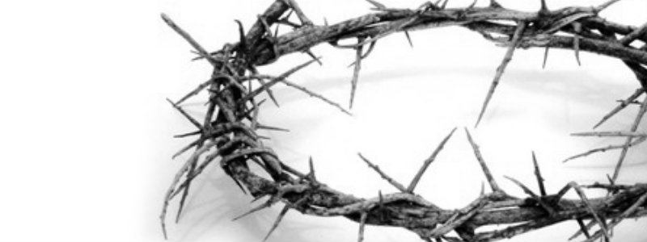
福音的本质
68
救恩论：上帝的救赎计划
Dr. Rick Griffith • 新加坡神学院
BibleStudyDownloads.org

Slide 2

拯救我们的福音是什么？
68
如果我们甚至不知道那个从前一次交付圣徒（犹大书1:3）的福音真理是什么，我们如何为信心而战呢？

Slide 3
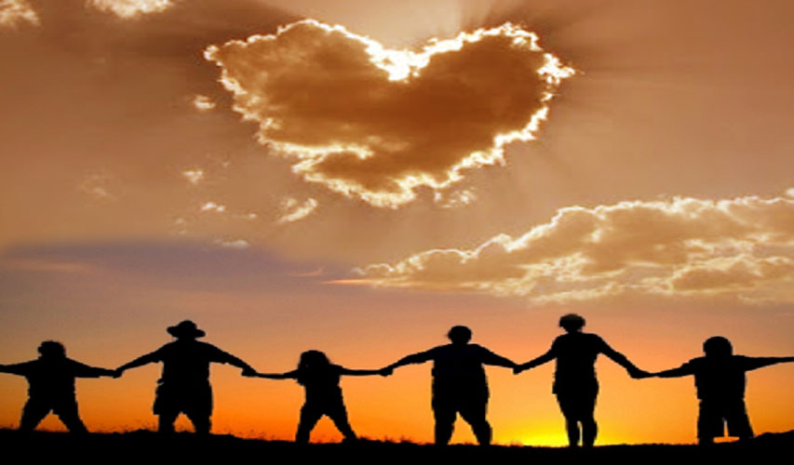
福音
真的改变了
我们的生命？
Notes:
The gospel is supposed to change lives.
Why doesn't the gospel change our lives like it should?
Too often the lives of Christians isn't really different from the non-believers.
In some situations in the USA, the church has a higher divorce rate than the world!
The way believers spend their money isn't much different either. The average Christian gives about 1-3% of his income, which is about the same as non-Christian giving.

Slide 4
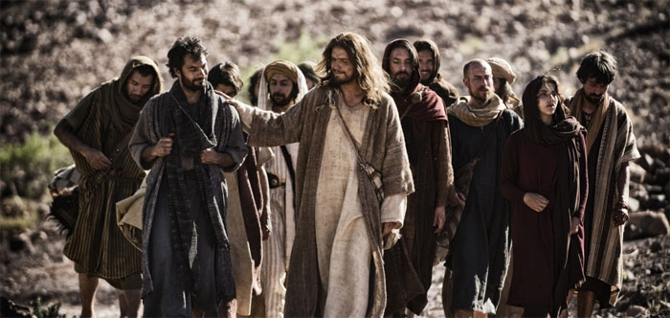
福音的结果往往与福音的本质被混为一谈。
Notes:
Well-meaning believers can confuse simple trust in the message of the cross with the behavioral change the gospel is supposed to make!

Slide 5
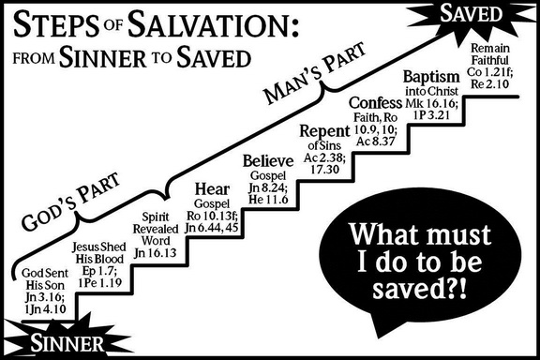
问题：虚假的福音宣告
救恩的步骤
得救
保持
忠实
西1:21；
启2:10
从罪人到得救
人的部分
洗礼归
入基督
可16:16
彼前3:21
承认
信心
罗10:9-10；
使8:37
罪的
悔改
使2:38，
17:30
相信
福音
约8:24；
希11:6
神的部分
听到
福音
罗10:13；约6:44，45
圣灵
启示
真理
约16:13
我应该要做什么才能得救呢？
耶稣流下宝血
弗1:7；彼前1:19
神差派他
的儿子
约3:16；约一4:10
罪人
Notes:
This is the Church of Christ view—But it looks to me like they say we need to do SIX things!
This brings NO assurance in this life as no one ever knows just how much he will “remain faithful”
Five Steps to Salvation
By Allan Stanglin
http://www.allanstanglin.com/five-steps-to-salvation/
24 April 2013
Accessed 9 May 2016
It’s just a Church of Christ thing, right? The “Plan of Salvation,” also called the “Five Steps of Salvation,” is unique to us, I think. And those of us who were raised in and by the Churches of Christ know them well: Hear, Believe, Repent, Confess, Baptism. In that order. As a kid in the ’70s, this was drilled into me by my Sunday school teachers in Bible class, by the preachers from the pulpits, by the youth ministers at the devotionals and rallies, and by the Open Bible Study my dad walked me through when I reached the “age of accountability.” The five steps were plastered on bulletin boards in the church hallways, illustrated by charts and diagrams on mimeographed handouts, and splashed across banners promoting the next Gospel meeting. These were the five steps, always accompanied by supporting verses of Scripture, that necessarily had to be followed — again, in order! — for one to be saved.
Hear. Believe. Repent. Confess. Be Baptized.
You ever wonder how that started? You ever question the validity of such a list? If you or your church were to make a list of supposed steps to salvation, what would you include? What parts of our CofC list would you leave out?
Historians point back to our movement’s focus on rational thought and enlightenment thinking that characterized the mainstream culture of America at the turn of the 19th century when Stone and Campbell and others were attempting to “restore” God’s Church. It was all about scientific reasoning and empirical evidence and deductive problem-solving. Society at this time was convinced that there were undeniable patterns, unalterable designs in nature and in the world that, if learned and applied, held the keys to everlasting peace and joy.
Alexander Campbell searched the Scriptures in this way and came up with what he called “the ancient gospel,” a pattern he believed was the divinely-ordained natural way to heaven. According to Campbell, it all boiled down to, in this order: gospel facts (death, burial, resurrection, and ascension of Christ), faith, repentance, reformation (of life), baptism, remission of sins, reception of the Holy Spirit, sanctification, resurrection of the saints, and eternal life. In that order. Campbell claimed that all Christian denominations believed in all these steps, but put them in different orders according to their own interpretations or theories of conversion.
At about the same time, Walter Scott came up with a biblical pattern and called it “the gospel restored.” He had six points originally. The first three were what humans had to do to be saved: believe, repent, and be baptized. The last three were what God promises to people who do the first three: forgiveness of sins, the gift of the Holy Spirit, and eternal life. Not too much later, Scott shortened his list to five points — one for each finger on a person’s hand, for easy remembering: faith, repentance, baptism, forgiveness of sin, and the gift of the Holy Spirit.
This method proved to be very successful on the early American frontier where most everybody had been trained in Calvinism which claimed that men and women were saved only by God’s predestination, that one couldn’t do anything to save himself, it was all up to God’s pre-ordained choosing. By telling these fiercely independent early frontier people that there really was something they could do to be saved, the Stone and Campbell churches fueled a massive rush to repentance and baptism.
As with most good things, we swung the pendulum a bit too far. Pretty soon, we were taking God’s initiative and the Holy Spirit’s active participation clear out of the conversion process. Preaching became all about proving “facts” with arguments and evidence. The Holy Spirit’s work in the past had been entered into the Biblical record and was there to be studied in a rational manner, but it wasn’t necessary for a person’s salvation. The emphasis was on logical fact-finding and step-following and persuading people to “obey the gospel.” The “gospel,” of course, being the steps.
So, at some point in the middle of the 1800s, it gets boiled down to what we have today in the five steps of salvation or the plan of salvation: hear, believe, repent, confess, be baptized. Notice how God’s divine activity is completely absent from any of the steps. Notice how this chart here to the right — all of these charts were downloaded from Church of Christ websites this morning — actually gives much more responsibility or credit to man than to God for salvation. Where is God in our “plan of salvation?”
Why is baptism the last step? Who took out “sanctification,” the guiding of the Holy Spirit, and the grace of God to continually wash our sins?
It is God who works to will and to act according to his good purpose. It is God who initiates salvation, who begins the good work and sees it through to completion. Belief and repentance and confession are salvation steps to be taken every day, not once on a ladder list of human accomplishments. Baptism is never the end of what the apostle Paul calls “being saved,” it’s the beginning. Our five steps minimize our God. Our five steps neglect a lifetime of day-by-day, hour-by-hour difficult discipleship to Jesus. And they ignore the unmerited and continuous grace of our merciful Father.
OK, maybe that’s a little harsh. Too judgmental, probably, Yes, we come by the “five-steps” thing naturally. It’s been handed down to us by faithful men and women who were doing their very best with what they had to work with during the times they lived. And I’m grateful for it. Seriously. But I’m also so glad that we’ve recognized the many shortcomings in this kind of incomplete view of salvation. I’m so glad that we’re acknowledging together the active role of God’s Spirit in the calling and saving and sanctifying of the saints. And I’m glad we can change. I’m so glad, by God’s grace, we’re allowed and even compelled to change.
Peace,
Allan

Slide 6

The Gospel is…
福音是。。。
68
好消息！
GOOD NEWS!
消息！
好

Slide 7
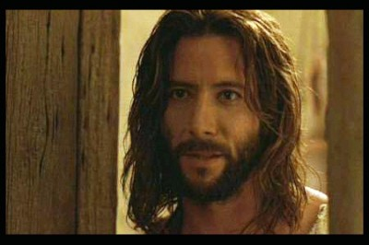
约翰福音
什么是得救的信心？
跟假信心有什么不同？

Slide 8
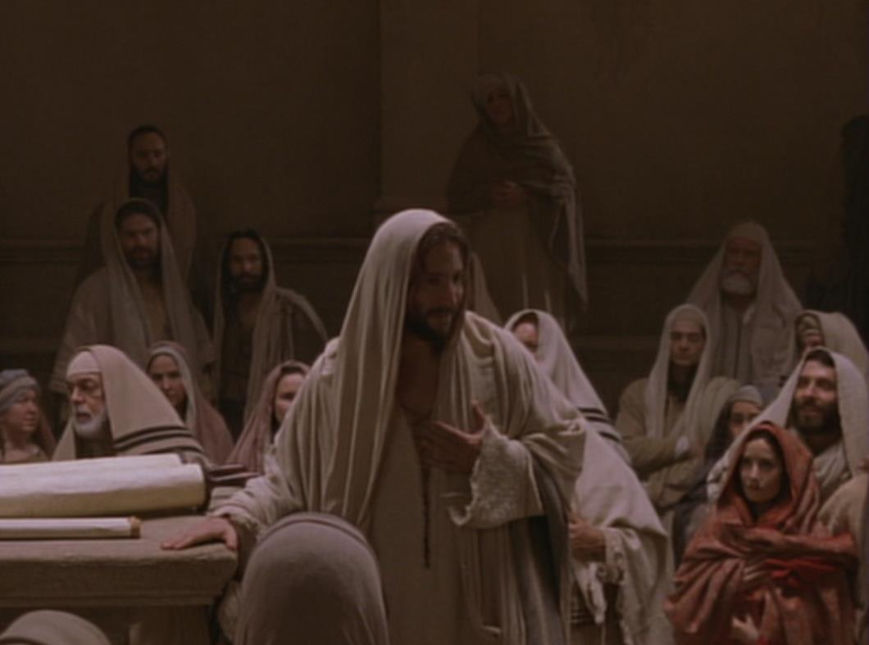
关键字
相信
约翰福音
107
关键节
“耶稣在门徒面前、另外行了许多神迹、没有记在这书上。但记这些事、要叫你们信耶稣是基督、是神的儿子．并且叫你们信了他、就可以因他的名得生命。” (20:30-31).

Slide 9
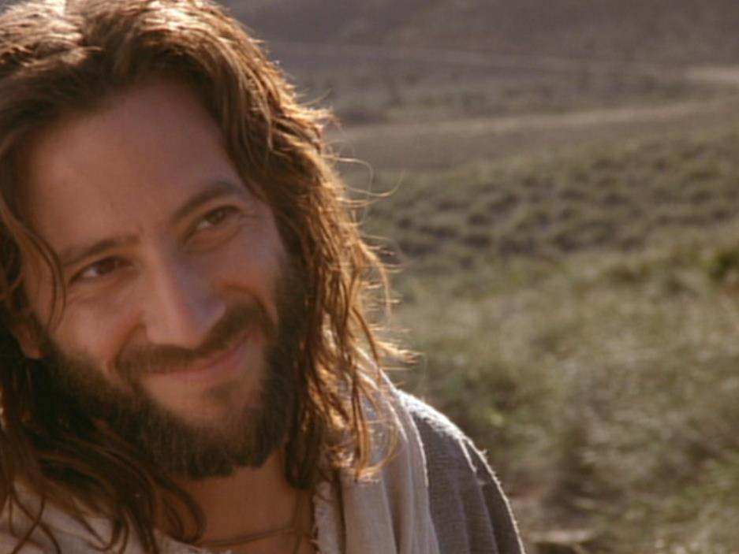
摘要陈述
约翰福音
107
约翰证明耶稣是神的儿子(神性) 道成肉身, 并透过基督的神迹奇事来说服不信的外邦人相信耶稣并得着永生.
应用
你是否百分百肯定相信基督必得着永生?

Slide 10
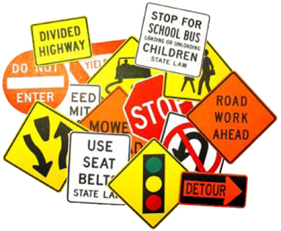

约翰记载的神迹
111
约翰福音独有的神迹-黄色方格内 (九个神迹中的六个)
变水为酒
2:1-11
医治大臣
的儿子
4:46-54
医治38年的
中风病患
5:1-18
喂饱5000人
6:1-15
行走海面上
6:16-21
医治生来
瞎眼的
9:1-7
叫拉撒路
从死里复活
11:1-45
基督复活
20:1-31
奇妙捕获
21:1-3

Slide 11

约翰一书5：11-13 中的保证
62 b) (2)
63
63
我们应该
怀疑吗？
我们应该
怀疑吗？
“这是神所证明的：
他已经给了我们永生，这生命在他的儿子身上。12凡有儿子有生命，没有神的儿子，就没有生命。13我已经写给你们 相信神的儿子的名，使你们知道你有永生。”
我们应该
怀疑吗？

Slide 12
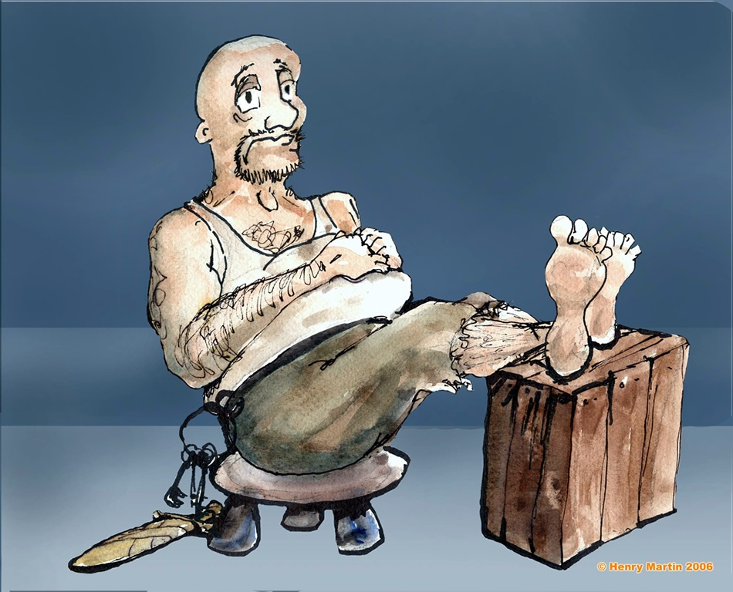
腓力比 监狱官 （使徒行传16)
Notes:
The jailor was sitting quietly one evening...

Slide 13
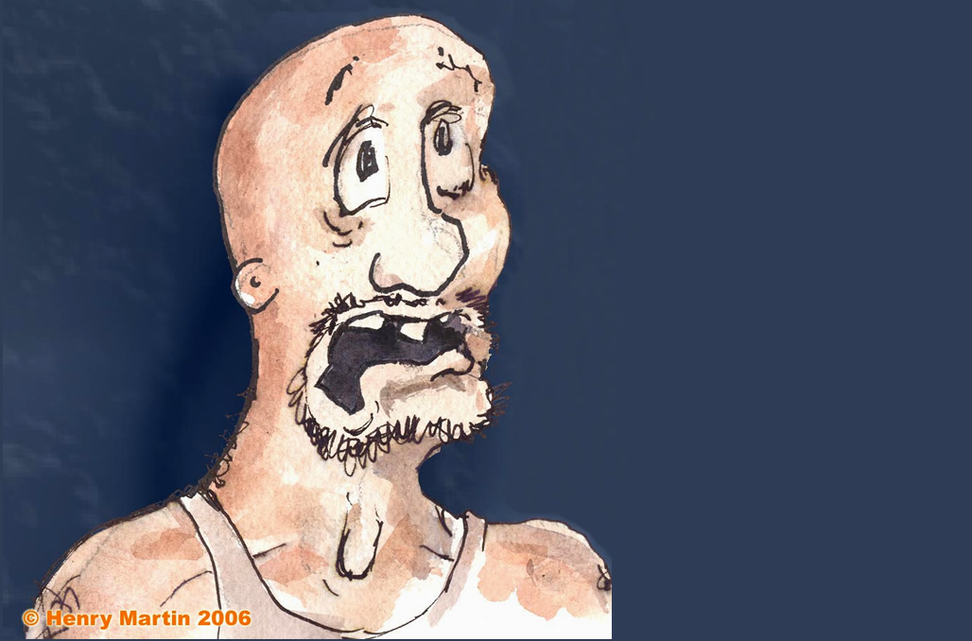
Fear seized him…
突然地震，感到害怕。
Notes:
Until suddenly there was an earthquake! Fear seized him…

Slide 14
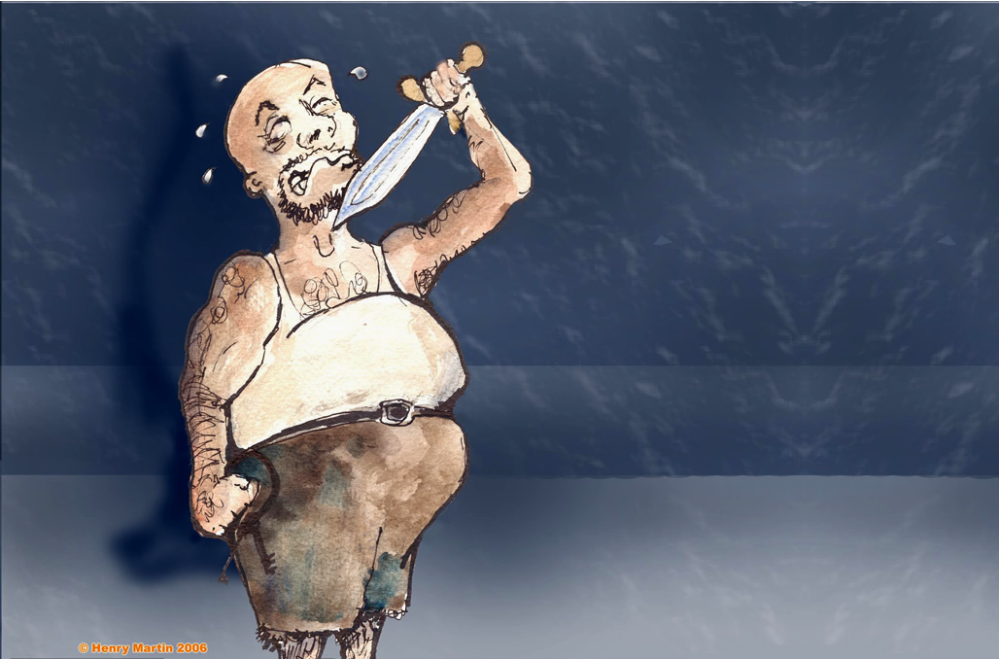
Attempted suicide
以为保罗和西拉跑了，正要自杀。
Notes:
He thought that Paul and Silas had escaped, so he sought to kill himself

Slide 15
"我应该作甚么才可以得救？"
Notes:
Until suddenly there was an earthquake! Fear seized him…

Slide 16
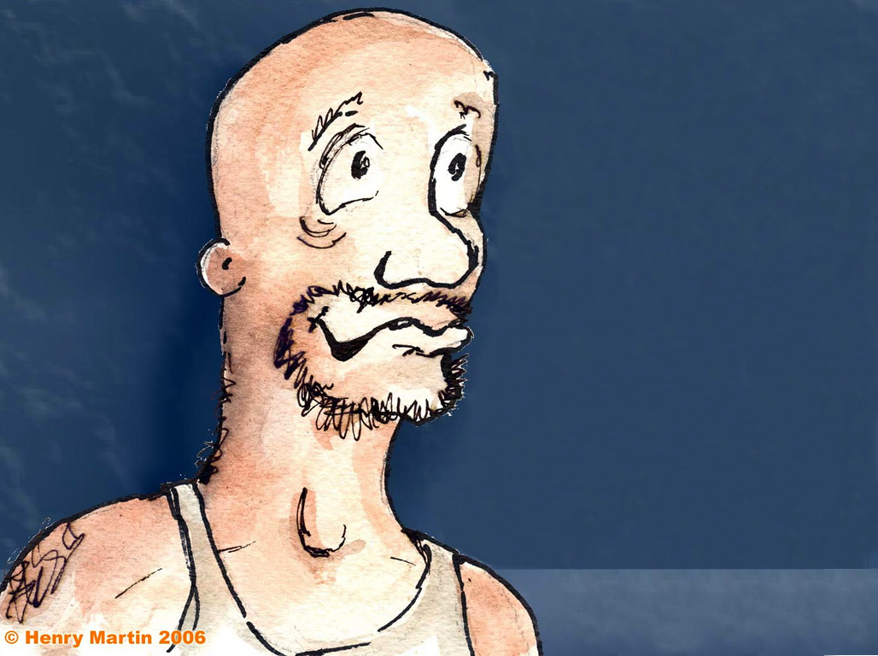
Joyful Jailor
保罗告诉他，“相信主耶稣你必被救 – 你和你的家人”（使徒16：16）
他就信耶稣，充满快乐。
Notes:
But Paul told him, "Believe in the Lord Jesus Christ and you will be saved—you and your entire household!" (Acts 16:16). So he trusted Christ and was filled with joy.

Slide 17
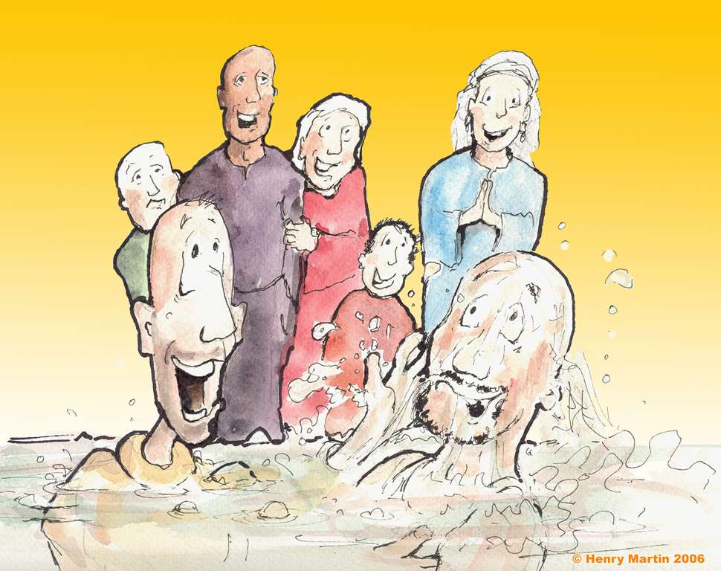
Immersing the jailow
Notes:
Or immersion!

Slide 18
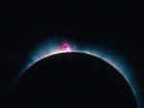
耶稣一直就是神
“太初有道，
道与神同在，
道就是神。”
（约 1:1）

Slide 19

在耶稣里，神成为人
“道成了肉身、住在我们中间、充充满满的有恩典有真理。我们也见过他的荣光、正是父独生子的荣光。” (约翰福音 1:14)

Slide 20
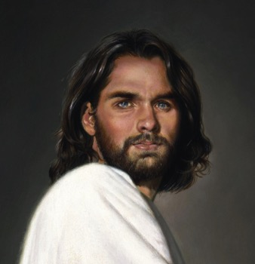
路加福音2:52
记载耶稣的成长
智慧
身量
神的喜爱
人的喜爱

Slide 21
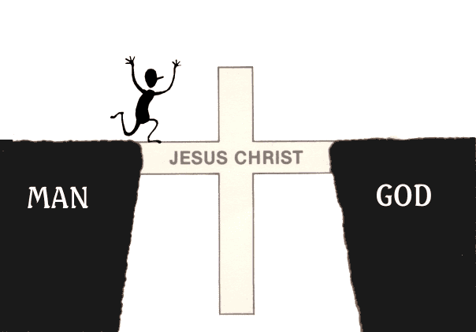
The Gospel is…
福音是。。。
好消息！
耶
稣
人
神

Slide 22
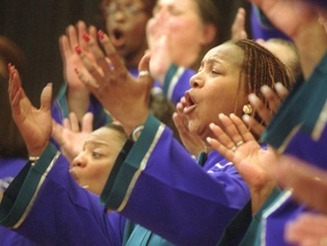
什么是全备的福音?

Slide 23
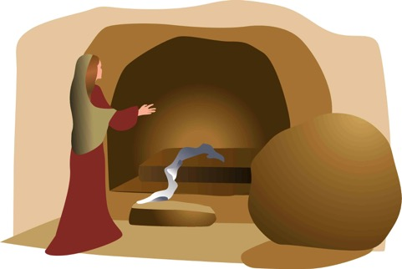
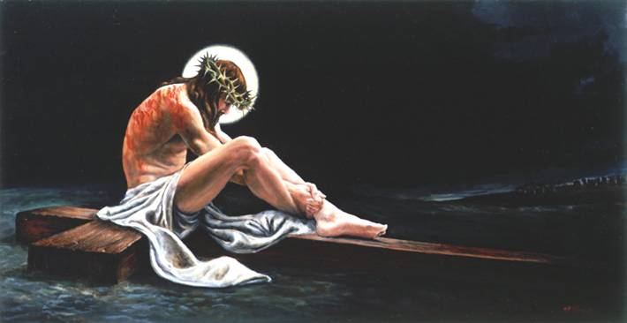
全备的福音
“我 如 今 把 先 前 所 传 给 你 们 的 福 音 告 诉 你 们 知 道。。”
埋葬
复活
死亡
“基督为了我们的罪死…”
“第三天，他从死里复活…”
“他被埋葬…”
林前15:3-4

Slide 24

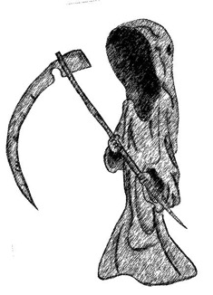
有什么分别?
已去世
佛
穆罕默德
马克思
仍活着

Slide 25
有什么分别?
5 并 且 显 给 矶 法 看 ， 然 后 显 给 十 二 使 徒 看 ；
6 后 来 一 时 显 给 五 百 多 弟 兄 看 ， 其 中 一 大 半 到 如 今 还 在 ， 却 也 有 已 经 睡 了 的 。
7 以 后 显 给 雅 各 看 ， 再 显 给 众 使 徒 看
已去世
耶稣
仍活着
佛
穆罕默德
马克思

Slide 26
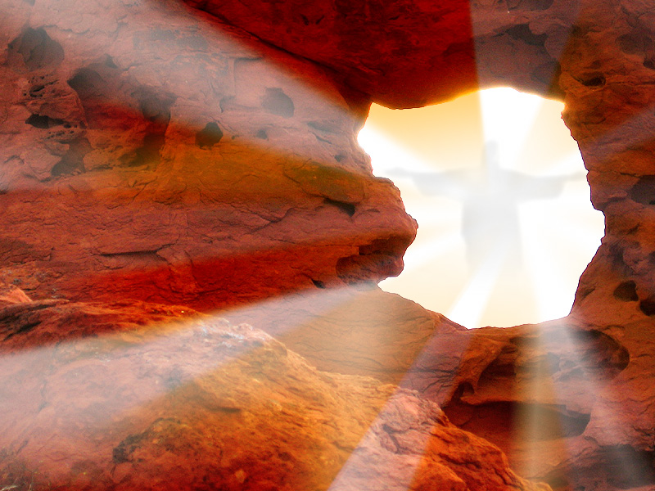
复活
的主

Slide 27

我们需要得到神的义
-- 但应该怎么做？

Slide 28

145
罗马书中的公义
神的公义，藉着在基督里因信称义–非借着律法
1–11章 | 12–16章
称义的解释 | 称义的应用
神学性 | 实用性
信什么 | 怎样表现
直向 | 横向
与神的关系 | 与人的关系

Slide 29


“成了”
155h
称义 (3:24)
神宣告我们“无罪”，并使我们与
他和好
合法
公义(3:25-26)
神的公平—他照个人的行为惩罚或归罪于无罪的代替者(耶稣基督)
完全
偿还

Slide 30
你应该分享什么作为一个清晰的福表达？
72-73
只凭单单对基督的信心
我们的问题
1. 我们得罪了一个圣洁的神
2. 我们的罪恶应受死亡的惩罚
神的解决方案
3. 上帝在耶稣基督里成为人
4. 耶稣在十字架上替代我们受罚
我们的责任只有一个：
5. 相信（信任，有信心）基督的死，埋葬和复活，以赦免你的罪

Slide 31
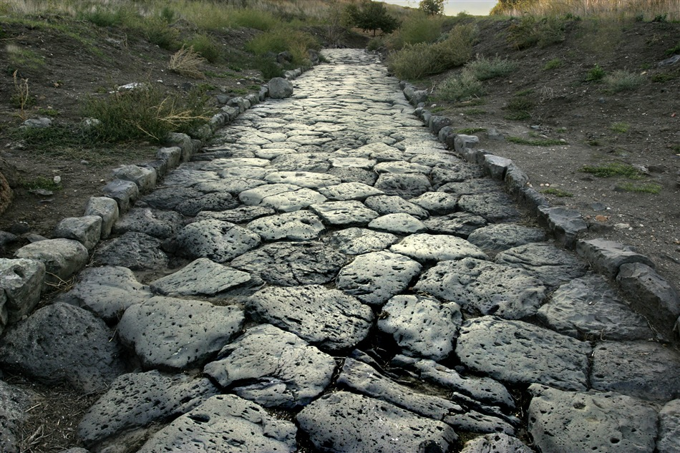
通往罗马之路
56

Slide 32
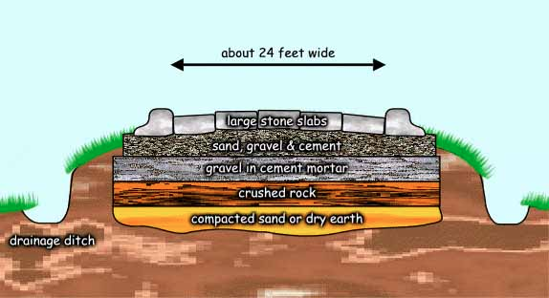
通往罗马之路
56
大约24英尺宽
大 石 板 层
沙子、碎石和水泥层
碎石和水泥灰浆层
碎 岩 石 层
紧密的沙子和干土地层

Slide 33
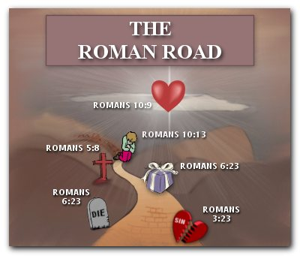
罗马之路
56
罗马书 10:9
罗马书 10:13
罗马书 5:8
罗马 6:23
罗马书
6:23
罗马书 3:23

Slide 34
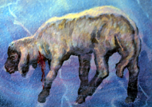
罗马之路
155i
罗 3:23
人人都犯了罪。
罗 6:23
罪的工价就是死。
罗 5:8
耶稣基督为我们的罪死。
罗 10:8-10
若想要罪被赦免，必须相信并承认耶稣为主。

Slide 35
你应该分享什么作为一个清晰的福表达？
72-73
只凭单单对基督的信心
我们的问题：
1. 我们得罪了一个圣洁的神
2. 我们的罪恶应受死亡的惩罚
神的解决方案：
3. 上帝在耶稣基督里成为人
4. 耶稣在十字架上替代我们受罚
我们的责任只有一个：
5. 相信（信任，有信心）基督的死，埋葬和复活，以赦免我的罪

Slide 36

Substitution View
50
耶稣偿清了一切
以赛亚书 53：5

Slide 37
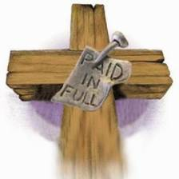
刑罚替代
50
“那本无罪的基督担当了人应当自己承受的罪责。”
—Ryrie, Basic Theology, 356
全部清偿

Slide 38

耶稣的死为我们的罪付上赎价

Slide 39
告诉其他人。

Slide 40
Black

Slide 41


救恩论链接地址 BibleStudyDownloads.org
免费获得该讲解!
圣经学习下载

