Slide 1
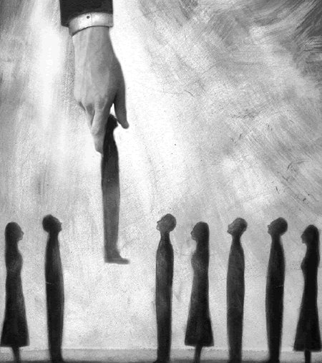
拣选
救恩论：上帝的救赎计划
Dr. Rick Griffith • 新加坡神学院
BibleStudyDownloads.org

Slide 2

拣选
55
神对个体或群体的拣选有其特殊的目的与旨意

Slide 3
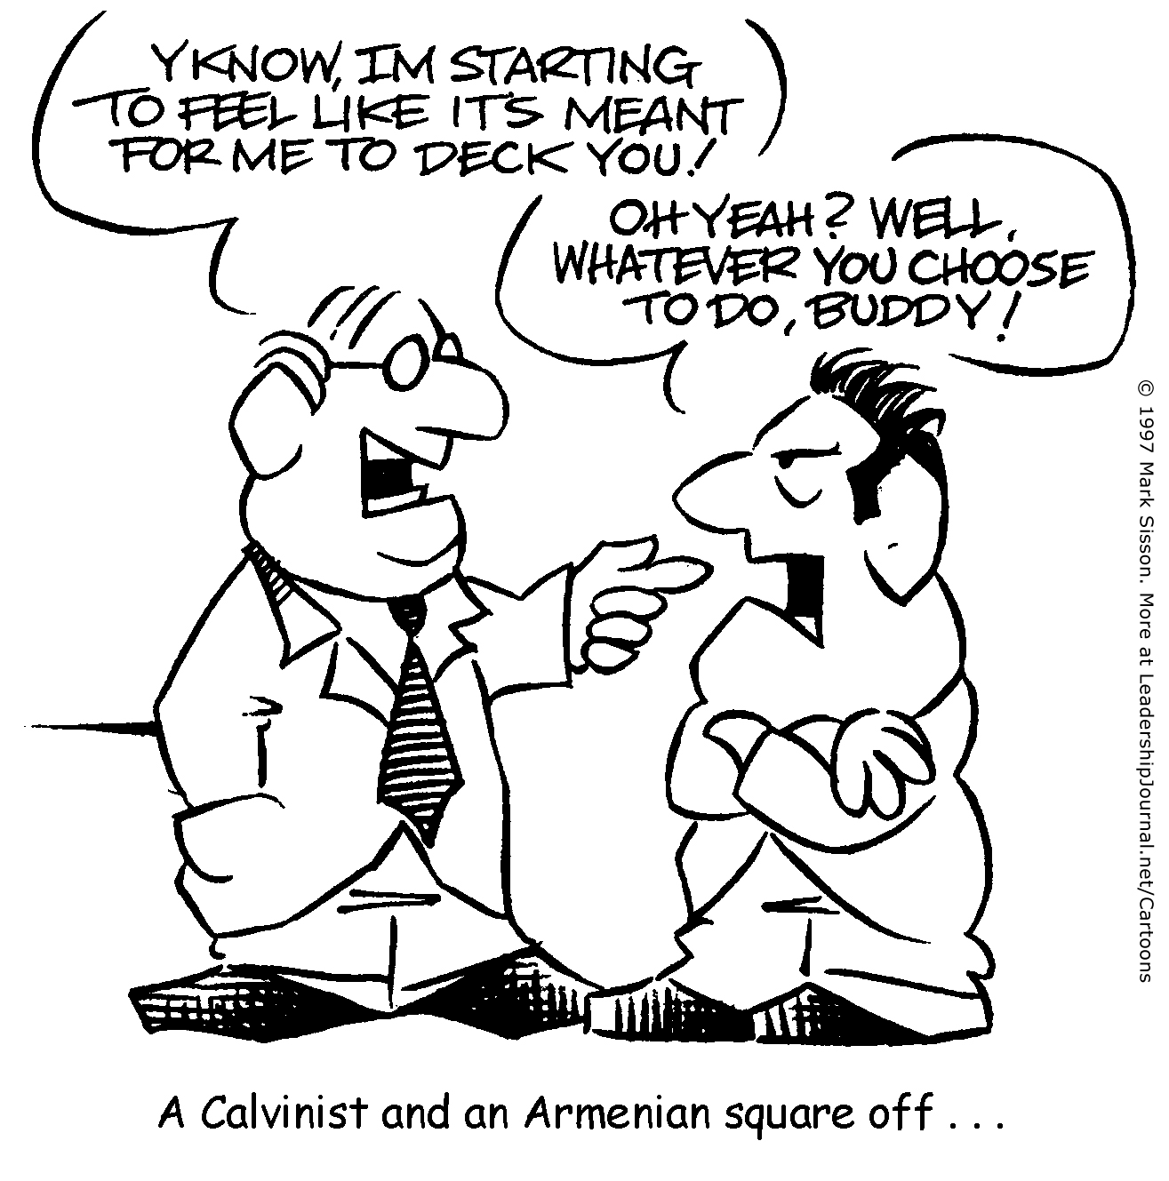
一个加尔文主义者和一个阿米尼亚人杠上了
你知道吗，我开始觉得如果打倒你显得我太小气了!
噢， 是吗? 你想做什么都是你的选择, 伙计!
?

Slide 4
你知道吗，我开始觉得如果打倒你显得我太小气了!
噢， 是吗? 你想做什么都是你的选择, 伙计!
!
一个加尔文主义者和一个阿米念主义者杠上了

Slide 5

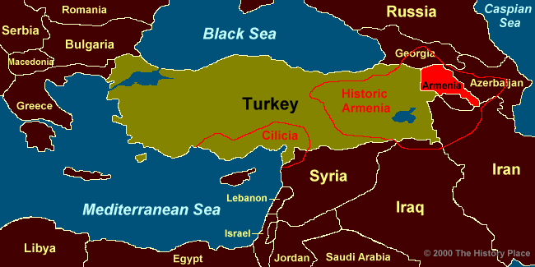
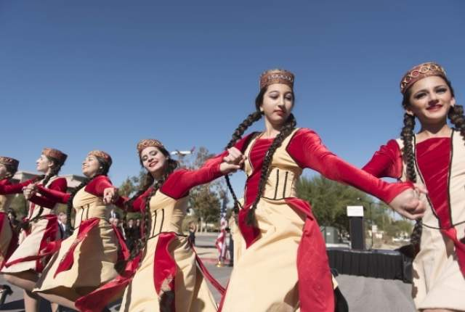
阿米尼亚人还是阿米念主义者?
俄罗斯
佐治亚
阿米尼亚
阿塞拜疆
历史上的阿米尼亚
伊朗
伊拉克

Slide 6

上天注定

Slide 7

拣选是无条件的
完全堕落
无条件的拣选
有限的赎罪
不可抗拒的恩典
圣徒的坚忍

Slide 8

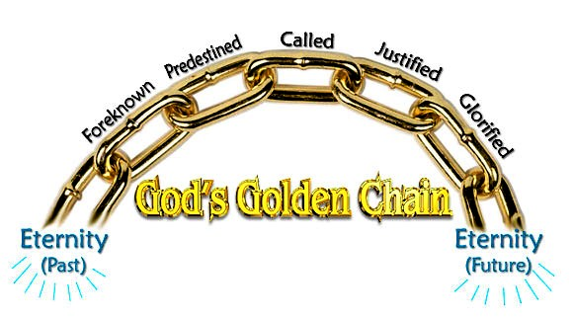
上帝的救恩计划中
不可打破的５个链条
51
被呼召
被预定
被称义
预先被知道
被荣耀
上帝的黄金链条
永生
(过去)
永生
(未来)
Notes:
Five Golden Links in God's Chain of Salvation
Posted by Editorial on July 14, 2015 at 6:46 pm
http://www.dallastelegraph.com/58850
Accessed 14 May 2016
By Elder Herb Hatfield, Pastor, Aberdeen Primitive Baptist Church, Aberdeen, Mississippi, USA
"For whom he did foreknow, he also did predestinate to be conformed to the image of his Son, that he might be the firstborn among many brethren. Moreover whom he did predestinate, them he also called: and whom he called, them he also justified: and whom he justified, them he also glorified." ROMANS 8:29-30
Introduction: Salvation is a grand and glorious subject. The salvation of a Hell-deserving soul from the torments of an eternal Hell is both amazing and glorious. What a wonderful thing that a person can, by the grace of God, be saved from eternal Hell. However, salvation is more than just deliverance from Hell, it involves much more. It includes our Redemption, our Regeneration, our Adoption as sons of God, our Sanctification and our eternal dwelling with God in glorified bodies. Dwelling eternally in Heaven with Jesus Christ our Saviour in our glorified bodies is the final result of the whole process of our salvation.
There are only two places that a soul can go after death, Hell or Heaven. Salvation is the whole process whereby God justifies, saves a Hell-deserving sinner by His free and sovereign grace, and gives them eternal life. They are regenerated, causing them to desire to live godly and glorified so they can then enjoy eternity with God the Father, God the Son, God the Holy Spirit, with the Holy angels and all the redeemed saints from all ages, with glorified bodies. That, my friends, is what salvation is all about; it is the delivering of a mortal soul from Hell's damnation and giving it eternal glory in Heaven. It is amazing! It is marvelous! It is wonderful and it is all true! God's plan for salvation ends in eternal glorification for all the saints of God.
These scripture verses set forth this glorious program of salvation. These verses say that those whom God did foreknow, He also did predestinate to be conformed to the image of His Son, and those whom He did predestinate, them He also called, and whom He called, them He also justified, and whom He justified, them He also glorified. There are five very important words in these verses. They are: Foreknow, Predestinate, Called, Justified and Glorified. These five words cover the whole program of God in the salvation of His people. This salvation is what I want to talk to you about, using these five words. I call them Five Golden Links in God's Chain of Salvation.
The Bible says that God has declared the end from the beginning (Isaiah 46:10).
Therefore, I want to take these five words in Romans, chapter eight, verses 29-30 in the reverse order that we have here. The last word is Glorification. That's where salvation ends, in our glorification, so I want to start with glorification and then work backwards. I want you to think with me about each of these five golden links in this chain of salvation.
The FIRST link in the chain that I want to discuss with you is the last one, GLORIFICATION. What a wonderful subject. Do you ever think about it? The Bible talks about it right here in these verses. It is what happens to the saints of God when they are given bodies in which they shall live forever. In I Corinthians chapter fifteen, the Apostle Paul talks about the resurrection and the glorification of our bodies. He even says that every saint may not necessarily die, but that we all shall be glorified. He says: "Behold, I shew you a mystery; We shall not all sleep, (that means die, that's what death is for the saints), but we shall ALL BE CHANGED, in a moment, in the twinkling of an eye, at the last trump: for the trumpet shall sound, and the dead shall be raised incorruptible, and we shall be changed. For this corruptible must put on incorruption, and this mortal must put on immortality" (I Cor.15:51-53). That's the same thing that the Apostle is talking about in Philippians chapter three where in verses 20 and 21 he says; "For our conversation (citizenship) is in heaven: from whence also we look for the Saviour, the Lord Jesus Christ: who shall CHANGE OUR VILE BODIES, that it may be fashioned like unto His glorious body".
This is what all the saints of God are looking forward to, when we shall have glorified bodies. We will have bodies that have been changed by the power of God, so that we put off mortality and put on immortality. These are bodies that have been "fashioned like unto His glorious body"! That is what the Apostle John is speaking about in I John chapter three, verses one and two when he says, "Behold what manner of love the Father hath bestowed upon us that we should be called the sons of God:…Beloved, now are we the sons of God, and it doth not yet appear what we shall be: but we know that, when He shall appear, we SHALL BE LIKE HIM, because we shall see him as He is."
Can you imagine it? Glorified bodies! Bodies that have been made like unto Jesus Christ's body. Not that we shall be gods, but we shall have bodies that will never die; there will be no pain or sickness, but most of all, no sin in them. We shall possess sinless bodies so we can sing and praise the Lord our Saviour for all eternity with pure hearts and glorified bodies. That's what Romans chapter eight says that salvation is all about. It says in verse 29 that we have been PREDESTINATED "to be conformed (that means made like) to the image of His Son". All who have trusted Jesus Christ as their Lord and Saviour in this life shall receive glorified bodies in eternity. That is our hope, it is our comfort in the time of sorrow and trouble, and it is what God has promised us, it is what He has predestined for us. Paul says in Romans 8:18: "For I reckon that the sufferings of this present time are not worthy to be compared with the glory which shall be revealed in us". HALLELUJAH!!! This is what makes the struggle and suffering for Christ all worthwhile. We who are the saints of God shall all, some day, be given glorified bodies to enjoy for all eternity in Glory. That is what David is referring to when he said, "As for me, I will behold thy face in righteousness: I shall be satisfied, when I awake, with thy likeness" (Ps 17:15). That, my friends, has been the hope of all saints in all ages. Job, in the oldest book in the Bible said, "For I know that my redeemer liveth, and that he shall stand at the latter day upon the earth: And though after my skin worms destroy this body, yet in my flesh shall I see God: Whom I shall see for myself, and mine eyes shall behold, and not another; though my reins be consumed within me." (Job 19:25-27)
I want you to see whom it is that is to be glorified. Paul says here in these verses that it is those who have been justified. In verse 29 of this eighth chapter of Romans, he says that those "whom He (God) justified, them He also glorified". I want you to see here that ONLY those who have been JUSTIFIED by God are going to be GLORIFIED. That's what the Bible says right here. It does not say those who live right, or those who joined the church, or those who have been baptized, or those who have done anything. No, it is ONLY those whom God has JUSTIFIED. This then is the second link in the golden chain of salvation, JUSTIFICATION.
JUSTIFICATION is a very, very important subject. It's a legal term. It speaks about our standing before the bar of God's Holy Law. The Word of the Lord says in Romans chapter three, that "all have sinned and come short of the glory of God", and that "there is none righteous, no not one". Therefore, before the bar of God's Holy Law, all mankind stands guilty of sin. We are all sinners because we all sinned in Adam and we are therefore worthy of eternal death in Hell. (Rom.5:12). But God did a wonderful and marvelous thing. He sent His only begotten Son into the world and laid upon Him all the sins of all those whom He would ever justify. Therefore, since the death and resurrection of Jesus Christ, God's Law has forever been satisfied concerning the sins of those whom He would justify and the guilty sinner has been declared, by God, to be just.
First, I want to show you the KIND OF PEOPLE that God justifies. In Romans 4:5 we read, "To him that worketh not, but believeth on Him (God) that justifieth the ungodly". There it is in black and white. Friend, read it and rejoice! The only kind of people that God justifies is "the ungodly"! It is not good people, nor religious people, nor those that feel themselves to be good people, but ONLY UNGODLY SINNERS! Paul says in First Timothy 1:15 that Christ died to save even the chief of sinners. In Romans 5:6, Paul tells us "when we were yet without strength …Christ died for the ungodly."
Now, I want to show you HOW it is that we are Justified. It is not by works that we do or by keeping the Law. In Acts 13:39, Paul says: "By Him (Jesus Christ) all that believe are justified from all things, from which ye could not be justified by the law of Moses". You see, the Law of Moses is good, but the Law cannot justify, it only condemns. It shows us our sin. It is like a mirror that we hold up and see our dirty faces. The mirror cannot cleanse our faces; we must use soap and water. Likewise, the Law of God shows us our sins, but it cannot justify us. The Bible teaches that it is God that justifies. In Romans 3:24 the Word of God says: "Being justified by His grace through the redemption that is in Christ Jesus".
You see, it is God that justifies us by His grace. Grace means without any merit. Therefore, God, by the good pleasure of His sovereign grace, justifies the guilty sinner. He does it "through the redemption that is in Christ Jesus." What that means is that Jesus Christ has paid the sin debt for all His people (Matt.1:21). The word "redemption" means, "to deliver by paying a price". That's what Jesus Christ did. He paid the price of death for the transgression of the guilty sinner. We read in the Book of I Peter 1:18-19: "Forasmuch as ye know that ye were not redeemed with corruptible things, as silver and gold, from your vain conversation (sinful conduct ) received by tradition from your fathers; but with the precious blood of Christ, as of a lamb without blemish and without spot." There is only one thing that could pay the price of our redemption; it was "the precious blood of Christ." .
In Romans 8:33, we see WHO it is that God justifies. "Who shall lay any thing to the charge of God's elect? It is God that justifies." There it is in black and white again. The people that God justifies are called "God's elect". They are the same people that we read about in Romans 8:28: "who are the called according to His purpose." God has justified His elect people by His free grace.
This brings us to the third word in the Golden Link of the Chain of our Salvation, it is the word CALLED. It is right there in our text in Romans chapter 8 and verse 30: "Moreover whom He did predestinate, them He also CALLED and whom He called, them He justified." Therefore, the people that God justifies are those who are "the called".
Paul began this Book of Romans by saying in chapter one and verse one: "Paul, a servant of Jesus Christ, called to be an apostle, separated unto the gospel of God." Then in verses six and seven, he addresses the book to "the called of Jesus Christ, to all that be in Rome, beloved of God, called to be saints". The word "called" is the Greek word "kaleo". This word is used 145 times in the New Testament. It means to name, or to bid, or command to come. It is used in Matthew 2:7 where we read "Then Herod, when he had privily called the wise men, inquired of them diligently what time the star appeared." You see its true meaning here. King Herod called the wise men to come to tell him about the star they had seen. These wise men had no choice about this matter, it was an invitation from one with supreme authority and it was to be obeyed. The same word is used in Matthew 4:21-22 where we read that Jesus "saw other two brethren, James the son of Zebedee, and John his brother, in a ship with Zebedee their father, mending their nets; and he called them. And they immediately left the ship and their father, and followed him".
Jesus Christ said in Matthew 9:13, "I am not come to call the righteous, but sinners to repentance." Peter says in Acts 2:39: "For the promise is unto you, and to your children, and to all that are afar off, even as many as the Lord shall call". Again, Paul says in I Thess. 2:12: "That ye would walk worthy of God, who hath called you unto His kingdom and glory." In First Peter 2:9, we read, "But ye are a chosen generation, a royal priesthood, an holy nation, a peculiar people; that ye should shew forth the praises of him who hath called you out of darkness into his marvelous light". God, by His Holy Spirit, has called (commanded to come) us from the spiritual darkness into which we were born by nature, into the marvelous light of the Son of God. It is what Christ did at the tomb of Lazarus in John chapter 11, when He said, "Lazarus, come forth" and next we read, "he that was dead came forth". So the call of God by His Holy Spirit to His elect, is both effectual and irresistible. Jesus Christ said in John 6:37, "All that the Father giveth me shall come to me." They are called by an IMMEDIATE, EFFECTUAL and IRRESISTIBLE drawing of the Holy Spirit of God, so that they willingly, by faith, come unto Jesus Christ, trusting Him as their Lord and Saviour.
If today you believe that, by the grace of God, you have been given a hope of your salvation in Jesus Christ, or if you shall ever be saved and glorified, it will be because God has called you. We would never have called on the Lord if God had not first called us. The Word of God says, "there is none that understandeth, there is none that seeketh after God" (Rom.3:11). Jesus Christ said in John 6:44: "No man can come to me, except the Father which hath sent me draw him…" We have all gone astray from God, so God must call us by His Holy Spirit and cause us to come unto Him. Psalms 65:4 says, "Blessed is the man whom thou choosest, and causest to approach unto thee". You see Friend; we come to God because He calls us and draws us to Himself. Therefore, in Jeremiah 31:3, God says, "with loving kindness have I drawn thee". Like Lazarus of old, we were dead in our trespasses and sins and God must first come to us and call us from darkness unto light. Whenever it is that the Holy Spirit comes to our dead hearts and calls us to Jesus Christ, we will be made alive and given eternal life.
We manifest God's spiritual life in us by believing the Gospel, by repenting of our sins, and by following Jesus Christ. All those that God has justified, He shall call from deadness unto life by His Holy Spirit, every one of them He will also glorify. It is very important that we see this clearly. The Holy Spirit of God shall call everyone whom God has justified by the death of His Son on the cross. This involves regenerating us so that we have faith in Jesus Christ as our Saviour. This is the work of the Holy Spirit of God as the third party to the eternal covenant of our salvation.
All of those whom the Holy Spirit has regenerated shall follow Jesus Christ. Christ said in John 10:27-28, "My sheep hear my voice (that is by the work of the Holy Spirit) and I know them (set my love upon them before the foundation of the world) and they follow me and I give unto them eternal life; and they shall never perish, neither shall any pluck them out of my hand". This means that all whom the Holy Spirit genuinely regenerates will be kept by the power of God until they are glorified. They will not lose their salvation because they are in the Almighty hand of God the Father and God the Son. They are sealed by the Holy Spirit of God (Eph.1:13), therefore they are eternally safe and secure and shall all be glorified, by the power and grace of God.
This brings us to the fourth word in the Five Golden Links of Our Salvation. It is the word PREDESTINATED. Again, it is right here in our text in Rom. 8:30 in black and white: "Moreover whom He did predestinate, them He also called." You see, the reason God called us unto salvation is because He had predestinated us to salvation. Predestination comes from the Greek word "proorizo" which according to Strong's Concordance means, "to limit in advance, determine before, ordain, or predestinate". Some people are afraid of this word, but do not be. It is a blessed word and has given the saints of God in all ages great comfort to know that God, before the world began, purposed all things, whatsoever comes to pass. It was a comfort to the saints at Jerusalem when they knew that all that Christ had suffered at the hand of Pilate or that they would suffer, was "whatsoever thy (God) hand and thy counsel determined before (proorizo) to be done" (Acts 4:28). Paul says in Ephesians 1:11 that, God "worketh all things after the counsel of his own will." Is that not a comforting thought, Dear One? Is it not good news to know that God is in control of all things and that He is working all things after the counsel of His own will? We read in Daniel 4:35, "He (God) doeth according to his will in the army of heaven, and among the inhabitants of the earth: and none can stay his hand, or say unto him, What doest thou? God is all-powerful and all-wise. He is the sovereign ruler over the universe.
God is in control of all events here on earth, working them to accomplish His predetermined will (Psa.76:10; Eph.1:11). If that were not true, we could not believe a single word of prophecy, because that is the very foundation of all prophecy. It is simply God foretelling by His prophets what He has predetermined to do. Every prophecy in the Bible is true, because it is God telling forth what He has before predetermined. God then moves and controls all the necessary events in time to accomplish what He determined before the world began. Jesus Christ was born in Bethlehem, fulfilling the ancient prophecy found in Micah 5:2, "But thou, Bethlehem Ephratah, though thou be little among the thousands of Judah, yet out of thee shall he come forth unto me that is to be ruler in Israel; whose goings forth have been from of old, from everlasting".
It was by the will of God, "that there went out a decree from Caesar Augustus, that all the world should be taxed" (Luke 2:1). This meant that Joseph must take Mary, when she was "great with child", carrying our Lord and Saviour in her womb, from Nazareth in Galilee to Bethlehem in Judah, a distance of over 60 miles, to pay his taxes. It was while they were there that Jesus Christ was born in Bethlehem, fulfilling the prophecy of Micah written about 700 years before the time of Jesus' birth. This prophecy was fulfilled because it was God's predetermined will and He brought it to pass just as He had foretold it by the prophets.
It is the same with our salvation. Paul says in II Tim.1:9: Who hath saved us and called us with an holy calling, not according to our works, but according to His own purpose and grace, which was given us in Christ Jesus before the world began". Isn't that amazing? Before time began, before there was an earth, or Adam and Eve, God had already predetermined to give grace to all His people whom He had chosen in Christ Jesus "before the foundation of the world, that we should be holy and without blame before Him" (Eph.1:4). He purposed before the world began to save them and to call them unto salvation by His Holy Spirit. You see, God does it all. He purposed to save His people from their sins. He sent His only begotten Son to die for their sins, and then He sends the Holy Spirit to call them to this wonderful salvation. They are made willing in the day of His power. (Psa.110:3)
The Apostle Paul says in Second Thessalonians 2:13, "But we are bound to give thanks alway to God for you, brethren beloved of the Lord, because God hath from the beginning chosen you to salvation through sanctification of the Spirit and belief of the truth". It is because God the Holy Spirit regenerates us, creating a new nature within us that causes us to have faith and believe the Gospel, hearing with a quickened ear. The Word of God says, "Eye hath not seen, nor ear heard, neither have entered into the heart of man, the things which God hath prepared for them that love him. But God hath revealed them unto us by His Spirit:" (1 Cor. 2:9-10)
You see friend, all of us were born, dead in sin. We were born spiritually dead, so that we could not understand spiritual things. Paul says, "But the natural man receiveth not the things of the Spirit of God: for they are foolishness unto him: neither can he know them, because they are spiritually discerned". (I Corinthians 2:14) Because of the spiritual deadness that we all were born into by nature, we cannot understand or know anything about the things of God until the Holy Spirit has regenerated us. That is why Jesus Christ told Nicodemus, and all of us, in John chapter three, "Verily, verily, I say unto thee, Except a man be born again, he cannot see the kingdom of God". It must be that God the Holy Spirit comes to us while we are yet dead in our sins, spiritually blind with spiritually deaf ears. He regenerates us, gives us a new birth that is from above, enabling the quickened soul to hear effectually the Gospel and believe in Jesus Christ as Lord and Saviour. So the saints of God can sing:
"My Lord, I did not choose You, for that could never be:
My heart would still refuse You, had You not chosen me.
You took the sin that stained me, You cleansed me made me new,
Of old You have ordained me, that I should live with You."
Now we come to the fifth word and final link in the golden chain of salvation, and it is the word FOREKNOW. There are various ideas about what this word means. Many think it only means to foreknow about things. They say that since God is all wise and eternal, He foreknows about events before they ever happen. It is certainly true that God is all wise and eternal and that He does foreknow all events before they ever happen. However, if you will think about it, you can only foreknow with any certainty what you have pre-determined to do. I have illustrated this by hitting another person. I foreknew that event because I had pre-determined that I would hit that person. However, I certainly did not know what would be the reaction of the other person whom I had hit. I did not foreknow whether they would hit me with a club or just laugh, but in no way did I foreknow with any certainty what they would do. The whole purpose of this illustration was to show that we could only foreknow with certainty what we had pre-determined to do. God foreknows all events with certainty. This is why anything prophesied in the Bible happened exactly as it was prophesied. God had before pre-determined the event and all the means necessary to accomplish that which had been pre-determined and prophesied.
However, the word "foreknow" as used in the Bible is not merely referring to God foreknowing events. The word is used in Romans chapter eight, verse 29 and Romans chapter eleven, verse 2. In both these cases, it is very clear that the writer is speaking about God foreknowing people. In Matthew chapter seven, the Lord speaks about the time of judgment when "Many will say to me in that day, Lord, Lord, have we not prophesied in thy name? and in thy name have cast out devils? and in thy name done many wonderful works? And then will I profess unto them, I never knew you: depart from me, ye that work iniquity."(verses 22-23). Most certainty the Lord knew about these people, so when He says, "I never knew you", He is speaking about something other than just the knowledge of their existence and their activity. He means, "I never knew you in a love relationship". This can be more clearly seen when we look at some other scriptures:
Genesis 4:1 "And Adam knew Eve his wife; and she conceived, and bare Cain,"
Genesis 4:17 "And Cain knew his wife; and she conceived, and bare Enoch:"
Genesis 4:25 "And Adam knew his wife again; and she bare a son, and called his name Seth"
Luke 1:34 "Then said Mary unto the angel, How shall this be, seeing I know not a man?
In each of these verses, it can be easily seen that the word "know" is used in such a way as to mean much more than merely knowing about someone. The way the word is used in these verses means to have a love relationship. That is how we should understand the word in Matthew 7:22-23, Romans 8:29, and Romans 11:2. The very first thing that God did when He determined to save some and give them eternal life, was to sovereignly set His love upon them and then predestinated them to eternal life and glorification.
So we read in Romans 8:29, "For whom (not what) He did foreknow (know in a love relation) He also did predestinate to be conformed to the image of His Son…"
This is the same order in Jeremiah 1:5 where God told Jeremiah, "Before I formed thee in the belly, I knew thee (set His love upon him); and before thou camest forth out of the womb, I sanctified thee, and I ordained thee a prophet unto the nations".
It is the same order in Ephesians 1:4-5 where we read, "according as He (God the Father) hath chosen us in Him (God the Son) before the foundation of the world, that we should be holy and without blame, in love having predestinated us unto the adoption of children by Jesus Christ…" Thus, we should learn that God has first set His love upon us and then He predetermines our eternal glorification.
This is the very order that is set forth here in Romans chapter eight. Read it again. The very first word in the order is foreknow. It is those WHOM God did foreknow in an eternal love relationship that He predestinated to be glorified. This is the reason we shall be glorified, it is because God foreknew us. He sovereignly set His love upon us before the foundation of the world and predestinated us to be conformed to the image of His only Son in eternal glory.
This then is the Golden Chain of God's Salvation. It reaches from eternity past where God foreknew His people before the foundation of the world and then did predestinate them to be conformed to the image of His dear Son. All those who were foreknown by God the Father in eternity past were also predestinated to be conformed to the image of His Son. Those whom He did foreknow and predestinated, He sent His only begotten Son into the world to die for their sins, that they might be "justified freely by His grace through the redemption that is in Christ Jesus' (Rom.3:24). He has died for them, they are therefore freely justified, and the Holy Spirit effectually calls them in time unto salvation. All of them shall also be glorified at the resurrection at the second coming of Christ (I Cor.15).
This is God's plan of Salvation. This plan of God works! It works because it is all linked together. Like any other chain, take one link out and the chain is broken and will not do the job, but this chain is an unbreakable chain. It is held together by the all-powerful, sovereign will of God. It is an all-wise plan that glorifies God, its author and finisher (Heb.12:2). This plan works because it is all of grace. There is nothing for the sinner to do, God does it all (Eph.2:8-9). It is all by God's free and sovereign grace that any are saved from the awful wages of sin. Yet, by the grace of God, all those whom He did foreknow before the foundation of the world are saved. They all shall be called, justified and glorified.
Friend, if you have any hope of ever being glorified and dwelling in eternal glory with God the Father, with Jesus Christ the Son of God, with all the Holy Angels and with the redeemed saints of God, it will only be because the Golden Chain of God's Salvation included you.
"Unless Your grace had called me and taught my quickened mind,
The world would have enthralled me, to heavenly glories blind.
My heart knows none above You, for Your rich grace I thirst,
I know that if I love You, You must have loved me first."
"Your love has been forever, from all eternity;
Its drawing power never shall be withdrawn from me.
I know that I am kept by the strength of love Divine,
And when I wake in Heaven, all glory shall be Thine."
My Lord, I Did Not Choose You, Josiah Conder, 1789-1855

Slide 9
上帝的救恩计划中
不可打破的５个链条
51
“我们晓得他 [上帝] 使万事[甚至是试练和苦难，罗马书8：18, 35-36] 都互相效力 [以有助益的和谐方式进行]叫爱神的人［从人的角度来看］得益处[我们的属灵的益处就是效法基督的美丽品质，罗马书8：29]，就是按他旨意［从神的角度来看］被召的人。罗马书 8:28)。
翻译出自John D. Grassmick, 达拉斯神学院, 1985年

Slide 10
上帝的救恩计划中
不可打破的５个链条
51
“[我们知道] 因为他[上帝] 预先知道 [拣选的恩典], 他就 预先定下 [他的预定目标] 效法他儿子的摸样 [内在和外在] 使他 [圣子，耶稣基督］在许多弟兄 [那些神的众子们，罗马书8：14-16]中作长子 [卓越的那一位] ”
(罗马书 8:29).
翻译出自John D. Grassmick, 达拉斯神学院, 1985年

Slide 11
上帝的救恩计划中
不可打破的５个链条
51
“他[上帝]预先定下的, 他又呼召[一个人以充满信心地顺服来回应的、有效用的、 能转化信仰的的呼召，罗马书 1:5; 10:16; 15:18; 16:26]他们 [不会失丧的] 来。”
(罗马书 8:30a).
翻译出自John D. Grassmick, 达拉斯神学院, 1985年

Slide 12
上帝的救恩计划中
不可打破的５个链条
51
“他所呼召来的人 [没有失丧的] 他又称他们为义 [上帝所赐的礼物是在他面前一个正确的身份，这礼物是藉着信心收取的, 罗马书 5:1], 所称为义的人 [不会失丧的] 他又叫他们得荣耀 [这是一个确定的事情(罗马书8： 29) 尽管还没有实现，因此也是将来的事情]”
(罗马书 8:30b).
翻译出自John D. Grassmick, 达拉斯神学院, 1985年

Slide 13

“神使万事互相效力，叫爱神的人得益处…”
(罗马书8:28-30)
51
被荣耀
被称义
被呼召
被预定
预先被知道

Slide 14
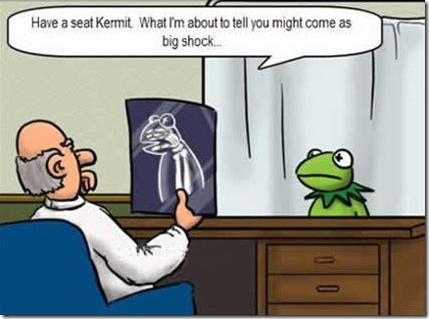
请坐, Kermit. 我要告诉你的将是一个令人震惊的发现…

Slide 15
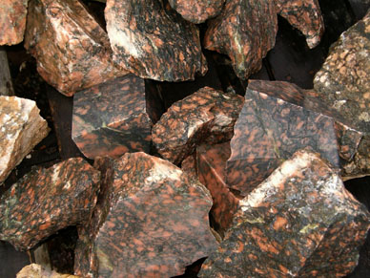
罗马书 8:28-30的一个比喻
155p
有一天一个非常
有智慧且技能精湛的雕刻家 想要制作一座美丽的大理石雕像…

Slide 16
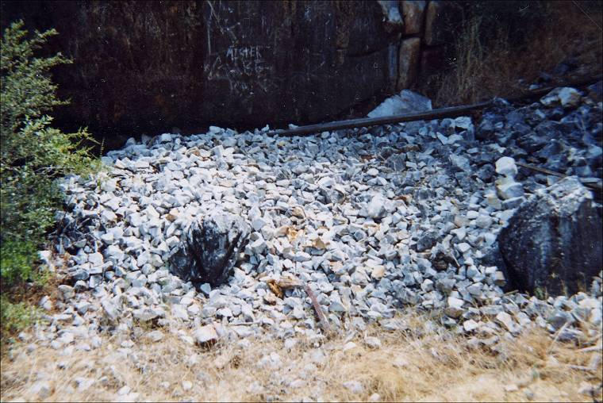
预知
155p
在一个大理石采石场，在有许多可能性的选择面前他挑选了一块粗糙的顽石, 他自由打算.

Slide 17
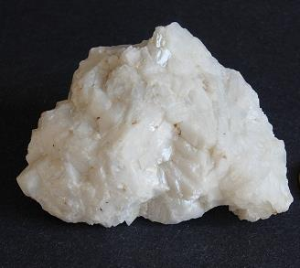
预定
155p
他给它画上标记，并由此注定将把它制作成为他心目中所设想的佳作。 那个记号保护了它不被丢弃或者毁灭。

Slide 18
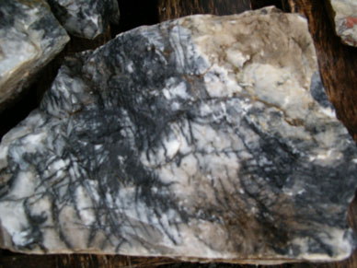
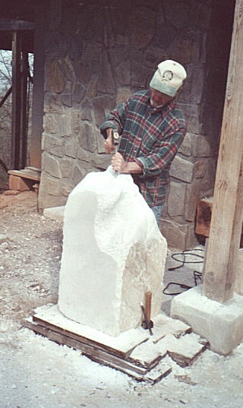
呼召与称义
155p
一段时间过后，他差遣他的助理 把石头拿回来放在他自己的工作台上.

Slide 19
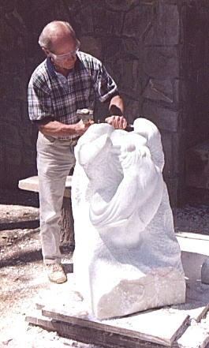
逐渐成圣以及永恒的保障
155p
于是，雕塑家开始用
凿子凿 , 用粗锉打磨，将
那块粗糙的石头锉光滑整形
以至于浮现他心目中理想
的样式。
然而至始至终，
他未曾想要毁坏这块石头，
也不许可任何人来破坏它。

Slide 20
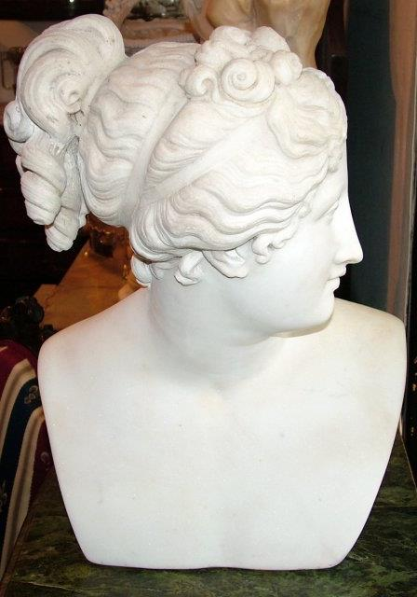
被提
155p
终于有一天，他的工作完成了。 石雕像成功地在石头上雕刻出精美的轮廓，样式与他的模型完全符合。
现在是把它从杂乱的工作台上挪移出来的时候了，将它运到展览馆等候揭幕，以便向大众展示。

Slide 21
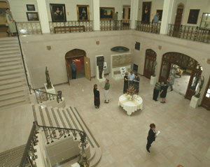
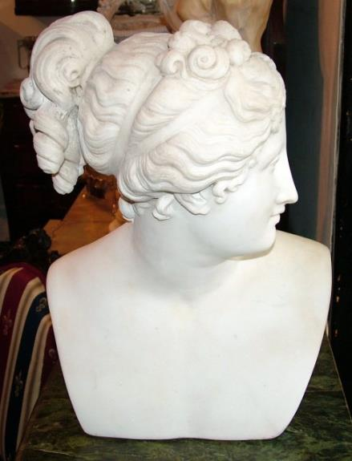
得荣耀
155p
所有经过的人面带
微笑以表赞赏，
并向聪明智慧、
技艺精湛的雕刻家
献上高度的
赞许和颂扬。

Slide 22
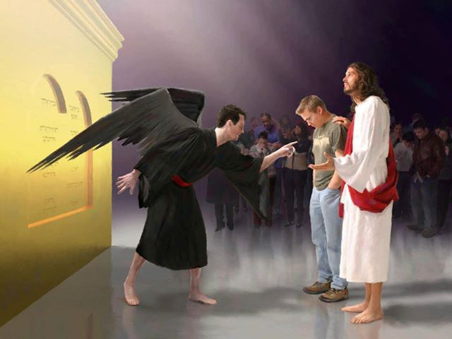
谁能定我们的罪呢．有基督耶稣已经死了、而且从死里复活、现今在 神的右边、也替我们祈求
罗马书 8:34

Slide 23
罗马书中的神学术语
55
拣选
罗马书 9:10-13
神对一个个体或群体的拣选是有其特殊的目的与旨意
称义
罗马书 4:25; 5:18
神宣告我们“无罪”的行动，使我们在他面前得以“称义”
和好
罗马书 3:25
神免去我们因罪而生的惩罚是因着耶稣基督所献上完全的祭，以至于神公义的愤怒得到满足
救赎
罗马书 3:24; 8:23
耶稣基督为我们已经付上了代价所以我们得以自由。罪的工价就是死；耶稣正是为此付上代价。
成圣
罗马书 5:2; 15:16
透过圣灵的工作我们越来越像耶稣基督。
得荣耀
罗马书 8:18, 19, 30
信徒的最高境界就是死后他/她变得像基督一样 (约一 3:2).

Slide 24

"因为我深信：无论是死、是生，是天使、是掌权的，是现在的事，是将来的事，是有能力的， 是高天的、是深渊的，或是任何别的被造之物，都不能叫我们与 神的爱隔绝，这爱是在我们的主耶稣基督里的。"
罗马书 8:38-39 (CNVS)

Slide 25
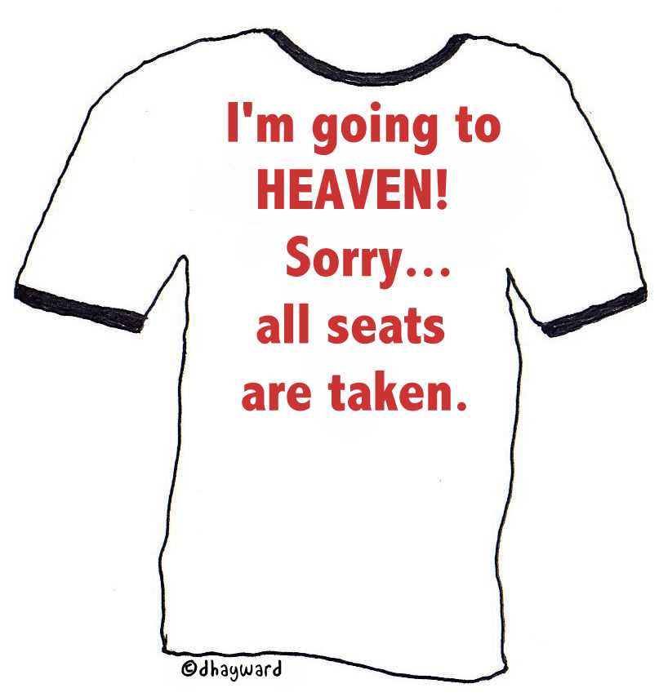
我将要去
天堂!
抱歉…
所有座位都已经满员.

Slide 26

上帝的拣选公平吗?
Notes:
----- Meeting Notes (19/5/16 12:21) -----
Do you really want God to be fair?

Slide 27
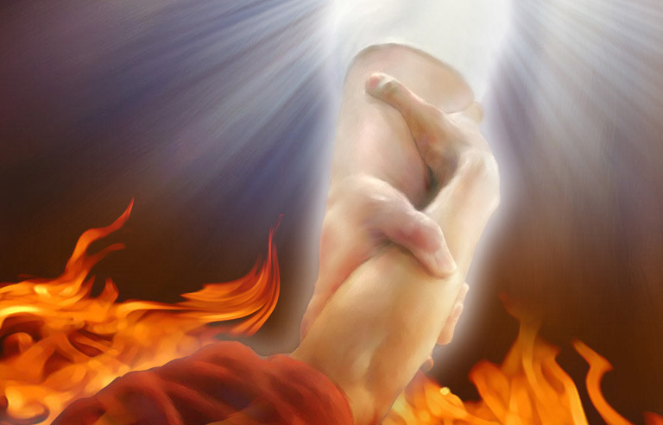
“既是这样，我们可以说甚么呢？ 神不公平吗？绝对不会！ ¹⁵ 因为他对摩西说：
“我要怜悯谁，就怜悯谁；我要恩待谁，就恩待谁。”
¹⁶ 这样看来，既不是出于人意，也不是由于人为（“人为”原文作“奔走”或“奔跑”），只在于那怜悯人的 神。 ”
(罗马 9:14-16 CNV).

Slide 28
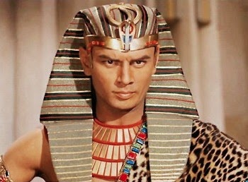
“¹⁷因为经上有话对法老说：“我把你兴起来，是要借着你显出我的大能，并且使我的名传遍全地。”
¹⁸这样看来，他愿意怜悯谁就怜悯谁，愿意谁刚硬就使谁刚硬。”
(罗马 9:17-18 CNV).

Slide 29
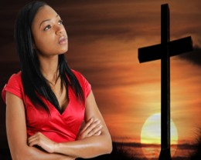
”¹⁹这样，你会对我说：“那么他为甚么责怪人呢？有谁抗拒他的旨意呢？”
²⁰你这个人哪，你是谁，竟敢跟 神顶嘴呢？被造的怎么可以对造他的说：“你为甚么把我做成这个样子呢？”“
(罗马书 9:19-20 CNV).

Slide 30
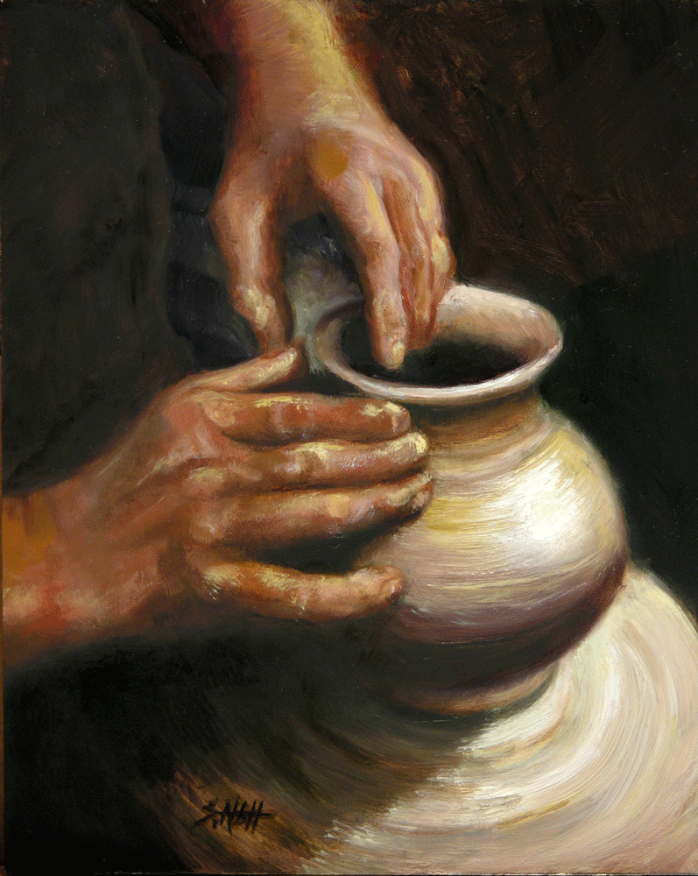
“陶匠难道没有权用同一团的泥，又做贵重的、又做卑贱的器皿吗？”
(罗马 9:21 CNV).

Slide 31

“²²如果 神有意要显明他的忿怒，彰显他的大能，而多多容忍那可怒、预备遭毁灭的器皿， ²³为了要使他丰盛的荣耀，彰显在那蒙恩、早已预备要得荣耀的器皿上，这又有甚么不可呢？ ²⁴ 这器皿就是我们这些不但从犹太人中，也从外族人中蒙召的人。”
(罗马 9:22-24 CNV).

Slide 32

罗马书里的义
145
主题 | 需要 | 供应 | 传授 | 证实 | 应用 | 传播
序言 1:1-17 | 定罪 1:18– 3:20 | 称义 3:21– 5:21 | 成圣 6–8 | 拣选 9–11 | 更新 12:1– 15:13 | 宣教 15:14– 16:27
开始 | 犯罪 | 救恩 | 分别为圣 | 主权 | 服事 | 差遣

Slide 33
如下这些人不信基督将真的被定罪吗？
让 全 世 界 都 知 道 他 ~
直 到全 地, 直 到 地 极 ~

Slide 34

被定罪的?

Slide 35

被定罪的?

Slide 36
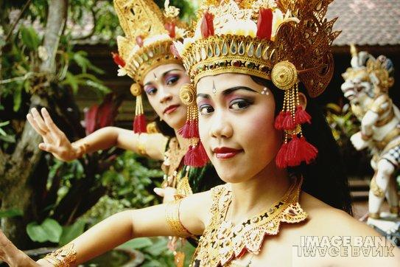
被定罪的?

Slide 37
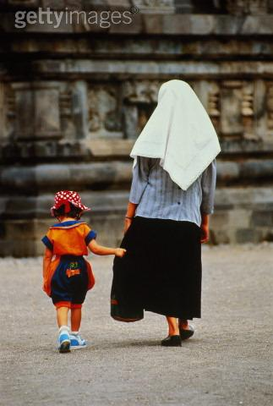
被定罪的?

Slide 38
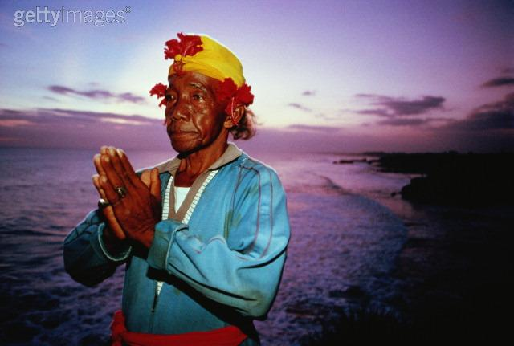
被定罪的?

Slide 39

被定罪的?

Slide 40

被定罪的?

Slide 41

被定罪的?

Slide 42

被定罪的?

Slide 43
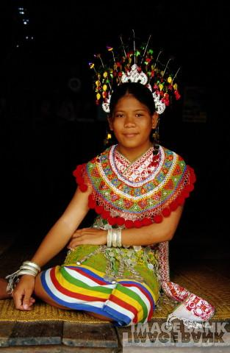
被定罪的?

Slide 44
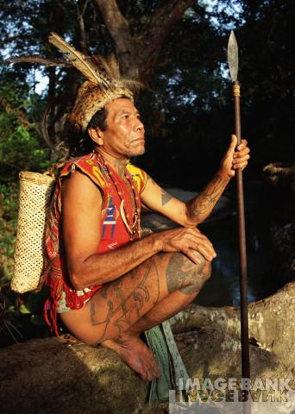
被定罪的?

Slide 45

被定罪的?

Slide 46
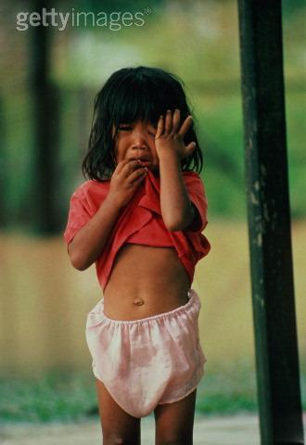
被定罪的?

Slide 47
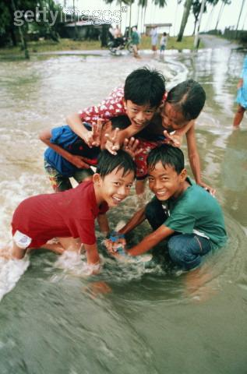
被定罪的?

Slide 48

被定罪的?

Slide 49
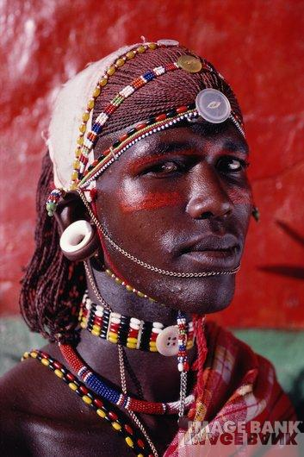
被定罪的?

Slide 50
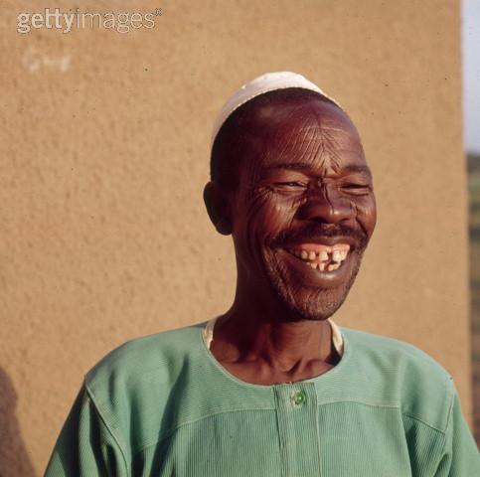
被定罪的?

Slide 51

被定罪的?

Slide 52
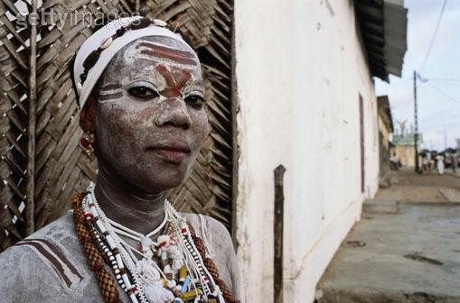
被定罪的?

Slide 53
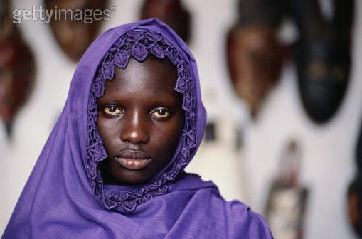
被定罪的?

Slide 54
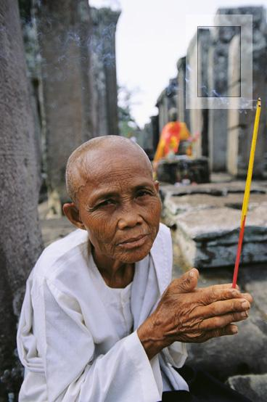
被定罪的?

Slide 55

被定罪的?

Slide 56
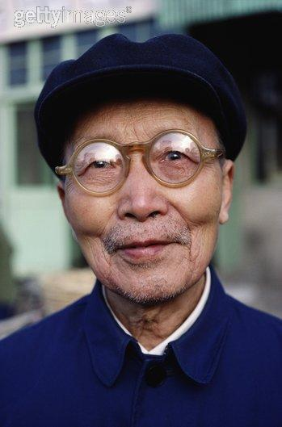
被定罪的?

Slide 57

被定罪的?

Slide 58

被定罪的?

Slide 59

被定罪的?

Slide 60

被定罪的?

Slide 61
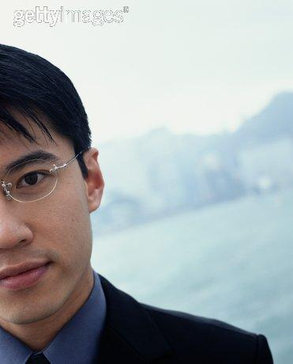
被定罪的?

Slide 62

被定罪的?

Slide 63
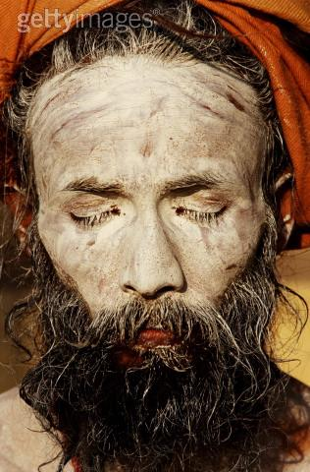
被定罪的?

Slide 64
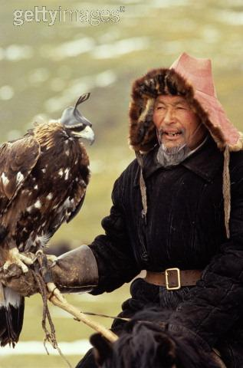
被定罪的?

Slide 65
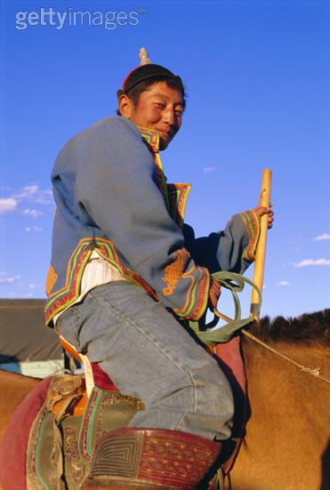
被定罪的?

Slide 66

被定罪的?

Slide 67

被定罪的?

Slide 68

被定罪的?

Slide 69

被定罪的?

Slide 70

被定罪的?

Slide 71

被定罪的?

Slide 72

被定罪的?

Slide 73

被定罪的?

Slide 74
如下这些人不信基督将真的被定罪吗？
让 全 世 界 都 知 道 他 ~
直 到全 地, 直 到 地 极 ~

Slide 75
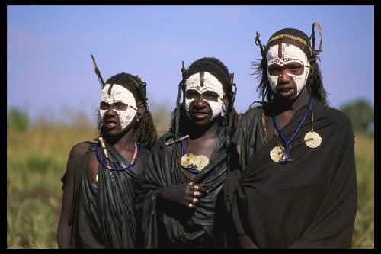

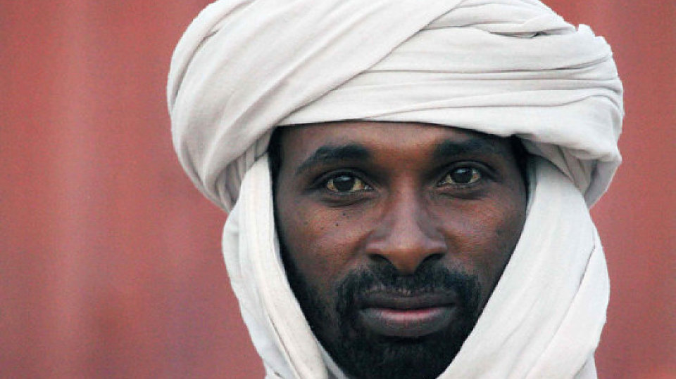
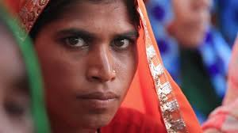
还没有听过福音的人怎么办?
52

Slide 76
地狱: 如果这是真的怎么办?
Notes:
tomstyle.com/ archive/hell.jpg

Slide 77
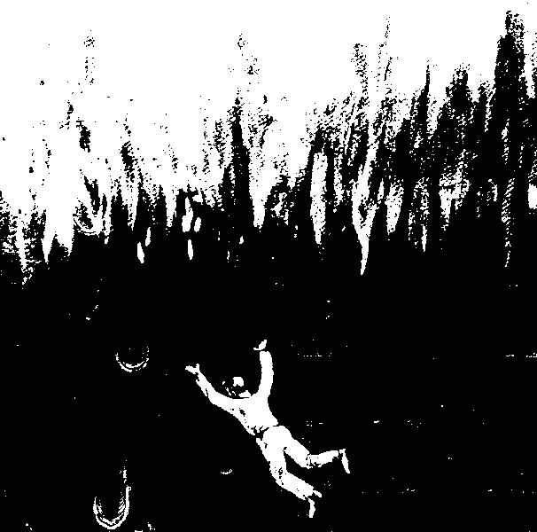

“凡是名字没有记在生命册上的，他就被抛在火湖里。”
(启示录 20:15 CNV)

Slide 78
进 攻 地 狱
52
普世性
毁灭性
炼狱

Slide 79
普 世 性
52
pt. a
这是什么?
引据论证
反驳

Slide 80

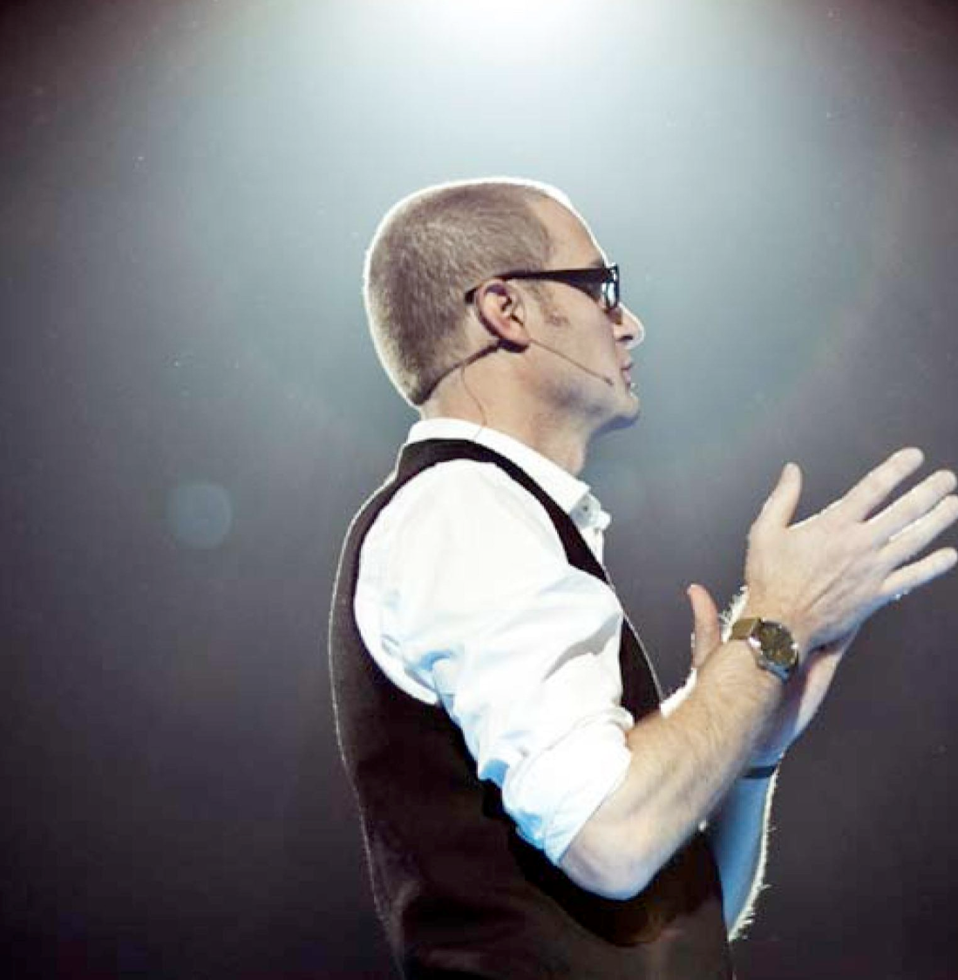
近代
普世论
“LOVE WINS 爱必胜”
这本书讲述关于天堂、地狱和
曾经活着的每个人的命运。
作 者：
Notes:
http://www.cbn.com/cbnnews/us/2011/april/love-wins-pastor-caught-off-guard-by-controversy/
'Love Wins' Pastor Caught Off Guard by Controversy
By Crystal Woodall CBN News Internet Producer
Sunday, April 10, 2011
Print 35 Comment(s)
Ad Feedback
Evangelical megachurch pastor Rob Bell says he was caught off guard by the condemnation his new book has received from leaders in the Christian community.
Standing before an audience of about 1,600 at Nashville's Belmont University, Bell said the last several weeks had been the "most painful" of his life.
"It has taken me to a place of profound brokenness," said Bell, who pastors the 10,000-member Mars Hill Bible Church in Grand Rapids, Mich.
Love Wins: Heaven, Hell, and the Fate of Every Person Who Ever Lived, released March 29, challenges the traditional Christian belief that few will enter Heaven.
"Will only a few select people make it into Heaven and will billions of people burn forever in Hell?" Bell asks in a promotional video of his book, recently released by publisher HarperOne. "And if that's the case, how do you become one of the few?" Watch the video here.
Bell insists it was never his intent to stir controversy, but to bring focus back to a message he suggests has got lost in dogma -- the love of God.
"I kept meeting religious people who were incredibly dogmatic about heaven and hell when you die but didn't seem to care about the fact that 8 million people will go to bed hungry tonight," Bell explained.
Bell denies charges that his book promotes a universalist theology - the belief that everyone, regardless of belief, will be saved by God.
"No, if by universalist we mean there's a giant cosmic arm that swoops everybody in at some point whether you want to be there or not," he told The Christian Post.
"That violates the laws of love and love is about freedom," he explained. "It's about choice; it's about do you want to be there? Because that's what would make it heaven."
According to the Associated Press, Bell says hell is something freely chosen that already exists on earth.
"Apparently this is a pastor who has written a book who has grown uncomfortable contending for the faith," CBN chaplain and Regent University theology professor Joel Palser said. "He is no longer able to defend what the Bible says and has endeavored to make that more palatable to modern culture."
"It may be trendy and it might sell a lot of books, but in fact Jesus speaks very clearly about heaven and hell," Palser added.

Slide 81
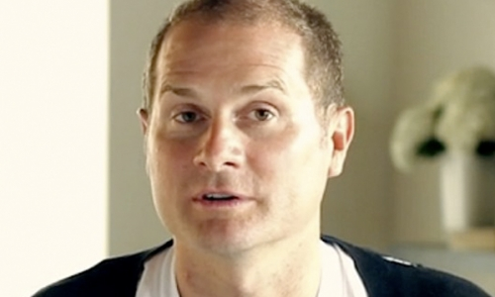
Grand Rapids Mars Hill 圣经教会拥有10,000个会众, 其中3,000人在该书出版后离开了该教会, 后来Bell也离开前往加利福尼亚经营一个 “信心改变谈话秀” 的节目。
Notes:
http://www.cbn.com/cbnnews/us/2011/april/love-wins-pastor-caught-off-guard-by-controversy/
'Love Wins' Pastor Caught Off Guard by Controversy
By Crystal Woodall CBN News Internet Producer
Sunday, April 10, 2011
Print 35 Comment(s)
Ad Feedback
Evangelical megachurch pastor Rob Bell says he was caught off guard by the condemnation his new book has received from leaders in the Christian community.
Standing before an audience of about 1,600 at Nashville's Belmont University, Bell said the last several weeks had been the "most painful" of his life.
"It has taken me to a place of profound brokenness," said Bell, who pastors the 10,000-member Mars Hill Bible Church in Grand Rapids, Mich.
Love Wins: Heaven, Hell, and the Fate of Every Person Who Ever Lived, released March 29, challenges the traditional Christian belief that few will enter Heaven.
"Will only a few select people make it into Heaven and will billions of people burn forever in Hell?" Bell asks in a promotional video of his book, recently released by publisher HarperOne. "And if that's the case, how do you become one of the few?" Watch the video here.
Bell insists it was never his intent to stir controversy, but to bring focus back to a message he suggests has got lost in dogma -- the love of God.
"I kept meeting religious people who were incredibly dogmatic about heaven and hell when you die but didn't seem to care about the fact that 8 million people will go to bed hungry tonight," Bell explained.
Bell denies charges that his book promotes a universalist theology - the belief that everyone, regardless of belief, will be saved by God.
"No, if by universalist we mean there's a giant cosmic arm that swoops everybody in at some point whether you want to be there or not," he told The Christian Post.
"That violates the laws of love and love is about freedom," he explained. "It's about choice; it's about do you want to be there? Because that's what would make it heaven."
According to the Associated Press, Bell says hell is something freely chosen that already exists on earth.
"Apparently this is a pastor who has written a book who has grown uncomfortable contending for the faith," CBN chaplain and Regent University theology professor Joel Palser said. "He is no longer able to defend what the Bible says and has endeavored to make that more palatable to modern culture."
"It may be trendy and it might sell a lot of books, but in fact Jesus speaks very clearly about heaven and hell," Palser added.

Slide 82
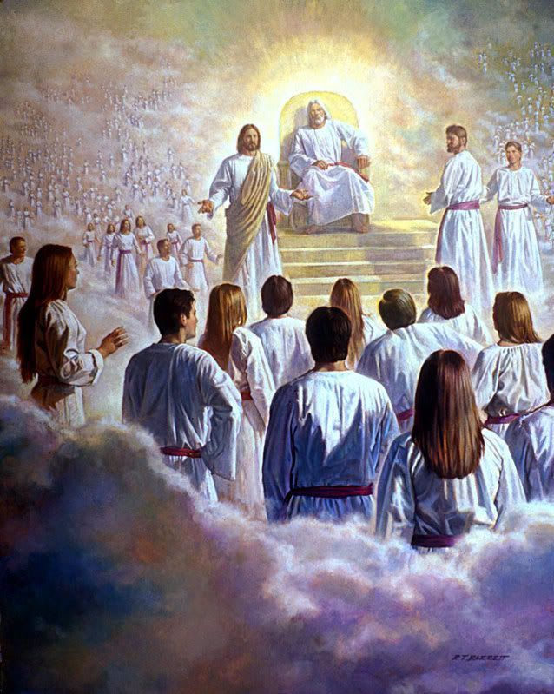
“我又看见一个白色的大宝座…”
(启示录20:11)

Slide 83
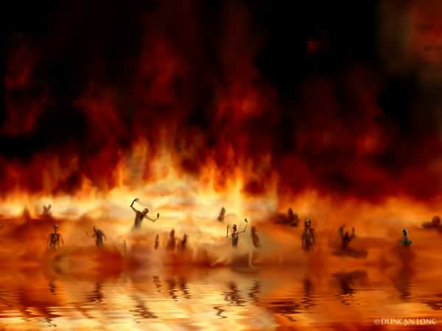
火湖
(启示录 20:14-15)

Slide 84
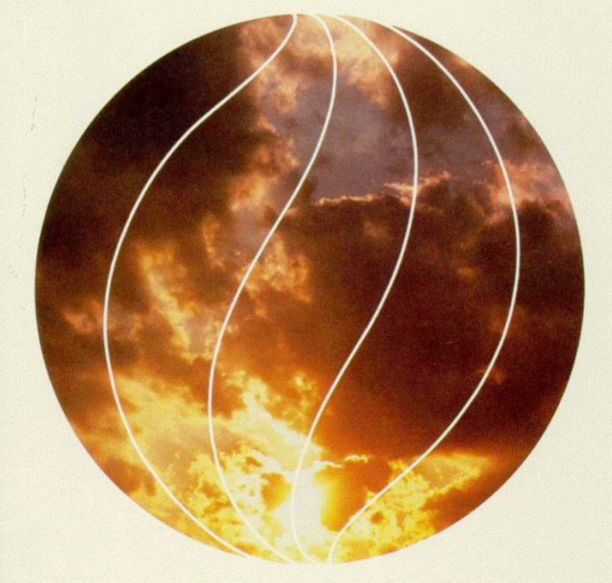
毁 灭 性
52
这是什么?
引据论证
反驳

Slide 85

持毁灭论的团体
52
第七日基督再临会
耶和华见证人
一些 “福音派教徒"?

Slide 86

持毁灭论者的辩论
52
反驳
上帝太仁慈了所以不会送人入永远的地狱
上帝是完全公义和圣洁的
“破坏”
意指毁灭
“破坏”
意指肉身死亡

Slide 87
英国教会报告,
1996年1月
“地狱是我们用来描述终极无乐世界的象征手法。可怕的恶魔是发明家和中世纪史学家想象出来的."
Bishop John Taylor
报告的作者们中的一位

Slide 88

炼 狱
52
pt. b
这是什么?

Slide 89
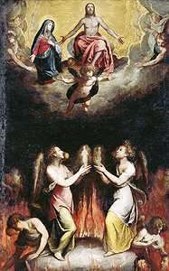
关于炼狱的论证
52
pt. b
“没有天堂那么美好，但是也没有地狱那么糟糕”
马加比后书

Slide 90
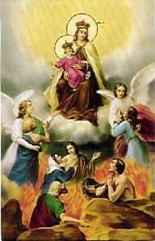
关于炼狱的反驳
52
pt. b
靠做工得救
伪经／次经
没有第二次机会

Slide 91

关于 “真诚最重要”的论证
52
pt. c

Slide 92
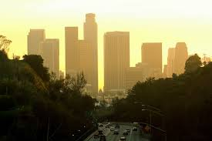

另一个观点…
52
pt. d
在信心中回应
接收到的光明
上帝藉着基督的死拯救人类
=

Slide 93
唯一对未被传福音者状态的恰当理解是“他们因为不认识基督而失丧了”。这种观点受几个方面的支持…
52
pt. e

Slide 94

神的愤怒 (罗马书1:18-20)
151
真实 (18a)
原因 (18b-20a)
后果(20b)

Slide 95

为什么你
没 有 借 口
罗马书1:20

Slide 96

罗马书 1:20
161
无限的神
超然的神
其实自从创世以来，神那看不见的事，就如他永恒的大能和神性，都是看得见的，就是从他所造的万物中可以领悟，叫人没有办法推诿。(新译本).

Slide 97
罗 1:20
161
自从创世以來
人已看见了神
= 在每天的
24小时里
其实自从创世以來，神那看不见的事，就如他永恆的大能和神性，都是看得见的，就是从他所造的万物中可以领悟，叫人沒有办法推诿。(新译本).

Slide 98

选择
是你的

Slide 99

为何神对外邦人生气
(罗马1:21-32)
52
e.1)b]
忽视神 (21-23)
神任凭他们
污秽(24)
拜偶像(25)
神任凭他们
同性恋(26-27)

Slide 100

同性恋怎么样?

Slide 101

同性“结婚”如何呢?
在 YouTube 上看家庭研究理事会博客 (frcblog)
“婚姻只限于一男一女吗？”
Notes:
The link is http://www.youtube.com/watch?v=nPgZ2Mq1Ugw

Slide 102
为何神对外邦人生气
(罗马1:21-32)
52
e.1)b]
忽视神 (21-23)
神任凭他们
污秽(24)
拜偶像(25)
神任凭他们
同性恋(26-27)
神任凭他们
堕落 (28-32)

Slide 103

^{10b}「 没 有 义 人 ， 连 一 个 也 没 有 。
¹¹ 没 有 明 白 的 ； 没 有 寻 求 神 的 ；
¹² 都 是 偏 离 正 路 ， 一 同 变 为 无 用 。
没 有 行 善 的 ， 连 一 个 也 没 有 。
¹³ 他 们 的 喉 咙 是 敞 开 的 坟 墓 ；
他 们 用 舌 头 弄 诡 诈 ，
嘴 唇 里 有 虺 蛇 的 毒 气 ，
¹⁴ 满 口 是 咒 骂 苦 毒 。
¹⁵ 杀 人 流 血 ， 他 们 的 脚 飞 跑 ，
¹⁶ 所 经 过 的 路 便 行 残 害 暴 虐 的 事 。
¹⁷ 平 安 的 路 ， 他 们 未 曾 知 道 ；
¹⁸ 他 们 眼 中 不 怕 神 。」
(罗3:10b-18)
所有人都在罪惡之下

Slide 104
¹⁹ 我 们 晓 得 律 法 上 的 话 都 是 对 律 法 以 下 之 人 说 的 ， 好 塞 住 各 人 的 口 ， 叫 普 世 的 人 都 伏 在 神 审 判 之 下 。
²⁰ 所 以 凡 有 血 气 的 ， 没 有 一 个 因 行 律 法 能 在 神 面 前 称 义 ， 因 为 律 法 本 是 叫 人 知 罪 。
(罗3:19-20)
所有人都在罪惡之下

Slide 105

徒 1:8
“地极”
“但圣灵降临在你们身上，你们就必得着能力；并要在耶路撒冷，犹太全地和撒玛利亚，直到地极，做我的见证。”
撒玛利亚
耶路撒冷
犹太

Slide 106

保罗的呼召:
肢体中的外邦人

Slide 107

保罗向西进行的事工
以利哩古
罗马
耶路撒冷

Slide 108

Romans 15:20-22
155f
e.3)
²⁰ 我立定主意，不在宣扬过基督的地方传福音，
免得建立在别人的根基上，
²¹ 反而照经上所记：
“那对他一无所闻的，将要看见；
那没有听过的，将要明白。”
保罗计划到罗马去
²² 因此，我多次受到拦阻，不能到你们那里去。
––罗马书 15:20-22

Slide 109

逻辑上的论证
53
e.4)
如果要让未被传福音的人不走向地狱, 一个基督徒做的最糟糕的事情就是向他传讲基督! 为什么? 因为如果他们听到 福音, 有可能他们会拒绝福音而走向地狱; 然而, 如果他们从来都没有听到福音, 那么他们是不可能去地狱的. 因此, 最好的决定就是召回所有传福音的人.

Slide 110


有什么不同?
53
pt. 2
恩典
怜悯
…是上帝给我们所
不
配得的
…是上帝
不 给
我们所
应
承受的

Slide 111

夭折的婴儿怎么办?
53
pt. 2
基于两处经文，我想信他们会去天堂:
大卫对和他夭折的儿子见面很有信心(撒母耳记下 12:23).
耶稣提到神的国是属于小孩子的(马可福音 10:14-15).

Slide 112

如何向非基督徒
谈论地狱?
53
pt. 3
一些建议:
a. 不要害怕谈论地狱。耶稣不怕！基督甚至谈论地狱多于谈论天堂。
b. 在你传福音的演讲中谈论罪。 谈论上帝是如何圣洁和公义的，因此会审判罪。
c. 提醒非信徒地狱是“为魔鬼和他的使者预备的”（马太福音25：42）人因为不信就已经进入了这样的安排中。

Slide 113
如何向非基督徒
谈论地狱?
53
pt. 3
一些建议:
d. 不要说地狱和罪是 “和上帝属灵的分离” 。 非信徒已经习惯和上帝分离，因为他们的罪很多人反而确信和上帝分离是好的－－因此和上帝属灵的分离很难听起来象是一种惩罚。
e. 注重更基要的神学理论来平衡地教导有关地狱的知识。

Slide 114

救恩靠行为吗?
关于工作的经文 解释
155g

Slide 115

你真地可以
对每个人说：
“神爱你” 吗?

Slide 116
Black

Slide 117


救恩论链接地址 BibleStudyDownloads.org
免费获得该讲解!
圣经学习资料下载

