Slide 1

圣经词汇
救恩论：上帝的救赎计划
Dr. Rick Griffith • 新加坡神学院
BibleStudyDownloads.org

Slide 2

旧约的救恩

Slide 3
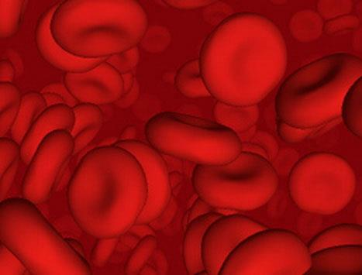
神为什么建立献祭
的体制？
（动物的）血真的饶恕
了罪吗？

Slide 4

血的献祭在律法下能拯救
以色列人吗？
血

Slide 5
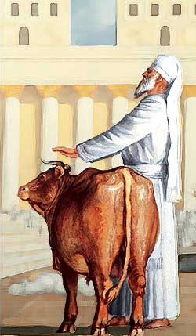
牺牲宽恕罪
“通过这个过程，祭司将净化人民，使他们与耶和华同在，他们将被赦免”
(4:20 NLT;参4:26,31,35）

Slide 6

153
哪一个是最准确
因…得救恩?
信心 +行为
单单
信心
信心 +行为
旧约
行为
单单
信心
单单
信心
信心 +行为
新约
信心
Notes:
Discuss this in your small group for 10 minutes and then report on your view to the class.
(After discussion group reports: I have held to each of these views at points in the past, but my perspective now is blue)

Slide 7
得救 & 成圣
121a
人的角色
神的回应
信心的生活
恢复的关系
旧约
信靠神的逾越节羔羊
出埃及
走向迦南
之旅
献祭
(罪、愆)
原型
|
对应型
原型
|
对应型
原型
|
对应型
原型
|
对应型
新约
信靠基督那神的羔羊
得拯救
属灵的成长
认罪
(约翰一书 1:9)
位分的成圣
逐步的成圣

Slide 8
旧约诉说罪的宽恕
管道=与神的关系
（永不改变）
罪
阻塞= 与神的交往
(被罪受阻）
牺牲=罪的忏悔
（罪被原谅恢复团契，但关系从未受到威胁）
Notes:
Do we still have a relationship with God when we sin? Yes!
Sin does not hinder our relationship with God but our fellowship with Him.
OT sacrifices did not establish a relationship with God but rather they restored their fellowship with God

Slide 9
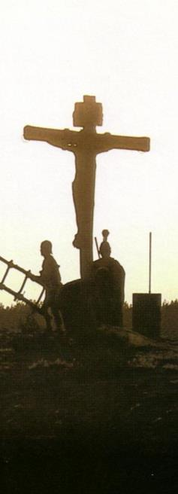
永远的救赎：
以十字架为中心
主前
向前看基督
的十字架
主后
往后看基督的十字架

Slide 10
旧约中的救赎
119e
旧约时期
(从摩西到基督的死)
新约时期
(从基督的死到今天)
救赎的基础
基督之死是上帝恩典的供应
(“因血里有生命，所以能赎罪,” 利 17:11b)
基督之死是上帝恩典的供应
(“若不流血，罪就不得赦免 了,” 来 9:22)
救赎的条件
信靠神所启示的供应—白白的
礼物 (诗 51:16-17)
信靠神所启示的供应—白白的
礼物(加 2:16)
救赎的最终内容
信靠的对象是神自己—
先知劝告悔改，而不是献祭
(耶 3:12)
信靠的对象是神自己—
信心之人劝告对神的信靠
(来 11)
救赎的特殊内容
信心的内容包含献祭 和 应许: 动物 (创 3:21), 亚伯的献祭 (创 4:4), 亚伯拉罕的约 (创 15)
信心的新内容是基督所流的血 (彼前 1:18-21) 将罪除去 (旧约的献祭仅仅覆盖了罪)
信徒得救的表现
遵守道德律法，动物献祭，摩西律法 (民法和礼仪)
遵守道德律法，守圣餐，洗礼等。因着圣灵的工作 (罗 8:9)

Slide 11
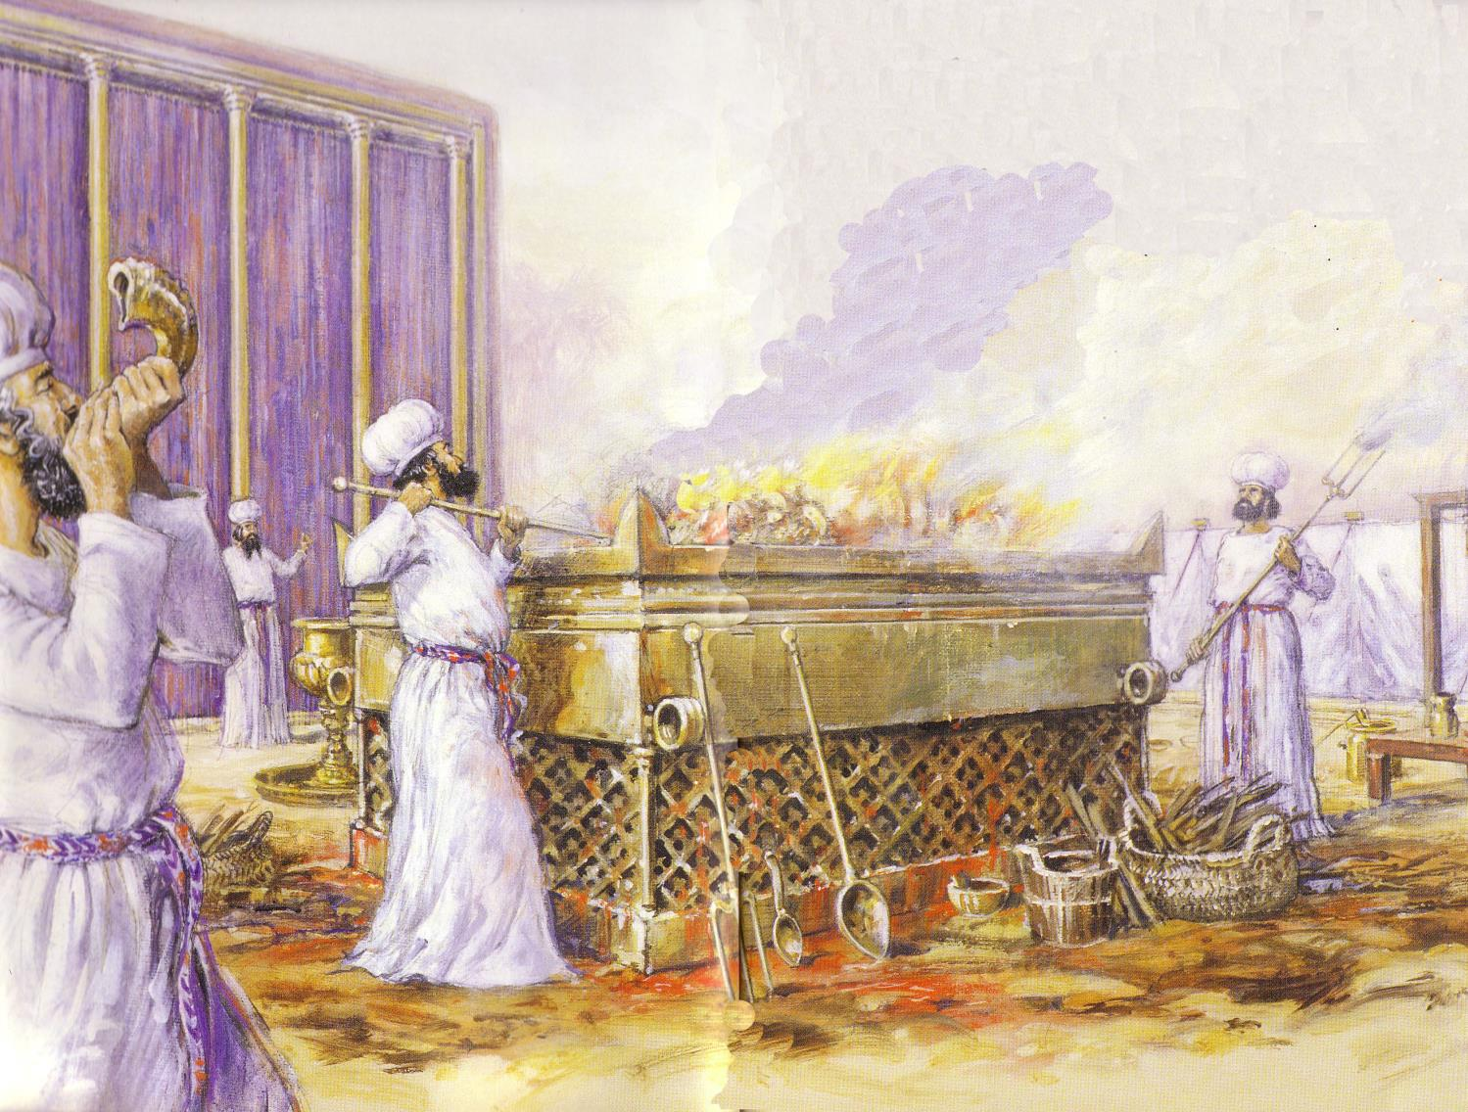
总而言之
124
通过献祭和分别成为圣洁
第1—10章 献祭
(敬拜上帝)
第11—27章 分别
(与神同行)

Slide 12
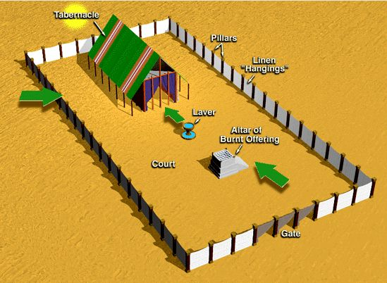
利未记第 1-7 章中的献祭
128
全牲的燔祭
素祭
平安祭
赎罪祭
赎愆祭
成圣
自愿的
洁净
义务的

Slide 13
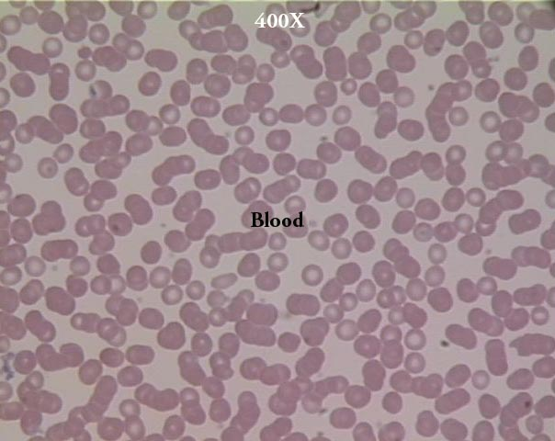
血?
血为什么重要？
“按着律法，几乎所有都是用血洁净的，如果没有流血，就没有赦免” (来 9:22)
Notes:
13

Slide 14

“生命是在血里”
“因为动物的生命是在血里，我指定这祭坛上的血代替你们的生命，因为血里有生命，所以能代赎生命” (利 17:11)
Notes:
14

Slide 15
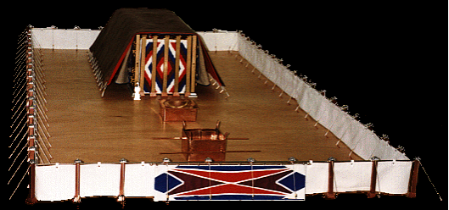
有关会幕的介绍，下面这个网站很不错:
http://www.domini.org/tabern/tabhome.htm

Slide 16
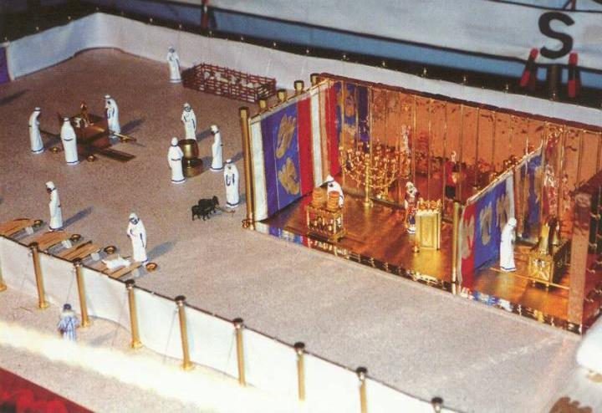
赎罪日:利未记第17章
院子
圣所
至圣所
Notes:
16

Slide 17
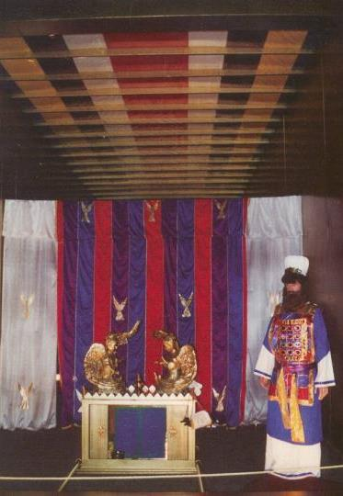
赎罪日
祭司的预备
祭司的赎罪祭物
百姓的赎罪祭物
替罪羊
洁净
利未记 16：29-34
Notes:
17

Slide 18
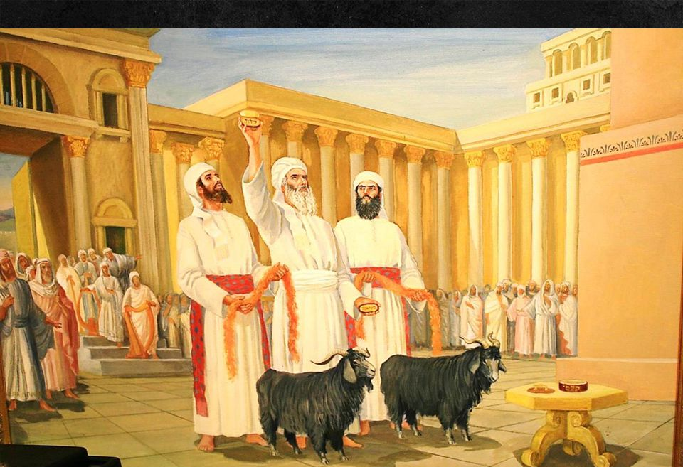
“然后把两只公山羊牵来，放在会幕门口，耶和华的面前； ⁸ 亚伦要为这两只山羊抽签：一签归耶和华，另一签归阿撒泻勒（“阿撒泻勒”是希伯来文音译，这字原意不能确定）。” (利未记 16:7-8 CNVS).

Slide 19
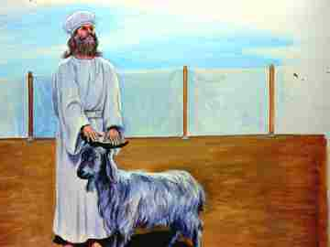
“亚伦要把那抽签归耶和华的山羊，献作赎罪祭。”
(利未记 16:9 CNVS).

Slide 20
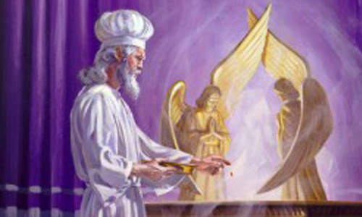
“然后他要宰杀那为人民作赎罪祭的公山羊，把血带进幔子里，弹羊血在施恩座的上面和施恩座的前面，好象弹公牛的血一样。”
(利未记16:15 CNVS).

Slide 21
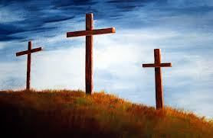
新约的救恩
23

Slide 22


新约中如何使用“拯救”术语?
23
救恩
下面列出了在《葡萄树的完整说明词典》的“拯救，救赎”条目下名词 “救恩”
(希腊语 sōteria) 和动词“拯救”(希腊语 sōzō)的使用方法。
Notes:
It's possible to believe in Jesus but not be saved…
By Jeremy Myers (BA at MBI, ThM in BE at DTS)
https://redeeminggod.com/believe-in-jesus-but-not-be-saved/
Posted in 2014
Accessed 9 May 2016
13 Comments
Like the word "gospel," the word "salvation" means much more and much less than usually assumed.
Just like the word "gospel," the way the word "salvation" is often used today is very different from the way the word is used in Scripture.
When people talk about "salvation" today or "being saved," what they most often have in mind is the idea of receiving the forgiveness of sins so we can escape hell and go to heaven when we die.
But in biblical usage, the noun "salvation" (Gk., sōteria) and the verb "save" (Gk., sōzō) very rarely have anything to do with receiving eternal life or going to heaven when we die. Instead, the words are most often used in connection with some sort of temporal or physical deliverance. We can be saved from enemies, saved from sickness, saved from drowning, saved from suffering, or even saved from a premature physical death. While "salvation" is sometimes used in connection with sin, this is only because sin often has devastating physical and temporal consequences in our life. To be saved from sin means to be delivered from the destruction and damage of sin in our lives.
One resource that shows this quite clearly is Vine's Complete Expository Dictionary. Under the entry for "Save, Saving," the dictionary includes the following options:
(a) Of material and temporal deliverance from danger, suffering, etc., e.g., Matt 8:25; Mark 13:20; Luke 23:35; John 12:27; 1 Tim 2:15; 2 Tim 4:18; Jude 5; from sickness, Matt 9:22; so Mark 5:34; Luke 8:48; Jas 5:15
(b) Of the spiritual and eternal salvation granted immediately by God to those who believe on the Lord Jesus Christ, e.g., Acts 2:47, 16:31; Rom 8:24; Eph 2:5, 8; 1 Tim 2:4; 2 Tim 1:9; Titus 3:5; of human agency in this, Rom 11:4; 1 Cor 7:16; 9:22
(c) Of the present experiences of God's power to deliver from the bondage of sin, e.g., Matt 1:21; Rom 5:10; 1 Cor 15:2; Heb 7:25; Jas 1:21; 1 Pet 3:21; of human agency in this, 1 Tim 4:16
(d) Of the future deliverance of believers at the second coming of Christ for his saints, being deliverance from the wrath of God to be executed upon the ungodly at the close of this age and from eternal doom, e.g., Rom 5:9
(e) Of the deliverance of the nation of Israel at the second advent of Christ, e.g., Rom 11:26
(f) Inclusively for all the blessings bestowed by God on men in Christ, e.g., Luke 19:10; John 10:9; 1 Cor 10:33; 1 Tim 1:15
(g) Of those who endure to the end of the time of the Great Tribulation, Matt 10:22; Mark 13:13
(h) Of the individual believer, who, though losing reward at the judgment seat of Christ hereafter, will not lose his salvation, 1 Cor 3:15; 5:5
(i) Of the deliverance of the nations at the Millennium, Rev 21:24
Though I would not state this list of various definitions quite this same way, and would put many of the references from definition (b) into other categories, it nevertheless shows that the words "save" and "salvation" in the Bible have a wide variety of meanings.
To help the reader of Scripture know what sort of "salvation" is in view when they are studying it, I recommend that whenever you comes across the words "save" or "salvation" in Scripture, you stop, replace it mentally with the word "deliver" or "deliverance" and then ask yourself, "Deliverance from what?" If you look in the surrounding context, you will quickly discover that the deliverance in view has nothing to do with gaining eternal life or going to heaven when you die.
Doing this will drastically help your understanding of numerous difficult passages in the Bible that many have thought of as referring to receiving eternal life, but refer instead to some sort of temporal deliverance.
It is possible, as the title of this post says, to believe in Jesus for eternal life (and of course, receive eternal life as a result), but still not be "saved" from many of the temporal and physical consequences of sin, or from sickness, or from enemies, or from many of the other negative things that can happen in life.

Slide 23
新约中如何使用“拯救”术语?
23
(a) 对危险、苦难物质和属世短暂的解救，例如，马太福音8:25; 马可福音13:20; 路加福音23:35; 约翰福音12:27;提摩太前书2:15; 提摩太后书4:18; 犹大书1:5 ，对疾病的医治，例如马太福音9:22; 马可福音5:34; 路加福音8:48; 雅各布书5:15
(b) 上帝直接给予那些相信主耶稣基督的人属灵和永恒的救恩，例如，使徒行传2:47，16:31； 罗马书8:24; 以弗所书2：5,8; 提摩太前书2：4;提摩太后书1：9; 提多书3：5; 通过人间接给予的属灵和永恒的救恩，例如，罗马书11：4;哥林多前7:16; 9:22
(c) 亲身经历上帝的大能从罪的束缚中得到的解救,
例如.（马太福音1:21; 罗马书5:10; 哥林多前书15：2; 希伯来书7:25; 雅各布书1:21; 彼得前书3:21; 通过人经历到上帝的大能从罪的束缚中得到的解救，例如，提摩太前书4:16）
Notes:
It's possible to believe in Jesus but not be saved…
By Jeremy Myers (BA at MBI, ThM in BE at DTS)
https://redeeminggod.com/believe-in-jesus-but-not-be-saved/
Posted in 2014
Accessed 9 May 2016
13 Comments
Like the word "gospel," the word "salvation" means much more and much less than usually assumed.
Just like the word "gospel," the way the word "salvation" is often used today is very different from the way the word is used in Scripture.
When people talk about "salvation" today or "being saved," what they most often have in mind is the idea of receiving the forgiveness of sins so we can escape hell and go to heaven when we die.
But in biblical usage, the noun "salvation" (Gk., sōteria) and the verb "save" (Gk., sōzō) very rarely have anything to do with receiving eternal life or going to heaven when we die. Instead, the words are most often used in connection with some sort of temporal or physical deliverance. We can be saved from enemies, saved from sickness, saved from drowning, saved from suffering, or even saved from a premature physical death. While "salvation" is sometimes used in connection with sin, this is only because sin often has devastating physical and temporal consequences in our life. To be saved from sin means to be delivered from the destruction and damage of sin in our lives.
One resource that shows this quite clearly is Vine's Complete Expository Dictionary. Under the entry for "Save, Saving," the dictionary includes the following options:
(a) Of material and temporal deliverance from danger, suffering, etc., e.g., Matt 8:25; Mark 13:20; Luke 23:35; John 12:27; 1 Tim 2:15; 2 Tim 4:18; Jude 5; from sickness, Matt 9:22; so Mark 5:34; Luke 8:48; Jas 5:15
(b) Of the spiritual and eternal salvation granted immediately by God to those who believe on the Lord Jesus Christ, e.g., Acts 2:47, 16:31; Rom 8:24; Eph 2:5, 8; 1 Tim 2:4; 2 Tim 1:9; Titus 3:5; of human agency in this, Rom 11:4; 1 Cor 7:16; 9:22
(c) Of the present experiences of God's power to deliver from the bondage of sin, e.g., Matt 1:21; Rom 5:10; 1 Cor 15:2; Heb 7:25; Jas 1:21; 1 Pet 3:21; of human agency in this, 1 Tim 4:16
(d) Of the future deliverance of believers at the second coming of Christ for his saints, being deliverance from the wrath of God to be executed upon the ungodly at the close of this age and from eternal doom, e.g., Rom 5:9
(e) Of the deliverance of the nation of Israel at the second advent of Christ, e.g., Rom 11:26
(f) Inclusively for all the blessings bestowed by God on men in Christ, e.g., Luke 19:10; John 10:9; 1 Cor 10:33; 1 Tim 1:15
(g) Of those who endure to the end of the time of the Great Tribulation, Matt 10:22; Mark 13:13
(h) Of the individual believer, who, though losing reward at the judgment seat of Christ hereafter, will not lose his salvation, 1 Cor 3:15; 5:5
(i) Of the deliverance of the nations at the Millennium, Rev 21:24
Though I would not state this list of various definitions quite this same way, and would put many of the references from definition (b) into other categories, it nevertheless shows that the words "save" and "salvation" in the Bible have a wide variety of meanings.
To help the reader of Scripture know what sort of "salvation" is in view when they are studying it, I recommend that whenever you comes across the words "save" or "salvation" in Scripture, you stop, replace it mentally with the word "deliver" or "deliverance" and then ask yourself, "Deliverance from what?" If you look in the surrounding context, you will quickly discover that the deliverance in view has nothing to do with gaining eternal life or going to heaven when you die.
Doing this will drastically help your understanding of numerous difficult passages in the Bible that many have thought of as referring to receiving eternal life, but refer instead to some sort of temporal deliverance.
It is possible, as the title of this post says, to believe in Jesus for eternal life (and of course, receive eternal life as a result), but still not be "saved" from many of the temporal and physical consequences of sin, or from sickness, or from enemies, or from many of the other negative things that can happen in life.

Slide 24
新约中如何使用“拯救”术语?
23
(d) 他的圣徒在基督第二次来临时得到为信徒预备未来解救，就是拯救人脱离上帝的愤怒和永恒的毁灭，这愤怒将在这个时代结束时，临到不敬虔的人身上。
例如: 罗马书5：9
(e) 在基督的第二次来临之后对以色列的拯救，
例如: 罗马书11:26
(f) 包括上帝在基督里给予人的所有祝福在内，
例如， 路加福音19:10; 约翰福音10：9; 林前10:33; 提摩太前书1:15
Notes:
It's possible to believe in Jesus but not be saved…
By Jeremy Myers (BA at MBI, ThM in BE at DTS)
https://redeeminggod.com/believe-in-jesus-but-not-be-saved/
Posted in 2014
Accessed 9 May 2016
13 Comments
Like the word "gospel," the word "salvation" means much more and much less than usually assumed.
Just like the word "gospel," the way the word "salvation" is often used today is very different from the way the word is used in Scripture.
When people talk about "salvation" today or "being saved," what they most often have in mind is the idea of receiving the forgiveness of sins so we can escape hell and go to heaven when we die.
But in biblical usage, the noun "salvation" (Gk., sōteria) and the verb "save" (Gk., sōzō) very rarely have anything to do with receiving eternal life or going to heaven when we die. Instead, the words are most often used in connection with some sort of temporal or physical deliverance. We can be saved from enemies, saved from sickness, saved from drowning, saved from suffering, or even saved from a premature physical death. While "salvation" is sometimes used in connection with sin, this is only because sin often has devastating physical and temporal consequences in our life. To be saved from sin means to be delivered from the destruction and damage of sin in our lives.
One resource that shows this quite clearly is Vine's Complete Expository Dictionary. Under the entry for "Save, Saving," the dictionary includes the following options:
(a) Of material and temporal deliverance from danger, suffering, etc., e.g., Matt 8:25; Mark 13:20; Luke 23:35; John 12:27; 1 Tim 2:15; 2 Tim 4:18; Jude 5; from sickness, Matt 9:22; so Mark 5:34; Luke 8:48; Jas 5:15
(b) Of the spiritual and eternal salvation granted immediately by God to those who believe on the Lord Jesus Christ, e.g., Acts 2:47, 16:31; Rom 8:24; Eph 2:5, 8; 1 Tim 2:4; 2 Tim 1:9; Titus 3:5; of human agency in this, Rom 11:4; 1 Cor 7:16; 9:22
(c) Of the present experiences of God's power to deliver from the bondage of sin, e.g., Matt 1:21; Rom 5:10; 1 Cor 15:2; Heb 7:25; Jas 1:21; 1 Pet 3:21; of human agency in this, 1 Tim 4:16
(d) Of the future deliverance of believers at the second coming of Christ for his saints, being deliverance from the wrath of God to be executed upon the ungodly at the close of this age and from eternal doom, e.g., Rom 5:9
(e) Of the deliverance of the nation of Israel at the second advent of Christ, e.g., Rom 11:26
(f) Inclusively for all the blessings bestowed by God on men in Christ, e.g., Luke 19:10; John 10:9; 1 Cor 10:33; 1 Tim 1:15
(g) Of those who endure to the end of the time of the Great Tribulation, Matt 10:22; Mark 13:13
(h) Of the individual believer, who, though losing reward at the judgment seat of Christ hereafter, will not lose his salvation, 1 Cor 3:15; 5:5
(i) Of the deliverance of the nations at the Millennium, Rev 21:24
Though I would not state this list of various definitions quite this same way, and would put many of the references from definition (b) into other categories, it nevertheless shows that the words "save" and "salvation" in the Bible have a wide variety of meanings.
To help the reader of Scripture know what sort of "salvation" is in view when they are studying it, I recommend that whenever you comes across the words "save" or "salvation" in Scripture, you stop, replace it mentally with the word "deliver" or "deliverance" and then ask yourself, "Deliverance from what?" If you look in the surrounding context, you will quickly discover that the deliverance in view has nothing to do with gaining eternal life or going to heaven when you die.
Doing this will drastically help your understanding of numerous difficult passages in the Bible that many have thought of as referring to receiving eternal life, but refer instead to some sort of temporal deliverance.
It is possible, as the title of this post says, to believe in Jesus for eternal life (and of course, receive eternal life as a result), but still not be "saved" from many of the temporal and physical consequences of sin, or from sickness, or from enemies, or from many of the other negative things that can happen in life.

Slide 25
新约中如何使用“拯救”术语?
23
(g) 坚持忍耐到大灾难结束的人们的拯救，
马太福音10:22; 马可福音13:13
(h) 那些虽然来世在基督的审判座前失去了奖赏的个别信徒不会失去救恩
哥林多前书3:15; 5：5
(i) 在千禧年对国家的解救,
启示录21:24
Notes:
It's possible to believe in Jesus but not be saved…
By Jeremy Myers (BA at MBI, ThM in BE at DTS)
https://redeeminggod.com/believe-in-jesus-but-not-be-saved/
Posted in 2014
Accessed 9 May 2016
13 Comments
Like the word "gospel," the word "salvation" means much more and much less than usually assumed.
Just like the word "gospel," the way the word "salvation" is often used today is very different from the way the word is used in Scripture.
When people talk about "salvation" today or "being saved," what they most often have in mind is the idea of receiving the forgiveness of sins so we can escape hell and go to heaven when we die.
But in biblical usage, the noun "salvation" (Gk., sōteria) and the verb "save" (Gk., sōzō) very rarely have anything to do with receiving eternal life or going to heaven when we die. Instead, the words are most often used in connection with some sort of temporal or physical deliverance. We can be saved from enemies, saved from sickness, saved from drowning, saved from suffering, or even saved from a premature physical death. While "salvation" is sometimes used in connection with sin, this is only because sin often has devastating physical and temporal consequences in our life. To be saved from sin means to be delivered from the destruction and damage of sin in our lives.
One resource that shows this quite clearly is Vine's Complete Expository Dictionary. Under the entry for "Save, Saving," the dictionary includes the following options:
(a) Of material and temporal deliverance from danger, suffering, etc., e.g., Matt 8:25; Mark 13:20; Luke 23:35; John 12:27; 1 Tim 2:15; 2 Tim 4:18; Jude 5; from sickness, Matt 9:22; so Mark 5:34; Luke 8:48; Jas 5:15
(b) Of the spiritual and eternal salvation granted immediately by God to those who believe on the Lord Jesus Christ, e.g., Acts 2:47, 16:31; Rom 8:24; Eph 2:5, 8; 1 Tim 2:4; 2 Tim 1:9; Titus 3:5; of human agency in this, Rom 11:4; 1 Cor 7:16; 9:22
(c) Of the present experiences of God's power to deliver from the bondage of sin, e.g., Matt 1:21; Rom 5:10; 1 Cor 15:2; Heb 7:25; Jas 1:21; 1 Pet 3:21; of human agency in this, 1 Tim 4:16
(d) Of the future deliverance of believers at the second coming of Christ for his saints, being deliverance from the wrath of God to be executed upon the ungodly at the close of this age and from eternal doom, e.g., Rom 5:9
(e) Of the deliverance of the nation of Israel at the second advent of Christ, e.g., Rom 11:26
(f) Inclusively for all the blessings bestowed by God on men in Christ, e.g., Luke 19:10; John 10:9; 1 Cor 10:33; 1 Tim 1:15
(g) Of those who endure to the end of the time of the Great Tribulation, Matt 10:22; Mark 13:13
(h) Of the individual believer, who, though losing reward at the judgment seat of Christ hereafter, will not lose his salvation, 1 Cor 3:15; 5:5
(i) Of the deliverance of the nations at the Millennium, Rev 21:24
Though I would not state this list of various definitions quite this same way, and would put many of the references from definition (b) into other categories, it nevertheless shows that the words "save" and "salvation" in the Bible have a wide variety of meanings.
To help the reader of Scripture know what sort of "salvation" is in view when they are studying it, I recommend that whenever you comes across the words "save" or "salvation" in Scripture, you stop, replace it mentally with the word "deliver" or "deliverance" and then ask yourself, "Deliverance from what?" If you look in the surrounding context, you will quickly discover that the deliverance in view has nothing to do with gaining eternal life or going to heaven when you die.
Doing this will drastically help your understanding of numerous difficult passages in the Bible that many have thought of as referring to receiving eternal life, but refer instead to some sort of temporal deliverance.
It is possible, as the title of this post says, to believe in Jesus for eternal life (and of course, receive eternal life as a result), but still not be "saved" from many of the temporal and physical consequences of sin, or from sickness, or from enemies, or from many of the other negative things that can happen in life.

Slide 26

“但基督已经来到，作了已经实现的美好事物的大祭司；他经过更大、更完备的会幕（不是人手所做的，
也就是不属于这被造的世界的）。”
(希伯来 9:11 CNVS).

Slide 27
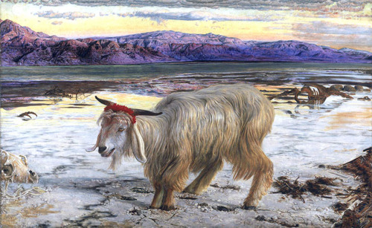
“那只山羊就担当他们的一切罪孽，把它们带到无人之地；所以那人要把那只山羊送到旷野里去。”
(利未记16:22).

Slide 28
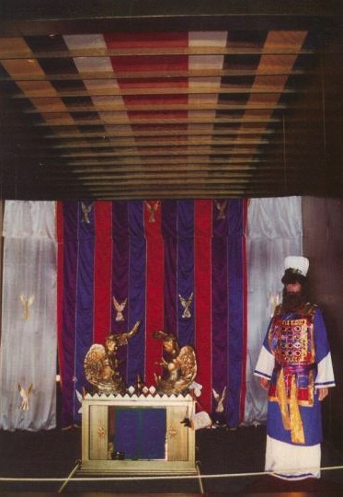
赎罪日的象征
“但基督已经来了，作了已经实现的美好事物的大祭司；他经过更大、更完备的会幕（不是人手所做的，也就是不属于这个受造的世界的）。"
希伯来书 9:11 (CNVS)

Slide 29
用祂的血为所有的一次献上!
他不是用山羊和牛犊的血，而是用自己的血，只一次进了至圣所，就得到了永远的救赎
希伯来书 9:12 (新译本)
Notes:
29

Slide 30
不再需要赎罪的祭
他不必多次把自己献上，好像大祭司每年带着不是自己的血进入至圣所一样。
希伯来书 9:25 (新译本)
Notes:
30

Slide 31
罪已经被除去(不仅仅是遮盖)
如果这样，他从创世以来，就必须受许多次的苦了。可是现在他在这世代的终结，只显现一次，把自己作为祭品献上，好除掉罪。
希伯来书 9:26 (新译本)
Notes:
31

Slide 32
至圣所里的宝座?
唯有基督献上了一次永远有效的赎罪祭，就在神的右边坐下来。
希伯来书 10:12 (新译本)
Notes:
32

Slide 33



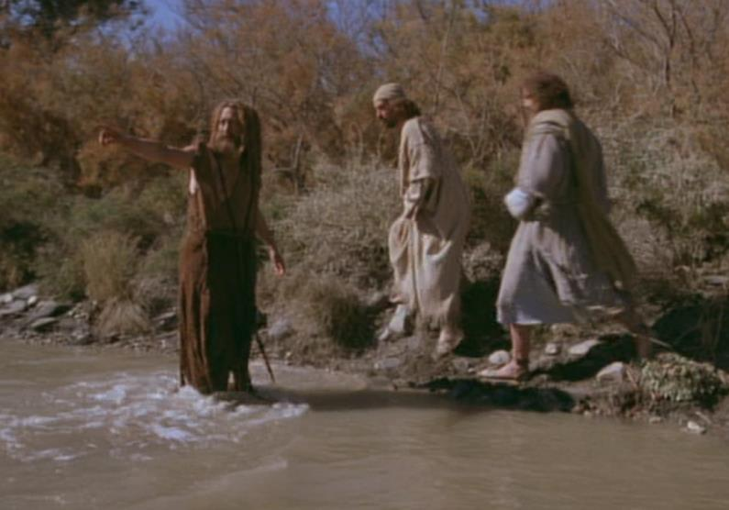
逾越节的羔羊
“看啊！上帝的羔羊，除去世人罪恶的！(约翰福音 1:29)

Slide 34

逾越节的荫蔽
“这血要在你们所住的房子上作记号，我一见这血，就越过你们去，我击杀埃及地头生的时候，灾殃必不临到你们身上灭你们。”
出埃及记 12:13 (和合)

Slide 35
信心的体现
他因着信，就守逾越节，行洒血的礼，免得那灭长子临近以色列的人。
希伯来 11:28 (合和)

Slide 36
神的羔羊
次日，约翰看见耶稣来到他那里，就说：“看哪，神的羔羊，除去世人罪孽的!”
约翰福音 1:29 (合和)

Slide 37
十字架的体现
因为我们逾越节的羔羊基督，已经被杀献祭了。
哥林多前书5:7 (合和)

Slide 38

对羔羊的信心
Notes:
38

Slide 39

“这是我的身体…”
Notes:
39

Slide 40

死亡的天使越过门上涂抹有血的家庭

Slide 41
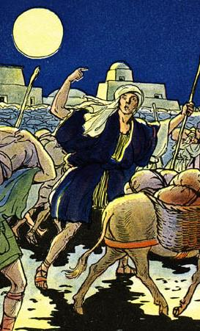
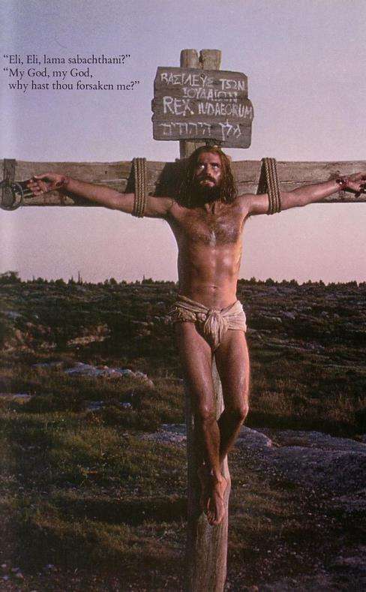
两者的联系
出埃及之于旧约正如……
季度的十字架之于新约
释放
Notes:
41

Slide 42
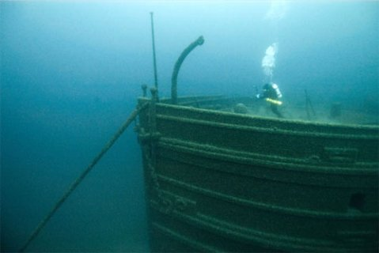
主题探索
找一个伙伴
各自解述释 罗1:17
对照这节经文思想你在未信主之前如何认为你可以乎合神的标准

Slide 43

我们需要得到神的义
-- 但应该怎么做？

Slide 44
罗马书的主题
145
¹⁶我不以福音为耻，这福音本是神的大能，要救一切相信的，先是犹太人，后是希利尼人；
¹⁷因为神的义正在这福音上显明出来，这义是本于信，以至于信，如经上所记：“义人必因信得生。”
不要以福音为耻因为它是有效的!
单是福音已可以让我们称义!

Slide 45

罗马书里的义
145
主题 | 需要 | 供应 | 传授 | 证实 | 应用 | 传播
序言 1:1-17 | 定罪 1:18– 3:20 | 称义 3:21– 5:21 | 成圣 6–8 | 拣选 9–11 | 更新12:1– 15:13 | 宣教 15:14– 16:27
开始 | 犯罪 | 救恩 | 分别为圣 | 主权 | 服事 | 差遣

Slide 46

神的愤怒 (罗马书1:18-20)
151
真实 (18a)
原因 (18b-20a)
后果(20b)

Slide 47

为什么你
没有 借口
罗马书1:20

Slide 48

罗 1:20
161
无限的神
超然的神
其实自从创世以来，神那看不见的事，就如他永恒的大能和神性，都是看得见的，就是从他所造的万物中可以领悟，叫人没有办法推诿。(新译本).

Slide 49
罗 1:20
161
自从创世以来
人已看见了神
= 在每天的
24小时里
其实自从创世以来，神那看不见的事，就如他永恒的大能和神性，都是看得见的，就是从他所造的万物中可以领悟，叫人没有办法推诿。(新译本).

Slide 50


为何神对外邦人生气 (1:21-32)
151
忽视神(21-23)
神任凭他们
污秽(24)
拜偶像(25)
神任凭他们
同性恋(26-27)

Slide 51
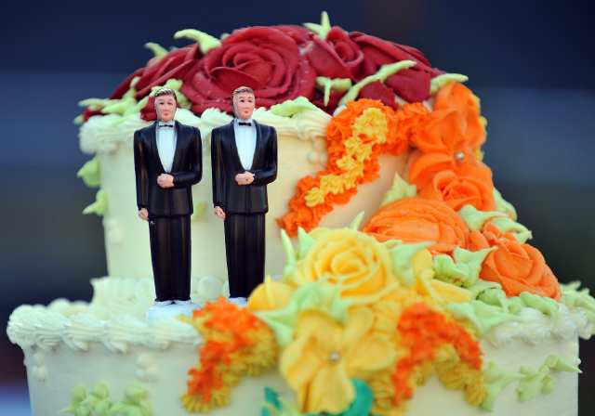
同性恋会怎么样?

Slide 52

同性“结婚”如何呢?
在 YouTube 上看家庭研究理事会博客 (frcblog)
“婚姻应限于一男一女吗？”
应该
婚姻
限于
一男
和一女？
Notes:
The link is http://www.youtube.com/watch?v=nPgZ2Mq1Ugw

Slide 53
151
为何神对外邦人生气 (1:21-32)
忽视神(21-23)
神任凭他们
污秽(24)
拜偶像(25)
神任凭他们
同性恋(26-27)
神任凭他们
堕落 (28-32)

Slide 54

^{10b}「 没 有 义 人 ， 连 一 个 也 没 有 。
¹¹ 没 有 明 白 的 ； 没 有 寻 求 神 的 ；
¹² 都 是 偏 离 正 路 ， 一 同 变 为 无 用 。
没 有 行 善 的 ， 连 一 个 也 没 有 。
¹³ 他 们 的 喉 咙 是 敞 开 的 坟 墓 ；
他 们 用 舌 头 弄 诡 诈 ，
嘴 唇 里 有 虺 蛇 的 毒 气 ，
¹⁴ 满 口 是 咒 骂 苦 毒 。
¹⁵ 杀 人 流 血 ， 他 们 的 脚 飞 跑 ，
¹⁶ 所 经 过 的 路 便 行 残 害 暴 虐 的 事 。
¹⁷ 平 安 的 路 ， 他 们 未 曾 知 道 ；
¹⁸ 他 们 眼 中 不 怕 神 。」
(罗3:10b-18)
所有人都在罪恶之下

Slide 55
¹⁹ 我 们 晓 得 律 法 上 的 话 都 是 对 律 法 以 下 之 人 说 的 ， 好 塞 住 各 人 的 口 ， 叫 普 世 的 人 都 伏 在 神 审 判 之 下 。
²⁰ 所 以 凡 有 血 气 的 ， 没 有 一 个 因 行 律 法 能 在 神 面 前 称 义 ， 因 为 律 法 本 是 叫 人 知 罪 。
(罗3:19-20)
所有人都在罪恶之下

Slide 56
Black

Slide 57


救恩论链接地址 BibleStudyDownloads.org
免费获得该讲解!
圣经学习下载

