Slide 1

注重比喻体裁的释经讲道
新加坡圣经学院， 由 Jeffrey Arthurs 博士于2014年7月举行的研讲会
康威尔神学院的讲道教授
由 Rick Griffith 博士上载 • 新加坡圣经学院
所有文件（多种语言）可从 BibleStudyDownloads.org 免费下载

Slide 2
提摩太前书 4:16
你要谨慎自己和自己的教训，要在这些事上恒心，因为这样行，又能救自己，又能救听你的人。

Slide 3
复习
神默示了圣经文本的内容和体裁。
每种 体裁有自己的文学形式, 及每种形式会产生一系列的修辞效果。
  例如 , 谚语很短，因此它们会储存在读者的记忆中并且促使他们思考。
释经讲道注释文本的内容及形式, 以便. . .
讲道说明神在经文里所说的话，并显明神在经文里所要做的事。

Slide 4
注重比喻体裁释经讲道

Slide 5
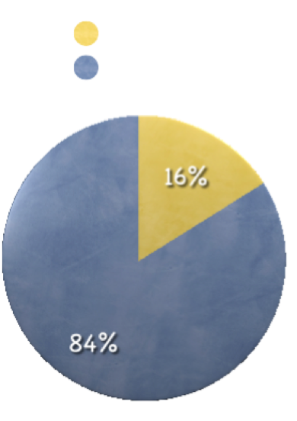
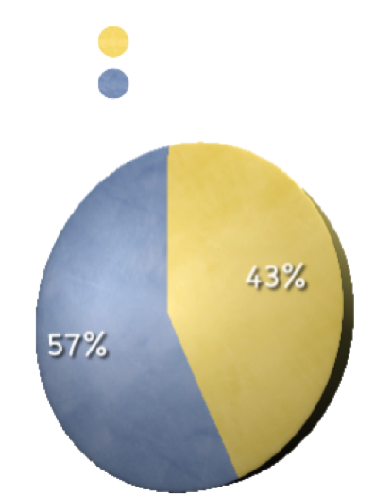
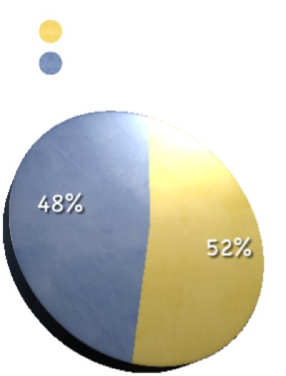
耶稣教导的核心
比喻
比喻
比喻
其他的言语
其他的言语
其他的言语
马太福音
马可福音
马可福音
Notes:
The heart of Jesus’ teaching. He spoke 50 to 70 parables, depending how you define the term, so that approximately 43% of his words in Matthew, 16% of his words in Mark, and 52% of his words in Luke are parables. The word parabole occurs fifty times in the New Testament. All but two of those occurrences appear in Matthew, Mark, and Luke. (The other two are Hebrews 9:9 and 11:19.)
It seems that Jesus virtually invented this genre. Researchers have discovered only three rabbinic parables before the time of Christ, although they became fairly common in the centuries after our Lord’s earthly ministry. Furthermore, the Hebrew Bible contains only a few, with Nathan’s story in 2 Samuel 12 as the best parallel to Jesus’ stories.
If you want to expound the Savior’s heart, you’ve got to preach the parables.

Slide 6
主耶稣使用动人的故事和类比，开创他的天国。
概要:
比喻的定义
比喻的文学及修辞特征
讲比喻的传讲

Slide 7

什么是“比喻” ?
一个 “有属天意义的故事。”
C.H. Dodd: “简而言之，比喻是从大自然或生活中提取的隐喻或明喻，以生动性或特异性让听众着迷，并留下足够的想象空间，使听众积极地思考如何精确地在生活中应用。”
  C. H. Dodd, The Parables of the Kingdom, rev. ed. (New York: Scribner’s, 1961), 5
Notes:
The term parabole means literally to “throw alongside,” and that’s what parables do. They make comparisons. They align one thing next to another to clarify the second thing. They portray scenes from everyday life—working in the field, sowing, fishing, traveling—which morph into spiritual lessons. Parabole is closely linked to the Hebrew term mashal (“to be like”), which is the characteristic term for “proverb,” but Old Testament mashalim and New Testament parabolai are broad categories which do not have exact parallels in English literature. They include riddles, allegories, and sayings.

Slide 8
什么是“比喻”?
Leland Ryken: “以现实的故事，简单的构造和教导的目的，传达基督教的真理，而它们的细节往往超出其文字叙事所包含的意义。”
  Leland Ryken, How to Read the Bible as Literature (Grand Rapids: Zondervan, 1984), 202.

Slide 9

比喻的文学及修辞的特征
类比
  比喻 “把两件东西并排”; 意即把两件不同的东西相比。
    种子 = 神的道
    撒种的人= 耶稣/ 传道者
    土 = 人的心
  因此，比喻内的“密码”必须被“破解”。
Notes:
As the term parabole suggests, parables are analogies. In the LXX, parabole is used of an event which has become emblematic (1 Sam. 10:12, “Is Saul also among the prophets?”) just as we might say that such-and-such a failure was the leader’s “Waterloo.” In the LXX the term also describes persons who have become emblematic (Jer. 24:9, “I will make them a horror to all the kingdoms of the earth, to be a reproach, a byword, a taunt and a curse”; Job 17:6, “He has made me a byword among the people”). We do the same when we say he is a “Quisling” or “Casanova.” The term is also attached to an allegorical story (Ezek. 7:1-10). In all of these cases, parabole is a figure of speech that compares one thing to another.
Individual parables can be located on a sliding scale between simple simile (“the kingdom of heaven is like . . .”) and intentional allegory (the four soils stand for the heart conditions of four hearers). That sliding scale has baffled scholars because we have no parallel literary form. Long speaks of “code, vessel, object of art.”
Code: unifies insiders and confirms what we already know/believe.
Vessel: teaches and enlightens.
[overhead: parables as similes]
Object of art: collaboration and imagination.

Slide 10
类比的比喻
(天国好像. . .)
教导/例证在这里发生
讲者的 经验领域
听者的 经验领域
天国
酵
天国悄然无声息地蔓延

Slide 11

类比的修辞
类比要求听众构建沟通者的意思。
比喻内待破解的“代码”，整合了局内人。
例如: “黑洞.”
https://www.youtube.com/watch?v=P5_Msrdg3Hk
讨论问题:
  比较那两件东西？
  什么是这部电影的主要含意？
Notes:
The code of parables is like an inside joke where only the initiated “get it.”

Slide 12
比喻的文学及修辞的特征
比喻
现实主义
Notes:
Jesus’ parables stroll through everyday life in the ancient Near East depicting characters and actions seen in every town and village. We meet homemakers, widows, virgins, servants, tenants, fathers, and sons. We see them light lamps, sow seed, invest money, and invite to weddings. The stories are realistic. As I’ll discuss in a minute, the stories often exaggerate (mustard plants don’t really grow as large as trees), but there are no talking animals, dragons, or haunted forests. Parables are not fairy tales.
Therefore, cultural study necessary. E.g. Luke 15, Good Shepherd. How much do sheep weigh? How much did average man weigh? Western notion of value of individual, but Kenneth Bailey says that Mid-East notion is pride in one’s accomplishments.

Slide 13
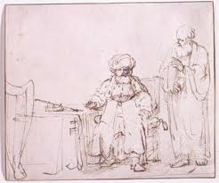
现实主义的修辞
  认同: 听众投身到故事里，并被故事所吸引。
  想像: 听众全神投入，包括情感在内。
  渗透的过程: 听众的思想变得中
  立, 以致他们可以感受到思想的
  爆发

Slide 14
比喻的文学及修辞的特征
比喻
现实主义
民间故事
  简短
  通俗的情节
  常用的角色

Slide 15
民间故事的修辞
  比喻 (又再) 使到思想变得中立
  比喻会存留在记忆里
  比喻有能力极化不同人的反应

Slide 16
注重比喻体裁的释经讲道
注释:
  要避免过多的想象力 –过度地解释比喻

Slide 17
奥古斯丁对“好撒玛利亚人”
比喻的解释
文字 解释_____________
一 “个人 ”… 亚当
强盗… 魔鬼和鬼魔
剥去他的衣裳… 夺走亚当永恒的生命
把他打个半死… 诱使亚当犯罪
祭司和利未人… 旧约的事工对亚当毫无帮助
好撒玛利亚人… 基督
用油和酒倒在他的伤处，包裹好了… 靠着基督抑制罪恶, 劝励我们
热心地侍奉
店… 教会
店主… 使徒保罗

Slide 18
如何以体裁敏感性传讲比喻
注释:
  要避免过多的想象力 –过度地解释比喻
  要特别注意文化背景
  要特别注意文学背景 (最后的强调, 前面的声明, 以及福音故事中比喻的置入处)
释经讲道:
  要与近代文化“融合”
  别害怕提出个人观点
Notes:
Exegesis:
Be careful of too much imagination, the dangers of allegory.
[Augustine]
Exegete cultural context. E.g. Luke 15, woman who lost coin—dark houses, flag stone floors.
Exegete literary context.
Lead-in statements (e.g. Luke 18:1; 18: 9; 19:11).
End stress (e.g. Luke 18:7-8, 18:14; 19:26-27)
Placement in gospel provide clues to meaning (e.g. what follows the parable of the Good Samaritan?)
Homiletics:
Translate.
For example, the original hearers must have been shocked to hear Jesus make a tax collector the exemplar in one of his stories with the Pharisee as the foil. Tax collectors were traitors! Modern audiences need to feel the shock. Perhaps we could translate with a story of how the Dutch treated collaborators after WWII.
We’ll probably need to translate the story of the Prodigal Son, too. Jesus’ listeners would have expected the father to take offense when his son left. To help our listeners respond to the story in the same way, perhaps we could show the scene from “Fiddler on the Roof” when Tevye pronounces his daughter “dead” for marrying a Gentile.
Don’t be afraid to make a point
e.g, Pray! Don’t give up!
[How explicitly . . .] Many postmodern authors today
[Sexy Carrot]

Slide 19
路加福音里的比喻
如何解释其观点？
聪明和愚蠢的建屋者 (6:46-49)
半夜来访的朋友 (11:5-10)
不结果实的树 (13:6-9)
精明的管家 (16:1-9)
恳切祈求的寡妇 (18:1-8)
税吏和法利赛人 (18:9-14)
十锭银子 (19:11-26)

Slide 20
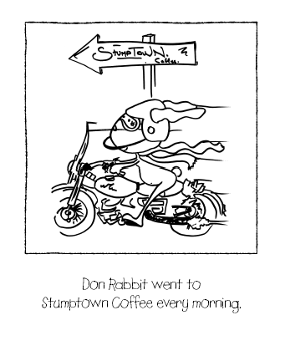
唐兔子每天早上去
Stumpton 咖啡店。
唐兔子的比喻
( Donald Miller, Blue Like Jazz)

Slide 21
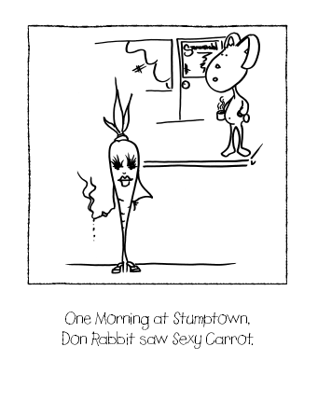
一天早上在Stumpton咖啡店，唐兔子遇见性感胡萝卜。

Slide 22
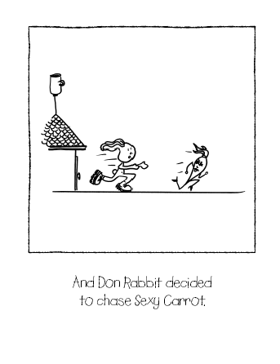
唐兔子决定追逐
性感胡萝卜。

Slide 23
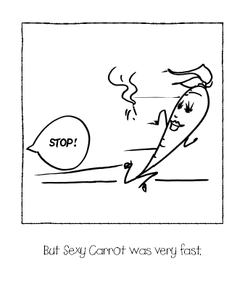
但是性感胡萝卜
跑的很快。
停住!

Slide 24
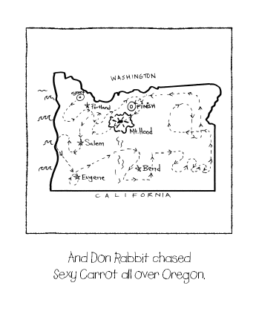
唐兔子在俄勒冈州各地
追逐性感胡萝卜。

Slide 25
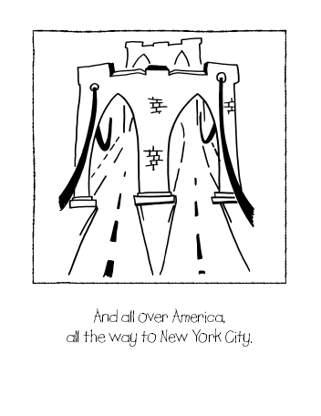
遍及整个美国，一直到纽约市。

Slide 26
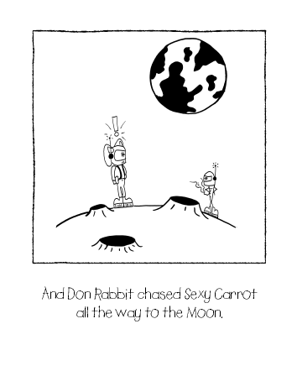
唐兔子甚至追性感胡萝卜到月球。

Slide 27
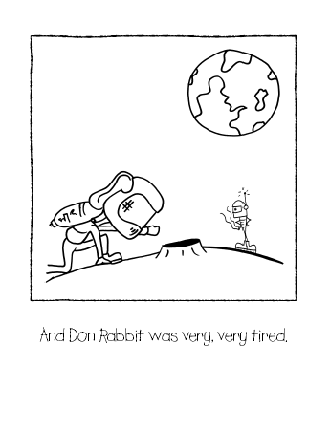
弄到唐兔子非常非常疲倦。

Slide 28
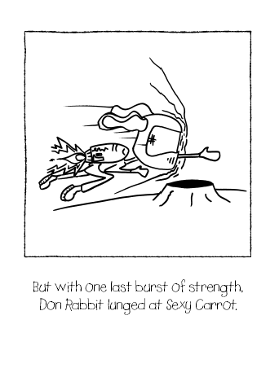
最后，唐兔子用仅存的最后力量冲向性感胡萝卜。

Slide 29
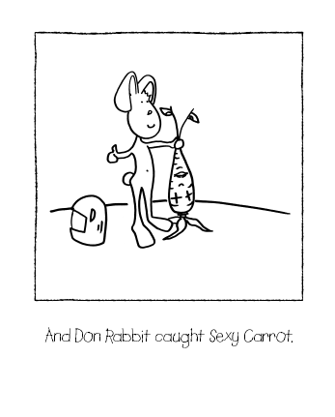
唐兔子终于捉了性感胡萝卜。
到

Slide 30
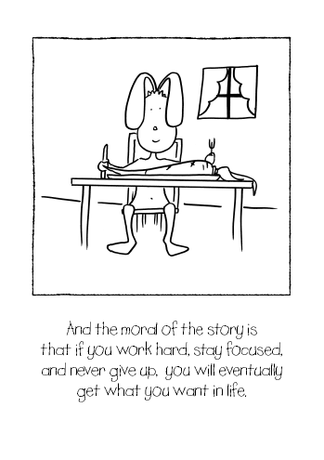
这个故事的寓意是，如果你努力工作，保持专注，永不放弃， 你最终将获得你生活中
最想要的东西。

Slide 31

不幸，这个故事被讲述后不久，唐兔子吃胡萝卜时哽死了。所以这个故事的第二个寓意是:
有时候，我们一生中最想要的东西
就是会杀死我们的东西。

Slide 32
如何以注重体裁的方式传讲比喻
注释:
  避免过多的想象力 –过度地解释比喻
  要特别注意文化背景
  要特别注意文学背景
释经讲道:
  要与近代文化“融合”
  要不要害怕提出观点
  别害怕清楚地表达自己的观点
Notes:
Don’t be afraid to not make your point explicit.
My point about not making a point is especially pointed when we preach to postmodern listeners since they value mystery, imagination, narrative, and silence. They recoil from pat answers and formulas which package the truth with brown paper, strapping tape, and ribbon.

Slide 33

“当所有的问题都有了答案 ，那是假的。 真正的真理在奥秘中 。”
演员肖恩·潘

Slide 34
如何以体裁敏感性传讲比喻
注释:
  避免过多的想象力 –过度的解释比喻
  要特别注意文化背景
  要特别注意文学背景
释经讲道:
  要与近代文化“融合”
  别害怕提出个人观点
  别害怕清楚地表达自己的观点
  以叙事方式讲述

Slide 35
比喻样本
短片:“黑洞。”
托尔斯泰:“一个人需要多少土地?”
巴顿 :“甜甜圈。”
巴顿:“渡口招标。”
亚瑟斯: 鸡肉厨师
亚瑟斯: 跌进坑里
亚瑟斯: 和尚与鸟
短片:“狗。”
罗宾逊:“在上帝的鸡肉餐馆里的基督教会。”

Slide 36
提摩太前书 4:16
你要谨慎自己和自己的教训，要在这些事上恒心，因为这样行，又能救自己，又能救听你的人。

Slide 37
Black

Slide 38

主页 BibleStudyDownloads.org
可使用此
QR码进入网页

Slide 39

讲道链接地址 BibleStudyDownloads.org
免费获得该简报!
Notes:
Preaching (pr)
Homiletics

