Slide 1
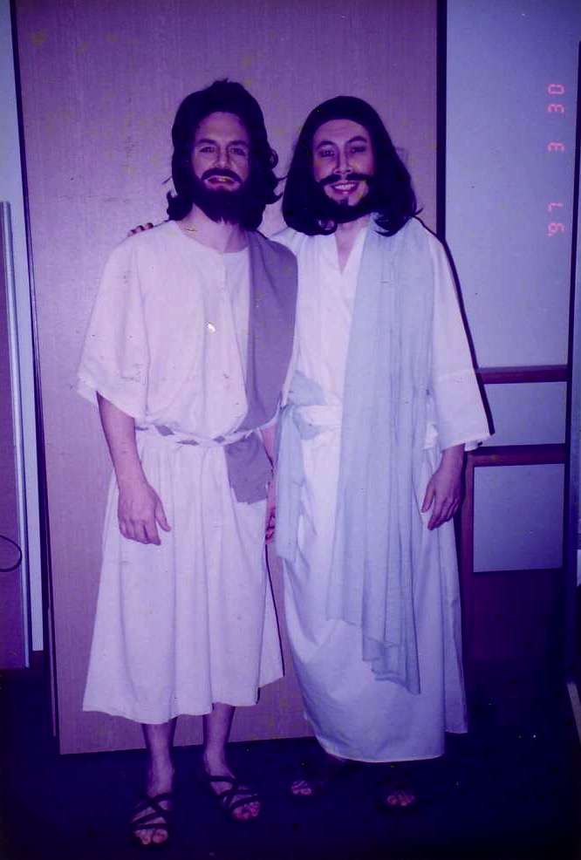
如何以 独白 讲道
时光倒流，把你的听众带回到当下
来传讲神的信息
Dr. Rick Griffith • 博士 • 新加坡神学院 • BibleStudyDownloads.org

Slide 2
“我为你完成这事”

Slide 3
158
独白是...
一段以第一人称、戏剧性地描述一位圣经人物，
用来向听众传其中心思想
和应用的经文

Slide 4
158
独白的优点
兴趣
多样性
传达

Slide 5
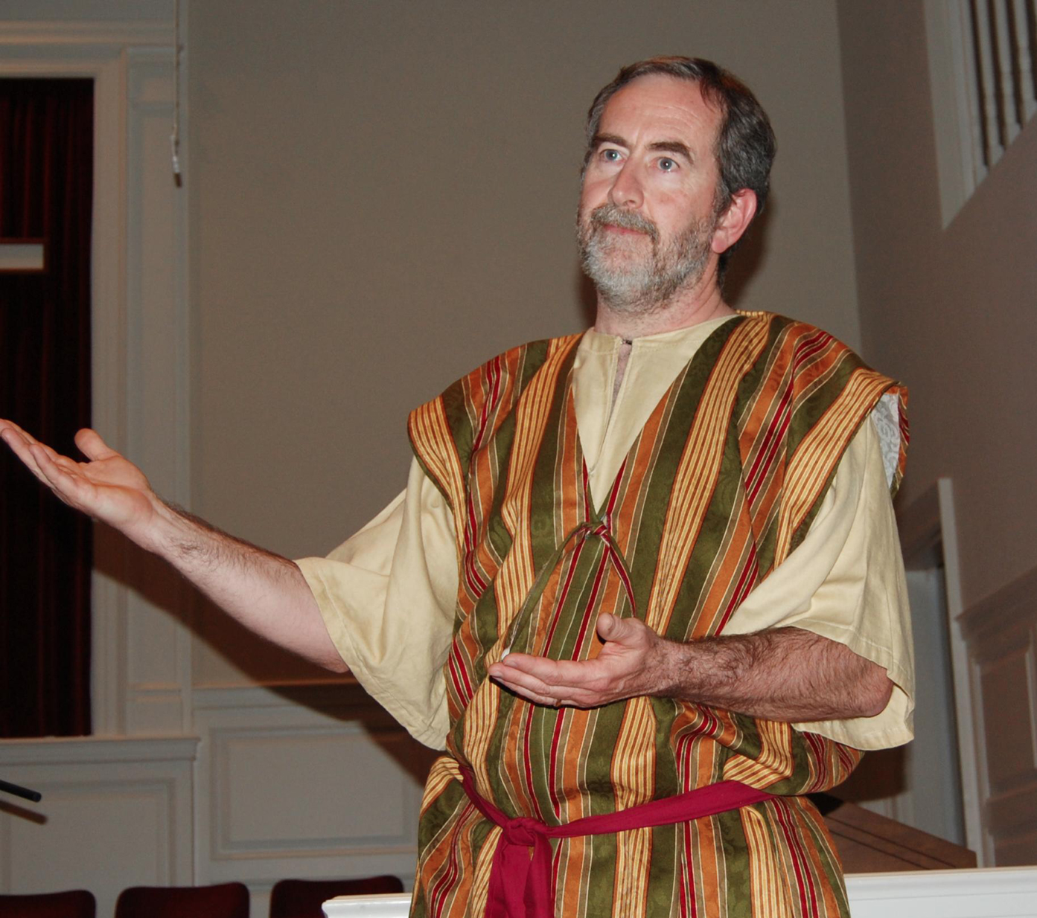
独白的危险性
经文诠释
轻率处理
使人为难事情
带有娱乐大众的性质
Notes:
These potential problems exist with doing monologues:
Exegesis must be even more in depth. We have to make sure our research is very accurate to properly play the role of a biblical character. Monologues must add background information and feelings not actually within the text of the Bible, so we must be careful that these are within the authorial intent.
Trivializing means there can be a temptation to preach a shallow message (moralizing) instead of the theology of the text that tells us much about God.
Embarrassment is also possible is the speaker cannot remember the lines. No one can use notes in monologues, but this is more difficult than a professional actor's job who can take many "takes" of the same scene until he gets it right on film. In contrast, the one who does the monologue must internalize the script well. If he doesn't, he could be embarrassed that, as a biblical character, he can't even tell his own story.
Entertainment-mentality is the danger of people seeing this as a performance instead of a sermon with a message. The goal is not for the listeners to clap at the end. It is for them to be transformed by the message of the monologue.

Slide 6
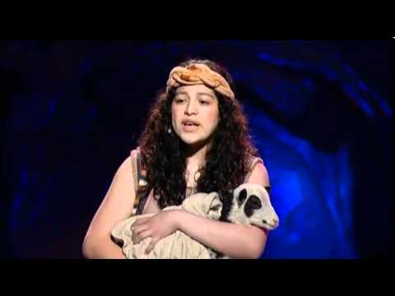
独白在什么时候最好用
158
新的系列
新鲜感
熟悉的经文

Slide 7
但要怎样演独白呢？

Slide 8
准备释经讲道的过程
27-28, 251
根据理查德.拉梅什的文字，《准备释经讲道》
经文
信息
5 个理想的听众回应
脑
4 3个发展思想的问题
信息目标作桥梁
3.2 解经主流思想
经文主旨
心
信息主旨
6 信息主流思想
7 信息大纲
8 清晰
9 前言/结论
3.1 解经大纲
结构
骨干
结构
2 分析经文
研读
肉
宣讲
10 写稿 &
讲道
1 选择经文
白色的字体的10个步骤是取自于哈顿罗宾逊的《圣经讲道 》(笔记, 105)
Notes:
Here is the overview of the course which follows Ramesh Richard's 7-step process of preparing expository sermons. This includes the body analogy in the center where the "flesh" parallels the words of the text with the words of the sermon—that is, what people actually see/hear on the "outside" in both text and sermon. Likewise, the "skeleton" reveals the outline or structure of both text and sermon, as does the "heart" summing up the CPT (Central Proposition of the Text) and the CPS (Central Proposition of the Sermon) in a single sentence that reflects either what the text or sermon is about. Finally, the "brain" refers to the need to really think about how to bridge the CPT to the CPS. This is best worded as a specific purpose statement that indicates the Desired Listener Response in terms of what the hearer should think, feel, or do after the sermon is finished. It is best to word this goal as "The listener will…"
The white text shows how the 10-step sermon process of Haddon Robinson relates to the 7-step process of Ramesh Richard. At the "Structure/CPT" steps it breaks Richard's steps into one step (EO and EI), whereas at the "Structure" step 6 it makes into 3 steps.
This slide presents pages 27-28 of the notes in visual form.
This slide is a stand-alone presentation 28. If that is already translated, please just copy it and paste it here.

Slide 9
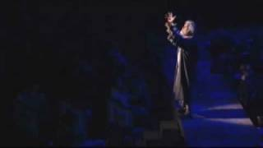
我要怎样处理独白？
158-159
根据 1-5 的步骤(第27-28页)
选择圣经人物
根据你的要旨规划概论
以圣经的例子 (不是现代的世界) 代替清晰的口白
穿上圣经的服饰,介绍你扮演的圣经人物, 作出总结
MSS 和练习（不用稿子）

Slide 10
独白的人物角色
160--哈波拿: “在波斯的一个晚上” (以斯贴记）
170--以斯拉: “我的家是上帝的事” (以斯拉 9)
179--约瑟: “约瑟眼里的圣诞节”
(路加福音 1:26-33)
183--占星家: “来自占星家的圣诞节反思”
(马太福音 2)
189--马可:“马可的介绍!” (马可福音)
192--保罗: “我爱贴撒罗尼迦人!” (贴撒罗尼迦前书)
196--欧尼西慕: “欧尼西慕的见证” (腓利门书)

Slide 11
舞台场面调度设计图
113
舞台前或平台
区域 4 | 区域 1 | 区域 3
区域 6 | 区域 2 | 区域 5
格兰特 & 茹苇, 叙述触动人心的故事, 68

Slide 12
舞台场面调度设计图
113
舞台前或平台
区域 4 酷 愁苦, 冲突 (大卫争吵)) | 区域 1 中 对抗性 (大卫与歌利亚 的战斗) | 区域 3 温 亲密 (大卫祷告、 挑选石头)
区域 4 酷 极度疏离 (歌利亚去世) | 区域 2 中 远处、远离某事 (大卫抵达营地) | 区域 5 温 更多 “距离” (大卫与耶西同一幕)
5
4
3
2
1
格兰特 & 茹苇, 叙述触动人心的故事, 69-70

Slide 13
Black

Slide 14
讲道链接地址 BibleStudyDownloads.org
免费获得该讲解!
圣经学习下载
Notes:
The explanation for free!
Preaching/Homiletics link address

