Slide 1
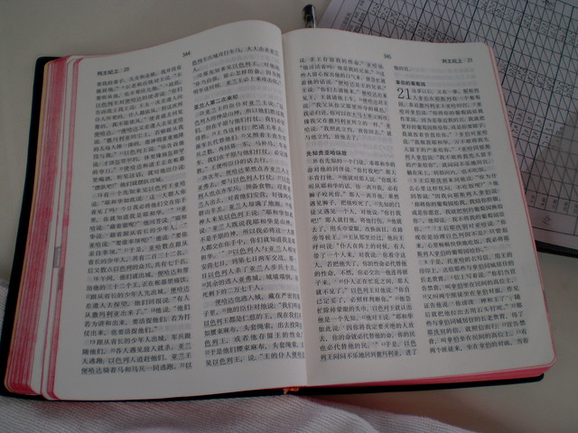
公众经文阅读
应如何将神的话语大声读出来会众才能真正的听见！
Dr. Rick Griffith • 博士 • 新加坡神学院 • BibleStudyDownloads.org

Slide 2
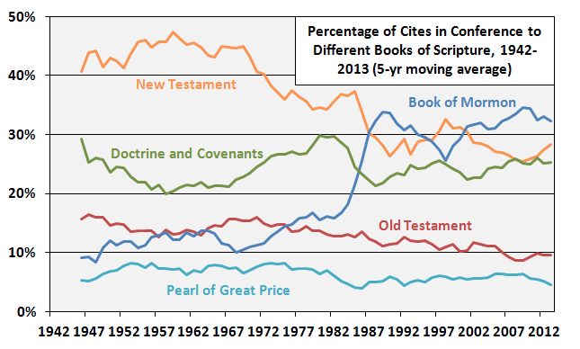
摩门教阅读摩门书较多，阅读圣经较少
1942-2013年城市会议不同圣书引文的百分比（5年移动平均值）
新约
摩门书
教义与圣约
旧约
无价珍珠
http://zelophehadsdaughters.com/ at 10 July 2014
Notes:
“Finally, I did one more adjustment to account for the norms of how often the different books of scripture are cited in Conference by all speakers during the years each Quorum member served. What I mean here is that at different points in time, different books of scripture were cited more or less by all speakers in Conference. Because members have been in the Quorum for different amounts of time, some of the differences between them can be accounted for by the different norms in Conference at the times they were giving talks.
The biggest shift in the time current Quorum members have served has been an increase in citations of the Book of Mormon. Here’s a graph showing the percentage of all citations of scriptures in Conference that came from each of the five books of scripture since 1942 (as far back as the LDSSCI has Conference talk data).”
Ziff, “Which GAs Prefer Which Books of Scripture?” at http://zelophehadsdaughters.com/ posted 10 July 2014 (accessed 12 Aug 2014)

Slide 3
讲章中最重要的部分…
9
…也是唯一会众直接听到的神的话语!

Slide 4
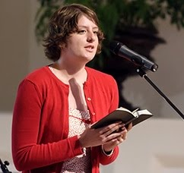
那么我们应如何正确的读经文呢？
9
让我们来看一些问题
及其解决方法…

Slide 5
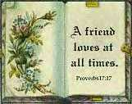
A. 经文阅读通常与当天早上的信息无关。
9
这两者之间应是有关联的!

Slide 6
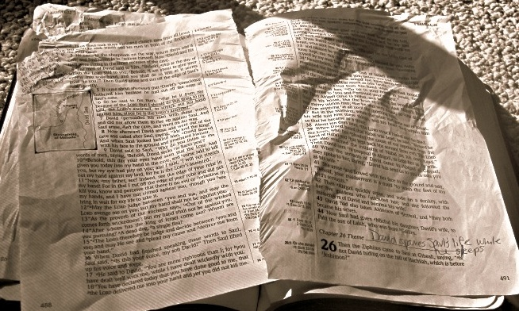
B. 我们没有很清楚的将经文出处指明，因此很多时候会众需要互相询问哪段经文。
9
所以在引言中将经文出处宣布三次以便让那些没有听清楚的会众可以听到。

Slide 7
C. 在会众还未翻到经文之前我们已经开始阅读。
9
所以当你听到停止翻页的声音之后才开始阅读经文。

Slide 8
你如何晓得会众已在手机上找到经文？
9

Slide 9
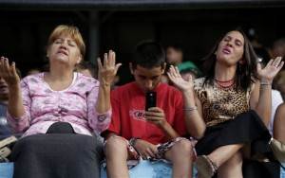
你如何晓得会众已在手机上找到经文？
9
请他们抬头看你！

Slide 10
D. 我们不给相关背景来理解经文 (例如： 没有上下文直接读使徒行传14:21)。
9
所以在宣讲经文之前提供上下文内容。

Slide 11
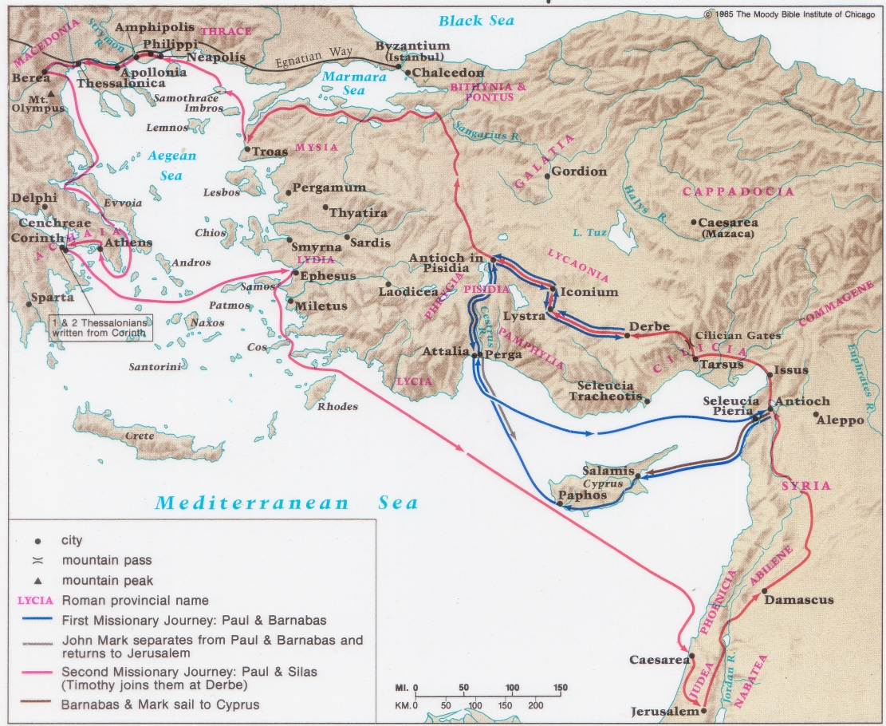
保罗与巴拿巴的第一次宣教之旅
(使徒行传 13–14)

Slide 12
因缺少预备而读错 一些较难读的字。
9
所以请使用笔记后面的指引正确阅读英文名字 (226-244页)

Slide 13
F. 我们注重错的字幕
9
(在加 2:20，我们必须注重
“舍己” 而不是 “为我" ).
“我已经与基督同钉十字架，现在活着的不再是我，乃是基督在我里面活着。并且我如今在肉身活着，是因信神的儿子而活，他是爱我，为我舍己。” (加 2:20 合).
Notes:
Note to Dr. Rick: The Chinese translation “为我舍己” included “gave and for” together.
“为我” is translated as “for me”, while “舍己” is to give up one’s life, that has the connotation of “gave”.

Slide 14
F. 我们注重错的字幕
9
(Accent "me," not "before," in Exod. 20:3).
“除了我以外，你不可有别的神” (出20:3 合).
Notes:
Note to Dr Rick: The Chinese translation is more direct — or it can be translated directly as “Except me, you shall have no other gods”
Chinese does not include ”before”, which in English can be misinterpreted as acceptance of many other gods as long as it is not higher than YHWH.
This is not an issue in the Chinese Bible translation.

Slide 15
F. 我们强调一些不重要的字眼 (例如：加拉太书2:20的重音为 “舍” 不是 “为”；在出埃及记20:3重音为 “我” 不是 “别”)。
9
所以练习阅读应强调的字眼并大声阅读经文多遍直至几乎可以背诵。

Slide 16
G. 读经文时只用一个音调。
9
所以在阅读时请多样化，用不同的速度和音调。读给孩童 － 他们可不会给面子!

Slide 17
H. 当人们有着 “我知道该怎样读” 的态度时很难教导他们该如何读的更好。
9
所以在教会中选出五个阅读比较好的人给他们这个小小的课程。

Slide 18
I. 我们以为每次结束都需要老生常谈的说 “愿神藉着阅读他的话语祝福更多。”
9
我们如果能正确的读圣经，
那已经是一个祝福。

Slide 19
阅读经文
9
A. 叙事: 荣耀进圣城 (马可福音 11:1-11)
预言: 天上的宝座 (启示录 4:1-11)
哀歌: 祈求帮助 (诗篇 70)

Slide 20
Black

Slide 21
讲道链接地址 BibleStudyDownloads.org
免费获得该讲解!
圣经学习下载
Notes:
The explanation for free!
Preaching/Homiletics link address

