Slide 1
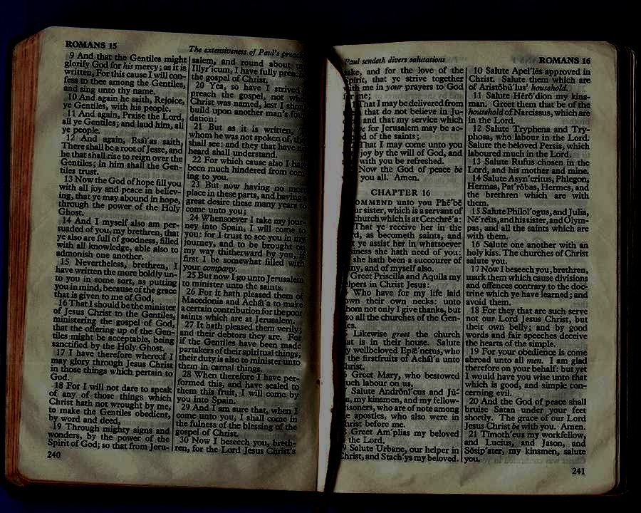
讲道学: 释经讲道的艺术
Dr. Rick Griffith • 博士 • 新加坡神学院 • BibleStudyDownloads.org
Notes:
Welcome & thanks

Slide 2
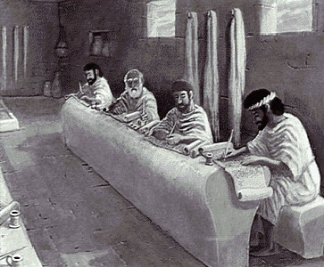
什么是释经 为何要释经

Slide 3
"下周我们将去旅行."
我们应该怎么走?
乘车?
乘火车?
乘巴士?
乘喷气式飞机?
乘出租车?
步行?
这取决于我们要去的地方!

Slide 4
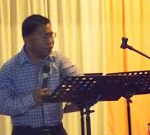
“我们将给出一个说明性的说教"
但它是什么?
一个圣经注释?
娱乐?
一个圣经的教训?
激情?
我们需要一个共同的定义.

Slide 5
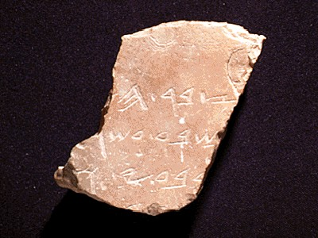
什么样的讲道符合释经性质?
1
定义
"释经讲道是对一段经文的解释从而引导会众正确和实际应用这段经文."
Walter Liefeld, NT Exposition, 6

Slide 6
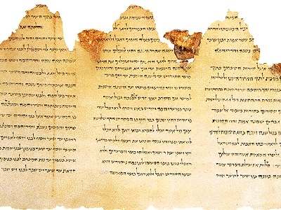
更详细的定义…
1
“释经讲道就是宣告 (或 传播) 圣经的概念，, 这概念是透过历史、文法、文体的研读该段经文的处境，圣灵首先在讲者的身上工作，之后通过他应用在会众的经验当中。" (参考：Robinson, 20, 在讲道研讨会中的整理)

Slide 7
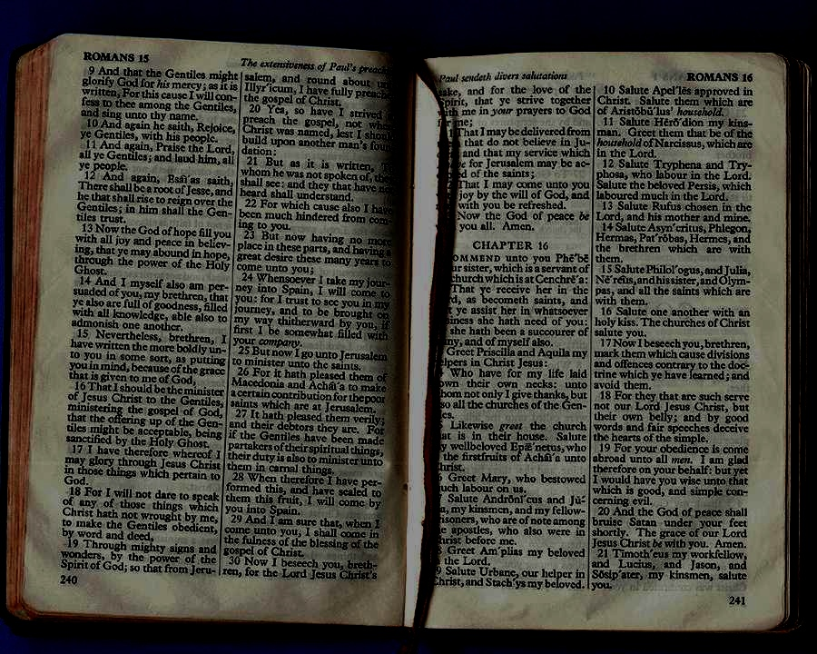
释经讲道的特性
1
集中解释一段主要经文
（参考：Liefeld, 6-7）
Notes:
E.g., 1 Cor 13:1-7
Reference to other Scriptures is subordinate to the exposition of the main passage

Slide 8
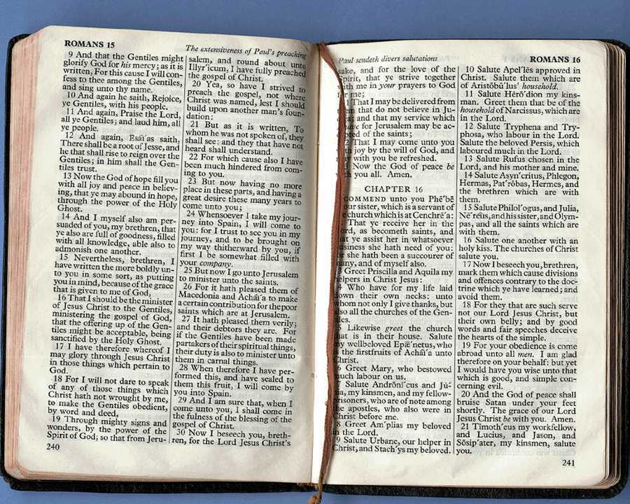
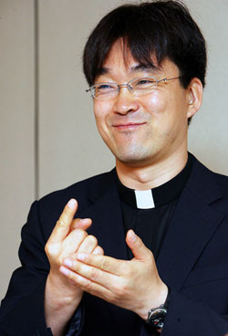
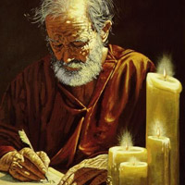
释经讲道的特性
1
要忠于原作者的意图
=
Liefeld, 6-7
Notes:
Neh 8:8
Luke 4:16-22 on Isa. 61:1-2
The text is not a box of candy from which one selects his favorite treats. It is the Word of God, which has come to us to be master, not servant.
For example, preaching leadership principles from Nehemiah 1—2 misreads authorial intent.
You can preach a biblical message from the wrong verse!
In other words, you can be held by a great theology so that you preach truth, but it may not be the message of the particular passage before you.

Slide 9
释经讲道的特性
1
浓缩
中心
意思
经文的意思
（参考：Liefeld, 6-7）
Notes:
True exposition expounds the one, central idea of the text called the Big Idea (homiletical idea or main idea or synthetic statement). Real exposition is not a series of exegetical comments, unrelated truths, or a cute outline that gives a survey of a passage

Slide 10
1
释经讲道的特性
发展与方向
I. 与中心意思相关
II. 与中心意思相关
III. 与中心意思相关
重申中心意思
经文的意思
（参考：Liefeld, 6-7）
Notes:
brings the hearers towards the same point made by the author. The message does not simply state the main idea over and over without some design that brings the listeners along in truth

Slide 11
释经讲道的特性
1
应用
听众应该。。。。
知道
感到
做到
经文的意思
（参考：Liefeld, 6-7）
Notes:
It relates biblical truth to the listener's life in line with the original purpose, meaning, or function of the text.
Application must first be applied to the preacher's life to be effective exposition
----- Meeting Notes (7/5/12 10:55) -----
Preaching without application is like making a car but forgetting to put the tyres on! It is "where the rubber meets the road" in this sense, for the sermon will go nowhere without application.

Slide 12
释经讲道特性的总结
1
释经讲道不是。。。 释经讲道是。。。
Notes:
Summary: So then, what is expository preaching and what is it not?

Slide 13
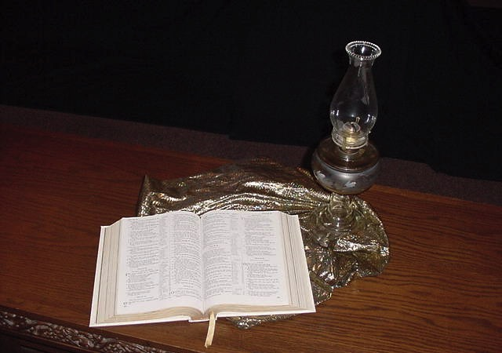
2
为何释经讲道那么重要

Slide 14
A. 释经讲道是透过无误的经文让神的旨意展示在
2
个人灵修
我们的家庭
我们的工作
我们的圣经研读 (包括现在)
Notes:
The more we preach from Scripture, the less false teaching we will have.
We have only ONE inerrant book! Why preach other things?

Slide 15
B. 释经讲道让圣灵选择处境来教导神的话语
2
防止“断章取义”
防止不当“原则化"
Notes:
God's Word is much more effective than the best of man's sermons to affect people's will and meet their needs.
"The type of preaching that best carries the force of divine authority is expository preaching" (Robinson, 19).

Slide 16
C. 释经讲道有内在的权威与能力
2
Notes:
Isaiah 55:10-11
----- Meeting Notes (7/5/12 11:23) -----
As water comes from God and blesses the earth, so God's Word comes from him and blesses his people.

Slide 17
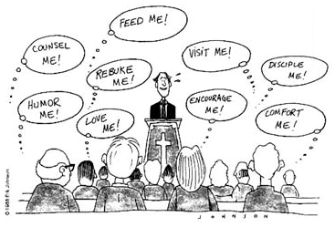
我们如何理解这漫画？
喂我!
辅导我!
看望我!
使我成为
门徒!
挑战我!
幽默我!
鼓励我!
爱我!
安慰我!
Notes:
Any kind of preaching is tough today!
Yet it still has inherent authority and power when it preaches God’s Word!

Slide 18
D. 释经讲道引导听众专注圣经
2
时装
午餐
孩子
Notes:
By teaching his people how to get answers from Scripture itself, the pastor frees himself up from always being the authority.
Expository sermons remind people that the final authority is the Bible—not the preacher!

Slide 19
为何神的话语那么重要?
圣经都是上帝所默示的，於教训、督责、使人归正、教导人学义都是有益的， 叫属上帝的人得以完全，预备行各样的善事。
提摩太后书3：16－17 （新和合本）

Slide 20
神话语的四种作用
2
督责
使人归正
教导
教训 (学义)
提摩太后书3：16－17 （新和合本）
Notes:
If you preach sequentially through the Bible, you will have the divine balance in these four areas:
Teaching tells people how to walk God's road
Rebuking tells them when they get off the path
Correcting shows how to get back to the right way
Training in righteousness is the result of the cycle of teaching, rebuking and correcting over and over.

Slide 21
E. 释经讲道能满足信徒灵命滋养的真正需要
2
Notes:
Good expository preaching does not impress the congregation; it feeds them.

Slide 22
F. 释经讲道能防止错误诠释圣经
2
处境
处境
经文
处境
处境
Notes:
"Spiritualizing" (drawing a spiritual lesson while ignoring the actual meaning of a passage) is more difficult to fall into when one preaches from a single text than when the pulpit hits at verses all over the Bible.

Slide 23
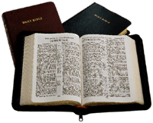
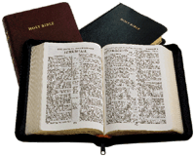
G. 释经讲道最能让讲道覆盖整本圣经
2
第一周
第四周
2015 讲道
2013 讲道
第五周
第二周
第三周
第六周
2008 讲道
2009 讲道
释经讲道
大多数的讲道
2011 讲道
2012 讲道
加拉太书
加拉太书
2010 讲道
第七周
第十周
2016 讲道
2014 讲道
2017 讲道
第八周
第十一周
第九周
第十二周
Notes:
In a 10 year period, topical preaching might at best hit a third of the text in these two pages.
Systematic exposition provides a vehicle for people to get to know the big picture of each biblical book and cover every passage.

Slide 24
H. 释经讲道能在毫无讲道主题头绪的时候节省时间
2
“神啊，这周该
讲什么呢？"

Slide 25
I. 释经讲道能使讲道的人凭信心讲解
2
冲突
奉献
性的纯洁

Slide 26
J. 释经讲道能帮我们提防主题讲道的某些危险
2
什么危险?

Slide 27
主题讲道的一些危险
主题讲道
释经讲道
2
主题讲道 | 释经讲道
使用两段或以上得经文 | 专注在一段经文
更加容易选出传道人本身想从经文中挑出的信息 | 辨别神透过作者所传达的信息
传道人自各设计讲稿的大纲 | 传道人从经文中得着讲稿的大纲
可能不够时间讲解所有经文的背景 | 有足够的时间解释经文的背景
传道人的信息可被误解成针对某些人 | 传道人若很用系统化的释经讲道就会有更少机会被误解针对某些人或事

Slide 28
Black

Slide 29
讲道链接地址 BibleStudyDownloads.org
免费获得该讲解!
圣经学习下载
Notes:
The explanation for free!
Preaching/Homiletics link address

