Slide 1
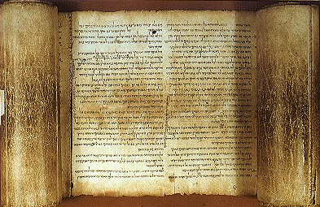


弥迦书
Judgment for Exploitation
Judgment for Exploitation
Dr. Rick Griffith • 博士 • 新加坡神学院 • BibleStudyDownloads.org

Slide 2
关键字
615
343
剥削
弥迦

Slide 3
主题
308
以色列和犹大的宣判
弥迦

Slide 4
关键节
615
"世人哪！耶和华已经指示你甚么是善，
他向你所要的又是甚么；
无非是要你行公义，好怜悯，
谦虚谨慎与你的 神同行。"
(弥迦 6:8).
弥迦

Slide 5

弥迦国度声明
343
以色列民欺压穷人，而遭到上帝的审判，当他们悔改后，上帝就会在弥赛亚的国度中祝福他们（2：12-13; 4：1-5：15; 7：7-20）。

Slide 6

弥迦书
信息声明
615
346
上帝控告以色列和犹大的罪恶和对穷人的剥削，并宣告在被掳期间的审判，以期他们可以悔改，并应许赦免以及在救主弥赛亚之下国度的祝福，以实现对亚伯拉罕之约。

Slide 7

圣约
347d
弥迦忽视了摩西之约的律例，但最终还是获得亚伯拉罕之约的祝福。（2：12-13; 4-5; 7：7-20）。
弥迦

Slide 8

救赎
347d
上帝将遵循犹大罪的惩罚与流亡的救赎
（4:10; 5：6），伴随着出埃及记中的奇事（7:15）。
弥迦

Slide 9

弥赛亚
347d
尽管是永恒的，弥赛亚将出生在伯利恒（5：2），后来将以正义统治世界（2：12-13; 4：1-8; 5：4-5）。
弥迦

Slide 10

本书结构
弥迦 hk'ymi
615
Judgment on Israel and Judah for Exploitation
以色列和犹大的宣判
以色列的罪行
领导层的罪行
假先知与祭司的罪行
第一，二章
“你们要听…” (1:2)
第三至五章
“你们要听…” (3:1)
第六，七章
“当听耶和华的话” (6:1)
刑罚与祝福
刑罚与祝福
刑罚与祝福
贪财
(2:1-2, 8-12)
贪财
(3:1-3, 9-11)
贪财
(6:10-12; 7:16)
对犹大和以色列的宣判
1:2-16
对压迫穷人的报应
2:1-11
招聚以色列剩下的人
2:12-13
宣布领导层的罪行
Chap 3
预言基督千禧年的国度
4–5
谴责假先知与祭司的罪行6:1-8
假先知与祭司的罪行
6:9–7:6
神为救恩之源
7:7-20
以色列与犹大
主前735-710 (以色列亡国时及亡国前后期）

Slide 11
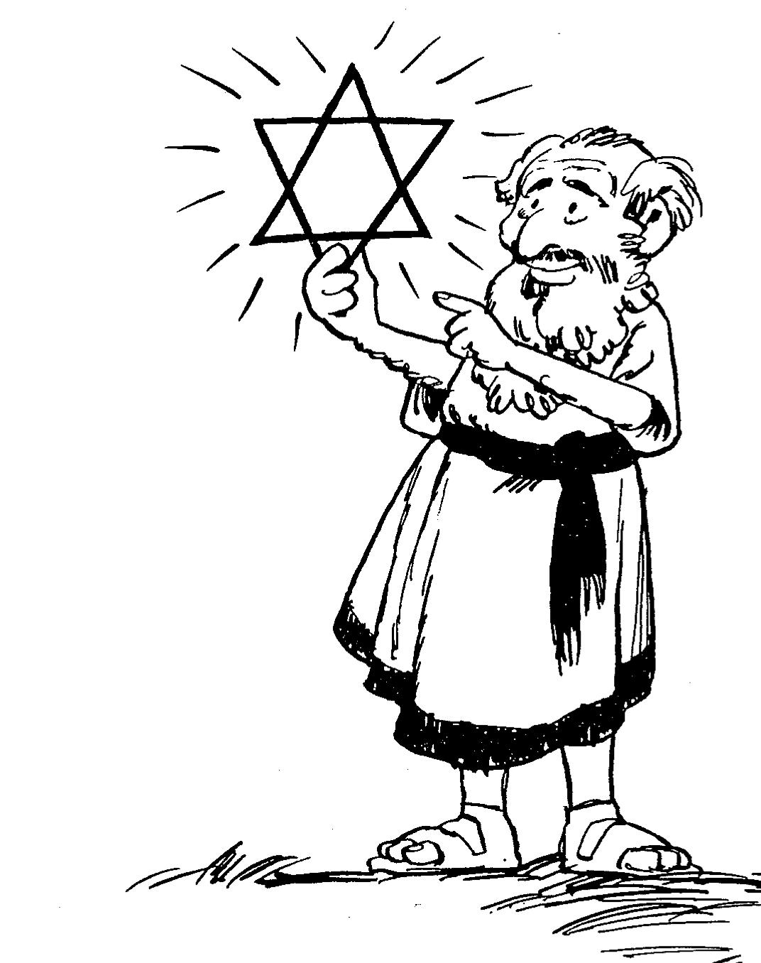
Barry Huddleston, The Acrostic Summarized Bible (Grand Rapids: Baker, 1992)
弥迦书
1 Messages against Samaria, Jerusalem
2 Evils of Israel's people
3 Sins of Israel's leaders
4 Sovereign king in Zion
5 Introduction of Bethlehem's Messiah
6 Actions of injustice rebuked
7 Hope in God's future

Slide 12

作个慷慨的人
弥迦
Dr. Rick Griffith, Crossroads International Church Singapore
BibleStudyDownloads.org

Slide 13
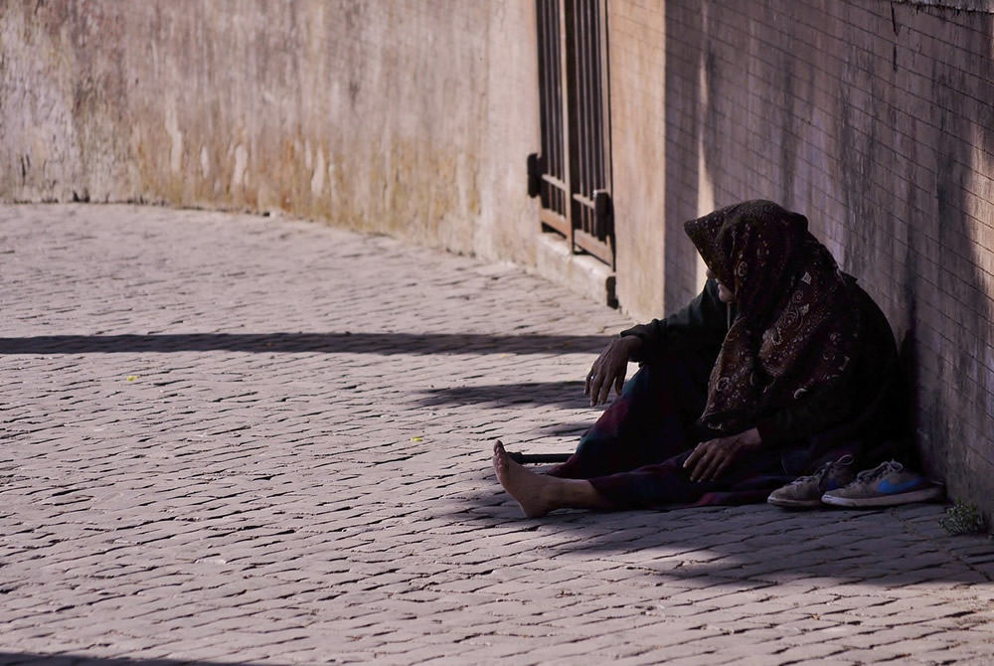
为什么上帝希望
你对穷人慷慨？

Slide 14
弥迦的三个讲章
“ 听！”
(1:2)
一。 上帝会慷慨的
奖励
(弥迦 1–2).
为什么你应该慷慨

Slide 15
弥迦的三个讲章
二。 上帝安慰慷慨的（3-5）
“ 听！”
(1:2)
“ 听！”
(3:1)
为什么你应该慷慨

Slide 16
弥迦的三个讲章
三。上帝给慷慨的人带来希望（6-7）。
“ 听！”
(1:2)
“ 听！”
(3:1)
“ 听！”
(6:1)
为什么你应该慷慨

Slide 17
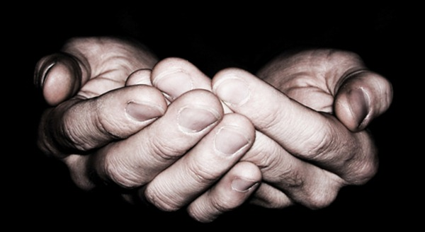
重点
对别人慷慨，
上帝同样会对你慷慨。

Slide 18

你能怎么更好地帮助
那些比你贫穷的人呢？

Slide 19

.不要麻木你的心。

Slide 20
Black

Slide 21

Interesting Facts

Slide 22
谁写？关于谁?
341
向犹大、以色列、以东、以及亚述宣讲的先知
犹大 | 以色列 | 以东 | 亚述
被掳前—犹大 约珥 以赛亚 弥迦 耶利米 哈巴谷 西番雅 | 何西阿 阿摩斯 | 俄巴底亚 | 约拿 那鸿
被掳中—巴比伦 以西结 但以理
被掳后—耶路撒冷 哈该 撒迦利亚 玛拉基
Bible Knowledge Commentary, 1:1027
Notes:
22

Slide 23
內证
弥迦1:1 就描写了这本书的作者，著作时代，著作的原意与目的。

Slide 24
弥迦的名有何意义 hk‘ymi?
关于弥迦
弥迦与米该亚革
乃是这本书的希腊与拉丁语
这是速写 Why>k‘m (7：18米该亚革的意思是“谁能像耶和华？”)

Slide 25
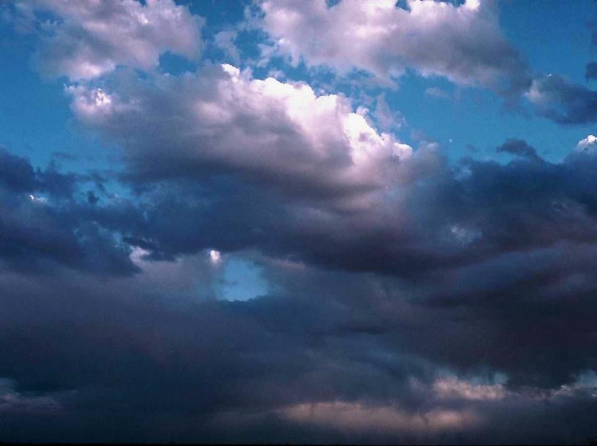
歌词取自弥迦书7:18
有谁能像你？（Who Is There Like You?）
哦主，有谁能像你？
在你形象中造了我们
哦主，有谁能像你？
敬拜你是我们一生所求
我们向大能者高举手
昔在今在永在全能者我们向大能者高举手
谁能与你相比？

Slide 26
日期
弥迦是当犹大王约坦（ 739-731 ）、亚哈斯（735－715）、希西家（715－686）在位的时候，得耶和华的默示
当先知的日期是主前735-710

Slide 27

弥迦当先知的任期
被掳至巴比伦主前722年
耶稣
主前4年
南北国分裂
主前931年
希西家作王至主前687年
大卫
主前1000年
约坦王
主前750年
任期

Slide 28

Chart of OT Kings & Prophets
232 & 342

Slide 29
在正典里的排位？
关于弥迦
从写作的时间
在希腊文正典里的十二小先知书当中排名第六
在七十士译本里排名第三

Slide 30
论以色列的罪，审判与复兴
关于弥迦
这本书里三分之一论以色列的罪恶，三分之一论上帝将会施行的审判，三分之一论刑法后的复兴

Slide 31
背景
(王下15:32-19:37; 代下 27:1-32:23)
经济繁荣
内政腐败－社会败坏
异教崇拜
亚述的威胁

Slide 32
作个慷慨的人
弥迦
Dr. Rick Griffith, Crossroads International Church Singapore
BibleStudyDownloads.org

Slide 33
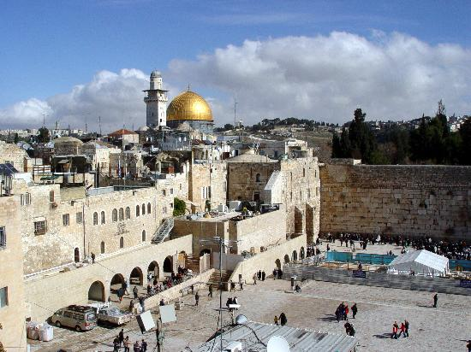
Jerusalem
December 1995
Notes:
God met me in Jerusalem in December 1995.
You see, at that time I had served on the faculty of Singapore Bible College for four years and I started teaching some courses for the fourth time––that can lose its challenge.
But the chance came to lead trips to Israel. I'd never been there before, but 25 daring souls braved to pay the $3000 to come with me.
But at the antiquities shop in Jerusalem I was stunned to see one of my tour members argue with the shop owner about the price of an artifact. "What? You want $20? I saw this for $18 down the street!"
I was so embarrassed that I left the shop, sat down on the curb, and pouted like Elijah. "What are you doing here, Rick?" I sensed God say to me (not audibly, yet still real).
"Lord, I'm bringing Your people to Your land to get to know Your Word."
"No, you're not," I sensed God saying to me. "You can't afford to come Israel so you rounded up 25 wealthy people to pay your way."
Then it struck me how little time Jesus spent in Jerusalem. Sure, he was a faithful Jew who made the required pilgrimages three times a year––and he spent the last week of his life in Jerusalem since he came there to die. But Jesus wasn't impressed with the wealth and power of Jerusalem.
Instead, he wanted to change the world through the poor. Jesus said that he had come to preach the gospel to the poor. And, as I thought about it, I realized that Jesus spent most of his ministry up in the poor north, in Galilee. He spent his time and energy in what people considered to be the place for roughnecks and insurrectionists.
Then I thought about the students that I had at SBC up to that point. I realized that the ones who came from the wealthy churches had to return back to their wealthy churches to pay back these churches for their support during seminary.
However, the ones from the poor countries returned to their countries had a tremendous impact for the cause of Christ.
So I said to the Lord, "OK, Lord, what do you want me to do? Where do you want me to go?"

Slide 34
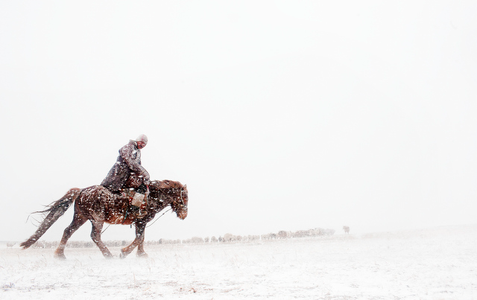
Mongolia
December 1995
Notes:
Then God put on my mind Mongolia. "Mongolia? Are you telling me to go to Outer Mongolia? I don't know a soul in Mongolia!"

Slide 35
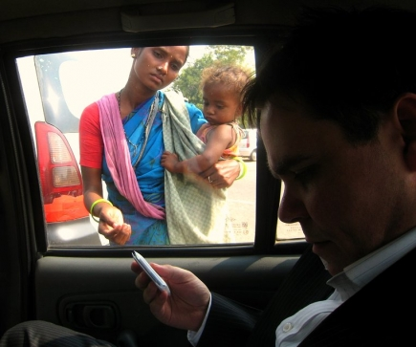
To what extent has your money insulated you?
Notes:
How much time do you devote to your possessions?
Do you own things—or do things own you?
Do you have more friends with less money than you now than you had five years ago?
What goals do you have to use your money for the poor?
Do you believe God wants you to be generous to the poor? He certainly does!

Slide 36
为什么上帝希望
你对穷人慷慨？

Slide 37

Background

Slide 38

THE
MINOR
PROPHETS

Slide 39
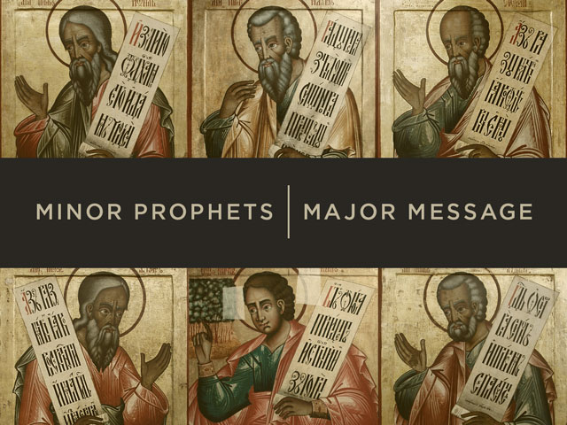
Minor Prophets | Major Message

Slide 40
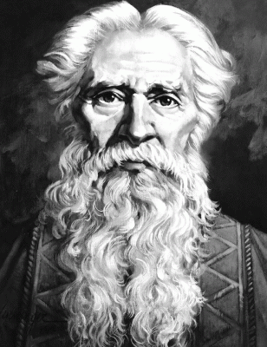
作者
Interesting Facts
616
摩利沙人弥迦

Slide 41

The split in 1 Kings would soon leave Judah as the Survivng Kingdom

Slide 42
Chart of OT Kings & Prophets
232 & 342

Slide 43
亚述威胁
亚述膨胀
尼尼微
地中海
亚兰
以色列
犹太
波斯湾
埃及

Slide 44
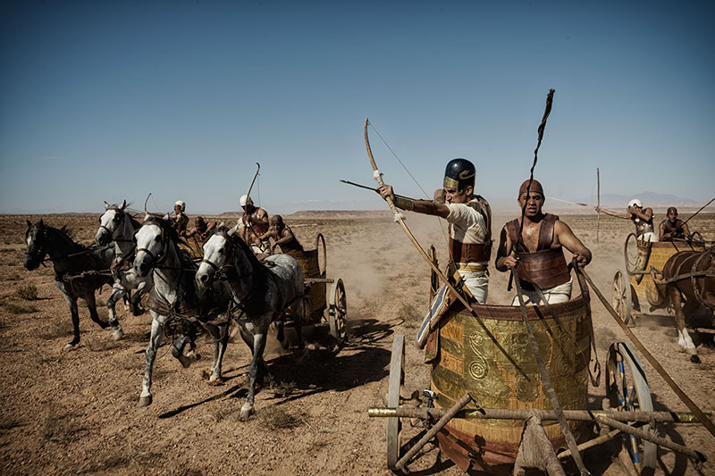
Assyrians conquered Israel in 弥迦’s Time

Slide 45
When Hosea, Isaiah & 弥迦 Wrote
453
End of the
Kings of Israel
Pekah
Hoshea
Kings of Judah
Uzziah
Jotham
Ahaz
Hezekiah
Isaiah's 60-Year Ministry
(739-680 BC)
Notes:
45

Slide 46
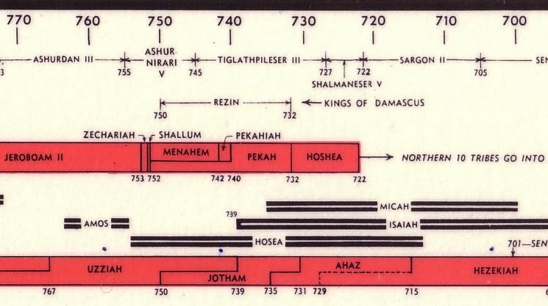
OT Kings & Prophets at Israel's Fall
232 & 342
John C. Whitcomb, 4th ed. (Winona Lake, IN: BMH Books, 1968), 2
HIM = Hosea + Isaiah + 弥迦

Slide 47
弥迦的三个讲章
“ 听！”
(1:2)
“ 听！”
(3:1)
“ 听！”
(6:1)
为什么你应该慷慨
Notes:
Today will have an overview of the whole book of 弥迦 where we’ll see three reasons to be generous. These will appear in three sermons in 弥迦’s prophecy, each that begins with the word “Listen!”

Slide 48

Keep in mind...
Notes:
In essence he says three times to have a heart for the poor—but there are also three benefits to us as well.

Slide 49
Slides on
弥迦 1

Slide 50
弥迦的三个讲章
“ 听！”
(1:2)
一。 上帝会慷慨的
奖励
(弥迦 1–2).
为什么你应该慷慨

Slide 51
弥迦的结构
620
审判
1:1-7
• 上帝
• 弥迦
希望
• 上帝
• 弥迦
Adapted from Homer Heater, Dallas Seminary

Slide 52
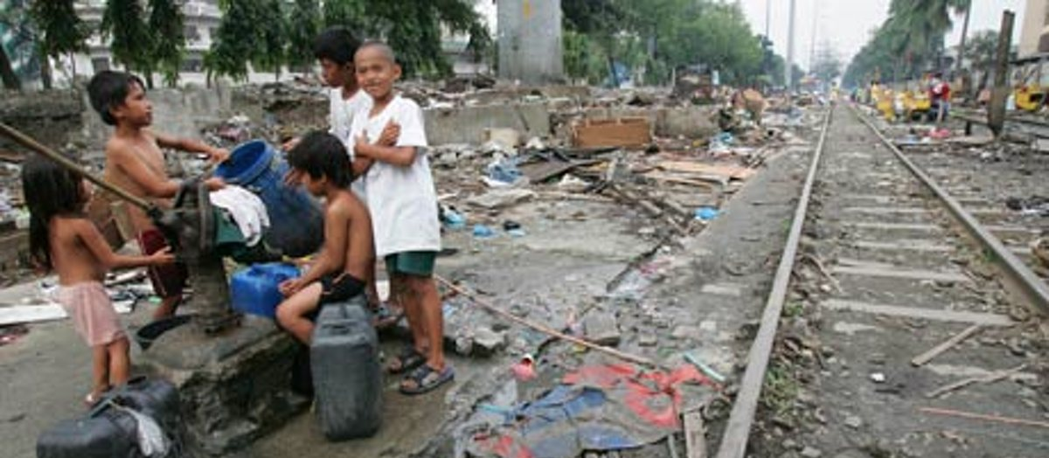
"万民哪！你们都要听；
地和地上所遍满的，你们要聆听；
主耶和华要指证你们的不是，
主必从他的圣殿指证你们的不是。"
(1:2 CNV).

Slide 53
看哪！ 耶和华离开自己的地方，他降下来，踏在地的高处。 4 群山在他脚下融化，众谷裂开，
如蜡在火前一般，
像水冲下斜坡一般
(弥迦 1:3-4 CNV).

Slide 54
这都是因为雅各的过犯，以色列家的罪恶。
雅各的过犯是甚么呢？
不就是撒玛利亚吗？
犹大家的罪恶是甚么呢？
不就是耶路撒冷吗？
撒玛利亚的刑罚
6 所以我必使撒玛利亚变成田间的废堆，
作栽种葡萄之处；
我必把撒玛利亚的石头倒在谷中，
连它的根基都露出来。
(弥迦 1:5-6 CNV).

Slide 55
它一切雕刻的偶像必被打碎；它全部的钱财，都要用火烧尽；
它所有的偶像，我都要毁灭；
因为从妓女钱财榨取的，
最后也必归为妓女的钱财。
犹大的刑罚
(弥迦 1:7 CNV).

Slide 56
为此我要痛哭哀号，赤膊光脚而行；
又要哀号如豺狼，
悲鸣像鸵鸟。
(弥迦 1:8 CNV).

Slide 57
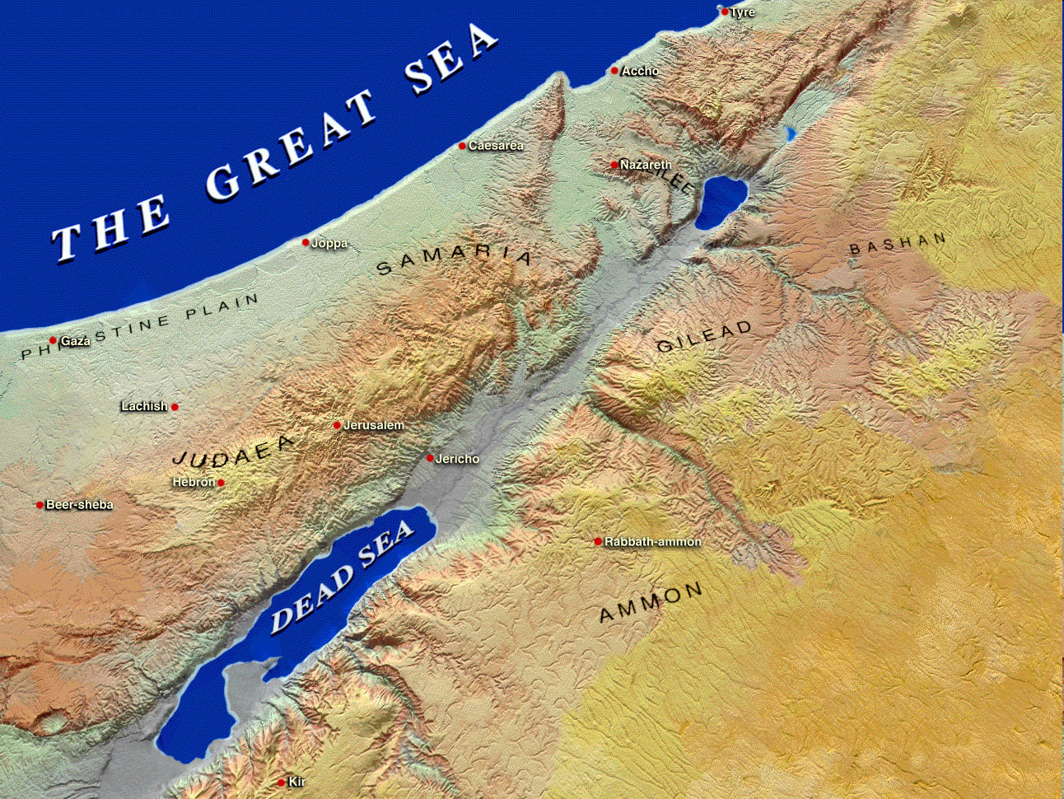
Moresheth-gath
以色列
撒玛利亚
"所以我必使撒玛利亚变成田间的废堆…" (1:6)
犹大
耶路撒冷
"犹大啊！为你所喜爱的儿女，
你要剃头，使你的头光秃，
完全光秃如同秃鹰；
因为他们都从你那里被掳去了。" (1:16).

Slide 58
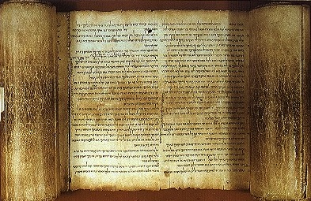
hk'ymi 弥迦's Lament
Judgment for Exploitation
Judgment for Exploitation
hk'ymi 弥迦

Slide 59
弥迦的结构
620
审判
1:1-7
• 上帝
"为此我要痛哭哀号，
赤膊光脚而行；
又要哀号如豺狼，
悲鸣像鸵鸟。"
(1:8 CNV).
• 弥迦
1:8-16
希望
• 上帝
• 弥迦
Adapted from Homer Heater, Dallas Seminary

Slide 60
关键字
615
343
剥削
弥迦

Slide 61
Slides on
弥迦 2

Slide 62
弥迦的结构
620
审判
1:1-7
2:1-5
• 上帝
• 弥迦
1:8-16
希望
• 上帝
• 弥迦
Adapted from Homer Heater, Dallas Seminary

Slide 63
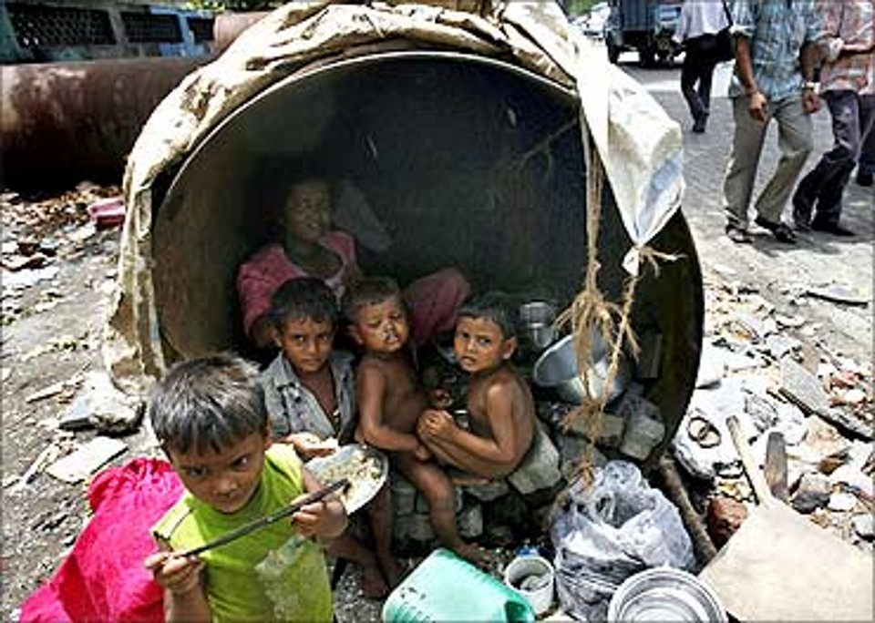
"那些在床上图谋不义，
并且行恶的人有祸了！
因为他们的手有力量，
天一亮，就作出来了。
他们要田地，就去抢夺；
想要房屋，就去强取。
他们欺压人和他的家眷，
取人和人的产业。"
(2:1-2 CNV).

Slide 64
因此耶和华这样说：看哪！ 我策划灾祸攻击这家族，
你们无法缩起颈项避开这灾祸。
你们不能昂首而行（“昂首而行” 或译：“高视阔步”）；
因为这是个灾难的时代。
(弥迦 2:3 CNV).

Slide 65
到那日，必有人作歌讽刺你们，
唱悲伤的哀歌，说：
“我们彻底被毁灭了，
我子民分内的产业，他竟转给别人了；
他怎可从我这里挪去，
把我们的田地分给掳掠我们的人
（“分给掳掠我们的人” 或译：“分给背道的人”） ！”
5因此你在耶和华的会众中，
必没有抽籤拉准绳的人了。
攻击先知的话
(弥迦 2:4-5 CNV).

Slide 66
弥迦的结构
620
审判
1:1-7
2:1-5
• 上帝
• 弥迦
1:8-16
2:6-11
希望
• 上帝
• 弥迦
Adapted from Homer Heater, Dallas Seminary

Slide 67
有人预言说：“你们不要说预言；人不可预言这些事；
羞耻不会临到我们。”
(弥迦 2:6 CNV).

Slide 68
雅各家啊！
人怎可说：“耶和华的心着急
（“耶和华的心着急” 直译作“耶和华的灵是短的吗”），
不能忍耐呢？
这些是他的作为吗？”
我耶和华的话对行事正直的人不是有益的吗？
(弥迦 2:7 CNV).

Slide 69
你们却像仇敌一样，起来攻击我的子民
（“你们却像仇敌一样，
起来攻击我的子民” 或译：
“然而，我的子民竟兴起来像仇敌一样”）；
你们竟从安详过路的人身上剥去衣服，
从不愿作战的人身上剥去外衣。
(弥迦 2:8 CNV).

Slide 70
你们把我民中的妇女赶逐，离开欢乐的家园；
你们把我的尊荣，从她们的婴孩身上夺去，
直到永远。
(弥迦 2:9 CNV).

Slide 71
起来，走吧！
这不是你们安息之地；
你们因为不洁净的缘故，
必被毁灭，
是不可挽救的毁灭。 11 若有人随从虚假的心，撒谎说：
“我要向你们说清酒和烈酒的预言。”
那人就是这民的预言家了。
(弥迦 2:10-11 CNV).

Slide 72
弥迦的结构
620
审判
1:1-7
2:1-5
• 上帝
• 弥迦
1:8-16
2:6-11
希望
2:12-
13
• 上帝
• 弥迦
Adapted from Homer Heater, Dallas Seminary

Slide 73
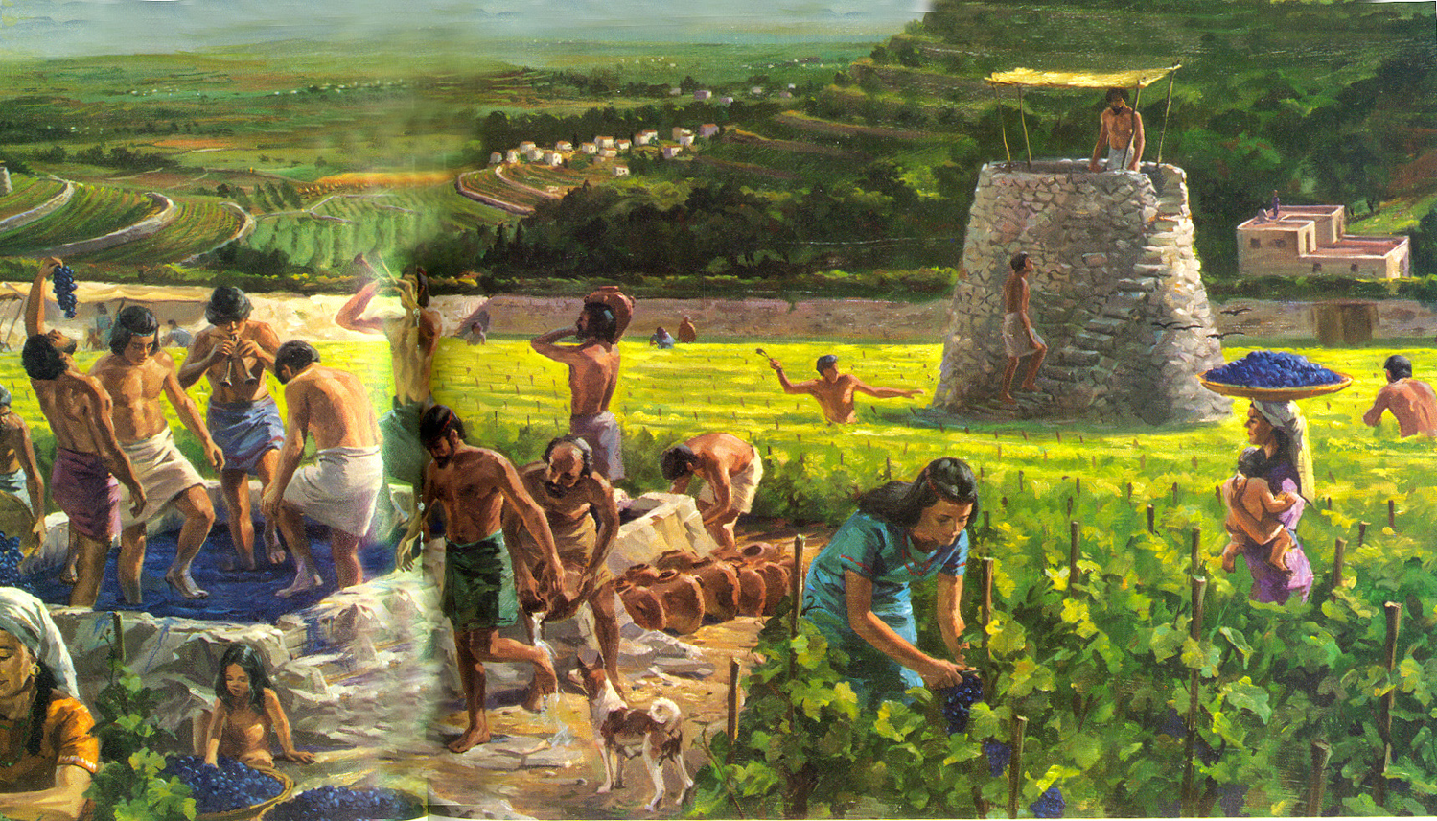
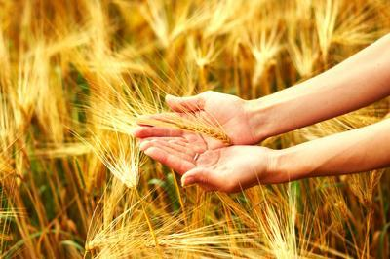

“雅各家啊！我必召集你们所有的人，
聚集以色列的余民；
我要把他们安置在一起，像羊在羊圈里，
像群羊远离了人，在草场上喧哗。”
(弥迦 2:12 CNV).

Slide 74
“开路的人领先上去；
他们开路，闯门进入，又从门里出来；
他们的王在他们面前走过，
耶和华领导他们。” (弥迦 2:13 CNV).

Slide 75
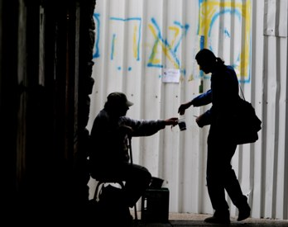
What about us?
God will judge or bless us based on how we treat the poor.

Slide 76

教导事工 1997-2016
蒙古
约旦
韩国
中国
尼泊尔
缅甸
印度
泰国
越南
马来西亚
斯里兰卡
新加坡
新神
印尼
Notes:
From 1997-July 2016 God has seen fit to grant me the privilege to train pastors in 12 other countries on 58 trips. Often pastors in the US team-teach with me on these trips.

Slide 77

Dies den Engelsen

Slide 78

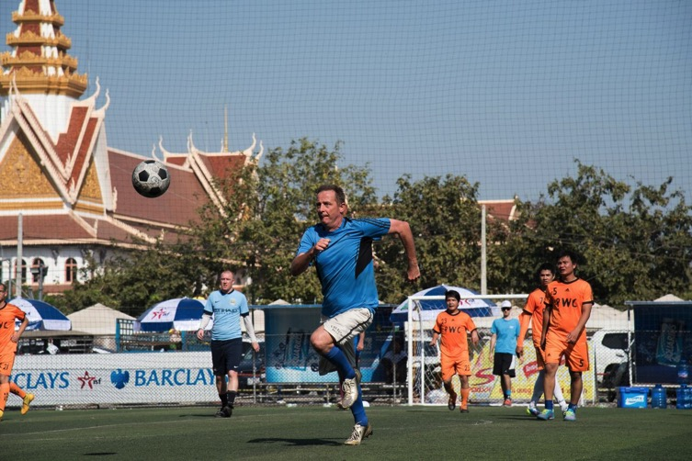

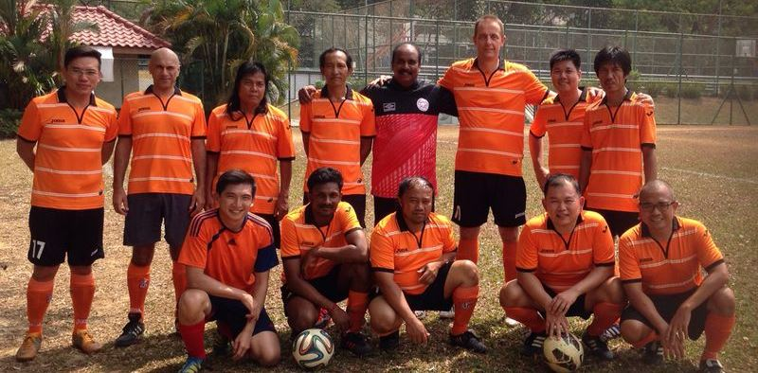

Slide 79








最爱的足球队？
Chak Kropop Po Mongkol

Slide 80


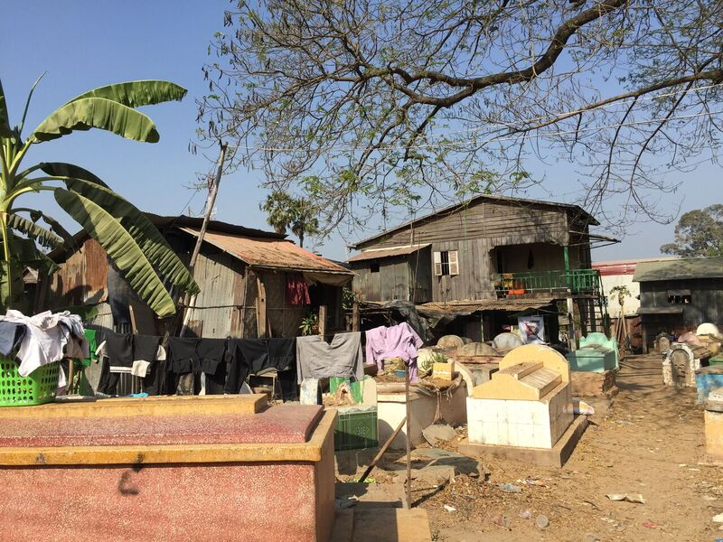
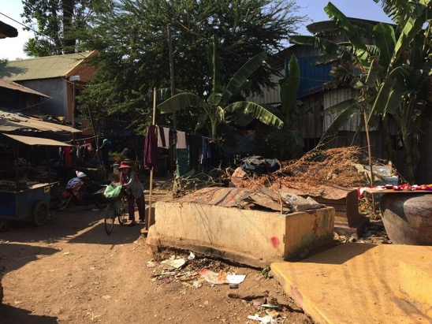
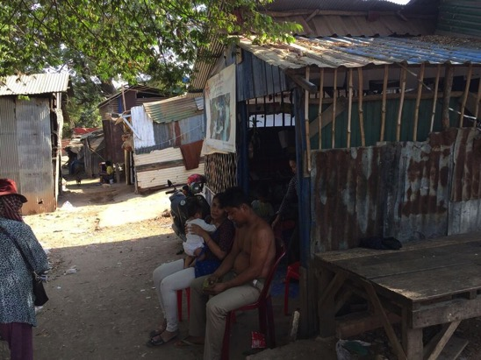

Slide 81

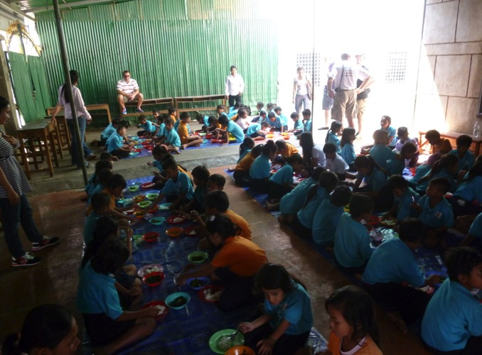
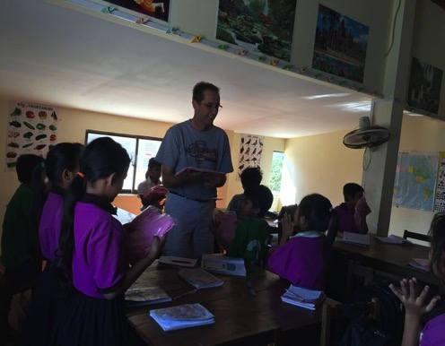
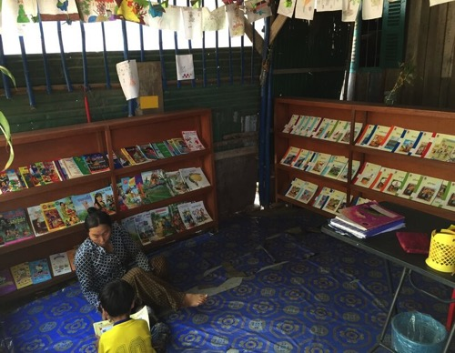

Indochina Starfish Foundation
Education
Medical Care
Nutritious food
School Uniforms
Incentive to the family
Community Service

Slide 82

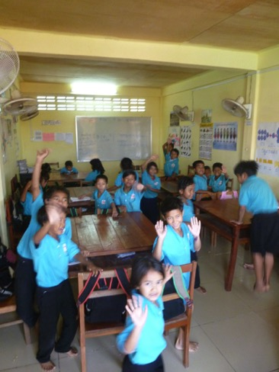
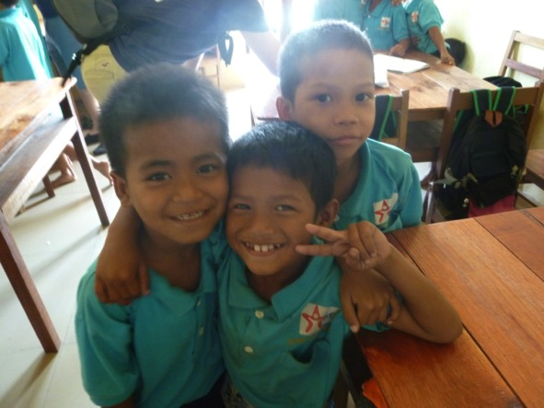
Integration
into
Cambodian Society

Slide 83

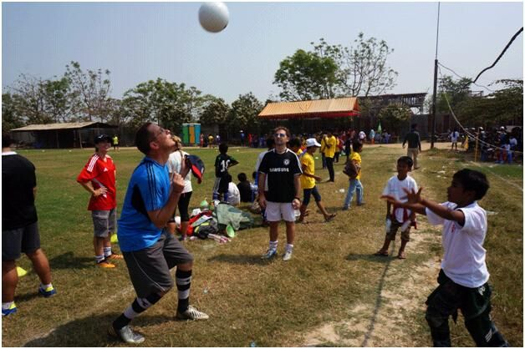

?

Slide 84


Slide 85
Back To Rick
and the Sermon on 弥迦

Slide 86

Get others out of their bind.

Slide 87
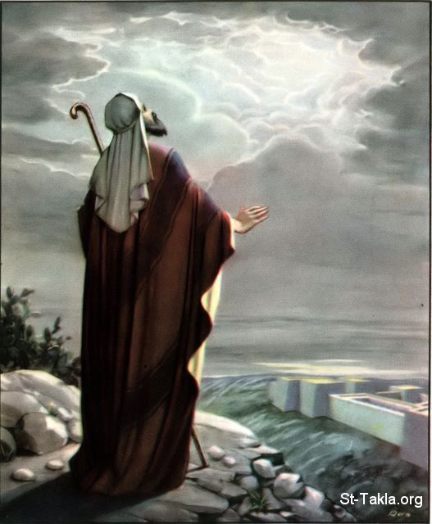
Foretelling Emphasis
Interesting Facts
616
弥迦 has one of the highest foretelling proportions of the prophetic books (70% of the content). It predicts:
the falls of Samaria and Jerusalem
the future restoration via a remnant leading into the messianic age

Slide 88

Problems & Tips in Interpreting Prophecy
438
Inaccurate Presuppositions
Prophets were mainly covenant enforcers based on the Mosaic law
Ethical
Forthtelling
Mosaic Covenant
Predictive
Foretelling
Abrahamic Covenant

Slide 89
The Prophetic Message
438
The prophets were not pushovers. They went against the tide to preach the word of Yahweh to a rebellious nation.

Slide 90
The Prophetic Message
The Prophetic Message
A major concern posed by the prophets was idolatry.
But they also had social and economic concerns.
They spoke pronouncements of judgments to steer the nation away from the curses.

Slide 91
弥迦的三个讲章
“ 听！”
(1:2)
一。 上帝会慷慨的
奖励
(弥迦 1–2).
为什么你应该慷慨

Slide 92
弥迦的三个讲章
二。 上帝安慰慷慨的（3-5）
“ 听！”
(1:2)
“ 听！”
(3:1)
为什么你应该慷慨

Slide 93
Slides on
弥迦 3

Slide 94
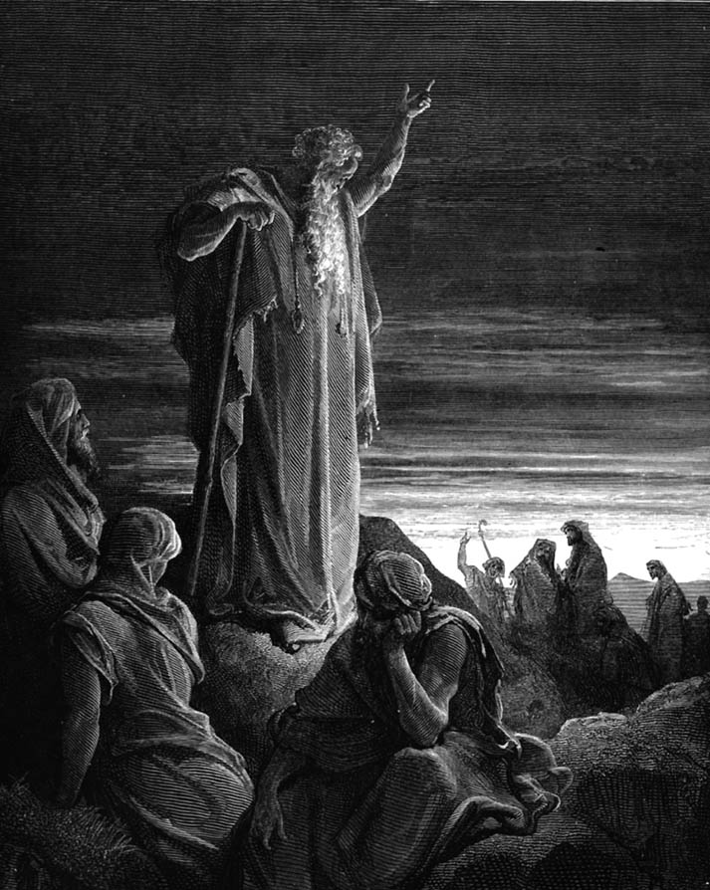
弥迦勇敢的宣告神的话
Judgment for Exploitation
Judgment for Exploitation
hk'ymi 弥迦

Slide 95
弥迦的结构
620
审判
1:1-7
2:1-5
3:1-4
• 上帝
• 弥迦
1:8-16
2:6-11
希望
2:12-
13
• 上帝
• 弥迦
Adapted from Homer Heater, Dallas Seminary

Slide 96
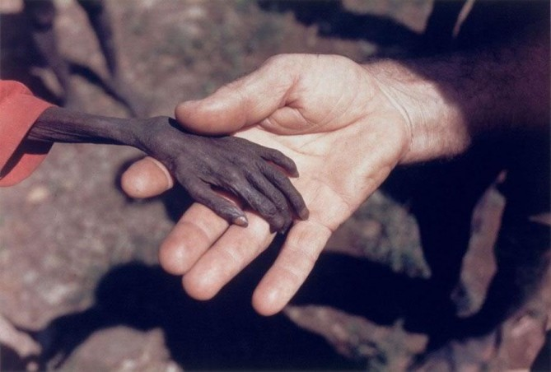
弥迦 Taught Compassion
Notes:
Here the hand of a missionary reaches out to a starving boy

Slide 97
弥迦是贫穷与被欺压者的先知
关于弥迦
616
这书里所列的罪恶有:
Oppression (2:1-2)
Bribery in judges, prophets & priests (3:11)
Exploitation of the powerless (3:2-3)
Covetousness (2:8-9)
Cheating (3:9)
Violence (3:10)
Pride (1:16; 2:6)

Slide 98
弥迦的结构
620
审判
1:1-7
2:1-5
3:1-4
• 上帝
• 弥迦
1:8-16
2:6-11
3:5-12
希望
2:12-
13
• 上帝
• 弥迦
Adapted from Homer Heater, Dallas Seminary

Slide 99
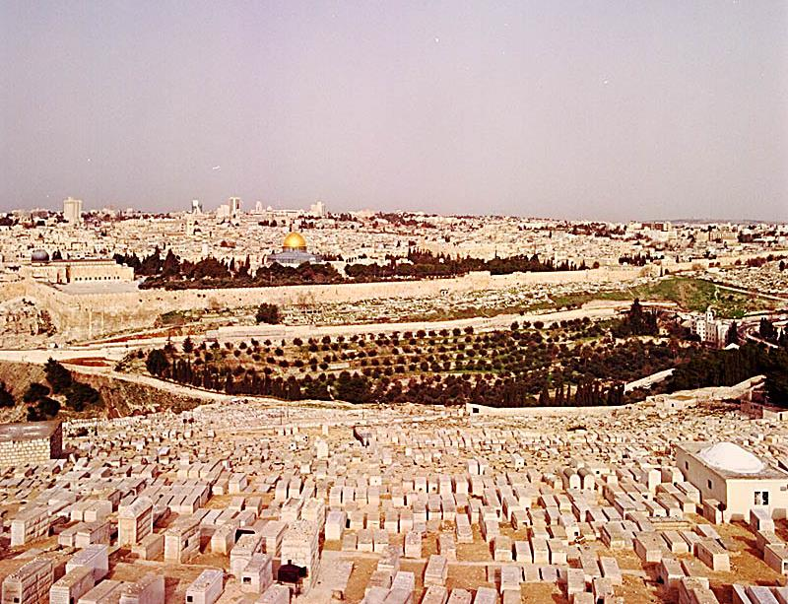
弥迦书3:12 耶路撒冷的毁灭
当犹大王希西家的日子，有摩利沙人弥迦对犹大众人预言说，‘万军之耶和华如此说：锡安必被耕种象一块田，耶路撒冷必变为乱堆；这殿的山必象丛林的高处。’
耶利米书26:18

Slide 100
Slides on
弥迦 4

Slide 101
弥迦的结构
620
审判
1:1-7
2:1-5
3:1-4
• 上帝
• 弥迦
1:8-16
2:6-11
3:5-12
希望
2:12-
13
4:1–5:15
• 上帝
• 弥迦
Adapted from Homer Heater, Dallas Seminary

Slide 102
Barry Huddleston, The Acrostic Summarized Bible (Grand Rapids: Baker, 1992)
弥迦
1 Messages against Samaria, Jerusalem
2 Evils of Israel's people
3 Sins of Israel's leaders
4 Sovereign king in Zion
5 Introduction of Bethlehem's Messiah
6 Actions of injustice rebuked
7 Hope in God's future

Slide 103
认定先知任期
h
弥迦
主前740-700
以色列国
（分裂后）
930-722
以色列国（分裂前）1050-930
犹大王国
722-586
被掳后
536-425
1100
1050
1000
950
900
850
800
7 5 0
7 0 0
650
600
550
500
450
被掳 586-536

Slide 104
弥迦书和以赛亚书相似之处
616
完全相似的平行
强调弥撒亚
写于耶路撒冷
写作关于以色列和犹大
影响了西西家
强调国度
当代性

Slide 105

千年耶路撒冷 (以赛亚)
106
“训诲必出于锡安, 耶和华的言语, 必出于耶路撒冷。”
- 以赛亚书 2:3

Slide 106
千年耶路撒冷 (弥迦)
106
"因为教训必出于锡安。
耶和华的话要来自耶路撒冷。"
––弥迦 4:2

Slide 107
谁抄袭谁？
以赛亚书2：2 末后的日子，耶和华殿的山必坚立，超乎诸山，高举过于万岭。万民都要流归这山。
弥迦书4：1 末后的日子，耶和华殿的山必坚立，超乎诸山，高举过于万岭。万民都要流归这山。
Notes:
107

Slide 108
谁抄袭谁？
以赛亚书2:3 必有多国的人前来，说：“来吧！我们上耶和华的山，登雅各 神的殿；他必把他的道指教我们，我们也必遵行他的路。”因为训诲必出于锡安，耶和华的话必来自耶路撒冷。
弥迦书4 :2 必有多国的民 前往，说，来吧，我们登耶和华的山，奔雅各神的殿。主必将他的道教训我们，我们也要行他的路。因为训诲必出于锡安，耶和华的言语必出于耶路撒冷。
Notes:
108

Slide 109
谁抄袭谁？
以赛亚书2:4 他必在列国中施行审判，为许多国民断定是非。他们要将刀打成犁头，把枪打成镰刀。这国不举刀攻击那国，他们也不再学习战事。
弥迦书4:3 他必在多国的民, 中施行审判，为远方强盛的国断定是非。他们要将刀打成犁头，把枪打成镰刀。这国不举刀攻击那国，他们也不再学习战事。
Notes:
109

Slide 110
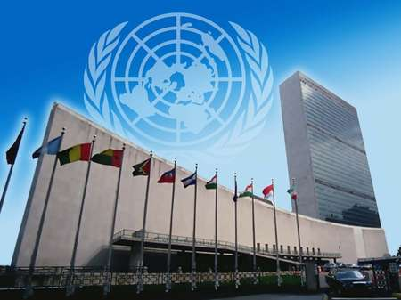
联合国
纽约

Slide 111
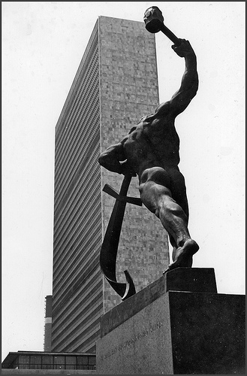
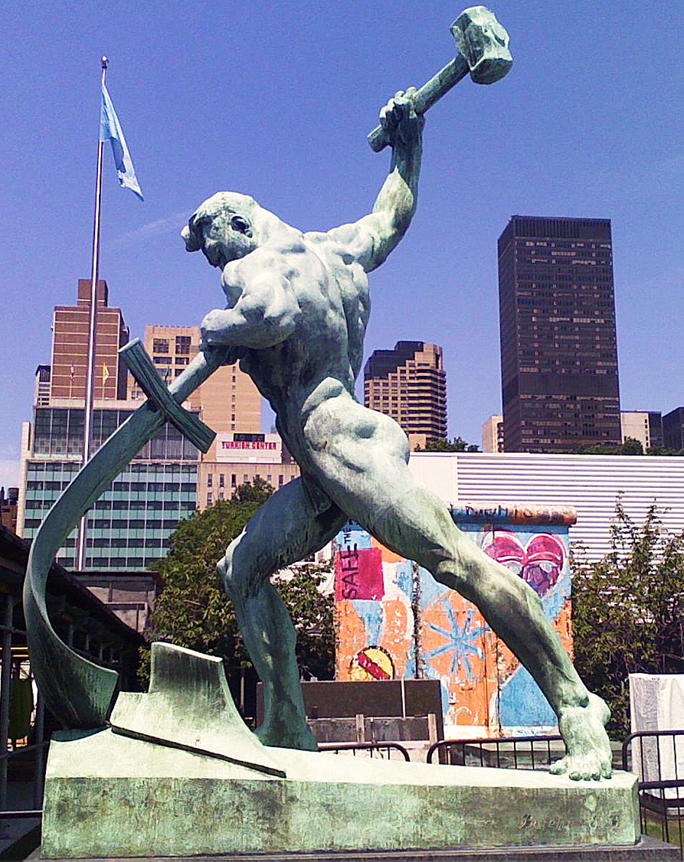
联合国
(纽约)
Notes:
"Let Us Beat Swords into Plowshares
But first...
What is a plowshare?!
A plowshare is part of a plow. It is the leading edge that cuts
into the earth when turning over the dirt.
Let Us Beat Swords into Plowshares was sculpted
by Yevgeny Vuchetich. It was donated to the UN by the USSR in 1959.
The sculpture stands in the garden of the UN Headquarters."
https://sites.google.com/site/cdaunexploration/let-us-beat-swords-into-plowshares
Accessed 8 July 2015

Slide 112
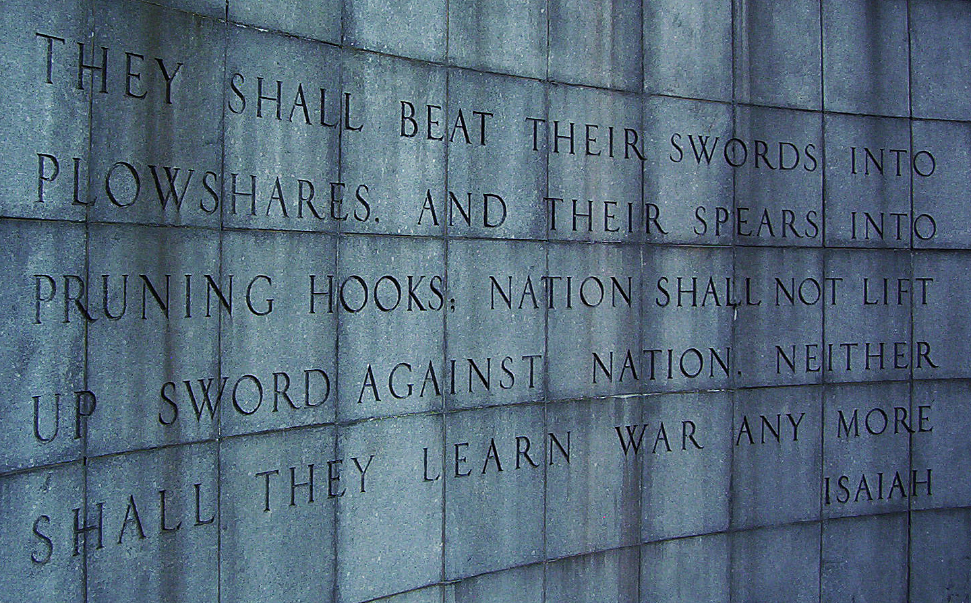
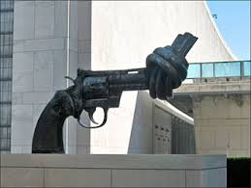
United Nations Building, New York

Slide 113
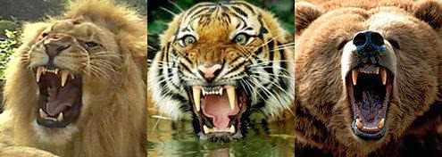
“狮子, 老虎与熊! 哇!"
Notes:
Isaiah 2:6 already noted that people will be at peace with one another in millennium when Jesus rules the earth. Now, in Isaiah 11, he goes way beyond this level of peace even to include the animal kingdom. People understandably fear lions, tigers and bears. They are among the most fierce in the animal kingdom. No wonder Dorothy in The Wizard of Oz proclaimed as they entered the forest, "Lions, tigers and bears! Oh, My!"

Slide 114
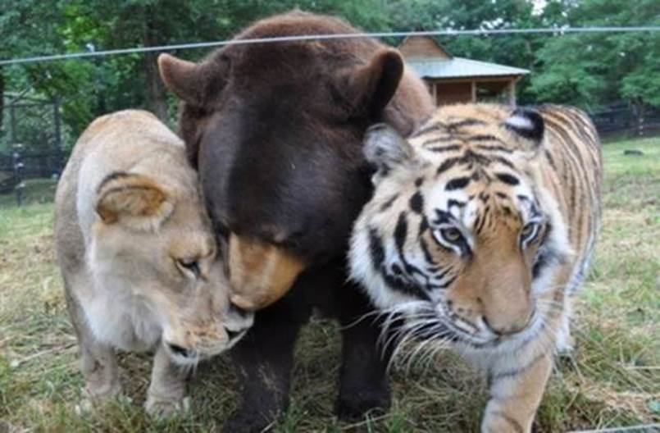
“狮子, 老虎与熊! 哇!"
Notes:
In "The Wizard of Oz," Dorothy exclaims with fear upon thinking that she would have to travel through the forest to get to Oz, "Lions, tigers and bears! Oh, My!" Yes, these are dangerous animals—most of the time!
• We may think that all carnivorous animals must kill to eat, but a peaceful environment even today can be instructive that peace in the animal kingdom doesn’t even have to wait until the millennium.
"An American black bear, a Bengal tiger and an African lion were the victims of animal cruelty...."
________________
How An Abused Lion, Tiger And Bear Became An Unlikely Family (PHOTOS)
The Huffington Post | By Alexandra Zaslow
Posted: 12/03/2013 12:28 pm EST Updated: 12/04/2013 11:57 am EST
http://www.huffingtonpost.com/2013/12/03/lion-tiger-bear-negligence_n_4374091.html
Accessed 30 Sep 2015

Slide 115
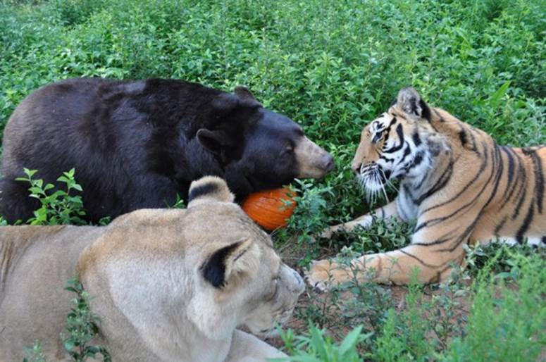
Baloo the Bear, Leo the Lion, and Shere Khan the Tiger (all three known as BLT)
Notes:
"Baloo the bear, Leo the lion, and Shere Khan the tiger (all three known as BLT) were brought together as 2-month-old cubs and have grown up as a family."
_______________
How An Abused Lion, Tiger And Bear Became An Unlikely Family (PHOTOS)
The Huffington Post | By Alexandra Zaslow
Posted: 12/03/2013 12:28 pm EST Updated: 12/04/2013 11:57 am EST
http://www.huffingtonpost.com/2013/12/03/lion-tiger-bear-negligence_n_4374091.html
Accessed 30 Sep 2015

Slide 116
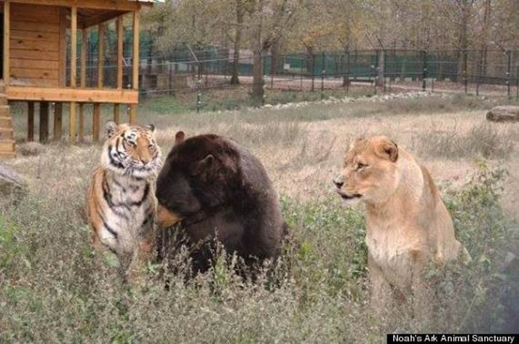
"Lions, Tigers & Bears! Oh, My!"
Notes:
"The trio was originally owned by a drug dealer who didn't properly care for them, leading to neglect, poor health and severe injuries."
_______________
How An Abused Lion, Tiger And Bear Became An Unlikely Family (PHOTOS)
The Huffington Post | By Alexandra Zaslow
Posted: 12/03/2013 12:28 pm EST Updated: 12/04/2013 11:57 am EST
http://www.huffingtonpost.com/2013/12/03/lion-tiger-bear-negligence_n_4374091.html
Accessed 30 Sep 2015

Slide 117
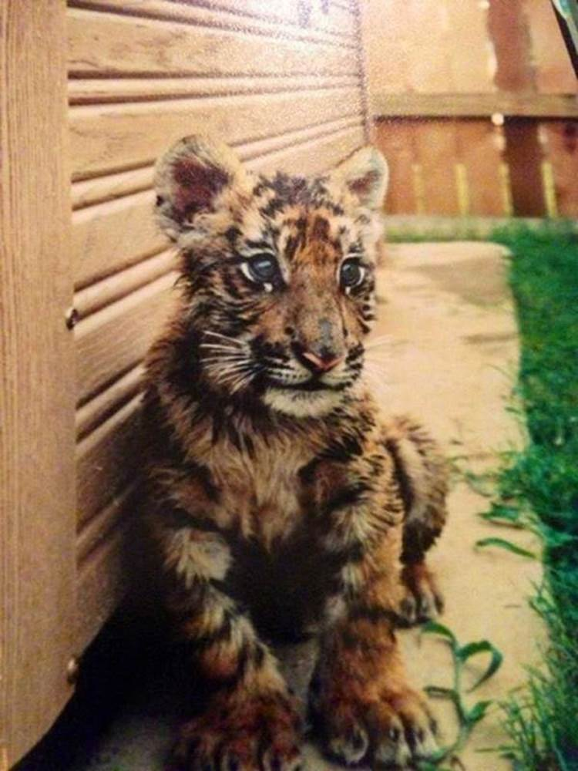
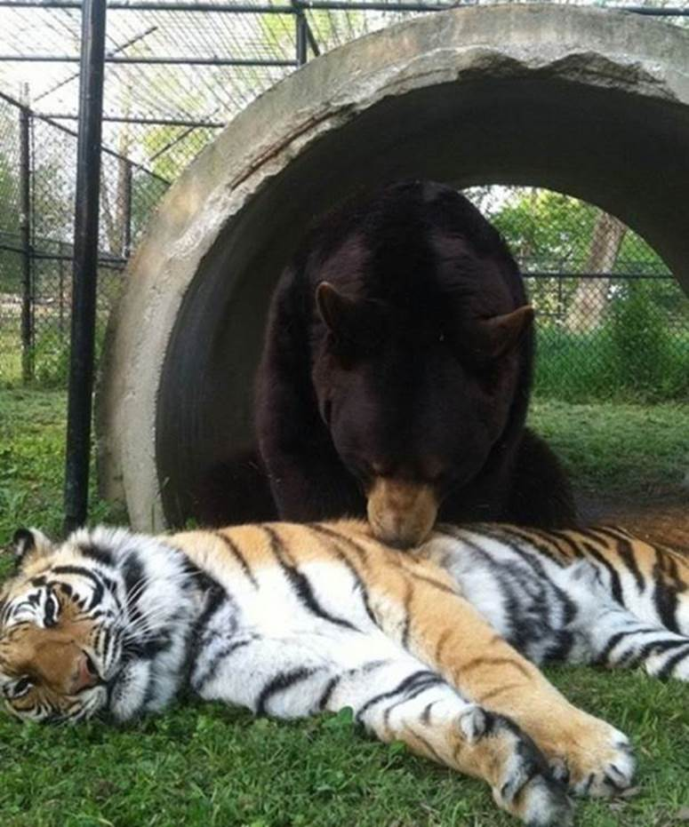
"Lions, Tigers & Bears! Oh, My!"
Notes:
"In 2001, Noah's Ark Animal Sanctuary, a nonprofit that cares for animals in need, came to the rescue, and took them to Locust Grove, Georgia, where they were treated for injuries."
_______________
How An Abused Lion, Tiger And Bear Became An Unlikely Family (PHOTOS)
The Huffington Post | By Alexandra Zaslow
Posted: 12/03/2013 12:28 pm EST Updated: 12/04/2013 11:57 am EST
http://www.huffingtonpost.com/2013/12/03/lion-tiger-bear-negligence_n_4374091.html
Accessed 30 Sep 2015

Slide 118

"Lions, Tigers & Bears! Oh, My!"
Notes:
"We could have separated them," Diane Smith, assistant director of the Noah's Ark Zoo told the Telegraph. "But since they came as a kind of family, the zoo decided to keep them together."
_______________
How An Abused Lion, Tiger And Bear Became An Unlikely Family (PHOTOS)
The Huffington Post | By Alexandra Zaslow
Posted: 12/03/2013 12:28 pm EST Updated: 12/04/2013 11:57 am EST
http://www.huffingtonpost.com/2013/12/03/lion-tiger-bear-negligence_n_4374091.html
Accessed 30 Sep 2015

Slide 119
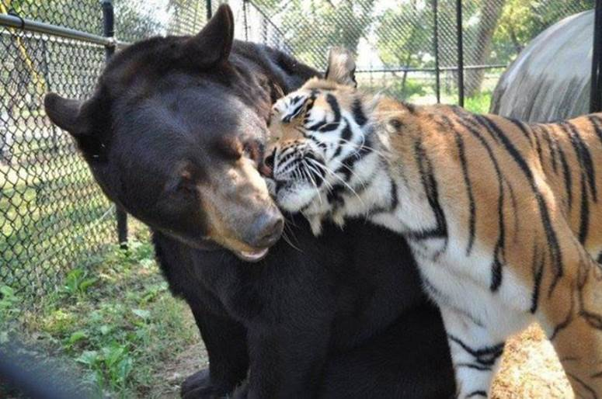
"Lions, Tigers & Bears! Oh, My!"
Notes:
"Baloo required greater care than his two friends -- his former owner had put a harness on him and didn't adjust it as he grew, leading to a deformity, Imgur reports."
_______________
How An Abused Lion, Tiger And Bear Became An Unlikely Family (PHOTOS)
The Huffington Post | By Alexandra Zaslow
Posted: 12/03/2013 12:28 pm EST Updated: 12/04/2013 11:57 am EST
http://www.huffingtonpost.com/2013/12/03/lion-tiger-bear-negligence_n_4374091.html
Accessed 30 Sep 2015

Slide 120
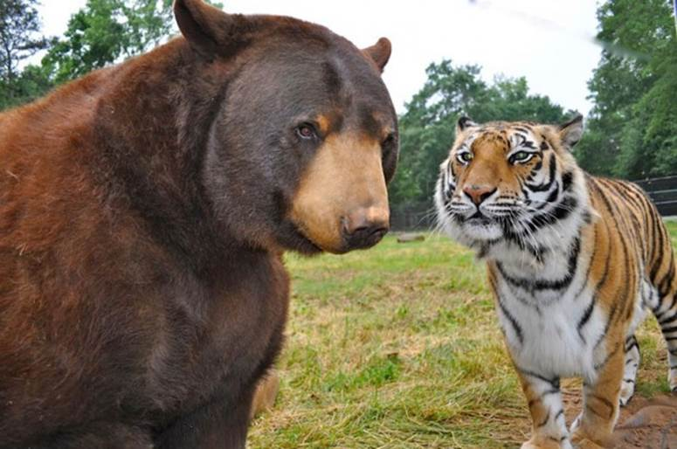
"Lions, Tigers & Bears! Oh, My!"
Notes:
"After arriving in Georgia, Baloo had the harness surgically removed."
_______________
How An Abused Lion, Tiger And Bear Became An Unlikely Family (PHOTOS)
The Huffington Post | By Alexandra Zaslow
Posted: 12/03/2013 12:28 pm EST Updated: 12/04/2013 11:57 am EST
http://www.huffingtonpost.com/2013/12/03/lion-tiger-bear-negligence_n_4374091.html
Accessed 30 Sep 2015

Slide 121
"Lions, Tigers & Bears! Oh, My!"
Notes:
"Given that the trio had found comfort in each other during their years of mistreatment, The Sanctuary's staff realized that they couldn't be separated and fenced them in together."
_______________
How An Abused Lion, Tiger And Bear Became An Unlikely Family (PHOTOS)
The Huffington Post | By Alexandra Zaslow
Posted: 12/03/2013 12:28 pm EST Updated: 12/04/2013 11:57 am EST
http://www.huffingtonpost.com/2013/12/03/lion-tiger-bear-negligence_n_4374091.html
Accessed 30 Sep 2015

Slide 122
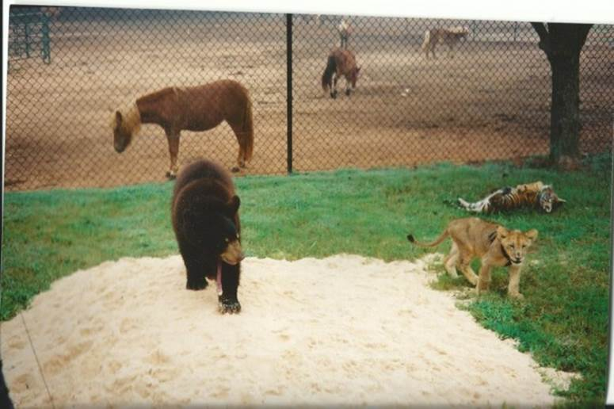
"Lions, Tigers & Bears! Oh, My!"
Notes:
"Unfortunately, the government passed new federal regulations requiring big cat enclosures to have 16 foot fences put up, which would take effect in October of this year. Baloo, Leo and Shere Khan's fence was only 8 feet high. If these regulations weren't met, the three animals would have to split up.
Rebuilding the fence would cost $489,000."
_______________
How An Abused Lion, Tiger And Bear Became An Unlikely Family (PHOTOS)
The Huffington Post | By Alexandra Zaslow
Posted: 12/03/2013 12:28 pm EST Updated: 12/04/2013 11:57 am EST
http://www.huffingtonpost.com/2013/12/03/lion-tiger-bear-negligence_n_4374091.html
Accessed 30 Sep 2015

Slide 123
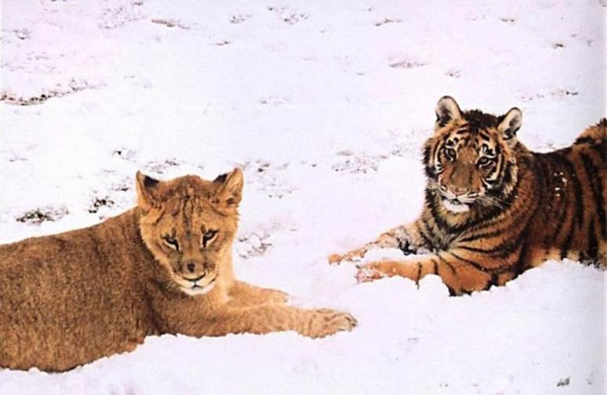
"Lions, Tigers & Bears! Oh, My!"
Notes:
"With October slowly approaching, The Sanctuary entered a contest to help raise money. On August 15, CrowdRise, an online fundraising site, teamed up with RYOT, a social news platform to announce a challenge called #STARTARYOT, according to ncronline.com. They offered $75,000 to the nonprofit that raised the most money in five weeks."
_______________
How An Abused Lion, Tiger And Bear Became An Unlikely Family (PHOTOS)
The Huffington Post | By Alexandra Zaslow
Posted: 12/03/2013 12:28 pm EST Updated: 12/04/2013 11:57 am EST
http://www.huffingtonpost.com/2013/12/03/lion-tiger-bear-negligence_n_4374091.html
Accessed 30 Sep 2015

Slide 124
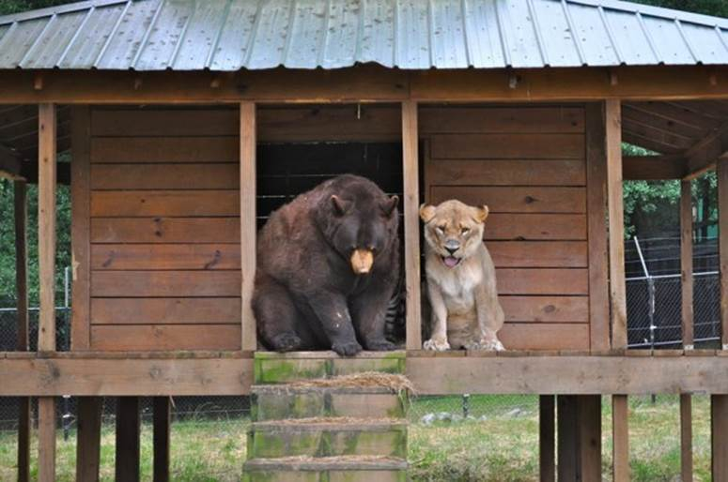
"Lions, Tigers & Bears! Oh, My!"
Notes:
"On Oct. 10, they had announced that Noah's Ark Animal Sanctuary had won. They even received an extra $10,000 for attracting the most unique visitors during the last week of the challenge.
Additionally, they were able to raise $362,269 through crowd-funding. The installment company even agreed to discount the price of the new fence.
And once more, all is right in the BLT-land."
_______________
How An Abused Lion, Tiger And Bear Became An Unlikely Family (PHOTOS)
The Huffington Post | By Alexandra Zaslow
Posted: 12/03/2013 12:28 pm EST Updated: 12/04/2013 11:57 am EST
http://www.huffingtonpost.com/2013/12/03/lion-tiger-bear-negligence_n_4374091.html
Accessed 30 Sep 2015

Slide 125

弥迦 4:6-7 CNV
"耶和华说：“到那日，
我必召聚瘸腿的，
集合被赶散的，
和我所苦待的。
⁷ 我必使瘸腿的作余民；
使被放逐的成为强国；
耶和华必在锡安山作王统治他们，
从现在直到永远。"

Slide 126

弥迦 4:8 CNV
"你这羊群的守望楼啊！锡安女子的俄斐勒啊！
从前的权柄，必归给你，就是耶路撒冷女子的国权，
要归还给你。"

Slide 127
“小”以赛亚
关于弥迦
弥迦 (社会与道德) | 主题 | 以赛亚 (世界与政治)
1:2 | “万民哪！你们都要听；地和其上所有的，也都要侧耳而听。主耶和华从他的圣殿要见证你们的不是“ | 1:2
1:9-16 | 对耶路撒冷全地的审判 | 10:28-32
2:8-9 | 欺压寡妇孤儿 | 10:2
2:12 | 以色列的余民 | 10:10-23
2:13 | 耶和华在你们前头行 | 52:12
3:5-7 | 没有人明白 | 29:9-12
4:1 | 末后的日子，耶和华殿的山必坚立 | 2:2
5:2 | 预言弥塞亚 | 7:14
5:4 | 有牧人的形象 | 40:11
6:6-8 | 只要你行公义，好怜悯，存谦卑的心，与你的神同行 | 58:6-7
7:7 | 要仰望等候耶和华。 | 8:17
7:12 | 亚述军兵将要来 | 1:11

Slide 128
国度与约的时间表
117b
国度概念的教导...
亚当与神同掌权（ 创. 1:26, 28; 2:19)
撒旦自以为神统治着这个世界 (创. 3:15;
2 Cor. 4:4)
神与亚伯拉罕立约透过以色列成为“祭司的国度”重新建立人的统治权 (创. 12:1-3; 出. 19:6)
以色列失去祭司国度的见证，于是被掳受外邦统治
以色列拒绝弥赛亚国度的邀请(太. 12:41-42; 23:37-39)
耶稣藉着教会以神奇的方式扩展张他的国度（太.13）
基督得胜以色列的仇敌，以色列全家都要得救（罗11:26-27）
基督与众圣徒一同掌权（弗1:9-10; 启20:1-6; 22:5下）
诺亚之约
创世记 6:18; 9:8-17
人的堕落 (创 3)
土地之约
以色列
教会
弥赛亚国度
民族的焦点)
“新人” (弗2:15)
千禧年永恒
土地
创世记 15:18 (参：申30:1-10)的应许:
从埃及哇地至幼发拉底河流域(赛27:12)
被掳归回／重建之后，土地永久占有权(创17:8)
因着巴勒斯坦地全世界蒙祝福 (赛14:1-2)
以色列因着拒绝弥赛亚受审判被赶逐出应许之地 长达19世纪（主后70－1948）现在部分恢复（结37:1-7）
完全恢复（结37:8-28) 耶路撒冷世界的首府(赛 2:1-5)
新耶路撒冷
(启 21)
大卫之约
基督是教会的头，教会是属灵的圣殿（2:19-22; 林后6:16)
基督作王与众圣徒统治全世界
基督将国度呈递给天父（林前15:24）
亚伯拉罕之约
撒母耳下7:12-16 永久的应许:
儿子 (“家室”永不遭废弃)
国 (政治王朝)
宝座 (后裔接续掌权)
圣殿 (儿子来建造)
创世记 12:1-3
后裔
新约
在民族复兴之际，新约的五个内容均得以实现（亚8）
一切都更新了！（启21:5）
耶利米书31:31-34 应许:
赦免
圣灵内住
新心，新人，新思想
以色列与犹大重新统一
不需要传福音
新约前三项取代摩西律法（路22:20; 林后3:6)
祝福
摩西之约
十字架废除、成就、取代了律法(罗7:1-6;1 林前9:19-21; 希8:13)
第五版
2015年7月17日
暂时的（加3:19）、有条件的，显明人的罪（罗7:7）并规范以色列人（加3:23-25）
经文突出强调双重国度之约。以色列的角色从亚伯拉罕到基督其内涵延伸至教会（继续中），而教会并非指“新以色列人”
（不连续）以便取代以色列民族。以色列将在基督第二次降临时信靠基督从而再现其世界显赫地位。

Slide 129
Slides on
弥迦 5

Slide 130
在弥迦书里的基督
关于弥迦
5:2 唯一预表弥塞亚的诞生地是伯利恒
2:12-13; 4:1-8; 5:4-5 也对基督用公义与和平统治世界的最好的描述

Slide 131

伯利恒
“犹大地的伯利恒阿，你在犹大诸城中，并不是最小的。因为将来有一位君王，要从你那里出来，牧养我以色列民。
(弥迦书5:2在马太福音2:6的引述)

Slide 132

到伯利恒的路程

Slide 133

One King 19/30
Jesus was easily identifiable

Slide 134

One King 18/30
Wise men came from the East

Slide 135

礼物

Slide 136

The Jewish leaders ignored Him (Matt 2:4-6)

Slide 137





Bethlehem is only 8 kilometers
(6 miles) south of Jerusalem
Bethlehem
Close Jews
Distant Gentiles

Slide 138

Jewish Loss of Land

Slide 139

看不见的手
Notes:
The Messiah will reunite and restore the nation (5:2-3).
The Messiah will care for the people and give them security (5:4).
The Messiah will destroy Israel’s enemies (5:5-9).
The Messiah will purge Israel of reliance on military power (5:10-11).
The Messiah will destroy false worship within Israel (5:12-15).

Slide 140

“那时雅各的余民，必在万国中，
在许多民族里，像树林里百兽中的狮子，
又像幼狮在羊群中；他若经过，
就必践踏、撕碎，没有人可以拯救。⁹愿你的手举起高过你的敌人，
愿你的一切仇敌都被剪除。” (弥迦 5:8-9 CNV).
Jesus the Victor
(启示录 19:11)

Slide 141

Mount of Olives
Eastern Gate
Kidron Valley

Slide 142
Slides on
弥迦 6

Slide 143
弥迦的三个讲章
三。上帝给慷慨的人带来希望（6-7）。
“ 听！”
(1:2)
“ 听！”
(3:1)
“ 听！”
(6:1)
为什么你应该慷慨

Slide 144
弥迦的结构
620
审判
1:1-7
2:1-5
3:1-4
6:1-5
• 上帝
• 弥迦
1:8-16
2:6-11
3:5-12
希望
2:12-
13
4:1–5:15
• 上帝
• 弥迦
Adapted from Homer Heater, Dallas Seminary

Slide 145
法庭式的指供
关于弥迦
弥迦6:1-8 以法庭为背景，描写上帝对以色列人背约的指供。提醒他们耶和华在他们当中的屡次的拯救，并要求山岭，冈陵作证人。

Slide 146

“面对法庭”
弥迦
Walk Through The Bible ©1989

Slide 147
弥迦的结构
620
审判
1:1-7
2:1-5
3:1-4
6:1-5
• 上帝
• 弥迦
1:8-16
2:6-11
3:5-12
6:6-8
希望
2:12-
13
4:1–5:15
• 上帝
• 弥迦
Adapted from Homer Heater, Dallas Seminary

Slide 148
关键节
615
"世人哪！耶和华已经指示你甚么是善，
他向你所要的又是甚么；
无非是要你行公义，好怜悯，
谦虚谨慎与你的 神同行。"
(弥迦 6:8).
弥迦

Slide 149

我们对弥迦书的强调
有趣的事实
616
毁灭
弥迦书的介绍
人们喜欢引述的小部分
6:8
Notes:
弥迦 has much to say about judgment upon Judah and the messianic kingdom. However, the exploitation of God’s people has become the focus in the teaching of the book by most preachers and teachers. This makes 弥迦 6:8 to most preached verse.

Slide 150
耶和华已指示你
（弥迦书6：8）
耶和华已指示你何为善。
他向你所要的是什么呢？
只要你行公义，好怜悯，
存着谦卑的心，
与你的神同行。

Slide 151
弥迦 6:8 in Hebrew
~d'a' ^l. dyGIhi 弥迦 6:8
vreAD hw"hy>-hm'W bAJ-hm;
tb;h]a;w> jP'v.mi tAf[]-~ai yKi ^M.mi
@ `^yh,l{a/-~[i tk,l, [;nEc.h;w> ds,x,

Slide 152
弥迦的结构
620
审判
1:1-7
2:1-5
3:1-4
6:1-5
6:9-16
• 上帝
• 弥迦
1:8-16
2:6-11
3:5-12
6:6-8
希望
2:12-
13
4:1–5:15
• 上帝
• 弥迦
Adapted from Homer Heater, Dallas Seminary

Slide 153

剥削
"我怎能忘记恶人家中的不义之财，
和那些可咒诅的小升斗呢？
¹¹ 用不义的天平，
和袋中诈骗的法码的人，
我怎能算他为清洁呢？
¹² 城里的财主充满了强暴，
其中的居民也说假话；
他们口中的舌头是诡诈的。"
(6:10-12 CNV).

Slide 154
Slides on
弥迦 7

Slide 155
弥迦的结构
620
审判
1:1-7
2:1-5
3:1-4
6:1-5
6:9-16
• 上帝
• 弥迦
1:8-16
2:6-11
3:5-12
6:6-8
7:1-6
希望
2:12-
13
4:1–5:15
• 上帝
• 弥迦
Adapted from Homer Heater, Dallas Seminary

Slide 156

“我有祸了！
因为我好象夏天采摘的果子，又像摘剩的葡萄，
没有一挂可吃的，
也没有我心所想望早熟的无花果。”
(弥迦 7:1 CNV).
剥削

Slide 157

“虔敬的人从地上灭绝了，
人间也没有正直的人，
人人都埋伏着要流人的血，
各人都用网罗猎取自己的兄弟。”
(弥迦 7:2 CNV).
剥削

Slide 158

“他们双手善于作恶，
官长和审判官都要求报酬；
达官贵人说出心里的欲望；
他们歪曲了一切。” (弥迦 7:3 CNV).
剥削

Slide 159


剥削
"他们中最好的，也不过像荆棘，
最正直的，也不过是有刺的篱笆。
你的守望者所预言的日子，
和你被鉴察的时候，已经来到；
现在他们必要慌乱不安。“ (弥迦 7:4 CNV).

Slide 160

剥削
"不可信靠邻舍，
也不可信任朋友，
要守住你的嘴唇，
不可向躺在你怀中的妻子透露。
⁶ 儿子藐视父亲，
女儿抗拒母亲，
媳妇与婆婆作对；
人的仇敌就是自己的家人。"
(弥迦 7:5-6 CNV).

Slide 161
弥迦的结构
620
审判
1:1-7
2:1-5
3:1-4
6:1-5
6:9-16
• 上帝
• 弥迦
1:8-16
2:6-11
3:5-12
6:6-8
7:1-6
希望
2:12-
13
4:1–5:15
• 上帝
• 弥迦
7:7-20
Adapted from Homer Heater, Dallas Seminary

Slide 162

“至于我，我却要仰望耶和华，
我要等候那拯救我的 神；
我的 神必应允我。”
(弥迦 7:7 CNV).

Slide 163

应许之地
531e
叙利亚
黎巴嫩
以色列
约旦
India
埃及
创世记 15:18
就在那时候，耶和华与亚伯兰立约说：“我已经把这地赐给你的后裔了，就是从埃及河直到幼发拉底河之地 ”(新译本)
Notes:
God’s promised land stretched northeard from the small wadi of Egypt south in the Sinai to the large Euphrates River in the far north—a HUGE piece of real estate! When today’s boundaries are placed over this land we can see the struggle modern Israel has to claim land from Egypt, Lebanon, Syria and possibly even Jordan on the other side of the Jordan River.

Slide 164
千年耶路撒冷
106
“训诲必出于锡安, 耶和华的言语, 必出于耶路撒冷。”
- 以赛亚书 2:3

Slide 165
千年耶路撒冷 (弥迦)
106
"因为教训必出于锡安。
耶和华的话要来自耶路撒冷。"
––弥迦 4:2

Slide 166
千禧年的以色列将祝福各国
531e
山脉
亚述
" 11必有一天，你要重建你的城墙；到那日，你的地界必扩展到远方。
12那日，必有人来归你，从亚述到埃及，从埃及到大河，
从这海到那海，从这山到那山，必有人来归你。”
(弥迦书 7:11-12 )
海洋
以色列
约旦
埃及
Notes:
God’s promised land stretched northward from the small wadi of Egypt south in the Sinai to the large Euphrates River in the far north—a HUGE piece of real estate! When today’s boundaries are placed over this land we can see the struggle modern Israel has to claim land from Egypt, Lebanon, Syria and possibly even Jordan on the other side of the Jordan River.
上帝的应许之地向北延伸，从埃及南部西奈半岛的小河谷一直延伸到遥远北方的幼发拉底河 — — 一大片土地！当今天的边界被置于这片土地上时，我们可以看到现代以色列不得不努力从埃及、黎巴嫩、叙利亚，甚至约旦河对岸的约旦索取土地。

Slide 167
“有何神像你，赦免罪孽，
不追究产业之余民的过犯呢？
他不永远怀怒，
因为他喜爱怜悯。”
(弥迦 7:18 CNV).

Slide 168
“他必再怜爱我们，
把我们的罪孽都践踏在脚下，
又把我们的一切罪恶都投在深海里。
²⁰ 你必向雅各显诚实，
向亚伯拉罕施慈爱，
就是古时，
你起誓应许我们列祖的。”
(弥迦 7:19-20 CNV).

Slide 169
为什么上帝希望
你对穷人慷慨？

Slide 170
重点
对别人慷慨，
上帝同样会对你慷慨。

Slide 171
弥迦的三个讲章
“ 听！”
(1:2)
一。 上帝会慷慨的
奖励
(弥迦 1–2).
为什么你应该慷慨

Slide 172
弥迦的三个讲章
二。 上帝安慰慷慨的（3-5）
“ 听！”
(1:2)
“ 听！”
(3:1)
为什么你应该慷慨

Slide 173
弥迦的三个讲章
三。上帝给慷慨的人带来希望（6-7）。
“ 听！”
(1:2)
“ 听！”
(3:1)
“ 听！”
(6:1)
为什么你应该慷慨

Slide 174
你能怎么更好地帮助
那些比你贫穷的人呢？

Slide 175

跟Lori学习
3只4月周日 2:10-3:30
Notes:
175
175

Slide 176

去短宣.

Slide 177

请客

Slide 178

This 99-Year-Old Man Begs Every Day And Gives It All Away To Churches And Orphanages
Notes:
http://www.huffingtonpost.com/2014/02/27/dobri-dobrev_n_4867974.html
IMPACT 02/27/2014 04:10 pm ET | Updated Mar 14, 2014
To the unfamiliar passerby, Dobri Dobrev, 99, may come off as a haggard beggar who depends on the kindness of strangers to get by in life.
But, for the residents of Sofia, Bulgaria, Dobrev is nothing of the sort. Rather, the area’s fixture has been called a “saint” and a “divine stranger,” according to a website dedicated to Dobrev.
Dobrev lost most of his hearing during World War II, according to Yahoo News Canada. He lives more than 15 miles outside of Sofia, a distance he used to trek by foot, but he now relies on the bus, according to SaintDobry.com. He spends his days asking people for money, but he doesn’t keep a cent.
The generous guy lives off of his monthly pension of 80 euros (about $100) and gives all his donations to institutions that are most dear to him: churches and orphanages.
Photo credit: Laura / Panoramio
Last year, Reddit user Nullvoid123 wrote on the site that he has met Dobrev a number of times and that the beneficent man said he once “did a bad thing,” and is now trying to make up for his past transgressions by helping others.
Dobrev has made a number of generous donations throughout the years to churches, but one of his largest gifts was when he gave 35,700 lev (more than $24,000) to the St. Alexander Nevsky Cathedral, according to a video released by the church. He has also been known to give money to orphanages to help them pay their utility bills.
“The good will is just and true. Everything in it is good,” Dobrev said in the film “Mite,” which was produced in 2000. “We must not lie, nor steal, nor commit adultery. We must love each other as God loves us.”

Slide 179

This 99-Year-Old Man Begs Every Day And Gives It All Away To Churches And Orphanages
Notes:
http://www.huffingtonpost.com/2014/02/27/dobri-dobrev_n_4867974.html
IMPACT 02/27/2014 04:10 pm ET | Updated Mar 14, 2014
To the unfamiliar passerby, Dobri Dobrev, 99, may come off as a haggard beggar who depends on the kindness of strangers to get by in life.
But, for the residents of Sofia, Bulgaria, Dobrev is nothing of the sort. Rather, the area’s fixture has been called a “saint” and a “divine stranger,” according to a website dedicated to Dobrev.
Dobrev lost most of his hearing during World War II, according to Yahoo News Canada. He lives more than 15 miles outside of Sofia, a distance he used to trek by foot, but he now relies on the bus, according to SaintDobry.com. He spends his days asking people for money, but he doesn’t keep a cent.
The generous guy lives off of his monthly pension of 80 euros (about $100) and gives all his donations to institutions that are most dear to him: churches and orphanages.
Photo credit: Laura / Panoramio
Last year, Reddit user Nullvoid123 wrote on the site that he has met Dobrev a number of times and that the beneficent man said he once “did a bad thing,” and is now trying to make up for his past transgressions by helping others.
Dobrev has made a number of generous donations throughout the years to churches, but one of his largest gifts was when he gave 35,700 lev (more than $24,000) to the St. Alexander Nevsky Cathedral, according to a video released by the church. He has also been known to give money to orphanages to help them pay their utility bills.
“The good will is just and true. Everything in it is good,” Dobrev said in the film “Mite,” which was produced in 2000. “We must not lie, nor steal, nor commit adultery. We must love each other as God loves us.”

Slide 180

This 99-Year-Old Man Begs Every Day And Gives It All Away To Churches And Orphanages
Notes:
http://www.huffingtonpost.com/2014/02/27/dobri-dobrev_n_4867974.html
IMPACT 02/27/2014 04:10 pm ET | Updated Mar 14, 2014
To the unfamiliar passerby, Dobri Dobrev, 99, may come off as a haggard beggar who depends on the kindness of strangers to get by in life.
But, for the residents of Sofia, Bulgaria, Dobrev is nothing of the sort. Rather, the area’s fixture has been called a “saint” and a “divine stranger,” according to a website dedicated to Dobrev.
Dobrev lost most of his hearing during World War II, according to Yahoo News Canada. He lives more than 15 miles outside of Sofia, a distance he used to trek by foot, but he now relies on the bus, according to SaintDobry.com. He spends his days asking people for money, but he doesn’t keep a cent.
The generous guy lives off of his monthly pension of 80 euros (about $100) and gives all his donations to institutions that are most dear to him: churches and orphanages.
Photo credit: Laura / Panoramio
Last year, Reddit user Nullvoid123 wrote on the site that he has met Dobrev a number of times and that the beneficent man said he once “did a bad thing,” and is now trying to make up for his past transgressions by helping others.
Dobrev has made a number of generous donations throughout the years to churches, but one of his largest gifts was when he gave 35,700 lev (more than $24,000) to the St. Alexander Nevsky Cathedral, according to a video released by the church. He has also been known to give money to orphanages to help them pay their utility bills.
“The good will is just and true. Everything in it is good,” Dobrev said in the film “Mite,” which was produced in 2000. “We must not lie, nor steal, nor commit adultery. We must love each other as God loves us.”

Slide 181


世人哪！耶和华已经指示你甚么是善，
他向你所要的又是甚么；
无非是要你行公义，好怜悯，
谦虚谨慎与你的 神同行。
弥迦6:8 （CNV）

Slide 182

无非是要你行公义，
好怜悯，
谦虚谨慎与你的 神同行。
弥迦6:8 （CNV）

Slide 183
.不要麻木你的心。

Slide 184

作个慷慨的人.

Slide 185

Feed the hungry.

Slide 186


给.

Slide 187

关心.

Slide 188

听.

Slide 189
本书结构
弥迦 hk'ymi
615
Judgment on Israel and Judah for Exploitation
以色列和犹大的宣判
以色列的罪行
领导层的罪行
假先知与祭司的罪行
第一，二章
“你们要听…” (1:2)
第三至五章
“你们要听…” (3:1)
第六，七章
“当听耶和华的话” (6:1)
刑罚与祝福
刑罚与祝福
刑罚与祝福
贪财
(2:1-2, 8-12)
贪财
(3:1-3, 9-11)
贪财
(6:10-12; 7:16)
对犹大和以色列的宣判
1:2-16
对压迫穷人的报应
2:1-11
招聚以色列剩下的人
2:12-13
宣布领导层的罪行
Chap 3
预言基督千禧年的国度
4–5
谴责假先知与祭司的罪行6:1-8
假先知与祭司的罪行
6:9–7:6
神为救恩之源
7:7-20
以色列与犹大
主前735-710 (以色列亡国时及亡国前后期）

Slide 190
评论
现代评论研讨
文学评论 Ewald （1867）
编辑历史法-弥迦书的最终的结构随着时间而扩大 - Mays, Willi Plein (1971), van der Woude, Renaud (1977) and Wolff.
Willis (1969), 发现有三段经文（1:2; 3:1 与 6:1）都是强调“听”而接着是审判的警告与拯救的应许。

Slide 191
其身份与古卷
弥迦是位先知还是一个长老？
破坏的古卷

Slide 192
神学的价值
神的属性
余民导论
预言弥撒亚

Slide 193
应用
弥迦的时代与我们今日的社会有何相同之除？教会？
从弥迦书里，我们认识了上帝的属性，这如何影响我们的的日常生活与人生观？
要行公义，喜爱怜悯，谦卑的与主同行，这到底是什么意思？

Slide 194
REVIEW QUIZ on 弥迦
弥迦 was from the _______ kingdom.
弥迦's name means "Who is like ___ ______?"
弥迦 was a contemporary of ______.
This book teaches God's concern for social ______.

Slide 195
REVIEW QUIZ on 弥迦
弥迦 was from the southern kingdom.
弥迦's name means "Who is like ___ ______?"
弥迦 was a contemporary of ______.
This book teaches God's concern for social ______.

Slide 196
REVIEW QUIZ on 弥迦
弥迦 was from the southern kingdom.
弥迦's name means "Who is like
the Lord?"
弥迦 was a contemporary of ______.
This book teaches God's concern for social ______.

Slide 197
REVIEW QUIZ on 弥迦
弥迦 was from the southern kingdom.
弥迦's name means "Who is like
the Lord?"
弥迦 was a contemporary of
Isaiah.
This book teaches God's concern for social ______.

Slide 198
REVIEW QUIZ on 弥迦
弥迦 was from the southern kingdom.
弥迦's name means "Who is like
the Lord?"
弥迦 was a contemporary of
Isaiah.
This book teaches God's concern for social justice.

Slide 199


旧约全书概论链接地址 BibleStudyDownloads.org
免费获取这讲解!
圣经学习下载
Notes:
The explanation for free!
OT Survey link address

Slide 200
Black

