Slide 1

Title Slide
约拿
Dr. Rick Griffith, 新加坡神学院
BibleStudyDownloads.org

Slide 2
关键字
599
343
怜悯
约拿书

Slide 3
主题
308
上帝对外邦人的怜悯
约拿书

Slide 4
关键节
599
“[约拿] 就向耶和华祷告，说：“耶和华啊！我还在本国的时候，不是这样说过吗？我知道你是有恩典有怜悯的 神，不轻易发怒，并且有丰盛的慈爱，转意不降灾祸，所以我才急忙逃往他施去。" (4:2).
约拿

Slide 5

约拿书国度声明
343
在约拿书未能成为尼尼微的神圣代表（4：10-11），上帝被显示为富有同情心的国王，并注意到以色列对所有外邦人的同样的罪。

Slide 6

约拿
信息声明
599
346
约拿的不顺服和对尼尼微人的漠不关心象征着以色列人身上同样的罪，并反映上帝的主权和对响应上帝的外邦人的怜悯，为此提醒以色列人上帝给他们向列邦宣教士的职分。

Slide 7

圣约
347d
上帝的约与亚伯拉罕和来自他而来的国家，但上帝邀请所有信靠以色列耶和华的外邦人与以色列同在这约中（2：8;cf. 创12：3）。
约拿书

Slide 8

救赎
347d
从死亡中被救赎，对水手来说，是件荣誉的事。神让约拿经历鱼和蓖麻，使得尼尼微人悔改。这表明上帝拯救了所有信靠他的人。
约拿书

Slide 9

弥赛亚
347d
基督对犹太人和外邦人的关爱，好比约拿书中的约拿在鱼腹中三天的患难，就好像他经历了死亡和复活。因为约拿是耶稣与他自己做类比的唯一一位先知（马太福音12：39-41）。
约拿书

Slide 10

Book Chart
上帝对外邦人的怜悯
不遵守宣教士的责任 |  |  |  | 遵守宣教士的责任
第1—2章 |  |  |  | 第3—4章
上帝对约拿的怜悯 |  |  |  | 上帝对尼尼微人的怜悯
大海 |  |  |  | 大城
委任 1:1-2 | 不顺服 1:3 |  | 结果 1:4–2:10 | 重新委任 3:1-2 | 顺服 3:3-4 |  | 结果 3:5–4:10
“去!" | “不!" |  | “去，划!” “看!” | “去!" | 唷 |  | “咳!” “哦，不!”
约拿的邪恶 第1章 (约拿想去死) |  | 约拿的祷告 第2章 (约拿想活) |  | 约拿的讲道 第3章 (约拿想活) |  | 约拿赌气 第4章 (约拿想死)
约主前 760 年
599

Slide 11
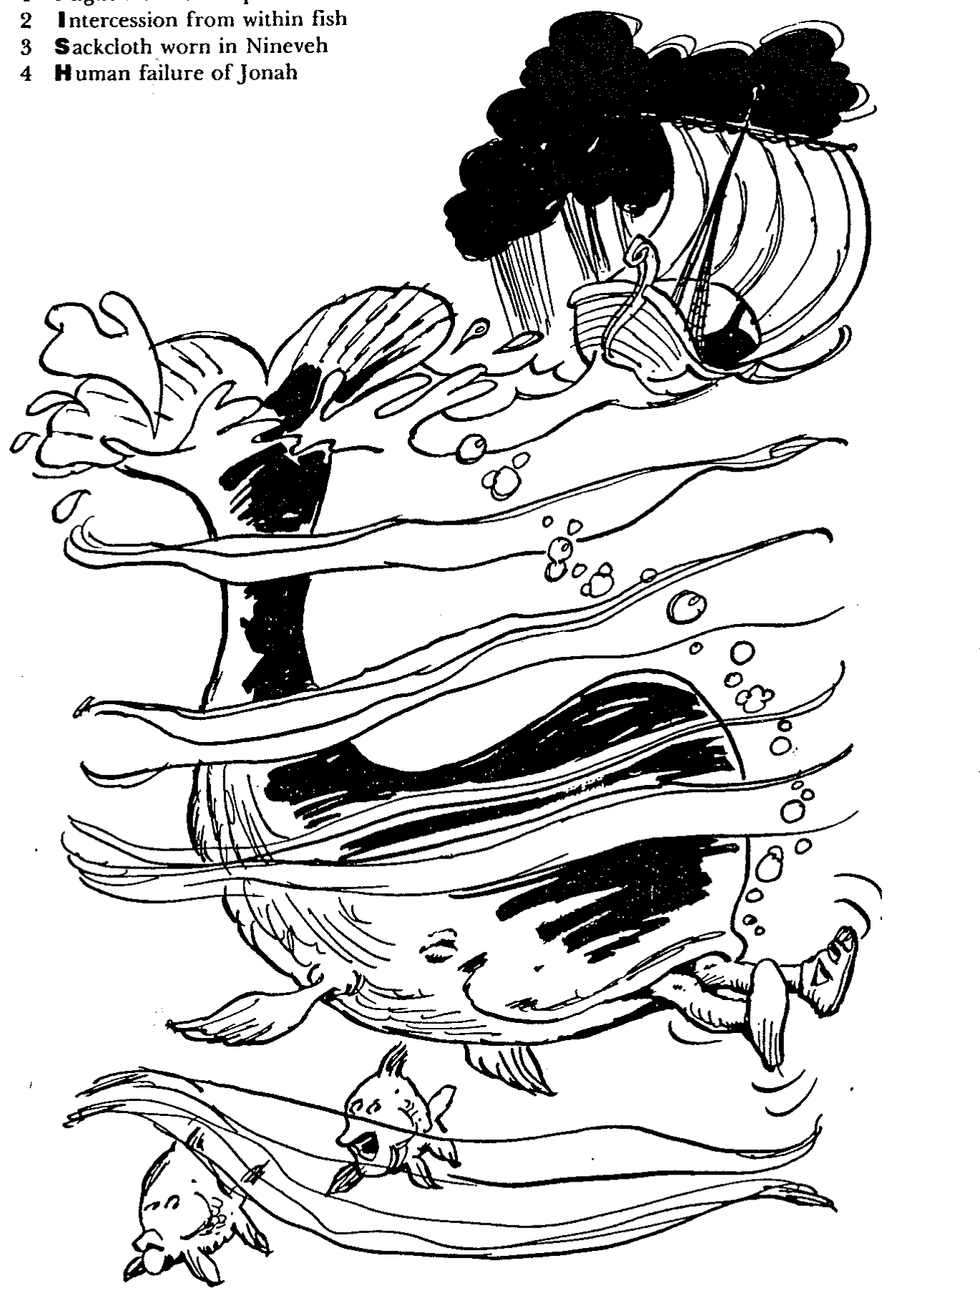
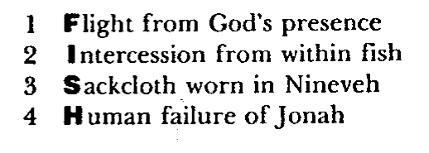
Barry Huddleston, The Acrostic Summarized Bible (Grand Rapids: Baker, 1992)
1 Inception of the world
2 Newlyweds placed in Eden
3 Temptation and man's fall
4 Hatred and first murder
5 Entire genealogy of Adam
6 Lessons on proper priorities
7 Outline for personal relationships
8 Faith of the centurion
约拿书
9 Matthew's call from Jesus
10 Apostles sent to preach
11 Testimony about John's message
12 True Messiah called demonic
13 Hidden message of parables
14 Execution of the Baptist
15 Wisdom is answering Pharisees
16 Keys of the kingdom
17 Impact of Jesus' transfiguration
18 Need for true forgiveness
19 Grounds for divorce clarified
20 Opportunities in the vineyard
21 Fig tree is cursed
22 Taxes paid to Caesar
23 Hypocrisy denounced by "woes"
24 Events of second coming
25 Judgment of the nations
26 Events on Calvary's eve
27 Way of the cross
28 Savior's resurrection and commission

Slide 12

作个关怀他人的人
约拿书
Dr. Rick Griffith, Crossroads International Church Singapore
BibleStudyDownloads.org

Slide 13
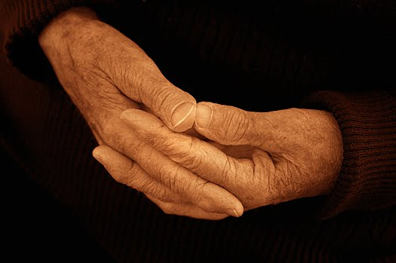
上帝如何让我们回应不悔改的人呢？
Notes:
上帝如何让我们回应不悔改的人呢？这样的事件太常见了。
事实上，今天我们将以同样无动于衷的态度看待圣经人物。
当我们这样做时，我相信上帝会用我们自己需要的四个原则来挑战我们，以彰显对他人的同情。

Slide 14
“去！不！竭力划船！”
约拿书 1
上帝转变事件来向我们彰显祂对人的怜悯。
Notes:
主通过引起我们注意的事件来彰显他对人的关心

Slide 15
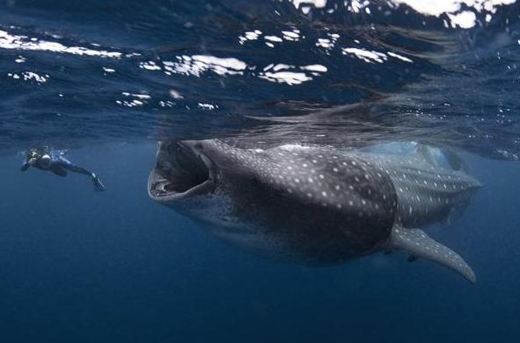
“囖!” 约拿书 2
感谢上帝对你的怜悯 - 尽管你犯了罪。
Notes:
15
你作为一个有罪的生物，你如何看待上帝，神又是如此的怜悯。我们应该为此而感恩。

Slide 16
“去！哟！哇！”
约拿书 3
分享上帝的信息，因为人们都有回应。
Notes:
16

Slide 17
“哦，不！”
约拿书 4
对人比事物表现出更大的同情心
Notes:
17

Slide 18
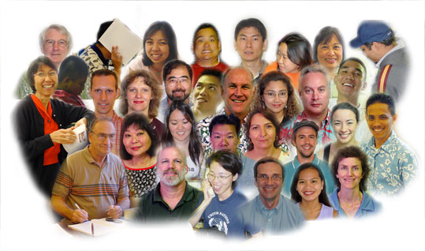
约拿书的要点：
599
把人放在我们在生活中最优先考虑的事件。
回应主的心意是指象他一样的看顾失落的。
Notes:
People are God’s first concern—so people should be our first concern.
Imitate God’s compassion for people by considering people more important than things.
Do you need to let some plates break?

Slide 19

思想问题
599
你的生活和约拿书之间看到了什么相似之处？
是什么原因导致基督徒 - 特别是年长者 - 失去对迷失者的同情？
您认为哪些做法有助于维护您对不信者的同情？
Notes:
19

Slide 20
Black
Notes:
20
Let's bow in prayer. But before we pray, honestly consider two questions:
Do others know you as compassionate—a "people person"? Why or why not?
2. What concern in your life hinders your concern for people? Studies? Perfectionism? A hobby which gobbles all your time? Not being able to say "no" to non-people-oriented tasks?
"Father, thank you for setting the example in your compassion on us. But help us to follow well in this area. May our comfort of persons be more important than our personal comforts. Show us how temporal things of this world really are—and how eternal people are—those for whom your Son died. In His precious name, Amen."

Slide 21

什么是最重要？
Notes:
What do you think is the most important thing we do as a church? Worship? Evangelism? Fellowship? Bible study? Prayer? A few weeks ago a man inquiring about our church asked me, “So what is most important to your church? What is unique?” If he had asked you, what would you have said? I told him one word: LOVE!
One of the teachers of religious law was standing there listening to Jesus debate. He realized that Jesus had answered well, so he asked, “Of all the commandments, which is the most important?” Jesus answered…

Slide 22

什么是最重要？
马可福音12：29-31
耶 稣 回 答 说 ： 第 一 要 紧 的 就 是 说 ： 以 色 列 阿 ， 你 要 听 ， 主 ─ 我 们 神 是 独 一 的 主 。 30 你 要 尽 心 、 尽 性 、 尽 意 、 尽 力 爱 主 ─ 你 的 神 。 31 其 次 就 是 说 ： 要 爱 人 如 己 。 再 没 有 比 这 两 条 诫 命 更 大 的 了 。
Notes:
One of the teachers of religious law was standing there listening to the debate. He realized that Jesus had answered well, so he asked, “Of all the commandments, which is the most important?” Jesus answered…

Slide 23




教会的异像 …
爱神
交叉路国际教会
爱教会
爱国家
多员一体
Notes:
• Love God
Where it starts—and ends—is in our call to LOVE. As Paul noted, “The greatest of these is love” (1 Cor. 13:13).
What is the most important thing we do as a church? It begins with loving the God who loves us.
• Love Church
Do you genuinely love him? If you don’t, then nothing else you do counts, really.
The second thing He said right after this: to love your neighbor as yourself.
• Love Nations
But who is your neighbor? It starts right here in the body—to love the church—but then it extends from this “close neighbor” to those who are out of the reach of this fellowship where we love the nations. Our leadership is committed to make all that we do revolve around one of these three priorities.
23

Slide 24
作个关怀他人的人
约拿书
Dr. Rick Griffith, Crossroads International Church Singapore
BibleStudyDownloads.org

Slide 25

A missed opportunity
Notes:
In June 1991 a car in Singapore's East Coast area hit a 70-year-old Chinese man. The owner of the car was relieved to find a doctor at his clinic just a short distance away. When the doctor was begged to try to save the man's life, he replied that he was too busy, didn't have the right equipment, and needed the victim's approval or his family's approval before he would treat him. The doctor never tried to see the old man, who died five hours later.

Slide 26
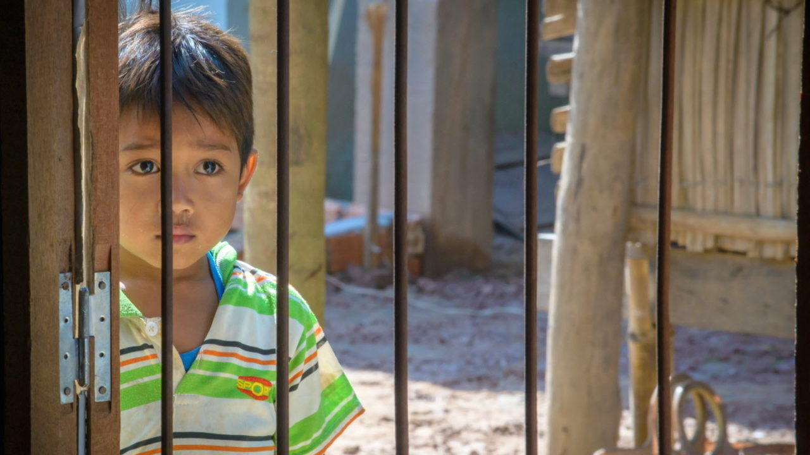
你关心其他人吗?
Notes:
I was shocked to read the account in the newspaper. How could anyone be so unfeeling—especially someone who has given himself to the "people's profession"? Would you have helped him? Do you care for people?

Slide 27
上帝如何让我们回应不悔改的人呢？
Notes:
上帝如何让我们回应不悔改的人呢？这样的事件太常见了。
事实上，今天我们将以同样无动于衷的态度看待圣经人物。
当我们这样做时，我相信上帝会用我们自己需要的四个原则来挑战我们，以彰显对他人的同情。

Slide 28
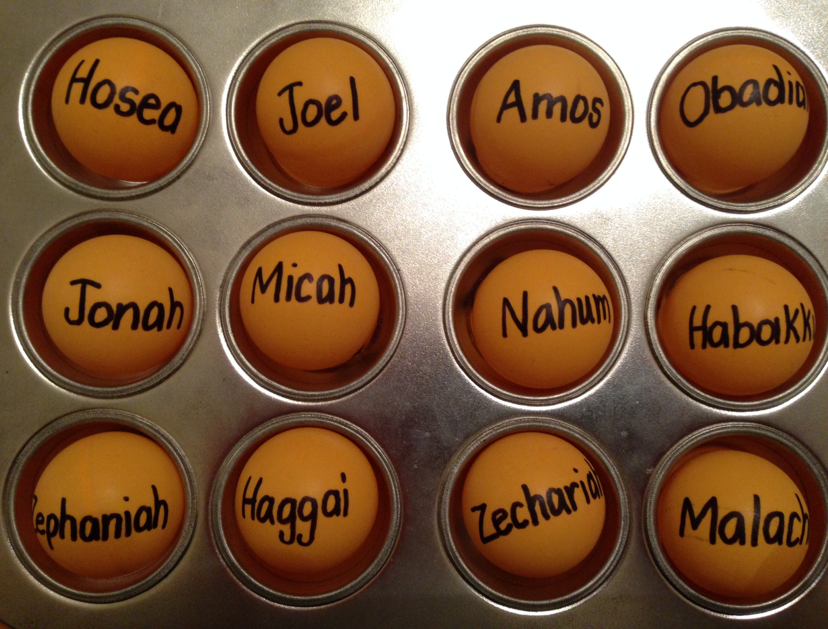
The Twelve
Courage to Confront Culture
—A Preaching Series on the Minor Prophets—
Notes:
Today we continue with part 2 of our series on the Minor Prophets that I'm calling simply "The Twelve."

Slide 29
Be...
Humble
Caring

Slide 30
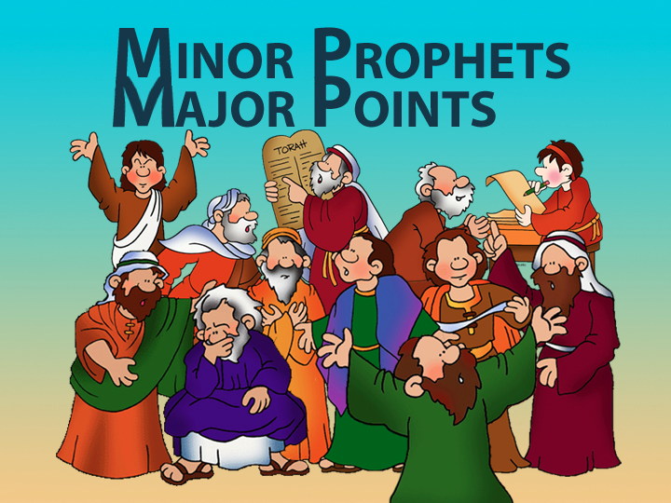
Minor Prophets—Major Points

Slide 31
Title Slide
约拿

Slide 32
Unique Elements in 约拿书
600
Unique Elements in 约拿书
    约拿书 speaks entirely through the experience of a prophet—not his words.
    约拿书 is the only prophet in Scripture who tried to run from God.
    约拿书 is the only entire biblical book on Israel's response to the Gentile nations.
    4. The historicity of 约拿书 has been denied by many scholars.

Slide 33
“去！不！竭力划船！”
约拿书 1
上帝转变事件来向我们彰显祂对人的怜悯。
Notes:
主通过引起我们注意的事件来彰显他对人的关心

Slide 34
约拿书第一章: 去!
604
上帝命令他的人去告诉邪恶者，他是多么的痛恨他们的罪恶(1-2)

Slide 35
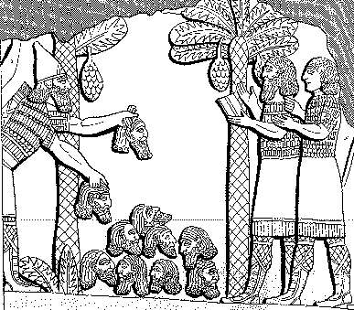
614
亚述的残暴
“我堆满如金字塔的人头在他的城市前面。我的火焰在燃烧他们的青少年和他们的姑娘.”
亚述王撒缦以色上，公元前859-824
= 约拿80年之前,
卢肯比尔，古代亚述和巴比伦记录1:213
Notes:
35

Slide 36
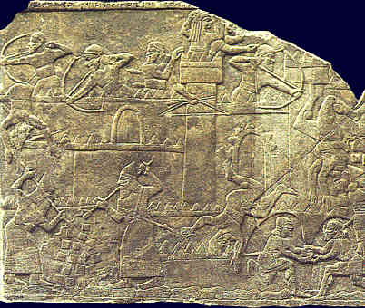
包围和袭击!
614
看 H. Hunt, “六世纪的围困战,”
圣经插图(败落 ’96): 43-45
Notes:
36

Slide 37
以撒哈顿的自豪骄傲(公元前660)
614
“我很强大，我是英雄，我很庞大，我很荣幸，我都全能了，我超于所有的国王，在亚述，纳布，并马尔杜克选择之一！”
卢肯比尔，古代亚述和巴比伦记录2:226

Slide 38
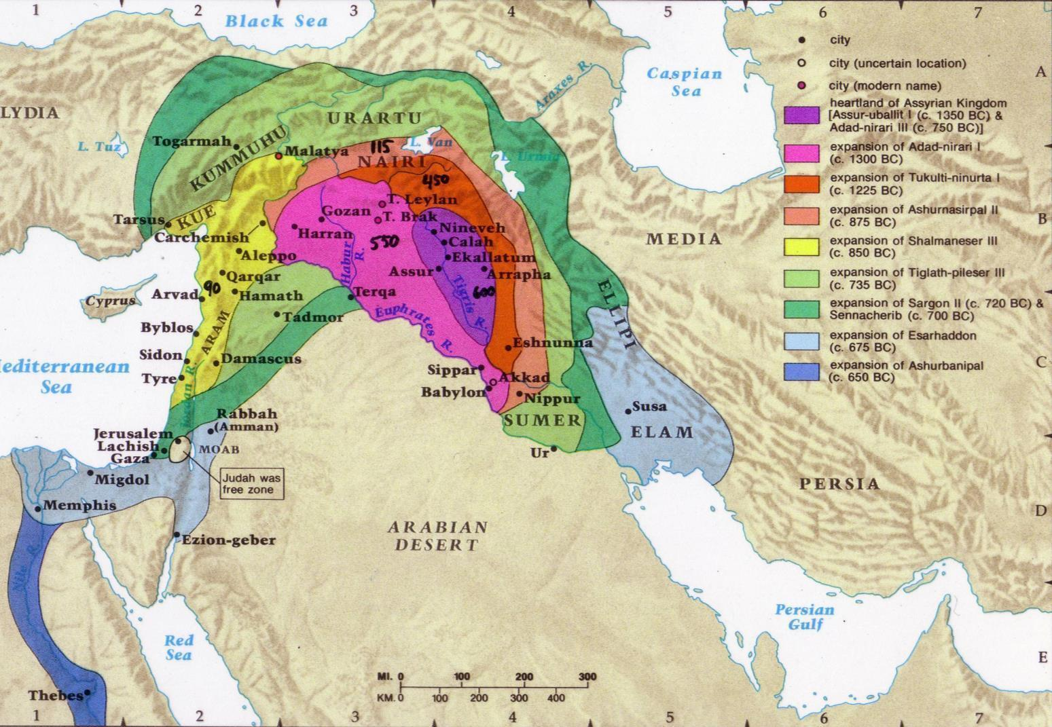
亚述的扩展
607
Notes:
38

Slide 39
亚述能力
443
刚强883-783
刚强745-626
软弱790-745
900
850
800
750
70 0
65 0
600
550
500
约拿

Slide 40
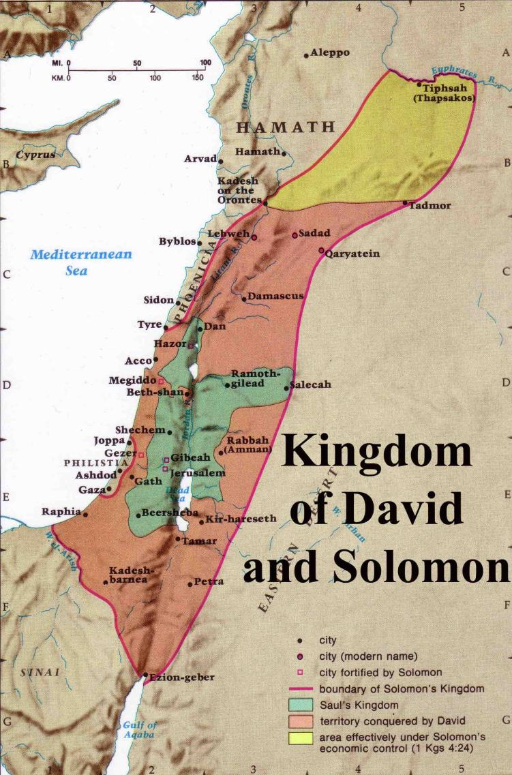
耶罗波安二世以下的扩展
446
耶 罗 波 安 (二)
“列 王 紀 下 14:25
耶 罗 波 安二世收 回 以 色 列 边 界 之 地 ， 从 哈 马 口 直 到 亚 拉 巴 海 ， 正 如 耶 和 华 ─ 以 色 列 的 神 藉 他 仆 人 迦 特 希 弗 人 亚 米 太 的 儿 子 先 知 约 拿 所 说 的 。
耶 罗 波 安 (一) 930 BC
大卫国王和所罗门的王国
Notes:
The boundaries under Jeroboam II went even farther than David and Solomon, who only had tribute sent from Hamath.

Slide 41

神 爱 你，并 且 为 你 的 生 命 有 一 奇 妙 的 计 划。
四个属灵的原则
四个属灵的原则
Notes:
Not exactly Law #1: God loves you and has a wonderful plan for your life

Slide 42
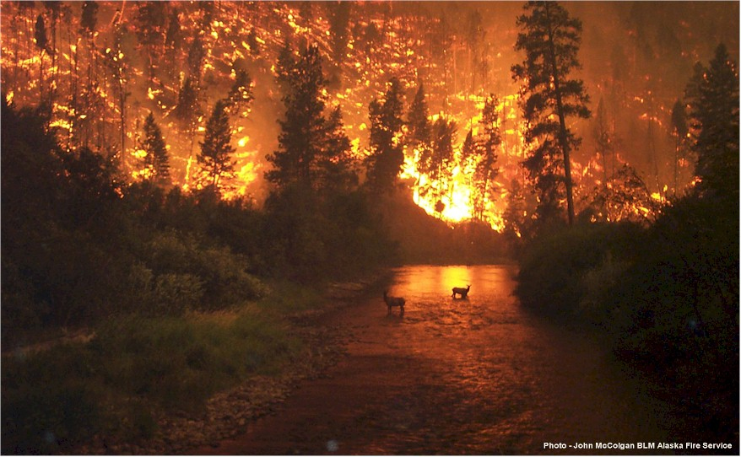
什么信息…
约拿的信息：
“尼尼微的罪过是上帝的疯狂！您好悔改或你会得到惩罚！”

Slide 43
以色列的战略位置
03
4
Notes:
43

Slide 44
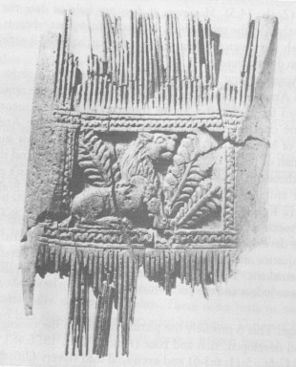
Ivory Comb
阿摩司書 (3:15; 6:4)提到 ：从米吉多的象牙梳子，代表财富和豪华 。
-- 东方学院，芝加哥大学
Oriental Institute, University of Chicago

Slide 45
约拿书的时间摘要
600
Circumstances Summary
日期: 当以色列的耶罗波安二在位期间
(列王纪下 14:25)
背景:
1. 由于内部分歧，亚述暂时下降.
2. 在耶罗波尔统治时期，以色了列的边界
扩大.
3. 带着一种狭隘的民族主义集中在以色
列，而享有的繁荣.

Slide 46
约拿书第一章: 去! 不!
上帝命令从人告诉邪恶者，他是多么的痛恨他们的罪恶
上帝的人往往不喜欢提醒坏人，他们实在很坏

Slide 47
约拿能去哪?
他施去
尼尼微
Gath-Hepher
约帕
Notes:
47

Slide 48
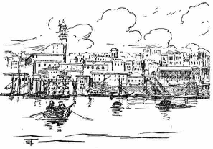
约帕是个很重要的海港
只有下到约帕才可以用船只来离开以色列-不像彼得800年后

Slide 49
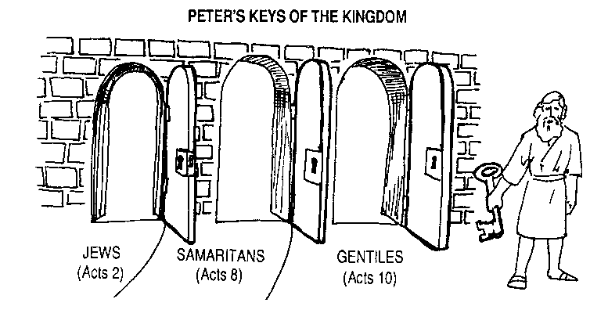
问：神如何克服在耶路撒冷教会的偏见？
答：渐渐的
彼得对于神的国度的关键
犹太人
撒玛利亚人
外邦人
使 2
使 8
使 10
主后 33
主后 35
主后 40
Notes:
God wisely led that Jerusalem church step-by-step so they could handle his big heart!
I suspect that if Samaritans and Gentiles were forced into the church too soon this would split the early church into three separate groups.

Slide 50
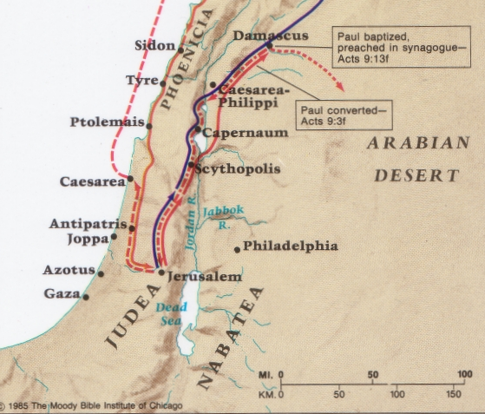
彼得在约帕不像约拿
该撒利亚
约帕

Slide 51
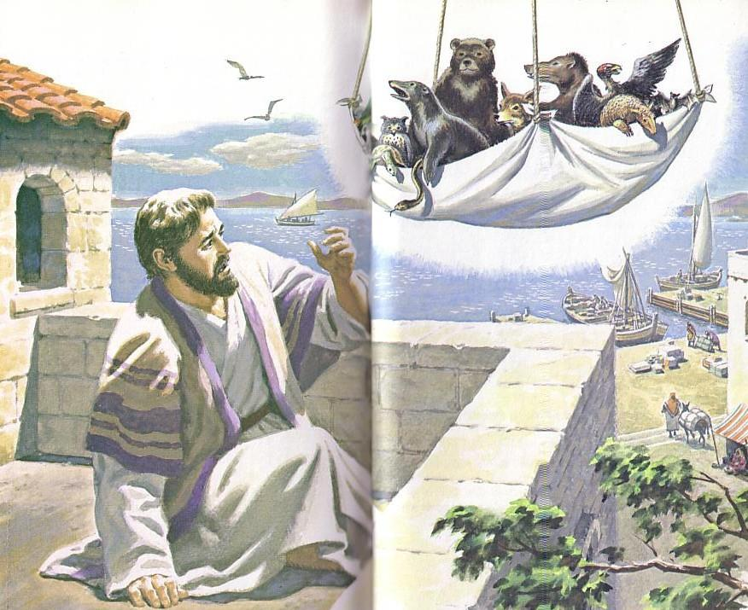
“起来，彼得！杀了来吃！”

Slide 52
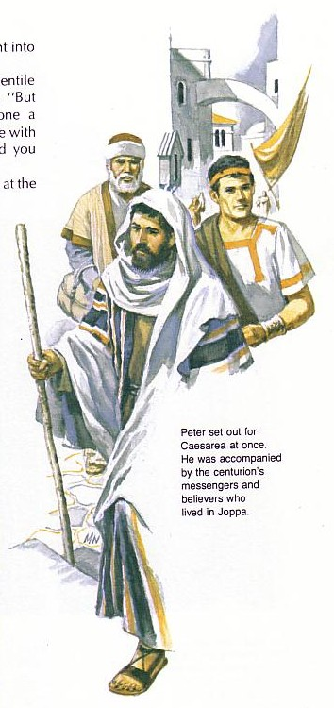
“上帝是怎样处理这些不洁的人? ”
彼得一定想知道为什么上帝要他与哥尼流的仆人一起去约帕。

Slide 53
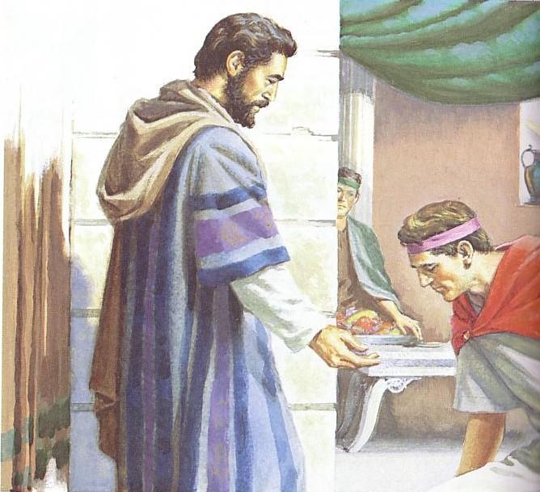
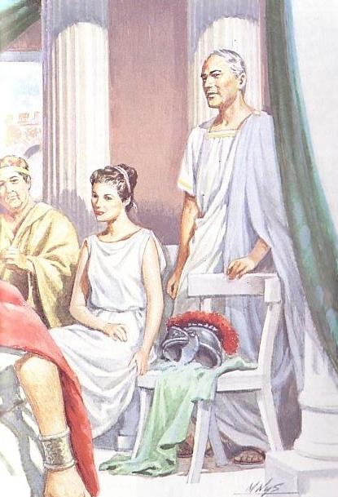
哥尼流向彼得鞠躬

Slide 54
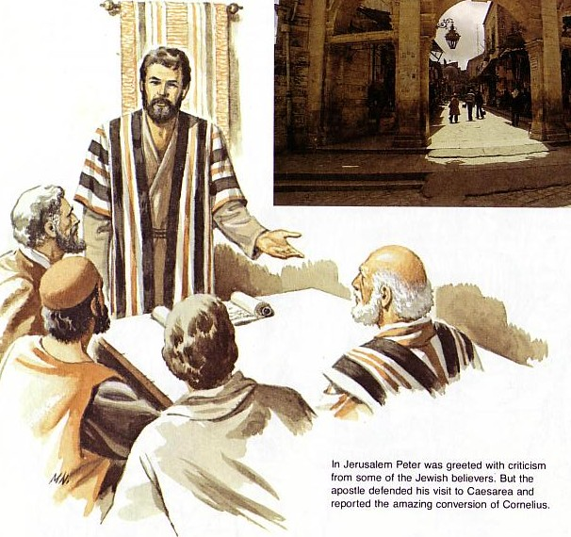
彼得捍卫他的立场（徒11：18）

Slide 55
Black
Notes:
Israel became naval-gazing, arrogant, and sinful (a mission field herself!)
We also disobey God by avoiding witnessing for Him (in break room, airplane seat, to neighbor or family member)

Slide 56
约拿第一章: 去! 去! 所以 划!
上帝命令从人告诉恶达者，他是多么的痛恨他们的罪恶
上帝的人往往不喜欢提醒坏人，他们实在很坏
忽视传道带来的后果
Notes:
56

Slide 57
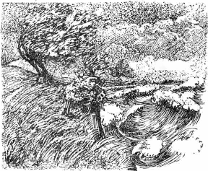
Raging Sea
Notes:
⁴ But the Lord hurled a powerful wind over the sea, causing a violent storm that threatened to break the ship apart. NLT

Slide 58
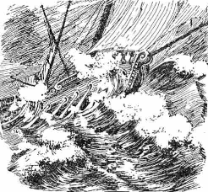
Ship Threatened to Break
Notes:
The Hebrew reads that the ship itself threatened to break up!

Slide 59
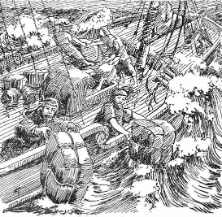
Cargo Overboard
Notes:
⁵ Fearing for their lives, the desperate sailors shouted to their gods for help and threw the cargo overboard to lighten the ship. NTL
The Bible in Pictures, drawn in 1922 but free to copy at www.creationism.org/books/

Slide 60
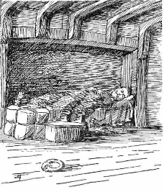
约拿书 Sleeping
Notes:
But all this time 约拿书 was sound asleep down in the hold. ⁶ So the captain went down after him. “How can you sleep at a time like this?” he shouted. “Get up and pray to your god! Maybe he will pay attention to us and spare our lives.”
NLT, Jon 1:5-6.
The Bible in Pictures, drawn in 1922 but free to copy at www.creationism.org/books/

Slide 61
Black
7 水手就彼此说："来吧！让我们抽签，好知道这场灾祸临到我们，是因谁的缘故。"于是他们抽签，结果抽中了约拿。
8 他们就对约拿说：“请告诉我们，这场灾祸临到我们，是因谁的缘故？你是作什么的？你从哪里来？你是哪一国的人？哪一族的人？”
9 他回答说：“我是希伯来人，我敬畏耶和华天上的 神，就是那创造海洋和陆地的。”

Slide 62
Black
Notes:
¹⁰ The sailors were terrified when they heard this, for he had already told them he was running away from the Lord. “Oh, why did you do it?” they groaned. ¹¹ And since the storm was getting worse all the time, they asked him, “What should we do to you to stop this storm?”
¹² “Throw me into the sea,” 约拿书 said, “and it will become calm again. I know that this terrible storm is all my fault.” (1:10-12 NLT)

Slide 63
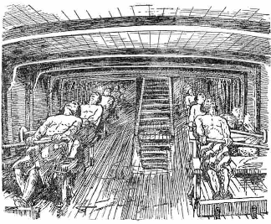
Sailors Rowing
Notes:
¹³ Instead, the sailors rowed even harder to get the ship to the land. But the stormy sea was too violent for them, and they couldn’t make it (1:13 NLT).
The Bible in Pictures, drawn in 1922 but free to copy at www.creationism.org/books/

Slide 64
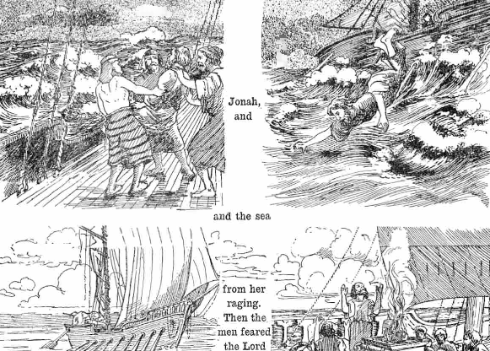
约拿书 Overboard
Notes:
¹⁴ Then they cried out to the Lord, 约拿书’s God. “O Lord,” they pleaded, “don’t make us die for this man’s sin. And don’t hold us responsible for his death. O Lord, you have sent this storm upon him for your own good reasons.”
¹⁵ Then the sailors picked 约拿书 up and threw him into the raging sea, and the storm stopped at once! ¹⁶ The sailors were awestruck by the Lord’s great power, and they offered him a sacrifice and vowed to serve him (Jon 1:14-16 NLT).

Slide 65
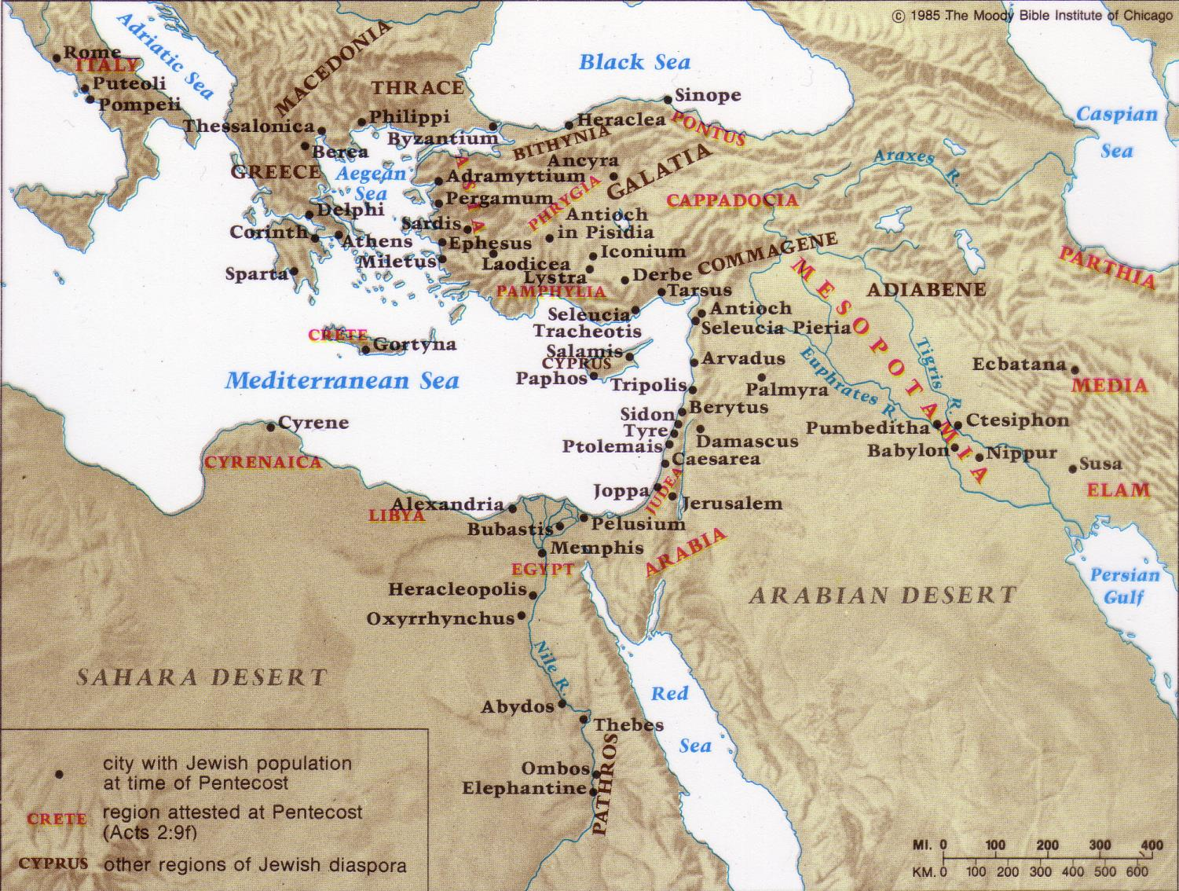
散居的犹太人
单独在罗马已有 40,000 犹太人!
83%
17%
Notes:
Only 17% of the Jews in the Roman Empire lived in Israel.
The other 83% lived scattered throughout the realm.
When Jesus was born in the time of Augustus, Rome alone had 40,000 Jews.
God had spread them throughout the known world to be His witnesses, but they, like 约拿书, failed.

Slide 66
约拿书第一章的主要思想
忽视传福音的后果
今天神仍使用方法向我们显示他重视传福音

Slide 67
“去！不！竭力划船！”
约拿书 1
上帝转变事件来向我们彰显祂对人的怜悯。
Notes:
主通过引起我们注意的事件来彰显他对人的关心

Slide 68
基督教扩展期
第一期
第二期
第三期
第四期
第五期
罗马书
野蛮人
北欧海盗
撒拉森人
天涯海角
0
400
800
1200
1600
2000
上帝时常将用入侵的机会改变侵入者!
拉尔夫冬李, 世界基督教运动
Notes:
68

Slide 69
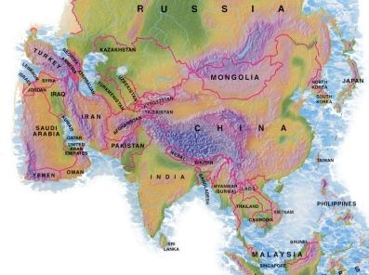
489万人。
168万外国人。

Slide 70
教会的异像 …
爱神
交叉路国际教会
爱教会
爱国家
多员一体
Notes:
• Love God
Where it starts—and ends—is in our call to LOVE. As Paul noted, “The greatest of these is love” (1 Cor. 13:13).
What is the most important thing we do as a church? It begins with loving the God who loves us.
• Love Church
Do you genuinely love him? If you don’t, then nothing else you do counts, really.
The second thing He said right after this: to love your neighbor as yourself.
• Love Nations
But who is your neighbor? It starts right here in the body—to love the church—but then it extends from this “close neighbor” to those who are out of the reach of this fellowship where we love the nations. Our leadership is committed to make all that we do revolve around one of these three priorities.
70

Slide 71

Mercedes-Benz
马赛第
Notes:
One Mercedes-Benz commercial shows their car colliding with a cement wall during a safety test. Someone then asks the company spokesman why they do not enforce their patent on the Mercedes-Benz energy-absorbing body, a design evidently copied by other companies because of its success. He replies matter-of-factly, “Because some things in life are too important not to share.”
How true. That also includes the gospel of salvation, which saves people from far more than auto collisions.
Jim Beranek, Leadership magazine

Slide 72
Black

Slide 73

约拿书第一章 小组问题
你能分享一个例子，神如何使你注意到你不服从传福音？
2. 其他的人有时会因为我们不服从而受苦？如何？
3. 为什么你有时不服从上帝的话 ，以拒绝分享你的信仰？
4. 你能采取什么切实步骤来改变呢？

Slide 74

重要事项
600
I. 介绍
A. 日期和背景
B. 尼尼微
C. 特性及图表
II. 议题
A. 历史性与文学类型。
B. 为什么约拿很快逃离和4:2的重要性？
C. 耶稣提到约拿书。
III. 启示/信息

Slide 75
旧约列王和先知
342
主要日期
931
俄巴底亚
722
约拿
阿摩司
何西阿
以赛亚
弥迦
那鸿
西番雅
耶利米
耶利米哀歌
耶珥
但以理
哈该
哈巴谷
以西结
撒迦利亚
玛拉基
586
Notes:
75

Slide 76
Book Chart
上帝对外邦人的怜悯
不遵守宣教士的责任 |  |  |  | 遵守宣教士的责任
第1—2章 |  |  |  | 第3—4章
上帝对约拿的怜悯 |  |  |  | 上帝对尼尼微人的怜悯
大海 |  |  |  | 大城
委任 1:1-2 | 不顺服 1:3 |  | 结果 1:4–2:10 | 重新委任 3:1-2 | 顺服 3:3-4 |  | 结果 3:5–4:10
“去!" | “不!" |  | “去，划!” “看!” | “去!" | 唷 |  | “咳!” “哦，不!”
约拿的邪恶 第1章 (约拿想去死) |  | 约拿的祷告 第2章 (约拿想活) |  | 约拿的讲道 第3章 (约拿想活) |  | 约拿赌气 第4章 (约拿想死)
约主前 760 年
599

Slide 77
“囖!” 约拿书 2
感谢上帝对你的怜悯 - 尽管你犯了罪。
Notes:
77
你作为一个有罪的生物，你如何看待上帝，神又是如此的怜悯。我们应该为此而感恩。

Slide 78
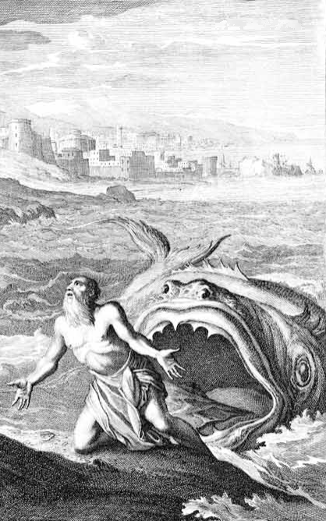
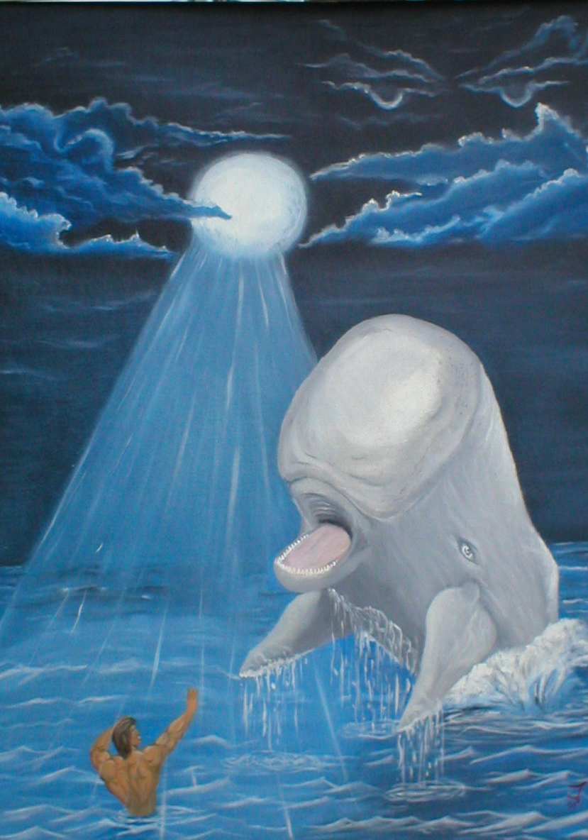
大鱼?
或 鲸?
圣经里:
Dag (“鱼”)
lAdêG" gD"
Notes:
78

Slide 79
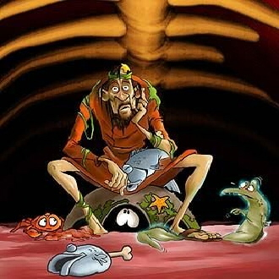
在大鱼里
Notes:
79
What would he eat? I hope he liked sea food!
Could he really breathe in there? Wouldn't the oxygen run out? Eco-system!

Slide 80
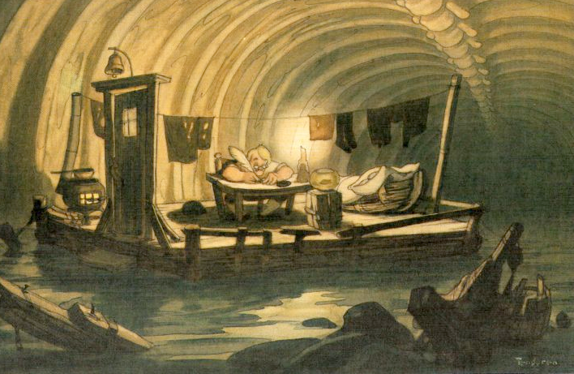
在大鱼里
Notes:
80

Slide 81
Black
Notes:
What would he eat? I hope he liked sea food!
Could he really breathe in there? Wouldn’t the oxygen run out? Eco-system!

Slide 82
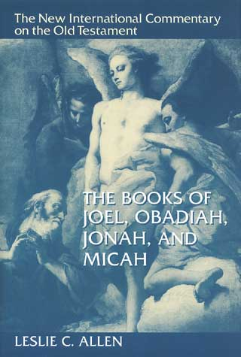
不信“福音“
“…作者的意图除了简单地描述历史事实”
(176页).

Slide 83

Is 约拿书 simply just a good story for kids?
是否相信？
601
约拿书
Notes:
James Bartley

Slide 84
601-3
为为什么不接受约拿？？
因三个问题，约拿的厉史性将被许多文学家拒绝:
1. 三天在大鱼里 (1:17)
2. 尼尼微一般地悔改不大可能 (3:5)
3. 尼尼微的人口很大十二万 (4:11)
然而:
在列王纪下14:25 约拿是个历史人物（先知）
耶稣本身坚持历史性的书籍 (马大福音 12:39-41)
Notes:
84
Why not accept 约拿书? The historicity of 约拿书 has been denied by many people over three issues Three days in a great fish (1:17)
2. All of Nineveh repenting (3:5)
3. Nineveh so big it had 120,000 people (4:11)

Slide 85

预料中的回应：
愤怒？
自大？
自杀性的忧郁症？
Notes:
85
So I take the fish account to be true, but what kind of response would one expect 约拿书 to have in this situation?
Anger? “God, I obeyed you concerning the prophecy about Jeroboam. Why do I have to go through all this torment just for one lousy act of disobedience?”
Pride? “Well, look here! How often does God help drowning people by getting them swallowed by a huge fish? I must really be special to the Lord!”
Suicidal Depression? “What?! Inside a fish? Why didn’t I die from drowning? I’d rather have died quickly from drowning than to starve to death inside this marine monster! I hate sea food—and now, I AM sea food!”

Slide 86
The Ten Million Dollar Question
一千万美金的题目
尽管我们的罪，我们应如何回应上帝的仁慈?
Notes:
86

Slide 87
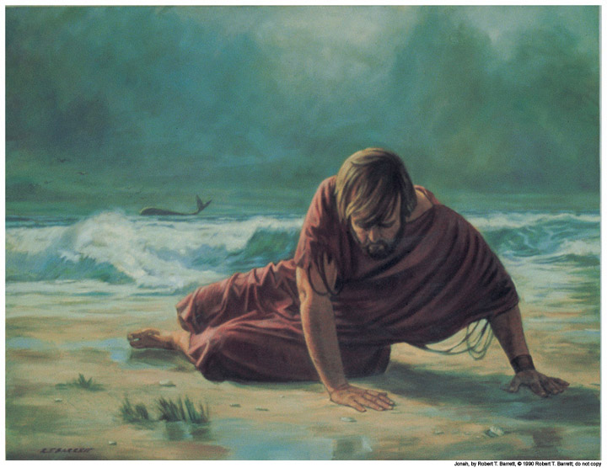
I. 约拿感谢上帝从溺水中拯救了他 (1:17-2:10)
你会吗？

Slide 88
审判？
拯救？
Notes:
88

Slide 89
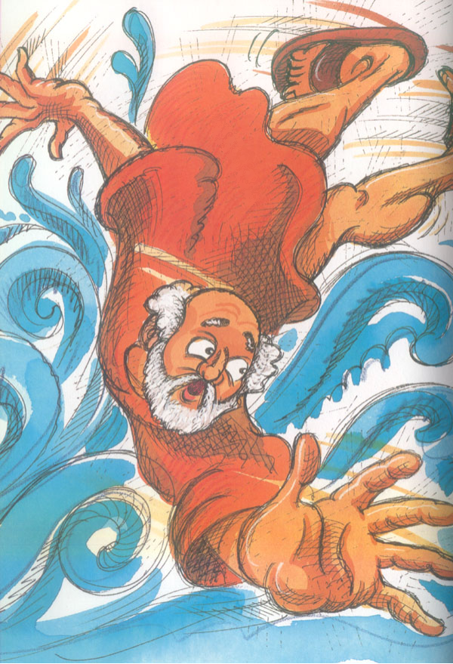
感恩诗
祈祷 (1-2)
悲叹 (3-7)
誓言 (8-9)
约拿书第二章
Notes:
89

Slide 90
感恩诗
祈祷 (1-2)
“我遭遇患难求告耶和华，你就应允我…”
约拿书第二章
Notes:
90

Slide 91
感恩诗
祈祷 (1-2)
悲叹 (3-7)
“你将我投下深渊”
(2:3, 参1:4, 5, 12, 15)
约拿书第二章

Slide 92
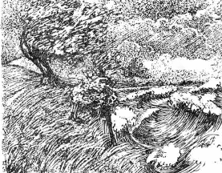
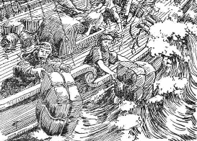
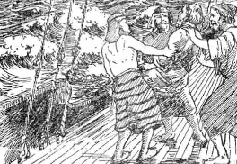
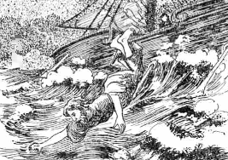
约拿书用的投字
耶和华在海上刮起大风 (1:4)
水手船上的东西拋在海里 (1:5)
他们把约拿投在海里 (1:15)
你们把我投在海里(1:12)
你把我投入深海 (2:3)

Slide 93
约拿书里的
“起来”
“起来起来，求告你的神 (1:6)
“你起来往尼尼微大城去” (1:2)

Slide 94
约拿书用的下字
他下到约帕
(1:3a)
约拿却下了船舱
(1:5)
我下沉直到山麓(2:6)

Slide 95
Black

Slide 96
感恩诗
祈祷 (1-2)
悲叹 (3-7)
誓言 (8-9)
约拿书第2 章
Notes:
96

Slide 97
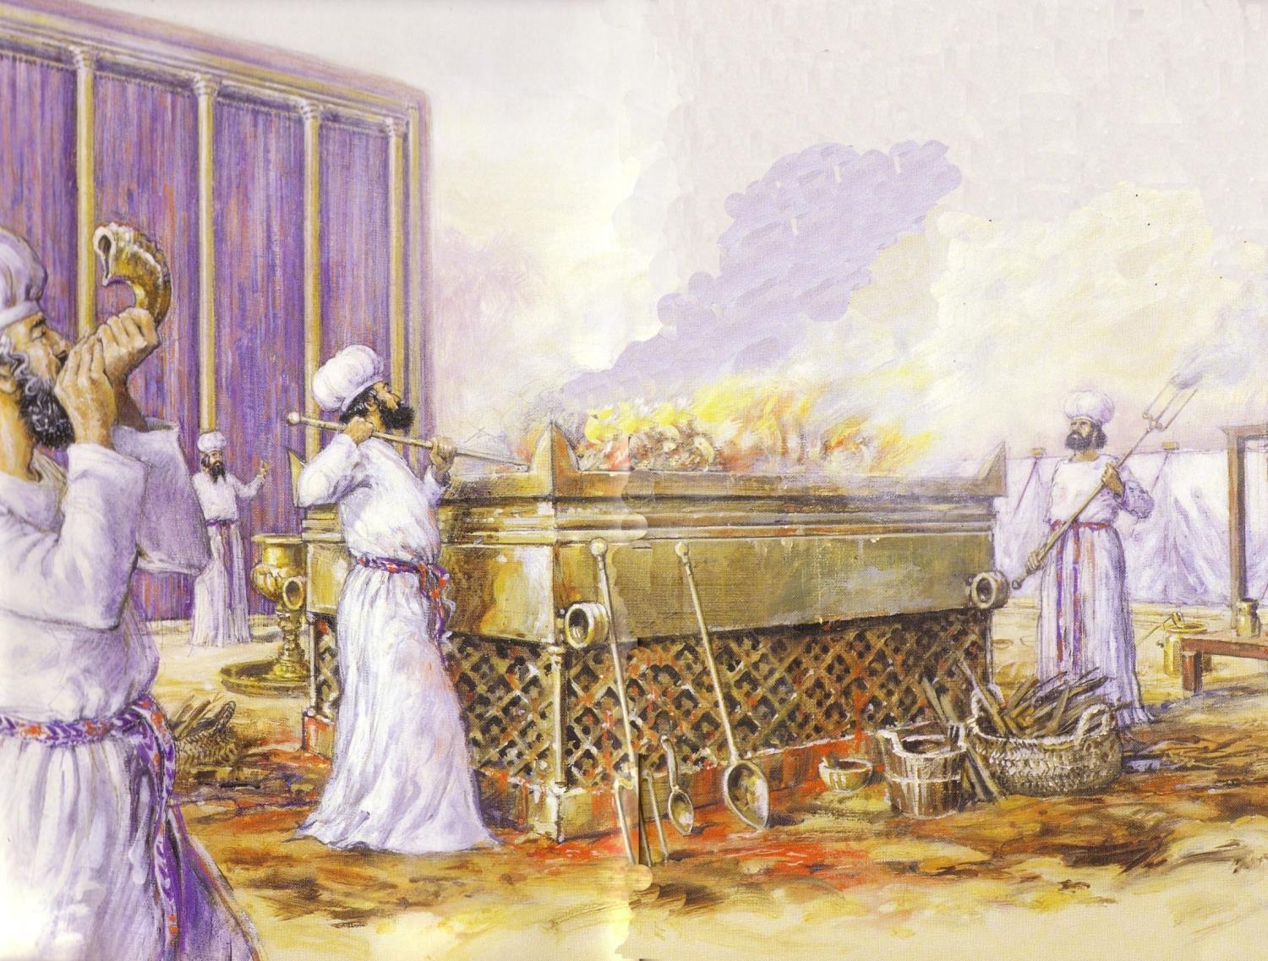
约拿的许愿
“但我必用感谢的声音献祭与你。我所许的愿，我必偿还。救恩出于耶和华 ” (2:9)
Notes:
97

Slide 98

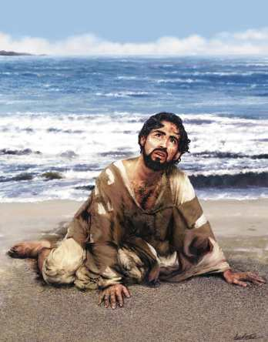
结果如何呢？约拿被吐出来
DRESSING
THE
STAGE
MS
SG
ER
“THE LAND”
DS
PG
RS
Handbook pg. 15-16
25

Slide 99
The Ten Million Dollar Question
一千万美金的题目
尽管我们的罪，我们应如何回应上帝的仁慈?
Notes:
99

Slide 100
我们应该感谢上帝，
尽管我们不顺服
上帝也饶恕我们
Notes:
100

Slide 101


哪是更好的激励 ?
Quiz Time. . .
恩典? 或
律法?
支持你的答案!

Slide 102

区别以下主要重点…
恩典:上帝赐给我们所不应受的
怜悯: 上帝不赐给我们所应受的
公正: 上帝赐给我们所应受的
Notes:
102
So what have I learned? Everything I am, have, and do—it’s all because of God’s grace. Who would have ever thought that this shy boy—from a broken home whose parents and those they have married have endured 12 divorces—who would ever thought that this guy would be privileged to serve Him at SBC and beyond?

Slide 103
Black
Notes:
Think how good God is to us erring creatures---1000 sins a year!
But God’s grace overshadows his justice on the cross.
Grace prevents premature death too: 234 traffic deaths, immune system

Slide 104

这是我的人生
家庭相册
Notes:
104
Today instead of the usual chapel message I thought I’d share something I know something about—what God has done in my own life

Slide 105
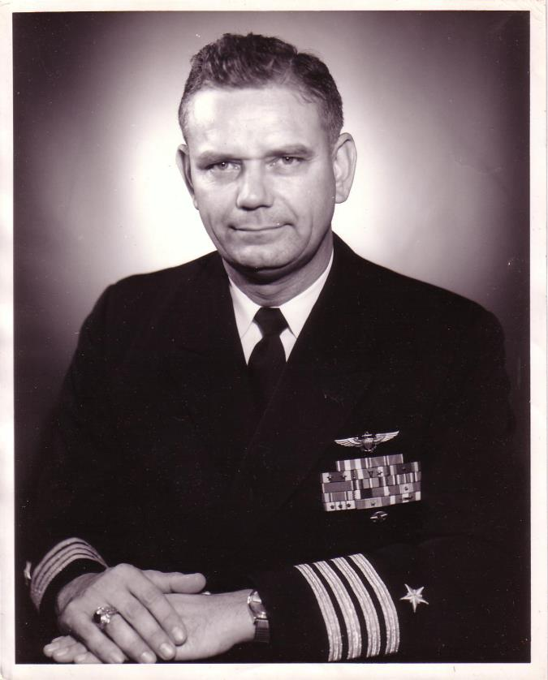
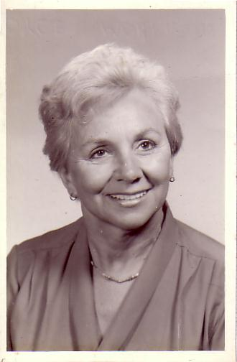
婚姻
海军中尉
Harold F. Griffith (另称父亲)
海军少尉
Joyce I. Griffith （另称母亲)
Notes:
105
The story, of course, must begin with my parents who met in the Navy.
They had a baby boy (my older brother Bob) and then were transferred to Japan.

Slide 106
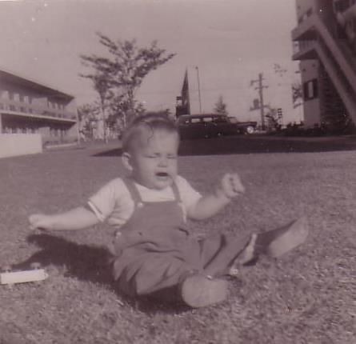
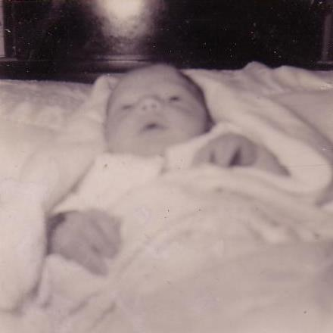
婴儿
里克
“因为有一婴孩为我们而生。。有一子赐给我们 。。”
东京, 1958
Notes:
106
That’s where I made my appearance. I was born in Japan at a very young age… as an MK (Military Kid)

Slide 107
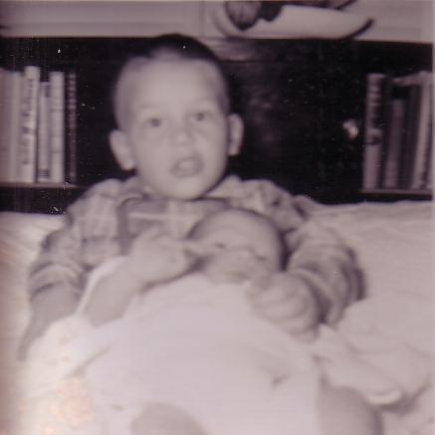
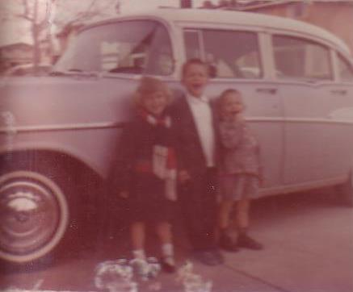
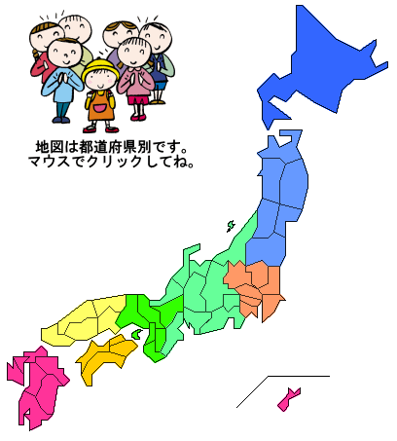

家庭的增加与移动居留…
Notes:
107
After my sister’s birth there 19 months later we moved to a strange land—California!

Slide 108

旧金山湾区
阿拉米达
旧金山
卡斯特罗谷
海沃德
Notes:
108
We first lived in Alameda across the bay from San Francisco, then later in two other cities.

Slide 109
离婚
1962
海军司令
Harold F. Griffith
（另称父亲)
社会工作者
Joyce I. Griffith
(另称母亲)
Notes:
109
After my younger brother’s birth my Mom concluded that my Dad was actually married to the Navy, so she divorced him. Ironically, she became a social worker to help other families put their lives together.

Slide 110

离婚对
母亲是
很
艰难…
鲍比, 6
里克, 4
克茜, 3
谈米, 1
Notes:
110
Those weren’t easy years being a single mother with four kids age 6 and under. Yes, that’s the good looking one with the sucker!

Slide 111




在贝利下更新
Notes:
111
Three or four years later my Mom met Bill—another divorcee with three children. They married once when I was on vacation to see my real Dad.

Slide 112





一年的
滑水 …
及另一年的
教会…
1966-1968
Notes:
112
Life began to turn around. Bill played sports with us and even took us to church for a year.

Slide 113

再次 离婚…
Notes:
113
But the arguments with my Mom became unbearable so my Mom divorced him too.

Slide 114




但是我们拥有对方…
Notes:
114
You may think I was lonely—but I had my big brother Bob and my sister Kathie. My little brother Tom was a pest.

Slide 115


一家五口(1972)
Notes:
115
But we learned to live without a Dad again while my real Dad married a third time—actually five times total!

Slide 116






School Pictures
幼稚园
一年级
二年级
三年级
四年级
五年级
Notes:
116
Life went on and, despite my rotten family background, I sensed that there was a God—so I figured that I better be a good boy. I obeyed my parents and did well in school and sports over the years.

Slide 117


棒球
Notes:
117
Of course, when Sunday morning came I still played baseball.

Slide 118




贝比的运动
Notes:
118
My siblings and I even dressed our dog Peppy up to play baseball—as well as hiking, football, and basketball. Yes, don’t remind me that my hands are in the basketball picture. My brother didn’t frame it right!

Slide 119


我的属灵旅程
Notes:
119
It’s been said that our view of the Heavenly Father follows our view of our earthly father. My father was an important man who achieved the rank of Captain. He loved me but was always far away fighting in Vietnam, so I saw God the same—One who loved me but was far away doing important things.

Slide 120


在70年代中寻找…
Love
Notes:
120
I was too young to be a hippie, but I did identify with the search for love and peace. I painted in bright fluorescent colors the love and peace signs on my bedroom wall, turned on my black light, laid on my bed and said “groovy,” “far out,” and other things hoping that real peace would fill my heart. It didn’t!

Slide 121


朋友的影响
约翰
得利
Notes:
121
So I tried and tried to be good—but I always knew I was failing to live up to my own expectations let alone God’s! Then two friends at school told me I could never be good enough—and that I needed to trust Christ by faith. When I saw the reality of the Christian life in their own families (especially their fathers), I finally trusted Christ at age 13.

Slide 122
我终于明白
恩典
与我
上帝的恩典把我从“自我为义”中释放出来
Notes:
122
For the first time in my life I had peace with God—His grace set me free from the nagging knowledge that I couldn’t make it alone.

Slide 123
在过去我学习到的…
完全
我自己
我所拥有的
我所能做到的
完全是靠主的恩典!
Notes:
123
So what have I learned? Everything I am, have, and do—it’s all because of God’s grace. Who would have ever thought that this shy boy—from a broken home whose parents and those they have married have endured 12 divorces—who would ever thought that this guy would be privileged to serve Him at SBC and beyond?

Slide 124
Black

Slide 125

大概念
上帝的慈爱
遮掩他的公义
Notes:
125

Slide 126
Black

Slide 127
约拿书第2章小组问题
“感谢上帝，他的慈悲笼罩他的正义” 对你个人的看法是什么？

Slide 128
约拿书第2章小组问题
1 你用哪些不同的方式来回应你生活中上
帝允许的困难？
2.解释“感谢上帝，他的慈悲笼罩他的正义”对你本人有什么看法？
3. 描述你认为还没成为一个基督徒时的生活将会是怎么样的呢？
你能用什么具体的方式来回应上帝对你的要求“与他人分享他”吗？
Notes:
What are some different ways you respond to difficulties God allows in your life?
2. Explain what “Thank God His mercy overshadows His justice” means to you personally.
3. Describe what you think life would be like for you now had you not become a Christian.
What tangible way can you respond to His call for you to share Him with others?
解释“感谢上帝，他的慈悲笼罩他的正义”对你本人有什么看法？
描述你认为还没成为一个基督徒时的生活将会是怎么样的呢？你能有什么具体的方式回应他对你要求与他人分享他吗？

Slide 129

唯有依靠神恩典, 我们才能进入
字和词由 Gerrit Gustafson
Notes:
129

Slide 130

惟有依靠耶稣恩典
我们来到宝座前
不是依靠人的成全
乃是羔羊的宝血
Notes:
130

Slide 131

祢呼召我 与我同在
祢呼召我来
领我前来 与我同在
是靠主恩典我来
靠主恩典我来
Notes:
131

Slide 132

主若数算罪恶
无人能得救
感谢主恩
得洁净完全靠祢宝血
Notes:
132

Slide 133

惟有依靠耶稣恩典
是靠主恩典我来
靠主恩典我来
靠主恩典我来
Notes:
133

Slide 134
Black

Slide 135
“去！哟！哇！”
约拿书 3
分享上帝的信息，因为人们都有回应。
Notes:
135

Slide 136

Success - Failure
成功
失败
Notes:
Susan’s HS reunion
Christopher Lee HK business cards
Dad’s 25th HS reunion

Slide 137

Failure of Logic
逻辑的失败
这就是为什么我们不能拥有好看的东西的理由
Notes:
137

Slide 138

When your best isn’t good enough
失败- 有时是尽了力还的不够

Slide 139

If at first you don't succeed, failure may be your style
输
若一开始你就不成功，
那么失败或许是你的风格
If at first you don't succeed,
failure may be your style
Notes:
139

Slide 140

我们无法少一个“U”字母拼“failure”(失败）这个字
失败
Notes:
140

Slide 141

Sometimes you just don’t have an excuse
失败- 有时是的没有借口

Slide 142

你害
你害怕失败吗？
怕
失
你害？
败
吗
?
Notes:
One western journalist referred to Singapore as a “city of fear”—fear of breaking the law, dear of not making the grade, fear of not having enough money, etc.
Years ago Lee Kuan Yew noted that Singaporeans are not risk-takers in business.

Slide 143

许多人害怕传福音
小时候，我会跑到他人家的门前，按下门铃，然后快跑。如今，我仍是这样做，但我们的教会称这为“拓展训练”。
Notes:
Have you not shared Christ for fear that you will be rejected?
Have you avoided sharing Christ with your family members due to fear?
Do you fear what your office mates will say if you witness?
Are you afraid that the Religious Harmony Bill could be used against you? (By the way, I’ve read it—it only outlaws ineffective methods of evangelism!)
Some of us may feel that our employment pass could be cancelled if we were caught witnessing inappropriately.

Slide 144
神如何看待失败—由其是传福音?
日起：
Notes:
144

Slide 145

约拿没服从命令
Notes:
145

Slide 146
Book Chart
上帝对外邦人的怜悯
不遵守宣教士的责任 |  |  |  | 遵守宣教士的责任
第1—2章 |  |  |  | 第3—4章
上帝对约拿的怜悯 |  |  |  | 上帝对尼尼微人的怜悯
大海 |  |  |  | 大城
委任 1:1-2 | 不顺服 1:3 |  | 结果 1:4–2:10 | 重新委任 3:1-2 | 顺服 3:3-4 |  | 结果 3:5–4:10
“去!" | “不!" |  | “去，划!” “看!” | “去!" | 唷 |  | “咳!” “哦，不!”
约拿的邪恶 第1章 (约拿想去死) |  | 约拿的祷告 第2章 (约拿想活) |  | 约拿的讲道 第3章 (约拿想活) |  | 约拿赌气 第4章 (约拿想死)
约主前 760 年
599

Slide 147

约拿书第3章: 去!
去! 神是怜悯的神。他给不忠心的先知第二次机会。
Notes:
147

Slide 148
“你无法在经文中找到被差遣的人会遭遇到失败”
--穆迪
Notes:
148

Slide 149

“经验是个美好的东西。当你重犯一个错误的时候，它帮助你认出来。”
Notes:
B. God, in His compassion for us, provides second opportunities even after we initially fail.
149

Slide 150

给第二个机会的神
亚伯拉罕
摩西
大卫
保罗
约翰马可
Notes:
150

Slide 151

失败是一件事 而 不是一个人
Notes:
151

Slide 152
约拿书第三章: 去!哟!
去! 神给第二个机会给不信的使者 (1-2).
你! 神的子民更应该宣传神的信息给那些从没听过的人 (3-4).
Notes:
152
开始！神是为（1-2）不忠使者第二次机会的神。
哟！神的人，尤其是要申报他给那些从来没有听过谁（3-4）

Slide 153
Black
Notes:
153
³ This time 约拿书 obeyed the Lord’s command and went to Nineveh, a city so large that it took three days to see it all.*
⁴ On the day 约拿书 entered the city, he shouted to the crowds: “Forty days from now Nineveh will be destroyed!” (3:3-4 NLT)

Slide 154



尼尼微城
602
利河伯
新加坡的面积
尼尼微大城市
亚述
迦 拉
创世记 10:11-12
0
20
公里
Notes:
There’s a problem here regarding the three-day’s journey (cf. OTS, 602). Nineveh’s inner wall was less than eight miles, so the diameter of the city was only two miles—hardly a three-day journey. One day’s journey in the open was usually 15-20 miles (Hannah, BKC, 1:1463).
But this isn’t really a problem in either of two ways:
“The great city of Nineveh” (1:2; 3:2; cf. 4:11) almost surely included three other towns in the vicinity as well. Four cities (Nineveh, Rehoboth Ir, Calah, and Resen) are mentioned in Genesis 10:11-12 as “the great city” and they still exist today with different names (Kouyunjik, Khorsbad, Nimroud, and Karamles). This can be observed on the following map by Austin Henry Layard, Nineveh and Its Remains, 2:40.
If we superimpose a map of Singapore over it, we can see that walking through Nineveh would be like walking in Singapore from the far north in Yishun to Harbourfront in the south. That could take 3 days easily!
154

Slide 155

“再等四十日，尼尼微必倾覆了”
(希伯來语只用五个字)
`tk,P'(h.n< hwEßn>ynI)w> ~Ayë ~y[iäB'r>a; dA[
Notes:
155
http://www.mythfolklore.net/lahaye/150/LaHaye1728Figures150约拿书III4约拿书EntersNiniveh.jpg

Slide 156
更大的诫命?
馬 可 福 音 12: 29-31
²⁹ 耶 稣 回 答 说 ：第 一 要 紧 的 就 是 说 ： 以 色 列 阿 ，你 要 听 ，主 ─ 我 们 神 是 独 一 的 主 。
³⁰ 你 要 尽 心 、尽 性 、尽 意 、尽 力 爱 主 ─ 你 的 神 。
³¹ 其 次 就 是 说 ：要 爱 人 如 己 。再 没 有 比 这 两 条 诫 命 更 大 的 了 。
Notes:
We also must obey by sharing God’s message with those who have never heard.
This reminds me of our church vision, based on Christ’s words in Mark 12:29…
156

Slide 157
教会的异像 …
爱神
交叉路国际教会
爱教会
爱国家
多员一体
Notes:
• Love God
Where it starts—and ends—is in our call to LOVE. As Paul noted, “The greatest of these is love” (1 Cor. 13:13).
What is the most important thing we do as a church? It begins with loving the God who loves us.
• Love Church
Do you genuinely love him? If you don’t, then nothing else you do counts, really.
The second thing He said right after this: to love your neighbor as yourself.
• Love Nations
But who is your neighbor? It starts right here in the body—to love the church—but then it extends from this “close neighbor” to those who are out of the reach of this fellowship where we love the nations. Our leadership is committed to make all that we do revolve around one of these three priorities.
157

Slide 158
蜡烛
Judgment for Exploitation
Judgment for Exploitation
Notes:
158

Slide 159
最佳的福音传教士...
Notes:
159
Susan used to take Chinese lessons from a woman from Beijing. I remember once meeting her husband. When he found out that I was a Bible college lecturer, he said, “Well, you definitely aren’t one I’m going to talk to about religion!”
My neighbor Kevin said basically the same thing when I asked him about the differences between Catholicism and Christianity.
“I’m paid to be good—you’re good for nothin’!”
You have more opportunities than me—take them!
Now what results from sharing God’s love?

Slide 160
约拿书第3章: 去!
去!神是怜悯的神。他给不忠心的先知第二次机会 (1-2)
神的子民应该把上帝的信息传给还没听见的人 (3-4)
热诚分享上帝会常带来意想不到的好的结果 (5-10)
Notes:
160

Slide 161

历史性

Slide 162



“我做了什么?”
约拿书3:5-10
Notes:
162
⁵ The people of Nineveh believed God’s message, and from the greatest to the least, they declared a fast and put on burlap to show their sorrow.
⁶ When the king of Nineveh heard what 约拿书 was saying, he stepped down from his throne and took off his royal robes. He dressed himself in burlap and sat on a heap of ashes. ⁷ Then the king and his nobles sent this decree throughout the city:
“No one, not even the animals from your herds and flocks, may eat or drink anything at all. ⁸ People and animals alike must wear garments of mourning, and everyone must pray earnestly to God. They must turn from their evil ways and stop all their violence. ⁹ Who can tell? Perhaps even yet God will change his mind and hold back his fierce anger from destroying us.”
¹⁰ When God saw what they had done and how they had put a stop to their evil ways, he changed his mind and did not carry out the destruction he had threatened (3:5-10 NLT)

Slide 163
约拿在乐园 ?
“他宣告后的效果是那么的奇妙! 连以色列最伟大的 先知也还未达到像他这样的效果… 我们就在仙境！当然这不是 记录实际的历史 事件也不打算这样做。我们把他的作品当成散文而作者是要做詩，这是得罪了作者。”
(Julius A. Bewer, A Critical and Exegetical Commentary on 约拿书, ICC, 3-4).
Notes:
163
http://www.mythfolklore.net/lahaye/150/LaHaye1728Figures150约拿书III4约拿书EntersNiniveh.jpg

Slide 164
预备认罪?
605
导致尼尼微在公元前758认罪的事件:
787 开始单一崇拜尼布
765 疫瘟在亚述散布
763 亚述人在城市里造反
763 日蚀
762 亚述人在城市里造反
761 亚拉发城市里造反
760 亚拉发城市里造反
759 另一个疫瘟
758 “天下太平” (在约拿的引导下认罪?)
Notes:
164

Slide 165

约拿成了尼尼微的神迹
(路加福音 11:30)
Notes:
165
Biblia Latina. Illuminated Manuscript Bible. [Northern Italy], 1273.
http://www.smu.edu/bridwell/publications/ryrie_catalog/4_1n.jpg

Slide 166

赐惊喜的神!
Notes:
166

Slide 167
Black
Notes:
167
Mongolia-Beijing-Singapore flight delay – 4 people, 1 PRC (Fiji)
Tom Roxas witnessed to Nino’s murderer
“If you don’t show, you’ll never know!”

Slide 168
人们的反应比我们想象的更大!
约拿书第3章
主要的目的
Notes:
168

Slide 169

你的定位 不是由失败所定的
Notes:
Don’t let possible failure in evangelism keep you from sharing because people are more positive than we generally think !
169

Slide 170
Black
Notes:
170
Oftentimes the worse the people are, the more they see their need to trust Christ!
Who do you know that’s “impossible” to trust Christ? Remember that the greatest missionary—Paul—was also the least likely to become a Christian!
Prayer

Slide 171
约拿书第3章小组问题
有哪位你认识的非信徒，你觉得他们对福音不会有正面的反应，因而还没有和他们分享耶稣基督?
你对上述非信徒的迟疑如何显得你的神太渺小？
你觉得他们对你分享耶稣基督的反应是怎么样?
Notes:
171

Slide 172
Black
Notes:
Oftentimes the worse the people are, the more they see their need to trust Christ!
Who do you know that's "impossible" to trust Christ? Remember that the greatest missionary—Paul—was also the least likely to become a Christian!
Prayer

Slide 173
我最终明白
恩点
与我
神的恩惠誏我自由，无需试图做得最好来得到神!
Notes:
173
For th上帝的恩典把我从“自我为义”中释放出来
e first time in my life I had peace with God—His grace set me free from the nagging knowledge that I couldn’t make it alone.

Slide 174


大搬迁
卡斯特罗谷
海沃德
Notes:
174
那么那些原以为我已经是一个好人的朋友，我要怎样告诉他们呢？上帝通过我们全家搬迁到另一个城市来解决。我到一间学校，我几乎不认识任何人，这使我开始结交新朋友，并自称为一个基督徒。But what about my friends who thought I was already a good guy? What would I tell them? God solved this by moving my family to the next town. I went to a school where I hardly knew anyone and it helped me start to make new friends and be known as a Christian.

Slide 175

一个新的开始
恩点
与他人
迪安
Notes:
175
我在学校的第一个星期我遇见迪安。他在精神上饥饿，很快就相信基督。三年内我中学的大部分朋友从我，迪安及其他新信徒那里听到福音。迪安
现在是在科罗拉多斯普林斯“聚焦家庭”当一位高级编辑。My first week at school I met Dean. He was spiritually hungry and soon trusted Christ. Within three years most of my secondary school friends had heard the gospel from me, Dean, and the other new believers. Dean is now the senior editor for Focus on the Family in Colorado Springs！

Slide 176
Black
Notes:
176

Slide 177
Unique Elements in 约拿书
600
约拿独特的元素
    约拿所讲的话完全是通过一个先知的经验—不是他的话。
    约拿是圣经中唯一的先知试图避开上帝。
    约拿书是在整个圣经里唯一记录以色列对希利尼国家的反应
    4. 约拿的历史真实存在被许多学者否认。
Notes:
177

Slide 178
“哦，不！”
约拿书 4
对人比事物表现出更大的同情心
Notes:
178

Slide 179
Black
Notes:
179
Chinese man hit by car
“Get as many people in the workplace as possible!”—even mothers of small children.
The Straits Times: “economically unproductive mothers.”
“Keep up on all your work!”—your job, school assignments, ministry projects—so that making people priority becomes a real task in itself!
Evan told me that he recently received 1000 emails daily!

Slide 180

我们如何展现怜悯？
Notes:
Sometimes I’m so overwhelmed with tasks I ask my wife, “Honey, who was it that died recently? It seems that some has, but I can’t remember who it was.”
Don’t you find it tough to find time to visit the sick?
How about people who visit your home? Even relatives? I’ve heard that fish and relatives both have one thing in common—after three days they both begin to stink! But doesn’t that kind of attitude betray our lack of compassion on people so that task always takes priority over people?
Today we will take a look at a biblical character that had the same unfeeling attitude as the East Coast doctor. As we do so I believe that God has something to say to us about how we can show compassion on others (subject).

Slide 181

约拿会往何处去？
尼尼微
塔尔西什
尼尼微
迦特-
约帕

Slide 182
感恩诗
祈祷 (1-2)
哀歌 (3-7)
誓言 (8-9)
约拿书 2
Notes:
182

Slide 183
结果如何呢？约拿呕吐
DRESSING
THE
STAGE
MS
SG
ER
“THE LAND”
DS
PG
RS
Handbook pg. 15-16
25
Notes:
183

Slide 184
“我做了什么?”
约拿书3:5-10
Notes:
184
⁵ The people of Nineveh believed God’s message, and from the greatest to the least, they declared a fast and put on burlap to show their sorrow.
⁶ When the king of Nineveh heard what 约拿书 was saying, he stepped down from his throne and took off his royal robes. He dressed himself in burlap and sat on a heap of ashes. ⁷ Then the king and his nobles sent this decree throughout the city:
“No one, not even the animals from your herds and flocks, may eat or drink anything at all. ⁸ People and animals alike must wear garments of mourning, and everyone must pray earnestly to God. They must turn from their evil ways and stop all their violence. ⁹ Who can tell? Perhaps even yet God will change his mind and hold back his fierce anger from destroying us.”
¹⁰ When God saw what they had done and how they had put a stop to their evil ways, he changed his mind and did not carry out the destruction he had threatened (3:5-10 NLT)

Slide 185
Book Chart
上帝对外邦人的怜悯
不遵守宣教士的责任 |  |  |  | 遵守宣教士的责任
第1—2章 |  |  |  | 第3—4章
上帝对约拿的怜悯 |  |  |  | 上帝对尼尼微人的怜悯
大海 |  |  |  | 大城
委任 1:1-2 | 不顺服 1:3 |  | 结果 1:4–2:10 | 重新委任 3:1-2 | 顺服 3:3-4 |  | 结果 3:5–4:10
“去!" | “不!" |  | “去，划!” “看!” | “去!" | 唷 |  | “咳!” “哦，不!”
约拿的邪恶 第1章 (约拿想去死) |  | 约拿的祷告 第2章 (约拿想活) |  | 约拿的讲道 第3章 (约拿想活) |  | 约拿赌气 第4章 (约拿想死)
约主前 760 年
599

Slide 186

约拿对先知职责本份的问题
尼尼微有多重要?
Notes:
186

Slide 187
1。约拿因为自己的执著而忽略人（4:1-9）。

Slide 188
A. 上帝的关注的是尼尼微，但其拯救使约拿愤怒（4:1-4）。
603
关键节
“[约拿]祷告耶和华，”耶和华啊，这不是我说，当我还在家里？这就是我为什么这么快逃往他施。我知道，你是仁慈和怜悯的上帝，不轻易的愤怒，有丰盛的慈爱，並且后悔不降所说的灾难“（4:2）
Notes:
188
约拿书’s theology about God is correct—and I think 4:2 is the key verse of the book.
Most of us fear failure, but 约拿书 feared success! He feared that the Ninevites might repent—and they did!
But why was he angry? He wanted the people judged!

Slide 189

给我智慧来了解我的老板
给我智慧来
亲爱的主啊，我求你！
给我爱来原谅他
给我耐心来了解他的行为
但是亲爱的上帝，不要给我权力
因为如果你给我权力
我会打破他的头
Notes:
约拿书 was powerless too.

Slide 190

戴德生
Notes:
190
Like God, Hudson Taylor was a man who had compassion on lost people too [adapted from Hudson Taylor, A Retrospect, 85-87, in Evangelism notes, 18]:
Among the passengers on board the boat was one intelligent man, who in the course of his travels had been a good deal abroad, and had even visited England, where he went by the name of Peter. As might be expected he had heard something of the Gospel, but had never experienced its saving power. On the previous evening I had drawn him into earnest conversation about his soul's salvation. The man listened with attention, and was even moved to tears, but still no definite result was apparent. I was pleased, therefore, when he asked … to accompany me, and to hear me preach.
I went into the cabin of the boat to prepare tracts and books for distribution on landing with my Chinese friend, when suddenly I was startled by a splash and cry from without. I sprang on deck and took in the situation at a glance. Peter was gone! The other men were all there, on board, looking helplessly at the spot where he had disappeared, but making no effort to save him. A strong wind was carrying the junk rapidly forward in spite of a steady current in the opposite direction, and the low-lying shrub less shore afforded no landmark to indicate how far we had left the drowning man behind.
I instantly let down the sail and leapt overboard in the hope of finding him. Unsuccessful, I looked around in agonizing suspense, and saw close to me a fishing-boat with a peculiar drag-net furnished with hooks, which I knew would bring him up.
"Come!" I cried, as hope revived in my heart. "Come and drag over this spot directly; a man is drowning just here!"
"Veh bin" (It is not convenient), was the unfeeling answer.
"Don't talk of convenience!" I cried in an agony; "a man is drowning I tell you!"
"We are busy fishing," they responded, "and cannot come."
"Never mind your fishing," I said, "I will give you more money than many a day's fishing will bring; only come—come at once!"
"How much money will you give us?"
"We cannot stay to discuss that now! Come, or it will be too late. I will give you five dollars."
"We won't do it for that," replied the men. "Give us twenty dollars, and we will drag."
"I do not possess so much; do come quickly, and I will give you all I have!"
"How much may that be?"
"I don't know exactly, about fourteen dollars."
At last, but even then slowly enough, the boat was paddled over, and the net let down. Less than a minute sufficed to bring up the body of the missing man. The fisherman were clamorous and indignant because their exorbitant demand was delayed while efforts at resuscitation were being made. But all was in vain—life was extinct.
To myself this incident was profoundly sad and full of significance, suggesting a far more mournful reality. Were not those fishermen actually guilty of this poor Chinaman's death, in that they had the means of saving him at hand, if they would have but used them? Assuredly they were guilty. And yet, let us pause [before] we pronounce judgment against them lest a greater than Nathan answer, "Thou art the man." Is it so hard-hearted, so wicked a thing to neglect to save the body? [Isn't he much worse who leaves the soul to perish, and like Cain says], "Am I my brother's keeper?"
The Lord Jesus commands, commands me, commands you, my brother, and you, my sister. "Go," says He, "go ye into all the world, and preach the Gospel to every creature." Shall we say to Him, "No, it is not convenient"? shall we tell Him that we are busy fishing and cannot go? that we have bought a piece of ground and cannot go? that we have purchased five yoke of oxen, or married, or are engaged in other and more interesting pursuits, and cannot go? [Before] long "we must all appear before the judgment seat of Christ; that every one may receive the things done in his body." Let us remember, let us pray for, let us labour for the unevangelised Chinese; or we shall sin against our own souls.

Slide 191

约拿绷脸
二 约拿只关注的是一棵植物，所以它的破坏，使他生气（4:5-9）。
0
Notes:
I wonder how long he planned on staying there—forty days like in 3:4?

Slide 192

约拿
到城市的东部
Notes:
192
You would think he would go west back to Israel, right?

Slide 193

为什么约拿坐在城市的东部？
607
尼尼微城
耶路撒冷
也许他认为上帝的判决是在从西部的耶路撒冷而
来，他不希望被碰上！
Notes:
193
也许他认为上帝的判决是在从西部的耶路撒冷而来，他不希望被碰上！

Slide 194

圣幕节（避风塘)
Notes:
He knew how to make shelters since he did this once a year for the Feast of Booths when Israelites lived for a whole week in a small shelter outside their homes住棚节（避风塘）

Slide 195

攻击与燃烧
Notes:
Some think this is a castor oil plant that grows 8 feet in five months.
But this is a miraculous one that grew in but a few minutes or hours.
There’s a word play here because it literally says,
“The worm attacked the plant and the sun attacked 约拿书.”
What a turn of events…
195

Slide 196
双关语
上帝。。。
612
• “安排一条鱼” (1:17)
• “安排排一棵蓖麻 ” (4:6)
• “安排一条虫子” (4:7)
• “安排炎热的东风” (4:8)
Notes:
Some think this is a castor oil plant that grows 8 feet in five months.
But this is a miraculous one that grew in but a few minutes or hours.
There's a word play here because it literally says,
"The worm attacked the plant and the sun attacked 约拿书."
What a turn of events…
196

Slide 197
又蚀又晒！
• “虫子蛀蚀蛀蚀这棵蓖麻” (4:7)
• “烈日晒在约拿的头上” (4:8)
Notes:
Some think this is a castor oil plant that grows 8 feet in five months.
But this is a miraculous one that grew in but a few minutes or hours.
There's a word play here because it literally says,
"The worm attacked the plant and the sun attacked 约拿书."
What a turn of events…
197

Slide 198

那是何等的事态发展…
第一章：约拿的信息...
““尼尼微的坏，上帝的疯狂！
你最好还是改变要不是就把你烧！ ”
第四章：约拿的刻薄...
“上帝的高兴和约拿的疯狂！
尼尼微已改变与约拿的怒火！”

Slide 199


二。把人看得比事物更优先（4:10-11）
Notes:
We should be “people people” rather than “things people.”
Read verses 10-11
199

Slide 200

东西吗？还是人民？
Notes:
A. We, like 约拿书, are often more concerned about things than people (4:10).
1. Actually, we don’t try to be concerned for earthly things—we just try to be concerned for everything all at once.

Slide 201

4:10 NLT
东西吗？还是人？
然后主说：“你对这植物感到惋惜，但那却不是你把它放在那里的。它来得迅速也死亡得迅速”（4:10）。
Notes:
约拿书 was not spinning plates here, though.
He was actually enjoying the blessings of God’s goodness. The Lord pointed out that he neither planted nor cared for this plant.
I guess we also can get used to God’ goodness and resent it when he takes something away—as if we deserved this blessing.
201

Slide 202

只有三件事是永恒的
神
神的话语
人
那么，你应该怎样投资你的生命？

Slide 203

我不应该为12万尼尼微人民惋惜？
约拿
神
审判
120,000
“你对植物感到惋惜...
拯救120,000
无知的人
野蛮人
谁关心他们的动物？
“我会”
...和动物吗？“
Notes:
203
B. We need to be like God, who is always more concerned about people than things (4:11).

Slide 204


你怎么能有上帝对人的怜悯呢？
你的时间
你的金钱
你的看法
你的耳朵
“如果你不共享，那么你不关心”
Notes:
Your time—keep an open door for conversation. Are you available when someone wants to talk? Or do the numerous tasks get in the way? While preparing this message, a neighbor of mine came over six nights in a row to talk about difficulties he’s having with his son. So many times I wanted to say, “Hey, I can’t afford this much time with you. I have to go prepare a message on giving people priority!”
Your money—is it invested in things or people? Do you give God your first fruits or your leftovers after you spend money on yourself?
Your view—how do you see people? We often see people’s attractiveness, social status, or race. But I encourage you to see people not for what they are now, but what they will become after death—see that person as radiant, happy, eternally blessed in a place beyond imagination, or see the person as despondent, wretched, eternally suffering among flames. Take every chance to share the gospel.
Your ear—To see if you are compassionate, ask the person closest to you, “Am I a person of compassion?” Ask him or her right now if he or she is right next to you. Look for a nod and then the other person can ask the same question of you. If you’re afraid to ask the question, you already know the answer.
204

Slide 205
约拿书的要点：
599
把人放在我们在生活中最优先考虑的事件。
回应主的心意是指象他一样的看顾失落的。
Notes:
People are God’s first concern—so people should be our first concern.
Imitate God’s compassion for people by considering people more important than things.
Do you need to let some plates break?

Slide 206



The Life-Saving Station
救生站
Notes:
206
On a dangerous seacoast where shipwrecks often occur there once was a life-saving station. The building was just a hut, but the devoted members went daily out to sea and saved many persons who otherwise would have drowned. As more people were saved, more crews were trained, and more lives saved. The little life-saving station grew.
However, some of those saved years before became concerned that the building was inadequately supplied. So they threw away the cots and bought beds, feeling that those saved from the sea should have a more comfortable place. Soon the building became very lavishly furnished and the members used it as sort or a club. Fewer members were interested in going out on life-saving missions so crews were hired to do this work. Yet there still was a liturgical lifeboat in the meeting room where the club’s meetings were held.
Soon after this, a large ship was wrecked on their coast. The hired crews brought boatloads of people into the building. They were wet, half-drowned, and had different colored skin. The club was in chaos, as this hindered the normal social life of the club, so the property committee immediately had shabby building built outside rather than letting these people into their beautiful building.
At the next meeting there was a split in the membership. Most of the members wanted to stop life-saving activities altogether, as this was a hindrance to the club’s activities. Others insisted that they were still called a life-saving station, but they were voted down and told that if they wanted to save the kinds of people ship-wrecked in those waters, they should begin their own life-saving station down the coast. They did.
History continued to repeat itself. The new station soon evolved into a club, and yet another life-saving station was formed. Shipwrecks are still frequent in those waters, but most of the people drown.

Slide 207
Black
Notes:
207
Let’s bow in prayer. But before we pray, honestly consider two questions:
Do others know you as compassionate—a “people person”? Why or why not?
2. What concern in your life hinders your concern for people? Studies? Perfectionism? A hobby which gobbles all your time? Not being able to say “no” to non-people-oriented tasks?
“Father, thank you for setting the example in your compassion on us. But help us to follow well in this area. May our comfort of persons be more important than our personal comforts. Show us how temporal things of this world really are—and how eternal people are—those for whom your Son died. In His precious name, Amen.”

Slide 208


旧约全书讲章 • BibleStudyDownloads.org
免费获得该讲解!
圣经学习下载
Notes:
The explanation for free
OT Preaching link address

Slide 209
思考问题
599
你的生活和约拿书第4章之间有什么相似之处？
什么原因导致基督徒--尤其是老的—对失落的人失去怜悯？
你有什么做法有助于你对非信徒的怜悯保持不变？
Notes:
209

Slide 210
旧约全书概论链接地址 BibleStudyDownloads.org
免费获取这讲解!
圣经学习下载
Notes:
The explanation for free!
OT Survey link address

Slide 211
Black

