Slide 1
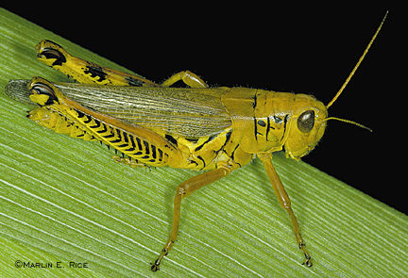
约珥
Dr. Rick Griffith • 新加坡神学院
BibleStudyDownloads.org

Slide 2
关键字
575
343
蝗虫
约珥

Slide 3
主题
308
上帝的日子
约珥

Slide 4
关键节
575
"…耶和华的日子伟大，
非常可畏，谁能忍受得住呢？耶和华说：
“现在虽然如此，
你们仍要全心全意，
以禁食、哭泣、哀号，归向我。"
(约珥 2:11b-12).
约珥

Slide 5

约珥国度声明
343
上帝透过蝗虫（1）和其他形式的灾难来（2：1-17）教训以色列民。但是，最终神在以色列真正悔改后，才恢复它完全的统治。（2：18-3：21）

Slide 6
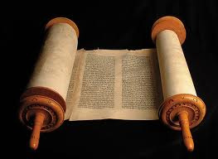
约珥书
信息声明
575
346
对犹大所执行的审判提醒我们要悔改，因为在耶和华的日子，神要藉着巴比伦的入侵带来更加悲惨的日子，但上帝仍然应许通过审判列国来执行赦免、释放和修复。

Slide 7

圣约
347c
上帝承诺将永远住在耶路撒冷（3：17-21），并差派祂的灵（2：18-32）。 这是根据祂的圣约，来保守耶路撒冷作为祂所拣选的地方。 （王上8：23-61； cf. 启21：3）
约珥

Slide 8

救赎
347c
在上帝审判中的拯救（1：1-2：17）只会出现在悔改并恳求耶和华名的以色列人身上 (2:32; cf. 2:12-14)。
约珥

Slide 9
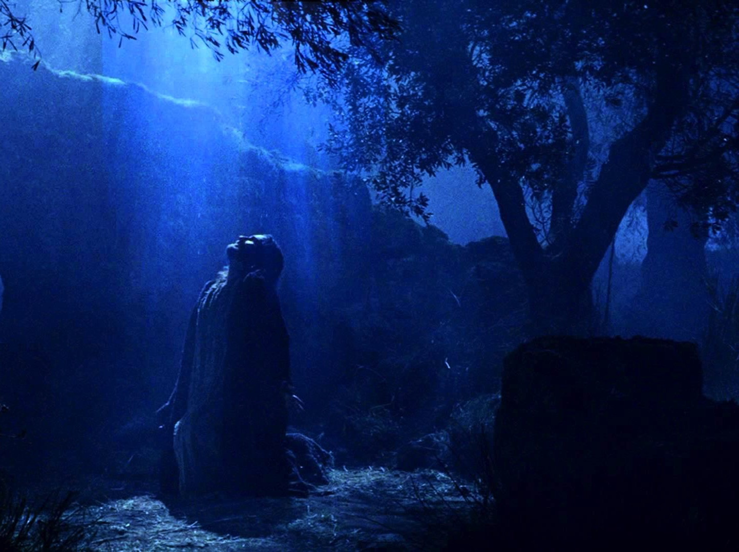
弥赛亚
347c
基督在约沙法谷的审判（珥3：2,12; cf. 马太福音25章）平衡了他在五旬节（;使徒行传2：16-21）差派的圣灵（2：28-32; 约翰福音16：7-15; 使徒行传1：8）
约珥

Slide 10
Outline 4 (Griffith)
575
上帝的日子
“蝗虫”之灾
祝福
1:1–2:17
2:18–3:21
锡安的管教
锡安的释放
上帝敌对他的子民
上帝为他的子民征战
简介
1:1-3
因蝗虫
（字面意）而悔改
1:4-20
因巴比伦/
末日
“蝗虫”
2:1-17
悔改后的赦免2:18-27
属灵的苏醒
2:28-3:21
哀歌
1:1-2:17
救恩
2:18-32
审判
3:1-21
过去
未来
犹大
约主前590
Past
Future
Judah
c. 590 BC

Slide 11
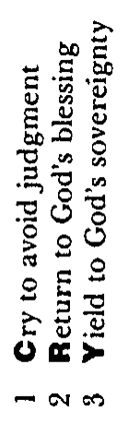
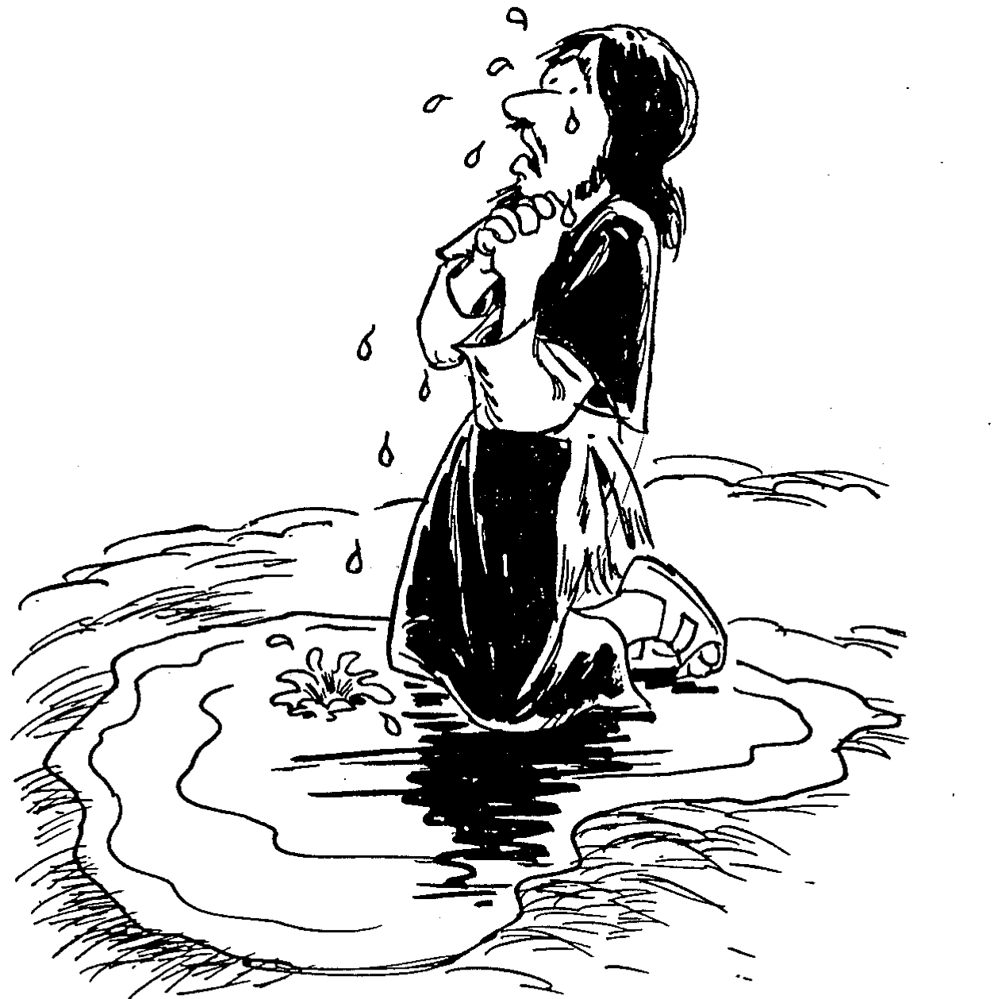
Barry Huddleston, The Acrostic Summarized Bible (Grand Rapids: Baker, 1992)
约珥
1 哭求逃避审判
2 归回神的祝福
3 顺服神的主权

Slide 12

作个有纪律的人
约珥
Dr. Rick Griffith, Crossroads International Church Singapore
BibleStudyDownloads.org

Slide 13
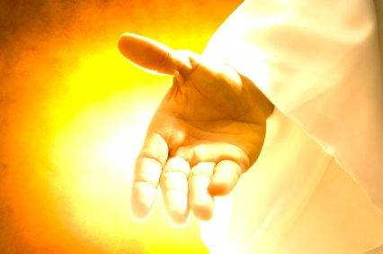
当我们受到纪律处分时，
我们该怎么办？
约珥
Notes:
让我们回到原本的问题......

Slide 14

一。纪律应该带来悔改
约珥 1:1–2:17
Notes:
困境时是改变我们观点的好时机。

Slide 15
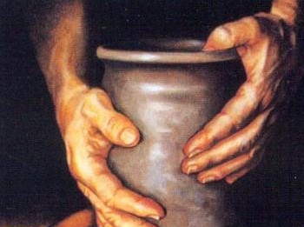
二。悔改将带来恢复
约珥 2:18–3:21
Notes:
改变我们对上帝的看法，才会改变我们的未来。

Slide 16

重点
约珥
纪律
悔改
恢复
纪律使得我们悔改；悔改使得我们
恢复与神的关系。

Slide 17

考虑的问题
一。 在悔改之前，你是否需要上帝清空你的一切？
（黄萨宾）
约珥

Slide 18
考虑的问题
二。 上帝训练你，是否是要再次引发你对祂的注意呢？
约珥

Slide 19
考虑的问题
三。您是否考虑过禁食（1:14; 2:12）或者您认为禁食不适用我们的现代社会？为什么不呢？
约珥

Slide 20
Black

Slide 21
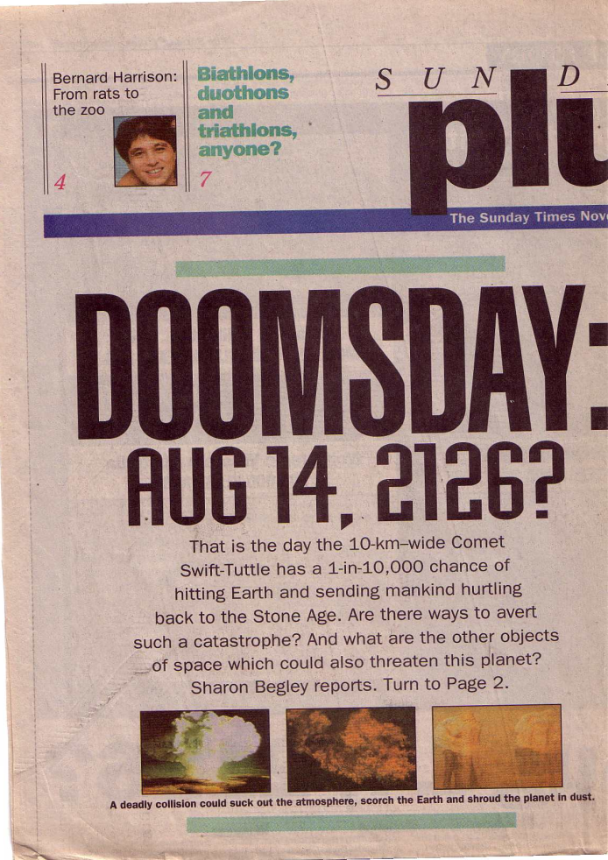
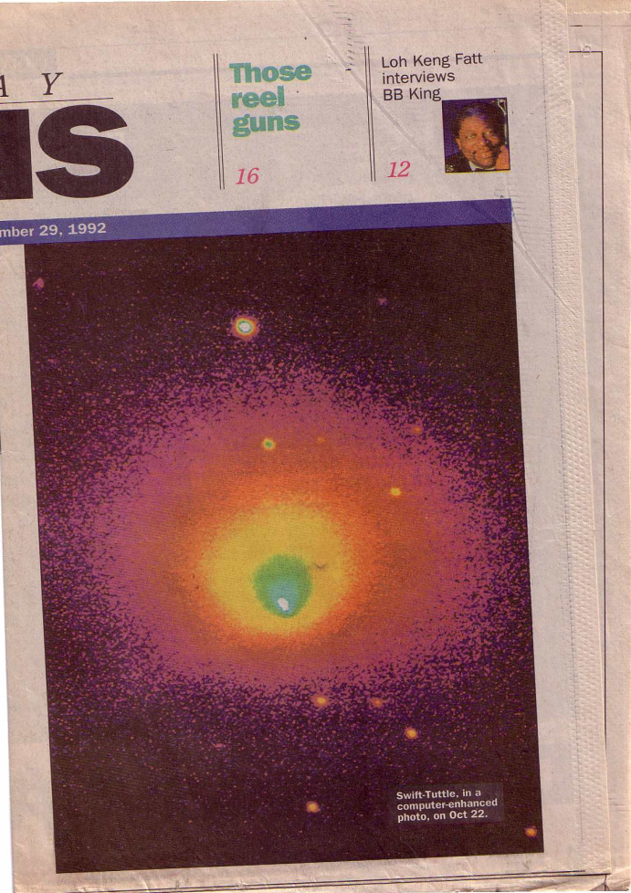
审判来了!
世界末日:
你对这个报告有何感想？

Slide 22
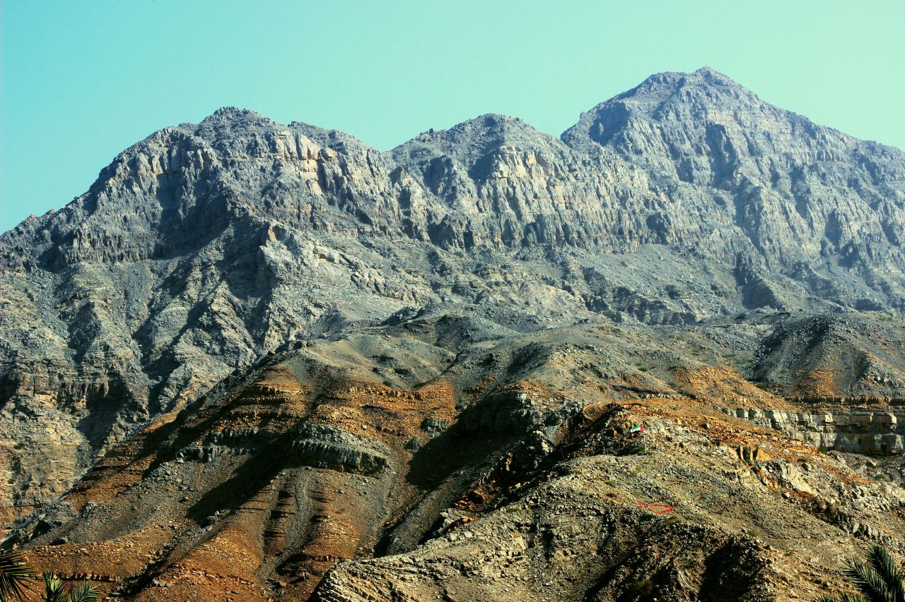
接近顶峰
Notes:
When we approach the summit of a mountain range, it looks like the peaks continually go upward.
当我们接近一座山脉的顶峰时，看起来山峰似乎不断向上延伸。

Slide 23

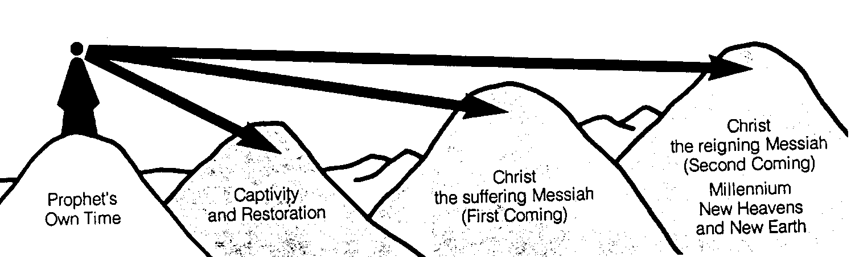
先知们的时间段
442
新天新地
基督
统治的弥赛亚
(第二次来临)
千喜年
基督
受难的弥赛亚
(第一次来临)
被掳与回归
先知所处的时代
克班.萨利姆, 启示录图表 (1979), 49

Slide 24

我们看到了山谷
Notes:
From our vantage point, we clearly see that the Messiah would come twice. It’s like being able to see the valleys between each set of peaks. However, the prophets did not see these valleys but only saw the future as a whole.
从我们的视角来看，我们清楚地看到弥赛亚会降临两次。这就像能够看到每组山峰之间的山谷一样。然而，先知们并没有看到这些山谷，而是将未来视为一个整体。

Slide 25
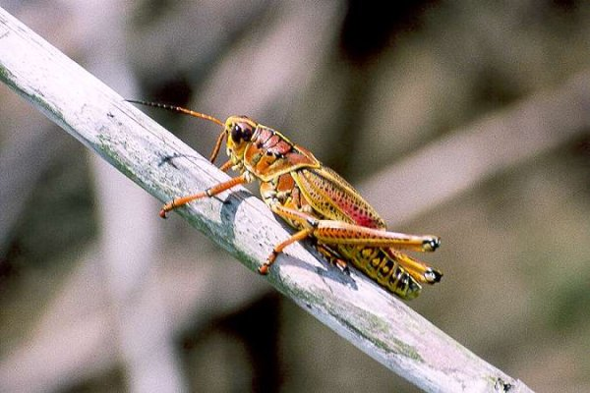
II. 结构与提纲
提纲
I. 简介
III. 接近新约
IV. 问题文本
V. 神学的价值
VI. 应用

Slide 26
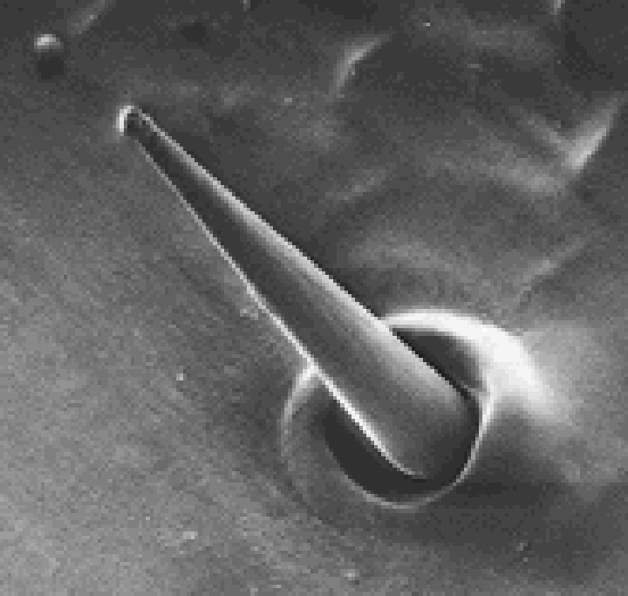
间接提纲
577
约珥书简介
A. 标题
B. 作者
C. 日期
D. 收件人
E. 场合
F. 合于圣经与文本*
G. 整体性*
Locust taste receptor

Slide 27
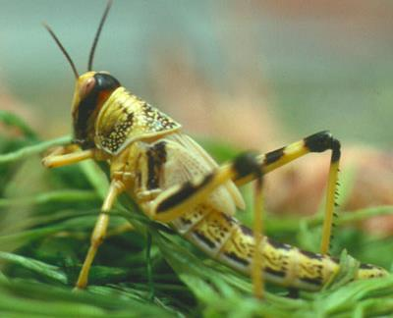
约珥书简介
A. 标题
576
laeÞAy (Yo’el): “耶和华是主”
其他相关意思可能是“意志坚强”或“寻求庇护”
B. 作者 (内部证据)
毗土珥的儿子 (1:1)
住在耶路撒冷附近 (cf. 1:9, 13-14;
2:15-17, 23, 32; 3:1, 5-6, 16-17, 20-21)
先知寺(cf. 1:13-14; 2:17)

Slide 28
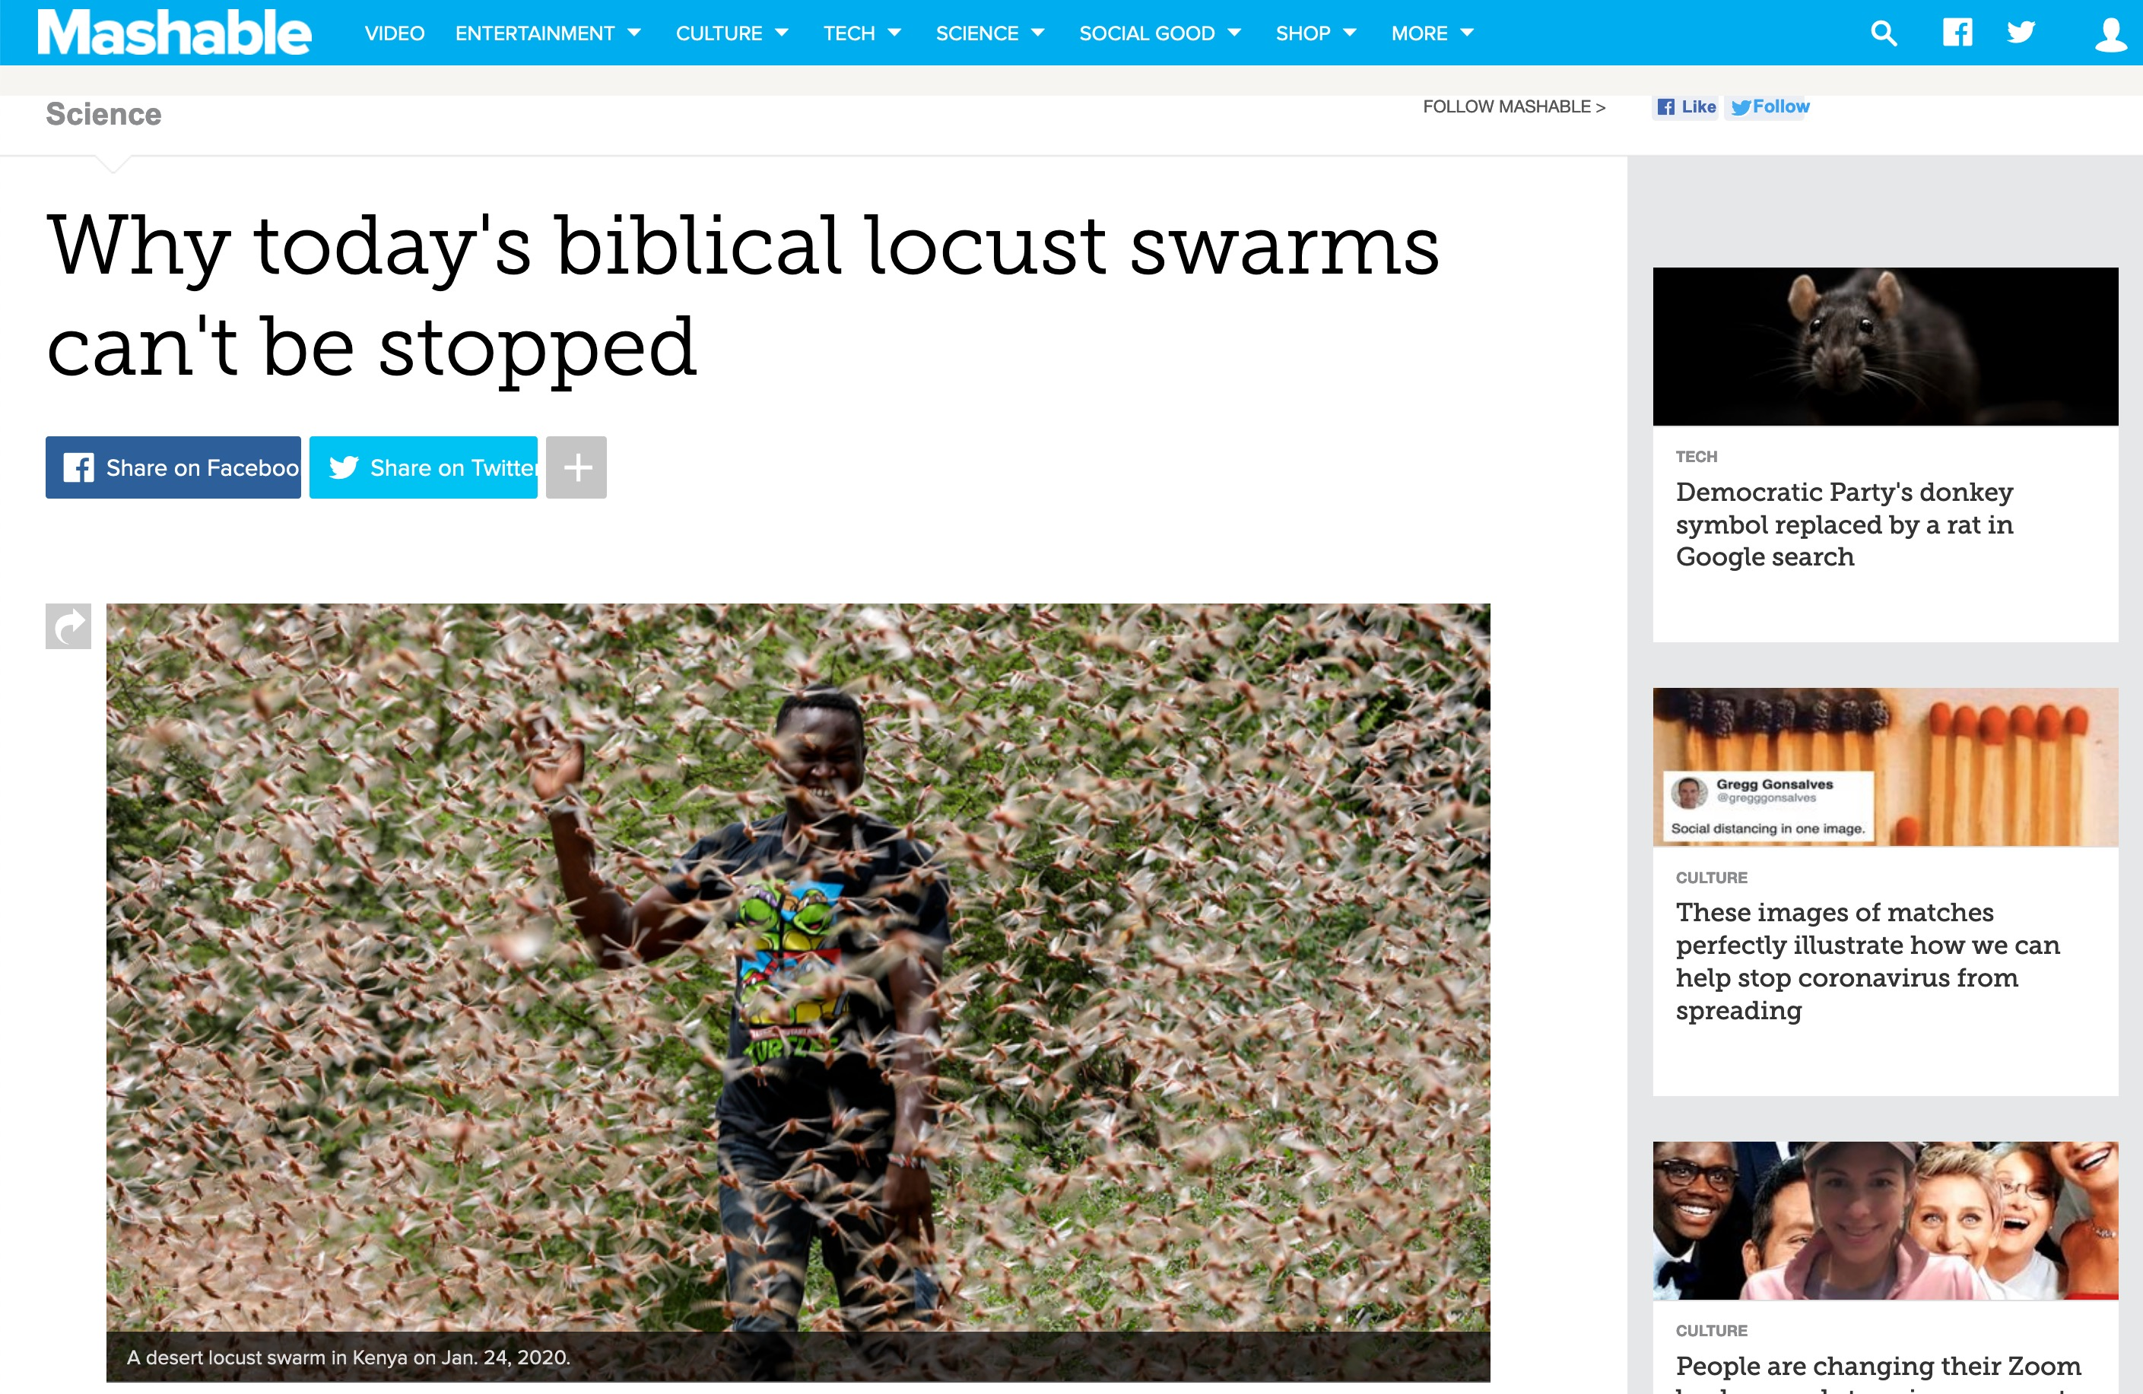
2020 年肯尼亚蝗虫
为什么今天的“圣经级”蝗灾无法被阻止
Locust swarms in Kenya on Jan. 24.
Notes:
WHOLE ARTICLE BROKEN INTO PARTS IN FOLLOWING SLIDES:
In 1937, aboard slowly-moving trains, the Army National Guard used flamethrowers in an attempt to quell a relentless plague of locusts crossing through Colorado.
But the flamethrowers failed. And so did explosives. The locusts easily endured, devouring farmland.
Over 80 years later, great locust swarms still can't be contained. Last week, the U.N. announced that desert locusts — the most devastating type — descended upon East Africa, and over the coming months the insects may increase their populations by a whopping 500-fold. "Kenya has not faced a locust threat of this magnitude in 70 years," the U.N. said.
A single swarm of locusts, which are voracious grasshopper species that can spread over 460-square miles of land, have been a scourge — at least through the eyes of humans — for thousands of years. In more modern times, the British formed an anti-locust unit at the height of World War II to combat the pests in Africa and the Middle East, and a New York Times reporter pondered, in 1976, if "swarms that darken the sky" and "denude the land of crops" could be eliminated by progressing technology. Still today, the locust affliction continues.
"It's not surprising to me that we still don’t have a grip on this," said Iain Couzin, the director of the Max Planck Institute of Animal Behavior who researches locust swarms.
Today, the best humanity can do is try and predict where the swarms will form before a massive population outbreak can occur and ultimately consume vast tracts of crops, which are often rural people's sustenance. "You need to catch it early," said Rick Overson, the research coordinator at Arizona State University's Global Locust Initiative.
Locust swarms in Kenya on Jan. 24.
Image: Ben Curtis / AP / Shutterstock
Desert locust movements and prediction released on Jan. 28, 2020.
Image: UN Fao
Once locusts grow wings as mature adults, there's no turning back. "They’re powerful fliers," said Overson. "They can be in one country and move to another by the end of the week." And "during plagues" of the desert locust, the U.N. notes swarms can "affect 20 percent of the Earth's land, more than 65 of the world's poorest countries, and potentially damage the livelihood of one-tenth of the world's population."
After an outbreak occurs or the swarming begins, the blunt strategy is often to drop millions of liters of chemical pesticides on the insects, which is bad for the environment and human health, Overson explained.
But identifying exactly where the locusts start to swarm can be enormously daunting, especially when it comes to desert locusts in Africa and neighboring areas, which naturally inhabit remote, mostly-uninhabited regions some 16 million square kilometers, or over 6 million square miles, in size. The creatures usually live solitary lives, but, when the right environmental conditions align (like after a good rainy season), the creatures become intensely attracted to each other, change color, and often grow longer wings and become more muscular. They transform into a formidable swarm.
"Locusts are highly cannibalistic" "We’re not going to solve this problem as a human society anytime soon," Overson said.
Critically, humanity shouldn't endeavor to completely wipe out locust swarms, just because their populations can explode. After all, locust swarms are wild, natural phenomena. Attempting to eliminate the insects, even if that were possible, could have unforeseen, cascading environmental consequences. "It's one of the wonders of the natural world," said Couzin."We don't want to stop them. We just want to manage them."
Locust swarms have similarities to wildfires, explained Overson. Sure, no one wants their house to burn down. But wide-scale suppression of wildfire, a natural phenomenon, has resulted in vastly overgrown forests, contributing to explosive infernos in the Western U.S. What might killing billions of locusts do? It's best not to find out.
To fend off some super-swarms from devouring human food, the primary mission today is prediction. The Food and Agricultural Organization of the United Nations currently strives to forecast the swarms. Where will the locusts strike? Locust populations can explode after the right rains, at the right times, or after mild winters, explained Overson.
But, there's a slew of other things to better account for stressed Couzin. "We’re at the tip of the iceberg of what we need to know" for better predictions, he said, like how billions of insects will react to changing weather, what there is to eat hundreds of miles ahead — and how much locusts will eat each other.
The green "recession area" is where locusts naturally live, before swarming.
Image: nasa
A Kenyan farmer picks up a desert locust in Jan. 2020.
Image: DAI KUROKAWA / EPA-EFE / Shutterstock
"Locusts are highly cannibalistic," explained Couzin, noting that they start cannibalizing when swarming begins and food starts to vanish. "As soon as resources are limited they turn on each other."
Though locust swarms impact about one in 10 people on Earth, there's a glaring lack of funding for swarm research. In part, this is because the swarms exist in boom and bust cycles, so there might be less research interest in the years, or sometimes decades, between outbreaks. What's more, Couzin pointed out that locust swarms usually aren't descending upon the rich world. "It's affecting poor people," he said, so there's a lack of interest from wealthier nations.
Humanity, though, isn't a completely hapless observer as clouds of locusts come swarming from the horizon. It's quite likely civilization is giving these swarms a boost, both Couzin and Overson agreed.
"We’re trying to change the dogma that humans are passive victims of locust swarms," said Overson.
SEE ALSO: Why Australia won't escape its vicious fire spiral
We irrigate vast tracts of land, providing locusts with the carbohydrate-rich foods they (and we) love. Climate change might make swarms more extreme, as rainfall events become more intense on a warming planet, perhaps giving rise to swarms feeding on plentiful growth following deluges. These questions demand more research.
In the coming months, locusts in East Africa will devour plants and croplands before their food runs out and they fade away — until the next swarm. It's what they're destined to do.
"It's quite extraordinary," said Couzin. "The locusts have found this trick to survive in booms and busts."
"It works well for them," he added. "Unfortunately, it doesn't work well for us."
Why today's biblical locust swarms can't be stopped
By Mark Kaufman Jan 28, 2020
https://mashable.com/article/locust-swarm-africa-explained/
Accessed 17 March 2020
1937年，在缓慢行驶的火车上，美国陆军国民警卫队尝试用火焰喷射器扑灭穿越科罗拉多州的一场顽强的蝗灾。
但火焰喷射器没能成功，炸药也无济于事。这些蝗虫顽强地存活下来，吞噬了农田。
80多年后，巨大的蝗虫群仍然无法被控制。上周，联合国宣布，沙漠蝗虫——最具破坏性的一种——袭击了东非，并在接下来的几个月中，其数量可能会增加到当前的500倍之多。“肯尼亚面临70年来最严重的蝗灾，”联合国表示。
一群蝗虫是一种贪婪的蚂蚱类昆虫，它们能覆盖460平方英里的土地，千百年来一直是人类眼中的灾祸。
在更现代的历史中，英国在第二次世界大战高峰期组建了一支反蝗虫部队，以应对非洲和中东的蝗虫灾害。而在1976年，《纽约时报》的一位记者思考，随着技术的进步，那些“遮天蔽日的蝗群”和“将土地上的作物一扫而光的蝗灾”是否能够被消灭。但直到今天，蝗灾的问题仍在持续。
“我一点也不惊讶我们至今仍未能解决这一问题，”马克斯·普朗克动物行为研究所的所长伊恩·库辛（Iain Couzin）说道，他专注于研究蝗虫群体行为。
如今，人类所能做的最好的方法是试图预测蝗群将在何处形成，以便在大规模蝗虫暴发并最终吞噬大片作物之前采取行动。
“你必须及早发现，”亚利桑那州立大学全球蝗虫计划的研究协调员里克·奥弗森（Rick Overson）说道。
图片：2020年1月24日，肯尼亚的蝗虫群。（图片来源：Ben Curtis / AP / Shutterstock）
图片：2020年1月28日，联合国粮农组织发布的沙漠蝗虫移动预测。（图片来源：UN FAO）
一旦蝗虫长出翅膀成为成熟的成虫，就没有回头路了。
“它们飞行能力极强，”奥弗森说。“它们可以在一个国家呆一天，到一周后就飞到另一个国家。”联合国指出，在沙漠蝗虫“灾害”期间，蝗群可能“影响地球20%的土地、65个世界上最贫困的国家，并可能破坏全球十分之一人口的生计”。
在暴发或蝗虫成群结队时，人类通常采取的粗暴策略是向这些昆虫投放数百万升的化学杀虫剂，但这对环境和人类健康都极为有害，奥弗森解释道。
但是，要准确识别蝗群的起源地非常困难，特别是对于非洲和邻近地区的沙漠蝗虫来说。
它们通常栖息在面积达1600万平方公里（约600万平方英里）的偏远且基本无人居住的区域。这些蝗虫通常过着独居生活，但在适宜的环境条件下（比如雨季过后），它们会变得对彼此强烈吸引，改变颜色，翅膀变长，身体更强壮，最终形成一支可怕的蝗虫群。
“蝗虫是高度同类相食的，”奥弗森说，“人类社会短时间内无法解决这一问题。”
关键的是，人类不应该试图完全消灭蝗群，因为它们是野生的自然现象。
即使能够做到，这也可能带来意想不到的生态后果。“这是自然界的奇迹之一，”库辛说道。“我们并不想完全阻止它们，我们只是想管理它们。”
蝗虫群与野火有相似之处。
奥弗森解释说，当然，没有人希望自己的房子被烧毁。但对野火这一自然现象的大范围压制，导致了森林过度生长，从而促成了美国西部的爆炸性大火。那么，杀死数十亿蝗虫会带来什么后果？最好不要去尝试。
为了防止超大规模蝗群吞噬人类的食物，当前的主要任务是预测。联合国粮农组织目前致力于预测蝗群的袭击地点。蝗虫种群可能在适宜的降雨、适当的时机或温和的冬季后迅速暴增，奥弗森解释道。
但仍有许多未知需要研究。
库辛强调，“我们目前只掌握了冰山一角的知识。”例如，数十亿昆虫如何应对天气变化？几百英里之外的食物情况如何？蝗虫会吃多少同类？
图片：蝗虫自然栖息地（绿色区域），这是它们开始成群结队前的栖息地。（图片来源：NASA）
图片：2020年1月，肯尼亚一位农民抓住一只沙漠蝗虫。（图片来源：DAI KUROKAWA / EPA-EFE / Shutterstock）
“蝗虫是高度同类相食的，”库辛解释道。
当食物开始短缺时，它们会开始互相吞噬。“一旦资源有限，它们就会彼此攻击。”
尽管蝗虫群影响了地球上约十分之一的人口，但对蝗虫研究的资金却严重不足。这部分是因为蝗灾呈现“繁荣-衰退”周期，在间歇期的几年甚至几十年间，研究兴趣可能会减少。此外，库辛指出，蝗灾通常不会侵袭富裕国家。“它影响的是贫困人口，”因此富裕国家的兴趣有限。
不过，人类并非完全无助于蝗群的到来。
库辛和奥弗森一致认为，人类活动很可能助长了这些蝗群。
“我们正在努力改变‘人类是蝗灾受害者’这一观念，”奥弗森说道。
我们灌溉了大片土地，为蝗虫（以及人类）提供了它们喜爱的富含碳水化合物的食物。
气候变化可能使蝗灾更加极端，因为随着地球变暖，降雨事件变得更为强烈，这可能导致蝗虫群在丰沛的植被上繁殖壮大。这些问题需要更多的研究。
在接下来的几个月中，东非的蝗虫将吞噬植物和农田，直到它们的食物耗尽并逐渐消失——直到下一次蝗灾再次来临。这是它们的宿命。
“这非常非凡，”库辛说道。“蝗虫找到了这种在繁荣与萧条中生存的方式。”
“这对它们非常有用，”他补充道。“不幸的是，这对我们不利。”
标题：为什么今天的“圣经级”蝗灾无法被阻止
作者：Mark Kaufman
发布时间：2020年1月28日
访问时间：2020年3月17日

Slide 29
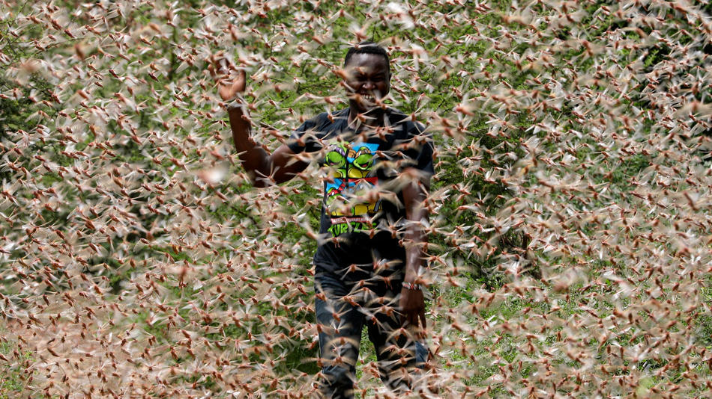
2020 年肯尼亚蝗虫
2020 年 1 月 24 日，肯尼亚的沙漠蝗虫群。
Notes:
In 1937, aboard slowly-moving trains, the Army National Guard used flamethrowers in an attempt to quell a relentless plague of locusts crossing through Colorado.
But the flamethrowers failed. And so did explosives. The locusts easily endured, devouring farmland.
Over 80 years later, great locust swarms still can't be contained. Last week, the U.N. announced that desert locusts — the most devastating type — descended upon East Africa, and over the coming months the insects may increase their populations by a whopping 500-fold. "Kenya has not faced a locust threat of this magnitude in 70 years," the U.N. said.
Why today's biblical locust swarms can't be stopped
By Mark Kaufman Jan 28, 2020
https://mashable.com/article/locust-swarm-africa-explained/
Accessed 17 March 2020
1937年，美国陆军国民警卫队乘坐缓慢行驶的火车，试图用火焰喷射器来遏制穿越科罗拉多州的顽强蝗灾。
但火焰喷射器失败了，炸药也没有奏效。这些蝗虫轻而易举地存活下来，吞噬了农田。
80多年后，大规模的蝗虫群仍然无法被控制。上周，联合国宣布，沙漠蝗虫——最具破坏性的一种——袭击了东非。在接下来的几个月里，这些昆虫的数量可能会增加500倍之多。“肯尼亚70年来从未面临如此严重的蝗灾，”联合国表示。
标题：为什么今天的“圣经级”蝗灾无法被阻止
作者：马克·考夫曼（Mark Kaufman）
发布时间：2020年1月28日
访问时间：2020年3月17日
来源链接

Slide 30
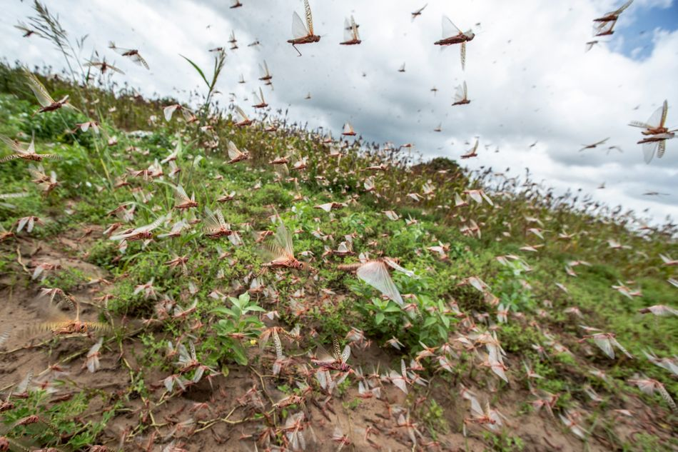
2020 年肯尼亚蝗虫
2020 年 1 月 24 日，肯尼亚的沙漠蝗虫群。
Notes:
A single swarm of locusts, which are voracious grasshopper species that can spread over 460-square miles of land, have been a scourge — at least through the eyes of humans — for thousands of years. In more modern times, the British formed an anti-locust unit at the height of World War II to combat the pests in Africa and the Middle East, and a New York Times reporter pondered, in 1976, if "swarms that darken the sky" and "denude the land of crops" could be eliminated by progressing technology. Still today, the locust affliction continues.
"It's not surprising to me that we still don’t have a grip on this," said Iain Couzin, the director of the Max Planck Institute of Animal Behavior who researches locust swarms.
Today, the best humanity can do is try and predict where the swarms will form before a massive population outbreak can occur and ultimately consume vast tracts of crops, which are often rural people's sustenance. "You need to catch it early," said Rick Overson, the research coordinator at Arizona State University's Global Locust Initiative.
Locust swarms in Kenya on Jan. 24.
Image: Ben Curtis / AP / Shutterstock
Why today's biblical locust swarms can't be stopped
By Mark Kaufman Jan 28, 2020
https://mashable.com/article/locust-swarm-africa-explained/
Accessed 17 March 2020
一群蝗虫——一种贪婪的蚱蜢类昆虫——可以覆盖460平方英里的土地，数千年来一直是人类眼中的灾难。
在更现代的历史中，英国曾在第二次世界大战高峰期组建了一支反蝗虫部队，以应对非洲和中东的蝗虫灾害。而在1976年，《纽约时报》的一位记者曾思考，随着技术的进步，那些“遮天蔽日的蝗群”和“将土地上的作物一扫而光的灾难”是否能够被消灭。然而，直到今天，蝗灾问题依然存在。
“我一点也不惊讶我们至今仍未能解决这一问题，”马克斯·普朗克动物行为研究所的所长伊恩·库辛（Iain Couzin）说道，他专注于研究蝗虫群体行为。
如今，人类所能做的最好的办法是试图预测蝗群将在何处形成，防止大规模种群暴发并最终吞噬大片农作物，这些农作物往往是农村人口的主要生活来源。
“你必须及早发现，”亚利桑那州立大学全球蝗虫计划的研究协调员里克·奥弗森（Rick Overson）说道。
2020年1月24日，肯尼亚的蝗虫群。
图片来源：Ben Curtis / AP / Shutterstock
标题：为什么今天的“圣经级”蝗灾无法被阻止
作者：马克·考夫曼（Mark Kaufman）
发布时间：2020年1月28日
访问时间：2020年3月17日
来源链接

Slide 31
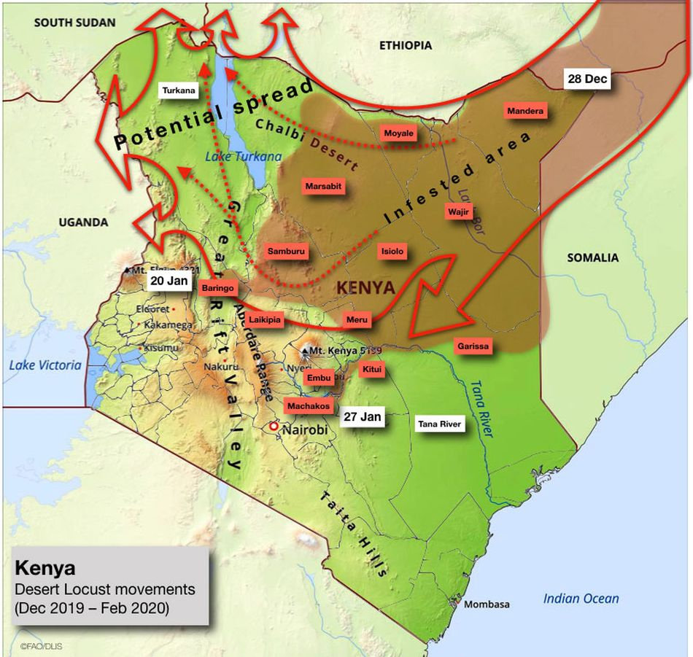
2020 Kenyan Locusts
Desert locust movements and prediction released on Jan. 28, 2020
Notes:
Once locusts grow wings as mature adults, there's no turning back. "They’re powerful fliers," said Overson. "They can be in one country and move to another by the end of the week." And "during plagues" of the desert locust, the U.N. notes swarms can "affect 20 percent of the Earth's land, more than 65 of the world's poorest countries, and potentially damage the livelihood of one-tenth of the world's population."
After an outbreak occurs or the swarming begins, the blunt strategy is often to drop millions of liters of chemical pesticides on the insects, which is bad for the environment and human health, Overson explained.
But identifying exactly where the locusts start to swarm can be enormously daunting, especially when it comes to desert locusts in Africa and neighboring areas, which naturally inhabit remote, mostly-uninhabited regions some 16 million square kilometers, or over 6 million square miles, in size. The creatures usually live solitary lives, but, when the right environmental conditions align (like after a good rainy season), the creatures become intensely attracted to each other, change color, and often grow longer wings and become more muscular. They transform into a formidable swarm.
"Locusts are highly cannibalistic" "We’re not going to solve this problem as a human society anytime soon," Overson said.
Critically, humanity shouldn't endeavor to completely wipe out locust swarms, just because their populations can explode. After all, locust swarms are wild, natural phenomena. Attempting to eliminate the insects, even if that were possible, could have unforeseen, cascading environmental consequences. "It's one of the wonders of the natural world," said Couzin."We don't want to stop them. We just want to manage them."
Why today's biblical locust swarms can't be stopped
By Mark Kaufman Jan 28, 2020
https://mashable.com/article/locust-swarm-africa-explained/
Accessed 17 March 2020
一旦蝗虫长出翅膀成为成熟的成虫，就没有回头路了。
“它们是强大的飞行者，”里克·奥弗森（Rick Overson）说道。“它们可以在一个国家停留一天，到一周后就飞到另一个国家。”联合国指出，在沙漠蝗虫的“灾害”期间，蝗群可能“影响地球20%的土地、65个世界上最贫困的国家，并可能破坏全球十分之一人口的生计。”
在蝗灾暴发或蝗虫开始成群结队时，人们通常采取粗暴的策略：向这些昆虫投放数百万升化学杀虫剂。
奥弗森解释道，这对环境和人类健康都非常不利。
但要准确地识别蝗虫开始集群的地点是非常困难的，
尤其是对于非洲及邻近地区的沙漠蝗虫。这些蝗虫通常栖息在广阔、偏远且几乎无人居住的区域，这些区域面积约为1600万平方公里（超过600万平方英里）。它们通常过着独居生活，但在适宜的环境条件下（例如雨季过后），它们会变得对彼此强烈吸引，改变颜色，并通常长出更长的翅膀，变得更强壮，最终形成一支可怕的蝗虫群。
“蝗虫是高度同类相食的。”
“我们作为一个人类社会，短期内无法解决这一问题，”奥弗森说道。
关键是，人类不应该仅仅因为蝗虫数量暴增就试图彻底消灭蝗虫群。
毕竟，蝗虫群是野生的自然现象。即使能够消灭这些昆虫，这也可能带来意想不到的连锁生态后果。“这是自然界的奇迹之一，”伊恩·库辛（Iain Couzin）说道。“我们并不想完全阻止它们，我们只是想管理它们。”
标题：为什么今天的“圣经级”蝗灾无法被阻止
作者：马克·考夫曼（Mark Kaufman）
发布时间：2020年1月28日
访问时间：2020年3月17日
来源链接

Slide 32
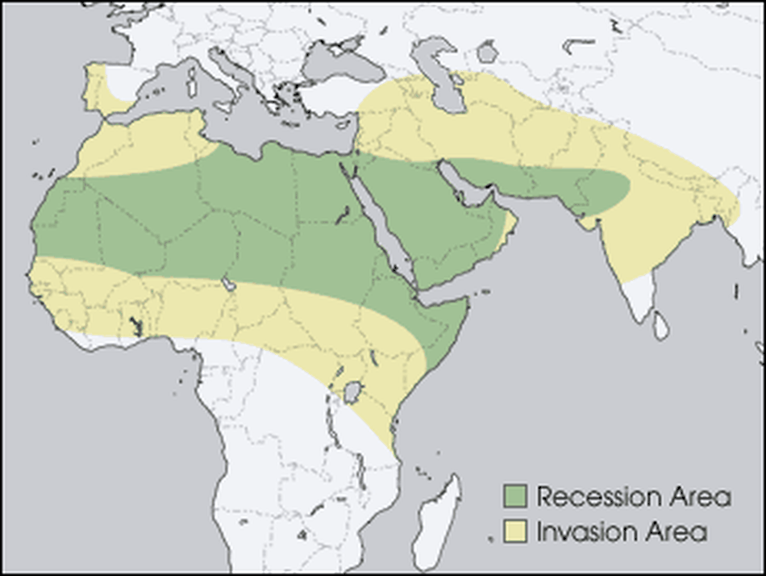
2020 年肯尼亚蝗虫
绿色的“退却区”是蝗虫在成群结队前自然栖息的地方
Notes:
Locust swarms have similarities to wildfires, explained Overson. Sure, no one wants their house to burn down. But wide-scale suppression of wildfire, a natural phenomenon, has resulted in vastly overgrown forests, contributing to explosive infernos in the Western U.S. What might killing billions of locusts do? It's best not to find out.
To fend off some super-swarms from devouring human food, the primary mission today is prediction. The Food and Agricultural Organization of the United Nations currently strives to forecast the swarms. Where will the locusts strike? Locust populations can explode after the right rains, at the right times, or after mild winters, explained Overson.
But, there's a slew of other things to better account for stressed Couzin. "We’re at the tip of the iceberg of what we need to know" for better predictions, he said, like how billions of insects will react to changing weather, what there is to eat hundreds of miles ahead — and how much locusts will eat each other.
The green "recession area" is where locusts naturally live, before swarming.
Image: nasa
Why today's biblical locust swarms can't be stopped
By Mark Kaufman Jan 28, 2020
https://mashable.com/article/locust-swarm-africa-explained/
Accessed 17 March 2020
奥弗森解释道，蝗虫群与野火有相似之处。
当然，没有人希望自己的房子被烧毁。但对野火这一自然现象的大范围压制，导致了森林的过度生长，从而促成了美国西部的爆炸性大火。那么，杀死数十亿蝗虫可能带来什么后果？最好不要去尝试。
为了防止超大规模蝗虫群吞噬人类的食物，当下的主要任务是预测。
联合国粮农组织目前致力于预测蝗虫群的活动。蝗虫会袭击哪里？奥弗森解释说，蝗虫种群可能在适宜的降雨、适当的时机或温和的冬季后迅速暴增。
但库辛强调，还有许多其他因素需要更好地考虑。
“我们目前只掌握了冰山一角的知识，”他说。要进行更好的预测，还需要了解数十亿昆虫如何应对天气变化，几百英里之外的食物状况，以及蝗虫之间会相互吞食多少。
绿色的“萧条区域”是蝗虫在成群结队之前的自然栖息地。
图片来源：NASA
标题：为什么今天的“圣经级”蝗灾无法被阻止
作者：马克·考夫曼（Mark Kaufman）
发布时间：2020年1月28日
访问时间：2020年3月17日
来源链接

Slide 33
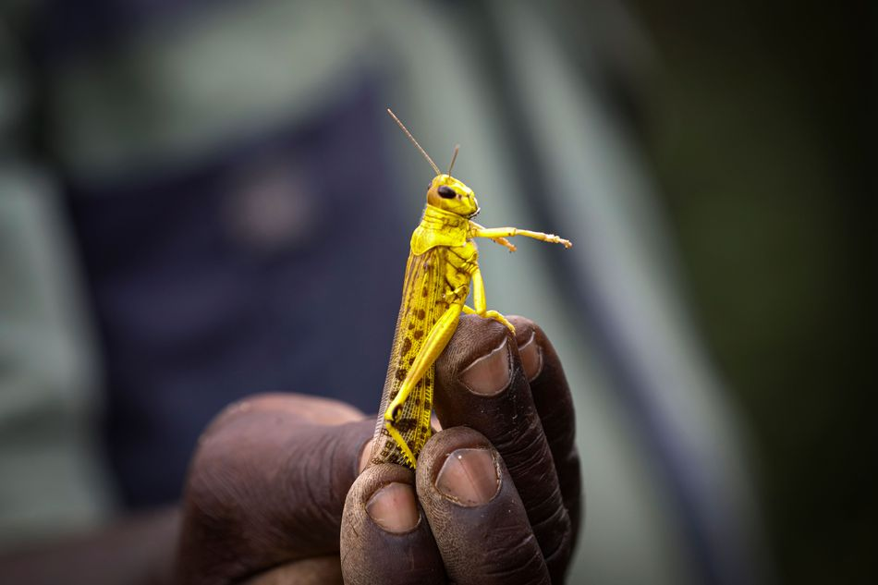
2020 年肯尼亚蝗虫
2020 年 1 月，一名肯尼亚农民捡到一只沙漠蝗虫。
Notes:
Though locust swarms impact about one in 10 people on Earth, there's a glaring lack of funding for swarm research. In part, this is because the swarms exist in boom and bust cycles, so there might be less research interest in the years, or sometimes decades, between outbreaks. What's more, Couzin pointed out that locust swarms usually aren't descending upon the rich world. "It's affecting poor people," he said, so there's a lack of interest from wealthier nations.
Humanity, though, isn't a completely hapless observer as clouds of locusts come swarming from the horizon. It's quite likely civilization is giving these swarms a boost, both Couzin and Overson agreed.
"We’re trying to change the dogma that humans are passive victims of locust swarms," said Overson.
SEE ALSO: Why Australia won't escape its vicious fire spiral
We irrigate vast tracts of land, providing locusts with the carbohydrate-rich foods they (and we) love. Climate change might make swarms more extreme, as rainfall events become more intense on a warming planet, perhaps giving rise to swarms feeding on plentiful growth following deluges. These questions demand more research.
In the coming months, locusts in East Africa will devour plants and croplands before their food runs out and they fade away — until the next swarm. It's what they're destined to do.
"It's quite extraordinary," said Couzin. "The locusts have found this trick to survive in booms and busts."
"It works well for them," he added. "Unfortunately, it doesn't work well for us."
Why today's biblical locust swarms can't be stopped
By Mark Kaufman Jan 28, 2020
https://mashable.com/article/locust-swarm-africa-explained/
Accessed 17 March 2020
尽管蝗虫群影响了全球约十分之一的人口，但对蝗虫研究的资金却严重不足。
部分原因是蝗虫灾害呈现“繁荣-萧条”周期，在间歇期的几年甚至几十年间，研究兴趣可能会减弱。此外，库辛指出，蝗虫群通常不会袭击富裕国家。“它影响的是贫困人口，”他说，因此富裕国家对此兴趣不足。
然而，人类并非在面对蝗虫群时完全无助。
库辛和奥弗森都认为，人类的活动很可能助长了这些蝗虫群。
“我们正在努力改变‘人类是蝗灾受害者’这一观念，”奥弗森说道。
此外，人类的大规模灌溉，为蝗虫提供了它们（和我们）喜爱的富含碳水化合物的食物。
气候变化可能使蝗灾更加极端，因为随着地球变暖，降雨事件变得更为强烈，可能导致蝗虫群在丰沛的植被上繁殖壮大。这些问题需要更多的研究。
在接下来的几个月里，东非的蝗虫将吞噬植物和农田，直到它们的食物耗尽并逐渐消失——直到下一次蝗灾再次来临。这是它们的宿命。
“这非常非凡，”库辛说道。“蝗虫找到了这种在繁荣与萧条中生存的方式。”
“这对它们非常有用，”他补充道。“但不幸的是，这对我们人类却不利。”
标题：为什么今天的“圣经级”蝗灾无法被阻止
作者：马克·考夫曼（Mark Kaufman）
发布时间：2020年1月28日
访问时间：2020年3月17日
来源链接

Slide 34
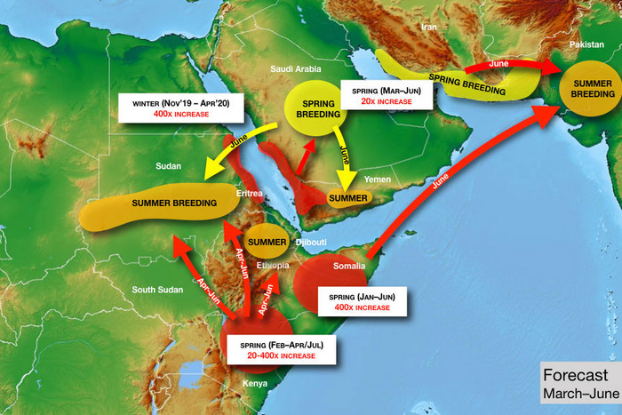
2020 年肯尼亚蝗虫
Photo: United Nations
Notes:
just asking questions Mar. 14, 2020
So There’s a Locust Plague Too?
By Matt Stieb
A volunteer sprays pesticide in eastern Kenya — which is suffering from its worst locust outbreak in 70 years. Photo: Tony Karumba/AFP via Getty Images
It’d be easy to quip biblically about the simultaneous breakout of pandemic and plague if not for the vast human toll that the intercontinental crises are exacting. As the coronavirus continues to spread on six continents, a desert locust outbreak has inundated East Africa with hundreds of billions of bugs, causing food shortages in Kenya, Somalia, and Ethiopia. “It was like an umbrella had covered the sky,” Joseph Katone Leparole, a 68-year-old living in central Kenya, told the New York Times.
In our age of overlapping crises, it shouldn’t be a surprise that climate change can be identified as a factor in the upsurge, the technical term used for such a natural disaster that is just below plague. It began in 2018, when a pair of cyclones came in from the Indian Ocean and hit the “empty quarter” of the Arabian peninsula — the vast desert region near the borders of Saudi Arabia, Yemen, and Oman. In a speech before the African Union in February, U.N. general secretary António Guterres explained the unfortunate cycle: “Warmer seas mean more cyclones, generating the perfect breeding ground for locusts.”
“When you have rains associated with cyclones, they’re much stronger than normal,” said Keith Cressman, the senior locust-forecasting officer at the United Nations’ Food and Agriculture Organization. “When those rains fall in desert areas with sandy soil, that will flood the soil. Once those floods recede, the soil retains so much moisture that it allows desert locust females to lay their eggs probably for a period of around six months.”
From these ideal conditions, the bugs moved south into Yemen (already in a food crisis, Yemenis turned to them as a protein source) and into the Horn of Africa. The spread was rapid: A single locust can travel up to 90 miles in a day and eat its own weight in plant matter, of which there was a bounty, thanks to the excessive rains. They also turned north, across the Persian Gulf into Iran, and into India and Pakistan last summer. National emergencies have been declared in Pakistan, Jordan, and Somalia to help mobilize a response: The only effective control operation once a swarm is in motion is to spray pesticide directly on the bugs from the air.
To help understand the crisis, Intelligencer spoke with the FAO’s Cressman about some of the bugs’ idiosyncrasies and what to expect in the coming months.
Today Only! Save 60% on unlimited access to Intelligencer and everything else New York
LEARN MORE » The FAO projects that the number of locusts could grow 400 times by June if not treated. Could you break that down?
The life cycle of a locust is about three months, so after three months the adults are ready to lay eggs again. With each three-month generation, there’s a 20-fold increase in locust numbers. Locust females lay around 300 or more eggs — more than 90 percent of them die or the resulting hoppers don’t make it to adulthood. Out of all that breeding, for every single female locust there’s about 20 locusts in the new generation that make it. It’s an exponential increase, so after three months you have 20 times, after six months you have 20 squared, so that’s 400 times. After nine months, you’d have 20 cubed, which is 8,000 times. When you get that type of exponential breeding, then those locust numbers rapidly increase, and that’s how swarms form, basically.
So with these new generations, countries in East Africa that have already been inundated could face even more locusts?
Absolutely. There’s a generation in progress now and breeding in Ethiopia, Somalia, and in Kenya. Conditions will probably remain favorable there because of a cyclone in northeastern Somalia in December. Conditions are probably favorable in those three countries until June, so that will allow another generation to occur before then.
How are the outbreaks in Pakistan, Iran, and China connected to those in East Africa?
For China, it’s a completely different species — apples and oranges. But the one in Iran and Pakistan, yes. What’s going on now in Pakistan is old swarms leftover from last summer that have been slowly maturing and now they’re ready to lay eggs, not in the deserts on the border of India and Pakistan but in the desert closer to Iran and Afghanistan.
There’s an FAO map that shows them traveling directionally from the horn of Africa over Arabian sea. Can they travel over water?
No problem. In the late ’80s, they went from West Africa to the Caribbean. They crossed the Atlantic in about ten days.
Photo: United Nations
How does that work if there’s no food?
They eat a lot before or after! The way it worked crossing the Atlantic was, they had enough fuel in the tanks but still needed to rest sometimes, so they’d rest onboard ships, and then they’d take off again. If there weren’t any ships, they’d land on the surface of the ocean, and then a second swarm would come and land on top of the first swarm and rest, and the second swarm would take off and continue flying and the first swarm would drown.
My impression was that they choose to go where food is. Do they have choice as a unit where they’re going or is it randomized by wind?
They seem to decide whether they want to take off or fly with the prevailing wind or not, in which case they’ll sit on the ground. They can somehow sense winds when they come from different directions, but they can’t fly like birds against the wind. So they are a victim of the wind, but still they do control motion to an extent.
Without human intervention, how does a locust outbreak end?
There would have to be a failure of the seasonal rains — that’s usually how mother nature helps to bring these things under control. Sometimes the winds will push locusts into areas they just don’t want to be in. For instance, if they got pushed further into the Democratic Republic of the Congo or into cold areas where they would die, or areas that are very tropical where they would pick up a lot of pathogens and die. They’re very susceptible to funguses. Like those guys that got pushed across the Atlantic ocean in the ’80s, they died immediately when they landed.
What happens in a country like Iran where there’s a simultaneous outbreak of locusts and the coronavirus.
Fortunately, different parts of the government are responding, so the Ministry of Agriculture is dealing with locusts and the Ministry of Health has to deal with the coronavirus. The resources and manpower are in completely different sectors of the economy. But any additional challenges that a country faces, they can have impacts on the control operations, and they might not be as effective as hoped.
What about states in open conflict or with major security issues, like Yemen or Somalia?
Yemen is very critical because it’s a frontline country for desert locusts. Desert locusts are there every year, and there’s a number of different breeding areas along the coast in the wintertime in the interior. It’s a country that has a really spectacular habitat for desert locusts, and when it rains, those locusts take advantage of it.
That’s probably one of the reasons why the locust infestation shifted from the empty corridor in 2019 across to the Horn of Africa in the summer, because they stopped off in Yemen for a generation of breeding in the spring. Because of the conflict, there’s very little that can be done. It’s just not safe for the national locust teams to to operate throughout the country to undertake the survey for control operations. There are a few limited areas they can work in, but it simply isn’t enough.
Fortunately, in Somalia, the key locust breeding areas are in the north of the country, which is a region that’s much easier to operate in. It’s much safer, so national teams can get in there and do the survey and control operations. However, in the south and central parts of the country, it is much more challenging. Those parts of the country don’t see locusts often, maybe once every few decades, so they also have very little capacity.
What about in South Sudan, where there is already a food shortage?
The good news is, it’s not really their typical habitat. It’s not dry enough, and they don’t have so much sandy soil. It’s more of a clay soil, and there’s much more vegetation cover, so this makes it hard for the females to find bare, empty places to lay their eggs. And we’ve seen this with those locusts that got into northeastern Uganda and the southeast of South Sudan: They flew around, and the females became so desperate that they just kind of dropped their eggs on top of the soil, which means that they immediately dry out and die. Desert locusts don’t do this very often. These guys are masters of survival. They’re professionals, so this means that those females are really desperate. So probably South Sudan is much more of a transit zone. Later on in the spring, a new generation of swarms will likely form in northern Kenya. Once it drys out there, they will be moving back into Somalia, back into Ethiopia, and probably into north Sudan to get really into the Sahara and the deserts they prefer.
What’s the most effective form of prevention and treatment if an outbreak is already in motion?
When you have these cyclones, it comes back to climate change: We’re starting to see more patterns of severe weather, which means unusually heavy rainfall, cyclones,t hese things. You can’t prevent them really. So we’re going to have to develop better mechanisms to respond to them better. Basically it means that countries are going to have to be very well prepared. To visit a wildfire metaphor, you need to have a lot of good fire stations with well trained crews and fire trucks — it’s the same with desert locusts. You need to have a good national locust program that’s well-equipped, well-trained, well-funded so that they can respond to these situations. But it’s probably too idealist to think these nations are always going to have sufficient resources. At one point, it will probably overwhelm capacities — that’s what’s happened now in Kenya, Somalia, and Ethiopia. Then the international community has to step in.
The U.N. is calling for $138 million to mitigate the crisis. What does the allocation of that money look like?
Roughly, it’s about half for control operations — that’s upscaling the aerial control operations and getting in more aircraft, more ground logistical teams, supplemented by ground control like vehicles, sprayers, pesticide. The other half is basically to protect the livelihoods or to help those who have already been damaged to help them to recover. This can be seed packages to farmers if their initial crop has been lost. For pastures, it would be animal feed, because there’s a lot of pastoralists in the Horn of Africa who rely on pastures for their grazing animals.
What are the most concerning and the most hopeful aspects about the upsurge as it stands today?
The greatest concern is where it’s occurring, in the Horn of Africa — which is already extremely vulnerable to any slight disruption to food security and livelihood, simply because they’ve had a series of droughts in the past. Now they’ve got floods and heavy rains, and on top of that, locusts. No. 2 is that the swarms are in countries that either do not have very robust national programs or don’t have them at all. Kenya has seen locusts twice in the last 70 years — don’t expect it to have a strong locust program compared to a country that has to deal with locusts every year that’s much better.
Maybe the silver lining here is that they’re not going to stay in the Horn of Africa forever. Desert locusts are migratory in nature. When they move, they’ll move back north and into those countries where they are normally present — like Sudan, Eritrea, Saudi Arabia, Oman, Iran, Pakistan, India, and Egypt — and those countries have much stronger national programs to address them.
Sign Up for the Intelligencer Newsletter
intelligencer is a Vox Media Network. © 2020 Vox Media, Inc. All rights reserved.
https://nymag.com/intelligencer/2020/03/a-u-n-locust-forecaster-explains-the-crisis-in-east-africa.html
Accessed 17 March 2020
2020年3月14日
所以，现在还有蝗灾吗？
作者：Matt Stieb
一名志愿者在肯尼亚东部喷洒杀虫剂——那里正经历70年来最严重的蝗灾。
照片来源：Tony Karumba / AFP / Getty Images
如果不是因为这些跨洲危机对人类造成的巨大影响，同时发生的疫情和蝗灾可以被轻松地用《圣经》故事中的术语来调侃。随着新冠病毒继续在六大洲传播，沙漠蝗虫爆发让东非淹没在数千亿只蝗虫之中，引发了肯尼亚、索马里和埃塞俄比亚的粮食短缺。“天空就像被伞遮住了一样，”68岁的肯尼亚中部居民约瑟夫·卡托内·莱帕罗勒告诉《纽约时报》。
在这个危机重叠的时代，气候变化被视为蝗灾爆发的因素之一也不足为奇。此次蝗虫灾害的技术术语是“上升期”（upsurge），是指这种自然灾害的级别略低于“灾害级”（plague）。它始于2018年，当时两次气旋从印度洋席卷阿拉伯半岛的“空白区”——靠近沙特阿拉伯、也门和阿曼边界的广大沙漠地区。在2月份的一次非盟会议上，联合国秘书长安东尼奥·古特雷斯解释了这种不幸的循环：“海洋变暖意味着更多的气旋，这为蝗虫创造了完美的繁殖环境。”
“当气旋带来的降雨比平常更强时，”联合国粮农组织（FAO）的高级蝗虫预测官基思·克雷斯曼说道，“这些雨水落在沙质土壤的沙漠地区，会使土壤被淹没。一旦洪水消退，土壤保留的湿气足以让沙漠蝗虫的雌性在接下来的六个月内产卵。”
在这些理想条件下，蝗虫南下进入也门（也门本已面临粮食危机，居民将蝗虫作为蛋白质来源）并进入非洲之角。它们的扩散非常迅速：一只蝗虫一天可以飞行90英里，并吃掉相当于其体重的植物，而由于过多的降雨，植被非常丰盛。蝗虫还向北迁移，越过波斯湾进入伊朗，甚至到达印度和巴基斯坦。去年夏天，巴基斯坦、约旦和索马里宣布进入国家紧急状态，以帮助应对蝗灾：当蝗虫群在运动中时，唯一有效的控制方式是从空中直接向蝗虫喷洒杀虫剂。
联合国粮农组织（FAO）预测，如果不采取控制措施，到6月蝗虫数量可能增长400倍。这是如何发生的？
蝗虫的生命周期约为三个月，因此每三个月成虫就会再次产卵。每三个月的繁殖周期，蝗虫的数量就会增加20倍。雌性蝗虫大约会产300个以上的卵，其中超过90%的幼虫或若虫无法存活到成年。经过筛选后，每只雌蝗虫可以产生约20只新一代的蝗虫，这种指数级增长意味着三个月后数量增长20倍，六个月后增长400倍，九个月后增长8000倍。当蝗虫以这种指数方式繁殖时，数量会迅速增加，形成蝗虫群。

Slide 35
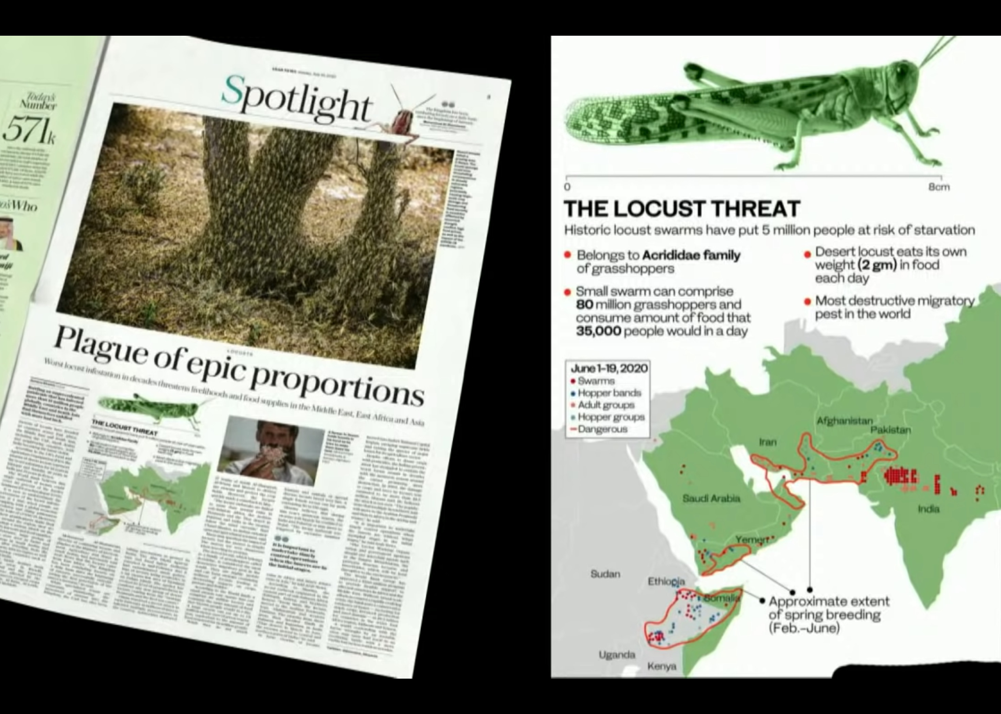
2020 年蝗虫扩大

Slide 36
作个有纪律的人
约珥
Dr. Rick Griffith, Crossroads International Church Singapore
BibleStudyDownloads.org

Slide 37

纪律
Notes:
Be disciplined or you will be disciplined.
遵守纪律，否则你就会被纪律处分。

Slide 38

纪律
Notes:
This is true because any good leader disciplines those he cares about, and ultimately, God is the best disciplinarian.
事实确实如此，因为任何优秀的领导者都会管教他所关心的人，而最终，上帝是最好的管教者。

Slide 39
遵守纪律，
否则你就会被纪律处分。
Notes:
Which better describes your life now? Disciplining yourself or being disciplined by God?
If your experiences are sweet, thank God. Maybe you are disciplining yourself so God doesn’t have to get your attention. But if your experiences are sour, thank God also. Maybe this is just what you need for God to get your attention. Are you listening?
哪种情况更符合你现在的生活？是自我管教，还是被上帝管教？
如果你的经历是甜美的，感谢上帝。也许你正在自我管教，因此上帝不需要特别提醒你。
但如果你的经历是苦涩的，也要感谢上帝。也许这正是上帝用来吸引你注意的方式。你听到了吗？

Slide 40

"Hear this, you leaders of the people.
Listen, all who live in the land"
(Joel 1:2a NLT).
The traditional Chinese character for "listen" consists of six radicals
当我们真正倾听某人说话时，我们会把他们当作国王或王后。仆人从不打断国王的话，而是用耳朵倾听，用“十只眼睛和一颗心”倾听国王的每一个字和面部表情
真正的倾听是给予对方完全的尊重和专注的注意力
Notes:
Are you really listening to what God is trying to tell you in your life?
Maybe he is trying to discipline you.
你真的在听上帝在你的生活中试图告诉你什么吗？
也许他正在试图管教你。

Slide 41
当我们受到纪律处分时，
我们该怎么办？
约珥
Notes:
让我们回到原本的问题......

Slide 42

出埃及记背景
Notes:
OS-29-Joel-34

Slide 43
Placing the Prophets
先知的位置
342
关键 时代
931
俄巴底亚
722
约拿
阿摩司
何西阿
以赛亚
弥迦
那鸿
西番亚
耶利米
耶利米哀歌
约珥
但以理
哈该
哈巴谷
以西结
撒迦利亚
马拉基
586

Slide 44

"他们抽签分了我的子民，将男童换妓女，卖女童买酒喝。"
(约珥书 3:3 CCB).
Notes:
Ar

Slide 45
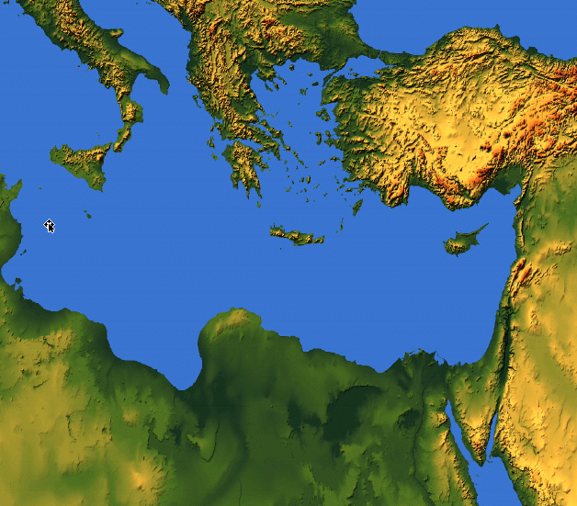

把犹太人
卖给希腊人
4「泰尔、西顿，和非利士四境的人哪，你们与我何干？你们要报复我吗？若报复我，我必使报应速速归到你们的头上。
5你们既然夺取我的金银，又将我可爱的宝物带入你们宫殿
约珥书（3:4-5）
219
西顿
泰尔
犹大
非利士
Notes:
Joel also mentions selling people to Greeks, which also happened only after about 600 BC when Greece became strong.
约珥还提到将人卖给希腊人，这也是在公元前600年左右希腊变强后才发生的。

Slide 46
把犹太人
卖给希腊人
" 6并将犹大人和耶路撒冷人卖给希腊人，使他们远离自己的境界。 "
(约珥书 3:6 ).
219
希腊
西顿
泰尔
希腊直到公元前 600-500 年左右才成为一个强大的国家，所以乔尔的年代可能更晚
犹大
非利士

Slide 47
耶路撒冷的陷落
耶路撒冷的陷落
232
342
560
关键日期
627
耶利米
605
但以理
597
以西结
586
538
西番雅
约尔
630
耶利米悲歌
哈巴谷
590
606
Notes:
In our study of the Minor Prophets we are now near the time of the destruction of Jerusalem in 586 BC under Nebuchadnezzar. This was one of the two key times the city was destroyed as God’s discipline of his wayward people.
_______
OS-29-Joel-39
在我们对小先知书的研究中，我们现在接近公元前586年耶路撒冷在尼布甲尼撒手下被毁灭的时期。这是上帝对他迷失的子民施行管教时，城市两次被毁灭的关键时刻之一。
OS-29-Joel-39

Slide 48
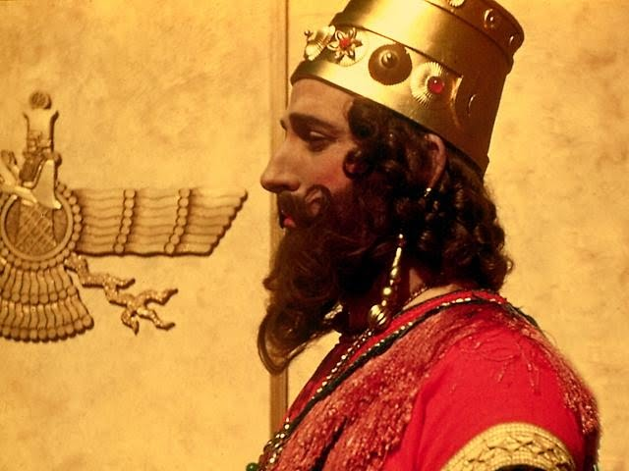
约珥在尼布甲尼撒王统治期间传道
Notes:
God's instrument of discipline was this pagan Babylonian king.
上帝惩戒的工具就是这个异教的巴比伦国王。

Slide 49

1. 现在该做什么
2. 结果如何
今日“待办事项”列表
Notes:
Today we’ll see what to do about present difficulties, and then how these will all turn out in the end.
今天，我们将看看如何解决当前的困难，以及最终结果如何。

Slide 50
当我们受到纪律处分时，
我们该怎么办？
约珥
Notes:
让我们回到原本的问题......

Slide 51
一。纪律应该带来悔改
约珥 1:1–2:17
Notes:
困境时是改变我们观点的好时机。

Slide 52
约珥书
毁灭
1:1–2:17
拯救
2:18–3:21
祝福 3:17-21
审判 3:1-16
恢复 2:18-32
灾害 1:1-20
入侵 2:1-17
过去
未来
上帝的日子

Slide 53
Slides on
约珥 1

Slide 54

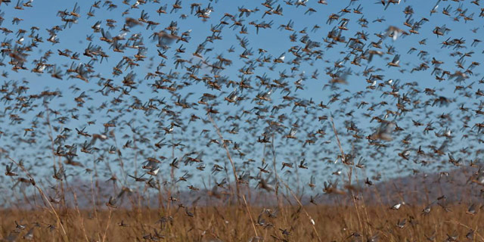
“告诉他们有关蝗虫的事。”
没有注明国王 = 没有注明日期
"1耶和华的话临到毗土珥的儿子约珥。"
(约珥书 1:1 ).
“好的."

Slide 55
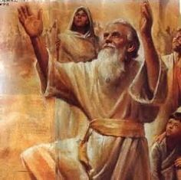
“约珥”名字 = 主神
约"Jo" = 耶和华 = 主
珥"El" =上帝 = 上帝

Slide 56
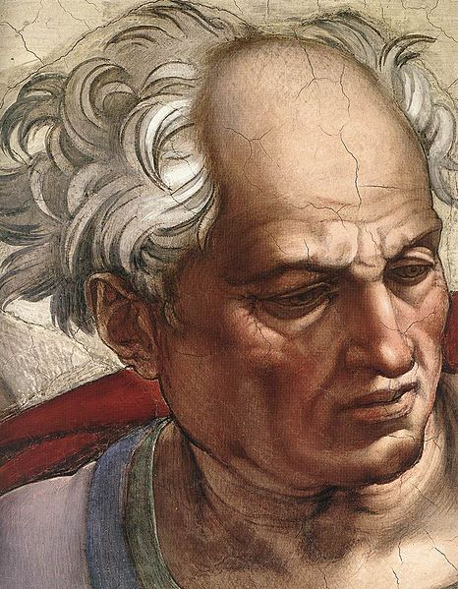
“老年人哪！你们要听这话。
这地所有的居民啊！你们要留心听。
在你们的日子，
或在你们祖先的日子，
曾有这样的事吗？
³ 你们要把这事传与子，
子传与孙，
孙传与后代。”
(约珥 1:2-3 CNV).

Slide 57
Barry Huddleston, The Acrostic Summarized Bible (Grand Rapids: Baker, 1992)
约珥
1. 呼求以避免审判
2. 回归神的祝福
3. 顺服神的主权

Slide 58
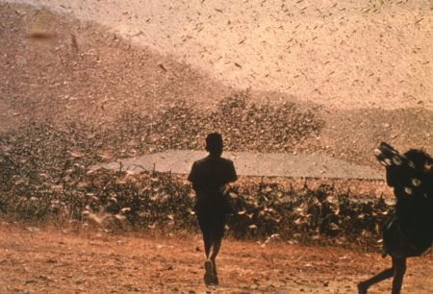
日期与收件人
577
C. 日期: 放逐前末期 (公元前597 与 586 之间).
D. 收件人: 犹大人，应为对锡安和寺庙的引用(1:9, 13-14; 2:15-17, 23, 32; 3:1, 5-6, 16-17, 20-21).

Slide 59
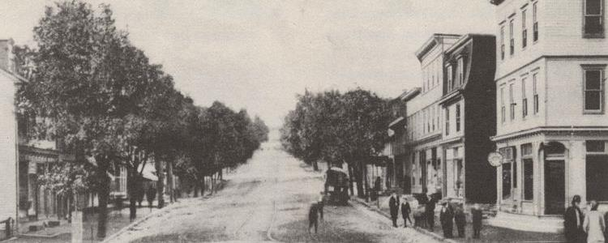
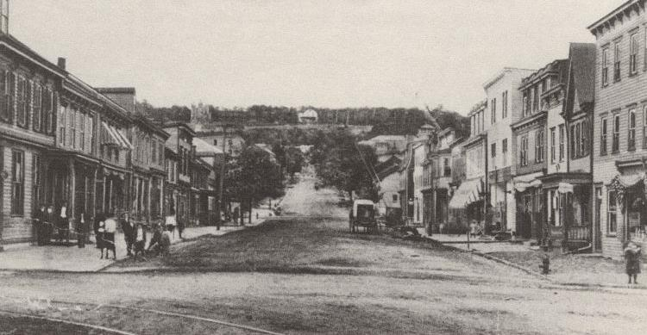
现代蝗灾
(森特勒利亚宾夕法尼亚州，美国）
蝗灾前
蝗灾后

Slide 60
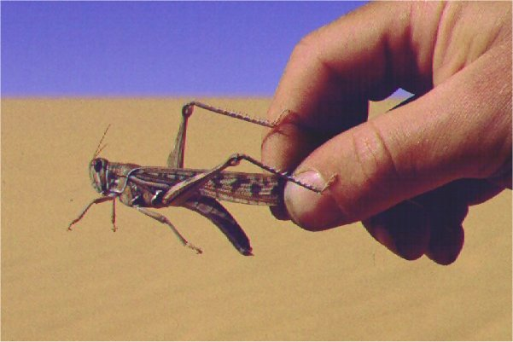
E. 场合
577
近期的蝗灾入侵犹大

Slide 61
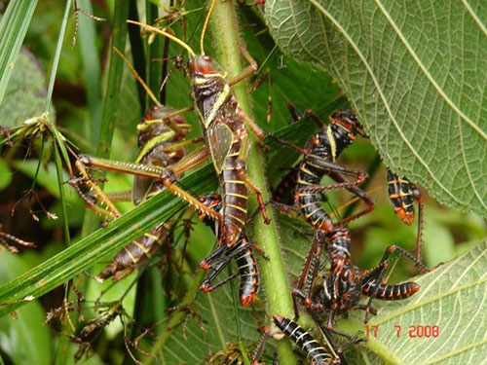
“剪虫剩下的，
蝗虫吃了；
蝗虫剩下的，
蝻子吃了；
蝻子剩下的，
蚂蚱吃了。”
(约珥 1:4 CNV).

Slide 62
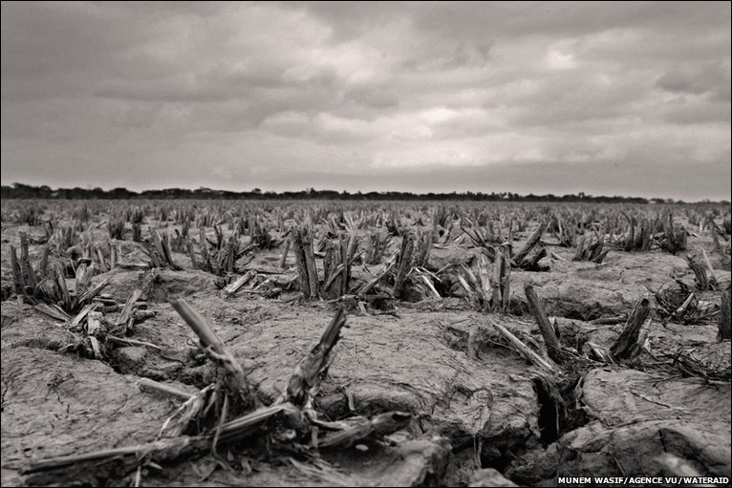
"酒醉的人哪！你们要醒过来；要哀哭！
所有嗜酒的人哪！你们都要为甜酒哀号，
因为甜酒从你们的口里断绝了。"
(1:5 CNV).

Slide 63
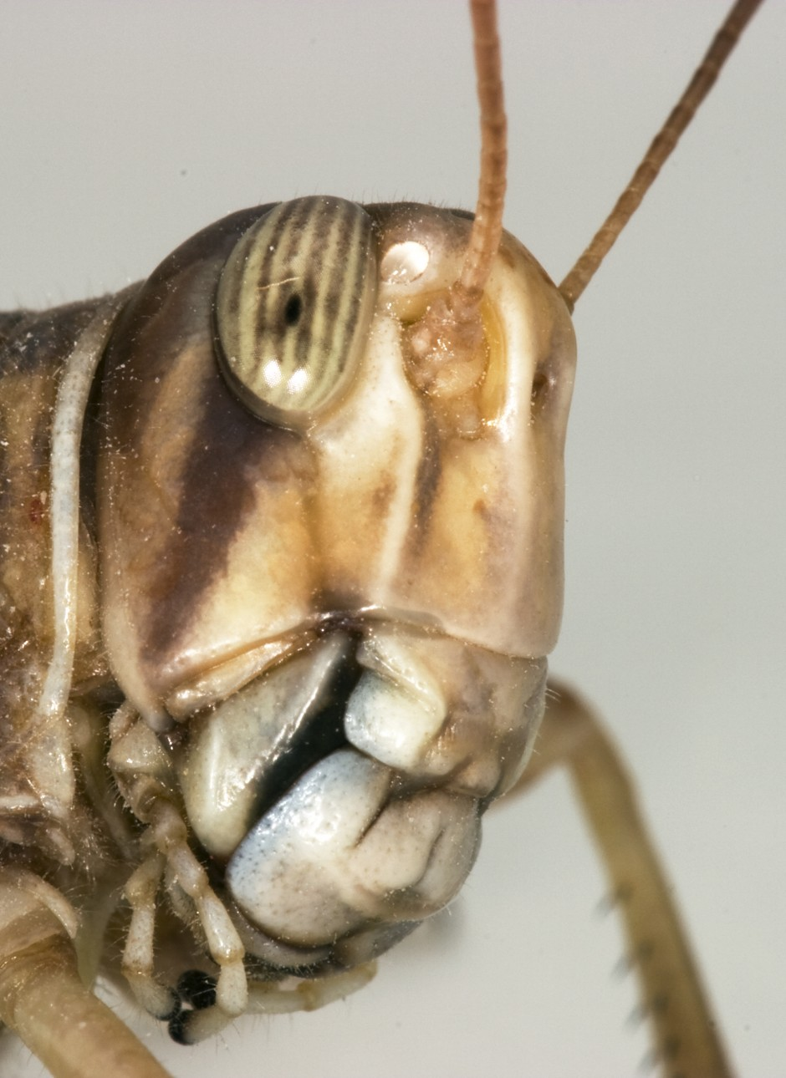
"因为有一民族上来侵犯我的国土，
他们强大又无数；
他们的牙齿像狮子的牙齿，
他们有母狮的大牙。"
(1:6 CNV).

Slide 64
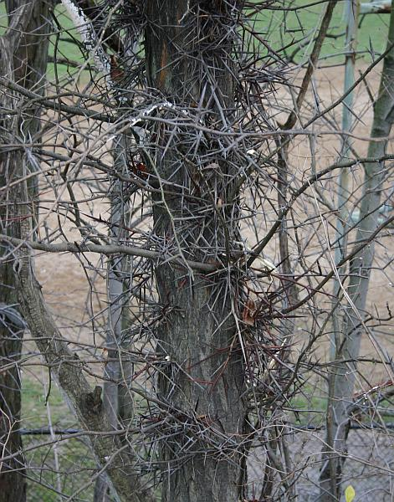
"他们使我的葡萄树荒凉，
折断了我的无花果树，
把树皮剥尽，丢在一旁，
使枝条露白。"
(1:7 CNV).

Slide 65
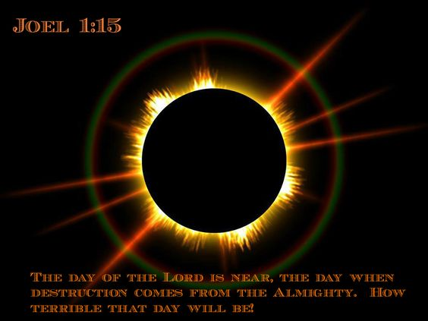
The Day of the LORD (Joel 1:15).
约珥
哀哉那日！
因为耶和华的日子临近了；
那日来到，好象毁灭从全能者临到一样。

Slide 66
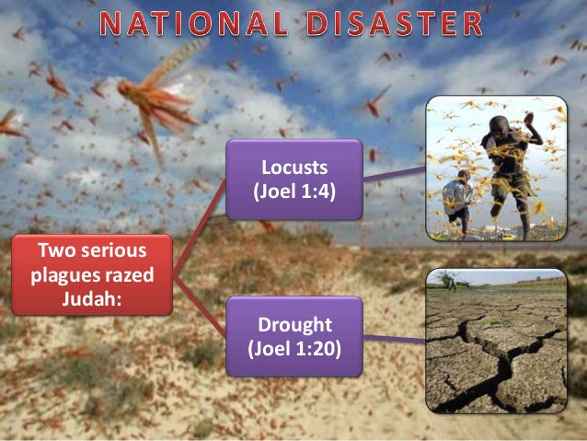
约珥书第1章中的国家灾难
蝗虫灾难
(约珥书 1:4)
两场严重的灾难摧毁了犹大：
干旱
（约珥书1:20）

Slide 67
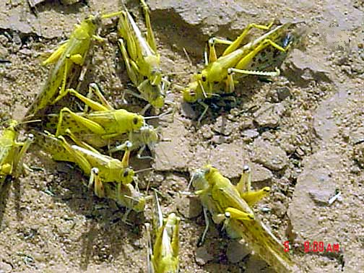
成年的
蝗虫在
交尾
Notes:
Mali: mature gregarious adults copulating (Tamesna, 11/03) http://www.fao.org/NEWS/GLOBAL/LOCUSTS/outbreakpix03.htm
马里：成熟的群居成年象正在交配 (Tamesna, 11/03) http://www.fao.org/NEWS/GLOBAL/LOCUSTS/outbreakpix03.htm

Slide 68
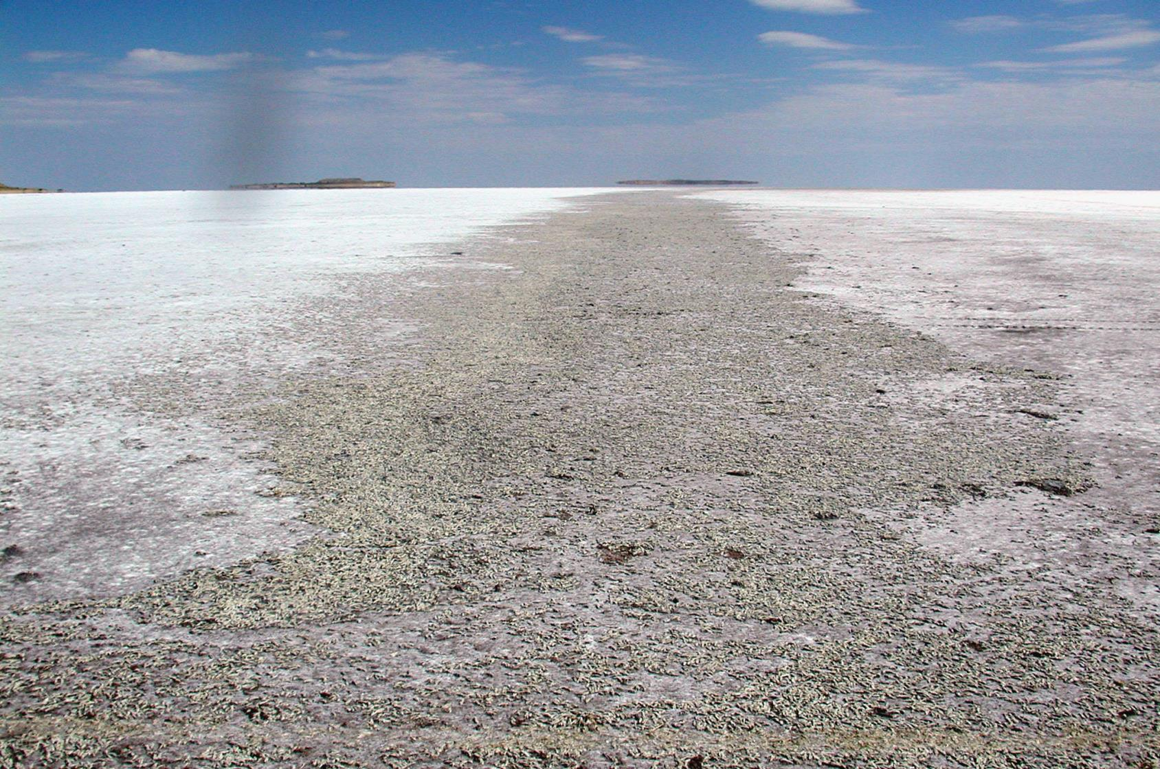
蝗虫的墓地, 盐湖, 犹他州

Slide 69

577
主词
蝗虫

Slide 70
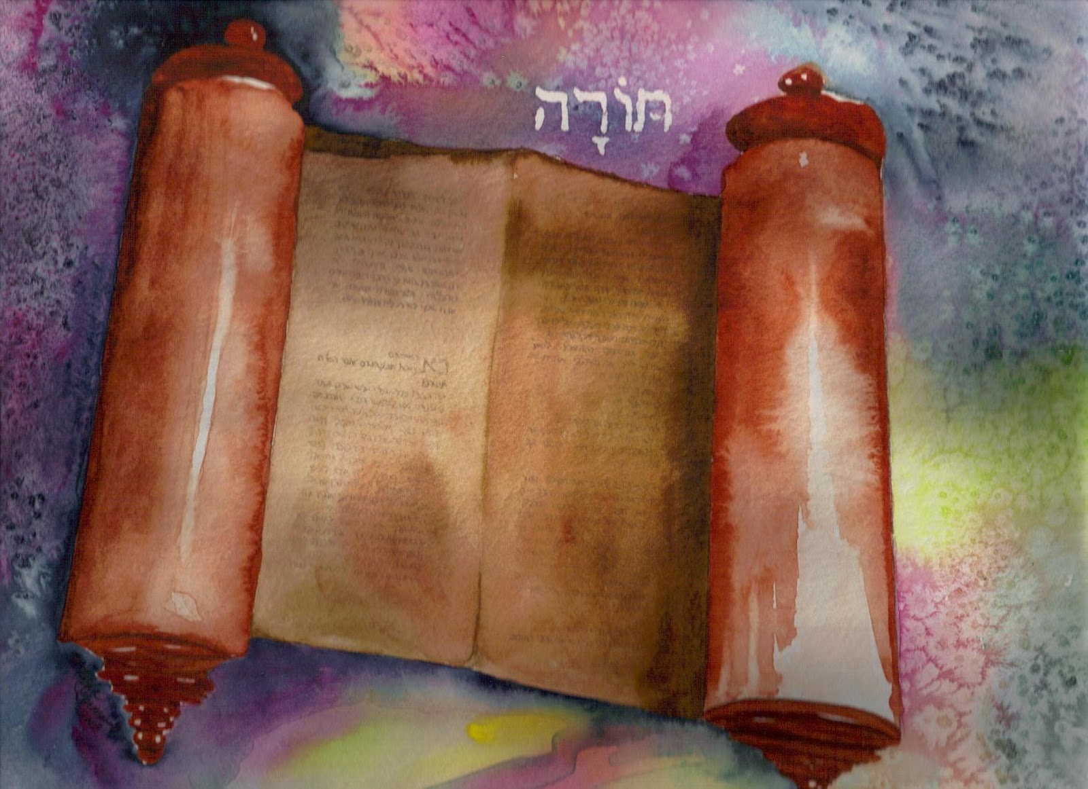
那么《妥拉》是如何描述蝗虫的呢？

Slide 71
祝福 与 咒诅 (申 28)
你的城里和田间必蒙福 (3)
你在城里在田间必受咒诅 (16)
你的孩子和地所产的必蒙福 (4)
你的孩子和地所产的必受咒诅 (17)
你的筐子和你的摶麵盆必蒙福 (5)
你的筐子和你的摶麵盆必受咒诅 (18)
你出你如必蒙福 (6)
你出你如必受咒诅 (19)
你的仇敌从一条路来攻击你， 必从七条路逃跑！(7)
你從一條路去攻擊他們、必從七條路逃跑！(25)
．你必借給許多國民、卻不至向他們借貸 (12)
他必借給你、你卻不能借給他 (44)

Slide 72
场合
220
为什么 ?
被掳
申命记 28章
Notes:
OS-05-Deut-203
OS-11-1Kings-40
OS-14-2Chron-58
Jeremiah’s prophecy and Lamentations record his eyewitness account of Babylon’s siege and destruction of Jerusalem for the nation’s sin, the Holy Spirit moved him to record an historical compilation which provides the context and justification for God’s judgment upon these two nations. The leaders and the people sinned through ungodliness and idolatry, and true to the curses of Deut. 28, God gave the people the consequences of their obedience.
OS-05-申命记-203
OS-11-列王纪上-40
OS-14-历代志下-58
耶利米的预言和《耶利米哀歌》记录了他亲眼目睹巴比伦围攻和毁灭耶路撒冷的过程，这是因国家的罪而受到的审判。圣灵感动他编写了一部历史汇编，为神对这两个国家的审判提供了背景和依据。领袖和百姓因不敬虔和拜偶像而犯罪，正如《申命记》第28章的咒诅所述，神将顺服的结果显明在百姓面前，使他们承受其后果。

Slide 73
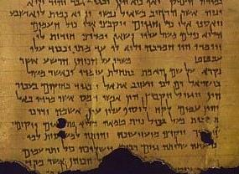
蝗灾的意义何在?
577
合和本 申命记28:38 “你带到 田间的种子虽多，收进来的却少，因为被蝗虫吃了”

Slide 74
Slides on
约珥 2

Slide 75
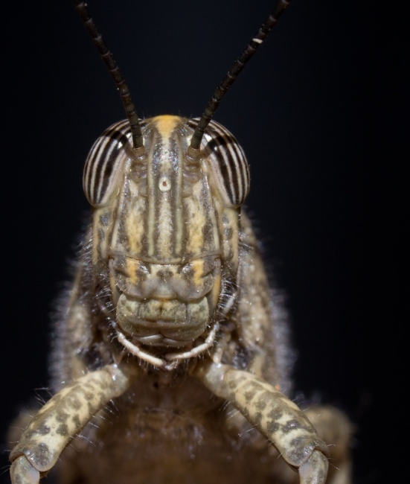
"你们要在锡安吹号，
并在我的圣山发出警讯，
让国中所有的居民都战栗，
因为耶和华的日子快到，必然临近了。"
(2:1 CNV).

Slide 76
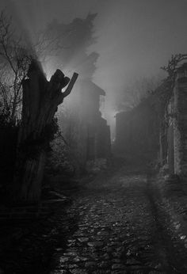
"那日是黑暗幽冥的日子，
是密云漆黑的日子。
有一队众多强盛的民来到，
好象晨光满布群山；
这样的事从前没有发生过，
以后直到万代，
也不会发生。"
(2:2 CNV).

Slide 77
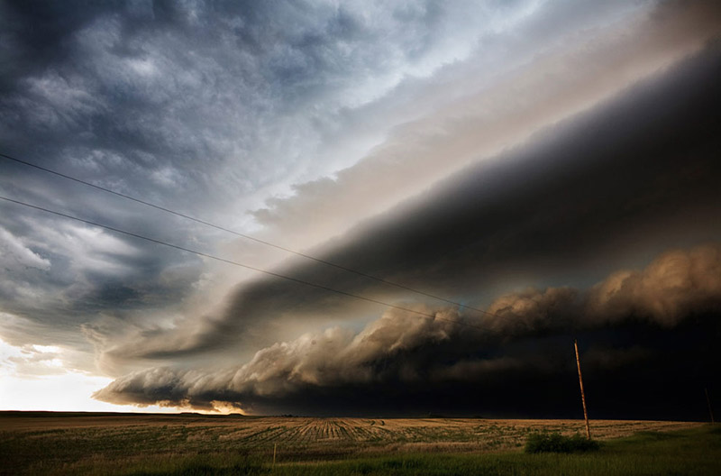
"在他们前面有吞灭的火，
在他们后面有燃烧的火焰；
他们未到以前，大地像伊甸园，
他们过去以后，大地成了荒凉的旷野，
没有一样能逃避他们的。"
(2:3 CNV).

Slide 78
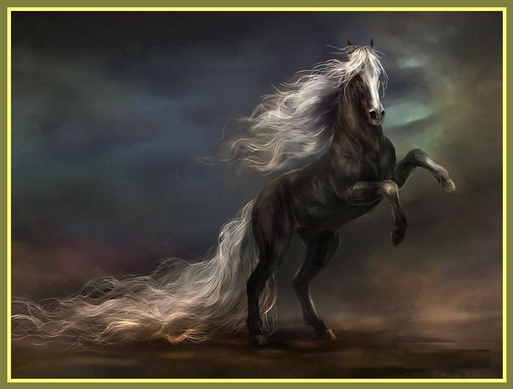
"他们的形状像马的形状，
战马怎样奔跑，他们也怎样奔跑。"
(2:4 CNV).

Slide 79
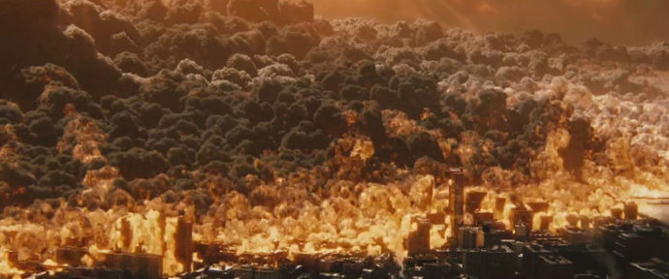
"他们在群山顶上跳跃的声音，
如战车的响声，
又如火焰
吞灭碎秸的响声，
像强盛的民
摆阵预备作战。" (2:5 CNV).

Slide 80
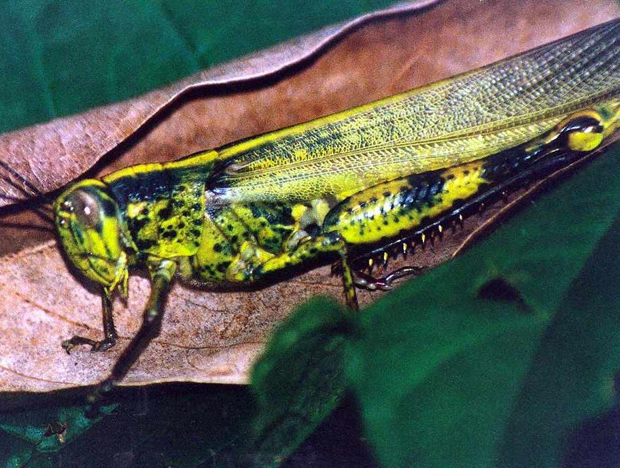
主要经文
575
“. . . 因为耶和华的日子大
而畏 ，谁能当得起呢？
耶和华说：虽然如此，
你们应 当禁食、哭泣、悲哀，一心归向我。” (2:11下b-12)

Slide 81
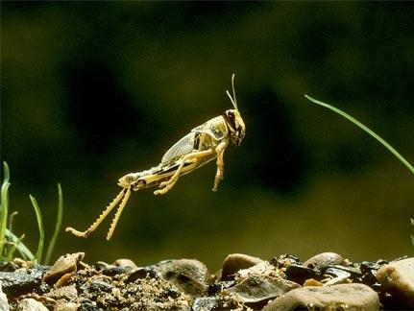
约珥书2:1-11的蝗虫是什么?
578
描绘蝗虫和军队？
超自然生物?
字面的蝗虫?
比喻一个军队?
比喻很多的军队?

Slide 82
约珥书
毁灭
1:1–2:17
拯救
2:18–3:21
祝福 3:17-21
审判 3:1-16
恢复 2:18-32
灾害 1:1-20
入侵 2:1-17
过去
未来
上帝的日子

Slide 83
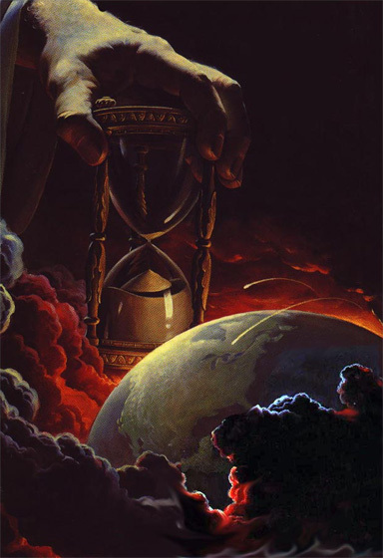
为什么未来？
578
1. 意象加强：地震、天里的迹象（2:10、30-31; 太24:29)

Slide 84

为什么未来？
578
1. 意象加强：地震、天里的迹象（2:10、30-31; 太24:29)
2. “民” (2:2)，“军队” (2:11)

Slide 85
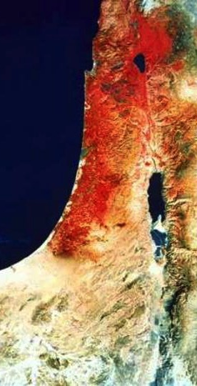

为什么未来？
578
1. 意象加强：地震、天里的迹象（2:10、30-31; 太24:29)
2. “民” (2:2)，“军队” (2:11)
3. 蝗虫从来没有像这“军队”从北方侵略 (2:20)
4. “北方” (2:20) 与从北方侵袭的末世仇敌吻合 (迦6:8，等)

Slide 86


主的日子
638-639
审判
+
祝福
大灾难
千年
启 6–19
启 20
7 年
1000 年

Slide 87
末世事件时序
473
白色
大宝座
(启 20:11-14)
圣徒被提
(提前 4:13-18)
主再来(亚 14:3-5)
主的日子
教会时代
大灾难
(亚 14:1-2)
千禧年
(亚14:6-21)
歌革和玛各
(哈米吉多顿)
(结 38–39)
歌哥革和玛各
的重现
(启 20:7-10)
Notes:
87

Slide 88
做什么？
"耶和华说：
“现在虽然如此，
你们仍要全心全意，
以禁食、哭泣、哀号，归向我。”
你们要撕裂你们的心肠，
不要撕裂你们的衣服。
并要归向耶和华你们的 神，
因为他有恩典有怜悯，
不轻易发怒，
并且有丰盛的慈爱，
随时转意不降灾祸。" (2:12-13 CNV).

Slide 89

你拒绝神的管教吗？
Notes:
God’s disciplining us should motivate us to seek the Lord.
神对我们的管教应当激励我们去寻求主。

Slide 90

上帝与美国
在美国人中：
“神与美国有特殊关系。”
赞同
赞同
赞同
Notes:
The moral height of the USA was in the 1950s. The USA rebuilt its former enemies Japan and Germany, adopted “In God We Trust” as the national motto, and began to see many turn to Christ under Billy Graham as well send out missionaries to the nations.
Home > 2015 > July
Jul 3, 2015
God and Country: Americans' Views of God's 'Relationship' with the U.S
What do Americans think about the United States and God? Fascinating new data. |
Ed Stetzer
http://www.christianitytoday.com/edstetzer/2015/july/god-and-country-new-research-on-americans-views-of-country.html
Accessed 9 April 2017
Happy Fourth of July weekend folks, my American readers!
Two hundred thirty-nine years ago tomorrow, Congress adopted the Declaration of Independence, nearly a month before it would eventually be signed. I hope you're having a fun weekend, getting to enjoy some time with family and friends.
As I explained in a post last year:
Christians are, in a sense, dual citizens-- of the Kingdom and of the nation where they live. I live in a country that is not without fault, but I am proud to be a citizen of that nation. I teach my children to be proud of their nation-- not unaware of its challenges-- and patriotic citizens.
Just this week, LifeWay Research released some new data on how Americans view their country and how God relates with it. Here's an excerpt from our report:
In a nation founded on religious liberty, most Americans believe God has a special relationship with the United States, and they’re optimistic the best is yet to come.
Despite headlines lamenting the global decline of the United States since the Cold War, 54 percent of Americans believe the nation is on the upswing, according to a September survey by LifeWay Research. Only 4 in 10 think “America’s best days are behind us.”
And though the U.S. Constitution makes no mention of God, 53 percent of Americans say they believe God and the nation have a special relationship, a concept stretching back to Pilgrim days. Even a third of atheists, agnostics, and those with no religious preference believe America has a special relationship with God.
“‘God Bless America’ is more than a song or a prayer for many Americans,” said Ed Stetzer, executive director of LifeWay Research. “It is a belief that God has blessed America beyond what is typical for nations throughout history. I am sure that would spawn many theological conversations, but it’s important to note most Americans think God has a special relationship with their country.”
Christianity Today reported on the data, and added additional research, in their article, "God and America: It's Complicated," explaining, "A third of Americans say the United States is a Christian nation. But more than half say the country has a special relationship with the Almighty."
Christianity Today also included a link to my post providing cautions about combining patriotism and worship, where I explained the importance of patriotism (and not just in the U.S.), but also cautioned, "If your church service was driven more by America than by Jesus, I think you need a change."
Here are a couple of the graphs depicting the major findings:
One of the most interesting parts of the survey was the gender divide among the views:
Women are significantly more likely than men to believe God has a special relationship with the United States. While 49 percent of men have that view, the number rises to 58 percent for women.
LifeWay Research also found differences by age, race, geography, education, and religious preference.
Nearly two-thirds (63 percent) of Americans 45-54 years old think God has a special relationship with the United States, a belief shared by 48 percent of those 18-44.
Belief in a special relationship is also high among:
African-Americans, at 62 percent, compared to whites at 51 percent. Southerners, at 59 percent, compared to 49 percent of Midwesterners and 50 percent of Westerners. Those with a high school degree or less, at 66 percent. For those with some college, the rate drops to 51 percent. It drops further to 40 percent of those with a bachelor’s degree and 29 percent of those with a graduate degree. Evangelical Christians are the most likely to believe in a special relationship, with 67 percent agreeing. Among evangelicals 45 and older, the share soars to 71 percent.
“Americans, particularly those in more religious segments or geography, are most likely to believe in this special relationship,” Stetzer said. “But, considering the history of the nation, from Manifest Destiny to Ronald Reagan’s ‘City on a Hill’ speech, it’s not surprising this long-held theme continues today.”
A lot of this, of course, is rooted in our sense of American exceptionalism. Here's a bit on that from our report, including a thought from me:
Both ends of the political spectrum—from President Obama to the Republican Party platform—have touted American exceptionalism, the belief that the United States plays a unique role in human history. For some, the concept includes the idea of a special relationship with God, although beliefs about the nature of the relationship vary.
“Some Christians view America as an archetype of biblical Israel, chosen and uniquely blessed by God,” Stetzer said. “That’s why Christians sometimes speak of God ‘healing our land,’ when most theologians say this American ‘land’ is not in the same category as the ‘land’ of biblical Israel.”
What do you think? Is America exceptional? Does God have a special relationship with the United States? Comment below.
Click here to see the full research report.
Support our work. Subscribe to CT and get one year free.
美国的道德巅峰时期是在1950年代
美国重建了昔日的敌人日本和德国，将“我们信靠上帝”（“In God We Trust”）定为国家格言，并开始在比利·格雷厄姆（Billy Graham）的带领下见证许多人归向基督，同时向世界各国派遣传教士。
首页 > 2015 > 7月
2015年7月3日
神与国家：美国人对“神与美国关系”的看法
美国人如何看待美国和上帝之间的关系？新数据令人着迷。
Ed Stetzer
http://www.christianitytoday.com/edstetzer/2015/july/god-and-country-new-research-on-americans-views-of-country.html
访问时间：2017年4月9日
祝大家独立日周末快乐，亲爱的美国读者们！
明天就是239年前的这一天，国会通过了《独立宣言》，这距离最终签署还有近一个月的时间。希望大家能度过一个愉快的周末，与家人和朋友共度美好时光。
正如我去年在一篇文章中解释的：
基督徒在某种意义上是双重国籍的公民——既是天国的公民，也是他们所在国家的公民。我生活在一个有缺陷但值得骄傲的国家。我教我的孩子为自己的国家感到骄傲——并不是忽视它的挑战——成为爱国的公民。
就在本周，LifeWay研究机构发布了一些关于美国人如何看待他们的国家以及上帝与之关系的新数据。以下是我们报告的摘录：
在一个建立于宗教自由之上的国家，大多数美国人认为上帝与美国有特殊的关系，并且他们对未来充满乐观。
尽管有头条新闻哀叹冷战后美国在全球的衰退，但根据LifeWay研究机构于9月进行的一项调查，54%的美国人相信国家正在复兴。只有十分之四的人认为“美国的黄金时代已经过去”。
尽管美国宪法没有提到上帝，但53%的美国人表示他们相信上帝与这个国家有特殊的关系，这种观念可以追溯到清教徒时期。即使是无神论者、不可知论者和没有宗教信仰偏好的三分之一的人也认为美国与上帝有特殊的关系。
LifeWay研究所执行主任埃德·斯特策（Ed Stetzer）说：“‘愿上帝保佑美国’对许多美国人来说不仅仅是一首歌或祷告。这是一种信念，即上帝以历史上其他国家所没有的方式祝福了美国。我相信这会引发许多神学上的讨论，但重要的是，大多数美国人认为上帝与他们的国家有特殊的关系。”
《今日基督教》报道了这些数据，并在文章《神与美国：复杂的关系》中加入了额外的研究，解释道：“三分之一的美国人认为美国是一个基督教国家。但超过一半的人表示，美国与全能的神有特殊的关系。”
《今日基督教》还附上了我关于将爱国主义与崇拜结合时需要注意事项的文章链接，文中我解释了爱国主义的重要性（不仅仅是在美国），但也提醒人们要警惕：“如果你的教会活动更多地以美国为中心，而不是以耶稣为中心，我认为你需要做出改变。”
以下是一些图表，描绘了主要发现：
调查中最有趣的部分之一是关于性别差异的观点：
• 女性比男性更有可能认为上帝与美国有特殊的关系。49%的男性持这种观点，而女性的比例上升到58%。
• LifeWay研究机构还发现了关于年龄、种族、地理、教育和宗教偏好的差异：
• 接近三分之二（63%）的45-54岁美国人认为上帝与美国有特殊的关系，而这一信念在18-44岁的人中占比为48%。
• 62%的非洲裔美国人持有这种信念，而白人仅为51%。
• 南方人中有59%，相比之下，中西部地区为49%，西部地区为50%。
• 具有高中及以下学历的人中有66%持这种观点；而拥有一些大学教育的人的比例下降到51%，拥有学士学位的比例进一步下降到40%，拥有研究生学位的比例则为29%。
• 福音派基督徒是最有可能相信特殊关系的人群，其中67%的人同意此观点。在45岁及以上的福音派基督徒中，这一比例更是升至71%。
埃德·斯特策说：“特别是在那些宗教性更强的地区或群体中，美国人更有可能相信这种特殊关系。但考虑到美国的历史，从‘天定命运’（Manifest Destiny）到里根总统的‘山巅之城’演讲，这种长期以来的主题延续至今也并不令人惊讶。”
当然，很多这些信念根植于我们的“美国例外论”。以下是我们的报告中的一些内容，包括我自己的一个想法：
无论是政治光谱的两端——从奥巴马总统到共和党的纲领——都强调了“美国例外论”，即认为美国在人类历史中扮演了独特的角色。对某些人来说，这一概念包括了上帝与美国之间特殊关系的想法，尽管对这种关系的性质的看法各不相同。
埃德·斯特策说：“一些基督徒将美国视为圣经中以色列的原型，认为它被神选择并独特地祝福。这就是为什么基督徒有时谈论神‘医治我们的土地’，而大多数神学家认为，这片‘土地’并不属于圣经以色列的‘土地’范畴。”
你怎么看？美国是否独特？上帝是否与美国有特殊的关系？欢迎在下方评论。
点击此处查看完整研究报告。
支持我们的工作，订阅《今日基督教》，并免费获得一年订阅！

Slide 91

上帝对美国的管教
Notes:
But the 1960s became a turning point: corporations wanting to prolong the Vietnam War to make more money off it, making it illegal to pray and read the Bible in schools, chaos in the many riots, and assassinations of key leaders like John F Kenney and Martin Luther King.
The last straw was America turning its back on Israel in recent years, even sponsoring a conference in January a week before the change of power in Washington.
但1960年代成为了一个转折点：
企业为了从越南战争中赚取更多利润，试图延长战争；学校中禁止祷告和阅读圣经成为法律；多地发生骚乱引发的混乱，以及约翰·F·肯尼迪（John F. Kennedy）和马丁·路德·金（Martin Luther King）等关键领导人的遇刺。
压垮骆驼的最后一根稻草是近年来美国背弃以色列，甚至在华盛顿权力更迭前的一月，还举办了一场针对以色列的会议。

Slide 92

上帝对美国的管教
问题不在于枪支！
问题在于没有神的心灵，
没有纪律的家庭，
没有祷告的学校，
以及没有公正的法庭。
Notes:
As a result, the USA has been in horrible disarray: 78 million abortions, half of births to unwed mothers, 110 million people with STDs, disrespect around the world, involved in the longest war in US history in Afghanistan and Iraq, etc.
The USA has been under the disciplining hand of God in order that the country might turn back to him.
因此，美国陷入了可怕的混乱：7800万例堕胎，半数婴儿出生于未婚母亲，1.1亿人感染性传播疾病，在世界范围内声誉受损，卷入了美国历史上最长的战争——阿富汗战争和伊拉克战争等。
美国正处于神惩戒的手中，目的是让这个国家回归祂的怀抱。

Slide 93

个人的纪律
教训
学习部
教训
重学部
哦，真是受不了了部

Slide 94
我不找借口，
我创造结果。
Notes:
Some of us could share our stories.
Some have played with sin until we finally got disgusted with ourselves.
Others of us have become complacent so that we hardly give God a thought until Sunday.
The result? We lack love, joy, peace, patience, kindness, goodness, faithfulness, gentleness and self-control. How could we expect the fruit of the Spirit without being controlled by the Spirit?
God is calling us to repentance—a change of mind in whom we trust. He also wants to see in us the fruits of repentance—a change of actions that reveal we really did change our mind.

Slide 95
一。纪律应该带来悔改
约珥 1:1–2:17
Notes:
困境时是改变我们观点的好时机。

Slide 96
二。悔改将带来恢复
约珥 2:18–3:21
Notes:
改变我们对上帝的看法，才会改变我们的未来。

Slide 97
约珥书
毁灭
1:1–2:17
拯救
2:18–3:21
祝福 3:17-21
审判 3:1-16
恢复 2:18-32
灾害 1:1-20
入侵 2:1-17
过去
未来
上帝的日子

Slide 98

以色列的悔改将带来宽恕、拯救和复兴
（约珥书 2:18-3:21）。

Slide 99


"耶和华为自己的土地发热心，
祂怜悯自己的子民。
¹⁹ 祂回应他们说：
“我必赐五谷、新酒和油给你们，
使你们饱足，
不再让你们受列国的羞辱。"
(约珥书 2:18-19 CCB).
Notes:
Israel’s repentance will bring forgiveness and blessing (2:18-27).
以色列的悔改将带来宽恕和祝福（2：18-27）。

Slide 100
上帝未来对以色列的保护
"我要使北方来的军队
远离你们；
我要把他们驱逐
到干旱荒凉之地，
他们的前队赶入东海，
他们的后队赶入西海；
并且他们的臭气上升，
他们的腥味上腾，
因为耶和华行了大事。
（约珥书 2:20）
219
北方
以色列

Slide 101
对比约珥书第1章和2:21-27
582
（根据1985年达拉斯神学院匿名手稿改编）
 | In Joel’s Day | In the Day of the LORD
土地 | 哀号 (1:10) | 将欢喜快乐 (2:21)
动物 | 哀鸣、游荡、饥饿（1:18） | 不再惧怕（2:22a）
田地和果园 | 荒芜、不结果实 （1:7, 10-12） | 将成长、结果实并富有生产力（2:22）
雨水 | 干旱，干燥引发火灾（1:20） | 将丰沛降下（2:23）
谷物、酒、油 | 毁坏并干枯（1:10） | 将丰富有余（2:24）
农作物 | 被蝗虫毁坏（1:4） | 损害将被生产力取代（2:25-26）

Slide 102


约珥书 2:21-27 中的土地对比
582
哀号
"... 土地凄凉…"
(1:10 CNV).
将欢喜快乐
"地土啊！你不要惧怕；
你要欢喜快乐，
因为耶和华行了大事。" (2:21 CNV).

Slide 103


约珥书 2:21-27 中的动物对比
582
哀鸣、游荡、饥饿
"牲畜发出哀鸣，
牛群到处流荡，
因为没有草场给牠们，
羊群也同样受苦。"
(1:18 CNV).
不再惧怕
"田野的走兽啊，你们不要惧怕，
因为旷野的草场又发青了" (2:22a CNV).

Slide 104


《约珥书》2:21-27 中的农场对比
582
荒芜、不结果实
"他们使我的葡萄树荒凉，
折断了我的无花果树，
把树皮剥尽，丢在一旁，
使枝条露白。" (1:7; cf. 1:10-12 CNV).
将成长、结果实并富有生产力
"树木又结果子了，
无花果树和葡萄树也都效力了。" (2:22b CNV).

Slide 105


约珥书 2:21-27 中的雨水对比
582
干旱，干燥引发火灾
"田野的走兽也向你发喘，
因为溪水都干涸了，
火吞灭了旷野的草场。"
(1:20 CNV).
将丰沛降下
"锡安的人民哪！你们要欢
喜，
要靠耶和华你们的 神快乐，
因为他赐给了你们合时的秋雨。
他给你们降下时雨，
就是秋雨春雨，像以前一样。" (2:23 CNV).

Slide 106


约珥书 2:21-27 中的谷物、酒和油
582
毁坏并干枯
"田野荒废，
土地凄凉，
因为五谷毁坏，
新酒干竭，
油也缺乏。"
(1:10 CNV).
将丰富有余
"禾场上必满了五谷；
榨酒池与油醡必溢出新酒与新油。"
(2:24 CNV).

Slide 107


约珥书 2:21-27 中的农作物对比
582
被蝗虫毁坏
"剪虫剩下的，蝗虫吃了；
蝗虫剩下的，蝻子吃了；
蝻子剩下的，蚂蚱吃了。“ (1:4 CNV).
损害将被生产力取代
"我差遣到你们中间去的，
我的大军队，
就是蝗虫、蝻子、蚂蚱和剪虫，
在那些年间吃尽的，
我必补给你们。…"
(2:25-26 CNV).

Slide 108
末世论术语
洁净。。宣告 (1:14; 3:9)
耶和华的日子接近了 (1:15; 2:12; 3:14)
耶和华的日子来临了 (2:1; 2:31)
黑暗 (2:2; 2:31)
逃脱 (2:3; 2:32)
天崩地裂 (2:10; 3:16)
太阳、月亮、星星变黑 (2:10; 3:15)
耶和华出声说话 (2:11; 3:16)
耶和华的日子，伟大而让人敬畏的(2:11; 2:31)
集聚 (2:16; 3:2)
我的人民和我的遗产 (2:17; 3:2)

Slide 109

III. 新约里的约珥书2:28-29 (参徒2)
579
“这正是先知约珥所说的。。。 ” (徒2:16)

Slide 110

约珥书2:28-29
579
“以后，我要将我的灵浇灌凡有血气的。你们的儿女要说预言。你们的老年人要作异梦。少年人要见异象。在那些日子，我要将我的灵浇灌我的仆人和使女。”

Slide 111

III. 新约里的约珥
“所有主的人民会成为先知”不过这是约珥说的吗？
所有人民将会被释放
呼求主名
蝗虫伸展

Slide 112

约珥 2:30-31 CNV
"我要在天上地下显出神迹奇事，
有血、有火、有烟柱。
³¹太阳将变为黑暗月亮将变为血红。
在耶和华伟大可畏的日子临到以前，
这一切都要发生。"
579

Slide 113
约珥书2:30-32
在天上地下，我要显出奇事，有血有火，有烟柱。
³¹ 日头要变为黑暗 ， 月亮要变为血 ，这都在耶和华大而可畏的日子未到以前。
³² 到那时候，凡求告耶和华名的就必得救。因为照耶和华所说的，在锡安山耶路撒冷必有逃脱的人，在剩下的人中必有耶和华所召的。
579

Slide 114

IV. 问题：5个实现约珥书 2:28-32的看法
在五旬节的终止
在五旬节的实现
为不履行或模式论
典型的履行观点
连续性的履行观点

Slide 115
Slides on
约珥 3

Slide 116

"看哪！到了那些日子，在那个时期，
我使犹大和耶路撒冷被掳的人归回
我必招聚列国，
领他们下到约沙法谷'"
(3:1-2a CNV).

Slide 117



"我要在那里亲临审判他们，
因为他们把我的子民分散在列国中，
又分取了我的地土。"
(3:2b CNV).
海法
亚维瓦
巴勒斯坦
以 色 列
耶路撒冷
巴勒斯坦
埃及
内盖夫
沙漠：
约旦
Notes:
This verse teaches that, at the return of Christ when the prosperity of Israel is restored and the nations judged (Joel 3:1-2a), Gentile armies will be judged for three crimes:
Harming Israel
Scattering Jews among the nations, and
Dividing Israel into various parts.
The 2020 peace accords between Israel and Bahrain and between Israel and UAE were accomplished on the condition that Israel keep the land divided among Israel and the Palestinians.
这节经文教导我们，当基督再来时，以色列的繁荣将得到恢复，列国将被审判（约珥书3:1-2a）。外邦的军队将因以下三项罪行而受到审判：
1. 伤害以色列；
2. 将犹太人分散到列国中；
3. 将以色列分割成不同的部分。
2020年以色列与巴林以及以色列与阿联酋之间的和平协议是在一个条件下达成的，即以色列必须将土地划分给以色列和巴勒斯坦人共同拥有。

Slide 118


" 以色列是中东地区唯一一个允许基督徒自由践行信仰的地方。”
本雅明·内塔尼亚胡

Slide 119

" 如果阿拉伯人今天放​​下武器，就不会再有暴力。如果犹太人今天放下武器，就不会再有以色列。”
本雅明·内塔尼亚胡

Slide 120
"他们为我的子民抽签，
用男童交换妓女，
女童被卖换酒喝。"
(3:3 CNV).

Slide 121

泰尔和西顿将
接受审判
"推罗、西顿和非利士四境的人哪！你们想对我作甚么呢？你们想向我报复吗？你们若向我报复，我很快就使报应归在你们的头上。 你们拿去了我的金银，又把我的珍宝带进了你们的庙宇。" (3:4-5 CNV).
219
西顿
提尔
犹大
非利士

Slide 122
把犹太人卖给
希腊人
"你们把犹大人和耶路撒冷人卖给希腊人，使他们远离自己的境界。"
(3:6 CNV).
219
希腊
西顿
泰尔
犹大
非利士

Slide 123
犹大的复兴
"看哪！我要激动他们离开被你们卖到的地方，我也要使报应归到你们的头上。 我必把你们的儿女卖在犹大人的手中，犹大人必把他们卖给远方示巴国的人，因为这是耶和华说的。"
(3:7-8 CNV).
219
希腊
西顿
泰尔
犹大
阿拉伯半岛

Slide 124

"你们要在列国中宣告以下这话：
“你们要预备争战，
要激动勇士。
让所有的战士都近前来，让他们都上去攻击。
¹⁰要把犁头打成刀剑，
把镰刀打成矛枪；软弱的要说：
‘我是勇士。’
¹¹ 四围的列国啊！你们快来帮助，
在那里一同聚集。
耶和华啊！求你叫你的勇士下来吧。"
(3:9-11 CNV).

Slide 125

"万国都当奋起，
上到约沙法谷去。
因为我必坐在那里，
审判四围的列国。
你们要伸出镰刀，
因为庄稼已经熟了。
来践踏吧，
因为压酒池满了，
酒池盈溢，
因为他们的罪恶极大。"
(3:12-13 CNV).

Slide 126

"无数的人群
齐集在判决谷，
因为耶和华的日子临近了判决谷。
日月昏暗，
星星无光。"
(3:14-15 CNV).

Slide 127

"耶和华从锡安
吼叫，
并从耶路撒冷
发声，
天地就震动。
耶和华却要作他子民的避难所，
作以色列众子的保障。"
(3:16 CNV).

Slide 128

"你们知道我是耶和华你们的 神，
是住在锡安我的圣山上。
那时，耶路撒冷必成为圣。
外族人必不得从其中经过。"
(3:17 CNV).

Slide 129

以色列与
埃及
"到那日，
大山都必滴下甜酒，
小山都必流出奶，
犹大的一切溪流，
都必水流不息。
必有泉源从耶和华的殿里流出来，
灌溉什亭谷。"
(3:18 CNV).

Slide 130

以色列与
埃及
以色列
埃及
"埃及将会荒凉，
以东必变成凄凉的旷野，
都因为他们向犹大人所行的强暴，
又因为在他们的国中流了无辜人血。"
(3:19 CNV).

Slide 131

"但犹大必存到永远，
耶路撒冷也必存到万代。
现在我要追讨我还未有追讨的流人血的罪。
耶和华在锡安居住。" (3:20-21 CNV).

Slide 132

你唯有信靠主，才能得到他的祝福
圣经
阅读我

Slide 133
上帝对美国的复兴
Notes:
Repentance will bring restoration in a nation: Repentance in the USA is bringing about his blessing.
In April 2016 the most conservative Supreme Court justice died suddenly and his body was pronounced dead by a coroner who never actually saw the body, then the body was cremated within hours. This set the stage for a huge showdown whether the Court would shift to the Left for the next generation.
悔改会为一个国家带来复兴：美国的悔改正带来神的祝福。
2016年4月，美国最保守的最高法院大法官之一突然去世，其死亡由一名从未实际见过遗体的验尸官宣布，而遗体在数小时内就被火化。这为一场重大对决铺平了道路，决定最高法院是否会在未来一代人时间内转向左派立场。

Slide 134

美国各县：红色保守派 + 蓝色自由派
Notes:
The breaking point came last year when we actually had a candidate running for office under FBI investigation who destroyed 30,000 government documents.
God brought American Christians to a breaking point. Franklin Graham devoted the year to 50 prayer vigils—one on the steps of each capital of each state in the USA.
Election night showed a huge lead for Clinton until a massive prayer effort nationwide surged at about 8-9 PM, when it totally shifted.
The result? The past 8 years over 1000 liberal elected officials have been removed from office, culminating in the first Republican president, House and Senate in nearly 100 years. Only 17 of the 50 state governors are liberal now.
去年，美国到达了一个临界点，当时竟有一名候选人在竞选期间正接受FBI调查，同时销毁了30,000份政府文件。
神使美国的基督徒面临一个关键时刻。富兰克林·格雷厄姆（Franklin Graham）将那一年献给了50场祷告集会——分别在美国每个州的州议会台阶上举行了一场祷告。
选举之夜，希拉里·克林顿（Clinton）一开始显示出明显的领先优势，直到晚上8点到9点左右，全国范围内掀起了一场大规模的祷告活动，局势完全逆转。
结果如何？在过去的8年里，有超过1000名自由派民选官员被逐出公职，最终迎来了近100年来第一位同时拥有共和党总统、众议院和参议院的局面。如今，50个州中仅有17位州长是自由派人士。

Slide 135

尼尔·
戈萨奇
Notes:
The culmination came just two days ago (7 April 2017) when Neil Gorsuch was confirmed to the Court, restoring the 5-4 Constitutional edge. This was by far the most enduring act of President Trump will have in his 4-year or 8-year term(s) of office.
高潮发生在两天前（2017年4月7日），当尼尔·戈萨奇（Neil Gorsuch）被确认进入最高法院，恢复了5比4的宪法优势。这无疑是特朗普总统在他4年或8年任期内最具持久影响力的举措之一。

Slide 136

我们的愿景
爱列国
爱教会
爱神
Notes:
Repentance will bring restoration in a church: God wants our church to really trust him.
We still don’t see our need for him as we don’t see our need to pray.
We also need to be involved in his work: missions, teaching, accountability groups, finances, etc.
_______________
OS-29-Joel-128
NS-13-1 Thess-115
悔改会为教会带来复兴：神希望我们的教会真正信靠祂。
我们仍未意识到对祂的需要，就像我们未意识到祷告的重要性一样。
我们还需要参与祂的事工：宣教、教导、问责小组、财务管理等。
OS-29-约珥书-128
NS-13-帖撒罗尼迦前书-115

Slide 137
当我们受到纪律处分时，
我们该怎么办？
约珥
Notes:
让我们回到原本的问题......

Slide 138
重点
约珥
纪律
悔改
恢复
纪律使得我们悔改；悔改使得我们
恢复与神的关系。

Slide 139
一。纪律应该带来悔改
约珥 1:1–2:17
Notes:
困境时是改变我们观点的好时机。

Slide 140
二。悔改将带来恢复
约珥 2:18–3:21
Notes:
改变我们对上帝的看法，才会改变我们的未来。

Slide 141

遵守纪律，否则你就会被纪律处分。
Notes:
The book Celebration of Discipline shows the value of spiritual disciplines.

Slide 142

Accept God's discipline.
¹¹ 我 儿 ， 你 不 可 轻 看 耶 和 华 的 管 教 （ 或 译 ： 惩 治 ） ， 也 不 可 厌 烦 他 的 责 备 ；
¹² 因 为 耶 和 华 所 爱 的 ， 他 必 责 备 ， 正 如 父 亲 责 备 所 喜 爱 的 儿 子 。
（箴言3:11-12）

Slide 143
考虑的问题
一。 在悔改之前，你是否需要上帝清空你的一切？
（黄萨宾）
约珥

Slide 144
考虑的问题
二。 上帝训练你，是否是要再次引发你对祂的注意呢？
约珥

Slide 145
考虑的问题
三。您是否考虑过禁食（1:14; 2:12）或者您认为禁食不适用我们的现代社会？为什么不呢？
约珥

Slide 146
Black

Slide 147


旧约全书讲章链接地址 BibleStudyDownloads.org
免费获取该讲解!
圣经学习下载
你需要更好地了解圣经吗？谁不需要呢？BibleStudyDownloads （圣经学习下载）为神学生和教师们提供了从 创世纪 到 启示录的 30万份 可编辑的免费PowerPoint和Word文件。
本网站的大部分资料由Dr. Rick Griffith 博士设计，他从1991年到2021年在新加坡神学院教授圣经、神学和讲道学，现在是约旦福音神学院的圣经释经教授。
圣经学习下载
Notes:
The explanation for free
OT Preaching link address

Slide 148

F. 合于圣经与文本
在合于圣经与文本方面没有严重的问题。
七十释译本（LXX）, 别大西译本和拉丁文圣经只是和吨圣，及彼此之间有稍微的分歧。
近期在河穆拉拜阿特找到的部分约珥书符合传统的吨圣。
LXX里文本稍微增加的部分(1:5, 8, 18; 2:12; 3:1) 可质疑。
吨圣里所谓的错误的部分(1:7, 17-18; 2:11; 3:11) 有可质疑的状态。

Slide 149
G. 整体性
有怀疑的
  杜姆, "Anmerkungen zu den zwolf Propheten," ZAW 31 (1911): 1-43, 184-88 只接受第一和二章里非世界末日的部分。
  比伟与其他人同意只支持第一和二章及2:28-31a, 3:2a; 3:9-14a非世界末日的部分。
支持的
  可是，近期的学者（艾伦、查里、卡佩尔鲁德、凯勒、迈尔斯、鲁道夫、斯图亚特、汤普森、威瑟、沃尔夫）认为作者只有一个
  但是，有稍微的编撰增加

Slide 150

否定整体性的
一个
预言?
所谓字面的分歧
看法或观点的
不同
一个
约珥?

Slide 151
但是仔细地审查显示了。。。
风格与字汇的一致性
所谓不同的观点无法证实
一个统一的主题：蝗灾
“耶和华的日子”统一了历史事件与属灵功课，而不是被判另一只手。
全部现存希伯来语重置和古版本证实了书的整体性。

Slide 152

V. 神学的价值
神的概念
敬拜
审判
末世论
主的日子

Slide 153
主的日子
638-639
审判
+
祝福
大灾难
千年
启 6–19
启 20
7 年
1000 年

Slide 154

约珥书复习测验
1. 约珥书使用了_____灾害的意象。
2. “耶和华的日子”这一表达在本书中出现了 ____ 次。
3. 判断题：约珥书的写作时间是否精确可考？
4. 约珥书2:28-32被哪位新约人物（_____）引用？是在旧约的哪个节期（_______）？

Slide 155
约珥书复习测验
1. 约珥书使用了蝗虫灾害的意象。
2. “耶和华的日子”这一表达在本书中出现了____次。
3. 判断题：约珥书的写作时间是否精确可考？
4. 约珥书2:28-32被哪位新约人物（_____）引用？是在旧约的哪个节期（_______）？

Slide 156
约珥书复习测验
1. 约珥书使用了蝗虫灾害的意象。
2. “耶和华的日子”这一表达在本书中出现了5次。
3. 判断题：约珥书的写作时间是否精确可考？
4. 约珥书2:28-32被哪位新约人物（_____）引用？是在旧约的哪个节期（_______）？

Slide 157
约珥书复习测验
1. 约珥书使用了 蝗虫灾害 的意象。
2. “耶和华的日子”这一表达在本书中出现了 5次。
3. 判断题：约珥书的写作时间是否 精确可考？（错误）
4. 约珥书2:28-32 被哪位新约人物（）引用？是在旧约的哪个节期（）？

Slide 158
约珥书复习测验
1. 约珥书使用了 蝗虫灾害 的意象。
2. “耶和华的日子”这一表达在本书中出现了 5次。
3. 判断题：约珥书的写作时间是否 精确可考？（错误）
4. 约珥书2:28-32 被哪位新约人物（彼得）引用？是在旧约的哪个节期（五旬节）？

Slide 159
II. 结构
A. 威廉森修订艾伦分析的表格
第一部分 1:2-2:17
一. 1:2-20
二. 2:1-17
并行的
第二部分. 2:18-3:21
一. 2:18-32
二. 3:1-21
并行的

Slide 160

C. 结构关系 （芬利）
悔改的呼召 (1:2-14)// 属灵恩赐 (2:28-29)
耶和华的日子 (1:15-2:2a) // 耶和华的日子 (2:28-32)
主的军队 (2:2b-11)// 国家的军队 (3:1-3)
神怜悯的圣约 (2:12-14)//神关心的圣约 (3:4-8)
悔改的呼召 (2:15-17) // 圣战的呼召 (3:9-11)
主的回应 (2:18-20) // 主的回应 (3:12-17)
更新的祝福 (2:21-27) // 更新的祝福 (3:18-21)

Slide 161
D. 提纲1 (帕特森)
约珥当前的指令：按着蝗灾 (1:1-2:27)
II. 神的未来旨意：末世计划 (2:28-3:21)

Slide 162
E. 提纲2 (麦克洛米基)
蝗灾：眼前的灾难 (1:2-20)
II. 耶和华的日子：临头的灾难(2:1-17)
III. 主的回应 (2:18-3:21)

Slide 163
提纲 3 (帕特森)
在土地上的蝗虫 (1:1-14)
在土地上的审判 (1:15-2:11)
在土地上的怜悯(2:12-27)
在世间的奇迹(2:28-32)
在世间的审判 (3:1-21)

Slide 164
约珥书
毁灭
1:1–2:17
拯救
2:18–3:21
祝福 3:17-21
审判 3:1-16
恢复 2:18-32
灾害 1:1-20
入侵 2:1-17
过去
未来
上帝的日子

Slide 165

VI. 应用
576
结论句：
A最近一个以蝗虫向犹大的审判应该是人民悔改因为一个更困难的主的日子将以巴比伦的侵袭和哈米吉多頓来临，但是上帝应许审判列国所带来的赦免、救赎 、以及复兴。
你是否需要上帝剥夺你的一切从而使你悔改？
(摘自Huang Sabin, 简化的旧约)

Slide 166
Black

Slide 167
旧约全书概论链接地址 BibleStudyDownloads.org
免费获取该讲解!
圣经学习下载
你需要更好地了解圣经吗？谁不需要呢？BibleStudyDownloads （圣经学习下载）为神学生和教师们提供了从 创世纪 到 启示录的 30万份 可编辑的免费PowerPoint和Word文件。
本网站的大部分资料由Dr. Rick Griffith 博士设计，他从1991年到2021年在新加坡神学院教授圣经、神学和讲道学，现在是约旦福音神学院的圣经释经教授。
圣经学习下载
Notes:
The explanation for free!
OT Survey link address

