Slide 1
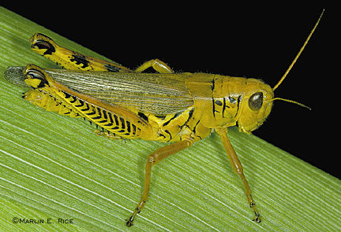
约珥
Dr. Rick Griffith • 新加坡神学院
BibleStudyDownloads.org

Slide 2
关键字
575
343
蝗虫
约珥

Slide 3
主题
308
上帝的日子
约珥

Slide 4
关键节
575
"…耶和华的日子伟大，
非常可畏，谁能忍受得住呢？耶和华说：
“现在虽然如此，
你们仍要全心全意，
以禁食、哭泣、哀号，归向我。"
(约珥 2:11b-12).
约珥

Slide 5

约珥国度声明
343
上帝透过蝗虫（1）和其他形式的灾难来（2：1-17）教训以色列民。但是，最终神在以色列真正悔改后，才恢复它完全的统治。（2：18-3：21）

Slide 6

约珥书
信息声明
575
346
对犹大所执行的审判提醒我们要悔改，因为在耶和华的日子，神要藉着巴比伦的入侵带来更加悲惨的日子，但上帝仍然应许通过审判列国来执行赦免、释放和修复。

Slide 7

圣约
347c
上帝承诺将永远住在耶路撒冷（3：17-21），并差派祂的灵（2：18-32）。 这是根据祂的圣约，来保守耶路撒冷作为祂所拣选的地方。 （王上8：23-61； cf. 启21：3）
约珥

Slide 8

救赎
347c
在上帝审判中的拯救（1：1-2：17）只会出现在悔改并恳求耶和华名的以色列人身上 (2:32; cf. 2:12-14)。
约珥

Slide 9

弥赛亚
347c
基督在约沙法谷的审判（珥3：2,12; cf. 马太福音25章）平衡了他在五旬节（;使徒行传2：16-21）差派的圣灵（2：28-32; 约翰福音16：7-15; 使徒行传1：8）
约珥

Slide 10
Outline 4 (Griffith)
575
上帝的日子
“蝗虫”之灾
祝福
1:1–2:17
2:18–3:21
锡安的管教
锡安的释放
上帝敌对他的子民
上帝为他的子民征战
简介
1:1-3
因蝗虫
（字面意）而悔改
1:4-20
因巴比伦/
末日
“蝗虫”
2:1-17
悔改后的赦免2:18-27
属灵的苏醒
2:28-3:21
哀歌
1:1-2:17
救恩
2:18-32
审判
3:1-21
过去
未来
犹大
约主前590
Past
Future
Judah
c. 590 BC

Slide 11
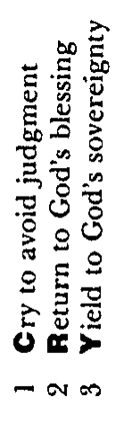
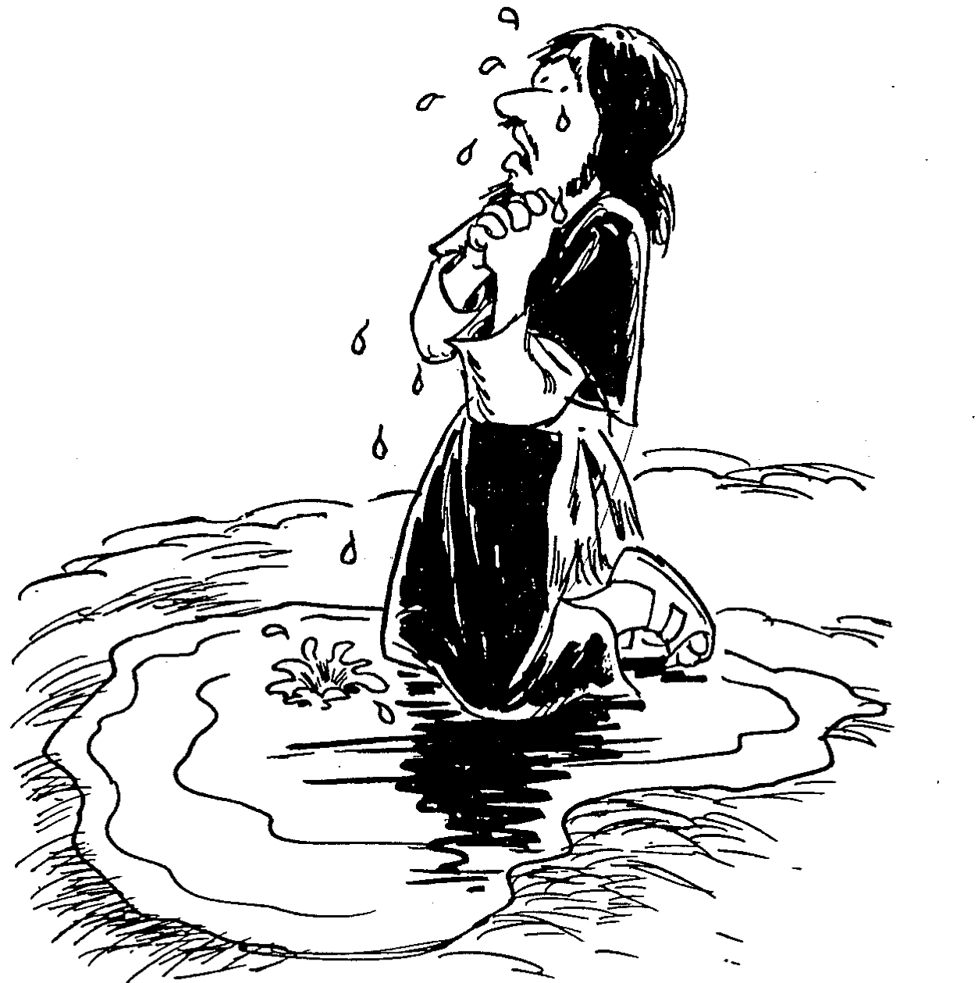
Barry Huddleston, The Acrostic Summarized Bible (Grand Rapids: Baker, 1992)
约珥
1 Cry to avoid judgment
2 Return to God's blessing
3 Yield to God's sovereignty

Slide 12

作个有纪律的人
约珥
Dr. Rick Griffith, Crossroads International Church Singapore
BibleStudyDownloads.org

Slide 13
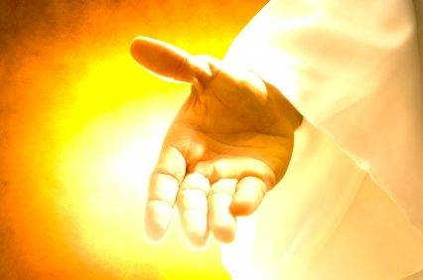
当我们受到纪律处分时，
我们该怎么办？
约珥
Notes:
让我们回到原本的问题......

Slide 14

一。纪律应该带来悔改
约珥 1:1–2:17
Notes:
困境时是改变我们观点的好时机。

Slide 15
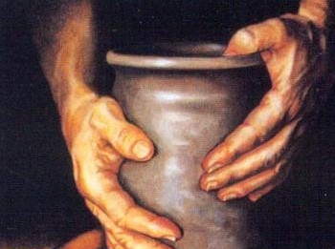
二。悔改将带来恢复
约珥 2:18–3:21
Notes:
改变我们对上帝的看法，才会改变我们的未来。

Slide 16

重点
约珥
纪律
悔改
恢复
纪律使得我们悔改；悔改使得我们
恢复与神的关系。

Slide 17

考虑的问题
一。 在悔改之前，你是否需要上帝清空你的一切？
（黄萨宾）
约珥

Slide 18
考虑的问题
二。 上帝训练你，是否是要再次引发你对祂的注意呢？
约珥

Slide 19
考虑的问题
三。您是否考虑过禁食（1:14; 2:12）或者您认为禁食不适用我们的现代社会？为什么不呢？
约珥

Slide 20
Black

Slide 21
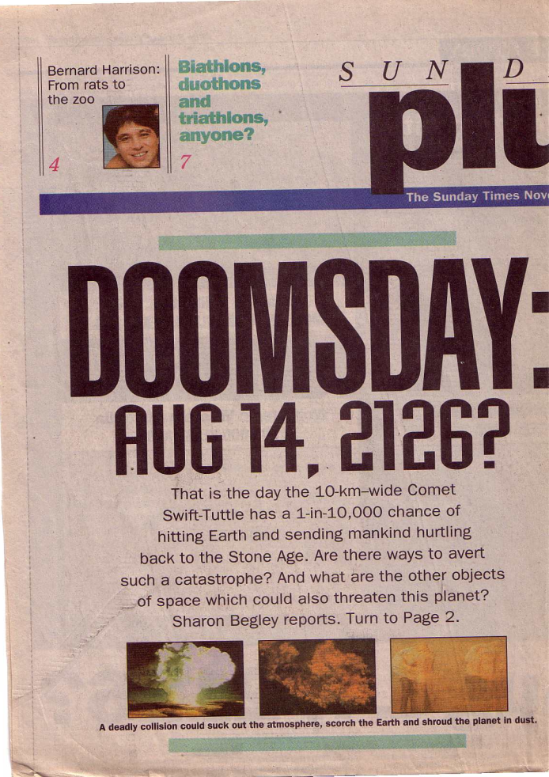
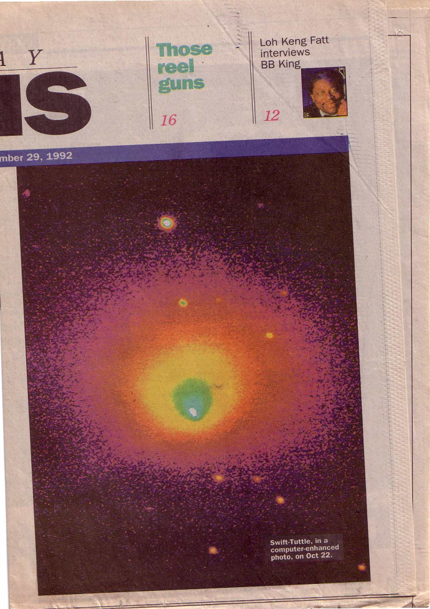
审判来了!
世界末日:
你对这个报告有何感想？

Slide 22
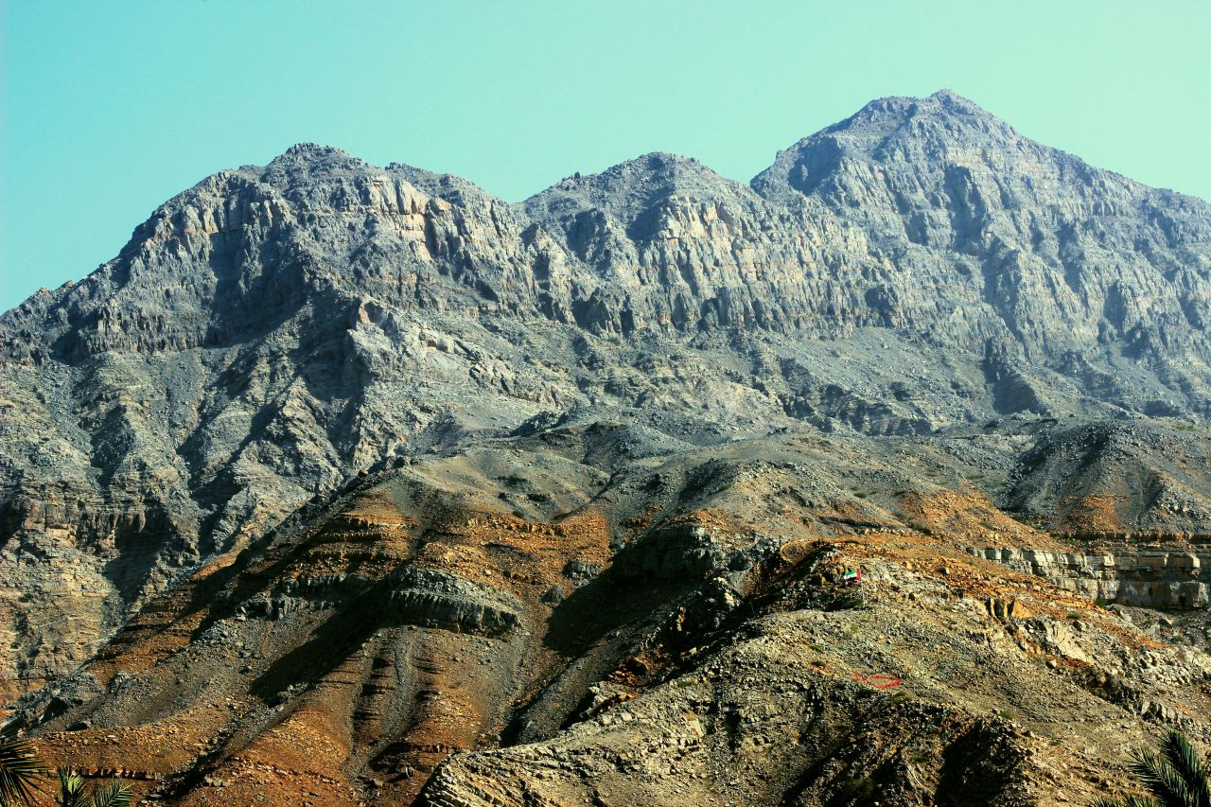
Approaching a Summit
Notes:
When we approach the summit of a mountain range, it looks like the peaks continually go upward.

Slide 23

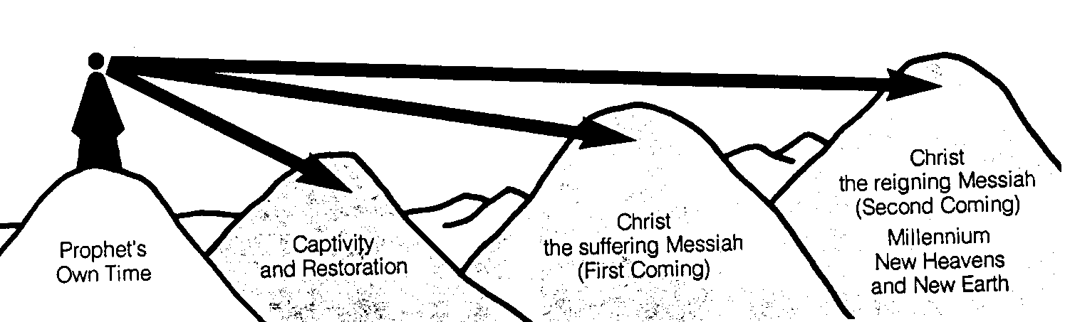
先知们的时间段
442
新天新地
基督
统治的弥赛亚
(第二次来临)
千喜年
基督
受难的弥赛亚
(第一次来临)
被掳与回归
先知所处的时代
克班.萨利姆, 启示录图表 (1979), 49

Slide 24

We See the Valleys
Notes:
From our vantage point, we clearly see that the Messiah would come twice. It’s like being able to see the valleys between each set of peaks. However, the prophets did not see these valleys but only saw the future as a whole.

Slide 25
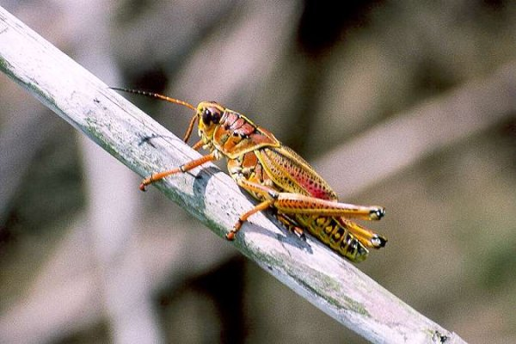
II. 结构与提纲
提纲
I. 简介
III. 接近新约
IV. 问题文本
V. 神学的价值
VI. 应用

Slide 26
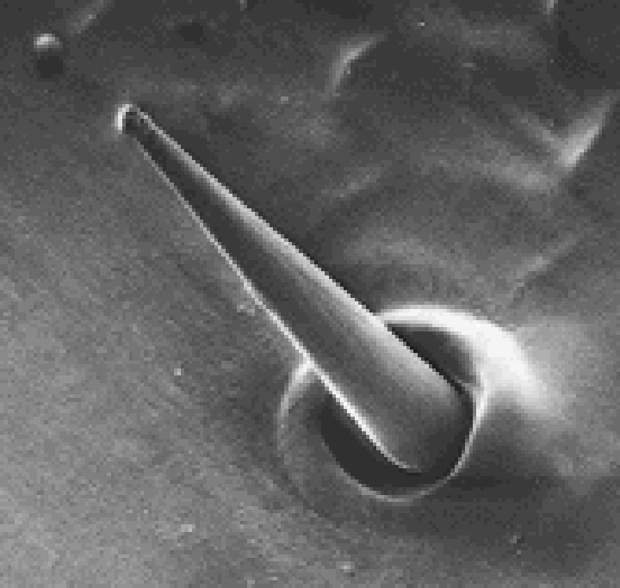
间接提纲
577
约珥书简介
A. 标题
B. 作者
C. 日期
D. 收件人
E. 场合
F. 合于圣经与文本*
G. 整体性*
Locust taste receptor

Slide 27
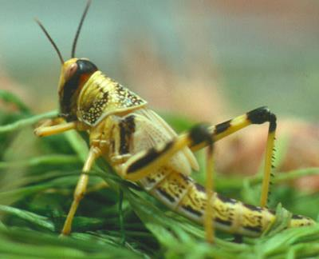
约珥书简介
A. 标题
576
laeÞAy (Yo’el): “耶和华是主”
其他相关意思可能是“意志坚强”或“寻求庇护”
B. 作者 (内部证据)
毗土珥的儿子 (1:1)
住在耶路撒冷附近 (cf. 1:9, 13-14;
2:15-17, 23, 32; 3:1, 5-6, 16-17, 20-21)
先知寺(cf. 1:13-14; 2:17)

Slide 28
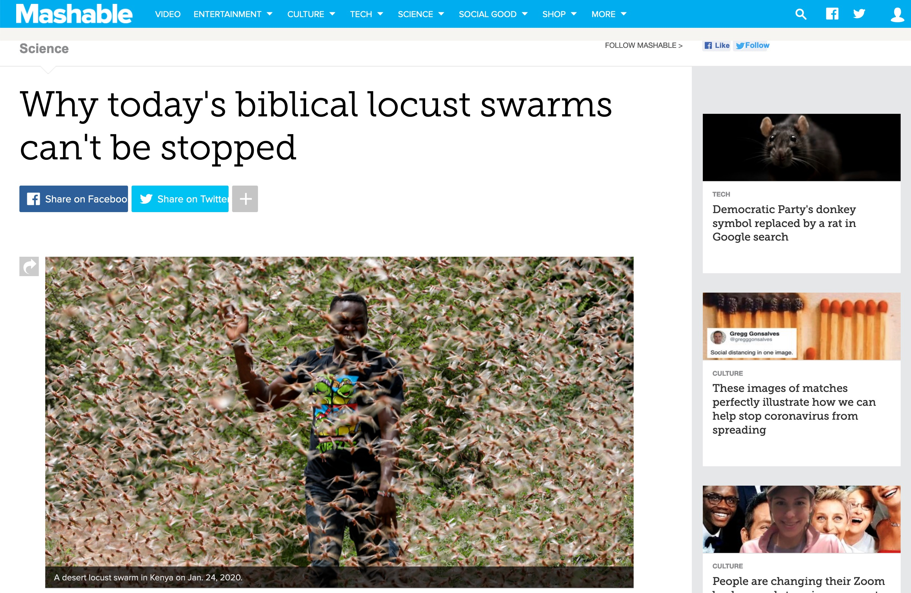
2020 Kenyan Locusts
Locust swarms in Kenya on Jan. 24.
Notes:
WHOLE ARTICLE BROKEN INTO PARTS IN FOLLOWING SLIDES:
In 1937, aboard slowly-moving trains, the Army National Guard used flamethrowers in an attempt to quell a relentless plague of locusts crossing through Colorado.
But the flamethrowers failed. And so did explosives. The locusts easily endured, devouring farmland.
Over 80 years later, great locust swarms still can't be contained. Last week, the U.N. announced that desert locusts — the most devastating type — descended upon East Africa, and over the coming months the insects may increase their populations by a whopping 500-fold. "Kenya has not faced a locust threat of this magnitude in 70 years," the U.N. said.
A single swarm of locusts, which are voracious grasshopper species that can spread over 460-square miles of land, have been a scourge — at least through the eyes of humans — for thousands of years. In more modern times, the British formed an anti-locust unit at the height of World War II to combat the pests in Africa and the Middle East, and a New York Times reporter pondered, in 1976, if "swarms that darken the sky" and "denude the land of crops" could be eliminated by progressing technology. Still today, the locust affliction continues.
"It's not surprising to me that we still don’t have a grip on this," said Iain Couzin, the director of the Max Planck Institute of Animal Behavior who researches locust swarms.
Today, the best humanity can do is try and predict where the swarms will form before a massive population outbreak can occur and ultimately consume vast tracts of crops, which are often rural people's sustenance. "You need to catch it early," said Rick Overson, the research coordinator at Arizona State University's Global Locust Initiative.
Locust swarms in Kenya on Jan. 24.
Image: Ben Curtis / AP / Shutterstock
Desert locust movements and prediction released on Jan. 28, 2020.
Image: UN Fao
Once locusts grow wings as mature adults, there's no turning back. "They’re powerful fliers," said Overson. "They can be in one country and move to another by the end of the week." And "during plagues" of the desert locust, the U.N. notes swarms can "affect 20 percent of the Earth's land, more than 65 of the world's poorest countries, and potentially damage the livelihood of one-tenth of the world's population."
After an outbreak occurs or the swarming begins, the blunt strategy is often to drop millions of liters of chemical pesticides on the insects, which is bad for the environment and human health, Overson explained.
But identifying exactly where the locusts start to swarm can be enormously daunting, especially when it comes to desert locusts in Africa and neighboring areas, which naturally inhabit remote, mostly-uninhabited regions some 16 million square kilometers, or over 6 million square miles, in size. The creatures usually live solitary lives, but, when the right environmental conditions align (like after a good rainy season), the creatures become intensely attracted to each other, change color, and often grow longer wings and become more muscular. They transform into a formidable swarm.
"Locusts are highly cannibalistic" "We’re not going to solve this problem as a human society anytime soon," Overson said.
Critically, humanity shouldn't endeavor to completely wipe out locust swarms, just because their populations can explode. After all, locust swarms are wild, natural phenomena. Attempting to eliminate the insects, even if that were possible, could have unforeseen, cascading environmental consequences. "It's one of the wonders of the natural world," said Couzin."We don't want to stop them. We just want to manage them."
Locust swarms have similarities to wildfires, explained Overson. Sure, no one wants their house to burn down. But wide-scale suppression of wildfire, a natural phenomenon, has resulted in vastly overgrown forests, contributing to explosive infernos in the Western U.S. What might killing billions of locusts do? It's best not to find out.
To fend off some super-swarms from devouring human food, the primary mission today is prediction. The Food and Agricultural Organization of the United Nations currently strives to forecast the swarms. Where will the locusts strike? Locust populations can explode after the right rains, at the right times, or after mild winters, explained Overson.
But, there's a slew of other things to better account for stressed Couzin. "We’re at the tip of the iceberg of what we need to know" for better predictions, he said, like how billions of insects will react to changing weather, what there is to eat hundreds of miles ahead — and how much locusts will eat each other.
The green "recession area" is where locusts naturally live, before swarming.
Image: nasa
A Kenyan farmer picks up a desert locust in Jan. 2020.
Image: DAI KUROKAWA / EPA-EFE / Shutterstock
"Locusts are highly cannibalistic," explained Couzin, noting that they start cannibalizing when swarming begins and food starts to vanish. "As soon as resources are limited they turn on each other."
Though locust swarms impact about one in 10 people on Earth, there's a glaring lack of funding for swarm research. In part, this is because the swarms exist in boom and bust cycles, so there might be less research interest in the years, or sometimes decades, between outbreaks. What's more, Couzin pointed out that locust swarms usually aren't descending upon the rich world. "It's affecting poor people," he said, so there's a lack of interest from wealthier nations.
Humanity, though, isn't a completely hapless observer as clouds of locusts come swarming from the horizon. It's quite likely civilization is giving these swarms a boost, both Couzin and Overson agreed.
"We’re trying to change the dogma that humans are passive victims of locust swarms," said Overson.
SEE ALSO: Why Australia won't escape its vicious fire spiral
We irrigate vast tracts of land, providing locusts with the carbohydrate-rich foods they (and we) love. Climate change might make swarms more extreme, as rainfall events become more intense on a warming planet, perhaps giving rise to swarms feeding on plentiful growth following deluges. These questions demand more research.
In the coming months, locusts in East Africa will devour plants and croplands before their food runs out and they fade away — until the next swarm. It's what they're destined to do.
"It's quite extraordinary," said Couzin. "The locusts have found this trick to survive in booms and busts."
"It works well for them," he added. "Unfortunately, it doesn't work well for us."
Why today's biblical locust swarms can't be stopped
By Mark Kaufman Jan 28, 2020
https://mashable.com/article/locust-swarm-africa-explained/
Accessed 17 March 2020

Slide 29
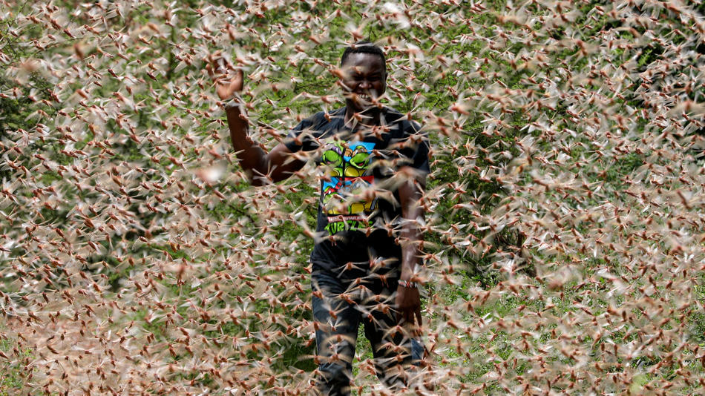
2020 Kenyan Locusts
A desert locust swarm in Kenya on Jan. 24, 2020.
Notes:
In 1937, aboard slowly-moving trains, the Army National Guard used flamethrowers in an attempt to quell a relentless plague of locusts crossing through Colorado.
But the flamethrowers failed. And so did explosives. The locusts easily endured, devouring farmland.
Over 80 years later, great locust swarms still can't be contained. Last week, the U.N. announced that desert locusts — the most devastating type — descended upon East Africa, and over the coming months the insects may increase their populations by a whopping 500-fold. "Kenya has not faced a locust threat of this magnitude in 70 years," the U.N. said.
Why today's biblical locust swarms can't be stopped
By Mark Kaufman Jan 28, 2020
https://mashable.com/article/locust-swarm-africa-explained/
Accessed 17 March 2020

Slide 30
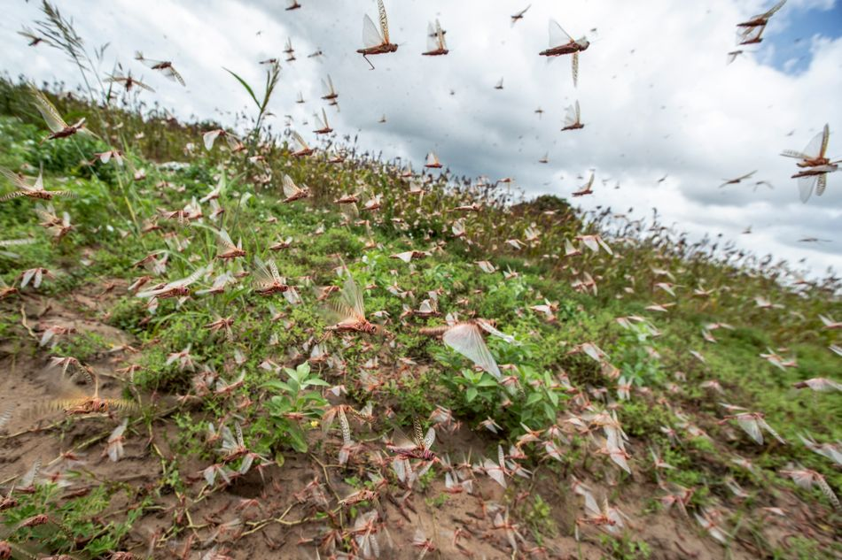
2020 Kenyan Locusts
Locust swarms in Kenya on Jan. 24.
Notes:
A single swarm of locusts, which are voracious grasshopper species that can spread over 460-square miles of land, have been a scourge — at least through the eyes of humans — for thousands of years. In more modern times, the British formed an anti-locust unit at the height of World War II to combat the pests in Africa and the Middle East, and a New York Times reporter pondered, in 1976, if "swarms that darken the sky" and "denude the land of crops" could be eliminated by progressing technology. Still today, the locust affliction continues.
"It's not surprising to me that we still don’t have a grip on this," said Iain Couzin, the director of the Max Planck Institute of Animal Behavior who researches locust swarms.
Today, the best humanity can do is try and predict where the swarms will form before a massive population outbreak can occur and ultimately consume vast tracts of crops, which are often rural people's sustenance. "You need to catch it early," said Rick Overson, the research coordinator at Arizona State University's Global Locust Initiative.
Locust swarms in Kenya on Jan. 24.
Image: Ben Curtis / AP / Shutterstock
Why today's biblical locust swarms can't be stopped
By Mark Kaufman Jan 28, 2020
https://mashable.com/article/locust-swarm-africa-explained/
Accessed 17 March 2020

Slide 31
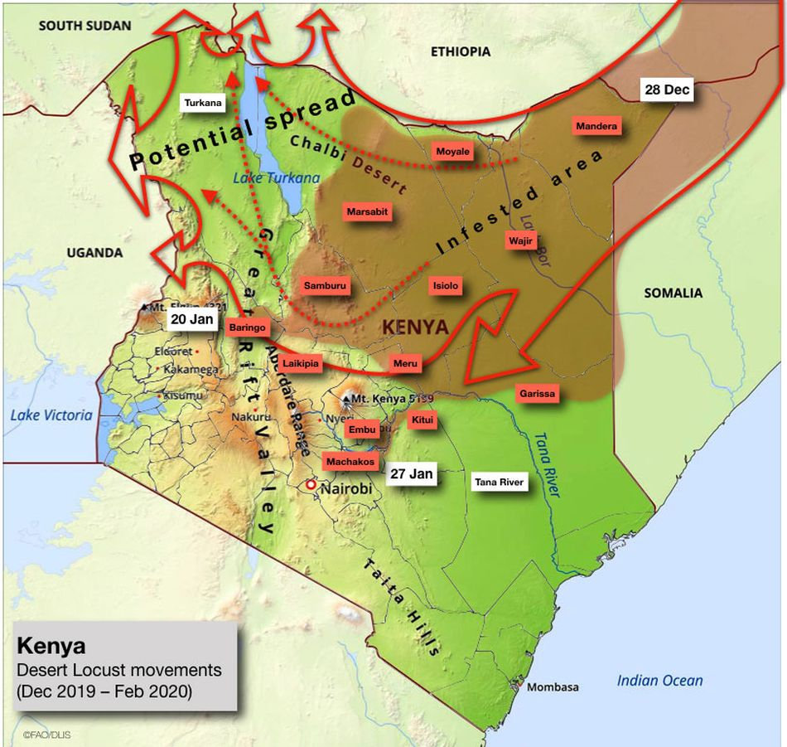
2020 Kenyan Locusts
Desert locust movements and prediction released on Jan. 28, 2020
Notes:
Once locusts grow wings as mature adults, there's no turning back. "They’re powerful fliers," said Overson. "They can be in one country and move to another by the end of the week." And "during plagues" of the desert locust, the U.N. notes swarms can "affect 20 percent of the Earth's land, more than 65 of the world's poorest countries, and potentially damage the livelihood of one-tenth of the world's population."
After an outbreak occurs or the swarming begins, the blunt strategy is often to drop millions of liters of chemical pesticides on the insects, which is bad for the environment and human health, Overson explained.
But identifying exactly where the locusts start to swarm can be enormously daunting, especially when it comes to desert locusts in Africa and neighboring areas, which naturally inhabit remote, mostly-uninhabited regions some 16 million square kilometers, or over 6 million square miles, in size. The creatures usually live solitary lives, but, when the right environmental conditions align (like after a good rainy season), the creatures become intensely attracted to each other, change color, and often grow longer wings and become more muscular. They transform into a formidable swarm.
"Locusts are highly cannibalistic" "We’re not going to solve this problem as a human society anytime soon," Overson said.
Critically, humanity shouldn't endeavor to completely wipe out locust swarms, just because their populations can explode. After all, locust swarms are wild, natural phenomena. Attempting to eliminate the insects, even if that were possible, could have unforeseen, cascading environmental consequences. "It's one of the wonders of the natural world," said Couzin."We don't want to stop them. We just want to manage them."
Why today's biblical locust swarms can't be stopped
By Mark Kaufman Jan 28, 2020
https://mashable.com/article/locust-swarm-africa-explained/
Accessed 17 March 2020

Slide 32
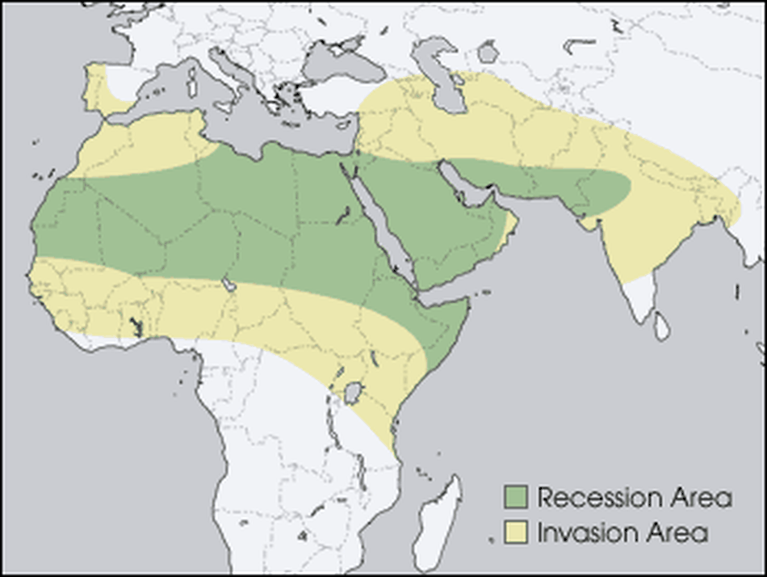
2020 Kenyan Locusts
The green "recession area" is where locusts naturally live, before swarming
Notes:
Locust swarms have similarities to wildfires, explained Overson. Sure, no one wants their house to burn down. But wide-scale suppression of wildfire, a natural phenomenon, has resulted in vastly overgrown forests, contributing to explosive infernos in the Western U.S. What might killing billions of locusts do? It's best not to find out.
To fend off some super-swarms from devouring human food, the primary mission today is prediction. The Food and Agricultural Organization of the United Nations currently strives to forecast the swarms. Where will the locusts strike? Locust populations can explode after the right rains, at the right times, or after mild winters, explained Overson.
But, there's a slew of other things to better account for stressed Couzin. "We’re at the tip of the iceberg of what we need to know" for better predictions, he said, like how billions of insects will react to changing weather, what there is to eat hundreds of miles ahead — and how much locusts will eat each other.
The green "recession area" is where locusts naturally live, before swarming.
Image: nasa
Why today's biblical locust swarms can't be stopped
By Mark Kaufman Jan 28, 2020
https://mashable.com/article/locust-swarm-africa-explained/
Accessed 17 March 2020

Slide 33
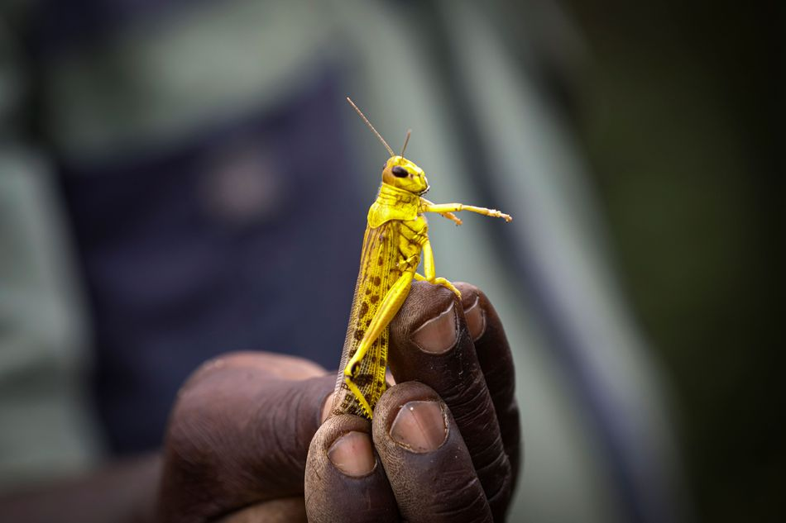
2020 Kenyan Locusts
A Kenyan farmer picks up a desert locust in Jan. 2020.
Notes:
Though locust swarms impact about one in 10 people on Earth, there's a glaring lack of funding for swarm research. In part, this is because the swarms exist in boom and bust cycles, so there might be less research interest in the years, or sometimes decades, between outbreaks. What's more, Couzin pointed out that locust swarms usually aren't descending upon the rich world. "It's affecting poor people," he said, so there's a lack of interest from wealthier nations.
Humanity, though, isn't a completely hapless observer as clouds of locusts come swarming from the horizon. It's quite likely civilization is giving these swarms a boost, both Couzin and Overson agreed.
"We’re trying to change the dogma that humans are passive victims of locust swarms," said Overson.
SEE ALSO: Why Australia won't escape its vicious fire spiral
We irrigate vast tracts of land, providing locusts with the carbohydrate-rich foods they (and we) love. Climate change might make swarms more extreme, as rainfall events become more intense on a warming planet, perhaps giving rise to swarms feeding on plentiful growth following deluges. These questions demand more research.
In the coming months, locusts in East Africa will devour plants and croplands before their food runs out and they fade away — until the next swarm. It's what they're destined to do.
"It's quite extraordinary," said Couzin. "The locusts have found this trick to survive in booms and busts."
"It works well for them," he added. "Unfortunately, it doesn't work well for us."
Why today's biblical locust swarms can't be stopped
By Mark Kaufman Jan 28, 2020
https://mashable.com/article/locust-swarm-africa-explained/
Accessed 17 March 2020

Slide 34
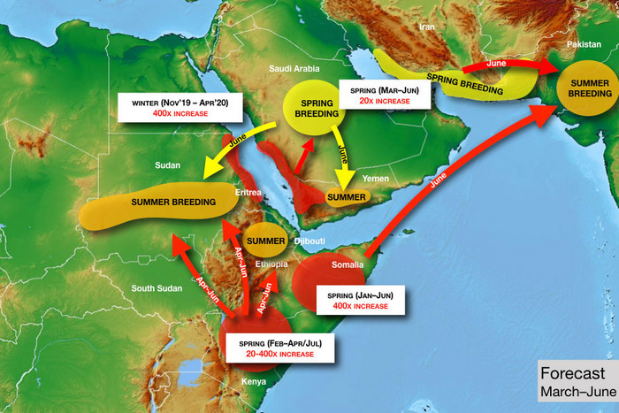
2020 Kenyan Locusts
Photo: United Nations
Notes:
just asking questions Mar. 14, 2020
So There’s a Locust Plague Too?
By Matt Stieb
A volunteer sprays pesticide in eastern Kenya — which is suffering from its worst locust outbreak in 70 years. Photo: Tony Karumba/AFP via Getty Images
It’d be easy to quip biblically about the simultaneous breakout of pandemic and plague if not for the vast human toll that the intercontinental crises are exacting. As the coronavirus continues to spread on six continents, a desert locust outbreak has inundated East Africa with hundreds of billions of bugs, causing food shortages in Kenya, Somalia, and Ethiopia. “It was like an umbrella had covered the sky,” Joseph Katone Leparole, a 68-year-old living in central Kenya, told the New York Times.
In our age of overlapping crises, it shouldn’t be a surprise that climate change can be identified as a factor in the upsurge, the technical term used for such a natural disaster that is just below plague. It began in 2018, when a pair of cyclones came in from the Indian Ocean and hit the “empty quarter” of the Arabian peninsula — the vast desert region near the borders of Saudi Arabia, Yemen, and Oman. In a speech before the African Union in February, U.N. general secretary António Guterres explained the unfortunate cycle: “Warmer seas mean more cyclones, generating the perfect breeding ground for locusts.”
“When you have rains associated with cyclones, they’re much stronger than normal,” said Keith Cressman, the senior locust-forecasting officer at the United Nations’ Food and Agriculture Organization. “When those rains fall in desert areas with sandy soil, that will flood the soil. Once those floods recede, the soil retains so much moisture that it allows desert locust females to lay their eggs probably for a period of around six months.”
From these ideal conditions, the bugs moved south into Yemen (already in a food crisis, Yemenis turned to them as a protein source) and into the Horn of Africa. The spread was rapid: A single locust can travel up to 90 miles in a day and eat its own weight in plant matter, of which there was a bounty, thanks to the excessive rains. They also turned north, across the Persian Gulf into Iran, and into India and Pakistan last summer. National emergencies have been declared in Pakistan, Jordan, and Somalia to help mobilize a response: The only effective control operation once a swarm is in motion is to spray pesticide directly on the bugs from the air.
To help understand the crisis, Intelligencer spoke with the FAO’s Cressman about some of the bugs’ idiosyncrasies and what to expect in the coming months.
Today Only! Save 60% on unlimited access to Intelligencer and everything else New York
LEARN MORE » The FAO projects that the number of locusts could grow 400 times by June if not treated. Could you break that down?
The life cycle of a locust is about three months, so after three months the adults are ready to lay eggs again. With each three-month generation, there’s a 20-fold increase in locust numbers. Locust females lay around 300 or more eggs — more than 90 percent of them die or the resulting hoppers don’t make it to adulthood. Out of all that breeding, for every single female locust there’s about 20 locusts in the new generation that make it. It’s an exponential increase, so after three months you have 20 times, after six months you have 20 squared, so that’s 400 times. After nine months, you’d have 20 cubed, which is 8,000 times. When you get that type of exponential breeding, then those locust numbers rapidly increase, and that’s how swarms form, basically.
So with these new generations, countries in East Africa that have already been inundated could face even more locusts?
Absolutely. There’s a generation in progress now and breeding in Ethiopia, Somalia, and in Kenya. Conditions will probably remain favorable there because of a cyclone in northeastern Somalia in December. Conditions are probably favorable in those three countries until June, so that will allow another generation to occur before then.
How are the outbreaks in Pakistan, Iran, and China connected to those in East Africa?
For China, it’s a completely different species — apples and oranges. But the one in Iran and Pakistan, yes. What’s going on now in Pakistan is old swarms leftover from last summer that have been slowly maturing and now they’re ready to lay eggs, not in the deserts on the border of India and Pakistan but in the desert closer to Iran and Afghanistan.
There’s an FAO map that shows them traveling directionally from the horn of Africa over Arabian sea. Can they travel over water?
No problem. In the late ’80s, they went from West Africa to the Caribbean. They crossed the Atlantic in about ten days.
Photo: United Nations
How does that work if there’s no food?
They eat a lot before or after! The way it worked crossing the Atlantic was, they had enough fuel in the tanks but still needed to rest sometimes, so they’d rest onboard ships, and then they’d take off again. If there weren’t any ships, they’d land on the surface of the ocean, and then a second swarm would come and land on top of the first swarm and rest, and the second swarm would take off and continue flying and the first swarm would drown.
My impression was that they choose to go where food is. Do they have choice as a unit where they’re going or is it randomized by wind?
They seem to decide whether they want to take off or fly with the prevailing wind or not, in which case they’ll sit on the ground. They can somehow sense winds when they come from different directions, but they can’t fly like birds against the wind. So they are a victim of the wind, but still they do control motion to an extent.
Without human intervention, how does a locust outbreak end?
There would have to be a failure of the seasonal rains — that’s usually how mother nature helps to bring these things under control. Sometimes the winds will push locusts into areas they just don’t want to be in. For instance, if they got pushed further into the Democratic Republic of the Congo or into cold areas where they would die, or areas that are very tropical where they would pick up a lot of pathogens and die. They’re very susceptible to funguses. Like those guys that got pushed across the Atlantic ocean in the ’80s, they died immediately when they landed.
What happens in a country like Iran where there’s a simultaneous outbreak of locusts and the coronavirus.
Fortunately, different parts of the government are responding, so the Ministry of Agriculture is dealing with locusts and the Ministry of Health has to deal with the coronavirus. The resources and manpower are in completely different sectors of the economy. But any additional challenges that a country faces, they can have impacts on the control operations, and they might not be as effective as hoped.
What about states in open conflict or with major security issues, like Yemen or Somalia?
Yemen is very critical because it’s a frontline country for desert locusts. Desert locusts are there every year, and there’s a number of different breeding areas along the coast in the wintertime in the interior. It’s a country that has a really spectacular habitat for desert locusts, and when it rains, those locusts take advantage of it.
That’s probably one of the reasons why the locust infestation shifted from the empty corridor in 2019 across to the Horn of Africa in the summer, because they stopped off in Yemen for a generation of breeding in the spring. Because of the conflict, there’s very little that can be done. It’s just not safe for the national locust teams to to operate throughout the country to undertake the survey for control operations. There are a few limited areas they can work in, but it simply isn’t enough.
Fortunately, in Somalia, the key locust breeding areas are in the north of the country, which is a region that’s much easier to operate in. It’s much safer, so national teams can get in there and do the survey and control operations. However, in the south and central parts of the country, it is much more challenging. Those parts of the country don’t see locusts often, maybe once every few decades, so they also have very little capacity.
What about in South Sudan, where there is already a food shortage?
The good news is, it’s not really their typical habitat. It’s not dry enough, and they don’t have so much sandy soil. It’s more of a clay soil, and there’s much more vegetation cover, so this makes it hard for the females to find bare, empty places to lay their eggs. And we’ve seen this with those locusts that got into northeastern Uganda and the southeast of South Sudan: They flew around, and the females became so desperate that they just kind of dropped their eggs on top of the soil, which means that they immediately dry out and die. Desert locusts don’t do this very often. These guys are masters of survival. They’re professionals, so this means that those females are really desperate. So probably South Sudan is much more of a transit zone. Later on in the spring, a new generation of swarms will likely form in northern Kenya. Once it drys out there, they will be moving back into Somalia, back into Ethiopia, and probably into north Sudan to get really into the Sahara and the deserts they prefer.
What’s the most effective form of prevention and treatment if an outbreak is already in motion?
When you have these cyclones, it comes back to climate change: We’re starting to see more patterns of severe weather, which means unusually heavy rainfall, cyclones,t hese things. You can’t prevent them really. So we’re going to have to develop better mechanisms to respond to them better. Basically it means that countries are going to have to be very well prepared. To visit a wildfire metaphor, you need to have a lot of good fire stations with well trained crews and fire trucks — it’s the same with desert locusts. You need to have a good national locust program that’s well-equipped, well-trained, well-funded so that they can respond to these situations. But it’s probably too idealist to think these nations are always going to have sufficient resources. At one point, it will probably overwhelm capacities — that’s what’s happened now in Kenya, Somalia, and Ethiopia. Then the international community has to step in.
The U.N. is calling for $138 million to mitigate the crisis. What does the allocation of that money look like?
Roughly, it’s about half for control operations — that’s upscaling the aerial control operations and getting in more aircraft, more ground logistical teams, supplemented by ground control like vehicles, sprayers, pesticide. The other half is basically to protect the livelihoods or to help those who have already been damaged to help them to recover. This can be seed packages to farmers if their initial crop has been lost. For pastures, it would be animal feed, because there’s a lot of pastoralists in the Horn of Africa who rely on pastures for their grazing animals.
What are the most concerning and the most hopeful aspects about the upsurge as it stands today?
The greatest concern is where it’s occurring, in the Horn of Africa — which is already extremely vulnerable to any slight disruption to food security and livelihood, simply because they’ve had a series of droughts in the past. Now they’ve got floods and heavy rains, and on top of that, locusts. No. 2 is that the swarms are in countries that either do not have very robust national programs or don’t have them at all. Kenya has seen locusts twice in the last 70 years — don’t expect it to have a strong locust program compared to a country that has to deal with locusts every year that’s much better.
Maybe the silver lining here is that they’re not going to stay in the Horn of Africa forever. Desert locusts are migratory in nature. When they move, they’ll move back north and into those countries where they are normally present — like Sudan, Eritrea, Saudi Arabia, Oman, Iran, Pakistan, India, and Egypt — and those countries have much stronger national programs to address them.
Sign Up for the Intelligencer Newsletter
intelligencer is a Vox Media Network. © 2020 Vox Media, Inc. All rights reserved.
https://nymag.com/intelligencer/2020/03/a-u-n-locust-forecaster-explains-the-crisis-in-east-africa.html
Accessed 17 March 2020

Slide 35
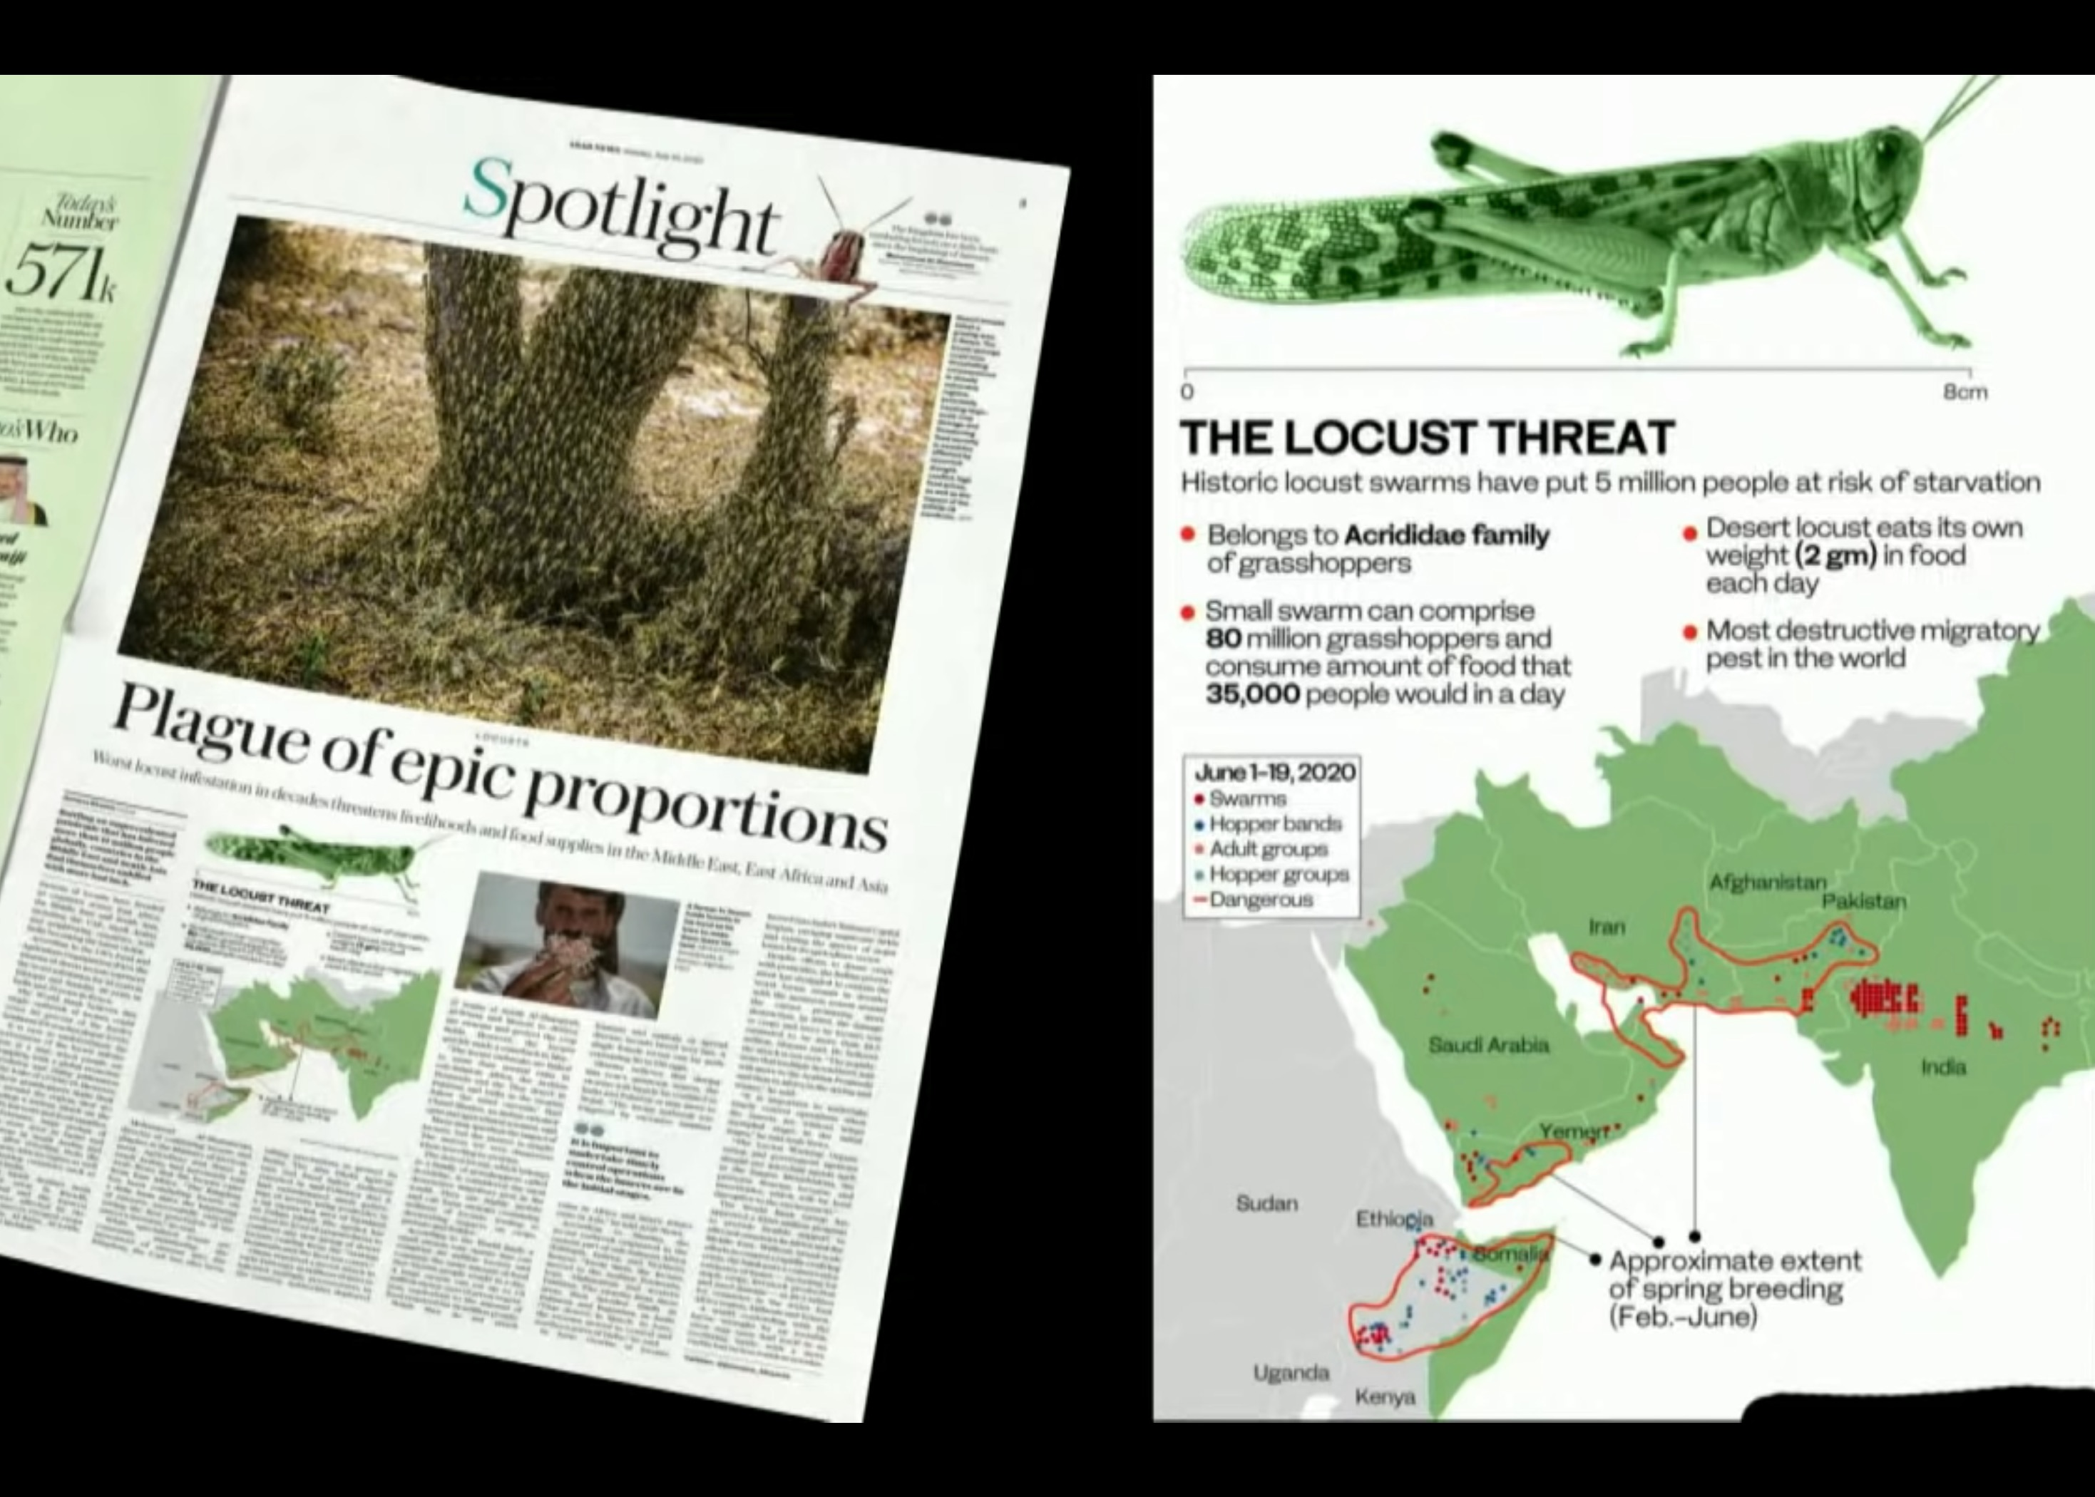
2020 Expanded Locusts

Slide 36
作个有纪律的人
约珥
Dr. Rick Griffith, Crossroads International Church Singapore
BibleStudyDownloads.org

Slide 37

纪律
Notes:
Be disciplined or you will be disciplined.

Slide 38

纪律
Notes:
This is true because any good leader disciplines those he cares about, and ultimately, God is the best disciplinarian.

Slide 39
Be disciplined or you will be disciplined.
Notes:
Which better describes your life now? Disciplining yourself or being disciplined by God?
If your experiences are sweet, thank God. Maybe you are disciplining yourself so God doesn’t have to get your attention. But if your experiences are sour, thank God also. Maybe this is just what you need for God to get your attention. Are you listening?

Slide 40

"Hear this, you leaders of the people.
Listen, all who live in the land"
(Joel 1:2a NLT).
The traditional Chinese character for "listen" consists of six radicals
When we truly listen to someone, we treat them as a king or queen. A servant never interrupts the king, but wraps his ear around him, attending every word & facial expression with "ten eyes & one heart"
True listening gives the other person our full respect and undivided attention.
Notes:
Are you really listening to what God is trying to tell you in your life?
Maybe he is trying to discipline you.

Slide 41
当我们受到纪律处分时，
我们该怎么办？
约珥
Notes:
让我们回到原本的问题......

Slide 42

出埃及记背景
Notes:
OS-29-Joel-34

Slide 43
Placing the Prophets
先知的位置
342
关键 时代
931
俄巴底亚
722
约拿
阿摩司
何西阿
以赛亚
弥迦
那鸿
西番亚
耶利米
耶利米哀歌
约珥
但以理
哈该
哈巴谷
以西结
撒迦利亚
马拉基
586

Slide 44

"他们抽签分了我的子民，将男童换妓女，卖女童买酒喝。"
(约珥书 3:3 CCB).
Notes:
Ar

Slide 45
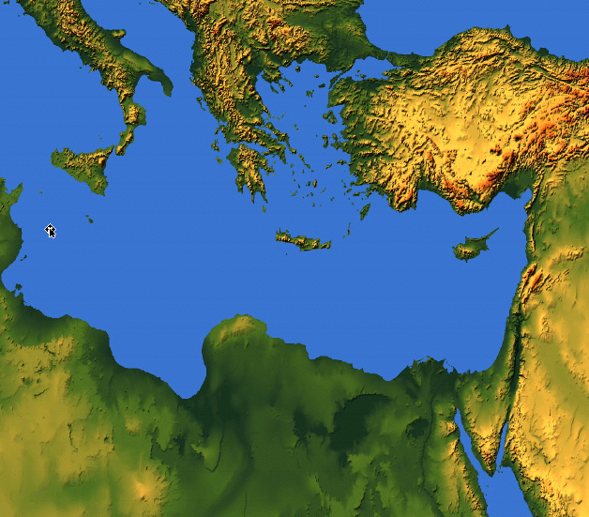

The Sale of Judeans to the Greeks
"What do you have against me, Tyre and Sidon and you cities of Philistia? Are you trying to take revenge on me? If you are, then watch out! I will strike swiftly and pay you back for everything you have done. ⁵You have taken my silver and gold and all my precious treasures, and have carried them off to your pagan temples" (Joel 3:4-5 NLT).
219
Sidon
Tyre
Judah
Philistia
Notes:
Joel also mentions selling people to Greeks, which also happened only after about 600 BC when Greece became strong.

Slide 46
The Sale of Judeans to the Greeks
"You have sold the people of Judah and Jerusalem to the Greeks, so they could take them far from their homeland"
(Joel 3:6 NLT).
219
Greeks
Sidon
Tyre
Greeks were not a strong power until around 600-500 BC so Joel probably has a later date
Judah
Philistia

Slide 47
Jerusalem's Fall
Jerusalem's Fall
232
342
560
Key Dates
627
Jeremiah
605
Daniel
597
Ezekiel
586
538
Zephaniah
Joel
630
Lamentations
Habakkuk
590
606
Notes:
In our study of the Minor Prophets we are now near the time of the destruction of Jerusalem in 586 BC under Nebuchadnezzar. This was one of the two key times the city was destroyed as God’s discipline of his wayward people.
_______
OS-29-Joel-39

Slide 48
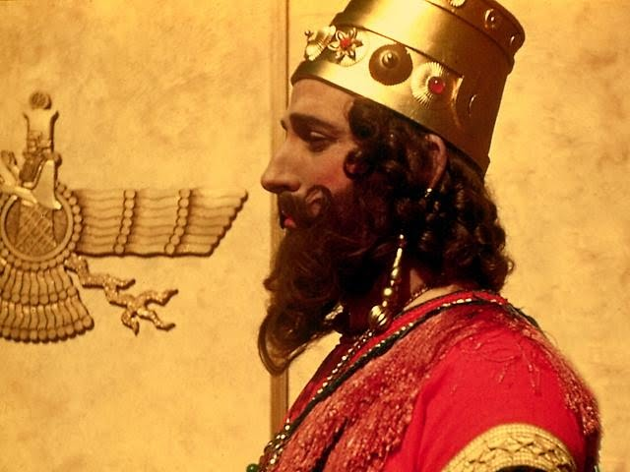
Joel Preached During King Nebuchadnezzar's Reign
Notes:
God's instrument of discipline was this pagan Babylonian king.

Slide 49

1. What to do now
2. How this will turn out
"TO DO" list for today
Notes:
Today we’ll see what to do about present difficulties, and then how these will all turn out in the end.

Slide 50
当我们受到纪律处分时，
我们该怎么办？
约珥
Notes:
让我们回到原本的问题......

Slide 51
一。纪律应该带来悔改
约珥 1:1–2:17
Notes:
困境时是改变我们观点的好时机。

Slide 52
约珥书
Devastation 1:1–2:17
Deliverance 2:18–3:21
Restoration 2:18-32
Blessing 3:17-21
Judgment 3:1-16
Disasters 1:1-20
Invasion 2:1-17
过去
未来
上帝的日子

Slide 53
Slides on
约珥 1

Slide 54

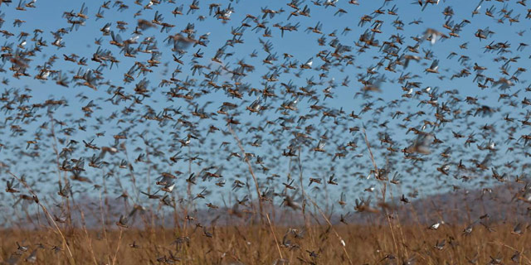
"Tell them about the locusts."
No king noted = no date noted
"The LORD gave this message to Joel son of Pethuel"
(Joel 1:1 NLT).
"OK."

Slide 55
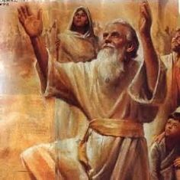
The Name "Joel" = LORD God
"Jo" = Jehovah = LORD
"El" = Elohim = God

Slide 56
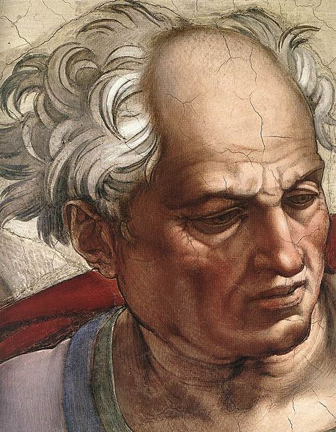
“老年人哪！你们要听这话。
这地所有的居民啊！你们要留心听。
在你们的日子，
或在你们祖先的日子，
曾有这样的事吗？
³ 你们要把这事传与子，
子传与孙，
孙传与后代。”
(约珥 1:2-3 CNV).

Slide 57
Barry Huddleston, The Acrostic Summarized Bible (Grand Rapids: Baker, 1992)
约珥
1 Cry to avoid judgment
2 Return to God's blessing
3 Yield to God's sovereignty

Slide 58
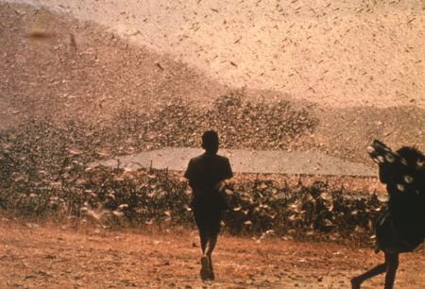
日期与收件人
577
C. 日期: 放逐前末期 (公元前597 与 586 之间).
D. 收件人: 犹大人，应为对锡安和寺庙的引用(1:9, 13-14; 2:15-17, 23, 32; 3:1, 5-6, 16-17, 20-21).

Slide 59
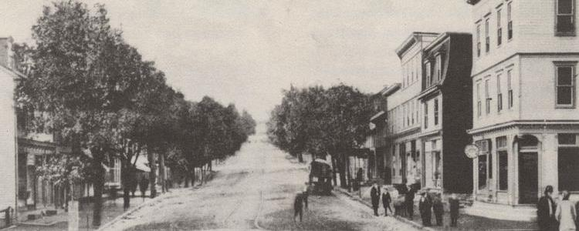
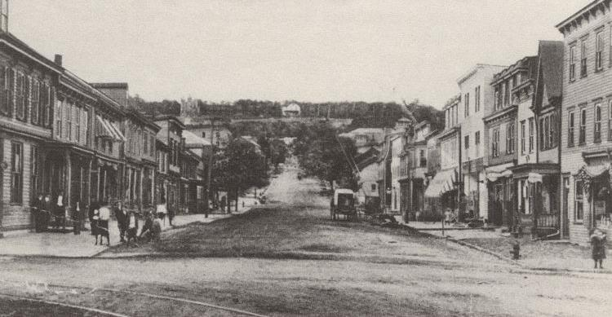
现代蝗灾
(森特勒利亚宾夕法尼亚州，美国）
蝗灾前
蝗灾后

Slide 60
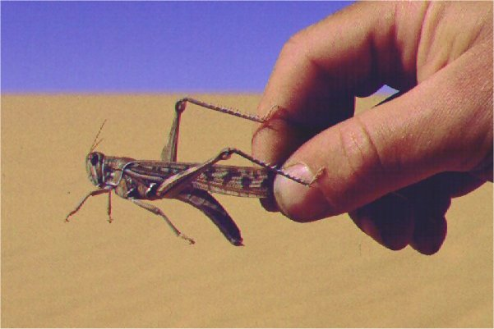
E. 场合
577
近期的蝗灾入侵犹大

Slide 61
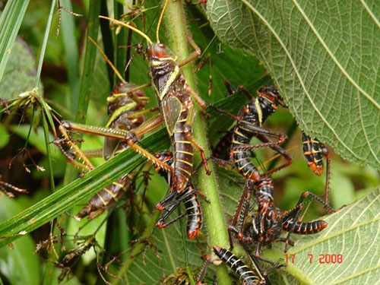
“剪虫剩下的，
蝗虫吃了；
蝗虫剩下的，
蝻子吃了；
蝻子剩下的，
蚂蚱吃了。”
(约珥 1:4 CNV).

Slide 62
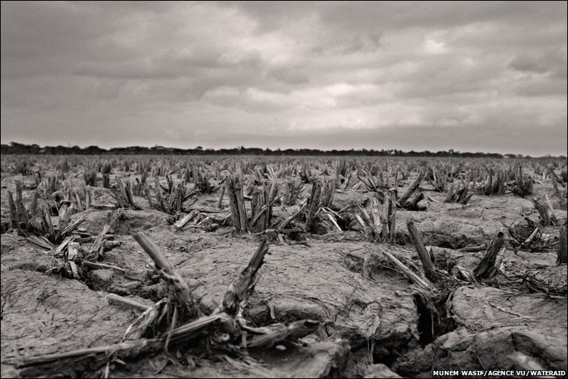
"酒醉的人哪！你们要醒过来；要哀哭！
所有嗜酒的人哪！你们都要为甜酒哀号，
因为甜酒从你们的口里断绝了。"
(1:5 CNV).

Slide 63
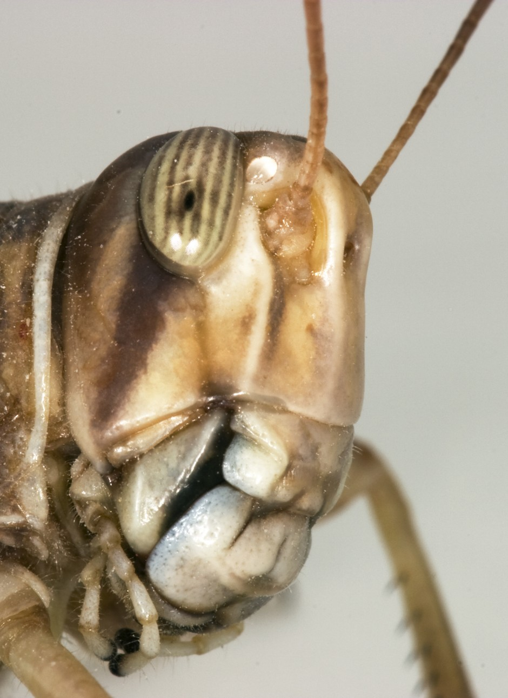
"因为有一民族上来侵犯我的国土，
他们强大又无数；
他们的牙齿像狮子的牙齿，
他们有母狮的大牙。"
(1:6 CNV).

Slide 64
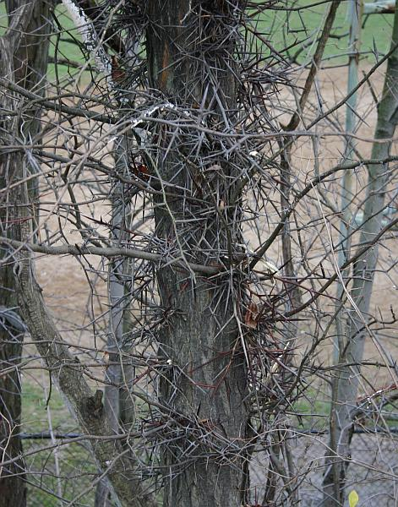
"他们使我的葡萄树荒凉，
折断了我的无花果树，
把树皮剥尽，丢在一旁，
使枝条露白。"
(1:7 CNV).

Slide 65
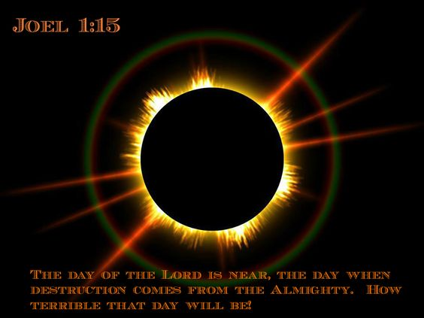
The Day of the LORD (Joel 1:15).
约珥
哀哉那日！
因为耶和华的日子临近了；
那日来到，好象毁灭从全能者临到一样。

Slide 66
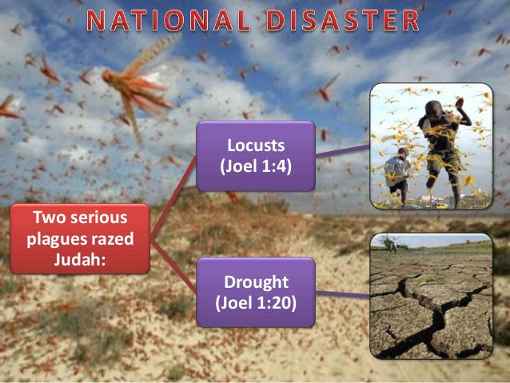
NATIONAL DISASTERS IN JOEL 1
Locusts
(Joel 1:4)
Two serious plagues razed Judah:
Drought
(Joel 1:20)

Slide 67
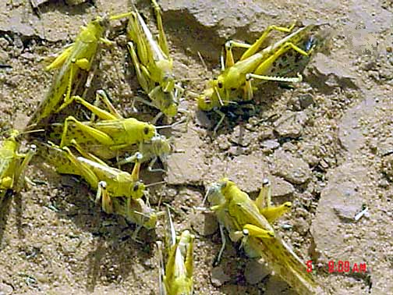
成年的
蝗虫在
交尾
Notes:
Mali: mature gregarious adults copulating (Tamesna, 11/03) http://www.fao.org/NEWS/GLOBAL/LOCUSTS/outbreakpix03.htm

Slide 68
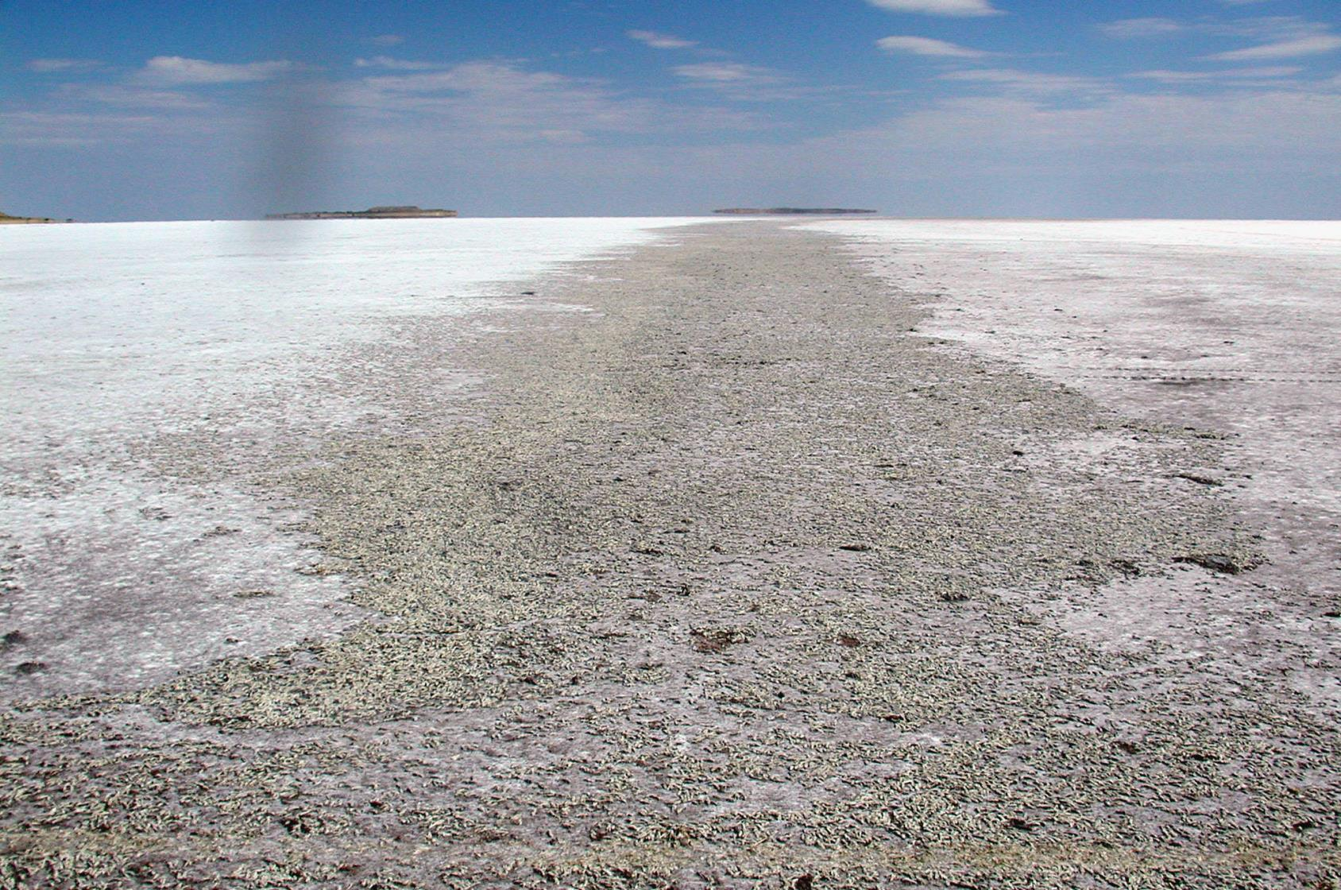
蝗虫的墓地, 盐湖, 犹他州

Slide 69

577
主词
蝗虫

Slide 70
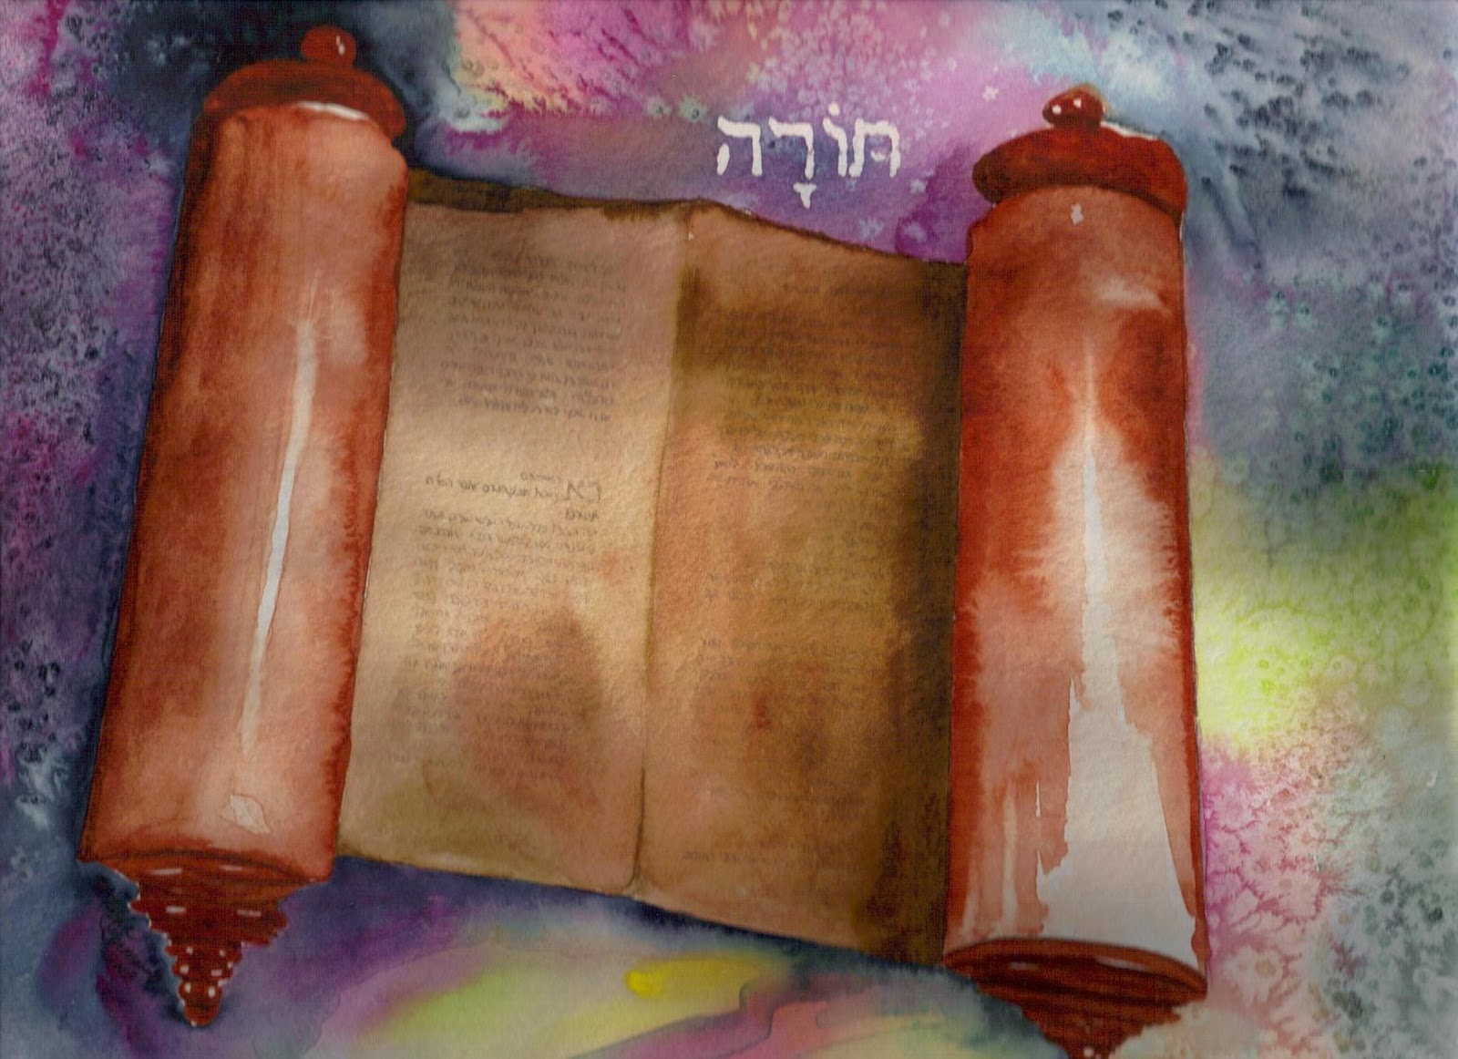
So what does the Torah say about locusts?

Slide 71
祝福 与 咒诅 (申 28)
你的城里和田间必蒙福 (3)
你在城里在田间必受咒诅 (16)
你的孩子和地所产的必蒙福 (4)
你的孩子和地所产的必受咒诅 (17)
你的筐子和你的摶麵盆必蒙福 (5)
你的筐子和你的摶麵盆必受咒诅 (18)
你出你如必蒙福 (6)
你出你如必受咒诅 (19)
你的仇敌从一条路来攻击你， 必从七条路逃跑！(7)
你從一條路去攻擊他們、必從七條路逃跑！(25)
．你必借給許多國民、卻不至向他們借貸 (12)
他必借給你、你卻不能借給他 (44)

Slide 72
场合
220
为什么 ?
被掳
申命记 28章
Notes:
OS-05-Deut-203
OS-11-1Kings-40
OS-14-2Chron-58
Jeremiah’s prophecy and Lamentations record his eyewitness account of Babylon’s siege and destruction of Jerusalem for the nation’s sin, the Holy Spirit moved him to record an historical compilation which provides the context and justification for God’s judgment upon these two nations. The leaders and the people sinned through ungodliness and idolatry, and true to the curses of Deut. 28, God gave the people the consequences of their obedience.

Slide 73
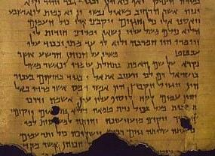
蝗灾的意义何在?
577
合和本 申命记28:38 “你带到 田间的种子虽多，收进来的却少，因为被蝗虫吃了”

Slide 74
Slides on
约珥 2

Slide 75
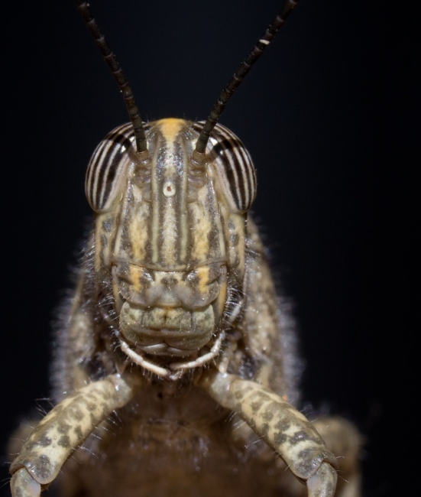
"你们要在锡安吹号，
并在我的圣山发出警讯，
让国中所有的居民都战栗，
因为耶和华的日子快到，必然临近了。"
(2:1 CNV).

Slide 76
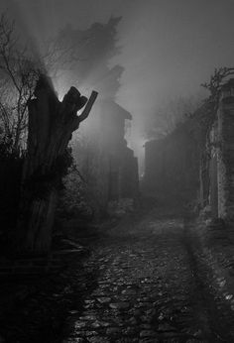
"那日是黑暗幽冥的日子，
是密云漆黑的日子。
有一队众多强盛的民来到，
好象晨光满布群山；
这样的事从前没有发生过，
以后直到万代，
也不会发生。"
(2:2 CNV).

Slide 77
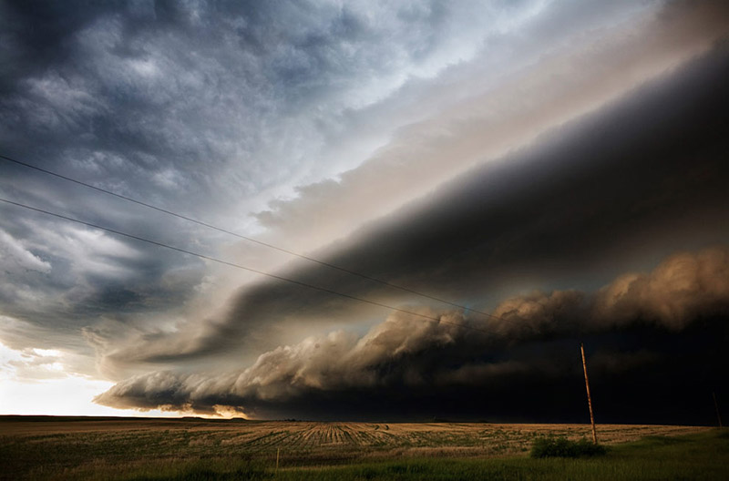
"在他们前面有吞灭的火，
在他们后面有燃烧的火焰；
他们未到以前，大地像伊甸园，
他们过去以后，大地成了荒凉的旷野，
没有一样能逃避他们的。"
(2:3 CNV).

Slide 78
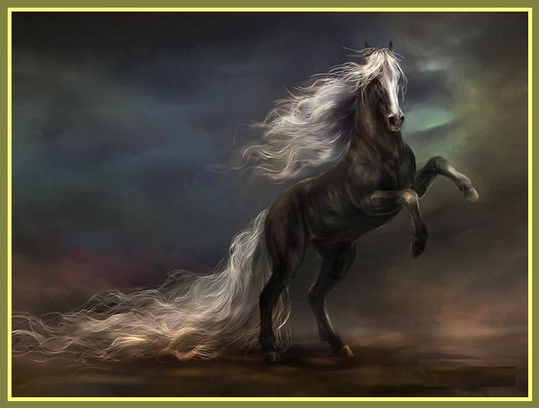
"他们的形状像马的形状，
战马怎样奔跑，他们也怎样奔跑。"
(2:4 CNV).

Slide 79
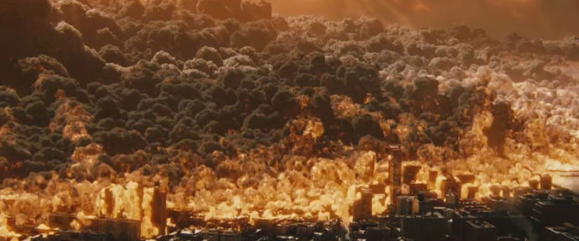
"他们在群山顶上跳跃的声音，
如战车的响声，
又如火焰
吞灭碎秸的响声，
像强盛的民
摆阵预备作战。" (2:5 CNV).

Slide 80
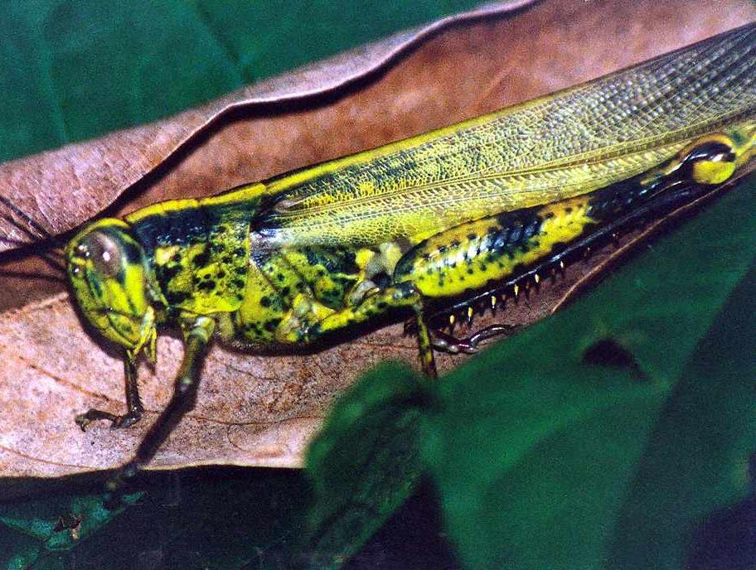
主要经文
575
“. . . 因为耶和华的日子大
而畏 ，谁能当得起呢？
耶和华说：虽然如此，
你们应 当禁食、哭泣、悲哀，一心归向我。” (2:11下b-12)

Slide 81
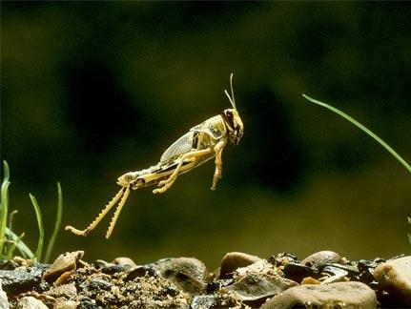
约珥书2:1-11的蝗虫是什么?
578
描绘蝗虫和军队？
超自然生物?
字面的蝗虫?
比喻一个军队?
比喻很多的军队?

Slide 82
Joel
Devastation 1:1–2:17
Deliverance 2:18–3:21
Restoration 2:18-32
Blessing 3:17-21
Judgment 3:1-16
Disasters 1:1-20
Invasion 2:1-17
History
Prophecy
The Day of the LORD

Slide 83
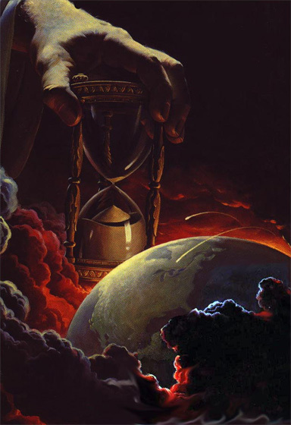
为什么未来？
578
1. 意象加强：地震、天里的迹象（2:10、30-31; 太24:29)

Slide 84

为什么未来？
578
1. 意象加强：地震、天里的迹象（2:10、30-31; 太24:29)
2. “民” (2:2)，“军队” (2:11)

Slide 85
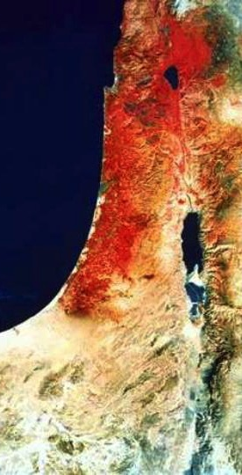
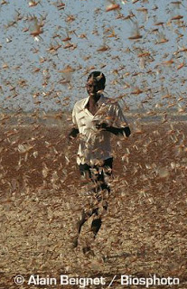
为什么未来？
578
1. 意象加强：地震、天里的迹象（2:10、30-31; 太24:29)
2. “民” (2:2)，“军队” (2:11)
3. 蝗虫从来没有像这“军队”从北方侵略 (2:20)
4. “北方” (2:20) 与从北方侵袭的末世仇敌吻合 (迦6:8，等)

Slide 86
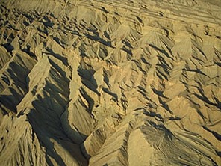

主的日子
638-639
审判
+
祝福
大灾难
千年
启 6–19
启 20
7 年
1000 年

Slide 87
末世事件时序
473
白色
大宝座
(启 20:11-14)
圣徒被提
(提前 4:13-18)
主再来(亚 14:3-5)
主的日子
教会时代
大灾难
(亚 14:1-2)
千禧年
(亚14:6-21)
歌革和玛各
(哈米吉多顿)
(结 38–39)
歌哥革和玛各
的重现
(启 20:7-10)
Notes:
87

Slide 88
做什么？
"耶和华说：
“现在虽然如此，
你们仍要全心全意，
以禁食、哭泣、哀号，归向我。”
你们要撕裂你们的心肠，
不要撕裂你们的衣服。
并要归向耶和华你们的 神，
因为他有恩典有怜悯，
不轻易发怒，
并且有丰盛的慈爱，
随时转意不降灾祸。" (2:12-13 CNV).

Slide 89

Do you reject God's discipline?
Notes:
God’s disciplining us should motivate us to seek the Lord.

Slide 90

God & the USA
Notes:
The moral height of the USA was in the 1950s. The USA rebuilt its former enemies Japan and Germany, adopted “In God We Trust” as the national motto, and began to see many turn to Christ under Billy Graham as well send out missionaries to the nations.
Home > 2015 > July
Jul 3, 2015
God and Country: Americans' Views of God's 'Relationship' with the U.S
What do Americans think about the United States and God? Fascinating new data. |
Ed Stetzer
http://www.christianitytoday.com/edstetzer/2015/july/god-and-country-new-research-on-americans-views-of-country.html
Accessed 9 April 2017
Happy Fourth of July weekend folks, my American readers!
Two hundred thirty-nine years ago tomorrow, Congress adopted the Declaration of Independence, nearly a month before it would eventually be signed. I hope you're having a fun weekend, getting to enjoy some time with family and friends.
As I explained in a post last year:
Christians are, in a sense, dual citizens-- of the Kingdom and of the nation where they live. I live in a country that is not without fault, but I am proud to be a citizen of that nation. I teach my children to be proud of their nation-- not unaware of its challenges-- and patriotic citizens.
Just this week, LifeWay Research released some new data on how Americans view their country and how God relates with it. Here's an excerpt from our report:
In a nation founded on religious liberty, most Americans believe God has a special relationship with the United States, and they’re optimistic the best is yet to come.
Despite headlines lamenting the global decline of the United States since the Cold War, 54 percent of Americans believe the nation is on the upswing, according to a September survey by LifeWay Research. Only 4 in 10 think “America’s best days are behind us.”
And though the U.S. Constitution makes no mention of God, 53 percent of Americans say they believe God and the nation have a special relationship, a concept stretching back to Pilgrim days. Even a third of atheists, agnostics, and those with no religious preference believe America has a special relationship with God.
“‘God Bless America’ is more than a song or a prayer for many Americans,” said Ed Stetzer, executive director of LifeWay Research. “It is a belief that God has blessed America beyond what is typical for nations throughout history. I am sure that would spawn many theological conversations, but it’s important to note most Americans think God has a special relationship with their country.”
Christianity Today reported on the data, and added additional research, in their article, "God and America: It's Complicated," explaining, "A third of Americans say the United States is a Christian nation. But more than half say the country has a special relationship with the Almighty."
Christianity Today also included a link to my post providing cautions about combining patriotism and worship, where I explained the importance of patriotism (and not just in the U.S.), but also cautioned, "If your church service was driven more by America than by Jesus, I think you need a change."
Here are a couple of the graphs depicting the major findings:
One of the most interesting parts of the survey was the gender divide among the views:
Women are significantly more likely than men to believe God has a special relationship with the United States. While 49 percent of men have that view, the number rises to 58 percent for women.
LifeWay Research also found differences by age, race, geography, education, and religious preference.
Nearly two-thirds (63 percent) of Americans 45-54 years old think God has a special relationship with the United States, a belief shared by 48 percent of those 18-44.
Belief in a special relationship is also high among:
African-Americans, at 62 percent, compared to whites at 51 percent. Southerners, at 59 percent, compared to 49 percent of Midwesterners and 50 percent of Westerners. Those with a high school degree or less, at 66 percent. For those with some college, the rate drops to 51 percent. It drops further to 40 percent of those with a bachelor’s degree and 29 percent of those with a graduate degree. Evangelical Christians are the most likely to believe in a special relationship, with 67 percent agreeing. Among evangelicals 45 and older, the share soars to 71 percent.
“Americans, particularly those in more religious segments or geography, are most likely to believe in this special relationship,” Stetzer said. “But, considering the history of the nation, from Manifest Destiny to Ronald Reagan’s ‘City on a Hill’ speech, it’s not surprising this long-held theme continues today.”
A lot of this, of course, is rooted in our sense of American exceptionalism. Here's a bit on that from our report, including a thought from me:
Both ends of the political spectrum—from President Obama to the Republican Party platform—have touted American exceptionalism, the belief that the United States plays a unique role in human history. For some, the concept includes the idea of a special relationship with God, although beliefs about the nature of the relationship vary.
“Some Christians view America as an archetype of biblical Israel, chosen and uniquely blessed by God,” Stetzer said. “That’s why Christians sometimes speak of God ‘healing our land,’ when most theologians say this American ‘land’ is not in the same category as the ‘land’ of biblical Israel.”
What do you think? Is America exceptional? Does God have a special relationship with the United States? Comment below.
Click here to see the full research report.
Support our work. Subscribe to CT and get one year free.

Slide 91

God's Discipline of the USA
Notes:
But the 1960s became a turning point: corporations wanting to prolong the Vietnam War to make more money off it, making it illegal to pray and read the Bible in schools, chaos in the many riots, and assassinations of key leaders like John F Kenney and Martin Luther King.
The last straw was America turning its back on Israel in recent years, even sponsoring a conference in January a week before the change of power in Washington.

Slide 92

God's Discipline of the USA
Notes:
As a result, the USA has been in horrible disarray: 78 million abortions, half of births to unwed mothers, 110 million people with STDs, disrespect around the world, involved in the longest war in US history in Afghanistan and Iraq, etc.
The USA has been under the disciplining hand of God in order that the country might turn back to him.

Slide 93

Discipline of Individuals

Slide 94

Discipline
Notes:
Some of us could share our stories.
Some have played with sin until we finally got disgusted with ourselves.
Others of us have become complacent so that we hardly give God a thought until Sunday.
The result? We lack love, joy, peace, patience, kindness, goodness, faithfulness, gentleness and self-control. How could we expect the fruit of the Spirit without being controlled by the Spirit?
God is calling us to repentance—a change of mind in whom we trust. He also wants to see in us the fruits of repentance—a change of actions that reveal we really did change our mind.

Slide 95
一。纪律应该带来悔改
约珥 1:1–2:17
Notes:
困境时是改变我们观点的好时机。

Slide 96
二。悔改将带来恢复
约珥 2:18–3:21
Notes:
改变我们对上帝的看法，才会改变我们的未来。

Slide 97
Joel
Devastation 1:1–2:17
Deliverance 2:18–3:21
Restoration 2:18-32
Blessing 3:17-21
Judgment 3:1-16
Disasters 1:1-20
Invasion 2:1-17
History
Prophecy
The Day of the LORD

Slide 98

Israel’s repentance will bring forgiveness, deliverance and restoration (Joel 2:18–3:21).

Slide 99


"耶和华为自己的土地发热心，
祂怜悯自己的子民。
¹⁹ 祂回应他们说：
“我必赐五谷、新酒和油给你们，
使你们饱足，
不再让你们受列国的羞辱。"
(约珥书 2:18-19 CCB).
Notes:
Israel’s repentance will bring forgiveness and blessing (2:18-27).

Slide 100
God's Future Protection of Israel
"'I will drive away these armies from the north. I will send them into the parched wastelands. Those in the front will be driven into the Dead Sea, and those at the rear into the Mediterranean.
The stench of their rotting bodies will rise over the land.'
Surely the Lord has done great things!"
(Joel 2:20 NLT).
219
The North
Israel

Slide 101
Contrasting Joel 1 and 2:21-27
582
Adapted from an Anonymous Handout (Dallas Seminary, 1985)
 | In Joel’s Day | In the Day of the LORD
Land | Mourned (1:10) | Will rejoice and be glad (2:21)
Animals | Groaned, wandered, were hungry (1:18) | Will not be afraid (2:22a)
Fields & Orchards | Were barren & nonproductive (1:7, 10-12) | Will grow and be fruitful and productive (2:22)
Rain | Drought with dryness causing fire (1:20) | Will pour down in abundance (2:23)
Grain, Wine, Oil | Ruined and dried (1:10) | Will be plentiful (2:24)
Crops | Damaged by locusts (1:4) | Damage will be replaced with productivity (2:25-26)

Slide 102


Land Contrasts in Joel 2:21-27
582
Mourned
"... 土地凄凉…"
(1:10 CNV).
Will be glad
"地土啊！你不要惧怕；
你要欢喜快乐，
因为耶和华行了大事。" (2:21 CNV).

Slide 103


Animal Contrasts in Joel 2:21-27
582
Groaned, wandered, hungry
"牲畜发出哀鸣，
牛群到处流荡，
因为没有草场给牠们，
羊群也同样受苦。"
(1:18 CNV).
Will not be afraid
"田野的走兽啊，你们不要惧怕，
因为旷野的草场又发青了" (2:22a CNV).

Slide 104


Fields Contrasts in Joel 2:21-27
582
Barren and unproductive
"他们使我的葡萄树荒凉，
折断了我的无花果树，
把树皮剥尽，丢在一旁，
使枝条露白。" (1:7; cf. 1:10-12 CNV).
Will grow…fruitful and productive
"树木又结果子了，
无花果树和葡萄树也都效力了。" (2:22b CNV).

Slide 105


Rain Contrasts in Joel 2:21-27
582
Drought (dryness caused fire)
"田野的走兽也向你发喘，
因为溪水都干涸了，
火吞灭了旷野的草场。"
(1:20 CNV).
Will pour down in abundance
"锡安的人民哪！你们要欢
喜，
要靠耶和华你们的 神快乐，
因为他赐给了你们合时的秋雨。
他给你们降下时雨，
就是秋雨春雨，像以前一样。" (2:23 CNV).

Slide 106


Grain, Wine & Oil in Joel 2:21-27
582
Ruined and dried
"田野荒废，
土地凄凉，
因为五谷毁坏，
新酒干竭，
油也缺乏。"
(1:10 CNV).
Will be plentiful
"禾场上必满了五谷；
榨酒池与油醡必溢出新酒与新油。"
(2:24 CNV).

Slide 107


Crop Contrasts in Joel 2:21-27
582
Damaged by locusts
"剪虫剩下的，蝗虫吃了；
蝗虫剩下的，蝻子吃了；
蝻子剩下的，蚂蚱吃了。“ (1:4 CNV).
Productive
"我差遣到你们中间去的，
我的大军队，
就是蝗虫、蝻子、蚂蚱和剪虫，
在那些年间吃尽的，
我必补给你们。…"
(2:25-26 CNV).

Slide 108
Eschatological Terminology
洁净。。宣告 (1:14; 3:9)
耶和华的日子接近了 (1:15; 2:12; 3:14)
耶和华的日子来临了 (2:1; 2:31)
黑暗 (2:2; 2:31)
逃脱 (2:3; 2:32)
天崩地裂 (2:10; 3:16)
太阳、月亮、星星变黑 (2:10; 3:15)
耶和华出声说话 (2:11; 3:16)
耶和华的日子，伟大而让人敬畏的(2:11; 2:31)
集聚 (2:16; 3:2)
我的人民和我的遗产 (2:17; 3:2)

Slide 109

III. 新约里的约珥书2:28-29 (参徒2)
579
“这正是先知约珥所说的。。。 ” (徒2:16)

Slide 110

约珥书2:28-29
579
“以后，我要将我的灵浇灌凡有血气的。你们的儿女要说预言。你们的老年人要作异梦。少年人要见异象。在那些日子，我要将我的灵浇灌我的仆人和使女。”

Slide 111

III. 新约里的约珥
“所有主的人民会成为先知”不过这是约珥说的吗？
所有人民将会被释放
呼求主名
蝗虫伸展

Slide 112

约珥 2:30-31 CNV
"我要在天上地下显出神迹奇事，
有血、有火、有烟柱。
³¹太阳将变为黑暗月亮将变为血红。
在耶和华伟大可畏的日子临到以前，
这一切都要发生。"
579

Slide 113
约珥书2:30-32
在天上地下，我要显出奇事，有血有火，有烟柱。
³¹ 日头要变为黑暗 ， 月亮要变为血 ，这都在耶和华大而可畏的日子未到以前。
³² 到那时候，凡求告耶和华名的就必得救。因为照耶和华所说的，在锡安山耶路撒冷必有逃脱的人，在剩下的人中必有耶和华所召的。
579

Slide 114

IV. 问题：5个实现约珥书 2:28-32的看法
在五旬节的终止
在五旬节的实现
为不履行或模式论
典型的履行观点
连续性的履行观点

Slide 115
Slides on
约珥 3

Slide 116

"看哪！到了那些日子，在那个时期，
我使犹大和耶路撒冷被掳的人归回
我必招聚列国，
领他们下到约沙法谷'"
(3:1-2a CNV).

Slide 117



"我要在那里亲临审判他们，
因为他们把我的子民分散在列国中，
又分取了我的地土。"
(3:2b CNV).
Haifa
Tel Aviv
PALESTINE
I S R A E L
Jerusalem
PALESTINE
EGYPT
Negev
Desert
JORDAN
Notes:
This verse teaches that, at the return of Christ when the prosperity of Israel is restored and the nations judged (Joel 3:1-2a), Gentile armies will be judged for three crimes:
Harming Israel
Scattering Jews among the nations, and
Dividing Israel into various parts.
The 2020 peace accords between Israel and Bahrain and between Israel and UAE were accomplished on the condition that Israel keep the land divided among Israel and the Palestinians.

Slide 118


"Israel is the only place in the Middle East where Christians are free to practice their faith."
Benjamin Netanyahu

Slide 119

"IF THE ARABS PUT DOWN THEIR WEAPONS TODAY, THERE WOULD BE NO MORE VIOLENCE. IF THE JEWS PUT DOWN THEIR WEAPONS TODAY, THERE WOULD BE NO MORE ISRAEL."
BENJAMIN NETANYAHU

Slide 120
"他们为我的子民抽签，
用男童交换妓女，
女童被卖换酒喝。"
(3:3 CNV).

Slide 121

Tyre & Sidon to be Judged
"推罗、西顿和非利士四境的人哪！你们想对我作甚么呢？你们想向我报复吗？你们若向我报复，我很快就使报应归在你们的头上。 你们拿去了我的金银，又把我的珍宝带进了你们的庙宇。" (3:4-5 CNV).
219
Sidon
Tyre
Judah
Philistia

Slide 122
The Sale of Judeans to the Greeks
"你们把犹大人和耶路撒冷人卖给希腊人，使他们远离自己的境界。"
(3:6 CNV).
219
Greeks
Sidon
Tyre
Judah
Philistia

Slide 123
The Restoration of Judah
"看哪！我要激动他们离开被你们卖到的地方，我也要使报应归到你们的头上。 我必把你们的儿女卖在犹大人的手中，犹大人必把他们卖给远方示巴国的人，因为这是耶和华说的。"
(3:7-8 CNV).
219
Greeks
Sidon
Tyre
Judah
Arabia

Slide 124

"你们要在列国中宣告以下这话：
“你们要预备争战，
要激动勇士。
让所有的战士都近前来，让他们都上去攻击。
¹⁰要把犁头打成刀剑，
把镰刀打成矛枪；软弱的要说：
‘我是勇士。’
¹¹ 四围的列国啊！你们快来帮助，
在那里一同聚集。
耶和华啊！求你叫你的勇士下来吧。"
(3:9-11 CNV).

Slide 125

"万国都当奋起，
上到约沙法谷去。
因为我必坐在那里，
审判四围的列国。
你们要伸出镰刀，
因为庄稼已经熟了。
来践踏吧，
因为压酒池满了，
酒池盈溢，
因为他们的罪恶极大。"
(3:12-13 CNV).

Slide 126

"无数的人群
齐集在判决谷，
因为耶和华的日子临近了判决谷。
日月昏暗，
星星无光。"
(3:14-15 CNV).

Slide 127

"耶和华从锡安
吼叫，
并从耶路撒冷
发声，
天地就震动。
耶和华却要作他子民的避难所，
作以色列众子的保障。"
(3:16 CNV).

Slide 128

"你们知道我是耶和华你们的 神，
是住在锡安我的圣山上。
那时，耶路撒冷必成为圣。
外族人必不得从其中经过。"
(3:17 CNV).

Slide 129

以色列与
埃及
"到那日，
大山都必滴下甜酒，
小山都必流出奶，
犹大的一切溪流，
都必水流不息。
必有泉源从耶和华的殿里流出来，
灌溉什亭谷。"
(3:18 CNV).

Slide 130

以色列与
埃及
以色列
埃及
"埃及将会荒凉，
以东必变成凄凉的旷野，
都因为他们向犹大人所行的强暴，
又因为在他们的国中流了无辜人血。"
(3:19 CNV).

Slide 131

"但犹大必存到永远，
耶路撒冷也必存到万代。
现在我要追讨我还未有追讨的流人血的罪。
耶和华在锡安居住。" (3:20-21 CNV).

Slide 132

Your trust in the Lord alone will bring his blessing

Slide 133
God's Restoration of the USA
Notes:
Repentance will bring restoration in a nation: Repentance in the USA is bringing about his blessing.
In April 2016 the most conservative Supreme Court justice died suddenly and his body was pronounced dead by a coroner who never actually saw the body, then the body was cremated within hours. This set the stage for a huge showdown whether the Court would shift to the Left for the next generation.

Slide 134

US Counties: Red Conservative + Blue Liberal
Notes:
The breaking point came last year when we actually had a candidate running for office under FBI investigation who destroyed 30,000 government documents.
God brought American Christians to a breaking point. Franklin Graham devoted the year to 50 prayer vigils—one on the steps of each capital of each state in the USA.
Election night showed a huge lead for Clinton until a massive prayer effort nationwide surged at about 8-9 PM, when it totally shifted.
The result? The past 8 years over 1000 liberal elected officials have been removed from office, culminating in the first Republican president, House and Senate in nearly 100 years. Only 17 of the 50 state governors are liberal now.

Slide 135

Neil Gorsuch
Notes:
The culmination came just two days ago (7 April 2017) when Neil Gorsuch was confirmed to the Court, restoring the 5-4 Constitutional edge. This was by far the most enduring act of President Trump will have in his 4-year or 8-year term(s) of office.

Slide 136

我们的愿景
爱列国
爱教会
爱神
Notes:
Repentance will bring restoration in a church: God wants our church to really trust him.
We still don’t see our need for him as we don’t see our need to pray.
We also need to be involved in his work: missions, teaching, accountability groups, finances, etc.
_______________
OS-29-Joel-128
NS-13-1 Thess-115

Slide 137
当我们受到纪律处分时，
我们该怎么办？
约珥
Notes:
让我们回到原本的问题......

Slide 138
重点
约珥
纪律
悔改
恢复
纪律使得我们悔改；悔改使得我们
恢复与神的关系。

Slide 139
一。纪律应该带来悔改
约珥 1:1–2:17
Notes:
困境时是改变我们观点的好时机。

Slide 140
二。悔改将带来恢复
约珥 2:18–3:21
Notes:
改变我们对上帝的看法，才会改变我们的未来。

Slide 141

Be disciplined or you will be disciplined.
Notes:
The book Celebration of Discipline shows the value of spiritual disciplines.

Slide 142

Accept God's discipline.

Slide 143
考虑的问题
一。 在悔改之前，你是否需要上帝清空你的一切？
（黄萨宾）
约珥

Slide 144
考虑的问题
二。 上帝训练你，是否是要再次引发你对祂的注意呢？
约珥

Slide 145
考虑的问题
三。您是否考虑过禁食（1:14; 2:12）或者您认为禁食不适用我们的现代社会？为什么不呢？
约珥

Slide 146
Black

Slide 147


旧约全书概论链接地址 BibleStudyDownloads.org
免费获取这讲解!
圣经学习下载
Notes:
The explanation for free!
OT Survey link address

Slide 148

F. 合于圣经与文本
在合于圣经与文本方面没有严重的问题。
七十释译本（LXX）, 别大西译本和拉丁文圣经只是和吨圣，及彼此之间有稍微的分歧。
近期在河穆拉拜阿特找到的部分约珥书符合传统的吨圣。
LXX里文本稍微增加的部分(1:5, 8, 18; 2:12; 3:1) 可质疑。
吨圣里所谓的错误的部分(1:7, 17-18; 2:11; 3:11) 有可质疑的状态。

Slide 149
G. 整体性
有怀疑的
  杜姆, "Anmerkungen zu den zwolf Propheten," ZAW 31 (1911): 1-43, 184-88 只接受第一和二章里非世界末日的部分。
  比伟与其他人同意只支持第一和二章及2:28-31a, 3:2a; 3:9-14a非世界末日的部分。
支持的
  可是，近期的学者（艾伦、查里、卡佩尔鲁德、凯勒、迈尔斯、鲁道夫、斯图亚特、汤普森、威瑟、沃尔夫）认为作者只有一个
  但是，有稍微的编撰增加

Slide 150

否定整体性的
一个
预言?
所谓字面的分歧
看法或观点的
不同
一个
约珥?

Slide 151
但是仔细地审查显示了。。。
风格与字汇的一致性
所谓不同的观点无法证实
一个统一的主题：蝗灾
“耶和华的日子”统一了历史事件与属灵功课，而不是被判另一只手。
全部现存希伯来语重置和古版本证实了书的整体性。

Slide 152

V. 神学的价值
神的概念
敬拜
审判
末世论
主的日子

Slide 153
主的日子
638-639
审判
+
祝福
大灾难
千年
启 6–19
启 20
7 年
1000 年

Slide 154

REVIEW QUIZ on Joel
Joel uses the imagery of a _____ plague.
The expression, "day of the LORD," occurs _ times in this book.
T F Joel's writing is precisely dated.
Joel 2:28-32 is cited by what New Testament character (_____), at which Old Testament feast (_______)?

Slide 155
REVIEW QUIZ on Joel
Joel uses the imagery of a locust plague.
The expression, "day of the LORD," occurs _ times in this book.
T F Joel's writing is precisely dated.
Joel 2:28-32 is cited by what New Testament character (_____), at which Old Testament feast (_______)?

Slide 156
REVIEW QUIZ on Joel
Joel uses the imagery of a locust plague.
The expression, "day of the LORD," occurs 5 times in this book.
T F Joel's writing is precisely dated.
Joel 2:28-32 is cited by what New Testament character (_____), at which Old Testament feast (_______)?

Slide 157
REVIEW QUIZ on Joel
Joel uses the imagery of a locust plague.
The expression, "day of the LORD," occurs 5 times in this book.
T F Joel's writing is precisely dated.
Joel 2:28-32 is cited by what New Testament character (_____), at which Old Testament feast (_______)?

Slide 158
REVIEW QUIZ on Joel
Joel uses the imagery of a locust plague.
The expression, "day of the LORD," occurs 5 times in this book.
T F Joel's writing is precisely dated.
Joel 2:28-32 is cited by what New Testament character (Peter), at which Old Testament feast (Pentecost)?

Slide 159
II. 结构
A. 威廉森修订艾伦分析的表格
第一部分 1:2-2:17
一. 1:2-20
二. 2:1-17
并行的
第二部分. 2:18-3:21
一. 2:18-32
二. 3:1-21
并行的

Slide 160

C. 结构关系 （芬利）
悔改的呼召 (1:2-14)// 属灵恩赐 (2:28-29)
耶和华的日子 (1:15-2:2a) // 耶和华的日子 (2:28-32)
主的军队 (2:2b-11)// 国家的军队 (3:1-3)
神怜悯的圣约 (2:12-14)//神关心的圣约 (3:4-8)
悔改的呼召 (2:15-17) // 圣战的呼召 (3:9-11)
主的回应 (2:18-20) // 主的回应 (3:12-17)
更新的祝福 (2:21-27) // 更新的祝福 (3:18-21)

Slide 161
D. 提纲1 (帕特森)
约珥当前的指令：按着蝗灾 (1:1-2:27)
II. 神的未来旨意：末世计划 (2:28-3:21)

Slide 162
E. 提纲2 (麦克洛米基)
蝗灾：眼前的灾难 (1:2-20)
II. 耶和华的日子：临头的灾难(2:1-17)
III. 主的回应 (2:18-3:21)

Slide 163
提纲 3 (帕特森)
在土地上的蝗虫 (1:1-14)
在土地上的审判 (1:15-2:11)
在土地上的怜悯(2:12-27)
在世间的奇迹(2:28-32)
在世间的审判 (3:1-21)

Slide 164
Joel
Devastation 1:1–2:17
Deliverance 2:18–3:21
Restoration 2:18-32
Blessing 3:17-21
Judgment 3:1-16
Disasters 1:1-20
Invasion 2:1-17
History
Prophecy
The Day of the LORD

Slide 165

VI. 应用
576
结论句：
A最近一个以蝗虫向犹大的审判应该是人民悔改因为一个更困难的主的日子将以巴比伦的侵袭和哈米吉多頓来临，但是上帝应许审判列国所带来的赦免、救赎 、以及复兴。
你是否需要上帝剥夺你的一切从而使你悔改？
(摘自Huang Sabin, 简化的旧约)

Slide 166
Black

Slide 167
旧约全书概论链接地址 BibleStudyDownloads.org
免费获取这讲解!
圣经学习下载
Notes:
The explanation for free!
OT Survey link address

