Slide 1

– 何西阿 –
婚姻失败的先知
Rick Griffith 博士 • 新加坡神学院 • BibleStudyDownloads.org

Slide 2
关键字
565
343
忠贞
何西阿

Slide 3
主题
565
神对悔改以色列民的忠贞
何西阿

Slide 4
关键节
565
(上帝对以色列) "我必为了自己把她栽种在这地。
我必怜恤罗．路哈玛。
我必对罗．阿米说：
‘你是我的子民’，
他必说：‘你是我的 神。“ (何西阿 2:23).
何西阿

Slide 5

何西阿国度声明
343
尽管上帝管教以色列民，但以色列民却仍然拒绝了他。可是上帝就像一个慈爱的丈夫，他仍然忠爱他的子民，成为以色列民顺服上帝统治的动力。

Slide 6
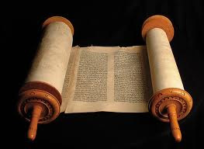
何西阿书
信息声明
565
346
何西阿经历个人悲剧的婚姻，其印证了上帝在他不敬虔子民的接纳，尽管他的子民不认识神，拒绝对神忠贞的爱，对他的约没有信心，（因着神的接纳），从而使得他们可以悔改。

Slide 7
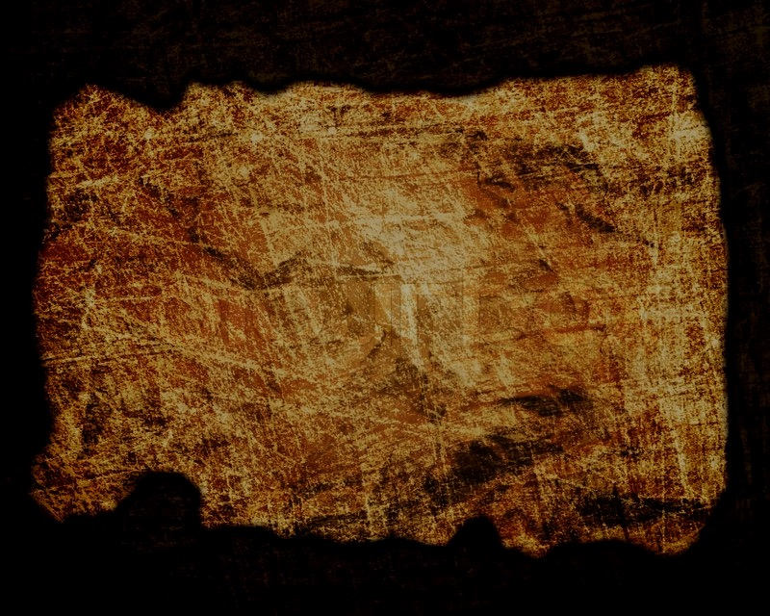
圣约
347c
上帝忠心的爱（希伯来：Hesed)是圣约。尽管以色列缺乏圣约的爱(2:19) ，上帝仍然忠于祂们，并对以色列恢复他的承诺。 (4:1; 6:4, 6; 10:12; 12:6[7]).
何西阿

Slide 8
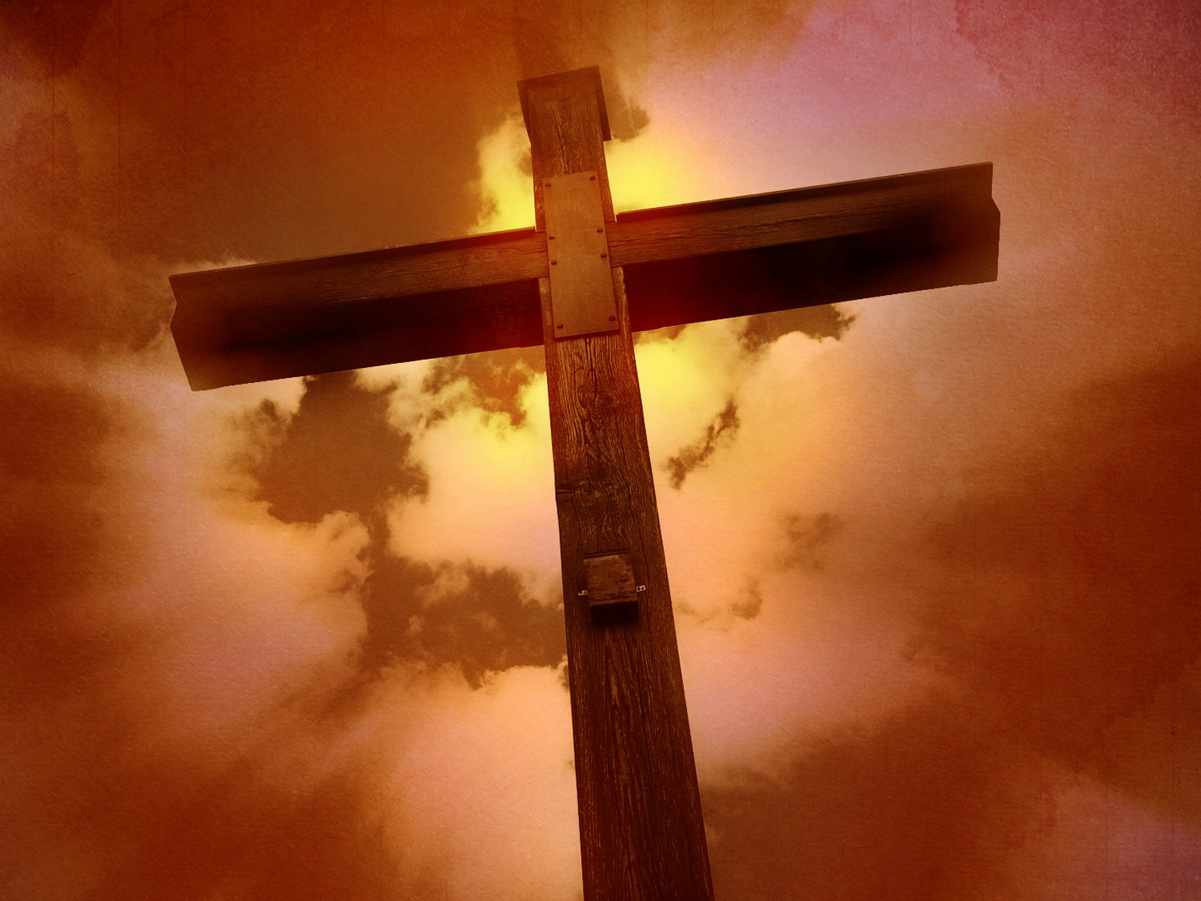
救赎
347c
歌篾从奴隶市场被赎回（第3章）描绘了上帝对属灵通奸的以色列的救赎之爱(1:7;13:14)。
何西阿

Slide 9
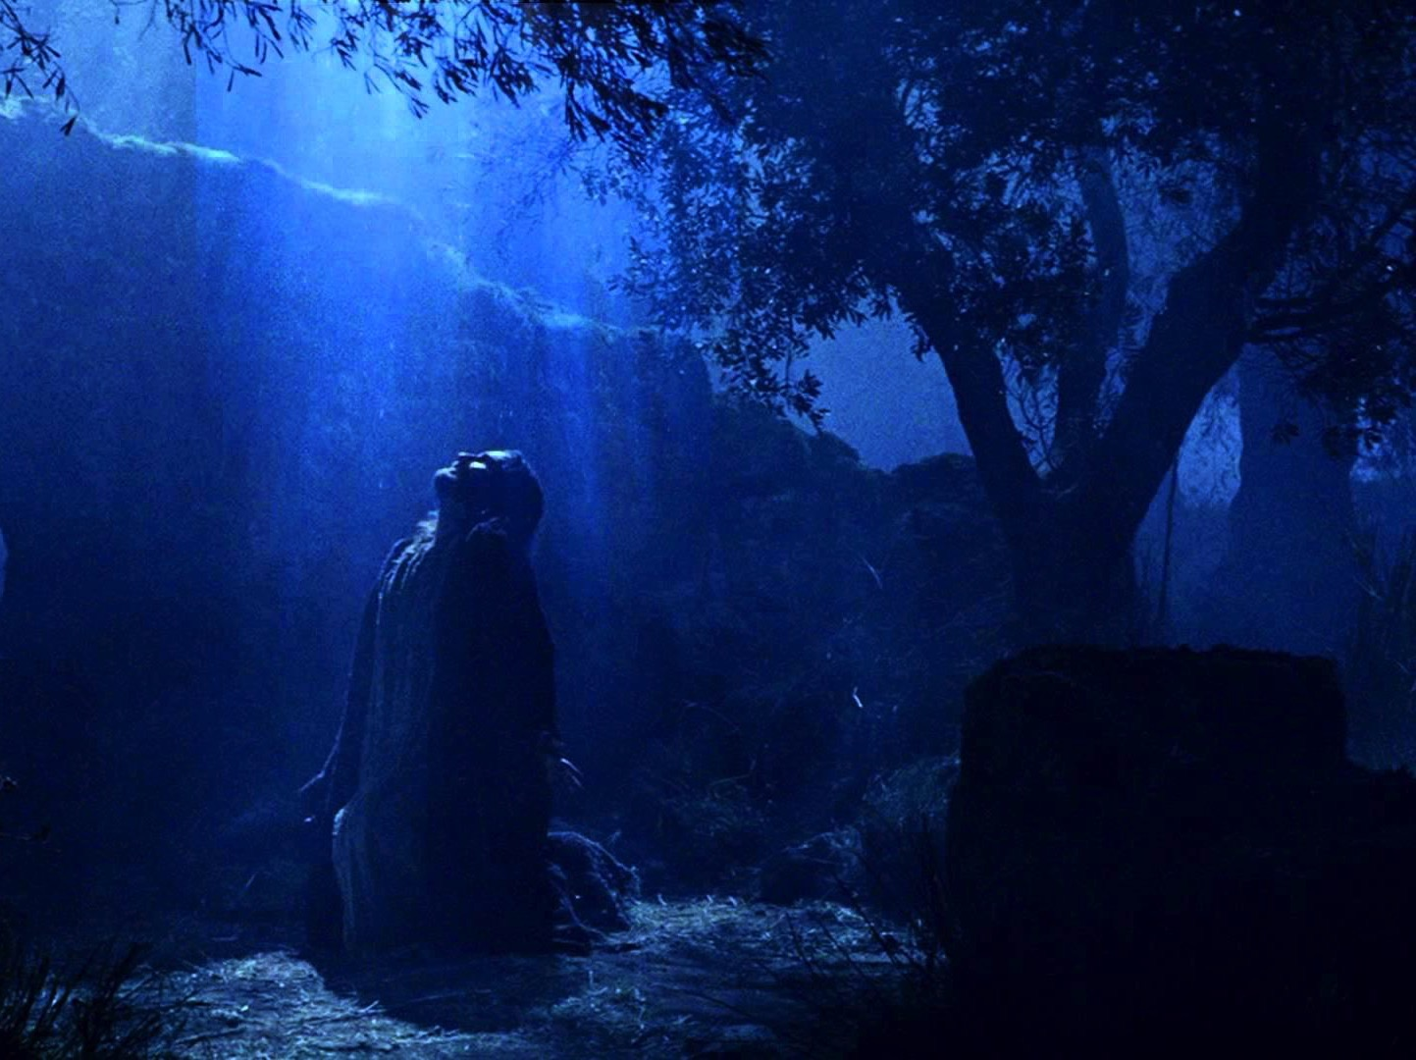
弥赛亚
347c
基督救赎的工作（第3章）体现在以色列人出埃及 （11：1），就如同耶稣与他的父母一同出埃及回到以色列一样 (马太福音 2:15)。
何西阿

Slide 10

神对悔改以色列民的忠贞
565
不忠贞的歌蔑 | 不忠贞的以色列民
忠贞的何西阿 | 忠贞的上帝
何西阿的婚姻 | 何西阿的信息
个人性的 | 国家性的
第 1–3 章 | 第 4–14 章

Slide 11
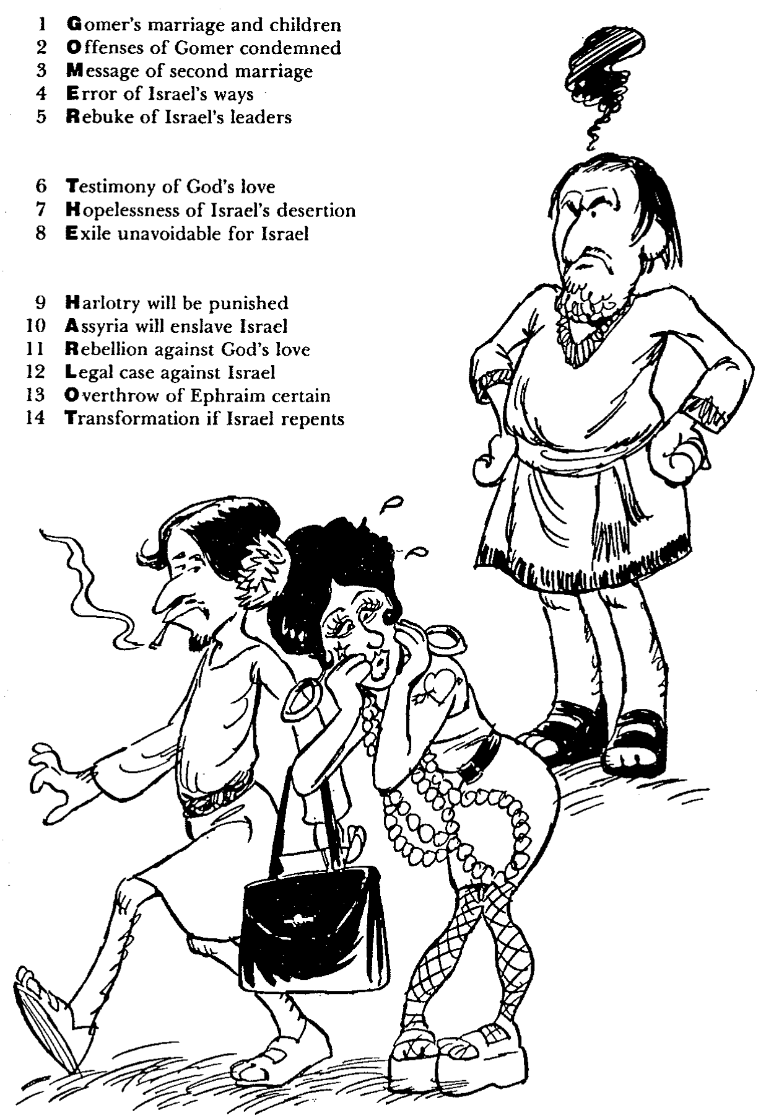
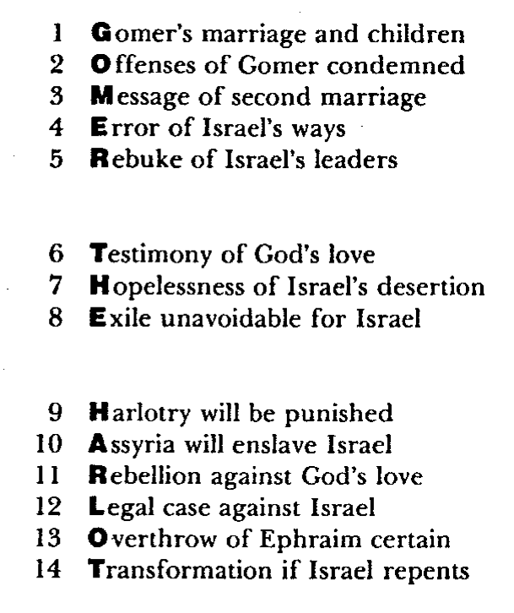
Barry Huddleston, The Acrostic Summarized Bible (Grand Rapids: Baker, 1992)
1 Inception of the world
2 Newlyweds placed in Eden
3 Temptation and man's fall
4 Hatred and first murder
5 Entire genealogy of Adam
6 Lessons on proper priorities
7 Outline for personal relationships
8 Faith of the centurion
何西阿
29 Genealogy of Jesus Christ
30 Opposition of King Herod
31 Spirit's descent upon Jesus
32 Power over Satan's temptations
33 Expounding Sermon on Mount
34 Lessons on proper priorities
35 Outline for personal relationships
36 Faith of the centurion
9 Matthew's call from Jesus
10 Apostles sent to preach
11 Testimony about John's message
12 True Messiah called demonic
13 Hidden message of parables
14 Execution of the Baptist
15 Wisdom is answering Pharisees
37 Matthew's call from Jesus
38 Apostles sent to preach
39 Testimony about John's message
40 True Messiah called demonic
41 Hidden message of parables
42 Execution of the Baptist
43 Wisdom is answering Pharisees
16 Keys of the kingdom
17 Impact of Jesus' transfiguration
18 Need for true forgiveness
19 Grounds for divorce clarified
20 Opportunities in the vineyard
21 Fig tree is cursed
44 Keys of the kingdom
45 Impact of Jesus' transfiguration
46 Need for true forgiveness
47 Grounds for divorce clarified
48 Opportunities in the vineyard
49 Fig tree is cursed
22 Taxes paid to Caesar
23 Hypocrisy denounced by "woes"
24 Events of second coming
25 Judgment of the nations
26 Events on Calvary's eve
27 Way of the cross
28 Savior's resurrection and commission
50 Taxes paid to Caesar
51 Hypocrisy denounced by "woes"
52 Events of second coming
53 Judgment of the nations
54 Events on Calvary's eve
55 Way of the cross
56 Savior's resurrection and commission

Slide 12

作个忠诚的人
何西阿
Dr. Rick Griffith, Crossroads International Church Singapore
BibleStudyDownloads.org

Slide 13

你忠诚吗？
Notes:
你忠心吗？你可以用什么证据来证明自己？

Slide 14
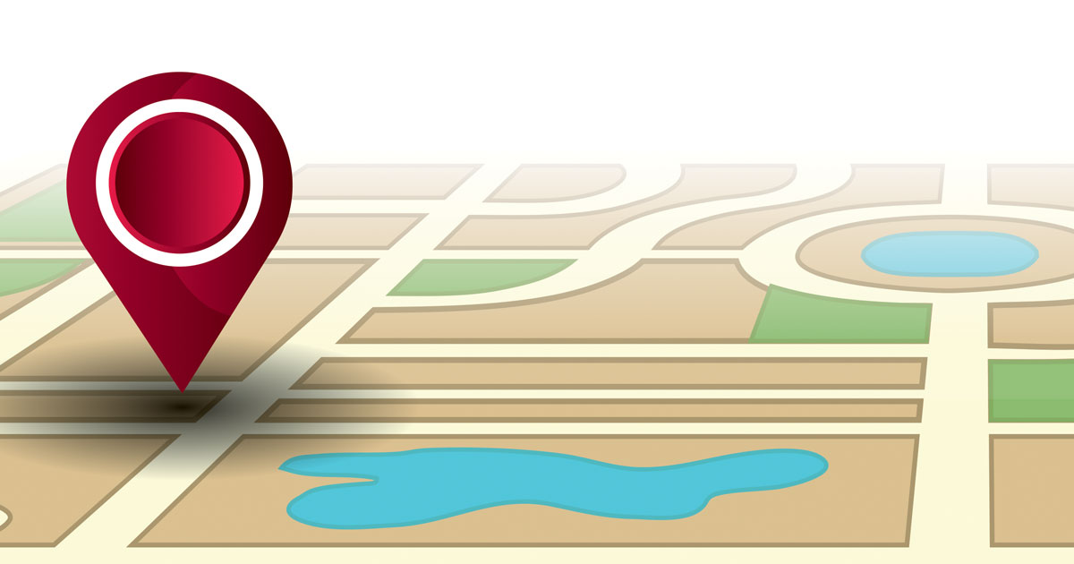
上帝如何激励我们效忠于他？
两种方式
Notes:
今天我们将看到上帝使我们忠诚于他的两种方式

Slide 15
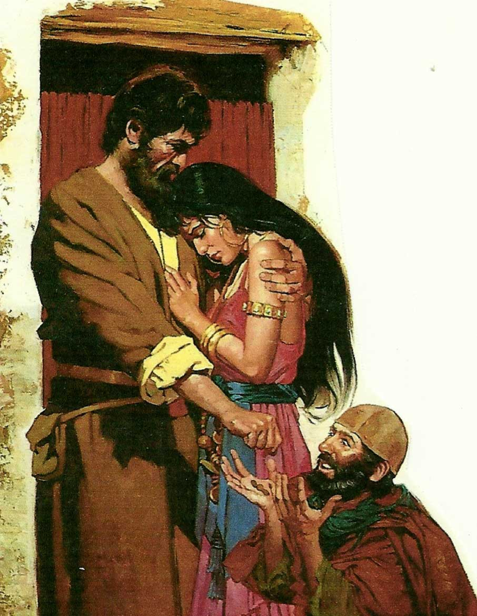
一。 上帝以身作则来激励我们忠诚
(何西阿 1–3).
Notes:
耶和华给与重大的例证来显示承诺的意义（何1-3）。

Slide 16

二。上帝通过平衡纠正和祝福来激励忠诚（何4-14）
Notes:
耶和华将他的刑罚与奖励配对。
上帝通过纪律和恢复彰显祂对以色列的忠诚(何西阿 4–14)。

Slide 17
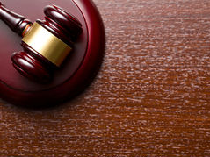
“以色列人哪，你们当听耶和华的话。耶和华与这地的居民争辩，因这地上无诚实，
无良善(hesed)，
无人认识神”
(何西阿 4:1)
4:4–6:3
6:4–11:11
11:12–13:16
Notes:
以色列人哪，你们当听耶和华的话。耶和华与这地的居民争辩，因这地上无诚实，无良善(hesed)，无人认识神 (何西阿 4:1)

Slide 18

重点
上帝忠于你，
所以你要忠于他
何西阿

Slide 19
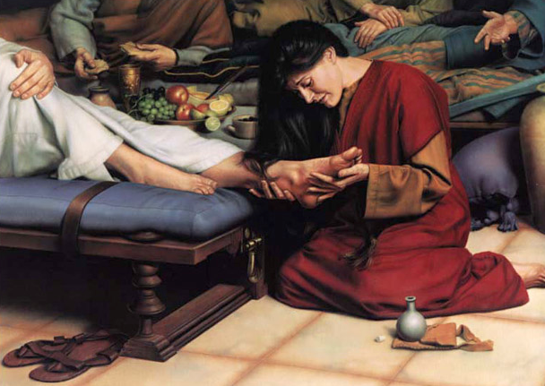
你是如何忠于忠诚的主呢？
Notes:
你是否相信祂已经去除你的罪吗？

Slide 20
Black

Slide 21
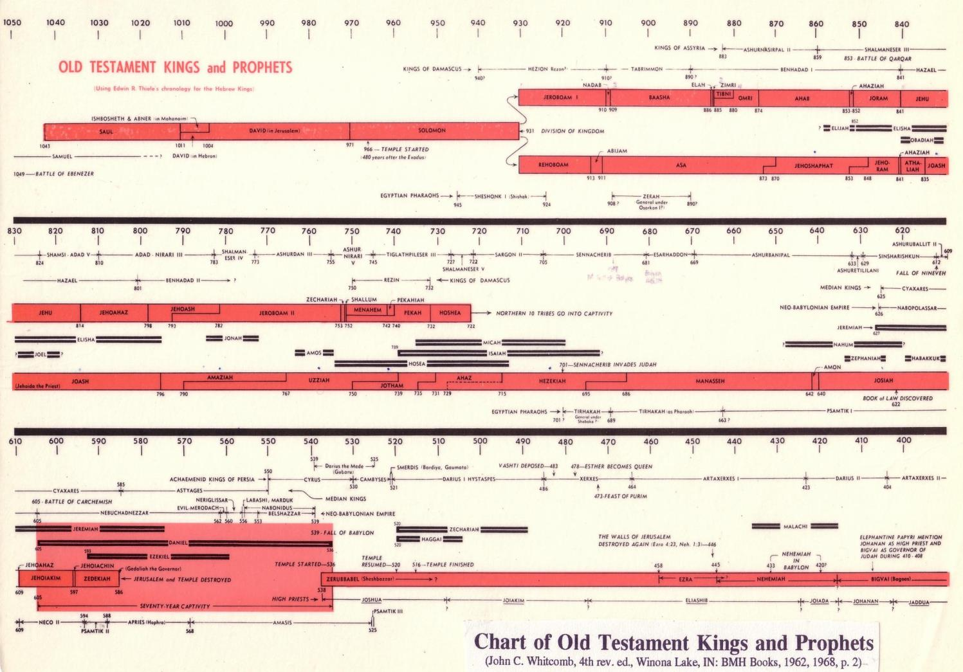
旧约王与先知的图表
342

Slide 22
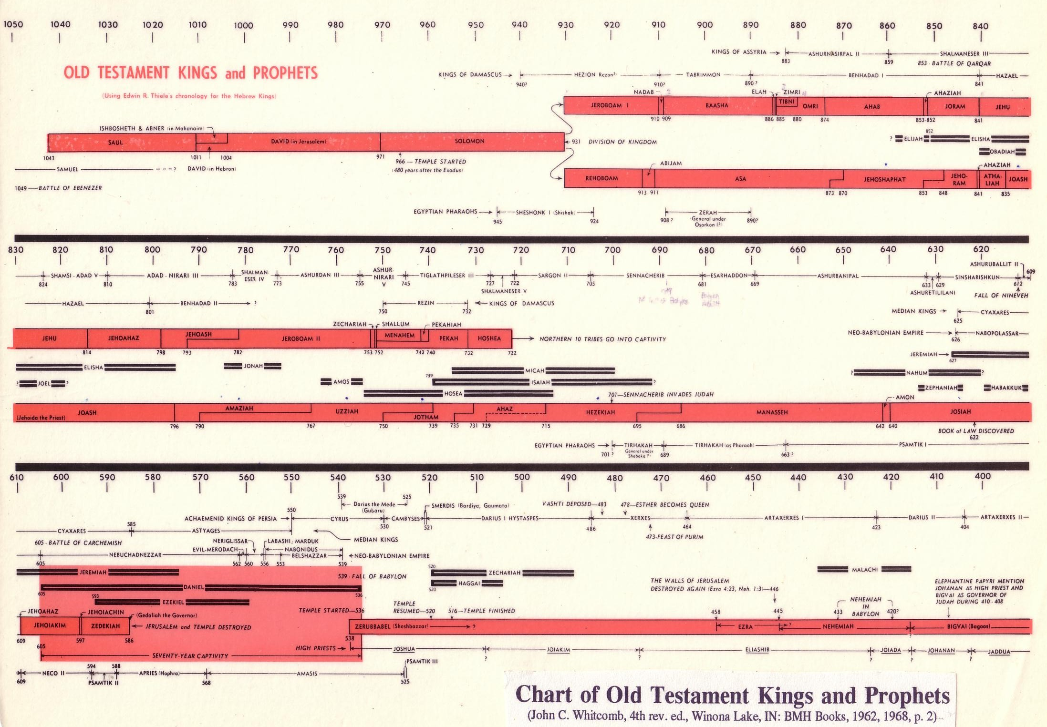
旧约王与先知的图表
旧约王与先知的
342
旧约王与先知的图表

Slide 23

你知道吗…?
566
何西阿是唯一记录预言并从以色列(北国)向以色列宣讲的先知
圣经中，何西阿是唯一娶一个犯奸淫的女子为妻的先知。
被掳之前，最长的小先知书。
作者
何西阿书 1:1 说明何西阿是作者。
对先知的认识不多, 我们不知道他的故乡、家庭或职业
他有可能是个烘面包的师傅 (见 7:4ff)
但他比较可能是个农夫，因为他应用了很多花园和农场的图像来描述。

Slide 24
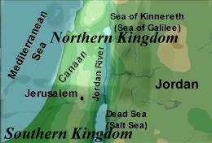

566
何西阿的履历表
姓名: 何西阿 (耶和华拯救)
基尼烈湖
(加利利湖）
家庭: 父亲 - 备利
妻子 - 歌篾
北国
地中海
停
第一个孩子 -耶斯列
约
旦
河
第二个孩子 – 罗路哈玛
迦南
第三个孩子 – 罗阿米
约旦
耶路撒冷
职业: 北国的先知
死海
(盐海)
南国

Slide 25
何西阿与阿摩斯的对比
590
何西阿 | 阿摩司
专业先知 (1:1) | 非专业先知 (7:14)
以色列公民 (7:5) | 从犹大来的宣教士 (1:1)
关注：宗教偶像崇拜 （敬拜） | 关注：社会不公义 （行）
以色列的不信实 | 以色列的不公正
上帝的信实 | 上帝的公正
上帝的恩典 | 上帝的公义
上帝的慈爱 (Hesed) | 上帝的审判
怜悯的语调 | 严厉的语调
怜悯 (11:1) | 粗俗 (4:1)
结构复杂 | 结构简单
以色列缺乏知识 | 以色列缺乏道德
“认识上帝” (4:1, 6; 6:6) | “寻求上帝” (5:4, 6)

Slide 26
作个忠诚的人
何西阿
Dr. Rick Griffith, Crossroads International Church Singapore
BibleStudyDownloads.org

Slide 27

忠贞
Notes:
Loyalty has fallen on hard times. People aren’t very loyal anymore.
People switch jobs all the time.
We aren’t committed (loyal) to institutions.
We aren’t even committed (loyal) to our marriages.

Slide 28
你忠诚吗？
Notes:
你忠心吗？你可以用什么证据来证明自己？

Slide 29

Loyal Relationships
Notes:
Do you show loyalty to others?

Slide 30
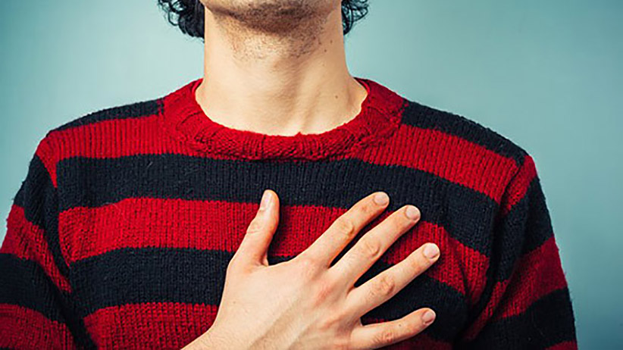
Are you loyal to God?
Notes:
Do you show loyalty to God?

Slide 31
上帝如何激励我们效忠于他？

Slide 32
Placing the Prophets
342
先知的位置
关键日期
931
俄巴底亚
722
约拿
阿摩司
何西阿
以赛亚
弥迦
586

Slide 33
富足的危险
592
 | 约拿 | 阿摩司 | 何西阿
责任交待 | 布道性质 | 社会 | 属灵
以色列的问题 | 近视 | 不公正 | 奸淫
上帝的属性 | 怜悯 | 公正 | 信实
关键字 | 怜悯 | 不公正 | 忠心
总结 | 至于残酷的犹太人上帝都关心，因此你也应当关心！ | 上帝对你公平，你也应当对他人公平！ | 上帝与你守约，所以照样对祂信实！
当代的相似之处 | 在宣教的责任上失败 | 欺压帮佣和外来劳工 | 教会的上帝是现代性（方法）
事工日期（大约） | 785-758 耶罗波安统治的开始 | 767-753 耶罗波安统治的中旬 | 755-710 耶罗波安统治的尾端
Notes:
The northern nation of Israel was in a period of prosperity.

Slide 34
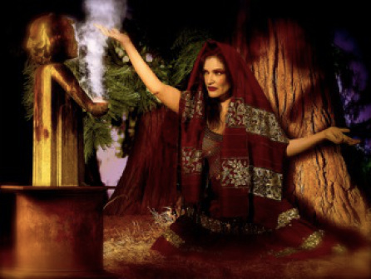
The Idolatry of Israel
Notes:
However, it also had a long history of idolatry. Finally, it was time to pay for their crimes against God, and 何西阿 acted as his messenger.

Slide 35
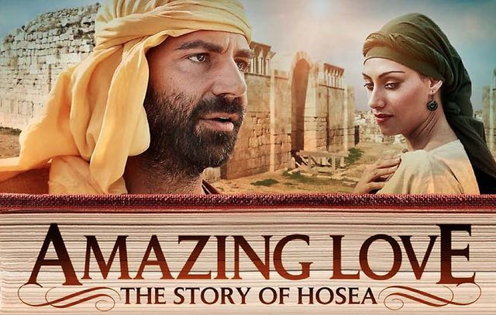
Amazing Love
Notes:
何西阿 not only taught the message. His very life was the message, for his marriage pictured God’s “marriage” to Israel.

Slide 36

Amazing Love
Notes:
The context was one of flagrant immorality, yet 何西阿 showed the opposite in his unrelenting commitment to his wayward wife.

Slide 37
上帝如何激励我们效忠于他？
两种方式
Notes:
今天我们将看到上帝使我们忠诚于他的两种方式

Slide 38
关键字
565
343
忠贞
何西阿

Slide 39
一。 上帝以身作则来激励我们忠诚
(何西阿 1–3).
Notes:
耶和华给与重大的例证来显示承诺的意义（何1-3）。

Slide 40
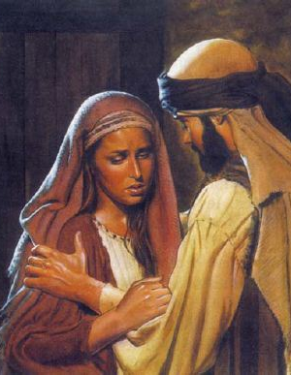
何西阿 showed amazing loyalty in his failed marriage (何西阿 1–3).

Slide 41
Slides on
何西阿 1

Slide 42
When 何西阿 Wrote (1:1)
453
Kings of Israel
Jeroboam
Pekah
Hoshea
Kings of Judah
Uzziah
Jotham
Ahaz
Hezekiah
何西阿's 45-Year Ministry
(755-710 BC)
Notes:
42
The date of the prophecy as a 45-year period before, during, and after the Assyrian deportation shows God's last minute warnings to His wayward people, Israel (1:1).

Slide 43

何西阿 1:2 CNV
"耶和华初次借着何西阿说话。耶和华对何西阿说：“你去娶一个像娼妓一样的女人，生养像娼妓一样的儿女，因为这地盛行淫
乱，离开了耶和华。"
Notes:
何西阿 obeys God's instructions to marry Gomer and she bears three children during her adultery who symbolize God's rejection of Israel and compassion on Judah (1:2-9).

Slide 44

Gomer took off for other lovers…
Notes:
何西阿 obeys God's instructions to marry Gomer and while she is committing adultery…

Slide 45
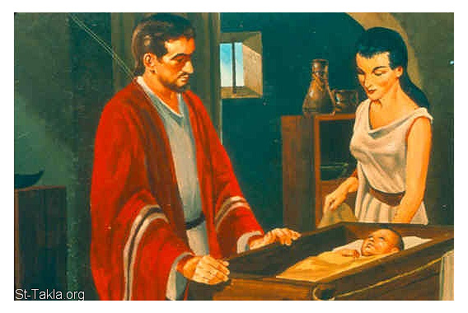
歌篾的孩子呢？
573
Notes:
While she is committing adultery they have children with strange names.

Slide 46
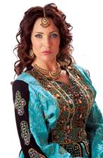
何西阿的孩子
573
经文 | 何西阿 1:2-5 | 何西阿 1:6-7 | 何西阿 1:8
姓名 | 耶斯列 | 罗路哈玛 | 罗阿米
性别 | 男 | 女 | 男
翻译 | “他 [神] 分散” | “不蒙怜悯” | “不是我的 子民”
Notes:
First is a son named "God scatters" to predict God's dispersion of the house of Jehu for his murder of Ahaziah and his relatives (1:2-5; cf. 2 Kings 9:27ff.).
Gomer then bears a daughter named "Not loved" to illustrate God's compassion upon Judah but His lack of compassion upon Israel (1:6-7).
Gomer finally bears a son named "Not my people" to illustrate God's rejection of the northern nation of Israel (1:8-9).

Slide 47
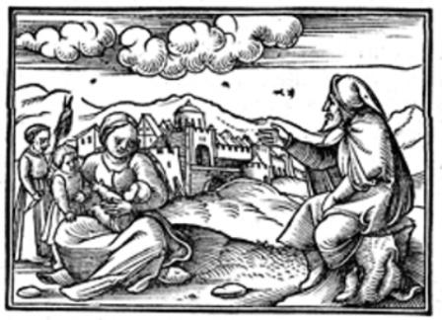
歌篾的孩子呢？
573

Slide 48
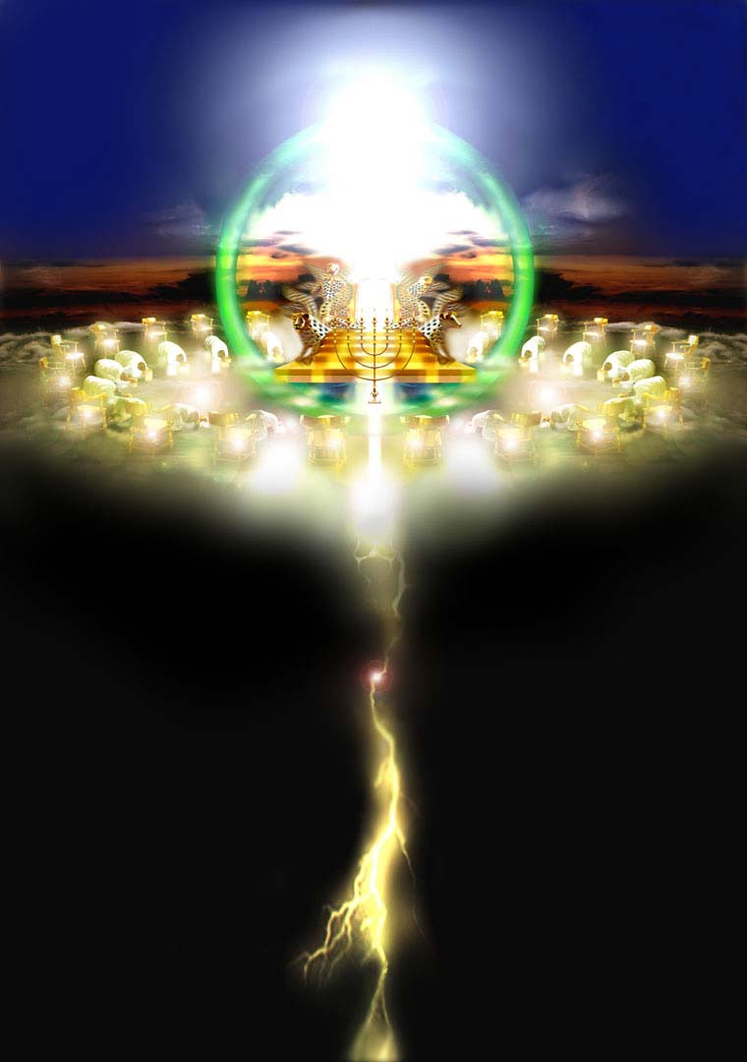
何西阿书里
的
末世意义

Slide 49
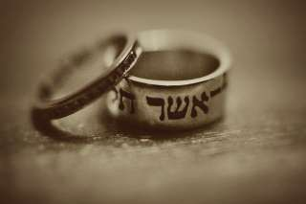
以色列未来的复兴 (1:10–2:1)
569
尽管上帝管教，上帝告诉何西阿终究祂会复兴这国：
  人数的增长 (1:10a)
  属灵方面的复兴 (1:10b)
  国家统一 (1:11a)
  民间集中 (1:11b)
  领土的占领 (1:11c)
  上帝的祝福 (2:1)
这些应许还没有应验。这样的文本显示上帝把这一类的应许当成是一个字义上的未来的国度，那时以色列将以平安占领土地并享受上帝的祝福。若你不相信有个千禧年，你需要忽视这些经文或者说他们在历史中已经应验了，或者将在教会里应验。

Slide 50
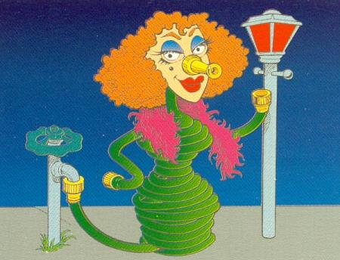
“卖淫”
何西阿
Walk Through The Bible ©1989

Slide 51
Slides on
何西阿 2

Slide 52
何西阿 公元前755-710
统一王国
1050-930
王国分裂
930-722
单一王国
(北国时期)
722-586
后放逐时期
536-425
1100
1050
1000
950
900
850
800
7 5 0
7 0 0
650
600
550
500
450
被掳 586-536

Slide 53
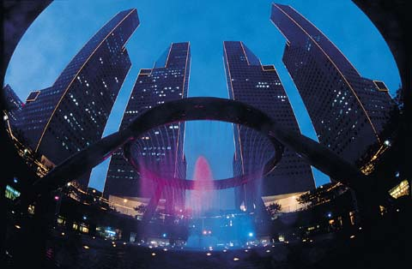
何西阿的时代
566
何西阿在亚述王国还没攻打并放逐以色列前，在北国向以色列宣讲预言，长达25年.
以色列在政治与军事上达到最高峰。因此在商业上得利。
经济欣欣向荣，人民都非常富裕，但他们想要跟多物质的东西.
亚述的势力渐渐兴起 (9:5,6)而何西阿在耶罗波安二世和乌西雅到希西家统治的时期宣讲预言 (公元前715-687).
当耶罗波安二死后(公元前782-753)， 北国陷入政治混乱，整个国家的局势不稳定.
以色列最终被提革拉毗列色占领了.

Slide 54
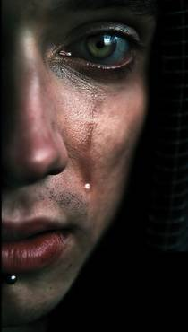
批评的观点: 娶个妓女 ?
567
上帝命令何西阿娶一位淫妇 (1:2) 但这造成很都问题 (见申22:20 ff) 这是什么意思？
这是什么意识呢? 以下有三大观点:
要娶个女子后成为淫妇
要娶个淫妇为妻
这只是一个寓言 (没有真正行淫) 所以行淫是个拜偶像的象征。

Slide 55
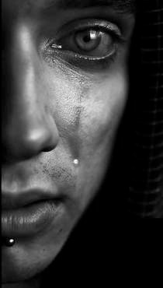
567
批评的观点: 娶个妓女 ?
字面主义的观点
  它像是一本历史的书籍.
  歌篾和滴拉音这两个名字并没有任何象征.
  用“妓女 ”来形容以色列的百姓是最适合的。
  何西阿的爱，好像神爱他的子民一样.
寓言观点所带来的问题
  这并没有解决问题.娶个淫妇为妻在道德上也是个疑问
  孩子们有象征示的名字.
  有些人问这是否是个不可思意的婚姻。这会影响何西阿宣讲语言的果效。 (不，因为何西阿自己的生命没被玷污.)

Slide 56
Slides on
何西阿 2

Slide 57
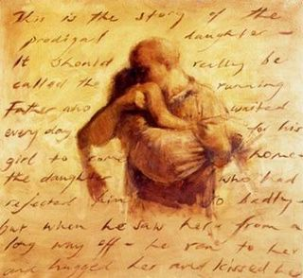
何西阿 2:1 CNV
"你们要对你们的兄弟说：‘我的子民’；要对你们的姊妹说：‘蒙怜悯的’'"

Slide 58

何西阿 2:2-3 CNV
"要与你们的母亲争论，你们要争论，
因为她不是我的妻子，我也不是她的丈夫；
好让她除掉脸上的淫相，
和乳间的淫态，
³ 免得我把她剥光，
赤身露体，使她像刚生下来的那天一样；
又使她像旷野，
像无水的旱地一般，
叫她因干渴而死。"

Slide 59
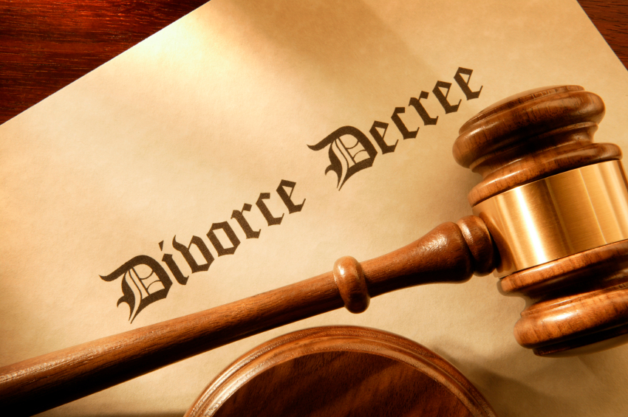
何西阿是否休了歌篾？
574
离婚法令

Slide 60

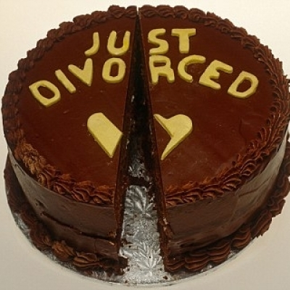
赞成与不赞成何西阿休歌篾的论据
574
新离婚

Slide 61
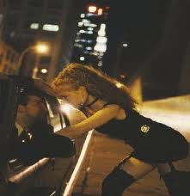
何西阿 2:5 CNV
"因为他们的母亲卖了淫，
怀他们的作了羞耻的事；
因为她曾说：‘我要跟随我那些爱人。
我的饼和水，
羊毛和麻布，油和我所喝的，都是他们给的。"
Notes:
God does not minimize her sins.

Slide 62
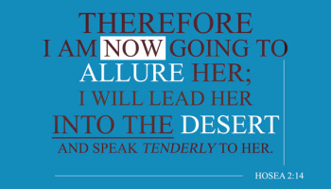
何西阿 2:14
因此，
我要诱导她，
领她
到旷野，
对她说安慰的话。
Notes:
But God does discipline her and then bring her back.

Slide 63
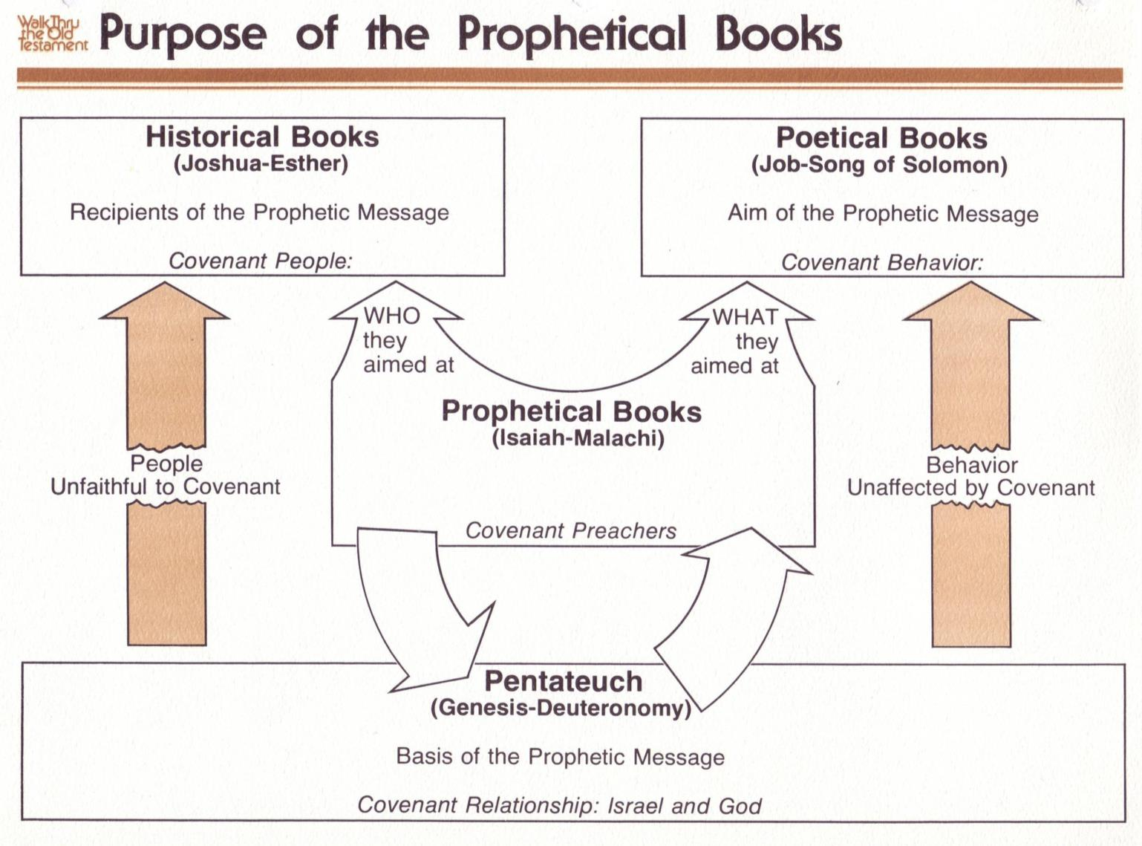
Purpose of the Prophetic Books
先知书的目的
122
历史书
(约书亚书-以斯帖)
先知信息的接受者
立约人
诗歌书
(约伯记 –雅歌)
先知信息的目的
约定行为
他们
的目标
是谁
他们
的目标
是什么
先知书
(以赛亚书 – 玛拉基书)
约传教士
人们不忠于
约定
行为没有受到
约定的影响
摩西的约
摩西五经
(创世纪-申命记)
先知信息的依据
约定关系: 以色列与上帝
亚伯拉罕的约
申. 28; 利. 26
创. 12:1-3; 15:18
有条件的
无条件的
审判
祝福

Slide 64
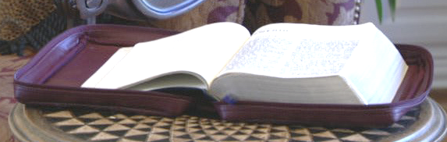
创 13:15; 创 15
60
7
亚伯拉罕的约
创 12: 1-3
地 后裔 祝福
• 原义的
• 永远的
• 无条件的
手册. 19-24
16
3

Slide 65
场合
220
为什么 ?
被掳
申命记 28章
Notes:
OS-05-Deut-203
OS-11-1Kings-40
OS-14-2Chron-58
Jeremiah’s prophecy and Lamentations record his eyewitness account of Babylon’s siege and destruction of Jerusalem for the nation’s sin, the Holy Spirit moved him to record an historical compilation which provides the context and justification for God’s judgment upon these two nations. The leaders and the people sinned through ungodliness and idolatry, and true to the curses of Deut. 28, God gave the people the consequences of their obedience.

Slide 66
祝福 与 咒诅 (申 28)
你的城里和田间必蒙福 (3)
你在城里在田间必受咒诅 (16)
你的孩子和地所产的必蒙福 (4)
你的孩子和地所产的必受咒诅 (17)
你的筐子和你的摶麵盆必蒙福 (5)
你的筐子和你的摶麵盆必受咒诅 (18)
你出你如必蒙福 (6)
你出你如必受咒诅 (19)
你的仇敌从一条路来攻击你， 必从七条路逃跑！(7)
你從一條路去攻擊他們、必從七條路逃跑！(25)
．你必借給許多國民、卻不至向他們借貸 (12)
他必借給你、你卻不能借給他 (44)

Slide 67
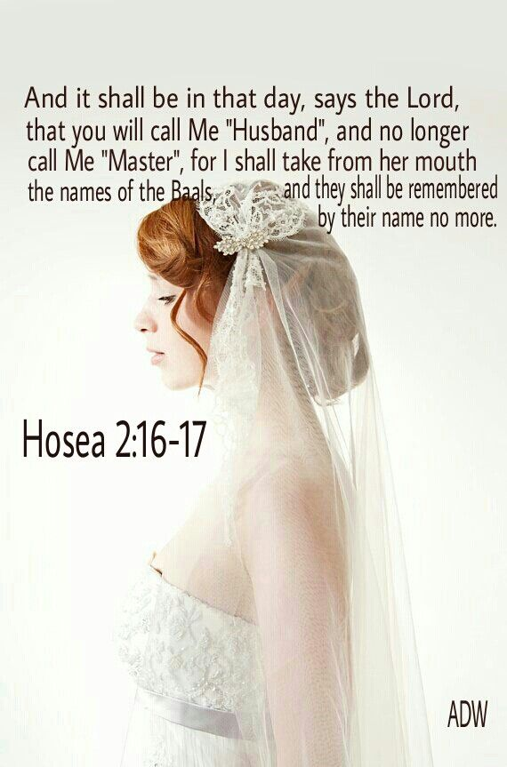
何西阿 2:16-17
耶和华说：“到那日，
你必称呼我‘伊施，’
不再称呼我‘巴力’。
我要把‘巴力’的名字从
她口中除掉；
他们的名字没有人再提起。
Notes:
God promises to woo His "wife" Israel back to Himself again because of His commitment to the Abrahamic Covenant (2:14-20).
God promises to restore the covenant relationship with His faithless "wife" Israel because of His commitment to the Abrahamic Covenant (2:21-23).

Slide 68
Slides on
何西阿 3

Slide 69
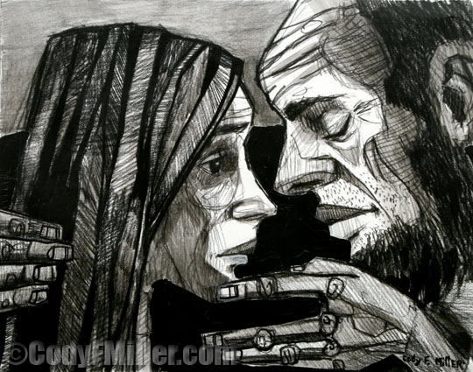
Restoration
Notes:
何西阿 redeems Gomer from prostitution by paying her debts and quarantines her from other men (3:1-3).

Slide 70
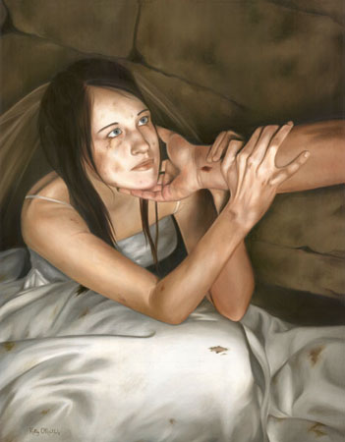
何西阿 3:1 CNV
"耶和华对我说：“你再去爱一个妇人，这妇人是为情人所爱，又是个淫妇，就像耶和华爱以色列人，虽然他们转去跟随别神，喜爱葡萄饼。"

Slide 71
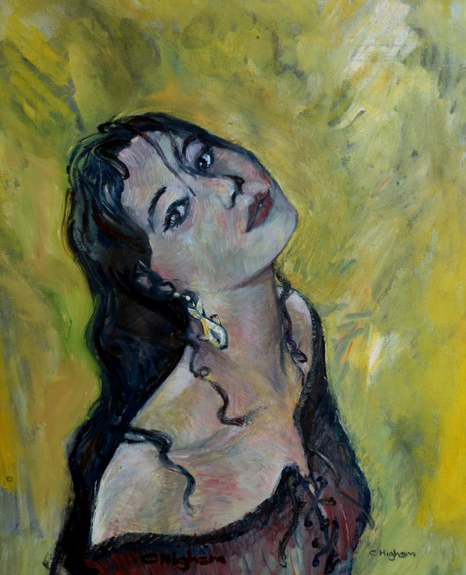
何西阿 3:2-3 CNV
"于是，我用一百七十一克银子，一百五十公斤大麦，买她回来归我。
我对她说：“你要给我独居多日，不要行淫，不要有别的男人，我也必不与你同房。"

Slide 72
妓女歌篾 (何 2)
被玷污的以色列
(参耶 3:1-5)
银子15舍客勒
+
大麦一贺梅珥半
何西阿 3:2
= 1 不忠的歌篾

Slide 73
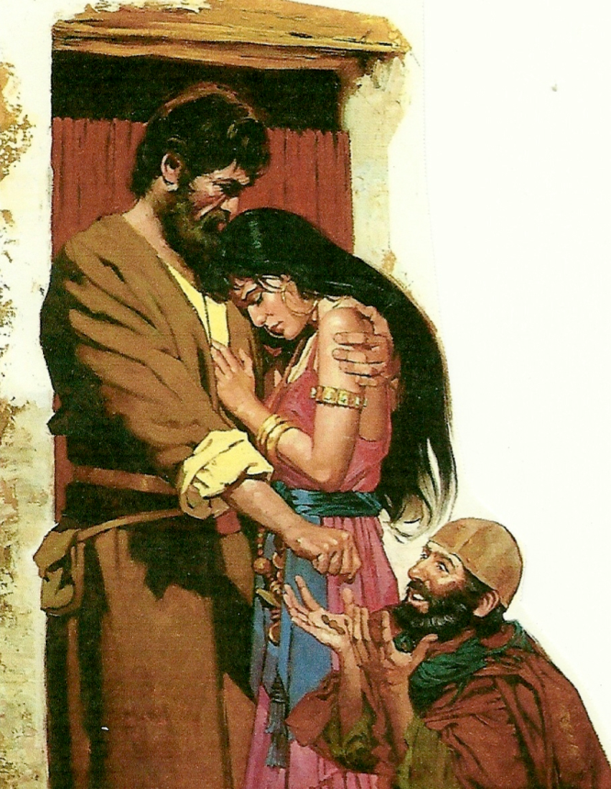
何西阿书和耶利米书里的妓女意象
569
妓女歌篾 (何2)
妓女以色列 (参耶3:1-5)
不认何西阿为爱的源头
苦干 (2:3)
自大
期望何西阿爱
淫欲 – 责怪歌篾
不认上帝为生命的源头
(耶2:27)
苦干 (耶3:3)
自大 (耶3:3)
期望上帝祝福他们
愤怒 – 责怪上帝

Slide 74
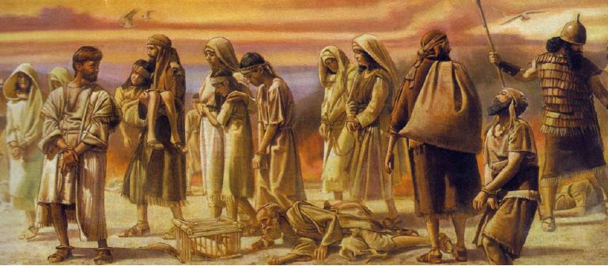
何西阿 3:4-5 CNV
"因为以色列人也要独居多日；没有君王，没有领袖，没有祭祀，没有柱像，没有以弗得，也没有家中的神像。
后来以色列人必归回，寻求耶和华他们的 神，寻求大卫他们的王。在末后的日子，他们必战战兢兢来到耶和华那里，接受他的恩惠。"
Notes:
何西阿 redeems Gomer from prostitution by paying her debts and quarantines her from other men (3:1-3).

Slide 75
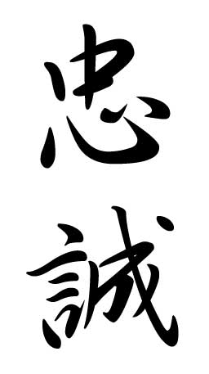
The Meaning of Hesed ds,x,
567
KJV圣经版本: “慈爱,” “怜悯,” “良善”
旧约神学家葛鲁克 (1927)的解释： “忠诚的约”
何西阿书的钥词：忠诚
何西阿的钥节：
“我必将她种在这地，素不蒙怜悯的，我必怜悯，本非我民的，我必对他说，你是我的民，他必说，你是我的神。
(2：23）

Slide 76
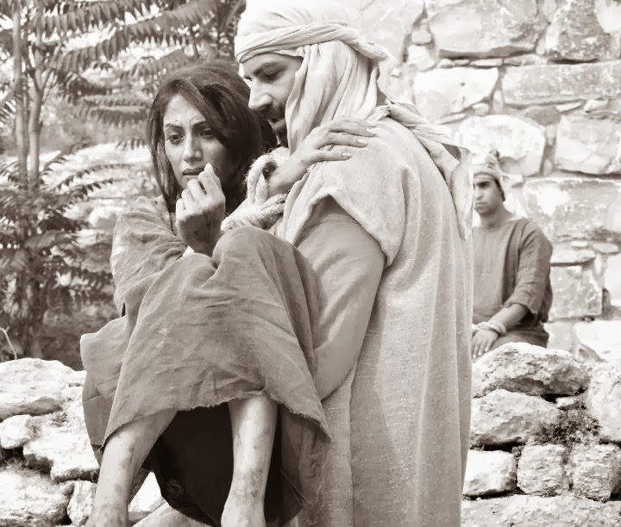
"Scripture" (6: NLT).
Notes:
My study of 何西阿 follows Glueck’s view that interprets the term as referring to covenant loyalty. In particular, the Mosaic Covenant is in view which obligates both God and Israel to certain requirements (cf. Exod. 19–20), including Israel’s blessings for obedience and curses for disobedience (Deut. 28). Therefore, God continues to show commitment and mercy towards the nation (based upon the Abrahamic Covenant) and Israel should respond by showing loyalty towards God by following the Mosaic stipulations.

Slide 77
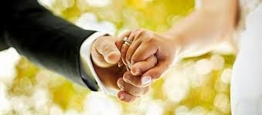
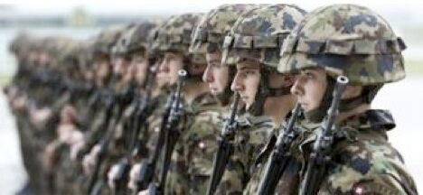
Others model God’s type of loyalty for us.
Notes:
We often feel that God owes us something because he hasn’t been loyal to us. Yet the opposite is true. We owe God everything because he actually has never once failed us!
He often shows that loyalty through significant people. Who has been the best example of loyalty to you in your own life? Your mother? Your father? Your spouse?
Let that person exemplify God’s loyalty to you! Then show that same loyalty to him.

Slide 78
一。 上帝以身作则来激励我们忠诚
(何西阿 1–3).
Notes:
耶和华给与重大的例证来显示承诺的意义（何1-3）。

Slide 79
神对悔改以色列民的忠贞
565
不忠贞的歌蔑 | 不忠贞的以色列民
忠贞的何西阿 | 忠贞的上帝
何西阿的婚姻 | 何西阿的信息
个人性的 | 国家性的
第 1–3 章 | 第 4–14 章

Slide 80
二。上帝通过平衡纠正和祝福来激励忠诚（何4-14）
Notes:
耶和华将他的刑罚与奖励配对。
上帝通过纪律和恢复彰显祂对以色列的忠诚(何西阿 4–14)。

Slide 81
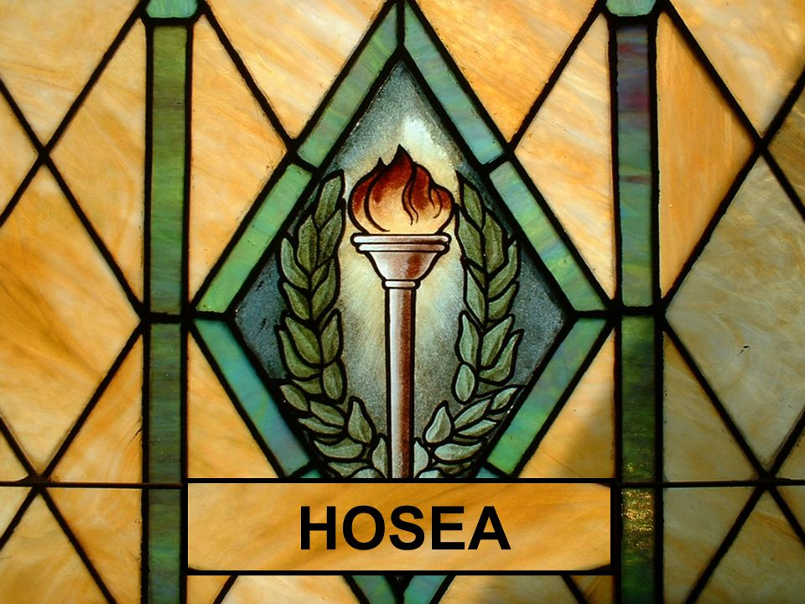
He punished Israel as he promised in his covenant with Moses (何西阿 4–13).

Slide 82
Slides on
何西阿 4

Slide 83
“以色列人哪！
你们要听耶和华的话。
耶和华要与这地的居民争辩:
‘因为在这地上没有诚实,
没有慈爱 (hesed),
也没有认识 神的知识”
(何西阿 4:1 CNV).
4:4–6:3
6:4–11:11
11:12–13:16
Notes:
God’s lawsuit against Israel (4:1-3) promises judgment for lacking covenantal knowledge of God (4:4–6:3), loving loyalty (6:4–11:11), and faithfulness (11:12–13:16).

Slide 84
"以色列人哪！
你们要听耶和华的话。
耶和华要与这地的居民争辩:
‘因为在这地上没有诚实,
没有慈爱 (hesed),
也没有认识 神的知识”
(何西阿 4:1 CNV).
4:4–6:3
Notes:
God will judge Israel and Judah for lack of spiritual knowledge, resulting in prostitution and idolatry, but promises to accept them when they repent (4:4–6:3).

Slide 85
Parallels with the Ten Commandments
何西阿 4:2
十诫 (出埃及记 20)
说谎
凶杀
偷窃
奸淫
诫命 9 (20:16)
诫命 6 (20:13)
诫命 8 (20:15)
诫命 7 (20:14)

Slide 86
Slides on
何西阿 5

Slide 87
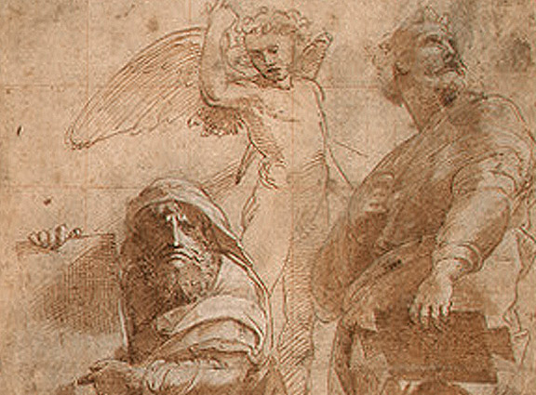
心理的降下螺旋 （5:4-15)
“他们的骄傲使他们不能归向耶和华” (5:4)
“当他们寻求耶和华，却寻不见” (5:6)
“神说他要回到原处，等以色列自觉有罪（或作：承认己罪)” (5:15)
Notes:
Lack of knowledge in both Judah and Israel prevents them from repenting of prostitution and idolatry, but God promises that they will eventually repent and seek Him (何西阿 5).

Slide 88
Slides on
何西阿 6

Slide 89
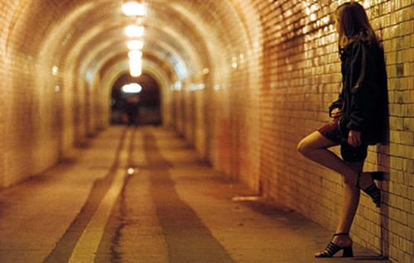
Israel went after other lovers instead of knowing her true husband, the LORD

Slide 90

“来吧！让我们回转归向耶和华；
因为，他虽然撕裂了我们，但必定医治我们”
(何西阿 6:1 CNV).
Notes:
何西阿 encourages the nation to repent because of God's willingness to accept them back (6:1-3).

Slide 91
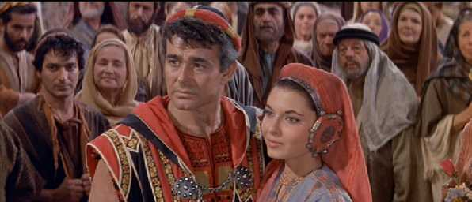
末世的意义 – 何西阿6:1-3
是其中一个复兴的应许
神永不完完全全和最终毁灭他的民
剩下的人会存留, 从被掳之地拯救出来
这段金文不限于旧约- 有一部分复兴的盼望已在新约成就了
重点是, 这是个邀请， 重新被神接纳成为他的子民 (这不是指单独或个人， 乃是多人或整个肢体)

Slide 92

末世的意义 – 何西阿6:1-3
经文提到:
a) 罪的教义 - 因为饶恕是复兴的应许的一部分
b) 以色列的未来教义 - 神应许他的信实永远与他的子民 (整个肢体)同在。
c) 神的教义(主要的重点) – 他的医治 (v. 1), 他的复兴 (v. 2), 和 他的信实 (v. 3)

Slide 93
"以色列人哪！
你们要听耶和华的话。
耶和华要与这地的居民争辩:
‘因为在这地上没有诚实,
没有慈爱 (hesed),
也没有认识 神的知识”
(何西阿 4:1 CNV).
4:4–6:3
6:4–11:11

Slide 94
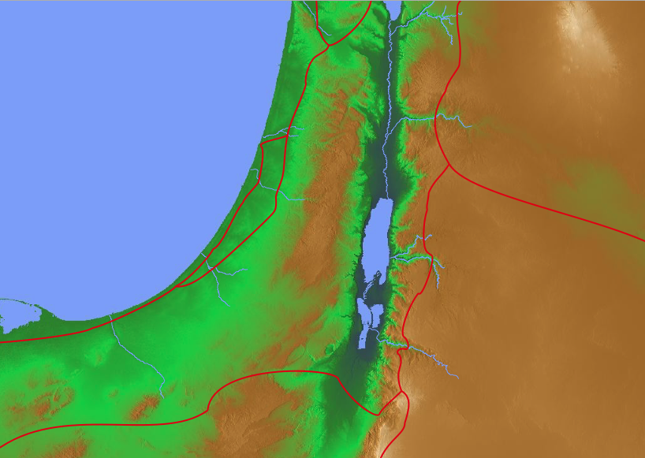
何西阿 6:7 Translations
Adam
"But like Adam, you broke my covenant and betrayed my trust"
(NLT).
"But like Adam, they have transgressed the covenant. There they have dealt treacherously against Me"
(NAU).
"But they like men have transgressed the covenant: there have they dealt treacherously against me"
(KJV).
"But at Adam, they have transgressed the covenant. There they have dealt treacherously against Me"
(RSV).
Notes:
"6:7. Rather than pleasing God, the people had broken the covenant and been unfaithful (bagad ; cf. comments on 5:7) to God. The Hebrew word for like Adam has been translated variously. "At Adam" (RSV) requires a slight change in the Hebrew and suggests a geographical place near the Jordan River. The presence of the word there in the next line, as well as references to other places in 6:8-9, might support this reading. "Like men" (KJV) takes the Hebrew adam in its widely attested generic sense, rather than as a proper name. In this case a comparison is made with fallen mankind, whose propensity to be unfaithful is well established (cf. Isa. 40:6-8, man's hesed ["glory," Isa. 40:6] is as transitory as grass and flowers that wither in the sun). On the other hand, the NIV and the NASB suggest a comparison with the first man, Adam, who blatantly violated God's requirement by eating from the forbidden tree" (BKC, 1:1394).

Slide 95
Slides on
何西阿 7

Slide 96
射不中目标!
何西阿 7章 – 医师 和 画家
恶劣态度被暴露 (7:1-3)
在火炉烤饼(7:4-8)
在头发斑白之前(7:9-10)
像鸽子愚蠢无知! (7:11-14)
如同翻背的弓- 不能射准!
(7:15-16，参诗78:57)

Slide 97
Believers today commit spiritual adultery by compromising with atheists
So how do Christians miss the target today?

Slide 98

Engaging the Atheists
A Seminar to Strengthen Your Faith and the Faith of Others
Dr. Rick Griffith • Singapore Bible College • www.biblestudydownloads.com
Notes:
What is the best apologetic for Jesus in an anti-God world?
That is the question that I have been asked to address in this seminar called "Engaging the Atheists."
So what advice would you give me in facilitating a seminar like this? How do you address atheists?
Should we focus on proving the existence of God?

Slide 99
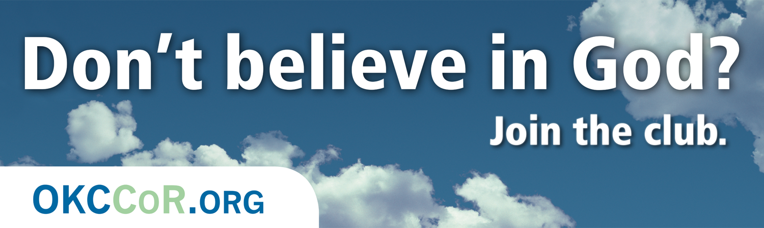
Don't believe in God? Join the club.
1
Notes:
Atheists directly attack Christmas…

Slide 100

Millions of Americans are living happily without religion. CFI. LivingWithoutReligion.org
1
Notes:
One billboard is quite blatant about our rejection of God …
____________
The Center for Inquiry is an organization of humanists, skeptics, freethinkers, and atheists all working together at the public policy and grassroots levels to advance science and secularism.

Slide 101

"God free, happy, and inspired by wonder."
1

Slide 102
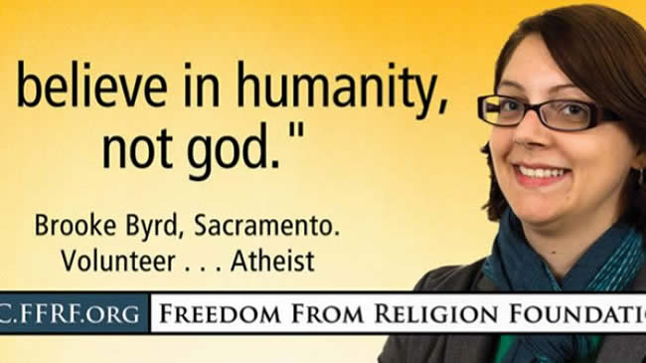
"Believe in humanity, not god."
1

Slide 103

Humbug.
1
Notes:
The world not only ignores the Christ of Christmas, but attacks him in direct and indirect ways

Slide 104

Christmas Shunned
1
I said the
"S-H" word
I said the "F" word
Principal's Office
I said "Christmas."
Notes:
In some places we get punished for even mentioning Christmas. At the principal's office, one child says, "I said the 'S-H' word," another says, "I said the 'F' word," and still another declares, 'I said 'Christmas.'"

Slide 105

Who Needs Christ During Christmas? Nobody.
1
Notes:
Satan still tries to make think we don't need God today.

Slide 106

Dear Christians, I share my toys. Why won't you share the season? Happy holidays for all!
1
Notes:
Today we also doubt God's goodness by saying God holds us back. One atheist billboard states, "Dear Christians, I share my toys. Why won't you share the season? Happy holidays for all!" Do you see the assumption here? Christians want God's goodness only for them—so we don't believe God is good to share with all!

Slide 107

Dear Santa, All I want for Christmas is skip church! I'm too old for fairy tales.
1
Notes:
Another writes, "Dear Santa, All I want for Christmas is to skip church! I'm too old for fairy tales." Some see the biblical story of the Fall as a fairy tale so that we don't want to be exposed to why God says death exists in our world. Ironic isn't? She writes to the fairy tale Santa and says she doesn't want to believe in God!

Slide 108

Atheist Christmas Card
1
DEAR CHILDREN
One day you will learn about Santa Claus. On that day remember everything the adults told you about Jesus.
Notes:
… such as in Christmas cards that equate Jesus and Santa [read card].

Slide 109

Santa
1
Notes:
But the fact is that Santa is based on Jesus and, as one blogger notes, "the history of Santa can be a way to teach kids about giving to others. The secular version of Santa that we know today is based on St. Nicholas, who was a Christian man that lived in the third century. When his parents died, they left him a large inheritance and rather than spend it on himself, he decided to give all his money away in an effort to obey Jesus's words to take care of the poor and sick. Some of the traditions that we associate with Santa are based on the stories of St. Nicholas. For example, leaving stockings out for Santa came from tales of St. Nicholas throwing bags of gold through open windows (which apparently sometimes landed in socks and shoes that were left by the fire)." (http://www.tommynelson.com/can-santa-jesus-coexist/).

Slide 110

怎么办?
1
Notes:
Do you know what you should do when you see the Christ of Christmas maligned?
• Should you rise up and kill those who dishonor him? No.
• Should you just do nothing and hope it will go away? No.
• Should you do something in between? If so, then what?

Slide 111

Kirkpatrick Worldview Chart
1

Slide 112
Ten Possible Worldviews
2
Indecision
(agnosticism)
Decision
No Divine
(atheism)
Divine
Many gods
(polytheism)
One God
Finite
Infinite
Impersonal
(panentheism)
Personal
(finite Godism)
Impersonal
(pantheism)
Personal
Miracles
(theism)
No Miracles
(deism)
Adapted from:
• Peter Kreeft
• Norman Geisler
• William D. Watkins
Triune
(Christian theism)
Unipersonal
(Unitarianism)
Notes:
“The chart is based in part on Peter Kreeft, “Introduction: Why Debate the Existence of God?” in Does God Exist? The Debate Between Theists and Atheists, by J. P. Moreland and Kai Nielsen (Buffalo: Prometheus Books, 1993), 15, and in part on Norman Geisler and William D. Watkins, Worlds Apart: A Handbook on World Views, 2d ed. (Grand Rapids: Baker, 1989), 16. It should be noted that in practice religions sometimes combine elements of more than one of these worldviews. For example, some forms of Hinduism affirm both pantheism and polytheism” (Kenneth D. Boa and Robert M. Bowman, Jr., “7. The Rationality of the Christian Worldview” https://bible.org/seriespage/7-rationality-christian-worldview#P33_10908 accessed 30 Sept 2015, footnote 13).

Slide 113

Worldviews:
How does God relate to the world?
2

Slide 114
Agnosticism:
We cannot be sure if a God is involved in our world (Confucius, Kant, Dewey, Bertrand Russell, Carl Sagan)
2
?
God?
?
?
?
?
?
?

Slide 115
Atheism:
No God exists or is involved in our world (Dawkins, philosophical Buddhism)
2

Slide 116
Polytheism:
Many gods relate to the worlds (Ancient Near East, Greek & Roman mythology, Mormons)
god
2
god
god
god
god

Slide 117
Panentheism:
A finite impersonal god is in the world (animism, Native American religion)
2
God

Slide 118
Finite Godism:
A finite personal god interacts with the world (Kushner)
god
2

Slide 119
Pantheism:
An infinite impersonal god is the world itself (Hinduism, Star Wars)
2
GOD

Slide 120
Deism:
God created the world but left it alone so no miracles occur (Jefferson, Franklin)
2
God

Slide 121
Christian Theism:
The Triune God loves our world and works miracles (Biblical view)
Father
2
God
Son
Spirit

Slide 122
Unipersonal Theism:
The Unitarian God relates to our world and works miracles (Islam, Jehovah Witnesses)
God
2

Slide 123
The Quick Guide for Dealing with Atheists
All Knowledge
Notes:
1. Draw a circle with a radius from the edge to the center.
2. Say, "This circle represents all the knowledge of the universe, known and unknown."
3. Hand the pen to the atheist and say, "Please draw a second line from the center to show what piece of the pie represents your own knowledge of all that can be known."
4. Humble atheists will draw a sliver to show they know about 1%. Arrogant atheists will claim to know up to half of all knowledge. I have never seen anyone draw more than half.
5. Say, "Since you know only _____% of the world's knowledge, would you not agree that God can exist in the majority of the pie that you do not know about?"
6. Whether you friend admits it or not, by claiming that he does not know everything, he has just switched from an atheist to an agnostic. God can exist outside of his knowledge.

Slide 124

耶稣自始至终就是神
「太初有道 。
道与神同在。
道就是神。」
(约翰福音 1:1)

Slide 125

神在耶稣里成了人
道成了肉身，住在我们中间，滿有恩典和真理。我们见过他的荣光，正是从父而來的独生子的荣光。
- 约1:14（新译本）

Slide 126

Answer the Critics
3
"But in your hearts set apart Christ as Lord. Always be prepared to give an answer to everyone who asks you to give the reason for the hope that you have. But do this with gentleness and respect."
1 Peter 3:15
Notes:
Peter tells us the foundation on which to respond (Christ's Lordship of our lives), the "what" to do (answer based on hope), and the "how" to do this (gently and respectfully). This is our desire as we respond to The Da Vinci Code.

Slide 127

Atheism is a faith system
3

Slide 128

Atheism is a faith system
3

Slide 129

Creation: The Argument from Design
3

Slide 130

ATHEISM
3
In the beginning there was nothing…
and then it exploded.

Slide 131

ATHEISM
3
The religious belief in a spontaneous, causeless, sourceless, purposeless, meaningless existence.

Slide 132

Are our computers and smart phones designed?
3

Slide 133

Is this building designed?
3

Slide 134

Is this baby designed?
3

Slide 135

Did this turtle get here by itself?
3
If not, what is your explanation?

Slide 136

Atheism
5

Slide 137

We must deal with facts instead of speculation
6

Slide 138

"Can we, just for a moment, Your Honor, ignore the facts?"
6
Notes:
Should we emphasize the reliability of the Bible? I don't want to be like the guy pleading before the judge, "Can we, just for a moment, Your Honor, ignore the facts?" I want to deal with facts to help atheists to see the truth of God, but how?

Slide 139

No genealogies?
6

Slide 140

The Moral Argument: Why do atheists believe in morality?
6
5

Slide 141

Richard Dawkins
6

Slide 142

The Moral Argument: Why do atheists believe in morality?
6

Slide 143
“愚顽人心里说：
“没有 神。””
(诗篇14:1)
Why is this true?

Slide 144

The Moral Argument: Why do atheists believe in morality?
6

Slide 145

Mark Twain
6

Slide 146

Ben Stein Interview of Richard Dawkins
6
His View on Origins

Slide 147
Black
Notes:
147

Slide 148


对圣经的攻击
自从早期教会以來，我们的信仰一直
面对着來自错谬教导的攻击。
Presentation_ID
148
148
© 2003 Cisco Systems, Inc. All rights reserved.
148

Slide 149

Attacks Continue
圣经不断地被攻击
可是，持续的发现查证出它是正确的

Slide 150

Is the Bible reliable?
7
Brown accuses via the mouth of "historian" Leigh Teabing…
"The Bible is a product of man, my dear. Not of God… [It] has evolved through countless translations, additions, and revisions. History has never had a definitive version of the book."
DVC, 195
Notes:
We are led to believe that some versions of the Bible have differing numbers of books--and that the fact that the Bible has been translated into more languages than any other book makes it suspect. No, this is a sign of worldwide recognition of it as the Word of God.

Slide 151

We trust ourselves instead of God.
7
Praying won't help.
Doing will.
Notes:
We need to be saved from our independence that leads to sin [restated].

Slide 152

We trust ourselves instead of God.
7
Lead with your heart.
Not with your Bible.
Notes:
So why do we die? Because since the beginning we have trusted ourselves instead of God.

Slide 153



Some liberal scholars redefine Christianity
7
Elaine Pagels teaches at Princeton that first century Christianity was also Gnostic!
Notes:
Pagels is a strong proponent of Gnostic thought which believed that salvation was not by faith in Christ but by receiving a supposed "secret knowledge" from God.

Slide 154

被模糊了的历史
Brown的
"福音书"
马太福音
马可福音
路加福音
约翰福音
因其「男性偏见」而被选上
据说有八十卷福音书
关乎福音书的事实
马太福音
马可福音
路加福音
约翰福音
伪造的福音书只有十三卷
公元325年
尼西亚会议
第一世纪

Slide 155
清理历史
尼西亚会议之前福音书被接纳的经过
个別人士
Didache (120-50)
Papias (130-40)
Pseudo-Barnabas (70-130)
Irenaeus (130-202)
Clement of Rome (95-97)
Polycarp (110-50)
X= 引用
Hermas (115-40)
O= 指为正典
马太福音
马可福音
路加福音
约翰福音
X
X
X
X
X
O
X
X
X
O
X
X
X
O
X
X
X
O
Gospel of Thomas
AD 50-140
Gospel of Judas
AD 170?
第一世纪
Notes:
This is found in H. Wayne House, Chronological & Background Charts to the New Testament, It is also the last page of the notes for this seminar. The point here is that our four gospels were consistently cited whereas "Brown's Gnostic gospels" were likely not even written until the second century (even if Thomas appeared as early as AD 50 it was still deemed heretical).

Slide 156

Irenaeus (AD 180)
7
"They declare that Judas the traitor was thoroughly acquainted with these things, and that he alone, knowing the truth as no others did, accomplished the mystery of the betrayal; by him all things, both earthly and heavenly, were thus thrown into confusion. They produce a fictitious history of this kind, which they style the Gospel of Judas."
Against Heresies 1.31.1
Notes:
http://www.ccel.org/fathers2/ANF-01/anf01-60.htm#P7477_2003920

Slide 157
依肋内(Irenaeus)主后180年
“福音书不可能多过或少过四福音书.因为世界分四大地域…风来自四个方向…所以教会有四个支柱…”(随后他列出马太,马可,路加及约翰)
抵御异端 3.11.8
Notes:
http://www.ccel.org/fathers2/ANF-01/anf01-60.htm#P7477_2003920

Slide 158
Irenaeus (AD 180)
7
"Matthew also issued a written Gospel among the Hebrews in their own dialect, while Peter and Paul were preaching at Rome, and laying the foundations of the Church. After their departure, Mark, the disciple and interpreter of Peter, did also hand down to us in writing what had been preached by Peter. Luke also, the companion of Paul, recorded in a book the Gospel preached by him. Afterwards, John, the disciple of the Lord, who also had leaned upon His breast, did himself publish a Gospel during his residence at Ephesus in Asia."
Against Heresies 3.1
Notes:
http://www.ccel.org/fathers2/ANF-01/anf01-60.htm#P7477_2003920

Slide 159
清理历史
尼西亚会议之前福音书被接纳的经过
个別人士
正典
翻译
Origen (185-254)
Didache (120-50)
Papias (130-40)
Irenaeus (130-202)
Pseudo-Barnabas (70-130)
Justin Martyr (150-55)
Clement of Rome (95-97)
Polycarp (110-50)
Hermas (115-40)
Tatian Diatesseron (170)
Marcion (140)
Old Latin (150-170)
Cyril of Jerusalem (315-86)
Old Syriac (200)
Muratonian (170)
X= 引用
Barococcio (206)
Apostolic (300)
O= 指为正典
马太福音
马可福音
路加福音
约翰福音
O
O
O
X
X
X
X
X
O
X
X
O
O
O
O
X
X
X
O
X
X
O
O
O
O
O
O
O
X
X
X
O
X
X
O
O
O
O
O
O
O
O
X
X
X
O
O
X
O
O
O
O
O
O
O
Gospel of Thomas
AD 50-140
Gospel of Judas
AD 170?
第一世纪
公元325年
尼西亚会议
Notes:
This is found in H. Wayne House, Chronological & Background Charts to the New Testament, It is also the last page of the notes for this seminar. The point here is that our four gospels were consistently cited whereas "Brown's Gnostic gospels" were likely not even written until the second century (even if Thomas appeared as early as AD 40 it was still deemed heretical).

Slide 160

NT Canon during 1st 4C
For Further Details see...
17
The NT Canon in the First Four Centuries
H. Wayne House, Chronological & Background Charts to the NT
Notes:
This page appears at the end of your notes. Note that the first council that officially affirmed our 27 NT books was not Nicaea, but Hippo in 393.

Slide 161
NT Canonicity
Requirements
7
What did it take for early documents to be considered Scripture?
Written by Apostle (or under an Apostle)
Widely Accepted (used by churches)
Theologically Sound (no false doctrine)
None of these applied to the books Dan Brown says were the "real Scripture," such as the Gospel of Philip & Gospel of Thomas
Notes:
The "canon" or "rule" meant the officially recognized books of Scripture. None of the councils DETERMINED this list. They only AFFIRMED what the church had believed for generations.

Slide 162
Slides on
何西阿 8

Slide 163
Slides on
何西阿 9

Slide 164
Slides on
何西阿 10

Slide 165

何西阿 10:1
“果子约多，
就越增添祭坛；
地土越肥美，
就越造美丽的柱像。”
“以色列多富足啊—
结满水果的葡萄黎。”

Slide 166
Slides on
何西阿 11

Slide 167

案例研究：
马太福音2:15里的何西阿书11:1
在这两个经文里，“儿子”是指向谁呢？
这之间的不同有何意义呢？
马太给我们的信息是什么？
他忠于旧约的处境和信息吗？
以色列
(何11:1)
耶酥
(太2:15)

Slide 168
案例研究：
马太福音2:15里的何西阿书11:1
何西阿称以色列为上帝的“儿子”，但以色列是个悖逆的儿子。
马太称耶酥为上帝的儿子，但是祂是个顺服的儿子。不像以色列，耶稣在每一方面都是完美的，然而以色列却失败了。
以色列
(何11:1)
耶酥
(太2:15)

Slide 169
"以色列人哪！
你们要听耶和华的话。
耶和华要与这地的居民争辩:
‘因为在这地上没有诚实,
没有慈爱 (hesed),
也没有认识 神的知识”
(何西阿 4:1 CNV).
4:4–6:3
6:4–11:11
11:12–13:16

Slide 170
Slides on
何西阿 12

Slide 171
Slides on
何西阿 13

Slide 172

“撒玛利亚必承担自己罪的刑罚，
因为他背叛了他的 神。
他们必倒在刀下。
他们的婴孩被摔死，
他们的孕妇必被剖开肚腹。”
(何西阿 13:16 CNV).

Slide 173
Slides on
何西阿 14

Slide 174

God balances discipline with blessings today too!
何西阿
FROM BROKEN TO BRAND NEW

Slide 175

FROM BROKEN
Notes:
He disciplines us like a loving father. Hebrews 12 reminds us of his discipline.

Slide 176

TO BRAND NEW
Notes:
He disciplines us like a loving father. Hebrews 12 reminds us of his discipline.

Slide 177
God balances discipline with blessings today too!
何西阿
FROM BROKEN TO BRAND NEW

Slide 178
上帝如何激励我们效忠于他？
Notes:
今天我们将看到上帝使我们忠诚于他的两种方式

Slide 179
重点
上帝忠于你，
所以你要忠于他
何西阿

Slide 180
简单地说...
565
343
做忠心的人
何西阿
Notes:
He encourages us to be loyal to him by first being loyal to us (MI restated).

Slide 181
上帝如何激励我们效忠于他？
两种方式
Notes:
今天我们将看到上帝使我们忠诚于他的两种方式

Slide 182
一。 上帝以身作则来激励我们忠诚
(何西阿 1–3).
Notes:
耶和华给与重大的例证来显示承诺的意义（何1-3）。

Slide 183
二。上帝通过平衡纠正和祝福来激励忠诚（何4-14）
Notes:
耶和华将他的刑罚与奖励配对。
上帝通过纪律和恢复彰显祂对以色列的忠诚(何西阿 4–14)。

Slide 184
你是如何忠于忠诚的主呢？
Notes:
你是否相信祂已经去除你的罪吗？

Slide 185

然而有一件事我要责备你，就是你把起初的爱心离弃了。
启示录 2:4

Slide 186
不要爱世界和世界上的事。人若爱世界，爱父的心就不在他里面了。
约翰一书 2:15

Slide 187
因为凡世界上的事，就像肉体的情欲，眼目的情欲，并今生的骄傲，都不是从父来的，乃是从世界来的。 这世界和其上的情欲都要过去，惟独遵行神旨意的，是永远常存。
约翰一书 2:16-17

Slide 188
你们这些淫乱的人（原文作淫妇）哪，岂不知与世俗为友就是与神为敌吗？所以凡想要与世俗为友的，就是与神为敌了。
雅各书 4:4

Slide 189


旧约全书概论链接地址 BibleStudyDownloads.org
免费获取这讲解!
圣经学习下载
Notes:
The explanation for free!
OT Survey link address

Slide 190
Black

