Slide 1
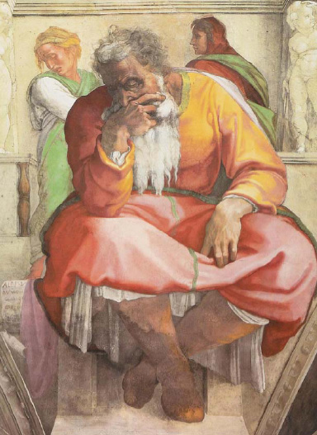
耶利米
"哀哭的先知" 还是 "盼望的先知"?
Dr. Rick Griffith • 博士 • 新加坡神学院 • BibleStudyDownloads.org

Slide 2
474
343

Slide 3
主题
474
应得的被掳与不配得的修复

Slide 4
474

Slide 5
343

Slide 6
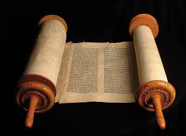
474
346
耶利米书
信息声明
耶利米，不惜个人代价，预言耶路撒冷将受到应得的摧毁，70年被掳，外邦人的审判，在新约之下被复国，给犹大国盼望以及劝勉其接受神必然成就的管教，降服于巴比伦。

Slide 7
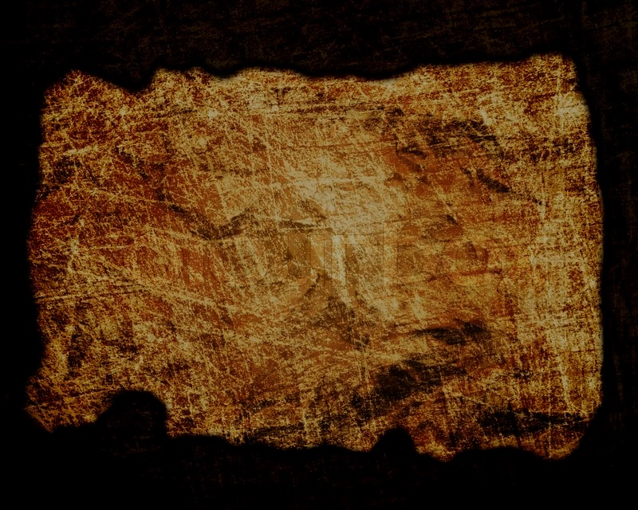
立约
347b
把以色列人带向审判的旧约会被新约的祝福代替，当以色列人悔改后将被赦免，圣灵将会居住在他们 (31:31-33).
耶利米书

Slide 8
救赎
347b
救赎是属灵的更新(第30–33章) 当以色列的不忠和不顺服结束后, 救赎就会降临而以色列作为一个国家将存到永远(31:35-37).
耶利米书

Slide 9
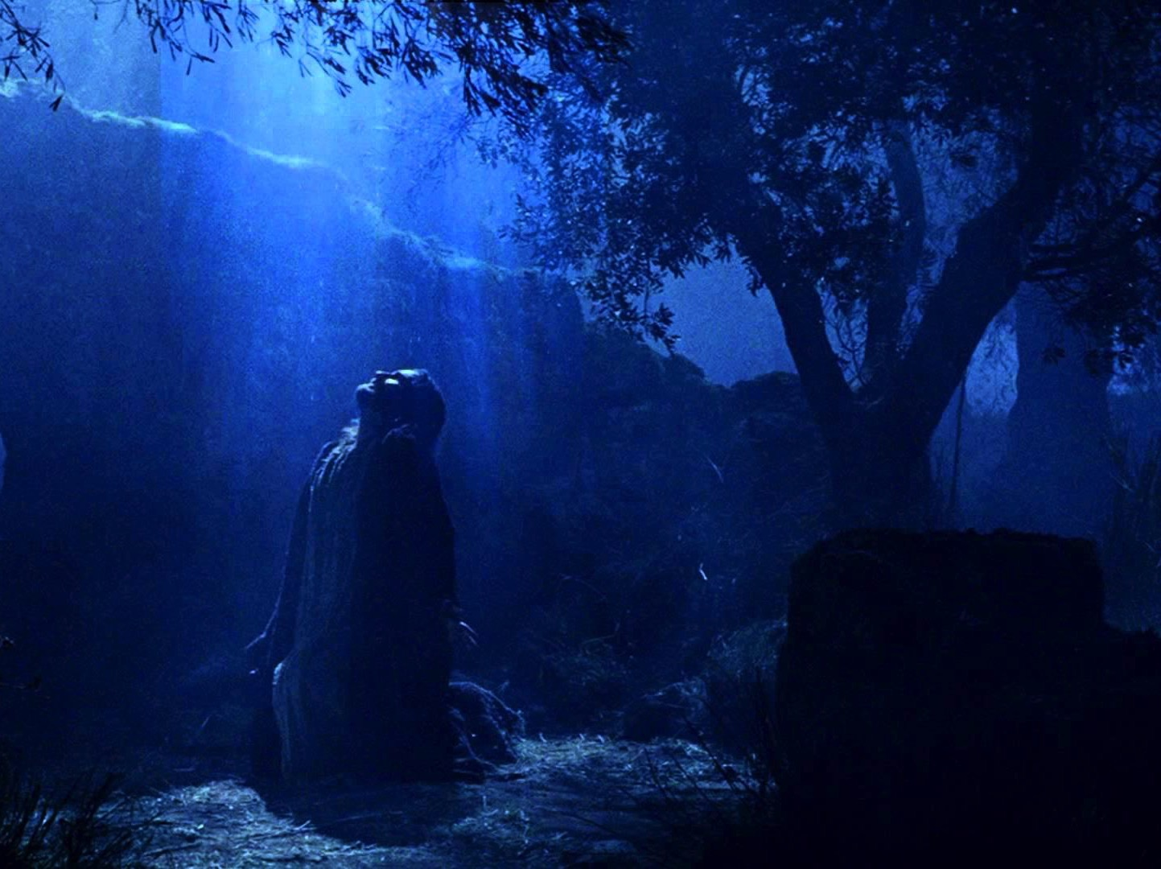
弥赛亚
347b
那位义者，我们的好牧人弥赛亚 (23:1-8) 将新的约赐下(31:31-33) 因着他被卖，他宝血的救赎，把我们带向基督的权柄。 (路加福音22:20).
耶利米书

Slide 10
Book Chart
474
应得的被掳与不配得的修复
耶利米的呼召 | 犹大应得的审判 |  |  |  | 各国应得的审判 |  |  |  | 耶路撒冷亡国
第 1 章 | 第 2–45 章 |  |  |  | 第 46–51 章 |  |  |  | 第 52 章
委 任 | 谴责 与 安慰 |  |  |  | 谴 责 |  |  |  | 被 掳
审判的信息 但有神的同在 | 亡国前 2–38 | 亡国 39 | 亡国后 40–44 | 巴录 45 | 西南 46–47 | 东 48:1–49:22 | 北 49:23-33 | 东北 49:34– 51:64 | 亡国 52:1-30 | 复国 52:31-34
序幕 | 事 工 |  |  |  |  |  |  |  | 结语
犹大 |  |  |  |  | 列国 |  |  |  | 巴比伦
约主前 627-580 年

Slide 11
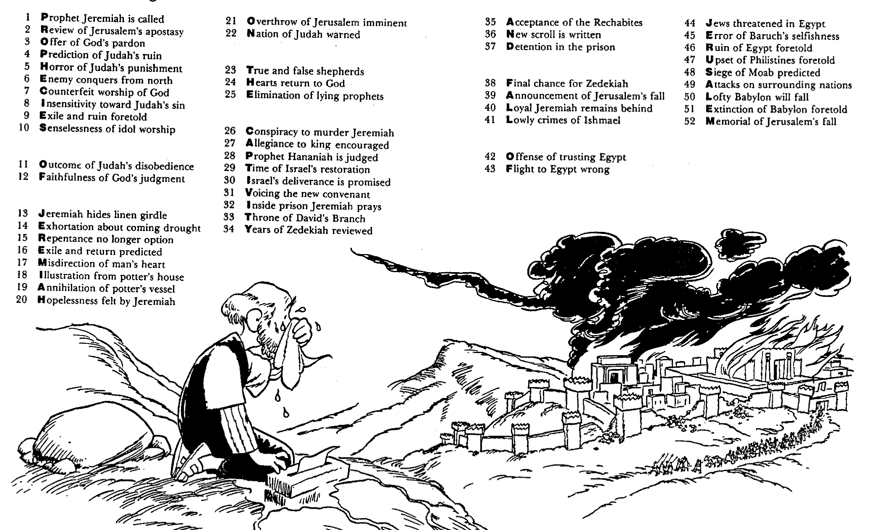
Barry Huddleston, The Acrostic Summarized Bible (Grand Rapids: Baker, 1992)
1 Inception of the world
2 Newlyweds placed in Eden
3 Temptation and man's fall
4 Hatred and first murder
5 Entire genealogy of Adam
6 Lessons on proper priorities
7 Outline for personal relationships
8 Faith of the centurion
耶利米书
29 Genealogy of Jesus Christ
30 Opposition of King Herod
31 Spirit's descent upon Jesus
32 Power over Satan's temptations
33 Expounding Sermon on Mount
34 Lessons on proper priorities
35 Outline for personal relationships
36 Faith of the centurion
9 Matthew's call from Jesus
10 Apostles sent to preach
11 Testimony about John's message
12 True Messiah called demonic
13 Hidden message of parables
14 Execution of the Baptist
15 Wisdom is answering Pharisees
37 Matthew's call from Jesus
38 Apostles sent to preach
39 Testimony about John's message
40 True Messiah called demonic
41 Hidden message of parables
42 Execution of the Baptist
43 Wisdom is answering Pharisees
16 Keys of the kingdom
17 Impact of Jesus' transfiguration
18 Need for true forgiveness
19 Grounds for divorce clarified
20 Opportunities in the vineyard
21 Fig tree is cursed
44 Keys of the kingdom
45 Impact of Jesus' transfiguration
46 Need for true forgiveness
47 Grounds for divorce clarified
48 Opportunities in the vineyard
49 Fig tree is cursed
22 Taxes paid to Caesar
23 Hypocrisy denounced by "woes"
24 Events of second coming
25 Judgment of the nations
26 Events on Calvary's eve
27 Way of the cross
28 Savior's resurrection and commission
50 Taxes paid to Caesar
51 Hypocrisy denounced by "woes"
52 Events of second coming
53 Judgment of the nations
54 Events on Calvary's eve
55 Way of the cross
56 Savior's resurrection and commission

Slide 12
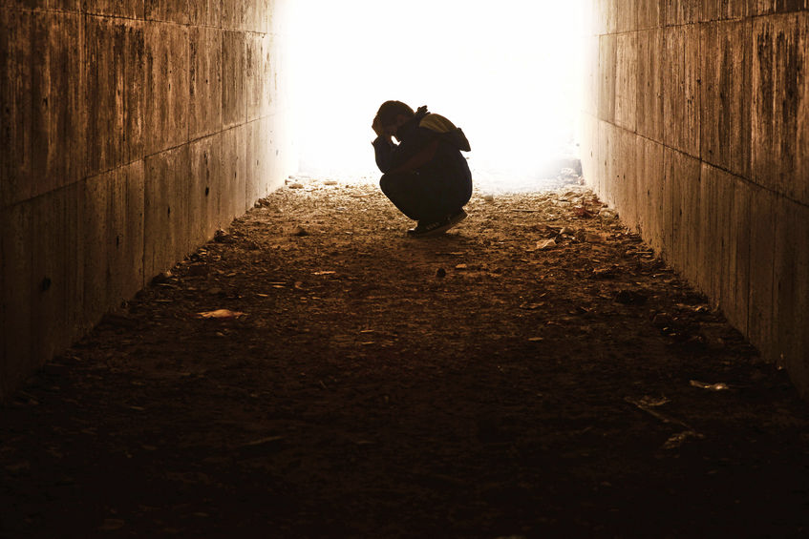
作个受安慰的人
耶利米书
Dr. Rick Griffith • Crossroads International Church Singapore
CICFamily.com • BibleStudyDownloads.org

Slide 13
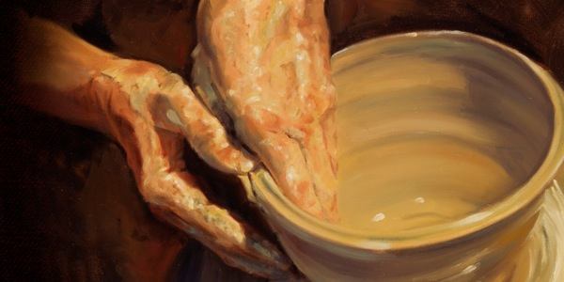
上帝如何安慰那些在他管教下的人?
Notes:
In what ways can we see God's compassion even when he has to punish sin?

Slide 14
I. 上帝呼召那些忠于他的先知 (耶利米 1).
上帝如何安慰那些在他管教下的人?
Notes:
He appoints candid people to show us both his discipline and restoration.

Slide 15
II. 上帝给我们有限的责备但是有无限的祝福 (耶利米 2–45).
上帝如何安慰那些在他管教下的人?
Notes:
The LORD's punishment is always less than his rewards.

Slide 16
III. 上帝用一样的标准看待所有的人 (耶利米 46–51).
上帝如何安慰那些在他管教下的人?
Notes:
He will judge unbelievers as well as his own people.

Slide 17
IV. 上帝平衡公义和恩典(耶利米 52).
上帝如何安慰那些在他管教下的人?
Notes:
He judges but also restores.

Slide 18
耶利米书的重点
上帝在有限中的做工，所以我们降服在他的责备中。
Notes:
The Lord judges us with constraint so we will yield to him.

Slide 19
你是忠心余民的一份子吗?
没希望?
你有将你的希望放在信实和怜悯的神吗?
你会向往耶和华日子的来临和那应许完全性的恢复吗?
还是...

Slide 21
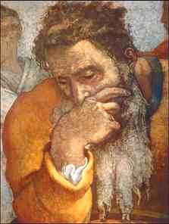
概要
背景
纲要
应用

Slide 22
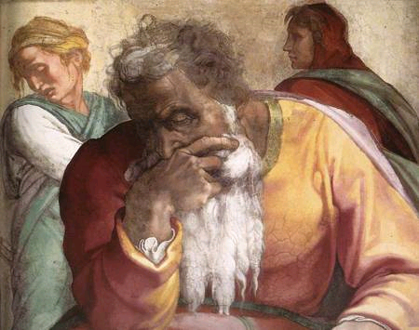
1. 耶利米书的背景

Slide 23
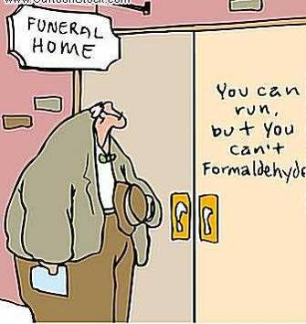
曾否感觉未来是个未知数?
耶利米书
=
必然成就
被掳
+
复国

Slide 24
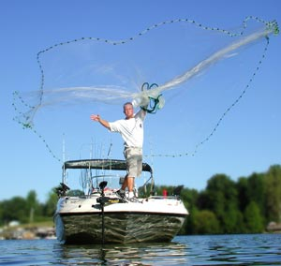
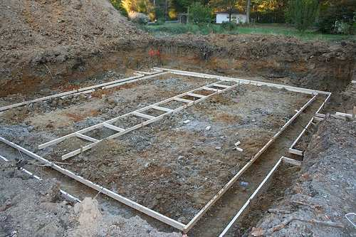
耶利米 – 希伯来文Yirməyāhū
475
从字根分析，有两个意思
“抛, 丢出” or ”松弛":
“耶和华建立，委任或差遣"
2. ”耶和华丢出," 有意思建立根基

Slide 25
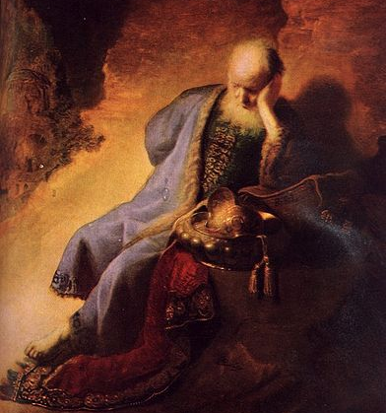
谁是耶利米?
Rembrandt van Rijn –
耶利米对耶路撒冷的被摧毁而悲哀

Slide 26
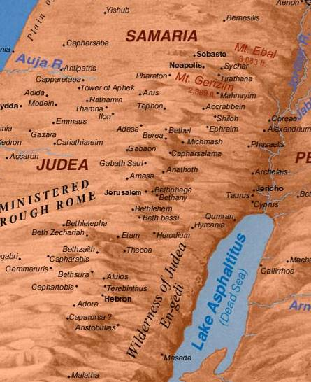
传记:
485
希勒家的儿子，祭司 (耶 1:1)
住在亚拿突城，位于耶路撒冷南北 3英里 (5公里)
在20岁开始传道
足够资金购买一块地 (耶 32)

Slide 27
作者
475
 | 是，他是耶利米! | 不，他不是耶利米!
External Evidence | 1) 明确性: 但 9:2 太 2:17-18 2) 暗示性 太 21:13; 可 11:17; 路 19:46, 罗 11:27 和 来 8:8-13 3) The Talmud, Josephus, and Ecclesiasticus | 第52章 十分相同于列王记下 24:18–25:30 很有可能第52章是与列王记下是同一个作者在圣灵的指导下写的
Internal Evidence | 耶 1:1, 11, 23; 29:27; 32:7-9. 耶利米在整个自我介绍很清楚的表明自己的身份 | 51:64 说 “耶利米的话到此为止。"

Slide 28
先知书的排列
445
归回后
被掳前
被掳期
以色列
亚述
所罗门
扫罗
大卫
被放逐的犹太人
在耶路撒冷的犹太人
犹大
以东

Slide 29
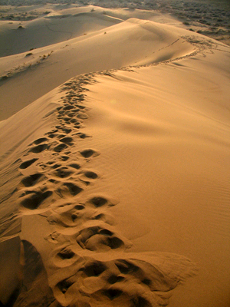
耶利米在先知中的排列
344
俄巴底亚 – 以东
约拿 – 怜悯
阿摩司 – 不公正
何西阿 – 忠诚
以赛亚 – 复国
彌迦 – 被利用
那鸿 – 尼尼微城
哈巴谷 – 信心
西番亚 – 那日子
约珥 – 蝗虫
耶利米 – 必然成就
→ 哀歌
→ 但以理, 以西结 (被掳)

Slide 30
神给犹大充足的警告
735-710 BC 彌迦: 犹大因着剥削穷人将会面对被掳的厄运
c. 630 BC 西番亚: 耶和华的日子将临到 － 悔改！
耶路撒冷被毁之前40年
607-5 BC 哈巴谷: 犹大将会被巴比伦处分
590 BC 约珥: 蝗虫的审判应该让犹大在巴比伦 should caus 侵入前悔改
627-580 BC 耶利米: 审判必然成就。70年被掳！

Slide 31
先知职分的服事年日
以赛亚
65 Years
何西阿
45 Years
耶利米
40+ Years
彌迦
25 Years

Slide 32
被掳的时间表
232 & 342
The Babylonian Exile
John C. Whitcomb, 4th rev. ed., Winona Lake, IN: BMH Books, 1962, 1968

Slide 33
旧约君王和先知的图表
342
耶利米
那鸿
西番雅
哈巴谷
以西结
亚们
约哈斯
约雅斤
约西亚
约雅敬
西底家
耶路撒冷和圣殿被毁
发现律法书
七十年

Slide 34
先知服事的年表
560
475
耶利米书的年表
627-622
608-605
593-586
586-585
627
609
605
597
586
重要时间:
约西亚
死亡
1
巴比伦侵入
2
巴比伦将
犹大驱逐
3
巴比伦被掳
呼召
但以理在巴比伦传道
犹大的君王:
以西结在巴比伦传道
约西亚
(640-609)
约哈斯
(609)
约雅敬
(608-598)
约雅斤
(598-597)
西底家
(597-586)
3 个月
11 年
3 个月
11 年
耶利米在约西亚王作王第13年 (627 BC) 开始先知的预言
经过犹大的被毁 (586 BC) 直到 580 BC.
他的服事有四十年之久，跨越5个君王

Slide 35
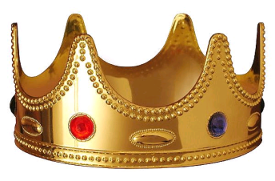
服事于这些统治者
485
475-6
1. 约西亚 – 犹大最后一个合神心意的王
2. 约哈斯 – (约西亚的儿子) 被埃及王尼哥废了，懦弱的君王
2. 约雅敬 – (约西亚的儿子) 恶的王，焚烧圣经
3. 约雅斤 – (约雅敬的儿子) 只有90为王，但被神审判
4. 西底家 – (约雅斤的叔叔) 犹大最后一个王
5. 尼布甲尼撒 – 强大巴比伦的征服者
6. 基大利 – 巴比伦王立的耶路撒冷境内省长
7. 加利亚 - 基大利被谋杀后，续做省长

Slide 36
犹大败坏的结束
256
1
约西亚
640-609
(31年)
好君王 - 白色
恶君王 - 黄色
3
5
2
加利亚 (没有统治)
约雅敬 (Eliakim) 609-597 (11年)
西底家 (Mattaniah) 597-586 (11年)
约哈斯 (Shallum) 609 (3个月)
4
约雅斤 (Jeconiah/Coniah) 597 (3个月)
巴比伦
被掳

Slide 37
约西亚的儿子和先知
232
342
但以理
605
以西结
亡国
约哈斯
约西亚
约雅敬
约雅斤
西底家
609
597
586
(3个月)
(11年)
(3个月)
(11年)
耶利米
627
短暂傀儡王

Slide 38
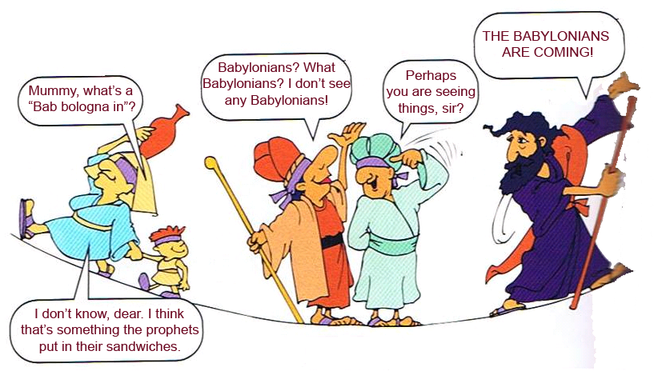
巴比伦 博洛尼亚红肠在– 谁那里??
红色警报
红色警报
什么?? 先知把一些东西放在三明治里??
巴比伦人快要来了
巴比伦人？什么巴比伦人？我什么都没有看见
先生，也许你看到的是这件事？
妈咪 巴比伦 博洛尼亚红肠在？
亲爱的我不知道，也许是先知夹在三明治里面的东西？

Slide 39
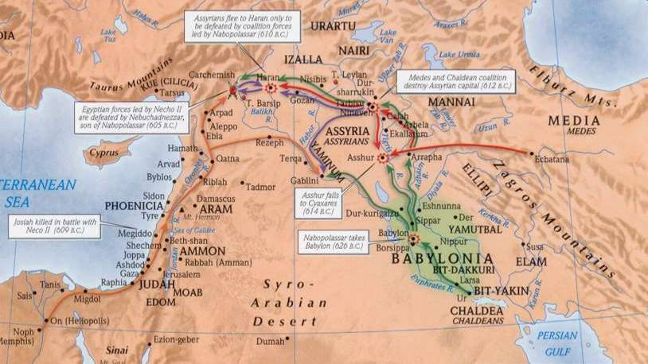
耶利米书的地理
475-6
4
1
3
2
1. 亚述: 自 722 BC, 亚述占领耶路撒冷.
2. 巴比伦: 612 BC 尼尼微, 亚述首都, 被巴比伦占领. 这意味着犹大将会服从于巴比伦.
3. 埃及: 亚述-巴比伦战争给予埃及控制以色列. 法老尼哥在609 BC 杀害犹大王约西亚, 然后他的儿子约哈斯统治三个月. 尼哥过后以约雅敬取代约哈斯.

Slide 40
Geography of 耶利米书
475-6
耶利米书的地理
4
1
3
2
4. 巴比伦: 当埃及被巴比伦的尼布甲尼撒打败，在 Carchemish 战役 (605 BC)后, 约雅敬 从效忠埃及转移效忠于巴比伦.

Slide 41
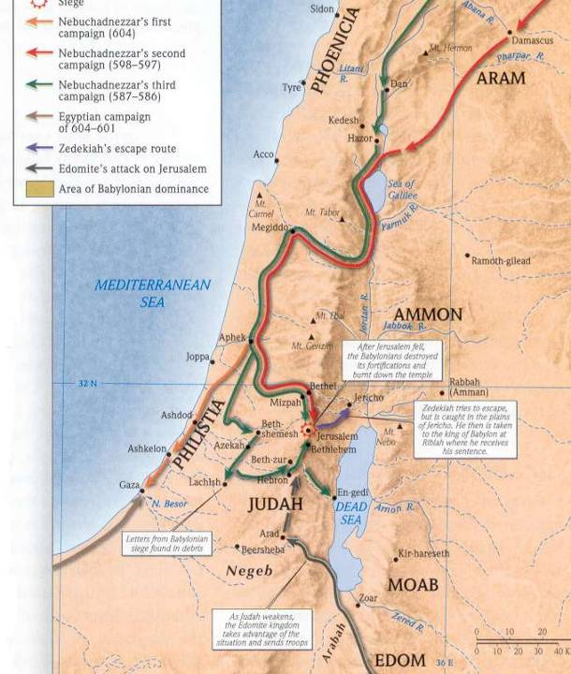
当代战役
475-6
埃及: 四年后(601 BC), 埃及
打败尼布甲尼撒，约雅敬又
效忠回埃及。这是一个错误!
巴比伦: 在 597 BC 尼布甲尼撒攻打耶路撒冷，杀了约雅敬。
约雅斤取代了约雅敬，但3个月后，尼布甲尼撒将他与10,000 个百姓驱逐去巴比伦.
他的叔叔，西底家，取代他，共统治 11年直到耶路撒冷在 586 BC 遭沦陷和亡国。

Slide 42
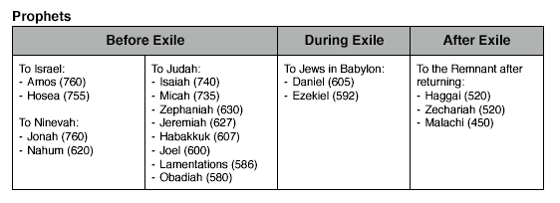
谁是收信人? (1)
475
被掳前
被掳期间
被掳后
给以色列
给犹大
给在巴比伦的犹太人
给归回的犹太人
给尼尼微

Slide 43
谁是收信人? (2)
475
在巴比伦的
流亡者在亡国前:
鼓 励
耶 29
亡国前的犹大:
警 告
亡国后的
流亡者
耶 38-44, 52

Slide 44
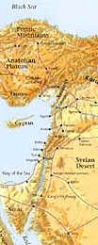
针对哪些国家预言 (耶46–51)
485
1. 埃及 (46:1-27) - 被巴比伦打败
2. 非利士 (47:1-6) - 被埃及泛滥
3. 摩押 (48:1-47) - 被巴比伦攻打
4. 亚扪 (49:1-6) - 被摧毁然后在千禧年再被建立
5. 以东 (49:7-22) - 成为所多玛和蛾摩拉
6. 大马士革 (49:23-27) - 在一天之内遭摧毁
7. 基达 和 夏琐 (49:28-35) - 被尼布甲尼撒摧毁
8. 以拦 (49:34-39) - 被尼布甲尼撒泛滥和在千禧年被重建
9. 巴比伦 (50:1-51:64) - 整个帝国将会摧毁

Slide 45
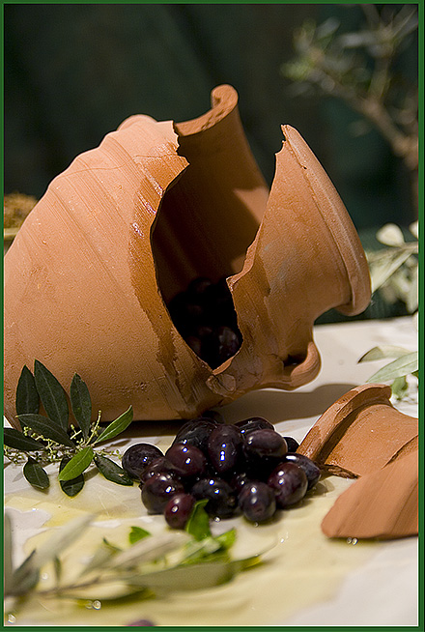
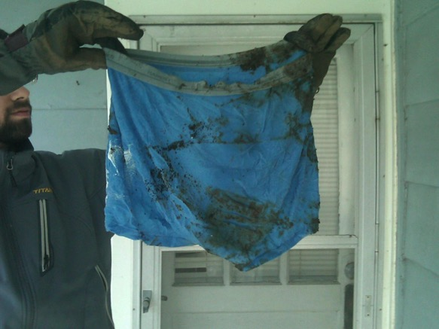
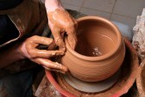
耶利米书的特点
476
象征性的行为
打碎的瓦瓶
(耶19)
陶匠的泥
(耶18)
腐坏的腰带
(耶13)

Slide 46
耶利米书的特点
476
象征性的行为
文学类型
马索拉抄本（MT）与七十士译本 （LXX) 的对比

Slide 47
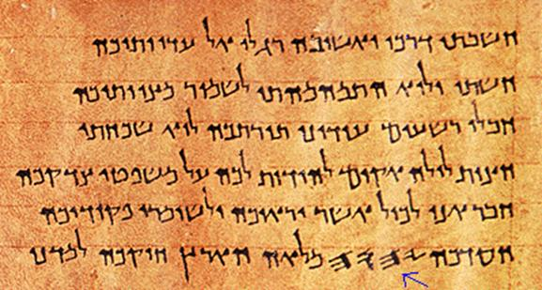
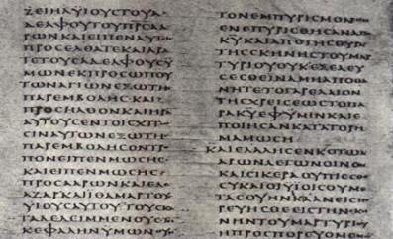
比较马索拉抄本（MT）与七十士译本
476
马索拉 (希伯来文.)
七十译本 (希腊文.)
比马索拉版本短1/8

Slide 48
耶利米书的特点
476
象征性的行为
文学类型
马索拉抄本（MT）与七十士译本 （LXX) 的对比
新约

Slide 49
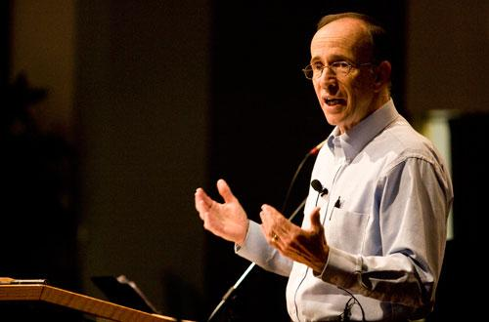
“怎样才能除去犹太人”？
35那使太阳白昼发光，派定月亮和
星辰照耀黑夜，又搅动海洋，使海
浪澎湃的，万军之耶和华是他的
名，他这样说：
36 “这些定律若能从我面前废掉，以色列
的后裔也就会在我面前断绝，永远不再
成为一个国家。”这是耶和华的宣告。
37 耶和华这样说：“人若能量度在上的诸天，
测透地下面的根基，我也就会因以色列后裔
所作的一切，弃绝他们众人。”
这是耶和华的宣告。
（耶31：35 – 37，新译本）
Notes:
A pastor once announced to his congregation, • "Next week I will speak on the topic of 'How to Get Rid of the Jews.'" The news spread throughout the small town to the extent that on the next Sunday, after the doors had closed and just before a packed service began, the doors opened again and into the church walked the city's chief rabbi, followed by two of his lawyers! They walked down the center aisle all the way to the front, then took seats in the very front row.
The service continued with songs, prayers, offering and finally the pastor stood at the pulpit. "I am thrilled to see so many at church today, including our distinguished rabbi and his friends. My topic today is 'How to Get Rid of the Jews.' The text is from Jeremiah, chapter 31. Please turn in your Bibles to Jeremiah 31, verse 35.'" [Animate slide and read vv. 35-37]
At this point, the rabbi smiled, the pastor winked, the congregation sighed in relief, and the lawyers realized that their job was over.
God was clear to Jeremiah that his covenant with the Jews is an eternal covenant, not dependent on them. He promised a New Covenant that assures that at some future point the nation will again trust in him by believing in Messiah, after which God will forgive their sins.

Slide 50
耶利米书的特点
476
象征性的行为
文学类型
马索拉抄本（MT）与七十士译本 （LXX) 的对比
新约
合理的排列

Slide 51
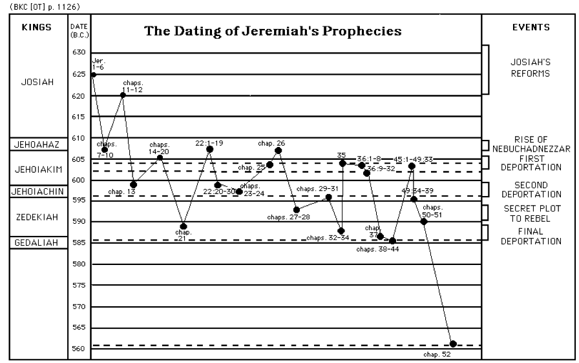
结构是按合理性，不是按时间顺序
477
王
耶利米的预言记录
事件
约西亚王的改革
约西亚王
约哈斯王
尼布甲尼撒的崛起
约雅敬王
第一次的被掳
约雅斤王
第二次被掳
西底家
秘密的叛乱
大利
最后一次被掳
Notes:
Jeremiah's prophecies were written down not in chronological order, but rather in a seemingly haphazard way, as shown in this chart. However, as we read the book of Jeremiah we can see that there is a logical flow in what and who it was trying to address.

Slide 52
耶利米书的特点
476
象征性的行为
文学类型
马索拉抄本（MT）与七十士译本 （LXX) 的对比
新约
合理的排列
70年预言

Slide 53
Two 70-Year Exiles
560
两个 70-Year 被掳
百姓被掳
605
586
539
536
516
圣殿被掳/毁
Notes:
53

Slide 54
耶利米书的特点
476-478
象征性的行为
文学类型
马索拉抄本（MT）与七十士译本 （LXX) 的对比
新约
合理的排列
70年预言
记载耶路撒冷两次的亡国

Slide 55
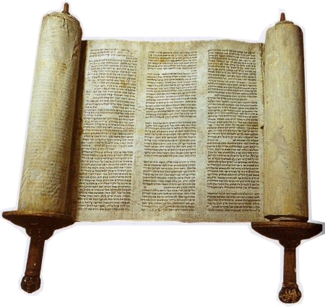
耶利米书的纲要

Slide 56
Book Chart
474
应得的被掳与不配得的修复
耶利米的呼召 | 犹大应得的审判 |  |  |  | 各国应得的审判 |  |  |  | 耶路撒冷亡国
第 1 章 | 第 2–45 章 |  |  |  | 第 46–51 章 |  |  |  | 第 52 章
委 任 | 谴责 与 安慰 |  |  |  | 谴 责 |  |  |  | 被 掳
审判的信息 但有神的同在 | 亡国前 2–38 | 亡国 39 | 亡国后 40–44 | 巴录 45 | 西南 46–47 | 东 48:1–49:22 | 北 49:23-33 | 东北 49:34– 51:64 | 亡国 52:1-30 | 复国 52:31-34
序幕 | 事 工 |  |  |  |  |  |  |  | 结语
犹大 |  |  |  |  | 列国 |  |  |  | 巴比伦
约主前 627-580 年

Slide 57
耶利米书的特点
476-478
象征性的行为
文学类型
马索拉抄本（MT）与七十士译本 （LXX) 的对比
新约
合理的排列
70年预言
记载耶路撒冷两次的亡国
经历耶路撒冷的亡国

Slide 58
耶路撒冷沦陷
耶路撒冷沦陷
232
342
560
重要年日
627
耶利米
605
但以理
597
以西结
586
538
西番亚
约珥
630
耶利米哀歌
哈巴谷
590
606

Slide 59
耶利米书的特点
476-478
象征性的行为
文学类型
马索拉抄本（MT）与七十士译本 （LXX) 的对比
新约
合理的排列
70年预言
记载耶路撒冷两次的亡国
经历耶路撒冷的亡国
最长的先知书 (诗篇是最长的书)

Slide 60
圣经最长的书卷
478
书 | 章 | 节 | 字
诗篇 | 150 | 2461 | 43,743
耶利米书 | 52 | 1364 | 42,659
以西结书 | 48 | 1273 | 39,407
创世纪 | 50 | 1533 | 38,267
以赛亚书 | 66 | 1292 | 37,044
http://www.kneeholedesk.com/Pages/Did_You_Know/Books_of_the_Bible.html

Slide 61
耶利米书的特点
478
在新约里最长的旧约引用 (耶31:31-34 在来 8:8-13)
必然成就

Slide 62
为何审判将是必然成就呢?
478
1. 劝勉百姓悔改只是到 第19章 (e.g., 15:19; 17:24; 18:8; cf. 5:3; 8:6). 在这之后，就没有悔改性的了.
2. 神吩咐耶利米不能为犹大的百姓祈求 (11:14; 14:11).
3. 耶利米告诉百姓，如果投降于巴比伦，他们不会死亡，能生存下来，但整个国家将会遭摧毁 (21:8-9; 24:1-10; 27:5-12, 16-17; 32:5; 38:17-23; 42:9-22; 52:24-27).

Slide 63
为何审判将是必然成就呢?
478
4. 神很肯定被掳为 70年 之久就表明审判是无可避免的 (25:11-12; 29:10).
5. 耶利米将瓦瓶打碎，意为着神摧毁城的决定不会被撤回 (19:1-2, 10-11).
6. 耶利米吩咐那些已经被掳的定居下来 (29:4-14) 而相反的，假先知哈拿尼亚说到他们被掳的年份为两年 (28:1-3, 10-12). 这显示 "已成定局" ，连百姓的悔改都不能拦住神审判的手.

Slide 64
耶利米书的特点
478
在新约里最长的旧约引用 (耶31:31-34 在来 8:8-13)
必然成就
Deuteronomy 28 fulfillments
给巴录的信息
自传
太 27:9 引用 耶 19:1-13 (又或者 耶 18:2-12 或 32:6-9) 一同用 撒迦利亚 11:12-13 但却常常归于是来自先知耶利米。

Slide 65
你知道吗？
476
不同的文学类型—例如有诗意的 (30–31), 演讲性的散文 (32–33) 和描述性的散文 (46–51)
耶 31:31-34 是在新约里引用旧约最长的经文
(来 8:8-13)
Notes:
The people in Israel were not too concerned about Babylon, in fact they thought they were secure in their successes

Slide 66
重要事实
474
简介
耶利米，不惜个人代价，预言耶路撒冷将被摧毁，面临70年被掳，外邦人的审判，在新的约被复国，给犹大一个盼望以及劝勉她接受神必然成就的审判，降服于巴比伦。
主要字句
必然成就
主要经文
"… 因为耶和华我们的神使我们静默不言，又将苦胆水给我们喝，都因我们得罪了耶和华" (耶 8:14下)

Slide 67
作个受安慰的人
耶利米书
Dr. Rick Griffith • Crossroads International Church Singapore
CICFamily.com • BibleStudyDownloads.org

Slide 68
3-days travel, 4-day visit
Notes:
It is wonderful to be with you all again after taking a week off to be with my family in the USA. This is a first for us—three days of flying to have four and half days with my family—but when a $4000 trip costs only $100 now since our son is a pilot, we had little excuse not to go!

Slide 69
We all need to be comforted
Notes:
We had special times with our youngest son John and Susan's mother.

Slide 70
3-day travel, 4-day visit
Notes:
John even showed off his climbing skills.

Slide 71
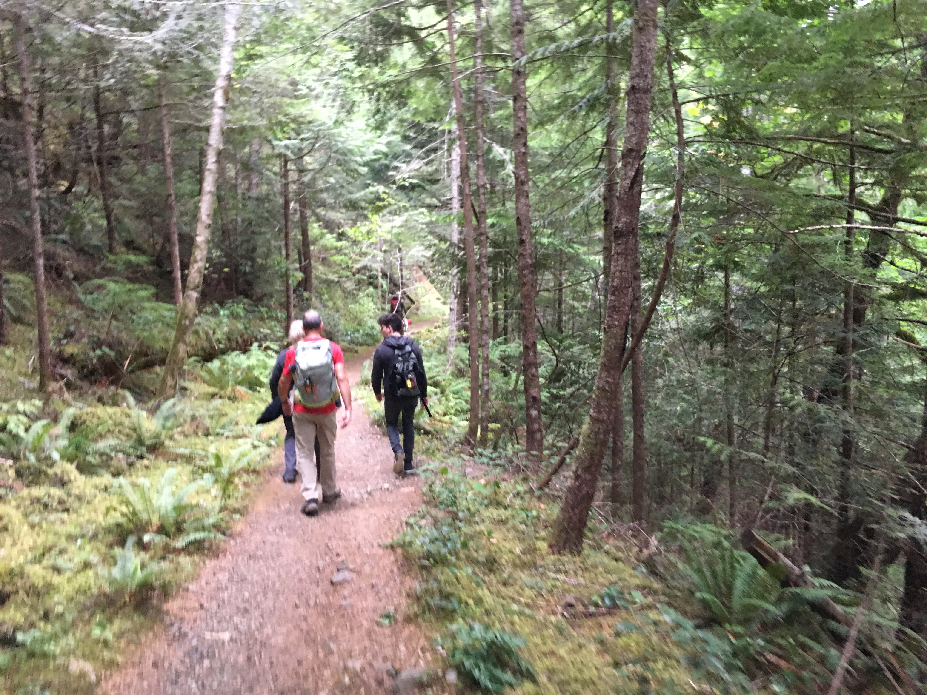
3-day travel, 4-day visit
Notes:
We got in some hiking…

Slide 72
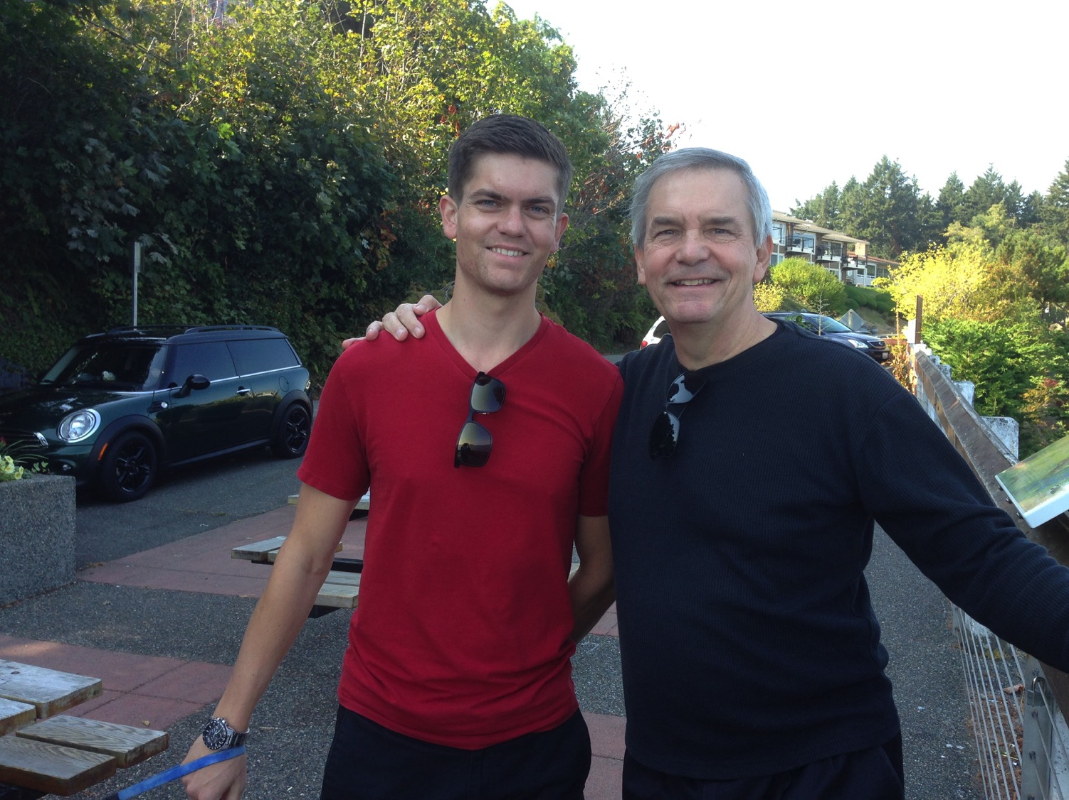
We all need to be comforted
Notes:
This was due to our United pilot son, Stephen.

Slide 73
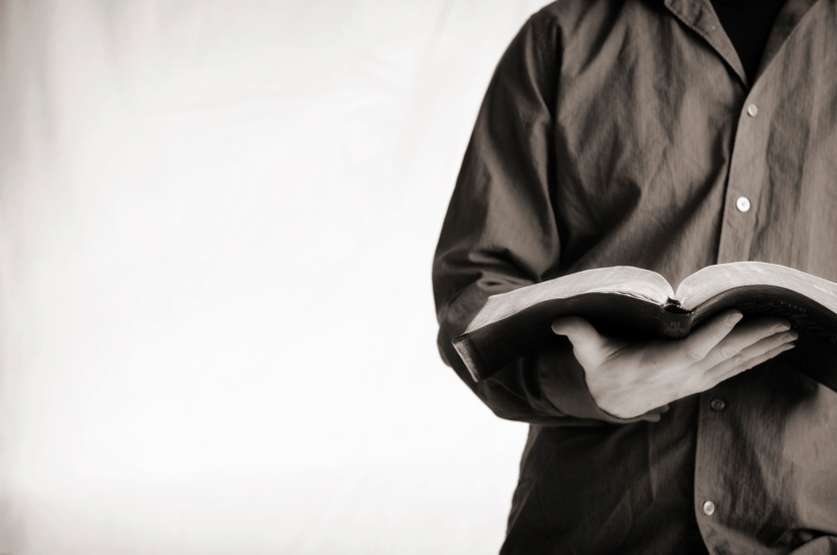
让我们一起考察经文
圣经：
每一卷书
创世记
Notes:
让我们一起考察经文
圣经：每一卷书

Slide 74
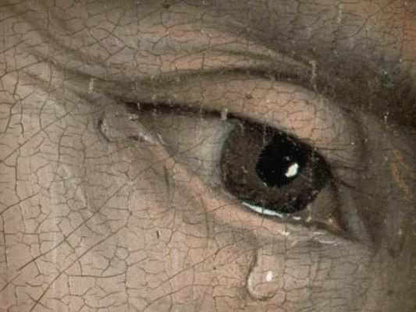
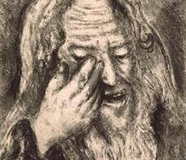
“哭泣的先知”
Notes:
耶利米书 was the only prophet to live through the 586 BC fall of Jerusalem. God called him to show God’s compassion even in Judah’s darkest hours. 耶利米书 is known as "The Weeping Prophet." I suspect you would weep also if you saw your country ravaged and destroyed before your very eyes and you were powerless to stop it. It actually makes sense that God would call one like him who experienced such loss to be one who teaches us the need to be comforted.

Slide 75
我们都需要被安慰
Notes:
That’s because we all need to be comforted at various times of our lives. This is true for women, of course, but not only for women.

Slide 76
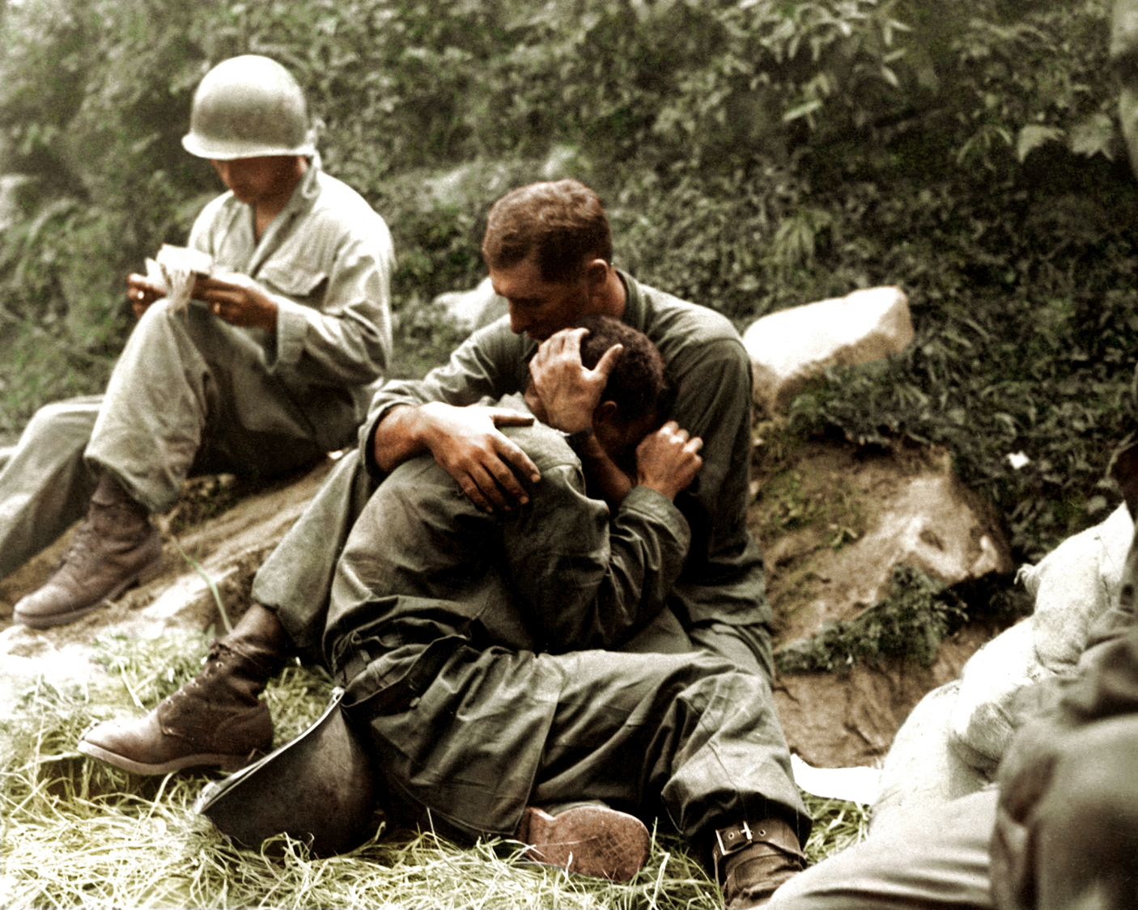
我们都需要被安慰
Notes:
Men also need comfort many times.

Slide 77
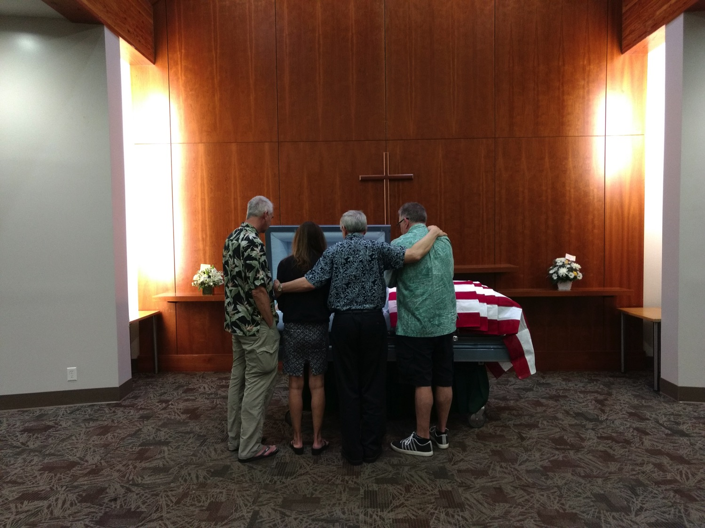
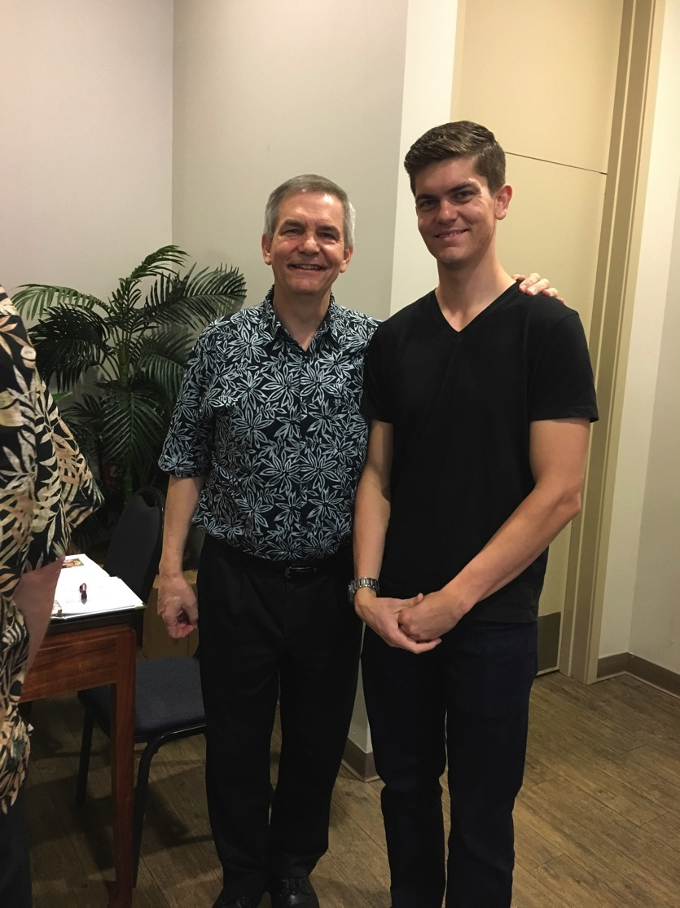
We all need to be comforted
Notes:
As one who often gives comfort, I found myself as one needing to be on the receiving end in January. It was challenging to be both the son and the officiating minister at my father’s memorial service,
• but God granted comfort from this same son, Stephen, who made the effort to fly to be there as a support.

Slide 78
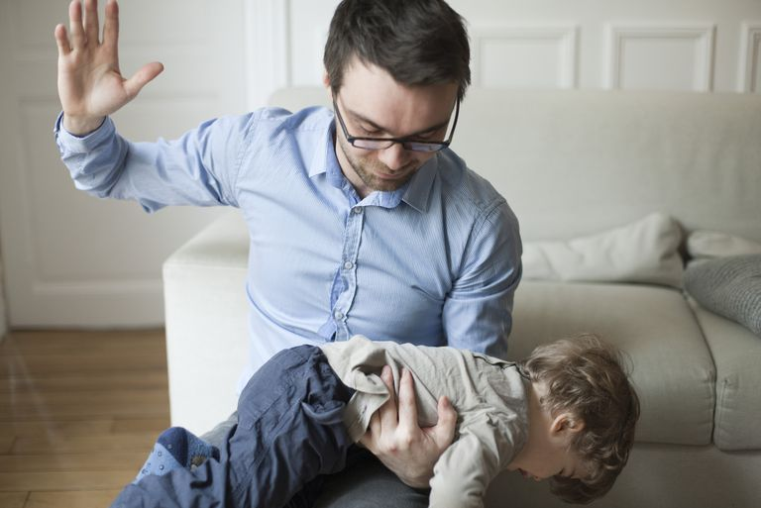
在责备和安慰中的平衡
Notes:
Of course, we all know that life is not only about comfort. One of the signs of growing up is to realize that we must balance discipline with comfort.
Discipline shows us when we are off track and need to realign.

Slide 79
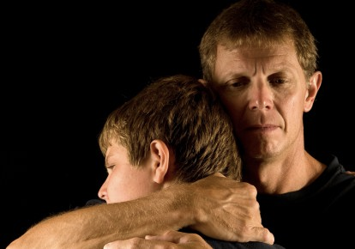
在责备和安慰中的平衡
Notes:
But comfort helps us feel appreciated and loved.

Slide 80
管教
Notes:
What images or memories come to your mind when you hear the word "discipline"?
When you were growing up, were you disciplined in a balanced way?
Did you receive mostly harsh discipline?
Or did your parents give you no discipline at all?
Or did you experience a good balance where standards (the principle of the thing) were matched with support? Did you receive comfort along with the discipline?

Slide 81
上帝如何在他的管教中来安慰我们。
Notes:
In what ways can we see God's compassion even when he has to punish sin?
A good father does not discipline in harshness and then reject and neglect his child.
Like the best earthly father, God wants us to realize that, despite his discipline, he also offers his comfort.

Slide 82
约西亚的儿子和先知
232
342
但以理
605
以西结
亡国
约哈斯
约西亚
约雅敬
约雅斤
西底家
609
597
586
(3个月)
(11年)
(3个月)
(11年)
耶利米
627
短暂傀儡王

Slide 83
474
343

Slide 84
主题
474
应得的被掳与不配得的修复

Slide 85
474

Slide 86
作个受安慰的人
耶利米书
Dr. Rick Griffith • Crossroads International Church Singapore
CICFamily.com • BibleStudyDownloads.org

Slide 87
上帝如何在他的管教中来安慰我们。
4种方式...
Notes:
In what ways can we see God's compassion even when he has to punish sin?

Slide 88
I. 上帝呼召那些对我们诚实的先知(耶1).
上帝如何在他的管教中来安慰我们。
Notes:
He appoints candid people to show us both his discipline and restoration.

Slide 89
Slides on 耶利米 1

Slide 90
先知职分的服事年日
以赛亚
65 Years
何西阿
45 Years
耶利米
40+ Years
彌迦
25 Years

Slide 91
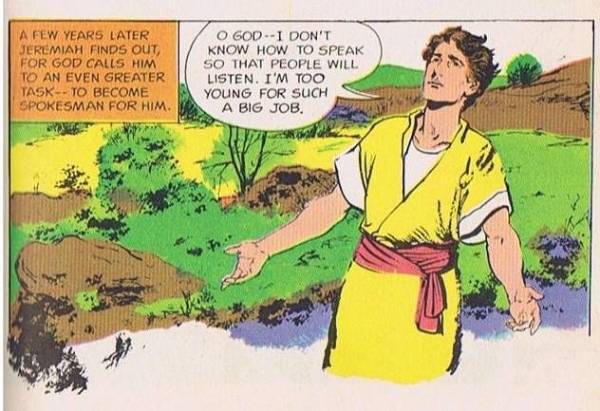
神呼召、差派耶利米
约西亚王的统治和改革不能长久.
神呼召了…
高大, 古铜色和 英俊的年轻人!
耶 1:4-9
Source: The Picture Bible (Chariot Books, David C Cook, 1978)

Slide 92
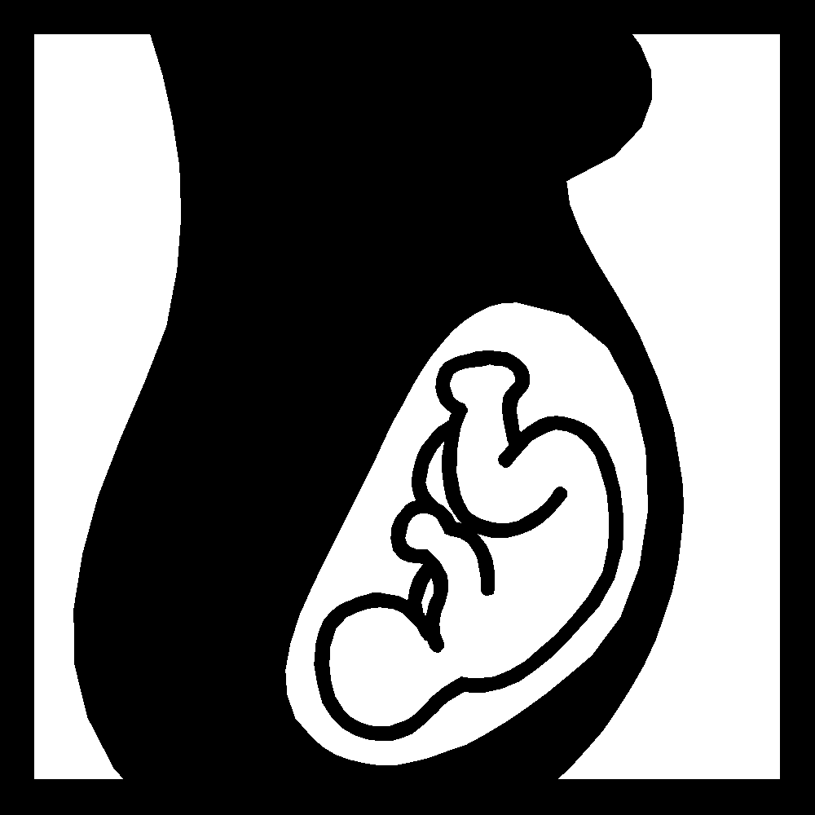
神给耶利米的保证
" 我将你造在腹中
我已晓得你, 你未出母胎
我已分别你为圣;
我已派你作列国的先知…
不要说, '我是年幼的.'
因为我差遣你到谁那里去，你都要去；我吩咐你说什么话，你都要说。你不要惧怕他们，因为我与你同在，要拯救你… 我已将当说的话传给你 …
耶 1:5, 7-9
Notes:
Brown arrows from bottom represent the Egyptian campaign

Slide 93
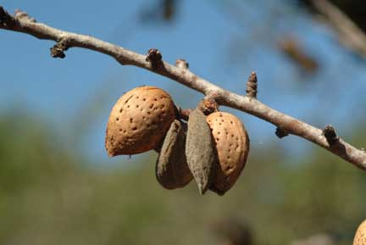
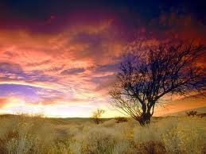
主题教材 #1 – 杏树枝
神在 留意 看守祂的话，使得成就.
("留意" 在希伯来语音调像是 "杏树枝")
耶 1:11-13
Notes:
A recap of which books were written to whom, as we see from this chart, 耶利米书 is written to Judah. Let's take a closer look.

Slide 94
主题教材 #2 – 烧开的锅
沸腾的锅，从北而倾 –
入侵者将从北方攻打和摧毁耶路撒冷.
耶 1:13-19
Picture Source: The Children's Bible in 365 stories, Lion Publishing, 1985
Notes:
耶利米书 addressed the people of Judah: (1) as a warning before the Fall, (2) as an encouragement to Exiles before the Fall, and (3) to Exiles after the Fall. The different widths of the circles represent the relative numbers of people.

Slide 95
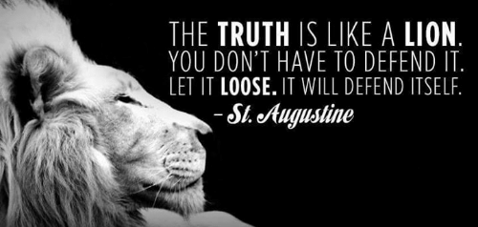
上帝是否通过他诚实的先知来安慰你?
Notes:
I will be honest with you—my main goal is to be honest with you!
That honest truth includes both the things we like to hear and those things that we do not like.
• St. Augustine said, “The truth is like a lion. You don’t have to defend it. Let it loose. It will defend itself.”
My prayer is that those of us who need comfort will find it here today. God is, after, the “God of all comfort” (2 Cor). That is the “building up” aspect of pastoral ministry. I have come to build you up.
But God has also called me to “tear down.” That means that God’s primary goal in your life is not to make you comfortable. It is to make you like his son Jesus. That will take some tearing down of patterns that hinder Christlikeness in us.

Slide 96
上帝如何在他的管教中来安慰我们。
Notes:
In what ways can we see God's compassion even when he has to punish sin?

Slide 97
I. 上帝呼召那些对我们诚实的先知(耶1).
上帝如何在他的管教中来安慰我们。
Notes:
He appoints candid people to show us both his discipline and restoration.

Slide 98
II. 上帝对我有限的责备但是有着无限的祝福 (耶利米 2–45).
上帝如何在他的管教中来安慰我们。
Notes:
The LORD's punishment is always less than his rewards.

Slide 99
Slides on 耶利米 2

Slide 100
犹大与神的关系
年轻的新娘
不忠贞 …. 许多情人
一位名巴力
耶 2–4
Notes:
However, more than just the people of Judah alone, there were prophecies addressed to the other non-Israelite cities in those days.

Slide 101
Slides on 耶利米 3

Slide 102
Slides on 耶利米 4

Slide 103
Slides on 耶利米 5

Slide 104
Slides on 耶利米 6

Slide 105
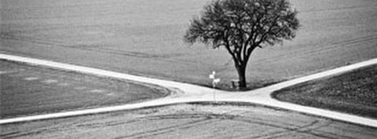
“耶和华这样说： “你们要站在路上察看， 寻访远古的路径， 看哪一条是美善的路，就走在其中； 这样，你们心里就必得安息。” (耶利米 6:16a CNV).
Notes:
This verse reminds us of some of our key priorities:
1. We must look out for people in need going through various crossroads in their lives.
2. We must prioritize that which is proven and not be pursuing every new fad that comes down the road.
3. We must instead pursue the Word of God, making the Bible central to all we do—and obey it.
4. We must be a place of rest for people in the very stressed out country of Singapore.

Slide 106
Slides on 耶利米 7

Slide 107
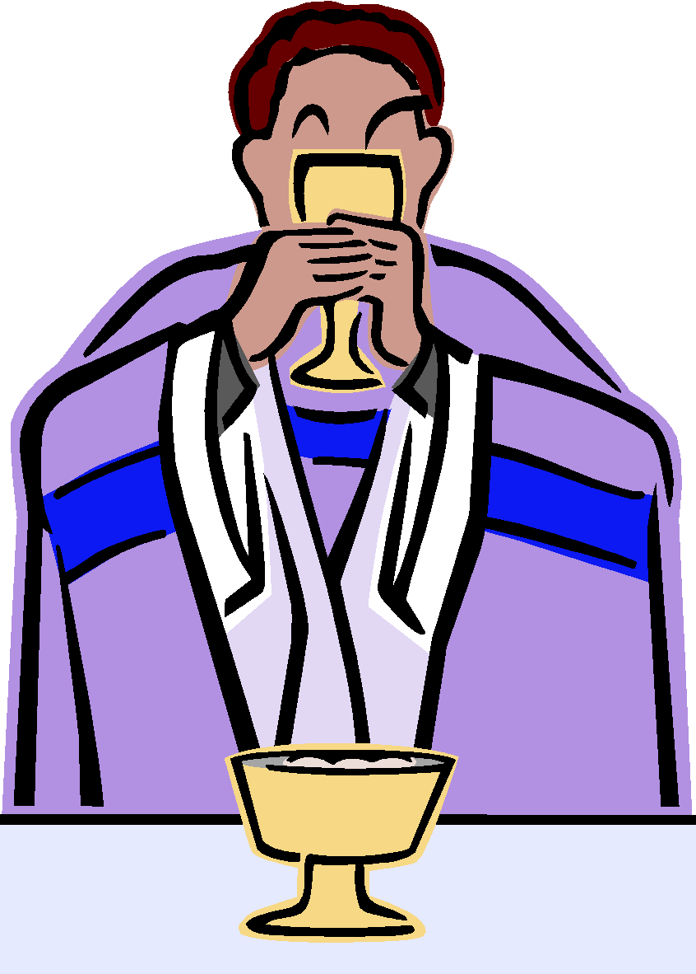
无用的公开敬拜
信靠虚假的话
和 "神不会摧毁圣殿"
神告诉耶利米...
停止为犹大祷告
他们的败坏已经无可想象.
连自己的孩子都当做祭物献给偶像!
耶 7–8
Notes:
The book is divided into 4 main sections / segments. First in chap 1, a familiar passage of 耶利米书's call, his person and identity, 耶利米书 got down to work very quickly in Chap 2. There are a number of object lessons that run through the 2nd segment. Clear signs that God asks 耶利米书 to do to give the Judeans an obvious reminder of what they had not done and their failure to return and repent before God. However, buried between this segment in chapters 30-33 is a message of hope in a future restoration, and embedded there is also the new covenant, that we will cover near the end. After that from 34 onwards, it is against message and warning after warning against disobedience. But interestingly in Chap 45, if we read it, it is really interestingly it is with regards to an incident that happened 20 years earlier, and it is placed here to encourage and show God's sovereignty. This is also a reminder of the encouragement that God gave to 耶利米书 in Chap 1: 19.. The next segment is the oracle against the nations that persecuted Judah. These are clear prophesies outlining the future of these nations, many of which where fulfilled. As we read the prophesies against the nations, we see that the Prophecies end with Babylon, and how God would very certainly destroy them. The focus on this was I believe also to bring hope to the Israelites at that time, where they couldn't really see beyond their suffering and subjugation. So the reality that future judgement lay ahead for Babylon was also an important encouragement for them to know that their God was a just God.

Slide 108
Slides on 耶利米 8

Slide 109
审判即将来临并且是可怕的!
他哭泣 …..
他悲哀的感慨是神渴望祂的百姓的悔改
耶 8–10

Slide 110
Slides on 耶利米 9

Slide 111
Slides on 耶利米 10

Slide 112
Slides on 耶利米 11

Slide 113
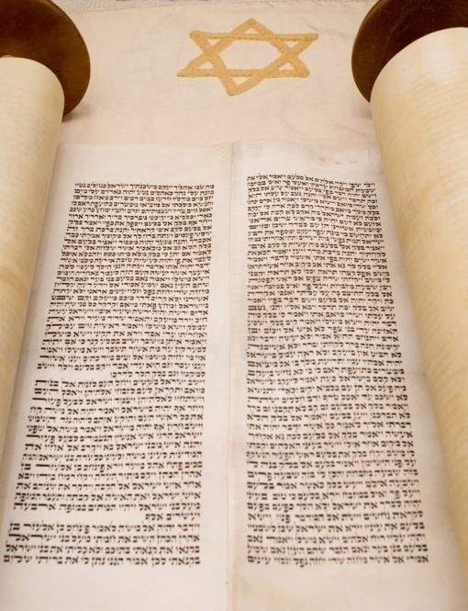
约, 阴谋 与 投诉
亚拿突的人有阴谋要杀害他
耶利米宣讲：约已破裂
耶利米向神投诉;
神鼓励他
耶 11–12

Slide 114
Slides on 耶利米 12

Slide 115
Slides on 耶利米 13

Slide 116
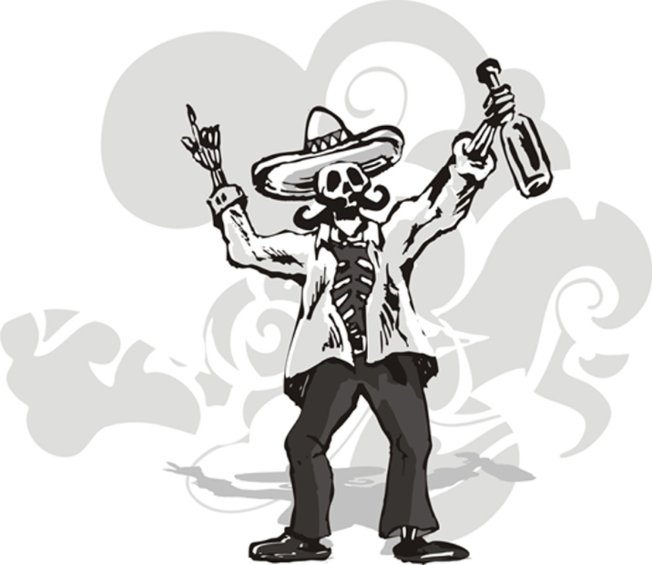
主题教材 – 审判的迹象
坏的腰带 – 在磐石穴中腐烂.
犹大受到外邦人的影响, 背弃神, 灵性已一文不值.
坛盛满了酒! 喝醉吧! – 当他们受苦时，神必不可伶、不顾惜、不怜悯.
耶 13

Slide 117
Slides on 耶利米 14

Slide 118
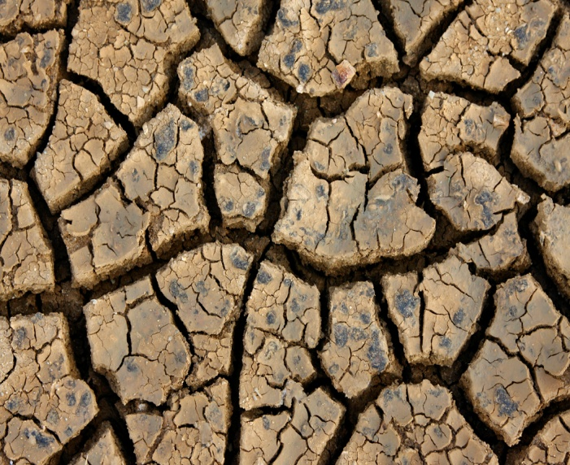
苦难的时候即来临 …
神降干旱警告犹大即将来临的审判和必须悔改.
神告诉耶利米不可为他们祷告!
耶利米将会
没有婚嫁,
没有葬礼,
没有舞会
耶 14–16

Slide 119
Slides on 耶利米 15

Slide 120
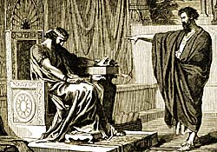
耶利米向约雅敬王
耶利米 15:1
"即使摩西和撒母耳站在我面前代求，我的心也不会转向这人民。你把他们从我面前赶走，叫他们出去！"
Notes:
"Even if Moses and Samuel were to stand before Me, My heart would not go out to this people. Send them away from My presence! Let them go!"

Slide 121
耶利米向约雅敬王
耶利米15:4
"因犹大王希西家的儿子玛拿西在耶路撒冷的所作所为，我必使地上万国看见他们的遭遇就惊恐。"
Notes:
"I will make them abhorrent to all the kingdoms of the earth because of what Manasseh son of Hezekiah king of Judah did in Jerusalem."

Slide 122
Slides on 耶利米 16

Slide 123
耶利米向约雅敬王
耶利米 16:11-13
“... 因为你们的列祖离弃了我。。。不遵守我的律法。 至于你们，你们作坏事比你们的列祖更厉害；看哪！你们各人都随从自己顽梗的恶心行
事，不听从我。 因此，我要把你们从这地赶出去，去到你们和你们列祖所不认识的地；你们在那里必昼夜事奉别的神，因为我不再向你们施
恩。"
Notes:
"...Your fathers forsook me… and did not keep my law. But you have behaved more wickedly than your fathers… instead of obeying Me. So I will throw you out of this land into a land neither you nor your fathers have known, and there you will serve other gods day and night, for I will show you no favour."

Slide 124
Slides on 耶利米 17

Slide 125
Slides on 耶利米 18

Slide 126
我是陶匠，你是泥
以色利家啊，我待你们，岂不能照这窑匠弄泥吗? (v. 6)
我所说的那一邦，若是转意离开他们的恶，我就必后悔，不将我想要施行的灾祸降与他们
(v. 8)
耶 18

Slide 127
Slides on 耶利米 19

Slide 128
主题教材 #? 什么..??
你跟从别的神，背弃了我，流了无辜人的血. 我要打碎这民和这城.
Picture Source: The Children's Bible in 365 stories, Lion Publishing, 1985
耶 19
Notes:
A pastor once announced to his congregation, "Next week I will speak on the topic of 'How to Get Rid of the Jews.'" The news spread throughout the small town to the extent that on the next Sunday, after the doors had closed and just before a packed service began, the doors opened again and into the church walked the city's chief rabbi, followed by two of his lawyers! They walked down the center aisle all the way to the front, then took seats in the very front row. [Animate slide]
The service continued with songs, prayers, offering and finally the pastor stood at the pulpit. "I am thrilled to see so many at church today, including our distinguished rabbi and his friends. My topic today is 'How to Get Rid of the Jews.' The text is from 耶利米书, chapter 31. Please turn in your Bibles to 耶利米书 31, verse 35.'" [Animate slide and read vv. 35-37]
At this point, the rabbi smiled, the pastor winked, the congregation sighed in relief, and the lawyers realized that their job was over.
God was clear to 耶利米书 that his covenant with the Jews is an eternal covenant, not dependent on them. He promised a New Covenant that assures that at some future point the nation will again trust in him by believing in Messiah, after which God will forgive their sins.
128

Slide 129
Slides on 耶利米 20

Slide 130
假先知 和 祭司 反对耶利米
耶利米被打和被圣殿的总管巴施户珥枷在高门内.
耶 20:1-3
释放后, 巴录, 一位年轻的隶, 志愿帮助他.
Picture Source: The Picture Bible, Chariot Books, David C Cook, 1978

Slide 131
Slides on 耶利米 21

Slide 132
耶利米向犹大的领袖和假先知预言, 但他们却不听
警告 ! 警告!
耶 21–23
Source: The Picture Bible, Chariot Books, David C Cook, 1978
Notes:
耶利米书's prophecies were written down not in chronological order, but rather in a seemingly haphazard way, as shown in this chart. However, as we read the book of 耶利米书 we can see that there is a logical flow in what and who it was trying to address.

Slide 133
Slides on 耶利米 22

Slide 134
Slides on 耶利米 23

Slide 135
Slides on 耶利米 24

Slide 136
尼布甲尼撒之后，耶路撒冷没有悔改
以圣殿的无花果来代表百姓
好的无花果
– 在巴比伦的流亡者已开始悔改.
– 神会照顾他们，带领他们归回.
坏、烂无花果
– 西底家王和他的首领和全部耶路撒冷的百姓
– 还在预谋和针对巴比伦
– 不配被保留下来
耶 24
Picture Source: The Children's Bible in 365 stories, Lion Publishing, 1985

Slide 137
Slides on 耶利米 25

Slide 138
尼布甲尼撒来了 (597 BC)
预言70-年被掳
带走百姓和约雅斤王. 将西底家放在王位, 让犹大有多一个机会服从巴比伦.
Picture Source: The Children's Bible in 365 stories, Lion Publishing, 1985
耶 24–25

Slide 139
Two 70-Year Exiles
560
两个 70-Year 被掳
百姓被掳
605
586
539
536
516
圣殿被掳/毁
Notes:
139

Slide 140
尼布甲尼撒六次将犹太人掳到巴比伦
492
人数 | 年日 | 犹大王 | 带走的数目 | 主要俘虏 | 结果/ 备注
1 少 | 605 BC | 约雅敬 | 少数 (但 1:3) | 但以理, 3个朋友和贵族和王族 | 征收贡物. 强大的埃及.
2 中 | 598 BC | 约雅敬 | 3023 (耶 52:28) |  | 少数驱逐
3 多 | 597 BC | 约雅斤 | 10,000 (王下 24:14) | 约雅斤, 以西结, 末底改 | 尼布甲尼撒驱逐许多; 安设西底家
4 少 | 587 BC | 西底家 | 832 (耶 52:29) |  | 摧毁前
5 多 | 586 BC | 西底家 | ca. 10,400 (王下 25:11) | 西底家 | 耶路撒冷和圣殿被毁
6 少 | 582 BC |  | 745 (耶 52:30) |  | 耶路撒冷亡国后4 年
Notes:
140

Slide 141
被掳的图表
232 & 342
The Babylonian Exile
John C. Whitcomb, 4th rev. ed., Winona Lake, IN: BMH Books, 1962, 1968

Slide 142
耶利米书 (25:11-12) 相对哈拿尼雅 (28:2-3)
真
假
“你会存留70年！”
“两年之后你会回来!”
活超过23年
(51:64)
两个月后就死了 (28:17)

Slide 143
Slides on 耶利米 26

Slide 144
Slides on 耶利米 27

Slide 145
耶利米向西底家王
耶利米 27:12, 13
"我照着这一切话对犹大王西底家说：“你们要把颈项放在巴比伦王的轭下，服事他和他的人民，就可以生存。你和你的人民为甚么要因刀剑、饥荒和瘟疫而死，正如耶和华论到不肯服事巴比伦王的国家所说的一样呢？"
Notes:
"I gave the same message to Zedekiah king of Judah. I said, "Bow your neck under the yoke of the king of Babylon; serve him and his people, and you will live. Why will you and your people die by the sword, famine, and plague with which the Lord has threatened any nation that will not serve the King of Babylon?"

Slide 146
耶路撒冷首领抗拒巴比伦的统治
耶利米戴上一个轭预表犹大的未来将降服与巴比伦.
耶 27–28
Notes:
At the beginning of Zedekiah's reign, there is talk of revolt against Babylon. As animals wore a yoke to inndicate their submissions, • so God instructs Jeremiah to wear a yoke to symbolize Judah's future submission to Babylon. God will place all nations under Nebuchadnezzar's yoke; any nation that resisted would perish. He urges the king not to listen to the false prophets.

Slide 147
Slides on 耶利米 28

Slide 148
耶利米书 (25:11-12) 相对哈拿尼雅 (28:2-3)
真
假
“你会存留70年！”
“两年之后你会回来!”
活超过23年
(51:64)
两个月后就死了 (28:17)

Slide 149
Slides on 耶利米 29

Slide 150
先知之间有什么分别？
186a-b
圣经
外邦
不求别人的帮助
预言术
来自神的呼召
自称是先知
任何地方
宗教场所
提醒
预言未来

Slide 151
假先知的转变
我确定这是
世界末日的日期！
三月

Slide 152
假先知的反对
假先知哈拿尼雅折断耶利米的轭，预表神折断巴比伦的势力和声称被掳只是两年. 两个月后, 他却死了.
假先知示玛雅也传讲反对耶利米的道.
耶 28–29

Slide 153
先知之间有什么分别？
186b
圣经
外邦
属神的性情
不道德
多为男性
多为女性
被圣灵感动
自己的想法
个人的风格
被污灵俯身

Slide 154
先知之间有什么分别？
186c-d
圣经
外邦
属神的动机
经济的来源
原本的信息
抄袭
100% 准确
呈现错误的
被逼迫的
被高举

Slide 155
圣经中的先知预言与外邦人的先知预言之间的分别
186b-d
思考问题：
这两者之间的差别，哪一项对你来说有特殊的意义呢？
为什么？

Slide 156
Slides on 耶利米 30

Slide 157
安慰的书信与新的约
耶 30–33
耶利米赎回一块地 (耶 32) – 希望的象征!
神没有撇弃祂的子民!
审判过后将会是荣耀的未来.
他们将会回去自己的土地.

Slide 158
Slides on 耶利米 31

Slide 159
“怎样才能除去犹太人”？
35那使太阳白昼发光，派定月亮和
星辰照耀黑夜，又搅动海洋，使海
浪澎湃的，万军之耶和华是他的
名，他这样说：
36 “这些定律若能从我面前废掉，以色列
的后裔也就会在我面前断绝，永远不再
成为一个国家。”这是耶和华的宣告。
37 耶和华这样说：“人若能量度在上的诸天，
测透地下面的根基，我也就会因以色列后裔
所作的一切，弃绝他们众人。”
这是耶和华的宣告。
（耶31：35 – 37，新译本）
Notes:
A pastor once announced to his congregation, • "Next week I will speak on the topic of 'How to Get Rid of the Jews.'" The news spread throughout the small town to the extent that on the next Sunday, after the doors had closed and just before a packed service began, the doors opened again and into the church walked the city's chief rabbi, followed by two of his lawyers! They walked down the center aisle all the way to the front, then took seats in the very front row.
The service continued with songs, prayers, offering and finally the pastor stood at the pulpit. "I am thrilled to see so many at church today, including our distinguished rabbi and his friends. My topic today is 'How to Get Rid of the Jews.' The text is from Jeremiah, chapter 31. Please turn in your Bibles to Jeremiah 31, verse 35.'" [Animate slide and read vv. 35-37]
At this point, the rabbi smiled, the pastor winked, the congregation sighed in relief, and the lawyers realized that their job was over.
God was clear to Jeremiah that his covenant with the Jews is an eternal covenant, not dependent on them. He promised a New Covenant that assures that at some future point the nation will again trust in him by believing in Messiah, after which God will forgive their sins.

Slide 160
新的约与大卫的苗
大卫的苗 – 新的王和祭司 -
耶 33
新约 – 律法写在心板上和圣灵的引导 - 耶 31

Slide 161
新的约
IN BRIEF
Notes:
161
What is the significance of buying a field?
Leviticus 25:25 says that if a person becomes so poor that he has to sell his land, his nearest relative must buy it.
Anathoth was 耶利米书's hometown four kilometers north of Jerusalem. Since he was the closest relative, God's will was for him to buy the land.

Slide 162
四个在圣经里无条件的约
476
亚伯拉罕 创 12:1-3
土地
后裔
祝福
土地
申 30:1-10
大卫
撒下 7:12-16
新
耶 31:31-34
新的约是神无条件扩大那莫大的祝福在亚伯拉罕的约里，犹大和以色利将会体验全国性和属灵性的救赎.
Notes:
162
But what's really significant is he needed to buy the field at this time! Why?
Anathoth was in Babylonian hands! Waste money to buy enemy land?!
I bet King Zedekiah was sitting there thinking 耶利米书 was a lunatic to even consider this bad debt loss!

Slide 163
新约
耶利米书 31:31-34
³¹耶和华说：“日子将到，我要与以色列家和犹大家另立新约.
³²不像我拉着他们祖宗的手，领他们出埃及地的时候，与他们所立的约。我虽作他们的丈夫，他们却背了我的约。”这是耶和华说的。
³³耶和华说：“那些日子以后，我与以色列家所立的约乃是这样
Notes:
163

Slide 164
新约
耶利米书 31:31-34
”我要将我的 律法你放在他们里面，写在他们心上。我要作他们的神，他们要作我的子民。 ³⁴他们各人不再教导自己的邻舍和自己的弟兄说： ‘你该认识耶和华’ 因为他们从最小的到至大的， 都必认识我。我要赦免 他们的罪孽，不再记念他们的罪恶。”这是耶和华说的。
Notes:
164

Slide 165
无条件的性质
477
永恒 (耶 31:36, 40; 32:40; 50:5; 赛 61:2. 8-9; 24:5; 结 37:26)
亚伯拉罕之约的扩大，也是无条件性
神的无条件 "我会"声明
"神的爱是无条件的. 但你必须立刻行动. 这个优惠可能随时取消. 在被法律禁止的地方无效."
Notes:
165

Slide 166
… 这杯是用我的血所立的新约，这血是为你们流的.
这杯（不是洗礼）就是新的约的记号
路加福音 22:20

Slide 167
当时，其他的条件还没有成就，耶稣怎能将新约的应许应用祂的使徒身上？ 以色列和犹大的重新合一？所有人都认识上帝？

Slide 168
如何协调?
耶利米书 31:31-34 (为以色列)
'永恒的约'
'新的心'
'新的灵'
'和平的约'
'一个约'
路加福音 22:20 (为教会)

Slide 169
规 定
477
应验
圣灵的降临 (耶31:33 和 结36:27)
新本质, 心 和 意 (耶31:33; 赛 59:21)
罪得赦免 (耶 31:34下)
未应验
每个人认识神 (耶 31:34上)
以色列和犹大团聚 (耶31:31)
Notes:
169
Years ago at SBC we embarked on an aggressive building project called Project Nehemiah during the huge 1998 economic downturn. People said, "You're crazy! How in the world can you raise the needed S$8.5 million?"
We replied, "We're training 403 students now, but God wants us to train more students and train them better. We're confident that to do this we need a new academic block. Like the biblical Nehemiah, we too must expand."
So even though some said it was a dumb time to build, we built in His name.

Slide 170
对几时成就的不同见解
477
Amillennialists 常说新约带来的所有规定已经在教会里面成就了因为教会就是"新以色列." 可是到底是吗?
1. 部分应验在现今教会
只有一个新约，是给以色列的 (Darby)
两个新约: 一个给以色列和一个给教会 (Chafer)
一个新约，两重应用: 主要针对以色列, 次要给教会
2. 基督再来后完全应验
Notes:
170
Learn Spanish in school and then minister to Chinese.

Slide 171
新约的不同看法
490
看法 | 解释 | 类别 | 问题
Restated Mosaic | 没有新约 | Critical | 忽略旧约/新约的特点 旧约=有条件性, 新约= 无条件性 旧约=暂时, 新约=永恒 旧约=外在, 新约=内在 旧约=不能成就, 新约=能够成就 新约=和平, 繁荣, 圣所 和 圣灵
只有教会 | 没有以色列的参与 | Amil / Postmil | 忽略旧约资料 - 以色列 = 教会 有新约不等于应验在以色列 现今需要认识耶和华 AD 70 耶路撒冷 vs. 耶 31:40
Notes:
171
[Work in a menial job that's below your abilities.]
One of our Sri Lankan students a few years back was James Kanaganayagam. He married a woman named Shevanthi Senahayaki Kanaganayagam who was a year behind him in school, so he needed to find work for a year until she graduated.
The only job available was to duplicate cassettes for a Christian tape ministry. He was paid pitiful wages, was treated unethically, and had to learn all kinds of things about audio-visual ministry that he didn't want to learn. After all, he was trained and qualified to be a pastor, not a cassette duplicator!
Though humanly James considered this plan "crazy," He also knew it was God's will since he knew God called him to live with his wife (1 Pet. 3:7), so he did it.

Slide 172
新约的不同看法 (2)
490
看法 | 解释 | 类别 | 问题
单单以色列 | 没有教会参与 | Misc/ Classical Dispensational | 忽略新约特点 基督最后晚餐的话 保罗在罗马书写的 希伯来书给教会的应用 忽略圣灵现在的工作
两个新约 | 新约给以色列 新约给教会 | 早起 1900s Dispensational | 同个原理给予旧约中和新约中的新约 以色列/教会划分太清楚 赦免的原理一样 若有两个新约，那么教会将没有旧约 教会不会继承以色列的应许
教会参与 | 主要给以色列 次要给教会 | Misc / Present Dispensational | 支持 主要在未来应验 – 罗 11 考虑到旧约和新约特点 赦免/圣灵 = 现在的祝福 新约有新的律法 驳斥以上的看法
Notes:
172

Slide 173
“新”代替 “旧"
24
Wayne Grudem, 系统神学（Systematic Theology）, 521页
“在基督里，‘旧约’ 和 ‘新约’的对比是什么呢? 它不代表整本旧约圣经, 因为 亚伯拉罕之约 和 大卫之约在新约里都不曾被称为‘旧’. 然而, 只有摩西之约， 那在 西奈山上所立的约 (出 19-24) 才被称为‘旧约’ (林后 3:14; cf. 希8:6, 13)。这‘旧约’在基督里将会被‘新约’取代。 (路 22:20; 林前11:25; 林后3:6; 希 8:8, 13; 9:15; 12:24)。”
Notes:
OS-24-Jeremiah-174
NS-08-2 Corinthians-41
NS-19-Hebrews-298
FU-05-Bliblical Covenants-34

Slide 174
国度与约的时间表
117b
国度概念的教导...
亚当与神同掌权（ 创. 1:26, 28; 2:19)
撒旦自以为神统治着这个世界 (创. 3:15;
2 Cor. 4:4)
神与亚伯拉罕立约透过以色列成为“祭司的国度”重新建立人的统治权 (创. 12:1-3; 出. 19:6)
以色列失去祭司国度的见证，于是被掳受外邦统治
以色列拒绝弥赛亚国度的邀请(太. 12:41-42; 23:37-39)
耶稣藉着教会以神奇的方式扩展张他的国度（太.13）
基督得胜以色列的仇敌，以色列全家都要得救（罗11:26-27）
基督与众圣徒一同掌权（弗1:9-10; 启20:1-6; 22:5下）
诺亚之约
创世记 6:18; 9:8-17
人的堕落 (创 3)
土地之约
以色列
教会
弥赛亚国度
民族的焦点)
“新人” (弗2:15)
千禧年永恒
土地
创世记 15:18 (参：申30:1-10)的应许:
从埃及哇地至幼发拉底河流域(赛27:12)
被掳归回／重建之后，土地永久占有权(创17:8)
因着巴勒斯坦地全世界蒙祝福 (赛14:1-2)
以色列因着拒绝弥赛亚受审判被赶逐出应许之地 长达19世纪（主后70－1948）现在部分恢复（结37:1-7）
完全恢复（结37:8-28) 耶路撒冷世界的首府(赛 2:1-5)
新耶路撒冷
(启 21)
大卫之约
基督是教会的头，教会是属灵的圣殿（2:19-22; 林后6:16)
基督作王与众圣徒统治全世界
基督将国度呈递给天父（林前15:24）
亚伯拉罕之约
撒母耳下7:12-16 永久的应许:
儿子 (“家室”永不遭废弃)
国 (政治王朝)
宝座 (后裔接续掌权)
圣殿 (儿子来建造)
创世记 12:1-3
后裔
新约
在民族复兴之际，新约的五个内容均得以实现（亚8）
一切都更新了！（启21:5）
耶利米书31:31-34 应许:
赦免
圣灵内住
新心，新人，新思想
以色列与犹大重新统一
不需要传福音
新约前三项取代摩西律法（路22:20; 林后3:6)
祝福
摩西之约
十字架废除、成就、取代了律法(罗7:1-6;1 林前9:19-21; 希8:13)
第五版
2015年7月17日
暂时的（加3:19）、有条件的，显明人的罪（罗7:7）并规范以色列人（加3:23-25）
经文突出强调双重国度之约。以色列的角色从亚伯拉罕到基督其内涵延伸至教会（继续中），而教会并非指“新以色列人” （不连续）以便取代以色列民族。以色列将在基督第二次降临时信靠基督从而再现其世界显赫地位。

Slide 175
Do you focus on God’s unlimited comfort or his limited discipline?
Notes:
You might ask, “Well which should I focus on? God has both, right?”
Yes, he does. Whatever your concern today, he offers you his unlimited comfort in this Book of Comfort. He cannot care for you more than he does right now!
But he also offers you his limited discipline. He will hold you accountable for how you live—not for salvation, since that is by faith in our Lord Jesus Christ—but accountable for your actions that lead to reward in the coming kingdom. Like the farmer who prunes his plant for greater yield later, he may be trimming you down in discipline for your glorious future.

Slide 176
Slides on 耶利米 32

Slide 177
为甚么你应该做疯狂的事
Dr. Rick Griffith
Singapore Bible College
耶 32

Slide 178
Black
官方
财富
朋友

Slide 179
我们的课题…
当神叫你做疯狂的事，你应该怎样回应？
疯狂?
耶 32
Notes:
179
When God called and commissioned him to be a prophet 耶利米书 was a young man, maybe a teenager, in the thirteenth year of King Josiah's reign. But he protests that he is too young for such a big job.

Slide 180
巴比伦的威胁
巴比伦扩张
地中海
叙利亚
巴比伦
以色利
犹大
586 BC
波斯湾
埃及
Notes:
God assures 耶利米书 – He knew, set apart, appointed him. And said he would put His words into His mouth. The Lord reached out His hand and touched his mouth. He is to stand up against nations and kingdoms, uproot and tear them down. He is to build up and plant others.

Slide 181
犹大王西底家的控告 (32:3-5)
第 3 节: "耶路撒冷亡国? 不可能!"
第 4-5节上: "我被捉? 那是背判!"
第 5 节下: "停止争战? 那是懦弱"!
耶 24 无花果
Notes:
181
God uses many object lessons to teach 耶利米书 and the people. God shows him the branch of an almond tree. The sign was a play on words. The word for almond tree sounds like God is watching over the fulfilment of His Word, thus assuring 耶利米书 that God will accomplish His word.

Slide 182
利未记 25:25
"你的弟兄，若渐渐穷乏，买了几分的业，他至亲的亲属就要来把弟兄所卖的赎回"
Notes:
182
Next, God shows a boiling pot, overflowing, tiliting from the north, symbolizing the disaster God would pour onto the land using invaders from the north to destroy Jerusalem and Judah. But God assures 耶利米书 of His presence and encourages him to speak without fear of God's message.

Slide 183
587 BC
亚兰
以色列
亚拿突
耶路撒冷
犹大
Notes:
183
So, 耶利米书 prophesies before the fall of Jerusalem. He proclaims God has just reasons for judging the nation – its punishment is deserved! God reminds them of the days He blessed them. But they have been idolatrous and spiritually rebellious. Judah is like an unfaithful wife who defiled herself with her lovers, to follow Baal and many other gods. He likens Israel and Judah to two sisters. Judah did not learn anything from Israel's judgment! Judgment will come from Babylon, so repent!

Slide 184
新加坡, 一月 1942
你在
克兰芝
的家
日本占领为绿色
自由地带为橙色
Notes:
184
耶利米书 preaches at the temple as people came by to worship. He warns them they are trusting in the empty words to save them, thinking God will not allow the temple to be destroyed. They think God will bless Judah no matter how they lived just because of the Davidic covenant. God instructs 耶利米书 to stop praying for the people. Their evil had become unthinkable and were even sacrificing their children to pagan gods.

Slide 185
I. 当上帝叫耶利米买一块看来似乎是毫无用途的田地时，耶利米就照着祂的吩咐做。（1-12）
Notes:
God is shocked at Judah. Animals observed God's laws, but not God's people. God details the coming judgment for the nation's idolatry. It will be imminent and terrible. The enemy will devastate the land. 耶利米书 mourns Judah's sad spiritual state and his lament models the kind of repentance God wants of the entire nation.

Slide 186
II. 当神叫你做"疯狂"的事...
做 吧!
Notes:
耶利米书 preaches the covenant sermon to proclaim that Judah has violated God's covenant through its idolatry. What is their response? The men of Anathoth, 耶利米书's own home town, plot against his life because they do not like what they hear. 耶利米书 struggles from their mocking and persecution. He complains to God about the prosperity of the wicked but God encourages him and warns him to continue. God says, Worse events are coming, but the destruction will bring Judah to repent.

Slide 187
SBC Estimated Cost
新加坡神学院
事务学术楼
预计 S$8.5 百万
Notes:
More object lessons ! God shows signs of judgment. He instructs 耶利米书 to purchase a linen waistband and hide in some rocks by the river. After some time, 耶利米书 went to retrieve the waistband which had rotted. God said the people were like the waistband. He had bound them to Himself, but they had strayed away after other gods. Through their exposure to such pagan influences, they are now spiritually worthless to Him. 耶利米书 also commands the people to 'drink it up!'. The Lord will bring spiritual drunkeness to Judah – He will not have compassion on them when they suffer sin's consequences.

Slide 188
华人学习西班牙语?
Notes:
God sends a drought to turn the people back to him. The ground cracked, and water became so scarce that animals deserted their young. 耶利米书 prays for the people, but God tells him not to. He has to deal severely with them so they would know the seriousness of their sin. Did God reject Judah forever, 耶利米书 wonders. Also, God restricts marriage, attendance to funerals or parties upon 耶利米书 because of the impending disasters.

Slide 189
James Kanaganayagam
Notes:
189
God sends 耶利米书 to the potter's house and gives a message there. The Lord shapes the nations according to His sovereign purpose. God is sovereign like a potter with the clay. People should not be presumptuous. God promises blessing to a nation, but will cancel the blessing if the nation turns against Him. But if the nation repents of its evil, He will relent of the disaster.

Slide 190
ICS
• 基督教学校于 1993 开始
• 13位学生
• 每月S$23万租金，签约当时只有 S$1000
Notes:
190
耶利米书 takes an earthenware jar from the potter's house to the Hinnom Valley in Jerusalem. He warns Judah of the terrible disaster that will come for they people abandoned the Lord to worship idols. They shed innocent blood and sacrificed their children. He describes the inevitable judgment to come – people will run out of food and turn to cannibalism. Corpses would lie everywhere and become food for wild animals. 耶利米书 smashes the jar, symbolizing Jerusalem's seemingly irreversible destruction.

Slide 191
III. 做疯狂的事表示你行在祂的 旨意中 (13-44)
Notes:
191
Pashhur reacts angrily to 耶利米书s' words against Jerusalem and Judah. He has 耶利米书 beaten and locked in the public stocks. But 耶利米书 is released, and pronounces judgment against Pashhur and his family. 耶利米书 laments to God for his suffering. Eventually, Baruch, a young scribe offers to help him.

Slide 192
从巴比伦回归
地中海
巴比伦
叙利亚
以色列
犹大
538 BC
埃及
波斯湾
Notes:
192
耶利米书 continues to preach God's messages. He prophesies judgments against Judah's kings and leaders and false prophets, but promises that the Messiah will come to lead the nation justly. (Zedekiah will be judged and God will reject his request to save them from Babylon; Jehoahaz will die in exile, Jehoiakim will die a terrible death without burial, Jehoiachin will be judged by not having any immediate descendants on the throne). The false prophets and priests have disgraced God's temple and spoken lies.

Slide 193
SBC Actual Cost
新加坡神学院
事务学术楼Academic Block
预计 S$8.5 百万
实际 S$5.8 百万
Notes:
193
8 years after 耶利米书s' prophecy about Nebuchadnezzar and the 70 years captivity, Nebuchadnezzar came and took King Jehoiachin away with many other exiles. He places his uncle, Zedekiah (Josiah's other son) in charge and gives Judah one more chance to submit to Babylon's rule.

Slide 194
西班牙语非常实用
希腊文
希伯来文
法语
德语
Notes:
This slide shows the Nebuchadnezzar's 6 deportations to Babylon. The 597 BC deportation was the third of the six and the first of 2 major deportations, with 10,000 people deported.

Slide 195
回到圣经
Notes:
195

Slide 196
Susan 在 ICS
• 图书馆理员
• 音乐老师
• 美术老师
Notes:
196
God uses another object lesson of 2 basket of figs in front of the temple. The good figs are those in Babylon whom God will protect, bless and one day restore. The bad figs symbolizes Zedekiah and those who remained in Jerusalem who still refused to submit to Babylon rule. This faithless group will die by sword, famine and disease.

Slide 197
提供学校教育给 400 + 我们的儿子
Notes:
197
At the beginning of Zedekiah's reign, there is talk of revolt against Babylon. God instructs 耶利米书 to wear a yoke to symbolize Judah's future submission to Babylon. God will place all nations under Nebuchadnezzar's yoke; any nation that resisted would perish. He urges the king not to listen to the false prophets.

Slide 198
当神叫你做 "疯狂的事" 做吧! 这表示你行在祂的旨意.
Notes:
耶利米书 faces serious opposition from false prophets. Hananiah seizes 耶利米书's yoke and breaks it, claiming God would break Babylon's power and the captivity is not 70 years, but only 2 years. Well, he pays for his lies with his own life. He dies 2 months later. After him, Shemaiah the false prophet also opposes 耶利米书.

Slide 199
有哪个 "土地" 神要 你 购买?
Notes:
Scholars refer to 耶利米书 30-33 as the Book of Comfort or Book of Consolation. 耶利米书's prophecies contained strong words against God's sinful people. But God has not cast aside His people nor forgotten His covenant. He promises a glorious future would follow their judgment and they will return to the land. The Lord instructs 耶利米书 to buy a field in Jerusalem from his cousin, Hanamel, as a sign of hope. The land will once again have value and God's people will return to claim it again.

Slide 200
Slides on 耶利米 33

Slide 201
Slides on 耶利米 34

Slide 202
Slides on 耶利米 35

Slide 203
Slides on 耶利米 36

Slide 204
耶利米的信息被纪录
耶利米口述一切的预言给巴录纪录下来读给犹大的首领听.
耶 36:2
Notes:
In these wonderful chapters, contain the New Covenant which we spoke of earlier. God will forgive Judah's sins, and God's laws will be written on our hearts and His Spirit will guide them. 耶利米书 also prophesies restoration of Judah under the new King from the Branch of David's line and promises to bless the priesthood.

Slide 205
王的反应
约雅敬王烧毁耶利米的书卷…
耶利米和巴录再写一份!
耶 36:21-23
Notes:
205

Slide 206
Slides on 耶利米 37

Slide 207
耶利米下在监牢里
敌人诬告耶利米投敌于巴比伦所以被下在监牢里.
西底家王召他, 却不听他的信息, "巴比伦人会来! 投降!"
他之后被投进淤泥牢狱中. 以伯米勒向王求情，释放耶利米.
耶 37–38
Picture Source: The Children's Bible in 365 stories, Lion Publishing, 1985
Notes:
207

Slide 208
Slides on 耶利米 38

Slide 209
Slides on 耶利米 39

Slide 210
耶路撒冷亡国 … 必然成就!!
耶 39
Notes:
210

Slide 211
Book Chart
474
应得的被掳与不配得的修复
耶利米的呼召 | 犹大应得的审判 |  |  |  | 各国应得的审判 |  |  |  | 耶路撒冷亡国
第 1 章 | 第 2–45 章 |  |  |  | 第 46–51 章 |  |  |  | 第 52 章
委 任 | 谴责 与 安慰 |  |  |  | 谴 责 |  |  |  | 被 掳
审判的信息 但有神的同在 | 亡国前 2–38 | 亡国 39 | 亡国后 40–44 | 巴录 45 | 西南 46–47 | 东 48:1–49:22 | 北 49:23-33 | 东北 49:34– 51:64 | 亡国 52:1-30 | 复国 52:31-34
序幕 | 事 工 |  |  |  |  |  |  |  | 结语
犹大 |  |  |  |  | 列国 |  |  |  | 巴比伦
约主前 627-580 年

Slide 212
耶路撒冷沦陷
耶路撒冷沦陷
232
342
560
重要年日
627
耶利米
605
但以理
597
以西结
586
538
西番亚
约珥
630
耶利米哀歌
哈巴谷
590
606

Slide 213
Slides on 耶利米 40

Slide 214
耶路撒冷亡国后 ….
耶利米牧养留在犹大和埃及的余民:
基大利 (省长) 被谋杀
叮嘱犹大继续降服于巴比伦而不要投靠埃及
被忽视，被强逼带去
在埃及劝诫和责备
耶 40–44
Notes:
214

Slide 215
Slides on 耶利米 41

Slide 216
Slides on 耶利米 42

Slide 217
Slides on 耶利米 43

Slide 218
Slides on 耶利米 44

Slide 219
Slides on 耶利米 45

Slide 220
How does God comfort even those he disciplines?
Notes:
In what ways can we see God's compassion even when he has to punish sin?

Slide 221
I. God calls messengers who are honest with us (耶利米 1).
How does God comfort even those he disciplines?
Notes:
He appoints candid people to show us both his discipline and restoration.

Slide 222
II. God has limited discipline but unlimited blessing (耶利米 2–45).
How does God comfort even those he disciplines?
Notes:
The LORD's punishment is always less than his rewards.

Slide 223
III. God applies the same standard to all people (耶利米 46–51).
How does God comfort even those he disciplines?
Notes:
He will judge unbelievers as well as his own people.

Slide 224
Slides on 耶利米 46

Slide 225
针对哪些国家预言
485
1. 埃及 (46:1-27) - 被巴比伦打败
2. 非利士 (47:1-6) - 被埃及泛滥
3. 摩押 (48:1-47) - 被巴比伦攻打
4. 亚扪 (49:1-6) - 被摧毁然后在千禧年再被建立
5. 以东 (49:7-22) - 成为所多玛和蛾摩拉
6. 大马士革 (49:23-27) - 在一天之内遭摧毁
7. 基达 和 夏琐 (49:28-35) - 被尼布甲尼撒摧毁
8. 以拦 (49:34-39) - 被尼布甲尼撒泛滥和在千禧年被重建
9. 巴比伦 (50:1-51:64) - 整个帝国将会摧毁

Slide 226
Do you recognize that God has been fair with you?
Notes:
None of these nations received the same level of revelation that Israel got, but they still were responsible based on the moral law that God has put into the heart of every person. They should not have persecuted Israel.
Likewise, God has been and will be fair to you. Now “fair” doesn’t mean that every one of us has had the same experiences in life. It only means that the way God has dealt with you is just—as he dealt fairly with these nations who refused him.

Slide 227
Slides on 耶利米 47

Slide 228
Slides on 耶利米 48

Slide 229
Slides on 耶利米 49

Slide 230
Slides on 耶利米 50

Slide 231
Slides on 耶利米 51

Slide 232
Slides on 耶利米 52

Slide 233
IV. God balances justice with mercy (耶利米 52).
How does God comfort even those he disciplines?
Notes:
He judges but also restores.

Slide 234
犹大败坏的结束
256
1
约西亚
640-609
(31年)
好君王 - 白色
恶君王 - 黄色
3
5
2
加利亚 (没有统治)
约雅敬 (Eliakim) 609-597 (11年)
西底家 (Mattaniah) 597-586 (11年)
约哈斯 (Shallum) 609 (3个月)
4
约雅斤 (Jeconiah/Coniah) 597 (3个月)
巴比伦
被掳

Slide 235
Book Chart
474
应得的被掳与不配得的修复
耶利米的呼召 | 犹大应得的审判 |  |  |  | 各国应得的审判 |  |  |  | 耶路撒冷亡国
第 1 章 | 第 2–45 章 |  |  |  | 第 46–51 章 |  |  |  | 第 52 章
委 任 | 谴责 与 安慰 |  |  |  | 谴 责 |  |  |  | 被 掳
审判的信息 但有神的同在 | 亡国前 2–38 | 亡国 39 | 亡国后 40–44 | 巴录 45 | 西南 46–47 | 东 48:1–49:22 | 北 49:23-33 | 东北 49:34– 51:64 | 亡国 52:1-30 | 复国 52:31-34
序幕 | 事 工 |  |  |  |  |  |  |  | 结语
犹大 |  |  |  |  | 列国 |  |  |  | 巴比伦
约主前 627-580 年

Slide 236
耶路撒冷沦陷
耶路撒冷沦陷
232
342
560
重要年日
627
耶利米
605
但以理
597
以西结
586
538
西番亚
约珥
630
耶利米哀歌
哈巴谷
590
606

Slide 237
Do you focus on God’s discipline instead of his mercy in your life?
Notes:
Few, if any, of us has had our country totally destroyed, though this still happens today in places like Iraq, Syria, Lebanon, and even closer to home like Jakarta in 1998 when a fourth of the city was destroyed. Yet even in these situations, God has shown his mercy. Many have trusted Christ by being expulse from their country.
But on a more personal level, do you think more of God’s judgment or his grace in your own life? Do you realize have much he has blessed you? The old song tells us to “count your many blessings, count them one by one.” Do you?

Slide 238
How does God comfort even those he disciplines?
Notes:
In what ways can we see God's compassion even when he has to punish sin?

Slide 239
Main Idea of 耶利米书
God works within his own limits so we will submit to his discipline.
Notes:
The Lord judges us with constraint so we will yield to him.

Slide 240
I. God calls messengers who are honest with us (耶利米 1).
How does God comfort even those he disciplines?
Notes:
He appoints candid people to show us both his discipline and restoration.

Slide 241
II. God has limited discipline but unlimited blessing (耶利米 2–45).
How does God comfort even those he disciplines?
Notes:
The LORD's punishment is always less than his rewards.

Slide 242
III. God applies the same standard to all people (耶利米 46–51).
How does God comfort even those he disciplines?
Notes:
He will judge unbelievers as well as his own people.

Slide 243
IV. God balances justice with mercy (耶利米 52).
How does God comfort even those he disciplines?
Notes:
He judges but also restores.

Slide 244
应用

Slide 245
应用
#1: 你像耶利米吗?
先知耶利米的生活显示跟从主的代价是何等大的.

Slide 246
耶利米困难和牺牲的事工
传道超过 40 年
告诉人他们的罪来显出神的公义
传讲接受神的纪律，降服于70年被掳在巴比伦
被命令守单身 (16:2)
被家人，同乡和属灵领袖逼迫
下在监牢里 (37:5)
被逼带去埃及，在那里继续传讲罪的问题 (43:1-7)
Notes:
246

Slide 247
神给耶利米的保证
" 我为将你造在腹中
我以晓得你, 你未出母胎
我已分别你为圣;
我已派你 作列国的先知…
不要说, '我是年幼的.'
因为我差遣你到谁那里去，你都要去；我吩咐你说什么话，你都要说。你不要惧怕他们，因为我与你同在，要拯救你… 我已将当说的话传给你 …
耶 1:5, 7-9
Notes:
Brown arrows from bottom represent the Egyptian campaign

Slide 248
你像耶利米吗?
耶利米附代价的服事信念如何激励你更忠心和顺服神?
你有质疑过你的呼召吗? 你曾否埋冤神给你的负担吗?

Slide 249
应用
#2: 你像犹大吗?
如果我们选择继续犯罪，我们将会面对神必然成就的审判.

Slide 250
犹大的罪
动物遵守神的律法但神的子民却没有.
子民的行为似乎像他们没有听过祂的律法.
参 耶利米书 8:7
Notes:
250
What about my learning Spanish? This helped me learn French, German, Greek, and Hebrew to make it through my seven-year tribulation at Dallas Seminary.

Slide 251
犹大的罪最后导致神的管教
犹大的君王和首领遭审判的处罚. 耶利米书 22
2. 犹太人承受被掳在巴比伦 70年. 耶利米书 25:11
神审判那些逼迫犹大的国家.
耶利米书 46–51
Notes:
251
And what happened to James Kanaganayagam after returning to Sri Lanka? There was an opening for director of Back to the Bible Radio Ministry in Colombo. They were looking for a native Sri Lankan with both biblical training and broad experience in multimedia ministry! James told me that had he not worked for 3M (Miserable Media Ministry—not the real name!), he would never know how to direct his staff of 36 production engineers, announcers, script writers, and the like. He is now the International Director of BBTB for the entire world!

Slide 252
你像犹大吗?
你的生活中有哪些地方继续犯罪和抗拒悔改呢?
你愿意接受神公义的管教吗?

Slide 253
应用
#3: 你像那些忠心的余民吗?
管教后有希望因为神的公义是存有怜悯和信实.

Slide 254
耶利米书审判的性质
1. 针对 犹大 和 外邦的民族
2. 章显神 的公义, 主权, 信实和怜悯
3. 平衡 在新约和复国中

Slide 255
你是忠心余民的一份子吗?
没希望?
你有将你的希望放在信实和怜悯的神吗?
你会向往耶和华日子的来临和那应许完全性的恢复吗?
还是...

Slide 256
你又当如何生活?

Slide 257
Black

Slide 258
旧约全书讲章 • BibleStudyDownloads.org
免费获得该讲解!
圣经学习下载
Notes:
The explanation for free
OT Preaching link address

Slide 259
一个很棒的讲述耶利米的电影
Notes:
259
But at times we don't know why God has us do "crazy" things.
I don't know why God called me to help start International Community School, but now ICS has 460 students and it provided Susan ministry opportunities for years—plus trained our sons.

Slide 260
Black

Slide 261
旧约全书概论链接地址 BibleStudyDownloads.org
免费获取这讲解!
圣经学习下载
Notes:
The explanation for free!
OT Survey link address

