Slide 1
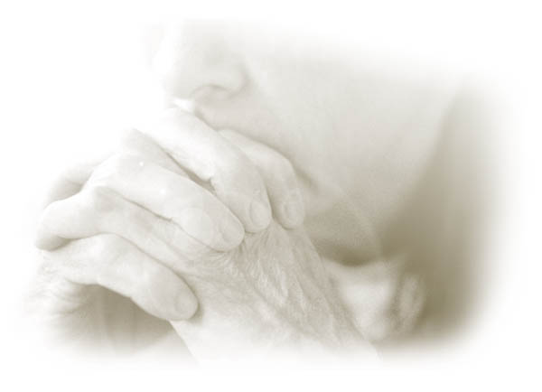
箴言
Dr. Rick Griffith • 博士 • 新加坡神学院 • BibleStudyDownloads.org

Slide 2
关键字
394
343
智慧
箴言

Slide 3
主题
394
智慧的价值和途径
箴言

Slide 4
关键节
394
“你要一心仰赖耶和华，
不可倚靠自己的聪明；
在你一切所行的路上，都要承认他，
他必使你的路径平坦正直。” (箴言 3:5-6).
箴言

Slide 5

箴言 国度命题
343
降服于神的掌权是智慧生活的基础 (1:7)。

Slide 6
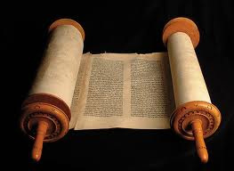
箴言
信息声明
394
346
所罗门和其他智者的箴言被引用，为的是指示少年人智慧更胜愚昧的价值，以致他们能在生活的各个方面敬虔地活在神面前

Slide 7

圣约
347a
就如妓女不视婚姻之约为圣 (2:17), 那藐视智慧的愚人对任何所立的约也是如此。
箴言

Slide 8

救赎
347a
智慧救人脱离邪恶之人 (2:12) 与淫妇 (2:16) — 这智慧建基于对神的敬畏 (1:7)。
箴言

Slide 9
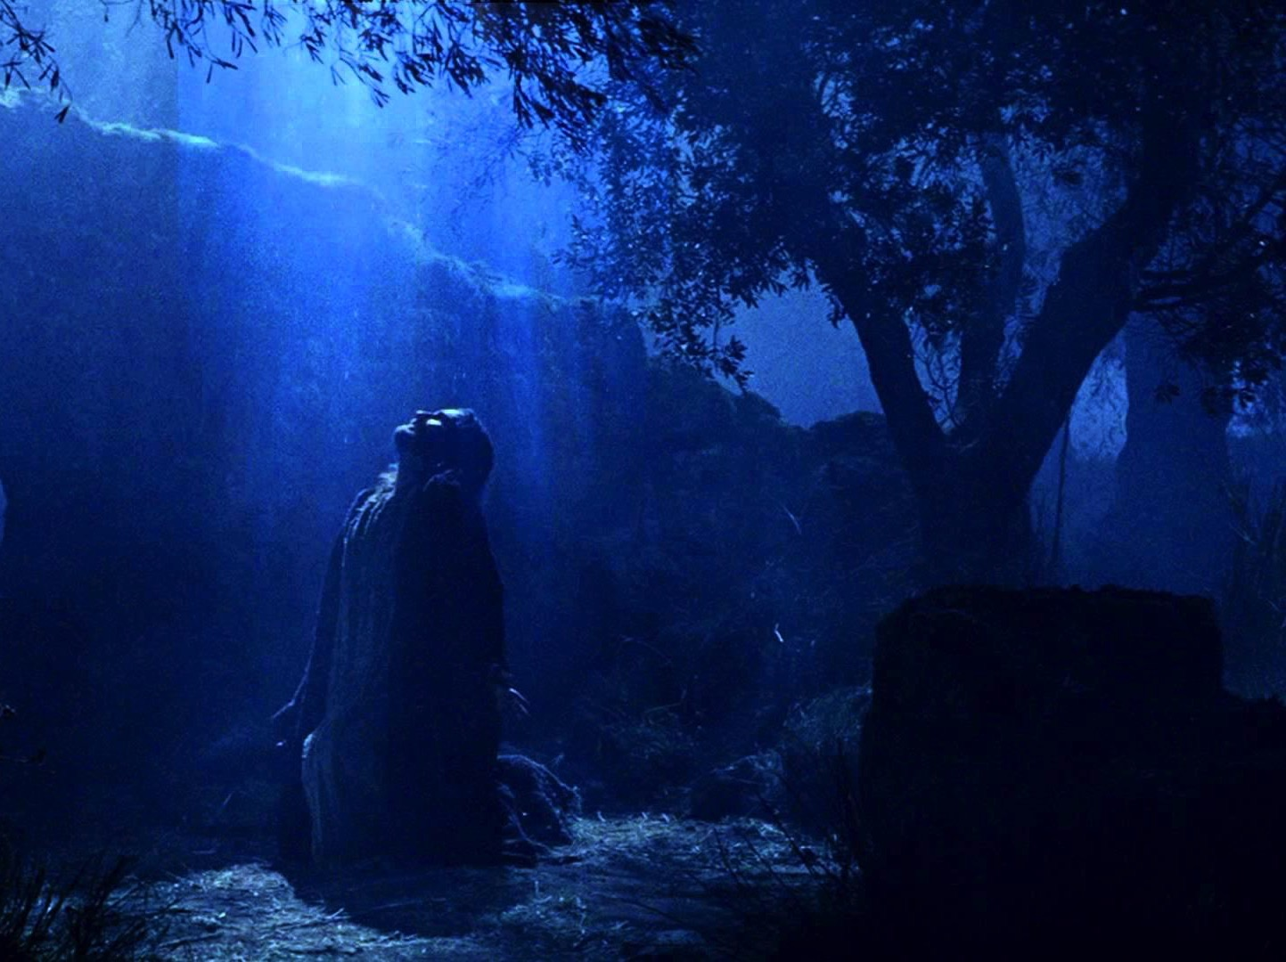
弥赛亚
347a
拟人化的智慧 (8章) 指向作为真智慧的耶稣 (林前1:24, 30; 西2:3).
箴言

Slide 10
书表
箴言 - 智慧的价值和途径
所罗门 |  |  | 智者 (身份不详) | 所罗门 | 智者 (亚古珥，利慕伊勒王， 身份不详)
1:1–22:16 |  |  | 22:17–24:34 | Ch. 25–29 | Ch. 30–31
13 句格言 375 双行 |  |  | 36 句格言 | ±100 双行 | 3 句格言
 |  |  | 社会及其他的课题 | 社会及其他的课题
开场白 | 智慧的原则 |  |  |  | 收场白
约主前950-700 年
394
对比和虔敬
10:1–22:16
执政
31:1-9
目标
1:1-7
社会及自然界 30章
虔敬的妻子 31:10-31
智慧的价值
1:8–9:18

Slide 11
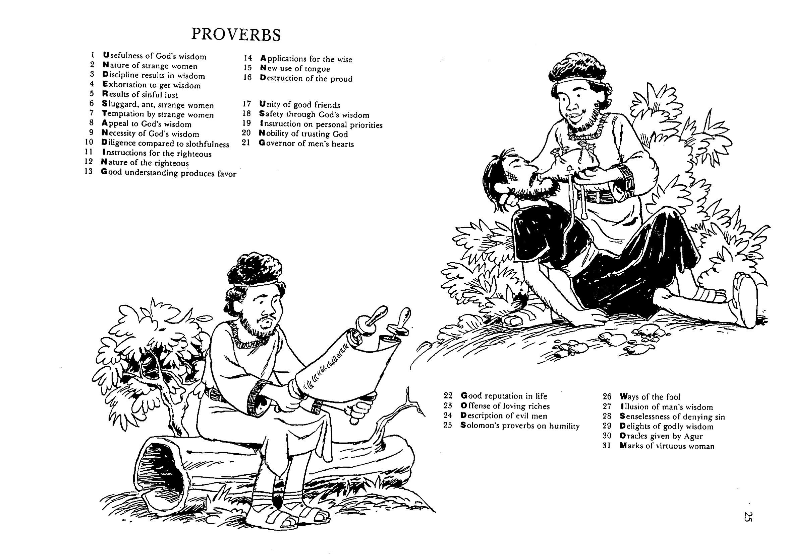
Barry Huddleston, The Acrostic Summarized Bible (Grand Rapids: Baker, 1992)
1 Inception of the world
2 Newlyweds placed in Eden
3 Temptation and man's fall
4 Hatred and first murder
5 Entire genealogy of Adam
6 Lessons on proper priorities
7 Outline for personal relationships
8 Faith of the centurion
箴言
29 Genealogy of Jesus Christ
30 Opposition of King Herod
31 Spirit's descent upon Jesus
32 Power over Satan's temptations
33 Expounding Sermon on Mount
34 Lessons on proper priorities
35 Outline for personal relationships
36 Faith of the centurion
9 Matthew's call from Jesus
10 Apostles sent to preach
11 Testimony about John's message
12 True Messiah called demonic
13 Hidden message of parables
14 Execution of the Baptist
15 智慧 is answering Pharisees
37 Matthew's call from Jesus
38 Apostles sent to preach
39 Testimony about John's message
40 True Messiah called demonic
41 Hidden message of parables
42 Execution of the Baptist
43 智慧 is answering Pharisees
16 Keys of the kingdom
17 Impact of Jesus' transfiguration
18 Need for true forgiveness
19 Grounds for divorce clarified
20 Opportunities in the vineyard
21 Fig tree is cursed
44 Keys of the kingdom
45 Impact of Jesus' transfiguration
46 Need for true forgiveness
47 Grounds for divorce clarified
48 Opportunities in the vineyard
49 Fig tree is cursed
22 Taxes paid to Caesar
23 Hypocrisy denounced by "woes"
24 Events of second coming
25 Judgment of the nations
26 Events on Calvary's eve
27 Way of the cross
28 Savior's resurrection and commission
50 Taxes paid to Caesar
51 Hypocrisy denounced by "woes"
52 Events of second coming
53 Judgment of the nations
54 Events on Calvary's eve
55 Way of the cross
56 Savior's resurrection and commission

Slide 12

作个明智的人
箴言
Dr. Rick Griffith • 博士 • 新加坡神学院 • BibleStudyDownloads.org

Slide 13


关键字
394
知道
智慧
日

Slide 14

如何成为明智的人?
Notes:
Restatement

Slide 15

I. 学习管教与敬畏神 (1:1-7).
如何成为明智的人...
Notes:
Restatement

Slide 16

II. 珍视智慧，它能带来丰盛生命 (1:8–9:18).
如何成为明智的人...
Notes:
Restatement

Slide 17

III. 谨守智慧人关于人生中各样关系的教导
(箴 10–31).
如何成为明智的人...
Notes:
Restatement

Slide 18

箴言 中心思想
通过遵行讲述价值与智慧道路的箴言来敬畏神。
Notes:
Restatement

Slide 19
运用
394
教导儿童箴言
背诵箴言来提倡有智慧的生活，
每天读一篇箴言

Slide 20
Black

Slide 21
箴言

Slide 22
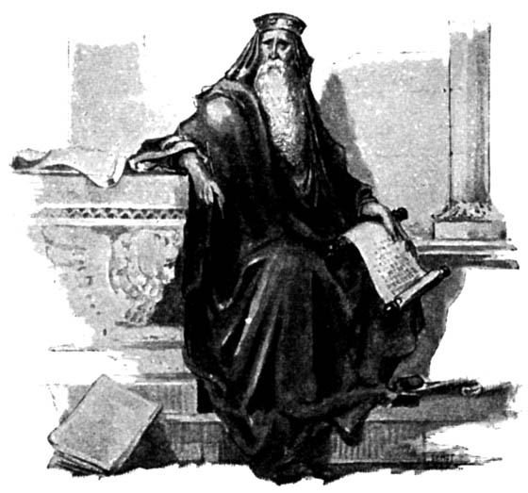
Didactic 智慧 – 箴言
"The plans of the righteous are just,
but the advice of the wicked is deceitful"
(箴言. 12:5)
箴言 guide us in challenges we face:
How to get along with people
How to make the right choices in personal and business affairs
How to win God's favor and avoid disaster
箴言 concern all areas of life no matter how great or small
Michael V. Fox, 箴言 1-9 The Anchor Bible (New York, Doubleday, 2000) 7.
Jeffrey Arthurs, Gordon-Conwell Theological Seminary
(SBC preaching conference, July 2014)

Slide 23
"箴言 are high points of human insight. To use a literary term, a 箴言erb is a moment of epiphany (insight, revelation)."
Leland Ryken, How to Read the Bible as Literature
(Grand Rapids: Zondervan, 1984), 124
Jeffrey Arthurs, Gordon-Conwell Theological Seminary
(SBC preaching conference, July 2014)

Slide 24
箴言 are a universal literary form
Chinese: "Talk does not cook rice."
Sumerian: "A donkey eats its own bedding."
Spanish: "He who knows little soon repeats it."
French: "All are not hunters who blow the horn."
English: "Call a man a thief and he will steal."
Nigerian: "A single partridge flying through the bush leaves no path."
Modern American: "Time is money." "No pain, no gain." "Different strokes for different folks."
Jeffrey Arthurs, Gordon-Conwell Theological Seminary
(SBC preaching conference, July 2014)

Slide 25
"The essence of a 箴言erbial saying is that it is based on observations of how things are in the world. It is a flash of insight into the repeatable situations of life on the world, and its aphoristic form not only represents insight but compels it . . . . Naturally, in the context of firm belief in God, the 箴言erb comes to express insight into the way things are, or should be, in the world ordered by God and a challenge to behavior that God will reward."
Norman Perrin, The New Testament: An Introduction, 296.
Jeffrey Arthurs, Gordon-Conwell Theological Seminary
(SBC preaching conference, July 2014)

Slide 26

Walk Thru the Poetical Books
355
Ecclesiastes……..Vanity
Song…..Love in Marriage
“智慧 can
overcome life’s vanities”
“智慧 can
maintain a godly marriage”
箴言 31:30 “Charm is deceitful and beauty is vain, but a woman who fears the Lord will be praised.”
箴言 5:18 “Let your fountain be blessed, and rejoice in the wife of your youth.”
箴言............智慧
“The Fear of the Lord
is the beginning of 智慧.”
Psalm 111:10 “The fear of the Lord is the beginning of 智慧; A good understanding have all those who do His commandments…”
Psalms..............Worship
“Worship develops the
Fear of the Lord”
Job 42:2 “I know that You can do all things, and that no purpose of yours can be thwarted.”
Source:
Walk Thru the Bible Ministries
Job…...........Sovereignty
“Seeing God’s Sovereignty
causes us to worship”

Slide 27
箴言 versus Ecclesiastes
Contrasts
402b
箴言 | ECCLESIASTES
Challenges of life | Meaning of life
Practical advice | Philosophical musings
How to live for God | Why to live for God
Ideals | Reality
Several authors | One man's testimony
Godly 智慧 only | Godly and worldly 智慧
Positive | Negative
General | Exceptions
Present orientation | Eternal orientation
Black & white orientation | Gray areas
智慧 praised | 智慧 doubted

Slide 28

你的话 1 之 5
你的话是我脚前的灯
又是我路上的光。
你的话是我脚前的灯
又是我路上的光。

Slide 29

你的话 2 之 5
当我心惧怕，
迷失了方向，
你仍在我的身旁。
如今我心坚定，
你同在已显明，
恳求你永远常同在。

Slide 30

你的话 3 之 5
你的话是我脚前的灯
又是我路上的光。
你的话是我脚前的灯
又是我路上的光。

Slide 31

你的话 4 之 5
我永不忘记，
在黑暗中徘徊，
主，你大爱来寻找我。
耶稣引领我，
跟随你的脚踪，
主，我要爱你到永远。

Slide 32

你的话 5 之 5
你的话是我脚前的灯
又是我路上的光。
你的话是我脚前的灯
又是我路上的光。

Slide 33

关键节
394
你要专心仰赖耶和华…
箴 3:5,6

Slide 34
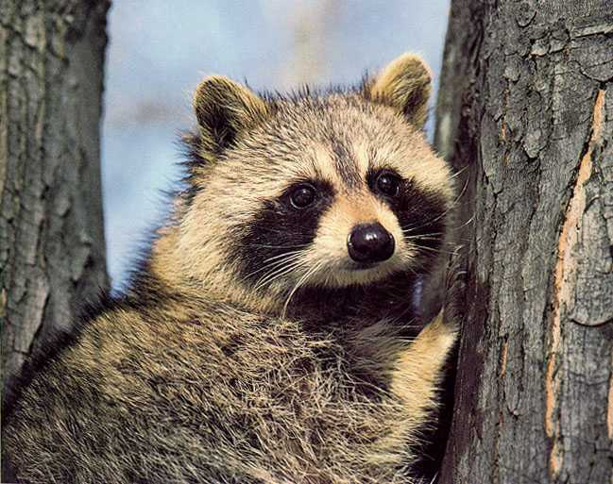
关键节
394
不可依靠自己的聪明;
箴 3:5,6

Slide 35

关键节
在你一切所行的事上都要认定他…
394
箴 3:5,6

Slide 36

关键节
他必指引你的路。
394
箴 3:5,6

Slide 37
著述
395
外在的证据
  列上 4:32
内在的证据
  1:1; 10:1; 25:1
  22:17-24:34
  30章
  31章
所罗门
所罗门
智者
亚古珥
利慕伊勒王, 不详

Slide 38
著述
396
多重著述
(其他：诗篇，撒母耳记上，申命记的某些部分，约书亚等)

Slide 39
对象
395
“我儿” 及 “众子”
  环境是家或是一间学府；
  学府里老师称学生为“众子”
但是…
“我儿，要听你父亲的教诲，不可离弃你母亲的法则。” (1:8)
这显示家庭还是主要的环境

Slide 40
时候
395
很肯能是由希西家王授权把所罗门的箴言编入当时已存有的箴言书里。

Slide 41
Book Chart
箴言 - 智慧的价值和途径
所罗门 |  |  | 智者 (身份不详) | 所罗门 | 智者 (亚古珥，利慕伊勒王， 身份不详)
1:1-22:16 |  |  | 22:17-24:34 | 25-29章 | 30-31章
13句格言 375 双行 |  |  | 36句格言 | ±100双行 | 3句格言
 |  |  | 社会及其他的课题 | 社会及其他的课题
开场白 | 智慧的原则 |  |  |  | 收场白
约主前950-700年
394
对比和虔敬
10:1-22:16
执政 31:1-9
目标
1:1-7
社会及自然界 30章
虔敬的妻子 31:10-31
智慧的价值
1:8-9:18

Slide 42

箴言的种类
396
形容性的
- 世事如何

Slide 43

形容性的…
“空夸赠送礼物的，好像无雨的风云。”
箴 25:14

Slide 44

箴言的种类
396
形容性的
规定性的
- 世事如何
如何活

Slide 45
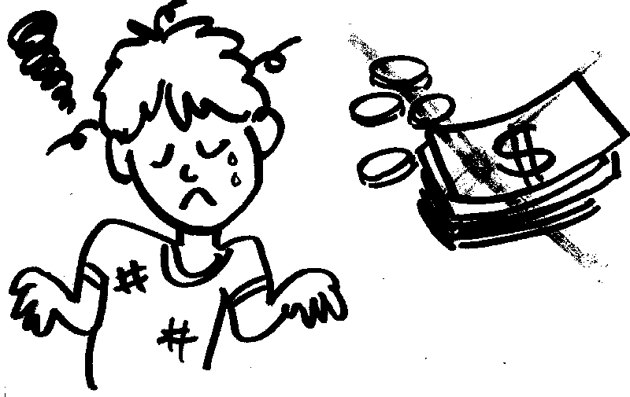
规定性的或是形容性的？
“不要忙碌求富，休仗自己的聪明” (箴 23:4)

Slide 46
箴言的种类
396
形容性的
规定性的
- 世事如何
如何活
结合的

Slide 47
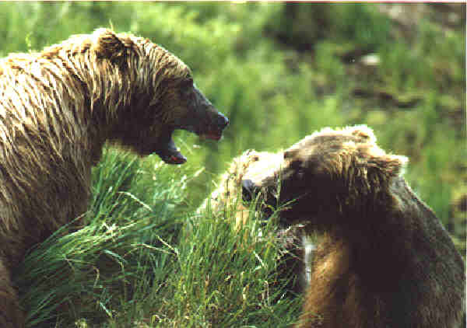

规定性的或是形容性的？
“朋友加的伤痕出于忠诚；仇敌连连亲嘴却是多余。”
箴 27:6

Slide 48
特性
396
着重点：现今的生活
  极少提及来世
幽默

Slide 49

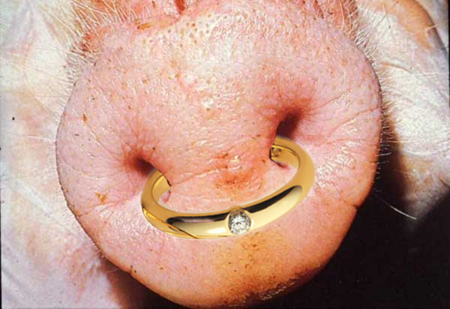
非常俱形容性！
“妇女美貌而无见识，如同金环戴在猪鼻上。” (箴 11:22)

Slide 50
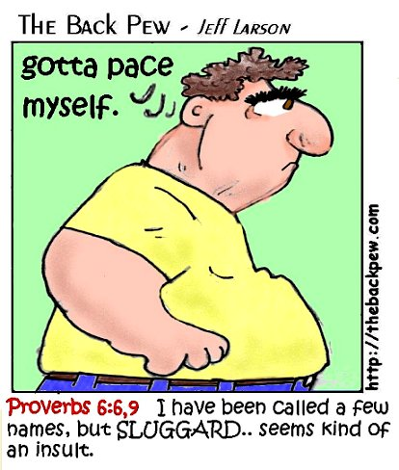
懒惰人
“懒惰人放手在盘子里，就是向口撤回，他也不肯。”
- 箴 19:24
译：我得留意我的步伐
译：我曾被别人取了不少的代号，但“懒惰人”…似乎是种侮辱。

Slide 51
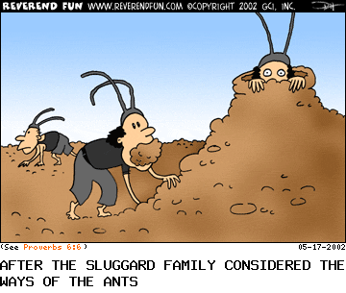
懒惰人哪！你去看看蚂蚁，
察看牠们所行的，就可得着智慧。
蚂蚁(6:6)
译：懒惰的家庭在查看蚂蚁之后。

Slide 52
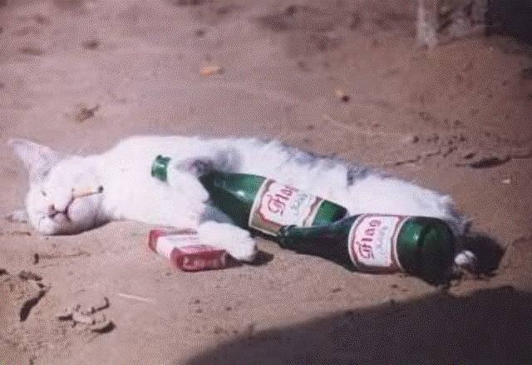
醉酒汉
“人打我，我却未受伤；人鞭打我，我竟不觉得。我几时清醒，我仍去寻酒。”
(箴 23:35)

Slide 53

懒惰人
“‘再睡片时，打盹片时，握着手躺卧片时，’
你的贫穷就如强盗速来…” 箴 24:33, 34a

Slide 54
箴言的独特性
396
迎合了人要规律的强烈欲望
既显著又难忘
Wilhoit & Ryken, Effective Bible Teaching 【有效的圣经教导】, 237-39

Slide 55
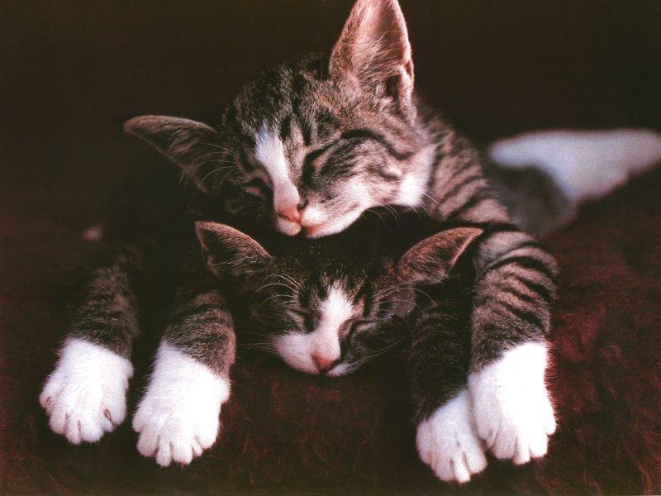
哭泣的 “狼”
    懒惰人说：道上有猛狮，街上有壮狮。
    箴 26:13

Slide 56
箴言的独特性
396
迎合了人要规律的强烈欲望
既显著又难忘
既简单又深入；沉思的
Wilhoit & Ryken, Effective Bible Teaching 【有效的圣经教导】, 237-39

Slide 57

留心你的欲望！
“你要保守你的心，胜过保守一切，因一生的果效是由心发出。”
(箴 4:23)

Slide 58
箴言的独特性
396
迎合了人要规律的强烈欲望
既显著又难忘
既简单又深入；沉思的
诗般的形态
Wilhoit & Ryken, Effective Bible Teaching 【有效的圣经教导】, 237-39

Slide 59

诗般的形态
“因人懒惰，房顶塌下”
(传 10:18)

Slide 60
箴言的独特性
396
迎合了人要规律的强烈欲望
既显著又难忘
既简单又深入；沉思的
诗般的形态
既具体又普及
Wilhoit & Ryken, Effective Bible Teaching 【有效的圣经教导】, 237-39

Slide 61
既具体又普及
“因人懒惰，房顶塌下”
(Eccles. 10:18)

Slide 62
解释
397
这类型的箴言体裁在解说上需要更多的洞察力。
箴言是绝对化，无条件的应许吗？换句话说。他们是毫无例外的原则吗？

Slide 63
释经准则
397
不要把箴言视为从上帝而来的应许，反倒要视他们为普及化的观察及原则。这些观察及原则往往是有效的，但不都有。
  例· 箴 22:6, “教养孩童，使他走当行的道，就是到老他也不偏离。”

Slide 64

"教养孩童走他当行的路，
就是到老，他也不会偏离。“
(箴言 22:6 CNV)
Jeffrey Arthurs, Gordon-Conwell Theological Seminary
(SBC preaching conference, July 2014)

Slide 65
释经准则
397
旧约的教导一定要以直接给予教会（使徒行传和书信）的启示来实施。
  重申的陈述
    “不可作假见证陷害人” (出 20:16)
    “所以你们要弃绝谎言” (弗 4:25)

Slide 66
释经准则
397
旧约的教导一定要以直接给予教会（使徒行传和书信）的启示来实施。
  重申的陈述
  引用的陈述
    箴 25:21, “如果你的仇敌饿了，就给他饭吃” 再出现于罗马书 12:20

Slide 67
释经准则
397
旧约的教导一定要以直接给予教会（使徒行传和书信）的启示来实施。
  重申的陈述
  引用的陈述
  平行的陈述
    箴 6:24 和帖前 4:3

Slide 68
释经准则
397
旧约的教导一定要以直接给予教会（使徒行传和书信）的启示来实施。
  重申的陈述
  引用的陈述
  平行的陈述
  若不是a至c, 箴言不应当成诫命，而是原则。

Slide 69
Literary/rhetorical Characteristics:
Short.
  This aids memory!
Indicative mood.
  This disarms us more than imperatives.
Poetry
  This encourages us to use poetic devices.
Jeffrey Arthurs, Gordon-Conwell Theological Seminary
(SBC preaching conference, July 2014)

Slide 70
Poetic Devices
Repetition
Alliteration
Assonance
Simile
Metaphor
Rhyme
Compare and contrast
Duane Garret, The New American Commentary: 箴言, Ecclesiastes & Song of Songs (Nashville, Broadman Press, 1993) 38.
Jeffrey Arthurs, Gordon-Conwell Theological Seminary
(SBC preaching conference, July 2014)

Slide 71
Literary/rhetorical Characteristics:
Short.
  This aids memory!
Indicative mood.
  This disarms us more than imperatives.
Poetry
  This encourages us to use poetic devices.
"Case studies"
  This encourages us to tell stories.
Jeffrey Arthurs, Gordon-Conwell Theological Seminary
(SBC preaching conference, July 2014)

Slide 72

箴言内的主题

Slide 73
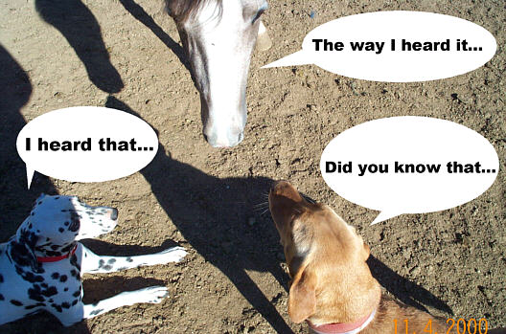
言语
401
译：我所听到的是…
“往来传舌的，漏秘事；
心中诚实的，遮隐事情。”
(箴 11:13)

Slide 74
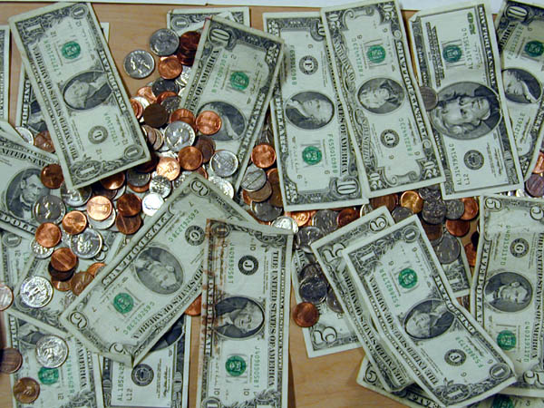
钱财

Slide 75
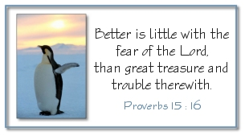
虔敬过于金子
少有财宝，敬畏耶和华，强如多有财宝，烦乱不安。
箴 15:16

Slide 76


真正的成功
译：实用风水 - 成功的方程式
译：就做吧！成功系列之为成功做安排
成功
在神的眼里？

Slide 77
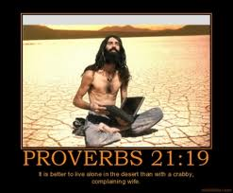
箴言 21:19
"宁可住在野地，也不跟吵闹易怒的妇人同住。"

Slide 78
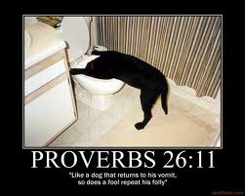
箴言 26:11
"愚昧人一再重复他的愚妄，正像狗转过来，吃自己所吐的。"

Slide 79

成功的方法
义 (10:7; 12:3)
恨恶虚假的 (13:5)
将所有的工作交托于神 (16:3)
克制用词 (17:27,28)
喜爱智慧 (19:8)
谦卑及对主的敬畏 (22:4)

Slide 80
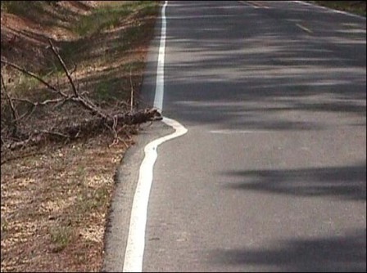
殷勤
与
懒惰
“懒惰人羡慕，却无所得；殷勤人必得丰裕。”
(箴 13:4)

Slide 81
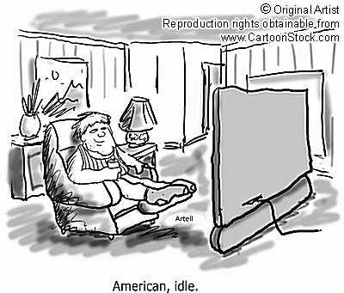
American, idle
译：美国，懈怠。（idle 与idol同音；有嘲讽懈怠为美国偶像之意）

Slide 82
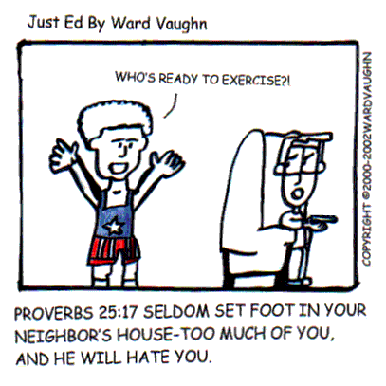
关系
译：谁以准备好要去运动？！
箴 25: 17“你的脚要少进邻舍的家，恐怕他厌烦你，恨恶你。”

Slide 83
内容
箴言 - 智慧的价值和途径
所罗门 |  |  | 智者 (身份不详) | 所罗门 | 智者 (亚古珥，利慕伊勒王， 身份不详)
1:1-22:16 |  |  | 22:17-24:34 | 25-29章 | 30-31章
13句格言 375 双行 |  |  | 36句格言 | ±100双行 | 3句格言
 |  |  | 社会及其他的课题 | 社会及其他的课题
开场白 | 智慧的原则 |  |  |  | 收场白
约主前950-700年
394
对比和虔敬
10:1-22:16
执政 31:1-9
目标
1:1-7
社会及自然界 30章
虔敬的妻子 31:10-31
智慧的价值
1:8-9:18

Slide 84
如何成为明智的人?
Notes:
Restatement

Slide 85
I. 学习管教与敬畏神 (1:1-7).
如何成为明智的人...
Notes:
Restatement

Slide 86
II. 珍视智慧，它能带来丰盛生命 (1:8–9:18).
如何成为明智的人...
Notes:
Restatement

Slide 87
智慧
gives honor to keep youth from the shame of foolishness (1:8-9).
Notes:
Text

Slide 88
智慧
preserves youth from disaster (1:10-33).
Notes:
Text

Slide 89
智慧
helps maintain moral behavior (箴言 2).
Notes:
Text

Slide 90
智慧
helps us relate
with God and man (箴言 3).
Notes:
Text

Slide 91
智慧
箴言ides a gracious life (4:1-9).
Notes:
Text

Slide 92
智慧
preserves youth from trouble (4:10-19).
Notes:
Text

Slide 93
智慧
produces healthy young people (4:20-27).
Notes:
Text

Slide 94
智慧
helps avoid sexual sin (箴言 5).
Notes:
Text

Slide 95
智慧
preserves from poverty (6:1-11).
Notes:
Text

Slide 96
智慧
preserves from dissension (6:12-19).
Notes:
Text

Slide 97
智慧
preserves youth from sexual immorality
(6:20–7:27).
Notes:
Text

Slide 98
智慧
has valuable virtues, rewards and was used in creation (箴言 8).
Notes:
Text

Slide 99
智慧
is valuable compared to the claims of foolishness (箴言 9).
Notes:
Text

Slide 100
III. 谨守智慧人关于人生中各样关系的教导
(箴 10–31).
如何成为明智的人...
Notes:
Restatement

Slide 101

About 375 two-line 箴言 of Solomon teach the practical benefits of 智慧 over wickedness in everyday life (10:1–22:16).
Notes:
Text

Slide 102

智慧
Longer sayings of wise men admonish practical 智慧 in many areas
(22:17–24:34).
Notes:
Text

Slide 103

智慧
The final collection of Solomon's 箴言 by Hezekiah's scribes 250 years later guide social relationships and various activities (箴言 25–29).
Notes:
Text

Slide 104

智慧
Sayings of Agur to Ithiel and Ucal show insights from nature and social relationships (箴言 30).
Notes:
Text

Slide 105

智慧
The unknown Lemuel’s mother prepares him for kingship by advising him to avoid the excesses of women and wine, and to protect the rights of the underprivileged (31:1-9).
Notes:
Text

Slide 106
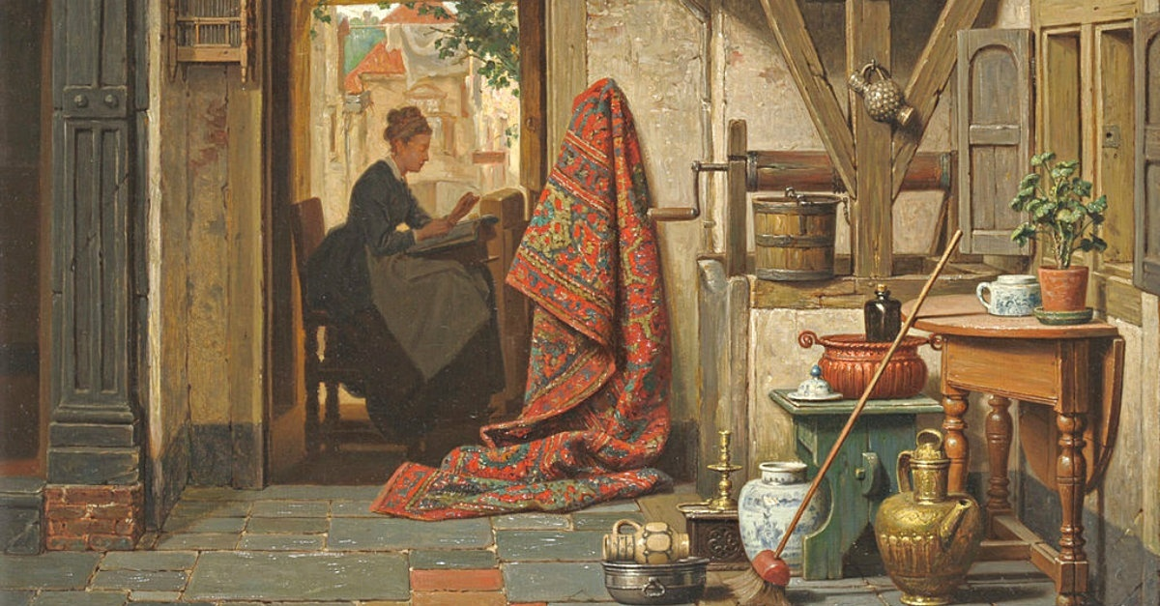
智慧
An acrostic and anonymous poem of a noble wife exhorts young women to be godly and diligent and exhorts young husbands to praise these qualities in their wives (31:10-31).
Notes:
Text

Slide 107
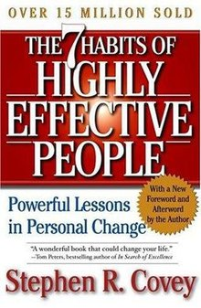

THE 10 HABITS OF HIGHLY WISE PEOPLE
OVER 5000 MILLION SOLD
10
THE HABITS OF
HIGHLY
WISE
PEOPLE
箴言erb Lessons
in Personal Change
The Bible Needs No Foreword and Afterward by the Author
_____________________________________________
“The fear of the LORD is the beginning of wisdom.”
—King Solomon, bestselling author of The 箴言 of Solomon
Sages R. Wise
Notes:
29 Good Bible Sales Statistics
May 23, 2017 by Brandon Gaille
https://brandongaille.com/27-good-bible-sales-statistics/
Accessed 21 Feb 2020
Christians take their Bibles everywhere with them… but sometimes they don’t. Sometimes the one book collecting dust on the bookshelf is the Bible. Yet this need to own at least one copy of the inspired word of God drives the Bible to being a top selling book every year whether it is opened or not.
More than 2,100 languages have at least one book of the Bible in that language.
Bible Sales Statistics
Between 1815 and 1975, it was estimated that there could have been 5 billion Bibles printed. In 1995, one version of the bible, the Good News version that is copyrighted by the Bible Societies, had sold nearly 18 million copies. There’s no doubt about it – the Bible is one of the world’s best-selling books. It also 箴言es that God’s Word is a moneymaker for today’s Christian publishers.
The best selling and fastest growing version of the Bible in the United States is the NIV.
82%. That’s the percentage of people who regularly read the Bible who will reach for a King James Version before any other.
There are more than 168,000 Bibles that are sold or given to others in the United States every day.
20 million. That’s the number of Bibles that are sold each year in the United States. That’s more than double the amount that was sold annually in the 1950s.
The Gideon’s International distributed 59,460,000 Bibles worldwide last year. That’s more than 100 Bibles per minute.
Zondervan, a leading Bible publisher, has more than 350 different versions of the Bible that are in print right now.
The percentage of Americans who own at least 1 Bible, whether it was given to them or purchased: 92%. Two-thirds of owners, regardless of religious affiliation, say that the Bible holds the meaning of life.
The average American Christian owns 9 Bibles and wants to purchase more. For this reason, the Bible is actually excluded from book bestsellers lists because it would always be on top.
1,300 translations of the Bible are in new languages.
There are 40 authors in the Bible.
Selling Bibles is big business for Christian publishers. There’s no denying it. Why else would a book that is considered to be “inerrant” have more than 350 versions by just one publisher? The fact that it sells so well is encouraging because there are incredible messages of love, forgiveness, and understanding that are contained within its 66 total books [or more depending on the version that is purchased]. It also means that some of the hype about persecution that is promoted in major Christian media could very well be a way to market this book to Christians who already have more Bibles than they can carry to buy more so they can “arm” themselves against coming attacks.
How Much Money Does The Bible Bring In Every Year?
The annual sales of all versions of the Bible routinely tops $425 million.
Over 100 million Bibles are printed every year. Consumers in the United States will purchase 25% of those newly printed Bibles every year.
In the world today, there are more than 80,000 different versions of the Bible that generate at least 1 sale annually.
A Bible also owns the record for least amount of sales per year – a translation of the New Testament into Coptic has never sold more than 2 copies in any year since 1791.
YouVersion, a top downloaded Bible app for mobile devices, has over 100 million total downloads and counting. It was one of the first 200 apps that were available on iTunes. It’s also been a top 100 free app for 3 consecutive years.
More than 66,000 people are using a Bible app at any given second. 3 people share a Bible verse on their social network every second as well.
Isaiah 53:5 is the most shared Bible verse on the internet today.
77% of people say that they read the Bible more frequently because they have it available on a mobile device.
60% of people use a digital Bible at church instead of hauling their own printed Bible.
Two-thirds of people prefer Bible apps because it gives them access to multiple versions of the Bible without the added cost.
In 2005, Thomas Nelson, a leading Bible publisher, was sold for $473 million. They publish 60 different editions of the Bible.
Bible apps are going to eventually change the way people purchase Bibles. Although sales are still up, there’s been a change in the consumer profile. Instead of American families purchasing Bibles on a regular basis, it is groups, churches, and summer camps that are purchasing them in bulk. With that observation noted, it only takes one traumatic event to encourage Bible sales to increase. In the week after the September 11, 2001 attacks in the US, some retailers saw 40% increases in Bible sales. When people need comfort, they go to the Bible if they’re Americans, regardless of religion. With apps available, multiple versions of comfort can be readily accessed.
Report this ad
How Is The Scope Of Bible Sales Changing?
60% of today’s Christians live in the developing world. In 1900, 80% of the world’s Christians lived in Europe or the United States.
More Presbyterians go to church in Ghana on a regular basis than they do in Scotland.
There are as many practicing Anglicans in England as there are practicing Muslims.
A Gallup survey found that less than 50% of Americans can name the first book of the Bible.
Only 1 in 3 Bible owners know that Jesus delivered the Sermon on the Mount. Billy Graham is a more popular answer than the correct answer.
12%. That’s the percentage of Christians who believed that Noah was married to Joan of Arc.
There are 900 different versions of the Bible just in English. There is even one Bible that has been translated into the fictional language of Klingon.
Bibles are always going to sell well. There’s no denying this fact whatsoever. What is unique about Bible sales, however, is that the people who have the most opportunity to purchase this holy book are also the most illiterate about it. That may ultimately be why this book continues to be a bestseller. It is being used as a sort of balm to increase personal spirituality through money. The only problem is that the Bible itself says that one cannot serve God and serve money at the same time. With over 80k different versions of the Bible, it is fair to ask who the real master in the Bible publishing world really happens to be.
Report this ad
Related Posts:
39 Terrific Bible Study Blog Names
101 Cool Christian Slogans and Taglines
27 Odd Jehovah Witness Statistics
31 Creative Religious Blog Names
Share
Pin
Tweet
About The Author
Although millions of people visit Brandon's blog each month, his path to success was not easy. Go here to read his incredible story, "From Disabled and $500k in Debt to a Pro Blogger with 5 Million Monthly Visitors." If you want to send Brandon a quick message, then visit his contact page here.
Categories Statistics Post navigation29 Social Networking Addiction Statistics
21 Unbelievable Workplace Romance Statistics
Brandon’s Incredible Story
From Disabled and $500k in Debt to a Pro Blogger with 5 Million Monthly Visitors
Recent Posts
43 Paper Industry Statistics, Trends & Analysis
Rich Dad Poor Dad Speed Summary (3 Minutes) w/ PDF Download
Outliers Quick Summary: 15 Takeaways from Malcolm Gladwell’s Book
46 Shipping Industry Statistics and Trends
The Tipping Point Speed Summary (3 Minutes) w/ PDF
Featured
Pros and Cons
Statistics
Blog Names
Slogans
Success is a Choice
43 Paper Industry Statistics, Trends & Analysis
Rich Dad Poor Dad Speed Summary (3 Minutes) w/ PDF Download
Outliers Quick Summary: 15 Takeaways from Malcolm Gladwell’s Book
46 Shipping Industry Statistics and Trends
The Tipping Point Speed Summary (3 Minutes) w/ PDF
Think and Grow Rich Quick Summary w/ Free PDF Download
41 Fishing Industry Statistics and Trends
The Art of War Speed Summary (3 Minutes): 15 Quick Takeaways
Thinking Fast and Slow Summary w/ Free PDF Download
21 Pro Tips for Starting & Running a Credit Repair Business
Believe in Yourself
Accounting
Blog Names
Blogging Tips
Business
Communication
Employees and HR
Entrepreneur
Featured
Finance
General
Logos
Mobile
People
Pros and Cons
Psychology
Never Give Up
Quotes
SEO
Slogans
Social Media
Statistics
Style
Videos
Web Design
—
Follow Brandon
Pinterest
—
Archives
Archives
Privacy and Disclosure Policies
Contact Me
2020 © BrandonGaille.com
Exclusive Member of Mediavine Home

Slide 108
作个明智的人
箴言
Dr. Rick Griffith • 博士 • 新加坡神学院 • BibleStudyDownloads.org

Slide 109

What are people passionate about?
Notes:
Money—so Singapore has the highest percentage of millionaires worldwide (16.5%)
Education—few feel you could be overeducated
Power—many are not happy with their job
Sex—few people remain with one person for life
Fun—the last experience didn’t satisfy, so try another
Travel—never before have so many traveled
Food—some travel across the country for a certain stall
Sports—depression if their team loses, elation if it wins

Slide 110

你想拥有智慧吗?
Notes:
Text

Slide 111
如何成为明智的人?
Notes:
Restatement

Slide 112

让我们一起考察经文
圣经：
每一卷书
创世记
Notes:
让我们一起考察经文
圣经：每一卷书

Slide 113

现代的箴言
"A bird in the hand is worth two in the bush!"

Slide 114
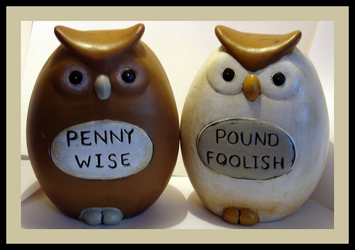
现代的箴言
“贪小失大!"

Slide 115

现代的箴言
"Waste not, want not!"

Slide 116

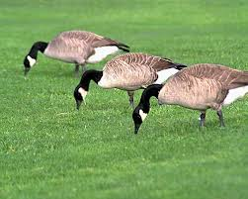
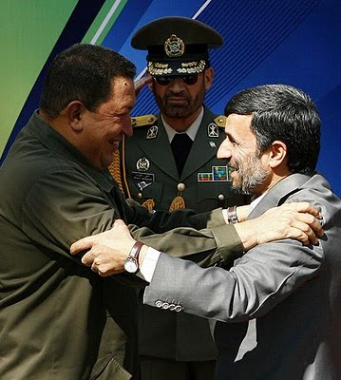
现代的箴言
“物以类聚，人以群分 "
Chavez &
Ahmadinejad

Slide 117

JUST DO IT.

Slide 118

“时间就是金钱"

Slide 119
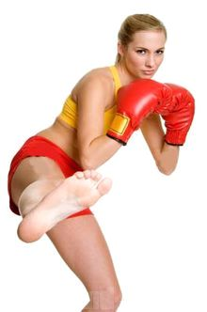

"Different strokes for different folks"
Notes:
http://www.wordwizard.com/phpbb3/viewtopic.php?f=7&t=20582
"The earliest use of DIFFERENT STROKES FOR DIFFERENT FOLKS that I could find was from 1966 (see quote below) by boxer and world heavyweight champion Muhammad Ali (Cassius Marcellus Clay, Jr.). Rhythm and soul singer Syl Johnson (father of Syleena) released the single titled 'DIFFERENT STROKES' in 1967 with the line also appearing in the song. But its appearance in Sly and the Family Stone's 1968 big hit single Everyday People is probably what put the phrase on the map. Additional exposure of the expression was burned into our collective psyches with the television comedy Diff'rent Strokes [1978-86] (an often used abbreviated form of the expression, but without the apostrophe) about a millionaire white widower who adopts two Black boys (one of which was that cute little guy Gary Coleman), and which was subsequently shown in the U.K where, so I've read, when the expression is used, the word folks may sometimes be replaced by blokes.
<1966 [quoting boxer Cassius Clay]" I got DIFFERENT STROKES FOR DIFFERENT FOLKS."—Great Bend Daily Tribune (Kansas), 11 November, page 6>
<1969 "The Adult has something to work on: what must I do to gain their STROKES, or their ap箴言al?"—I'm OK, You're OK by T. A. Harris, iii. page 45>
<1973 "The popular saying around the P[almer]D[rug]A[buse]P[rogram] is 'DIFFERENT STROKES FOR DIFFERENT FOLKS,' and that's the basis of the program."—Houston Chronicle Magazine, 14 October, page 4/1>
<1978 "He started off dishing out some nice STROKES. With an admiring smile he told me how smart I was, how honest, so absolutely reliable."—Fools Die by Mario Puzzo, xi. page 122>
<1981 "Let's face it, everybody needs their STROKES and that would be very ego-satisfying."—TV Picture Life, March, page 12/3>
<1986 "The whole point, says John Poindexter, [[President]] Reagan's national security adviser, is DIFFERENT STROKES FOR DIFFERENT FOLKS. 'We need different policies toward Communist dictatorships . . . , . . . for non-democratic regimes that are slowly evolving toward democracy, and different policies for non-democratic regimes in which there is no viable democratic center . . .'"—in New York (magazine), "How Reagan Does It" by Michael Kramer>
<1999 "There are a hundred times as many people addicted to alcohol, antidepressants and nicotine as there are to heroin or Charlie [cocaine]. DIFFERENT STROKES FOR DIFFERENT FOLKS, right?"—Spanish Highs by Wayne Anthony, page 65>
<2003 "If one motto sums up the [[weight loss]] industry, it could be 'DIFFERENT STROKES FOR DIFFERENT FOLKS.' At No. 1, with revenues this year expected to reach $1 billion, is 40-year-old Weight Watchers, with its program of weekly meetings and group support. Next comes Slim-Fast, the maker of bar and shake replacement meals. . . ."— U.S. News & World Report, 16 July>
<2008 "Suddenly [[Professor Wolfgang]] Mieder [[renowned expert on 箴言 at the University of Vermont]] reminds me that he hasn't yet told me his favorite 箴言erb. Can he really have a favorite? . . . But Mieder is a decisive man. 'DIFFERENT STROKES FOR DIFFERENT FOLKS is my favorite 箴言erb,' he says. . . . 'I would argue it had to grow on American ground, because it doesn't tell you what to do. It says, "Accept the differences in people." . . . 'I think it's a truly liberating 箴言erb.'"—Christian Science Monitor, 6 March>" (accessed 20 Aug 2014)

Slide 120
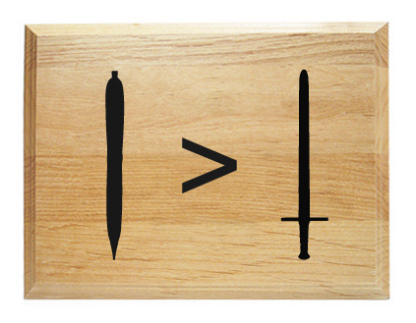
“笔胜于刀文比武强"

Slide 121
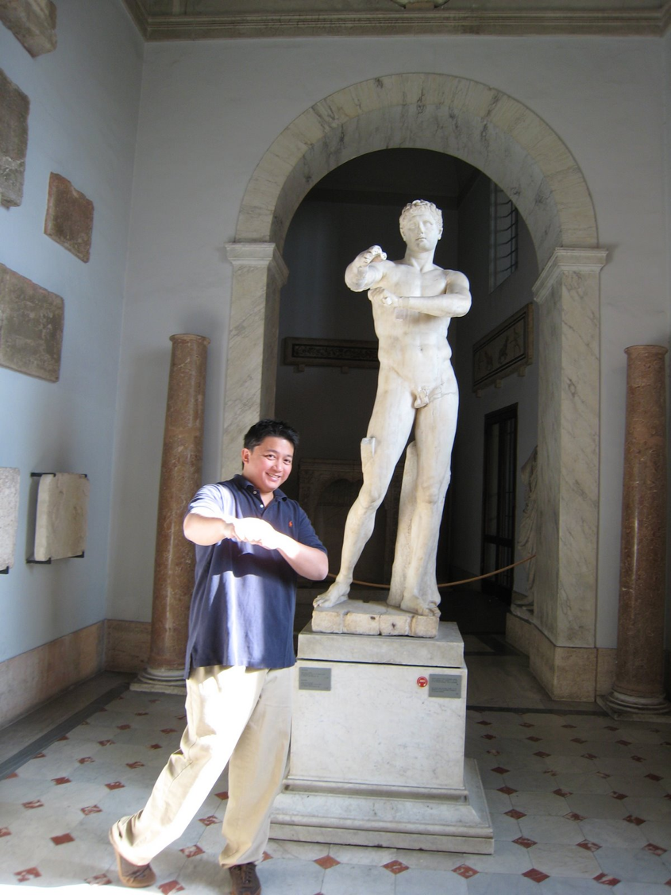
罗马
“随乡
入乡"

Slide 122
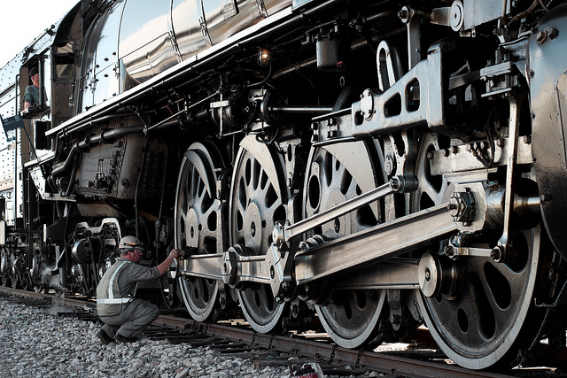
"The squeaky wheel gets the grease."
grease

Slide 123

"No man is an island."

Slide 124
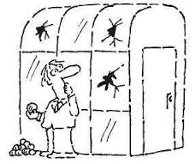
"People who live in glass houses shouldn't throw stones."

Slide 125
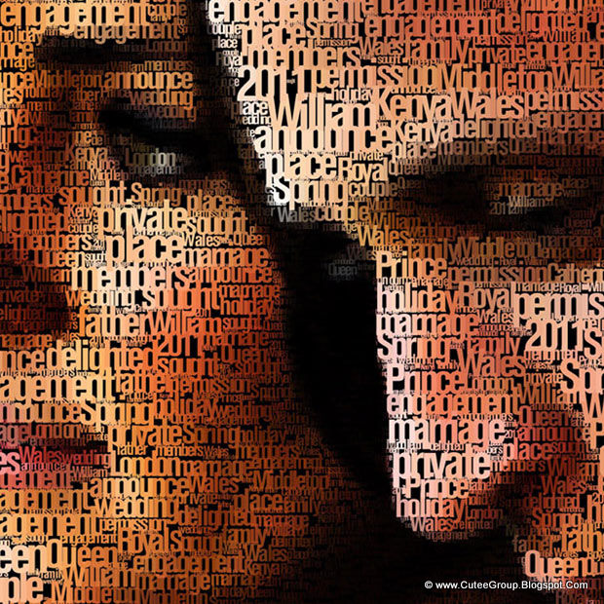
"A picture is worth a thousand words."

Slide 126

“有所得必有所失"

Slide 127
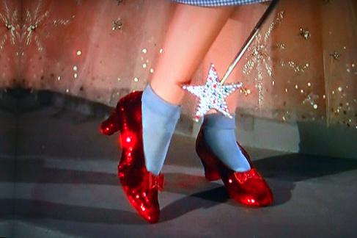
“金窝银窝不如自己的狗窝"

Slide 128
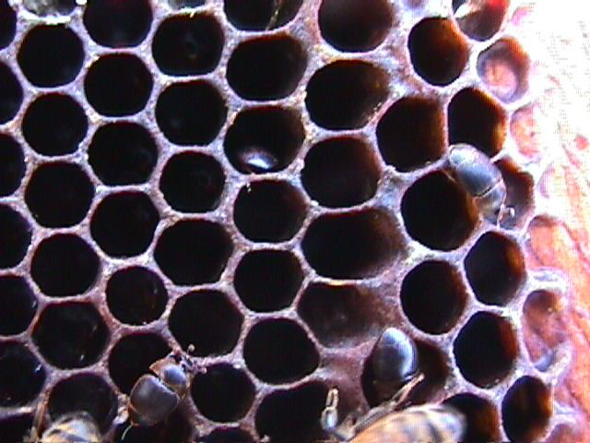
智慧对你有益
“我儿，你要吃蜜，因为
是好的；吃蜂房下滴的蜜便觉甘甜。你心得了智慧，
也必觉得如此。”
~ 箴 24:13,14a

Slide 129
关键字
394
知道
智慧
日

Slide 130
书名及时期
箴言 - 智慧的价值和途径
所罗门 |  |  | 智者 (身份不详) | 所罗门 | 智者 (亚古珥，利慕伊勒王， 身份不详)
1:1-22:16 |  |  | 22:17-24:34 | 25-29章 | 30-31章
13句格言 375 双行 |  |  | 36句格言 | ±100双行 | 3句格言
 |  |  | 社会及其他的课题 | 社会及其他的课题
开场白 | 智慧的原则 |  |  |  | 收场白
约主前950-700年
394
对比和虔敬
10:1-22:16
执政 31:1-9
目标
1:1-7
社会及自然界 30章
虔敬的妻子 31:10-31
智慧的价值
1:8-9:18

Slide 131
书名
395
“箴言” – “如同” 或
“相比较”
箴言是一句对照或形容日常经历的陈述。
拉丁文标题：箴言是一个代表许多字的字。也就是说，许多的字浓缩为一句短语。

Slide 132
箴言内的主题

Slide 133
言语
401
译：我所听到的是…
“往来传舌的，漏秘事；
心中诚实的，遮隐事情。”
(箴 11:13)

Slide 134
钱财

Slide 135
虔敬过于金子
少有财宝，敬畏耶和华，强如多有财宝，烦乱不安。
箴 15:16

Slide 136
真正的成功
译：实用风水 - 成功的方程式
译：就做吧！成功系列之为成功做安排
成功
在神的眼里？

Slide 137
箴言 21:19
"宁可住在野地，也不跟吵闹易怒的妇人同住。"

Slide 138
箴言 26:11
"愚昧人一再重复他的愚妄，正像狗转过来，吃自己所吐的。"

Slide 139
殷勤
与
懒惰
“懒惰人羡慕，却无所得；殷勤人必得丰裕。”
(箴 13:4)

Slide 140
American, idle
译：美国，懈怠。（idle 与idol同音；有嘲讽懈怠为美国偶像之意）

Slide 141
关系
译：谁以准备好要去运动？！
箴 25: 17“你的脚要少进邻舍的家，恐怕他厌烦你，恨恶你。”

Slide 142
如何成为明智的人?
Notes:
Restatement

Slide 143
Slides on
箴言 1

Slide 144
I. 学习管教与敬畏神 (1:1-7).
如何成为明智的人...
Notes:
Restatement

Slide 145

How to Be a Wise Guy
An Introduction
to 箴言
Dr. Rick Griffith • Crossroads International Church Singapore
CICFamily.com • BibleStudyDownloads.org

Slide 146
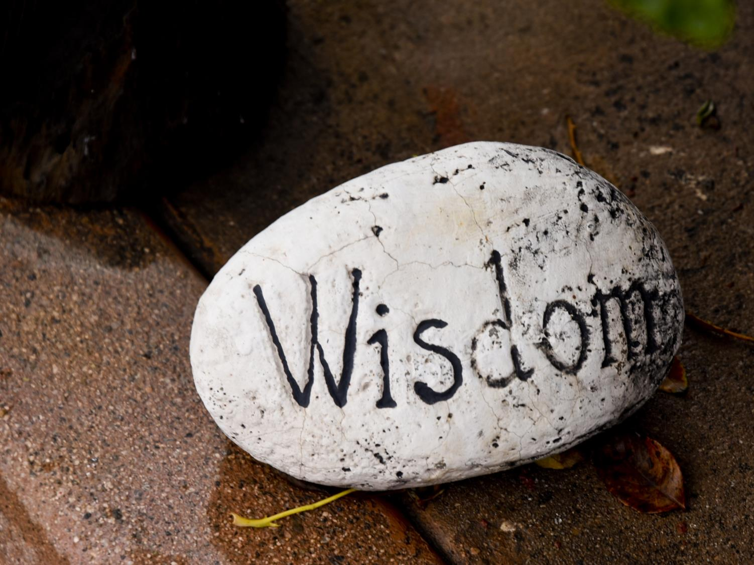
Pursue…
Notes:
Few of us really ever seek wisdom.
We want to be rich.
We want to be popular.
We want to be smart.
We want to be happy.
We want to be sexy.
We want to be respected.

Slide 147
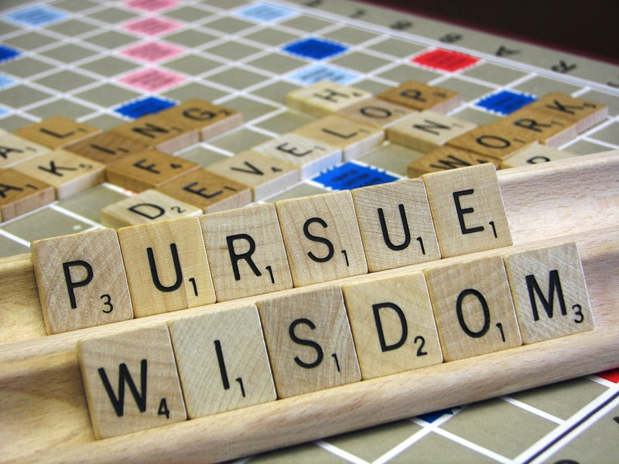
Pursue…
Notes:
But how many of us really—really—want to be wise?

Slide 148
got wisdom?
Notes:
Do you seek wisdom more than anything else?
Do you want wisdom since you know God wants this for you?
How many days do you wake up and pray that God would grant you his wisdom?
I am just going to take it by faith that you came to church today because you really seek wisdom, but…

Slide 149
如何成为明智的人?
Notes:
Restatement

Slide 150
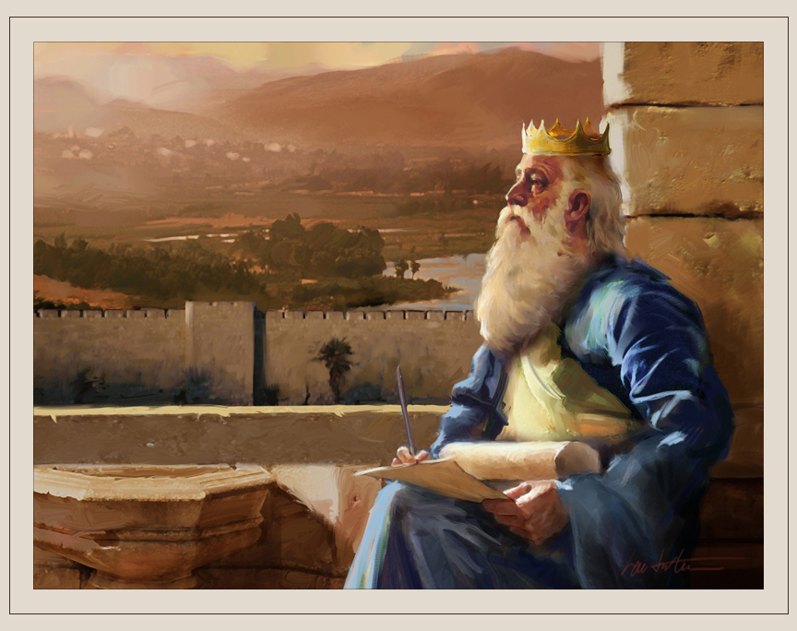
Background
Notes:
God allowed Solomon to ask whatever he wanted.
God wasn’t a genie who granted three wishes—he gave Solomon only one request.
Solomon wisely picked wisdom (1 Kings 3).
Amazingly, God’s wisdom is also offered to us.

Slide 151
THE 10 HABITS OF HIGHLY WISE PEOPLE
OVER 5000 MILLION SOLD
10
THE HABITS OF
HIGHLY
WISE
PEOPLE
箴言erb Lessons
in Personal Change
The Bible Needs No Foreword and Afterward by the Author
_____________________________________________
“The fear of the LORD is the beginning of wisdom.”
—King Solomon, bestselling author of The 箴言 of Solomon
Sages R. Wise
Notes:
Stephen R. Covey wrote The 7 Habits of Highly Effective People. This book sold over 15 million copies with “Powerful Lessons in Personal Change.” This is said to be “a wonderful book that could change your life.” This edition even has a new forward and afterward by the author.
But, as good as it is to be effective, you can be effective at the wrong thing. So today we embark on a new series that we are calling “The 10 Habits of Highly Wise People.” Here we will find “箴言erb Lesson in Personal Change” by Sages R. Wise. In particular, “the fear of the Lord is the beginning of wisdom,” wrote King Solomon, bestselling author of The 箴言 of Solomon. This book has far outsold Covey’s 15 million copies because the Bible has sold over 5000 million copies (that’s 5 billion, by the way). And “The Bible Needs No Foreword and Afterward by the Author” since it is already complete as is.
______________________________
29 Good Bible Sales Statistics
May 23, 2017 by Brandon Gaille
https://brandongaille.com/27-good-bible-sales-statistics/
Accessed 21 Feb 2020
Christians take their Bibles everywhere with them… but sometimes they don’t. Sometimes the one book collecting dust on the bookshelf is the Bible. Yet this need to own at least one copy of the inspired word of God drives the Bible to being a top selling book every year whether it is opened or not.
More than 2,100 languages have at least one book of the Bible in that language.
Bible Sales Statistics
Between 1815 and 1975, it was estimated that there could have been 5 billion Bibles printed. In 1995, one version of the bible, the Good News version that is copyrighted by the Bible Societies, had sold nearly 18 million copies. There’s no doubt about it – the Bible is one of the world’s best-selling books. It also 箴言es that God’s Word is a moneymaker for today’s Christian publishers.
The best selling and fastest growing version of the Bible in the United States is the NIV.
82%. That’s the percentage of people who regularly read the Bible who will reach for a King James Version before any other.
There are more than 168,000 Bibles that are sold or given to others in the United States every day.
20 million. That’s the number of Bibles that are sold each year in the United States. That’s more than double the amount that was sold annually in the 1950s.
The Gideon’s International distributed 59,460,000 Bibles worldwide last year. That’s more than 100 Bibles per minute.
Zondervan, a leading Bible publisher, has more than 350 different versions of the Bible that are in print right now.
The percentage of Americans who own at least 1 Bible, whether it was given to them or purchased: 92%. Two-thirds of owners, regardless of religious affiliation, say that the Bible holds the meaning of life.
The average American Christian owns 9 Bibles and wants to purchase more. For this reason, the Bible is actually excluded from book bestsellers lists because it would always be on top.
1,300 translations of the Bible are in new languages.
There are 40 authors in the Bible.
Selling Bibles is big business for Christian publishers. There’s no denying it. Why else would a book that is considered to be “inerrant” have more than 350 versions by just one publisher? The fact that it sells so well is encouraging because there are incredible messages of love, forgiveness, and understanding that are contained within its 66 total books [or more depending on the version that is purchased]. It also means that some of the hype about persecution that is promoted in major Christian media could very well be a way to market this book to Christians who already have more Bibles than they can carry to buy more so they can “arm” themselves against coming attacks.
How Much Money Does The Bible Bring In Every Year?
The annual sales of all versions of the Bible routinely tops $425 million.
Over 100 million Bibles are printed every year. Consumers in the United States will purchase 25% of those newly printed Bibles every year.
In the world today, there are more than 80,000 different versions of the Bible that generate at least 1 sale annually.
A Bible also owns the record for least amount of sales per year – a translation of the New Testament into Coptic has never sold more than 2 copies in any year since 1791.
YouVersion, a top downloaded Bible app for mobile devices, has over 100 million total downloads and counting. It was one of the first 200 apps that were available on iTunes. It’s also been a top 100 free app for 3 consecutive years.
More than 66,000 people are using a Bible app at any given second. 3 people share a Bible verse on their social network every second as well.
Isaiah 53:5 is the most shared Bible verse on the internet today.
77% of people say that they read the Bible more frequently because they have it available on a mobile device.
60% of people use a digital Bible at church instead of hauling their own printed Bible.
Two-thirds of people prefer Bible apps because it gives them access to multiple versions of the Bible without the added cost.
In 2005, Thomas Nelson, a leading Bible publisher, was sold for $473 million. They publish 60 different editions of the Bible.
Bible apps are going to eventually change the way people purchase Bibles. Although sales are still up, there’s been a change in the consumer profile. Instead of American families purchasing Bibles on a regular basis, it is groups, churches, and summer camps that are purchasing them in bulk. With that observation noted, it only takes one traumatic event to encourage Bible sales to increase. In the week after the September 11, 2001 attacks in the US, some retailers saw 40% increases in Bible sales. When people need comfort, they go to the Bible if they’re Americans, regardless of religion. With apps available, multiple versions of comfort can be readily accessed.
Report this ad
How Is The Scope Of Bible Sales Changing?
60% of today’s Christians live in the developing world. In 1900, 80% of the world’s Christians lived in Europe or the United States.
More Presbyterians go to church in Ghana on a regular basis than they do in Scotland.
There are as many practicing Anglicans in England as there are practicing Muslims.
A Gallup survey found that less than 50% of Americans can name the first book of the Bible.
Only 1 in 3 Bible owners know that Jesus delivered the Sermon on the Mount. Billy Graham is a more popular answer than the correct answer.
12%. That’s the percentage of Christians who believed that Noah was married to Joan of Arc.
There are 900 different versions of the Bible just in English. There is even one Bible that has been translated into the fictional language of Klingon.
Bibles are always going to sell well. There’s no denying this fact whatsoever. What is unique about Bible sales, however, is that the people who have the most opportunity to purchase this holy book are also the most illiterate about it. That may ultimately be why this book continues to be a bestseller. It is being used as a sort of balm to increase personal spirituality through money. The only problem is that the Bible itself says that one cannot serve God and serve money at the same time. With over 80k different versions of the Bible, it is fair to ask who the real master in the Bible publishing world really happens to be.
Report this ad
Related Posts:
39 Terrific Bible Study Blog Names
101 Cool Christian Slogans and Taglines
27 Odd Jehovah Witness Statistics
31 Creative Religious Blog Names
Share
Pin
Tweet
About The Author
Although millions of people visit Brandon's blog each month, his path to success was not easy. Go here to read his incredible story, "From Disabled and $500k in Debt to a Pro Blogger with 5 Million Monthly Visitors." If you want to send Brandon a quick message, then visit his contact page here.
Categories Statistics Post navigation29 Social Networking Addiction Statistics
21 Unbelievable Workplace Romance Statistics
Brandon’s Incredible Story
From Disabled and $500k in Debt to a Pro Blogger with 5 Million Monthly Visitors
Recent Posts
43 Paper Industry Statistics, Trends & Analysis
Rich Dad Poor Dad Speed Summary (3 Minutes) w/ PDF Download
Outliers Quick Summary: 15 Takeaways from Malcolm Gladwell’s Book
46 Shipping Industry Statistics and Trends
The Tipping Point Speed Summary (3 Minutes) w/ PDF
Featured
Pros and Cons
Statistics
Blog Names
Slogans
Success is a Choice
43 Paper Industry Statistics, Trends & Analysis
Rich Dad Poor Dad Speed Summary (3 Minutes) w/ PDF Download
Outliers Quick Summary: 15 Takeaways from Malcolm Gladwell’s Book
46 Shipping Industry Statistics and Trends
The Tipping Point Speed Summary (3 Minutes) w/ PDF
Think and Grow Rich Quick Summary w/ Free PDF Download
41 Fishing Industry Statistics and Trends
The Art of War Speed Summary (3 Minutes): 15 Quick Takeaways
Thinking Fast and Slow Summary w/ Free PDF Download
21 Pro Tips for Starting & Running a Credit Repair Business
Believe in Yourself
Accounting
Blog Names
Blogging Tips
Business
Communication
Employees and HR
Entrepreneur
Featured
Finance
General
Logos
Mobile
People
Pros and Cons
Psychology
Never Give Up
Quotes
SEO
Slogans
Social Media
Statistics
Style
Videos
Web Design
—
Follow Brandon
Pinterest
—
Archives
Archives
Privacy and Disclosure Policies
Contact Me
2020 © BrandonGaille.com
Exclusive Member of Mediavine Home

Slide 152
如何成为明智的人?
三种方式…
Notes:
Restatement

Slide 153

I. Study 箴言 to do what is right (1:1-4).
Notes:
Ponder these sayings so you can tell right from wrong.

Slide 154

¹ 这是大卫的儿子以色列王所罗门的箴言。² 为使人认识智慧和教诲，
领悟真知灼见；
箴言 1:1-7 CCB
Notes:
The author of most of the 箴言 is Solomon (1).
The benefit of studying 箴言 is wisdom to do what is right (2-4; ILL family devotions).

Slide 155
³ 为使人接受劝诫，
为人处事仁义、公平、正直；
箴言 1:1-7 CCB

Slide 156
⁴ 使愚昧人明智，
使青年有知识和明辨力；
箴言 1:1-7 CCB

Slide 157
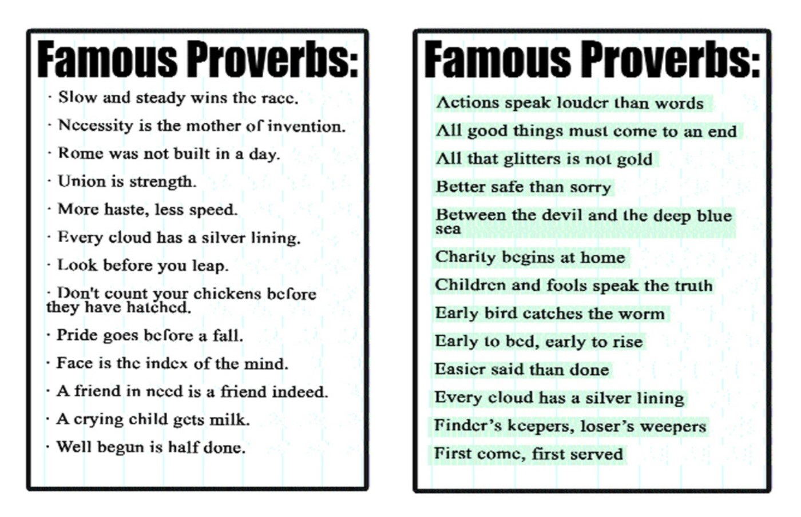
Famous 箴言
Notes:
Restatement

Slide 158
如何成为明智的人?
三种方式…
Notes:
Restatement

Slide 159
I. Study 箴言 to do what is right (1:1-4).
Notes:
Ponder these sayings so you can tell right from wrong.

Slide 160

II. Apply 箴言 to gain skill in living (5-6).
Notes:
Practice these sayings and it will result in knowing how to live.

Slide 161
⁵ 使智者听了长学问，
明哲听了得指引；
⁶ 使人领悟箴言和比喻，
明白智者的话和谜语。
箴言 1:1-7 CCB
Notes:
Applying 箴言 gives wisdom (5a).
Applying 箴言 gives guidance (5b).
Applying 箴言 gives insight into life’s perplexities (6).

Slide 162
"The essence of a 箴言erbial saying is that it is based on observations of how things are in the world. It is a flash of insight into the repeatable situations of life on the world, and its aphoristic form not only represents insight but compels it . . . . Naturally, in the context of firm belief in God, the 箴言erb comes to express insight into the way things are, or should be, in the world ordered by God and a challenge to behavior that God will reward."
Norman Perrin, The New Testament: An Introduction, 296.
Jeffrey Arthurs, Gordon-Conwell Theological Seminary
(SBC preaching conference, July 2014)

Slide 163
如何成为明智的人?
三种方式…
Notes:
Restatement

Slide 164
I. Study 箴言 to do what is right (1:1-4).
Notes:
Ponder these sayings so you can tell right from wrong.

Slide 165
II. Apply 箴言 to gain skill in living (5-6).
Notes:
Practice these sayings and it will result in knowing how to live.

Slide 166

III. Respect the LORD to gain skill in living (7).
Notes:
Honor God as the basis of wisdom in your life.

Slide 167
⁷ 知识始于敬畏耶和华，
愚人轻视智慧和教诲。
箴言 1:1-7 CCB
Notes:
A wise man gains wisdom by respecting God (7a).
A fool is not teachable (7b).

Slide 168
"箴言 are high points of human insight. To use a literary term, a 箴言erb is a moment of epiphany (insight, revelation)."
Leland Ryken, How to Read the Bible as Literature
(Grand Rapids: Zondervan, 1984), 124
Jeffrey Arthurs, Gordon-Conwell Theological Seminary
(SBC preaching conference, July 2014)

Slide 169

如何成为明智的人?
Notes:
What is the way to be a discerning person?

Slide 170
Main Idea of 箴言 1:1-7
STUDY 箴言
APPLY 箴言
RESPECT THE LORD

Slide 171
运用
394
教导儿童箴言
背诵箴言来提倡有智慧的生活，
每天读一篇箴言

Slide 172
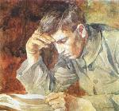
为何要读箴言？
请查阅 1:1-7

Slide 173
箴言 give wisdom, discipline & insights (1:1-2)
¹ 这是大卫的儿子以色列王所罗门的箴言。
² 为使人认识智慧和教诲，
领悟真知灼见；
Why Study 箴言 ?
Notes:
Wisdom is practical because it helps us to continue to learn from others who are wiser than we are (1:2b).

Slide 174
箴言 guide us to do what is right (1:3)
³ 为使人接受劝诫，
为人处事仁义、公平、正直；
Why Study 箴言 ?
Notes:
Wisdom is ethical because it shows us the difference between right and wrong (1:5).

Slide 175
箴言 give insight throughout life (1:4-6)
⁴ 使愚昧人明智，
使青年有知识和明辨力；
⁵ 使智者听了长学问，
明哲听了得指引；
⁶ 使人领悟箴言和比喻，
明白智者的话和谜语。
Why Study 箴言 ?

Slide 176
箴言 teach us to fear God (1:7)
⁷ 知识始于敬畏耶和华，
愚人轻视智慧和教诲。
Why Study 箴言 ?
Notes:
In 1 John 4:18, we see that, “There is no fear in love. But perfect love drives out fear, because fear has to do with punishment. The one who fears is not made perfect in love,” so does the NT contradict the OT?
Actually, this NT verse speaks of fear of people, not fear of God.
We should fear what might have to do to us to get us back on the right path when we stray from him!
Only a fool despises the things that benefit his life.

Slide 177
II. 珍视智慧，它能带来丰盛生命 (1:8–9:18).
如何成为明智的人...
Notes:
Restatement

Slide 178
智慧
gives honor to keep youth from the shame of foolishness (1:8-9).
Notes:
Text

Slide 179
智慧
preserves youth from disaster (1:10-33).
Notes:
Text

Slide 180
Slides on
箴言 2

Slide 181
智慧
helps maintain moral behavior (箴言 2).
Notes:
Text

Slide 182
1:8–9:18
箴言 - 智慧的价值和途径
所罗门 |  |  | 智者 (身份不详) | 所罗门 | 智者 (亚古珥，利慕伊勒王， 身份不详)
1:1-22:16 |  |  | 22:17-24:34 | 25-29章 | 30-31章
13句格言 375 双行 |  |  | 36句格言 | ±100双行 | 3句格言
 |  |  | 社会及其他的课题 | 社会及其他的课题
开场白 | 智慧的原则 |  |  |  | 收场白
约主前950-700年
394
对比和虔敬
10:1-22:16
执政 31:1-9
目标
1:1-7
社会及自然界 30章
虔敬的妻子 31:10-31
智慧的价值
1:8-9:18

Slide 183

箴言 2:6-7 (CCB)
⁶ 因为耶和华赐人智慧，
知识和悟性出自祂的口。
⁷ 祂使正直人充满智慧，
是行为纯全者的盾牌。

Slide 184
箴言 2:8-9 (CCB)
⁸ 祂看守正义之路，
护卫虔诚人的道。
⁹ 这样，你就明白何为仁义、
公平和正直，
懂得一切美善之道。

Slide 185
箴言 2:10-11 (NIV)
¹⁰ 因为智慧必进入你心，
知识必令你的灵欢快。¹¹ 明辨力必护佑你，
悟性必看顾你。

Slide 186

箴言 2:21 (CCB)
²¹ 因为在地上，
正直人必安居，
纯全无过的人必长存，

Slide 187
Slides on
箴言 3

Slide 188
智慧
helps us relate
with God and man (箴言 3).
Notes:
Text

Slide 189
关键节
394
你要专心仰赖耶和华…
箴 3:5,6

Slide 190
关键节
394
不可依靠自己的聪明;
箴 3:5,6

Slide 191
关键节
在你一切所行的事上都要认定他…
394
箴 3:5,6

Slide 192
关键节
他必指引你的路。
394
箴 3:5,6

Slide 193
箴言 3:32 (CCB)
³² 因为耶和华憎恶邪僻之徒，
喜爱正直的人。

Slide 194
箴言 3:34 (CCB)
耶和华讥笑好讥诮的人，
恩待谦卑的人。

Slide 195
Slides on
箴言 4

Slide 196
智慧
箴言ides a gracious life (4:1-9).
Notes:
Text

Slide 197
智慧
preserves youth from trouble (4:10-19).
Notes:
Text

Slide 198
智慧
produces healthy young people (4:20-27).
Notes:
Text

Slide 199
Slides on
箴言 5

Slide 200
智慧
helps avoid sexual sin (箴言 5).
Notes:
Text

Slide 201

箴言 5:1-23 CCB
¹ 孩子啊，要留心听我的智言，
侧耳听我的慧语，
² 好保持明辨力，
嘴唇谨守知识。
³ 淫妇满口甜言蜜语，
油嘴滑舌，

Slide 202
⁴ 最后却苦如艾草，
锋利似双刃剑。
⁵ 她的双脚走进死地，
她的步伐迈向阴间。
⁶ 她不走生命的康庄大道，
偏离了正途也不自知。

Slide 203
⁷ 孩子们啊，要听从我，
不可违背我的话！
⁸ 要远远避开淫妇，
不可靠近她的家门，
⁹ 免得你为别人枉费精力，
为残忍之徒断送青春；
¹⁰ 免得外人吞尽你的财富，
你的辛劳所得归给他人。

Slide 204
¹¹ 临终之时，肉体衰残，
你必呻吟不止，
¹² 说：“我为何厌恶教诲，
心里藐视责备！
¹³ 不听从老师的话，
不侧耳听导师之言。

Slide 205
¹⁴ 在众人面前，
我几乎身败名裂。”
¹⁵ 你当喝自己池中的水，
饮自己井里的活水。
¹⁶ 你的泉水岂可外流？
你的河水怎可溢到街上？

Slide 206
¹⁷ 这些要专属于你，
不可与外人共享。
¹⁸ 要使你的泉源蒙福，
要爱你年轻时所娶的妻。
¹⁹ 她高贵可爱宛如母鹿，
愿她的胸令你时时满足，
愿她的爱令你常常陶醉。

Slide 207
²⁰ 孩子啊，为何迷恋淫妇？
为何拥抱妓女的胸？
²¹ 因为人的所作所为逃不过耶和华的眼目，
祂必鉴察人走的一切路。
²² 恶人被自己的罪恶捉住，
被自己的罪恶捆绑。
²³ 他因不听教诲而丧命，
因极其愚妄而入歧途。

Slide 208

Straight Talk on Sex
箴言 5
Dr. Rick Griffith, Crossroads International Church Singapore
BibleStudyDownloads.org

Slide 209
THE 10 HABITS OF HIGHLY WISE PEOPLE
OVER 5000 MILLION SOLD
10
THE HABITS OF
HIGHLY
WISE
PEOPLE
箴言erb Lessons
in Personal Change
The Bible Needs No Foreword and Afterward by the Author
_____________________________________________
“The fear of the LORD is the beginning of wisdom.”
—King Solomon, bestselling author of The 箴言 of Solomon
Sages R. Wise
Notes:
29 Good Bible Sales Statistics
May 23, 2017 by Brandon Gaille
https://brandongaille.com/27-good-bible-sales-statistics/
Accessed 21 Feb 2020
Christians take their Bibles everywhere with them… but sometimes they don’t. Sometimes the one book collecting dust on the bookshelf is the Bible. Yet this need to own at least one copy of the inspired word of God drives the Bible to being a top selling book every year whether it is opened or not.
More than 2,100 languages have at least one book of the Bible in that language.
Bible Sales Statistics
Between 1815 and 1975, it was estimated that there could have been 5 billion Bibles printed. In 1995, one version of the bible, the Good News version that is copyrighted by the Bible Societies, had sold nearly 18 million copies. There’s no doubt about it – the Bible is one of the world’s best-selling books. It also 箴言es that God’s Word is a moneymaker for today’s Christian publishers.
The best selling and fastest growing version of the Bible in the United States is the NIV.
82%. That’s the percentage of people who regularly read the Bible who will reach for a King James Version before any other.
There are more than 168,000 Bibles that are sold or given to others in the United States every day.
20 million. That’s the number of Bibles that are sold each year in the United States. That’s more than double the amount that was sold annually in the 1950s.
The Gideon’s International distributed 59,460,000 Bibles worldwide last year. That’s more than 100 Bibles per minute.
Zondervan, a leading Bible publisher, has more than 350 different versions of the Bible that are in print right now.
The percentage of Americans who own at least 1 Bible, whether it was given to them or purchased: 92%. Two-thirds of owners, regardless of religious affiliation, say that the Bible holds the meaning of life.
The average American Christian owns 9 Bibles and wants to purchase more. For this reason, the Bible is actually excluded from book bestsellers lists because it would always be on top.
1,300 translations of the Bible are in new languages.
There are 40 authors in the Bible.
Selling Bibles is big business for Christian publishers. There’s no denying it. Why else would a book that is considered to be “inerrant” have more than 350 versions by just one publisher? The fact that it sells so well is encouraging because there are incredible messages of love, forgiveness, and understanding that are contained within its 66 total books [or more depending on the version that is purchased]. It also means that some of the hype about persecution that is promoted in major Christian media could very well be a way to market this book to Christians who already have more Bibles than they can carry to buy more so they can “arm” themselves against coming attacks.
How Much Money Does The Bible Bring In Every Year?
The annual sales of all versions of the Bible routinely tops $425 million.
Over 100 million Bibles are printed every year. Consumers in the United States will purchase 25% of those newly printed Bibles every year.
In the world today, there are more than 80,000 different versions of the Bible that generate at least 1 sale annually.
A Bible also owns the record for least amount of sales per year – a translation of the New Testament into Coptic has never sold more than 2 copies in any year since 1791.
YouVersion, a top downloaded Bible app for mobile devices, has over 100 million total downloads and counting. It was one of the first 200 apps that were available on iTunes. It’s also been a top 100 free app for 3 consecutive years.
More than 66,000 people are using a Bible app at any given second. 3 people share a Bible verse on their social network every second as well.
Isaiah 53:5 is the most shared Bible verse on the internet today.
77% of people say that they read the Bible more frequently because they have it available on a mobile device.
60% of people use a digital Bible at church instead of hauling their own printed Bible.
Two-thirds of people prefer Bible apps because it gives them access to multiple versions of the Bible without the added cost.
In 2005, Thomas Nelson, a leading Bible publisher, was sold for $473 million. They publish 60 different editions of the Bible.
Bible apps are going to eventually change the way people purchase Bibles. Although sales are still up, there’s been a change in the consumer profile. Instead of American families purchasing Bibles on a regular basis, it is groups, churches, and summer camps that are purchasing them in bulk. With that observation noted, it only takes one traumatic event to encourage Bible sales to increase. In the week after the September 11, 2001 attacks in the US, some retailers saw 40% increases in Bible sales. When people need comfort, they go to the Bible if they’re Americans, regardless of religion. With apps available, multiple versions of comfort can be readily accessed.
Report this ad
How Is The Scope Of Bible Sales Changing?
60% of today’s Christians live in the developing world. In 1900, 80% of the world’s Christians lived in Europe or the United States.
More Presbyterians go to church in Ghana on a regular basis than they do in Scotland.
There are as many practicing Anglicans in England as there are practicing Muslims.
A Gallup survey found that less than 50% of Americans can name the first book of the Bible.
Only 1 in 3 Bible owners know that Jesus delivered the Sermon on the Mount. Billy Graham is a more popular answer than the correct answer.
12%. That’s the percentage of Christians who believed that Noah was married to Joan of Arc.
There are 900 different versions of the Bible just in English. There is even one Bible that has been translated into the fictional language of Klingon.
Bibles are always going to sell well. There’s no denying this fact whatsoever. What is unique about Bible sales, however, is that the people who have the most opportunity to purchase this holy book are also the most illiterate about it. That may ultimately be why this book continues to be a bestseller. It is being used as a sort of balm to increase personal spirituality through money. The only problem is that the Bible itself says that one cannot serve God and serve money at the same time. With over 80k different versions of the Bible, it is fair to ask who the real master in the Bible publishing world really happens to be.
Report this ad
Related Posts:
39 Terrific Bible Study Blog Names
101 Cool Christian Slogans and Taglines
27 Odd Jehovah Witness Statistics
31 Creative Religious Blog Names
Share
Pin
Tweet
About The Author
Although millions of people visit Brandon's blog each month, his path to success was not easy. Go here to read his incredible story, "From Disabled and $500k in Debt to a Pro Blogger with 5 Million Monthly Visitors." If you want to send Brandon a quick message, then visit his contact page here.
Categories Statistics Post navigation29 Social Networking Addiction Statistics
21 Unbelievable Workplace Romance Statistics
Brandon’s Incredible Story
From Disabled and $500k in Debt to a Pro Blogger with 5 Million Monthly Visitors
Recent Posts
43 Paper Industry Statistics, Trends & Analysis
Rich Dad Poor Dad Speed Summary (3 Minutes) w/ PDF Download
Outliers Quick Summary: 15 Takeaways from Malcolm Gladwell’s Book
46 Shipping Industry Statistics and Trends
The Tipping Point Speed Summary (3 Minutes) w/ PDF
Featured
Pros and Cons
Statistics
Blog Names
Slogans
Success is a Choice
43 Paper Industry Statistics, Trends & Analysis
Rich Dad Poor Dad Speed Summary (3 Minutes) w/ PDF Download
Outliers Quick Summary: 15 Takeaways from Malcolm Gladwell’s Book
46 Shipping Industry Statistics and Trends
The Tipping Point Speed Summary (3 Minutes) w/ PDF
Think and Grow Rich Quick Summary w/ Free PDF Download
41 Fishing Industry Statistics and Trends
The Art of War Speed Summary (3 Minutes): 15 Quick Takeaways
Thinking Fast and Slow Summary w/ Free PDF Download
21 Pro Tips for Starting & Running a Credit Repair Business
Believe in Yourself
Accounting
Blog Names
Blogging Tips
Business
Communication
Employees and HR
Entrepreneur
Featured
Finance
General
Logos
Mobile
People
Pros and Cons
Psychology
Never Give Up
Quotes
SEO
Slogans
Social Media
Statistics
Style
Videos
Web Design
—
Follow Brandon
Pinterest
—
Archives
Archives
Privacy and Disclosure Policies
Contact Me
2020 © BrandonGaille.com
Exclusive Member of Mediavine Home

Slide 210
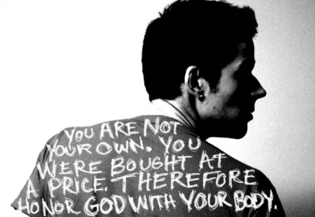
"我儿，要留心听我的智慧，
侧耳听我的哲理，
² 好让你持守明辨的态度，
你的嘴唇谨守知识。" (5:1-2 CNV).

Slide 211

How are you doing at moral purity?
Notes:
Moral purity has been a challenge for men for millennia (箴言 5:1-2).

Slide 212
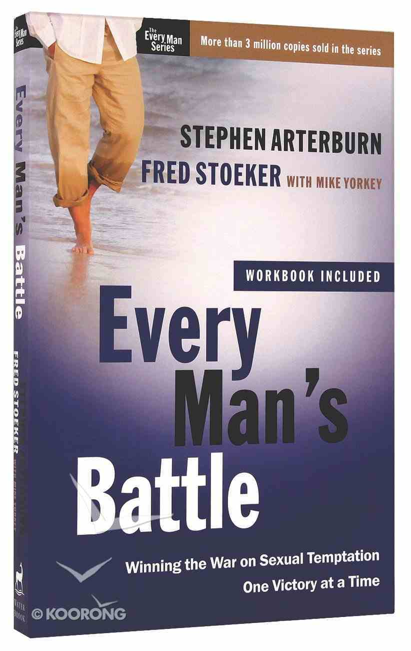
Hard Hitting & Honest
Notes:
Need for Men: Men, do you need to grow in the area of moral purity?
There is not a man who has not struggled with lust.
There is no man who has not been tempted in the area of sex.
This is why the key book on it is called Every Man’s Battle.
Millions of men have defeated the advance of entire armies of other men but have fallen to the advances of a single woman!

Slide 213
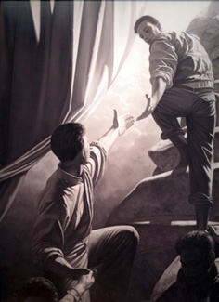
Relevant to You?
      Are your thoughts about women completely honorable?
      Are you tempted to look at images that you know you shouldn't—especially online?
      If so, you need this passage today.

Slide 214
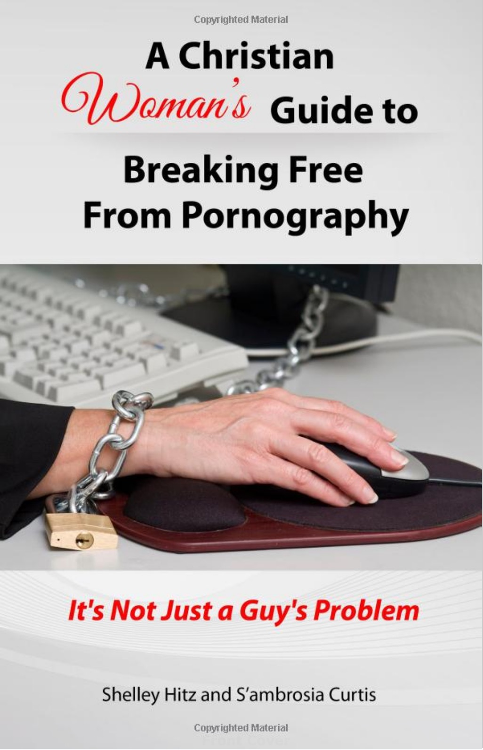
Women too?
Notes:
Need for Women: Women, do you have a porn problem also? And if not, how can you help us men be morally pure?
Do you know what you might do—or not do—to make this more difficult for us?
If so, you need this passage today.

Slide 215

Learn from Solomon?
Notes:
Solomon didn't avoid sexual sin (1 Kings 11; Eccl. 2).
However, he wrote today's text to spare us the pain of this particular sin that trips men up.

Slide 216
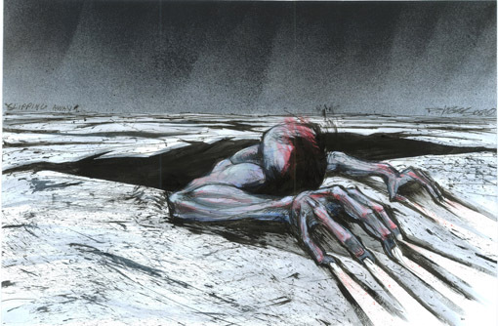
Why should we avoid sexual sin?
Notes:
Background:
Solomon didn't avoid sexual sin (1 Kings 11; Eccl. 2).
However, he wrote today's text to spare us the pain of this particular sin that trips men up.
Text: 箴言 5
Preview: We will see four basic reasons to avoid this trap of sexual sin—and we will discover these in small groups that each take a portion of Scripture and then report back to the group.
Transition: What reason(s) should we avoid sexual sin in the passage assigned to you?

Slide 217
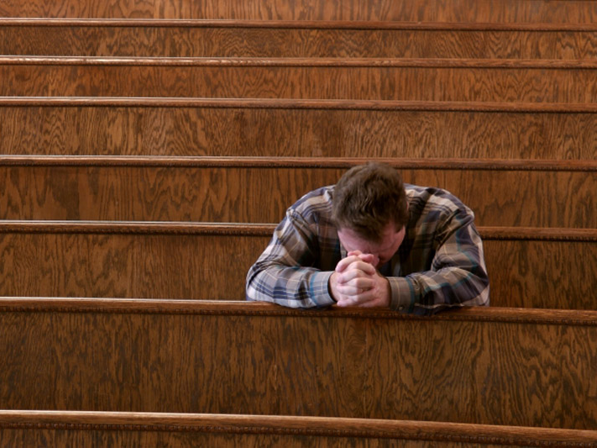
I. 箴言 5 gives four good reasons to avoid sexual sin.

Slide 218
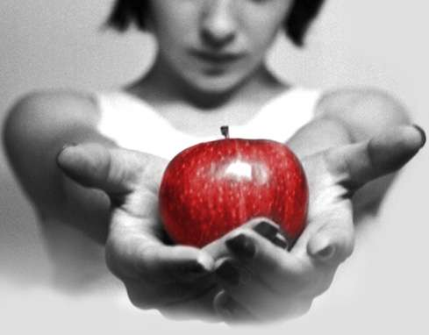
A. Sexual sin is enjoyable in the short run but bitter in the end (3-6).

Slide 219

"因为淫妇的嘴唇滴下蜂蜜，
她的口比油更滑"
(5:3 CNV).
Notes:
(5:3) Immoral people's advances are genuinely enticing in touch and sound.

Slide 220

“至终却苦似苦菫，
快如两刃的剑。
⁵ 她的脚走下死地，
她的脚步踏向阴间。" (5:4-5 CNV).
Notes:
(5:4-5) However, following such advances leads to certain ruin.

Slide 221

“她不理会生命之路，
她的路径变迁无定，自己也不知道。”
(5:6 ＣＮＶ).
Notes:
(5:6) Sex addicts can't discern momentary pleasure from long-term goals.

Slide 222
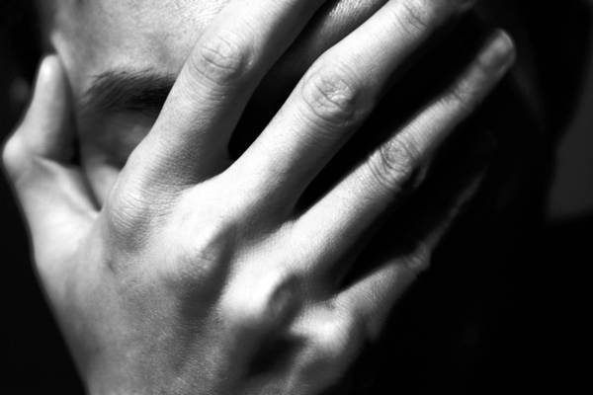
B. Avoid sexual sin to escape its physical, financial, and emotional woes (7-14).

Slide 223
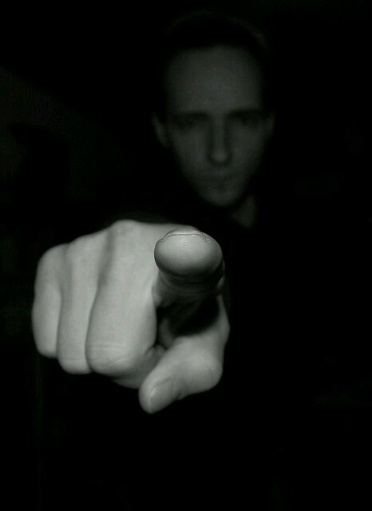
“孩子们，现在要听从我，
不可离弃我口中的话。
⁸ 你的道路要远离她，
不可走近她的家门!”
(5:7-8 ＣＮＶ).
Notes:
(5:7-8) Don't expose yourself to temptations in the sexual arena.

Slide 224


“免得你的精力给了别人，
你的年日交给了残忍的人” (5:9 ＣＮＶ).
Notes:
(5:9-10) Sexual sin diverts the physical strength and money saved for one's spouse to strangers instead.

Slide 225

"免得外人饱享你的财物，
你劳碌得来的归入别人的家。" (5:10 CNV).
Notes:
(5:9-10) Sexual sin diverts the physical strength and money saved for one's spouse to strangers instead.

Slide 226
"在你生命终结，你的肉体和身躯衰残的时
候，你就悲叹，
¹² 说：“我为甚么恨恶管教，
我的心为甚么轻视责备，
¹³ 不听从我老师的话，
也不留心听那些教导我的人。
¹⁴ 在众民的集会中，
我几乎落在万劫不复之地。"
(5:11-14 CNV).
Notes:
(5:11-14) Sexual sin leads to a life of public regret for disobeying teachers.

Slide 227

Harvey Weinstein indicted on many sexual assault charges
Notes:
(5:11-14) Sexual sin leads to a life of public regret for disobeying teachers.
Harvey Weinstein In October 2017, following sexual abuse allegations, Weinstein was dismissed from his company and expelled from the Academy of Motion Picture Arts and Sciences.^{[3][4]} More than 80 women had made allegations against Weinstein by October 31 (Wikipedia)
______
BornMarch 19, 1952 (age 67)
New York City, U.S.
EducationUniversity at BuffaloOccupationFilm producerYears active1979–2017Spouse(s)Eve Chilton
(m. 1987; div. 2004)
Georgina Chapman
(m. 2007; div. 2017)
Children5RelativesBob Weinstein (brother)Criminal informationCriminal statusCurrently incarcerated, awaiting second trial in Los AngelesConviction(s)1 count of third-degree rape, 1 count of criminal sexual assault in the first degree
Criminal chargeRape, criminal sex act, sex abuse, and sexual misconduct

Slide 228

C. Sex with one partner in marriage is the most enjoyable experience (15-20).

Slide 229

"你要喝自己池中的水，
饮自己井里的活水。
¹⁶ 你的泉源怎么可以外溢？
你的河水怎么可以流在街上？
¹⁷ 它们要独归你一人所有，
不要让外人与你共享。” (5:15-17 CNV).
Notes:
(5:15-17) Sex should be shared with only one person.

Slide 230
"要使你的泉源蒙福，
要喜悦你年轻时所娶的妻子。
¹⁹ 她像可爱的母鹿，人所喜悦的母山羊，
愿她的乳房时常使你满足，
愿她的爱情常常使你恋慕。
²⁰ 我儿，为甚么恋慕淫妇？
为甚么拥抱妓女的胸怀呢？" (5:18-20 CNV).
Notes:
(5:18-20) Sex is most satisfying with one's own spouse.

Slide 231
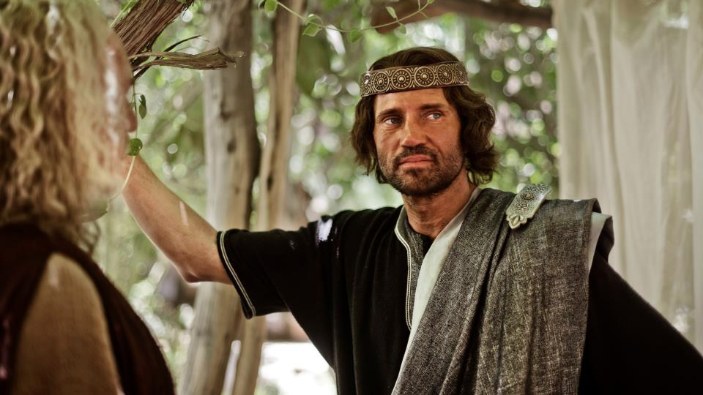
D. Avoid sexual sin because God calls it evil and will judge us for it (21-23).
Notes:
(5:21) Resist sexual sin because God sees everything we do and judges each deed.

Slide 232

"因为人的道路都在耶和华眼前，
他也审察人的一切路径。"
(5:21 CNV).

Slide 233

"恶人必被自己的罪孽捉住，
他必被自己罪恶的绳索缠住。
²³ 他必因不受管教而死亡，
又因自己过分愚妄而走进歧途。"
(5:22-23 CNV).
Notes:
(5:22-23) Resist sexual sin because it is an evil deed that causes personal ruin.

Slide 234
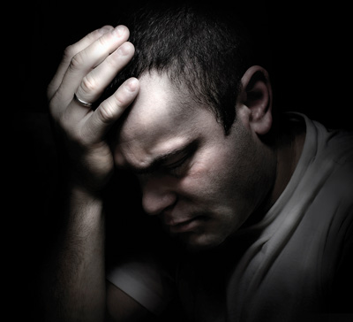
II. Here are ideas to avoid the trap of sex sin.

Slide 235


Questions
Have you promised purity to God?
Are you going down the path of the simpleton right now? How?
What should you do about it?

Slide 236

Realize that your eye is the gateway to your mind.

Slide 237


WARNING! facebook may lead to adultery
Notes:
Remove your sources of temptation!

Slide 238

Safeguard your computer and mobile phone!
Use ONLY Google safe search mode

Slide 239

“眼睛就是身体的灯。如果 你的眼睛健全，全身就都明亮”
(马太福音6:22).
Train your eye not to see things that stimulate lust.

Slide 240

Guard your hands from lust (Matt 5:30)

Slide 241

“如果你的右手使你犯罪，就把它砍下来丢掉；宁可失去身体的一部分，胜过全身进到地狱里去。”
(马太 5:30 ＣＮＶ).
Notes:
Would a one eyed and one-handed person be guaranteed not to sin?
Obviously not—you can still lust with the left eye and still touch someone inappropriately with the left hand.
Both the right eye and right hand were viewed as more valuable in antiquity, as most people then (as now) were right-handed. So the point is that we must be willing to take severe measures to protect ourselves from sin.

Slide 242

“少年人用甚么洁净自己的行为呢？
就是要遵守你的话。
我一心寻求你，
求你不要容我偏离你的诫命。”
(诗篇 119:9-10).
Replace your sources of temptation with sources of purity.

Slide 243

Hug right.
Notes:
Avoid touching anything or anyone that encourages lust. Hug right—

Slide 244

Avoid the AWKWARD HUG
Notes:
—but not the awkward hug!

Slide 245

"What's the big deal? All men look at porn. It is perfectly normal. Well, most men look at porn. This is normal."

Slide 246

Bill Clinton still makes excuses.
Clinton says his adultery with Monica Lewinsky helped him cope with the pressures of the presidency (5 Mar 2020)
Notes:
Bill Clinton had Monica Lewinsky affair to cope with anxieties of office, documentary reveals
Bill and Hillary Clinton underwent 'painful' marriage counselling after he admitted fling with White House intern
By David Millward, US Correspondent 5 March 2020 • 8:33pm
Bill Clinton says he had his affair with Monica Lewinsky to cope with the pressures of the presidency.
Bill Clinton became embroiled in his notorious affair with Monica Lewinsky to help cope with the anxieties of office, he has said in a new documentary about his wife.
The former US president's fling with Ms Lewinsky, then a 22-year-old White House intern, nearly brought down his presidency and rocked his marriage to Hillary, who later became the US Secretary of State.
"I thought how I could think about the most stupid thing to do and do it," Mr Clinton says in the documentary, 'Hillary', which premieres on Hulu on Friday.
He said the pressures of being president had made him stray, adding: "You feel like you're staggering around, you've been in a 15-round prize fight that was extended to 30 rounds and here's something that will take your mind off it for a while, that's what happens....”
https://www.telegraph.co.uk/news/2020/03/05/bill-clinton-had-affair-monica-lewinsky-cope-anxieties-office/
Accessed 7 March 2020

Slide 247

“你们要逃避淫乱的事。人所犯的，无论是甚么罪，都是在身体以外，唯有行淫乱的，是触犯自己的身体。” (林前 6:18 ).

Slide 248

"我与自己的眼睛立了约，
决不注视处女。"
约伯 31:1 ＣＮＶ

Slide 249

SIGN UP FOR
COVENANT EYES
SOFTWARE

Slide 250

Covenant Eyes

Slide 251

Christian Accountability
Christ-Centered Questions for Accountability Partners
Notes:
We men need to help each other here.

Slide 252



Covenant Eyes
Notes:
Protect your kids too.

Slide 253


Title
网络责任和过滤
网络责任和过滤
你的
脑袋
色情

Slide 254



Resources
Notes:
XXXChurch.com is a free porn addiction accountability program.
Investigate movies with Plugged In to see how many times sexually explicit images appear in a movie.

Slide 255

"How could I sin against God?"
(Gen. 39:9)
Covenant with God NOW that you will remain sexually pure until marriage (for singles) or in marriage (for those married).
Notes:
Obviously Potiphar's wife was the one to blame, but other women are like her.

Slide 256

How to Quit Porn
Want to quit porn
Do things you haven't done before
Be brutally honest with another person
"Clean house"
Block entry points
Get accountable to a man
Douglas Weiss
CovenantEyes.com
Notes:
How to Quit Porn: 6 Essential Steps
Monday, April 23, 2012 | Written by Guest Author
Accessed 19 Feb 2017
The first part to quitting porn is you really have to want to quit porn. You need to be sick and tired of porn and the sickness that it causes you in order to quit. If you are not committed, you will only be quitting until the next time you look. Deep inside you have to want to stop.
Secondly, you have to be willing to do things you haven't done before. Seriously, if you keep quitting the same way, you're likely to fail again. To quit, you have to give up what you've been doing and do what you have to do.
Thirdly, you have to be brutally honest with another person. This person may be a male friend, your wife, a person of clergy, a life coach or a twelve step group person. Somebody has to know the truth about your porn usage for you to get and stay free.
Next, you have to do what I call "clean house." You have to get rid of the porn you have. Throw away the discs, magazines, anything you have used as pornography, and make sure to dump and clean out your computer. This is just a start, some you have to clean house regularly.
The next step is you have to block entry points. This means have a porn blocker and accountability software like Covenant Eyes on your phone, computer at home, and at the office. If you have people sending you compromising emails, block them. Unsubscribe from porn websites. You may have to decide if credit cards are a problem. You know how porn is coming into your life. If you had a gun to your head in a minute you could block entry points.
Finally, get accountable to a man on a daily basis about your porn usage. Make a call a day and a commitment to call this person before you even consider looking at porn. People who set consequences for porn relapse do better. Seriously, if you look at porn, set a consequence. Some guys run laps, give money to the political party they don't vote for, do leg lunges for a half mile, give up some privilege or just pick up trash on the highway for a few hours.
You have to decide that you are worth living porn free. I decided that almost 25 years ago and just passed a polygraph verifying my freedom. I believe you're worth it but your behavior will show you if you are. Don't believe your words. Believe only your behaviors; otherwise, you can be in denial as to your commitment to being porn free.
Remember, you are not the only one being affected if you are married. She is in pain because of your porn usage. Your children are being affected as well. They deserve the best man you can be. You decide. Do they get the porn-drunk you or the porn-free you? I recommend the porn-free you. It's the better you.
Photo credit: um_gngama
. . . .
Douglas Weiss, Ph.D. is a nationally known author, speaker and licensed psychologist. He has appeared on many national talk shows including Oprah, Dr. Phil, Good Morning America and 20/20. Dr. Weiss travels the country training professionals in the treatment of marriage, sexual addiction, and sexual abuse. Dr. Weiss is currently the executive director of Heart to Heart Counseling Center where his staff offers 3-Day Intensives and Telephone Counseling in his Colorado Springs, Colorado office.

Slide 257

How can you guard yourself from sexual sin?

Slide 258

智慧 gives us many reasons to avoid sexual sin.
Main Idea:
Notes:
Vow and guard!

Slide 259
Main Points (箴言 5):
Preserving yourself will…
      Keep you from regret (3-6)
      Guard your body, money, emotions, and reputation (7-14)
      Help you enjoy sex in marriage (15-20)
      Enable you to account to God (21-23)

Slide 260
Questions
Have you promised purity to God?
Are you going down the path of the simpleton right now? How?
What should you do about it?

Slide 261
Slides on
箴言 6

Slide 262
智慧
preserves from poverty (6:1-11).
Notes:
Text

Slide 263
The Ant (6:6)
"Go to the ant, O sluggard.
Observe her ways and be wise."
After the Sluggard family considered the ways of the ants

Slide 264
智慧
preserves from dissension (6:12-19).
Notes:
Text

Slide 265
智慧
preserves youth from sexual immorality
(6:20–7:27).
Notes:
Text

Slide 266

神所恨恶的
暴力的人
不诚实的人
译：我是为了不让妳知道真相才撒谎的。

Slide 267

神所恨恶的
暴力的人
不诚实的人
恶者的献祭
恶者的道路
恶者的思想

Slide 268

神所恨恶的
暴力的人
不诚实的人
恶者的献祭
恶者的道路
恶者的思想
骄傲者

Slide 269

神所恨恶的
暴力的人
不诚实的人
恶者的献祭
恶者的道路
恶者的思想
骄傲者
不公义判决的人

Slide 270

“和妇人通奸的，实在无知；
行这事的，是自我毁灭。
他必遭受击打，被凌辱，
他的耻辱永不能涂抹。” (箴言 6:32-33).

Slide 271
Slides on
箴言 7

Slide 272

— Mark Twain —
It is better to keep your mouth closed and let people think you are a fool
than to open it and remove all doubt.
Notes:
And yet, is Mark Twain known for opening his mouth or for keeping silent?

Slide 273

— Mark Twain —
It's easier to fool people
than to convince them
that they have been fooled.
Notes:
Twain showed himself to be a wise fool.

Slide 274

— Mark Twain —
THE BIBLE
"It is full of interest.
It has noble poetry in it; and some clever fables; and some blood-drenched history;
and some good morals; and a wealth of obscenity;
and upwards of a thousand lies."
Notes:
He was a godless man who rejected God's Word and encouraged others to do so also.

Slide 275
Slides on
箴言 8

Slide 276
智慧
has valuable virtues, rewards and was used in creation (箴言 8).
Notes:
Text

Slide 277
Slides on
箴言 9

Slide 278
智慧
is valuable compared to the claims of foolishness (箴言 9).
Notes:
Text

Slide 279
I. 学习管教与敬畏神 (1:1-7).
如何成为明智的人...
Notes:
Restatement

Slide 280
II. 珍视智慧，它能带来丰盛生命 (1:8–9:18).
如何成为明智的人...
Notes:
Restatement

Slide 281
Slides on
箴言 10

Slide 282
III. 谨守智慧人关于人生中各样关系的教导
(箴 10–31).
如何成为明智的人...
Notes:
Restatement

Slide 283
About 375 two-line 箴言 of Solomon teach the practical benefits of 智慧 over wickedness in everyday life (10:1–22:16).
Notes:
Text

Slide 284
箴言 10:3, 6 (CCB)
³ 耶和华不让义人挨饿，
祂使恶人的奢望成空。
⁶ 祝福临到义人的头，
残暴充满恶人的口。

Slide 285

Reputable
  义人流芳于世，
  恶人名声朽烂。
  (箴言 10:7).

Slide 286
Encouraging
  义人的口是生命之泉，
  恶人的口却充满残暴。
  (箴言 10:11).

Slide 287
箴言 10:16, 25 (CCB)
¹⁶ 义人的报酬是生命，
恶人的果子是惩罚。
²⁵ 暴风扫过，
恶人消逝无踪，
义人永不动摇。

Slide 288
Hopeful
  义人的憧憬带来欢乐，
  恶人的希望终必破灭。 (箴言 10:28).

Slide 289
Slides on
箴言 11

Slide 290
Encouraging
  纯全人行义走坦途，
  恶人作恶致沉沦。
  (箴言 11:5).

Slide 291
言语
401
译：我所听到的是…
“往来传舌的，漏秘事；
心中诚实的，遮隐事情。”
(箴 11:13)

Slide 292

箴言 11:16 (CCB)
贤淑的女子得到尊荣，
残暴的男子得到资财。
Notes:
Looking at these two verses about graciousness and loving kindness, I noticed something interesting.
I find it interesting that the 箴言 do not look down on the poor and glorify the rich as the world does.
These 箴言 actually show the opposite of the world view. It condemns the rich, stating ruthless men retain riches. That is something to think about as you try to establish the habit of graciousness.

Slide 293
箴言 11:17 (CCB)
仁慈的人造福自己，
残酷的人惹祸上身。

Slide 294
Stable
  恶人赚来的转眼成空，
  播种公义的必获奖赏。
  (箴言 11:18).

Slide 295
Family-Oriented
  恶人终必落入法网，
  义人的子孙必得拯救。
  (箴言 11:21).
Notes:
The best place to show godliness is in the home. No person is surprised to find out that a family member is godly—“Oh, really? My dad is godly? I didn’t know that!” Churches must require elders to be “one that manages his own family well” (1 Tim 3:4).

Slide 296
Hopeful
  义人的愿望结出善果，
  恶人的希望招致烈怒。
  (箴言 11:23).

Slide 297

A Measure of Godliness
Don’t ask
Marginal
OK
Good
Great
-2
-1
0
+1
+2
Stable
____
____
____
____
____
Reputable
____
____
____
____
____
Encouraging
____
____
____
____
____
Hopeful
____
____
____
____
____
Family-Oriented
____
____
____
____
____
Just
____
____
____
____
____
Generous
____
____
____
____
____
Total
-14
-7
0
+7
+14
____
____
____
____
____
Notes:
Which of the 7 areas we looked at today is your lowest score?
Hopefully you didn’t score yourself a minus 2 on everything—or a plus 2 on everything! Neither is certainly true!

Slide 298
非常俱形容性！
“妇女美貌而无见识，如同金环戴在猪鼻上。” (箴 11:22)

Slide 299

赫夫纳的三个金环
今日
二零零六年
八月二十八日
译：不断向前行的兔子

Slide 300

Hefner's One Ring of Gold
At age 86 he married Crystal Harris on 31 Dec 2012 (age 26)
Notes:
In January 2009, Harris started dating Hugh Hefner,^{[12]} joining the Shannon Twins after his previous "number one girlfriend", Holly Madison, had ended their 7-year relationship.^{[13]} On December 24, 2010, she became engaged to Hefner, to become his third wife.^{[14]} Harris broke off their engagement on June 14, 2011, five days before their planned wedding.^{[15]} In anticipation of the wedding, the July issue of Playboy, which reached store shelves and customers' homes within days of the wedding date, featured Harris on the cover and in a photo spread as well. The headline on the cover read "Introducing America's Princess, Mrs. Crystal Hefner".^{[16]} It was later covered on newsstand issues with a sticker that read "Runaway Bride". The two later reconciled, and on December 31, 2012, Harris and Hefner married at the Playboy Mansion in a small private ceremony; he was 86 and she was 26.^{[17][18]}
In 2016 Hefner announced on Twitter that she's been suffering from Lyme disease.
https://en.wikipedia.org/wiki/Crystal_Hefner

Slide 301
Slides on
箴言 12

Slide 302
Just
fair,
honest
  义人的心思公平正直，
  恶人的计谋阴险诡诈。
  (箴言 12:5).
Notes:
Justice is a joy to him and to all who follow him.

Slide 303
箴言 12:25 (CCB)
忧虑的心使人消沉，
一句良言振奋人心。
Notes:
So what exactly are gracious words? How are they used? Here are a few examples.
Anxiety weighs . . .
A kind or encouraging word can be used to cheer someone up. Because of the COVID-19 situation, many people have already lost their job or being put on unpaid leave, some don’t know how long they will be out of work or if they are able to still work, will there be future layoffs? For students who are currently attending or planning to start attending school, wondering when will classes resume, what will school look like next term, will there be a next term? These uncertainties lead to anxiety. It is safe to assume that may people are anxious right now. Remember that when speaking to co-workers on conference call, or standing in long lines at the grocery store.
Gentle words or a soothing tongue is a tree of life. This is contrasted with the perverse or deceitful tongue that crushes the spirit. We need to be careful in our speech to not use a perverse tongue

Slide 304
Slides on
箴言 13

Slide 305
殷勤
与
懒惰
“懒惰人羡慕，却无所得；殷勤人必得丰裕。”
(箴 13:4)

Slide 306
Slides on
箴言 14

Slide 307
箴言 14:21 (CCB)
藐视邻舍是罪过，
怜悯穷人蒙福乐。

Slide 308
Slides on
箴言 15

Slide 309
箴言 15:1 (CCB)
温和的回答平息怒气，
粗暴的言词激起愤怒。
Notes:
Because we are spending so much time at home we need to be careful how we speak to our loved ones. The 箴言erb mentions a gentle answer but I think you an change that to that a gentle question. Don’t ask why is the toast burnt? Don’t ask why don’t you put your dishes in the sink when you are finished. Try to ask a gentle question and be prepared to answer with a gentle soothing tongue.
Because, who wants to stir up anger?

Slide 310
箴言 15:4 (CCB)
温和的言词带来生命，
乖谬的话语伤透人心。
Notes:
So what exactly are gracious words? How are they used? Here are a few examples.
Anxiety weighs . . .
A kind or encouraging word can be used to cheer someone up. Because of the COVID-19 situation, many people have already lost their job or being put on unpaid leave, some don’t know how long they will be out of work or if they are able to still work, will there be future layoffs? For students who are currently attending or planning to start attending school, wondering when will classes resume, what will school look like next term, will there be a next term? These uncertainties lead to anxiety. It is safe to assume that may people are anxious right now. Remember that when speaking to co-workers on conference call, or standing in long lines at the grocery store.
Gentle words or a soothing tongue is a tree of life. This is contrasted with the perverse or deceitful tongue that crushes the spirit. We need to be careful in our speech to not use a perverse tongue

Slide 311
虔敬过于金子
少有财宝，敬畏耶和华，强如多有财宝，烦乱不安。
箴 15:16

Slide 312
箴言 15:26 (CCB)
耶和华憎恨恶人的意念，
喜爱纯洁的言语。
Notes:
We all know that words are powerful, and when it comes to being gracious or practicing graciousness, it is important to realize the impact our words have.
The Lord detests . . . ,
Our God, in whose image we are created in, sees our gracious words as pure.
Imagine that, --- we can be seen as pure in the sight of the creator of the universe simply with gracious words.
The wise in heart . . .,
In 箴言 16:21 we learn that gracious words are also useful. They promote instruction, the are persuasive.
Gracious words are a . . .
Our words can be, should be be gracious.

Slide 313

Soothing or Perverse Tongue?
Notes:
When you get to spend extra time with your family due to the current lock down, does it seem that the house gets really small? What type of speech do you think is being demonstrated by this coupe?
We need to be extra mindful about our words because of the COVID 19 situation.

Slide 314
Slides on
箴言 16

Slide 315
箴言 16:21 (CCB)
智者以明辨著称，
甜言能说服人心。
箴言 16:24 (CCB)
良言如蜜，
使人心灵甘甜、身体康健。
Notes:
We all know that words are powerful, and when it comes to being gracious or practicing graciousness, it is important to realize the impact our words have.
The Lord detests . . . ,
Our God, in whose image we are created in, sees our gracious words as pure.
Imagine that, --- we can be seen as pure in the sight of the creator of the universe simply with gracious words.
The wise in heart . . .,
In 箴言 16:21 we learn that gracious words are also useful. They promote instruction, the are persuasive.
Gracious words are a . . .
Our words can be, should be be gracious.

Slide 316
Mercy vs Grace vs Justice
MERCY: God DOESN'T give us
what we DO deserve
GRACE: God gives us what
we DON'T deserve
JUSTICE: God gives us
what we DO deserve
Notes:
It is good to understand the definition of mercy and how it relates to grace as well as justice

Slide 317
Mercy vs Grace vs Justice
Rom 6:23 (NLT)
For the wages of sin is death,
but the free gift of God is eternal life through Christ Jesus our Lord.
Justice
Grace
Mercy
Notes:
In order to demonstrate the essence of mercy, grace, and justice let’s take a look at Romans 6:23
If God were to give us what we do deserve, that is Justice
But when God gives us what we don’t deserve, that is grace
Put these together you see mercy, we deserve death, where God does not give us what we deserve
Fortunately we can receive this free gift simply by repenting of our sins and calling on the name of our Lord, Jesus. Then we experience mercy.

Slide 318
Slides on
箴言 17

Slide 319
Slides on
箴言 18

Slide 320


The power of words
箴言 18:21

Slide 321


箴言 18:21 CCB
口舌能够定生死，
多嘴多言食恶果。

Slide 322
Slides on
箴言 19

Slide 323
箴言 19:17 (CCB)
善待穷人等于借贷给耶和华，
耶和华必回报他的善行。

Slide 324

箴言 19:22 (CCB)
人心爱慕忠诚，
受穷胜过撒谎。
箴言 11:16 (CCB)
贤淑的女子得到尊荣，
残暴的男子得到资财。
Notes:
Looking at these two verses about graciousness and loving kindness, I noticed something interesting.
I find it interesting that the 箴言 do not look down on the poor and glorify the rich as the world does.
These 箴言 actually show the opposite of the world view. It condemns the rich, stating ruthless men retain riches. That is something to think about as you try to establish the habit of graciousness.

Slide 325
懒惰人
“懒惰人放手在盘子里，就是向口撤回，他也不肯。”
- 箴 19:24
译：我得留意我的步伐
译：我曾被别人取了不少的代号，但“懒惰人”…似乎是种侮辱。

Slide 326
Slides on
箴言 20

Slide 327
Slides on
箴言 21

Slide 328
箴言 21:10 (CCB)
恶人贪恋邪恶，
对邻舍残忍无情。

Slide 329
Just
fair,
honest
  正义得到伸张，
  义人喜、恶人怕。
  (箴言 21:15).
Notes:
Justice is a joy to him and to all who follow him.

Slide 330
箴言 21:19
"宁可住在野地，也不跟吵闹易怒的妇人同住。"

Slide 331
箴言 21:21 (CCB)
智者攀上勇士的城池，
摧毁他们倚仗的坚垒。
Notes:
The Apostle Peter tells us something similar in 2 Peter 3:3: I want to remind you that in the last days scoffers will come, mocking the truth and following their own desires.
• I am here to tell you that these mockers and scoffers who follow their own desires, they are being selfish and prideful, which is the opposite of being gracious and humble.
• And you know what, these mockers, these scoffers, will not find life, righteousness, and honor.
But we can, we can pursue graciousness, especially once we have humbled ourselves before the cross and accepted the free gift of God, which is eternal life through Christ Jesus our Lord.

Slide 332
Generous
  懒人整天贪得无厌，
  义人施舍毫不吝啬。
  (箴言 21:26)!

Slide 333
Slides on
箴言 22

Slide 334
智慧
Longer sayings of wise men admonish practical 智慧 in many areas
(22:17–24:34).
Notes:
Text

Slide 335

智慧文学的相似之处
188b
阿门内莫普教诲
箴言 22:17–24:22
“倾听你的声音，听见我说的话，用你的心去忧虑。把它们放在你心中，让它们安放在你腹部的棺材里对你有好处。他们可以充当你的舌头上的钉子” (第一章)
“你要留心听智慧人的言语，专心领受我的知识。如果你心里谨守，嘴唇上常常诵念这一切，自会觉得甘美。”
(箴言 22:17-18 CNV)
Notes:
"The Legacy of Egypt", S. R. K. Glanville, contributor W. O. E Oesterley, p. 246-248, Oxford, 1942 (http://en.wikipedia.org/wiki/Instruction_of_Amenemope accessed 9 July 2014)

Slide 336
智慧文学的相似之处
188b
阿门内莫普教诲
箴言22:17–24:22
“小心不要抢劫穷人，压压迫 苦难者” (第二章)
“你不可因贫穷人穷乏，就抢夺他的东西，也不可在城门口欺压穷苦人” (箴言 22:22 CNV)
Notes:
"The Legacy of Egypt", S. R. K. Glanville, contributor W. O. E Oesterley, p. 246-248, Oxford, 1942 (http://en.wikipedia.org/wiki/Instruction_of_Amenemope accessed 9 July 2014)

Slide 337
Slides on
箴言 23

Slide 338
规定性的或是形容性的？
“不要忙碌求富，休仗自己的聪明” (箴 23:4)

Slide 339
醉酒汉
“人打我，我却未受伤；人鞭打我，我竟不觉得。我几时清醒，我仍去寻酒。”
(箴 23:35)

Slide 340
Slides on
箴言 24

Slide 341
智慧对你有益
“我儿，你要吃蜜，因为
是好的；吃蜂房下滴的蜜便觉甘甜。你心得了智慧，
也必觉得如此。”
~ 箴 24:13,14a

Slide 342
Stable
  因为义人跌倒七次也必起来，
  恶人却被灾祸击垮。
  (箴言 24:16).

Slide 343
懒惰人
“‘再睡片时，打盹片时，握着手躺卧片时，’
你的贫穷就如强盗速来…” 箴 24:33, 34a

Slide 344
Slides on
箴言 25

Slide 345
智慧
The final collection of Solomon's 箴言 by Hezekiah's scribes 250 years later guide social relationships and various activities (箴言 25–29).
Notes:
Text

Slide 346
形容性的…
“空夸赠送礼物的，好像无雨的风云。”
箴 25:14

Slide 347
关系
译：谁以准备好要去运动？！
箴 25: 17“你的脚要少进邻舍的家，恐怕他厌烦你，恨恶你。”

Slide 348
Slides on
箴言 26

Slide 349
箴言 26:11
愚昧人一再重复他的愚妄，正像狗转过来，吃自己所吐的 (CNV)

Slide 350
OVER 5000 MILLION SOLD
10
THE HABITS OF
HIGHLY
Purity
Speech
Friends
Teachability
Godliness
Graciousness
WISE
PEOPLE
箴言erb Lessons
in Personal Change
The Bible Needs No Foreword and Afterward by the Author
_____________________________________________
“The fear of the LORD is the beginning of wisdom.”
—King Solomon, bestselling author of The 箴言 of Solomon
Sages R. Wise
Notes:
As part of our series in 箴言, we have already discussed the importance of watching our words in a previous lesson, that is available on our website at CICFamily.com.

Slide 351

You are gracious when you . . .
You are wise when you . . .
Consider the outcome of your words
Show restraint in speaking
Build up others with your words
Recognize the contrasting effect of words
Speak words that help people
Speak kind / encouraging words
Respond gently, not harshly
Notes:
In that lesson, Pastor Jim shows that we are wise when . . .
I think we can simply change that to you are GRACIOUS when . . .
And you can add . . .

Slide 352

箴言 26:25 (CCB)
纵然他甜言蜜语，你也不可信他，
因为他心中充满各种可憎之事。
Notes:
Be careful though, our words are not the only thing we need to focus on when trying to develop a habit of graciousness.
That is why we are warned that even though someone’s voice may sound gracious or kind or soothing, it does not make up for what is in their heart.
Speaking of what is in people’s hearts, as I was looking through various 箴言 focusing on words related to graciousness such as mercy, kindness, and to show favor, I noticed several 箴言 where graciousness or a similar word was contrasted with its opposite, specifically the word EVIL, such as we read here . . .

Slide 353
Slides on
箴言 27

Slide 354
Slides on
箴言 28

Slide 355
Reputable
  义人得胜，遍地欢腾；
  恶人当道，人人躲藏。
  (箴言 28:12).

Slide 356
Slides on
箴言 29

Slide 357
收场白
箴言 - 智慧的价值和途径
所罗门 |  |  | 智者 (身份不详) | 所罗门 | 智者 (亚古珥，利慕伊勒王， 身份不详)
1:1-22:16 |  |  | 22:17-24:34 | 25-29章 | 30-31章
13句格言 375 双行 |  |  | 36句格言 | ±100双行 | 3句格言
 |  |  | 社会及其他的课题 | 社会及其他的课题
开场白 | 智慧的原则 |  |  |  | 收场白
约主前950-700年
394
对比和虔敬
10:1-22:16
执政 31:1-9
目标
1:1-7
社会及自然界 30章
虔敬的妻子 31:10-31
智慧的价值
1:8-9:18

Slide 358
Generous
  义人关心穷人的冤屈，
  恶人对此漠不关心。
  (箴言 29:7).

Slide 359
Slides on
箴言 30

Slide 360
智慧
Sayings of Agur to Ithiel and Ucal show insights from nature and social relationships (箴言 30).
Notes:
Text

Slide 361




箴言 30:18-20 (CNV)
"我测不透的奇事有三样， 连我不知道的，
共有四样:"
就是鹰在空中飞翔之道,
蛇在磐石上爬行之道,
船在海中航行之道,
男与女交合之道.

Slide 362
Slides on
箴言 31

Slide 363
智慧
The unknown Lemuel’s mother prepares him for kingship by advising him to avoid the excesses of women and wine, and to protect the rights of the underprivileged (31:1-9).
Notes:
Text

Slide 364
智慧
An acrostic and anonymous poem of a noble wife exhorts young women to be godly and diligent and exhorts young husbands to praise these qualities in their wives (31:10-31).
Notes:
Text

Slide 365

Supermom
箴言 31:10-31
Dr. Rick Griffith • Crossroads International Church Singapore
CICFamily.com • BibleStudyDownloads.org

Slide 366
Online Job Applications
Position:
Director of Operations
Notes:
(Begin without speaking—just show the slide)

Slide 367

Online Job Applications
Position:
Director of Operations
Notes:
(Automatically starts)

Slide 368
A Fair Pay
Position Years Annual Pay Total Owed
Teacher 25 $50k $1.25 million
Cook 25 $50k $1.25 million
Counselor 9125 days $100/session $912,500
Maid 36 $25k $900,000
Chauffer 25 $30k $750,000
Notes:
How much would you have to pay a wife and mother to do what she does?
• My wife taught our sons from 1987 to 2011. She helped begin their school, homeschooled them for a few years, and tutored them for their homework thousands of times. Her teacher pay should be about $50k a year, so those 25 years would total $1.25 million.
• But she also was their chief cook. Cooks for three meals a day would also make at least $50k annually too, so let’s add another $1.25 million.
• Counselors are not cheap, though. At $100 a session and the fact that her childrearing lasted 9,125 days, I would say she counseling them at least once a day. That would add another $912,500.
• But wait—what about cleaning the house? That’s not cheap either. The going rate for a full-time maid is maybe $25k. It looks like I owe you $900,000 for the past 36 years.
• But wait—you have also been chauffer par excellence for thousands of trips to school, to our son’s plays, to our son’s sports events, and numerous other activities. The going rate for a safe, caring chauffer must be at least $30k annually, so over 25 years of parenting, I would owe you $750,000. Wow, I must be rich!

Slide 369

箴言 31:10-31
Rare & Priceless

Slide 370
Supermom
箴言 31:10-31
Notes:
Must every wife be Supermom—able to leap tall buildings at a single bound?

Slide 371

箴言 31:10-31 CCB
¹⁰ 谁能找到贤德之妻？
她的价值远胜过珠宝。
“noble” (NIV)
“excellent” (NASB95)
“virtuous and capable” (NLT)
Notes:
What does it mean to have “noble character” (10a)? How is this different from being nobility? Or does this mean she acts like a godly queen?

Slide 372
The word for noble character is translated “capable” in Exodus 18:21
“But select from all the people some capable, honest men who fear God and hate bribes. Appoint them as leaders over groups of one thousand, one hundred, fifty, and ten”
(Exod 18:21 NLT).
Notes:
Ruth was called “a woman of noble character” (Ruth 3:11)—BKC

Slide 373

The same word is used in 箴言 12:4
“An excellent wife is the crown of her husband,
but she who shames him is like
rottenness in his bones” (NAU).
“A worthy wife is a crown for her husband,
but a disgraceful woman is like
cancer in his bones” (NLT).

Slide 374

Capable
谁能找到贤德之妻？
她的价值远胜过珠宝。
箴言31:10
Notes:
Literally the Hebrew reads “corals” as a figure of value—but translations today render it ”rubies” (NIV) or “jewels” (NAU)>

Slide 375

"有才德的妻子，谁能得着呢？
她的价值远胜过红宝石。“
(箴言 31:10 CNV).

Slide 376

How is a capable wife rare and priceless?
Notes:
This passage describes a competent, exceptional woman of great value.

Slide 377


The List
Notes:
Warning: I once gave my girlfriend my list of the ideal wife. It was 4 pages long! Big mistake!
It even required that she enjoy snow skiing—a skill that I later imposed on Susan during our honeymoon.
This dream of mine ended when the ski instructor on the bunny slope told Susan that he wouldn’t recommend even the bunny slope for her!
I look back at this now and thank God that I have learned a few things in 36 years of marriage. For one like me who likes to make lists, here is one list that I regret.
Besides that, little did I realize that God’s plan for me was to live three decades in the tropics!
Susan has forgiven me for my foolishness and still hasn’t learned to snow ski, but she really enjoys the hot tea at the lodge when our three sons and I hit the slopes once every few years or so when we are back in the USA.

Slide 378

Do ladies have to do everything in this chapter?
It is not a litmus test where every single trait must be imitated to the letter.
Notes:
The focus is on a wife but the description is of her also as a mother.
Yet it gives ways that people can become capable.

Slide 379



She is deemed the best model
Notes:
—despite the many Bible studies ladies can find on “being a 箴言 31 woman.”

Slide 380
Stop comparing yourself to the 箴言 31 woman.
http://924jeremiah.wordpress.com/2014/03/21/stop-comparing-yourself-to-the-箴言-31-woman/ advises…
Learn who invented the 箴言 31 woman and why this list of "ideal" qualities doesn't align with God's priorities for you.
Notes:
For all you women who are trying to please God but feel utterly despaired every time someone whips out 箴言 31: take heart! God is not comparing you to this fictitious female, nor should you be interpreting this passage as His personal calling on your life. To put this passage in perspective, you need to put the whole book of 箴言 in perspective. A 箴言erb is simply a saying. The Holy Spirit will make it clear to you when a particular 箴言erb has any value for you in a given moment. But let's be clear about the kind of effect the Holy Spirit's Voice has on us. When He speaks to your heart, you don't end up feeling beat down, discouraged, and hopelessly flawed. So as you're reading through 箴言 31, if it feels like someone is shoveling wet cement onto your back and you're feeling more and more burdened with every word you read, then you're not hearing from the Holy Spirit. You're hearing from that nasty old deceiver Satan, or one of his many sordid friends.
Demons are the ones who want you to go through life feeling like a flop because you don't live up to someone's fantasy woman. And fantasy is what we're dealing with in 箴言 31, because the woman described there has magically escaped the burden of carnal flesh. Not only is this woman utterly selfless, she's also in perfect health, she's got bundles of energy, she's super social, she's physically strong, and she clearly has more than 24 hours in a day. And as this charming lady is busy making everything from scratch and running a charity house for the poor out of her home, she's also super wealthy (since she and her children only wear the best of threads), plus she's politically powerful. Her husband is one of the leaders in the land (v23), which puts her hobnobbing in higher society. And to top it all off, this lady who weaves her own fabric and sews everything she owns from scratch also gets by on only a few hours of sleep. We're told she works late into the night and is up before the sun feeding the servant girls. She never wastes her time (v27), and she gives her husband everything he needs. So of course her family praises her and everyone thinks this lady is fabulous. And by the time she's done making wardrobes from scratch, planting vineyards, cooking meals and running a booth at the local marketplace, we wonder what those servant girls do besides get up before dawn to eat their pre-made breakfast.
So how do we put things in perspective here? Well, for one thing, let's remember how credit is assigned to people in the Old Testament. For example, we're told that King Solomon built God's Temple, per the instructions of his father King David. But while Solomon gets all the glory for creating that massive structure, what did he really contribute besides a long prayer on dedication day? In real life King Solomon didn't lift a single stone—he just told other people to go and build the Temple while he went off and parked in a nice shaded room with lots of goodies and soft sofas. When all the laborers were done sweating and slaving under the hot sun, their accomplishments were recorded as Solomon's accomplishments. This is how it works when you're the king or the head of a household. In 箴言 31, the woman being described is running a rich household. That means she'd have a bunch of servants who she'd get to boss around all day. Would a woman in her position really be trimming wool off the sheep and weaving it into thread? No, because such tasks are beneath her. What we really have being described in 箴言 31 is a good delegator—someone who is definitely busy, but she's also telling everyone else what to do all day and then taking the glory for both their work and hers. Well, no wonder she gets so much done.
Look up rich people in the Bible and you'll find they are credited for all sorts of things that they didn't do. In a culture where women got the credit for the babies their slave girls birthed, we have to read records of accomplishments with caution.
So who wrote 箴言 31, anyway? It's a man named King Lemuel who is sharing things his mother drilled into his brain. In verse 1 we're told: "These are the words of King Lemuel, the message his mother taught him." Lemuel's mom then starts off by telling her son to stay away from liquor because kings don't rule well when they're drunk. Then she tells him to look out for the needs of the poor. This is certainly sound advice. Interestingly in verse 3, Mom doesn't sound very keen on women in general, for she tells her son:
"Don't waste your strength on women, or your time on those who ruin kings.”
The way poetry works in the Bible, these two phrases are meant to be descriptions of the same people: Mom is defining women as "those who ruin kings." Now we all know that rich men become targets for Delilah type vipers. Mom sounds pretty protective, and she has good reason to be. There's a reason kings have harems—once a guy gets some rank, his hormones have a way of taking him over and pretty soon he cares more about sex than he does about his kingdom and God. This is what happened with King Solomon and his 1,000 recorded lovers (plus who knows how many unrecorded flings). Solomon has had a lot more airtime in the book of 箴言. We only hear about Lemuel here at the end, when Mom pipes up to tell her son "no wine and no women." Rather harsh. One wonders if Mom is ruling out all women or just the shady ones. It's interesting that she doesn't use any extra adjectives to pinpoint what percentage of her own gender she disap箴言es of. The way her words are written, it sounds like Mom's pretty much anti-female. Perhaps she's been burned in the past by seeing evil women corrupt those she cares about and she's not going to let that happen to her Lemuel.
Now it's not very realistic to think Lemuel isn't going to get married, so after Mom tells him to stay away from women in general, she then supplies a long, detailed definition of an acceptable wife. Because Lemuel is crediting Mom for everything he's saying in this passage, we have to assume that this perfect wife is something she's come up with—and this would make sense because the passage has a very female tone to it. Women are the nurturing gender and we hear the nurturing instinct coming through in a comment about the woman being concerned for her family's warmth in the winter months (v21), plus we hear an awful lot about clothes and cooking. The 箴言 31 perspective is very much that of a homemaker and not at all that of a busy king. Clearly Lemuel's mom is a fan of the textile industry for we hear all about fabric in this passage—weaving it, sewing it, and selling it. We hear about raw material: wool and flax. We hear about the quality of the finished product: fine linen. And we hear about colors: scarlet and purple. With such a strong focus on fabric, it's quite possible that Lemuel's inherited wealth came from the clothing business. So what we find in 箴言 31 is not a description of God's ideal woman, but of one king's mother's ideal vision for the kind of woman she wants her son to marry. What mother doesn't hope for the stars when it comes to marrying off her pride and joy? And with Mom's hostility towards women in general so openly expressed, it's no wonder that she's demanding the best of the best for her son. She wants Lemuel to find a woman who will satisfy his every need, make him a bunch of money, and be a total workaholic. With her daughter-in-law working hard day in and day out, she certainly wouldn't be much competition for Lemuel's attention. When we realize who is really supplying the words of this passage, it's interesting to wonder about all the ulterior motives that went into painting a picture of an "ideal" woman—a woman who clearly doesn't exist. Obviously Mom isn't in any rush for grandchildren. And clearly she isn't going to be an easy sell to anyone Lemuel tries to bring home for dinner.
"An excellent wife, who can find?" (v10)
Indeed, and as we read through Mom's list of impossible requirements, we wonder if she ever wants Lemuel to get a wife. It's really Mom's character that's coming through in this passage more than anything else. Whoever Lemuel's mother was, she clearly felt that lollygagging about was a major sin. She sounds like a very driven woman—obsessed with productivity and very concerned with social reputation. What does God tell us about these themes elsewhere in the Bible? Well, when Martha complained that her sister Mary was slacking with the household chores, Jesus took the side of the slacker. Productivity is all fine and well, but God tell us not to store up our treasures here on earth, or to spend our lives focused on accumulating wealth.
As for all people thinking well of us—this is another dream that both Yahweh and Jesus shoot down. As Christians, we don't want to be agitating others just to do it. But God's truth is a divisive thing, and His influence is often greeted with great hostility. Jesus said He didn't come to bring peace to the world, but to cause division and strife (Lk 12:51). The more we mature in the faith, the more division we will cause as well. Lukewarm Christians are generally tolerated by the world, but fully devoted ones are met with opposition in both the world and the Church. Who was it that really pushed for Jesus to be crucified? It was the religious leaders, not the lay people. It was the ancient Jewish equivalent of our modern pastors, theologians and elders. The more like Christ we are, the more we can expect the same hostile treatment He received. So while Lemuel's mom dreams of a daughter-in-law who is both righteous in character and super popular, in real life, these two…
http://924jeremiah.wordpress.com/2014/03/21/stop-comparing-yourself-to-the-箴言-31-woman/ advises…

Slide 381

箴言 31
Is this for women only?
Not really. It gives an example of what wisdom looks like in a woman.
Men need the same qualities!
Notes:
But the qualities here are traits that every believer should seek.

Slide 382


两个女人：
智慧和愚昧

Slide 383
Where we’re going today…
How
she
is
priceless
How
we
should
respond
Notes:
Preview: Let’s see how wisdom under the image of a capable wife is priceless—and then how to respond. And let’s also apply this to our lives, whoever we are!
Text: 箴言 31:11-27 help us identify such a rare and priceless woman—and anyone like this, for that matter.
(Verses 11-27 tell us how a capable wife is priceless...)

Slide 384

I. A capable wife has godly selfless deeds (11-27).
Notes:
The godly wife and mother helps other people instead of herself.

Slide 385

4 ways a capable wife has
godly selfless deeds
1. She works hard for others (11-24).

Slide 386

How does a capable woman work hard for others (11-24)?
1. She is an asset to her husband (11-12).

Slide 387
箴言 31:10-31 CCB
¹¹ 她丈夫信赖她，
什么也不缺乏。
¹² 她一生对丈夫有益无损。

Slide 388

Each society has its ideal woman
"The model of women in tribal patriarchalism is a brood mare;
in hedonistic naturalism, she is the bunny or plaything;
in feminist ideology, she is the self-sufficient career woman;
in romanticism, she is the fairy princess or maiden in distress waiting to be rescued;
in biblical faith, she is the partner in ministry."
Theologian Donald Bloesch (1928-2010)
Notes:
Susan’s thoughtfulness and “bringing good to her husband” has been shown thousands of time. One of the latest is her leaving the last yoghurt while shopping. Only two were left and she could have bought both, but she considered the disappointment of the next person to see an empty shelf.
Being married to me hasn’t been easy. I felt that we should sell our home 30 years ago to come to Singapore so we could serve unencumbered. She agreed.
Our challenges raising three boys here without house help or family nearby amazed my students over the years.
But it started when we brought our firstborn son Kurt home from the hospital in a freezing January in Texas. We had no idea how to wash him in the cold—so we cranked up the heat all the way, but he was still cold. We switched to wash him in the kitchen sink with the blazing oven opposite to keep him warm, but that didn’t work either. Finally, we figured that if she handed him to me while I took a shower, he could enjoy it and still get clean while remaining warm.
Susan has been my greatest asset for 36 years now.

Slide 389

How does a capable woman work hard for others (12-24)?
"Scripture" (6: NLT).
1. She is an asset to her husband (11-12).
2. She cares for her family (13-22).

Slide 390
箴言 31:10-31 CCB
¹³ 她寻找羊毛和细麻，
愉快地亲手做衣。
¹⁴ 她好像商船，
从远方运来粮食。
Notes:
She works with her hands (13).
She feeds her family well (14).

Slide 391

箴言 31
她起得早
“天还未亮，她就起来，把食物分给家人，把当作的工分派众婢女。”
(箴言 31:15)

Slide 392
箴言 31:10-31 CCB
¹⁶ 她选中田地便买下来，
亲手赚钱栽种葡萄园。
¹⁷ 她精力充沛，
双臂有力。
¹⁸ 她深谙经营之道，
她的灯彻夜不熄。
Notes:
She supplies her family from afar (16-18).

Slide 393

Sarah Sekho
Notes:
393
393
Sarah is our youngest mother but also one who exemplifies this truth of living in many worlds.
Some of us have followed the journey of Sarah leaving her comfortable small community in UK to marry Noah and commit to serve by his side among his small people group in India.
Her challenges are many as she supplies her family from afar—trying to get a passport for little Keziah, visa issues, separation from Noah for a time. But she does it with a capable and trusting spirit.

Slide 394
箴言 31:10-31 CCB
¹⁹ 她手拿卷线杆，
手握纺线锤。
²⁰ 她乐于周济穷人，
伸手帮助困苦者。

Slide 395
箴言 31:10-31 CCB
²¹ 她不因下雪而为家人担心，
因为全家都穿着朱红暖衣。
²² 她为自己缝制绣花毯，
用细麻和紫布做衣服。
Notes:
One of the outstanding traits of my mother is her industry—“eager hands” (13), hard worker (17), not “eating the bread of idleness” (27b). As far back as I can remember, she was always doing something useful.

Slide 396


The Divorce
1962
Navy Commander
Harold F. Griffith (alias Dad)
Social Worker
Joyce I. Griffith (alias Mom)
Notes:
After my younger brother's birth my Mom concluded that my Dad was actually married to the Navy, so she divorced him. Ironically, she became a social worker to help other families put their lives together.

Slide 397

Divorce for Mom was tough…
Bobby, 6
Ricky, 4
Kathy, 3
Tommy, 1
Notes:
Those were tough years for Mom as a single mother with four kids age 6 and under. Yes, I'm the good looking one with the sucker!

Slide 398

…and the band concert

Slide 399

Knitting again

Slide 400






School Pictures
Kindergarten
Grade 1
Grade 2
Grade 3
Grade 4
Grade 5
Notes:
Life went on and, despite my rotten family background, I sensed that there was a God—so I figured that I better be a good boy. I obeyed my parents and did well in school and sports over the years.

Slide 401

我是谁? (我钟情的事)
我的神
我的家庭

Slide 402



Romance, 1982
Notes:
God also began to open my eyes to the woman singing next to me! She initially despised me but after a year or so she saw the light. That's our engagement picture. In 1983 we returned to the USA..

Slide 403

1991: Move to Singapore
Rick, 33
Susan, 30 something
Kurt, 4
Stephen, 1
Notes:
So 10 years after our first move to Asia as singles, we arrived as a family of four.

Slide 404

The Griffiths
31 May 2019
2019
约翰
(27)
克尔和 卡拉
(33)
史帝文
和卡蒂 杰西(30)
力克和苏珊

Slide 405

How does a capable woman work hard for others (12-24)?
1. She is an asset to her husband (11-12).
2. She cares for her family (13-22).
3. She helps her husband lead (23).
Notes:
People often ask how I have managed full-time ministry for 40 years now.
The answer is simply two words—God and Susan!

Slide 406
箴言 31:10-31 CCB
²³ 她丈夫在城门口与当地长老同坐，
受人尊重。

Slide 407

1997
Notes:
Susan has always looked to me as her “captain.”

Slide 408

儿孙耶西

Slide 409

How does a capable woman work hard for others (12-24)?
1. She is an asset to her husband (11-12).
2. She cares for her family (13-22).
3. She helps her husband lead (23).
4. She is productive (24).

Slide 410
箴言 31:10-31 CCB
²⁴ 她缝制细麻衣裳出售，
又制作腰带卖给商人。
Notes:
Does the ideal woman have to be a business woman—a buyer (13) and land purchaser (16a) and farmer (16b) and trader (18) and linen worker (24)?
No. But she must have a good work ethic.
The idea here is that God dis箴言es of laziness.

Slide 411


Eunice Ng
Notes:
411
411

Slide 412

Sunday School for Ages 1-8

Slide 413
4 ways a capable wife has
godly selfless deeds
1. She works hard for others (11-24).
2. She is optimistic about the future (25).

Slide 414

箴言 31
想到日后的幸福就欢笑
“她以能力和威仪为衣服，
想到日后的幸福就欢笑” (箴言 31:25)
Notes:
Chrystal Evans Hurst
https://www.箴言31.org/speakers

Slide 415
4 ways a capable wife has
godly selfless deeds
1. She works hard for others (11-24).
2. She is optimistic about the future (25).
3. She speaks with wisdom (26).

Slide 416
箴言 31:10-31 CCB
²⁶ 她说的话带着智慧，
她的训言充满慈爱。

Slide 417

箴言 31
有智慧的妇人

Slide 418
4 ways a capable wife has
godly selfless deeds
1. She works hard for others (11-24).
2. She is optimistic about the future (25).
3. She speaks with wisdom (26).
4. She manages her home diligently (27).

Slide 419
箴言 31:10-31 CCB
²⁷ 她料理一切家务，
从不偷懒吃闲饭。

Slide 420
How is a capable wife rare and priceless?
Notes:
This passage describes a competent, exceptional woman of great value.

Slide 421
Where we’re going today…
How
she
is
priceless
How
we
should
respond

Slide 422
I. A capable wife has godly selfless deeds (11-27).
Notes:
The godly wife and mother helps other people instead of herself.

Slide 423

II. We should publicly praise a capable wife (28-31).
Notes:
Let’s be generous with compliments to the virtuous wife and mother.

Slide 424

箴言 31:10-31 CCB
²⁸ 她的儿女肃立，
为她祝福，
她的丈夫也称赞她，

Slide 425
箴言 31:10-31 CCB
²⁸ 她的儿女肃立，
为她祝福，
她的丈夫也称赞她，
²⁹ 说：“世上贤德的女子很多，
唯有你无与伦比。”

Slide 426

箴言 31:30
“艳丽是虚假的，美容是虚浮的；
唯有敬畏耶和华的妇女，必得称赞。”
(箴言 31:30).

Slide 427

箴言 31:10-31 CCB
³¹ 愿她享受自己的劳动成果，
愿她的事迹使她在城门口受称赞。

Slide 428
Wisdom
An acrostic and anonymous poem of a noble wife exhorts young women to be godly and diligent and exhorts young husbands to praise these qualities in their wives (31:10-31).
Notes:
Did you notice that the poem has 22 verses?
And how many letters are there in Hebrew? Yes, 22!
Each verse successively begins with the letter A, then B, etc. to the last letter in Hebrew.
We don’t know who wrote it, but the message is clear that wisdom is capable and selfless.
So we should praise such qualities in women—wives, mothers—and all of us.

Slide 429


Main Idea of 箴言 31:10-31
Praise a capable wife and mother for her priceless selflessness
Notes:
So how should we treat a capable wife?
Tell her that you appreciate her always thinking of others and working hard for them.

Slide 430

How can you better praise people?
How should you praise your wife? “Give her the reward she has earned” (31:31a NIV).
How should you praise your mother (31:15)? How can you follow verse 28? “Her children arise and call her blessed.”
How should you praise those who have cared for you?
How can you better care for others like this capable wife?

Slide 431
如何成为明智的人?
Notes:
Restatement

Slide 432
I. 学习管教与敬畏神 (1:1-7).
如何成为明智的人...
Notes:
Restatement

Slide 433
II. 珍视智慧，它能带来丰盛生命 (1:8–9:18).
如何成为明智的人...
Notes:
Restatement

Slide 434
III. 谨守智慧人关于人生中各样关系的教导
(箴 10–31).
如何成为明智的人...
Notes:
Restatement

Slide 435
Summary Statement
394
所罗门和其他智者的箴言被引用，为的是指示少年人
智慧更胜愚昧的价值，以致他们能在生活的各个方面敬虔地活在神面前

Slide 436
箴言 中心思想
通过遵行讲述价值与智慧道路的箴言来敬畏神。
Notes:
Restatement

Slide 437
运用
394
教导儿童箴言
背诵箴言来提倡有智慧的生活，
每天读一篇箴言

Slide 438
Black

Slide 439


旧约全书讲章 • BibleStudyDownloads.org
免费获得该讲解!
圣经学习下载
Notes:
The explanation for free
OT Preaching link address

Slide 440

The Habit of Graciousness
箴言
Matt Lyle • Crossroads International Church Singapore
CICFamily.com • BibleStudyDownloads.org
Notes:
Thanks you for joining us at Crossroads International Church as we continue our study through the book or 箴言

Slide 441
3 Their purpose is to TEACH people to live disciplined and successful lives,
to HELP THEM DO what is
right, just, and fair.
箴言 1:3 (NLT)
Notes:
At the beginning of the book of 箴言, we are told their purpose is to . . .

Slide 442
OVER 5000 MILLION SOLD
10
THE HABITS OF
HIGHLY
Purity
Speech
Friends
Teachability
Godliness
Graciousness
WISE
PEOPLE
箴言erb Lessons
in Personal Change
The Bible Needs No Foreword and Afterward by the Author
_____________________________________________
“The fear of the LORD is the beginning of wisdom.”
—King Solomon, bestselling author of The 箴言 of Solomon
Sages R. Wise
Notes:
One way to teach or study the book of 箴言 is by topic. That is why Crossroads International Church has been teaching on the 10 habits of Highly Wise People. We have already addressed 5 important habits: purity, speech, friends, teachability, and Godliness. Today we will take a look at the habit of graciousness.

Slide 443
1️⃣ Be Proactive
2️⃣ Begin With the End in Mind
3️⃣ Put First Things First
4️⃣ Think Win-Win
5️⃣ Seek First to Understand,
Then to Be Understood
6️⃣ Synergize
7️⃣ Sharpen the Saw
Notes:
As you may have noticed, our study on 箴言 resembles the book by Stephen R. Covey The 7 Habits of Highly Effective People. Covey’s book listed 7 habits. We are focusing on 10 habits for our series
William MacDonald, who wrote the Believers Bible Commentary breaks 箴言 into 6 sections: 1 The Lord, 2 parenting, 3 speech, and 4 wealth, 5 women but then has a 6 section called various in which he lists over 30 different topics
No matter how you decide to study the 箴言, whether it be one chapter a day (31 chapters, one a day for a month), or by topic, you will be blessed.

Slide 444








What is Graciousness?
Notes:
The questions “What does it mean to show graciousness? How can we get in the habit of graciousness? are easier to address because we live in Singapore thanks to the LTA and their annual graciousness campaign.
The annual Graciousness Campaign was started in 2009 to promote acts of thoughtful behavior on public transport, such as giving up seats, queuing in an orderly manner, and moving in for a more pleasant commute.
This campaign has given us the lovable characters you know as
The names and clever catch phrases of the characters tell us WHAT we need to do to be gracious or HOW we can show graciousness. The WHY you want to be gracious is to simply have a joyful ride or pleasant commute.

Slide 445




Notes:
But graciousness is more than being courteous on public transport. A recent survey looked at 6 “traits” that demonstrate graciousness and compared Thailand (land of smiles) to Singapore (the garden city)

Slide 446

Notes:
One of the definitions of graciousness is excellence of manners or social conduct. It is considered good social conduct to NOT cut in line and to NOT throw trash on the ground. Singaporeans excelled in demonstrating graciousness with only 2% of the survey responders stating they cut queues all the time vs 18% in Thailand. Singaporeans also excel in keeping litter off the streets and sidewalks with 56% of the respondents stating the NEVER litter compared to only 16% in Thailand.

Slide 447

Notes:
The good social conduct aspect of graciousness is not just about what you don’t do (such as litter or cut in line) it is also about what you do such as give up your seat on the bus or train, or if you are driving do you give way to other vehicles.
Although Singaporeans are quite gracious, they could be more gracious when driving, as they are edged out by the Thai’s for both of these categories.

Slide 448

Notes:
The last two items looked at in the survey were whether you smile at strangers and do you greet your neighbors.
As you would expect with Thailand being the “land of smiles” you would have a large majority of people who smile at strangers all of the time. However, when it comes to greeting your neighbors, Singapore is quite friendly, just not as friendly as Thailand.
However, I decided to update the smiling at strangers portion of the poll based on walking about Singapore or looking at news casts of people in Thailand and I came to the conclusion that . . .

Slide 449





Never
100%
Notes:
100% of people in Thailand and Singapore no longer smile at strangers.
Now that may be due to the masks that everyone is required to wear, so I came up with a way to always smile at strangers.

Slide 450
Definitions
(n) Graciousness
  quality of being gracious
  excellence of manners or social conduct the quality of being kind and gentle
(adj) Gracious
  characterized by kindness and warm courtesy
  abounding in grace or mercy
  disposed to bestow favors
Notes:
As you can tell by looking at the dictionary definitions of graciousness and gracious,
Graciousness is more than being courteous on public transport
Graciousness is more than smiling at strangers, greeting your neighbors, picking up trash, or simply waiting your turn while standing in line.
In order to understand Graciousness from a Biblical point of view you need to go back to the beginning.

Slide 451

成为我异象
求我心中王，成为我异象，
我別无爱慕，唯主我景仰；
充滿我思想，我心向往，
睡著或睡醒，慈容是我光。

Slide 452

成为我异象
成為我智慧，成為我箴言，
我愿常跟随，你在我身边；
你是我圣父，我是你子，
你常居我心，我与你合一。

Slide 453

成为我异象
我不求虚名，也不求富有，
你是我基业，從今到永久；
惟你在我心，永远居首，
天上大君王，你是我万有。

Slide 454

成为我异象
天上大君王，光明的太阳，
容我享天乐，我已打胜仗；
我心属你心，永无变更，
万有的主宰，成为我异象。

Slide 455
二零零三年十月八日·小组报告
箴言
旧约导论

Slide 456
Black

Slide 457
旧约全书概论链接地址 BibleStudyDownloads.org
免费获取这讲解!
圣经学习下载
Notes:
The explanation for free!
OT Survey link address

