Slide 1
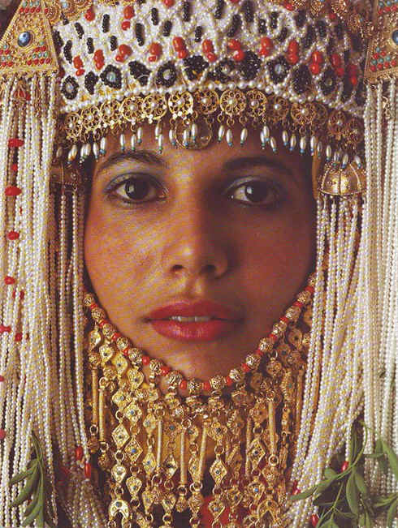
以斯帖记
灭绝阴谋
被破解
Dr. Rick Griffith • 博士 • 新加坡神学院 • www.BibleStudyDownloads.org
Notes:
1

Slide 2
关键字
308
39
神的介入
以斯帖

Slide 3
主题
308
灭族阴谋被瓦解
以斯帖

Slide 4
关键节
308
(末底改对以斯帖) “这时你若是缄默不言，犹大人必会从别的地方得着解救，那时你和你的父家就必灭亡。谁知你得了王后的位分，不是为了挽救现今的危机吗?”
(以斯帖 4:14).
以斯帖

Slide 5
以斯帖 国度宣言
39
神所预备的扭转了以色列民被灭族的危机，这显示了神掌管万国万民。

Slide 6
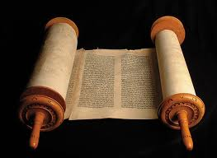
以斯帖记 信息声明
308
41
上帝旨意籍着末底改和以斯帖扭转哈曼的灭族阴谋，使其作茧自缚承担灭族后果，并激励被掳后期以色列人上帝对亚伯拉罕之约的坚守。

Slide 7
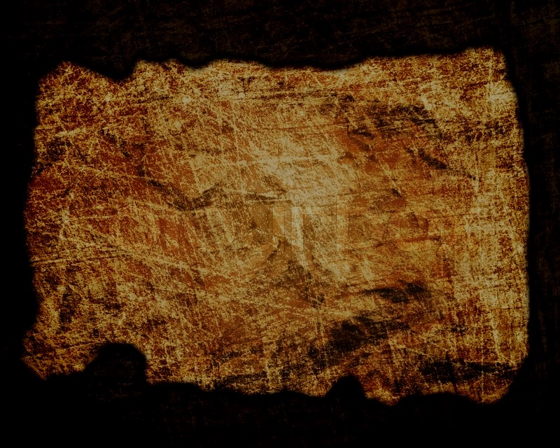
圣约
42b
神保守以色列民免受灭族的危机 (4:14; 比较 耶 31:35-37), 实现他的约所应许的, 默默地预备了将来弥赛亚的临到。
以斯帖

Slide 8
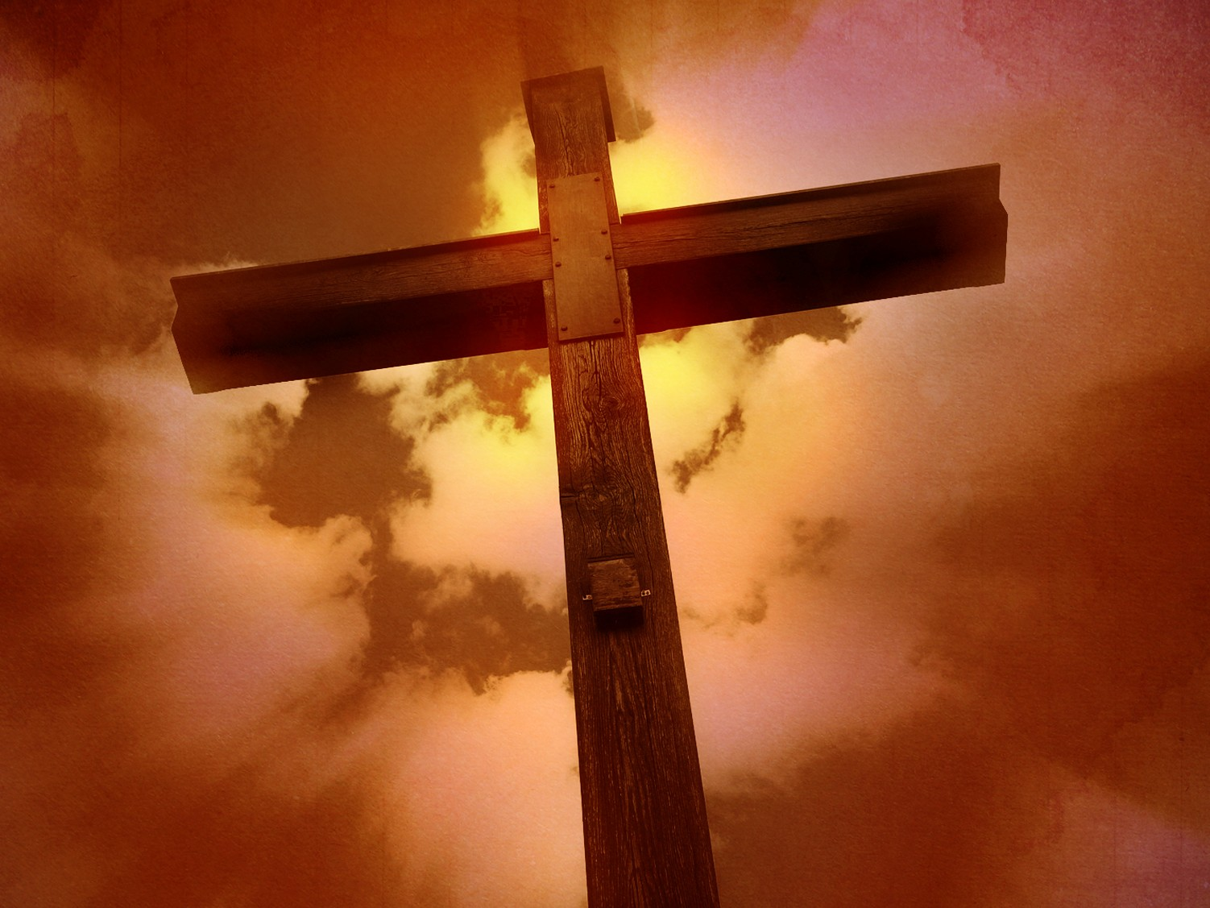
救赎
42b
正如哈曼的计谋，
所有要透过铲除神所救赎的以色列民
来摧毁神的拯救计划的计谋都会失败。
以斯帖

Slide 9
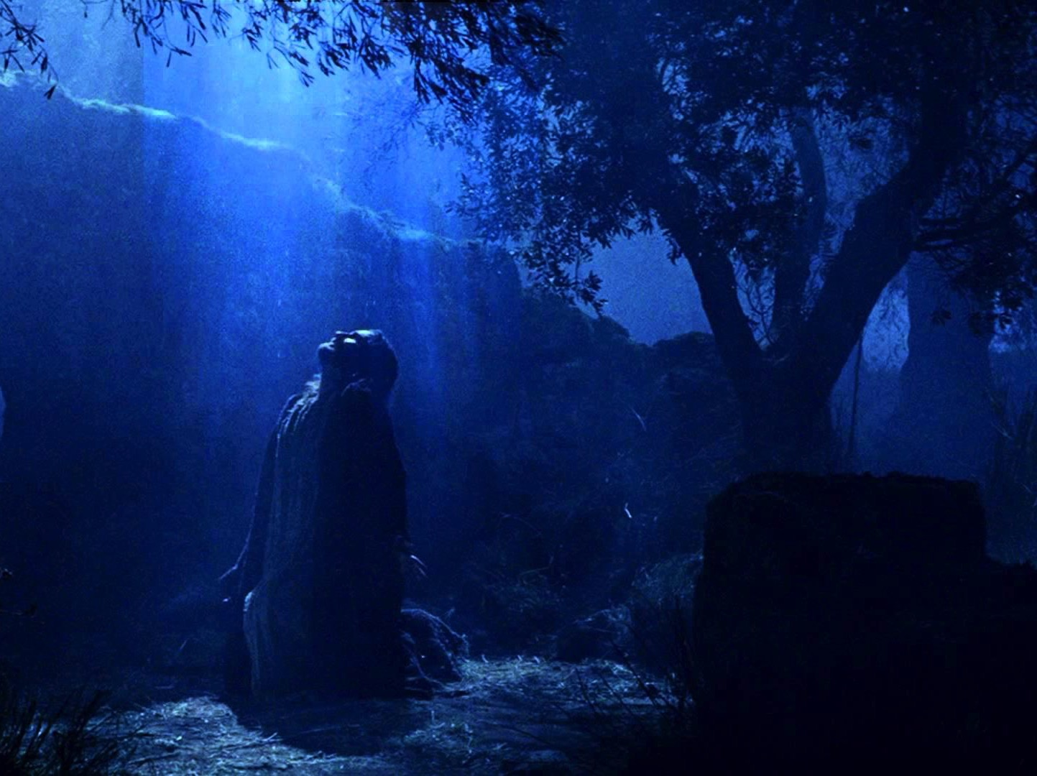
弥赛亚
42a
皇后冒生命危险拯救犹太人 (4:16)
并且为他们辩护 (7:1-6)，
这些都描绘了基督所扮演的角色。
以斯帖

Slide 10
以斯帖记
308
灭族阴谋被瓦解
策划阴谋
瓦解阴谋
第 1—4 章
第 5—10 章
威胁
胜利
预备上帝的介入
实施上帝介入
迫害
保存
大危机
大拯救
亚哈随鲁王大宴
以斯帖的普珥宴
以斯帖被高举
1:1—2:18
哈曼的威胁
2:19—4:17
末底改胜
哈曼
5:1—8:2
以色列胜 敌人
8:3—9:32
末底统治波斯
10
波丝
10 年 (483-473 BC)

Slide 11
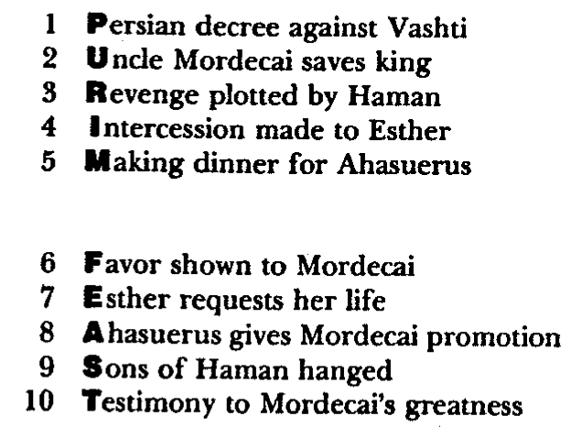
Barry Huddleston, The Acrostic Summarized Bible 圣经总意离合诗集 (Grand Rapids: Baker, 1992)
1 Inception of the world
2 Newlyweds placed in Eden
3 Temptation and man's fall
4 Hatred and first murder
5 Entire genealogy of Adam
6 Lessons on proper priorities
7 Outline for personal relationships
8 Faith of the centurion
以斯帖
29 Genealogy of Jesus Christ
30 Opposition of King Herod
31 Spirit's descent upon Jesus
32 Power over Satan's temptations
33 Expounding Sermon on Mount
34 Lessons on proper priorities
35 Outline for personal relationships
36 Faith of the centurion
9 Matthew's call from Jesus
10 Apostles sent to preach
11 Testimony about John's message
12 True Messiah called demonic
13 Hidden message of parables
14 Execution of the Baptist
15 Wisdom is answering Pharisees
37 Matthew's call from Jesus
38 Apostles sent to preach
39 Testimony about John's message
40 True Messiah called demonic
41 Hidden message of parables
42 Execution of the Baptist
43 Wisdom is answering Pharisees
16 Keys of the kingdom
17 Impact of Jesus' transfiguration
18 Need for true forgiveness
19 Grounds for divorce clarified
20 Opportunities in the vineyard
21 Fig tree is cursed
44 Keys of the kingdom
45 Impact of Jesus' transfiguration
46 Need for true forgiveness
47 Grounds for divorce clarified
48 Opportunities in the vineyard
49 Fig tree is cursed
22 Taxes paid to Caesar
23 Hypocrisy denounced by "woes"
24 Events of second coming
25 Judgment of the nations
26 Events on Calvary's eve
27 Way of the cross
28 Savior's resurrection and commission
50 Taxes paid to Caesar
51 Hypocrisy denounced by "woes"
52 Events of second coming
53 Judgment of the nations
54 Events on Calvary's eve
55 Way of the cross
56 Savior's resurrection and commission

Slide 12
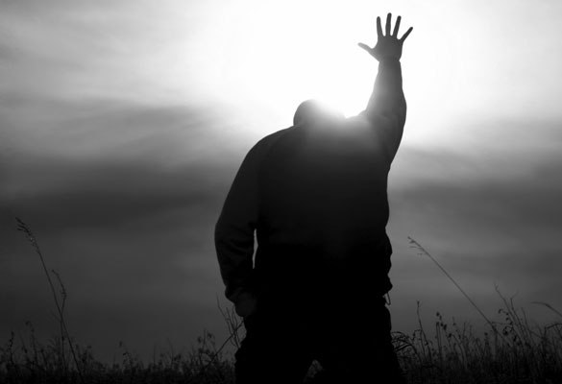
作个坚定忠实的人
以斯帖
Dr. Rick Griffith • Crossroads International Church Singapore
CICFamily.com • BibleStudyDownloads.org

Slide 13
一般教会都缺少了认真的委身
为什么会这样?
Notes:
Why do you think? Tell your neighbor next to you.

Slide 14
神真的关心那些被遗留下来的人吗?
大部分的犹太人即使在被掳时期之后也没能回归到以色列地

Slide 15
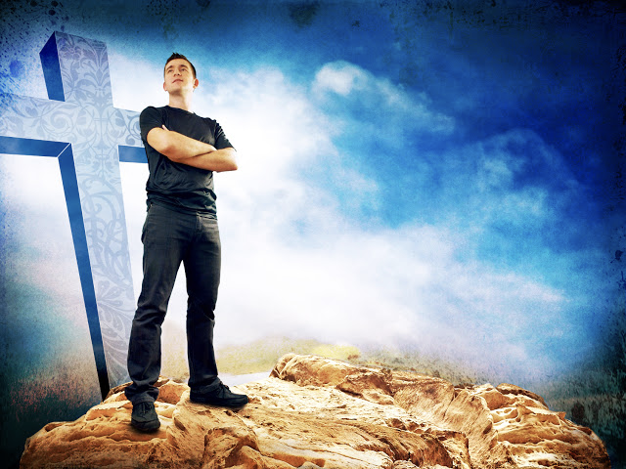
为什么你需要 委身与神?
以斯帖
Notes:
What reasons can you give to be dedicated, loyal and devoted to the Lord?

Slide 16
神的工作面临威胁 (以斯帖 1–4)。
为什么要委身与神?
Notes:
Satan is always trying to push down whatever the Lord does.
God commands our wholehearted devotion as we face many obstacles while God fulfills his plan.

Slide 17
神的工作面临威胁 (以斯帖 1–4)。
为什么要委身与神?
神的工作终必得胜
(以斯帖 5–10)。
Notes:
Satan is always trying to push down whatever the Lord does.
But the Lord will eventually be the victor.
It’s easier to be committed to God’s plan when we know that it will ultimately succeed.

Slide 18
神的工作面临威胁 (以斯帖 1–4)。
为什么要委身与神?
神的工作终必得胜
(以斯帖 5–10)。
主旨: 尽管撒旦诸般威胁， 神终必胜利
Notes:
The devil is especially intent on trying to destroy God's plan for Israel.
Yet God has promised to Abraham that he will bless this nation and all peoples through them!

Slide 19
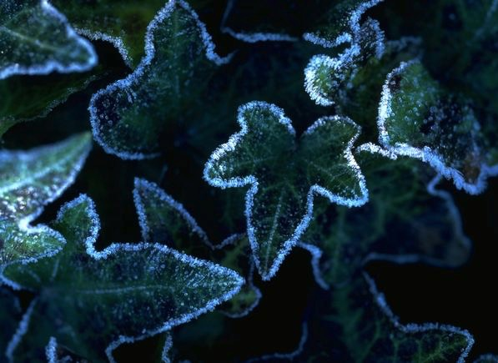
应用
308
在上帝把你摆在的位
置上去帮助神的百姓。

Slide 20
Black

Slide 21
复习测验：以斯拉记-尼希米记
以斯拉记的两位主要人物是________ 和 _______.
尼希米记的两位主要人物是 _______ 和 _________.
以斯拉着重于重建 _____, 尼希米着重于重建____.两人都着重于改革_____.

Slide 22
复习测验：以斯拉记-尼希米记
以斯拉的两位主要人物是 所罗巴伯 和以斯拉.
尼希米记的两位主要人物是________ 和 _________.
以斯拉着重于重建 ____, 尼希米着重于重建 ___. 两人都着手于改革 _____.

Slide 23
复习测验：以斯拉记-尼希米记
以斯拉的两位主要人物是 所罗巴伯 和 以斯拉.
尼希米的两位主要人物是 以斯拉 和 尼希米.
以斯拉着重于重建_____,尼希米着重于重建 ____. 两人都着手于改革 ____.

Slide 24
测验复习：以斯拉记-尼希米记
以斯拉的两位主要人物是所罗巴伯 和以斯拉.
尼希米的两位主人物是以斯拉
和尼希米.
以斯拉着重于重建神殿. 尼希米着重于重建城墻. 两人都着手于改革子民.

Slide 25
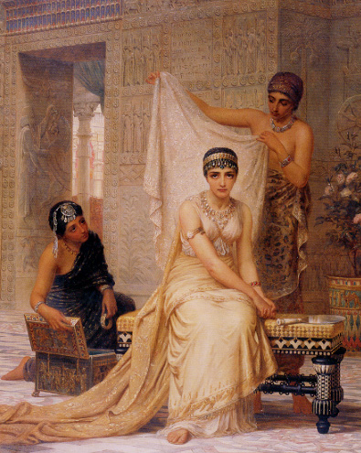
以斯帖记在旧约历史中的什么时期？
Notes:
25

Slide 26
以斯帖
耶稣
大卫
亚伯拉罕
洪水
今代
列王记
教会
部落
3000
2000
1000
0
1000
2000
创造
新创造

Slide 27
出埃及记- 撒母耳记上
撒母耳记下– 以斯帖记
耶稣
创世记
大卫
亚伯拉罕
洪水
今代
列王记
教会
部落
3000
2000
1000
0
1000
2000
创造
新创造

Slide 28
尼希米
以斯拉记-尼希米记
联盟
王国
1050-930
分裂
王国
930-722
孤立
王国
722-586
流亡
后期
536-425
1100
1050
1000
950
900
850
800
7 5 0
7 0 0
650
600
550
500
450
流亡 606-536

Slide 29
以斯帖记
联盟
王国
1050-930
分裂
王国
930-722
孤立
王国
722-586
流亡
后期
536-425
1100
1050
1000
950
900
850
800
7 5 0
7 0 0
650
600
550
500
450
流亡 606-536

Slide 30
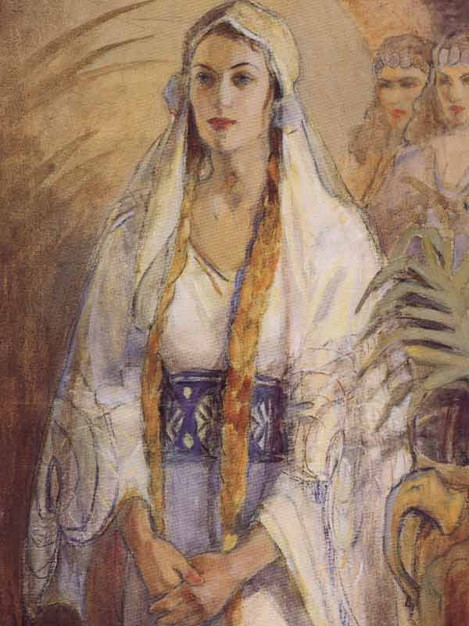
以斯帖记流亡后期的什么时期？
Notes:
30

Slide 31
回归年代表
尼希米
(444-430)
所罗巴伯
(537-516)
以斯帖 483-473
以斯拉 (457-444)
540
530
520
510
500
490
480
470
460
450
440
430
420
410
佛祖 560-477
蘇格拉底 470-399
孔子 551-479
柏拉圖 427-347

Slide 32
尼布甲尼撒六次将犹太人掳到巴比伦
492
人数 | 年日 | 犹大王 | 带走的数目 | 主要俘虏 | 结果/ 备注
1 少 | 605 BC | 约雅敬 | 少数 (但 1:3) | 但以理, 3个朋友和贵族和王族 | 征收贡物. 强大的埃及.
2 中 | 598 BC | 约雅敬 | 3023 (耶 52:28) |  | 少数驱逐
3 多 | 597 BC | 约雅斤 | 10,000 (王下 24:14) | 约雅斤, 以西结, 末底改 | 尼布甲尼撒驱逐许多; 安设西底家
4 少 | 587 BC | 西底家 | 832 (耶 52:29) |  | 摧毁前
5 多 | 586 BC | 西底家 | ca. 10,400 (王下 25:11) | 西底家 | 耶路撒冷和圣殿被毁
6 少 | 582 BC |  | 745 (耶 52:30) |  | 耶路撒冷亡国后4 年
Notes:
32
OS-17-Nehemiah-32
OS-24-Jeremiah-

Slide 33
波丝王国事蹟时序 John H. Walton, Chronological and Background Charts of the OT, 2d ed., 70
313
波丝帝国的君王
日期
与圣经相关之事
与希腊相关之事
居鲁士
539-530
所罗巴伯与
耶书亚回归 (以斯拉记 1-3)
刚比西丝斯
530-522
耶路撒冷重建停止 (以斯拉记 4)
大流士一世
522-486
哈该与撒迦利亚
的预言(520)
神殿完工 (516)
(以斯拉记 5-6)
雅典军队於马拉松打败波丝军队 (490)
薛西斯
486-464
以斯帖的故事
(以斯帖记 1-9)
雅典军队伍打败波丝军队於
帖模派里 (480) 与
萨拉米斯 (479)
希罗多德 485-425
亚达薛西 一世
464-423
以斯拉回归 (458)
(以斯拉记 7-10)
尼希米回归 (445)
(尼希米 1-2)
马拉基的预言 (433)
黄金时代 (461-431)
伯利克里 (460-429)
雅典统治

Slide 34
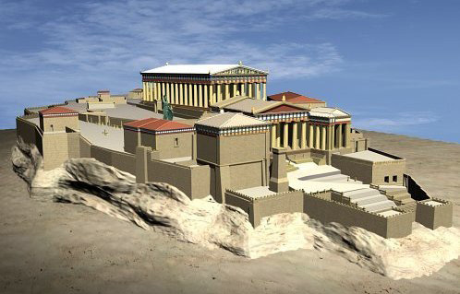
The Pinnacle of Greek History
Democracy & Building the Parthenon
Notes:
The background to 以斯帖 is the rise of democracy in Greece in the preceding century. It was based on the natural hill in Athens.

Slide 35
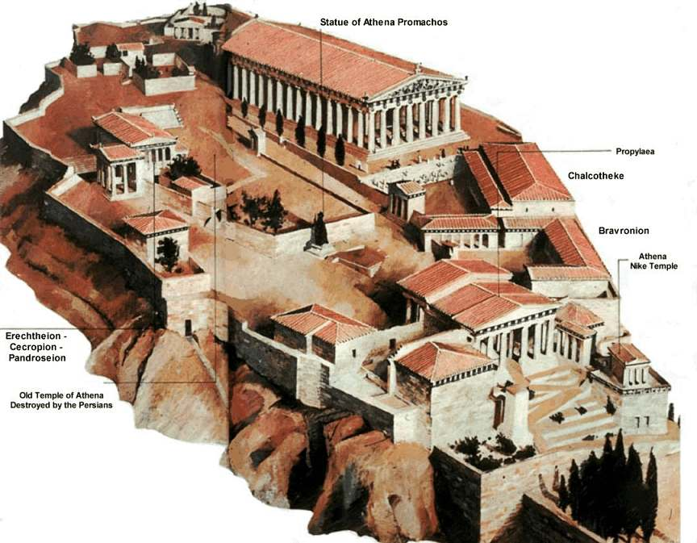
The Acropolis
Notes:
On this outcrop called the Acropolis was the center of Greek pagan religion that focused on the goddes Athena.

Slide 36
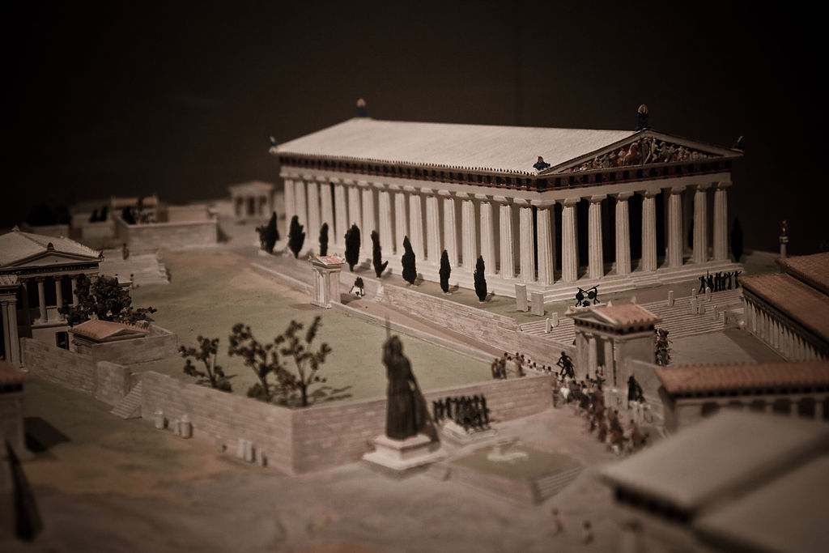
A Target for Persia…
Democracy & Building the Parthenon
Notes:
The Parthenon was considered the pinnacle of all buildings with so-called perfect proportions.

Slide 37
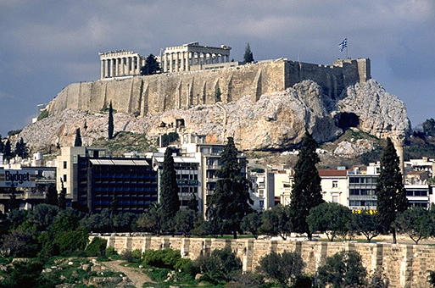
The Acropolis Today
Notes:
Although it doesn’t look like much today…

Slide 38
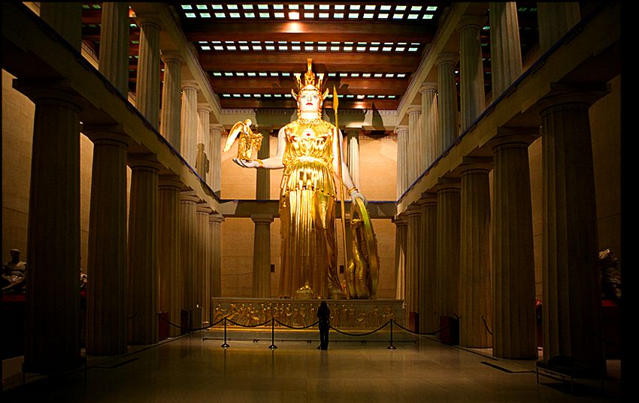
The Pinnacle of Greek History
Athena (goddess of wisdom) inside the Parthenon
Notes:
Inside the Parthenon was a gold-lated statue of the goddess of wisdom, Athena.

Slide 39
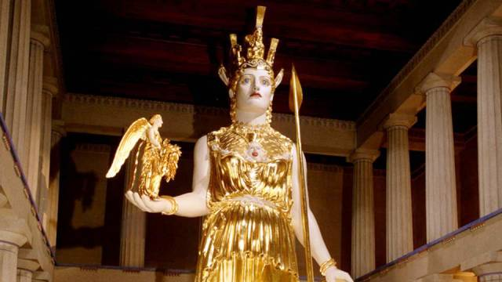
The Pinnacle of Greek History
Athena (goddess of wisdom) inside the Parthenon
Notes:
How ironic that the builders who sought wisdom from Athena lacked the wisdom to avoid idolatry!

Slide 40
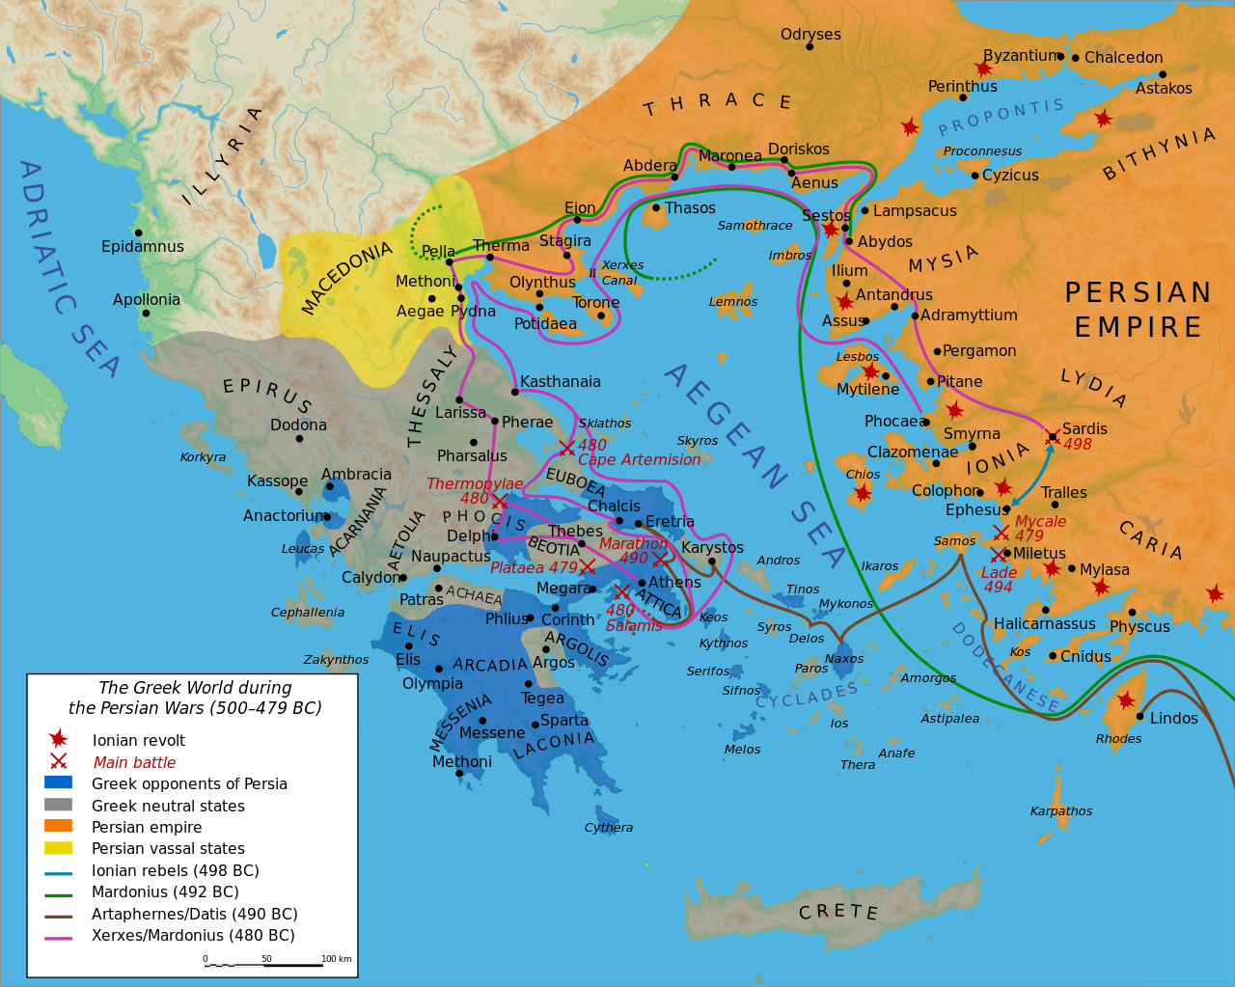
Persian Invasions of Greece (500-479 BC)
Notes:
Xerxes followed the lead of his predecessor Darius I, who a decade earlier had invaded Greece and was defeated at Marathon (490 BC).
“The Battle of Marathon (Greek: Μάχη τοῦ Μαραθῶνος, Machē tou Marathōnos) took place in 490 BC, during the first Persian invasion of Greece. It was fought between the citizens of Athens, aided by Plataea, and a Persian force commanded by Datis and Artaphernes. The battle was the culmination of the first attempt by Persia, under King Darius I, to subjugate Greece. The Greek army decisively defeated the more numerous Persians, marking a turning point in the Greco-Persian Wars.
The first Persian invasion was a response to Greek involvement in the Ionian Revolt, when Athens and Eretria had sent a force to support the cities of Ionia in their attempt to overthrow Persian rule. The Athenians and Eretrians had succeeded in capturing and burning Sardis, but they were then forced to retreat with heavy losses. In response to this raid, Darius swore to burn down Athens and Eretria. According to Herodotus, Darius asked for his bow, he placed an arrow upon the string and he discharged it upwards towards heaven, and as he shot into the air he said: "Zeus, grant me to take vengeance upon the Athenians!". Also he charged one of his servants, to say to him, every day before dinner, three times: "Master, remember the Athenians."^{[3]}
At the time of the battle, Sparta and Athens were the two largest city states. Once the Ionian revolt was finally crushed by the Persian victory at the Battle of Lade in 494 BC, Darius began plans to subjugate Greece. In 490 BC, he sent a naval task force under Datis and Artaphernes across the Aegean, to subjugate the Cyclades, and then to make punitive attacks on Athens and Eretria. Reaching Euboea in mid-summer after a successful campaign in the Aegean, the Persians proceeded to besiege and capture Eretria. The Persian force then sailed for Attica, landing in the bay near the town of Marathon. The Athenians, joined by a small force from Plataea, marched to Marathon, and succeeded in blocking the two exits from the plain of Marathon. The Athenians also sent a message asking for support to the Spartans. However, at the time the Spartans were involved in a religious festival and gave this as a reason for refusing to aid the Athenians.
https://en.wikipedia.org/wiki/Battle_of_Marathon
Accessed 13 Sep 2016

Slide 41
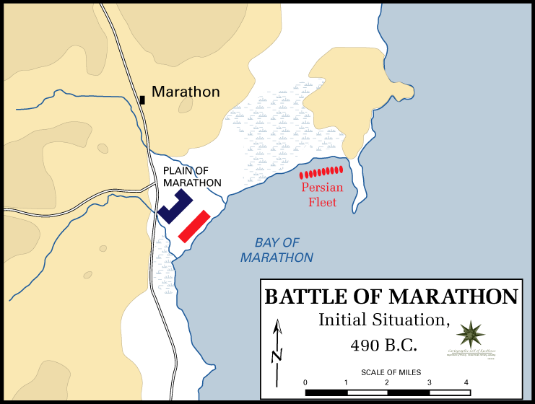
The Battle of Marathon (490 BC)
Greece defeated the Persians
Notes:
“The Battle of Marathon…
The Greeks could not hope to face the superior Persian cavalry; however, the location chosen was surrounded by marshes and mountains and so the cavalry was unable to join the main Persian army. Miltiades, the Greek general, ordered a general attack against the Persians. He reinforced his flanks, luring the Persians' best fighters into his centre.”
https://en.wikipedia.org/wiki/Battle_of_Marathon
Accessed 13 Sep 2016

Slide 42
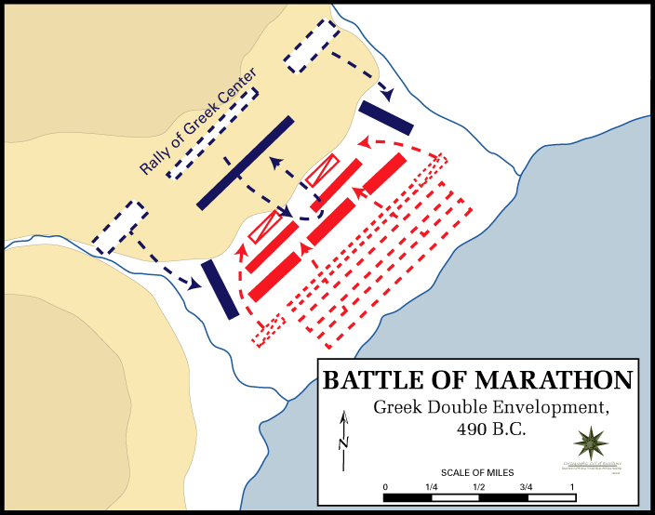
The Battle of Marathon (490 BC)
Greece defeated the Persians
Notes:
“The Battle of Marathon…
The inward wheeling flanks enveloped the Persians, routing them.”
https://en.wikipedia.org/wiki/Battle_of_Marathon
Accessed 13 Sep 2016

Slide 43
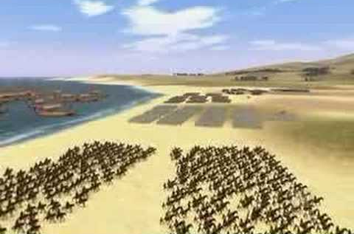
The Battle of Marathon (490 BC)
Greece defeated the Persians
Notes:
“The Battle of Marathon…
The Persian army broke in panic towards their ships, and large numbers were slaughtered. The defeat at Marathon marked the end of the first Persian invasion of Greece, and the Persian force retreated to Asia. Darius then began raising a huge new army with which he meant to completely subjugate Greece; however, in 486 BC, his Egyptian subjects revolted, indefinitely postponing any Greek expedition. After Darius died, his son Xerxes I restarted the preparations for a second invasion of Greece, which finally began in 480 BC.
https://en.wikipedia.org/wiki/Battle_of_Marathon
Accessed 13 Sep 2016

Slide 44
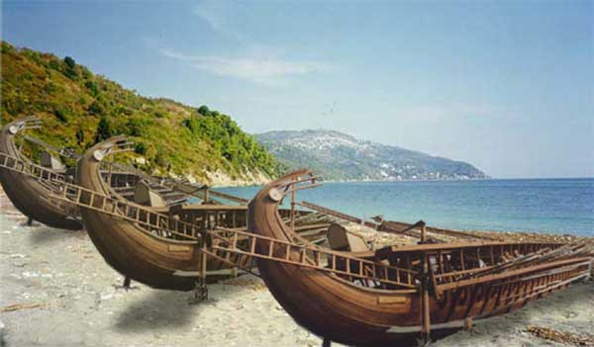
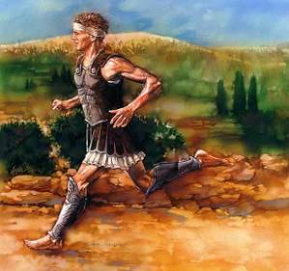
The Battle of Marathon (490 BC)
Greece defeated the Persians
Notes:
“The Battle of Marathon was a watershed in the Greco-Persian wars, showing the Greeks that the Persians could be beaten; the eventual Greek triumph in these wars can be seen to begin at Marathon. The battle also showed the Greeks that they were able to win battles without the Spartans, as they had heavily relied on Sparta previously. This win was largely due to the Athenians, and Marathon raised Greek esteem of them. Since the following two hundred years saw the rise of the Classical Greek civilization, which has been enduringly influential in western society, the Battle of Marathon is often seen as a pivotal moment in Mediterranean and European history.
The battle is perhaps now more famous as the inspiration for the marathon race. Although thought to be historically inaccurate, the legend of the Greek messenger Pheidippides running to Athens with news of the victory became the inspiration for this athletic event, introduced at the 1896 Athens Olympics, and originally run between Marathon and Athens.”
https://en.wikipedia.org/wiki/Battle_of_Marathon
Accessed 13 Sep 2016

Slide 45
Persian Invasions of Greece = Frustrated Xerxes
Greeks defeat Persians at Marathon (490)
Xerxes 7-day banquet where Queen Vashti deposed (483)
Persians defeat Greeks at Thermopylae but reversed at Salamis (Sept 480)
Book of 以斯帖 483-473
490
489
488
487
486
485
484
483
482
481
480
479
478
477
Darius 522-486
Xerxes 486-464

Slide 46
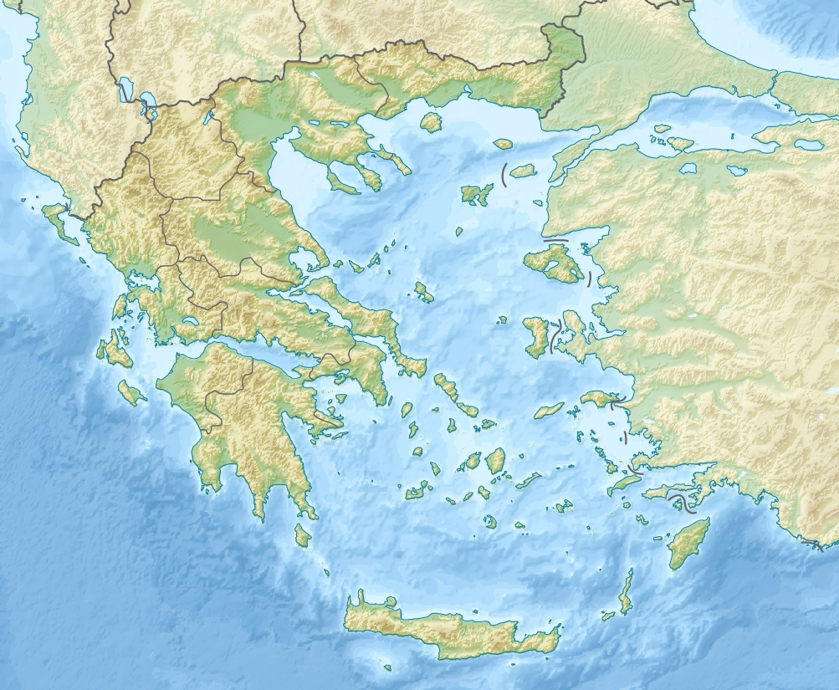
The Battle of Thermoplylae (480 BC)
Thermoplylae
Bay of Salamis
Notes:
“The Battle of Thermopylae (/θərˈmɒpᵻliː/ thər-MOP-i-lee; Greek: Μάχη τῶν Θερμοπυλῶν, Machē tōn Thermopylōn) was fought between an alliance of Greek city-states, led by King Leonidas of Sparta, and the Persian Empire of Xerxes I over the course of three days, during the second Persian invasion of Greece. It took place simultaneously with the naval battle at Artemisium, in August or September 480 BC, at the narrow coastal pass of Thermopylae ("The Hot Gates"). The Persian invasion was a delayed response to the defeat of the first Persian invasion of Greece, which had been ended by the Athenian victory at the Battle of Marathon in 490 BC. Xerxes had amassed a huge army and navy, and set out to conquer all of Greece. The Athenian general Themistocles had proposed that the allied Greeks block the advance of the Persian army at the pass of Thermopylae, and simultaneously block the Persian navy at the Straits of Artemisium.
A Greek force of approximately 7,000 men marched north to block the pass in the middle of 480 BC. The Persian army, alleged by the ancient sources to have numbered over one million, but today considered to have been much smaller (various figures are given by scholars, ranging between about 100,000 and 150,000),^{[8][9]} arrived at the pass in late August or early September. The vastly outnumbered Greeks held off the Persians for seven days (including three of battle) before the rear-guard was annihilated in one of history's most famous last stands. During two full days of battle, the small force led by Leonidas blocked the only road by which the massive Persian army could pass. After the second day, a local resident named Ephialtes betrayed the Greeks by revealing that a small path led behind the Greek lines. Leonidas, aware that his force was being outflanked, dismissed the bulk of the Greek army and remained to guard their retreat with 300 Spartans, 700 Thespians, 400 Thebans, and perhaps a few hundred others, most of whom were killed.
At Artemisium, the Greek navy, under the command of the Athenian politician Themistocles, received news of the defeat. Since the Greek strategy required both Thermopylae and Artemisium to be held, and given their losses, it was decided to withdraw to Salamis. The Persians overran Boeotia and then captured the evacuated Athens. The Greek fleet—seeking a decisive victory over the Persian armada—attacked and defeated the invaders at the Battle of Salamis in late 480 BC. Fearful of being trapped in Europe, Xerxes withdrew with much of his army to Asia (losing most to starvation and disease), leaving Mardonius to attempt to complete the conquest of Greece. However, the following year saw a Greek army decisively defeat the Persians at the Battle of Plataea, thereby ending the Persian invasion.
Both ancient and modern writers have used the Battle of Thermopylae as an example of the power of a patriotic army defending its native soil. The performance of the defenders is also used as an example of the advantages of training, equipment, and good use of terrain as force multipliers and has become a symbol of courage against overwhelming odds.”
https://en.wikipedia.org/wiki/Battle_of_Thermopylae
Accessed 12 Sep 2016

Slide 47
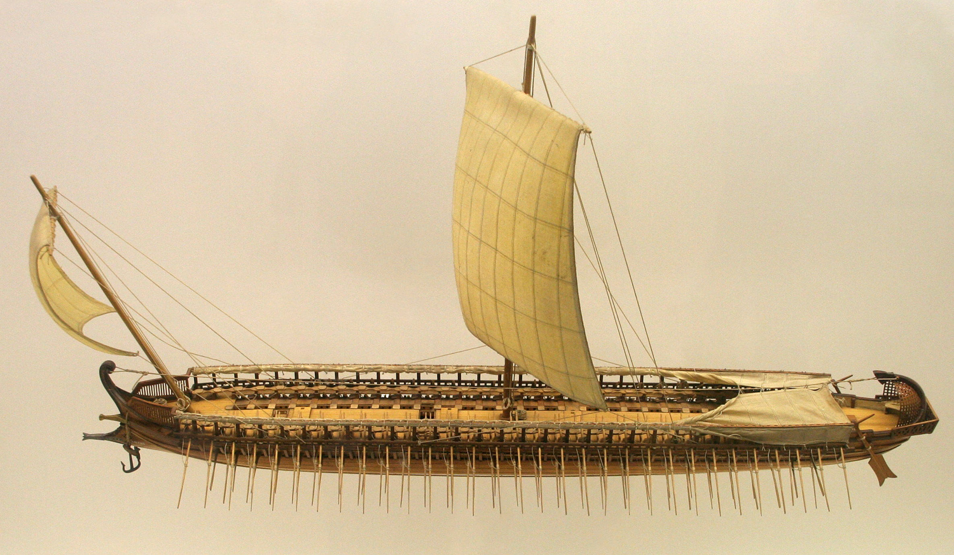
The Greek Trireme
Small but fast and deadly

Slide 48
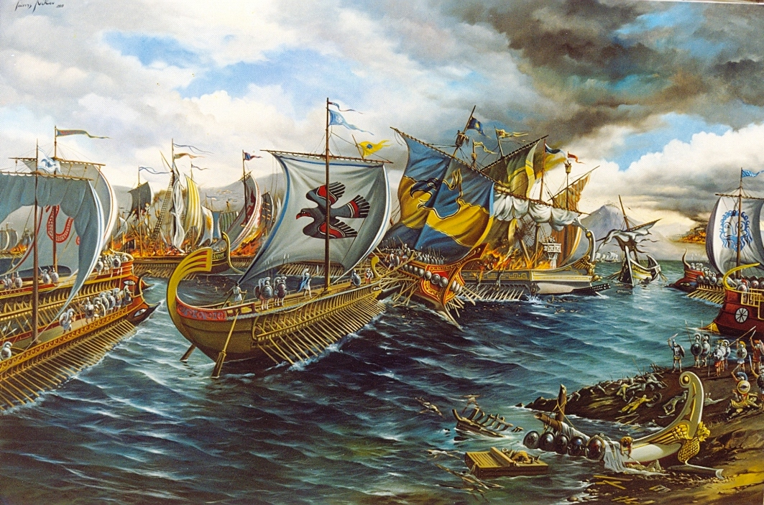
The Battle of Salamis (480 BC)

Slide 49
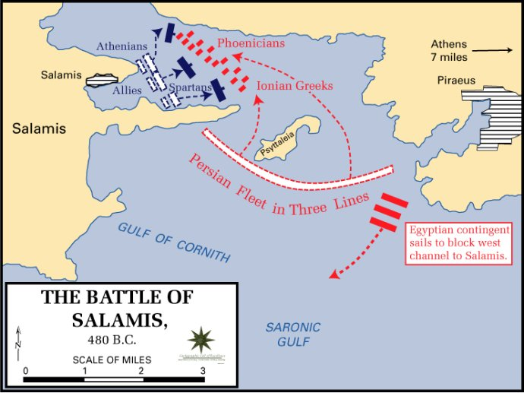
The Battle of Salamis (480 BC)

Slide 50
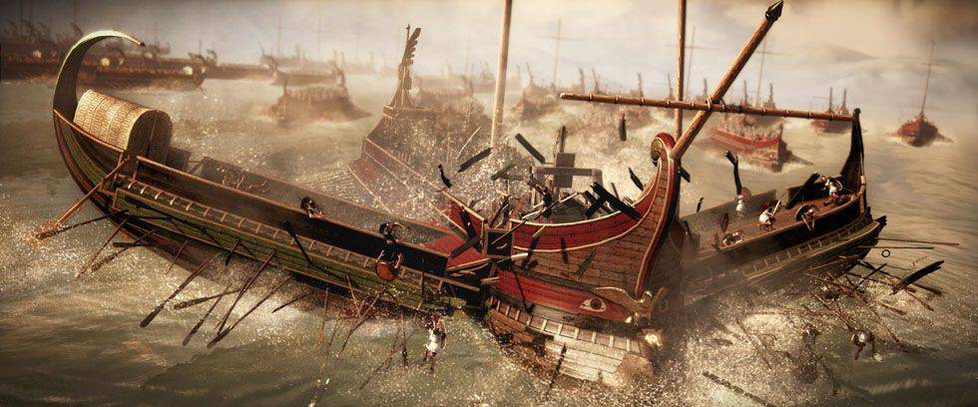
The Battle of Salamis (480 BC)
Casualties: Greeks lost 40 ships Persians: 200-300. Victory at Salamis ended Xerxes' invasion and preserved Greek freedom

Slide 51
Persian Invasions of Greece = Frustrated Xerxes
Greeks defeat Persians at Marathon (490)
Xerxes 7-day banquet where Queen Vashti deposed (483)
Persians defeat Greeks at Thermopylae but reversed at Salamis (Sept 480)
以斯帖 became queen after a 4-year beauty contest (Dec 480 or Jan 479)
Book of 以斯帖 483-473
490
489
488
487
486
485
484
483
482
481
480
479
478
477
Darius 522-486
Xerxes 486-464

Slide 52
Chart of OT Kings & Prophets
232 & 342

Slide 53
Chart of OT Postexilic Era
232 & 342

Slide 54
Key Dates Related to the Book of 以斯帖
314
Reference
Date
Event
–
486
Xerxes' reign began
1:3
483
(3rd year of Xerxes)
Xerxes 7-day banquet for his nobles & officials where Queen Vashti was deposed
–
482-479
Xerxes led disastrous campaigns against Greece, esp. at navy Battle of Salamis (480); recorded by Greek historian Herodotus (7.8)
2:16
Dec 479 or Jan 478
以斯帖 became queen after a 4-year beauty contest
3:7
Early April 474
In the 5th year of 以斯帖's reign, Haman & the astrologers (5:10, 14; 6:12-13) cast the pur (lot) to determine the day to exterminate the Jews 11 months later (7 March 473)
3:12
April 17, 474
(13th of Nisan)
Xerxes' 1st edict (to destroy the Jews) informed everyone of the fateful day, royal secretaries wrote it out in the various languages of the empire

Slide 55
Part 1: Feasts & Jews Threatened
A. Greatness of King Xerxes (1:1-4)
B. Feasts of King & Queens (1:5–2:18)
C. Mordecai Averts King's Death (2:21-23)
D. Promotion of Haman (3:1-6)
E. Haman's Plot & Letters (3:7-15)
F. Mordecai & 以斯帖's Risky Appeal (4:1–5:4)
David Lang, SBC Chapel, 29 Mar 2012

Slide 56
Part 2: Mordecai Honored/Haman Hanged
G. 以斯帖's 1st Banquet for King/Haman (5:5-8)
H. Words of Haman's Wife & Friends (5:9-14)
I. Mordecai Honored by Haman (6:1-11)
H'. Words of Haman's Wife & Friends (6:12-14)
G'. 以斯帖's 2nd Banquet for King/Haman (7:1–8:2))
F'. 以斯帖's Risky Appeal (8:3-7)
David Lang, SBC Chapel, 29 Mar 2012

Slide 57
Part 3: Jews Saved & Feasts
E'. Haman's Plot Foiled & Mordecai's Letters (8:8-17)
D'. Promotion of Mordecai (8:15-11)
C'. Mordecai & 以斯帖 Save Jews (9:1-19)
B'. Feasts Ordered by Mordecai & 以斯帖 (9:20-32)
A'. Greatness of Mordecai (10:1-3)
David Lang, SBC Chapel, 29 Mar 2012

Slide 58
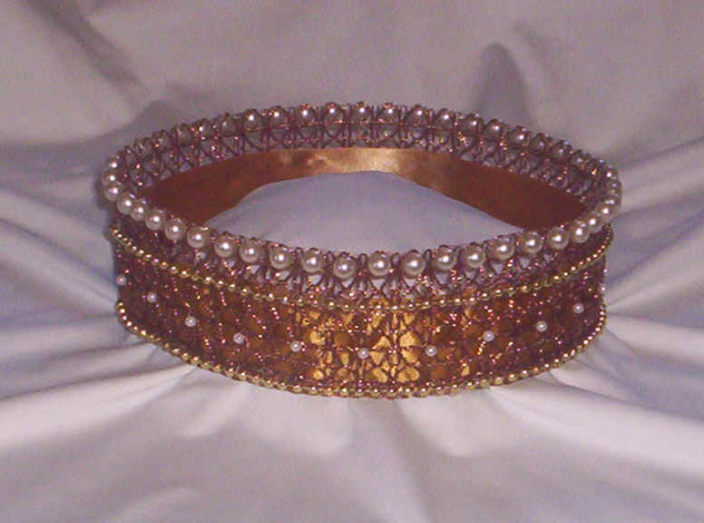
作者
309
外部的証據
犹太讨论以斯帖记不只在于作者不明确的身份,也涉及其他问题.
教会与犹太教堂对于作者的对比经段和意见并不显著.
内部的証據
由于此书没有给于明确的提示，所以只能猜测作者的身份.
此书非常详细的记载波丝和犹太人的生活,所以很难假设作者不是一位通晓波丝方式的犹太人.
以斯拉，尼希米，和莫迪凯都有人提意为作者.
无人真正知晓此书作者的身份.

Slide 59
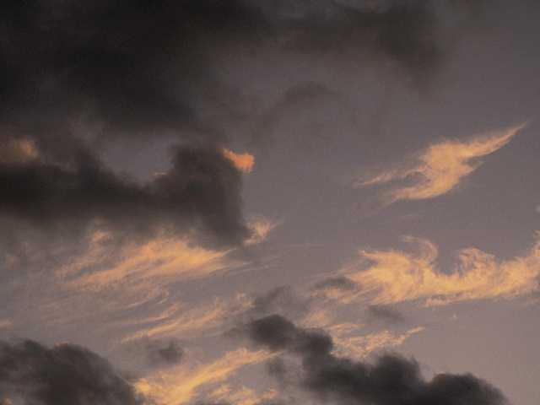
情况
309
日期
既此书记载的事件止于公元前473年, 假定笔录的日期是在这不久之后是合理的－ 或许在薛西斯统治（至464年）之后 ，却不晚于公元前435年书珊宫被烧毁的年份，因以斯帖记没有记载这重大的事件.

Slide 60
情况
309
接纳者
以斯帖记最初的读者包括尼希米与玛拉基时代和旧新约之间 回归后的群体.
神对犹太人的眷顾对居留在波丝和以色列的犹太人都起了很大的鼔励作用.

Slide 61
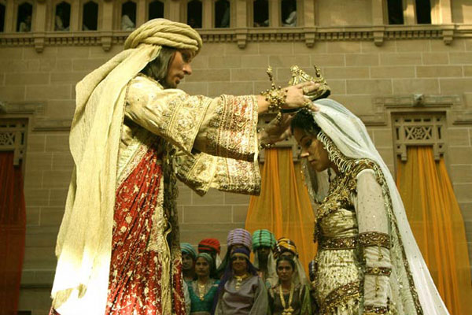
场合
309
以斯帖记是记载以斯拉记六至七章(公元前516-458 )五十八年之间－段十年所发生的事端.
故事发生于公元前483 至 473，既是犹太人第一次由所罗巴伯领导回归(公元前538)与第二次以斯拉领导回归 (公元前458)之间.

Slide 62
场合
309
若没有以斯帖记在圣经里的记载,当一小部分回归后，大多数选择遗留在巴比伦的后放逐犹太人的状况将不为人所知。
以斯拉及尼希米这两本书断言上帝对小部分回归部落的眷顾，而以斯帖则表现出上帝慷慨照顾这些属灵冷漠,需要整顿的犹太人。

Slide 63
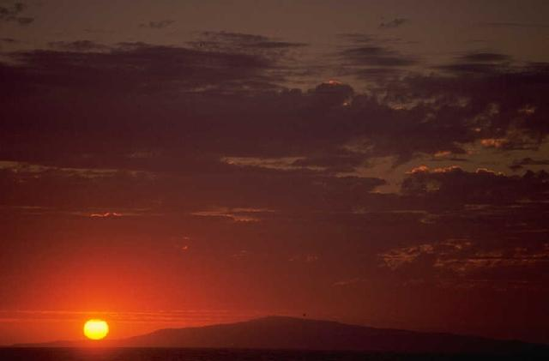
特征
309-310
史实性
以斯帖记内存许多关于波斯帝国的目击记录几乎都没有得到外部来源的核实。直到近期，亚哈随鲁才被确定就是公元
前485-465统治波斯的薛西斯.

Slide 64
特征
309-310
正规：以斯帖记的价值长久以来一直被辩论。
摩尼得斯讲解，当弥赛亚来了，每本在犹太圣经里的书将消失，只有法律与以斯帖记将永存 。
但马丁路德却希望这本书从未被写因它存有很多难解的问题.
对这本书有分歧意见的原因是它存有的许多特点：
这本书从未提及上帝之名 。
以斯帖记没有被引用在新约或被记载在死海古卷。
它从来没有提及法律或犹太供奉或祭品。
它从未提及祷告。
这本书不曾提到任何有关神或属灵的事。
因其独特的文学类型，它被列入旧约书籍里几个不
同分类的部分。

Slide 65
特征
309-310
位置: :
以斯帖记是圣经里唯一记载犹太人在外邦人时代（公元前586至基督返回）生活在国土以外历史的书。
虽然它的时间顺序是排在尼希米记之前，但书中同样的状况则从外邦人时代一直沿续到基督回返让犹太人得到釋放为止。这可能就是解释它为什么会被列为英文圣经历史部里最后一本书的理由 。

Slide 66
特征
309-310
经验教训：以斯帖记教教导几个原则，如：
撒旦的目的是使用他国摧毁犹太人.
上帝的目的是使用他国维护犹太人。
上帝在国际事务上操作，以完成祂护子民的意愿。
上帝在个人事务上操作，以完成祂维护子民的意愿。

Slide 67
诠释途徑
309-310
答复：没有提到“外邦人时代”,而是用简单的方式记录为历史。
1. 预言-以斯帖预测在外邦人时代, 国土外的犹太人将被存留。
历史-以斯帖记记载上帝对祂所遴选的子民的眷顾是为了证明祂对亚伯拉罕盟约实行的义务。以下这节将展示这论点是最佳的选择。
答复：这是含糊的因为所用的是个简单的历史叙事方式。
2. 寓言-以斯帖记是有关人类的故事 。
答复：虽然这是一个独特的观点，但它的弱点在于新约倒读返回久约。
典型-以斯帖记是一个说明基督徒在教会年代或千福年的神圣
象征的举例。

Slide 68
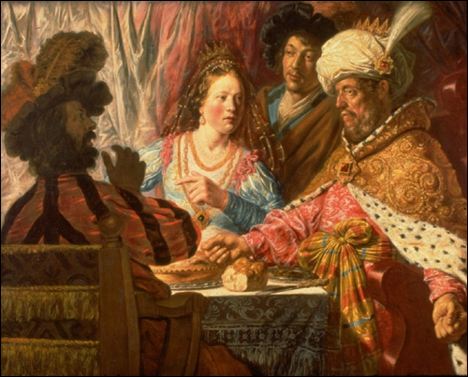
錀題
309
“以斯帖”这名取自波斯语, 意思是
“一颗星”. 这名恰当不过因以斯帖是这本书之星. 她的希伯来名称, 哈大沙, 乃是 “桃金娘树".

Slide 69
论点
310
以斯帖记这历史故事记载上帝如何通过一位虔诚的犹太妇女，以斯帖王后,使到企图歼灭整个犹太民族的阴谋被破解。
这记载叙述了犹太人面对的威胁（1-4章）和他们如何战胜威胁其生存的敌人（5-10章）。
第九章的后部所记载的普珥节庆祝国家被保存，也每年追忆上帝对子民们的忠实。

Slide 70
作个坚定忠实的人
以斯帖
Dr. Rick Griffith • Crossroads International Church Singapore
CICFamily.com • BibleStudyDownloads.org

Slide 71
一般教会都缺少了认真的委身
为什么会这样?
Notes:
Why do you think? Tell your neighbor next to you.

Slide 72
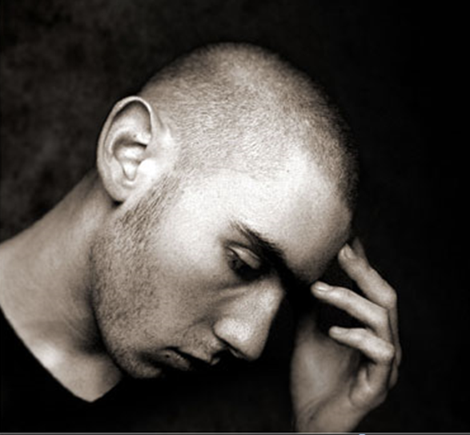
How committed are you to God’s work?
Notes:
If you were accused of being devoted to Jesus, would there be enough evidence to convict you in a court of law?

Slide 73
为什么你需要 委身与神?
以斯帖
Notes:
What reasons can you give to be dedicated, loyal and devoted to the Lord?

Slide 74
Background to 以斯帖
NEVER GIVE UP
Notes:
Today in the book of 以斯帖 we will see that apathy can be cured.

Slide 75
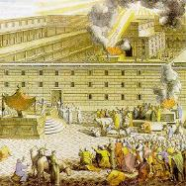
The Postexilic Era
560
被掳后时代
圣殿建造
先知:
哈该
撒迦利亚
玛拉基
605
586
539
536
520
516
483-473
444-425
其他:
所罗巴伯
以斯帖
以斯拉
尼希米
波斯国王:
塞鲁士
大利乌
亚哈随鲁
亚达薛西

Slide 76
神真的关心那些被遗留下来的人吗?
大部分的犹太人即使在被掳时期之后也没能回归到以色列地

Slide 77
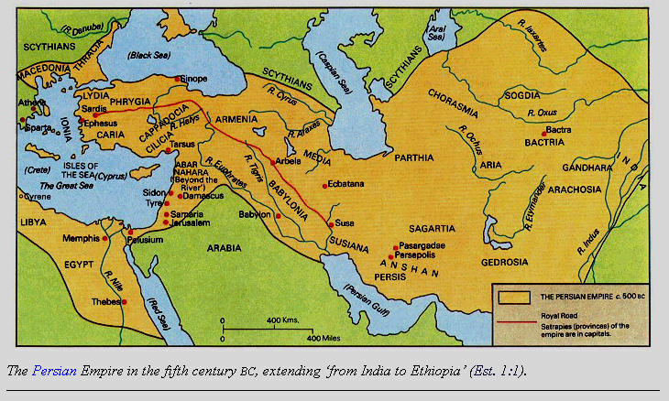
波丝帝国地图
317
Barry J. Beitzel, Moody Atlas of Bible Lands, 150-51
由古列王二世所开始，大利乌一世王统管的帝国边界。这边界由希腊开始直到印度。 （以斯帖1:1）

Slide 78
与以斯拉记的关系
289
重修圣殿与民
圣殿
以斯帖记 (五十八 年分隔)
民
所罗巴伯
以斯拉
以斯拉1–6
以斯拉7–10
50,000 归回
5,000 归回
生存
复兴
工作
敬拜
公元前 538-516 (22 年)
公元前 458-457 (1 年)
外敌:撒玛利亚人
内敌: 娶外邦女子结亲
归回
1–2
重建
3–6
归回
7–8
重修
9–10
告示
1
愿做心智
2
开始
3
敌对
4:1—6:12
完工
6:13-22
资格与预备
7
回归者与保护
8
结亲和哀悼
9
实行分离
10
Notes:
78

Slide 79
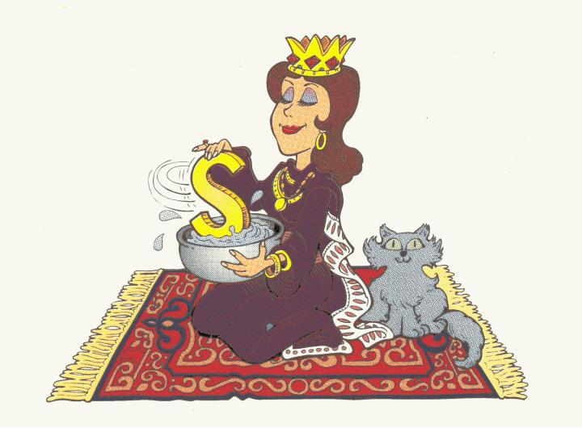
以斯帖:
波斯王后
Walk Through The Bible ©1989

Slide 80
以斯帖记
308
灭族阴谋被瓦解
策划阴谋
瓦解阴谋
第 1—4 章
第 5—10 章
威胁
胜利
预备上帝的介入
实施上帝介入
迫害
保存
大危机
大拯救
亚哈随鲁王大宴
以斯帖的普珥宴
以斯帖被高举
1:1—2:18
哈曼的威胁
2:19—4:17
末底改胜
哈曼
5:1—8:2
以色列胜 敌人
8:3—9:32
末底统治波斯
10
波丝
10 年 (483-473 BC)

Slide 81
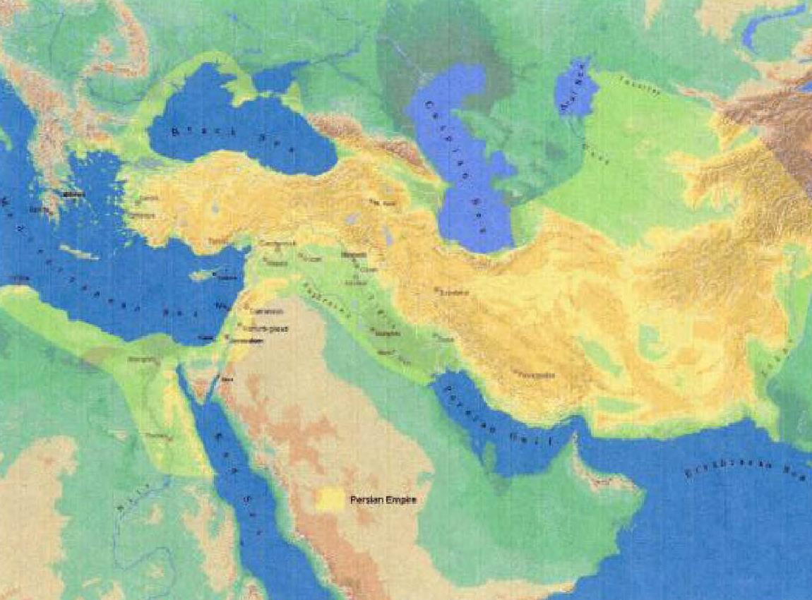
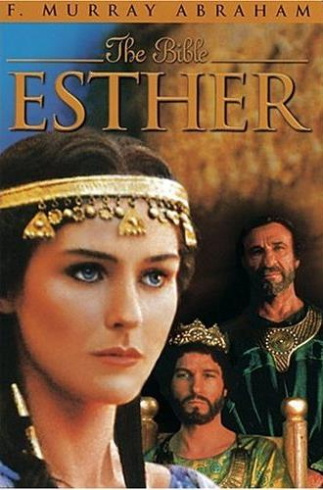
錀词
308
上帝的眷顾

Slide 82
錀节
308
(末底改对以斯帖说) “此时你若闭口不言, 犹大人必从别处得解脱, 蒙拯救, 你和你父家必至灭亡. 焉知你得了王后的位分不是为现今的机会吗?” (以斯帖4:14).

Slide 83
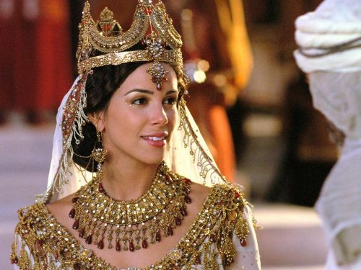
“..为现今的机会”
Notes:
83

Slide 84
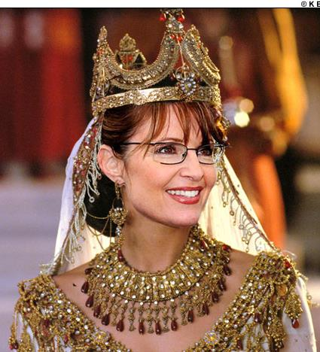
“..为现今的机会”
Notes:
84

Slide 85
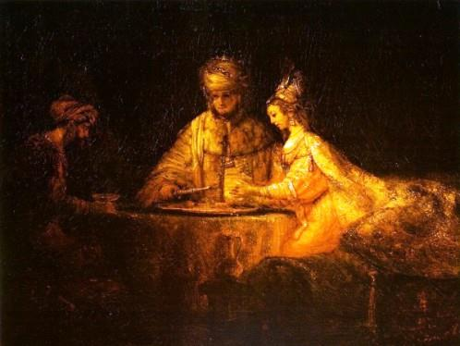
信息声明
308
上帝旨意籍着末底改和以斯帖扭转哈曼的灭族阴谋，使其作茧自缚承担灭族后果，并激励被掳后期以色列人上帝对亚伯拉罕之约的坚守。

Slide 86
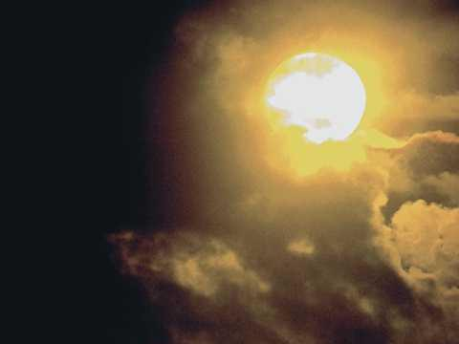
综合
311
灭绝阴谋被破解
1—4计划阴謀 — 威脅
5—10 阴謀破解— 胜利

Slide 87
Why should you be committed to God?
2 REASONS
Notes:
What reasons can you give to be dedicated, loyal and devoted to the Lord?

Slide 88
神的工作面临威胁 (以斯帖 1–4)。
为什么要委身与神?
Notes:
Satan is always trying to push down whatever the Lord does.
God commands our wholehearted devotion as we face many obstacles while God fulfills his plan.

Slide 89
Slides on 以斯帖 1

Slide 90
波丝帝国地图
317
Barry J. Beitzel, Moody Atlas of Bible Lands, 150-51
由古列王二世所开始，大利乌一世王统管的帝国边界。这边界由希腊开始直到印度。 （以斯帖1:1）

Slide 91
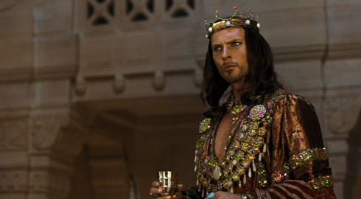
King Xerxe's Unreasonable Command to Queen Vashti
Notes:
The account begins with a very frustrated King Xerxes, or Ahasuerus.

Slide 92
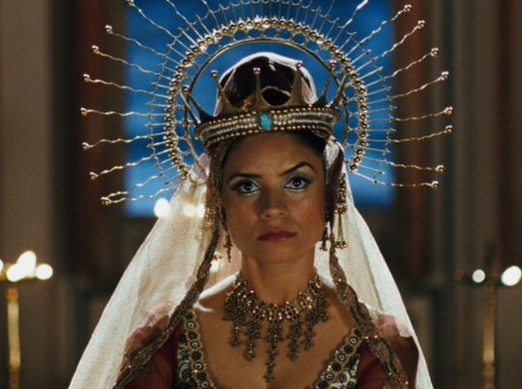
Vashti Upset
Notes:
Xerxes (Heb. Ahasuerus in the book) divorced his disobedient Queen Vashti, unaware of God’s plan for 以斯帖 to replace Vashti to preserve the Jews (以斯帖 1; 483 BC; 1:3).

Slide 93
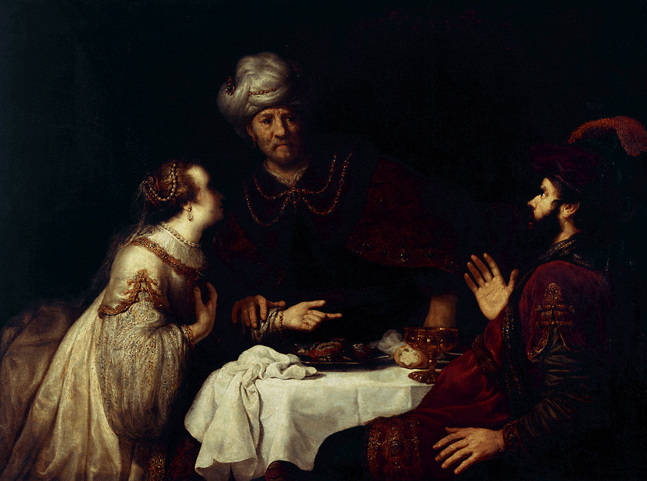
第1–2章
以斯帖
惶惑 1-2
瓦实提
483
479
末底改的擢升
宴席

Slide 94
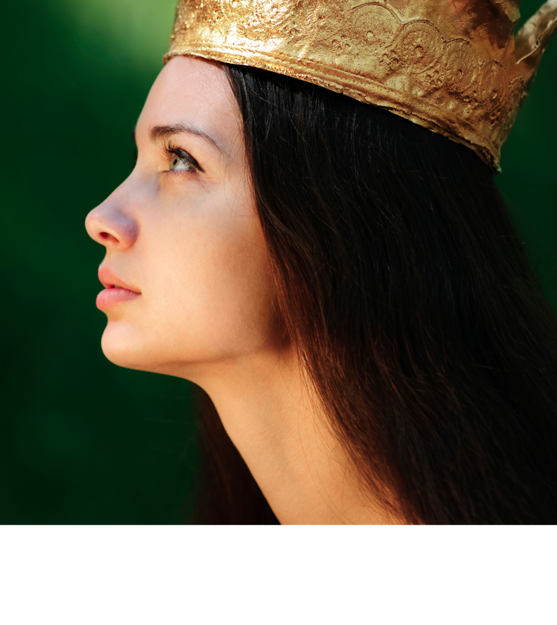
概要
311-312
I. (1—4章) 因上帝巧妙的策略安排, 末底改与以斯帖
发现了哈曼的灭绝阴谋. 神以这事件告诫以色列如若
没有祂的插手，它将无发生存.

Slide 95
Slides on 以斯帖 2

Slide 96
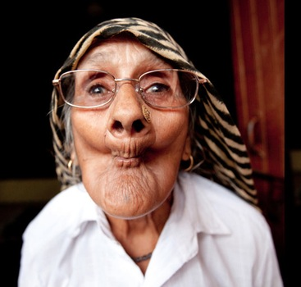
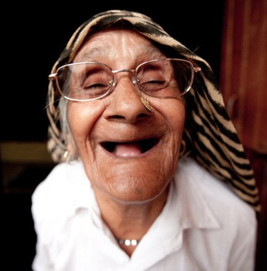
选美大赛

Slide 97
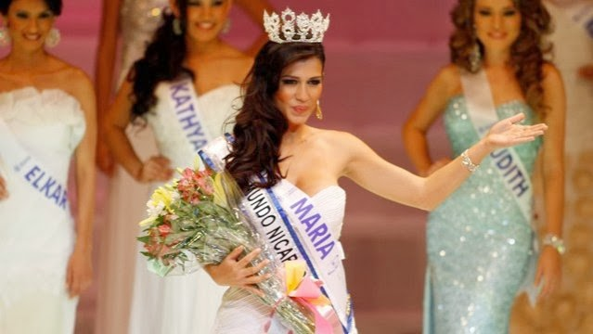
选美大赛

Slide 98
Mordecai the Jew (以斯帖 2:5)
Notes:
"At that time there was a Jewish man in the fortress of Susa whose name was Mordecai son of Jair. He was from the tribe of Benjamin and was a descendant of Kish and Shimei. ⁶ His family had been among those who, with King Jehoiachin of Judah, had been exiled from Jerusalem to Babylon by King Nebuchadnezzar" (2:5-6 NLT).

Slide 99
Mordecai's Young Cousin 以斯帖 (2:7)
Notes:
"This man had a very beautiful and lovely young cousin, Hadassah, who was also called 以斯帖. When her father and mother died, Mordecai adopted her into his family and raised her as his own daughter" (2:7 NLT).

Slide 100
以斯帖是否德行无暇?

Slide 101
以斯帖是否德行无暇?

Slide 102
All the King's Men
Notes:
Haman’s plot to kill the Jews came just after Mordecai foiled a plot to murder the king to show God protecting Jews via 以斯帖 to uphold the Abrahamic Covenant (2:19–4:17).

Slide 103
Eavesdropping
以斯帖
惶惑 1-2
瓦实提
483
479
末底改的擢升
宴会

Slide 104
Slides on 以斯帖 3

Slide 105
Haman the Agagite (以斯帖 3:1-2)
Notes:
"Some time later King Xerxes promoted Haman son of Hammedatha the Agagite over all the other nobles, making him the most powerful official in the empire. ² All the king’s officials would bow down before Haman to show him respect whenever he passed by, for so the king had commanded. But Mordecai refused to bow down or show him respect" (3:1-2 NLT).
"Because Haman was an Agagite, some have supposed that he was descended from Agag, king of the Amalekites (1 Sam. 15:8). However, it seems unlikely that a high-ranking Persian official would be related to a west Semite who lived 600 years earlier. Archeologists have uncovered an inscription which indicates that Agag was also the name of a province in the Persian Empire. This probably explains why Haman was called an Agagite" (John A. Martin, "以斯帖," Bible Knowledge Commentary, 1:705).

Slide 106
No Respect (3:1-2)
以斯帖
大危机
阴谋 3-4
惶惑 1-2
哈曼的擢升与没落
瓦实提
483
479
末底改的擢升
宴会
禁食

Slide 107
Slides on 以斯帖 4

Slide 108
錀节
308
(末底改对以斯帖说) “此时你若闭口不言, 犹大人必从别处得解脱, 蒙拯救, 你和你父家必至灭亡. 焉知你得了王后的位分不是为现今的机会吗?” (以斯帖4:14).

Slide 109
为什么你需要 委身与神?
以斯帖
Notes:
What reasons can you give to be dedicated, loyal and devoted to the Lord?

Slide 110
神的工作面临威胁 (以斯帖 1–4)。
为什么要委身与神?
Notes:
Satan is always trying to push down whatever the Lord does.
God commands our wholehearted devotion as we face many obstacles while God fulfills his plan.

Slide 111
We are secure in our relationship with God—but that doesn’t mean there are no attacks!

Slide 112
We are at war.
Notes:
We are at war. The sad reality is that many of us do not realize it—so we are not committed to God as a result.

Slide 113
Crossroads
Notes:
Each of us is at a crossroads—thus our church is Crossroads International Church.
Like the Jews in the story of 以斯帖, right now we are attacked at home, at work, and a number of other arenas.
We are challenges whether we will take God’s road at the crossroads. Too often our problem is not that we don’t know which road is God’s road. Our issue is having the courage and commitment to do it.
Why should we be committed to God?

Slide 114
神的工作面临威胁 (以斯帖 1–4)。
为什么要委身与神?
神的工作终必得胜
(以斯帖 5–10)。
Notes:
Satan is always trying to push down whatever the Lord does.
But the Lord will eventually be the victor.
It’s easier to be committed to God’s plan when we know that it will ultimately succeed.

Slide 115
概要
311-312
I. (1—4章) 因上帝巧妙的策略安排, 末底改与以斯帖
发现了哈曼的灭绝阴谋. 神以这事件告诫以色列如若
没有祂的插手，它将无发生存.
II. (5—10章)上帝籍着末底改和以斯帖的眷顾行动使到哈曼的灭绝阴谋反转成作茧自缚，激励了回流的以色列族群相信祂会维持与亞伯拉罕立下的旨约.

Slide 116
Slides on 以斯帖 5

Slide 117
以斯帖
大危机
勇气 5-7
阴谋 3-4
惶惑 1-2
哈曼的擢升与没落
瓦实提
483
479
末底改的擢升
宴会
禁食
宴会

Slide 118
以斯帖为犹太人冒了生命

Slide 119
以斯帖记 5:1-8

Slide 120
以斯帖 invited Haman and the king to eat (5:4)
Notes:
The king enthusiastically and curiously accepted 以斯帖's boldness, yet 以斯帖 only invited him to a banquet to put him in the proper mood to grant her request (5:1-8).

Slide 121
以斯帖记 5:9-14
Notes:
Yet, when Haman leaves after the meal, Mordecai refused to stand for Haman which motivated Haman to impale Mordecai.
So Haman arrogantly plotted to murder Mordecai on a 75-foot gallows as God's provision for his own death to protect the Jews (5:9-14).

Slide 122
"a sharpened pole… seventy-five feet tall” (5:14 NLT)
"a gallows built… seventy-five feet tall” (5:14 NIV, NAU)
Notes:
"Haman’s wife, Zeresh, and all his friends were no better than he was. They suggested that Haman have a gallows built that would be 75 feet high and that he have Mordecai hanged on it before the banquet so he would have nothing bothering him when he went to the feast. The gallows probably was an impaling stake, a common method of execution in the ancient world (cf. comments on 2:23). The purpose in suggesting such a tall stake was so it would be a lesson to all who saw it. The person on the stake would be visible from all directions, since he would be higher than all the trees. This spectacle would solemnly emphasize that Haman was in control (cf. 3:1) and that no one should try to stand in his way.
Haman undoubtedly felt that with Mordecai gone there would be no organized opposition from the Jewish camp. He would be freed from his enemy forever. Here the tension in the Haman-Mordecai conflict reached its peak. From this point on it was relieved little by little through circumstances that had already been set in motion. As the events unfold, the reader is reminded of seemingly insignificant or forgotten events that the skillful narrator had previously mentioned but had not highlighted. God was sovereignly at work behind even such a hateful act as building a gallows (cf. Acts 2:23; 4:27-28)" (John A. Martin, "以斯帖," Bible Knowledge Commentary, 1:708).

Slide 123
Slides on 以斯帖 6

Slide 124
以斯帖记 6
Notes:
I can just hear Haman pronounce under his voice, "This is what the king does for the one he wants to honor" and then Mordecai says, "Hey, say it a little louder!"

Slide 125
我看出 神并没有差派他，是他自己宣讲这话攻击我，因为多比雅和参巴拉收买了他。 (6:12 CNV)

Slide 126
Slides on 以斯帖 7

Slide 127
以斯帖 6:3-4a NIV
Then Queen 以斯帖 answered, "If I have found favor with you, O king, and if it pleases your majesty, grant me my life—this is my petition. And spare my people—this is my request. ⁴For I and my people have been sold for destruction and slaughter and annihilation."

Slide 128
"仇人敌人就是这恶人哈曼” (7:6)

Slide 129
“这恶人哈曼…” (7:6)

Slide 130
以斯帖记 7:8
Notes:
"In despair he fell on the couch where Queen 以斯帖 was reclining, just as the king was returning from the palace garden. The king exclaimed, “Will he even assault the queen right here in the palace, before my very eyes?” And as soon as the king spoke, his attendants covered Haman’s face, signaling his doom" (7:8 NLT).

Slide 131
"a sharpened pole… seventy-five feet tall” (5:14 NLT)
"a gallows built… seventy-five feet tall” (5:14 NIV, NAU)
Notes:
"Haman’s wife, Zeresh, and all his friends were no better than he was. They suggested that Haman have a gallows built that would be 75 feet high and that he have Mordecai hanged on it before the banquet so he would have nothing bothering him when he went to the feast. The gallows probably was an impaling stake, a common method of execution in the ancient world (cf. comments on 2:23). The purpose in suggesting such a tall stake was so it would be a lesson to all who saw it. The person on the stake would be visible from all directions, since he would be higher than all the trees. This spectacle would solemnly emphasize that Haman was in control (cf. 3:1) and that no one should try to stand in his way.
Haman undoubtedly felt that with Mordecai gone there would be no organized opposition from the Jewish camp. He would be freed from his enemy forever. Here the tension in the Haman-Mordecai conflict reached its peak. From this point on it was relieved little by little through circumstances that had already been set in motion. As the events unfold, the reader is reminded of seemingly insignificant or forgotten events that the skillful narrator had previously mentioned but had not highlighted. God was sovereignly at work behind even such a hateful act as building a gallows (cf. Acts 2:23; 4:27-28)" (John A. Martin, "以斯帖," Bible Knowledge Commentary, 1:708).

Slide 132
Slides on 以斯帖 8

Slide 133
V-Day
以斯帖
大危机
大拯救
阴謀 3-4
復仇 8
惶惑 1-2
勇气 5-7
勝利 9-10
哈曼的擢升与没落
对犹大人的守护
瓦实提
483
479
末底改的擢升
473
宴会
欢宴
宴会
禁食

Slide 134
Slides on 以斯帖 9

Slide 135
V-Day
以斯帖
大危机
大拯救
阴謀 3-4
復仇 8
惶惑 1-2
勇气 5-7
勝利 9-10
哈曼的擢升与没落
对犹大人的守护
瓦实提
483
479
末底改的擢升
473
宴会
欢宴
宴会
禁食

Slide 136
因以丝帖记里的记载，普珥节成为犹太日历里一个较小的假日. 在它之前的以丝帖禁食日是记念当时被拯救前, 人民聚集一起禁食和祷告的事件. 依据他勒目律法习俗,犹太人在庆祝普珥节时, 会在教堂朗诵彌基碌 (以丝帖记卷轴), 救済穷人 , 彼此餽送礼物,以及设筵共欢.
Harper’s Bible Dictionary

Slide 137
签放在怀里，定事由耶和华。
箴言 16:33 (和合本)

Slide 138
这故事每一年都活在犹太人的话剧中

Slide 139
普珥 :胜利者之掣签

Slide 140
Slides on 以斯帖 10

Slide 141
We are secure in our relationship with God—but that doesn’t mean there are no attacks!

Slide 142
We also have a future victory because God’s plan will not be thwarted.

Slide 143
錀节
308
(末底改对以斯帖说) “此时你若闭口不言, 犹大人必从别处得解脱, 蒙拯救, 你和你父家必至灭亡. 焉知你得了王后的位分不是为现今的机会吗?” (以斯帖4:14).

Slide 144
You can't thwart God’s sovereign plan. But you can be part of it.
Notes:
It is the same with us! You cannot thwart God’s sovereign plan! He is the king and will accomplish it with or without you. The real question is whether you will have that blessing to be reigning with him.

Slide 145
“圣经”的视交叉
446
以相反的顺序重复模式
基督的规则
基督的救赎
在千年恢复男人的规则
男人的规则失去在秋季
创造
新创造
Notes:
Creation in Genesis 1–2 is repeated In the Restored, New Creation in Rev 21–22
Man was created to rule over the fish, birds, and land animals (Gen. 1:28) but he gave over his rule over to the god of this world, Satan (2 Cor. 4:4)
However, this rule is restored during the 1000-year reign of the saints (Rev. 20:4-6)
But Christ is the central Person of history: both as Lamb (Redeemer) and as Lion (Ruler of all creation in the line of David)

Slide 146
启 示 录 20:4-6 简图
^{4b} 他们都复活了、与基督一同作王一千年。
^{4a} 我又看见几个宝座、也有坐在上面的、并有审判的权柄赐给他们．我又看见那些因为给耶稣作见证、并为 神之道被斩者的灵魂、和那没有拜过兽与兽像、也没有在额上和手上受过他印记之人的灵魂…
1000 年
^{5b} 这是头一次的复活。 ^{6a} 在头一次复活有分的、有福了、圣洁了．第二次的死在他们身上没有权柄…
^{6b} 他们必作 神和基督的祭司、并要与基督一同作王千一年。
^{5a} 其余的死人还没有复活、直等那一千年完了。 .

Slide 147
为什么你需要 委身与神?
以斯帖
Notes:
What reasons can you give to be dedicated, loyal and devoted to the Lord?

Slide 148
神的工作面临威胁 (以斯帖 1–4)。
为什么要委身与神?
神的工作终必得胜
(以斯帖 5–10)。
主旨: 尽管撒旦诸般威胁， 神终必胜利
Notes:
The devil is especially intent on trying to destroy God's plan for Israel.
Yet God has promised to Abraham that he will bless this nation and all peoples through them!

Slide 149
应用
308
在上帝把你摆在的位
置上去帮助神的百姓。

Slide 150
以斯帖坟墓存留与今天的伊朗

Slide 151
Black

Slide 152
旧约全书讲章 • BibleStudyDownloads.org
免费获得该讲解!
圣经学习下载
Notes:
The explanation for free
OT Preaching link address

Slide 153
真理永远悬挂在支架上，
错误永立于宝座上
然而，支架左翼右倾着未来，
而在暗淡不明的背后，
上帝虽隐藏不见,
主祂必定慈爱佑护。
现代的危机 [1844], 詹姆斯 罗素 洛威尔

Slide 154
上主作为何等奧秘
1 上主作为何等奧秘，
行事伟大神奇
海洋之中有其踪，
驾御风暴飞驰。
威廉 蔻佩爾, 1731-1800

Slide 155
上主作为何等奧秘
2. 深不可测, 祂的蕴藏
巧妙永不失败，
隐藏祂的智慧设计，
行祂独立旨意。
威廉 蔻佩爾, 1731-1800

Slide 156
上主作为何等奧秘
3. 圣徒应当鼓勇振奋，
不怕天空多云，
云中深慈爱隣悯，
化为恩雨降临。
威廉 蔻佩爾, 1731-1800

Slide 157
上主作为何等奧秘
4. 莫憑感觉臆断上主， 一心靠主恩典，
愁云雾隐密之处，
有主仁慈笑脸.
威廉 蔻佩爾, 1731-1800

Slide 158
上主作为何等奧秘
5. 祂的计划逐渐成熟, 正沿时日推展; 苞虽难免生涩带苦, 花却必定芬甘.
威廉 蔻佩爾, 1731-1800

Slide 159
上主作为何等奧秘
6. 盲目不信导致错误， 观察却不令悟; 惟神自己洞悉其工, 向人啟发显明.
威廉 蔻佩爾, 1731-1800

Slide 160
以斯帖记
. . . 并且知道你是从小明白圣经，这圣经能使你因信基督耶稣，有得救的智慧。
提摩太 3:15 (和合本)

Slide 161
以斯帖记
从前所写的圣经都是为教训我们写的，叫我们因圣经所生的忍耐和安慰可以得著盼望。
罗马书 15:4 (和合本)

Slide 162
哥林多前书 10:11 (和合本)
他们遭遇这些事，都要作为监戒；
并且写在经上，正是警戒我们这
末世的人。

Slide 163
V-Day
以斯帖
大危机
大拯救
阴謀 3-4
復仇 8
惶惑 1-2
勇气 5-7
勝利 9-10
哈曼的擢升与没落
对犹大人的守护
瓦实提
483
479
末底改的擢升
473
宴会
欢宴
宴会
禁食

Slide 164
波丝王国事蹟时序 John H. Walton, Chronological and Background Charts of the OT, 2d ed., 70
313
波丝帝国的君王
日期
与圣经相关之事
与希腊相关之事
居鲁士
539-530
所罗巴伯与
耶书亚回归 (以斯拉记 1-3)
刚比西丝斯
530-522
耶路撒冷重建停止 (以斯拉记 4)
大流士一世
522-486
哈该与撒迦利亚
的预言(520)
神殿完工 (516)
(以斯拉记 5-6)
雅典军队於马拉松打败波丝军队 (490)
薛西斯
486-464
以斯帖的故事
(以斯帖记 1-9)
雅典军队伍打败波丝军队於
帖模派里 (480) 与
萨拉米斯 (479)
希罗多德 485-425
亚达薛西 一世
464-423
以斯拉回归 (458)
(以斯拉记 7-10)
尼希米回归 (445)
(尼希米 1-2)
马拉基的预言 (433)
黄金时代 (461-431)
伯利克里 (460-429)
雅典统治

Slide 165
波丝王国事蹟时序 John H. Walton, Chronological and Background Charts of the OT, 2d ed., 70
313
波丝帝国的君王
日期
与圣经相关之事
与希腊相关之事
大流士 二世
423-404
伯罗奔尼撒之战
(431-404)
雅典落败(404)
斯巴达统治
亚达薛西 二世
404-359
蘇格拉底 (470-399)
柏拉图 (428-348)
亚里斯多德 (384-322)
圣经沉寂之期 .
亚达薛西 三世
359-338
马其顿王腓立二世在 察落尼亚打败希腊国(338)
亚西
338-335
大流士 三世
335-331
波丝帝国亡於亚利山大大帝之手
亚利山大大帝
336-323
希腊王国统治开始

Slide 166
与以斯帖记相关的 重要日期
314
附註
日期
事件
—
486
薛西斯登基
1:3
483
(薛西斯
登位三年)
薛西斯为贵族和官员进行为期七天的宴会,瓦提王后被废
—
482-479
希臘历史学家希罗多德 (7.8)记载薛西斯 向希臘国进行毁灭性的强攻
2:16
十二月 479
一月 478
经过四年的选美赛，以斯帖终獲胜被立为王后
3:7
四月初 474
以斯帖封后的第五年, 哈曼与占星家 (5:10, 14; 6:12-13)掣普珥(掣签) 以择十一个月后
(三月七日 473年)图谋灭绝 犹大人
3:12
四月十七日, 474
(尼桑十三日)
臣书记奉薛西斯王的名,以各族方言立下第一道御旨，告知所有百姓犹大人将被灭绝的那一天。

Slide 167
与以斯帖记相关的 重要日期
314
附註
日期
事件
8:9
六月二十五日, 474
(西弯月二十三日)
薛西斯的第二道御旨 (保护犹大人民)是
在四月十七日第一道御旨被立后的两个月又十天被颁布
3:13
8:12
9:1, 17a
三月七日, 473
(亚达月初
三日)
在这一天犹大人民未被殺害，反而在第二道
御旨被立后的八个月又二十天在自保下 灭了至少75,810 个仇敌
9:17b-18a
三月八日473
(亚达月十
四日)
除了有额外一天屠杀仇敌的苏珊城之外,在整个帝国的犹太人都尽情地庆祝他们的胜利(在今时，除了耶路撒冷以外，其他地方的犹大人都会在亚达月十四日这一天庆祝普珥节）
9:18b
三月九日 473
(亚达月十五日)
在苏珊城的犹太人尽情地庆祝他们的胜利（在今时，耶路撒冷的犹大人都会在亚达月十五日庆祝普珥节）
—
464
书珊城的宫殿被火烧毁, 也结束
了薛西斯的统治

Slide 168
以斯帖记
丰富晚宴
Notes:
168

Slide 169
以斯帖记里的宴会
315
附註
主人
賓客
事件
1
1:3-4
薛西斯
贵族与
众臣
展示王家宏伟的财富和荣华一百八十天
2
1:5-8
薛西斯
所有人民
御酒七天不断
3
1:9
瓦实提
宫内妇女
瓦实提因违王命被废
4
2:18
薛西斯
贵族与
众臣
以斯帖被封为王后
5
3:15
薛西斯
哈曼
颁布歼灭犹大人
的御旨
Notes:
宣布

Slide 170
以斯帖记里的宴会
315
附註
主人
賓客
事件
6
5:1-8
以斯帖
薛西斯
与哈曼
以斯帖让薛西斯猜测她真正的要求
7
7:1-10
以斯帖
薛西斯
与哈曼
以斯帖指哈曼企图
谋害她
8
8:17
犹大人
犹大人
犹大人为国王替他们
所立的御旨而欢腾，而许多 外邦人 为此成为犹大人
9
9:17
犹大人
犹大人
犹大族应屠杀了超过75,810
个仇敌而欢腾
10
9:18-32
犹大人
犹大人
因末底改的立旨， 普
珥节成为犹大人每年
的节日

Slide 171
以斯帖记列为教规正典的地图 Carey A. Moore, 以斯帖, Anchor Bible, xxvi-xxvii
316

Slide 172
旧约全书概论链接地址 BibleStudyDownloads.org
免费获取这讲解!
圣经学习下载
Notes:
The explanation for free!
OT Survey link address

Slide 173
Black

