Slide 1
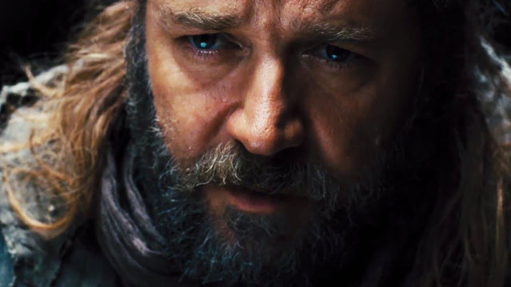
诺亚: 虚构的人物还是真实的?
创世纪6-9章
Dr. Rick Griffith • Singapore Bible College • BibleStudyDownloads.org

Slide 2
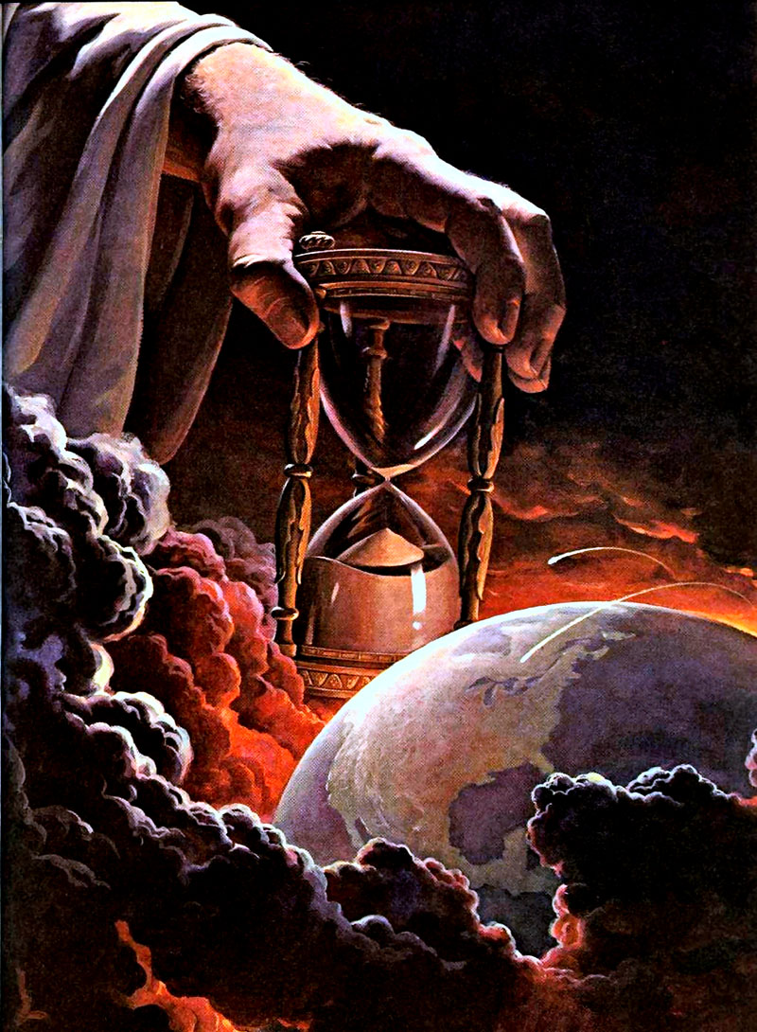
上帝审判的权柄是什么

Slide 3
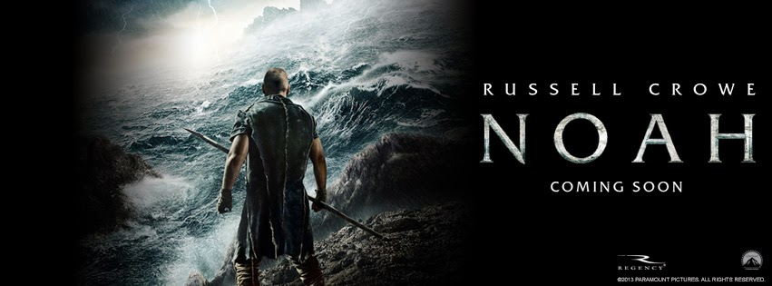
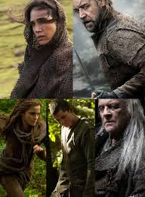
Noah
Shadowed

Slide 4

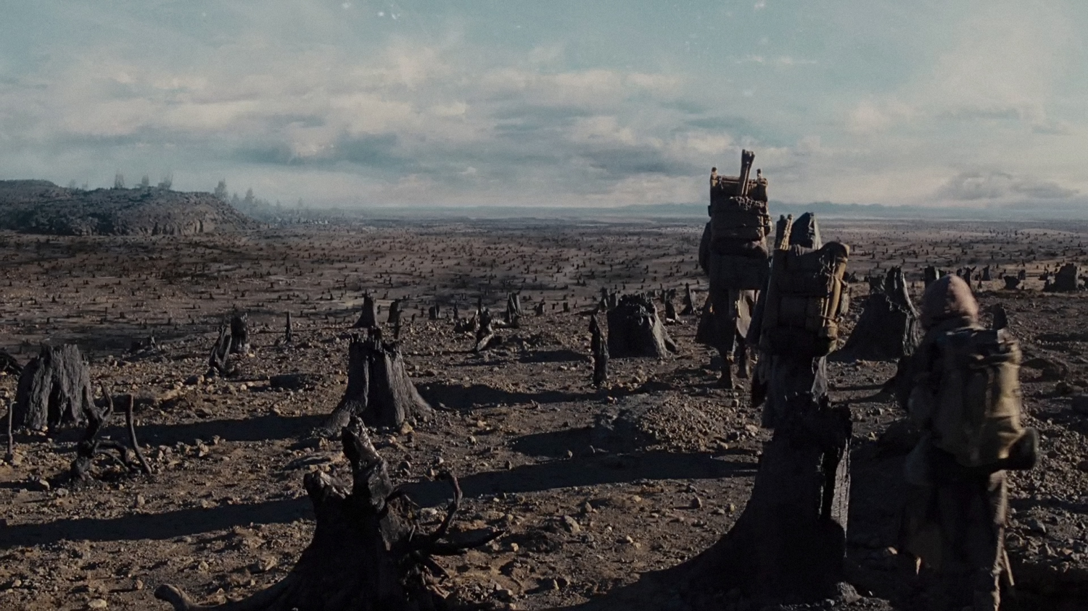
Noah
因为人们没有保护好环境，所以地球必须被毁灭

Slide 5
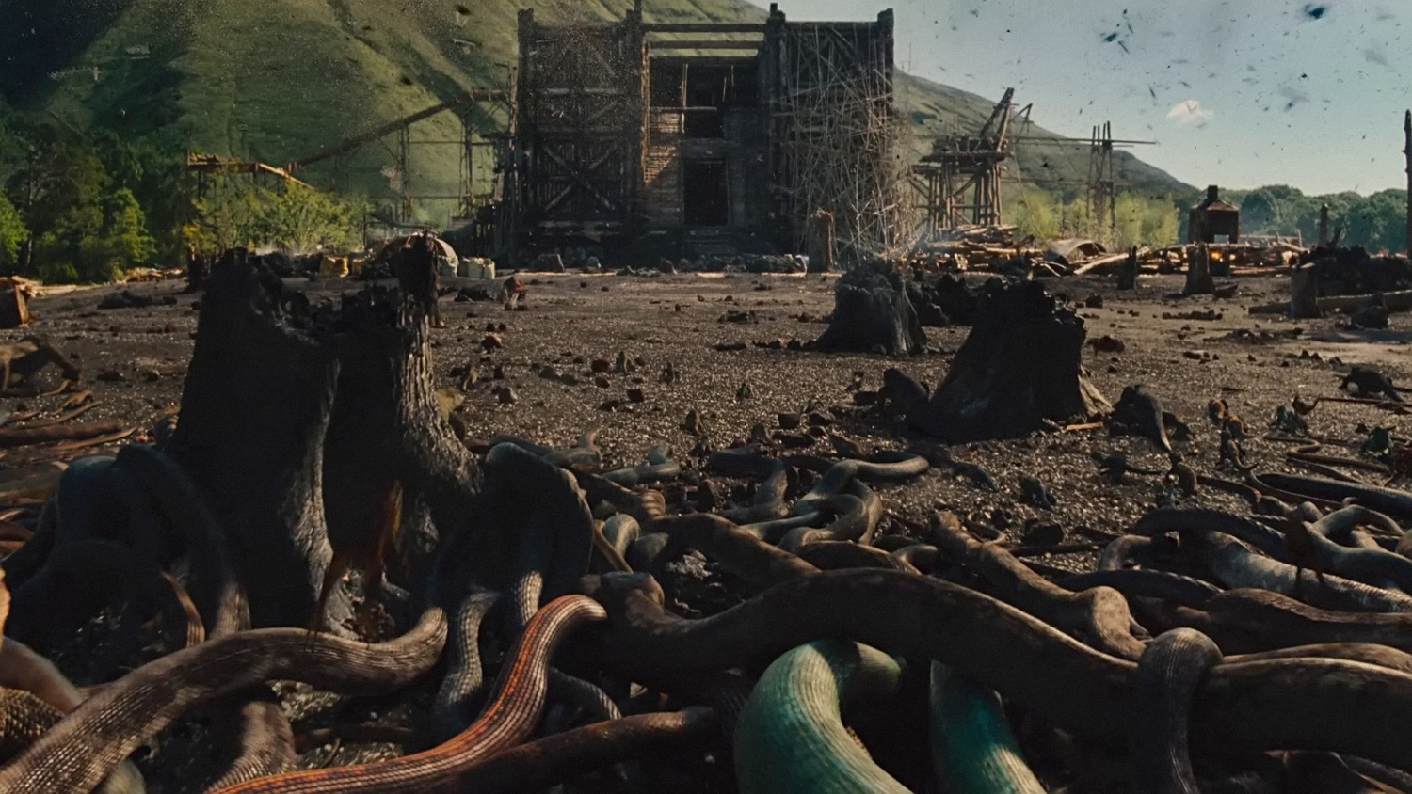
Noah
毒蛇入侵

Slide 6
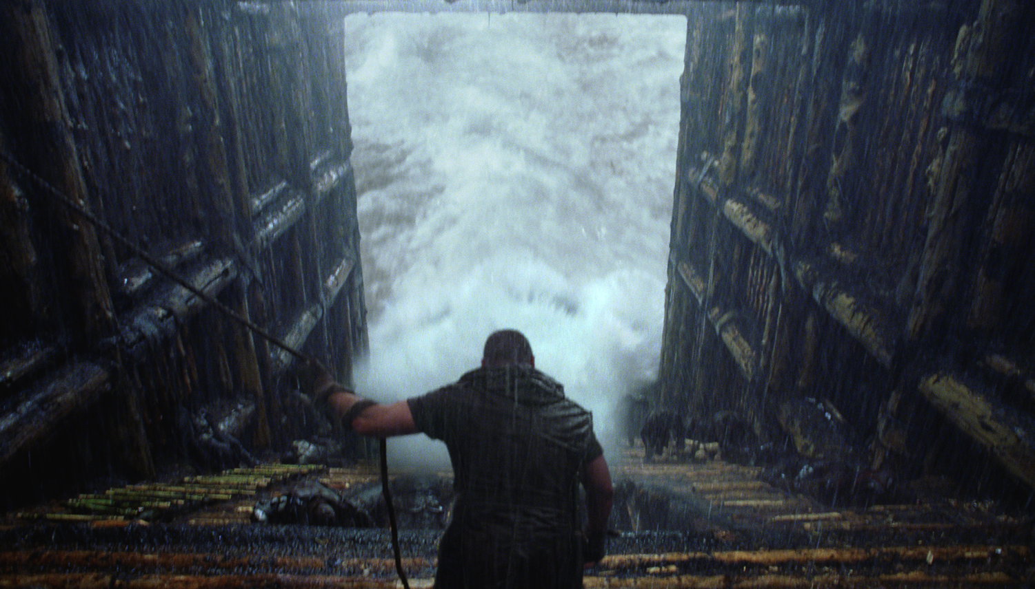
Noah
洪水降临的前七天，是谁关住了大门？

Slide 7
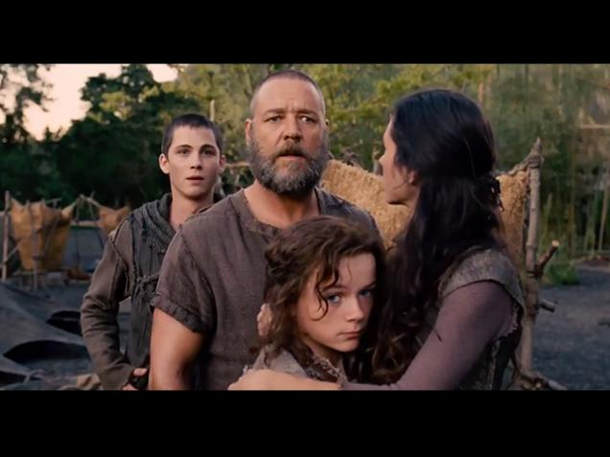
Noah
闪、含和雅弗在哪里？

Slide 8
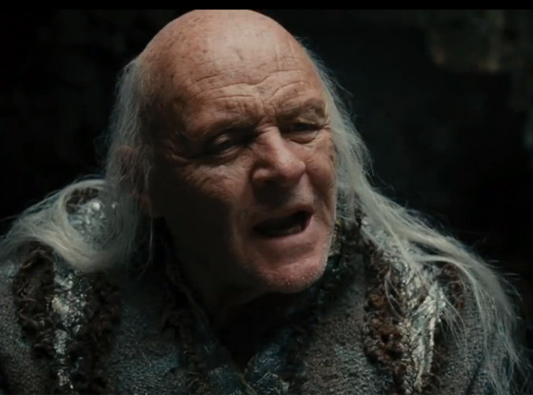
Noah
长寿的秘诀是“巫术”

Slide 9
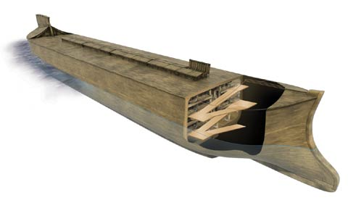
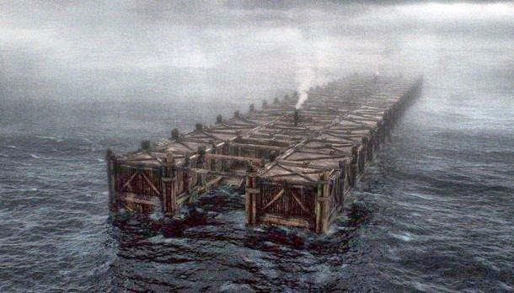
Noah
更现实的方舟
原始的方舟

Slide 10
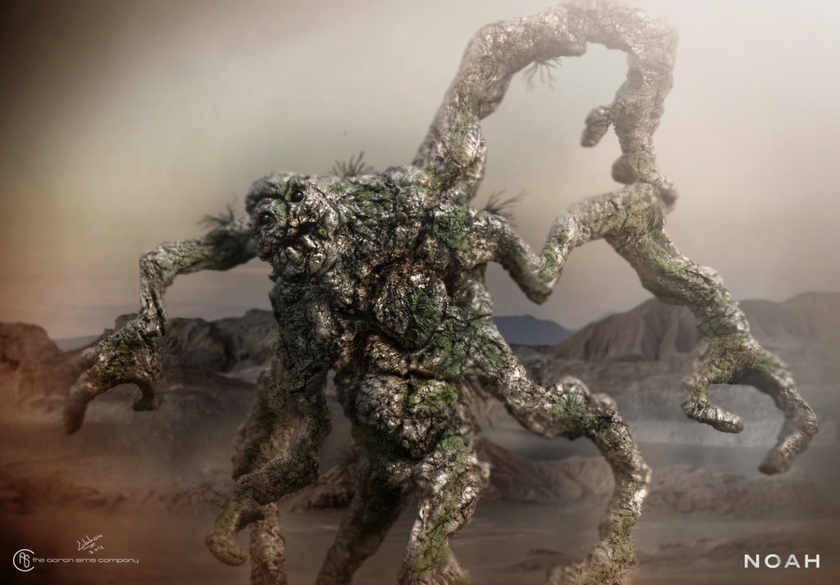
Noah
“这部电影将会介绍给很多国家的观众: 按照阿罗诺夫斯基的版本，堕落的天使 有着石头的外壳, 积极的帮助诺亚来建造方舟 (巨人们，用手沾着在岩石上的唾液手会变得非常的灵敏). 观众们非常的传统, 受到两千多年犹太人和基督徒的诠释. 不过他们回不到创世纪的年代”
Notes:
Joel Baden, ‘Noah’: The Bible vs. the Blockbuster at http://www.thedailybeast.com/articles/2014/03/30/what-noah-gets-right.html accessed 2 Jan 2015

Slide 11
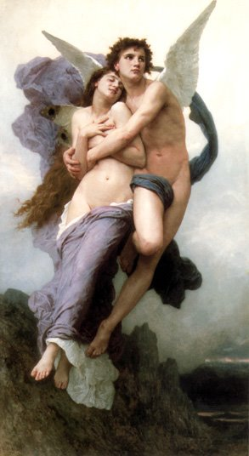
1 以诺6
¹人子在地上越来越多的时候，女儿为他们而生，优雅而美丽
² 当天使们,* 天堂之子 看到她们, 就很迷恋她们, 于是对彼此说, ”来让我们在这些人子中选一些来做我们的妻子，使得我们可以从她们之中得孩子."
³ 堕落的天使长对他们说, “我觉得你们不应当赞同这件事, 只有我一个人才可以对这极大的罪负责.
*亚兰问的记载 ”守望者“ (约瑟夫·塔德乌斯·米利克, 来自死海古卷的四号洞的 亚兰文片段 [牛津：克拉伦登出版社, 1976],第167 页).
Notes:
http://www.johnpratt.com/items/docs/enoch.html#06 translated from Ethiopic by Richard Laurence, London, 1883
Edited into modern English at points from Charlesworth, 1:15

Slide 12
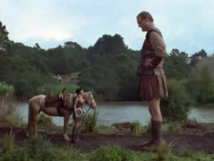
1 以诺 6
⁴ 但是他们对他说, ”让我们发誓并且用咒诅来把我们彼此相连，让我们不要放弃这个计划，让我们来这样做吧。于是他们就相互发誓，并且用咒诅来彼此相连
⁵ 他们一共有两百人从阿迪斯降下来, 就是阿蒙上的山顶.
Notes:
http://www.johnpratt.com/items/docs/enoch.html#06 translated from Ethiopic by Richard Laurence, London, 1883
Edited into modern English at points from Charlesworth, 1:15

Slide 13
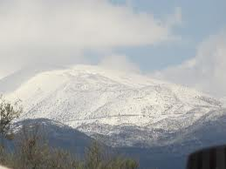

1 以诺 6
⁶ 于是他们就叫这个山是阿蒙山,* 并且用咒诅的誓言把他们彼此相连.
⁷他们领袖的名字是
萨摩亚兹, 是他们的总领袖，
乌卡巴每, 阿奇贝, 塔米尔, 拉枚, 但尼, 阿克尔, 萨卡尼亚, 阿萨尔, 阿莫尔, 巴垂, 安纳尼, 扎韦博,
萨姆萨维, 伊尔塔, 图尔, 由美雅尔, 阿尔奇亚.
⁸这两百位天使都是领袖，其余天使都跟随他们
* 阿蒙或者是赫蒙, 从希伯来文赫尔母，咒诅中摘录下这些名字(查尔斯, 63页).
Notes:
http://www.johnpratt.com/items/docs/enoch.html#06 translated from Ethiopic by Richard Laurence, London, 1883
Edited into modern English at points from Charlesworth, 1:15

Slide 14
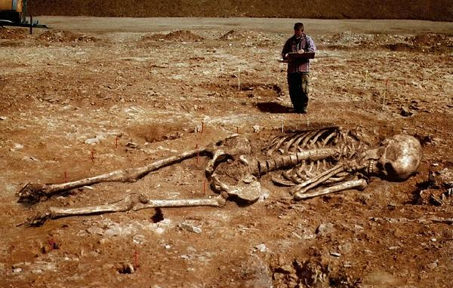
1 以诺7
¹于是他们每个人为自己娶妻; 亲近她们并与她们同居; 教她们法术和咒语把树干和树根分离
²于是妇人就生出巨人来* 有300肘高[137 米]
* 希腊文是从埃塞尔比亚文变化而来的. 有一处希腊文的手稿这样说,“于是她们[这些妇人] 生出他们来[守望者] 有3个种族: 第一就是那些巨人. 这些巨人带出纳非林, 然后纳菲林带出 伊利胡德. 他们都是存在的并且不断的增长他们的力量”根据千禧年书
Notes:
http://www.johnpratt.com/items/docs/enoch.html#06 translated from Ethiopic by Richard Laurence, London, 1883
Edited into modern English at points from Charlesworth, 1:15

Slide 15
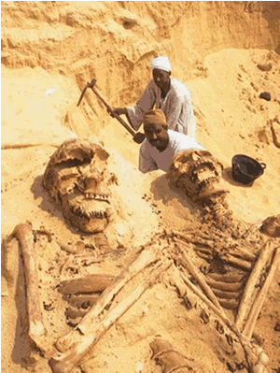
1 以诺7
³ 他们 (巨人们) 消耗了所有人类的劳动，直到人类厌恶他们而不在供应他们了。
⁴ 于是 巨人们开始攻击他们(人类) 以至于要吃掉他们。
Notes:
Image from:
Forbidden Gates
Part 17
By Thomas R. Horn
November 11, 2010
NewsWithViews.com
http://www.newswithviews.com/Horn/thomas153.htm
The Spirit Behind Transhumanism
English theologian George Hawkins Pember, in his 1876 masterpiece, Earth's Earliest Ages, analyzed the prophecy of Jesus Christ that says the end times would be a repeat of "the days of Noah." Pember outlined
the seven great causes of the antediluvian destruction and documented their developmental beginnings in his lifetime. The seventh and most fearful sign, Pember wrote, would be the return of the spirits of Nephilim, "the appearance upon earth of beings from the Principality of the Air, and their unlawful intercourse with the human race."
Jesus Himself, in answering His disciples concerning the signs of His coming and of the end of the world, said it would be "as the days of [Noah] were" (Matthew 24:37). The implication is, just as it was before the Flood when the spirits of Nephilim were powerful upon earth (Genesis 6:4), mankind would experience an end-times renaissance of the influence of these entities. From Scripture we are made to understand the purpose of this latter-day wave of supernaturalism includes deception (2 Timothy 3:13), and the effect upon mankind would be so successful that heresy and delusion would become firmly entrenched—even within institutionalized Christianity. In writing of this scenario, Paul prophesied to Timothy that "in the latter times, some shall depart from the faith, giving heed to seducing spirits, and doctrines of devils" (1 Timothy 4:1).
Based on contemporary developments, the foretold increase in demonism and its influence within secular and religious society is rapidly unfolding this century—abruptly, dramatically, and suspiciously. In a recent edition of Prophecy in the News magazine, biblical scholar Gary Stearman agreed, stating in disturbing language how the manifestation of these powers are quickening now because the world is under conditions "in which the influence of God's Holy Spirit is diminishing." This is apparent not only in metaphysics, but within science and technology, where genetic engineering and transhumanist aspirations seem literally hell-bent on repeating what the Watchers did in giving birth to the spirits of Nephilim as in the days of Noah.
The First Time Nephilim Appeared on Earth
As far back as the beginning of time and within every major culture of the ancient world, the astonishingly consistent story is told of "gods" who descended from heaven and materialized in bodies of flesh. From Rome to Greece—and before that, to Egypt, Persia, Assyria, Babylonia, and Sumer—the earliest records of civilization tell of the era when powerful beings known to the Hebrews as "Watchers" and in the book of Genesis as the b'nai ha Elohim ("sons of God") mingled themselves with humans, giving birth to part-celestial, part-terrestrial hybrids known as "Nephilim." The Bible says this happened when men began to increase on earth and daughters were born to them. When the sons of God saw the women's beauty, they took wives from among them to sire their unusual offspring. In Genesis 6:4, we read the following account: "There were giants [Nephilim] in the earth in those days; and also after that, when the sons of God came in unto the daughters of men, and they bare children to them, the same became mighty men which were of old, men of renown."
When this Scripture is compared with other ancient texts, including Enoch, Jubilees, Baruch, Genesis Apocryphon, Philo, Josephus, Jasher, and others, it unfolds to some that the giants of the Old Testament such as Goliath were the part-human, part-animal, part-angelic offspring of a supernatural interruption into the divine order and natural development of the species. The apocryphal Book of Enoch gives a name to the angels involved in this cosmic conspiracy, calling them "Watchers." We read:
And I Enoch was blessing the Lord of majesty and the King of the ages, and lo! the Watchers called me—Enoch the scribe—and said to me: "Enoch, thou scribe of righteousness, go, declare to the Watchers of the heaven who have left the high heaven, the holy eternal place, and have defiled themselves with women, and have done as the children of earth do, and have taken unto themselves wives: Ye have wrought great destruction on the earth: And ye shall have no peace nor forgiveness of sin: and inasmuch as they delight themselves in their children [the Nephilim], The murder of their beloved ones shall they see, and over the destruction of their children shall they lament, and shall make supplication unto eternity, but mercy and peace shall ye not attain." (1 Enoch 10:3–8)
According to Enoch, two hundred of these powerful angels departed "high heaven" and used women (among other dna providers) to extend their progeny into mankind's plane of existence. The Interlinear Hebrew Bible (ihn) offers an interesting interpretation of Genesis 6:2 in this regard. Where the King James Version of the Bible says, "The sons of God saw the daughters of men that they [were] fair," the ihn interprets this as, "The [b'nai ha Elohim] saw the daughters of Adam, that they were fit extensions" (emphasis added). The term "fit extensions" seems applicable when the whole of the ancient record is understood to mean that the Watchers wanted to leave their proper sphere of existence in order to enter earth's three-dimensional reality. They viewed women—or at least their genetic material—as part of the formula for accomplishing this task. Departing the proper habitation that God had assigned them was grievous to the Lord and led to divine penalization. Jude described it this way: The "angels which kept not their first estate, but left their own habitation, He hath reserved in everlasting chains under darkness unto the judgment of the great day" (Jude 6).
Besides apocryphal, pseudepigraphic, and Jewish traditions related to the legend of the Watchers and the "mighty men" born of their union with humans, mythologized accounts tell the stories of "gods" using humans and animals to produce heroes or demigods (half-gods). When the ancient Greek version of the Hebrew Old Testament (the LXX or Septuagint) was made, the word "Nephilim"—referring to the part-human offspring of the Watchers—was translated gegenes, a word implying "earth born." This same terminology was used to describe the Greek Titans and other legendary heroes of part-celestial and part-terrestrial origin, such as Hercules (born of Zeus and the mortal Alcmena), Achilles (the Trojan hero son of Thetis and Peleus), and Gilgamesh (the two-thirds god and one-third human child of Lugalbanda and Ninsun). These demigods were likewise accompanied in texts and idol representation by half-animal and half-human creatures like centaurs (the part-human, part-horse offspring of Apollo's son, Centaurus), chimeras, furies, satyrs, gorgons, nymphs, Minotaurs, and other genetic aberrations. All of this seems to indicate that the Watchers not only modified human dna during the construction of Nephilim, but that of animals as well, a point the Book of Enoch supports, saying in the seventh chapter that the fallen angels "sinned" against animals as well as humans.
Other books such as Jubilees add that this interspecies mingling eventually resulted in mutations among normal humans and animals whose "flesh" (genetic makeup) was "corrupted" by the activity, presumably through crossbreeding (see 5:1–5; 7:21–25). Even the Old Testament contains reference to the genetic mutations that developed among humans following this time frame, including "men" of unusual size, physical strength, six fingers, six toes, animal appetite for blood, and even lion-like features (2 Samuel 21:20, 23:20). But of all the ancient records, the most telling extrabiblical script is from the Book of Jasher, a mostly forgotten text referred to in the Bible in Joshua 10:13 and 2 Samuel 1:18. Jasher records the familiar story of the fall of the Watchers, then adds an exceptional detail that none of the other texts is as unequivocal about, something that can only be understood in modern language to mean advanced biotechnology, genetic engineering, or "transgenic modification" of species. After the Watchers had instructed humans "in the secrets of heaven," note what Jasher says occurred: "[Then] the sons of men [began teaching] the mixture of animals of one species with the other, in order therewith to provoke the Lord" (4:18).
The phrase "the mixture of animals of one species with the other" does not mean Watchers had taught men hybridization, as this would not have "provoked the Lord." God made like animals of different breeds capable of reproducing. For example, horses can propagate with other mammals of the equidae classification (the taxonomic "horse family"), including donkeys and zebras. It would not have "provoked the Lord" for this type of animal breeding to have taken place, as God Himself made the animals able to do this.
If, on the other hand, the Watchers were crossing species boundaries by mixing incompatible animals of one species with the other, such as pig dna with humans like science is doing today, this would have been a different matter and may cast light on the numerous ancient stories of mythical beings of variant-species manufacturing that fit perfectly within the records of what the Watchers were accomplishing. Understandably, this kind of chimera-making would have "provoked the Lord," and raises the serious question of why the Watchers would have risked eternal damnation by tinkering with God's creation in this way. Yahweh had placed boundaries between the species and strictly ordered that "each kind" reproduce only after its "own kind." Was the motive of the Watchers to break these rules simply the desire to rebel, to assault God's creative genius through biologically altering what He had made? Or was something of deeper significance behind the activity? We'll talk about this in the next entry, but the following quotes provide a hint:
It would be nice to be an artilect, a god, a supremely powerful omnipotent being. I could be such a creature [soon.] It's possible. It's not an unattainable dream.... All I can do here is attempt to convey some measure of the strength of "religious" feeling that I and other[s] will make public this century. —Prof. Hugo de Garis, artificial brain designer
All of the boundaries are up for grabs. All of the boundaries that have defined us as human beings, boundaries between a human being and an animal and between a human being and a super human being or a god. —Prof. Leon R. Kass, former chairman, President's Council on Bioethics
A non-human race once lived upon earth. They came to be called the Rephaim [Nephilim]. They were genetic monsters, mutants whose end is darkness, just as was their society upon earth. Will JCVI's [J. Craig Venter Institute, which created the entirely new life form nicknamed "Synthia"] work result in another such atrocity? —Gary Stearman, Bible scholar
http://arcticcompass.blogspot.sg/2010/08/new-paradigm-integration-of-human.html

Slide 16
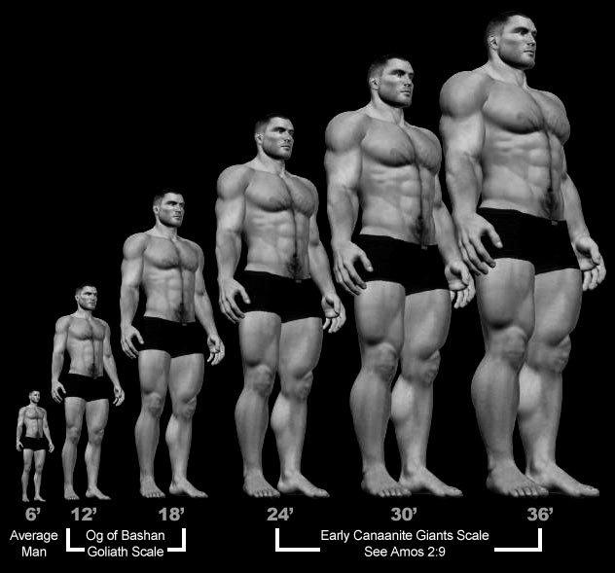
1 以诺7
⁵ 于是他们开始向鸟，野兽爬虫和鱼犯罪，吃它们的肉，并且喝它们的血。
⁶ 所以大地开始指控他们这些压迫者
* 或者, ”另一个人肉.在罗伯特 亨利 查尔斯的中，代表着一个巨人摧毁另一个巨人的意思 (查尔斯, 65).
Notes:
http://www.johnpratt.com/items/docs/enoch.html#06 translated from Ethiopic by Richard Laurence, London, 1883
Edited into modern English at points from Charlesworth, 1:15

Slide 17
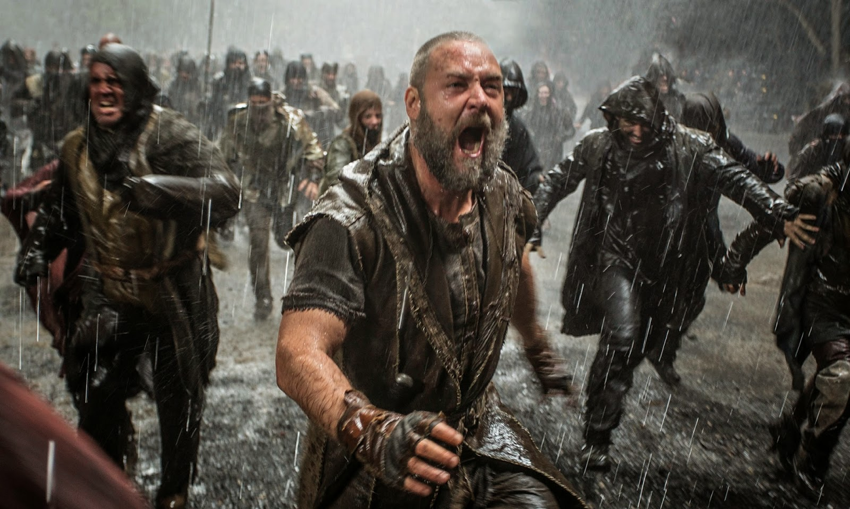
Noah
暴力

Slide 18
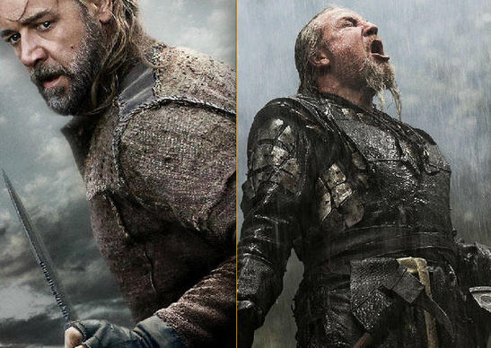
Noah
诺亚 对比 图巴尔-该隐?

Slide 19
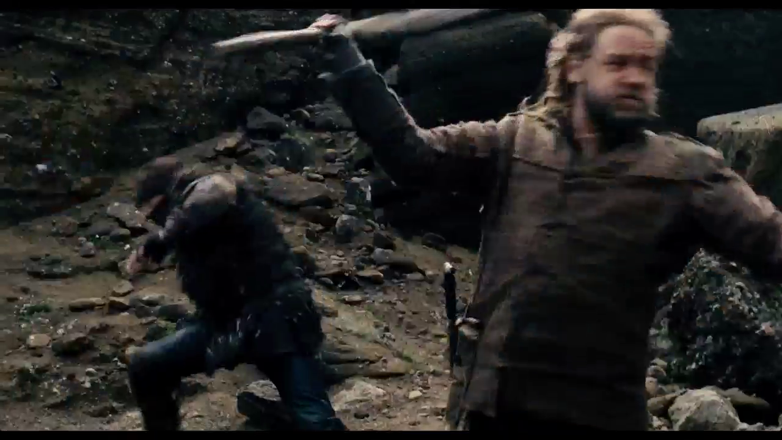
Noah
Shadowed

Slide 20
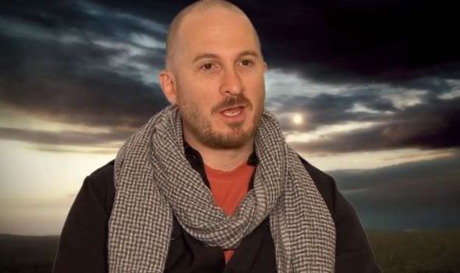
自无神论的制片人 达伦 阿罗诺夫斯基
“最不符合圣经的圣经题材电影”
Notes:
"Russell Crowe hits 'Noah' critics: 'Bordering on absolute stupidity'". The Washington Times. March 27, 2014. Retrieved March 27, 2014; cited at Wikipedia, "Noah (movie)."

Slide 21
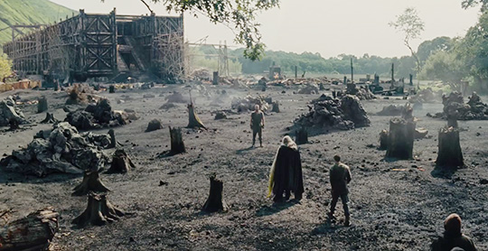
Noah
诺亚是 ”第一个环境主义者"
—阿罗诺夫斯基

Slide 22
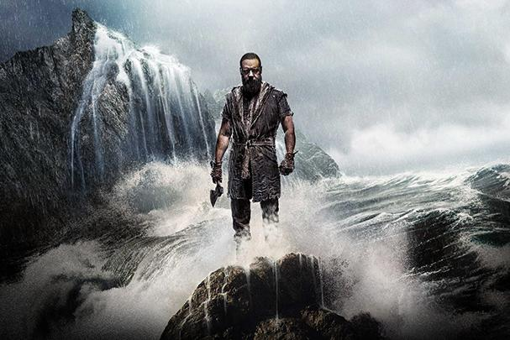
Noah
基督徒因该看吗?

Slide 23
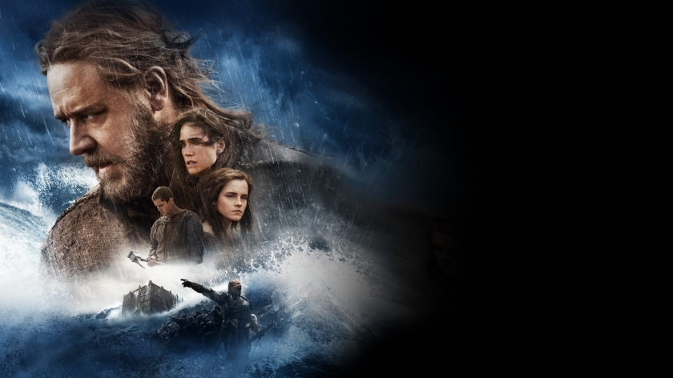
对电影“诺亚”的赞美
你的版本圣经软件注意到，在诺亚电影周末的三天上映中that 关于诺亚被阅读或聆听了389,794 次, 或者每天有129,931次."
“这是人们查考有关诺亚的篇章最多的一次,‘ 根据魅力新闻的报道."
Bill Hitchcock at http://www.refiningtruth.com/noah-genesis-6-facts/
Notes:
http://www.refiningtruth.com/noah-genesis-6-facts/

Slide 24
对电影“诺亚”的赞美
”根据美国圣经协会的报道百分之87的受访人表示他们阅读诺亚在圣经创世纪的篇章是受了电影的影响."
”当诺亚电影在电影院上映的当天, 人们在看诺亚的故事在创世纪6章增加了300% 在美国，而在全球的范围则增加；了 245% 来自于你的版本周二在推特发出的报道.
H/T Breaking Christian News; cited by Bill Hitchcock at http://www.refiningtruth.com/noah-genesis-6-facts/
Notes:
http://www.refiningtruth.com/noah-genesis-6-facts/

Slide 25

对电影“诺亚”的赞美
“聚焦在家庭” 主席吉姆 达利 说道:
“[诺亚] 是对于经文具有创意的诠释使得我们可以 想象诺亚深深的挣扎 对于诺亚回应上帝对他在他生命中的呼召. 这部电影版本的诺亚的故事给了我们基督徒一个很好的机会给我们的这个世代的文化来展现一个符合圣经经文的诺亚 并且和我们的朋友还有家庭吗来讨论关于永恒的意义。”
https://en.wikipedia.org/wiki/Noah_%282014_film%29#Test_screenings
Notes:
http://www.refiningtruth.com/noah-genesis-6-facts/

Slide 26

对电影“诺亚”的赞美
生命罗格斯 基金声明 “对于这个故事最重要的解释—这部电影我最喜欢的部分是根据诺亚的孩子，诺亚重新讲述了创世纪, 于是乎我们看到在亚当和夏娃之后这个世界新的发展.”
https://en.wikipedia.org/wiki/Noah_%282014_film%29#Test_screenings
Notes:
Stump, Jim (April 2, 2014). "The Noah Movie". The Biologos Foundation. Retrieved April 2, 2014. "And we saw the importance of stories as explanations—my favorite part of the whole movie was when Noah retold the Genesis creation accounts to his sons, and we saw the evolutionary creation of the world up to some mysterious Adam and Eve figures."

Slide 27
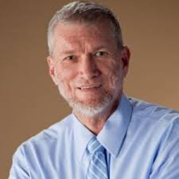
对电影“诺亚”的批评
肯 哈姆(创世纪的解答者):
“除了一些名字的记载…我们很难发现有关圣经创世纪第6章至第9章的内容出现在电影中。 是的, 电影里出现了方舟，并且在圣经中出现了很多次, 但是电影里的方舟看起来不可以航行. 有很多的动物进入方舟, 但是有太多的动物挤进去了, 确实比所需的还要多。”
http://time.com/42274/ken-ham-the-unbiblical-noah-is-a-fable-of-a-film/

Slide 28
对电影“诺亚”的批评
肯 哈姆(创世纪的解答者)
“关于对人类邪恶的描述, 电影罪的描述是人们破坏地球的环境电影所缺失的是 在洪水之前真正的罪是人们对抗上帝和不人道的对待彼此”
http://time.com/42274/ken-ham-the-unbiblical-noah-is-a-fable-of-a-film/

Slide 29
对电影“诺亚”的批评
肯 哈姆(创世纪的解答者)
“最重要的这部电影完全不忠于圣经. 从一开始这就不是一部忠于圣经的而是一部异端的电影. 电影的一开始一点都没有关于上帝的描述。而圣经一开始的时候说, 起初神。 这些的不一样帮我们来总结在电影中所遇到的问题。圣经是关于真神的创造; 而电影却没有呈现圣经中所记载的真神。”
http://time.com/42274/ken-ham-the-unbiblical-noah-is-a-fable-of-a-film/

Slide 30

瑞 安慰”诺亚"
http://www.noahthemovie.com/

Slide 31
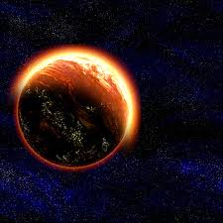
上帝有权利审判世界吗？
为什么?

Slide 32
图表
创世纪 6–9
56
历史事件
创造 1–2
洪水 6–9
罪3–5
事件 1–11
人类

Slide 33

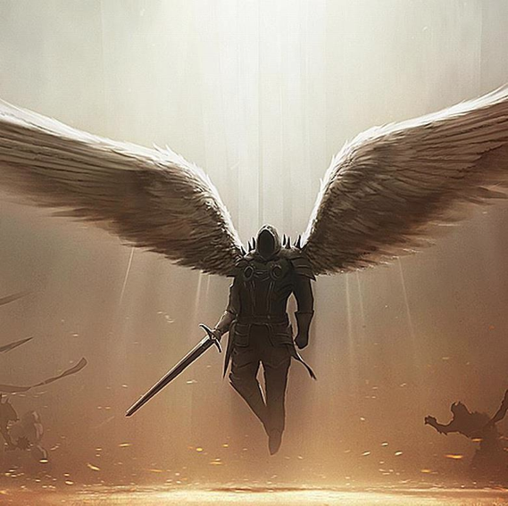
“上帝的儿子” 不道德和巨人导致了洪水的发生 (创世纪. 6:1-4)
83
是谁使妇人受孕?
魔鬼(天使)?
掌权者?
被魔鬼压制的掌权者?
赛特的后代?
该隐的后代?
较小的神灵?
敬虔的人类?

Slide 34

关于创世纪6:1-4的问题
谁是 “神的儿子” (6:2)?
谁是 “人的女儿们” (6:2)?
人类120岁的限制是象征 “恩典的岁月”是直到洪水来临 还是个人的年岁?
拿非利士人巨人的出生是从 “上帝的儿子” 来的还是“人类的女儿”来的 ?
拿非利士人 “在地上的年月和之后的年月” 是不是可以证明他们不是 “上帝的儿子” ?
主前1400年拿非利士人是如何在迦南出现的如果他们是被洪水毁灭 (申命记 13:33)?

Slide 35

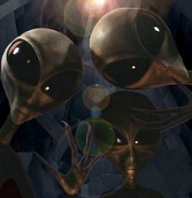
“上帝的儿子们”是天使吗?
83
外星人与堕落天使
上帝的后裔
www.alienresistance.com

Slide 36
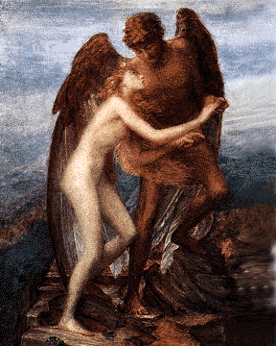
支持是天使的观点
83
关于天使出现的经文(约伯记1:6; 2:1; 38:7;. 诗篇. 29:1)
天使解释了上帝和人的对比和超越了自然的界限
古老的观点
(1 以诺, 等等.)
新约支持的观点
(彼得后书. 2:4; 尤大书6-7)
解释了拿非利士后代所拥有的能力

Slide 37
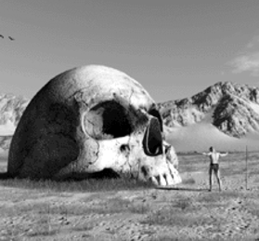
质疑是天使的观点
83
“上帝” 能够指示人类的人类的士师(诗篇. 82:1, 6-7)
—但不是“上帝的儿子”
"At the resurrection people will neither marry nor be given in marriage; they will be like the angels in heaven" (Matt. 22:30)
—但是未来的独身可以应用在过去的独身吗?
用天使的罪来惩罚人们看起来有点不公平
—但是尤大书6 章说有些天使被捆绑
新约圣经支持这样的辩论
神话的传说
天使不在上下文的语境中

Slide 38
敬虔赛特后代的观点
重点
但是. . .
上帝有在几次提到人类
在创世纪4章有世俗该隐的后代对比敬虔的赛特的后代
祝福的后代要保持纯正的血统
路德和加尔文支持这样的观点
这不是一个常见的说法
“人类的女儿”是一个普遍的且不带有邪恶的说法
没有证据表明这些后代是分开的
这些支持都是后来的且并不相关
第一代人必须和第二代人相匹配

Slide 39
是统治者的观点
支持
问题
上帝在很多次指示统治者(出埃及记. 21:6; 22:8-9, 28; 诗篇. 82:1, 6-7)
上帝与王的关系就好像“父” 与“子”(撒母耳记下. 7:14)
是的，但是统治者并没有出现在“父”与“子”的上下文，而天使却更加合理。
是的，可是创世纪 6 章没有提到君王。
君王们从来都没有被称为“上帝的儿子”在旧约圣经或者其它的地方。

Slide 40

上帝蔑视人类
沙哈姆巴赫
体验超能力
Notes:
www.schambach.org/

Slide 41
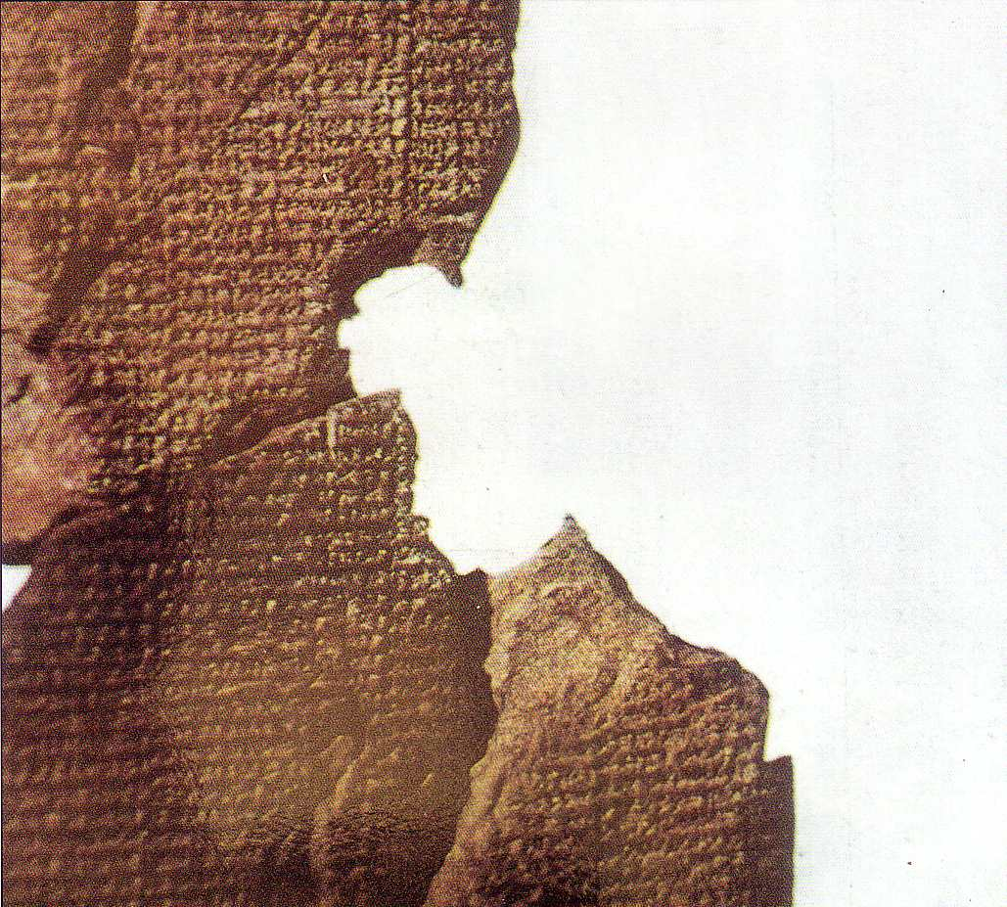
神灵关于异教徒的观点
阿特拉哈西斯史
创世纪
阿努, 最大的神
人对神来说很麻烦
阿特拉哈西斯建造的方舟
使用度量单位
动物被带进去
7天的大雨
后悔的洪水
(阿诺德/拜耳, 21-31)
亚威 唯一的真神
人犯太多的罪
诺亚建造了方舟吧
使用度量单位
上帝把动物带进去
40天的大雨
彩虹的应许
(创世纪6–9)

Slide 42
Noah
诺亚是“第一位环保人士”
—阿罗诺夫斯基

Slide 43
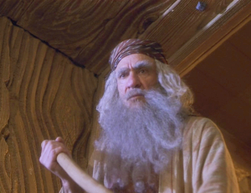

基督徒和环境问题
圣经的诺亚
上帝对环境污染的愤怒
凶杀，奸淫，拜偶像
不完全的拯救者
我们完美的拯救者

Slide 44
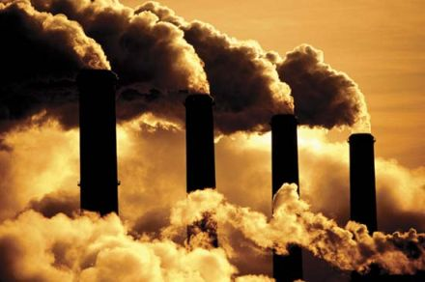
全球变暖是人为的吗?
不.

Slide 45
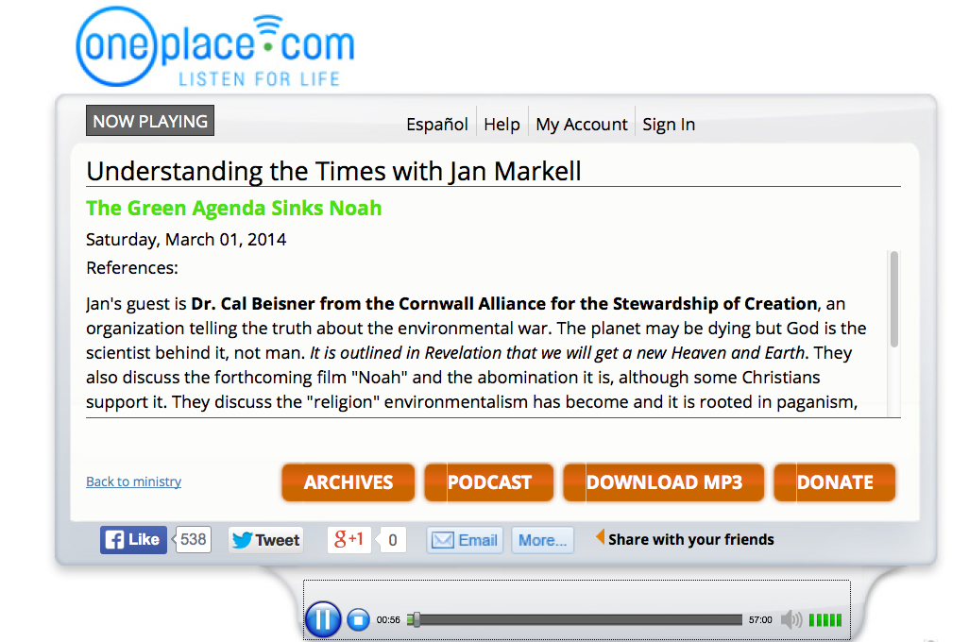
全球变暖是人为的吗??
不.

Slide 46
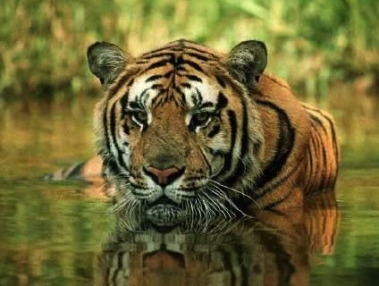
Animals
上帝的创造 第6天
448
神说：“地上要生出活物来，各从其类；牲畜、爬行的动物和地上的野兽，各从其类！”事就这样成了。于是，神造了地上的野兽，各从其类；牲畜，各从其类；地上各种爬行的动物，各从其类。 神看这是好的。
（创世纪1章24节-25节）

Slide 47

Man
上帝的创造 第6天
448
"神说：“我们要照着我们的形象，按着我们的样式造人；使他们管理海里的鱼、空中的鸟、地上的牲畜，以及全地，和地上所有爬行的生物！
（创世纪1章27节）

Slide 48

Woman
上帝的创造 第6天
“上帝按照自己的形象创造人
就是按照神的形象创造了他
他所创造的有男有女" (传世纪1章27节).

Slide 49

Mandate
448
也要管理空中的鸟
"神就赐福给他们，对他们说：“要繁衍增多，充满这地，征服它;
管理海中的鱼
和地上所有走动的生物'" (创世纪1章27节).

Slide 50
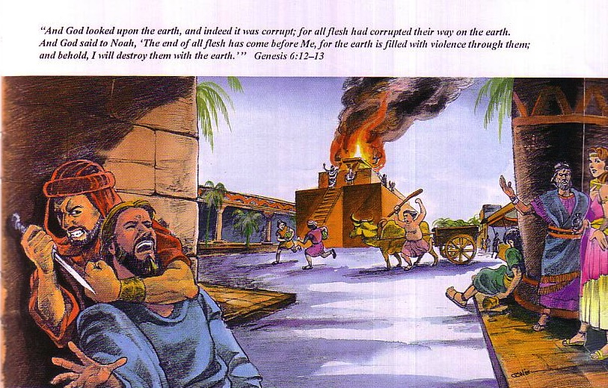
需要一个新的开始
65
神观看大地，看见世界已经败坏了；全人类在地上所行的都是败坏的。神对挪亚说：“在我面前全人类的尽头已经来到，因为地上由于他们的缘故满了强暴。看哪，我要把他们和世界一起毁灭
(创世纪6章12-13节).

Slide 51
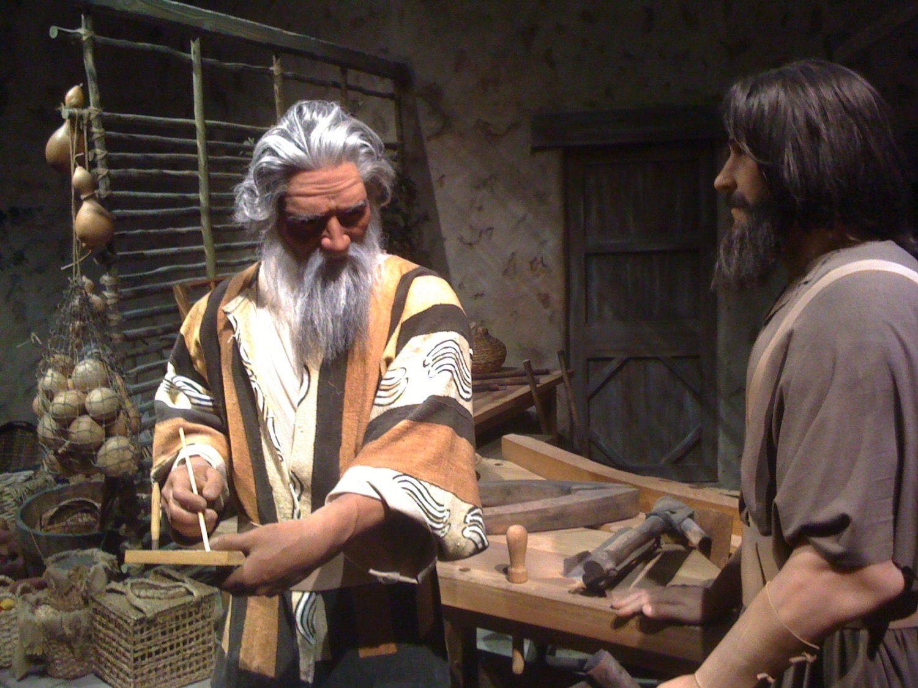
Noah & His Son

Slide 52
”因着信。。" (希伯来书11章)
" 因着信，挪亚在还没有看见的事上，得了 神的警告，就动了敬畏的心，做了一艘方舟，使他全家得救。借着这信心，他就定了那世代的罪，自己也承受了那因信而来的义 " (希伯来书11章7节)

Slide 53
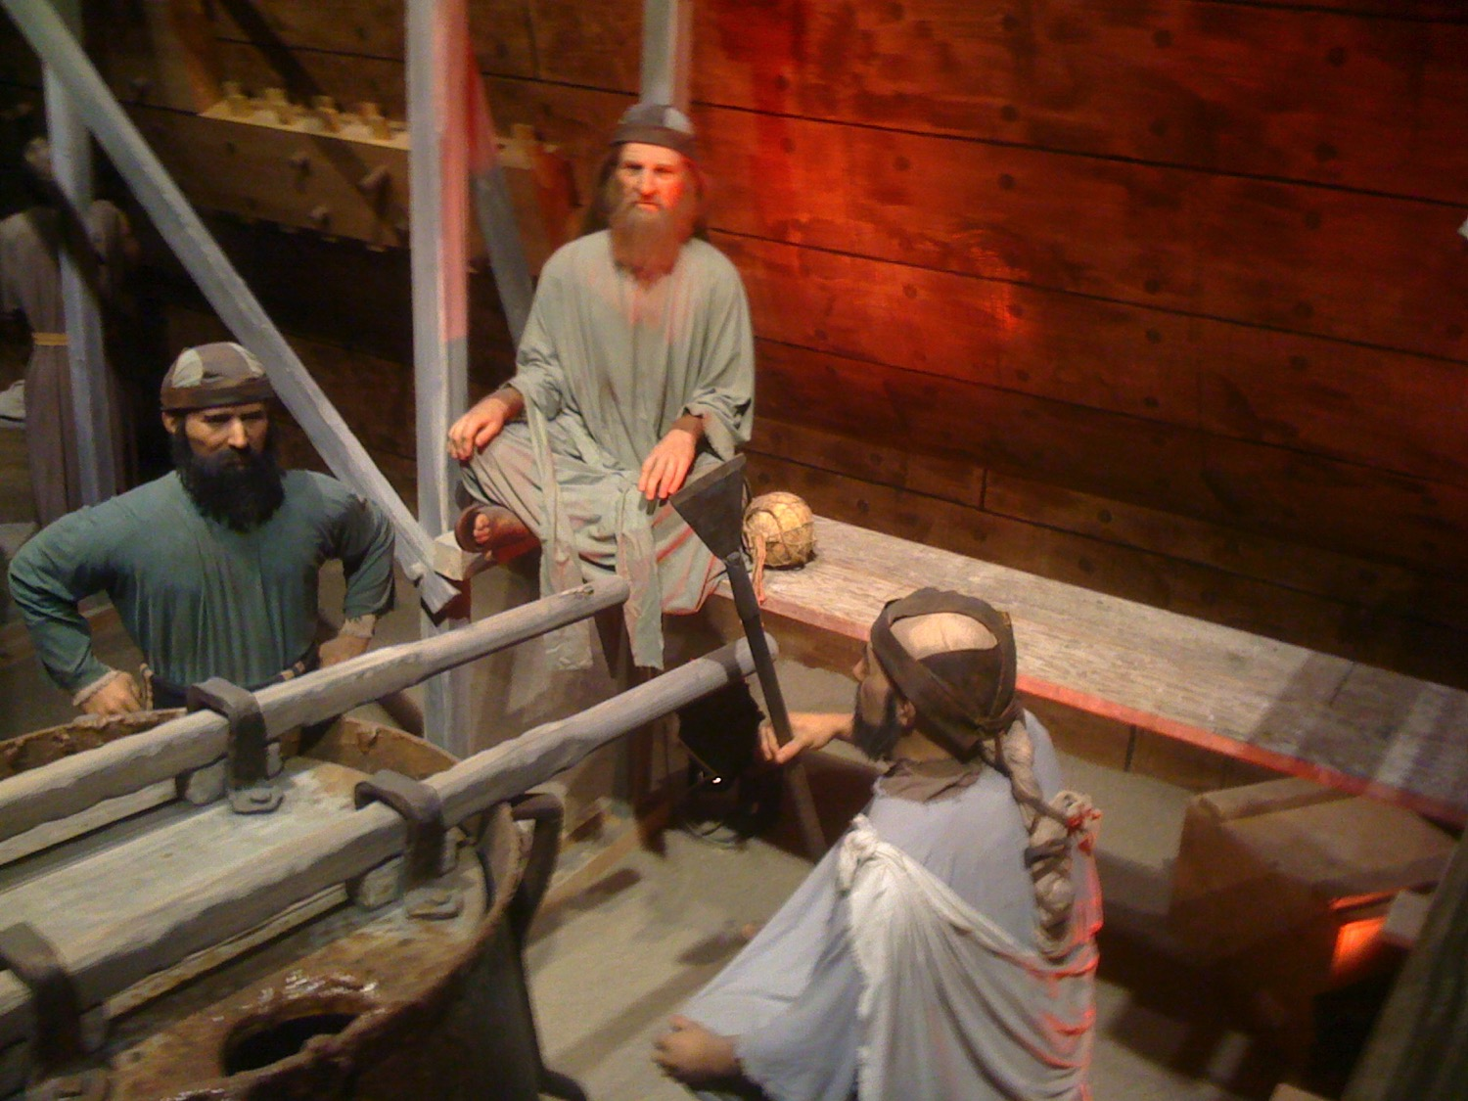
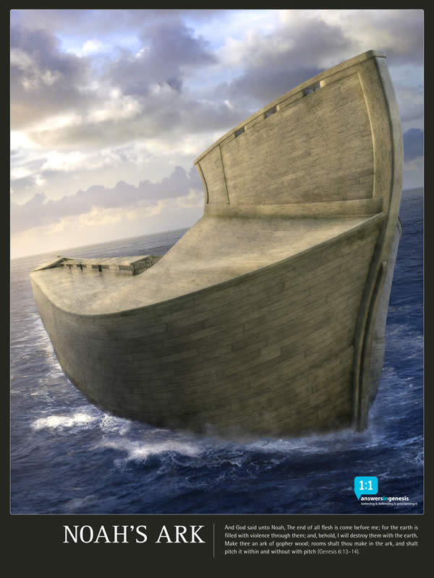
Noah & His Son

Slide 54
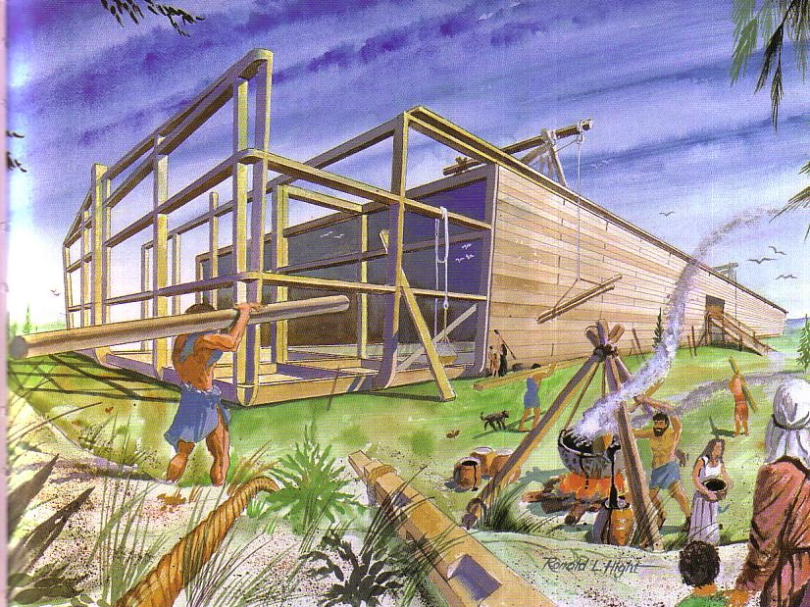
Building the Ark
65

Slide 55
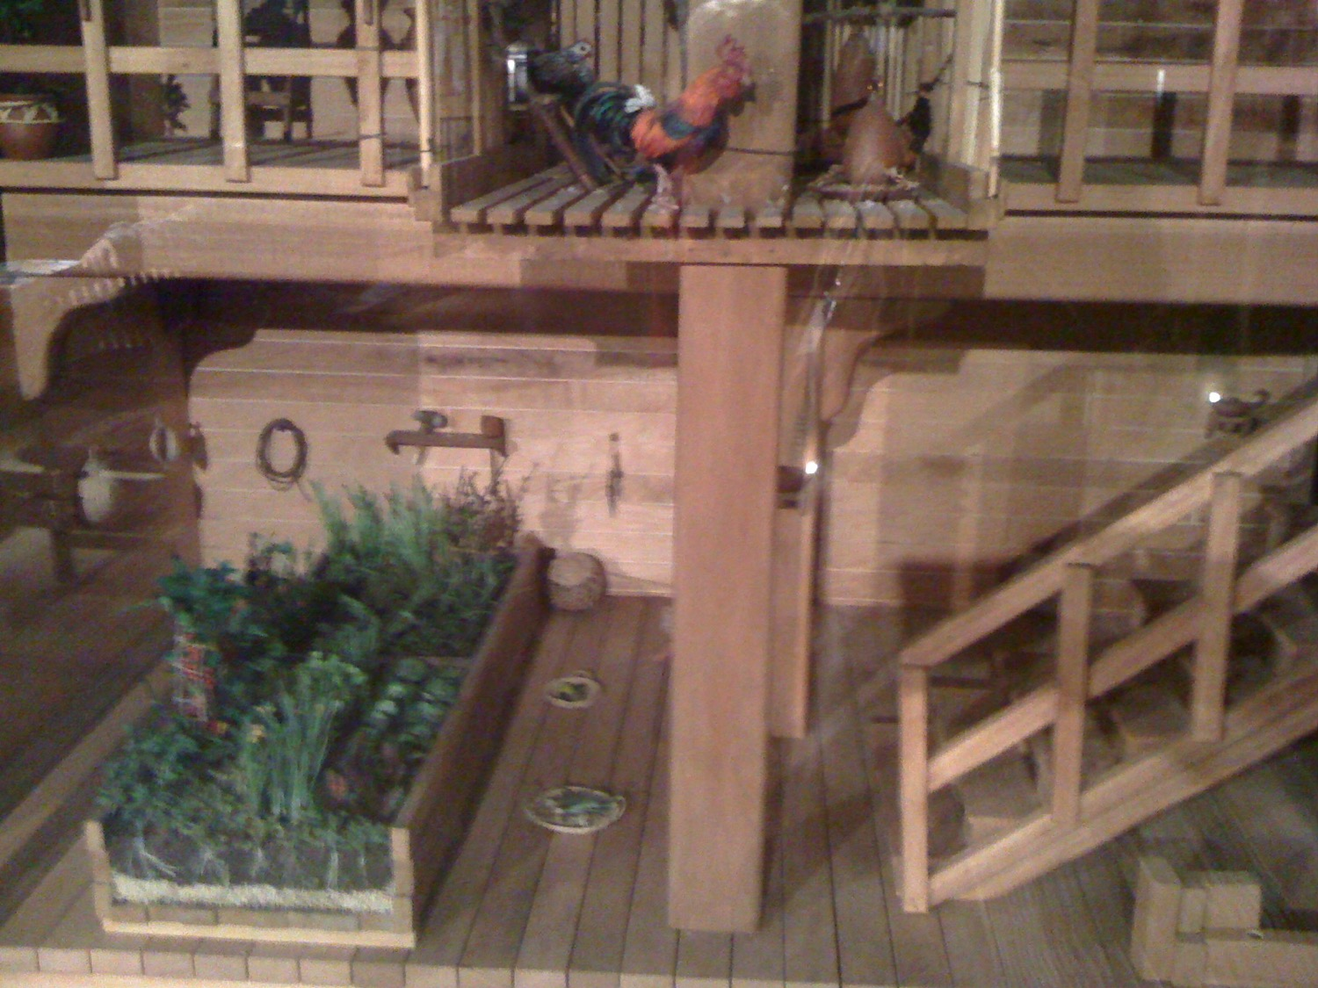
Food in the Ark

Slide 56
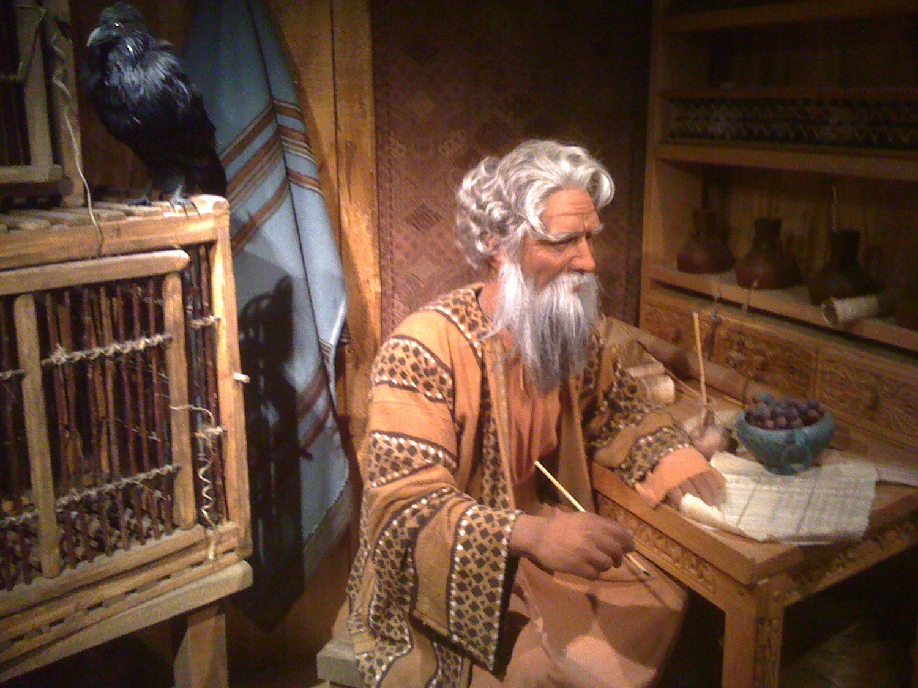
Noah & His Study

Slide 57


Cubit Diagram Sample
这个范本是由“世界圣经”主日学所呈现
This is a sample page from "The World of the Bible" a PowerPoint Sunday School Series from eBibleteacher.com
圣经
手指
18 英尺
= 1 腕尺
宽度
1个手的宽度
长度的测量
INDEX
© EBibleTeacher.com
Notes:
The new "World of the Bible" series has over 450 slides and covers Bible lands, people, time, measurements and culture.
The ancient Bible people used measurements that could be easily reproduced. The cubit was simply the measurement from your elbow to the end of your fingers. Cubits are known to have varied from 16 to 19 inches. In the case of dispute, the king's arm was used to determine the standard cubit.
Like the cubit, spans, handbreadth and fingers were also easily determined. Even today, some people still use these measurements such as in measuring horses.

Slide 58
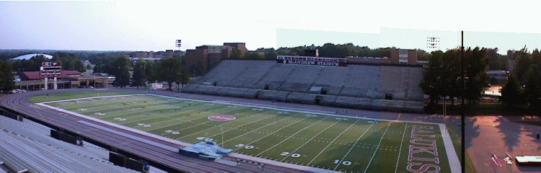
诺亚方舟的尺寸
你要这样做方舟：方舟要长一百三十三公尺，宽二十二公尺，高十三公尺 创世纪6章15节
INDEX

Slide 59
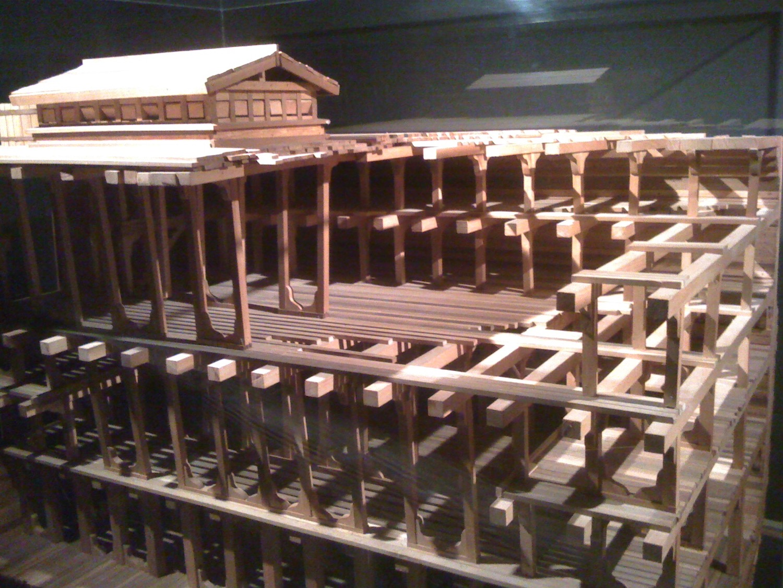
The Ark

Slide 60
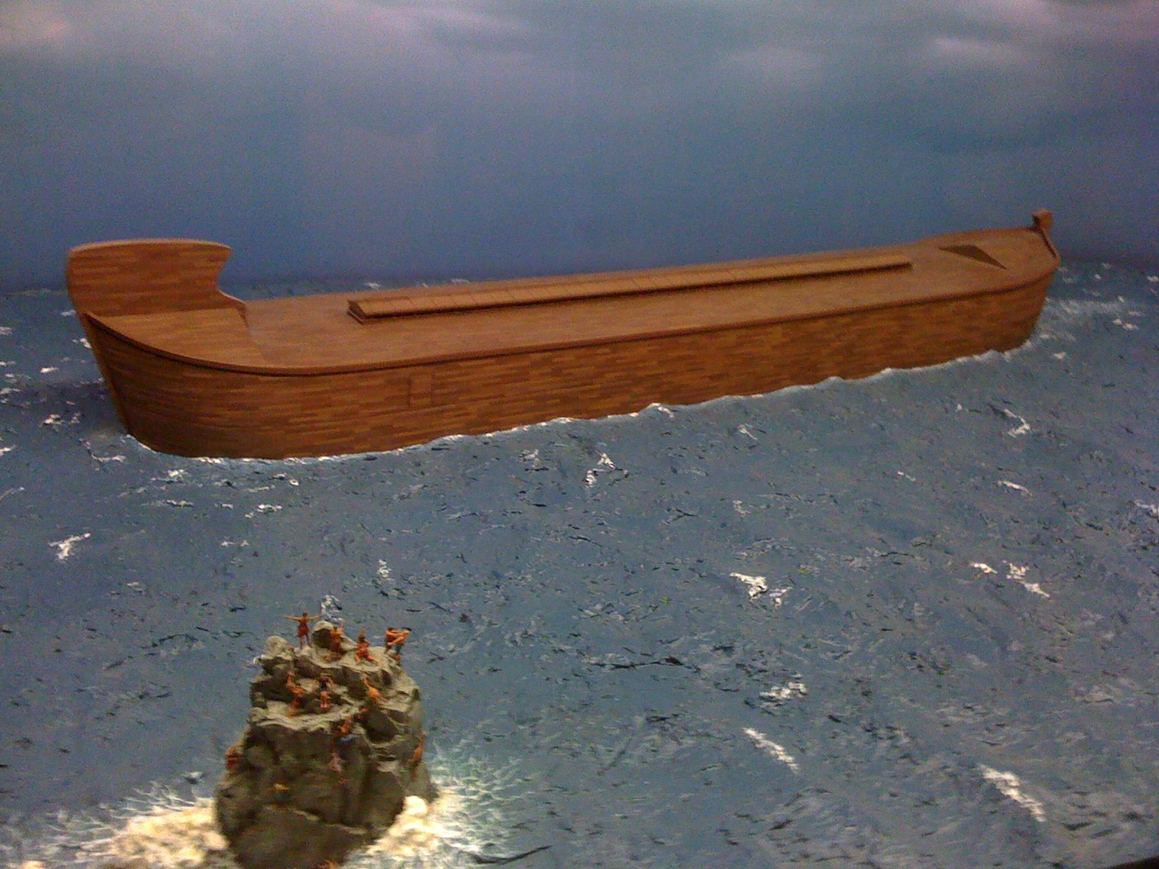
The Ark

Slide 61
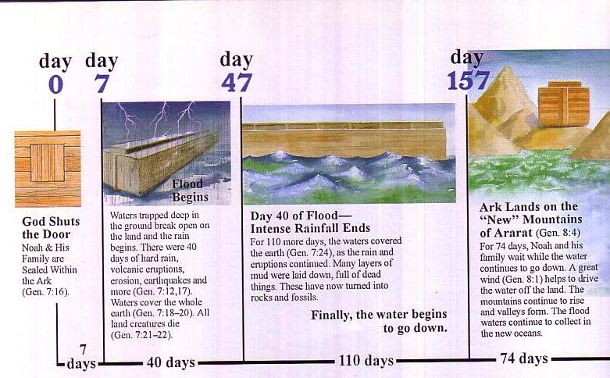
洪水的年表
天 天
天
天
洪水开始
上帝关住了门
诺亚和他的家人进了方舟（创世纪7：16）
水从天上降下也从地里涌出来，洪水持续了40个昼日（创7：12,17）
洪水淹没了整个大地
（创7：18-20）
地上所有的生物都死了
（创7 ：21-22）
40 天的洪水
方舟最终停在阿勒山上（创8：4）
110天后洪水覆盖了整个大地（创7：24）由于洪水泛滥，大地塌陷，所有的生物都死了，这些生物都变成了化石
诺亚和他的家人在等待了74天后，大风持续的在吹（创 8：1）大山和山谷都显露了出来洪水变成了新的海洋
7天
110天
74 天
40天

Slide 62
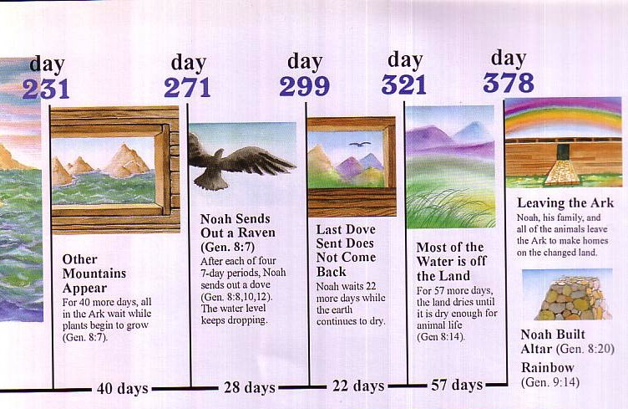
洪水的年表
天 天 天 天 天
离开方舟
诺亚和他的家人还有所有的动物都离开了方舟在新的地上居住
诺亚放出去一座鸽子
（创 8：7）
每隔7天诺亚都会放鸽子出去
（创 8：8，10，12）
洪水持续下降
最后一只鸽子放出去再也没有回来
诺亚等待了22天大地持续变干
大多数的土地都显露出来
57天后，大地变干了动物都可以居住在大地上
（创8：14）
其它的山峰都与显露出来
40天后，方舟里的r人都在等待植物生长出来
（创 8：7）
诺亚建造祭坛（创8：20）
彩虹
（创9：14）

Slide 63
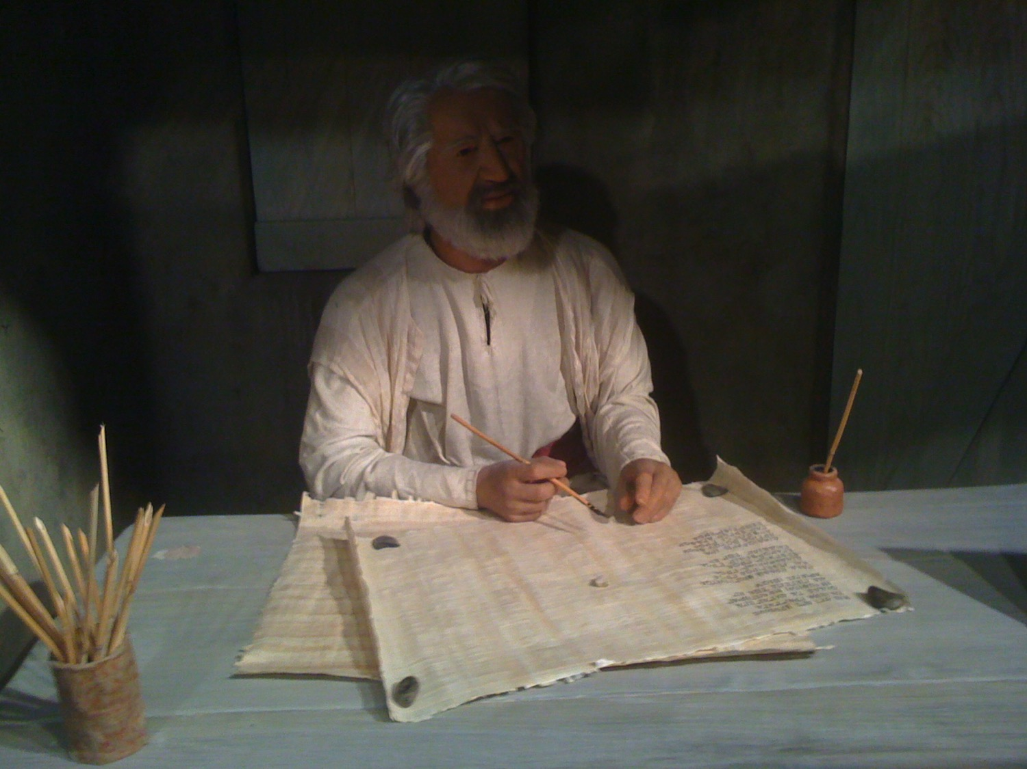
洪水的交错配列法
7天等待洪水(7:4)
7天等待洪水(7:10)
40 天的洪水(7:17a)
150 天洪水的泛滥(7:24)
上帝纪念诺亚(8:1)
150 天洪水的减弱(8:3)
40 天的等待(8:6)
7天的等待(8:10)
7天的等待(8:12)
– 戈登 韦纳姆, 创世纪 1–15, 全球圣经注释
(达拉斯:词与书, 1994)

Slide 64



Patriarch's long lives
洪水过后上帝缩短了人类的寿命大概有70年
90
亚当
930年
玛土撒拉
969年
诺亚
950年
闪
600年
洪水可以解释人类的寿命为何缩短了
亚伯拉罕
175年
摩西
120年
大卫王
70年
洪水之前世界和现在很不一样，有些人甚至可以活到1000年
但是洪水过后，人的寿命缩短了很多，活到100岁的都很少
Notes:
From John Morris, Noah's Ark and the Ararat Adventure, p. 10.

Slide 65
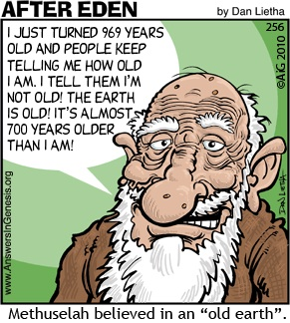
玛土撒拉
伊甸园之后
90
我刚刚969 岁了，但是人们总是说我已经非常老了。我告诉他们，我不是非常老，地球比我还老! 它比我差不多还要老700年
玛土撒拉 被认为是活在”旧的的地球."

Slide 66


创世纪6章19节（新译本）
所有的活物，你要把每一对，就是一公一母，带进方舟，好和你一同进入方舟

Slide 67

诺亚的性格
“ 于是，耶和华后悔造人在地上，心中忧伤。7耶和华说：“我要把我创造的人，从地上消灭；无论是人或牲畜，是爬行的动物或是天空的飞鸟，我都要消灭，因为我后悔造了他们。”8只有挪亚在耶和华眼前蒙恩。"
(创世纪6章7-8节).

Slide 68

诺亚的不完美
" 迦南的父亲含看见了自己父亲的下体，就去告诉在外面的两个兄弟。23于是，闪和雅弗二人拿了件外衣，搭在自己的肩膀上，倒退着进去，盖上他们父亲的下体；因为他们背着脸，所以没有看见他们父亲的下体 "
(创世纪9章22-23节新译本).

Slide 69

诺亚
“挪亚酒醒以后，知道小儿子对他所作的事，25就说：
迦南应当受咒诅，
他必给自己的兄弟，
作奴仆的奴仆”
(创世纪9:24-25 新译本).

Slide 70

全球性洪水的存在真的重要吗?
77j
创世纪7–8

Slide 71

修 罗斯博士: 中东洪水的拥护者
77i
http://www.reasons.org/exploring-extent-flood-what-bible-says-part-two
“创世纪中的洪水已经超过了米索伯达米亚. 大多数的地名记载在创世纪的2章至8章 都与米索伯达米亚相连, 但是有一些不是的. 其中包括 比逊河 还有基训河, 它们都从阿拉伯半岛流入. 所以这是有可能的创世纪所记载的洪水不仅仅淹没了米索伯达米亚全境并且包括波斯湾和阿拉伯半岛的南部。”
Notes:
http://www.reasons.org/interpreting-genesis/noahs-flood/exploring-extent-flood-part-one

Slide 72
修 罗斯博士: 中东洪水的拥护者
77i
http://www.reasons.org/exploring-extent-flood-what-bible-says-part-two
为何罗斯拥护洪水是局限性的?
以前的世界是假想的世界。
在旧约其它的篇章对“世界”的定义。
Notes:
http://www.reasons.org/interpreting-genesis/noahs-flood/exploring-extent-flood-part-one

Slide 73

为何不是区域性的洪水
77j
如果洪水时区域性的, 那么为何诺亚要建造方舟? 他可以去山的另外一侧去躲避洪水。
如果洪水时区域性的, 为什么上帝会把动物带入方舟让它们来躲避灭亡? 其它的动物可以靠繁殖来取代那些被洪水所淹灭的动物。
肯 哈姆 和 特里 莫特森, ”渐进性的创造论有什么问题?"
取自新书答案2
New Answers Book 2 [http://www.answersingenesis.org/articles/nab2/whats-wrong-with-progressive-creation]

Slide 74

为何不是区域性的洪水
77j
如果洪水时区域性的为何要建造如此大的方舟 来装所有不同种类的动物? 如果只是米索伯达米亚的动物在方舟里面，这架方舟应该小很多才对。
如果洪水时区域性的为何会有鸟在犯广州里面? 它们大可飞去另外一座山去避难。
肯 哈姆 和 特里 莫特森, ”渐进性的创造论有什么问题?"
取自新书答案2
[http://www.answersingenesis.org/articles/nab2/whats-wrong-with-progressive-creation]

Slide 75

为何不是区域性的洪水
77j
如果洪水时区域性的，洪水怎么会涨到15肘 (8 米) 超过山顶 (传世纪7:20)? 洪水不会只是超过区域性的山脉而不触及到其它的地方
肯 哈姆 和 特里 莫特森, ”渐进性的创造论有什么问题?"
取自新书答案2
[http://www.answersingenesis.org/articles/nab2/whats-wrong-with-progressive-creation]

Slide 76

洪水到底有多高？
77j
¹⁸ 水势浩大，在地上大大地往上长，方舟在水面上漂来漂去。¹⁹ 水势在地上极其浩大，天下的高山都淹没了。²⁰ 水势比山高过十五肘，山岭都淹没了。 (Gen. 7:18-20).

Slide 77
但是为什么不是区域性的洪水？
77j
如果洪水、是区域性的, 住在附近的人不可能不会被影响到. 他们会逃避神对罪的审判. 如果这样的事情发生, 基督的第二次降临审批所有的人就像诺亚的日子审判“所有的人”是什么意思呢？
(马太福音24:37–39)? 在诺亚的日子对于部分人的审判代表着将来对部分人的审判
肯 哈姆 和 特里 莫特森, ”渐进性的创造论有什么问题?"
取自新书答案2
[http://www.answersingenesis.org/articles/nab2/whats-wrong-with-progressive-creation]

Slide 78

CW-Local Flood 1 01129
77j
创造的智慧
看哪多么美丽的彩虹，这是上帝的应许他不再降下向诺亚时代的洪水
看哪美丽的彩虹，这是来自上帝的应许，他必不再降诺亚时代一样的洪水来淹没全地
他告诉你洪水时区域性的？
他告诉你洪水时区域性的？
他是这么说的
他是这么说的
我的基督徒大学教授说洪水并没有淹没这个地球
我的基督徒大学教授说洪水并没有淹没这个地球
创世纪9：8-17

Slide 79

CW-Local Flood 2 01130
SO HE BELIEVES THAT GOD PROMISED TO NEVER AGAIN SEND A "LOCALIZED" FLOOD?
所以上帝应许不在降下“区域性”的洪水？

Slide 80

区域性的洪水?
77j
如果只是区域性的洪水, 那么上帝就是持续的打破他的应许 再也不会降下这样的洪水
Notes:
http://www.answersingenesis.org/Home/Area/overheads/archive/oh20030829_191_scrn.jpg

Slide 81

罗迪尼亚––被毁灭的世界
从亚当时代的世界到我们现在世界的转变

Slide 82

被毁灭的世界
从亚当时代的世界到我们现世界的转变
洪水时期o
现在的世界
罗蒂尼亚

Slide 83

洪水的意义
上帝公义的审判
上帝恩典的救赎
水的洗礼(彼得前书. 3:20-21)
^{新译本} 彼得前书3:20 他们就是挪亚建造方舟的日子、神容忍等待的时候，那些不顺从的人。当时进入方舟、借着水得救的人不多，只有八个 这水预表的洗礼. . .

Slide 84




Flood Legends
83c
270 洪水的传说
夏威夷
巴比伦
墨西哥
共同的元素:
世界性的洪水
被船所拯救
乘客都是家庭成员
中国

Slide 85

嘲笑者相信均变论
" 最重要的，你们应当知道：在末后的日子，必定有好讥笑的人出来，随着自己的私欲讥笑说：“他要降临的应许在哪里呢？因为自从列祖睡了以来，万物依然存在，与起初创造的时候一样.'
彼得后书3:3-4(新译本)

Slide 86
嘲笑着怀疑洪水
" 他们故意忘记这事：在太古的时候，因着 神的话，就有了天，和从水而出、藉水而成的地。6当时的世界，因被水淹没而消灭了。7但现在的天地，还是因着同样的话可以存留，直到不敬虔的人受审判和遭灭亡的日子，用火焚烧."
彼得后书3:5-7(新译本)

Slide 87

为什么恐龙不在方舟上?
诺亚的方舟和阿勒山大冒险

Slide 88

恐龙存在的最新的记载
河马-巨大的食草动物
(约伯记40:15-24)
力威亚探-残忍的食肉动物(约伯记41)
大不列颠王 莫迪乌斯被一个猛兽所杀“就像被一条大鱼吞下一样” (主前336年)
一个猛兽在1693年在英格兰的拜德 阿凡克所杀
在英格兰将近有200个地方报道出现了猛兽
Notes:
Bill Cooper, After the Flood (Chicester, England: New Wine, 1995), 131.

Slide 89



贝奥武夫 和 丹麦的怪兽
丹麦的诗歌颂扬贝奥武夫(公元495-583)--王有50年
怪兽格伦德尔(“ 格林德, 毁灭者”) 在丹尼斯12 年被捕获(公元503-515)
这位英雄在丹麦和瑞典的海岸线消灭了很多的怪兽
他把格伦德尔的前爪拉下来, 并且把它和它的洞穴销毁
DENMARK

Slide 90


日本的渔夫发现了一个怪兽的尸体
(泰晤士报 1977年7月21日)
2吨重，10米长
在基督城附近的330米深的海域被发现
属于蛇颈龙 : 身形巨大, 头小，爬行类动物的一种，颈部很长，并且有四个鳍片
海洋生物学家矢野道彦摄影及绘图
船长担心污染到自己的鱼，把怪兽的尸体扔回海中
之后英国广播公司报道这是一个鲨鱼(1977年7月30日)!
Enlarge and read this!
杜安 吉斯, 恐龙的设计 (4730 巴尔内斯路, 科泉市, 原创: 大师书籍与被造的生命 出版社, 1992), 86
Notes:
Duane T. Gish, Dinosaurs by Design, 4730 Barnes Road, Colorado Springs, CO: Master Books and Creation-Life Publishers, 1992, 86

Slide 91

这是鲨鱼吗？！
图10.1这张图和测量是由日本生物学家矢野道彦在新西兰1977年绘制的英国广播电视台和大不列颠博物馆声称这是一个鲨鱼的尸体
比尔 库珀, 洪水之后, 140

Slide 92

Noah's Ark Mt. Ararat
从宇宙空间所拍摄到在土耳其东部被雪所掩盖的阿勒山和一个小且不活跃的火山口阿勒山比海平面高3英里这座山在传统意义认为是诺亚方舟索尼停的地方
阿勒山
NASA Photo
© EBibleTeacher.com
INDEX
Notes:
The picture shows a satellite view of snow covered Mt. Ararat and Little Ararat. These mountains are inactive volcanoes located in eastern Turkey. Mt. Ararat rises over 3 miles above sea level. This mountain is the traditional resting place of the Ark. You can see the lava flow fields to the south part of the mountain peak. Below the lava field you can see green fields.

Slide 93

死刑的开始
创 9:5
“流你们的血、害你们生命的，
我必向他们追偿；
无论是走兽或人类，甚至各人自己的兄弟，我必要他偿命。
⁶ 流人血的，人也必流他的血；
因为 神造人，
是按着他自己的形象。
⁷ 你们要繁衍增多；
要在地上滋生、增多。.”

Slide 94

看见了“诺亚”还是没有看见
关键章节
“凡越过基督的教训又不持守的，就没有 神；持守这教训的，就有父和子了。如果有人到你们那里，不传这教训，你们就不要接待他到家里，也不要问候他；因为问候他的，就在他的恶事上有分了。”
(约翰二书9-11).

Slide 95

基督徒如何
“帮助”异教?
297
鼓励异教的传教
奉献金钱给异教(广播, 电视, 等等.)
购买异教的书籍
出席违背圣经经文的电影
接受虚假的福音布道书籍

Slide 96

“ 我又看见一个新天新地，因为先前的天地都过去了 ” （启示录21:1a新译本).
449

Slide 97

客观的
新天和新地!
447

Slide 98


所有的事都成了
448
创世纪1–3
启示录20–22
" 起初， 神创造天地 " (1:1)
" 我又看见一个新天新地 " (21:1)
Notes:
The first three chapters of Scripture have many parallels in the last three chapters.

Slide 99

“是的，我必快来！”阿们！主耶稣啊，请你来吧
愿主耶稣的恩惠与所有的圣徒同在！阿们！”
(启示录22:20-21 新译本).

Slide 100
Black

Slide 101


旧约全书概论链接地址 BibleStudyDownloads.org
免费获取该讲解!
圣经学习下载
你需要更好地了解圣经吗？谁不需要呢？BibleStudyDownloads （圣经学习下载）为神学生和教师们提供了从 创世纪 到 启示录的 30万份 可编辑的免费PowerPoint和Word文件。
本网站的大部分资料由Dr. Rick Griffith 博士设计，他从1991年到2021年在新加坡神学院教授圣经、神学和讲道学，现在是约旦福音神学院的圣经释经教授。
圣经学习下载
Notes:
The explanation for free!
OT Survey link address

