Slide 1
Look Up! 向天举目!
Isaiah 40 以赛亚书 40
Dr. Rick Griffith, Singapore Bible College
www.biblestudydownloads.com

Slide 2
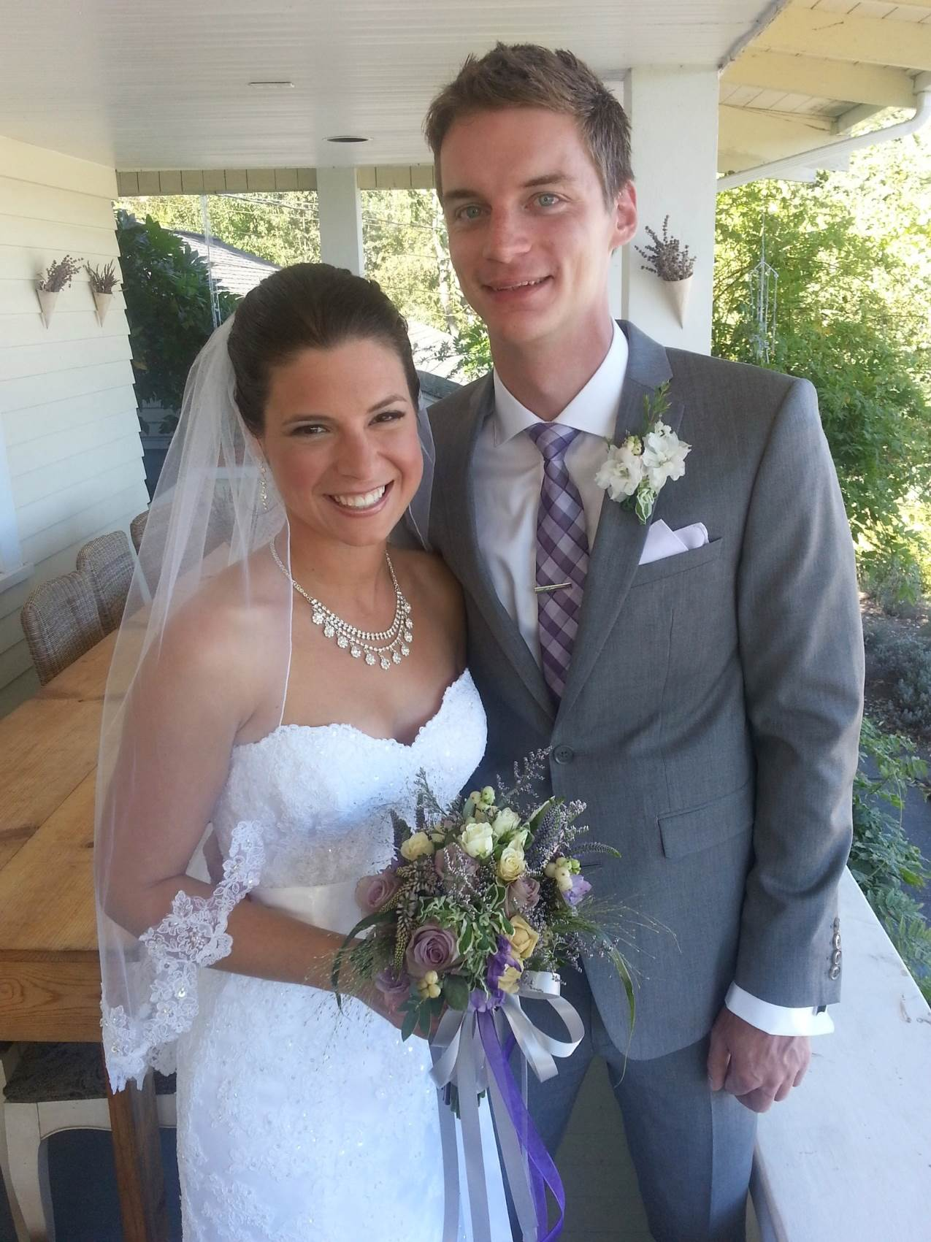
1991: Move to Singapore
1991: 迁移到新加坡
Rick, 33
Susan, 30+
Kurt, 4
Stephen, 1

Slide 3
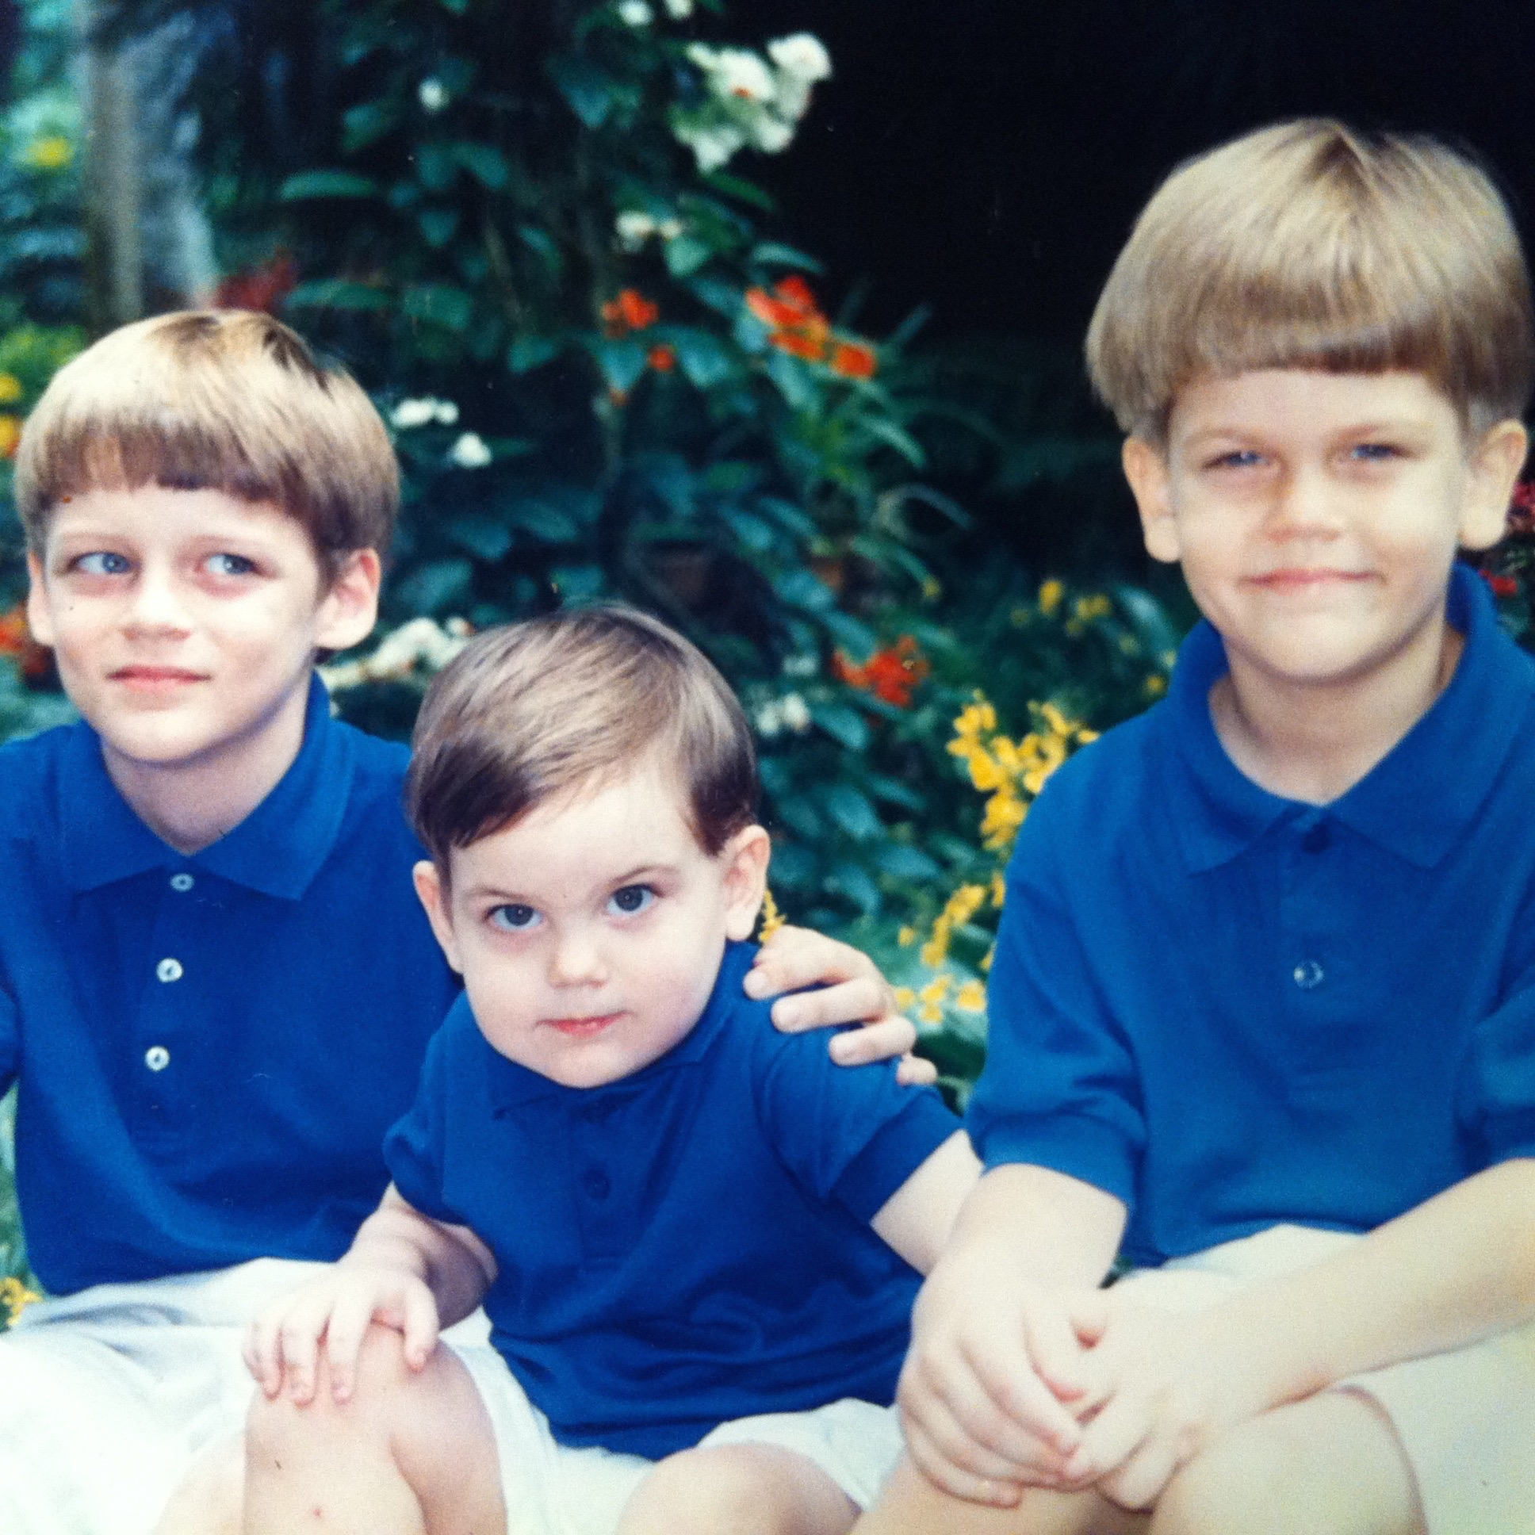
Our Three Sons

Slide 4
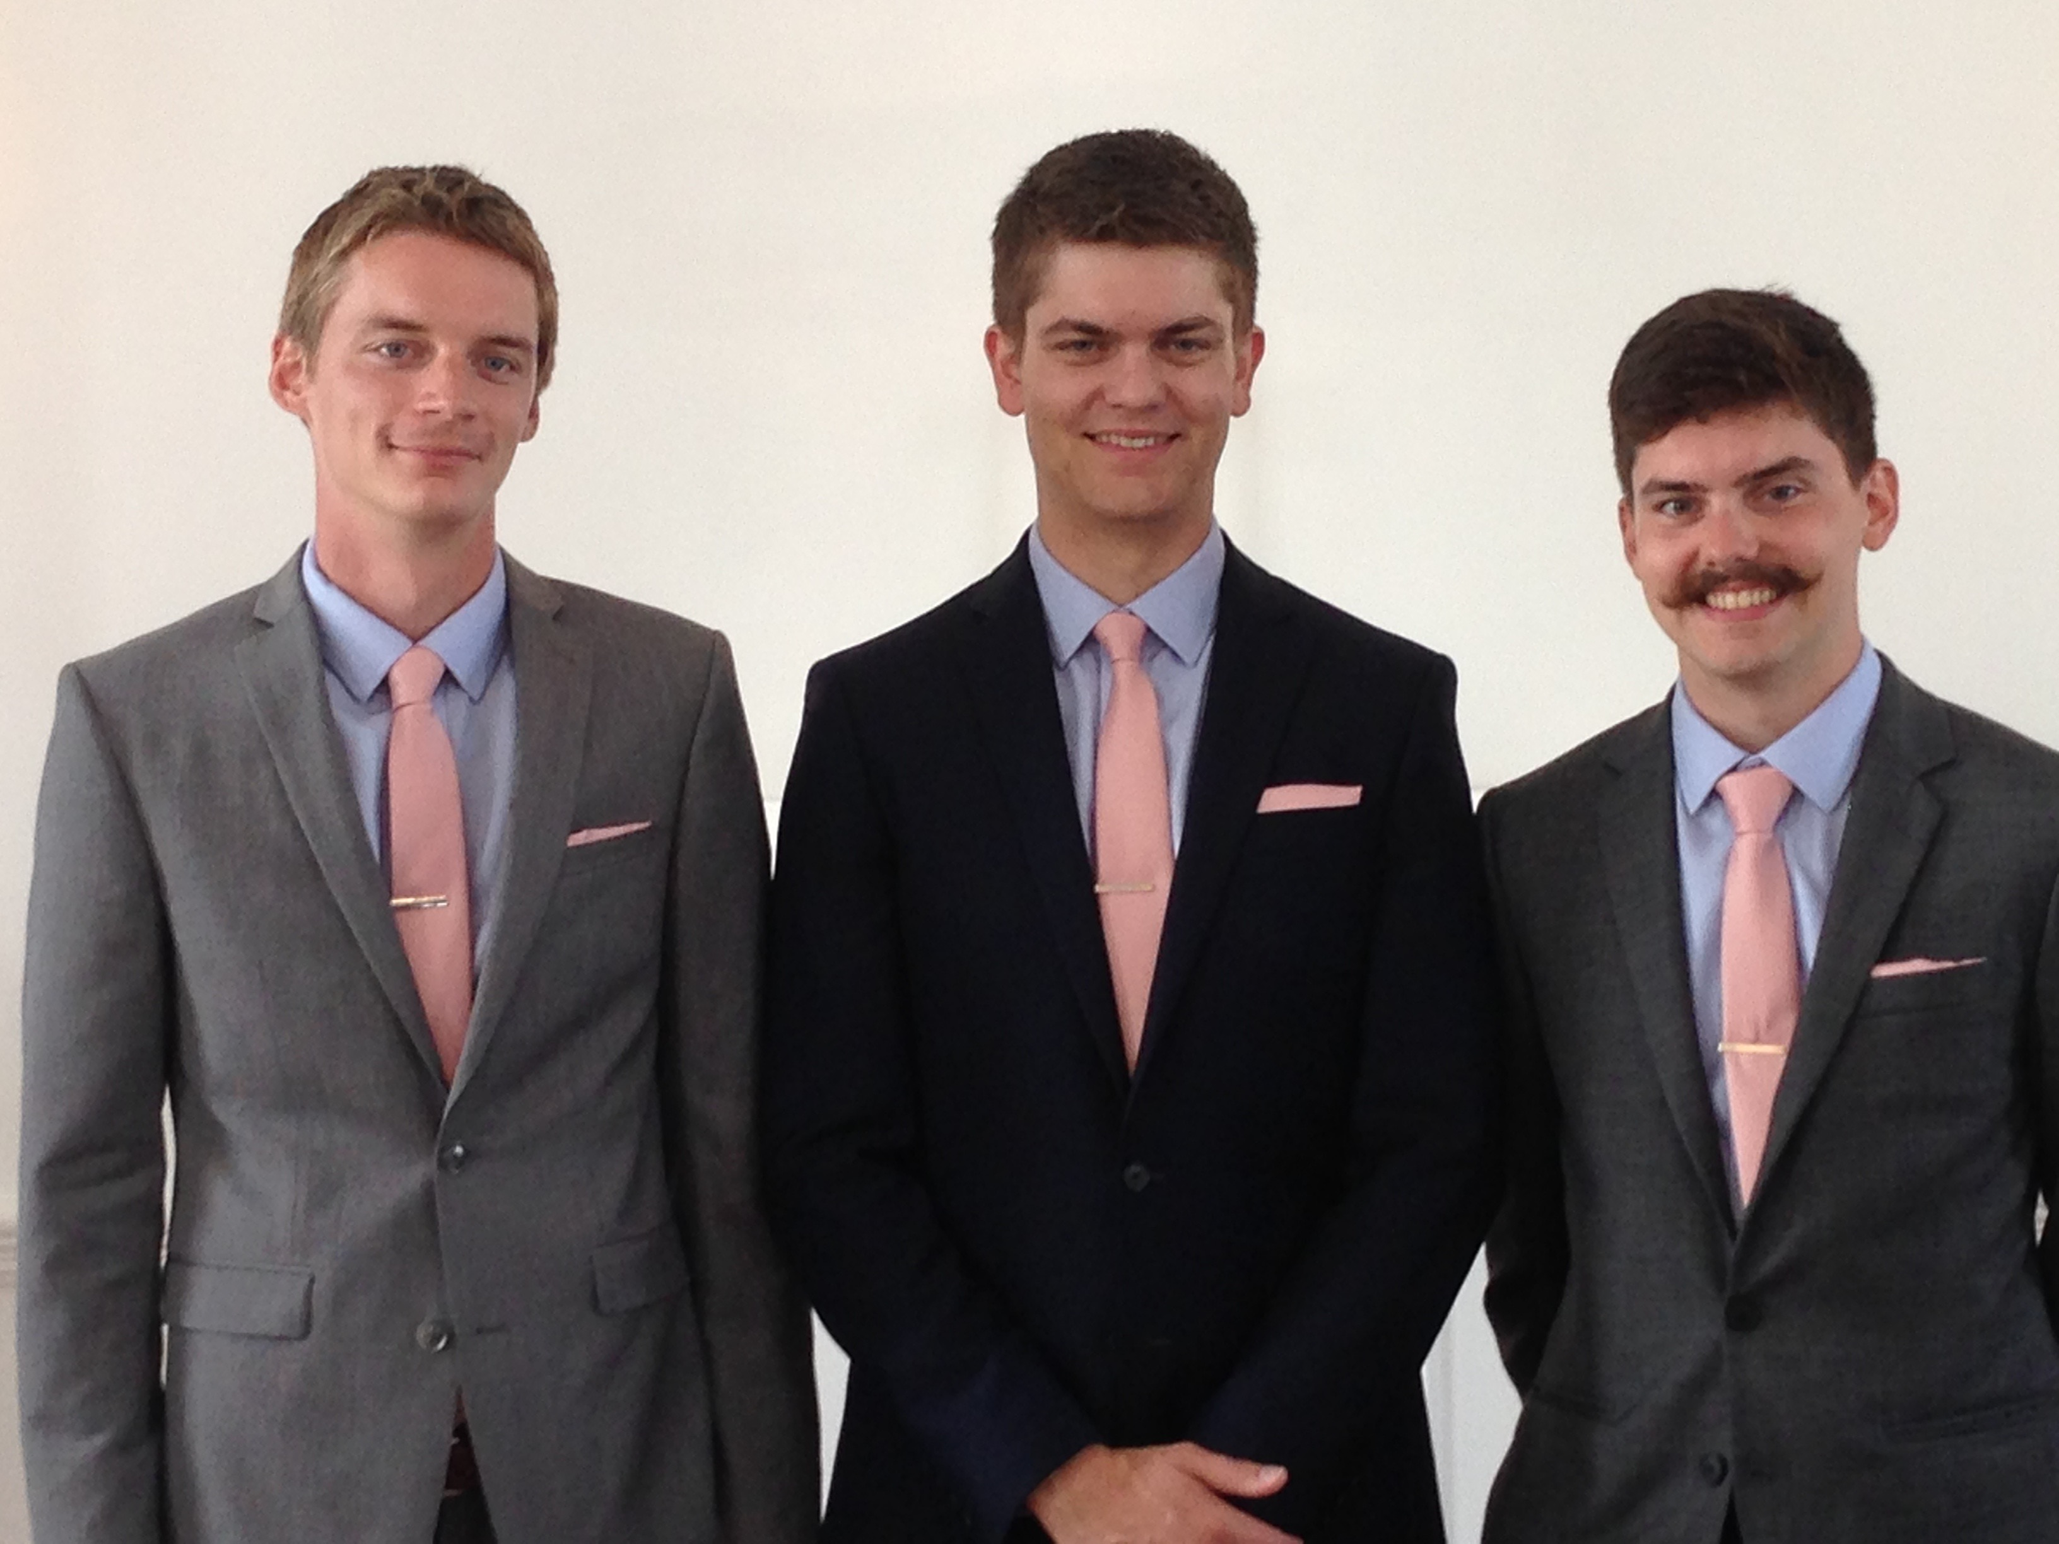
Our Three Sons

Slide 5
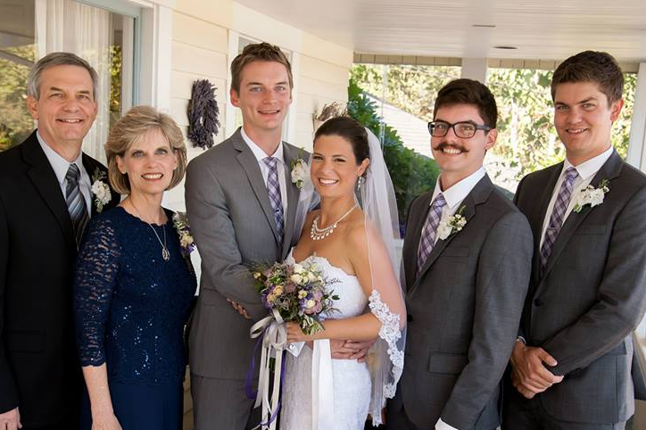
The Griffith Family Sept 2014
2014
Rick
Stephen 25
Susan
John 22
Kurt & Cara 28

Slide 6
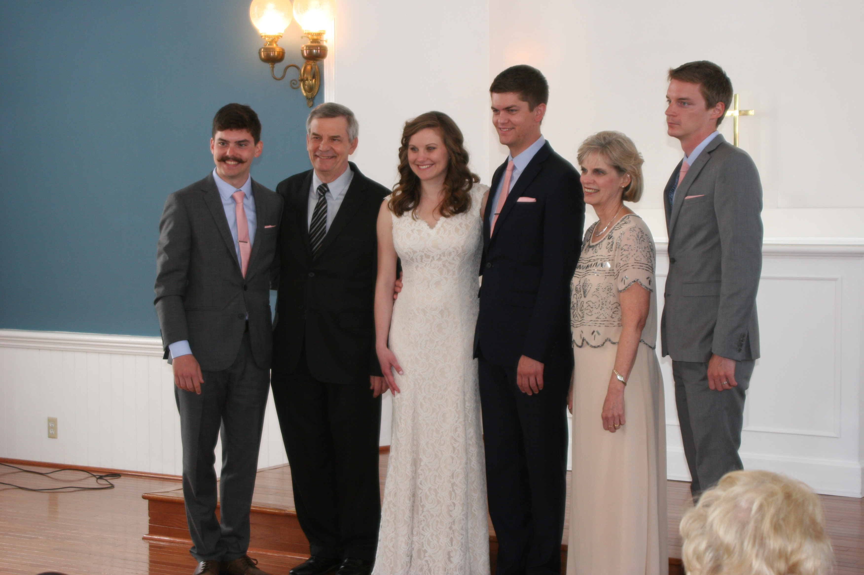
The Griffith Family May 2015
2015
John 22
Kurt 28
Rick
Susan
Stephen & Katie 25

Slide 7
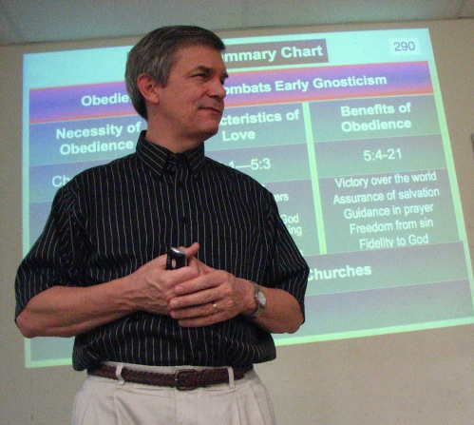
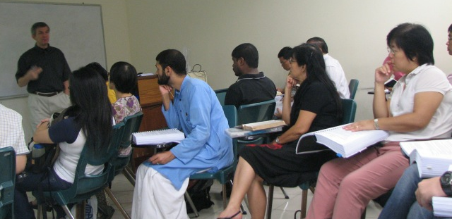
Singapore Bible College 新加坡神学院
Notes:
Dr. Rick has taught at Singapore Bible College since 1991, the past many years as NT Department Coordinator

Slide 8
Susan Mentors Student Wives Susan 作师母团契的导师

Slide 9
Temptations to Look Down 垂头丧气的试探
• How much longer does the Lord want us to pastor and teach in Singapore?
• How will John graduate debt free next year?
• Will we ever own a house or have money to retire?
• 上帝要我们在新加坡牧养和教导到甚么时候？
• 怎样才可以使 John 明年毕业又能还清大学学费的贷款？
• 我们能否拥有自己的房子或足够的金钱去保障日后的退休生活？

Slide 10
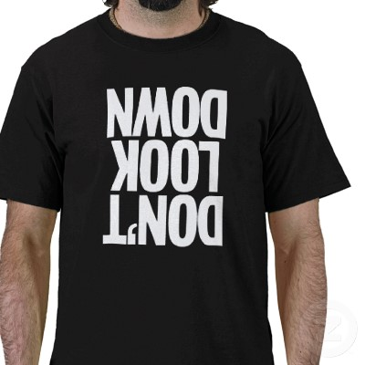
Don't Look Down
不要 垂头丧气
Notes:
We are tempted to look down when things don't go our way

Slide 11
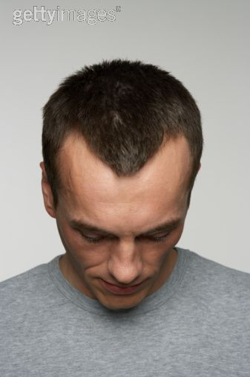
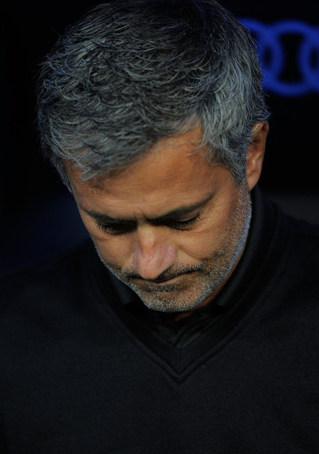
What causes you
甚么令你
Transition? 人生转变?
Finances? 财政状况?
Physical? 身体五官?
Relational? 人际关系?
… to look down?
…垂头丧气?

Slide 12
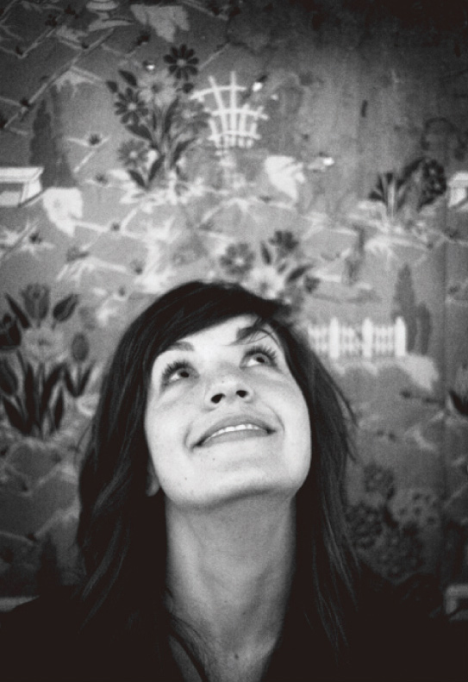
How can you look up to the LORD during your struggle?
你们如何能在困难挣扎中向上帝举目？

Slide 13
Timeline 时间轴
Isaiah以赛亚 740-680 BC
342
United Kingdom 联合王国
1050-930
Divided Kingdom 分裂王国
930-722
1100
1050
1000
950
900
850
800
7 5 0
7 0 0
650
600
550
500
450
Notes:
13
Isaiah lived in a time when people in Judah were tempted to look down.

Slide 14
The Assyrian Threat 亚述的威胁
The Assyrian Threat
Assyrian Expansion 亚述势力扩张
Nineveh 尼尼微
MediterraneanSea
地中海
Syria 亚兰
Israel 以色列
Judah 犹太
PersianGulf 波斯湾
Egypt埃及
Notes:
14
The Assyrian army had conquered every nation north of Judah in Isaiah's time.

Slide 15
Timeline 时间轴
Isaiah以赛亚 740-680 BC
United Kingdom 联合王国
1050-930
Divided Kingdom 分为王国
930-722
Solitary Kingdom 孤立王国
722-586
Post-Exile 被掳归回 536-425
1100
1050
1000
950
900
850
800
7 5 0
7 0 0
650
600
550
500
450
Exile被掳 586-536
Notes:
15
Isaiah lived in a time when people in Judah were tempted to look down.

Slide 16
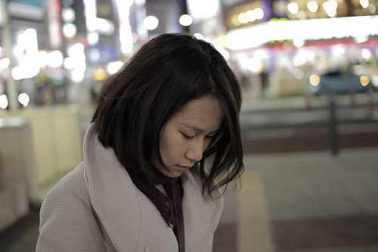
Isaiah 40: Three ways to look up…
以赛亚书 40: 向天举目的三个方法…

Slide 17
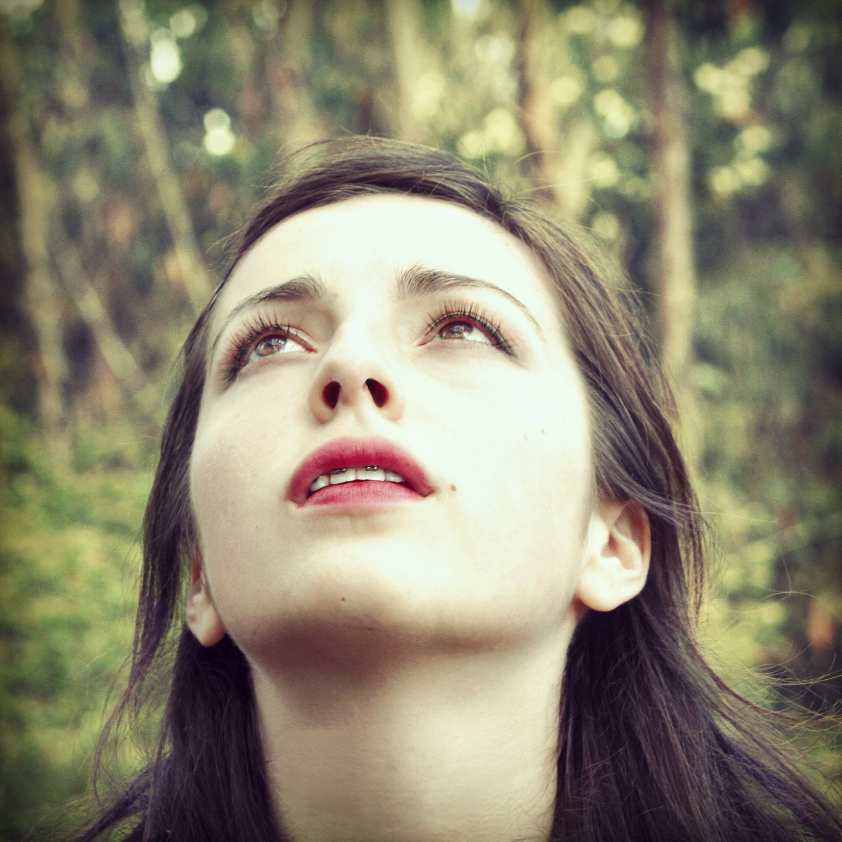
I. Know that He cares (1-11).
I. 要知道祂 在乎 (1-11).

Slide 18
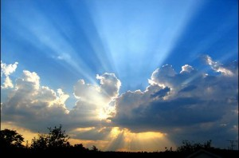
A. God tenderly replaced His discipline with His glory and Word (40:1-11).
A. 上帝满有慈爱地把祂的荣耀和话语 取代了祂的管教 (40:1-11).

Slide 19
Isaiah 40:1
你们的 神说： "你们要安慰， 要安慰我的子民！

Slide 20
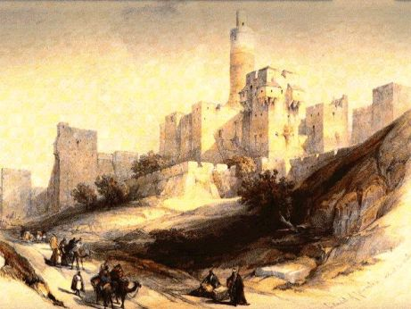
Isaiah 40:2 NLT
"Speak tenderly to Jerusalem.
Tell her that her sad days are gone
and her sins are pardoned.
Yes, the LORD has punished her twice over for all her sins."
你们要向耶路撒冷说慈爱的话， 又要向它宣告： 他们的苦难已经满足了，
他们的罪孽已经还清了，
他们因着自己的一切罪，
已经从耶和华的手里受到过重的刑罚。"
预言在旷野有预备主道的

Slide 21
Isaiah: Restoration of the Created Order
Judgment (and Salvation) | Salvation (and Judgment)
Chapters 1–39 | Chapters 40–66
以赛亚书: 恢复原本创造的秩序
审判 (与拯救) | 拯救 (与审判)
第一至三十九章 | 第四十至六十六章
Notes:
21

Slide 22
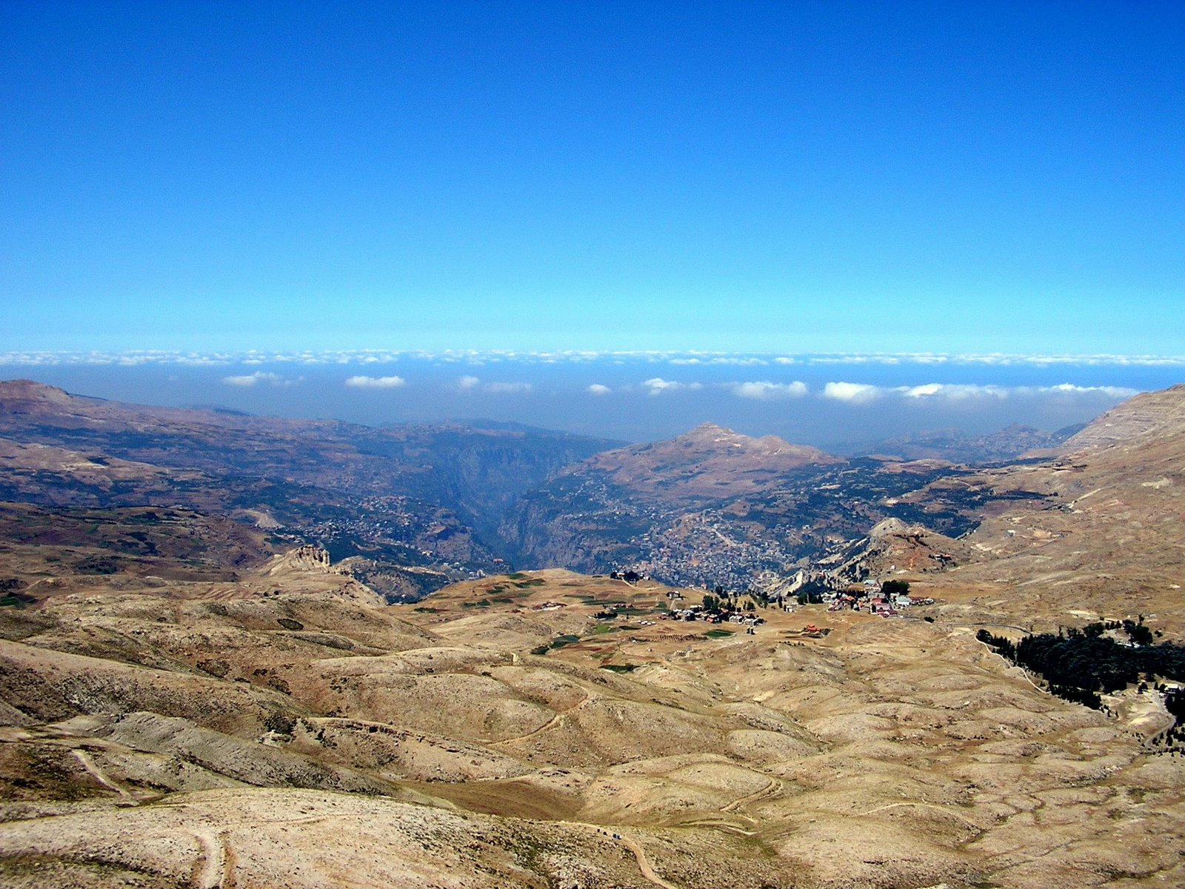
God's glory would be seen with His Word (3-8).
神的荣耀借着祂的话语得以彰显 (3-8).

Slide 23
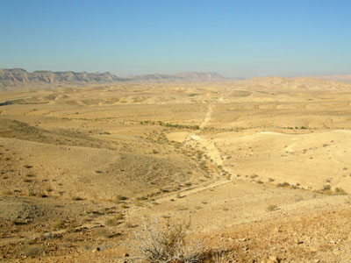
Isaiah 40:3
Listen! It's the voice of someone shouting,
"Clear the way through the wilderness
for the LORD! Make a straight highway through the wasteland for our God!
有声音呼喊说：
"你们要在旷野清理耶和华的路，
在沙漠修直我们 神的大道。

Slide 24
Isaiah 40:4-5
⁴Fill in the valleys, and level the mountains and hills. Straighten the curves, and smooth out the rough places. ⁵Then the glory of the LORD will be revealed, and all people will see it together. The LORD has spoken!"
⁴ 一切深谷都要填满，
一切山冈都要削平；
险峻的要改为平地，
崎岖的要改为平原。
⁵ 耶和华的荣耀必要显现，
所有的人都必一同看见，
因为这是耶和华亲口说的。"

Slide 25
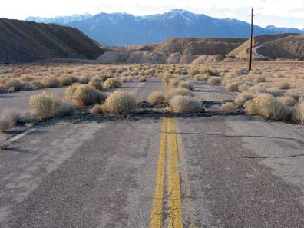
Rough Riders
Notes:
Most of us would never "welcome" an important person with a messed up road!

Slide 26
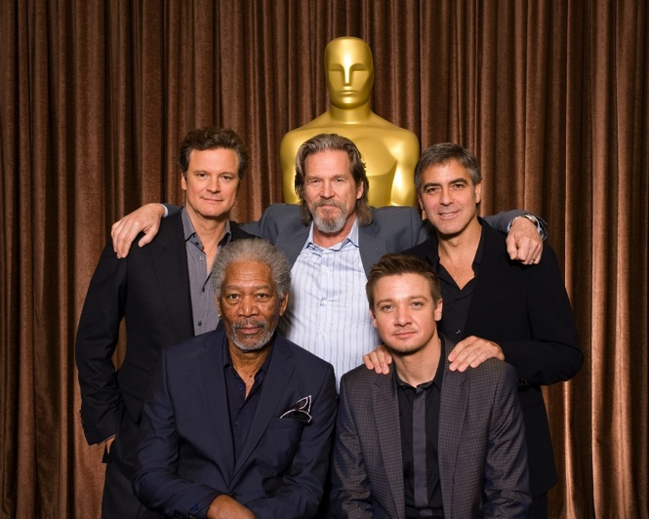
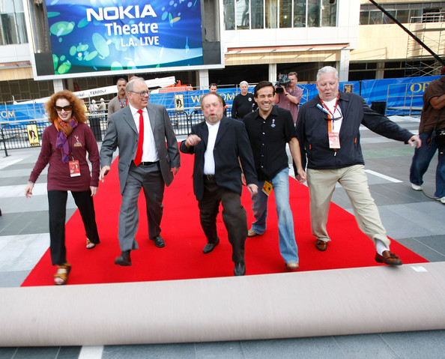
"Roll out the red carpet!"
"把红地毯展开！"
Notes:
Instead, we "roll out the red carpet" for important people, whether political or in Hollywood.

Slide 27
Isaiah 40:6 NLT
A voice said, "Shout!"
I asked, "What should I shout?" "Shout that people are like the grass.
Their beauty fades as quickly
as the flowers in a field.
有声音说："你呼喊吧！"
他问："我呼喊甚么呢？"
"所有的人尽都如草；
他们的荣美都像野地的花。

Slide 28
Isaiah 40:7-8 NLT
⁷The grass withers and the flowers fade
beneath the breath of the LORD.
And so it is with people.
⁸The grass withers and the flowers fade,
but the word of our God stands forever."
⁷ 草必枯干，花必凋谢；
因为耶和华的气吹在上面；
真的，这民的确是草！
⁸ 草必枯干，花必凋谢，
唯有我们 神的道永远长存。"

Slide 29
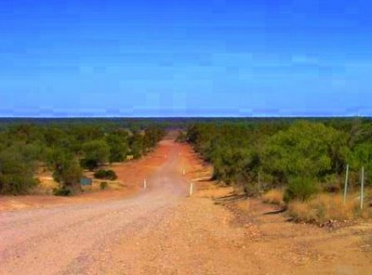
God cared for Judah tenderly (40:9 NLT)
神满有慈爱地看顾犹大 (40:9)
O Zion, messenger of good news, shout from the mountaintops!
Shout it louder, O Jerusalem.
Shout, and do not be afraid.
Tell the towns of Judah,
"Your God is coming!"
报好信息给锡安的啊！
你要登上高山。
报好信息给耶路撒冷的 啊！
你要极力扬声。
要扬声，不要惧怕！
要对犹大的众城说：
"看哪，你们的 神！"

Slide 30
God cared for Judah tenderly (40:10 NLT)
神满有慈爱地看顾犹大 (40:10)
¹⁰Yes, the Sovereign LORD is coming in power.
He will rule with a powerful arm. See, he brings his reward with him as he comes.
¹⁰ 看哪！主耶和华必像 大能者临到，
他的膀臂要为他掌权；
看哪！他给予人的赏赐在他那里，
他施予人的报应在他面 前。

Slide 31
Isaiah 40:11 NLT
He will feed his flock like a shepherd. He will carry the lambs in his arms, holding them close to his heart. He will gently lead the mother sheep with their young.
他必像牧人牧养自己的羊群，
像用膀臂聚集羊羔，
抱在自己的怀中，
慢慢引导乳养小羊的。

Slide 32
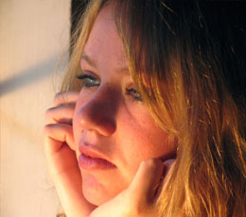
Do you feel that God cares for you?
你感受到上帝看顾你吗 ?

Slide 33
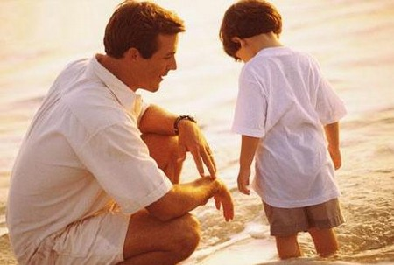
Loving Discipline (Heb. 12:5-6 NLT)
爱的管教 (希伯来书12:5-6)
"My child, don't make light of the LORD's discipline, and don't give up when he corrects you. ⁶For the LORD disciplines those he loves,
and he punishes each one he accepts as his child."
"我儿！你不可轻看主的管教，
受责备的时候也不要灰心；
因为主所爱的，他必管教，
他又鞭打所收纳的每一个儿子。"

Slide 34
Loving Discipline (Heb. 12:7 NLT)
爱的管教 (希伯来书12:7)
⁷As you endure this divine discipline, remember that God is treating you as his own children. Who ever heard of a child who is never disciplined by its father?
⁷为了接受管教，你们要忍受，因为 神待你们好像待儿子 一样；哪有儿子不受父亲管教的呢？

Slide 35
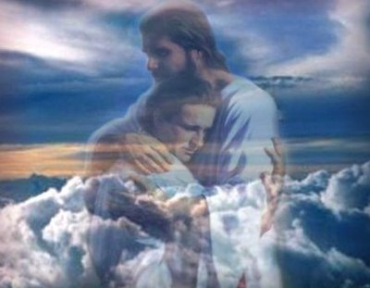
Title
Notes:
Do you sense God's care for the thing that you struggle with now?

Slide 36
I. Know that He cares (1-11).
I. 要知道祂 在乎 (1-11).

Slide 37
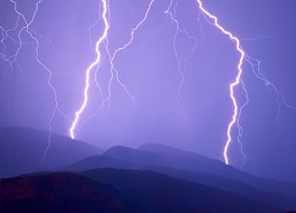
II. Know that He's able (12-26).
II. 要知道祂能够 (12-26).

Slide 38
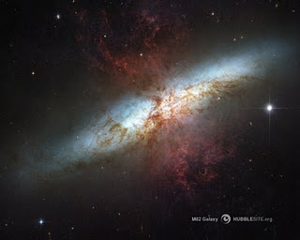
A. God rules the world with all power (12-26).
A. 神以全能掌管世界 (12-26).

Slide 39
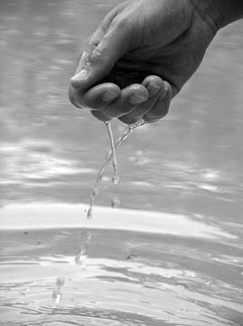
Isaiah 40:12a NLT
1. He's bigger than anything (12-13).
"Who else has held the oceans in his hand?"
1. 祂比世界一切都大 (12-13).
"谁曾用掌心量过海水？"

Slide 40
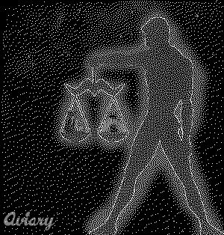
Isaiah 40:12b NLT
Who has measured off the heavens with his fingers? Who else knows the weight of the earth
or has weighed the mountains and hills on a scale?
用手掌测过苍天呢？
谁曾用升斗量过大地的尘土，
用秤称山岭，
用天平称冈陵呢？

Slide 41
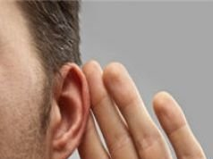
He's wiser than anyone (40:13-14 NLT).
Who is able to advise the Spirit of the LORD? Who knows enough to give him advice or teach him? ¹⁴Has the LORD ever needed anyone's advice? Does he need instruction about what is good? Did someone teach him what is right or show him the path of justice?
祂比谁都更有智慧 (40:13-14).
谁曾测度耶和华的灵，
或作过他的谋士教导他呢？
他与谁商议，谁使他有聪明？
谁把正确的路指教他，把知识指教他，
又把明智的路教导他呢？

Slide 42
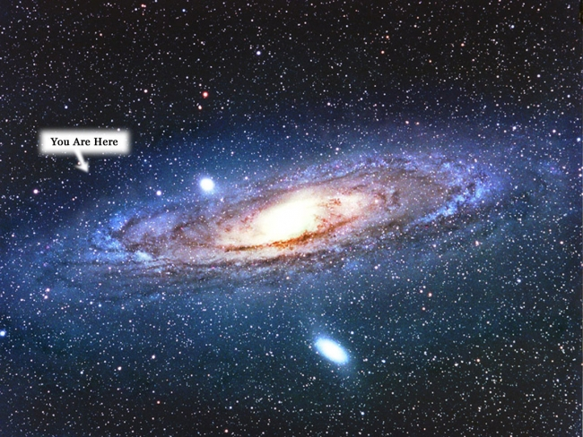
He's incomparable (15-26).
You are here.
你就在这里.
祂是无与伦比 (15-26).

Slide 43
Isaiah 40:15 NLT
看哪！万国都像水桶里的一滴，
又被看作天平上的微尘。
看哪！他举起众海岛，好像微细之物。
No, for all the nations of the world are but a drop in the bucket. They are nothing more than dust on the scales. He picks up the whole earth as though it were a grain of sand.

Slide 44
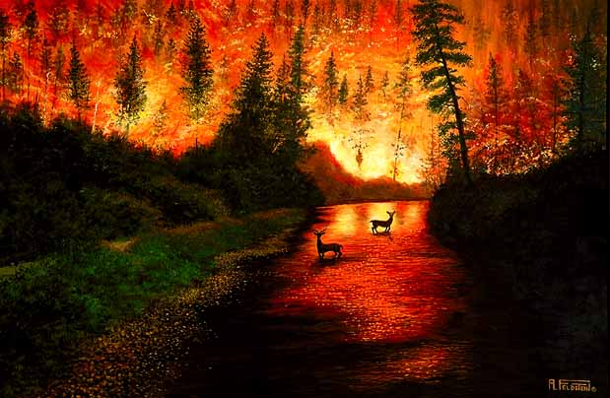
All the wood in Lebanon's forests and all Lebanon's animals would not be enough to make a burnt offering worthy of our God.
Isaiah 40:16 NLT
黎巴嫩的树林不够当柴烧，
其中的走兽也不够作燔祭。
以赛亚书 40:16
Notes:
44

Slide 45
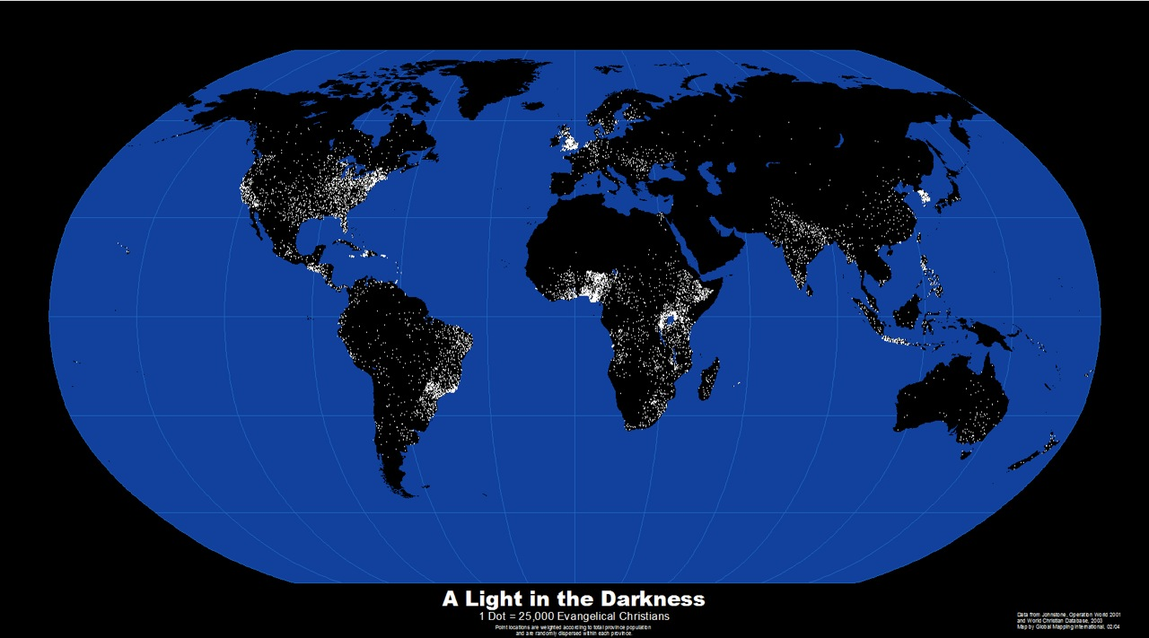
Isaiah 40:17 NLT
The nations of the world are worth nothing to him. In his eyes they count for less than nothing—mere emptiness and froth.
万国在他跟前好像不存在，
在他看来，只是乌有和虚空。

Slide 46
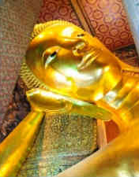
Isaiah 40:18-19 NLT
To whom can you compare God? What image can you find to resemble him? ¹⁹Can he be compared to an idol formed in a mold,
overlaid with gold, and decorated with silver chains?
你们把谁来跟神相比呢？
你们用甚么形象来与神并列呢？
至于偶像，是匠人铸造的，
铸匠用金子把它包裹，
用银子为它做银炼。

Slide 47
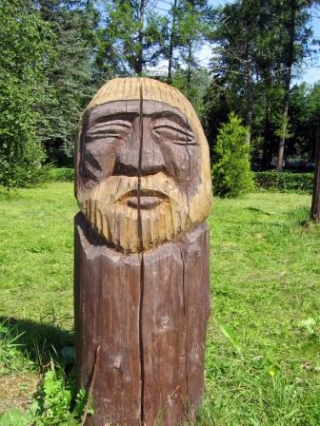
Isaiah 40:20 NLT
Or if people are too poor for that, they might at least choose wood that won't decay and a skilled craftsman to carve an image that won't fall down!
贫穷献不起这供物的，
就拣选不朽坏的树木，
为自己寻找巧匠，
立起不会动摇的偶像。

Slide 48
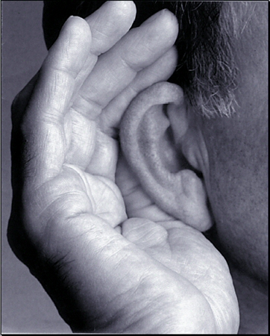
Isaiah 40:21 NLT
Haven't you heard? Don't you understand?
Are you deaf to the words of God—
the words he gave before the world began? Are you so ignorant?
你们不曾知道吗？ 你们不曾听见吗？
不是从起初就已经告诉过你们吗？
自从大地的根基立了以来，你们还不曾 明白吗？

Slide 49
Isaiah 40:22 NLT
God sits above the circle of the earth. The people below seem like grasshoppers to him! He spreads out the heavens like a curtain and makes his tent from them.
神坐在大地的圆穹之上，
地上的居民好像蚱蜢，
他铺张诸天如铺张幔子，
展开众天像展开可以居住的帐棚。

Slide 50
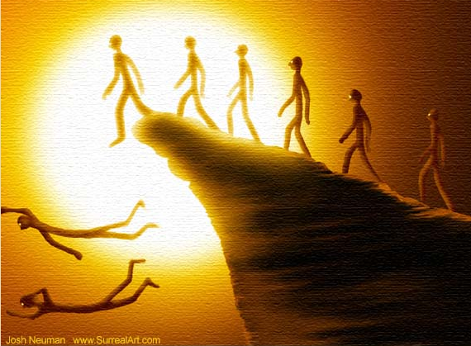
Isaiah 40:23-24 NLT
²³He judges the great people of the world and brings them all to nothing. ²⁴They hardly get started, barely taking root, when he blows on them and they wither. The wind carries them off like chaff.
²³ 他使诸侯都归于无有，使地上的审判官成为 虚空。²⁴ 他们才刚刚栽上，刚刚种上，他们的树头刚刚地里扎根，他一吹在其上，他们就枯干了，旋风把他们像碎秸一样吹去。

Slide 51
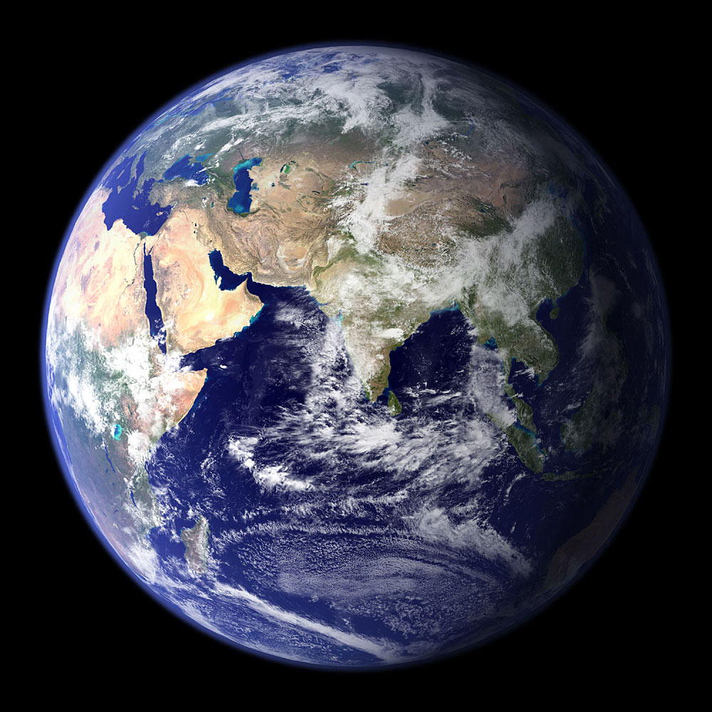
Isaiah 40:25 NLT
"To whom will you compare me? Who is my equal?" asks the Holy One.
那圣者说："你们把谁来跟我相比，使他与我相等呢？"

Slide 52
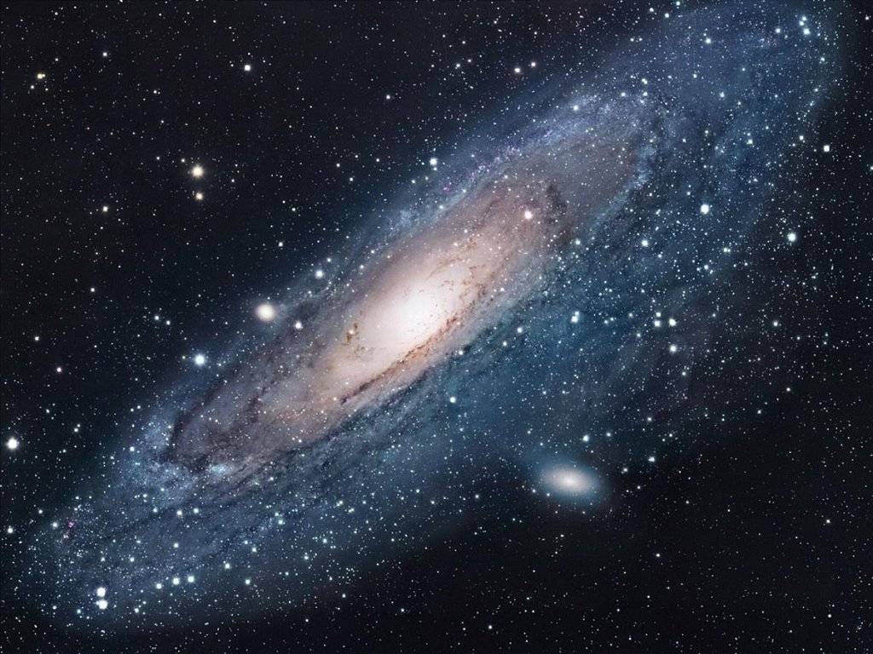
"Look up into the heavens. Who created all the stars? He brings them out like an army, one after another, calling each by its name."
"你们向天举目吧！
看是谁创造了这些万象？
是谁按着数目把万象领出来，
一一指名呼唤？"
Is He Bigger? 祂更大吗?
"因他的大能大力，
连一个也不缺少。" (以赛亚书 40:26).
"Because of his great power and incomparable strength, not a single one is missing" (Isa 40:26 NLT).
Notes:
52
Think of the struggle you face right now. Is it small or big? That depends upon what you compare it to! Is God bigger? Of course!

Slide 53
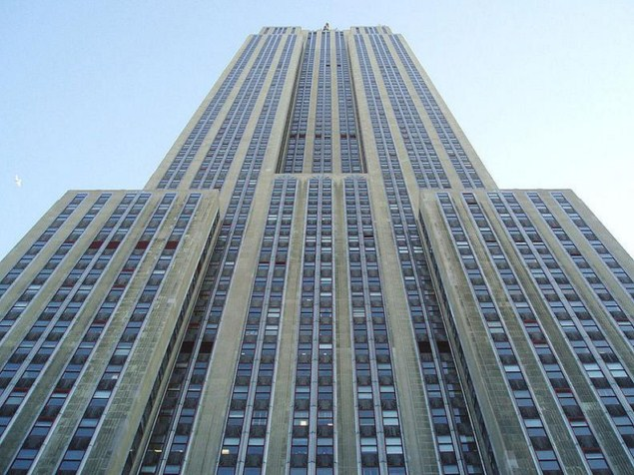
A building with its own zip code!
Notes:
When standing below a huge building, you feel very small.

Slide 54
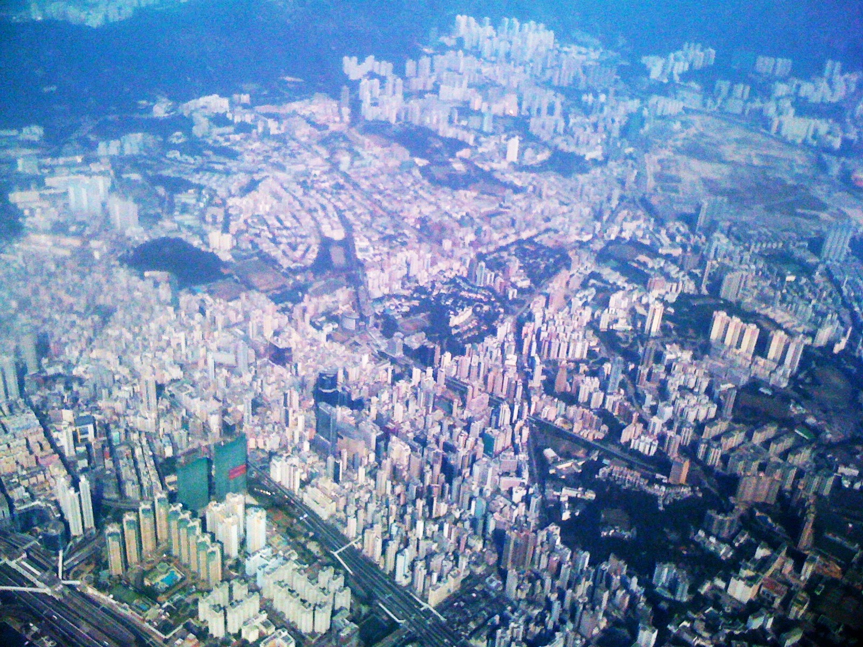
Hong Kong from my flight
我在飞机上看到的香港
Notes:
But on one of my trips through Hong Kong, the pilot looped around right above the city. I was amazing to see the hundreds of huge buildings look so small that they looked like toys. A huge building is actually quite small in God's eyes—and so are our problems!

Slide 55
I. Know that He cares (1-11).
I. 要知道祂 在乎 (1-11).

Slide 56
II. Know that He's able (12-26).
II. 要知道祂能够 (12-26).

Slide 57
III. Trust in His strength (27-31).
III. 信靠祂的能力 (27-31).

Slide 58
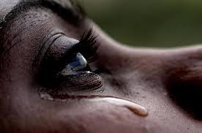
Isaiah 40:27 NLT
O Jacob, how can you say the LORD does not see your troubles? O Israel, how can you say God ignores your rights?
雅各布啊！你为甚么这样说；以色列啊！你为甚么 埋怨说："我的道路向耶和华隐藏，
我的案件被我的 神忽略了"？
Notes:
Don't have a pity party!

Slide 59
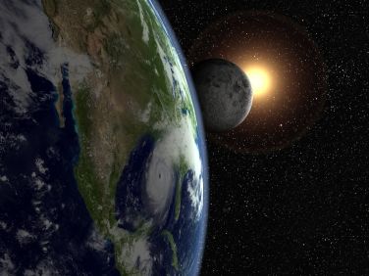
Isaiah 40:28 NLT
Have you never heard? Have you never understood? The LORD is the everlasting God, the Creator of all the earth. He never grows weak or weary. No one can measure the depths of his understanding.
你不知道吗？ 你没有听过吗？
永在的 神、耶和华、地极的创造主 既不疲乏，也不困倦；
他的知识无法测度。

Slide 60
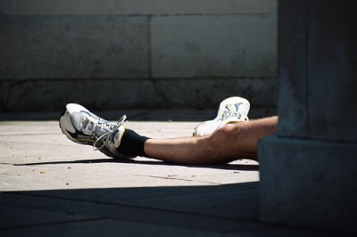
Isaiah 40:29-30 NLT
²⁹ 疲乏的，他赐气力，
无力的，他加力量。
³⁰ 就是年轻人也会疲乏困倦，强壮的人也会全然跌倒。
²⁹He gives power to the weak and strength to the powerless.
³⁰Even youths will become weak and tired, and young men will fall in exhaustion.

Slide 61
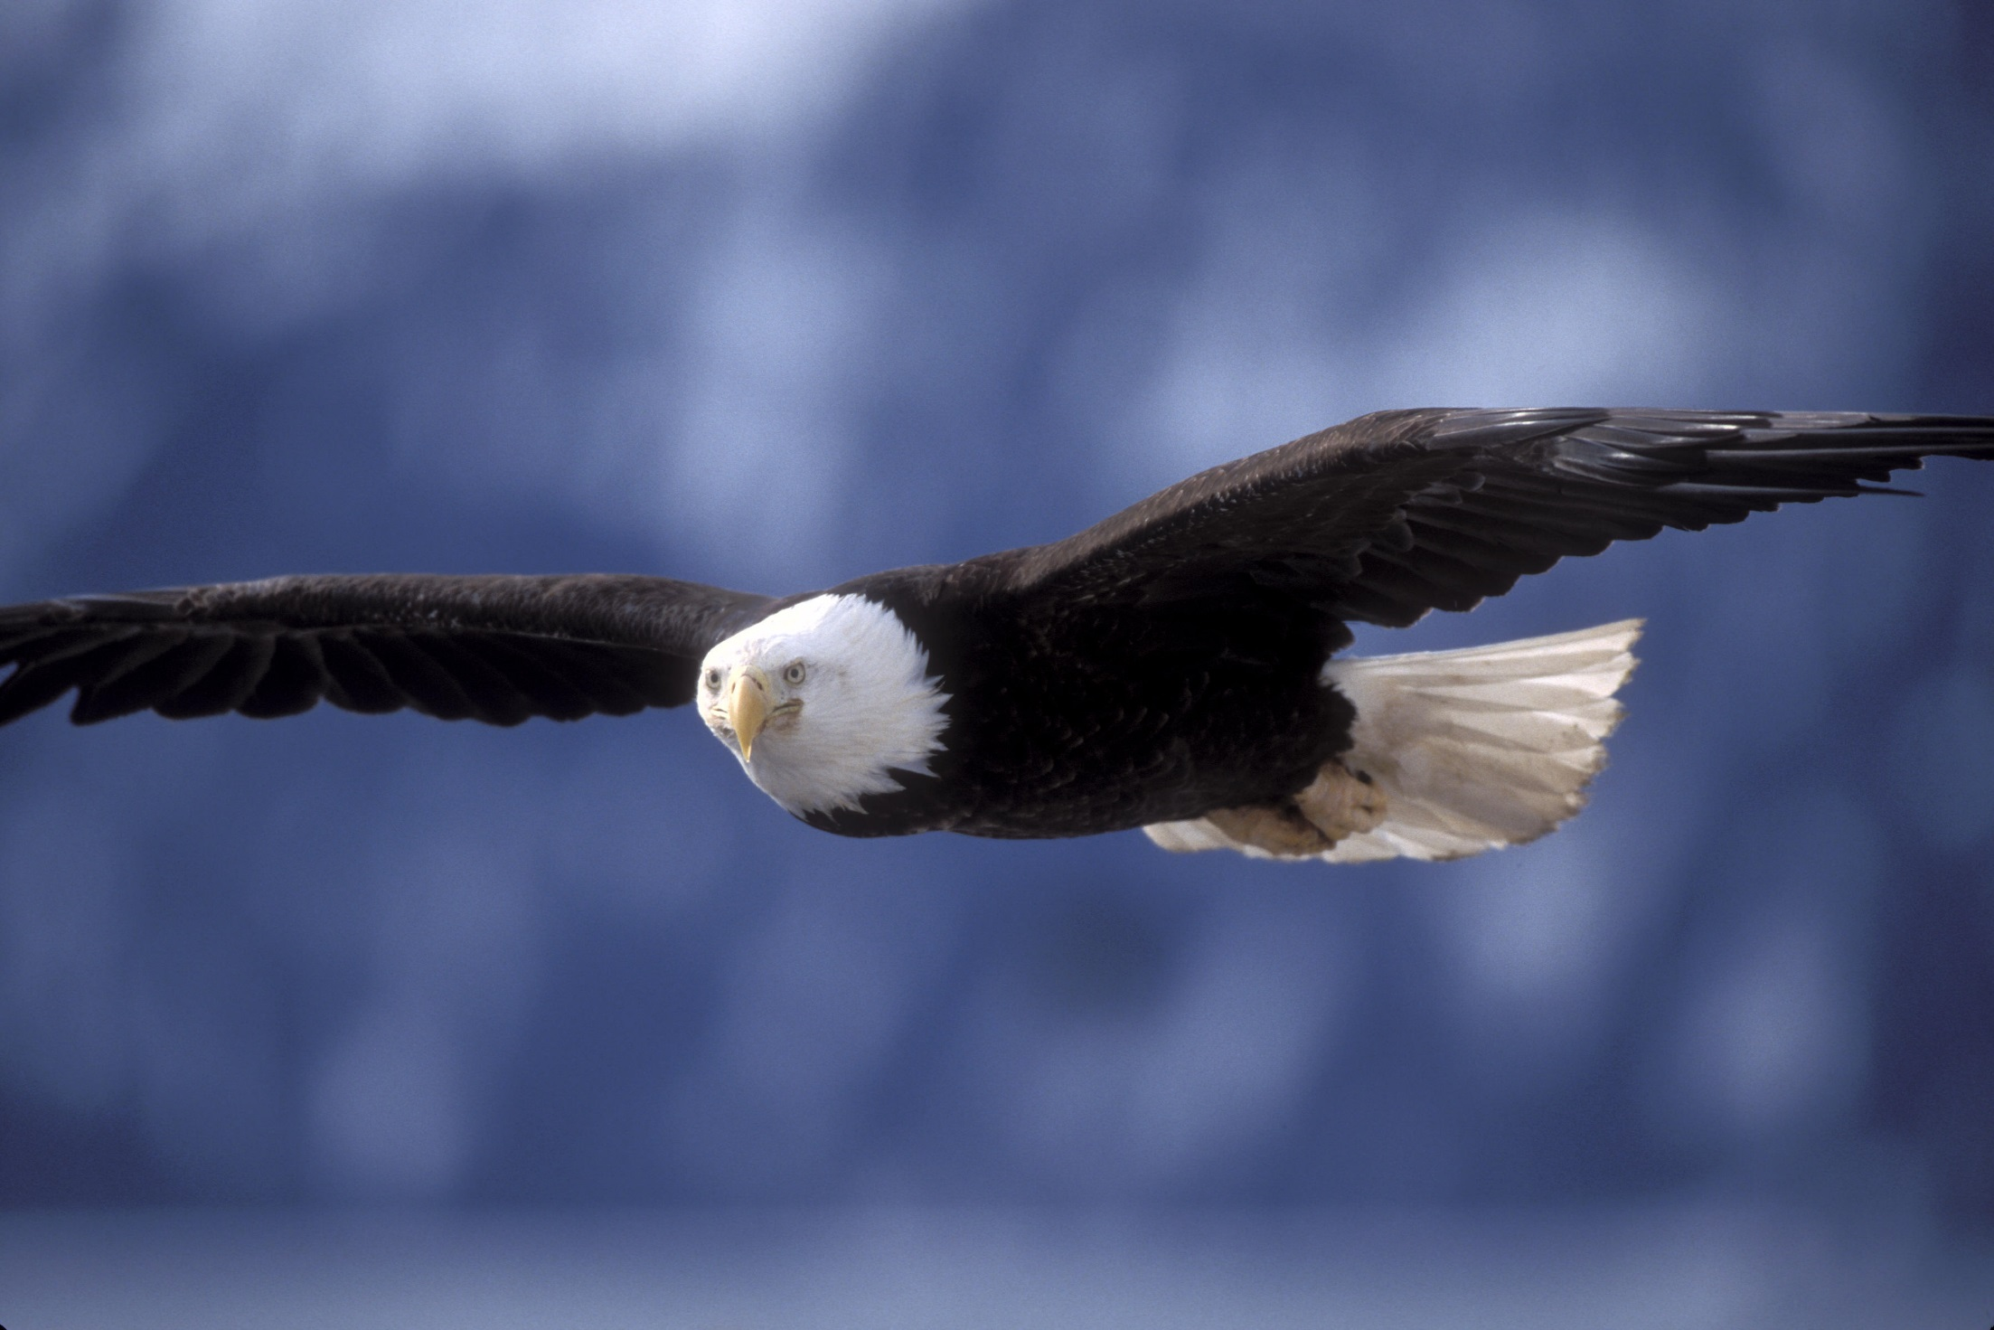
Isaiah 40:31 NLT
But those who trust in the LORD will find new strength.
但那些仰望耶和华的人，必重新得力；
They will soar high on wings like eagles.
They will run and not grow weary.
They will walk and not faint.
他们必像鹰一样展翅上腾；
他们奔跑，也不困倦，
他们行走，也不疲乏。
Notes:
Did you know an eagle knows when a storm is approaching long before it breaks?

Slide 62
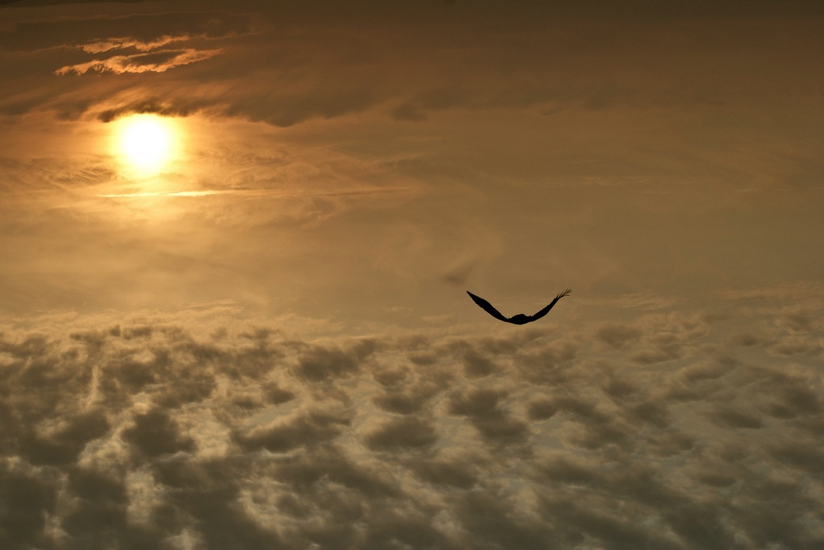
Isaiah 40:31 NLT
…They will soar high on wings like eagles…
…他们必像鹰一样展翅上腾…
Notes:
The eagle will fly to some high spot and wait for the winds to come. When the storm hits, it sets its wings so that the wind will pick it up and lift it above the storm. While the storm rages below, the eagle is soaring above it.
The eagle does not escape the storm. It simply uses the storm to lift it higher. It rises on the winds that bring the storm.

Slide 63
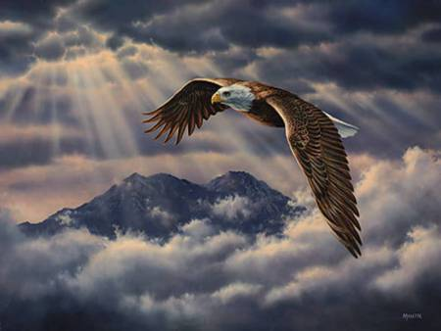
Eagle Above Clouds
It is not the burdens of life that weigh us down––it is how we handle them
把我们压下去的不是人生的担子––而是在于我们如何面对和处理
Notes:
When the storms of life come upon us - and all of us will experience them - we can rise above them by setting our minds and our belief toward God. The storms do not have to overcome us. We can allow God's power to lift us above them.
God enables us to ride the winds of the storm that bring sickness, tragedy, failure and disappointment in our lives. We can soar above the storm.
Friends, it is not the burdens of life that weigh us down. It is how we handle them

Slide 64
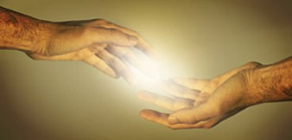
Main Idea 中心思想
He cares and He's able, so trust Him
祂在乎和祂能够, 所以要信靠祂
Notes:
So what's the point of Isaiah 40? Simply, He cares and He's able, so trust Him.

Slide 65
How can you trust God with your struggle right now?
只要向天举目
神比你想象中更靠近

Slide 66
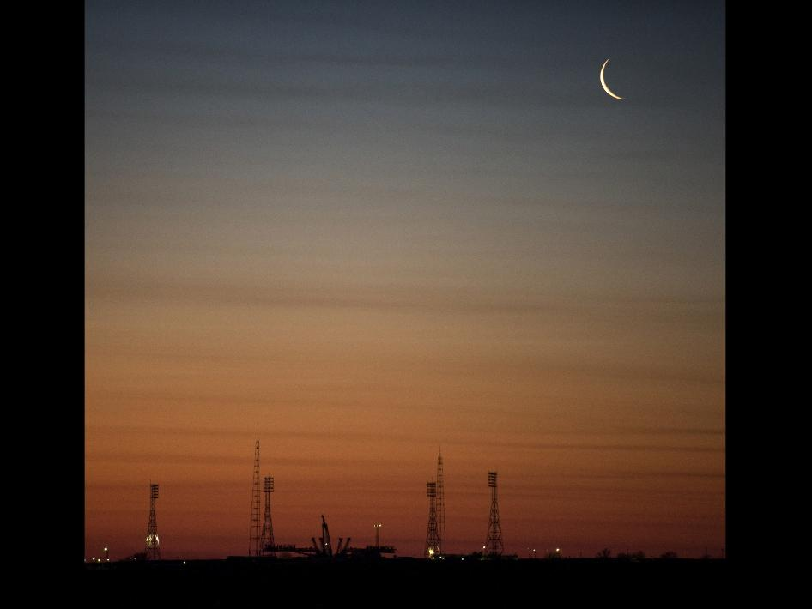
The Gaze-Glance Principle 注视-描过的准则
Seeking God's Hand寻求神的手
God神
Source: Elton & Shirley Gillam, The Restoration of Biblical Prayer (Greely, CO: Chambers College Press, 2009), 33
Glance 描过
Our Request 我们的请求
Gaze 注视
Notes:
To look up I want to share with you the Gaze-Glance Principle. This is a simple, biblical method I was taught years ago that goes like this.
When a struggle comes into our lives, we normally gaze at this request with occasional, quick glances to God for his help. We ask him to remove the problem because we are only seeking His hand. We're only seeking what He can give us.

Slide 67
The Gaze-Glance Principle 注视-描过的准则
Seeking God's Face寻求神的脸
God神
Source: Elton & Shirley Gillam, The Restoration of Biblical Prayer (Greely, CO: Chambers College Press, 2009), 33
Gaze 注视
Our Request 我们的请求
Glance 描过
Notes:
But Isaiah 40 tells us to shift our focus. We should gaze at God and only glance at our request. This is seeking His face instead of seeking His hand. When and if He removes the problem becomes His business, so we don't end up resenting Him.
Where has your focus been concerning the issue that concerns you?
• Have you been gazing at God or gazing at your problem?
• Have you been seeking God's face or God's hand?

Slide 68
NTS Chinese Link
biblestudydownloads.com

Slide 69
神学与讲道链接地址 biblestudydownloads.com
免费获得该讲解!
圣经学习 下载
Notes:
The explanation for free!
Theology & Preaching link address

Slide 70
Black

